Slide 1
Some recent decisions:
Names and Blueprints
Dru Smith
NSRS Modernization Manager
NOAA’s National Geodetic Survey

Slide 2
Since 2008…
NGS has had two “ten year plans”
Heavy on broad sweeping decisions
e.g. “Replace NAD 83”
Light on details
How? What do we call it?
2016 was a good year for filling in those details
Notes:
There are actually 3 “NAD 83”s, NAD 83(2011), NAD 83(PA11) and NAD 83(MA11)
There are also many more vertical datums than NAVD 88 in the NSRS, each one for specific states or territories that have no line of sight to CONUS/Alaska

Slide 3
So…what’s new?
Names

Slide 4
Names
The Old:
NAD 83(2011)
NAD 83(PA11)
NAD 83(MA11)
The New:
The North American Terrestrial Reference Frame of 2022
(NATRF2022)
The Caribbean Terrestrial Reference Frame of 2022
(CTRF2022)
The Pacific Terrestrial Reference Frame of 2022
(PTRF2022)
The Mariana Terrestrial Reference Frame of 2022
(MTRF2022)

Slide 5
Names
The Old:
NAVD 88
PRVD 02
VIVD09
ASVD02
NMVD03
GUVD04
IGLD 85
IGSN71
GEOID12B
DEFLEC12B
Orthometric
Heights
The New:
The North American-Pacific Geopotential Datum of 2022 (NAPGD2022)
- Will include GEOID2022
Normal
Orthometric
Heights
Dynamic
Heights
Gravity
Geoid
Undulations
Deflections of
the Vertical

Slide 6
So…what’s new in 6 months?
Names
Scientific Decisions
Codified in “Blueprint for 2022” documents

Slide 7
Scientific Decisions
Blueprint for 2022, Part 1: Geometric
Four plate-fixed Terrestrial Reference Frames
And what “plate fixed” means
Mathematical equation between IGS and TRFs
Plate Rotation Model for each plate
Coordinates at survey epoch
Intra-frame velocity model
To compare coordinates surveyed at different epochs

Slide 8
Replacing the NAD 83’s
Three plate-(pseudo)fixed frames will be replaced with four plate-fixed reference frames
N. Amer., Pacific, Mariana, Caribbean(new!)
Remove long-standing non-geocentricity of NAD 83 frames
All four : identical to IGSxx at a TBD epoch
2020.00?
All four : differ from IGSxx by plate rotation only
Updated Euler Pole determination for rigid plate only

Slide 9
Each frame will get 3 parameters
Euler Pole Latitude
Euler Pole Longitude
Rotation rate (radians / year)
This will be used to compute
time-dependent TRF2022
coordinates from time-dependent
IGS coordinates.

Slide 10
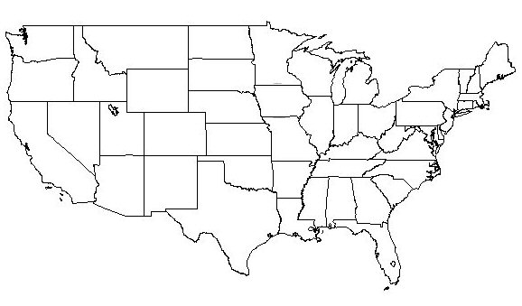
NATRF2022 frame is rigid and fixed to rigid part of the N.A. plate
Non-rigid part of the N.A. plate
(deformation)
area

Slide 11
NATRF2022 coordinates over time (Remember: The NATRF2022 frame is rigid)
Point on deforming part of plate
Point on rigid part of plate
λ
λ
t
t

Slide 12
NATRF2022 coordinates over time (Remember: The NATRF2022 frame is rigid)
Point on deforming part of plate
Point on rigid part of plate
λ
λ
t
t

Slide 13
NATRF2022 coordinates over time (Remember: The NATRF2022 frame is rigid)
Point on deforming part of plate
Point on rigid part of plate
λ
λ
t
t

Slide 14
NATRF2022 coordinates over time (Remember: The NATRF2022 frame is rigid)
Point on deforming part of plate
Point on rigid part of plate
λ
λ
t
t

Slide 15
Intra-frame velocities
This is the velocity of the
point in NATRF2022.
Rotation of plate removed.
It is not constant because
the point still suffers small
“intra-frame” velocities.
Such IFVs will be captured
in a model by NGS.
This is the velocity of the
point in ITRF. Includes all
movements, but the
dominant one is the
rotation of the N.A. Plate.

Slide 16
Scientific Decisions!!
Blueprint for 2022, Part 2: Geopotential
Global 3-D Geopotential Model (GGM)
Will contain all GRAV-D data
Able to yield any physical value on/above surface
Special high-resolution geoid, DoV and surface gravity products consistent with GGM
Not global: NA/Pacific, American Samoa, Guam/CNMI
Time-Dependencies
Geoid monitoring service
Impacts of deglaciation, sea level rise, earthquakes, etc

Slide 17
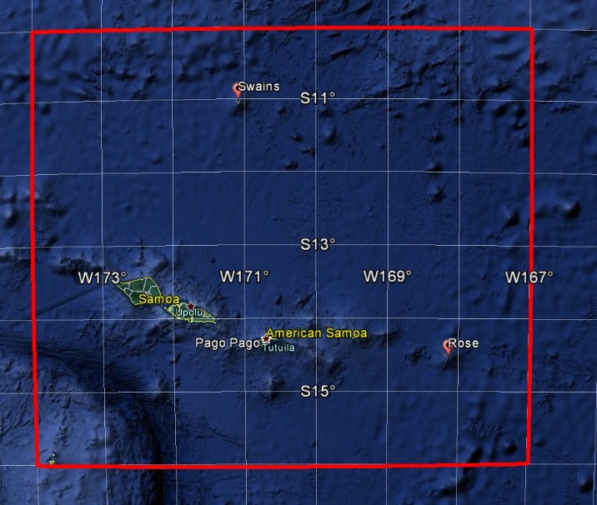
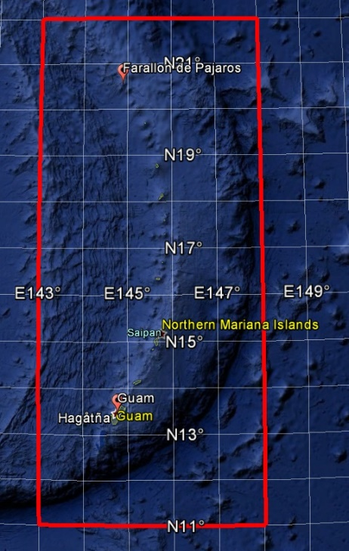
GEOID2022 (et al) over American Samoa:
-16 to -10, 186-193
GEOID2022 (et al) over Guam/CNMI:
11-22, 143-148
GEOID2022 (et al) over the North America/Pacific/Caribbean/Central America/Greenland region will range from
0 to 90 latitude and from 170 to 350 longitude.

Slide 18
Blueprint for 2022
Part 1: Geometric
Part 2: Geopotential
Part 3: Bluebooking

Slide 19
Time-Dependencies as a service: NATRF2022 and actual survey epochs
NAD 83 forcibly combined data spanning many years (using HTDP with no vertical modeling) to compute and find one height at one epoch.
NATRF2022 will compute coordinates at survey epoch to show actual motion.
Even gridding surrounding CORS yields better subsidence rates than you have today.
NAD 83 best estimate of dh/dt: +2.8 mm / year
NATRF2022 best estimate of dh/dt: -4.2 mm / year
CORS best estimate of dh/dt: -2.2 mm / year
Notes:
Potential outline and speaker assignments; can be adjusted as needed.

