Slide 1
The North American/Pacific Geopotential Datum of 2022
Dru Smith
NSRS Modernization Manager
Monica Youngman
GRAV-D Project Manager
Derek van Westrum
GSVS17 Project Manager
NOAA’s National Geodetic Survey

Slide 2
Agenda
Geopotential Basics
GRAV-D and xGEOID models
Geoid Slope Validation Surveys (GSVSs)
Q&A

Slide 3
1. Geopotential Basics

Slide 4
Geopotential Basics
Why isn’t this a vertical datum?
Because it contains more than heights
And therefore NGS wants to be accurate in its name

Slide 5
So…what is “Geopotential”
Geo: Earth
Potential: Gravity Potential Energy
Geopotential: Gravity Potential Energy Field that surrounds the Earth.

Slide 6
Surely you remember this page from your high school physics textbook?
For example: Choosing
which “W ” value is “the geoid”
0

Slide 7
Gravity vs Gravitation
Warning: Getting in the weeds…
Q: But you said “Gravity” potential energy, yet that textbook said “Gravitational” potential energy…
A: Very observant!
Gravitation: Masses attracting each other
Gravity: Gravitation plus Centrifugal
Gravity is what we actually feel on a rotating planet

Slide 8
Let’s get out of the weeds…

Slide 9
NAPGD2022
Begins with a 3-D global geopotential model
Then, derivative products are built
GEOID2022
DEFLEC2022*
NGRAV2022*
* Names not yet finalized

Slide 10
NAPGD2022
Can’t build a GGM without gravity data
GRAV-D
GEOID2022 will:
Have time-dependencies
Geoid Monitoring Service
Be tested for achievable accuracy
Geoid Slope Validation Surveys

Slide 11
2. GRAV-D

Slide 12
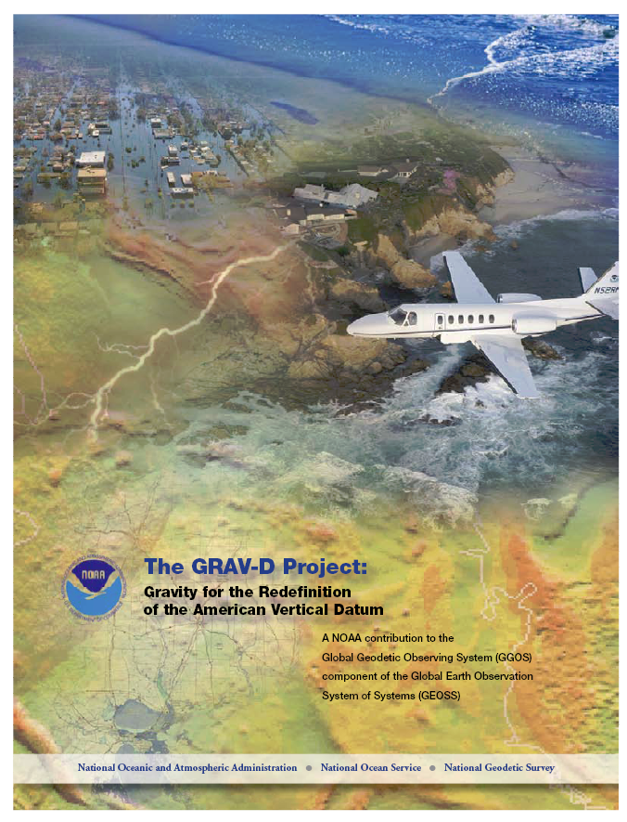
GRAV-D Project Overview
Overall Target: 2 cm accuracy orthometric heights from GNSS and a geoid model
GRAV-D Goal: Create gravimetric geoid accurate to 1 cm where possible using airborne gravity data
GRAV-D: Two thrusts of the project
Airborne gravity survey of entire country and its holdings
Long-term monitoring of geoid change
Leveraging partnerships to improve and validate gravity data
Notes:
Target is to be able to achieve 2 cm accuracy orthometric heights (where possible) using a GNSS receiver and a geoid model
Roughly 1 cm uncertainty from GNSS and 1 cm from the geoid model
GRAV-D
Phase 1: snapshot of the entire country to provide a consistent data set
Phase 2: long term monitoring of geoid change – in development
Work with partners to incorporate additional gravity data, particularly surface gravity data, validate existing data, and monitor change

Slide 13
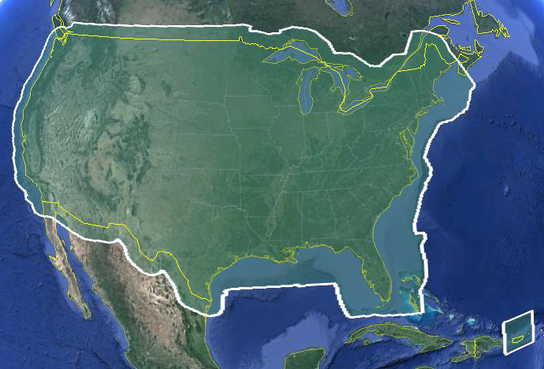
Data Collection Scope
Entire U.S. and territories
Total Square Kilometers: 15.6 million
Initial target area for 2022 deadline
~200 km buffer around territory or shelf break if possible
Notes:
Project Scope:
Scope of the project: cover roughly 15.6 million square kilometers – contiguous united states, Alaska, Hawaii, Guam, and American Samoa
In order to blend with satellite altimetry data the airborne survey is done to the continental shelf where possible or ~ 200 km beyond the shoreline or border, whichever is further
Deadline of 2022 for datum rollout, which means a target of 2021 to finish the airborne survey
Priority areas were defined as Alaska and coastal areas
Challenges:
Fixed annual budget and time → design of surveys had to fit within an annual budget of $3.5 million and meet the deadline
This was a major factor in setting altitude and line spacing

Slide 14
Priority Order for Surveys
Greatest Datum Needs
Other Variables to Consider
Alaska
Coastal US & Great Lakes
Hawaii & Pacific Islands
Aleutians
Interior CONUS
Mountains first
Need to meet annual collection metric
Aircraft availability and capability
Appropriate season for measurement
Contract fuel availability
Notes:
NGS evaluated the US and all of its territories and established a priority order according to the where the datum is in greatest need of repair. Alaska has the biggest need, so tops the list. Next in priority are the coastal regions of the US and the Great Lakes. Then the Hawaiian and Pacific Islands, the Aleutians, and then interior CONUS. The mountainous regions have the greatest geoid errors and will get our first attention. The actual order we fly the surveys is also informed by the availability of aircraft, the appropriate seasons for measurement, the availability of government contract fuel, and the coordination of logistical constraints so as to most efficiently use our resources.

Slide 15
Performance Metric For Airborne Surveys
FY09 Baseline | Targets vs Actual
 | FY10 | FY11 | FY12 | FY13 | FY14 | FY15 | FY16 | FY17 | FY18 | FY19 | FY20 | FY21 | FY22
6.14% | 7.5% | 12% | 20% | 28% | 36% | 45% | 53% | 62% | 70% | 79% | 87% | 96% | 100% and Implement
6.14 | 8% | 15% | 24% | 31% | 38% | 45% | 55% | 59%
Measure: Percentage of the U.S. and its territories with GRAV-D data available
to support a 1 cm geoid supporting 2 cm orthometric heights.
Notes:
We’ve set up a basic GIS GPRA monitoring in the War Room. We will report the coordinates of our survey monthly and they will calculate our percentages.

Slide 16
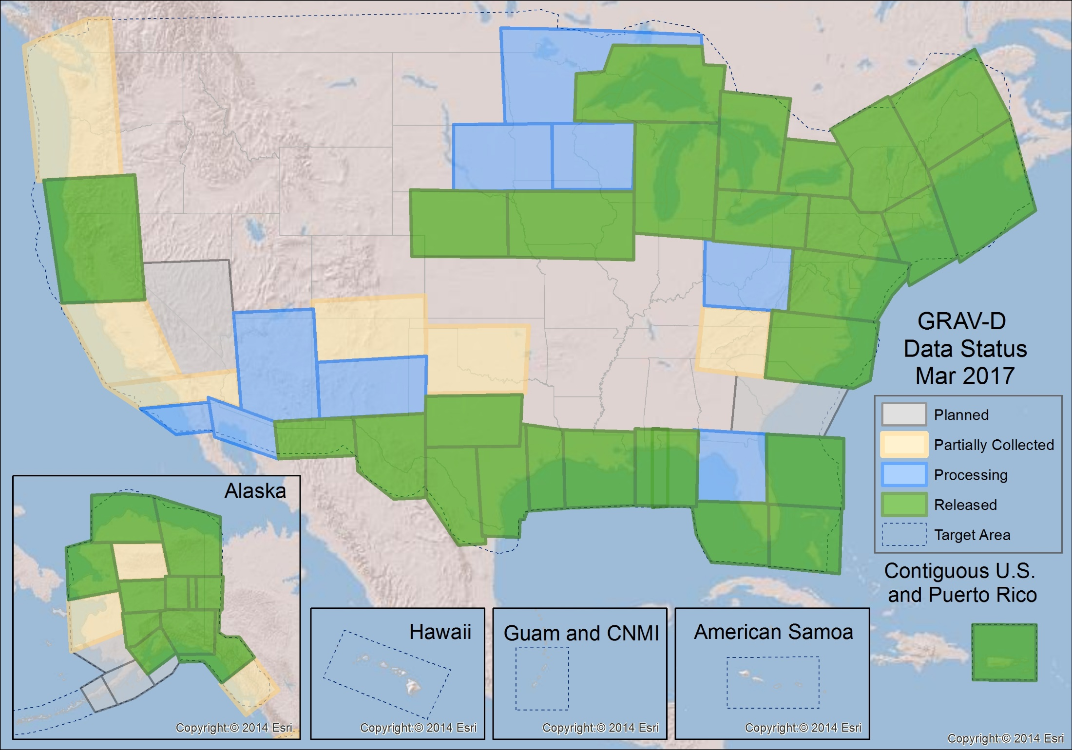
GRAV-D Status 3-31-17: 59%

Slide 17
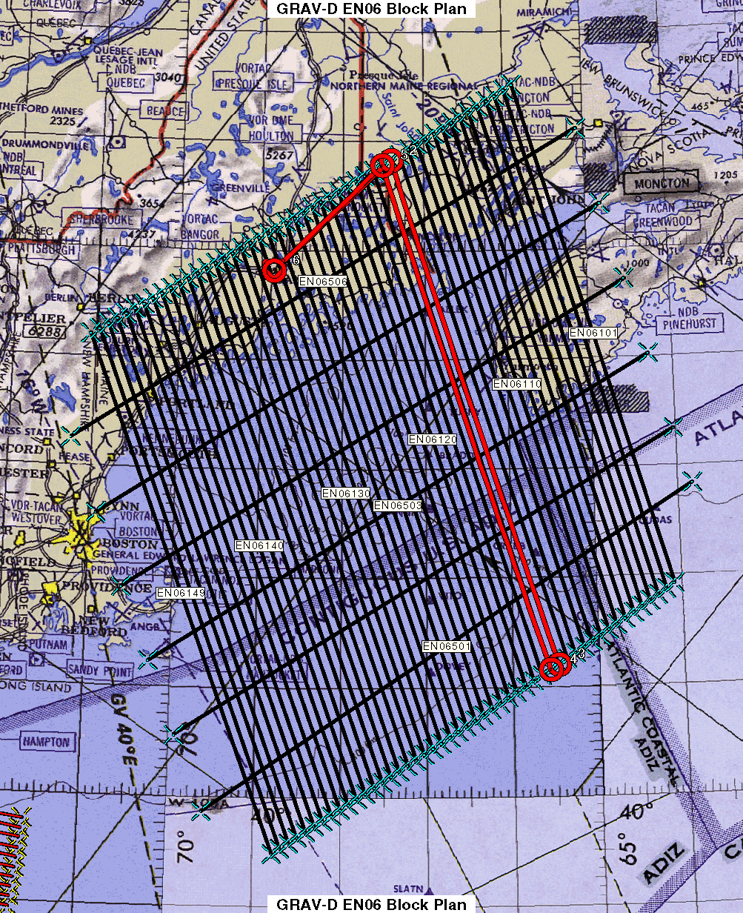
Survey and Block Plans
Blocks designed based on aircraft capabilities, available airports, and target area
Data lines spaced 10 km apart
Cross lines spaced 60-80 km apart
Flight altitude 20,000 ft
Nominal speed 220-250 kts
Notes:
Block layout based on aircraft, adjust size of block if needed

Slide 18
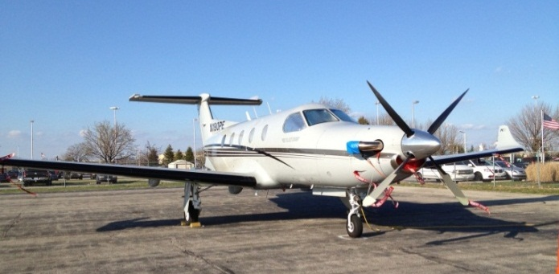
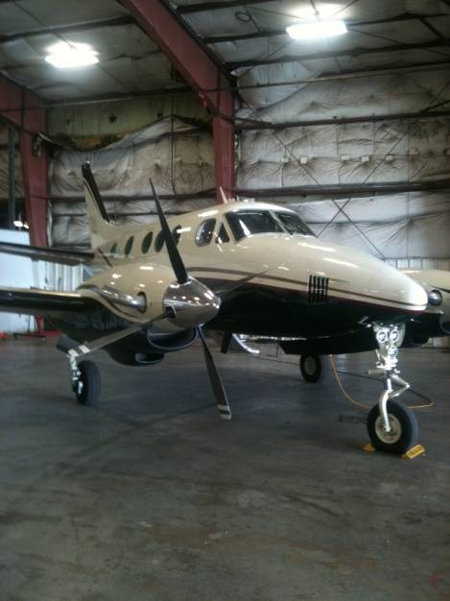
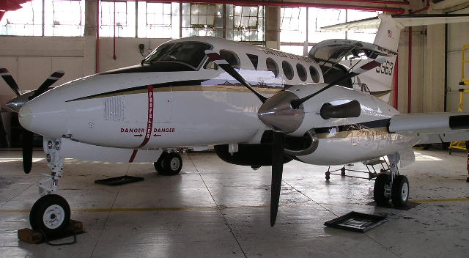
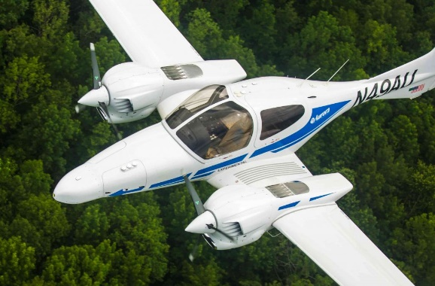
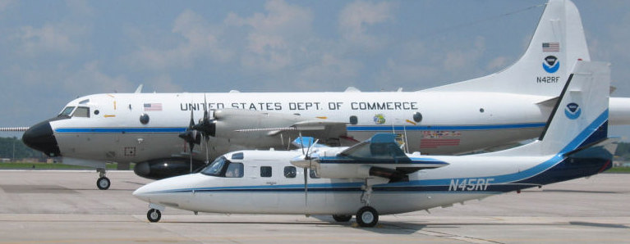
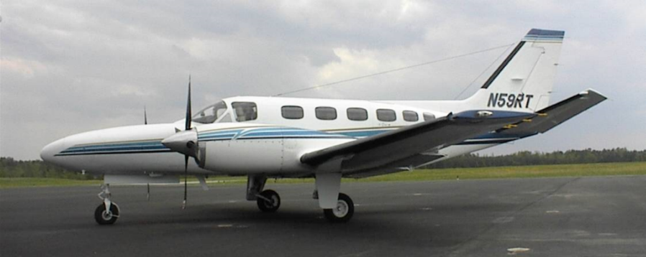
GRAV-D Aircraft
Bureau of Land Management Pilatus PC-12
Dynamic Aviation King Air 200T
Fugro King Air E-90A
Naval Research Laboratory King Air RC-12
Aurora Flight Sciences Centaur Optionally Piloted Aircraft
NOAA P-3 (background) NOAA Turbo Commander (foreground)
Fugro Cessna Conquest
Notes:
GRAV-D surveys have been operating on a number of aircraft. In order to accomplish our objectives within budget, we utilize a “portfolio” of aircraft of both government and contract origin. We’ve used the NOAA Jet Prop and the P-3, although little opportunity exists for further use of these aircraft. We operate about five months/year aboard the BLM Pilatus PC-12 aircraft. This aircraft is used for fire-spotting during warmer weather months in AK and the western US. This year we began working with Fugro to provide us aircraft services. We plan also to work this year with the Naval Research Lab and the VXS-1 Navy Squadron aboard their RC-12 King Air aircraft.

Slide 19
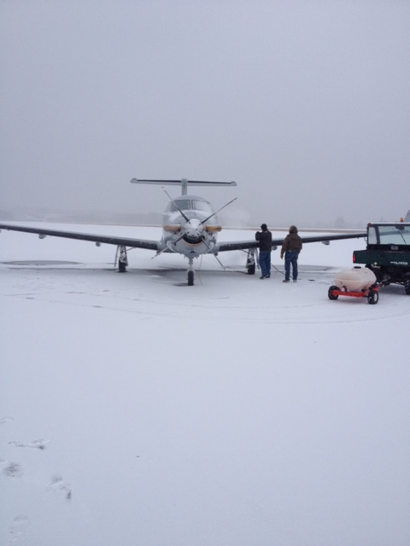
Airborne Surveying Challenges
Flight requirements:
Weather/atmosphere is calm (turbulence can cause poor data)
Instruments and aircraft are in working order
Good GPS geometry, no GPS jamming
Military airspace permission
Operator/pilot must be within duty day limits

Slide 20
Data Processing
Field Quality Control Processing
Determine whether lines are accepted/rejected
Plan re-flights
Final Processing
Perform final processing and trimming of data
Prepare all documentation and release data publicly
Notes:
Data Processing
In the field a differential GPS-IMU solution is used to evaluate daily whether flights need to be reflown because precise ephemeris are not available
Final processing is done using Precise Point Positioning (PPP) – an analysis was done comparing differential and PPP, there was either no effect or small improvements in the gravity solutions from PPP
Gravity processing done using in-house software, Newton, which applies the absolute gravity tie, removes drift, and applies a vertical acceleration, Eotvos, and offlevel corrections and then is filtered three times with a time-domain frequency filter
End of line trimming
Data documentation produced and package released on the website
This plot is an example of part of the output. We aim for +/- 5 mGals from EGM08 – as you can see in this plot there is a significant section that deviates from that. However, part of the goal of the airborne campaign is to improve upon EGM08, so while it is a good guide, it cannot be the final determination. This line, for example, if you compare to an adjacent line it looks like this.

Slide 21
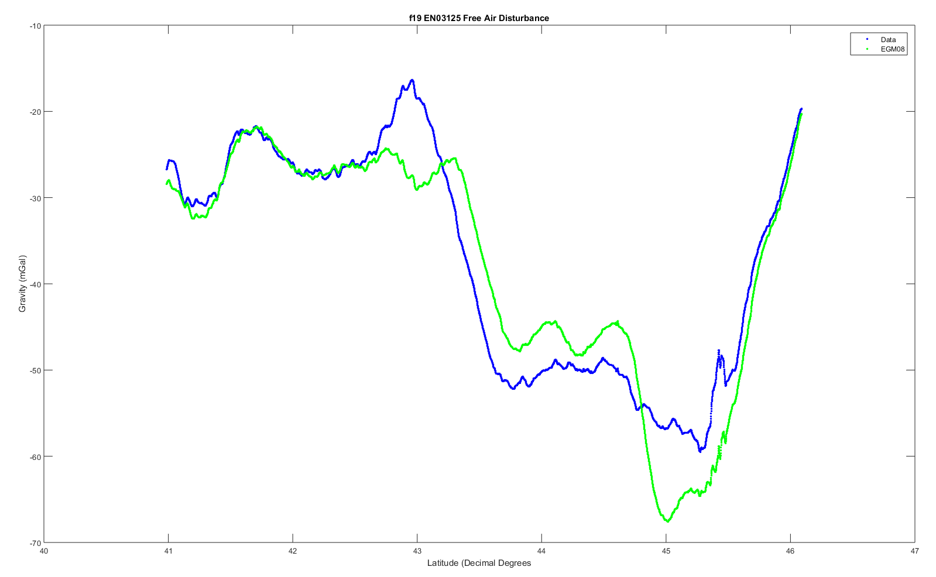
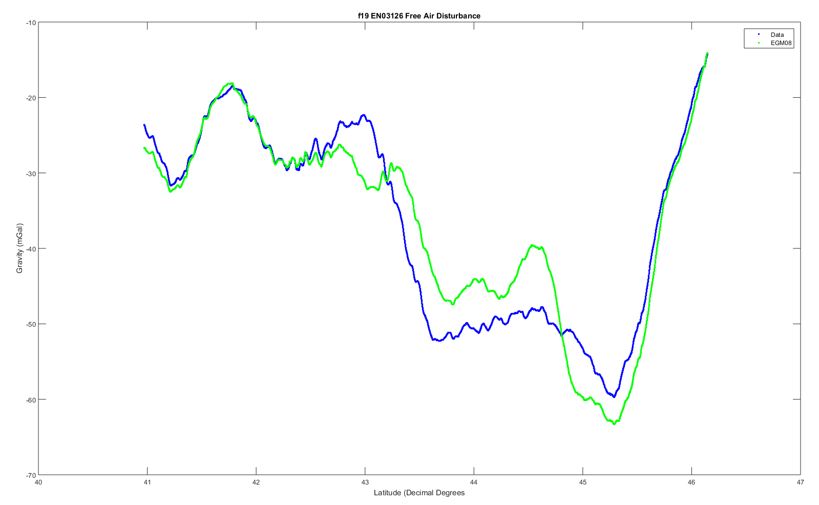
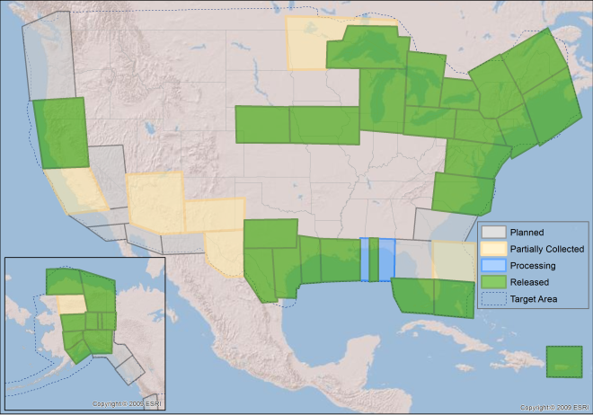
Lake Michigan
Notes:
These are two lines over Lake Michigan where the airborne data (blue) shows significant deviations from EGM08 (Green). However, the x-axis is latitude and you can see that the deviations are supported independently by both lines. This type of visual analysis is extremely useful day-to-day in the field as we determine which lines need to be reflown. In the final processing we also do line to line cross correlation to evaluate overall line agreement.

Slide 22
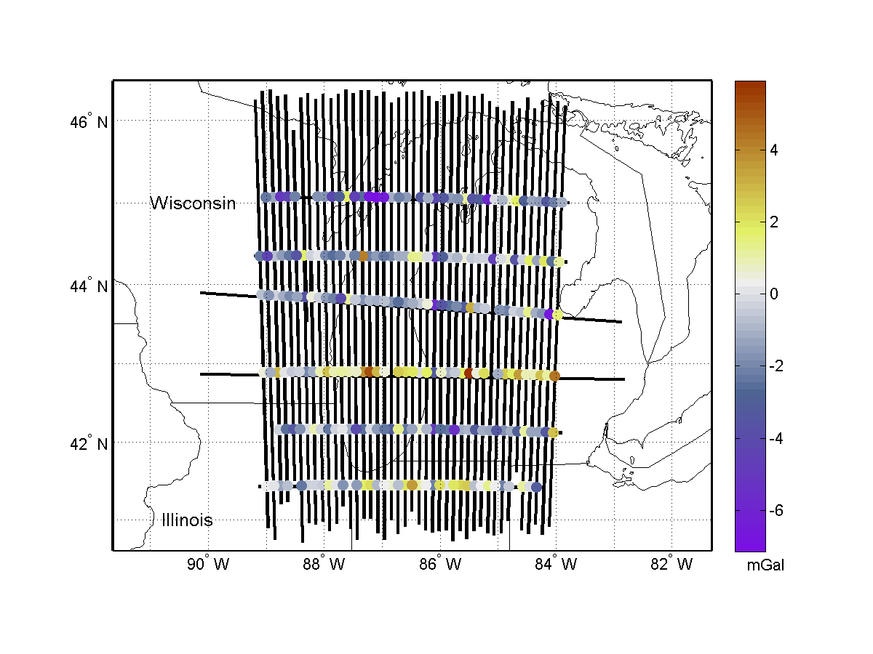
Internal Validation
Internal Validation
Crossover analysis
Line to line comparison
Line reflights
These quality control measures are why partial blocks are not released
Notes:
Internal:
Start with internal comparison
Crossover analysis compares intersection points, aim for RMS of residuals of less than 5 mGals – identifies errors that may need to be removed
Line to line comparison, as was shown earlier, but look at the cross correlation of the entire block
Reflights of lines provide repeatability statistics
External:
Geoid comparison --
Compared to EGM08 the airborne data often agrees with the satellite gravity
Most updates are seen in areas of poor data coverage
Shown is Lake Michigan, the gridded airborne data, EGM2008 versus GOCE, and then adding the airborne data to EGM2008 and again comparing with GOCE
GSVS –
Three surveys: first flat and low gravity signal, second flat and high gravity signal, third rugged and high gravity signal
First is completed and published, second completed and papers in progress, third in the planning stages
2011 survey confirmed that the airborne gravity was contributing to the goal of a 1 cm accurate geoid

Slide 23
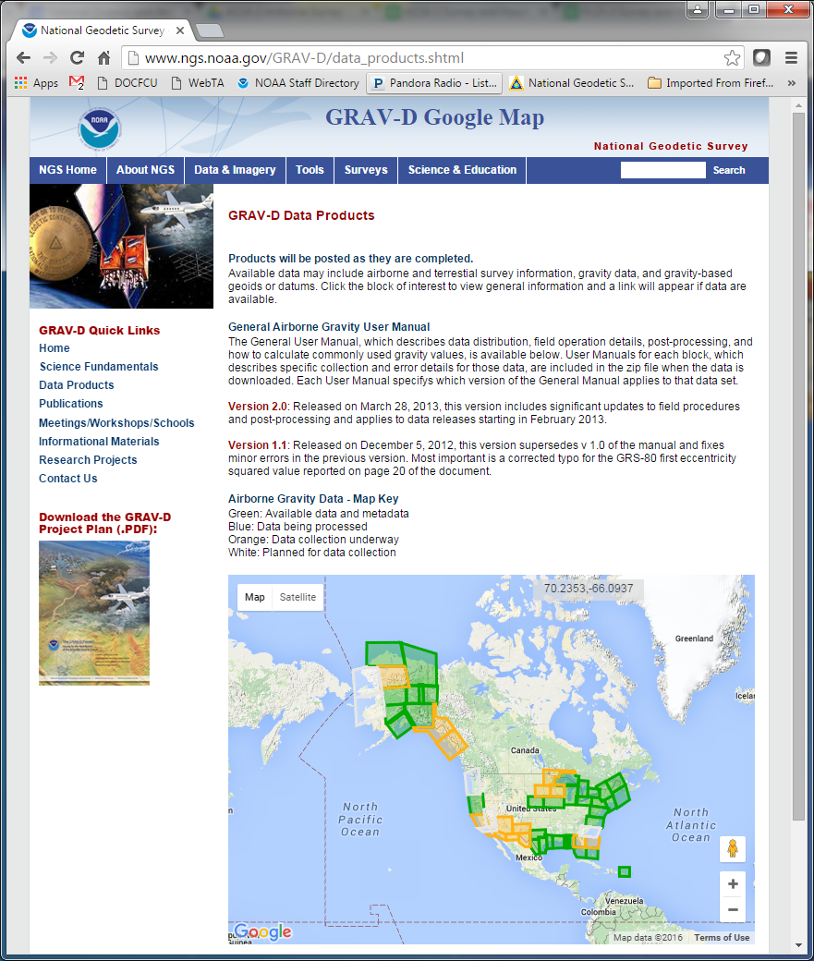
GRAV-D Website
geodesy.noaa.gov/GRAV-D

Slide 24
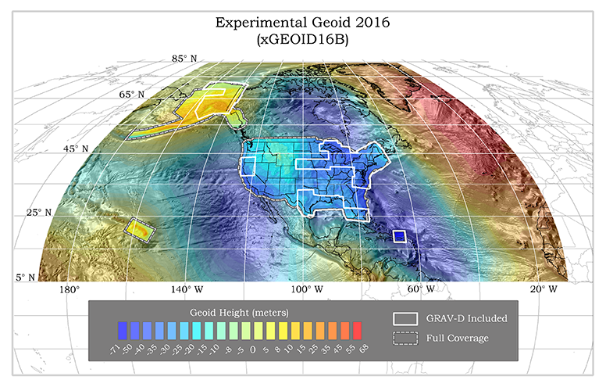
Experimental Geoids
Combining most recent satellite, airborne, and terrestrial gravity data to test methods for 2022
Published annually
Updated with airborne gravity data
Available on the website
Testing methods
Blending techniques
Density
Terrestrial data improvements
http://beta.ngs.noaa.gov/GEOID/xGEOID/

Slide 25
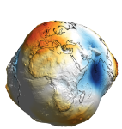
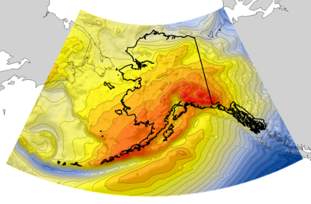
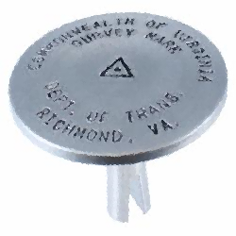
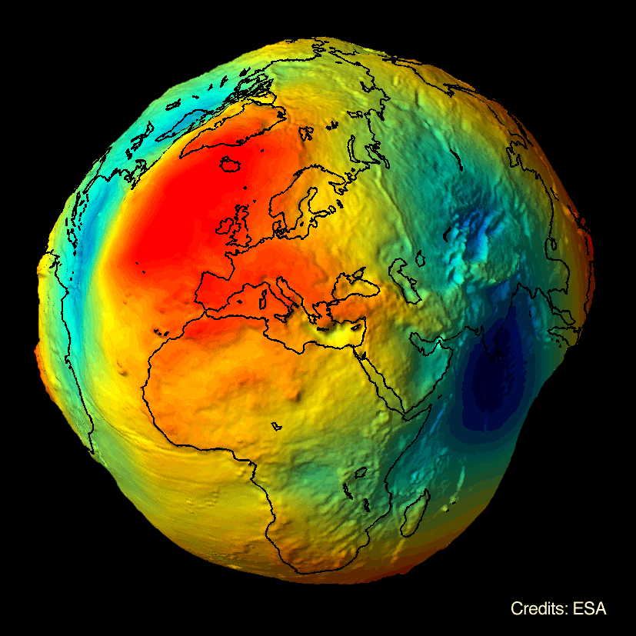
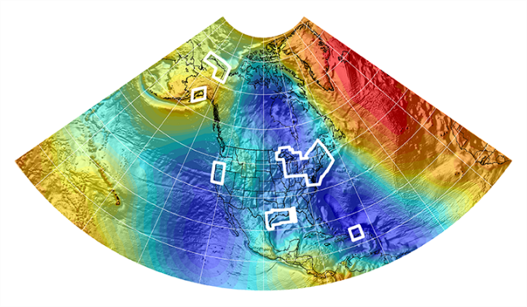
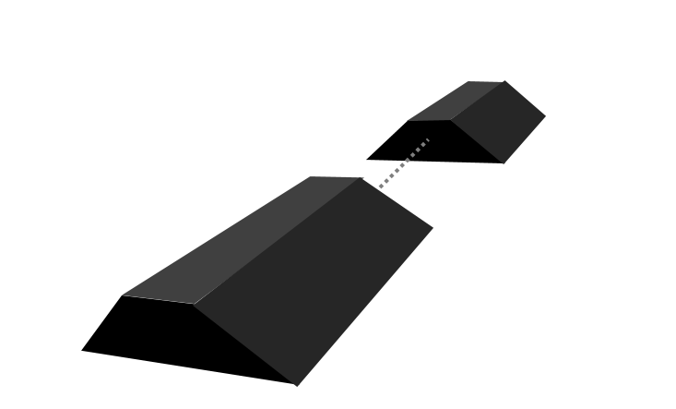
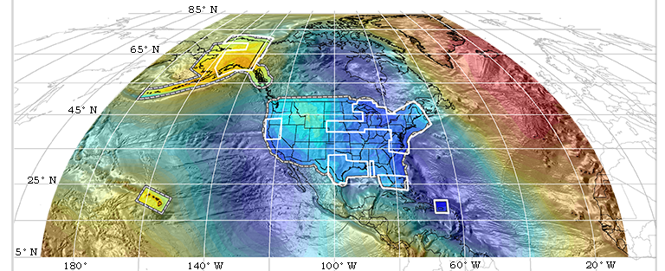
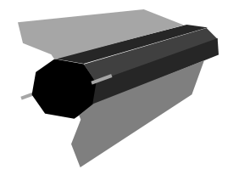
Evolution of the Geoid
EGM08
USGG2012
GEOID12A/B
NGA
ArcticGP
GRAV-D
2008
2012
2014
GOCO05S
2015
2016
xGeoid14B
GRACE
xGeoid15B
xGeoid16B
+
GOCE
Notes:
NGA Arctic Gravity Grid (2017)

Slide 26
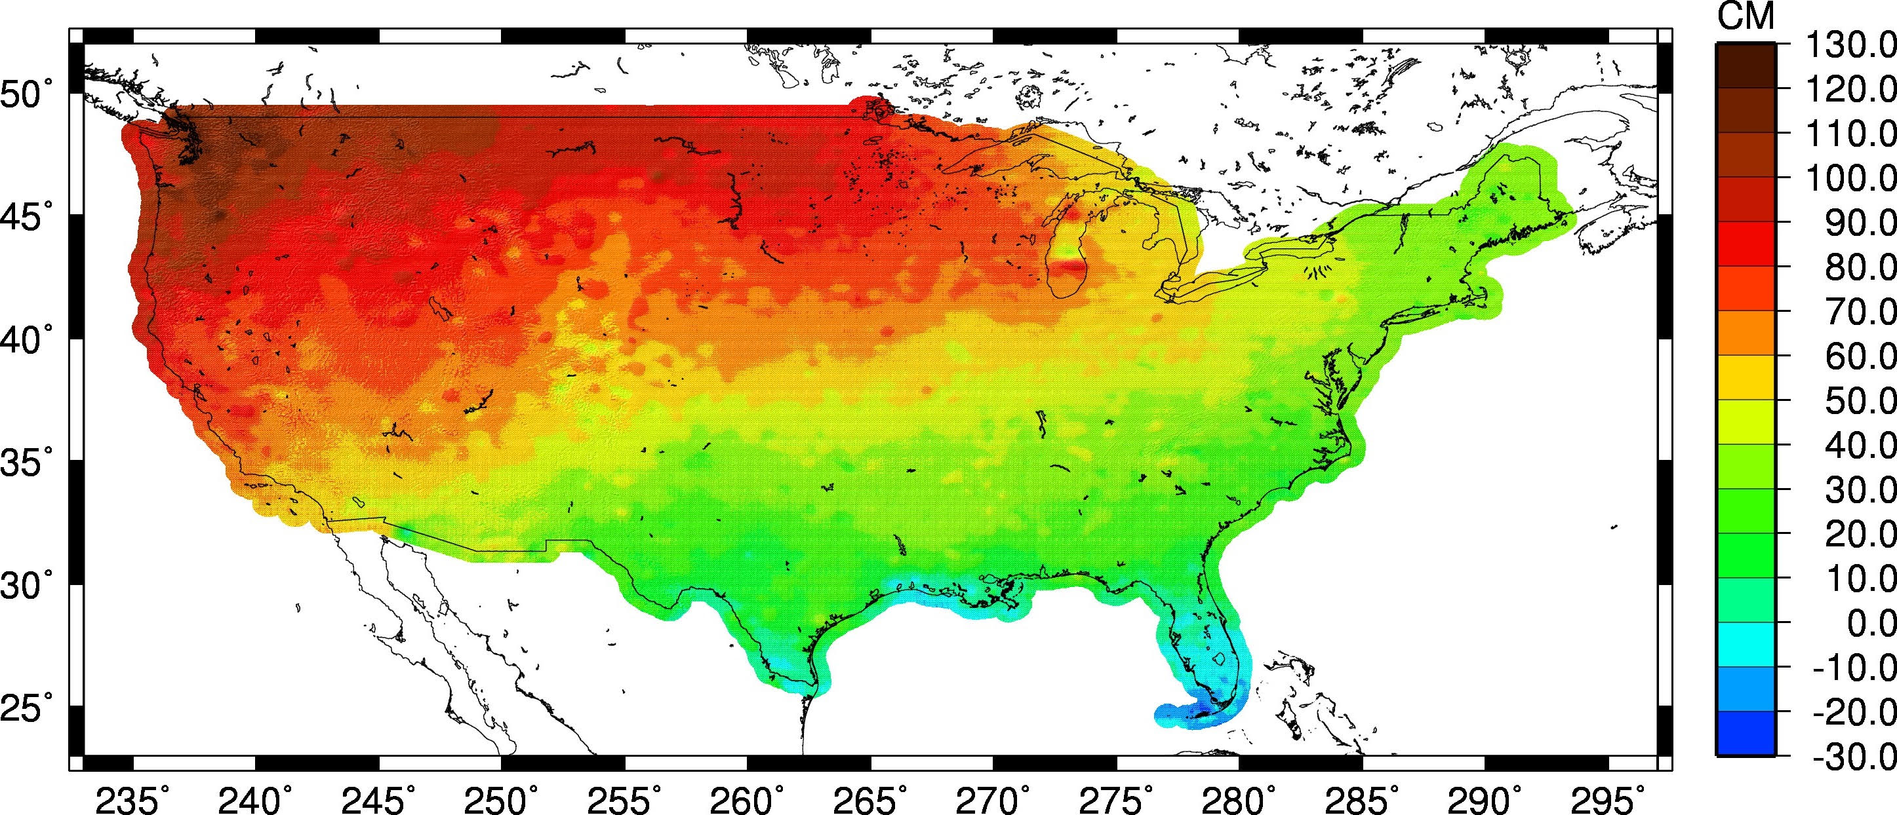
Estimate of Geoid Change
Current Experimental Geoid Compared to Hybrid Geoid: xGeoid16B – Hybrid Geoid12B
HYBRID vs. GRAVIMETRIC
Notes:
Approximately +0.1 m (Florida) to -1.3 m (Washington)
More than 2 meters of change in Alaska

Slide 27
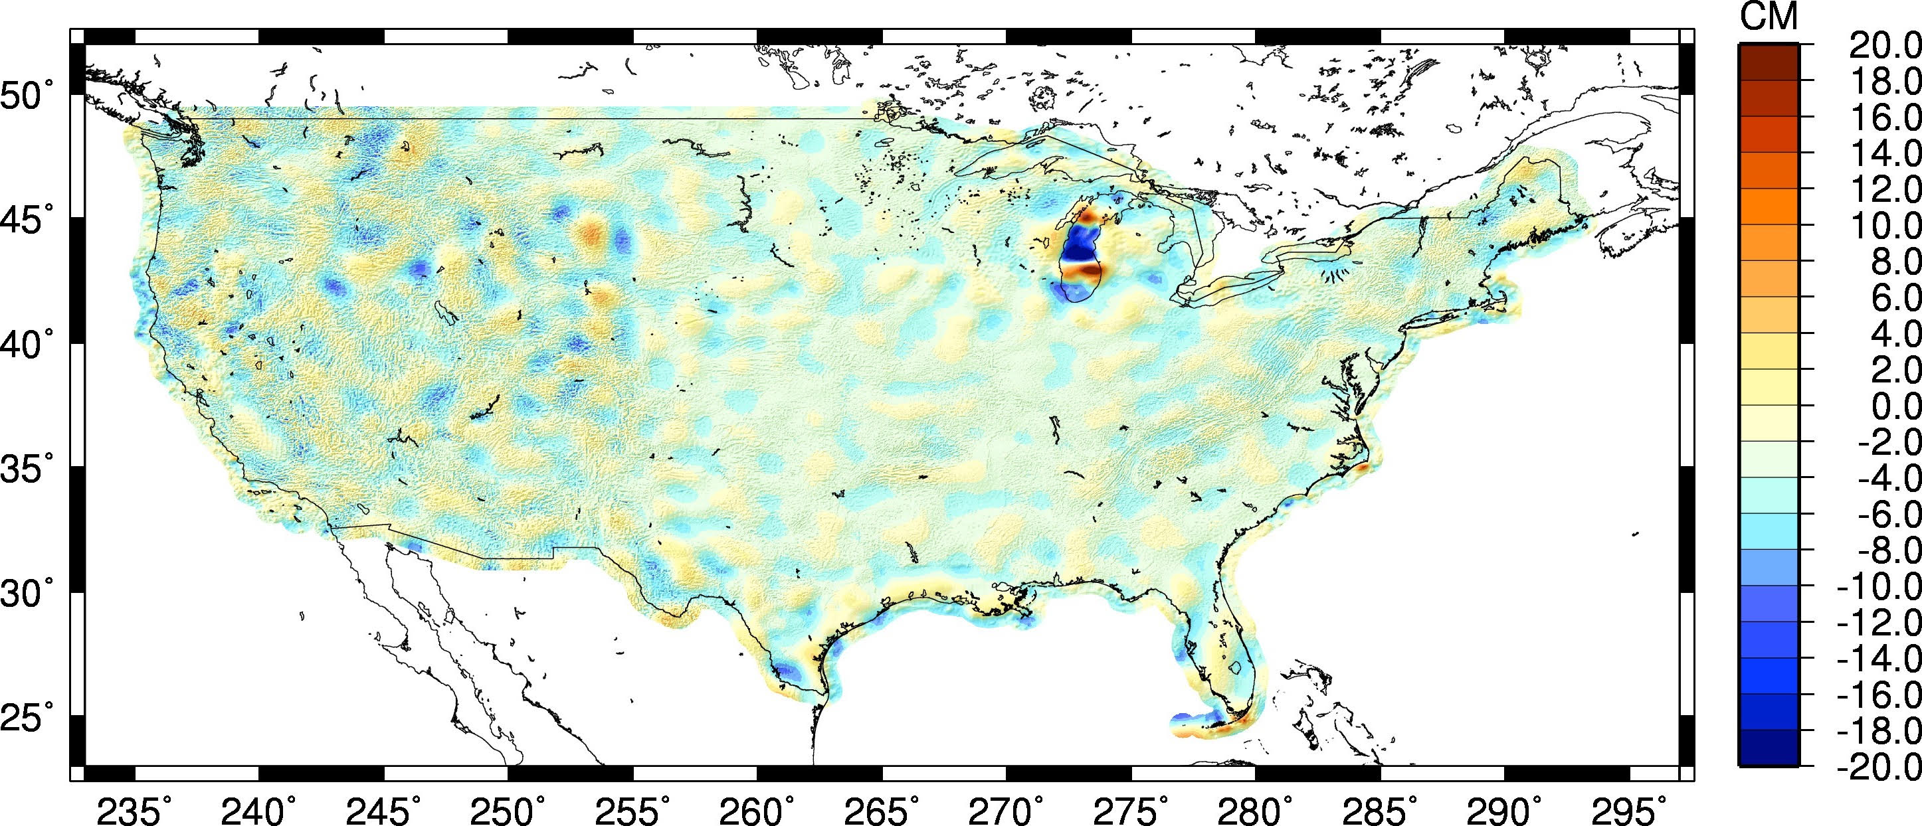
Estimate of Geoid Change
Current Experimental Geoid Compared to Gravimetric Geoid: xGeoid16B – USGG12
GRAVIMETRIC Without vs. With Airborne

Slide 28
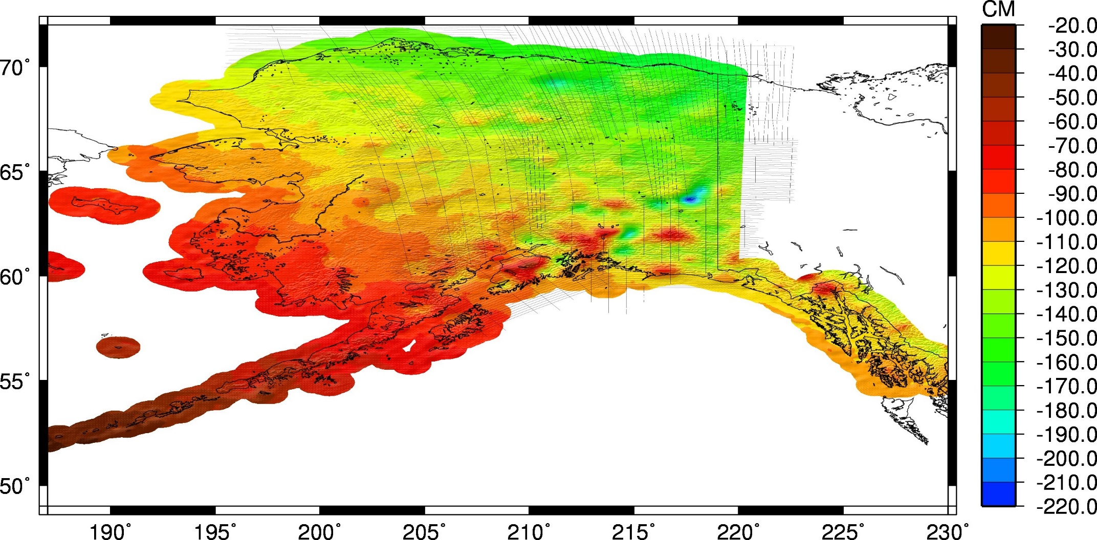
Estimate of Geoid Change
Current Experimental Geoid Compared to Hybrid Geoid: xGeoid16B – Hybrid Geoid12B
HYBRID vs. GRAVIMETRIC
Notes:
This is the big change plot!! Going from the hybrid Geoid12B to the most recent experimental geoid. Huge change, 2 meters with a lot of areas between 0.8 and 1.7 meters.

Slide 29
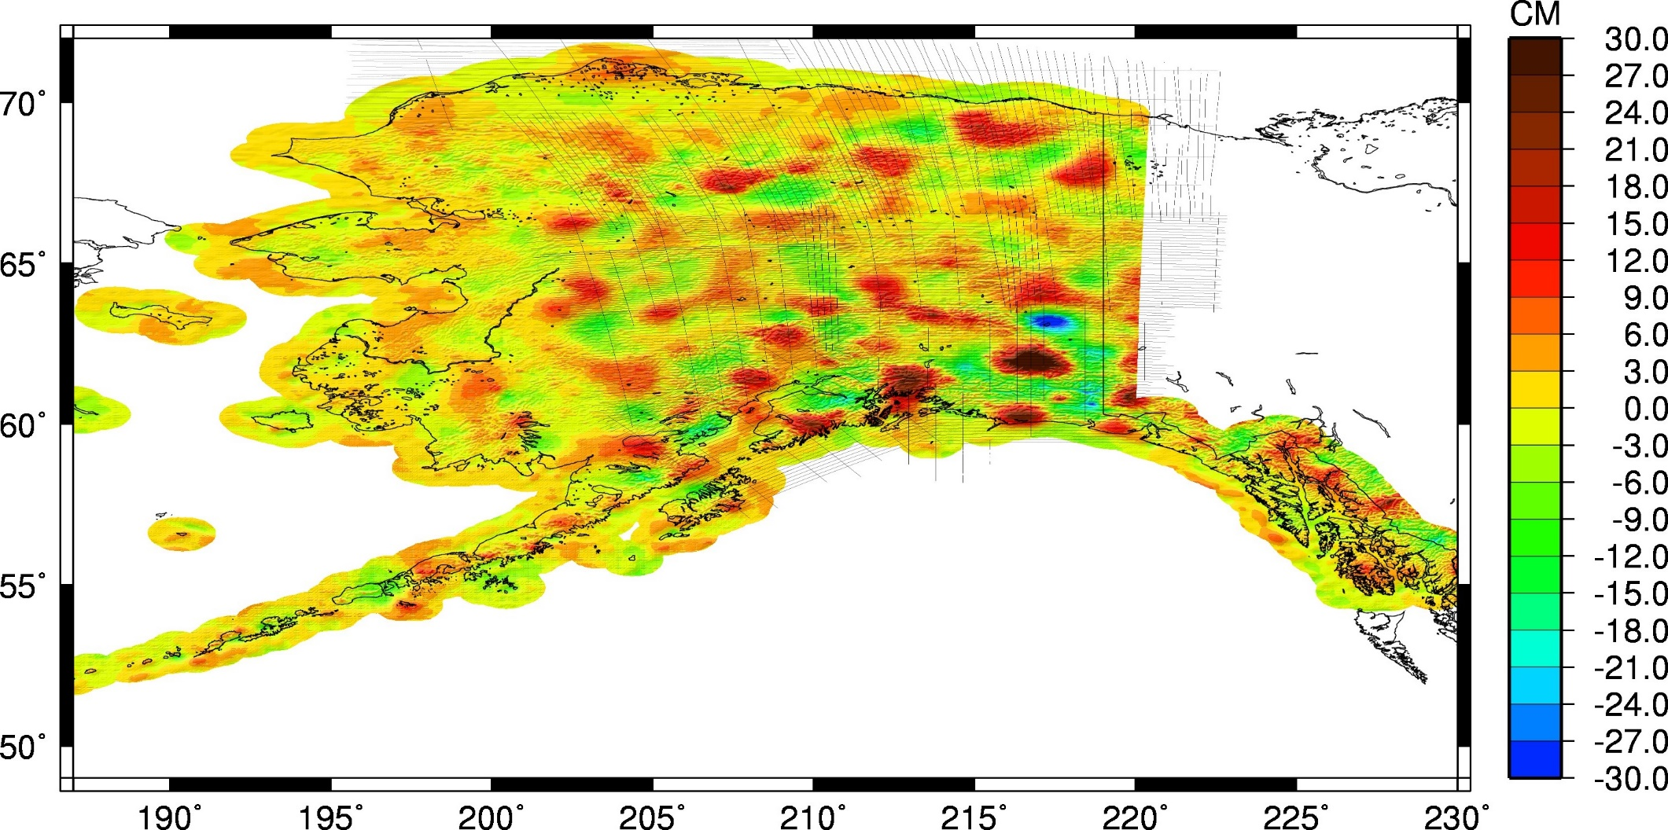
Geoid in Alaska
Current Experimental Geoid Compared to Gravimetric Geoid: xGeoid16B – USGG12
GRAVIMETRIC Without vs. With Airborne
Notes:
Shows the information being added gravimetrically to the 2012 GRAVIMETRIC GEOID model.

Slide 30
Summary
GRAV-D currently at 59% complete and on track to finish data collection in 2022
Expected height changes compared to hybrid geoid
CONUS: -30 to 130 cm
Alaska: -20 to -220 cm

Slide 31
3. Geoid Slope Validation Surveys

Slide 32
Geoid Slope Validation Surveys
Basic Concept
GSVS11 in Texas
Survey Techniques
GSVS14 in Iowa
GSVS17 in Colorado
Differences
Current Status & Schedule
2

Slide 33
3

Slide 34
Objective of the GSVSs
How do we know that GRAV-D is working?
The Geoid Slope Validation Surveys (GSVSs) use high precision, high resolution (~1.5km spacing), ground-based survey techniques to determine the shape of the geoid consistently along a large (~300km) distance.
This allows for the direct comparison of the geoid shape predicted by various, gravity-based geoid models.
This also allows for a quantification of the airborne gravity’s contribution to the improvement of these models.

Slide 35
Objective of the GSVSs (cont.)
Why compare the shape of the models?
Rather than using “absolute” values of the geoid at specific locations to compare models, it is actually more useful to look at the changes in the shape of the geoid over various distance scales (i.e. looking at the slope between various pairs of survey points separated by 1, 2, 5, 10, 20, 50, 100, 200 km, etc.) . Hence the name…
Example of slopes over various distance scales:
Every 1 interval
Every 2 intervals
Every 3 intervals
Every 4 intervals

Slide 36
GSVS11, South Texas
The first survey was performed in south Texas in 2011
Low (close to the geoid) and flat.
Results were excellent!
"Confirming regional 1 cm differential geoid accuracy from airborne gravimetry: the Geoid Slope Validation Survey of 2011", Smith et al., Journal of Geodesy,
2013.

Slide 37
GSVS Survey Techniques
7
Survey techniques employed:
Bechmarks installed ~1.5km
Leveling
Absolute/Relative Gravity
Vertical Gravity Gradient
Long-session GPS
Deflection of Vertical

Slide 38
Leveling and Gravity
The entire line was leveled (double-run). Geodetic heights provided at each benchmark.
Leveling and gravity are both needed for orthometric height determination. Usually gravity is modeled, but in this case was actually measured at every point.
Relative gravity and vertical gravity gradient at every benchmark
Absolute gravity (A10 and/or FG5) at ~every 7th benchmark
8

Slide 39
Long Period GPS
Calibrated, fixed-height antennas, all identical models
In Texas 2011:
20 complete sets of equipment (2 parties, 10 sets each)
Each party observed 10 new stations each day
20 hours of observation each day
Project processed with OPUS Projects
9

Slide 40
Deflection of the Vertical (DoV)
Measure the slope of the geoid directly!
Precision tilt meters provide alignment “level” to the geoid.
Celestial almanacs provide predicted alignment with star field (relative to ellipsoid).
The difference between the two vectors (broken into orthogonal components) are the Deflections of the Vertical (or “slopes”).
In Texas 2011:
228 stations (204 official points, 11 redundant
observations, 3 reobservations)
31 nights
7 stations/night
Observing with Swiss CODIAC (COmpact DIgital Astrometric Camera)
10

Slide 41
GSVS14 Iowa
After the success of GSVS11, Iowa was chosen for the next test in 2014.
Higher elevation and geologically interesting terrain (traversing the Midcontinent Rift System).
(Very) similar survey techniques were employed.
Preliminary results again show excellent (<2 cm geoid discrepancy) agreement and noticeable improvement when airborne data are included. March 2017: Accepted for publication in Journal of Geodesy
11

Slide 42
GSVS17 Colorado
The third (and likely final) GSVS will take place along US160, from Durango to Walsenburg, in southern Colorado.
High elevation and rugged topography. “Worst case” for geoid modeling.
Variation from 6,000’ (MSL) to 11,000’, over two passes.
12

Slide 43
GSVS17 Colorado (cont.)
220 benchmark locations (approximately 1 per mile) have been installed
The survey will take place in overlapping phases beginning May 2017 and is expected to continue through September.

Slide 44
Differences with GSVS17
Numerous “extra” bench marks had to be installed for leveling accuracy purposes (very steep terrain in some sections).
Absolute gravity (A10) and quadratic (3 tier) gravity gradients will be measured at all benchmarks.
Topographic corrections are being developed to aid in field DoV quality control as well as post-survey geoid modeling.

Slide 45
Summary
Ground-based geoid slope measurements (derived from both classic techniques and direct measurements of DoV) over varying distance scales are used to compare various geoid models.
Comparing this “ground truth” to the models also allows for a direct quantification of the improvement when airborne gravity data are included.
To date, two such surveys have been conducted successfully in reasonably flat terrain.
Colorado is up next for a final, challenging test.

Slide 46
Acknowledgements
The team at NGS would like to sincerely thank the Colorado Department of Transportation (CDOT) for its invaluable assistance with permitting, mark placement, and mark installation.

Slide 47
Contact Information
Dru Smith dru.smith@noaa.gov
NSRS Modernization Manager
Monica Youngman monica.youngman@noaa.gov
GRAV-D Project Manager
Derek van Westrum derek.vanwestrum@noaa.gov
GSVS17 Project Manager

