Slide 1
Proposal for a comprehensive vertical datum for North America, Central America and the Caribbean
Dru Smith, Dan Roman, Vicki Childers,
Mark Eckl, Monica Youngman
NOAA’s National Geodetic Survey

Slide 2
Outline
Status of Vertical Datums in the Region
Why isn’t NAVD 88 good enough anymore?
GRAV-D
North American Gravity Holdings
Future Work
Notes:
This is a listing of the parts of subject matters to be covered.

Slide 3
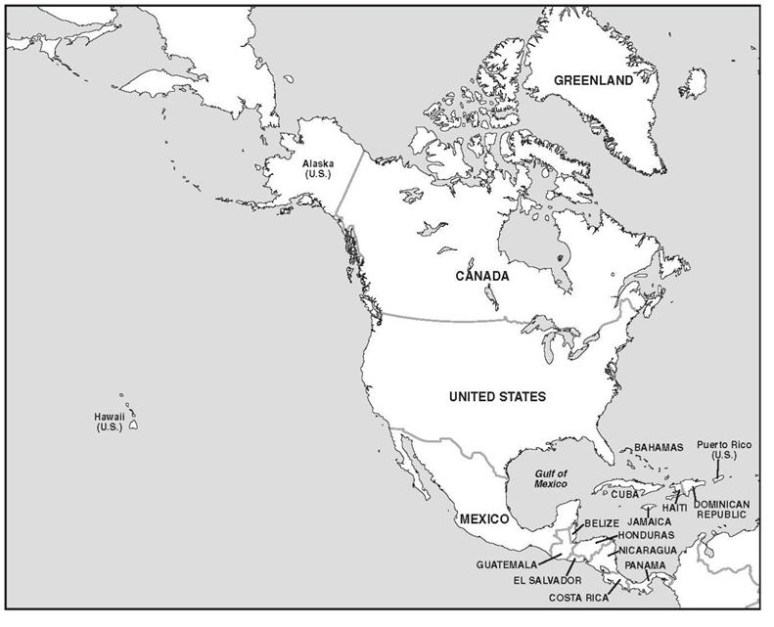
No official
Vertical datum
CGVD 28*
NAVD 88
No official
Vertical datum
* NAVD 88 exists; also soon (2013) to be
replaced by a new geoid/GNSS based datum
Notes:
Status of known vertical datums in North America, ca 2013

Slide 4
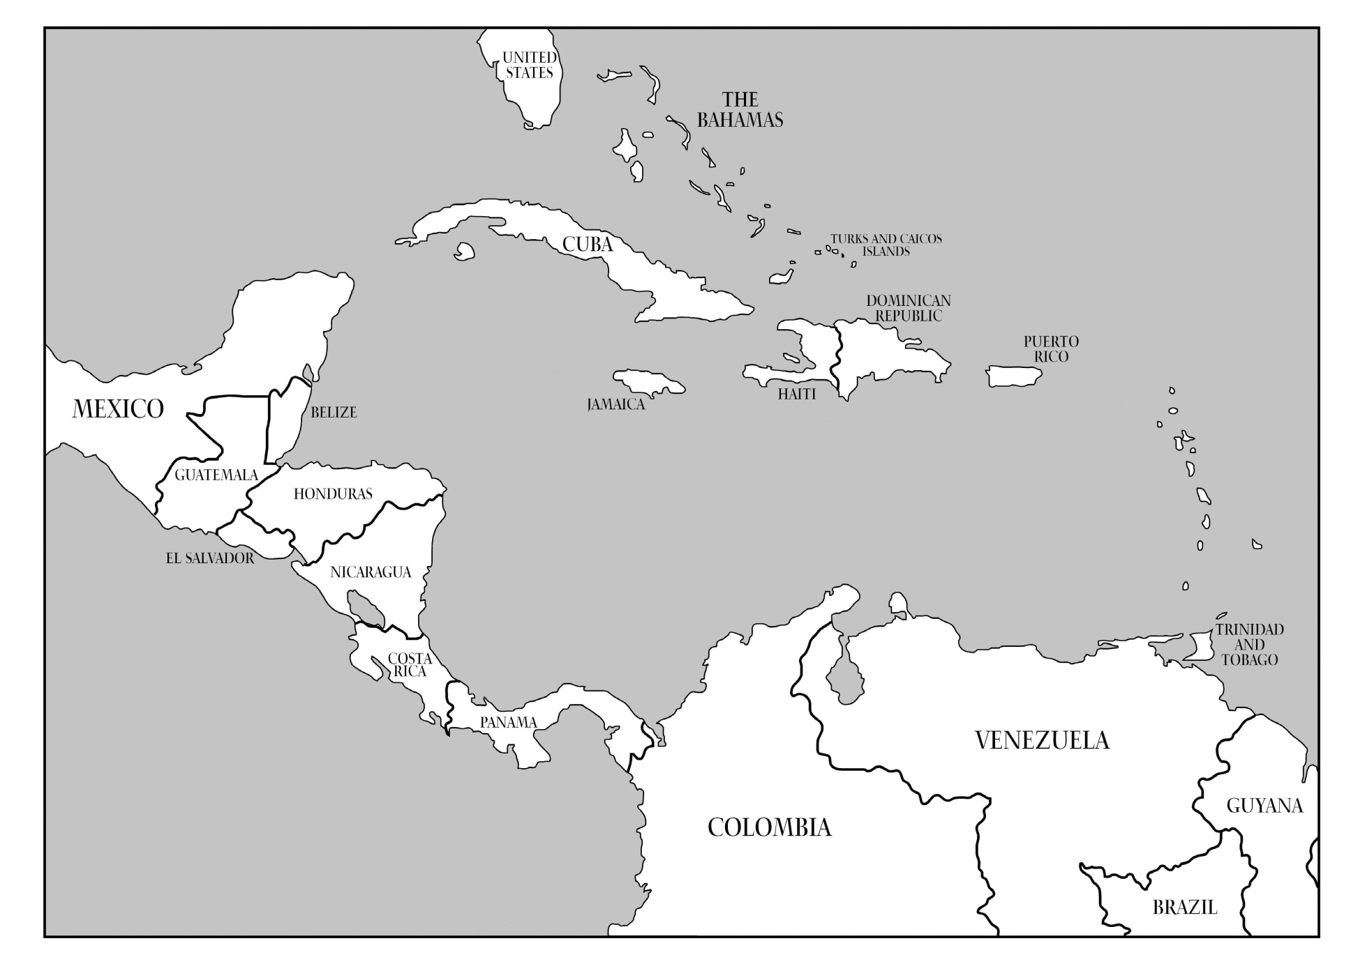
?
PRVD02
VIVD09
?
?
⁽¹⁾
?
?
?
?
?
Santo Domingo⁽¹⁾
?
Puerto Cortéz⁽¹⁾
?
?
Corinto 1952⁽¹⁾
?
?
San José⁽¹⁾
?
?
La Unión 1960⁽¹⁾
Puntarenas⁽¹⁾
Cristóbal⁽¹⁾
⁽¹⁾ Información cortesía de David Avalos
Notes:
Status of known vertical datums in North America, ca 2013

Slide 5
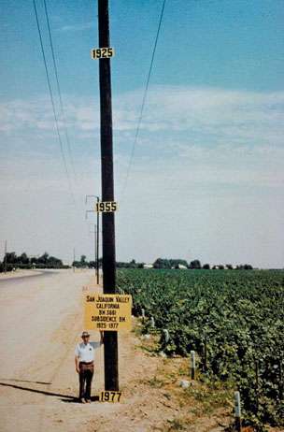
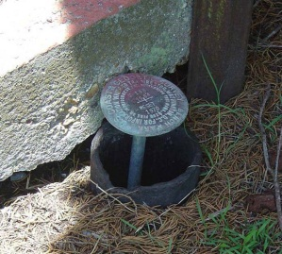
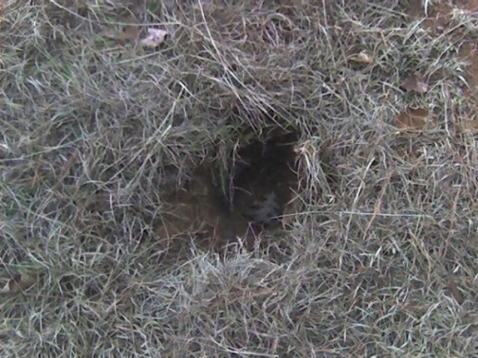
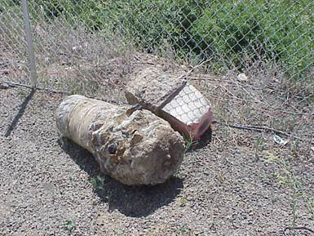
Why isn’t NAVD 88 good
enough anymore?
NAVD 88 suffers from use of bench marks that:
Are almost never re-checked for movement
Disappear by the thousands every year
Are not funded for replacement
Are not necessarily in convenient places
Don’t exist in most of Alaska
Weren’t adopted in Canada
Were determined by leveling from a single point, allowing cross-country error build up
PID: EZ0840
Notes:
Clarification on the word “convenient” – this is used to mean “there isn’t always a bench mark around when you need one – sometimes you have to find one far away and level from it to your site of interest”

Slide 6
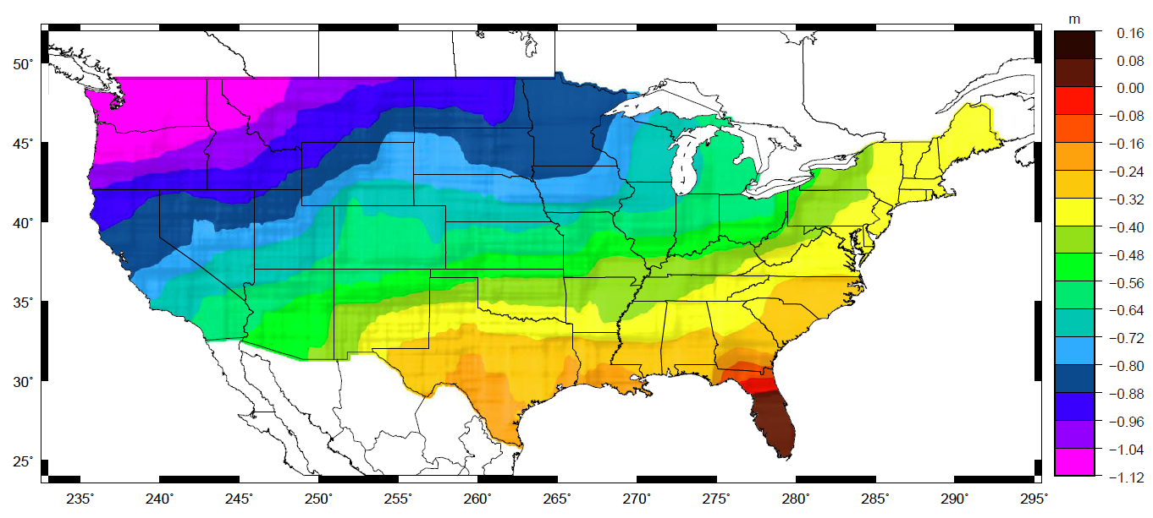
Why isn’t NAVD 88 good
enough anymore?
Approximate level of geoid mismatch known to exist in the NAVD 88 zero surface:
Notes:
This map reflects the sort of height changes that users could expect if NAVD 88 were replaced with a geoid-based vertical datum.
This is only a large scale approximation and should not be used as an absolute guide. Each benchmark might have its own level
Of mismatch, say from uplift or subsidence, not captured by this broad brush.
Also, this is the difference between the zero level of NAVD 88 and the actual geoid. The difference between NAD 83 ellipsoid heights and
ITRF/GRS-80 ellipsoid heights has NO influence on this graph and should not be part of the story.
Updated October 2010

Slide 7
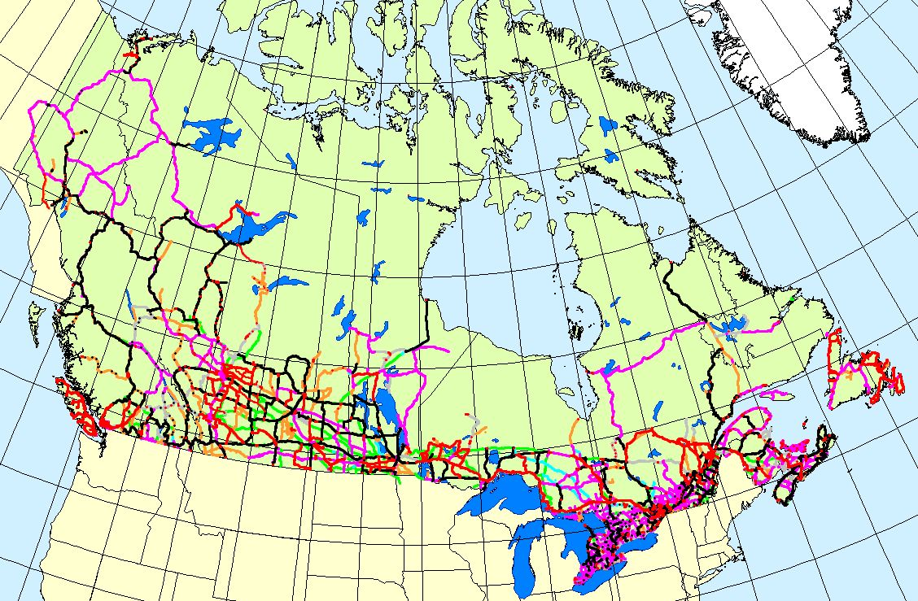
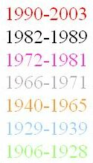
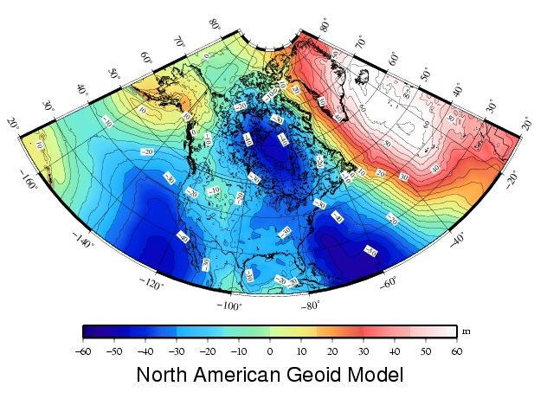
Canada Height Modernization - 2013
The geoid model:
1. Entire coverage of the
Canadian territory
(land, lakes and oceans)
2. Compatible with space-
based positioning
(e.g., GNSS, altimetry)
3. Less expensive for
maintenance
4. Fairly stable reference
surface
Levelling Networks:
1. Established over the
last 100 years
2. 120,000 km of levelling
lines
3. Some 80,000
benchmarks
1. Time consuming
2. Expensive
3. Limited coverage
4. BMs are unstable
5. BMs disappear
6. Local networks
H = h_{GNSS} – N_{Model}
Notes:
As mentioned, in 2013 this is Canada’s plan to switch from a benchmark-based CGVD28 to a geoid-based vertical datum.

Slide 8
What is GRAV-D? (1 of 3)
Gravity for the Redefinition of the American* Vertical Datum
An NGS project whose target is to redefine the official civilian vertical datum as the geoid, realized through the use of GNSS technology and a gravimetric geoid model over at least the United States and its territories
Notes:
*American = “of or pertaining to North or South America”
Updated Oct 2010

Slide 9
What is GRAV-D? (2 of 3)
GRAV-D means fast, accurate, consistent orthometric heights everywhere in the USA
GPS already gives fast accurate ellipsoid heights
If the geoid were modeled (and monitored) to highest accuracy…fast, accurate orthometric heights, anywhere, anytime
No need to use leveling to “bring in the datum”
Notes:
Monitoring of the geoid will be done a combination of satellite derived geoid changes (such as from the GRACE mission or its follow-ons), geophysical modeling and a coordinated field campaign of absolute and relative gravimeters and CORS.
Updated October 2010.

Slide 10
What is GRAV-D? (3 of 3)
GRAV-D will mean:
Primary access to the vertical datum will be through a GNSS receiver and a gravimetric geoid model
One consistent vertical datum for all of North America
CONUS, Alaska, Hawaii, PR, VI
Available for adoption by
Canada, Mexico, Caribbean, Central America

Slide 11
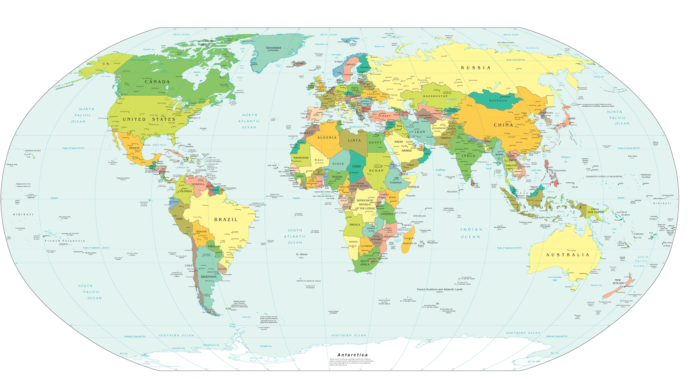
Expected GRAV-D airborne gravity coverage by 2022
Alaska
“CONUS”
Guam / Northern Marianas
Hawaii
Puerto Rico / Virgin Islands
American Samoa
GRAV-D
Planned
Coverage
Notes:
The coverage of GRAV-D that is expected by 2022.

Slide 12
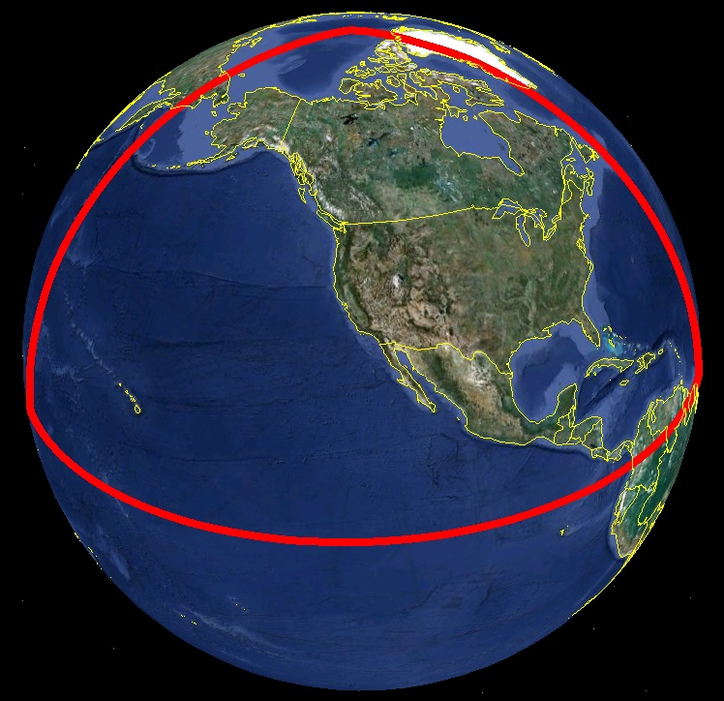
Extent of 2022 geoid
model used for
new vertical datum

Slide 13
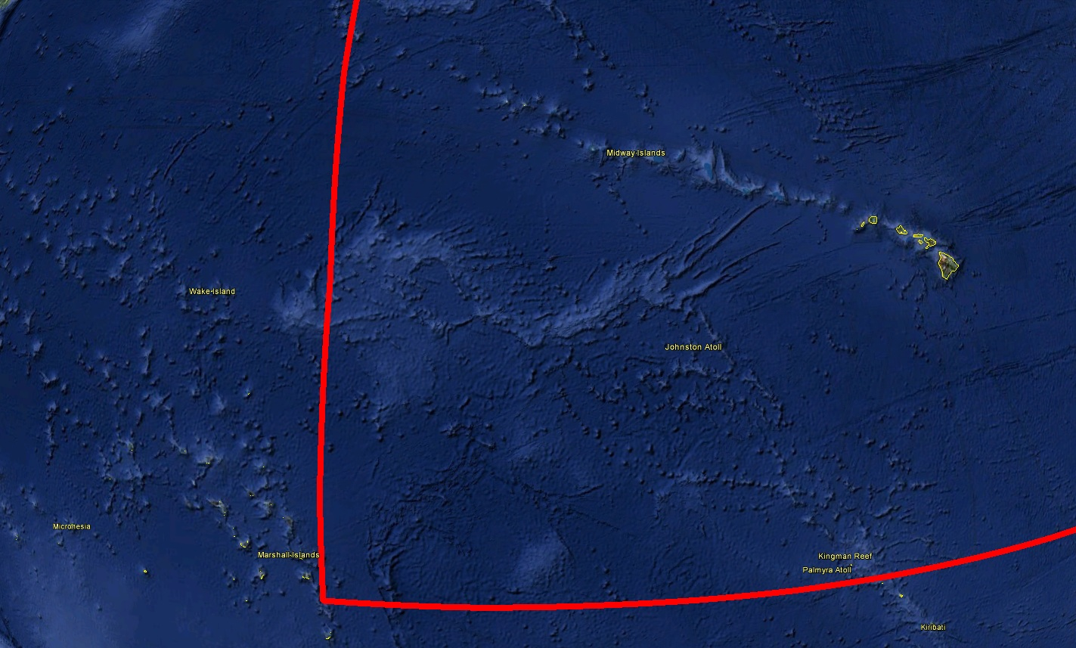
Hawaii
Many US Pacific Territories
(not Guam, CNMI nor American Samoa)

Slide 14
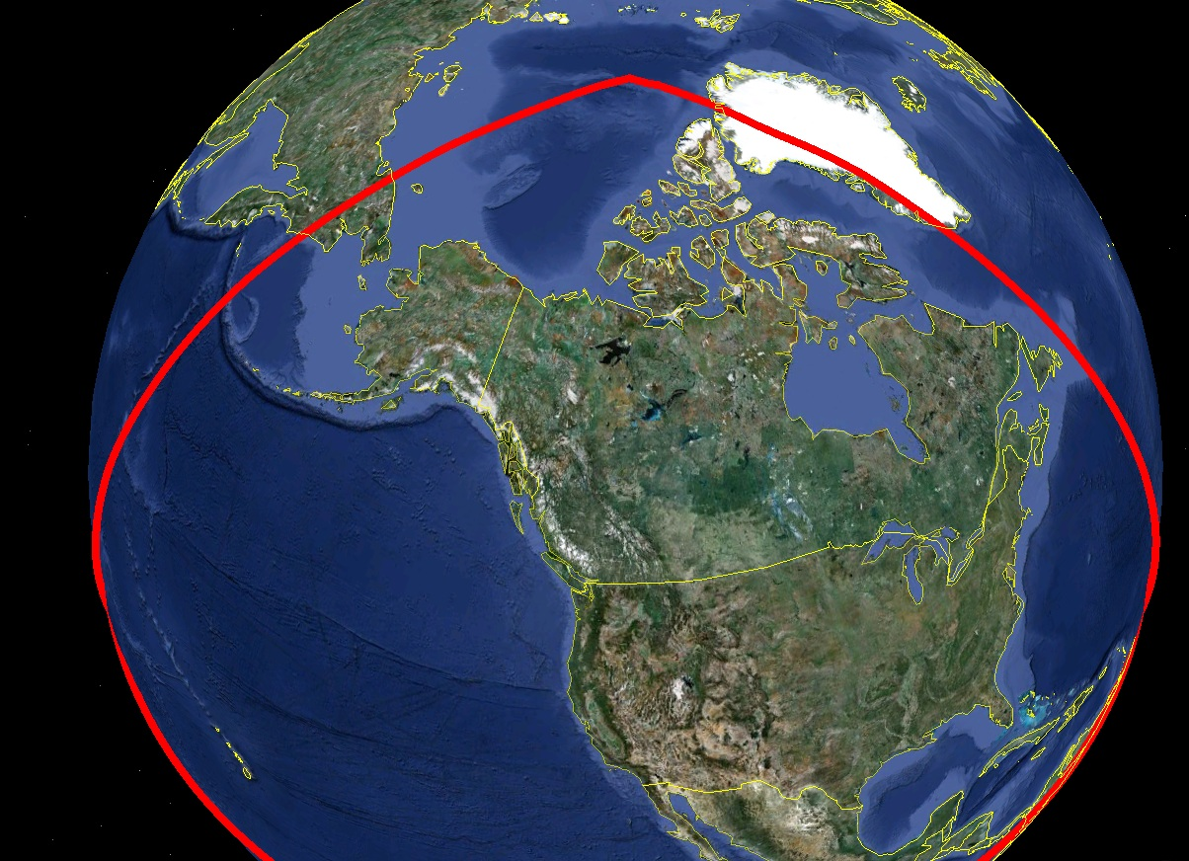
Alaska, including
entire Aleutian
Island Chain
Canada
CONUS (USA)

Slide 15
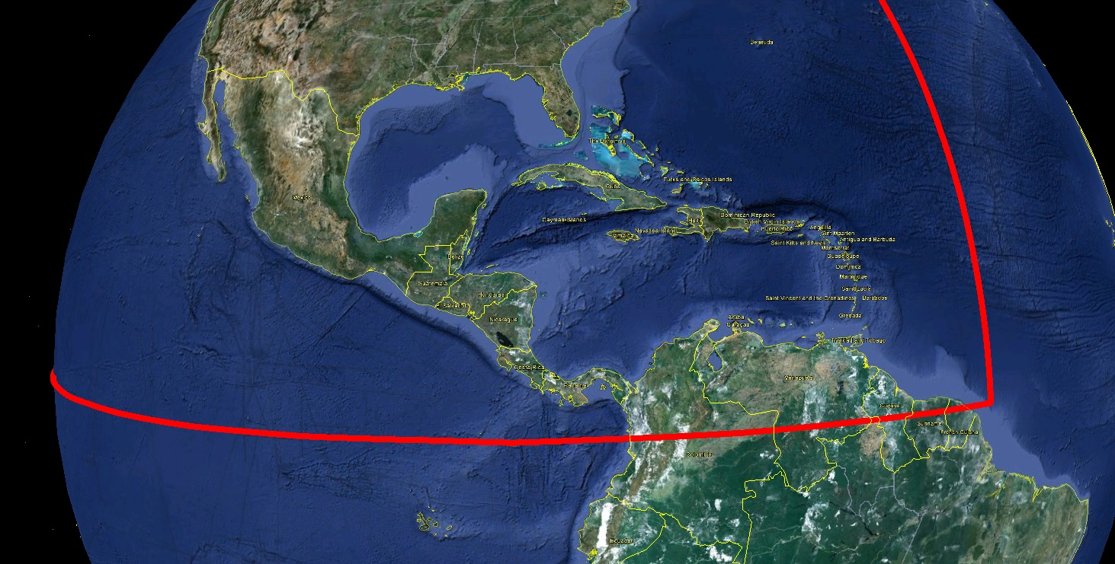
Bermuda
Mexico
All Caribbean
Countries
All Central
American Countries

Slide 16
Gravity Holdings
GRAV-D is only funded to collect over USA by 2022
Data collection plans beyond 2022:
Geoid monitoring across the continent
Airborne collection in surrounding countries if necessary and through cooperative agreements
Existing gravity holdings
Sparse
Metadata issues

Slide 17
Alaska: Sparse coverage;
GRAV-D has concentrated here first
Greenland: Multiple airborne
surveys, but not currently in
NGS holdings
Cuba: Political issues
mean a gap on the largest
Island in the Caribbean
Guatemala, Belize, El Salvador: Gap between two
historic computations: MEXICO97 and CARIB97

Slide 18
Close-up of gravity holdings currently available at NGS

Slide 19
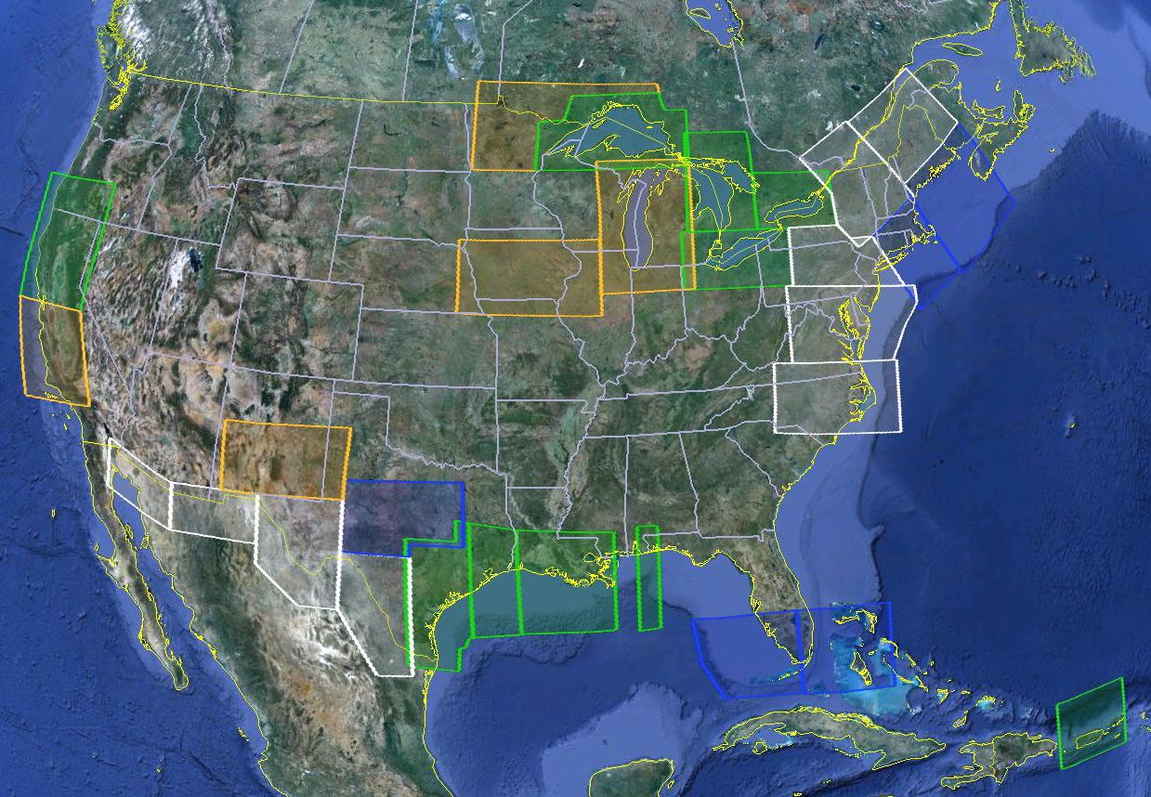
Gravity for the Redefinition of the American Vertical Datum (GRAV-D)
FY13
FY13
FY13
FY13
FY13
FY13
FY14
Available on the Website
FY14
In Processing
Partially Collected
FY13/14
Planned
FY14
Status of and plans for data collection – more information and data available at www.ngs.noaa.gov/GRAV-D

Slide 20
Future Work
Engage all countries in North American Geoid working group (IAG Sub-commission 2.3c)
Chair: David Avalos (INEGI)
Collect up existing terrestrial gravity in gaps
Organize new collections collaboratively with other countries
Terrestrial
GRAV-D

Slide 21
Future Work
Agreement on W₀ value
USA and Canada have agreed to create all geoid models until 2022 using this new value
Done, in French and English

Slide 22
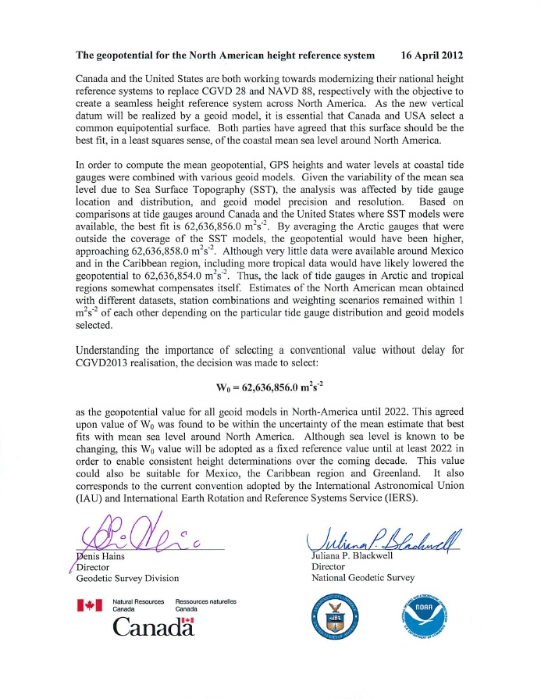
Future Work

Slide 23
Future Work
Make geoid-based orthometric heights available via OPUS
Done, in extended output

Slide 24
Future Work
www.ngs.noaa.gov/OPUS

Slide 25
Future Work
Develop a geoid-monitoring service
Plan with and without GRACE-type satellites
Likely to include:
A tracking network
Co-located CORS with gravimeters?
Geophysical Models
Working group established
Boulder conference in 2009
Unstaffed at the moment

Slide 26
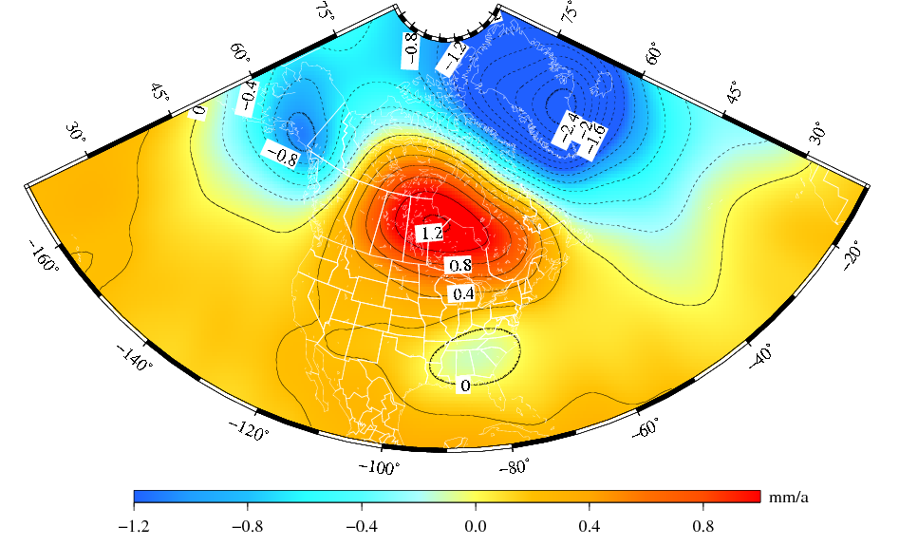
The “secular” geoid change from the monthly GRACE models (2002-2008).
Deglaciation
The solution represents the effect due to total mass changes.
The solution uses a 400-km Gaussian filter.
Glacial Isostatic
Adjustment
Drought
Notes:
Secular is between quotation marks because only GIA is secular, the deglaciation and drought are currently more recent multi-year systematic variations of the geoid. I used the term “secular” not to confuse with seasonal variations of the geoid.

Slide 27
Interested?
Geoid / Vertical Datum Contacts:
NA Geoid Working Group Chair & Mexico Geoid:
David Avalos (david.avalos@inegi.org.mx)
USA: Dan Roman (dan.roman@noaa.gov)
Canada: Marc Véronneau (marc.veronneau@nrcan-rncan.gc.ca)
Notes:
This PPT is the October 2010 update (by Dru Smith) to a set of slides that was originally created in November 2009 by Dru Smith.
Until such time as a project manager for the new vertical datum is announced, any updates to this PPT will be his responsibility.

Slide 28
Extra Slides

Slide 29
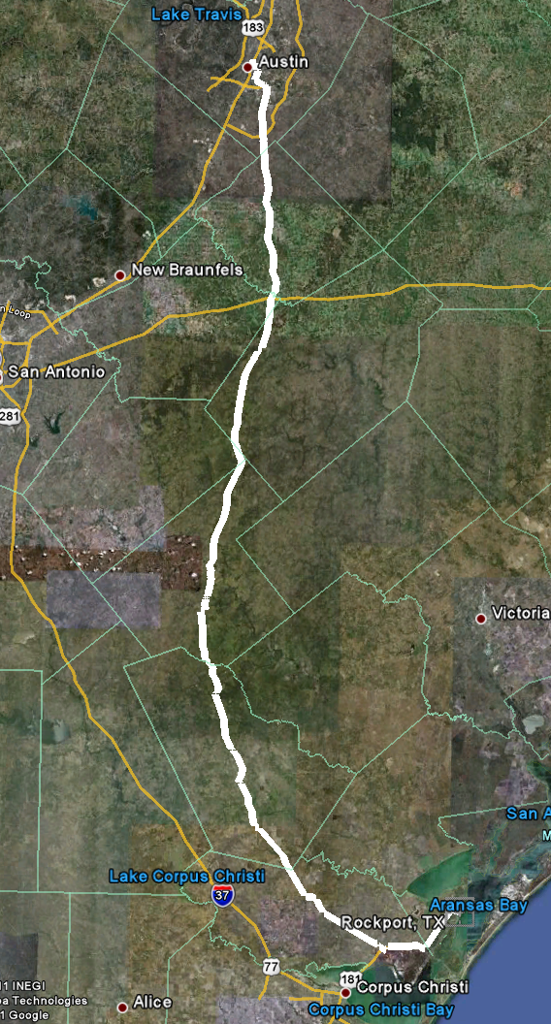
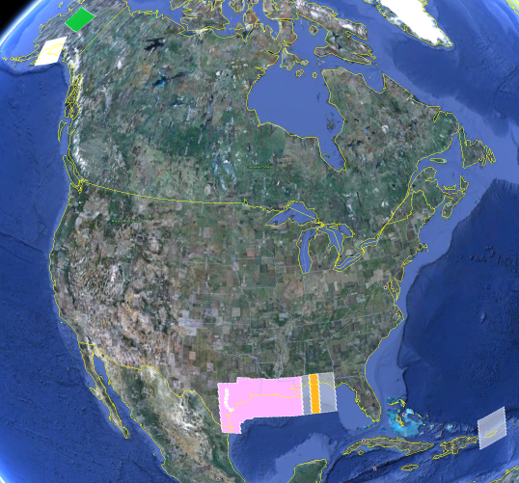
Geoid Slope Validation Survey of 2011 (GSVS11)
Terrestrial Survey using:
GPS
Leveling
DOVs
To quantify accuracy of:
Current geoid models
Geoids with GRAV-D added
325 km
218 points
1.5 km spacing
Notes:
The final line was a 325 km stretch from downtown Austin, Texas (North end) to Rockport, Texas (South end). There were 218 official survey points along the line, with an average spacing of 1.5 km between them. The shaded areas in the above picture were the existing GRAV-D data at the time of planning GSVS11 (since expanded). Although the weather report looks extreme, most surveying was done in the milder times of day.

Slide 30
GSVS11: Proving why we need GRAV-D
Geoids without new GRAV-D data: 1-3 cm differential accuracy
over distances from 0.4 to 325 km
Geoids with new GRAV-D data:
1 cm differential accuracy over distances from 0.4 to 325 km
Notes:
GSVS11: Geoid Slope Validation Survey of 2011 – a 325 km long terrestrial survey intended to quantify the accuracy of gravimetric geoid modeling in a low, flat, gravimetrically benign area.

Slide 31
How will I access the new
vertical datum? (3 of 3)
H₂₀₂₂=5.000m +/- 0.020m
(GNSS/geoid)
H₂₀₂₉=4.830m +/- 0.020m
(GNSS/geoid)
Height
H₂₀₂₄=4.960m +/- 0.030m
(GNSS/geoid)
H₂₀₂₉=4.860m +/- 0.150m
(modeled)
2022
2024
Year
2029
V(modeled 22/24) = -2 cm/yr +/- 2.5 cm/yr
V(modeled 22/29) = -2.1 cm/yr +/- 0.3 cm/yr
Notes:
NGS will eventually stop making the claim that we “know” the heights of bench marks as the method of providing access to the vertical datum. What NGS will do is provide the orthometric height to a user on the day of their survey (and with the disclaimer that this height should not be taken as “known” for very long, due to the dynamic nature of the Earth). If possible, height changes (velocities) will be computed and provided to
assist in predicting heights in the future.
Updated October 2010.

Slide 32
Monumented NGS Data

Slide 33
Spot NGS + Canadian data

Slide 34
Spot DMA

Slide 35
Possible ways to fix
NAVD 88 (1 of 1)
Long term fix: Replace NAVD 88
Find a method of defining a vertical datum that seeks to fix all of the known issues with NAVD 88
Best option: Define the datum as a given geoid model and realize it through GNSS technology
GRAV-D
Notes:
Why is this the best option? Because it addresses:
Different datums existing for CONUS, Hawaii, PR/VI (and, theoretically, Canada, Mexico, and the Caribbean and Central American countries)
Sparseness of bench marks
Error build up as one gets far from an origin point
Financial and personnel realities
Fragility of bench mark network

Slide 36
