Slide 1

NSRS Modernization in 2022
Dru Smith
NSRS Modernization Manager
Vicki Childers
Observation and Analysis Division Chief
NOAA’s National Geodetic Survey

Slide 2
Outline of Lectures
Time | Speaker | Topic
15 minutes | Dru | History of geodetic datums and geodetic surveys in the USA
15 minutes | Dru | Justifying and planning to replacing the current datums
1 hour | Vicki/Monica | GRAV-D airborne campaign – overview, progress, future
15 min | Dru | Proving geoid accuracy - GSVS11 and 14
15 min | Vicki | GRAV-D geoid monitoring campaign – plans and progress
15 min | BREAK | BREAK
30 min | Dru | The future of the new vertical datum – GNSS, leveling, time dependency
30 min | Vicki | The future of bluebooking
30 min | Dru | Transformation tools to get you into the future / Adoption and Outreach

Slide 3
History

Slide 4
History
  1807: Survey of the Coast is established
  1836: Becomes the Coast Survey
  1878: Becomes the Coast and Geodetic Survey
  1899: Transcontinental triangulation arc on the N 39th parallel
    Crosses with Triangulation arc along the W 98th meridian at Meades Ranch
  1901: Combined to make the U.S. Standard Datum
  1927: USSD expanded and re-adjusted to become NAD 27

Slide 5
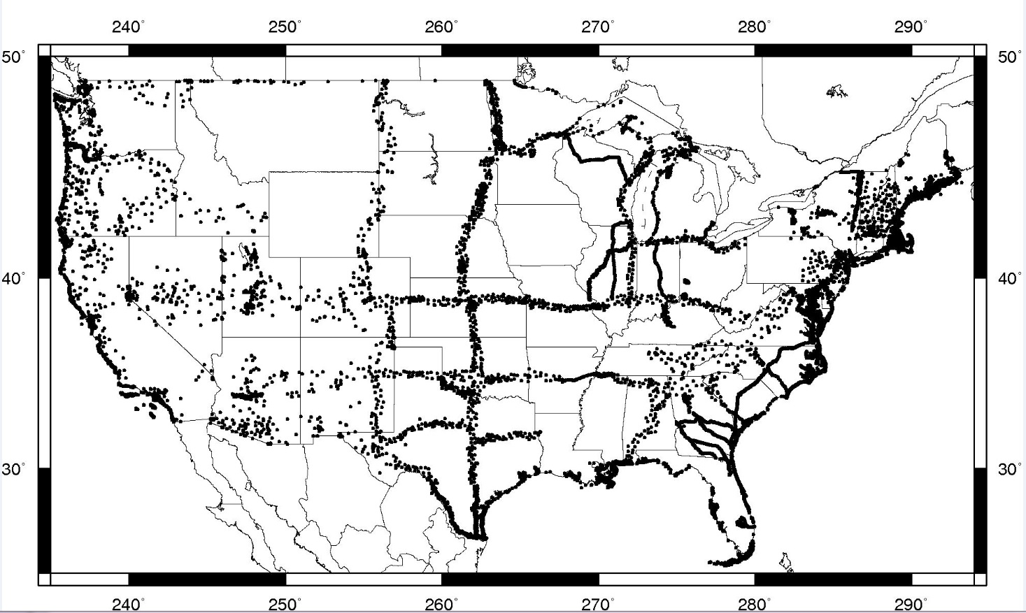
Points common to USSD and NAD 27

Slide 6
History
  1929: NGVD 29 becomes fifth vertical datum in CONUS from C&GS
    First to include Canadian leveling and be more or less “nationwide”
  1970: C&GS splits into the National Geodetic Survey and the Coast Survey under newly created NOAA
  1986: NAD 83 replaces NAD 27
  1991: NAVD 88 replaces NGVD 29

Slide 7
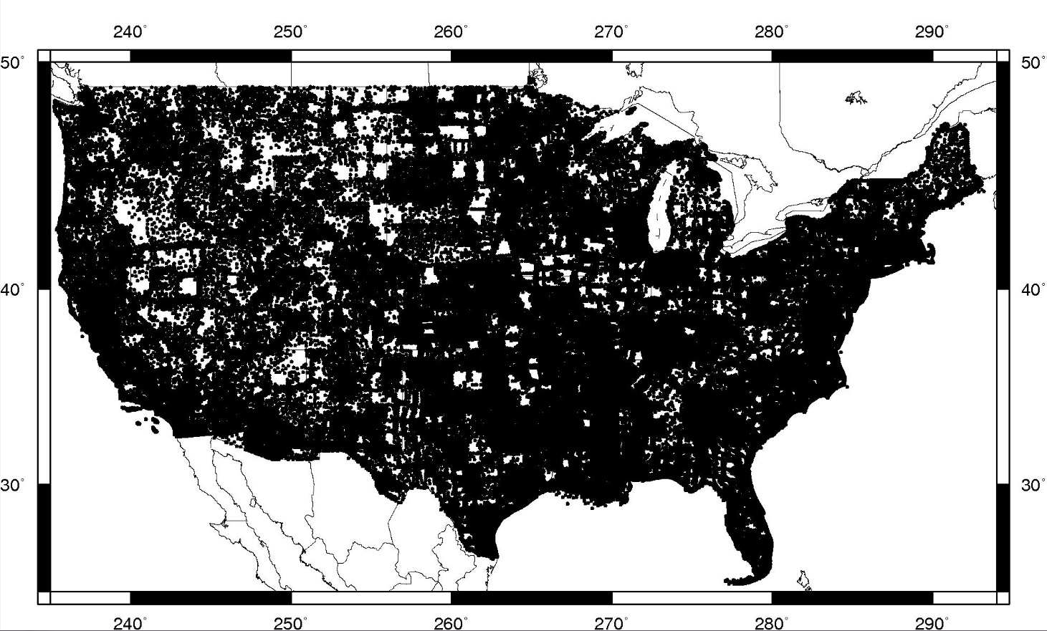
Points common to NAD 27 and NAD 83

Slide 8
History
  October 19, 1990: White House issues OMB circular A-16
    Defining the NSDI
    Defining roles of government agencies toward the NSDI
    Since updated 2002, 2010

Slide 9
NGS’s Mission and Role
  NGS Mission: “To define, maintain, and provide access to the National Spatial Reference System to meet our nation’s economic, social, and environmental needs”
OMB Circular A-16 names DOC and NOAA as “lead agency” for Geodetic Control:
    “All NSDI framework data and users' applications data require geodetic control to accurately register spatial data.”
    “The National Spatial Reference System is the fundamental geodetic control for the United States.”
Coast and Geodetic Survey Act (Public Law 80-373) gives DOC the right to (among numerous other things) “… conduct … geodetic control surveys … ”
http://uscode.house.gov/download/pls/33C17.txt

Slide 10
NGS’s Mission and Role
NGS has defined the datums of the NSRS as NAD 83 and NAVD 88 (plus others)
FGCS requires that all civilian federal surveying and mapping use NAD 83 and/or NAVD 88 (plus others)
“To the extent practicable, legally allowable, and feasible, require that all Federal agencies using or producing (vertical height / coordinate) information undertake an orderly transition to (NAVD 88/NAD 83)”
  1989 FGCC Federal Register Notice (54 FR 25318)
  1993 FGCS Federal Register Notice (Vol. 58, No. 120)
These regulations do not apply to DoD nor to state and local surveying, but these groups often do adopt NAD 83 / NAVD 88

Slide 11
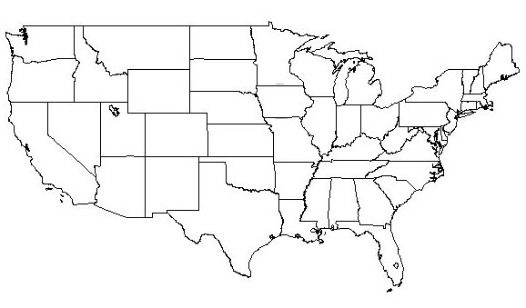
Adjusting Coordinates within the Datum
1 cm
“Modifying each point for its own issues”:
Actual Motion
Error correction
New Information
On the order of centimeters
Done regularly: Most recent, 2011
1983

Slide 12
Changing the Datum
1927
“Picking the Grid”
Everything gets a
new coordinate!!
1927-1983: 100’s of meters
1983-2022: 1-2 meters
1983

Slide 13
Official horizontal datums have been replaced or adjusted regularly throughout our nation’s history
Region | Datums
CONUS | USSD | NAD 27 | NAD 83(1986) | NAD 83(HARN) | NAD 83(FBN) | NAD 83(NSRS2007) | NAD 83(2011)
Alaska |  |  |  | M.R.D.* | NAD 27 | NAD 83(NSRS2007) | NAD 83(2011)
Hawaii |  |  |  | OHD | NAD 83(1986) | NAD 83(2002) | NAD 83(2011)
PR/VI | PR40 | NAD 83(1986) | NAD 83(1993) | NAD 83(1997) | NAD 83(2002) | NAD 83(NSRS2007) | NAD 83(2011)
Guam/CNMI |  |  |  |  | GU 63 | NAD 83(2002) | NAD 83(2011)
A. Samoa |  |  |  |  | AS 62 | NAD 83(2002) | NAD 83(2011)
* Multiple Regional Datums

Slide 14
Official vertical datums have rarely been defined throughout our nation’s history
Region | Datums
CONUS |  | 1900 | 1903 | 1907 | 1912 | NGVD 29 | NAVD 88
Alaska |  |  |  |  |  |  | NAVD 88
Hawaii |  |  |  |  |  |  | D.N.E.
PR |  |  |  |  |  |  | PRVD 02
VI |  |  |  |  |  |  | VIVD 09
Guam |  |  |  |  |  |  | GUVD 04
CNMI |  |  |  |  |  |  | NMVD 03
A. Samoa |  |  |  |  |  |  | ASVD 02

Slide 15
What will be replaced in 2022
What’s being replaced:
Horizontal Vertical
  NAD 83(2011)
  NAD 83(PA11)
  NAD 83(MA11)
  NAVD 88
  PRVD 02
  VIVD09
  ASVD02
  NMVD03
  GUVD04
  IGLD 85
Heights
Latitude
Longitude
Ellipsoid Height
State Plane Coordinates

Slide 16
Questions?

Slide 17
Justifying and Planning for the new datum(s)
*
* If three datums are unified in their definitions and all coordinates can be realized
through common GNSS technology, are they really separate entities?

Slide 18
Why isn’t NAVD 88 good
enough anymore? (1 of 4)
NAVD 88 suffers from use of passive control that:
  Are almost never re-checked for movement
  Disappear by the thousands every year
  Are not funded for replacement
  Are not necessarily in convenient places
  Don’t exist in most of Alaska
  Weren’t adopted in Canada
  Were determined by leveling from a single point, allowing cross-country error build up
Notes:
Clarification on the word “convenient” – this is used to mean “there isn’t always a bench mark around when you need one – sometimes you have to find one far away and level from it to your site of interest”

Slide 19
Why isn’t NAVD 88 good
enough anymore? (2 of 4)
NAVD 88 suffers from:
A zero height surface that:
  Has been proven to be ~50 cm biased from the latest, best geoid models (GRACE satellite)
  Has been proven to be ~ 1 meter tilted across CONUS (again, based on the independently computed geoid from the GRACE satellite)

Slide 20
Why isn’t NAVD 88 good
enough anymore? (3 of 4)
Earth’s
Surface
H (NAVD 88)
H
NAVD 88 reference level
The Geoid
Errors in NAVD 88 : ~50 cm average,
100 cm CONUS tilt,
1-2 meters average in Alaska
NO tracking
Notes:
This slide shows what NGS now knows about the error in NAVD 88 itself. Using a continental geoid computed from the GRACE satellite, a bias and tilt in NAVD 88 has been computed using GPS derived ellipsoid heights on NAVD 88 bench marks. These are now known errors that exist in all NAVD 88 bench marks. This datum realization error, relative to the geoid, is over and above the errors from marks moving.

Slide 21
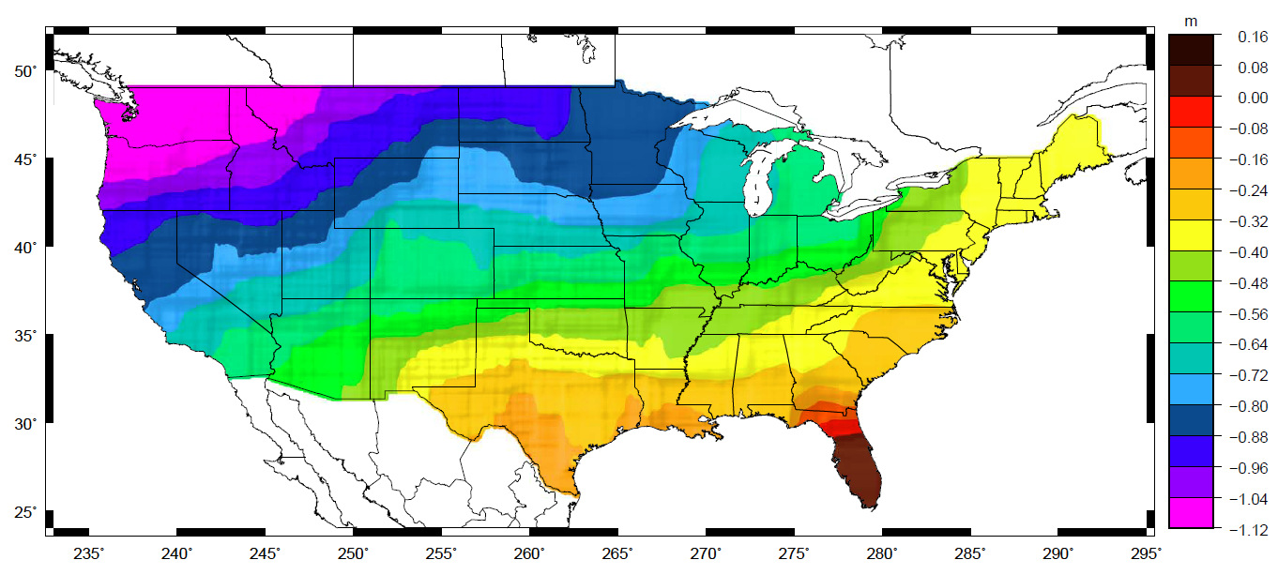
Why isn’t NAVD 88 good
enough anymore? (4 of 4)
Approximate level of geoid mismatch known to exist in the NAVD 88 zero surface:
Notes:
This map reflects the sort of height changes that users could expect if NAVD 88 were replaced with a geoid-based vertical datum.
This is only a large scale approximation and should not be used as an absolute guide. Each benchmark might have its own level
Of mismatch, say from uplift or subsidence, not captured by this broad brush.
Also, this is the difference between the zero level of NAVD 88 and the actual geoid. The difference between NAD 83 ellipsoid heights and
ITRF/GRS-80 ellipsoid heights has NO influence on this graph and should not be part of the story.
Updated October 2010

Slide 22
Old vs New Datums: Origin
NAD 83 was theoretically “geocentric”
  Primarily based on pre-GNSS satellite geodesy
    Doppler, etc
  Off from ITRF2008 origin by ~ 2 meters
New geometric reference frame will all be “geocentric” to IGS frame circa 2020.00 or so

Slide 23
Simplified Concept of NAD 83 vs. ITRF
Earth’s Surface
h_{NAD83}
h_{ITRF}
h_{NAD83} – h_{ITRF} varies
smoothly by latitude
and longitude
ITRFxx origin
~2.24 m
NAD 83 origin

Slide 24
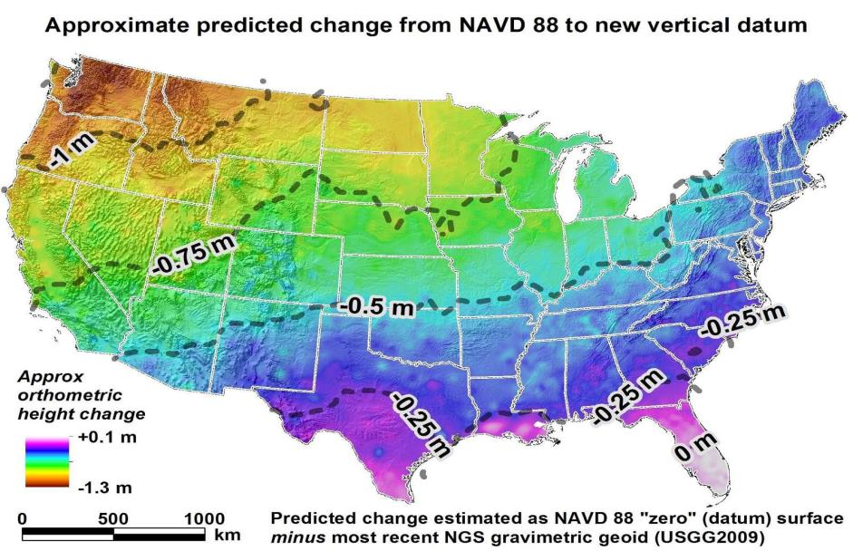
How will the new datums affect you?
The new geometric datum
will change latitude, longitude,
and ellipsoid height by between 1 and 2 meters.
The new vertical datum will change heights on average 50 cm (20''), with a1 meter (39'') tilt towards the Pacific Northwest.
24

Slide 25
Planning
The diversity of new projects necessary required a centralized coordination
  NGS Project Review Board
    Gate check and resource allocation
  NSRS Modernization Manager
    Coordination across divisions
  “New Datums” web page
    Tracking our progress to the public

Slide 26
Planning
Over 15 new multi-year projects begun in 2015
  Takes resources away from “status quo”
    Customers may see delays in accepting/processing submitted projects, but so far isn’t a problem
Many are foundational to upcoming projects

Slide 27
NGS Ten Year Plan 2013-2023
Goal 2: Modernize and Improve the National Spatial Reference System.
Objective 1: Replace NAD 83
Objective 2: Replace NAVD 88
Objective 3: Re-invent Bluebooking
Objective 4: Fix the Toolkit
Objective 5: Better Surveying
Notes:
For more details on the planning for 2022, please reference the NGS Ten Year plan, particularly Goal #2.

Slide 28
Replace NAVD 88
Changing from a leveling-based to a geoid/GNSS-based vertical datum
Biggest requirement: An updated, accurate, nationwide gravity survey
  Airborne
  GRAV-D!

Slide 29
Questions?

Slide 30
GRAV-D airborne campaign:
Overview, Progress, Future

Slide 31
(insert Vicki and Monica’s slides)

Slide 32
Questions?

Slide 33
Proving geoid accuracy:
Geoid Slope Validation Surveys

Slide 34
Proving Geoid Accuracy
“...the gravimetric geoid used in defining
the future vertical datum of the United States should have an absolute accuracy of 1 centimeter at any place and at any time.”
-- The NGS 10 year plan (2008-2018)*
Admirable!...Achievable?
* Latest 10 year plan runs 2013-2023, but does not change this basic goal
Notes:
The above quote refers to one of many ambitious goals in the NGS 10 year plan. While admirable, its achievability remains an open question. In order to begin addressing the actual achievable accuracy of a gravimetric geoid model, NGS will engage in a variety of testing methods prior to the 2022 date when the gravimetric geoid will serve as the reference surface for a new vertical datum. The first such testing method took place in the summer of 2011 and is known as the Geoid Slope Validation Survey of 2011, or GSVS11. As its name implies, this survey tested the accuracy of differential geoid undulations between points ("geoid slopes") from NGS's gravimetric geoid models. The baseline for comparison will be independently computed geoid slopes from two methods, GPS and leveling as well as Deflections of the Vertical.

Slide 35
What are GSVS’s?
Geoid Slope Validation Surveys
  Empirical proof of how well a geoid-based datum can accurately replace a traditional vertical datum
  Less focus on absolute accuracy; more on relative accuracy “geoid slope validation survey”

Slide 36
Goal of the surveys
Observe geoid shape (slope) using multiple independent terrestrial survey methods
  GPS + Leveling
  Deflections of the Vertical
Compare observed slopes (from terrestrial surveys) to modeled slopes (from gravimetry or satellites)
  With / Without new GRAV-D airborne gravity
Notes:
Although a geoid slope validation survey won’t validate the absolute accuracy of the geoid model, it will help point out weakness in data and theory. The accuracy of the terrestrial surveys will be the best achievable, and formal accuracy estimates will be used to bound allowable disagreements with modeled geoid slopes.

Slide 37
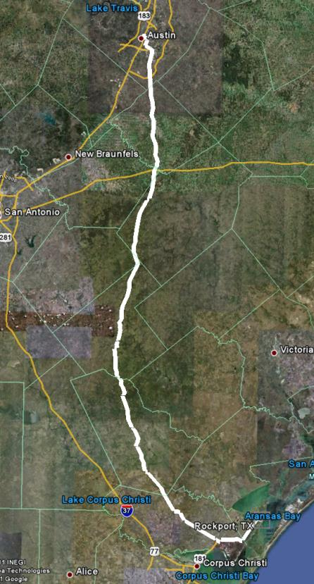
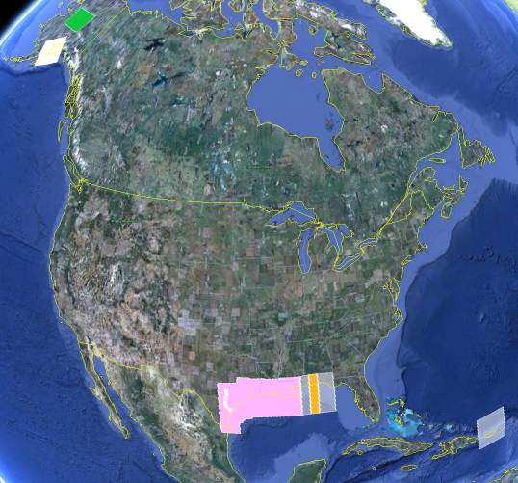
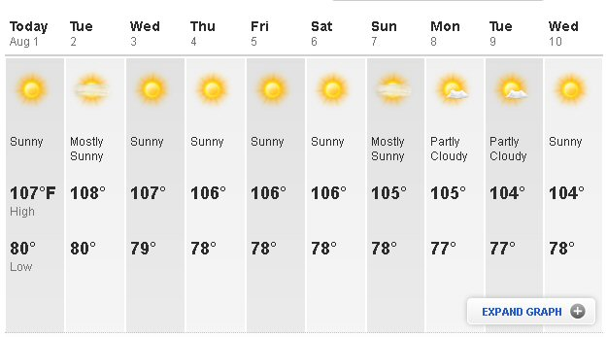
GSVS11
325 km
218 points
1.5 km spacing
South Texas
July-October, 2011
hot…Hot…HOT!
Notes:
The final line was a 325 km stretch from downtown Austin, Texas (North end) to Rockport, Texas (South end). There were 218 official survey points along the line, with an average spacing of 1.5 km between them. The shaded areas in the above picture were the existing GRAV-D data at the time of planning GSVS11 (since expanded). Although the weather report looks extreme, most surveying was done in the milder times of day.

Slide 38
Surveys Performed
GPS: 20 identical. units, 10/day leapfrog, 40 hrs ea.
Leveling: 1st order, class II, digital barcode leveling
Gravity: FG-5 and A-10 anchors, 4 L/R in 2 teams
DoV: ETH Zurich DIADEM GPS & camera system
LIDAR: Riegl Q680i-D, 2 pt/m² spacing, 0.5 km width
Imagery: Applanix 439 RGB DualCam, 5000’ AGL
Other:
  RTN, short-session GPS, extra gravity marks around Austin, gravity gradients

Slide 39
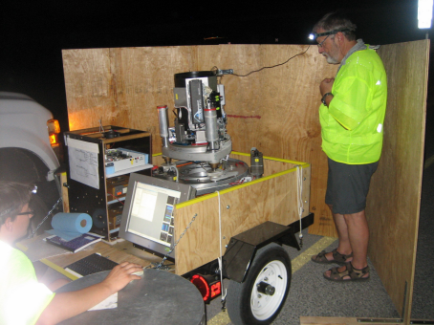
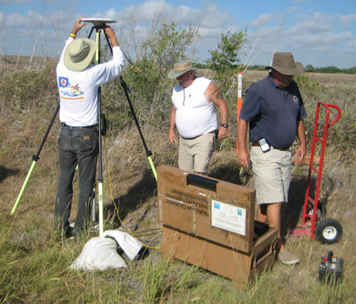
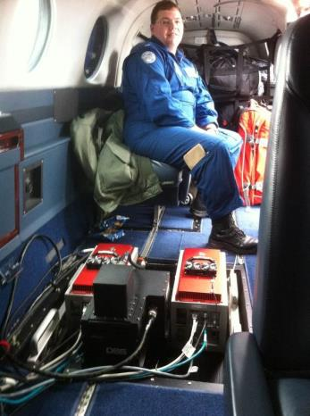
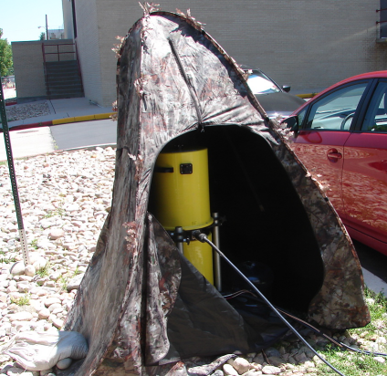
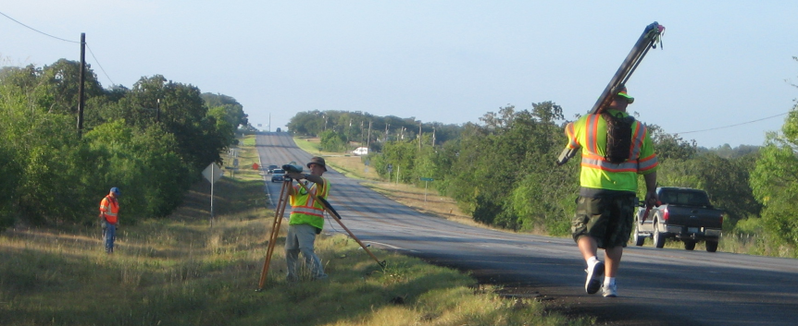
GPS
LIDAR/
Imagery
DoV
Gravity
Leveling
Notes:
These are just a small sampling of the field crews in action. Not shown are the RTN, FG-5, short-session GPS, relative gravity, gravity gradients and mark setting crews.

Slide 40

Empirical Error Estimates
σ_{Δh} (OPUS-S) : 2 - 6 cm
  GPSCOM combination: ~ 4 mm
  (no significant baseline dependency)
=> 16 mm RMS over GSVS11
σ_{ξ} , σ_{η} : 0.06 arcseconds
  ~ 0.43 mm / 1.5 km => 6.6 mm RMS over GSVS11
Notes:
These values are empirical estimates coming from various sources.
For the differential ellipsoid height accuracies, these come from either the OPUS-S runs, showing peak-to-peak error, or else
from a least squares adjustment of all the data, showing a baseline-length-independent ~4mm (give or take 2 mm) error
between any two of the 218 points.
For the differential orthometric height accuracy, the value quoted is the 1st Order, Class II relative maximum
elevation difference accuracy is 0.7 mm per (sq.rt. km) based on Table 2.2 of FGCC Standards and Specifications
for Geodetic Control Networks.
For the Deflections of the Vertical, the expected error for the DIADEM camera was 0.1 arc seconds, but the
empirically determined accuracy estimates from the data itself were 0.06 arcseconds. This corresponds to about 0.43 mm over 1.5 km, which, added in an RMS sense over 218 points yields a highly optimistic 6.6 mm of RMS over the entire line.

Slide 41
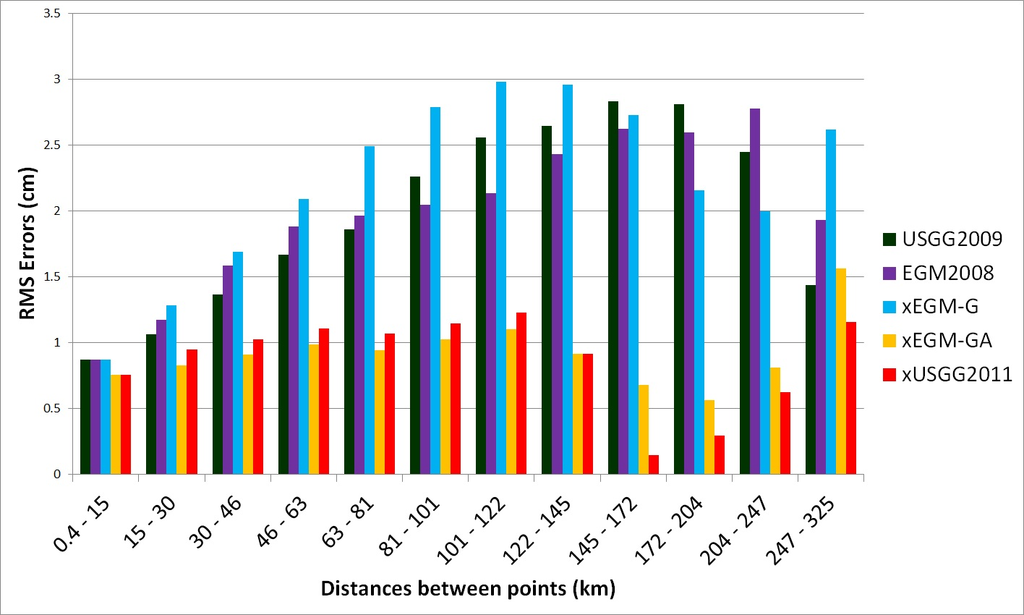
GSVS11: Proving why we need GRAV-D
Geoids without new GRAV-D data: 1-3 cm differential accuracy
over distances from 0.4 to 325 km
Geoids with new GRAV-D data:
1 cm differential accuracy over distances from 0.4 to 325 km

Slide 42
GSVS11 Conclusions
For GSVS11, adding airborne gravity data improves geoid slope accuracy at all distances <325 km
    Low elevation, flat topography
Gravimetric geoid models and GPS are a viable alternative to long-line leveling
Paper: Confirming regional 1 cm differential geoid accuracy from airborne gravimetry: the Geoid Slope Validation Survey of 2011
  J Geod DOI 10.1007/s00190-013-0653-0

Slide 43
GSVS14
New criteria:
  GSVS11 was “low and flat”
    GSVS14 was “high and flat”
      But “challenging”
      East/West (GSVS11 was N/S)
  Similar other criteria from GSVS11
    roads, costs, cloud-free nights, etc
  Choice: Iowa!
    Bonus reason: Mid-continent gravity high

Slide 44
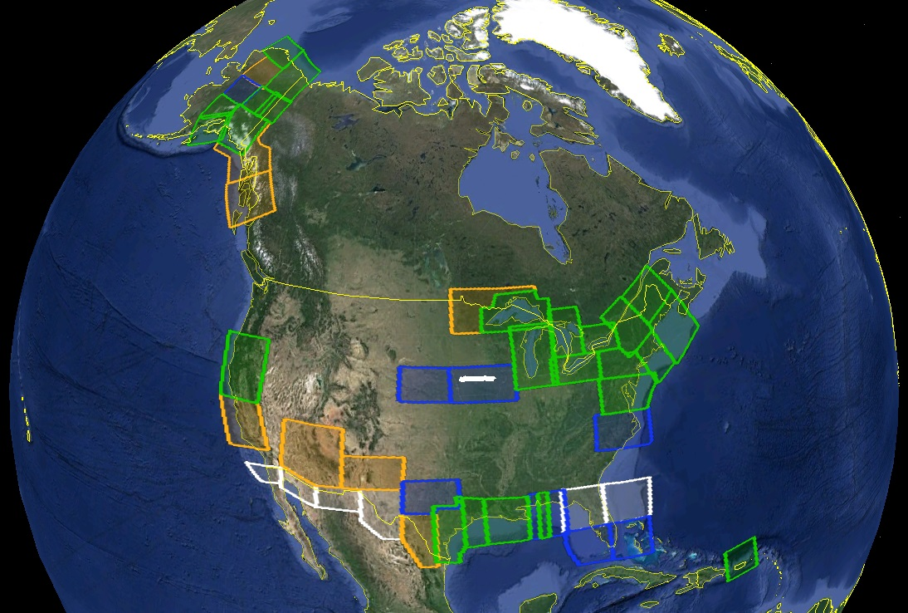
GRAV-D circa 2014

Slide 45
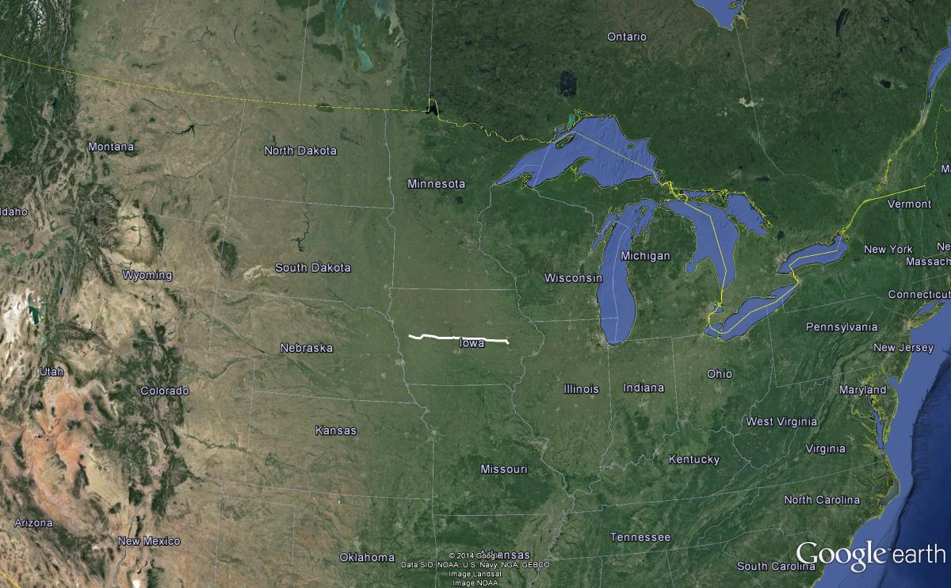
GSVS14 Line in Iowa

Slide 46
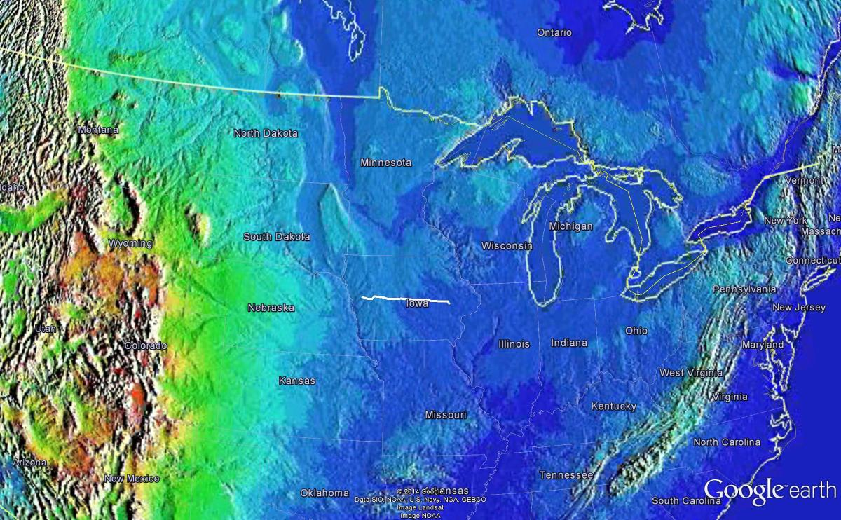
GSVS14 line (topography)

Slide 47
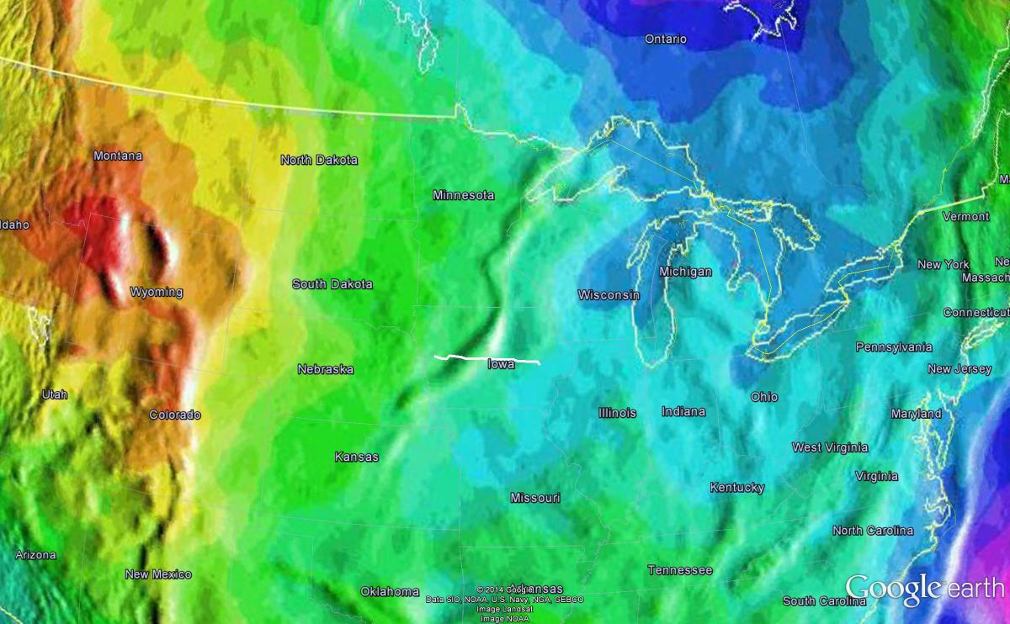
GSVS14 line (geoid)

Slide 48
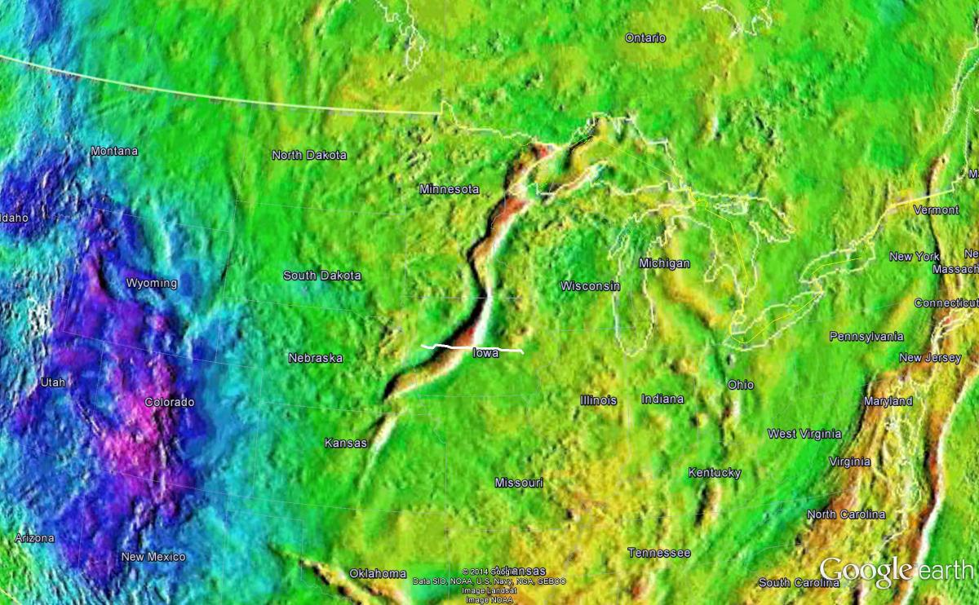
GSVS14 line (Bouguer anomalies)

Slide 49
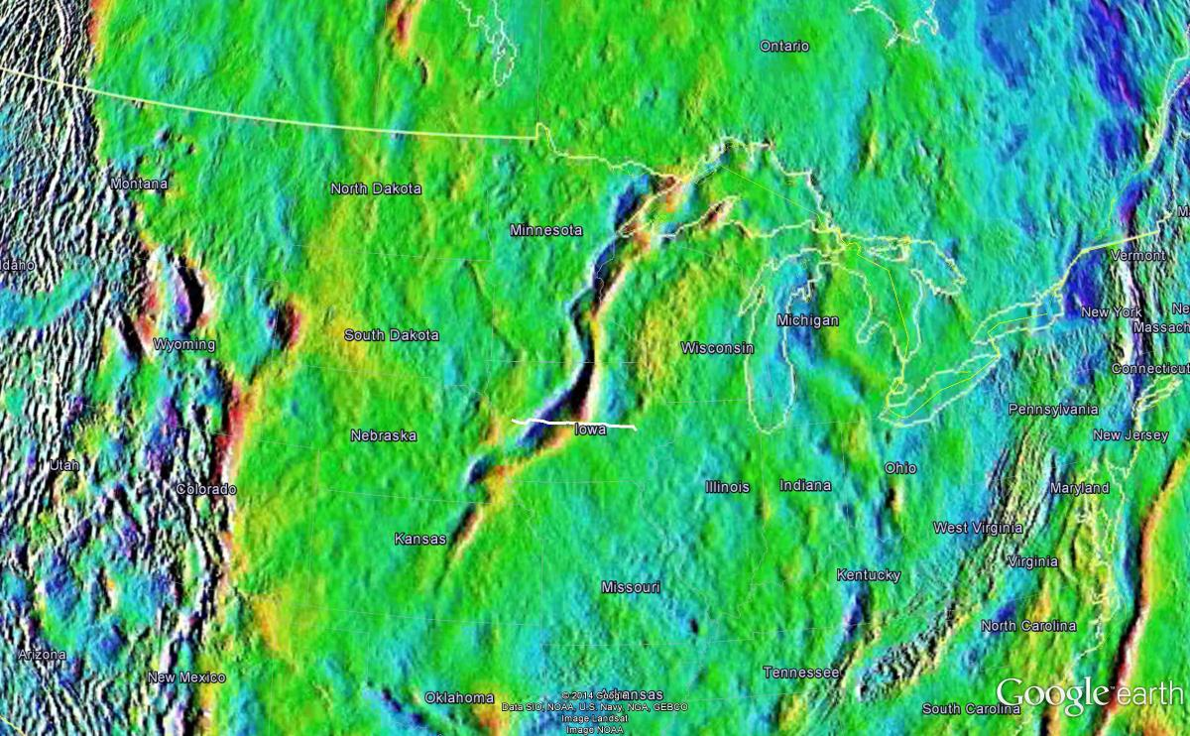
GSVS14 line (E/W DoVs)

Slide 50
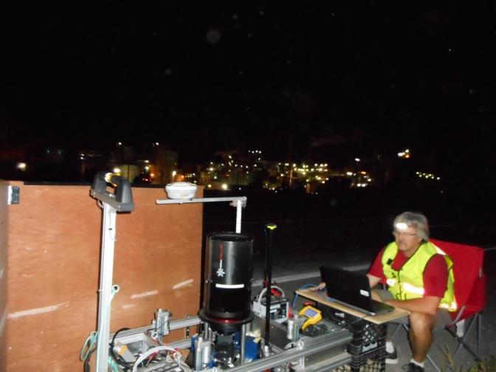
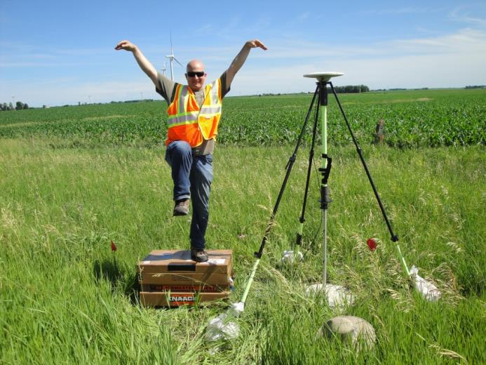
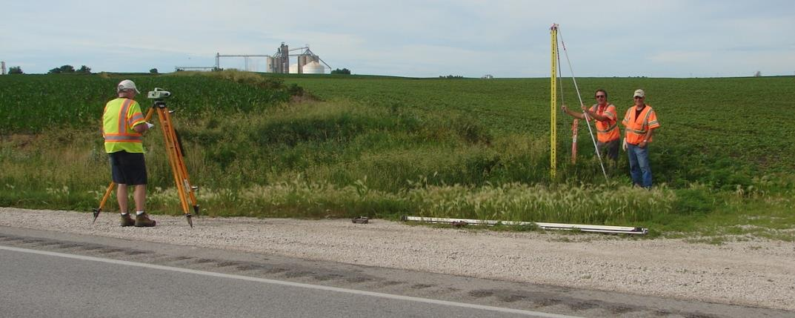
GPS
DoVs
GPS
LIDAR/
Imagery
DoV
Gravity
Leveling
Leveling
Notes:
These are just a small sampling of the field crews in action. Not shown are the RTN, FG-5, short-session GPS, relative gravity, gravity gradients and mark setting crews.

Slide 51
GSVS14 Conclusions
For GSVS14, adding airborne gravity data showed only moderate improvement in geoid slope accuracy at nearly all distances <325 km
  Medium elevation, flat topography
    Lilkely due to the existing dense terrestrial gravity in Iowa (no gaps) coupled with little geologic movement in the last few decades
Gravimetric geoid models and GPS are a viable alternative to long-line leveling
  Paper: Still being completed

Slide 52
GSVS17
Third and likely final GSVS
High and rugged
  Rocky Mountains
Some of the improvements needed:
  2nd order effects, due to terrain ruggedness on:
    Orthometric corrections to leveled heights
    Surface-to-geoid conversion of DoVs

Slide 53
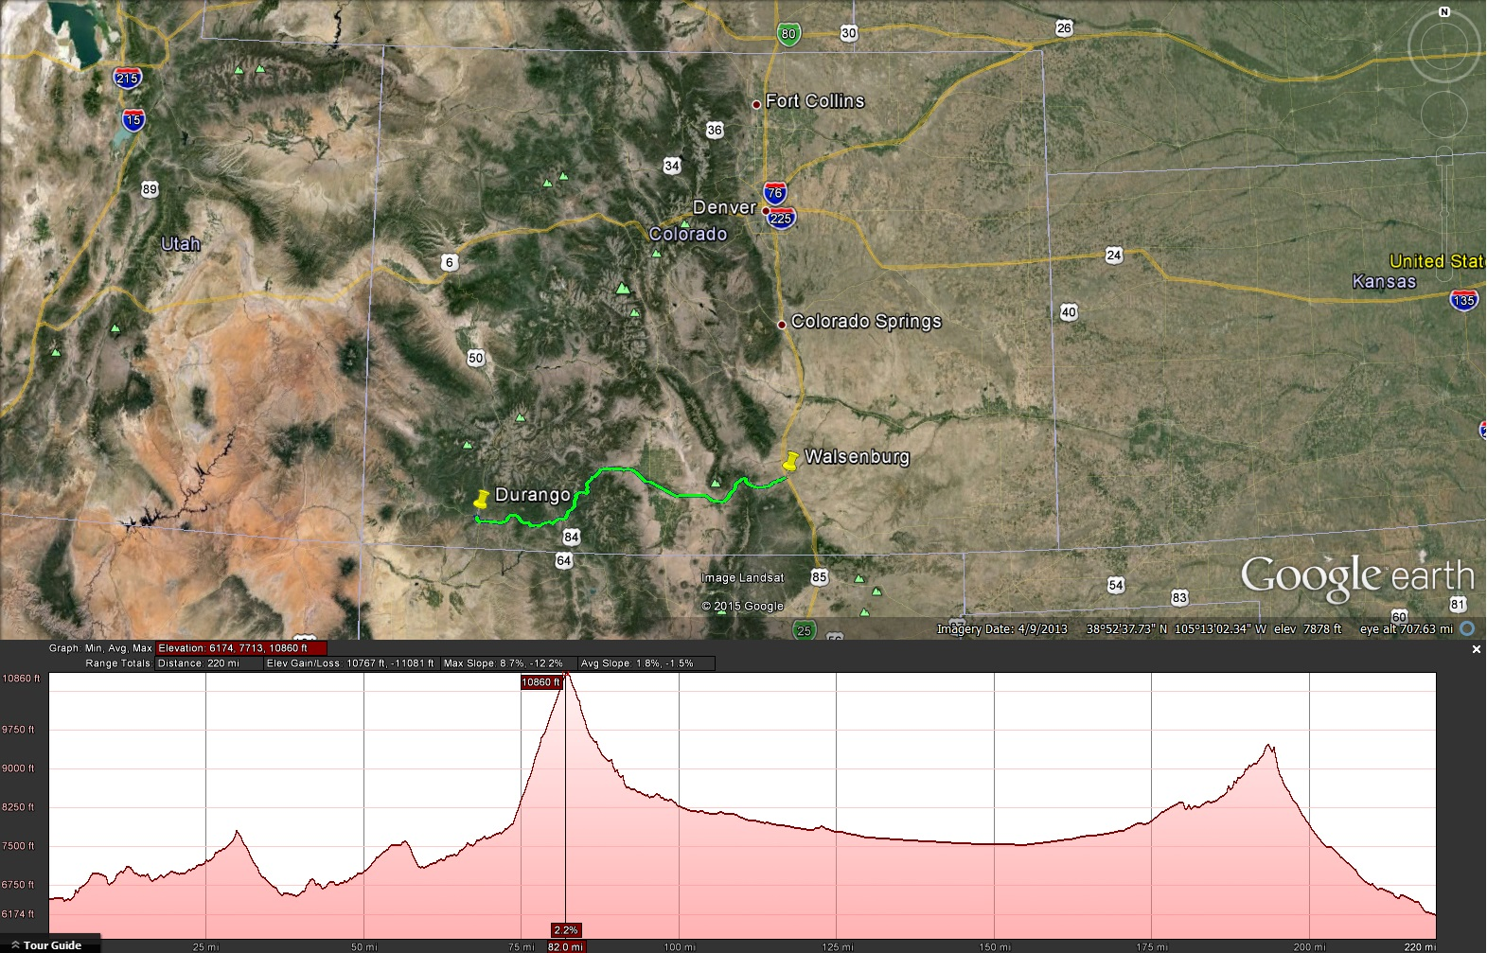
GSVS17
The final Geoid Slope Validation Survey (2017) location was chosen: Durango to Walsenburg, CO

Slide 54
Questions?
http://www.ngs.noaa.gov/GEOID/GSVS11
http://www.ngs.noaa.gov/GEOID/GSVS14

Slide 55
GRAV-D geoid monitoring campaign:
Plans and Progress

Slide 56
(insert Vicki and Monica’s slides)

Slide 57
Questions?

Slide 58
BREAK

Slide 59
The future of the new vertical datum:
GNSS, leveling, time dependency

Slide 60
Primary Access
Since 2008, NGS has clearly and publicly stated:
“The primary means of accessing this new datum is GNSS technology”

Slide 61
Primary Access: GNSS
This means (at a minimum):
  CORS positions, velocities and discontinuities in the latest IGS reference frame
  OPUS-S
  Relationship between the IGS reference frame and new geometric reference frame
    Spatially and temporally

Slide 62
Primary Access: GNSS
It could mean(bonus):
  An RTN validation service, quantifying levels of agreement with the NSRS
  OPUS-RS, OPUS-Projects
  A PPP positioning service run by NGS

Slide 63
Secondary Access
Since 2008, NGS has clearly and publicly stated:
“While passive control continues to be used as
a secondary method to access the NSRS, such
control will be ‘tied to’, not a ‘part of’, the
NSRS.”

Slide 64
Secondary Access: Passive Control
This means (at a minimum):
  GPS surveys on marks after 2022 can be bluebooked and submitted to NGS
This could mean (bonus):
  A complete overhaul for bluebooking, database storage and time dependencies
    These three are a package deal. All or nothing.

Slide 65
A GNSS/geoid vertical datum
 | Today | 2022
Step 1: | Find passive control in NAVD 88 near you, if it exists. Accept that there has been no validation of the published heights since the points were last occupied. | Find or set any new control near your project area.
Step 2: | Level or “Ht Mod” survey to the new control. This could be tens of kilometers at least. | Perform GNSS on your local control (maybe even RTN)
Step 3: | Use NGS 58/59 (decades old) and NGS DOS based tools to bluebook and adjust your project (to the possibly outdated NAVD 88 control | Use OPUS (or RTN software), tied to monitored CORS, to get h and H at the epoch of your survey, to cm of accuracy
Step 4: | Perform leveling from your control to your local project | Perform leveling from your control to your local project

Slide 66
Accuracy of this approach
Leveling yields
  very accurate, differential heights, over short distances
NAVD 88 cross-country errors:
  FGCC expectation: 0.045 meters
  Using GPS/GRACE: 1.280 meters
Any expectation that NAVD 88 yields an absolute starting height of 2 cm is unrealistic
  But a CORS/geoid based absolute orthometric height will have that accuracy in many places, at all times!

Slide 67
Old vs New Datums: Passive Control
Role of passive control in the future:
  Control for projects
    Depending on accuracy needs, new coordinates should be freshly determined, rather than relying on published coordinates based on old surveys
  Monitoring sites for motion
  Calibrating RTNs

Slide 68
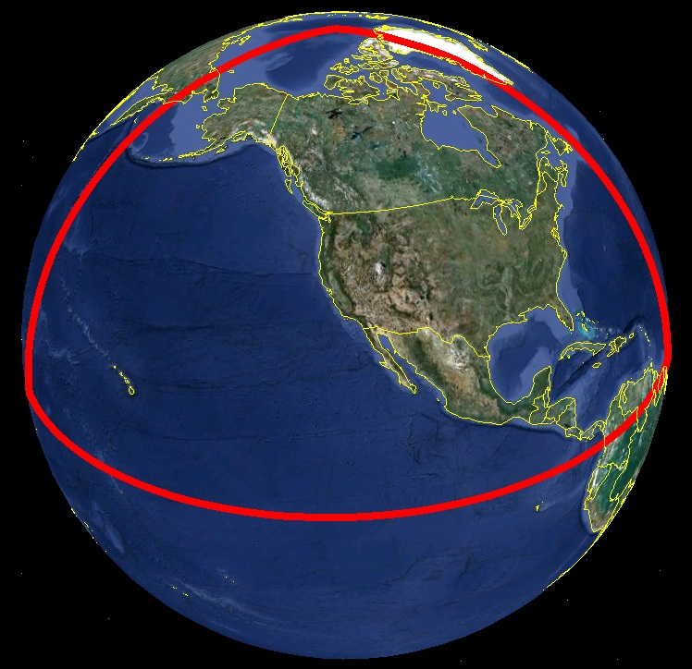
Approximate extent of
2022 geoid model used
for the “North American”
part of the new geopotential
part of the new datum

Slide 69
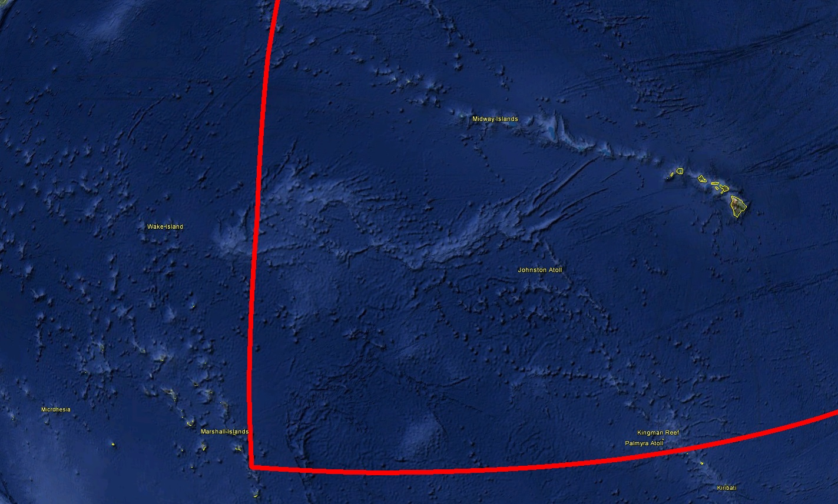
Hawaii
Many US Pacific Territories
(not Guam, CNMI nor American Samoa)

Slide 70
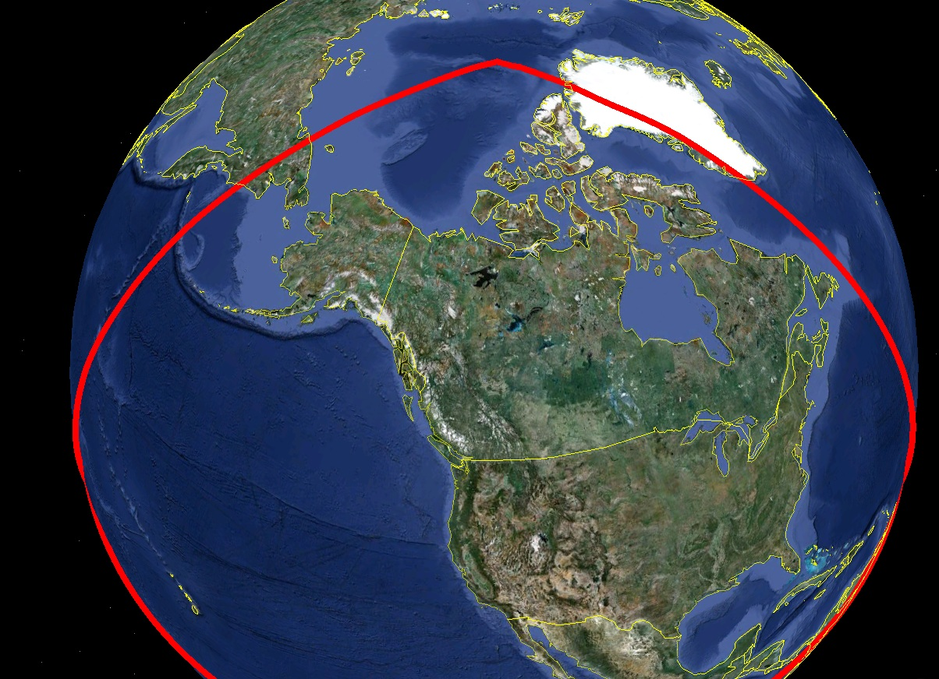
Alaska, including
entire Aleutian
Island Chain
Canada
CONUS (USA)

Slide 71
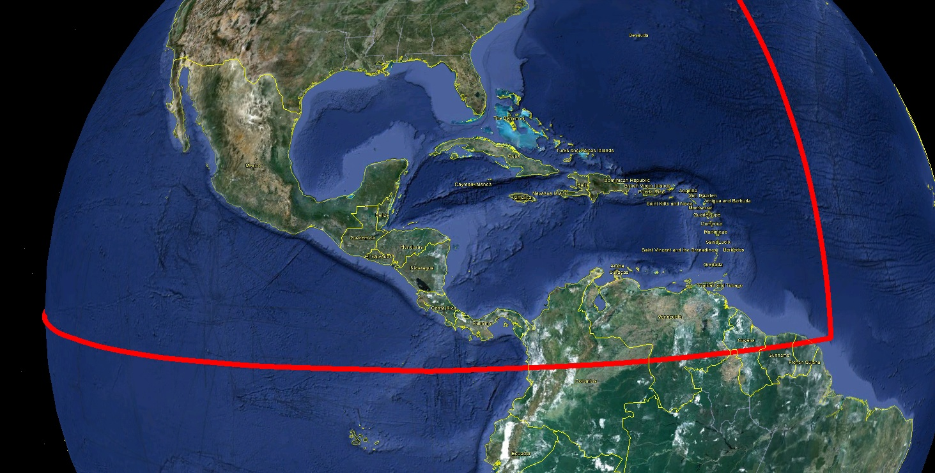
Bermuda
Mexico
All Caribbean
Countries
All Central
American Countries

Slide 72
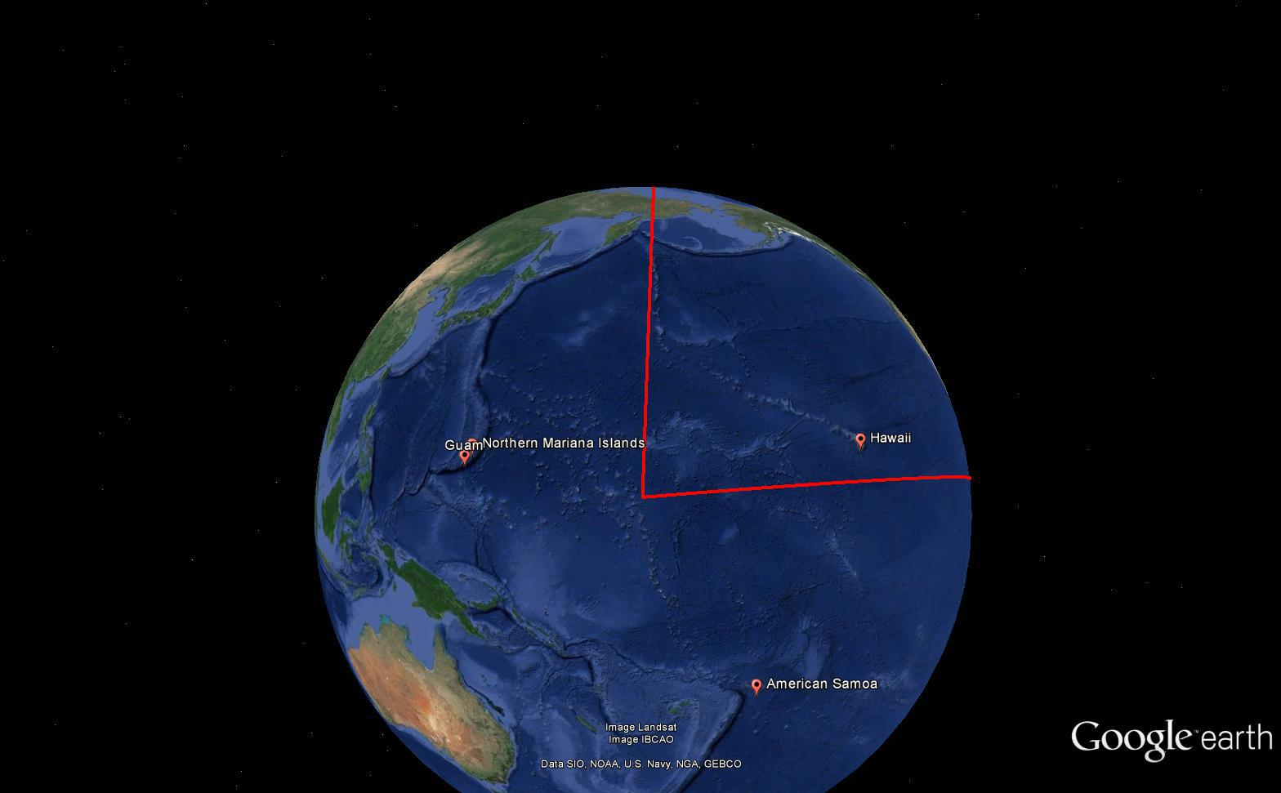
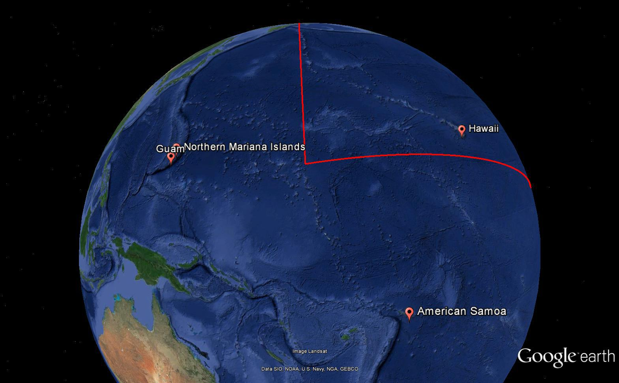
Bermuda
Mexico
All Caribbean
Countries
All Central
American Countries

Slide 73
A thought experiment concerning time dependent heights on passive control:
Possible?

Slide 74
Assume “H” was determined four different times:
1990: 2.100
1994: 2.110
2002: 2.190
2009: 2.180
2.350
2.300
2.250
2.200
H
2.150
2.100
2.050
2.000
1975
1980
1985
1990
1995
2000
2005
2010
2015
2020
2025
2030
time

Slide 75
All measurements have error. Shown here are the same
values of “H”, but with error bars representing their standard deviations.
1990: 2.100 +/- 0.0375 (3.75 cm)
1994: 2.110 +/- 0.0250 (2.50 cm)
2002: 2.190 +/- 0.0200 (2.00 cm)
2009: 2.180 +/- 0.0250 (2.50 cm)
2.350
2.300
2.250
2.200
H
2.150
2.100
2.050
2.000
1975
1980
1985
1990
1995
2000
2005
2010
2015
2020
2025
2030
time

Slide 76
In standard NGS procedure, a height is held fixed until
replaced. So plotting the height as seen on a datasheet
over time would look like this:
2.350
2.300
2.250
2.200
H
Height unknown
before first survey
2.150
2.100
2.050
2.000
1975
1980
1985
1990
1995
2000
2005
2010
2015
2020
2025
2030
time

Slide 77
If we assume the point is moving linearly through time,
a line can be fit to these measurements to estimate that
motion
2.350
2.300
2.250
2.200
H
2.150
2.100
2.050
2.000
1975
1980
1985
1990
1995
2000
2005
2010
2015
2020
2025
2030
time

Slide 78
We use H = mt+b, and:
m = 0.00505 m/y (+5.05 cm uplift per year)
b(1970) = 2.004 m
2.350
2.300
2.250
2.200
H
2.150
H = (0.00505)(t-1970) + 2.004
2.100
2.050
2.000
1975
1980
1985
1990
1995
2000
2005
2010
2015
2020
2025
2030
time

Slide 79
And knowing that motion through time, we can predict “H” at
any given year (in this example, at even five year intervals
2.350
2.300
2.250
2.200
H
2.150
2.100
2.050
2.000
1975
1980
1985
1990
1995
2000
2005
2010
2015
2020
2025
2030
time

Slide 80
As such, an NGS datasheet may have a graph like
this for:
h (t) ?
h (t) ?
H (t) ?
2.350
ITRF20xx
2.300
NAD2022
NAVD2022
2.250
2.200
H
2.150
2.100
2.050
2.000
1975
1980
1985
1990
1995
2000
2005
2010
2015
2020
2025
2030
time

Slide 81
The (in)ability of current approach to
properly inform users of the height of
this mark can be seen in green below.
2.350
2.300
2.250
2.200
H
2.150
2.100
2.050
2.000
1975
1980
1985
1990
1995
2000
2005
2010
2015
2020
2025
2030
time

Slide 82
Because latitude and longitude will behave significantly
differently in a plate-fixed system than in ITRF,
such graphs may look different.
2.350
2.300
2.250
2.200
H
2.150
2.100
2.050
2.000
1975
1980
1985
1990
1995
2000
2005
2010
2015
2020
2025
2030
time

Slide 83
Questions?

Slide 84
The future of bluebooking

Slide 85

The National Geodetic Survey
Ten-Year Plan
Support the users of the National
Spatial Reference System.
Modernize and improve the National
Spatial Reference System.
Expand the National Spatial Reference
System stakeholder base through
partnerships, education, and outreach.
Develop and enable a workforce with
a supportive environment.
Improve organizational and administrative functionality.
http://www.geodesy.noaa.gov/web/news/Ten_Year_Plan_2013-2023.pdf
Notes:
The NGS Ten-Year Plan was adopted at the beginning of 2013, including four major goals and an enterprise goal:
Goal 1: Support the Users of the National Spatial Reference System.
Goal 2: Modernize and Improve the National Spatial Reference System.
Goal 3: Expand the National Spatial Reference System Stakeholder Base through Partnerships, Education and Outreach.
Goal 4: Develop and Enable a Workforce with a Supportive Environment.
Enterprise Goal: Improve Organizational and Administrative Functionality.

Slide 86
NGS Ten Year Plan 2013-2023
Goal 2: Modernize and Improve the National Spatial Reference System.
Objective 1: Replace NAD 83
Objective 2: Replace NAVD 88
Objective 3: Re-invent Bluebooking
Objective 4: Fix the Toolkit
Objective 5: Better Surveying
Notes:
Potential outline and speaker assignments; can be adjusted as needed.

Slide 87
Re-Invent Bluebooking
Consists of three major projects:
  “OPUS-Projects into the IDB”
  “Build an NSRS database”
  “Mathematical Connection between IGSxx and the new datum”

Slide 88
OPUS-Projects into the IDB (1)
IDB (Integrated Database) is the official repository of NSRS data
  Currently may only be populated through the FGCS Bluebook process
Ongoing project to replace “PAGES” and “ADJUST” in the current Bluebooking proecess with OPUS-Projects
  Expected Beta release: Dec 2016

Slide 89
OPUS-Projects into the IDB (2)
Sub-project: Use of OP for Airport Surveys
  Showed “vector processing” (e.g. “creation of vectors from RINEX files”) was effectively equivalent between OP and PAGES
  Did not address adjustment of vectors between OP and ADJUST
  Did not provide a way to take the adjustment from OP and load it into the IDB

Slide 90
OPUS-Projects into the IDB (3)
Ultimate goal, in order:
  OP for leveling
  OP for gravity
  OP for traverse
All of the above will build upon the core interface of OP

Slide 91

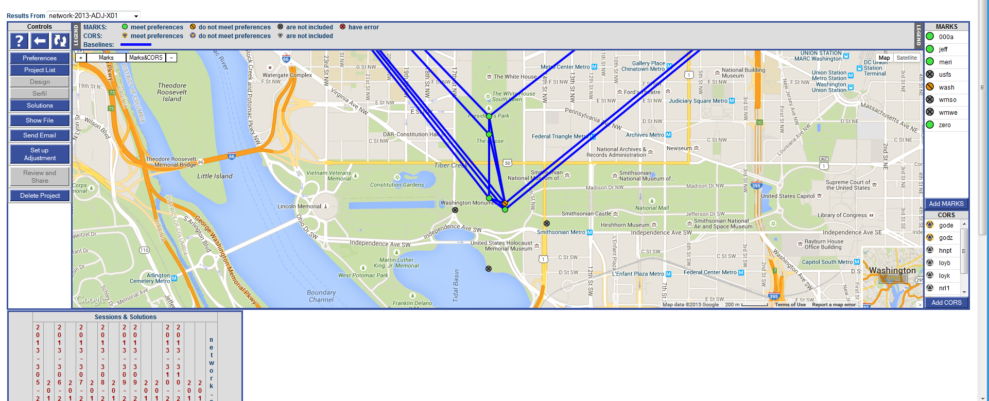
OPUS-Projects of the future?
The 2013 Survey of the
Washington Monument
had GPS, leveling and
traverse components.
An integrated OP might
allow for easier
processing and especially
cross-processing
Notes:
This slide shows a fictitious, yet possible, future mock-up of the OP interface. Note the TABS. A project consisting of multiple techniques, such as the survey of the Washington Monument, could have a tab for processing the GNSS data, and another for the Leveling, and etc.

Slide 92
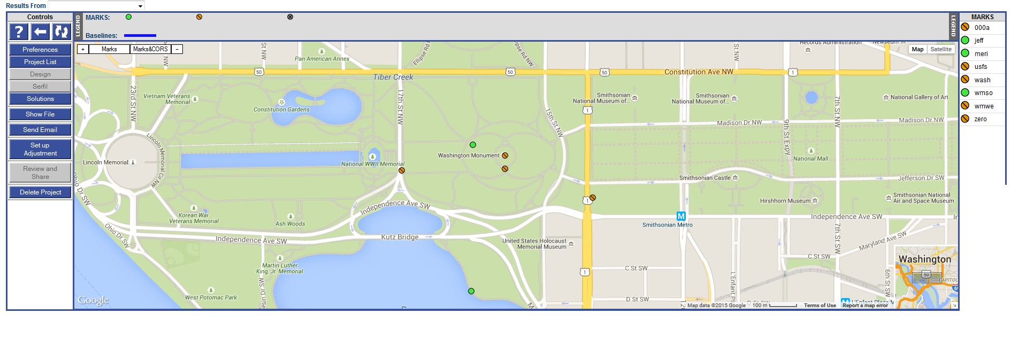
OPUS-Projects of the future?
Day 4 – 2014 04 21
Leveled point
Not Leveled
GPS/geoid control point
Forward Running
Backward Running
Notes:
This slide shows a fictitious, yet possible, future mock-up of the OP interface. Note the TABS. A project consisting of multiple techniques, such as the survey of the Washington Monument, could have a tab for processing the GNSS data, and another for the Leveling, and etc.

Slide 93
OPUS-Projects into the IDB (4)
OP into “OPUS Sharing” (was OPUS-DB)
  OPUS Sharing is currently a dead end place for OPUS-S
    OPUS-Projects doesn’t populate it
    Even if it did, it’s still a dead end, but this must change this year
  NGS plans to make OPUS-Sharing a “holding place” for projects being prepped to load into the IDB
    Once the OP-IDB project is done, the first source of new data into the IDB will be OPUS-Sharing

Slide 94
Build an NSRS Database(1)
The IDB was built by combining two previous databases
  Horizontal
  Vertical
Both components, and the IDB itself are not:
  Spatial
  Capable of handling time dependencies
  Built to handle GPS data

Slide 95
Build an NSRS Database(2)
GPS data in today’s IDB:
  Raw receiver files are stored offline
  Vectors are created once, using the software of the day
  Vectors are adjusted (as geometric entities) but never re-created from the raw receiver files

Slide 96
Build an NSRS Database(3)
A new NSRS database will be:
  A spatial database
  Capable of working with 4 dimensional data
  Able to hold raw GPS data for fast reprocessing
Target: 2020

Slide 97
Build an NSRS Database(4)
As OP-into-the-IDB becomes reality:
  It will replace bluebooking
  Behind the scenes, NGS will also prepare OP to populate the new NSRS database
    When the new database comes online, OP will be the primary tool for populating it

Slide 98
Build an NSRS Database(5)
To prepare to populate the new NSRS with existing GPS data:
NGS has some 3000 GPS projects on file
  400,000 receiver files out of 1.2 million files
    Any name, any directory…no organization
    Metadata (receiver, antenna height, PID, times)
  Once organized, these files will go through OP and build the NSRS database foundation

Slide 99
Math Model: IGSxx to 2022
Define this:
(X,Y,Z) |  | (X,Y,Z)
In IGSxx |  | In 2022 datum
At epoch of survey |  | At what epoch?
?

Slide 100
Math Model: IGSxx to 2022
Potential candidates, in order of complexity and “enforced lack of change to coordinates”:
  1) The identity matrix
  2) A 14 parameter transformation or an Euler Pole rotation for each plate
  3) A grid of velocities
  4) An HTDP approach combining all secular and episodic velocities

Slide 101
Time-Dependency
All of the above projects will be moot, if NGS and NGS customers can not agree upon the purpose of geodetic control in a dynamic world
  In vertical, this seems less divisive.
  In horizontal, this is tied to the “math model” and is highly divisive. Let’s perform a thought experiment to see why…

Slide 102
A thought experiment concerning “plate fixed” coordinates:
How and why?

Slide 103
“Plate-Fixed”: Historic Issue
NAD 83 was theoretically “plate fixed”
  Tectonic rotation removed
    Based on a now-obsolete rotation model
    Should have no systematic time-dependent latitude or longitude signal in “stable” areas except at very small (< 1 mm/y) residual, non-systematic levels.

Slide 104
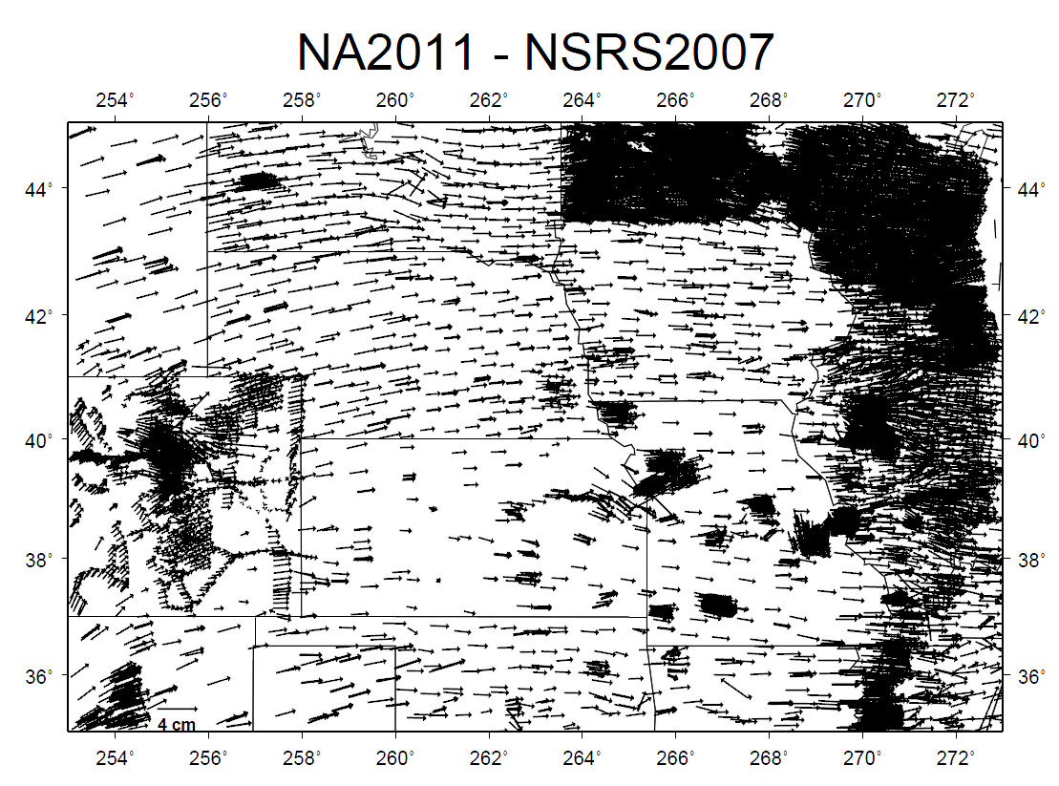
“Plate-Fixed”: Historic Issue
NAD 83(2011) epoch 2010.00 minus NAD 83(NSRS2007) epoch 2002.0

Slide 105
Assumptions
Assume:
  CORS exists
  ITRF coordinates on CORS are known from 1994 to 2022
    Presumes the reference frame is determined continuously through time, and discontinuities in ITRF coordinates at CORS (due to earthquakes, antenna changes, etc.) are known and accounted for.
  Differential GPS is used to position passive control in the ITRF by holding CORS fixed
    At the epoch of the survey

Slide 106
Assume the ITRF value of “λ” was determined eight different times
at one passive control point
2.350
2.300
2.250
2.200
λ
2.150
2.100
2.050
2.000
1975
1980
1985
1990
1995
2000
2005
2010
2015
2020
2025
2030
time

Slide 107
Assume also NGS has a model of plate rotation from CORS which
fits our station poorly for a few years….
2.350
2.300
2.250
2.200
λ
2.150
2.100
2.050
2.000
1975
1980
1985
1990
1995
2000
2005
2010
2015
2020
2025
2030
time

Slide 108
Until an earthquake occurs….
2.350
2.300
2.250
2.200
λ
2.150
2.100
2.050
2.000
1975
1980
1985
1990
1995
2000
2005
2010
2015
2020
2025
2030
time

Slide 109
At which point our plate rotation model still doesn’t fit perfectly.
2.350
2.300
2.250
2.200
λ
2.150
2.100
2.050
2.000
1975
1980
1985
1990
1995
2000
2005
2010
2015
2020
2025
2030
time

Slide 110
At this point, NGS has provided good, solid scientific information
about the longitude on the point within ITRF.
But then what?
2.350
2.300
2.250
2.200
λ
2.150
2.100
2.050
2.000
1975
1980
1985
1990
1995
2000
2005
2010
2015
2020
2025
2030
time

Slide 111
Should we remove the plate rotation?
2.350
2.300
2.250
2.200
λ
2.150
That still won’t make the longitude
constant in time…
2.100
2.050
2.000
1975
1980
1985
1990
1995
2000
2005
2010
2015
2020
2025
2030
time

Slide 112
Should we model the earthquake’s displacement and remove it too?
2.350
2.300
2.250
2.200
λ
2.150
That still won’t make the longitude
constant in time…
and NGS is not doing the modeling!
We are reliant on geophysicists to
provide us with every Earthquake
model.
2.100
2.050
2.000
1975
1980
1985
1990
1995
2000
2005
2010
2015
2020
2025
2030
time

Slide 113
Should we model the residual deformations that are left in the station?
2.350
2.300
2.250
2.200
λ
2.150
So now, depending on how well we
model those residual deformations,
the longitude gets sorta constant.
2.100
2.050
2.000
1975
1980
1985
1990
1995
2000
2005
2010
2015
2020
2025
2030
time

Slide 114
Purpose?
Why attempt to force a changing longitude to match its historic values?
  Historic answer: To adjust all of the data together
    This approach shores up the historic approach of providing “the” coordinate at one singular epoch

Slide 115
The big question
When you survey to a passive control mark, which of the following two choices will win, if there is a conflict?
A) I want to match the previous coordinate
B) I want to know today’s true coordinate

Slide 116
Questions?

Slide 117
Transformation tools to get you into the future

Slide 118
“Transformational Access”
The National Geodetic Survey considers actual readjustment of survey measurements, and not coordinate transformations, as best practice.
However, NGS will provide transformations between historic datums and the new reference frames
  For speedy transformation of maps to modern datums without the need for geodetic accuracy

Slide 119
Median Horizontal Transformations
(CONUS)
From | To | Median Shift in Meters
USSD | NAD 27 | 17.220
NAD 27 | NAD 83(1986) | 33.300
NAD 83(1986) | NAD 83(HARN) | 0.264
NAD 83(HARN) | NAD 83(FBN) | 0.050
NAD 83(FBN) | NAD 83(NSRS2007) | 0.020
NAD 83(NSRS2007) | NAD 83(2011) | 0.016
NAD 83(2011) | “2022” | ~ 1.200

Slide 120
Median Horizontal Transformations
(Alaska)
From | To | Median Shift in Meters
NAD 27 | NAD 83(1986) | 113.065
NAD 83(1986) | NAD 83(1992) | 170.801* or 0.496
NAD 83(1992) | NAD 83(NSRS2007) | 0.042
NAD 83(NSRS2007) | NAD 83(2011) | 0.017
NAD 83(2011) | “2022” | ~ 1.500
* Including St. Paul and St. George islands

Slide 121
NADCON 5
Ongoing project
  Combine NADCON 4.2 (original NADCON plus HARN extension) with GEOCON v2.0 (HARN to FBN to 2007 to 2011)
  Documentation
  Correction of long-standing issues
  Geographic error estimates
  Into the Beta New Toolkit by Summer 2016

Slide 122
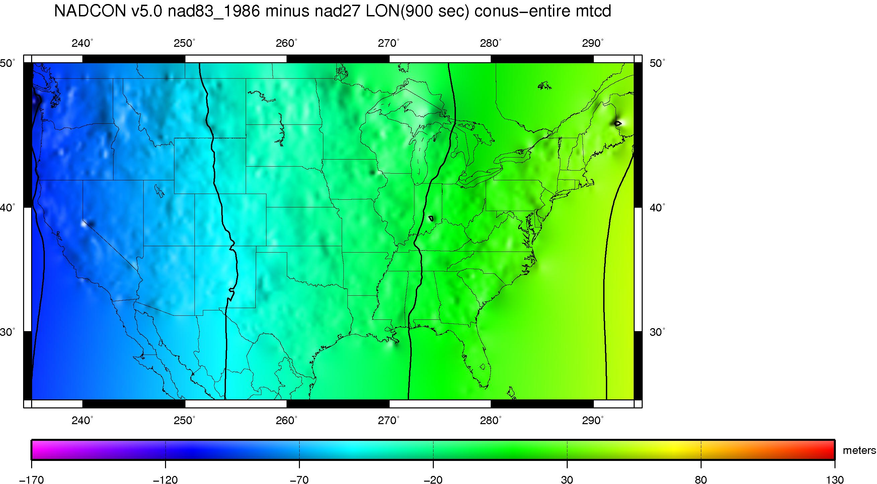
NADCON 5
(ex: NAD27/NAD83(86) longitude/meters)

Slide 123
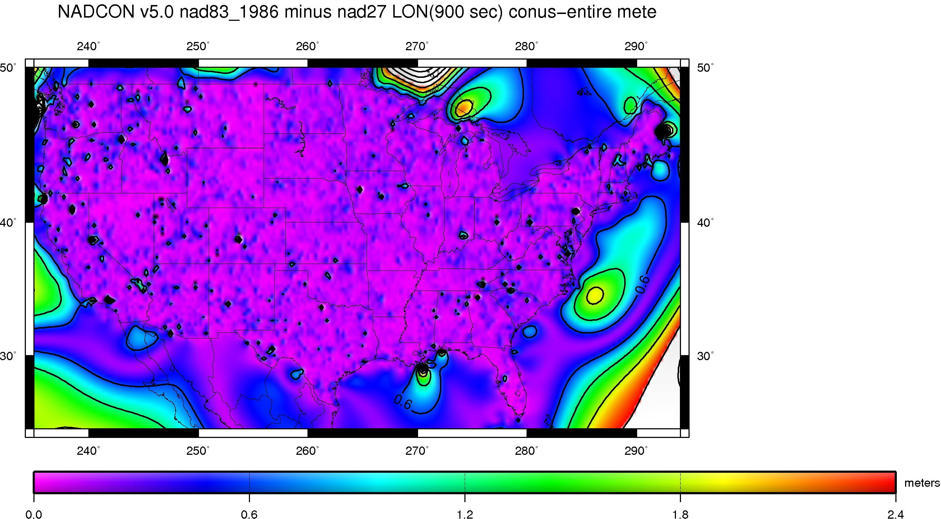
NADCON 5
(ex: NAD27/NAD83(86) longitude error /meters)

Slide 124
“Transformational Access”
This means (at a minimum):
  Grids and basic software to perform these:
  φ,λ,h: NAD 83(2011) “2022”
  H: NAVD 88 “2022”
  H : IGLD 85 “2022”
This could mean (bonus):
  A complete re-build of all NGS transformation software under one engine, as a web service
Dyn

Slide 125
State Plane Coordinates
Barring user-requested changes, NGS may use existing SPC projections, boundaries and equations, but with new false northings & eastings (to distinguish from NAD 27 and NAD 83)
User-provided plug-ins (pre-written code) for SPC or other projections may be possible

Slide 126
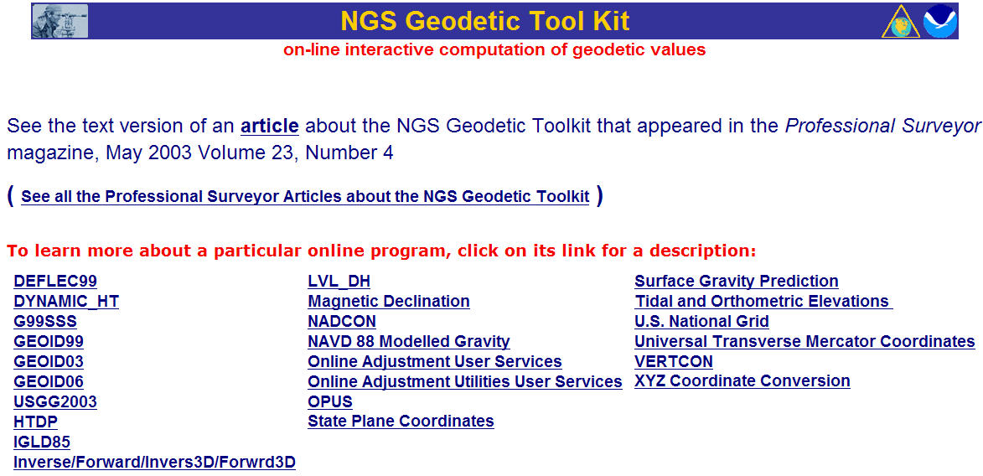
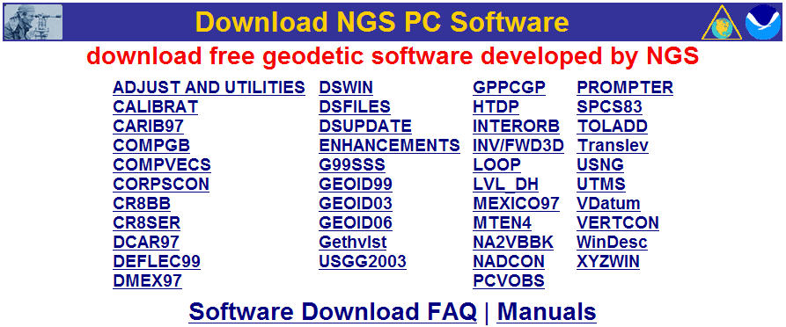
Fix the Toolkit
datum/coordinate conversion
time-dependent positioning
datasheet utilities
geodetic utilities
geoid modeling
gravity prediction
network adjustment
GPS project analysis
project submission

Slide 127
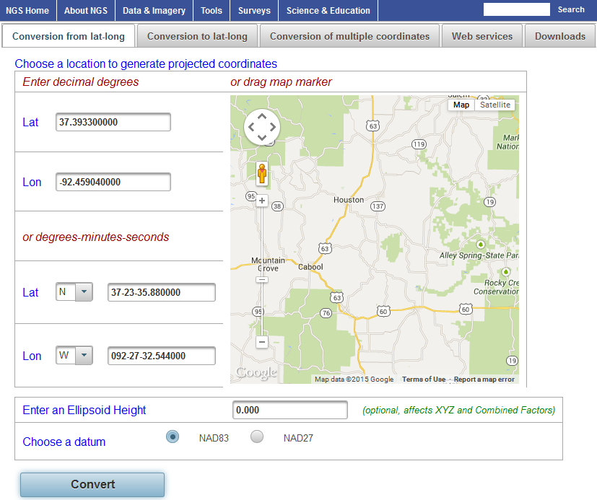
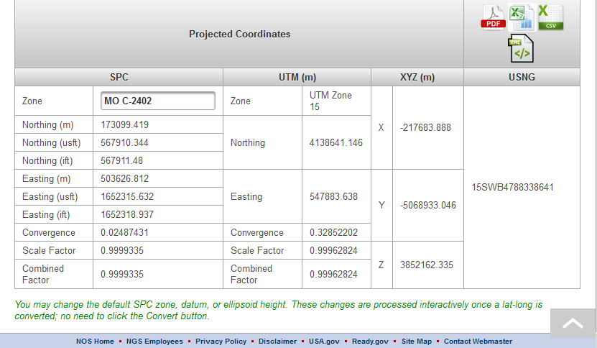
Fix the Tool Kit
Notes:
New Java based Geodetic Toolkit
Will be command line useable
Download a jar and have all the geodetic tools available

Slide 128
Fix the Toolkit
Try it yourself at:
  http://beta.ngs.noaa.gov/gtkweb/
Next to be added:
  NADCON 5
  VERTCON 3
  VDatum and HTDP

Slide 129
Questions?

Slide 130
Adoption and Outreach

Slide 131
Adoption: Legal / Feds
The datums will be official once the FGCS approves them
OMB A-16 then requires all federal, civil agencies to transition to the new datums
Other groups may adopt at their own speed and need

Slide 132
Adoption: Legal / States
NGS historically provided template acts for each state to help adopt changes
  NAD 83 , SPC
Has one major drawback: “NAD 83” is now by-name mandated in 48 states.
NGS/NSPS/AAGS committee working to define new template:
  E.g. “the latest coordinates of the NSRS as defined by the NGS”
  Avoids name-specific issues in the future

Slide 133
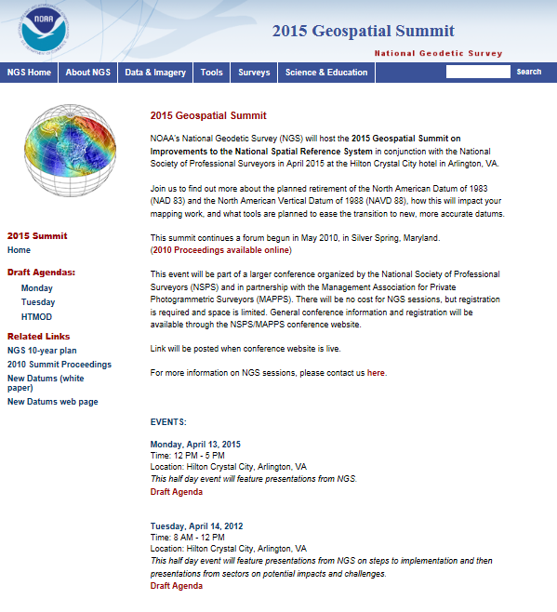
2015 Geospatial Summit
April 13-14, 2015, in the Washington, DC Area
As part of a broader “conference of conferences” with National Society of Professional Surveyors and Management Association for Private Photogrammetric Surveyors (MAPPS)
Follows the successful 2010 Geospatial Summit. More info at the 2015 Geospatial Summit website.
http://www.geodesy.noaa.gov/2015GeospatialSummit/

Slide 134
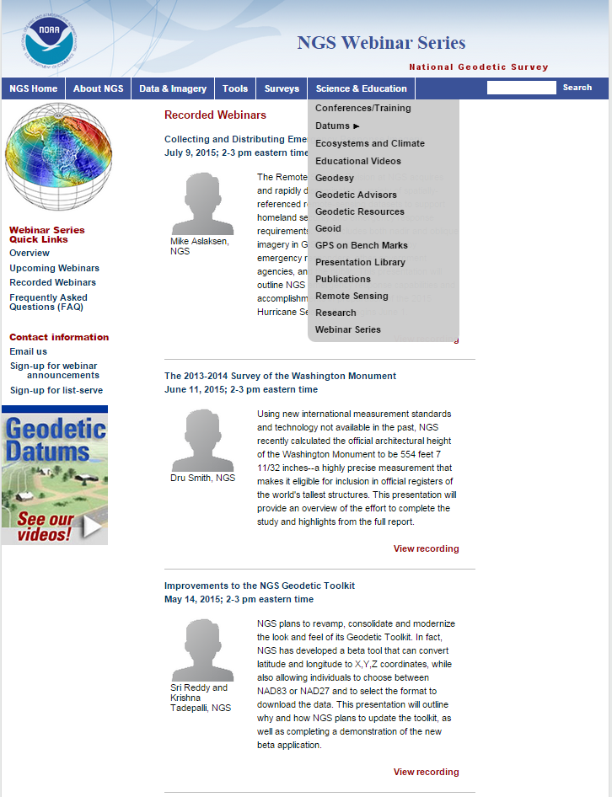
NGS Monthly Webinar Series
http://www.ngs.noaa.gov/web/science_edu/webinar_series/
Presentations related to NGS programs, projects, products and services.
Second Thursday of every month,
2:00-3:00 p.m. East Coast time.
Webinar series Web-pages:
view previously recorded webinars,
register for upcoming webinars, and
subscribe for monthly notifications.
Contact: NGS.Webinar@noaa.gov

Slide 135

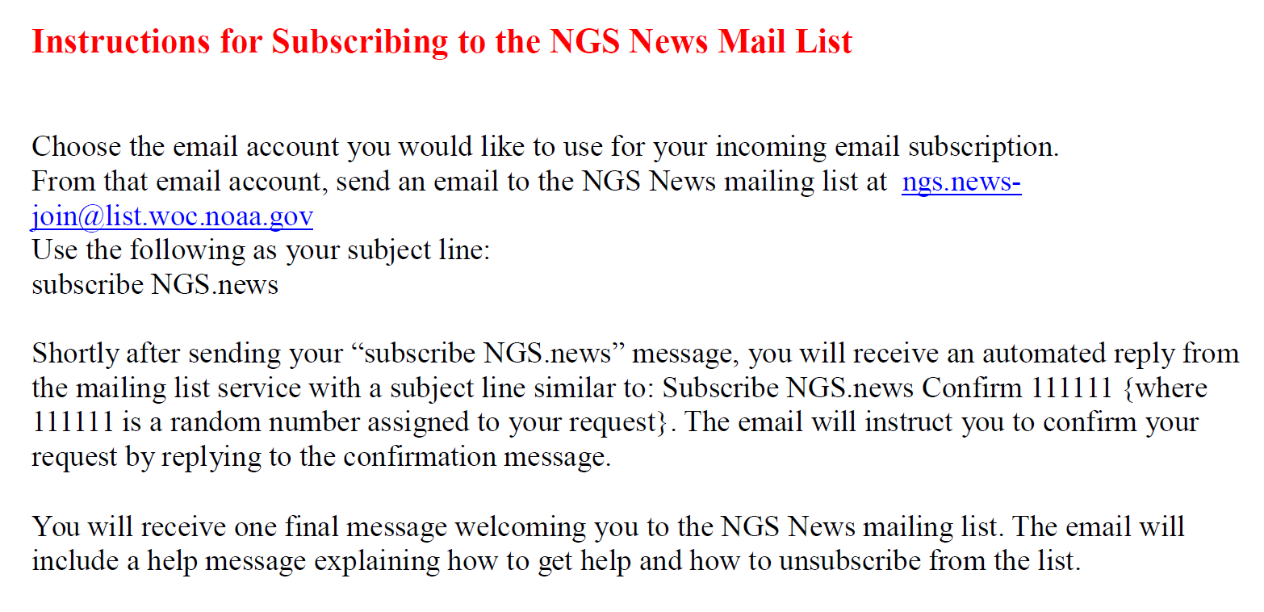
Sign up for the NGS ListServe
http://www.geodesy.noaa.gov/

Slide 136
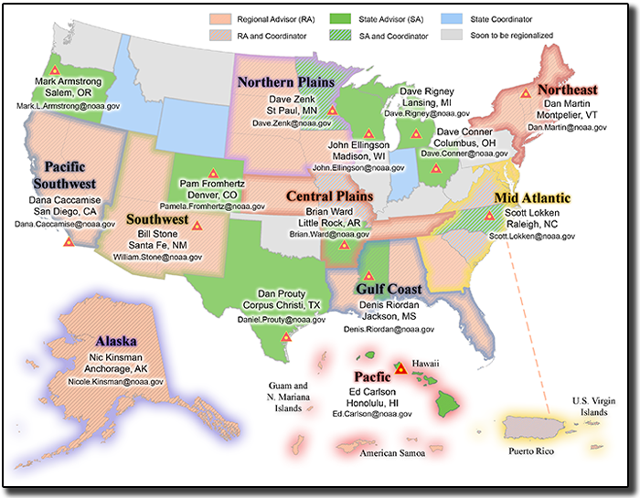
NGS Geodetic Advisor Program
http://www.geodesy.noaa.gov/ADVISORS/
The NGS Geodetic Advisor Program currently provides either a NOAA employee (jointly funded by NOAA and the state) or a designated coordinator residing in the state.
Geodetic advisors guide and assist the state’s geodetic and surveying programs.
Advisor program is transitioning
to a regional approach for more coverage but fewer advisors.
Notes:
Currently (as of December 2015), there are 15 Geodetic Advisors (including 10 Regional Advisors and 3 State Coordinators), covering 40 states.
NGS has studied the current structure and effectiveness of the State Advisor Program and has assessed the options for expanding the reach of the program. The advisor program will be restructured to improve its effectiveness via a phased shift from a "state" advisor approach to a "regional" advisor focus. NGS plans to transition completely by the end of FY16.
The NGS State Geodetic Advisor Program is a cost-sharing program that provides a liaison between NOAA and the host state, usually with a jointly-funded NOAA employee residing in the state to guide and assist the state's geodetic and surveying programs.
Full-time Regional Advisors:
Southwest
(Includes UT, AZ and NM)
William Stone
Pacific Southwest
(Includes CA and NV)
Dr. Dana Caccamise
Northeast
(Includes NY, NJ, MA, CT, RI, VT, NH, ME)
Daniel J. Martin
Alaska
Nicole Kinsman
Half-time Regional Advisors (still assigned to a specific State half-time):
Gulf Coast
(Includes LA, MS, AL and FL)
Denis Riordan
Mid-Atlantic
(Includes DE, GA, MD, NC, SC, and VA)
Scott Lokken

Slide 137
Summary: Priorities
NGS Priorities, in order:
  Define datums on solid scientific footing
  Provide tools for transitioning
  Work within FGCS to ensure OMB A-16 compliance
  Work with additional groups to aid in adoption

Slide 138
Questions

Slide 139
Thank you!

Slide 140
END

Slide 141
Extra Slides

Slide 142
Extra: Details about GSVS11

Slide 143





Choosing the Place and Time for GSVS11
Criteria:
  Significantly exceed 100 km
  Under existing GRAV-D data
  Avoid trees and woods
  Along major roads
  Cloud-free nights
  No major bridges along the route
  Low elevations
  Significant geoid slope
  Inexpensive travel costs
Notes:
The reasons for the above are:
>100 km : to allow for direct comparison to GOCE and GRACE
Under GRAV-D : So that geoids with/without airborne gravity can be compared
Avoid woods: Better GPS visibility
Roads: Ease of accessibility
Cloud-Free Nights: For the DoV camera to see the stars
Bridges: To avoid “river crossings” in the geodetic leveling
Low Elevations: So the errors from correcting from surface data to the geoid are minimized
Geoid slope: To have an interesting signal to choose from
Travel costs: To minimize cost of survey

Slide 144
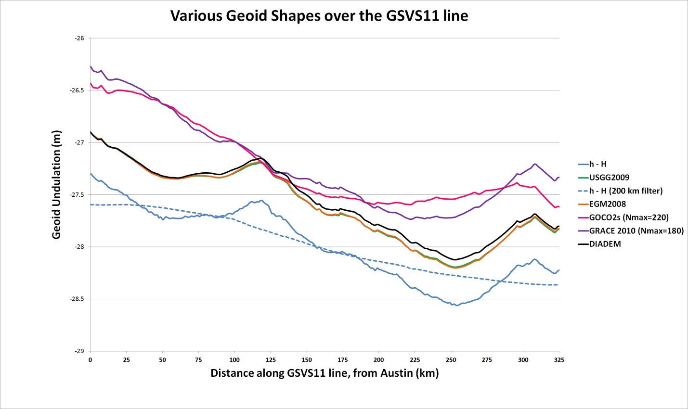
Existing Geoids vs GSVS11
Austin
(North end)
Rockport
(South end)
Notes:
The shapes in this plot are various forms of the geoid shape over the GSVS11 line. Of primary interest is the blue line (h-H) which represents the very best differential ellipsoid heights and differential orthometric heights from the new GPS and leveling of GSVS11. The blue dashed line is a smoothed (200 km filter) version of this. Note that this survey was about geoid slopes, so the absolute offsets seen here are immaterial to the goal of this survey.
The green and orange lines almost on top of each other are the latest gravimetric geoid from NGS (USGG2009) and EGM2008. Note how closely they appear to follow the h-H blue line.
The purple and pink lines are SHMs ITG-GRACE2010s and GOCO02s. Note their general inability to track even the largest details (except the more or less upward slope from Rockport to Austin) of the geoid. One would presume this is from omission error, but the failure to match the filtered h-H values (blue dashed line) calls into question whether there is commission, not omission error going on here. If EGM2008 were only given to maximum degree 220, it follows closely to these two models.

Slide 145
Notes:
This slide shows the RMS error (disagreement) between h, H and N for the USGG2009 geoid model as compared to the best GPS and leveling on GSVS11. The data are in “distance bins”, representing how far apart any two points in the survey were. There were 218 points, yielding 23,871 possible *pairs* of points, separated by distances ranging from 0.4 km (the closest any two points were to one another) to 325 km (the distance between the first and last points in the survey). Each “distance bin” contains about 2,000 pairs of points, separated by a distance which puts them in that particular bin.
As this is a *total* RMS error chart, it is worth nothing that in this fairly uncomplicated, and low-elevation area that even with the combined errors of GPS, leveling and a gravimetric geoid model, the total error barely reaches 3 cm over medium distances (wavelengths).

Slide 146
EGM2008 is better here
USGG2009 is
better here
Notes:
This slide builds upon the previous one, now showing EGM2008’s performance alongside of USGG2009. Since these two geoid models have almost identical input terrestrial gravity data, it is not surprising that they behave in very similar ways when compared to the GSVS11 GPS/leveling data. Differences between the two models can be attributed to the different modeling approaches, plus slight differences in input data.

Slide 147
Adding GOCO2s makes
things better here
Adding GOCO2s makes things worse here
Notes:
This slide builds upon the previous two, now showing a new experimental EGM (xEGM) created at NGS which blends EGM2008 and GOCO2s (called xEGM-G). The geoid model remains 5’ x 5’, like EGM2008. This blending of GOCO2s was shown to have a CONUS-wide overall improvement to the geoid, but in this particular area it is obvious that GOCO2s only improves the geoid at certain wavelengths, and actually degrades them over short wave lengths.

Slide 148
Airborne Gravity Improves the
Geoid across ALL DISTANCES
Notes:
This slide builds upon the previous three. The significant change now is that airborne gravity data, from the GRAV-D project, has been added over this region, and blended into an experimental EGM (xEGM). The blending combines EGM2008, GOCO2s and GRAV-D, and the experimental EGM is called “xEGM-GA” (“GA” meaning “with GOCO2s and with Airborne”). The geoid model built upon that data has a significant improvement in comparison to the GSVS11 GPS/leveling data.
The take-away message of this slide is that the contemporary, consistent airborne gravity data is the key to improving geoid accuracy. The previous three models (USGG2009, EGM2008 and xEGM-G) all relied upon / massaged the same terrestrial gravity data, but none of that improved the geoid significantly, whereas the airborne gravity data, being new, contemporary and consistent showed significant improvement over the other geoids.

Slide 149
New software makes
things worse here
New software
Makes things
better here
Notes:
This slide builds upon the previous four. NGS has been experimenting with more rigorous ways to account for topography and perform kernal truncations. The most recent iteration was used to create an experimental high resolution gravimetric geoid model (xUSGG), using upon the xEGM-GA model, plus high resolution gravimetry and topography. As can be seen, this gives a slight degradation to the model at short wavelengths, but has a noticeable improvement to the model at medium to long wavelengths.

Slide 150
Let’s remove this
from all of the other
bars to leave
geoid-only RMSE
Notes:
This slide builds upon the previous five. This time a new set of bars in green are added which are NOT the combined errors of GPS, Leveling and a geoid model, but are instead *only* GPS & Leveling errors. They are displayed to show the magnitude of these errors in comparison with the combined GPS/leveling/geoid errors.

Slide 151
The “1 cm
geoid”
Notes:
This slide is a companion to the previous one, but the h-H errors have been removed, in an RMS sense, from the total h-H-N errors, leaving gravimetric geoid model errors only.
As seen previously, the geoids based on airborne gravity data are the best performers, and the very slight degradation using new high resolution software at short wavelengths is noticeably offset by the significant improvement at medium wavelengths.
In fact, as a general statement, it could be said that adding airborne gravity data to the gravimetric geoid model has yielded about 1 cm differential geoid undulation accuracy across all distances, in the region of GSVS11, and that this can be further improved by continued improvement to the high resolution modeling software.

Slide 152
Extra: GRAV-D Info

Slide 153
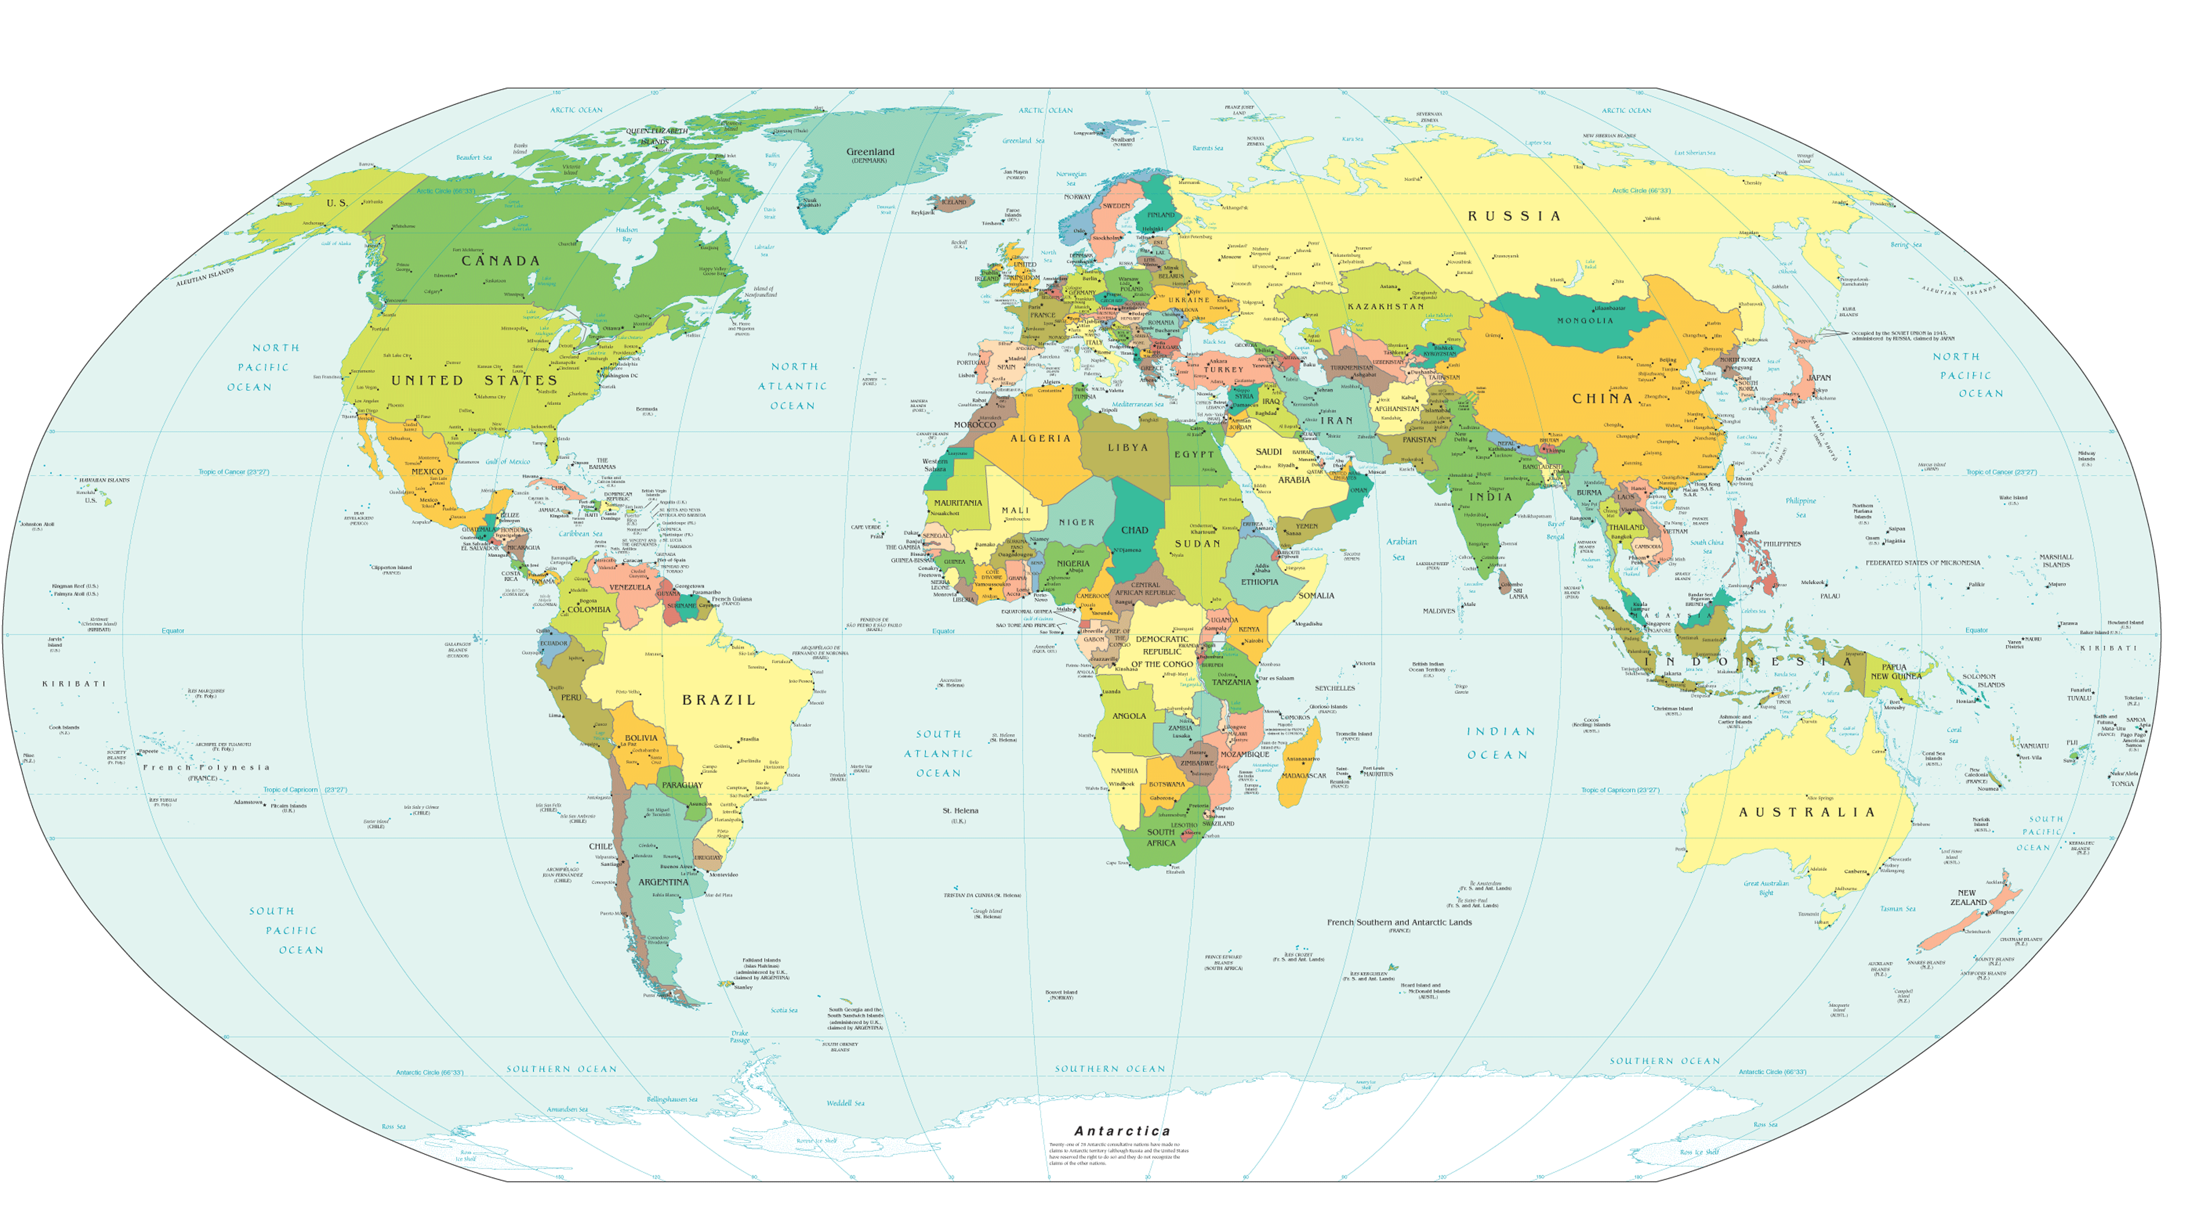
Expected GRAV-D airborne gravity coverage by 2022
Alaska
“CONUS”
Guam / Northern Marianas
Hawaii
Puerto Rico / Virgin Islands
American Samoa
GRAV-D
Planned
Coverage

Slide 154
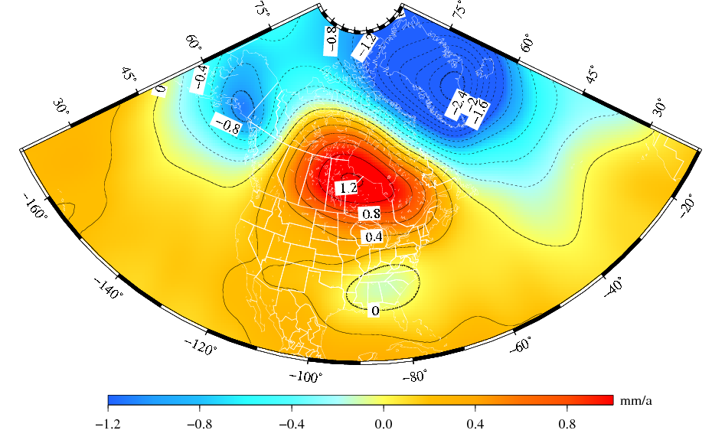
The “secular” geoid change from the monthly GRACE models (2002-2008)
Deglaciation
The solution represents the effect due to total mass changes.
The solution uses a 400-km Gaussian filter.
Glacial Isostatic
Adjustment
Drought

Slide 155
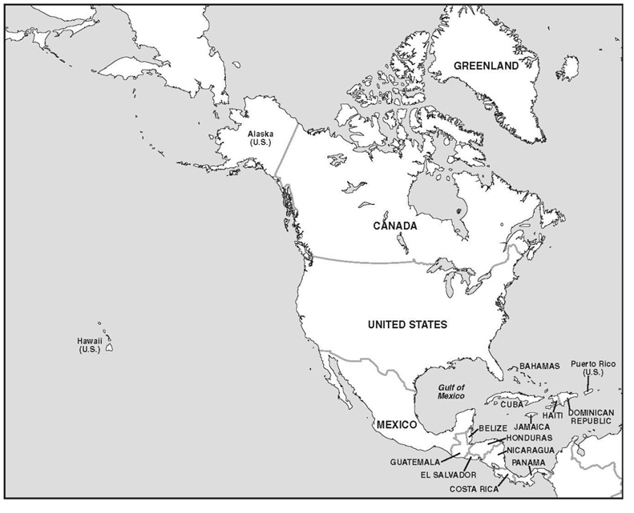
No official
Vertical datum
CGVD2013*
NAVD 88
No official
Vertical datum
* geoid/GNSS based datum

Slide 156
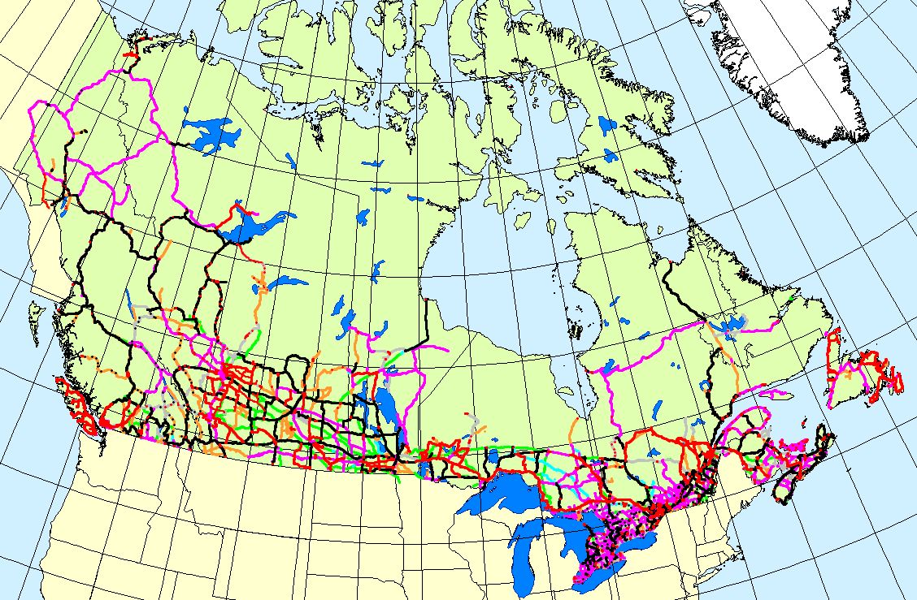

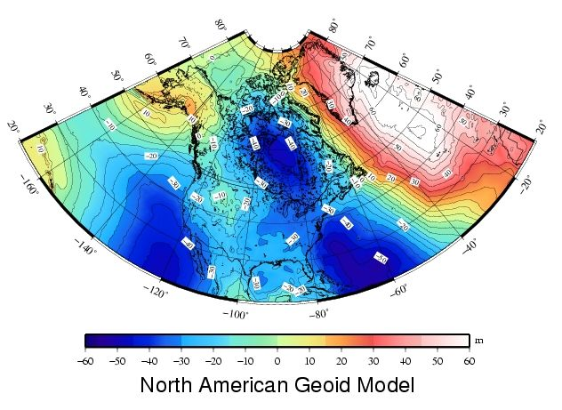
Canada Height Modernization - 2013
The geoid model:
1. Entire coverage of the
Canadian territory
(land, lakes and oceans)
2. Compatible with space-
based positioning
(e.g., GNSS, altimetry)
3. Less expensive for
maintenance
4. Fairly stable reference
surface
Levelling Networks:
1. Established over the
last 100 years
2. 120,000 km of levelling
lines
3. Some 80,000
benchmarks
1. Time consuming
2. Expensive
3. Limited coverage
4. BMs are unstable
5. BMs disappear
6. Local networks
H = h_{GNSS} – N_{Model}

Slide 157
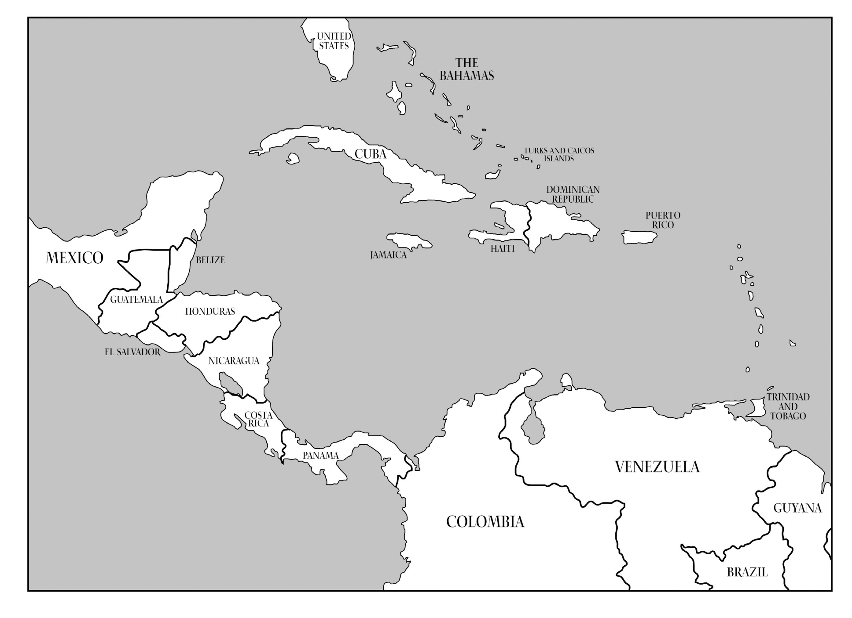
?
PRVD02
VIVD09
?
?
⁽¹⁾
?
?
?
?
?
Santo Domingo⁽¹⁾
?
Puerto Cortéz⁽¹⁾
?
?
Corinto 1952⁽¹⁾
?
?
San José⁽¹⁾
?
?
La Unión 1960⁽¹⁾
Puntarenas⁽¹⁾
Cristóbal⁽¹⁾
⁽¹⁾ Información cortesía de David Avalos

Slide 158
Extra: Subsidence Example

Slide 159
From t₀ to t₁, subsidence occurs
T=t₀
T=t₁
Surface
Δh = h₁-h₀
g₀
ΔH = H₁-H₀
Surface
=Δh-ΔN
g₁
H₀
ΔN=N₁-N₀
H₁
h₀
N₀=f(g₀,H₀)
h₁
N₁=f(g₁,H₁)
Geoid
Geoid
N₀
N₁
Ellipsoid
Ellipsoid
g₀ hasn’t been measured in decades:
This is the essence of
“Campaign I” of GRAV-D
g₁≠g₀ : This is the essence
of “Campaign II” of GRAV-D

Slide 160

E
B
D
A
C
H ≈ h – N
h^{D}₀
h^{E}₀
H^{A}₀
h^{A}₀
h^{C}₀
h^{B}₀
H^{C}₀
H^{E}₀
H^{B}₀
H^{D}₀
N^{B}₀
N^{C}₀
N^{D}₀
Geoid
N^{A}₀
N^{E}₀
Ellipsoid
Time: t= t₀

Slide 161
Δh easily measured / monitored by GPS
Δh
Δh
Δh
Δh
Δh
Ellipsoid Does Not Change!!
Ellipsoid
Effect of Subsidence on Ellipsoid Heights

Slide 162
Δh
Δh
Δh
Δh
Δh
Earth’s mass distribution has changed!
So, Earth’s gravity field has changed….
ΔH ≈ Δh – ΔN
(wanted) (GPS) (GRAV-D)
Including the location and shape of the geoid…
Which means new orthometric heights rely on new locations of:
The crust and
The geoid
ΔN
ΔN
ΔN
ΔN
ΔN
Geoid
Effect of Subsidence on Orthometric Heights

Slide 163
ΔH from Leveling?
Why not just re-level to monitor orthometric height changes?

Slide 164
Leveling and Gravity
“Leveling without gravity measurements, although applied in practice, is meaningless from a rigorous point of view”
  Physical Geodesy
    Heiskanen and Moritz

Slide 165
g^{E}₀
g^{E}₁
g^{B}₀
g^{C}₀
g^{D}₀
g^{A}₀
g^{B}₁
g^{D}₁
g^{C}₁
g^{A}₁
Issue #1: Find a provably “stable” point
Issue #2: Presumption that gravity hasn’t changed
Issue #3: Failure to measure gravity while leveling, in general
Issue #4: Reliance on finite point-cloud of vulnerable benchmarks
Thus, NGS has adopted GRAV-D as its future policy
toward defining and monitoring the vertical datum
Geoid
Orthometric Height Monitoring by Leveling

