Slide 1
Teaching the Modernized the National Spatial Reference System of 2022
Dru Smith
NSRS Modernization Manager
NOAA’s National Geodetic Survey

Slide 2
“Modernized NSRS” means…
Replacing NAD 83
Replacing NAVD 88
Re-inventing Bluebooking
Improving the Geodetic Toolkit
Better Surveying Methodologies
Notes:
There are actually 3 “NAD 83”s, NAD 83(2011), NAD 83(PA11) and NAD 83(MA11)
There are also many more vertical datums than NAVD 88 in the NSRS, each one for specific states or territories that have no line of sight to CONUS/Alaska

Slide 3
NSRS Modernization
The Old:
NAD 83(2011)
NAD 83(PA11)
NAD 83(MA11)
The New:
The North American Terrestrial Reference Frame of 2022
(NATRF2022)
The Caribbean Terrestrial Reference Frame of 2022
(CATRF2022)
The Pacific Terrestrial Reference Frame of 2022
(PATRF2022)
The Mariana Terrestrial Reference Frame of 2022
(MATRF2022)

Slide 4
NSRS Modernization
  The Old:
  NAVD 88
  PRVD 02
  VIVD09
  ASVD02
  NMVD03
  GUVD04
  IGLD 85
  IGSN71
  GEOID12B
  DEFLEC12B
  The New:
  The North American-Pacific Geopotential Datum of 2022 (NAPGD2022)
  Primary component is a global harmonic model of geopotential which includes all GRAV-D data:
    GM2022
  Related regional gridded products:
    GEOID2022
    DEFLEC2022
    GRAV2022
Orthometric
Heights
Normal
Orthometric
Heights
Dynamic
Heights
Gravity
Geoid
Undulations
Deflections of
the Vertical

Slide 5
Details: Blueprint documents
Blueprint for 2022, Part 1: Geometric Coordinates
  A.K.A. NOAA Technical Report NOS NGS 62 (April 2017 release)
  Time-dependency
  Four terrestrial reference frames
  Intra-frame velocity models
Blueprint for 2022, Part 2: Geopotential Coordinates
  A.K.A. NOAA Technical Report NOS NGS 64 (September 2017 release)
  Time-dependency
  One geopotential datum
    Interrelated global geopotential model, regional geoid grids, regional DoV grids, regional surface gravity grids

Slide 6
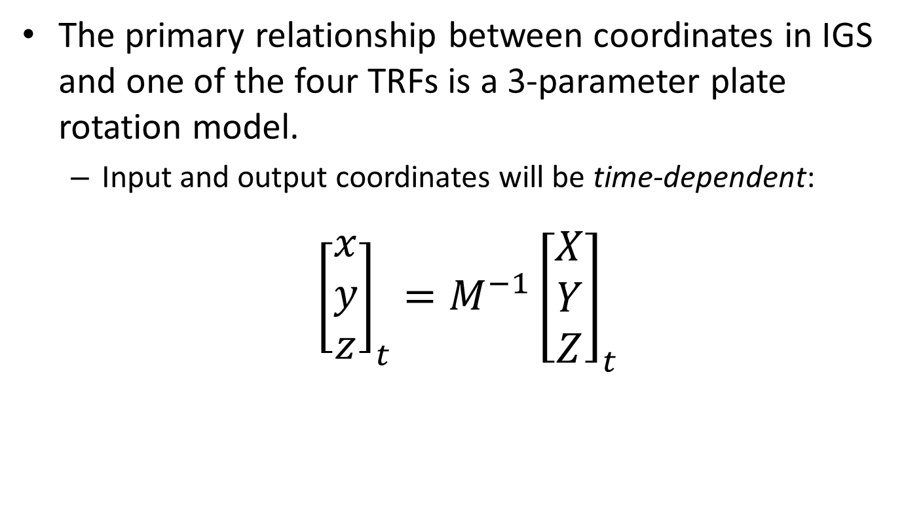
Terrestrial Reference Frames
The primary relationship between coordinates in IGS and one of the four TRFs is a 3-parameter plate rotation model.
  Input and output coordinates will be time-dependent:
${{{\left[\begin{matrix}x \\ y \\ z\end{matrix}\right]}_{t}=M}^{−1}\left[\begin{matrix}X \\ Y \\ Z\end{matrix}\right]}_{t}$
*TRF2022
coordinates
Plate rotation model
for plate *
IGS coordinates

Slide 7
Terrestrial Reference Frames
Why make the TRF coordinates time dependent?
  Because in the vast majority of cases, these time dependent coordinates will be semi-stationary because their only (or only significant) motion is tectonic rotation (“Eulerian Motion”)
  But, all points will be assumed to have residual (“non-Eulerian”) motions, besides plate rotation
    Even so-called “stable” points
    Captured in an intra-frame velocity model (IFVM) for each frame

Slide 8
Non-Eulerian motions in the TRFs
Non-Eulerian motions at CORS
Note the obvious impact of the plate boundary in western CONUS
Note the non-zero nature of all vectors even in “stable North America”
Notes:
Potential outline and speaker assignments; can be adjusted as needed.

Slide 9
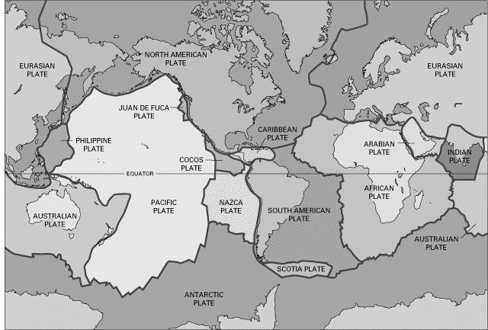
BSMK (North Dakota)

Slide 10
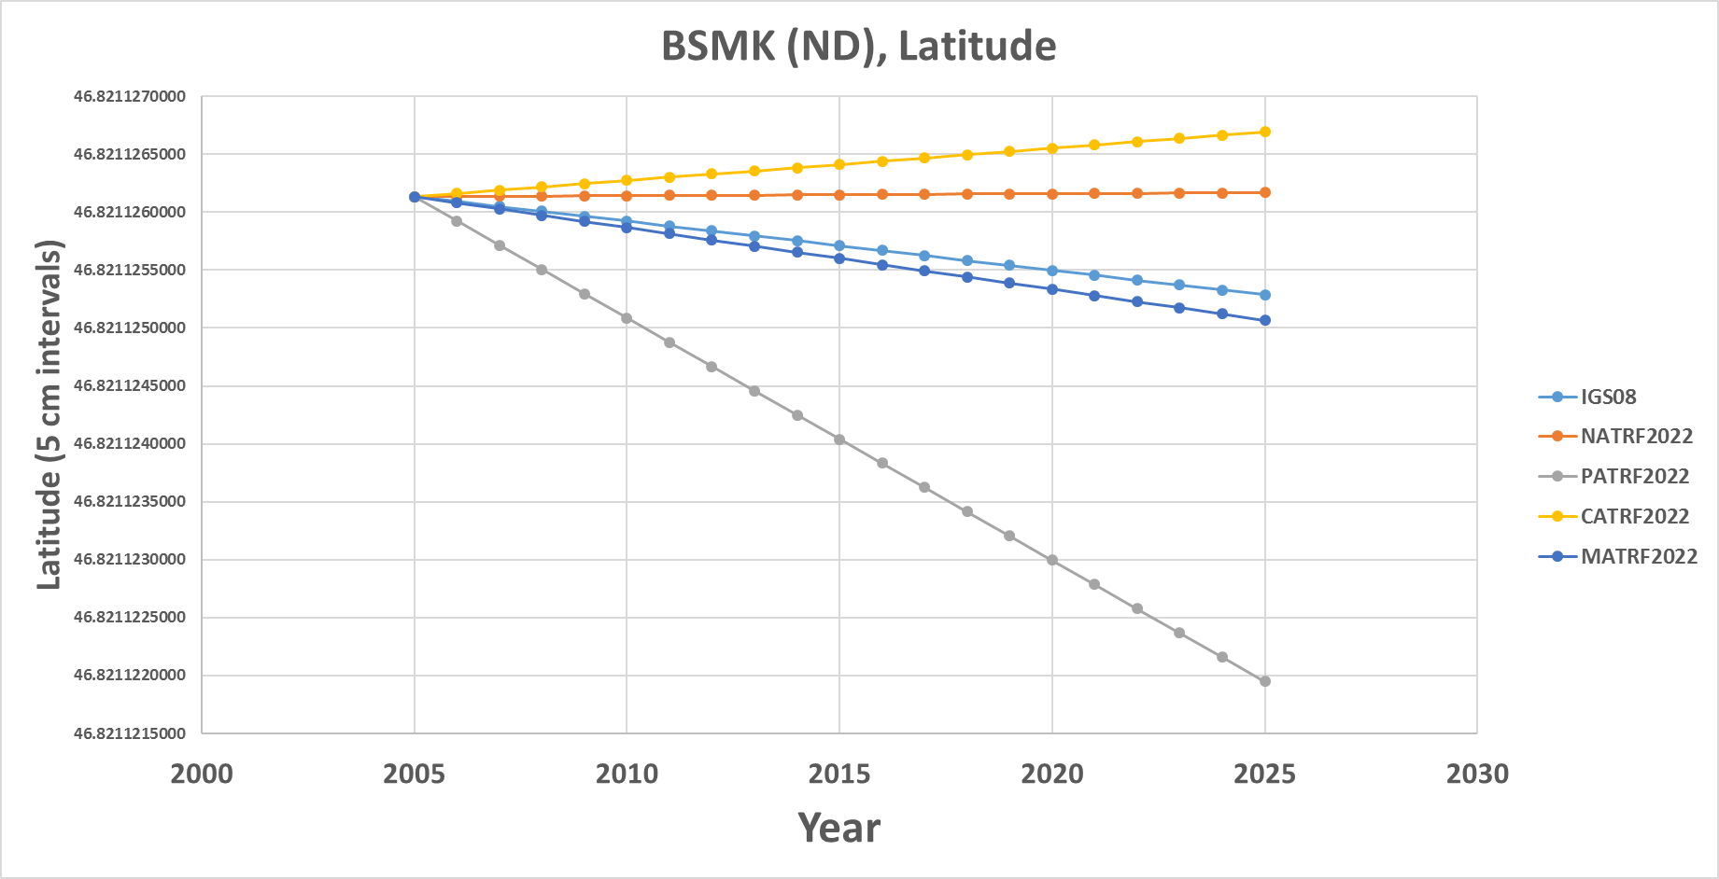
BSMK (North Dakota)

Slide 11
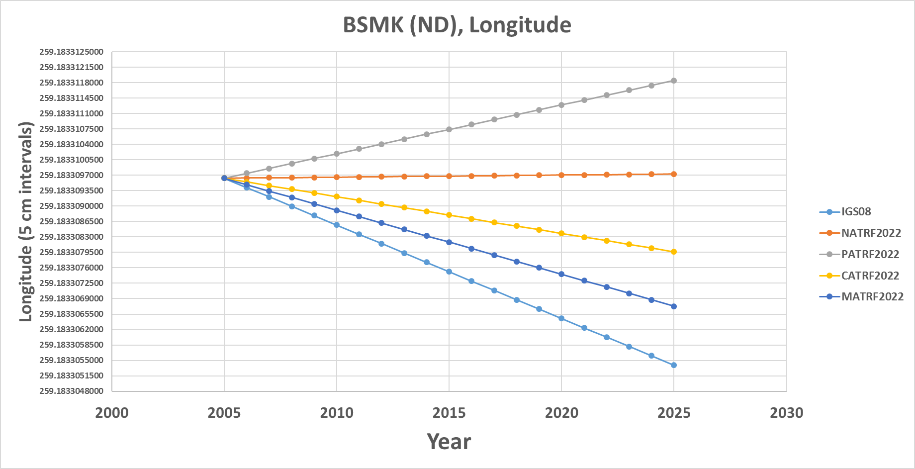
BSMK (North Dakota)

Slide 12
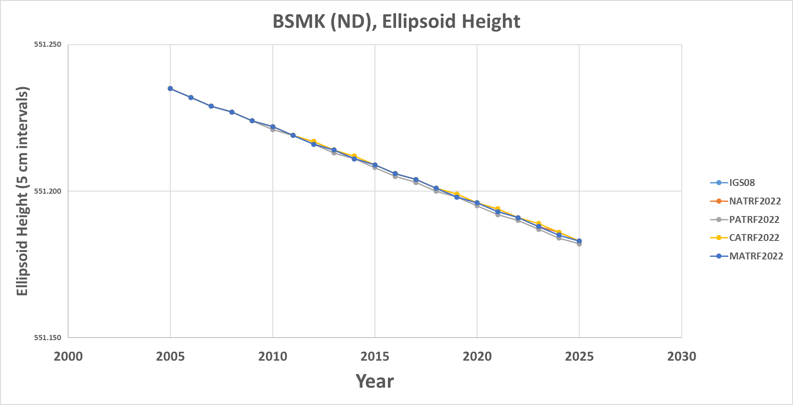
BSMK (North Dakota)

Slide 13
ICT2 (Kansas)

Slide 14
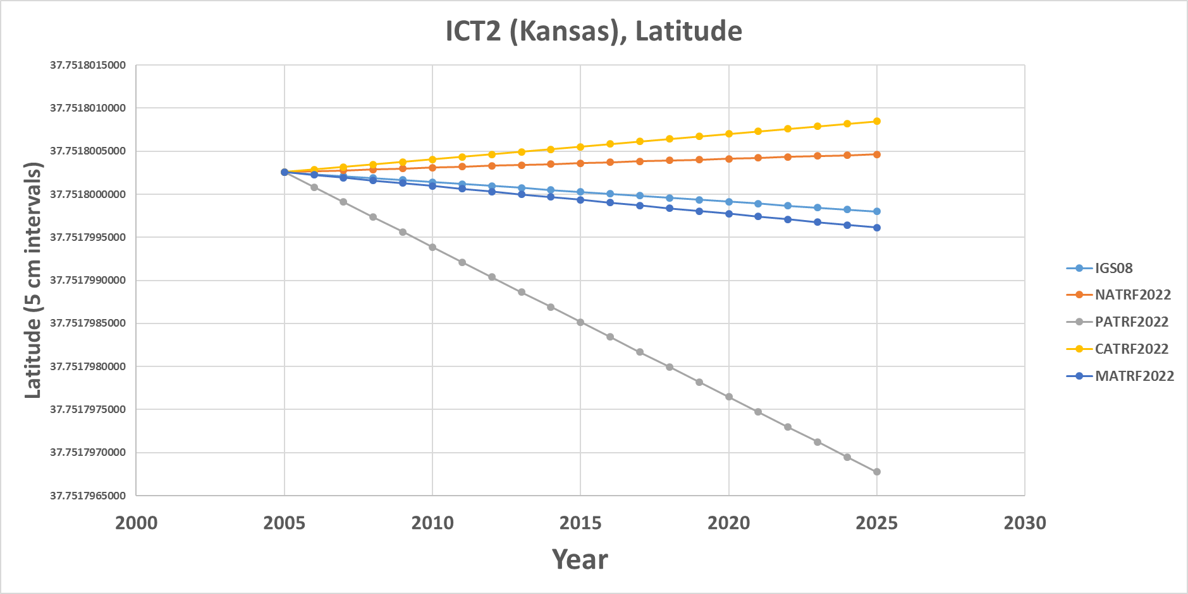
ICT2 (Kansas)
Note the time-dependent movement of this Kansas point in latitude in NATRF2022! Such movement will be captured in the IFVM.

Slide 15
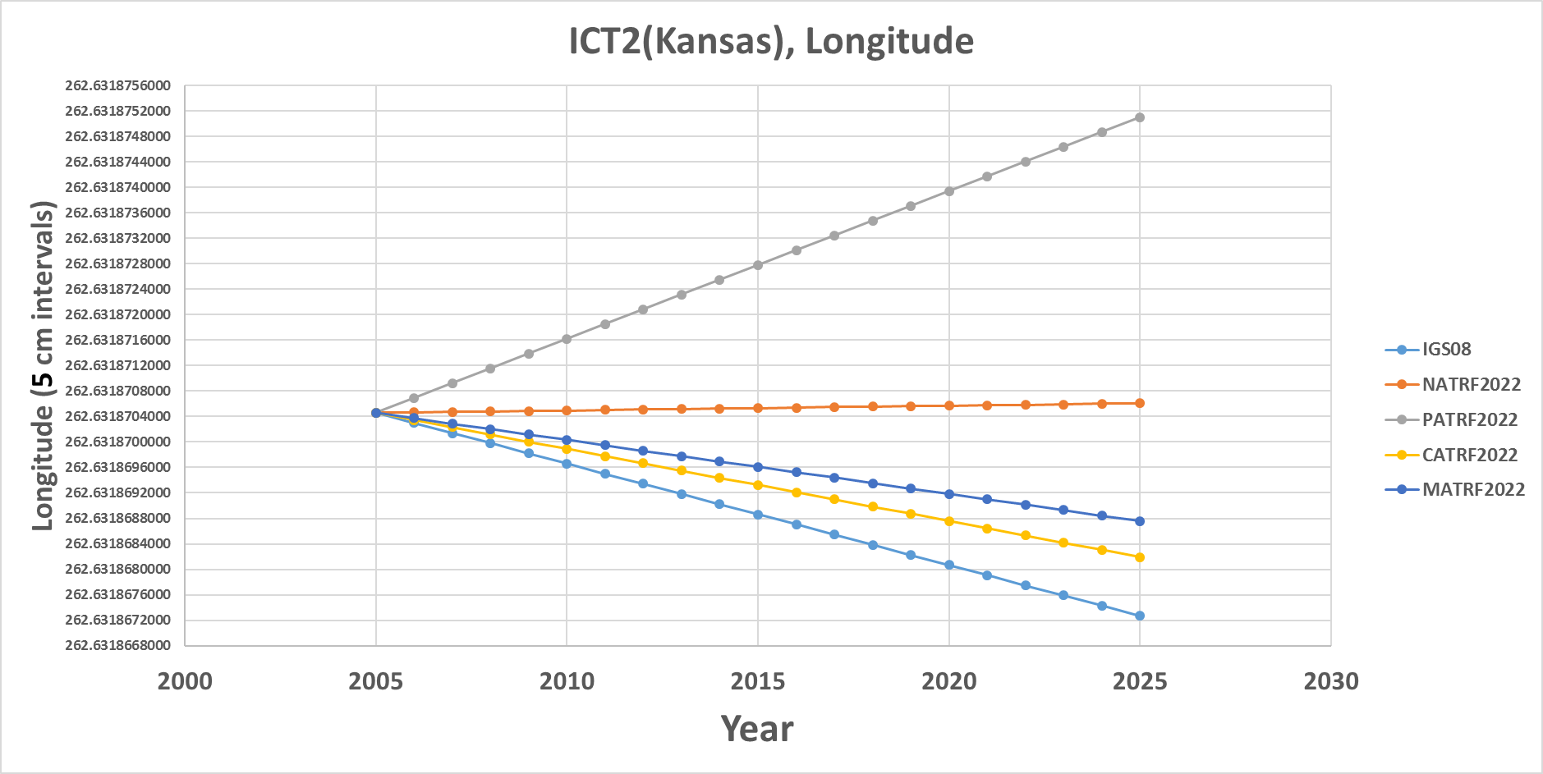
ICT2 (Kansas)
This CORS is very stable in longitude in NATRF2022 though! Still, any deviation from stability would be in the IFVM.

Slide 16
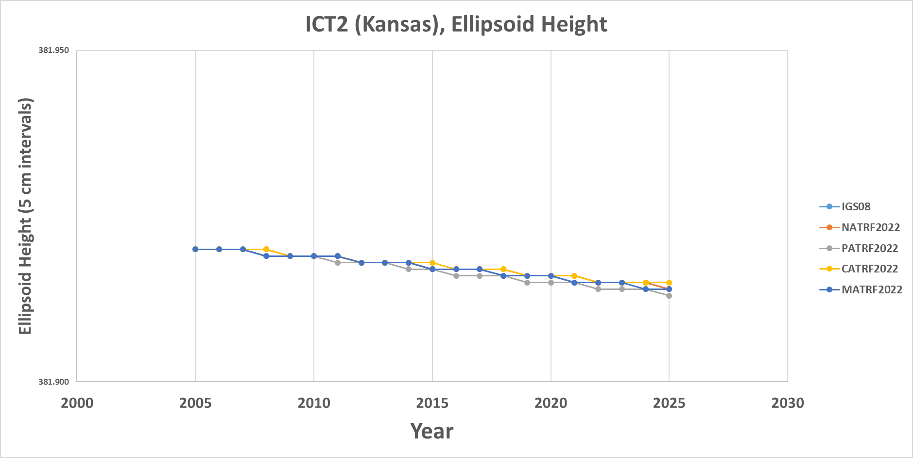
ICT2 (Kansas)
All vertical motion is captured in the IFVM.

Slide 17
PIN1 (S. California)

Slide 18
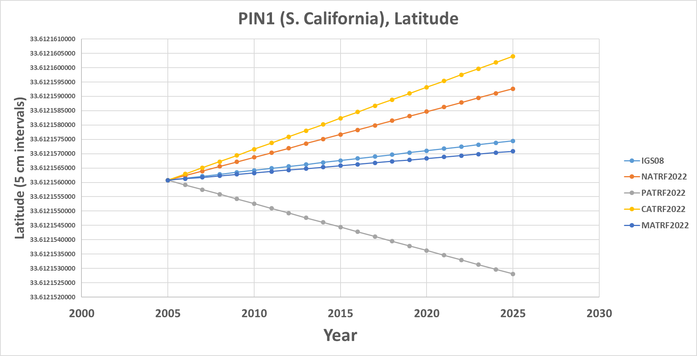
PIN1 (S. California)
In latitude, S. California neither behaves like the NA plate nor the Pacific plate. Both deviations from stability will be captured in each frame’s IFVM.

Slide 19
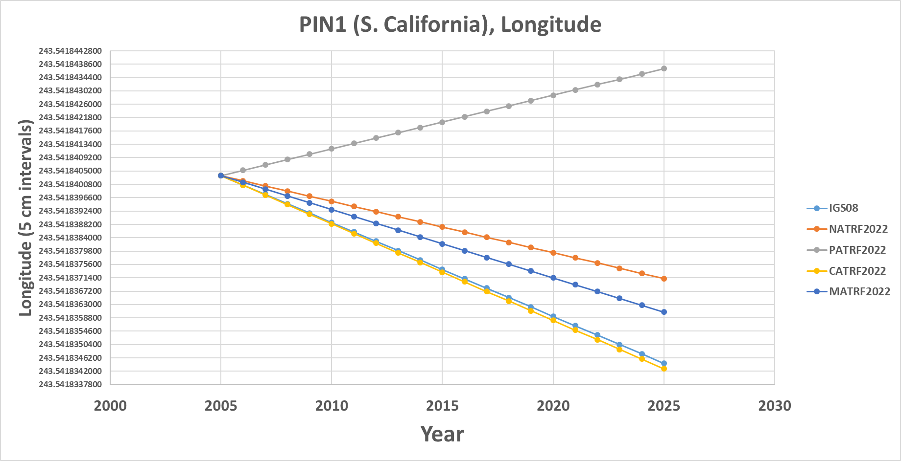
PIN1 (S. California)
In longitude, S. California neither behaves like the NA plate nor the Pacific plate. Both deviations from stability will be captured in each frame’s IFVM.

Slide 20
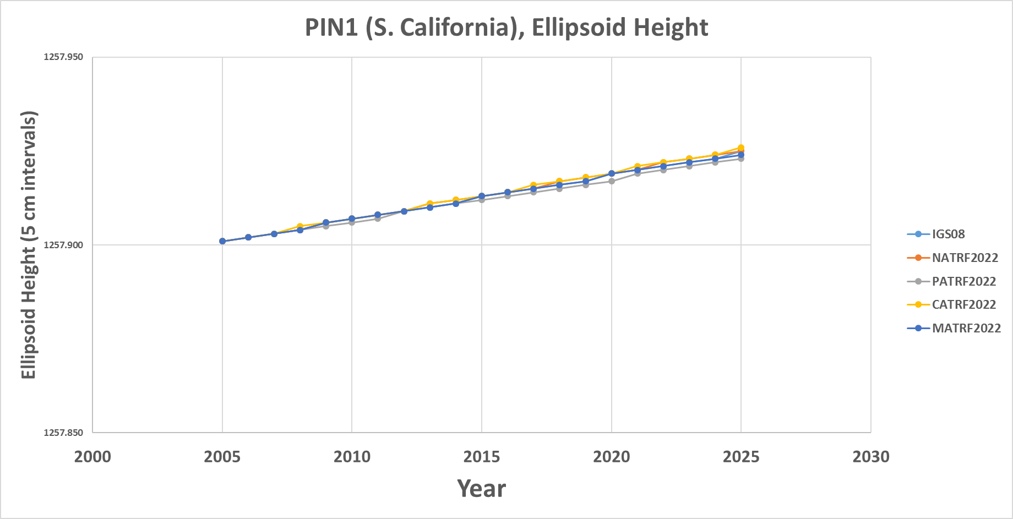
PIN1 (S. California)
In ellipsoid height, all frames are equal and the entire signal is captured in the IFVM.

Slide 21
Absolute motion
Thus the absolute motion of a point (within the IGS frame) in Kansas can be represented identically by:
  The EP rotation of the NA plate + the NA IFVM
  The EP rotation of the PA plate + the PA IFVM
  The EP rotation of the CA plate + the CA IFVM
  The EP rotation of the MA plate + the MA IFVM
Etc ad nauseum
  As the old saying goes, there are two kinds of people in this world:
    Those who can extrapolate from incomplete data

Slide 22
IFVM – How?
Intra-Frame Velocity Models must:
  Estimate non-Eulerian motions at any location
Three primary methods being investigated
  Interpolation from CORS
    Pro: Easy
    Con: Gets worse as CORS gets coarse
  Satellite IfSAR
    Pro: Covers vast areas
    Con: No IfSAR experts in NGS; data availability issues
  Geodynamic
    Pro: Like HTDP, so NGS has experience
    Con: Requires knowing why things move, rather than just measuring that they move (and requires “keeping up” with every event.)

Slide 23
Geopotential Datum

Slide 24
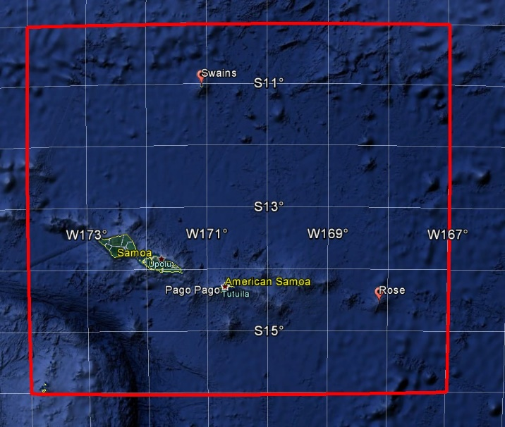
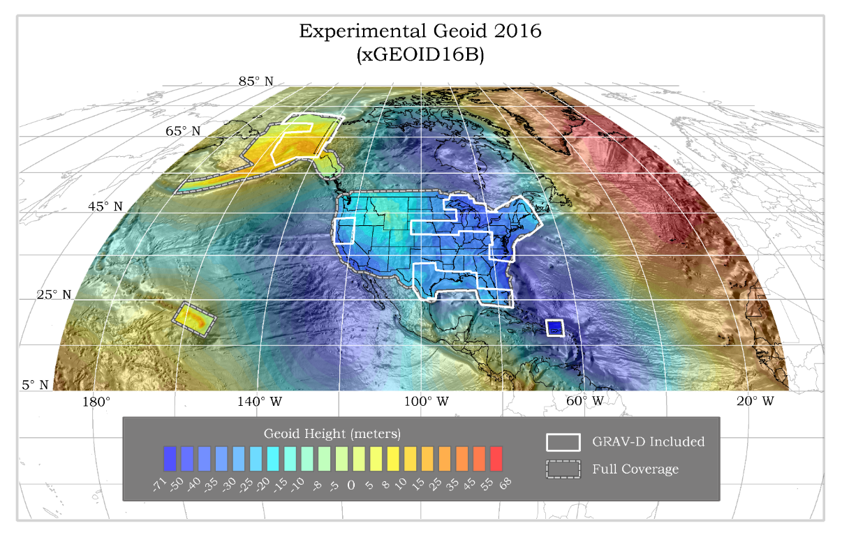
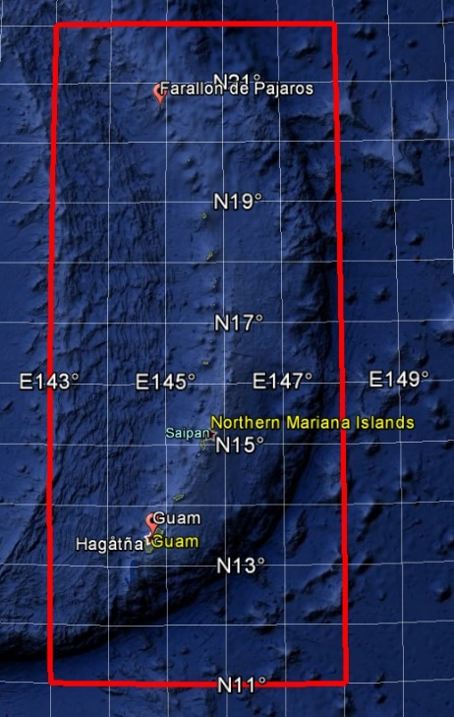
GEOID2022 (et al) over American Samoa:
-16 to -10, 186-193
GEOID2022 (et al) over Guam/CNMI:
11-22, 143-148
GEOID2022 (et al) over the North America/Pacific/Caribbean/Central America/Greenland region will range from
0 to 90 latitude and from 170 to 350 longitude.

Slide 25
Thank you!

Slide 26
Extra Slides

Slide 27
Using the TRFs
User Supplied
GNSS Receiver File(t)
CORS data (t)
NGS Supplied
IAG Supplied
OPUS
Geodetic Control
High Accuracy
Fixed at true epoch
XYZ (t, IGS)
GRS-80
φλh (t, IGS)
4 Euler Poles, by plate:
NA, PA, CA, MA
Estimated cords
Medium Accuracy
Subject to updates
XYZ (t, NATRF2022)
XYZ (t, PATRF2022)
XYZ (t, CATRF2022)
XYZ (t, MATRF2022)
4 Intra-Frame Velocity Models, by frame:
NA, PA, CA, MA
Latest estimate of:
φλh (t0, NATRF2022)
φλh (t0, PATRF2022)
φλh (t0, CATRF2022)
φλh (t0, MATRF2022)
GRS-80
φλh (t, NATRF2022)
φλh (t, PATRF2022)
φλh (t, CATRF2022)
φλh (t, MATRF2022)
Most recent past reference epoch “t0”
Blueprint for 2022, Part 1: Geometric Coordinates

Slide 28
Using NAPGD2022
User Supplied
h (t, IGS)
GM2022
Spectrally Limited Estimates of the following, anywhere in 3-D space at/above Earth’s surface:
Geop/Spherop Separation : N(t, NAPGD2022)
DoV – E/W : ξ(t, NAPGD2022)
DoV – N/S : η(t, NAPGD2022)
Gravity : g(t, NAPGD2022)
<plus any other value dependent on geopotential>
NGS Supplied
IAG Supplied
φλ (t, IGS)
Geodetic Control
High Accuracy
Fixed at true epoch
Estimated cords
Medium Accuracy
Subject to updates
N (t, NAPGD2022)
GEOID2022
Estimated cords
Medium Accuracy
Fixed at true epoch
N (t0, NAPGD2022)
ξ (t, NAPGD2022)
η(t, NAPGD2022)
Most recent past reference epoch “t0”
ξ (t0, NAPGD2022)
η(t0, NAPGD2022)
DEFLEC2022
g (t, NAPGD2022)
(Tentative. Not ready by 2022)
GRAV2022
g (t0, NAPGD2022)
(DGRAV2022 not ready by 2022)

Slide 29
Putting them together
User Supplied
NGS Supplied
h (t, IGS)
N (t, NAPGD2022)
IAG Supplied
H (t, NAPGD2022)
Geodetic Control
High Accuracy
Fixed at true epoch
(all same)
H=h-N
h (t, NATRF2022)
h (t, PATRF2022)
h (t, CATRF2022)
h (t, MATRF2022)
Estimated cords
Medium Accuracy
Subject to updates
Estimated cords
Medium Accuracy
Fixed at true epoch
Latest estimate of (all the same):
h (t0, NATRF2022)
h (t0, PATRF2022)
h (t0, CATRF2022)
h (t0, MATRF2022)
H=h-N
H (t0, NAPGD2022)
N (t0, NAPGD2022)
Notes:
By definition, the relationship between IGS and the four TRFs is an Euler Pole rotation, which does not cause changes to “h”. Thus “h” in the IGS or other four frames will be identical at any given time (whether “t” or “t0”). Thus, any of the 5 “h” values at “t” or any of the 4 “h” values at “t0” can be used to get “H” at “t” and “H” at “t0”.

Slide 30
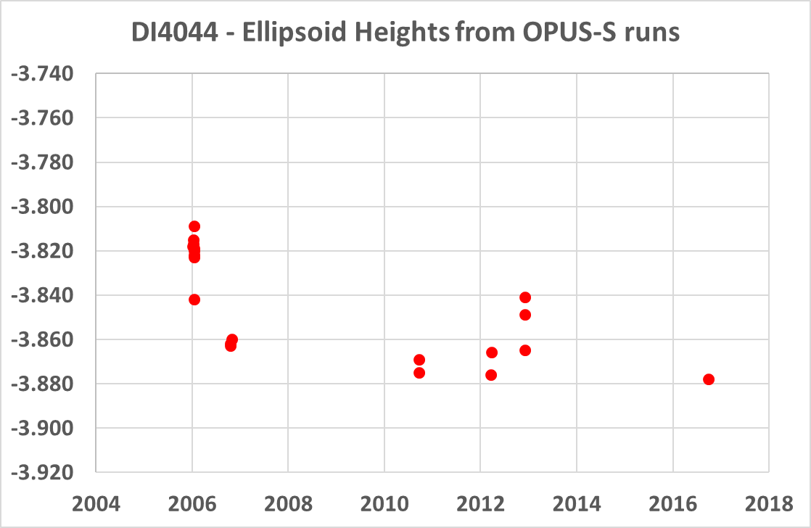
NATRF2022 and actual survey epochs
Point DI4044 was surveyed with GPS in 2006, 2006 (again), 2010, 2012 (in 2 parts which will be treated separately) and 2016. Each of those surveys spanned a few days to weeks, and had multiple occupations. To get to NATRF2022 coordinates, begin with an occupation-by-occupation run through OPUS-S
Notes:
Potential outline and speaker assignments; can be adjusted as needed.

Slide 31
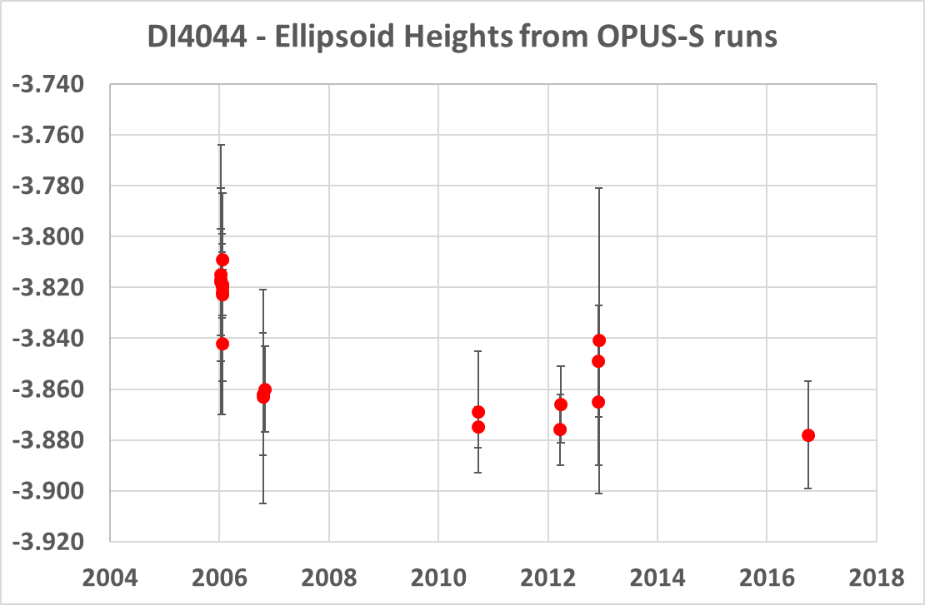
NATRF2022 and actual survey epochs
Put error bars on these runs for context, but it also helps see the 6 survey clusters…
Let’s zoom in on just one…
1
5
2
3
4
6
Notes:
Potential outline and speaker assignments; can be adjusted as needed.

Slide 32
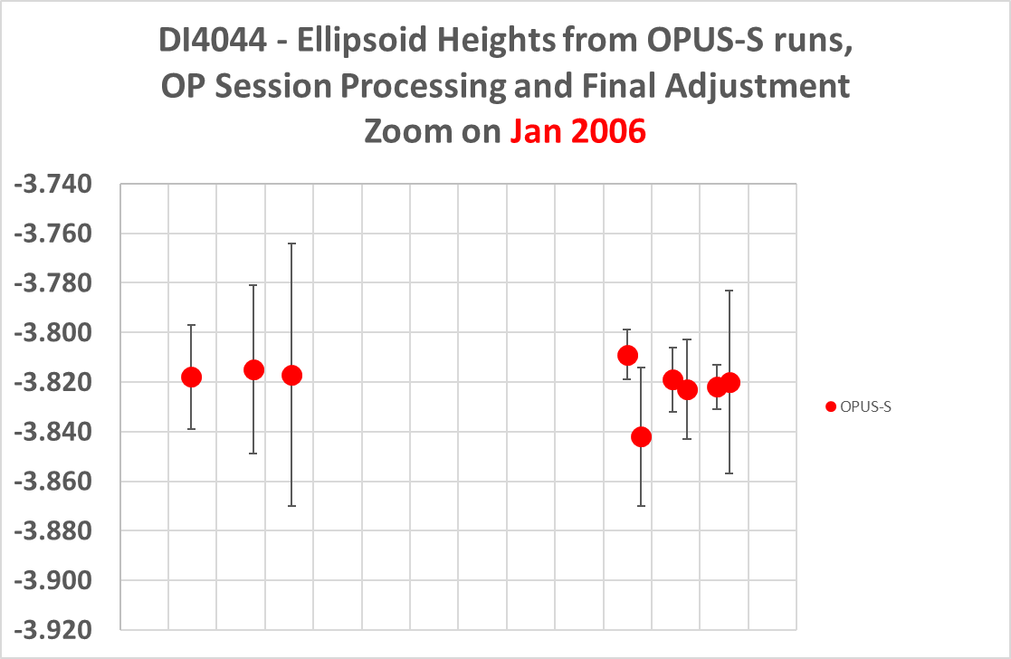
Processing one survey….
Step 1: OPUS-S
1

Slide 33
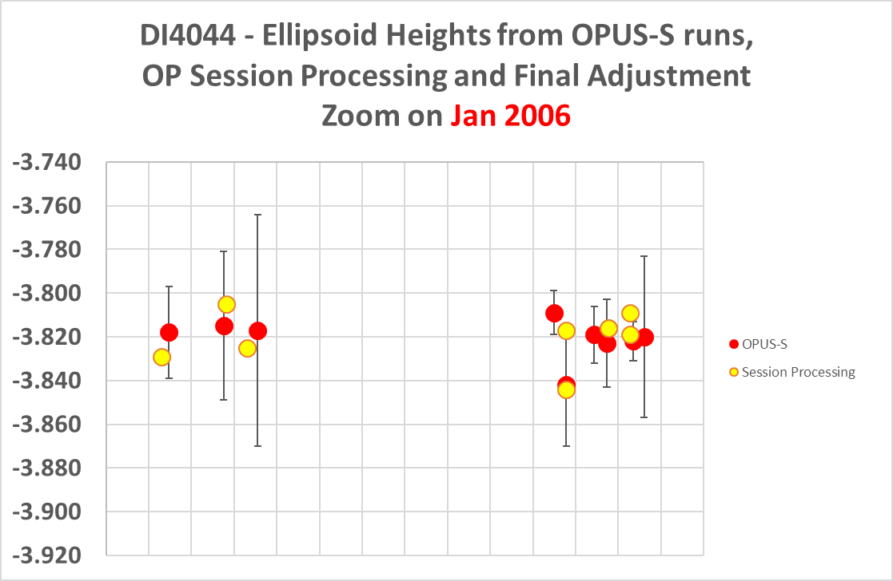
Processing one survey…
Step 2: Session Processing

Slide 34
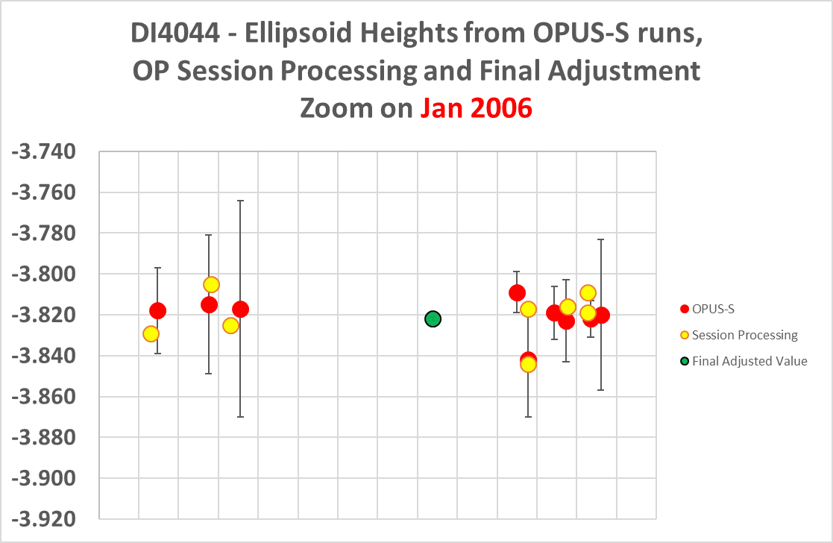
Processing one survey…
Step 3: Final Adjustment

Slide 35
NATRF2022 and actual survey epochs
With the final adjusted value in the IGS frame, the same processing can be applied to the other 5 surveys

Slide 36
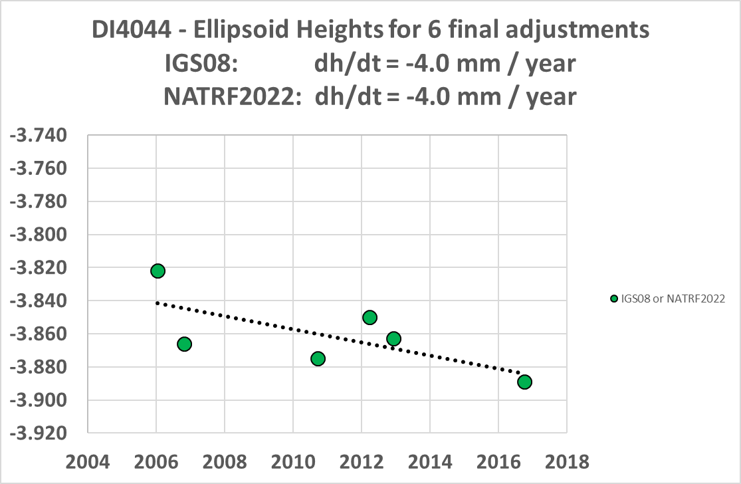
DI4044 – True Ellipsoid Height History

Slide 37
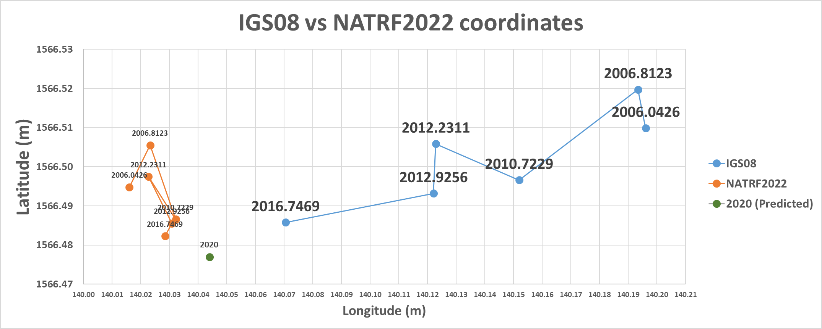
IGS08 vs NATRF2022
NATRF2022 coordinates will have the plate rotation removed, but still
exhibit their time-dependency, until
the Intra-frame velocity model is used to estimate a coordinate at an epoch of convenience.
IGS08 coordinates are dominated by the primary motion associated with the North American Plate rotation, as manifest at this lat/lon:
12.9 mm/y West
1.1 mm/y South

Slide 38
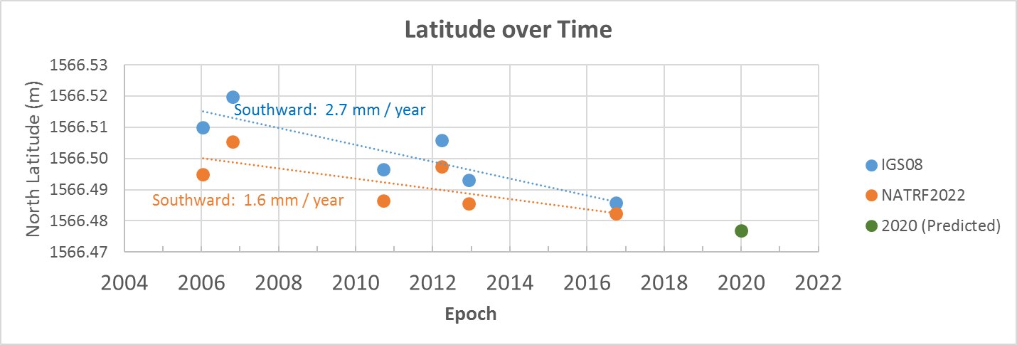
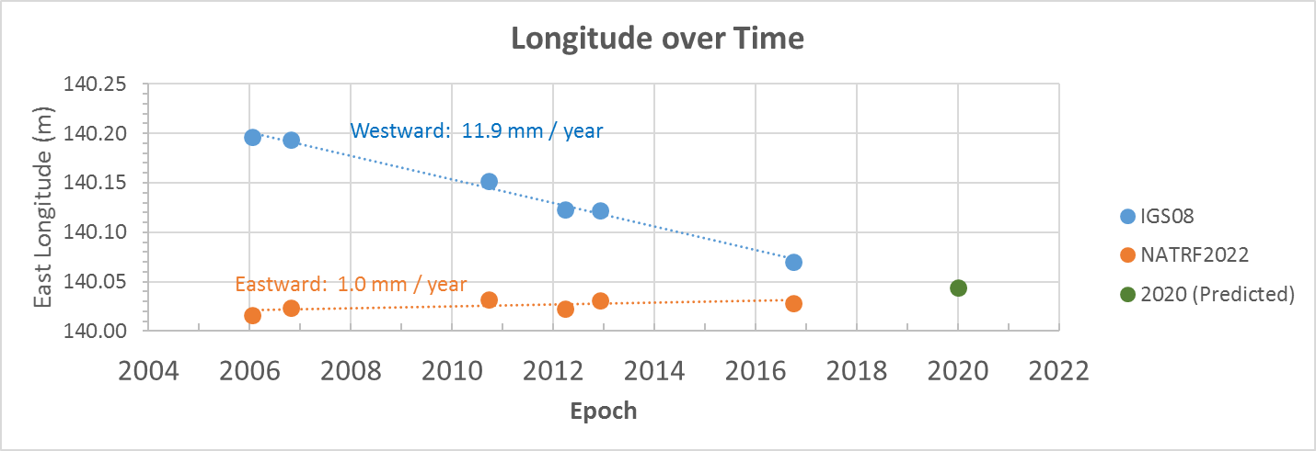
IFV implied by interpolating
from surrounding CORS:
Northward 0.4 mm / year:
Difference: 2.0mm/year
NA plate rotation:
South 1.1 mm/year
“Intra Frame Velocity”
IFV implied by interpolating
from surrounding CORS:
Eastward 0.3 mm / year
Difference: 0.7 mm / year
“Intra Frame Velocity”
NA plate rotation:
West 12.9 mm/year

