Slide 1
The impact of errors in Euler Pole parameters on TRF2022 coordinates
Dru Smith
NSRS Modernization Manager
NOAA’s National Geodetic Survey

Slide 2
National Spatial Reference System
The coordinate system for all federal civilian mapping in the USA
Includes:
North American Datum of 1983
Three frames, historically called “horizontal datums”

Slide 3
Replacing the NAD 83’s
The Old:
NAD 83(2011)
NAD 83(PA11)
NAD 83(MA11)
The New:
The North American Terrestrial Reference Frame of 2022
(NATRF2022)
The Caribbean Terrestrial Reference Frame of 2022
(CATRF2022)
The Pacific Terrestrial Reference Frame of 2022
(PATRF2022)
The Mariana Terrestrial Reference Frame of 2022
(MATRF2022)

Slide 4
TRF definitions
In the NSRS of 2022, four new terrestrial reference frames will be defined
Each named for a tectonic plate
Each related to the IGS frame through an Euler Pole matrix for that tectonic plate
$${\left[\begin{matrix}x_{NATRF2022} \\ y_{NATRF2022} \\ z_{NATRF2022}\end{matrix}\right]}_{t}{=M_{NA}^{−1}\left[\begin{matrix}X_{IGS} \\ Y_{IGS} \\ Z_{IGS}\end{matrix}\right]}_{t}$$
Euler
Pole
Matrix
for
N.A. plate
NATRF2022
coordinates
IGS
coordinates
(Similarly for Pacific, Caribbean and Mariana plates)

Slide 5
Errors in TRF coordinates
Previous slide defined TRF coordinates
Errors in TRF coordinates will come from four sources
Errors in the IGS coordinates themselves
Errors in the Euler Pole Parameters
Mathematical approximations in the Euler Pole matrix
Spherical approximations in the Euler Pole matrix
$${\left[\begin{matrix}x_{NATRF2022} \\ y_{NATRF2022} \\ z_{NATRF2022}\end{matrix}\right]}_{t}{=M_{NA}^{−1}\left[\begin{matrix}X_{IGS} \\ Y_{IGS} \\ Z_{IGS}\end{matrix}\right]}_{t}$$

Slide 6
Mathematical Approximations
(Euler Pole Parameters in RED)
$$M_{NA}^{−1}={\left[R_{1}\left(λ_{0_{NA}}\right)\right]}^{−1}{\left[R_{2}\left(θ_{0_{NA}}\right)\right]}^{−1}{\left[R_{3}\left(α_{NA}\right)\right]}^{−1}R_{2}\left(θ_{0_{NA}}\right)R_{1}\left(λ_{0_{NA}}\right)$$
Rotate Euler frame back to IGS frame
Rotate the point
about the Euler pole
Rotate IGS frame into
Euler frame
$$M^{−1}≈\tilde{R}=\left[\begin{matrix}1 & ω_{Z} & −ω_{Y} \\ −ω_{Z} & 1 & ω_{X} \\ ω_{Y} & {−ω}_{X} & 1\end{matrix}\right]$$
$$ω_{X}={\dot{ω}}_{0}Δtcosλ_{0}sinθ_{0}$$
$$ω_{Y}={\dot{ω}}_{0}Δtsinλ_{0}sinθ_{0}$$
$$ω_{Z}={\dot{ω}}_{0}Δtcosθ_{0}$$

Slide 7
Mathematical Approximation
$${\left[\begin{matrix}x \\ y \\ z\end{matrix}\right]}_{t}=M^{−1}{\left[\begin{matrix}X \\ Y \\ Z\end{matrix}\right]}_{t}$$
$${\left[\begin{matrix}x \\ y \\ z\end{matrix}\right]}_{t}≈\tilde{R}{\left[\begin{matrix}X \\ Y \\ Z\end{matrix}\right]}_{t}$$
vs
Plate | Years until $M^{−1}$ vs $\tilde{R}$ approximation exceeds 0.5 mm anywhere on that plate
N. American | ~ 3,860
Pacific | ~ 1,070
Caribbean | ~ 2,370
Mariana | ~ 520

Slide 8
Spherical Approximations
Euler’s theorem assumes lithospheric plates are “rigid”
But a rigid cap on an ellipsoidal surface can not rotate without deforming

Slide 9
Rigid Plate after
180 degrees
of rotation about
Euler Pole
B
A
Euler Pole
A
Original Rigid Plate
B
Notes:
Obviously, the plate takes millennia to rotate 180 degrees, but the lack of a common radius of curvature at different latitudes on the ellipsoid means that any plate which sits on the ellipsoid can not rotate even an infinitesimally small angle without deforming off of the ellipsoid. (The sole exception would be a plate whose Euler Pole just happened to be at the North or South poles, so that the rotation did not change the latitude of any point on the plate).

Slide 10
Spherical Approximations
Solutions being investigated:
Work in spherical and apply a correction to geodetic at the end
Commonly used, but does not address the rigidity question
Conservation of distance
Each point maintains a constant (geodesic) distance from the Euler Pole while remaining on the ellipsoid.
More complex, but more physically realistic.
In either case, the solution will not be a random error but will be a systematic formula applied to the problem

Slide 11
Errors in TRF coordinates
Errors in TRF coordinates will come from four sources
Errors in the IGS coordinates themselves
Errors in the Euler Pole Parameters
Mathematical approximations in the Euler Pole matrix
Spherical approximations in the Euler Pole matrix
Negligible
Solvable,
non-random

Slide 12
History versus Future
${\left[\begin{matrix}X_{NAD 83} \\ Y_{NAD 83} \\ Z_{NAD 83}\end{matrix}\right]}_{t_{0}}=f_{83/2008}\left({\left[\begin{matrix}X_{ITRF2008} \\ Y_{ITRF2008} \\ Z_{ITRF2008}\end{matrix}\right]}_{t}\right)$
Multiple 14 parameter transformations
connecting NAD 83 to ITRF2008
Although NGS uses 14 parameter transformations to
convert ITRF/IGS coordinates into NAD 83, the errors in those
transformations are not propagated into NAD 83 coordinates.
D $\left({\left[\begin{matrix}X_{NAD 83} \\ Y_{NAD 83} \\ Z_{NAD 83}\end{matrix}\right]}_{t_{0}}\right)≈\text{D}\left({\left[\begin{matrix}X_{ITRF2008} \\ Y_{ITRF2008} \\ Z_{ITRF2008}\end{matrix}\right]}_{t}\right)$
(Approximate because of different orientations of the frames)

Slide 13
Formal Error Propagation
In all NGS products and services, the TRF coordinates could have formal errors based on both
The formal errors of the IGS coordinates
The formal errors of the Euler Pole Parameters
$$D\left(\left[\begin{matrix}x_{t} \\ y_{t} \\ z_{t}\end{matrix}\right]\right)=JD\left(\left[\begin{matrix}\begin{matrix}X_{t} \\ Y_{t} \\ Z_{t}\end{matrix} \\ \begin{matrix}{\dot{ω}}_{X} \\ {\dot{ω}}_{Y} \\ {\dot{ω}}_{Z}\end{matrix}\end{matrix}\right]\right)J^{T}$$

Slide 14
Current EPP knowledge
The most recent estimates of Euler Pole parameters:
North America, Pacific, Caribbean
From ITRF2008
Mariana
From 2017 NGS study
What follows are some examples of formally propagating current levels of error in the Euler Pole Parameters to select points…

Slide 15
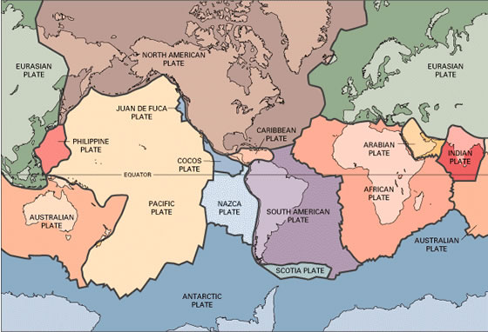
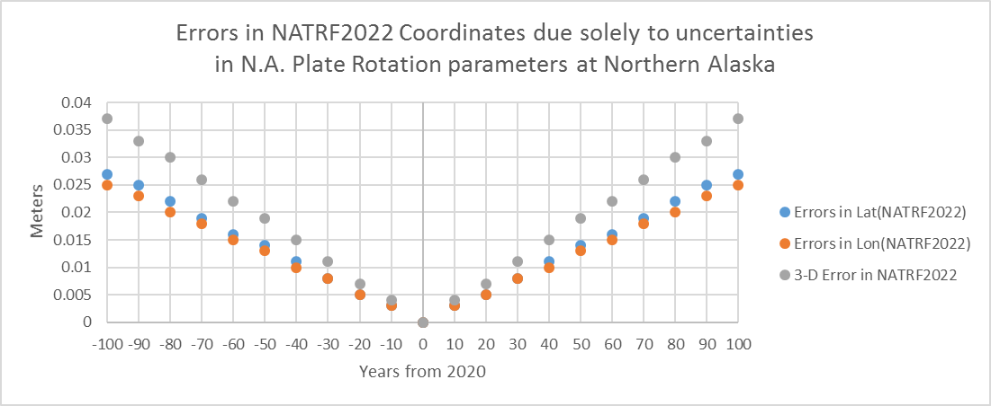
Example: North American Plate
2.10 ± 0.03 cm/y
+/- 27 years
1 cm

Slide 16
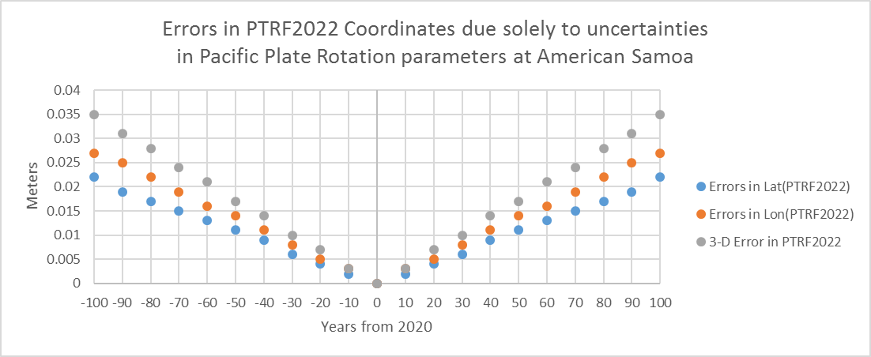
Example: Pacific Plate
7.10 cm/y ± 0.03 cm/y
+/- 30 years
1 cm

Slide 17
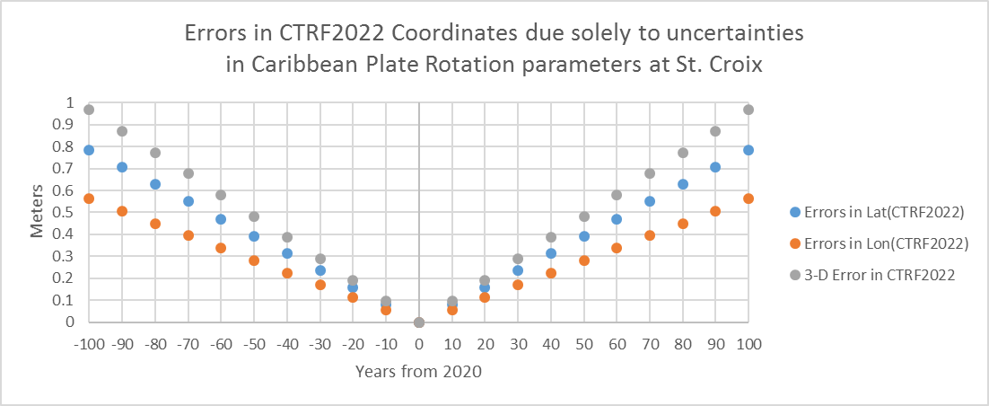
Example: Caribbean Plate
1.5cm/y ± 0.97 cm/y
+/- 1 years
1 cm

Slide 18
Conclusions
The “small angle” approximation holds for centuries and will be ignored
Spherical approximations can be controlled
TRF coordinates, defined as a function of both IGS coordinates and an adopted plate motion model, could have errors which reflect the errors of both, but…
Current best plate motion models will cause over one cm of error
in 30 years for NATRF2022 and PATRF2022
in 1 year for CATRF2022 and MATRF2022

Slide 19
The closing question…
$$ω_{X}={\dot{ω}}_{x}Δt$$
$$ω_{Y}={\dot{ω}}_{Y}Δt$$
$$ω_{Z}={\dot{ω}}_{Z}Δt$$
${{\left[\begin{matrix}x \\ y \\ z\end{matrix}\right]}_{t}=\left[\begin{matrix}1 & ω_{Z} & −ω_{Y} \\ −ω_{Z} & 1 & ω_{X} \\ ω_{Y} & {−ω}_{X} & 1\end{matrix}\right]\left[\begin{matrix}X \\ Y \\ Z\end{matrix}\right]}_{t}$
If this is true:
And these are true:
Then why shouldn’t
this be true also?
$D\left(\left[\begin{matrix}{\dot{ω}}_{X} \\ {\dot{ω}}_{Y} \\ {\dot{ω}}_{Z}\end{matrix}\right]\right)≠0$
$$D\left({\left[\begin{matrix}X \\ Y \\ Z\end{matrix}\right]}_{t}\right)≠0$$
$$D\left(\left[\begin{matrix}x_{t} \\ y_{t} \\ z_{t}\end{matrix}\right]\right)=JD\left(\left[\begin{matrix}\begin{matrix}X_{t} \\ Y_{t} \\ Z_{t}\end{matrix} \\ \begin{matrix}{\dot{ω}}_{X} \\ {\dot{ω}}_{Y} \\ {\dot{ω}}_{Z}\end{matrix}\end{matrix}\right]\right)J^{T}$$

Slide 20
Extra Slides

Slide 21
Velocities

Slide 22
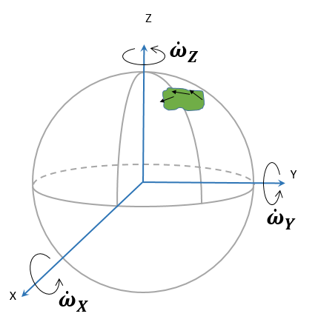
Defining a rotating plate
Most common method: Three small rotation rates about the three ITRF axes
${\dot{ω}}_{X}, {\dot{ω}}_{Y},$ ${\dot{ω}}_{Z}$
Order of rotations doesn’t matter
This method only works
if all three rotation rates are
small enough to invoke these
trig identities:
cos (${\dot{ω}}_{∗}×$ Δt) = 1
sin (${\dot{ω}}_{∗}×$ Δt) = ${\dot{ω}}_{∗}×$ Δt
Notes:
Potential outline and speaker assignments; can be adjusted as needed.

Slide 23
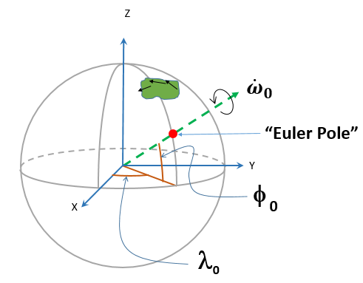
Defining a rotating plate
(Small) rotation rates can be easily related to three other parameters:
Latitude and longitude of the point about which the plate is rotating
The “Euler Pole”
$φ_{0}, λ_{0}$
Rotation rate about that pole
${\dot{ω}}_{0}$
Relationship
$λ_{0}=ArcTan\left[\frac{{\dot{ω}}_{Y}}{{\dot{ω}}_{X}}\right]$
$φ_{0}=ArcTan\left[\frac{\sqrt{\left({\dot{ω}}_{X}^{2}+{\dot{ω}}_{Y}^{2}\right)}}{{\dot{ω}}_{Z}}\right]$
${\dot{ω}}_{0}=\sqrt{{{\dot{ω}}_{X}^{2}+{\dot{ω}}_{Y}^{2}+\dot{ω}}_{Z}^{2}}$
Notes:
Potential outline and speaker assignments; can be adjusted as needed.

Slide 24
Errors in Plate Rotation Models
ITRF2008 values and uncertainties for the N.A. Plate:
In terms of the Euler Pole, these become:
Rotation | Value (mas/y) | Uncertainty (mas/y)
$${\dot{ω}}_{X}$$ | 0.035 | ±0.008
$${\dot{ω}}_{Y}$$ | -0.662 | ±0.009
$${\dot{ω}}_{Z}$$ | -0.100 | ±0.008
Parameter | Value | Uncertainty
$$φ_{0}$$ | -8.578° | ±0.686°
$$λ_{0}$$ | 273.026° | ±0.692°
$${\dot{ω}}_{0}$$ | 0.670 mas/y | ±0.009 mas/y

Slide 25
*TRF2022
NGS will define four terrestrial reference frames in 2022, one for each plate
NATRF2022 (North America)
CATRF2022 (Caribbean)
PATRF2022 (Pacific)
MATRF2022 (Mariana)

Slide 26
2.1cm/y
2.1cm/y
2.1cm/y
1.8cm/y
1.7cm/y
1.3cm/y
1.0cm/y

Slide 27
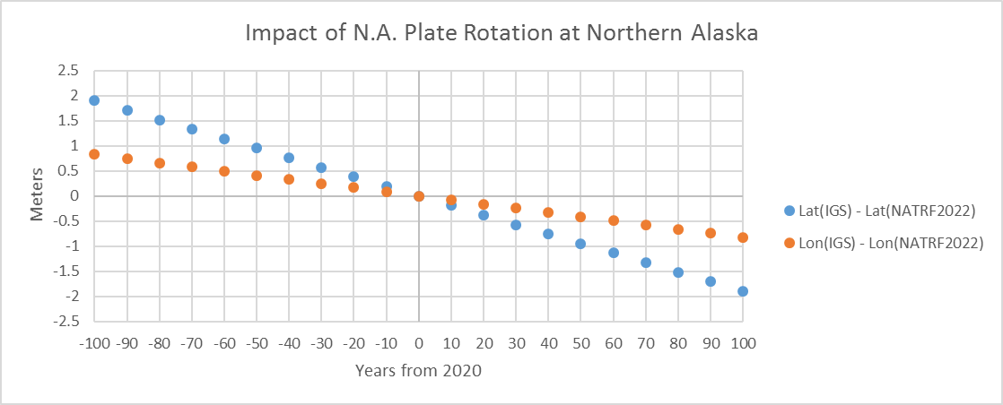
Example: North American Plate
2.1cm/y
Getting a lot less North every year…
Getting slightly less East every year…

Slide 28
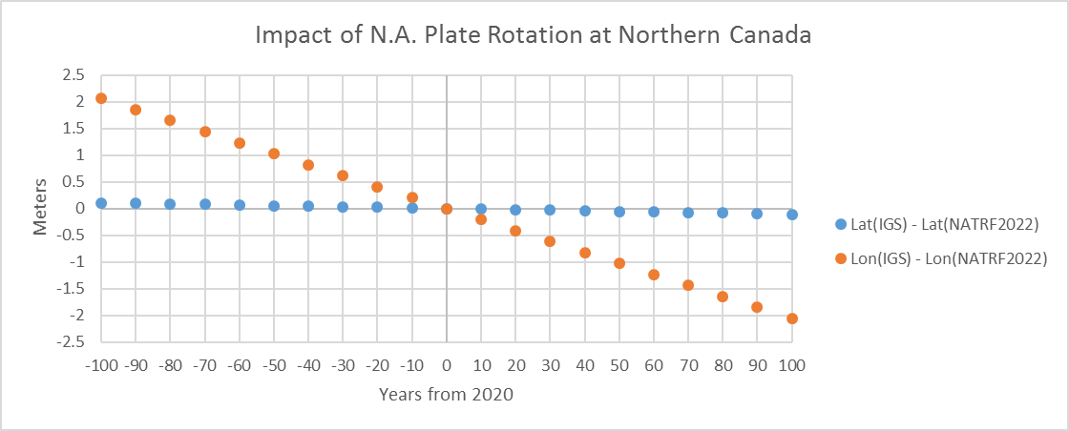
Example: North American Plate
2.1cm/y
Getting a lot less East every year…
Almost no change to North every year…

Slide 29
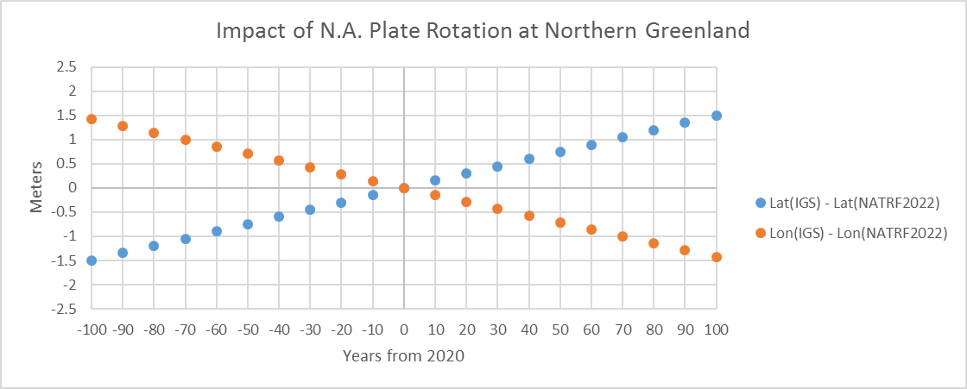
Example: North American Plate
2.1cm/y
Getting a lot less East every year…
Getting a lot more North every year…

Slide 30
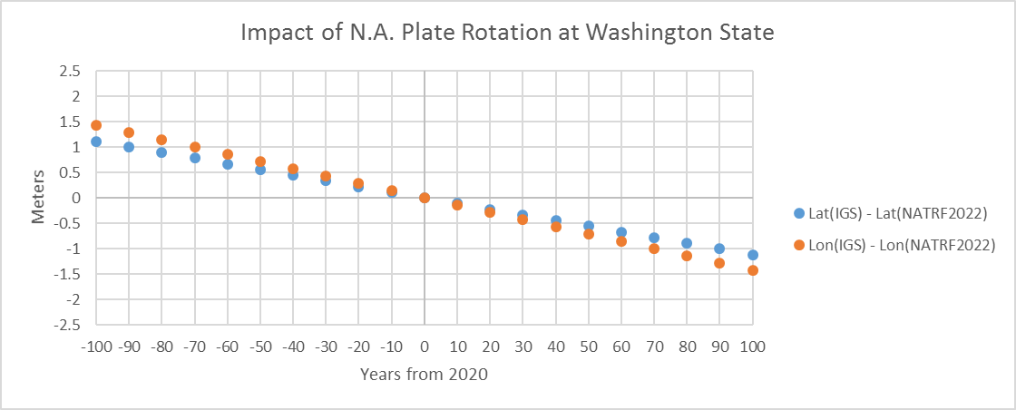
Example: North American Plate
1.8cm/y
Getting a bit less North and East every year…

Slide 31
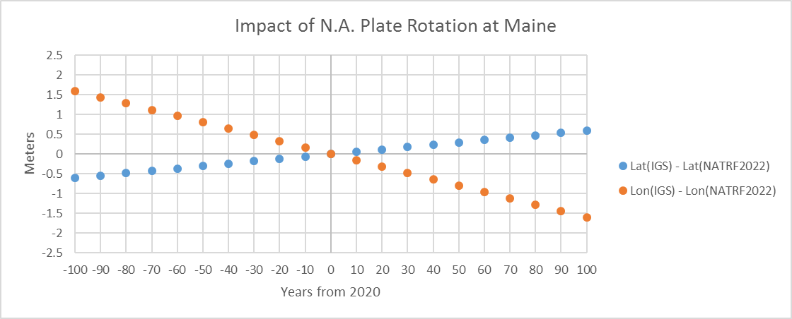
Example: North American Plate
1.7cm/y
Getting a lot less East every year…
Getting a bit more North every year…

Slide 32
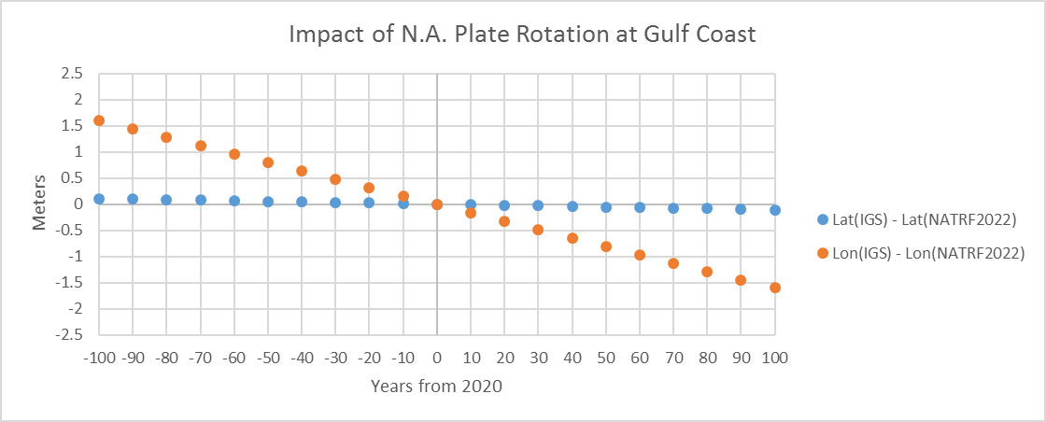
Example: North American Plate
1.3cm/y
Getting a lot less East every year…
Almost no change to North every year…

Slide 33
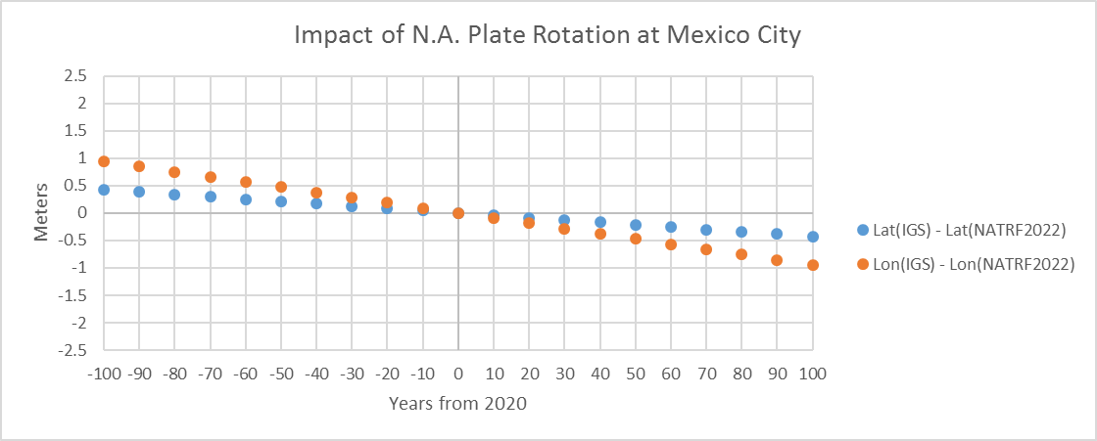
Example: North American Plate
1.0cm/y
Small change to North every year…
Even smaller change to East every year…

Slide 34
Example: North American Plate
The preceding slides showed the motions of the N.A. plate at various locations over a span of +/- 100 years.
Those movements will be seen in IGS coordinates, but removed from *TRF2022 coordinates
Largest movements: ~ 200 cm / 100 years
What is the impact of the errors in the plate motion model on *TRF2022 coordinates?

Slide 35
Example: North American Plate
2.1cm/y
+/- 27 years
1 cm

Slide 36
Example: North American Plate
Similar graphs can be made for each spot.
Turns out, there isn’t much difference from the fastest moving spots to the slowest…

Slide 37
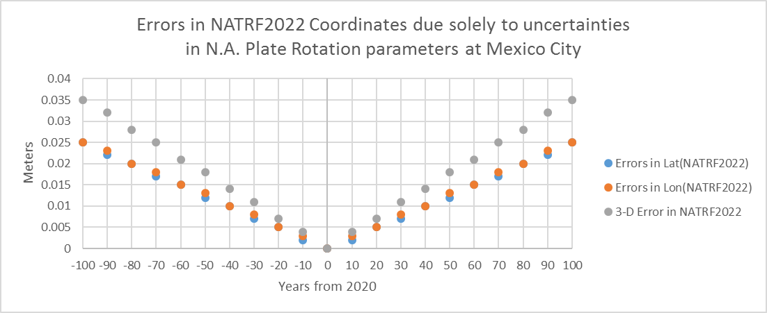
Example: North American Plate
1.0cm/y
+/- 30 years

Slide 38
Summary: North America
The mathematical relationship between IGS and the four TRF2022’s will be a 3-parameter plate rotation model
Current state-of-the-art estimates of the uncertainty in those 3 parameters for North America will yield 1 cm coordinate error within 3 decades
Over and above IGS coordinate error itself

Slide 39
The other 3 plates
Pacific
(ITRF2008)
Caribbean
(ITRF2008)
Mariana
(Snay 2003, ITRF2000)
Rot. | Value (mas/y) | Uncertainty (mas/y)
$${\dot{ω}}_{X}$$ | -0.411 | ±0.007
$${\dot{ω}}_{Y}$$ | 1.036 | ±0.007
$${\dot{ω}}_{Z}$$ | -2.166 | ±0.009
Par. | Value | Uncertainty
$$φ_{0}$$ | -62.771° | ±0.176°
$$λ_{0}$$ | 111.639° | ±0.360°
$${\dot{ω}}_{0}$$ | 2.436 | ±0.009 mas/y
Rot. | Value (mas/y) | Uncertainty (mas/y)
$${\dot{ω}}_{X}$$ | 0.049 | ±0.201
$${\dot{ω}}_{Y}$$ | -1.088 | ±0.417
$${\dot{ω}}_{Z}$$ | 0.664 | ±0.146
Par. | Value | Uncertainty
$$φ_{0}$$ | 31.370° | ±11.237°
$$λ_{0}$$ | 272.579° | ±10.610°
$${\dot{ω}}_{0}$$ | 1.276 | ±0.364 mas/y
Rot. | Value (mas/y) | Uncertainty (mas/y)
$${\dot{ω}}_{X}$$ | -0.020 | Not given
$${\dot{ω}}_{Y}$$ | 0.105 | Not given
$${\dot{ω}}_{Z}$$ | -0.347 | Not given
Par. | Value | Uncertainty
$$φ_{0}$$ | -72.879° | Can’t be computed
$$λ_{0}$$ | 100.784° | Can’t be computed
$${\dot{ω}}_{0}$$ | 0.363 | Can’t be computed

Slide 40
Example: Pacific Plate
7.1cm/y
7.1cm/y

Slide 41
Pacific Plate
Despite moving 3.5 times as fast as the North American Plate, its parameters are almost exactly as well determined.
+/- 30 years

Slide 42
Example: Caribbean Plate
1.5cm/y

Slide 43
Caribbean Plate
Despite moving as slowly as parts of the N.A. plate, its rotation is poorly known. Over 1 cm of error builds up in only 1 year.
+/- 1 years

