Slide 1
The modernized National Spatial Reference System

Slide 2
Note to international attendees
Much of this talk is relevant to surveying in the United States, but…
There are certainly many aspects to our modernization efforts relevant to any national reference system
Many of the tools NGS is building can be used by anyone, anywhere.
Notes:
So I hope everyone finds something relevant and useful herein

Slide 3
Outline
Why is NGS modernizing the NSRS?
What changes are coming?
How this will impact you
How to prepare
Tools and transformations
Current status

Slide 4
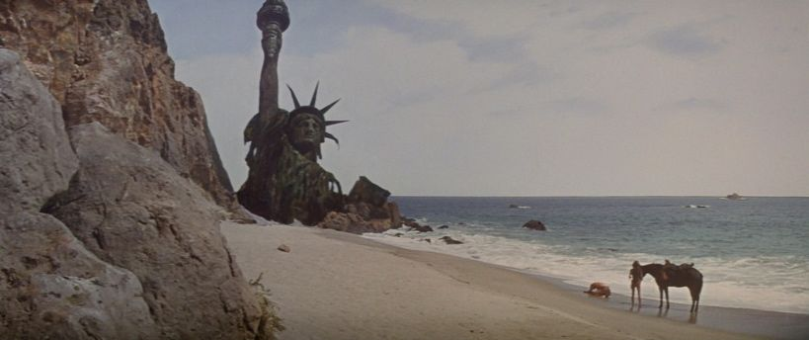
Notes:
It is possible that you view the future with slightly less enthusiasm than we do at NGS….

Slide 5
Notes:
It is our hope that this talk can help alleviate some of that anxiety…so let’s look at the topics we’ll be covering.

Slide 6
Decision to modernize
In 2007, NGS publicly announced their decision to completely change how it approached its mission.
In a word, they chose to modernize the NSRS
Let’s look at the issues that drove that decision, and the direction they decided to go

Slide 7
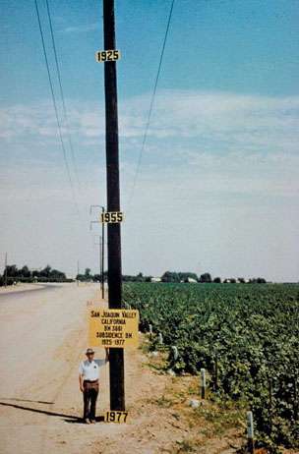
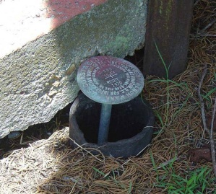
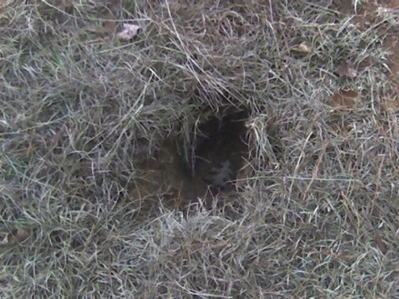
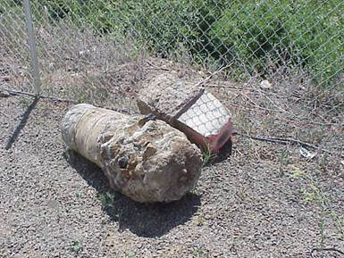
Issues
NAVD 88 suffers from use of infrequently surveyed geodetic control marks that:
Are almost never re-checked for movement
Disappear by the thousands every year
Are not funded for replacement
Are not necessarily in convenient places
Don’t exist in most of Alaska
Weren’t adopted in Canada
Were part of a level network constrained to a single point, allowing cross-country error build up
PID: EZ0840

Slide 8
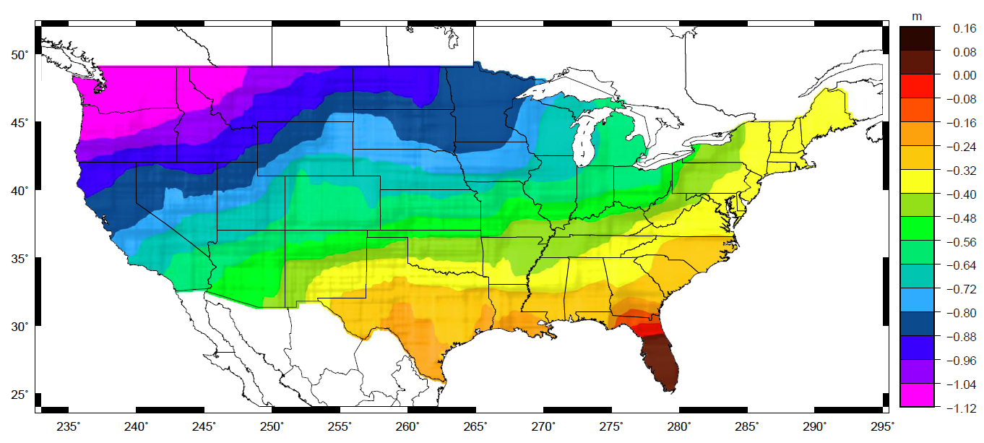
Issues
NAVD 88 suffers from a known bias (50 cm) and tilt (about 1 meter across CONUS)
Approximate level of geoid mismatch known to exist in the NAVD 88 zero surface:
PID: EZ0840

Slide 9
Issues
NAD 83 suffers from a 2+ meter non-geocentricity (which misaligns it with ITRF and all GNSS orbits)
Earth’s Surface
h_{ITRF}
h_{NAD83}
ITRF origin
~2.24 m
NAD 83 origin

Slide 10
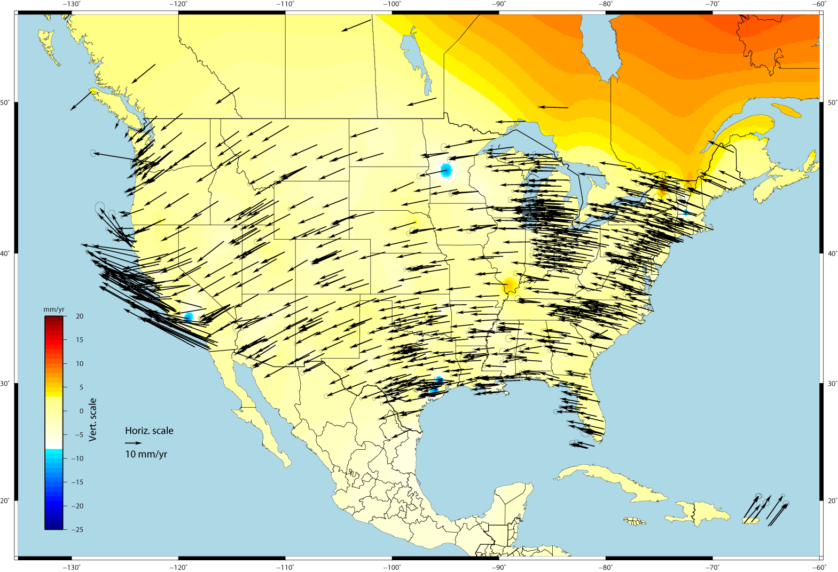
Issues
Geodetic control is usually affixed to a crust that is moving
Even so-called “plate fixed” frames are only as stable as:
The rigidity of a plate
The complete lack of subsidence or uplift

Slide 11
General Direction
Future details would come, but in 2007 the general direction was:
Replace both NAD 83 and NAVD 88, at the same time
Transition to a geoid-based vertical datum
Leverage the rise of GNSS and RTNs

Slide 12
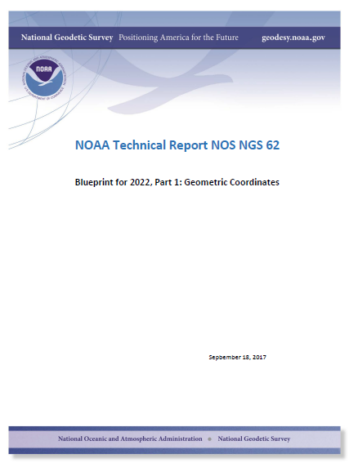
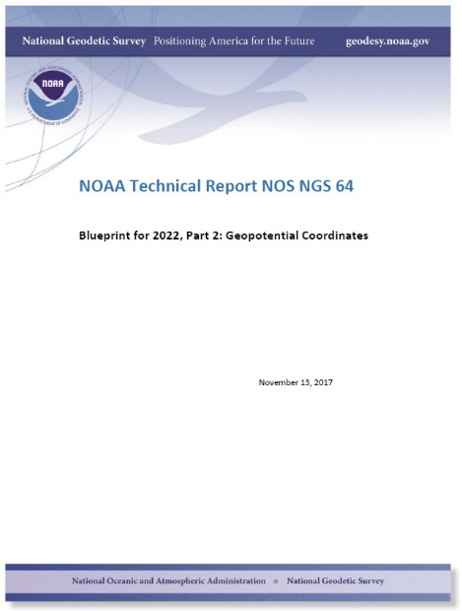
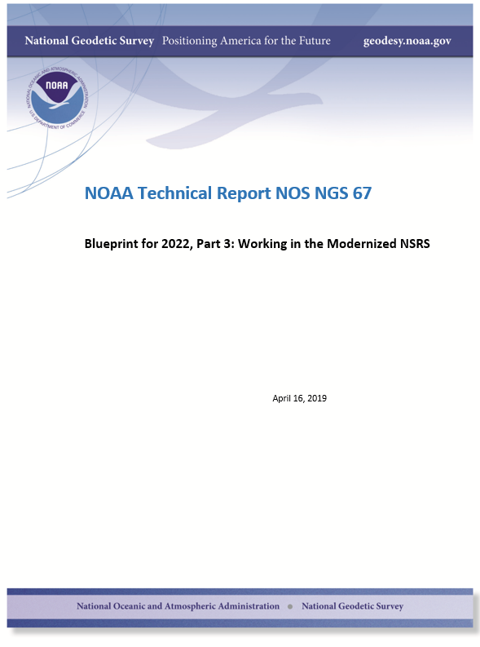
Modernizing the NSRS
The “blueprint” documents: Your best source for information
Geometric:
Sep 2017
NOAA TR NOS NGS 62
32 pages
Geopotential:
Nov 2017
NOAA TR NOS NGS 64
41 pages
Working in the
modernized NSRS:
April 2019
NOAA TR NOS NGS 67
77 pages

Slide 13
Replacing the NAD 83’s
The Old:
NAD 83(2011)
NAD 83(PA11)
NAD 83(MA11)
The New:
The North American Terrestrial Reference Frame of 2022
(NATRF2022)
The Caribbean Terrestrial Reference Frame of 2022
(CATRF2022)
The Pacific Terrestrial Reference Frame of 2022
(PATRF2022)
The Mariana Terrestrial Reference Frame of 2022
(MATRF2022)

Slide 14
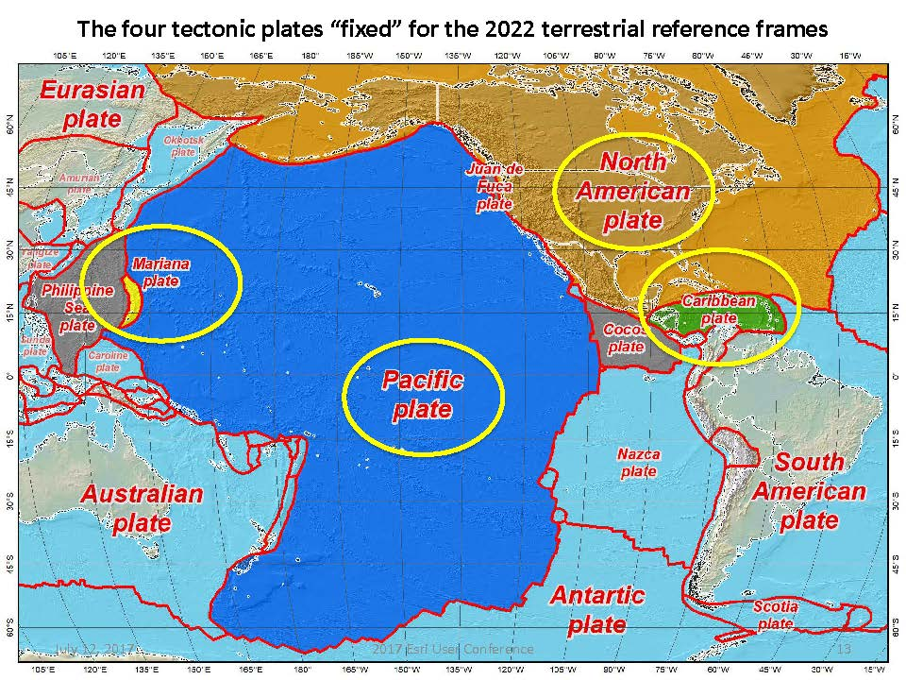
Notes:
-there’s four reference frames because there are four major tectonic plates within the NGS Area of Responsibility.
-As the National Geodetic Survey, we’re part of the DoC so we must cater to all US States and Territories
-thus we’ve got four tectonic plates in our Area of Operations, so four Ref Frames
-But…

Slide 15
The TRFs
All are global frames (no “boundary”)
This was true for the NAD 83’s also, BTW
But each frame will rotate with one tectonic plate
Put another way: “The frame rotates so your coordinates don’t have to”

Slide 16
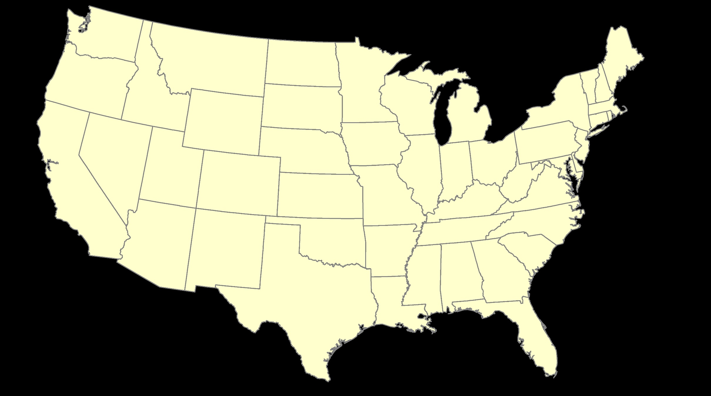
ITRF2020 – constant frame, rotating plate

Slide 17
“Plate-Fixed”
NATRF2022 – rotating frame, constant with plate

Slide 18
ITRF2020 or NATRF2022 – your choice, just use EPP2022

Slide 19
Shift and Drift
When transitioning off of NAD 83, your coordinates will experience shift and drift
Shift: A one-time jump somewhere in the 0 to 4 meter range (latitude, longitude, ellipsoid height)
From fixing NAD 83’s non-geocentricity
Drift: Coordinates are now time-dependent. The shift will take you to 2020.00. Working at any other epoch means you must account for the drift (velocity) of your coordinates
As well as any other motions over time

Slide 20
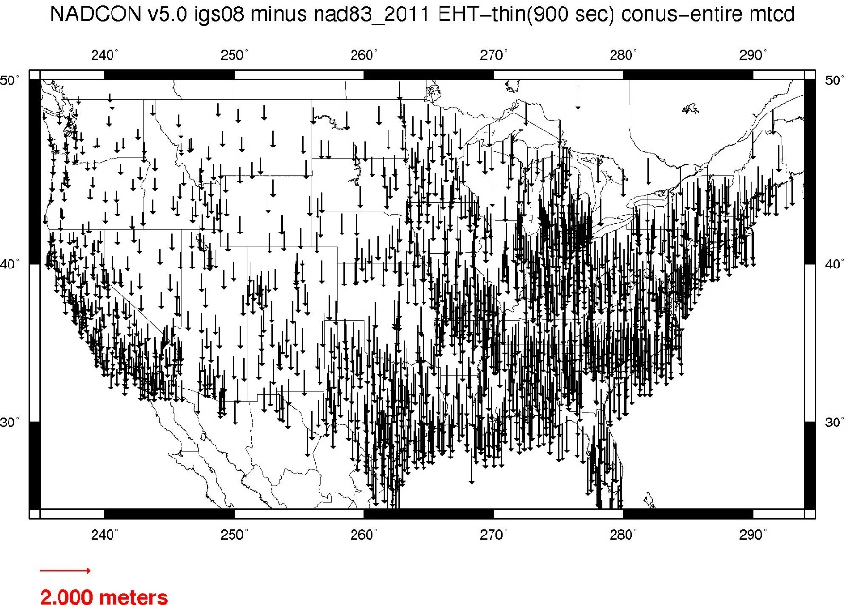
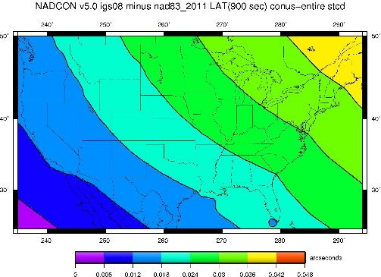
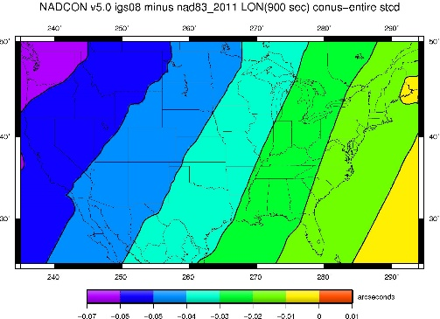
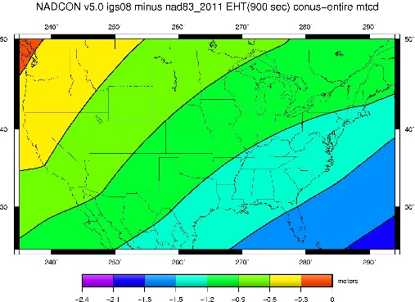
NAD 83(2011) epoch 2010.0 to NATRF2022 epoch 2020.00 (estimate)

Slide 21
Drift
What does it mean to provide time-dependent coordinates in 5 frames?
Let’s look at the known velocities of an active control station in ITRF2020, NATRF2022, PATRF2022, CATRF2022 and MATRF2022

Slide 22
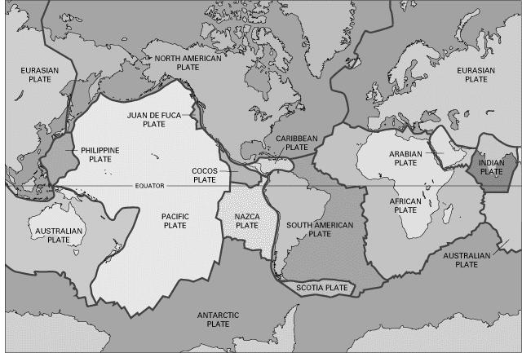
BSMK (North Dakota)

Slide 23
BSMK (North Dakota)
t₀=2020.0, when all five frames are identical
Note the time-dependent coordinate in latitude in NATRF2022 is stable! That means the NATRF2022 IFVM for latitude will be ZERO for this point.
Notes:
* Intra-Frame Velocity Model: More on this later, but it is basically “all of the movement that is left over at a point after I take away the simple tectonic rotation of a plate”

Slide 24
BSMK (North Dakota)
Similarly, the time-dependent coordinate in longitude in NATRF2022 is stable! That means the NATRF2022 IFVM for longitude will be ZERO for this point.

Slide 25
BSMK (North Dakota)
However, in every frame, this point is subsiding! That will be captured in the ellipsoid height component of the IFVM for each frame.

Slide 26
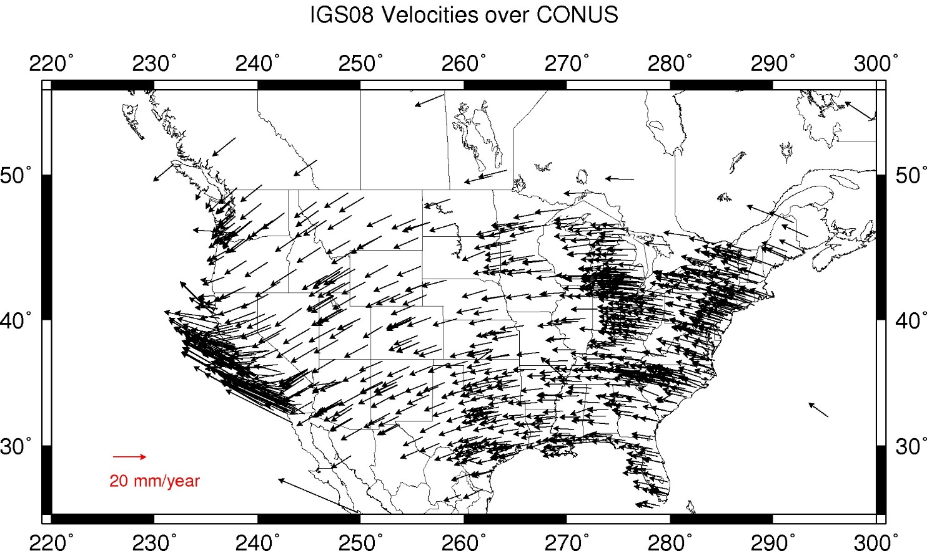
IFVM2022 Velocities – ITRF2020/CONUS

Slide 27
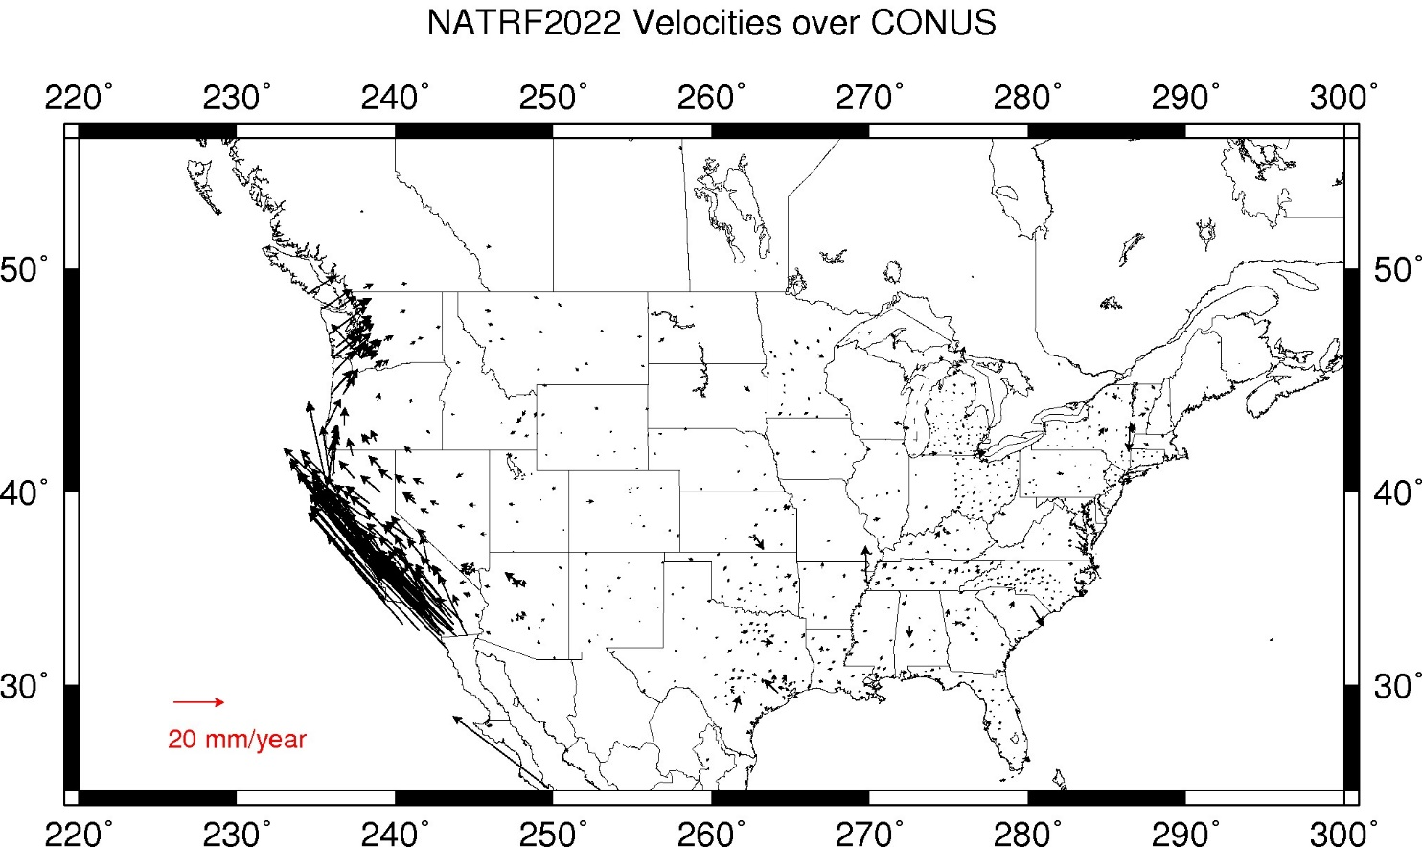
IFVM2022 Velocities – NATRF2022/CONUS
Notes:
Note that even in “stable North America”, these velocities are not absolutely zero! The IFVM2022 model will contain these tiny deviations from simple plate rotation!

Slide 28
Replacing NAVD 88
The Old:
NAVD 88
PRVD 02
VIVD09
ASVD02
NMVD03
GUVD04
IGLD 85
IGSN71
GEOID12B
DEFLEC12B
Orthometric
Heights
The New:
The North American-Pacific Geopotential Datum of 2022 (NAPGD2022)
- Will include GEOID2022
Normal
Orthometric
Heights
Dynamic
Heights
Gravity
Geoid
Undulations
Deflections of
the Vertical

Slide 29
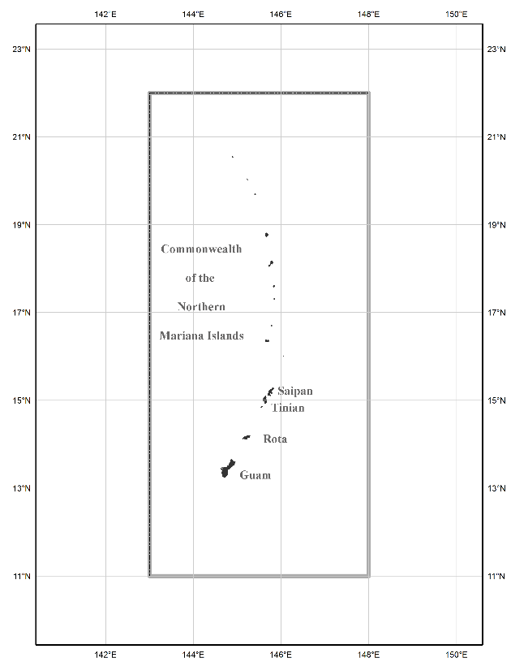
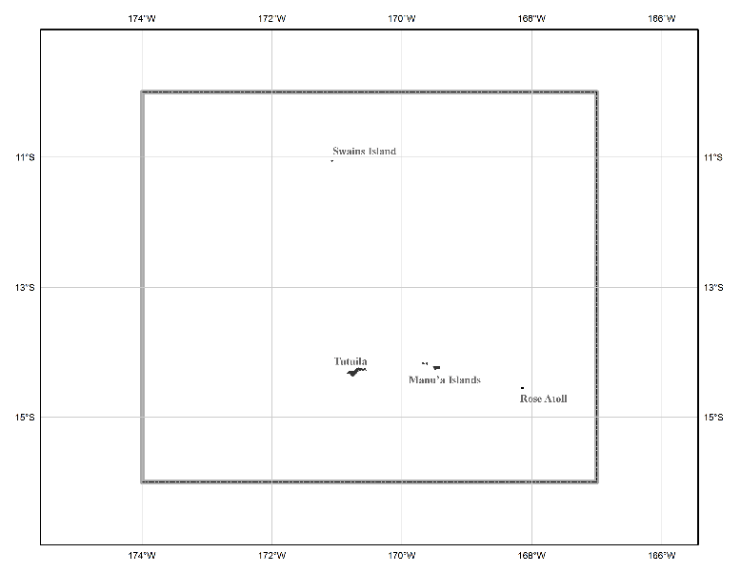
The three gridded regions
“North American region”
¼ of the Earth
“American Samoa region”
“Guam/CNMI region”

Slide 30
Shift and Drift
When transitioning off of NAVD 88 or other vertical datum, your coordinates will experience shift and drift
Shift: A one-time jump somewhere in the 0 to 2 meter range (orthometric height)
From fixing biases and/or tilts in NAVD 88 and others
Drift: Coordinates are now time-dependent. The shift will take you to 2020.00. Working at any other epoch means you must account for the drift (velocity) of your coordinates
As well as any other motions over time

Slide 31
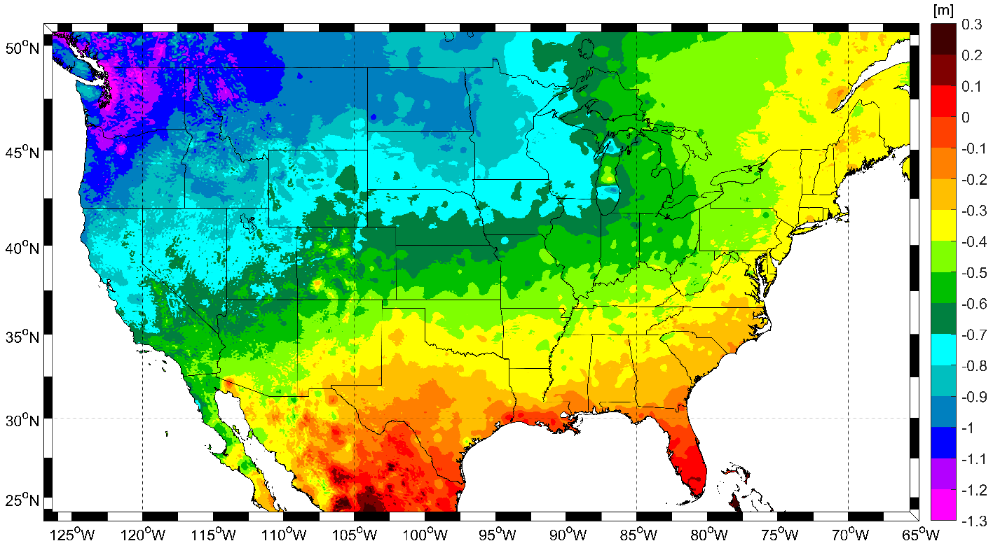
NAVD 88 (epoch ?) to NAPGD2022 epoch 2020.00 (estimate)

Slide 32
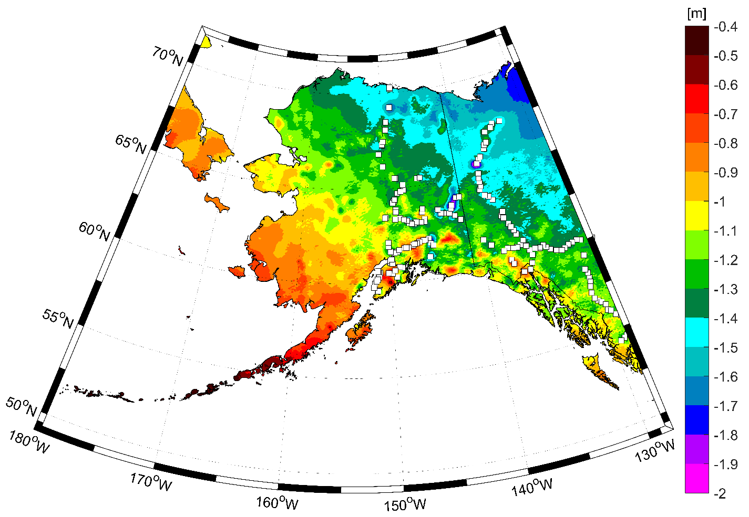
NAVD 88 (epoch ?) to NAPGD2022 epoch 2020.00 (estimate)

Slide 33
Definitional Relationship
$${H(t)}_{NAPGD2022}≡{h(t)}_{ITRF2020}−{N\left(t\right)}_{GEOID2022 }$$
We end with orthometric height in NAPGD2022 at the same epoch as the ellipsoid height.
All work is done in ITRF2020 XYZ coordinates first.
Conversion to orthometric heights is definitional through GEOID2022.

Slide 34
Impacts
All existing data will need to be transformed
NGS’s default NADCON transformations will be:
Expect 0.5-4.0 meters of shift in φ, λ, h
Region | From | To
CONUS | NAD 83(2011) epoch 2010.00 | NATRF2022 epoch 2020.00
Alaska | NAD 83(2011) epoch 2010.00 | NATRF2022 epoch 2020.00
Hawaii | NAD 83(PA11) epoch 2010.00 | PATRF2022 epoch 2020.00
PR / VI | NAD 83(2011) epoch 2010.00 | CATRF2022 epoch 2020.00
American Samoa | NAD 83(PA11) epoch 2010.00 | PATRF2022 epoch 2020.00
Guam / CNMI | NAD 83(MA11) epoch 2010.00 | MATRF2022 epoch 2020.00

Slide 35
Impacts
All existing data will need to be transformed
NGS’s default VERTCON transformations will be:
Expect 0.5-2.0 meters of shift in H
Region | From | To
CONUS | NAVD 88 | NAPGD2022 epoch 2020.00
Alaska | NAVD 88 | NAPGD2022 epoch 2020.00
PR | PRVD 02 | NAPGD2022 epoch 2020.00
VI | VIVD 09 | NAPGD2022 epoch 2020.00
Guam | GUVD 04 | NAPGD2022 epoch 2020.00
CNMI | NMVD 03 | NAPGD2022 epoch 2020.00

Slide 36
Impacts
Future NGS tools (OPUS) will yield:
All 5 frames (ITRF2020, NATRF2022, PATRF2022, CATRF2022, MATRF2022)
At various epochs:
Your mean survey epoch
The most recent “Reference Epoch” (5 year intervals, starting with 2020.00)
You can choose to adjust your data to any epoch

Slide 37
Impacts – Many things will be similar to today
If today you… | Then in the future you will…
Use OPUS-S | Use OPUS
Use OPUS-Projects | Use OPUS
Adjust projects to NAD 83(2011) epoch 2010.0 | Adjust projects to *ATRF2022 epoch 2020.00
Work in the ITRF | Work in the ITRF

Slide 38
Impacts – And many new services will be added
If today you… | Then in the future you will…
Use GNSS but can’t use OPUS | Use OPUS
Use Leveling but can’t use OPUS-Projects | Use OPUS
Pull datasheets from the NGS IDB | Use the data delivery system to see full coordinate history of a mark

Slide 39
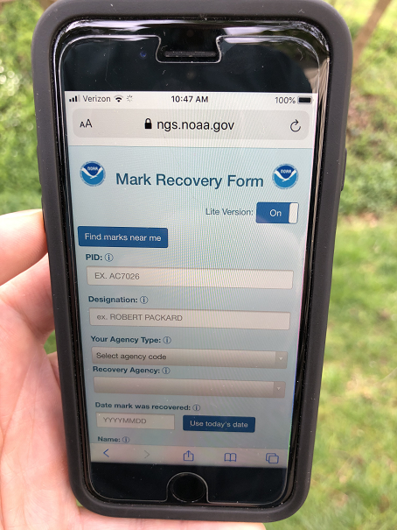
Get prepared…
NGS has a new mobile-friendly mark recovery webpage. Please try it out!
https://www.ngs.noaa.gov/cgi-bin/mark_recovery_form.prl

Slide 40
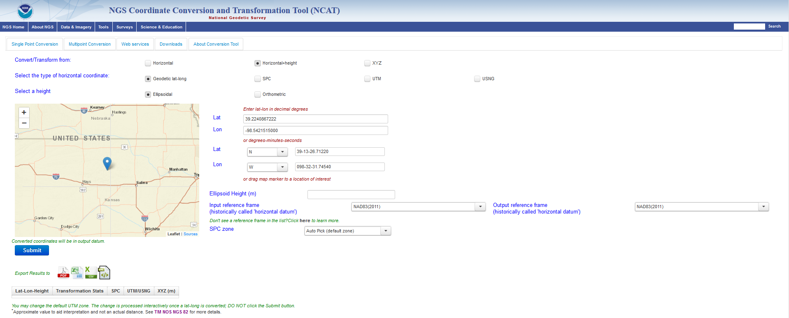
Get prepared…
Check out NCAT (now with NADCON and VERTCON!)
https://www.ngs.noaa.gov/NCAT/

Slide 41
Ways to use NCAT
Browser: Interactive, 1 point at a time
Browser: Upload a file / get a file back (text, xlsx)
As a Web Service
Download and run locally
Beware: this works, but NCAT is updated frequently, so the copy you have may be outdated, so always download the latest version

Slide 42
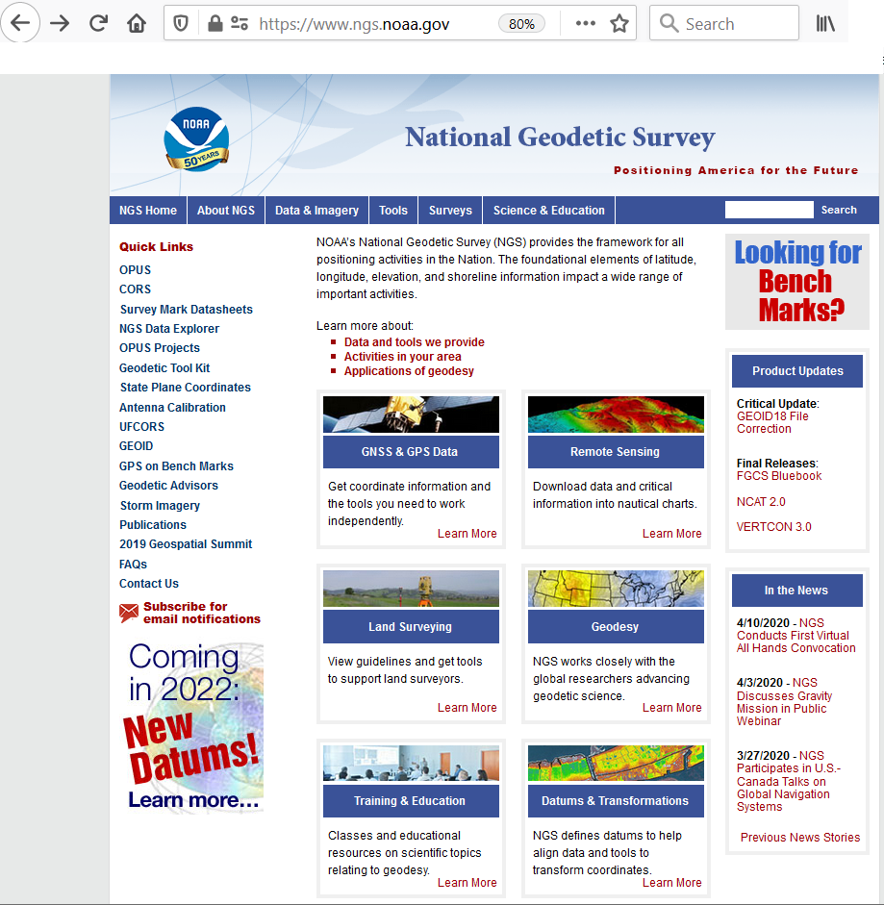
Get prepared…
Check out NGS’s website
www.ngs.noaa.gov

Slide 43
Status
Numerous issues have strained NGS resources recently
Staffing issues
Current events
The likelihood of completing the modernization by the end of 2022 is growing vanishingly small
An official delay message will be released in a few months

Slide 44
Status
But still good works are happening:
The SPCS is on track to be designed by 2022
RTK/N support in OPUS-Projects by end of 2020
GRAV-D is over 80% done
A complete overhaul of the NOAA CORS Network is underway
Evaluating all SOPs
Grading of stations for data quality/availability

Slide 45
Summary
The NSRS of today is based on
pre-space-age geodetic technology
The concept of one unique coordinate assigned to a point, in perpetuity
The modernized NSRS will
Leverage GNSS
Embrace the movements of points on Earth’s crust

Slide 46
Summary
All of your geometric coordinates will change by 2-4 meters
All of your orthometric heights will change by 2 meters (or more)
And that just gets you to a “reference epoch”
Which looks like it supports the “one coordinate forever” myth
After that, real motions kick in and become part of the world of geodetic control

Slide 47
Summary
But it’s not all “change”…
You will still be able to:
Get a position using OPUS
Adjust your projects to some reference epoch
Look at a mark’s “datasheet”
Only now, there will be a lot more information and a lot more service provided

Slide 48
Thank you

Slide 49
Questions?

Slide 50
The preeminence of ITRF
Rotation of the
North American Plate
The North American Terrestrial Reference Frame of 2022
(NATRF2022)
The Caribbean Terrestrial Reference Frame of 2022
(CATRF2022)
The Pacific Terrestrial Reference Frame of 2022
(PATRF2022)
The Mariana Terrestrial Reference Frame of 2022
(MATRF2022)
Rotation of the
Caribbean Plate
ITRF2020
Rotation of the
Pacific Plate
Rotation of the
Mariana Plate
EPP2022
EPP for “Euler Pole Parameters”
(a way of describing a plate’s rotation)

Slide 51
Definitional Relationship
$${\left[\begin{matrix}X(t) \\ Y(t) \\ Z(t)\end{matrix}\right]}_{NATRF2022}={R(t,t_{0})}_{N,I}{\left[\begin{matrix}X(t) \\ Y(t) \\ Z(t)\end{matrix}\right]}_{ITRF2020}$$
OPUS does everything
in ITRF2020 XYZ…
A simple 3x3 matrix from
EPP2022 (built into OPUS)…
And OPUS gives you coordinates in NATRF2022. Same epoch as ITRF2020.
Same goes for the other 3 frames.

