Slide 1

It’s 2022…are you done yet?
Dru Smith
NSRS Modernization Manager
NOAA’s National Geodetic Survey

Slide 2
No

Slide 3
Questions?

Slide 4
Just kidding

Slide 5
Outline
Why this title?
Brief overview
  New Reference Frames / Datum
  New Types of Coordinates
  OPUS 6
Recent progress
Re-prioritization: a “data first” approach
Timeline

Slide 6
Why this title?

Slide 7
Modernized NSRS and “2022”
Intent: release the modernized NSRS in 2022
Years ago, many yet-to-be-built components were given “2022” in their names:
  GEOID2022, NATRF2022, NAPGD2022, etc.
“We are delayed” – announcement in June 2020
To avoid confusion with long-standing communications, NGS chose to leave “2022” in the names
When will we be done? Answer: at the end of the webinar.

Slide 8
Brief overview
Notes:
NGS has been talking about the modernized NSRS for years. This overview is brief, assuming attendees are familiar with most aspects of it already.

Slide 9

























Federal Users of the NSRS
Notes:
Many of these users also sit on the Federal Geodetic Control Subcommittee, so there is a feedback loop between the providers of geodetic control (NGS) and the users of that control.

Slide 10
Brief overview:
New Reference Frames / Datum

Slide 11
Replacing NAD 83
The Old:
NAD 83(2011)
NAD 83(PA11)
NAD 83(MA11)
The New:
The North American Terrestrial Reference Frame of 2022
(NATRF2022)
The Caribbean Terrestrial Reference Frame of 2022
(CATRF2022)
The Pacific Terrestrial Reference Frame of 2022
(PATRF2022)
The Mariana Terrestrial Reference Frame of 2022
(MATRF2022)

Slide 12
Replacing NAVD 88
  The Old:
  NAVD 88
  PRVD 02
  VIVD09
  ASVD02
  NMVD03
  GUVD04
  IGLD 85
  IGSN71
  GEOID12B
  DEFLEC12B
  The New:
  The North American-Pacific Geopotential Datum of 2022 (NAPGD2022)
  Will include:
  GEOID2022
  DEFLEC2022
  GRAV2022
  DEM2022
  More
Orthometric
Heights
Normal
Orthometric
Heights
A HUGE component of this
effort is GRAV-D:
Gravity for the Redefinition of
the American Vertical Datum
Dynamic
Heights
Gravity
Geoid
Undulations
Deflections of
the Vertical

Slide 13
Brief overview:
New Types of Coordinates

Slide 14
A two-track approach to coordinates
Reference Epoch Coordinates
Survey Epoch Coordinates
An estimated “snapshot” of entire network
Every 5 or 10 years
Similar to NAD 83(2011) epoch 2010.00
Time-dependent!
Reflects coordinates at time of observation
Multiple SECs can show changes over time

Slide 15
Brief overview:
Re-inventing “Bluebooking” or
The Modernized OPUS
AKA
“OPUS 6”

Slide 16
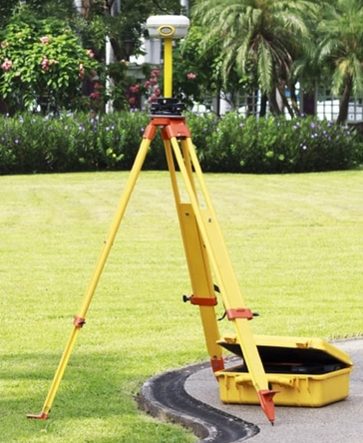
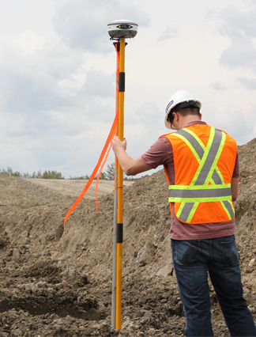
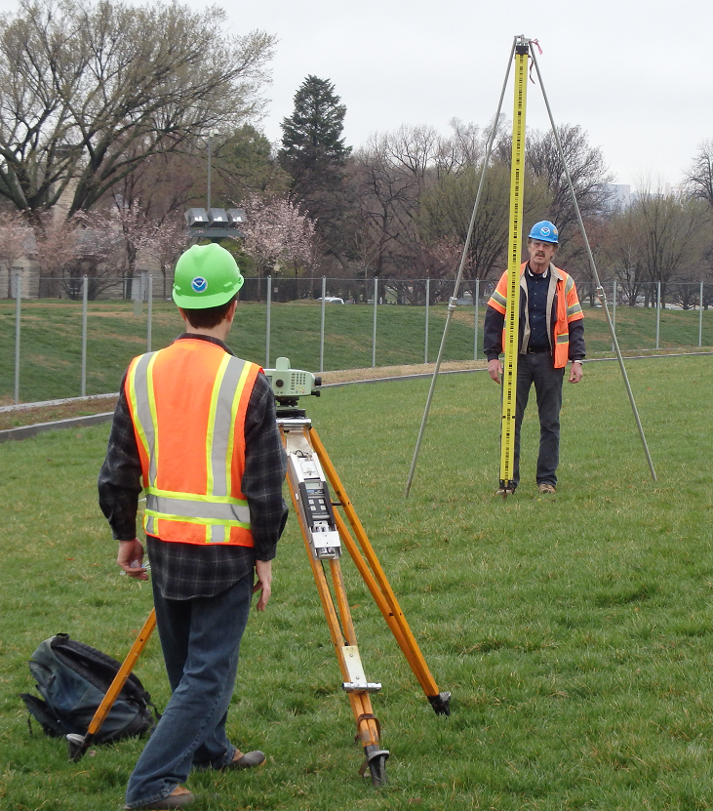
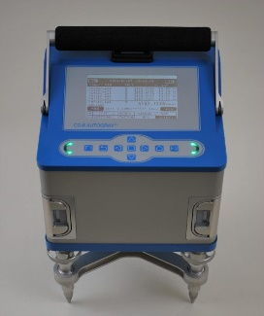
Static GNSS
RTK/RTN
Classical
Leveling
Rel. Gravity
RINEX
GVX
CVX
LVX
RGX
RINEX
GVX
CVX
LVX
RGX
RINEX
GVX
CVX
LVX
RGX
RINEX
GVX
CVX
LVX
RGX
Upload multiple types of data and multiple files into a single survey project
Process RINEX into a position (like today’s OPUS-S)
Process RINEX into mark-to-mark vectors
Process Classical into mark-to-mark angles/distances
Process Leveling into mark-to-mark ortho. differences
Process Rel. Gravity into mark gravity
Combine GNSS, RTK/N, Classical in a Geometric Adjustment
Combine Classical and Leveling in an Orthometric Adj.
Adjust Relative Gravity for either gravity or vertical gradients in a Gravimetric Adjustment
Special settings for “Calibration Base Lines”
Choose your epoch and frame
All coordinates returned are “OPUS Coordinates”
Submit your data to NGS for QA/QC, database loading, and improvement of future passive mark coordinates (RECs and SECs)
OPUS 6
Notes:
OPUS 6 will allow you to upload multiple types of data, and multiple files for each type, to a single survey project. You can then process/reduce the data, and adjust it.
The colors imply how finished each format is. RINEX is well established, GVX was released in 2021 but requires an update, likely in 2022 in a joint roll-out with CVX and LVX. RGX has not been substantially fleshed out yet.

Slide 17
Recent Progress

Slide 18
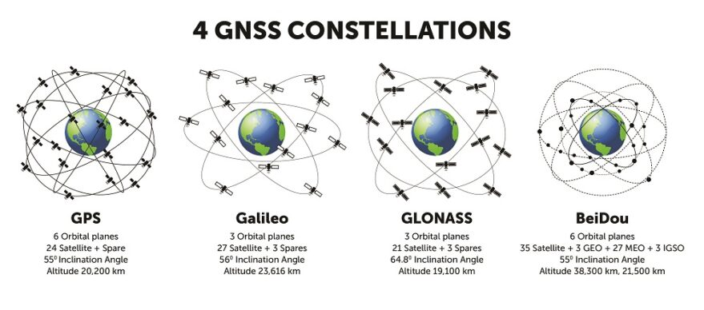
Progress in the last year: Frames
A rotation model for the Mariana plate released
  Uses all available active & passive control data
  Relative to ITRF2014
    Will need to be updated to ITRF2020 to define MATRF2022
M-PAGES can now process data from all existing constellations
  Still under development

Slide 19
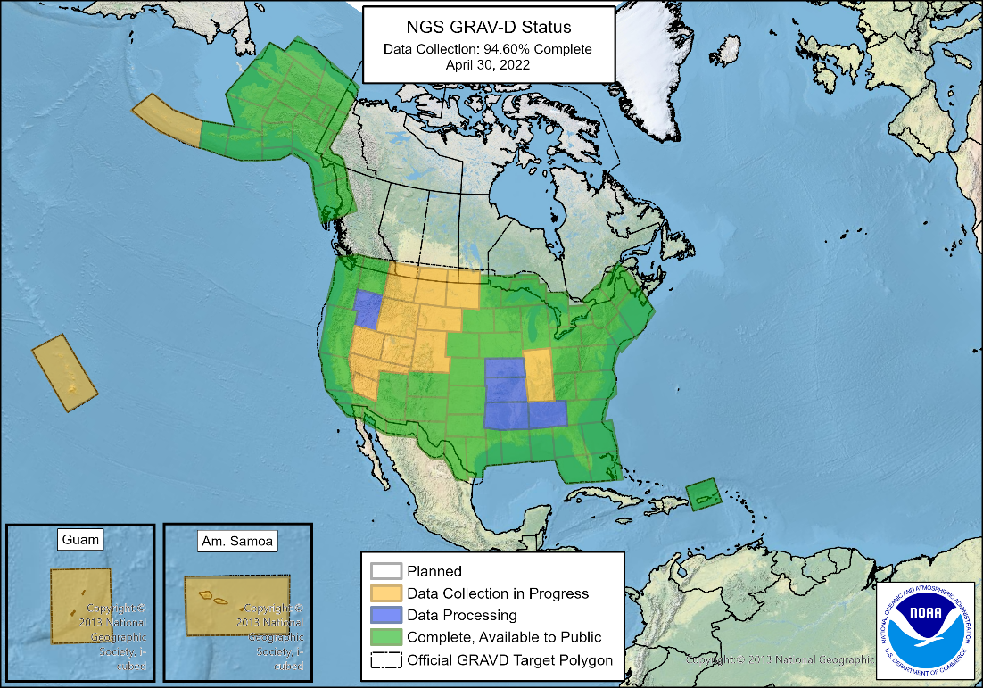
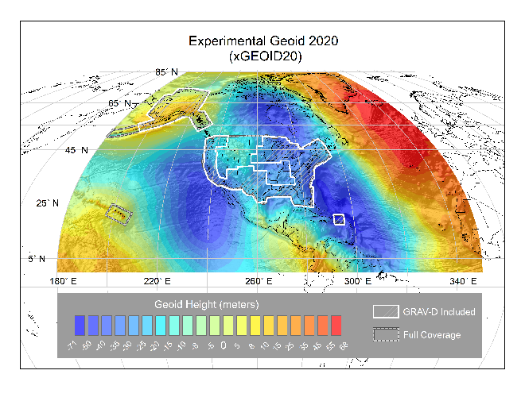
Progress in the last year: Geopotential
GRAV-D flying is 94.6% done (May 1, 2022)
NGS and Canada released the first ever joint geoid model
  The final GEOID2022 model will also be a joint model

Slide 20
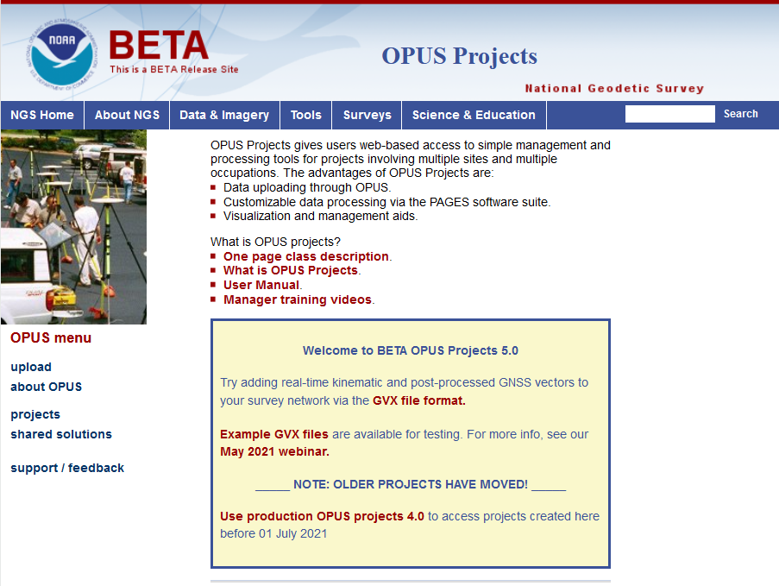
Progress in the last year: OPUS
GVX (GNSS Vector Exchange) 1.0 format released
  Being adopted by industry
    Scheduled for a small update in 2022
OPUS-Projects 5.0 released
  Works with the current NSRS
  Supports upload of GNSS vectors in GVX format

Slide 21
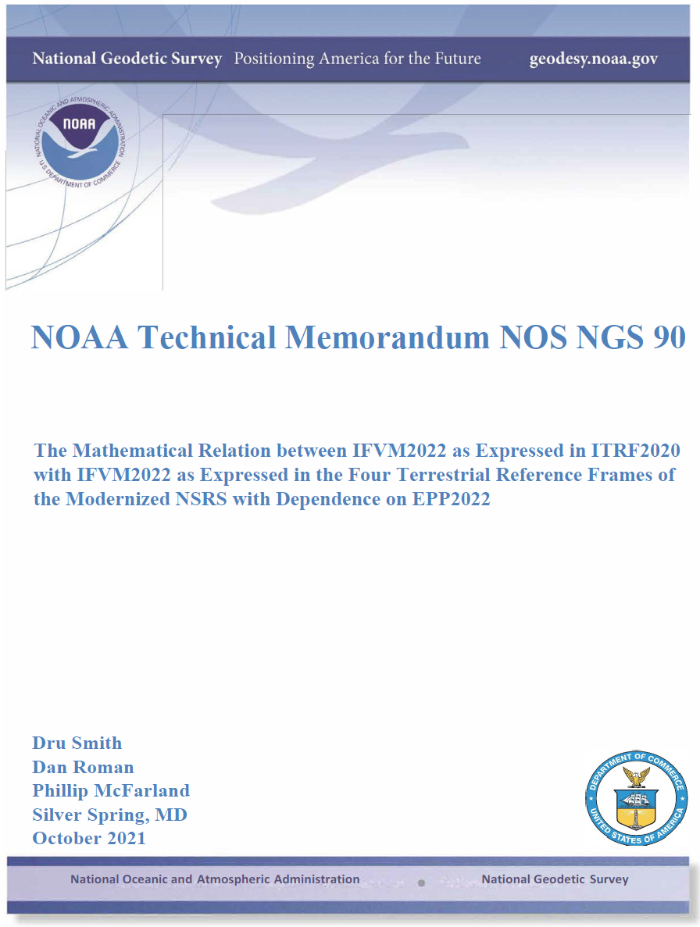
Progress in the last year: Science
Nine science papers in the last 2 years
  More coming this year
  https://geodesy.noaa.gov/library/

Slide 22
Progress in the last year: LASER
LASER (replaces ADJUST, et al.) modules for GNSS and Leveling
  Least squares Adjustments: Statistics, Estimates and Residuals
    Replicated the 2011 national adjustment in 2 hours on a modern laptop
      Without “Helmert Blocking”
  Currently can adjust
    GNSS vectors with/without EDM slant distances
    Leveling networks
  Coming soon:
    Vertical and horizontal angles, relative gravity, CBLs

Slide 23
Progress in the last year: Data Delivery System
The Data Delivery System (DDS) is a system for querying the new NSRS database
  The most common query will be for a new version of datasheets
  But other queries will be part of the DDS
    Mark recovery and mark reporting
    Active control (CORSs)
    Projects, observations, data, etc.

Slide 24
DDS datasheet example

Slide 25
What to look for by the end of 2022
OPUS-S to be updated to M-PAGES
Science papers focusing on least squares adjustments
An “alpha” set of 2020.00 RECs

Slide 26
Re-prioritization: a “data first” approach

Slide 27
Re-prioritization
There are 33 active projects within NGS explicitly dedicated to NSRS modernization
  In an agency of ~200 people….resources are spread thin
Meanwhile the current NSRS slowly deteriorates
  Marks subside without checking
  CORSs drift away from their published coordinate functions
  The passive control network deviates from active control

Slide 28
Re-prioritization
NGS has recently decided to release all of the modernized NSRS data before we have fully completed all support tools
If we do not take this approach, we are not likely to see the modernized NSRS defined and released until 2030

Slide 29
Data
Upon release, the modernized NSRS will consist of this data:
  The NOAA CORS Network (NCN) operating on ITRF2020
  NATRF2022, PATRF2022, MATRF2022, CATRF2022 defined relative to ITRF2020
  NAPGD2022, including:
    GM2022, GEOID2022, DEFLEC2022, GRAV2022
  Geometric (XYZ / φλh) and orthometric (H) reference epoch coordinates (RECs) at 2020.00 at those passive control with the observations to support such coordinates
  Geometric (XYZ / φλh) and orthometric (H) survey epoch coordinates (SECs) at survey epochs between about 1994 and 2020 at those passive control with the observations to support such coordinates
  State Plane Coordinates of 2022 (SPCS2022), plus UTM and USNG
  NADCON
    Connecting NAD 83(2011/MA11/PA11) epoch 2010.00 to N/P/M/CATRF2022 epoch 2020.00
  VERTCON
    Connecting NAVD 88, PRVD02, ASVD02, NMVD03, GUVD04 and VIVD09 to NAPGD2022 epoch 2020.00

Slide 30
Tools
At a minimum, NGS is targeting these tools upon release:
  A DDS capable of yielding:
    RECs on some kind of datasheet
    Information on CORSs
  A downloadable version of LASER
  A browser-based online multi-GNSS service:
    Like OPUS-S
    Like OPUS-Projects 5.x
  NCAT and Vdatum capable of invoking NADCON, VERTCON and SPCS2022

Slide 31
What will have to wait…
Promises we intend to keep, but not until after the initial release of the modernized NSRS include:
  Integrating leveling, classical data and gravity into OPUS
  Full integration of all old tools into NCAT and Vdatum
  SECs for pre-1994 (AKA “pre-NCN”) years, plus SECs for post-2020

Slide 32
Timeline

Slide 33
Timeline
Resources are being diverted from tool building to the assurance of quality data first and foremost
As such, based on this new approach, NGS anticipates the release of all data, and limited tools, by the middle of 2025.
  Some of this requires the “stars to align”, such as NGS receiving congressionally-approved IIJA money to accelerate GRAV-D
Work on additional tools will continue in the out-years

Slide 34
Thank you!

Slide 35
Two quick poll questions…

Slide 36
Questions?

