Slide 1
Turning Towards the Future
Pam Fromhertz
Rocky Mountain Regional Advisor
240-988-6363
Pamela.Fromhertz@noaa.gov
John Hunter
CO State Geomatic Coordinator
COCoordinator@plsc.net
GIS in the Rockies
September 2018
geodesy.noaa.gov

Slide 2
3 marks and 4 corners
NGVD29
NAVD88

Slide 3
Agenda
CO State Geomatics Coordinator and Working Group
The National Spatial Reference System
Very brief history to now
The Future: 2022
GPS on BM
Crowd Sourcing – How you can help
SPCS2022
Changes are coming – what do you want for CO
Guest Speakers
Denver Water
Denver International Airport
USGS

Slide 4
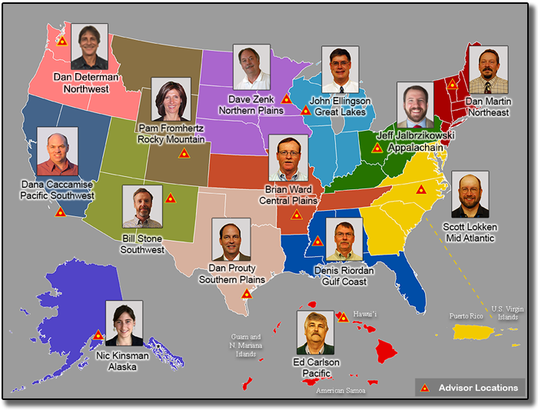
NGS Regional Geodetic Advisors
Notes:
The NGS 10 year plan had a goal for all the regional advisor to be in place Oct 1, 2016. Prior it was a patchwork of advisors in some states based on partnering agreements with various state agencies. At most there were 28 state advisors. NGS moved away from this model to ensure every state had an advisor. The Rocky Mountain Regional Advisor covers CO, WY and MT.

Slide 5
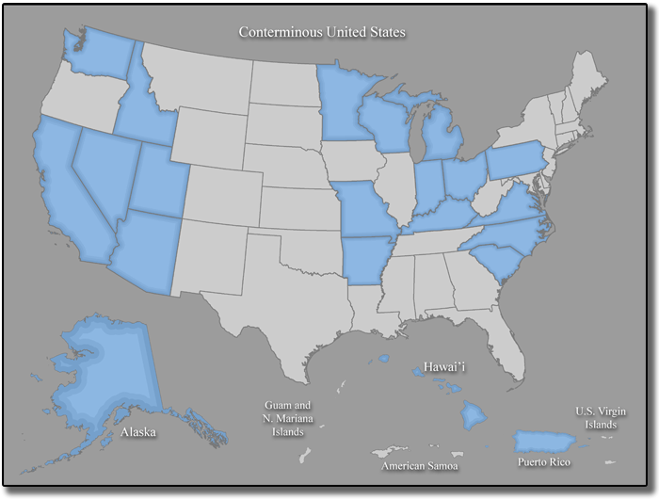
Current Geodetic Coordinators
Notes:
Needing geospatial community support – once happens states will have them on the NGS website
Discussion Friday – meet and greet – lots of fun things

Slide 6
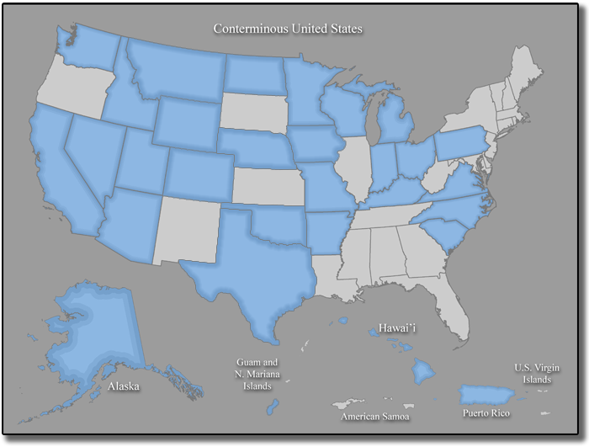
State Geodetic Coordinators

Slide 7
Who
State Coordinator:
John Hunter, Professional Land Surveyors of Colorado (PLSC), Denver Water
Members:
Thomas Breitnauer, Denver International Airport,
Rick Corsi, Office of Information and Technology
Annabelle Montoya, GIS Colorado, City of Wheatridge
Joey Stone, Denver Water
CDOT
Advisors:
Todd Beers, President PLSC
Pam Fromhertz, NGS Rocky Mountain Regional Advisor
Becky Roland, PLSC Executive Secretariat
CoCoordinator@plsc.net

Slide 8
Montana Coordinator Working Group
*Joshua Phillips, MT Association of Registered Land Surveyors (MARLS)
*Tyson Olinger, MT Department of Transportation (MDT)
Erin Fashoway, MT State Library
Wally Gladstone, Tribal
MT Association of Geographic Information Professionals (MAGIP)
Pam Fromhertz, NGS
MTCoordinator@marls.com
Marls.com
* Coordinator listed on the NGS website

Slide 9
Wyoming Coordinator Working Group
Mark Corbridge, WYDOT/PLSW
Karen Rogers, WGFD/WyGEO
Chad Kopplin, DEQ/TAG
Rich Greenwood, Greenwood Mapping/WyGEO
Wally Gladstone, Tribal
Paddington Hodza, WYGISC
Local Government
Technical Advisors – Mike Londe, Herb Stoughton, Mary Wilson
Pam Fromhertz, National Geodetic Survey (NGS)
WYngsCoordinator@gmail.com
wygeo.org

Slide 10
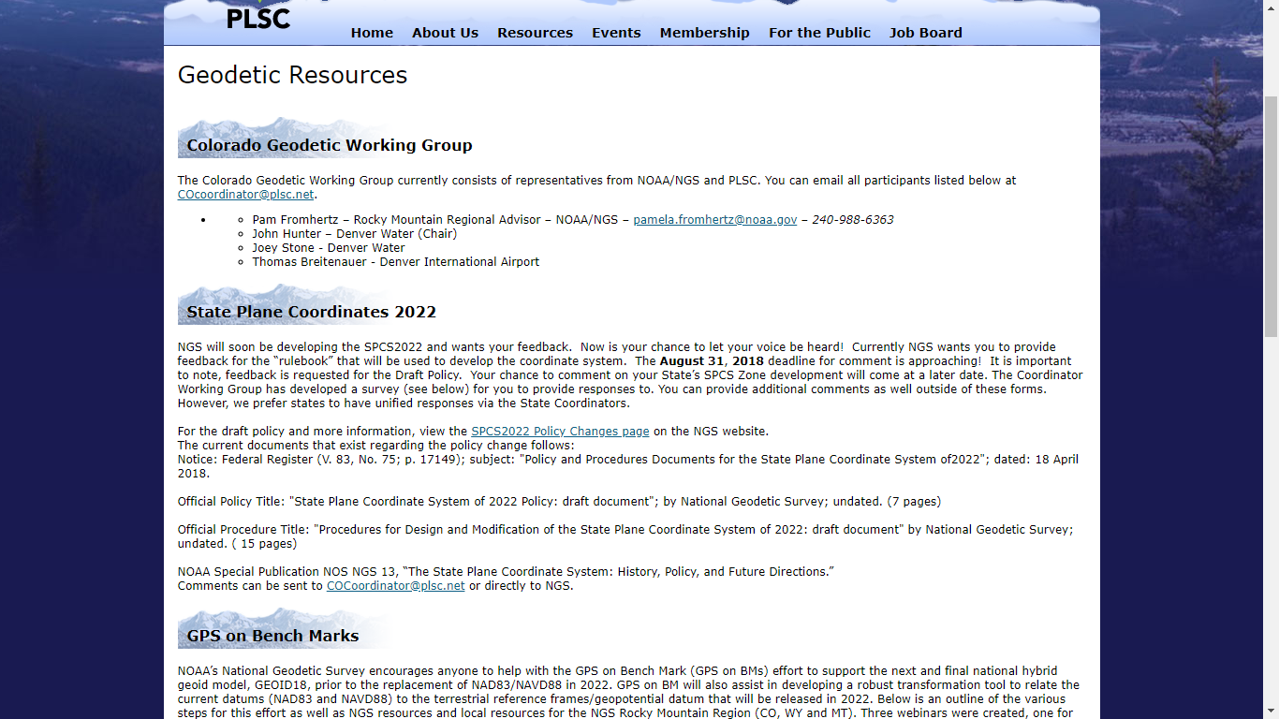

Slide 11
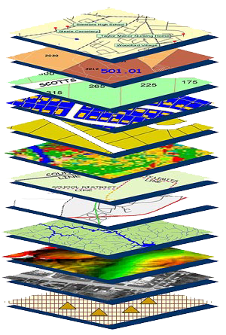
Role of Datums and Geodetic Control
Geodetic control provides a common reference system for establishing coordinates for all geographic data.
All NSDI framework data and users' applications data require geodetic control to accurately register spatial data.
The National Spatial Reference System is the fundamental geodetic control for the United States.
A geodetic datum is an abstract coordinate system with a reference surface (such as sea level) that serves to provide known locations to begin surveys and create maps.

Slide 12
NSRS
The National Spatial Reference System (NSRS) is the official coordinate system for all geospatial work done by the civilian federal government.
Current datums:
NAD 83 (latitude, longitude, ellipsoid height)
NAVD 88 (orthometric height)
IGLD 85 (dynamic heights: predominantly on the Great Lakes)
These datums are often adopted, even legislated, by states, counties and municipalities.
Notes:
There are actually 3 “NAD 83”s, NAD 83(2011), NAD 83(PA11) and NAD 83(MA11)
There are also many more vertical datums than NAVD 88 in the NSRS, each one for specific states or territories that have no line of sight to CONUS/Alaska

Slide 13
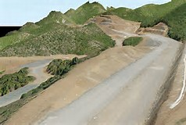
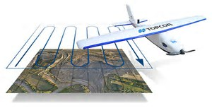
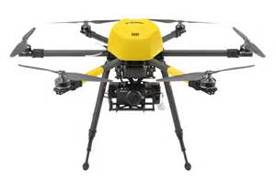
LiDAR, UAV, GPS Data

Slide 14
Horizontal Datum
?
Vertical Datum
?

Slide 15
Horizontal Datum
Vertical Datum

Slide 16
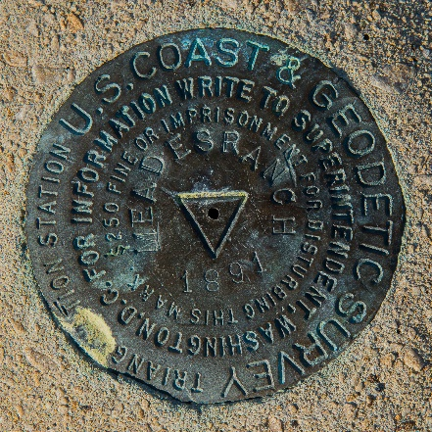
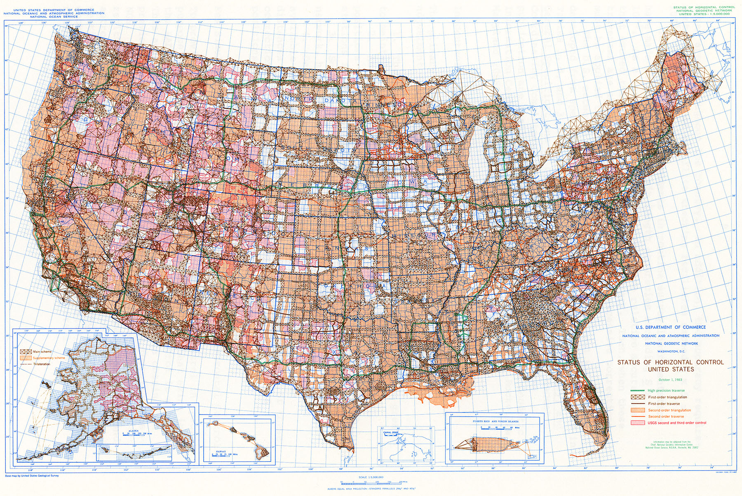
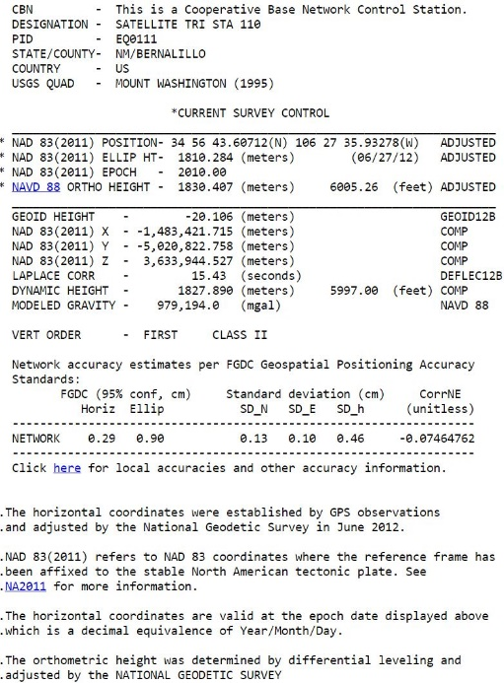
Passive NAD83 Horizontal Control Network

Slide 17
National Spatial Reference System (NSRS) Improvements over time
NETWORK TIME NETWORK LOCAL
SPAN ACCURACY ACCURACY
NAD 27 1927-1986 10 meter s (1:100,000)
NAD83(86) 1986-1990 1 meter (1:100,000)
NAD83(199x)* 1990-2007 0.1 meter (1:1 million)
“HARN”, “FBN” (1:10 million)
NAD83(NSRS2007) 2007-2011 0.01 meter 0.01 meter
NAD83(2011) 2011- 2022 0.01 meter 0.01 meter
Prior to GPS
GPS
Notes:
NAD27 based on old observations and old system
NAD83(86) based on old observations and new system
NAD83(xx) based on new and old observations and same system (HARN)
NAD83(NSRS2007) based on new observations and same system. Removed regional distortions and made consistent with CORS
NAD83(2011) based on new observations and same system. Kept consistent with CORS

Slide 18
Horizontal Datums/Coordinates… What do we (you) use in your state?
NAD 83 (Lat-Lon) State Plane Coordinates
Which one???
NAD 83 (1986)
NAD 83 (1992)
NAD 83 (1996)
NAD 83 CORS96(2002)
NAD 83 (NSRS2007)
NAD 83 (2011)
NAD 27
WGS 84
Which one???
WGS 84 (1987)
WGS 84 (G730)
WGS 84 (G873)
WGS 84 (G1150)
WGS 84 (G1674)
WGS 84 (G1762)
ITRF00 (epoch 97)
IGS08 (epoch 2005)

Slide 19
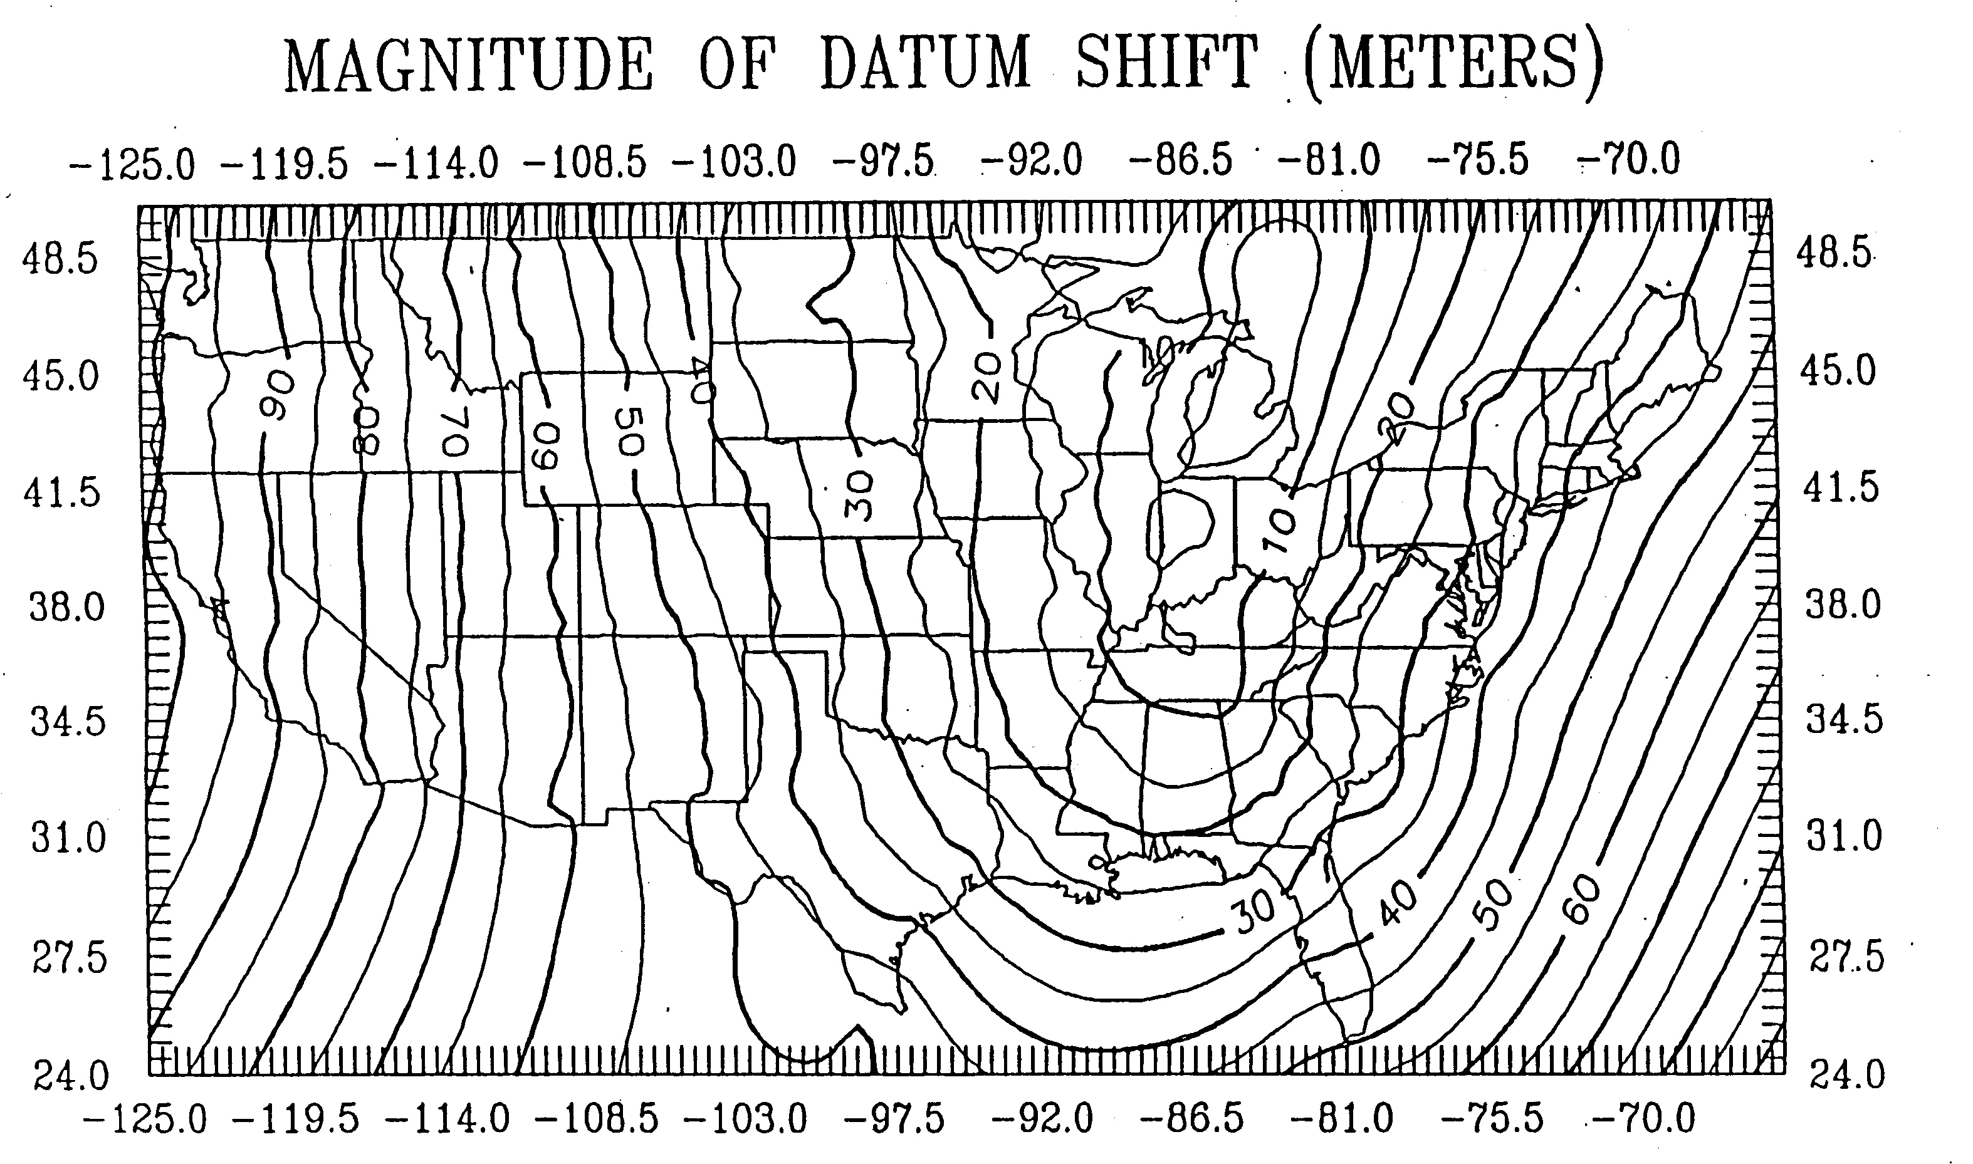
Difference between NAD 83 and NAD 27

Slide 20
Difference Between WGS 84 & NAD 83
dX = 0.9956 m
dY = -1.9013 m
dZ = -0.5215 m

Slide 21
Comparison Of Vertical Datum Elements
NGVD 29 NAVD 88
Datum Definition 26 Tide Gauges Father’s Point
National Tidal In The U.S. & Canada Quebec, Canada
Datum Epoch None 1960-1978
Bench Marks 100,000 450,000
Leveling (Km) 102,724 1,001,500
Geoid Fitting Distorted to Fit Best Continental Model

Slide 22
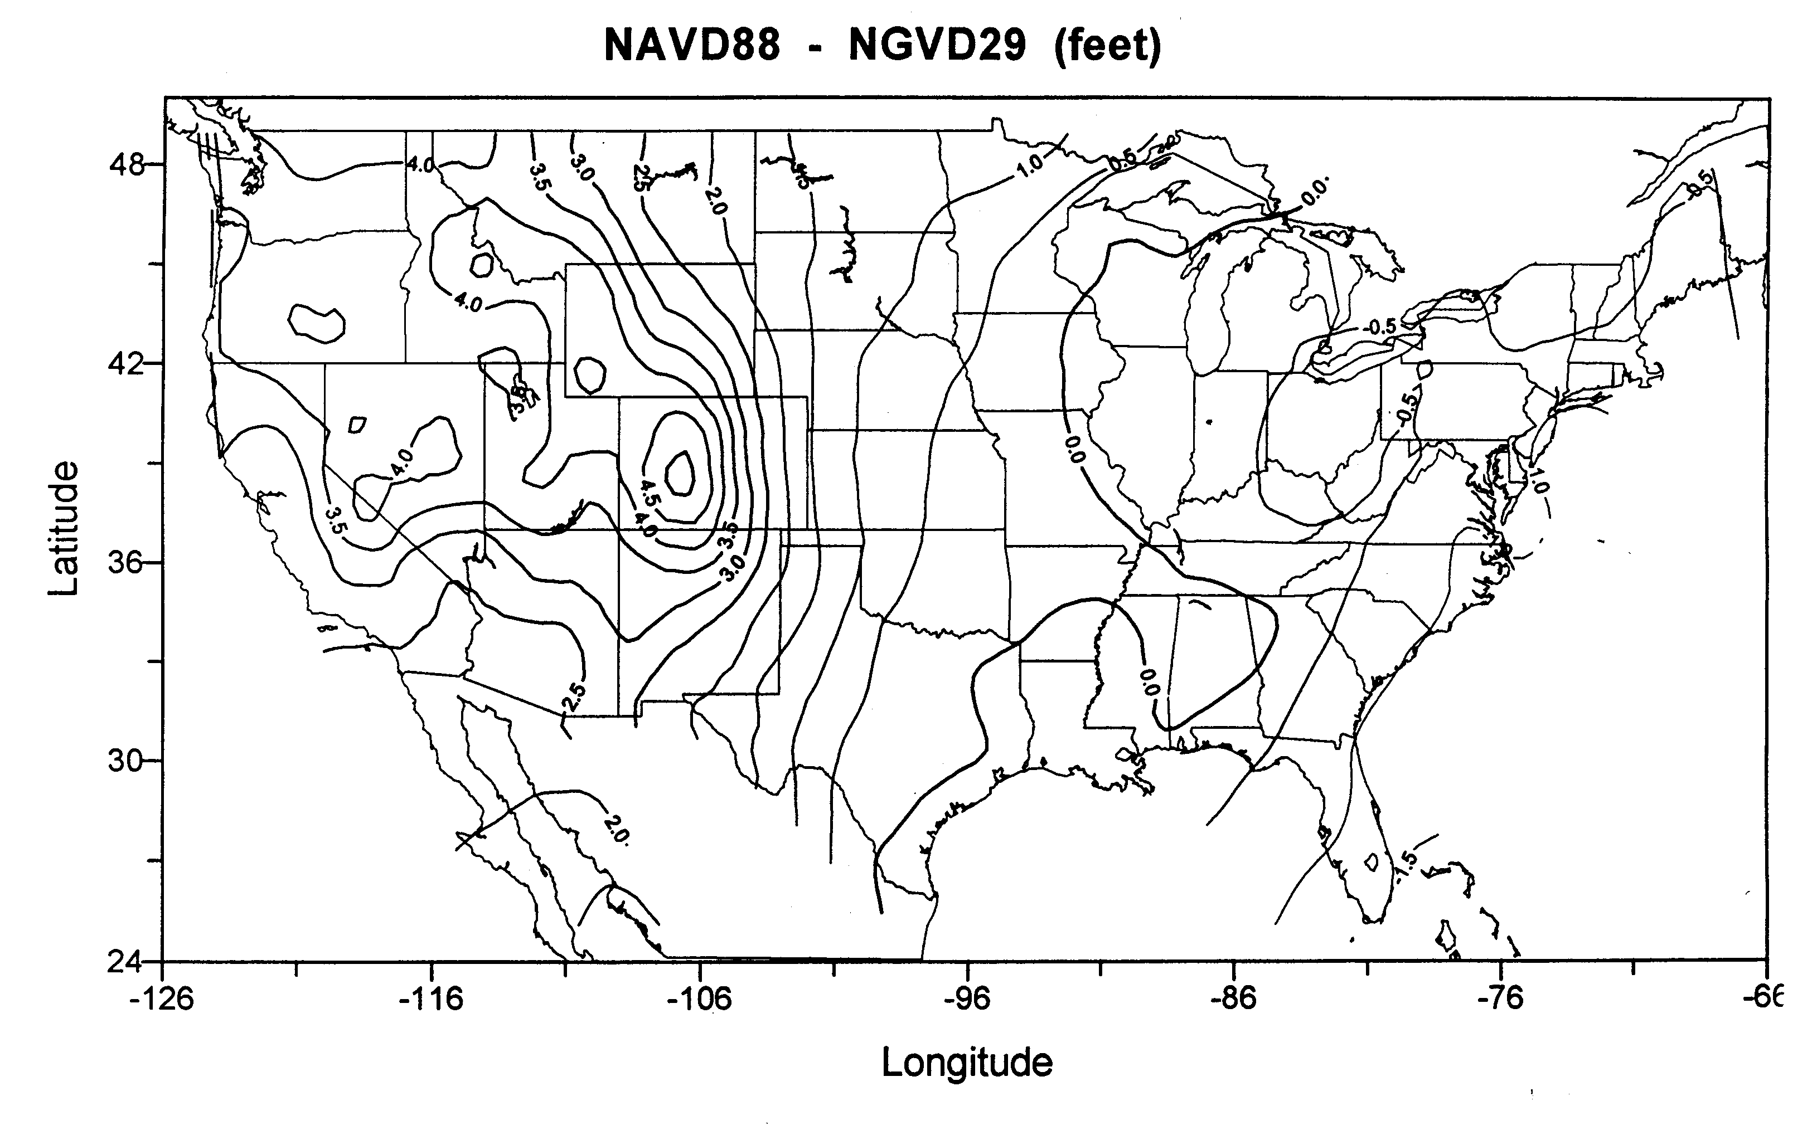
NGVD 29 and NAVD 88

Slide 23
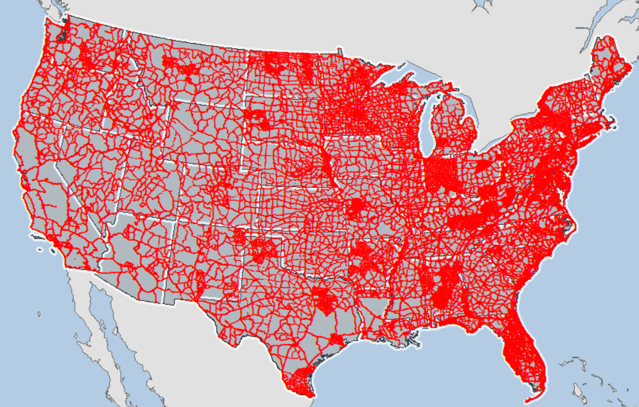
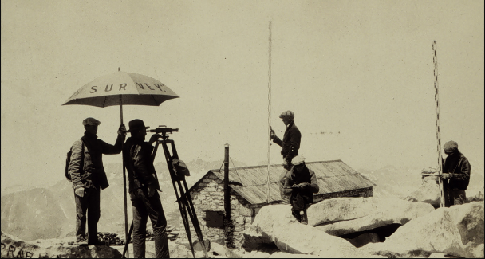
NAVD 88 Leveled lines
Notes:
NAVD 88 consists of about 800,000 benchmarks and ~2.2M km of leveling. Data was collecting over many decades by roving bands of surveyors who walked across the country multiple time over the years, east to west, north to south and back again. It is currently the official vertical datum of the US and is required for all federal mapping projects.
GPS data on those leveled marks will be used to create GEOID18 – the model used to derive NAVD88 heights from GPS ellipsoid heights, and the transformation tools to that will be released with NAPGD2022

Slide 24
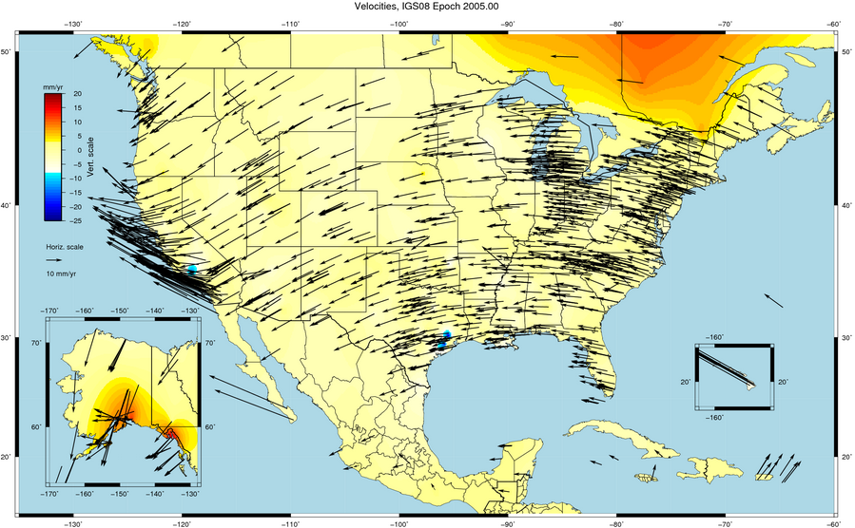
Things Are moving – we can not measure it accurately

Slide 25
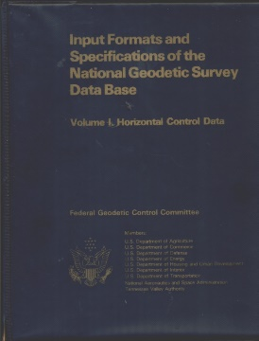
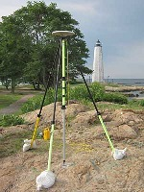
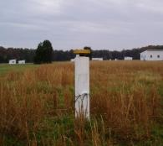
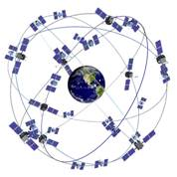
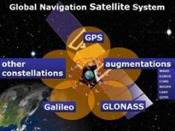
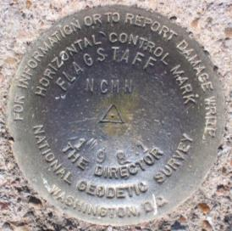
New
Reference Frames
Planned for 2022
Replace NAD83 with a
geocentric reference frame
GNSS based
Replace NAVD88 with a
gravity based geoid

Slide 26
National Geodetic Survey Ten-Year Strategic Plan
By 2022, reduce all definitional & access-related errors in geometric reference frame to 1 cm when using 15 min of GNSS data
“Replace NAD83”
(NAD83 = North American Datum 1983)
By 2022, reduce all definitional & access-related errors in orthometric heights in geopotential datum to 2 cm when using 15 min of GNSS data
“Replace NAVD88”
(NAVD88 = North American Vertical Datum 1988)
https://geodesy.noaa.gov/web/about_ngs/info/tenyearfinal.shtml

Slide 27
New Reference (Datums) Frames
Horizontal
Vertical
Geometric
Latitude
Longitude
Ellipsoidal Height
Euler Rotation and angle
Intra-frame Velocity Models
Geopotential
Geoid Model
Time Dependent Coordinates on a fixed Plate

Slide 28
NSRS Modernization News
Four Terrestrial Reference Frames
North American Terrestrial Reference Frame of 2022 (NATRF2022)
Pacific Terrestrial Reference Frame of 2022 (PATRF2022)
Mariana Terrestrial Reference Frame of 2022 (MATRF2022)
Caribbean Terrestrial Reference Frame of 2022 (CATRF2022)
Geopotential Datum for Heights and other Physical Coordinates
North American-Pacific Geopotential Datum of 2022 (NAPGD2022)
Geoid Model (time-dependent, provided in three regions)
GEOID2022
Notes:
Four Terrestrial Reference Frames
Replacing the three existing NAD 83 reference frames will be four plate-fixed terrestrial reference frames. The tectonic plate for each frame may be inferred from their names.
Geopotential datum
A geopotential datum will be created which will contain all of the information necessary to provide mutually consistent orthometric heights, geoid undulations, gravity anomalies, deflections of the vertical and all other geodetic coordinates related to the gravity field.
Geoid model
Within NAPGD2022, a variety of products will exist. The most prominent will be a time dependent model of the geoid, provided in three regions (the first covering the entirety of North and Central America, Hawaii, Alaska, Greenland and the Caribbean, the second covering American Samoa and the third covering Guam and the Commonwealth of the Mariana Islands).

Slide 29
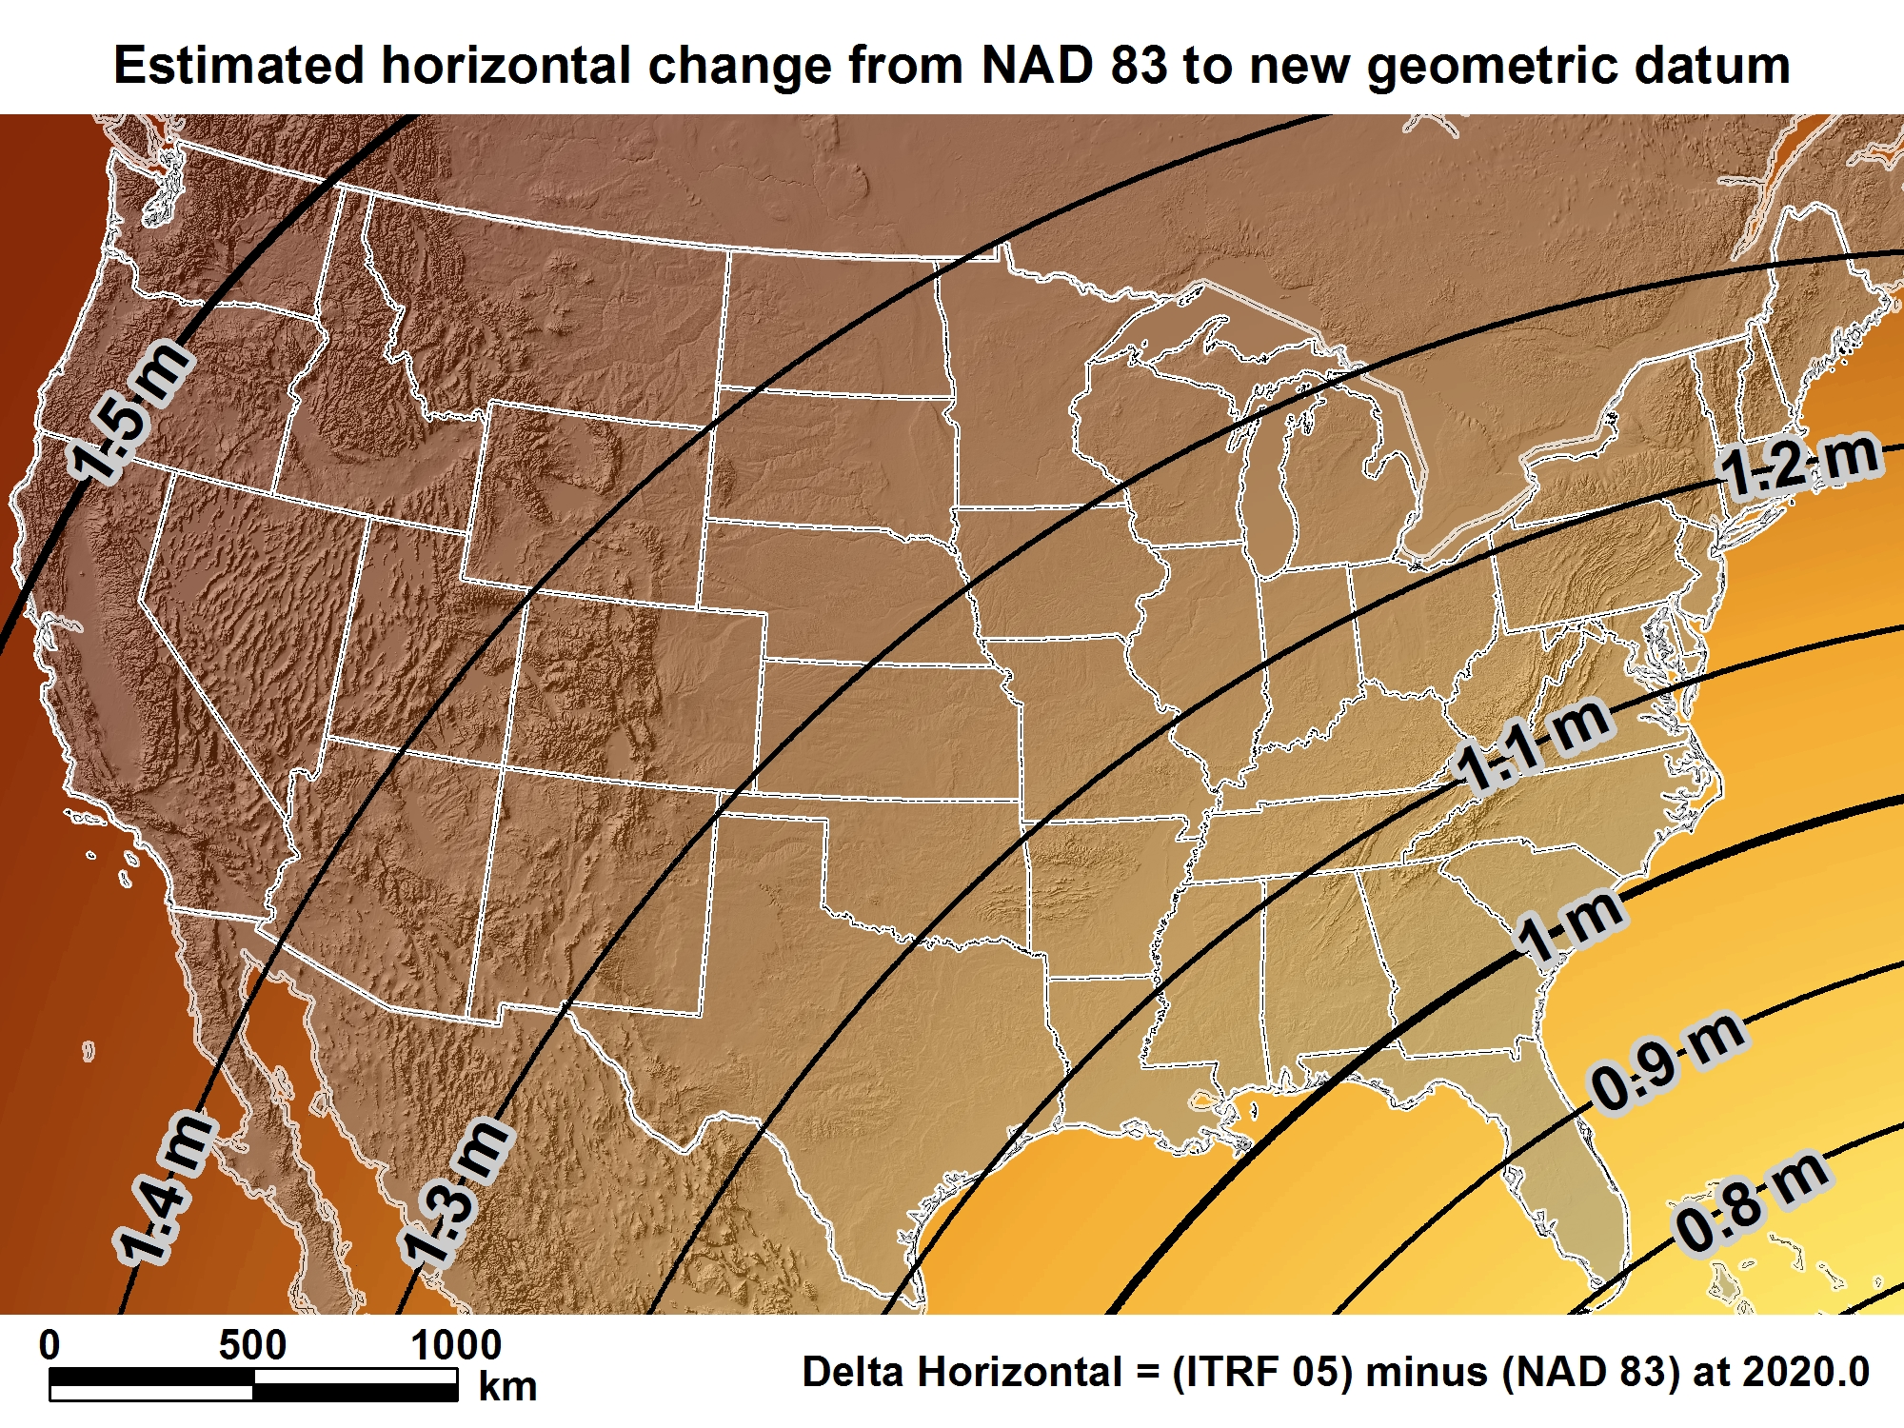
New geometric datum minus NAD 83 (horizontal)

Slide 30
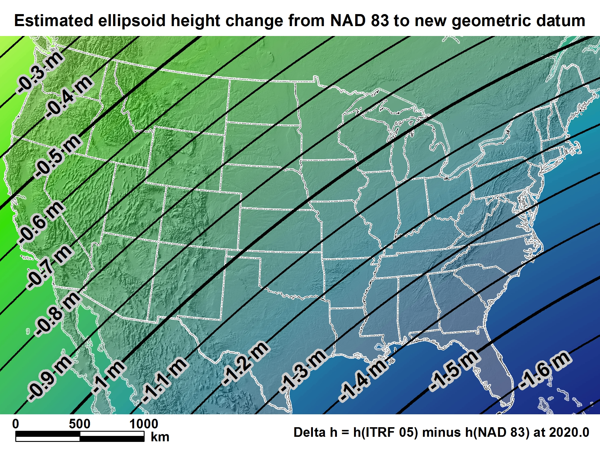
New geometric datum minus NAD 83 (ellipsoid height)

Slide 31
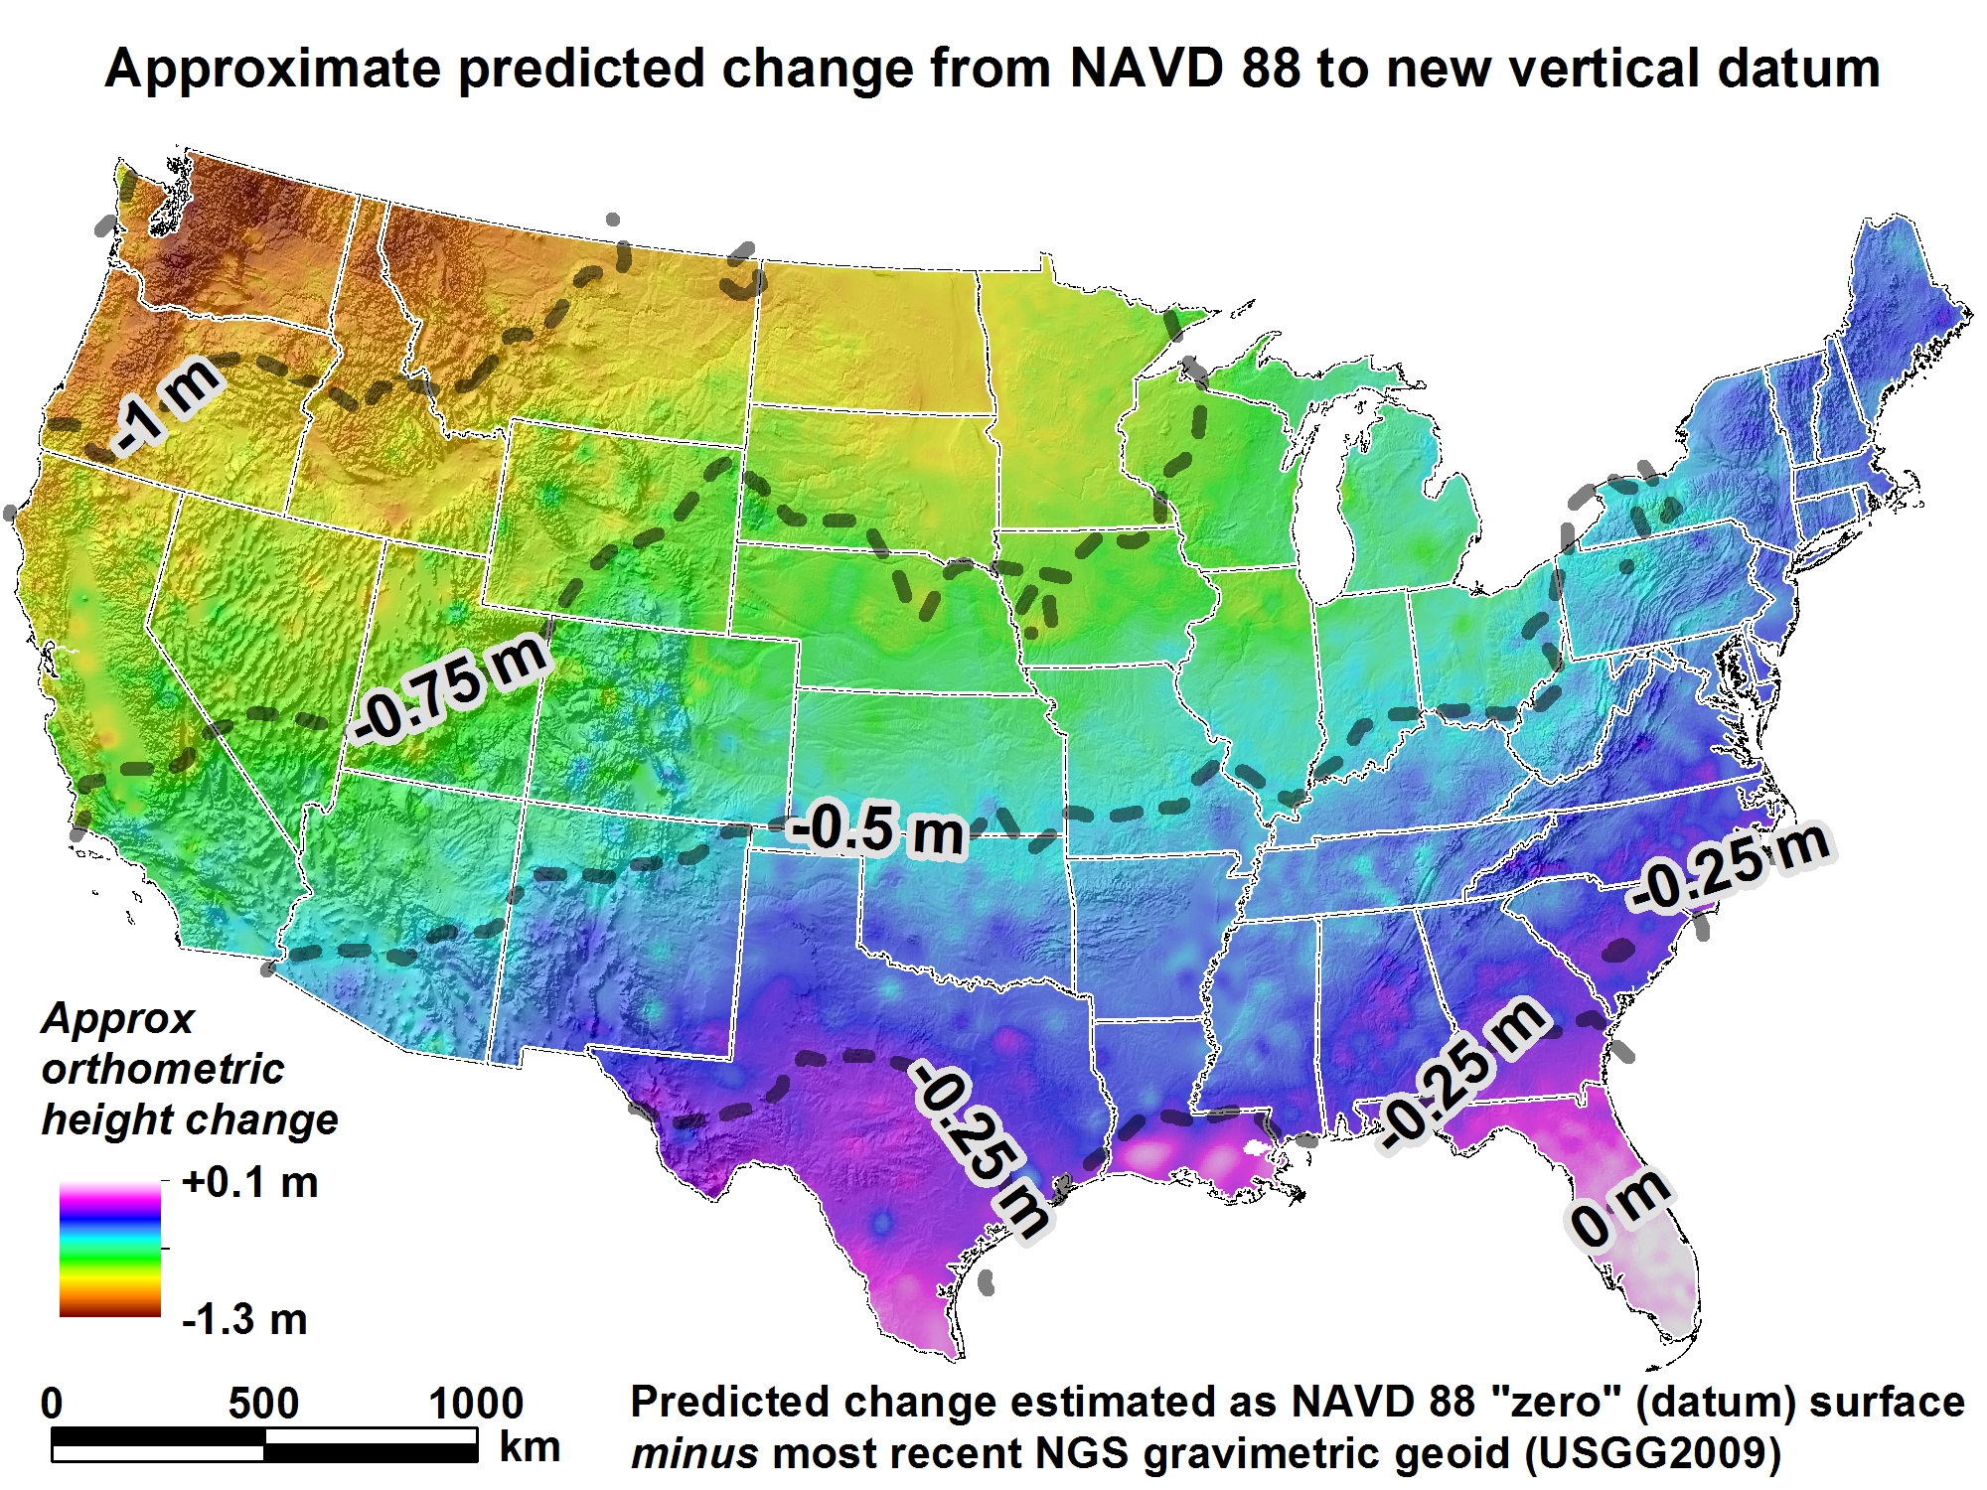
New Vertical Datum (Outcome)

Slide 32
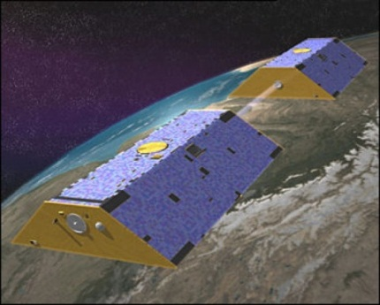
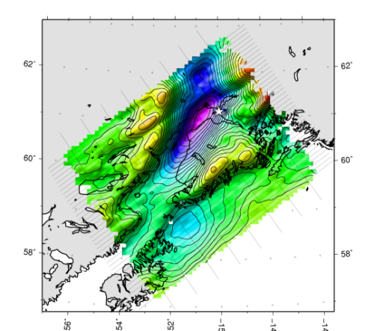
Building a Gravity Field
Long Wavelengths
(≥ 250 km)
GRACE/GOCE/Satellite Altimetry
+
Intermediate Wavelengths
(300 km to 20 km)
Airborne Measurement
+
Short Wavelengths
(< 100 km)
Surface Measurement and
Predicted Gravity from Topography

Slide 33
Gravity for the Redefinition of the American Vertical Datum (GRAV-D)
https://www.geodesy.noaa.gov/GRAV-D/
Notes:
Pictured: Airborne gravity survey grid and the current status of GRAV-D, with more than 45 percent of the U.S. and its territories covered and GRAV-D airborne data collected.
In 2010, began operational collection of airborne gravity data to calculate a geoid model and ultimately a new vertical reference system for accurate height measurements up to 2 cm in the U.S. and territories.
Provides highly accurate height measurements to determine where water flows
Connects satellite and terrestrial gravity measurements for efficient and accurate gravity monitoring
Benefits include $240 Million from improved floodplain mapping alone

Slide 34
Predicated Positional Changes in 2022
Computed for S 411(KK1411) near Arvada, CO
HORIZONTAL = 1.3671 m (4.5 ft)
ELLIPSOID HEIGHT = - 0.87 m (-2.85 ft)
Computed with HTDP and Inverse
ORTHOMETRIC HEIGHT = - 0.35 m (-1.14 ft)
Computed with xGEOID16B
Ortho HT from Leveling 1611.012 m (5285.472 ft)
Computed Ortho HT using Geoid 12B 1611.046 m (5285.58 ft)
Ortho HT NGVD29 1610.112 m (5282.51 ft)
New computed Height using xGEOID16B 1610.399 (5283.461 ft)

Slide 35
Predicted Positional Changes in 2022
Computed for Q 32(NR0035) near Casper, WY
HORIZONTAL = 1.2401 m (4.07 ft)
ELLIPSOID HEIGHT = - 0.77 m (-2.53 ft)
Computed with HTDP and Inverse
ORTHOMETRIC HEIGHT = - 0.706 m (-2.32 ft)
Computed with xGEOID16B
Notes:
NAD 83(2011) POSITION- 42 55 33.76190(N) 106 19 58.11320(W) ADJUSTED
NAD 83(2011) ELLIP HT- 1615.234 (meters) (06/27/12) ADJUSTED
NAD 83(2011) EPOCH - 2010.00
NAVD 88 ORTHO HEIGHT - 1628.602 (meters) 5343.17 (feet) ADJUSTED
NR0035

Slide 36
Predicted Positional Changes in 2022
Computed for Q 32(NR0035) near Casper, WY
HORIZONTAL = 1.2401 m (4.07 ft)
ELLIPSOID HEIGHT = - 0.77 m (-2.53 ft)
Computed with HTDP and Inverse
ORTHOMETRIC HEIGHT = - 0.706 m (-2.32 ft)
Computed with xGEOID16B
Ortho HT from Leveling 1628.602 m (5343.17 ft)
Ellipsoidal Height from DataSheet 1615.234 (5299.32 ft)
Computed Ortho Ht using Geoid 12B 1628.595 m (5343.16 ft)
Ortho Ht NGVD29 1627.72 m (5340.28 ft)
New computed Ortho Height 1627.896 1627.870 (5340.87/5340.78 ft)
Notes:
NAD 83(2011) POSITION- 42 55 33.76190(N) 106 19 58.11320(W) ADJUSTED
NAD 83(2011) ELLIP HT- 1615.234 (meters) (06/27/12) ADJUSTED
NAD 83(2011) EPOCH - 2010.00
NAVD 88 ORTHO HEIGHT - 1628.602 (meters) 5343.17 (feet) ADJUSTED
NR0035

Slide 37
h – N = H
-
=
H is an NAVD 88 Orthometric Height traditionally from Leveling
h is ellipsoid height measured using GPS
N is from a geoid model
Theoretically, the difference between these three values should be zero. In practice, using actual observations gives a residual, or measure of the misfit between the three. We use the residual to evaluate the observations.

Slide 38
Ellipsoid, Geoid, and Orthometric Heights
Heights – why so important?
H = Orthometric Height (leveling)
H = h - N
h = Ellipsoidal Height (GPS)
N = Geoid Height (model)
h (NAD83)
TOPOGRAPHIC
SURFACE
(NAVD88) H
N
Geoid Height
(GEOID12B)
Geoid
Ellipsoid

Slide 39
Ellipsoid, Geoid, and Orthometric Heights
H = Orthometric Height (leveling)
H = h - N
h = Ellipsoidal Height (GPS)
N = Geoid Height (model)
h (NAD83)
TOPOGRAPHIC
SURFACE
(NAVD88) H
N
Geoid Height
(GEOID12B)
Geoid
Ellipsoid
O 33 (DataSheet)
2024.853=2015.918 – (-8.893)M
2024.853= 2024.811
Difference 0.042 m
Disk in concrete 1923
D 565 (DataSheet & OPUS Share)
1621.067=1612.388 – (-8.730)M
1621.067= 1621.118
Difference 0.051 m
Disk in bedrock 1983

Slide 40
Which Geoid for Which NAD 83?
NAD 83(2011) --- Geoid12B
NAD 83(2007) --- Geoid09
NAD 83(19xx) --- Geoid03
--- Geoid99
--- Geoid96

Slide 41
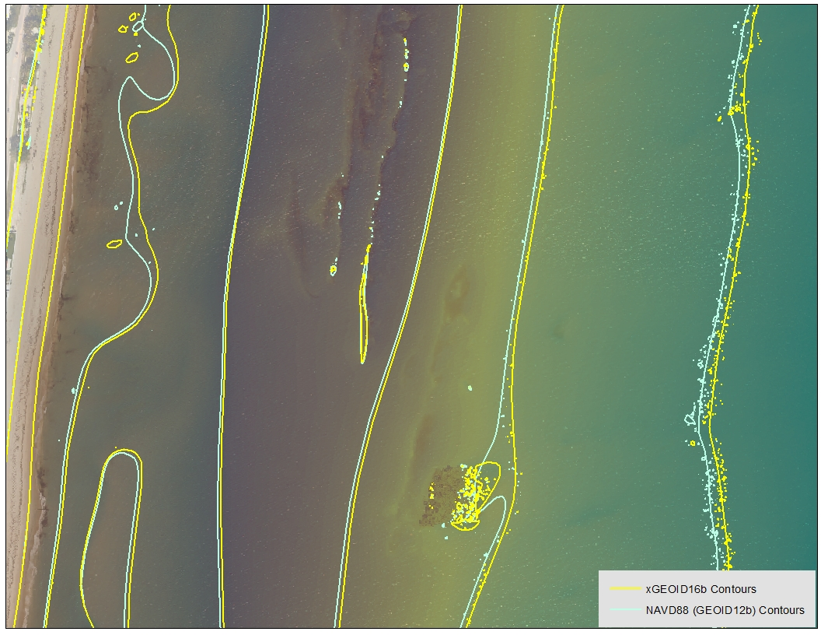
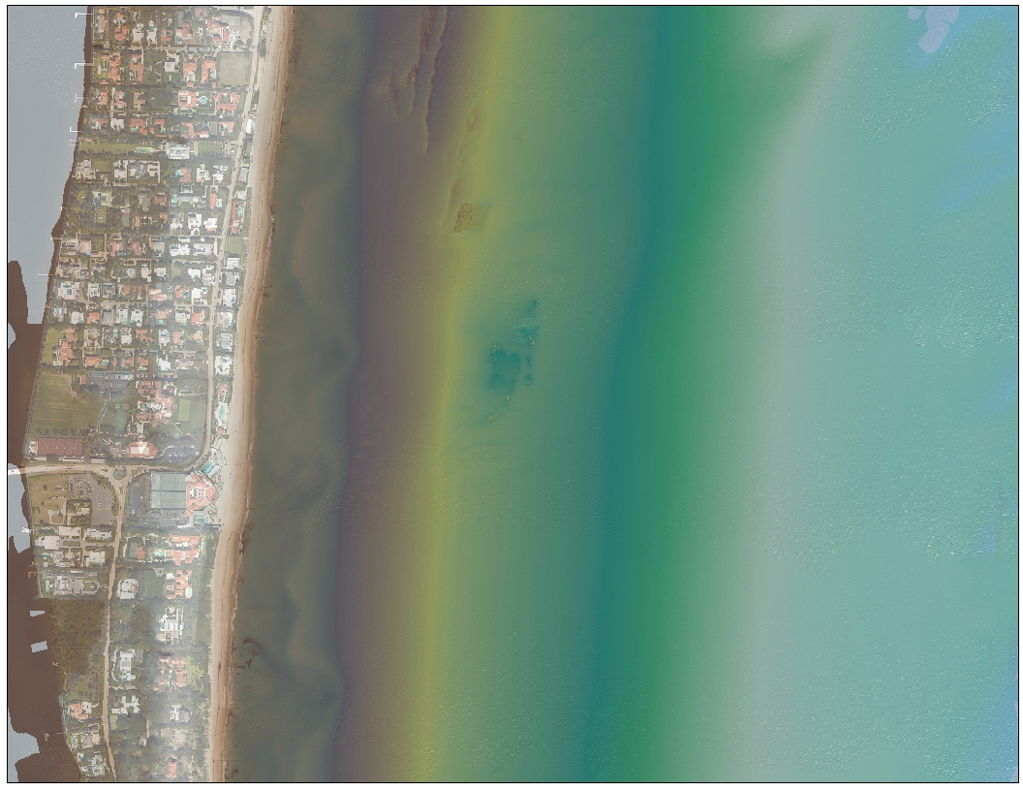
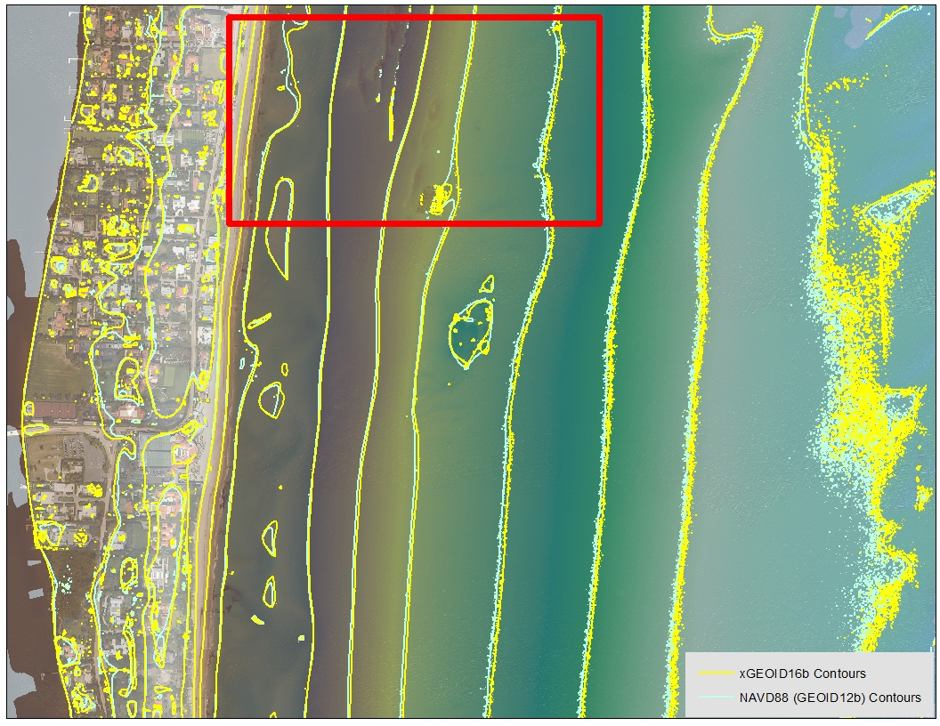
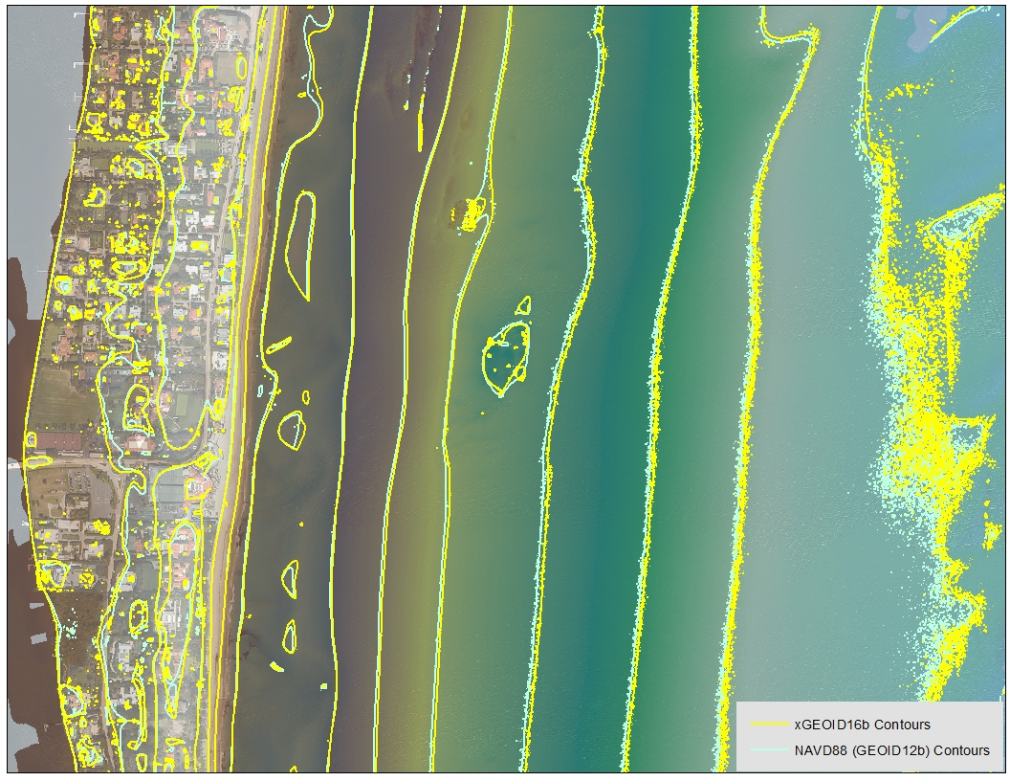
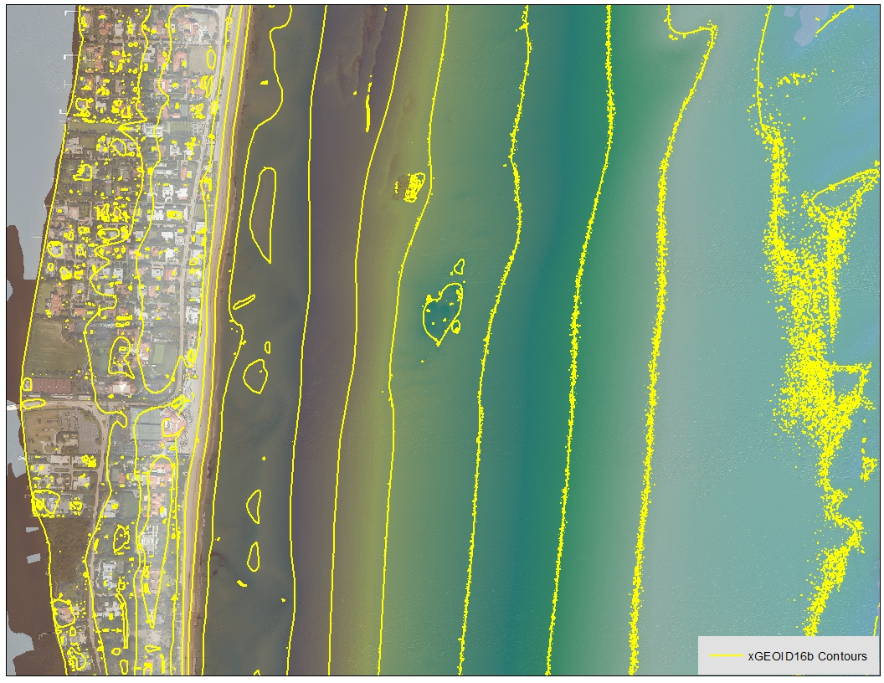
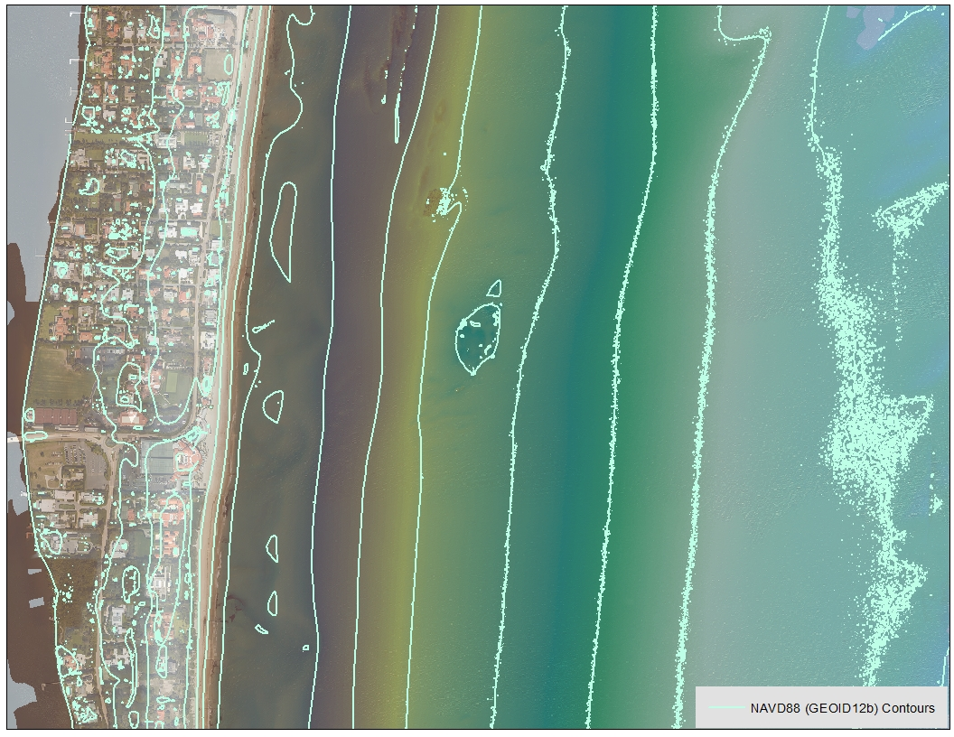
Palm Beach, FL
Approximately 6-10 meter offsets

Slide 42
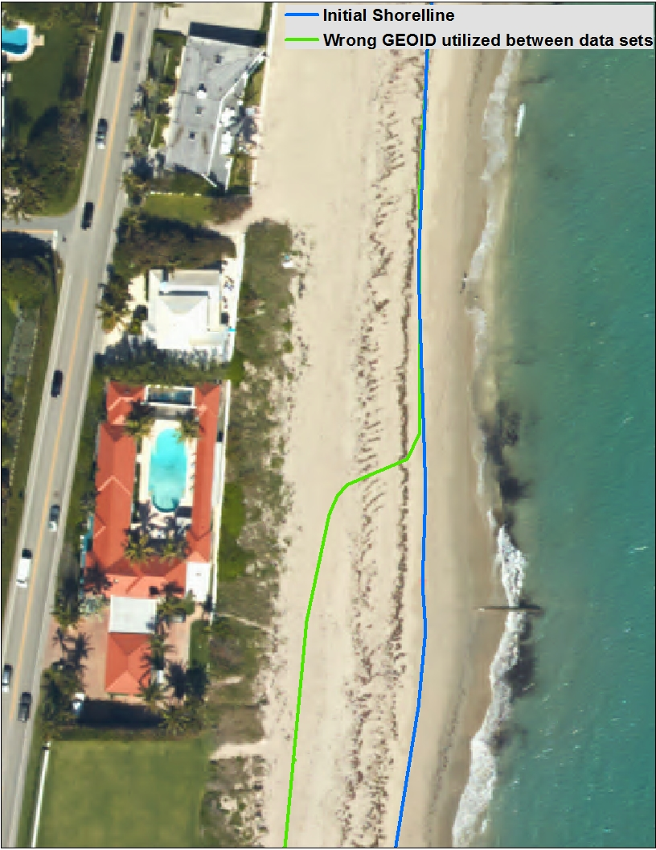
Applying the new GEOID incorrectly
4-6 Degree sloping beach
18m Offset
Notes:
NAD83 and the new GEOID on one side and NAD83 and the old GEOID on the other side

Slide 43
GPS on Bench Marks

Slide 44
Crowdsourcing GPS on Bench Marks
Help with final hybrid Geoid Model
Help with the transformation tools to the new systems
Find Bench Marks
Use our priority BM/tracking map
Use NGS Data Explorer
Use DS-World
Provide a recovery note
Use DS-World
Collect GPS data
Share through OPUS

Slide 45
Rocky Mountain Region Map and Volunteer Sign up
Signup sheet:
https://survey123.arcgis.com/share/130be382350e4a38a71de3b2e4d92a98 (Must cut and paste)
Status Map:
https://www.arcgis.com/apps/webappviewer/index.html?id=0829616b6ec740b7a0bfbf057188e865

Slide 46
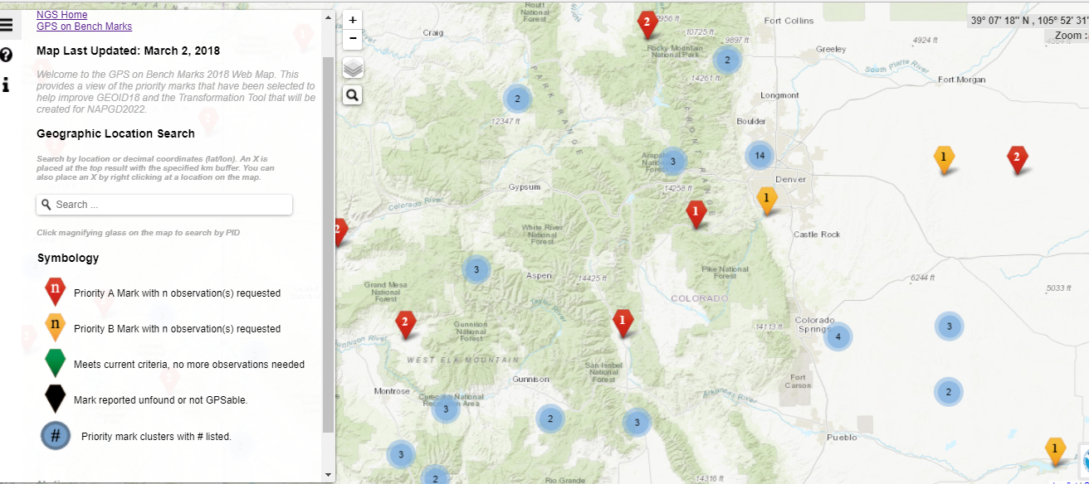
Priority BMs Identified

Slide 47
Priority BMs Identified

Slide 48
Geodetic Control in Carbon County

Slide 49
Geodetic Control in the area

Slide 50
Geodetic Control in the area

Slide 51
NGS Data Sheet for
V 75 in Saratoga, WY

Slide 52
Priority BMs Identified
A Priority
B Priority

Slide 53
Priority Stations near Saratoga, WY

Slide 54
Crowdsourcing
Find Bench Marks (priority and others)
Provide updated descriptions, Coordinates, photos (use DS-World)
Collect 4 Hours of GPS grade data and create an OPUS Data sheet (share through OPUS)

Slide 55
Upcoming Rocky Mountain Region Webinars
May 21 2:00 Basics, why, how, when
June 7 2:00 WinDesc
June 14 2:00 Sharing through OPUS
CoCoordinator@plsc.net

Slide 56
Why do we need 4 hours of data?
NGS is working on OPUS for RTK that will accept 3 minute observations, however the accuracy will NOT be as good as 4 hour observations.
1 sigma
Graph Courtesy of Dr. Daniel Gillins
Notes:
Better solutions with lower RMS are important for creating the hybrid geoid model. The Transformation Tools will need a higher density of data, so we are willing to trade a decrease in accuracy for the ability to get data on many more marks.

Slide 57
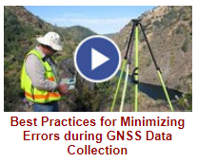
NGS Training Material
GPS on Bench Marks Webpages
NGS Video Library
NGS Online Lessons

Slide 58
OPUS Share Data Sheet

Slide 59
DS-World

Slide 60
DS-World

Slide 61
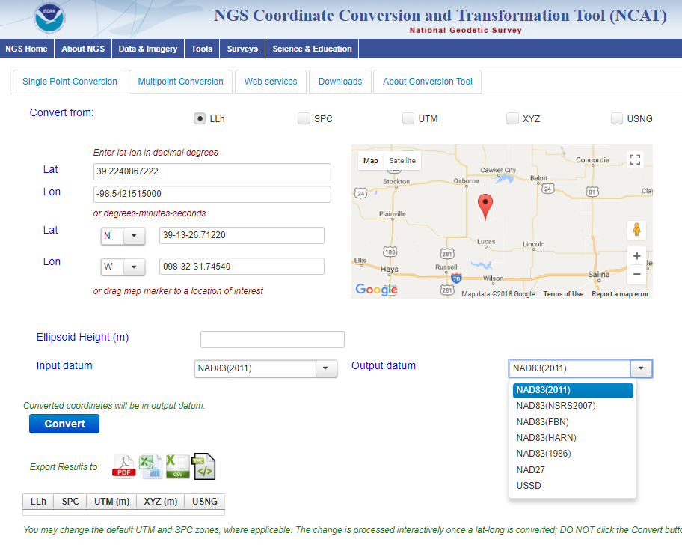
NCAT NGS Coordinate Conversion and Transformation Tool
Notes:
We also have a new tool available to convert between various coordinate systems using various projects.

Slide 62
Rocky Mountain Region Webinars GPS on BM
May 21 2:00 Basics, why, how, when
Recorded
June 7 2:00 Mark Recovery (DS-World)
Recorded
June 14 2:00 Collecting GPS data and Sharing through OPUS (Survey Grade, min. of 4 hrs) https://attendee.gotowebinar.com/recording/3222375402987297281
https://attendee.gotowebinar.com/recording/4100208993309956616
https://attendee.gotowebinar.com/recording/8767732610551898883

Slide 63
Next Steps
Sept 21 – provide what you can
New priority stations for Transformation tool
Many more stations
Design a more localized approach
Provide incentive
NGS is exploring use of RTK

Slide 64
State Plane Coordinate Systems 2022

Slide 65
Federal Register Notice
Assist NGS in developing a new State Plane Coordinate System for the future.
Comments may address any aspect of the draft SPCS2022 policy and procedure
Documents
Draft SPCS2022 Policy
DRAFT SPCS2022 Procedures
NOAA Special Publication NOS NGS13
Webinar – March 8, 2018 and April 12, 2018
Survey coming

Slide 66
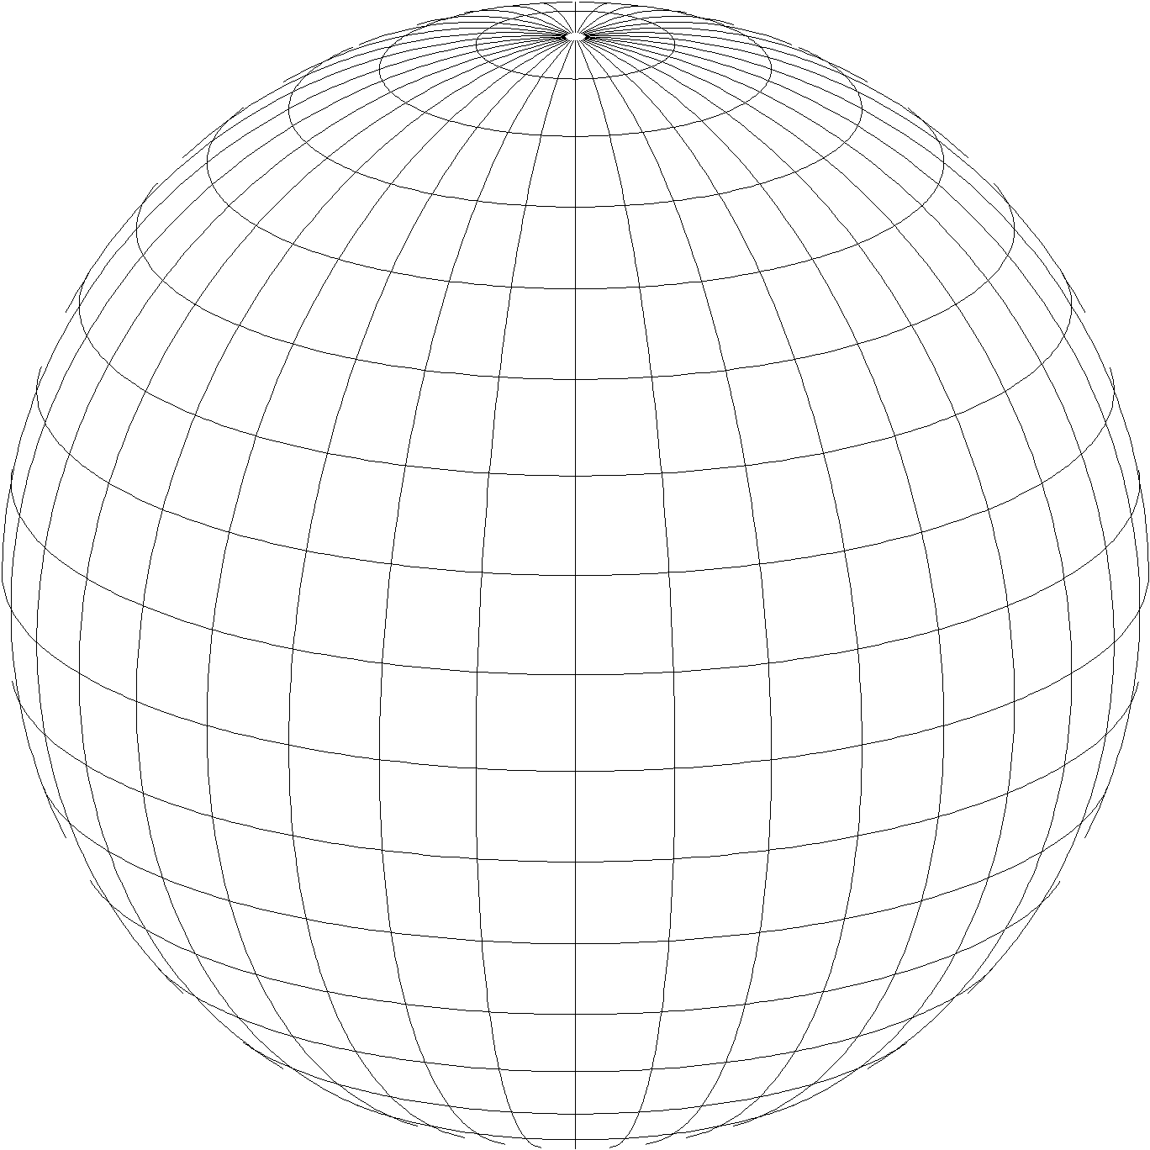
A New State Plane Coordinate System
State Plane Coordinate System of 2022 (SPCS202)
Referenced to new 2022 Terrestrial Reference Frames (TRFs)
Based on same reference ellipsoid (GRS 80)
Same 3 conformal projection types:
Lambert conformal conic
Transverse Mercator
Oblique Mercator

Slide 67
SPCS2022 project moving forward!
Main differences with existing State Plane:
Design to minimize distortion at topographic surface
Switch to one-parallel Lambert
Use of default SPCS2022 definitions
“Layered” and “special purpose” zones
Allowance for low distortion projections
Need for effective communication, outreach, and response
Goal: Work with customers to define practical SPCS2022 that best meets their needs for the NSRS of the future

Slide 68
Federal Register Notice SPCS2022
Special Zones
Major urbanized areas
Large American Indian reservations
Federal applications covering large geographic areas
*NGS seeks to determine whether it is appropriate to include special purpose zones as part of SPCS2022, or support special purpose zones in some other manner, if at all

Slide 69
Linear distortion at topo surface
Policy§II.C and Procedures§5.c.
Distortion for design evaluated at topo surface
Minimize range and mean distortion in zone
Account for cities with distortion weighted by population
Design not evaluated at the ellipsoid surface
Nobody lives or works on the ellipsoid
Likely used in past because it is easier
Projection scaled to topo surface (“ground”)
Reduces difference between “grid” and “ground”
Topographic ellipsoid height not part of definition

Slide 70
Why only a 1-parallel LCC?
Policy§II.A.1-2 and Procedures§5.a.i.
Consistency
Explicitly define projection scale (same as TM and OM)
Can use same number of parameters as TM
Applicable to both “secant” and “non-intersecting” cases
Simplicity
Easier to design with respect to topography
Scale due to separation of 2 standard parallels not obvious
Can more readily use “clean” values for parallels
Mathematically identical to 2-parallel
Any 2-parallel LCC can be recast as 1-parallel that behaves exactly the same

Slide 71
Default SPCS2022 designs
Policy§IV and Procedures§5.g.
For complete system even with no stakeholder input
To ensure coverage of all states and U.S. territories
Nearly same as SPCS 83 but with some modifications
Almost all zone projection types and extents the same
Modified to align with SPCS2022 policy and procedures
Small number of zones may change projection type, extents
Modifications to align with SPCS2022 policy:
Scale redefined with respect to topographic surface
One-parallel Lambert and local Oblique Mercator

Slide 72
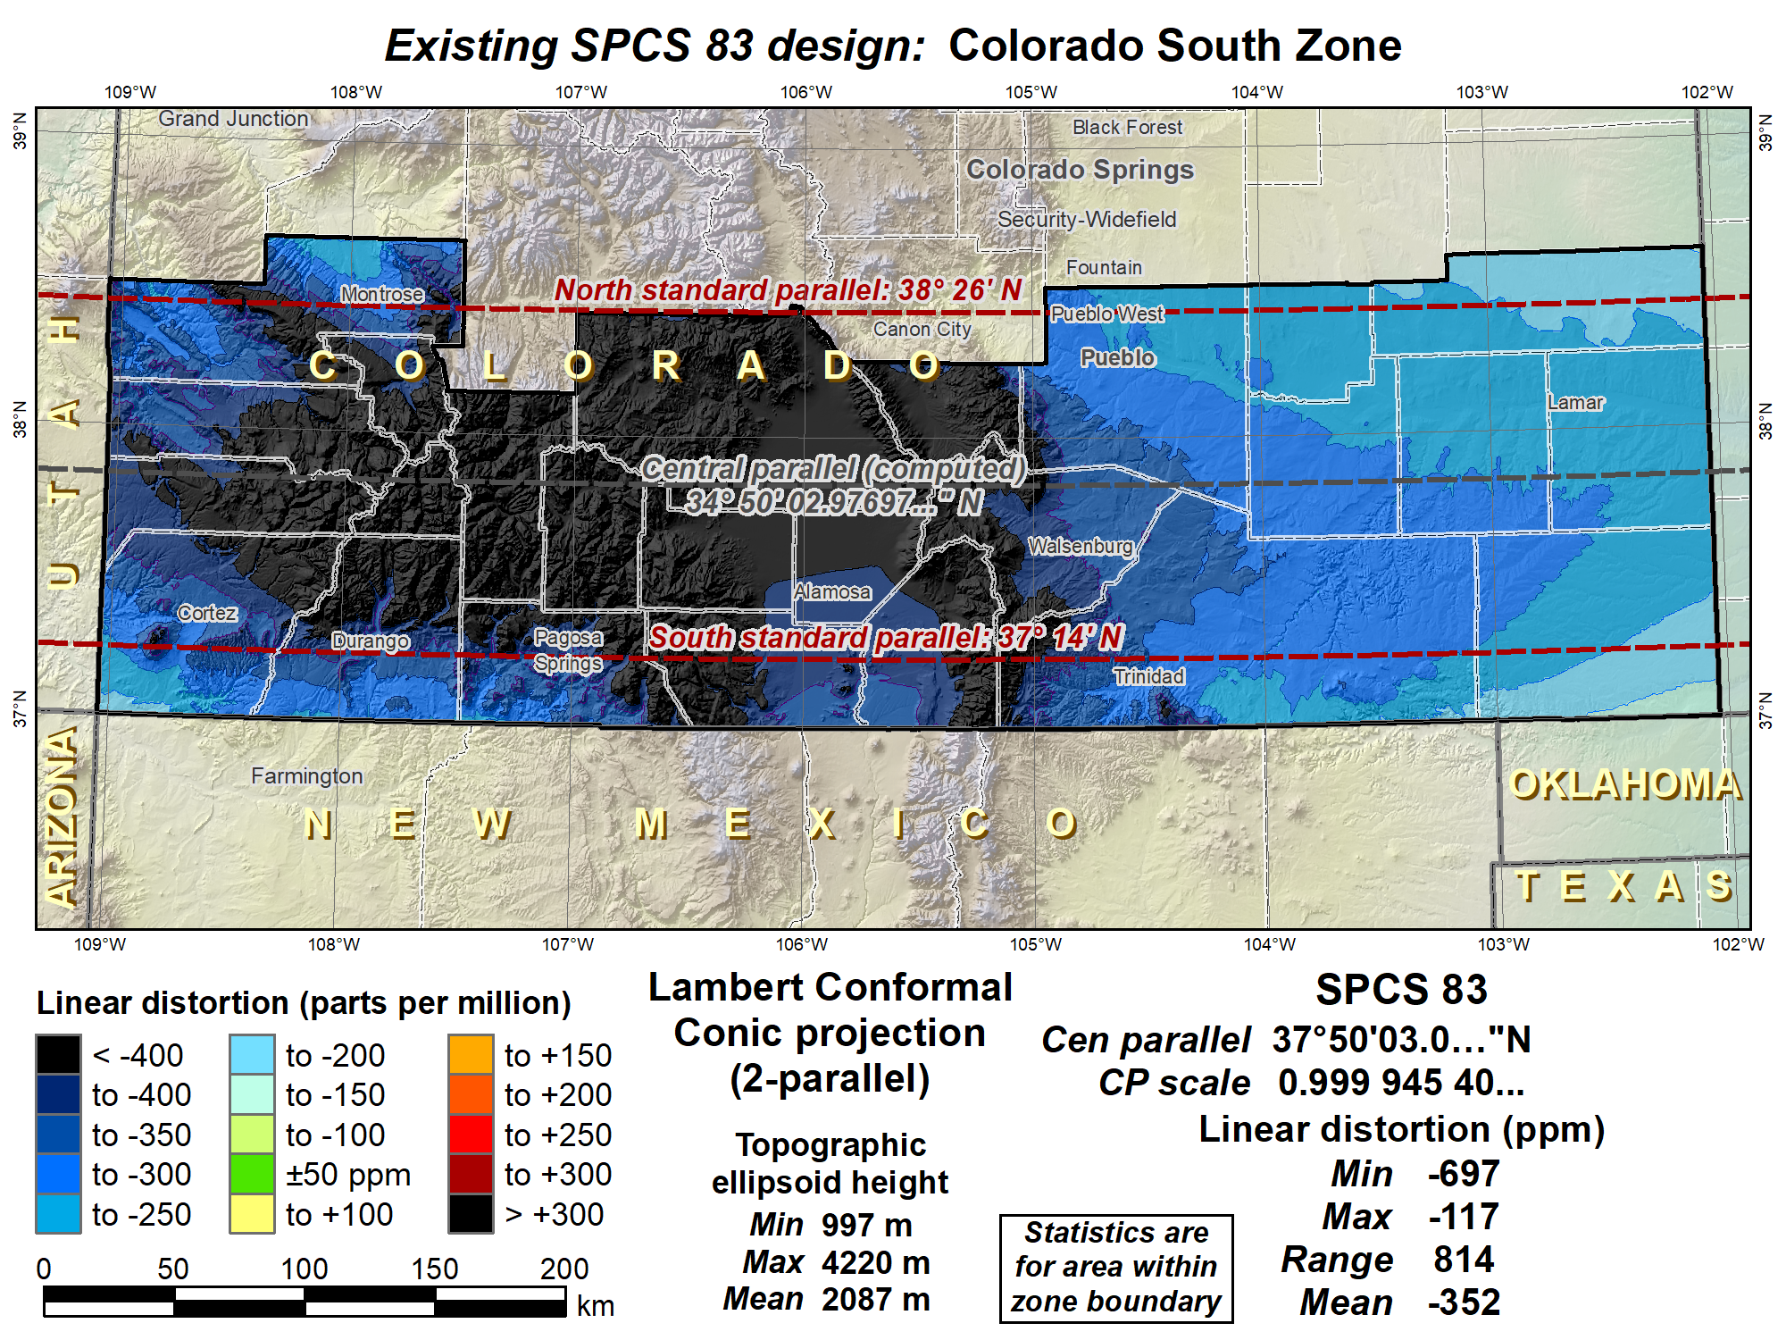

Slide 73
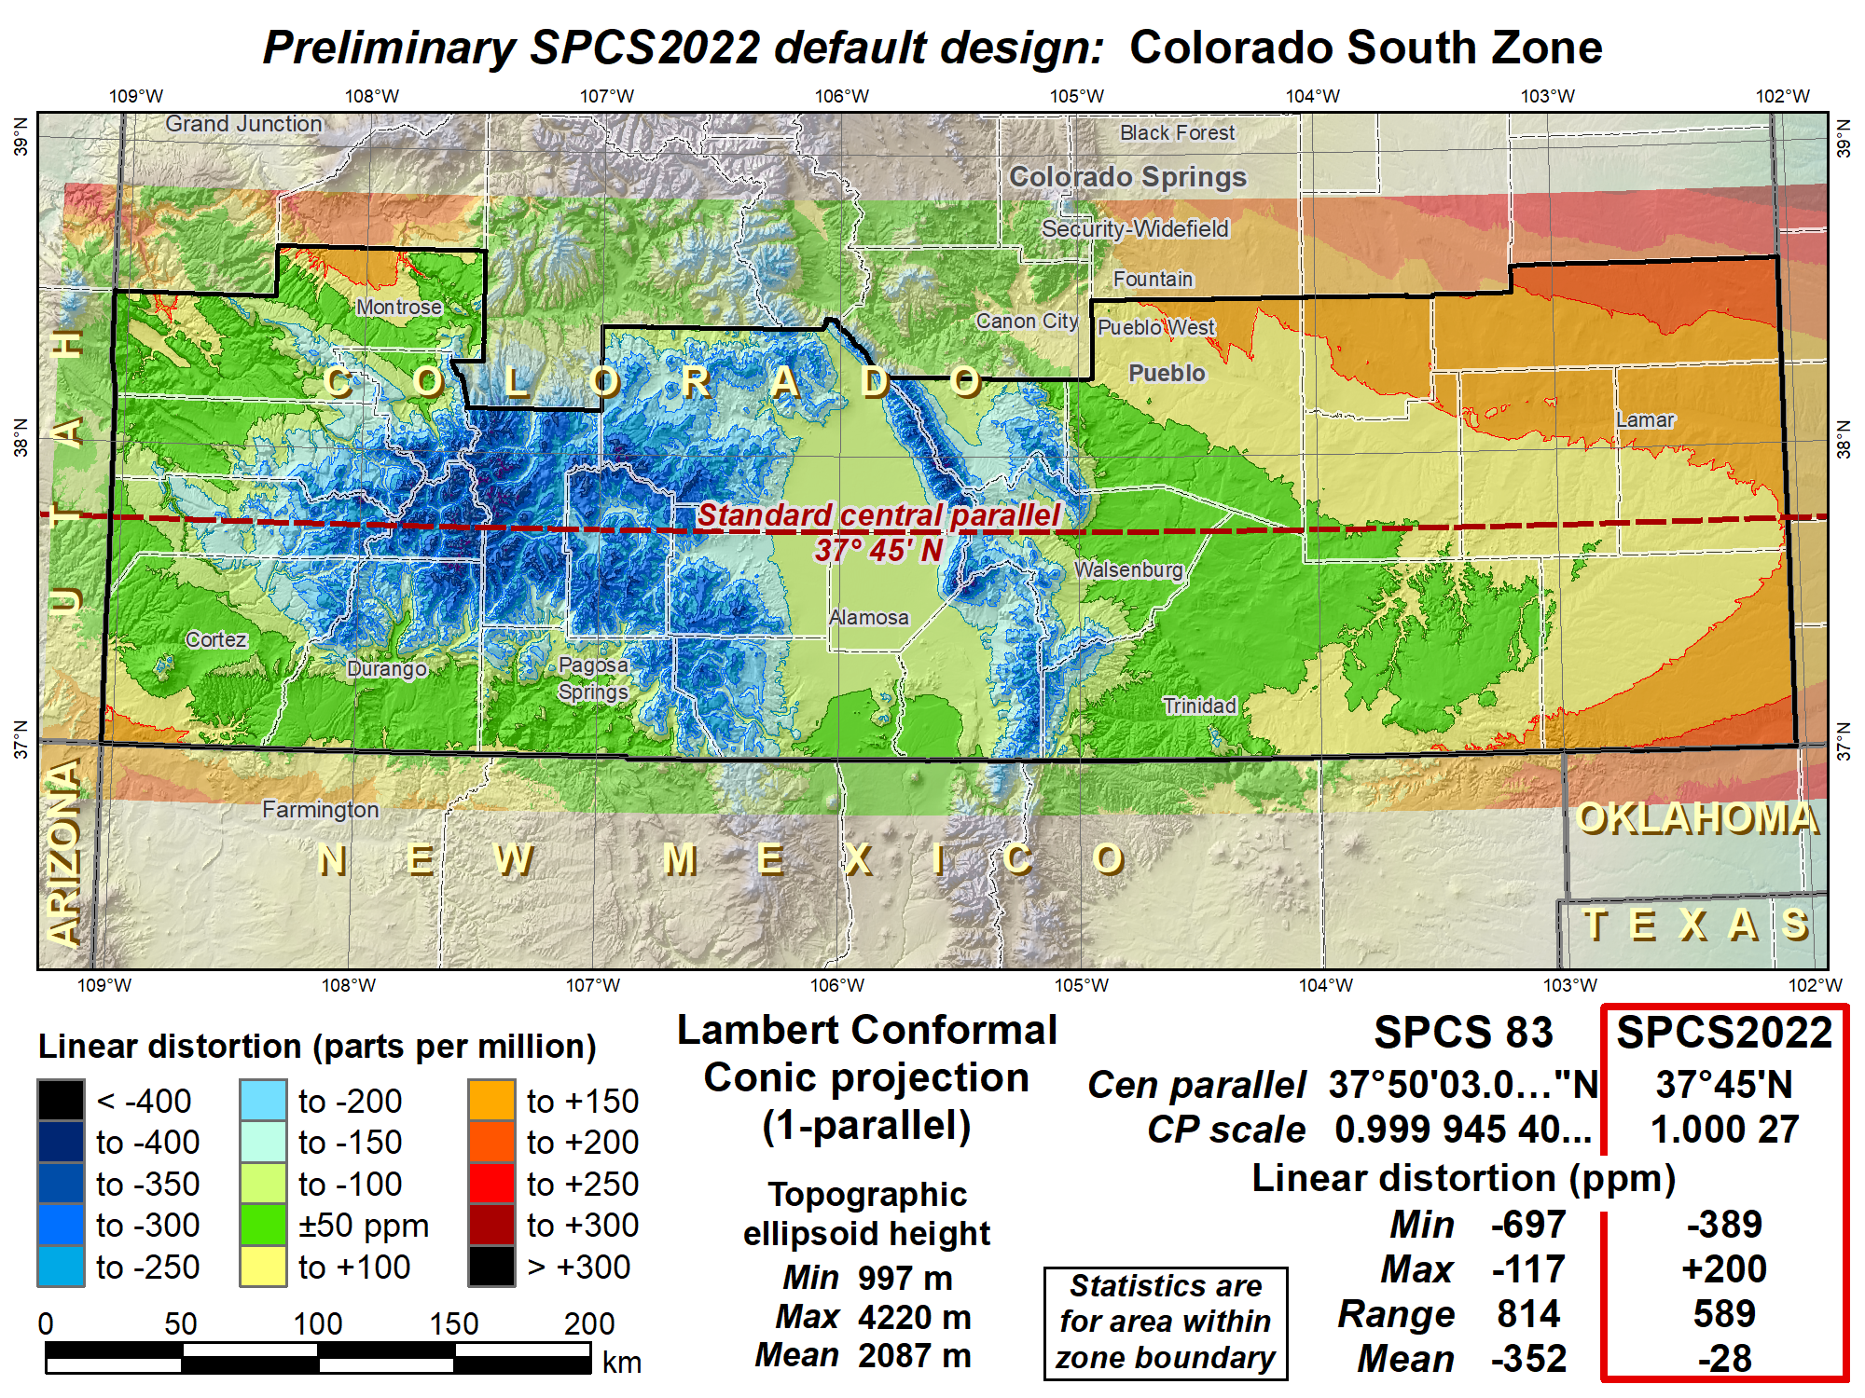
Shifted central parallel south to reduce distortion range, decreased scale to reduce distortion in cities.

Slide 74
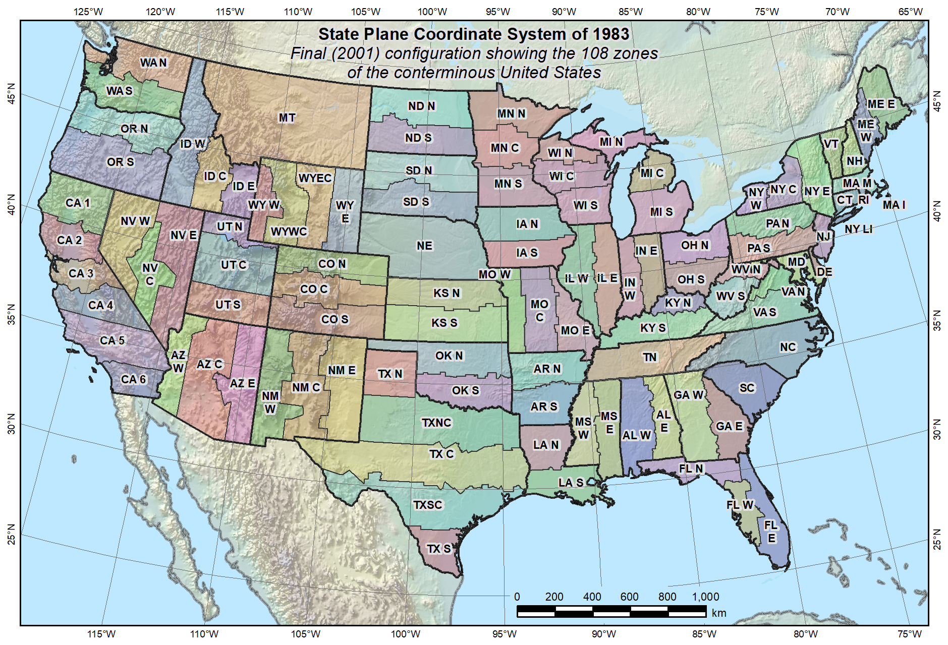
Default SPCS2022 would look a lot like SPCS 83…

Slide 75
Statewide and “layered” zones
Policy§III.A.2.
Limitations
Max of TWO layers: Statewide and sub-zones
If two layers, one MUST be statewide
Minimum subzone dimension > 50 km
States often want statewide and small zones
Statewide: Single geometry required for state GIS
Sub-zones: Lower distortion for surveying/engineering
Accommodates state needs, but with restrictions
Prevent poor design choices for statewide zones

Slide 76
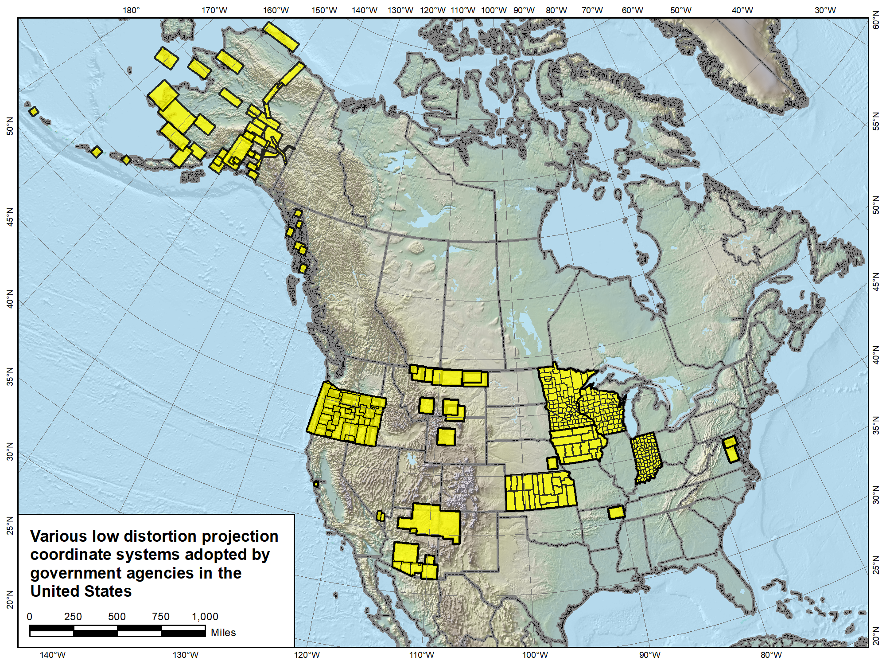

Slide 77
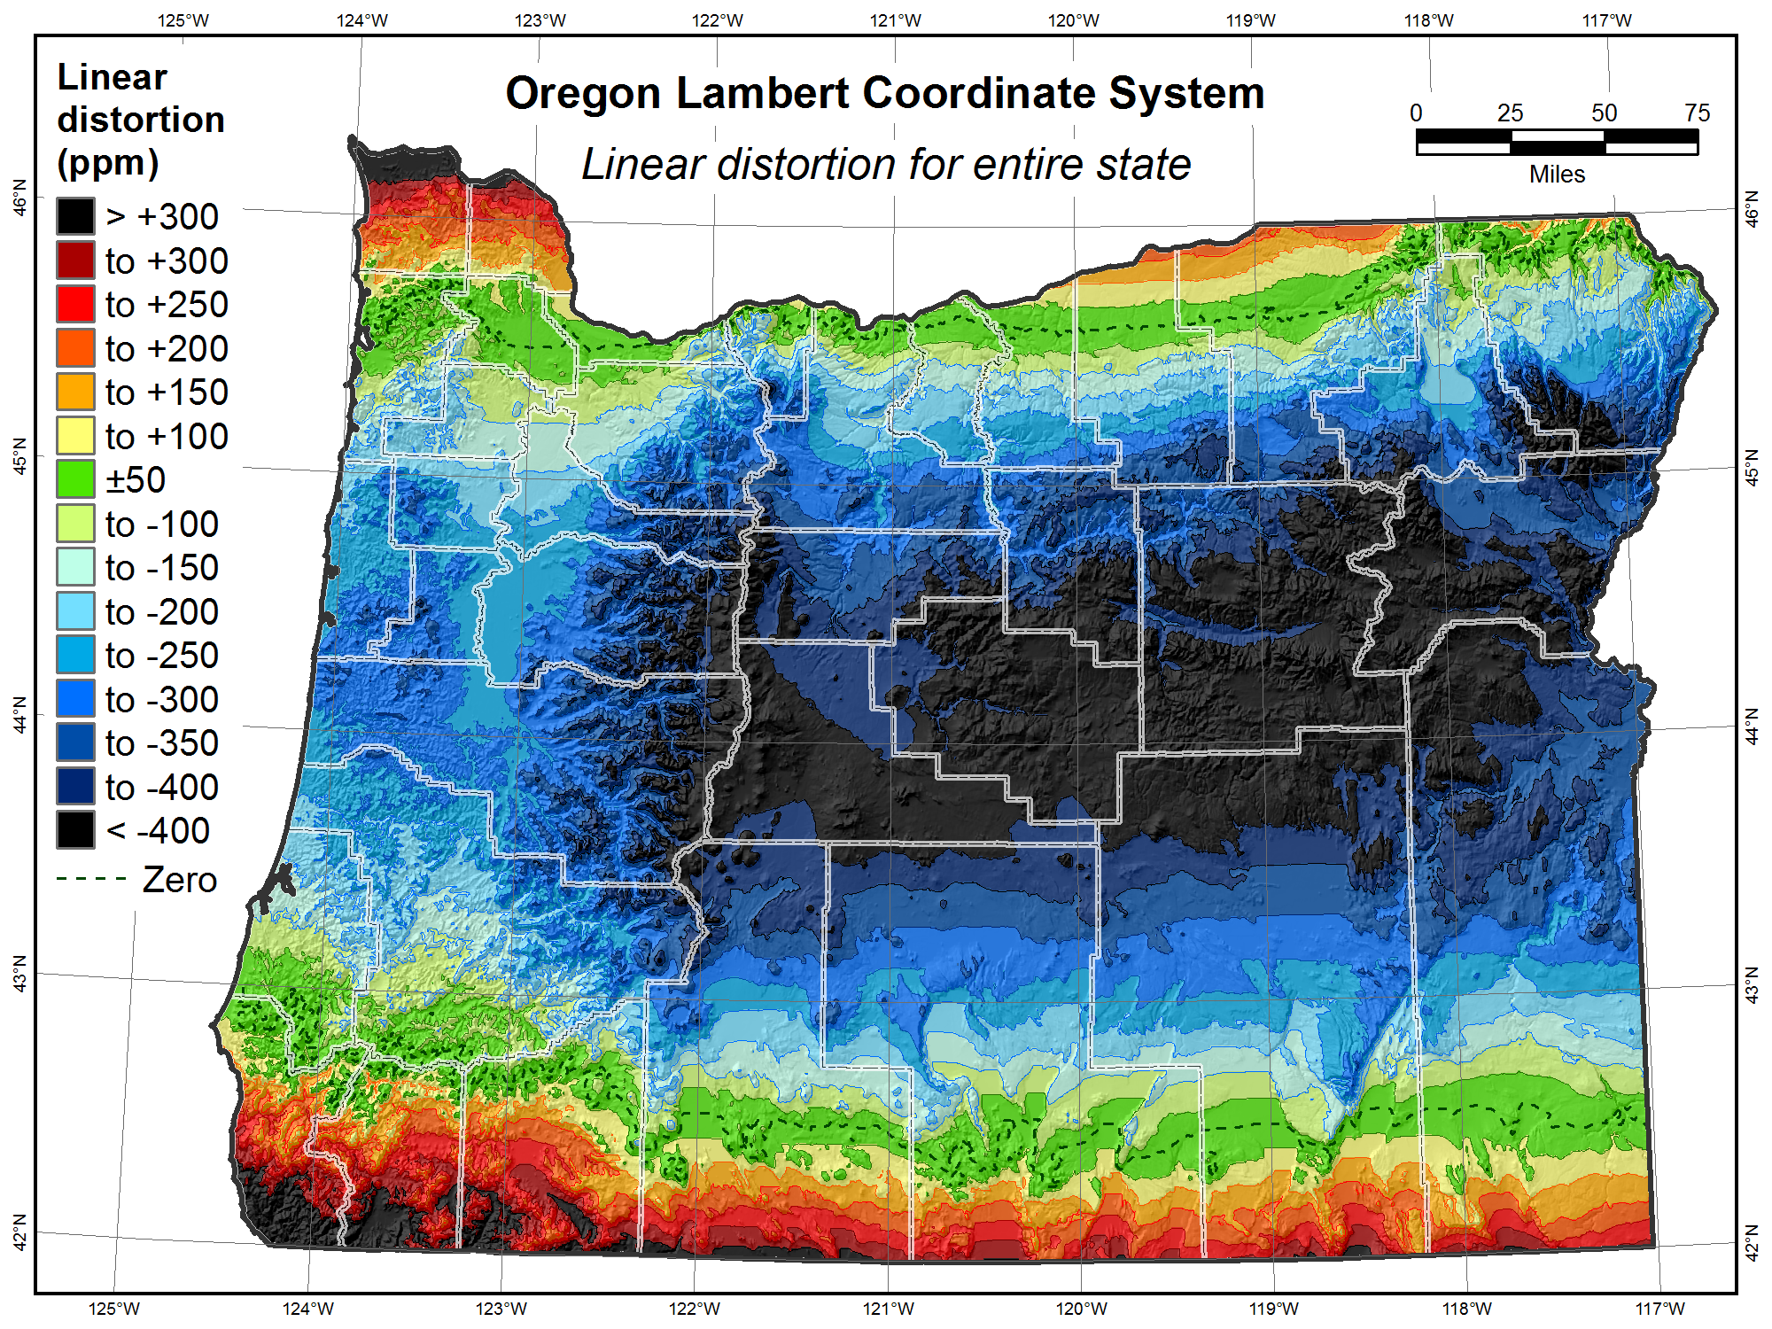

Slide 78
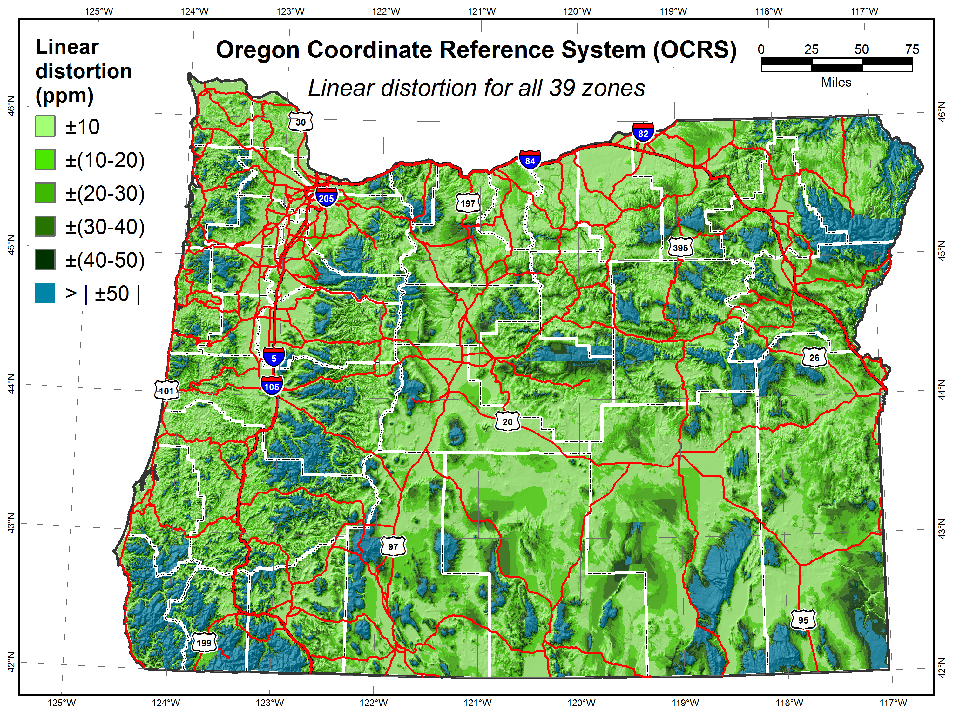

Slide 79
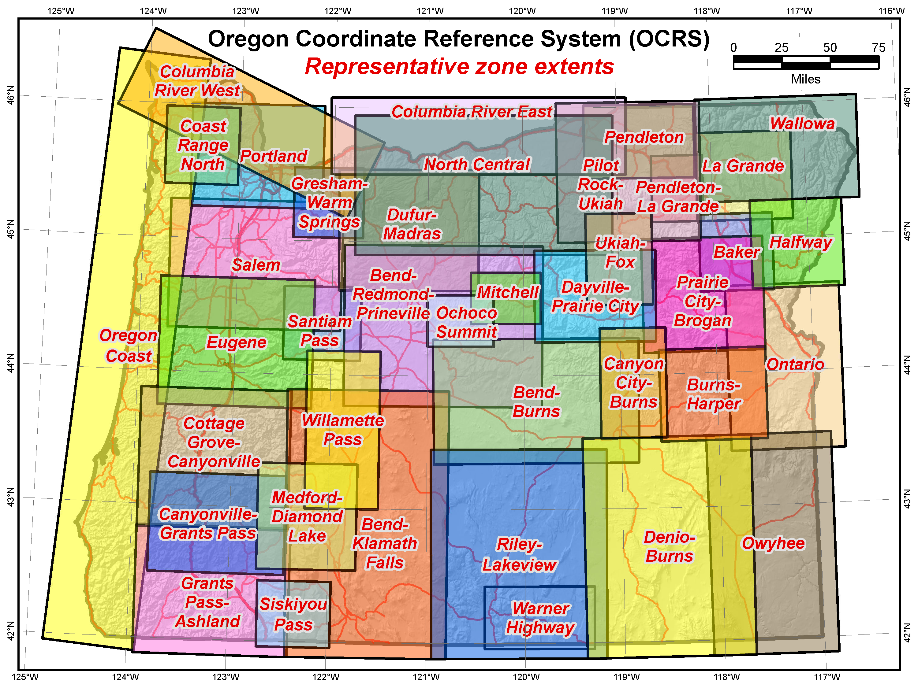

Slide 80
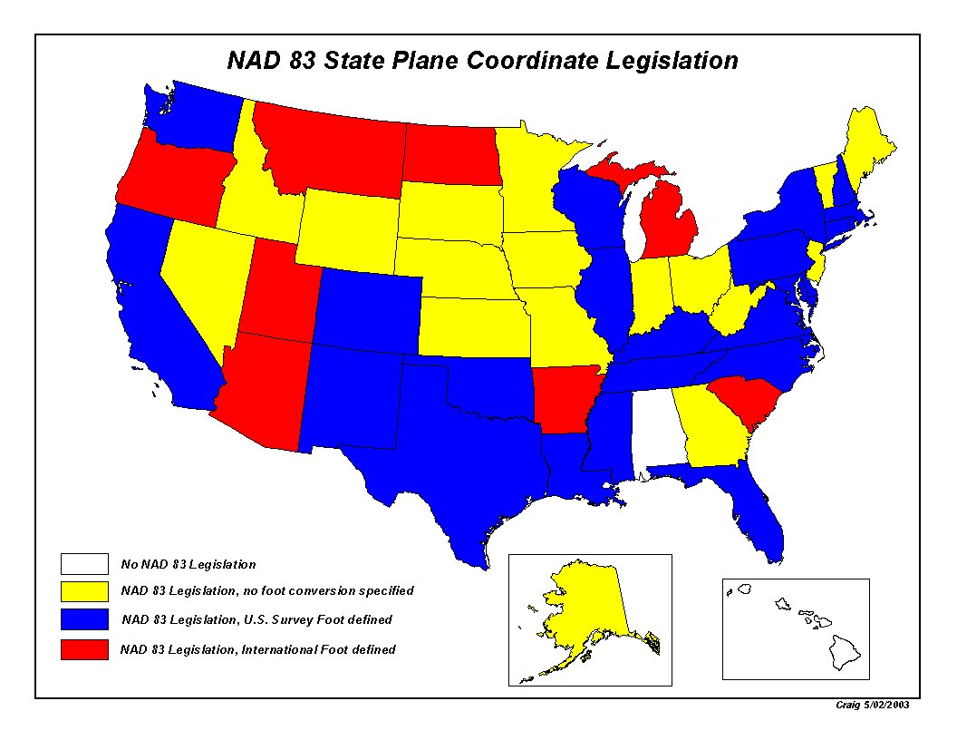

Slide 81
Deadlines (could change)
August 31, 2018 for Federal Register Notice comments
On policy and procedures
Includes “special purpose” zones
Deadlines for consensus input (Procedures 1.d.i.)
Dec 31, 2019 for requests and proposals
Requests are for designs by NGS
Proposals are for designs by contributing partners
Dec 31, 2020 for submittal of approved designs
Proposal must first be approved by NGS
Designs submitted by contributing partners
Designs must be complete before NGS review
Dec 31, 2021 for NGS to confirm zone computations
After deadlines, will be a change request for SPCS2022
NGS.Feedback@noaa.gov
NGS.SPCS@noaa.gov

Slide 82
Deadlines:
August 31, 2018
Respond to NGS Draft Policy and Procedures
December 31, 2019
Request for State Plane Coordinate Zones designed by NGS or proposals for zones designed by contributing partners
December 31, 2020
Submit defining parameters for zones designed by contributing partners approved by NGS
December 31, 2021
Confirmation of final design characteristics and computations will be provided by NGS

Slide 83
Guest Speakers
Josh Nimetz, USGS
Thomas Breitnauer, Denver International Airport
John Hunter, Denver Water

Slide 84
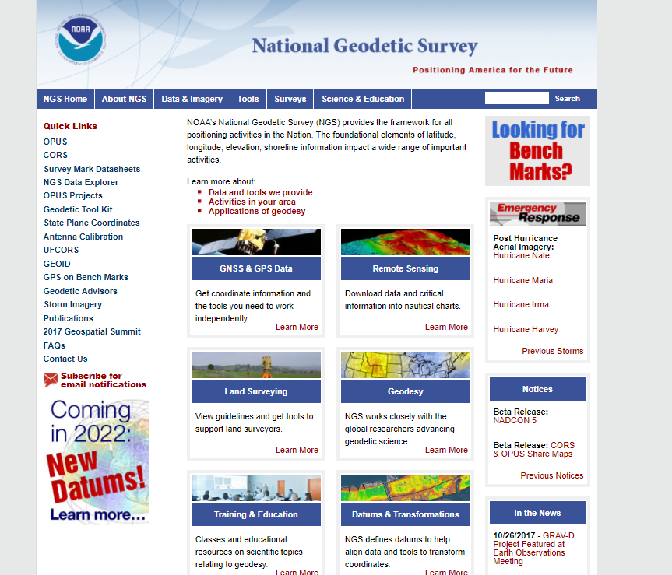
geodesy.noaa.gov

Slide 86
Blueprints
Updated Acroynms
xGeoid, OP2IDB
SPCS 2022
Toolkit Improvements
NOAA Technical Report NOS NGS 62, “Blueprint for 2022, Part 1: Geometric Coordinates
NOAA Technical Report NOS NGS 64, “Blueprint for 2022, Part 2: Geopotential Coordinates

Slide 87
Next steps and Future
SPCS 2022
Consensus needed across the State
3 existing zones, 1 zone, both, others?
GPS on BM for transformation tools
Need GIS communities assistance in identifying whether marks are in place and good for GPS
Interns
RTK
???

Slide 88
NOAA’s National Geodetic Survey
Thank you
Pam Fromhertz
Pamela.fromhertz@noaa.gov
240-988-6363

Slide 89
Backup Slides

