Slide 1
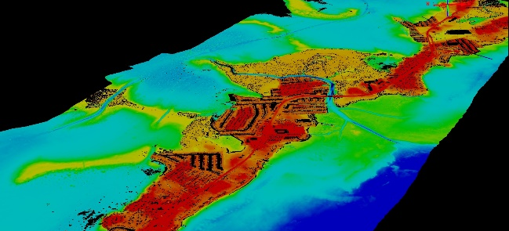
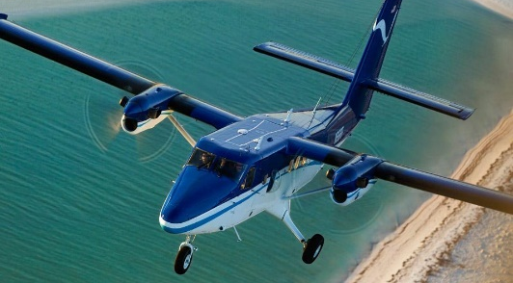
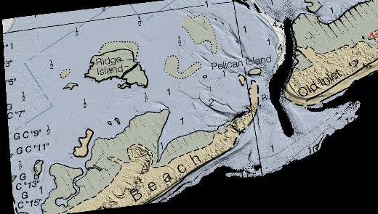
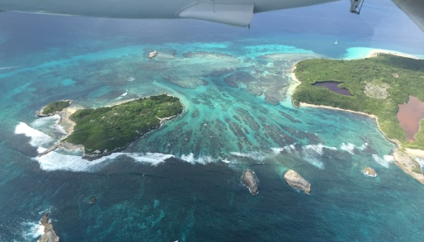
NGS Coastal Mapping Program Update Shoreline, Imagery, and Nearshore Bathymetry
Mike Aslaksen
Chief, Remote Sensing Division
National Geodetic Survey
NGS Webinar Series November 12, 2020

Slide 2
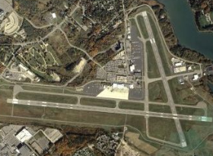
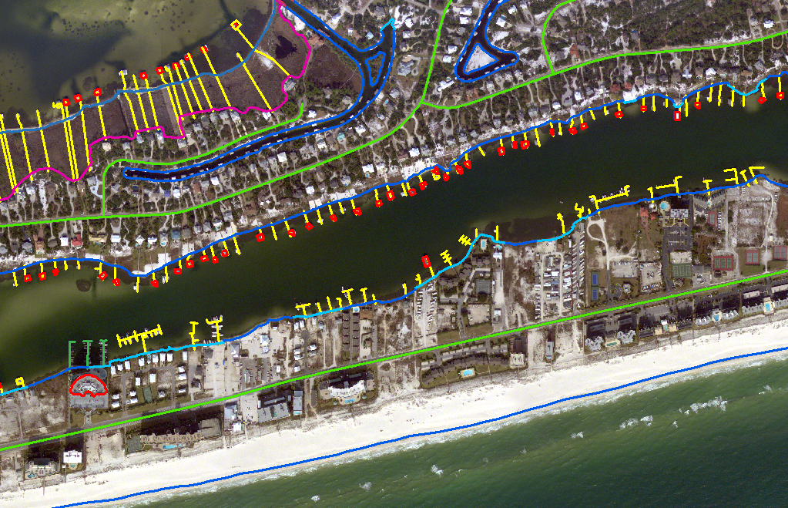
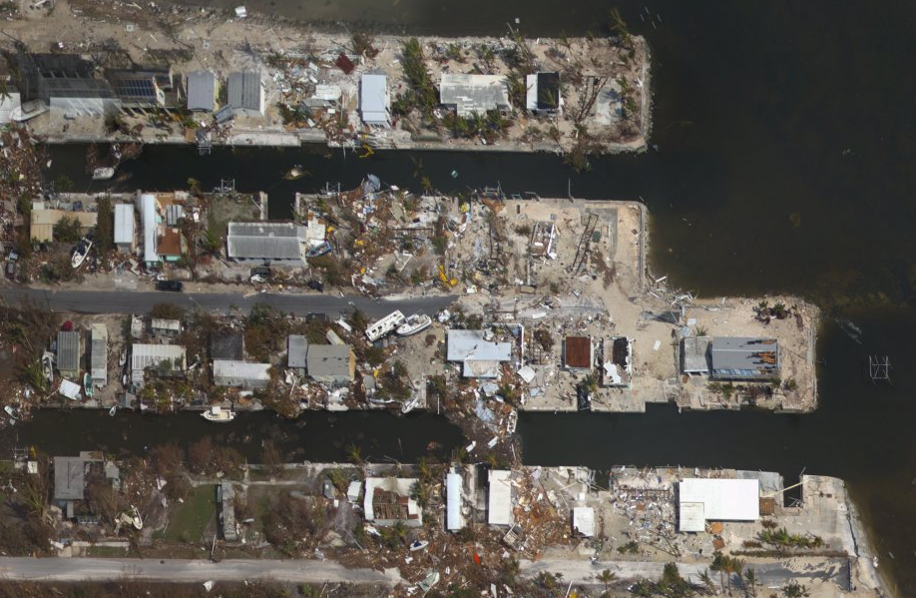
National Geodetic Survey
Mission: Define, maintain and provide access to the National Spatial Reference System.
RSD Primary Programs:
Aeronautical Survey
Program
Coastal Mapping
Program
Emergency Response

Slide 3
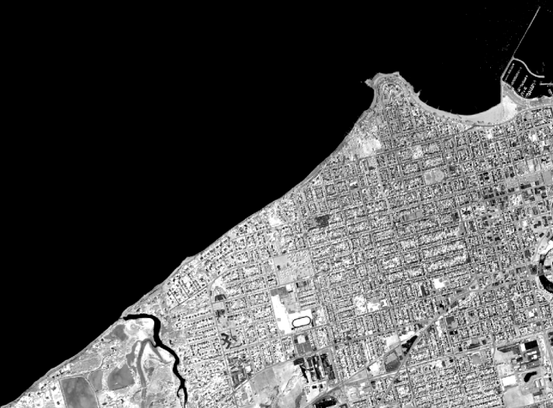
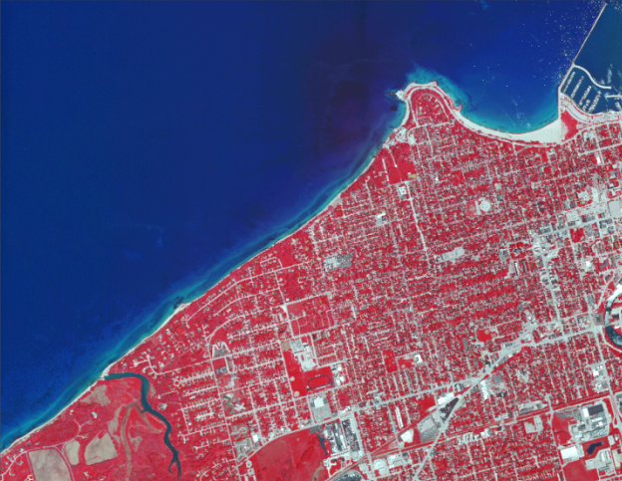
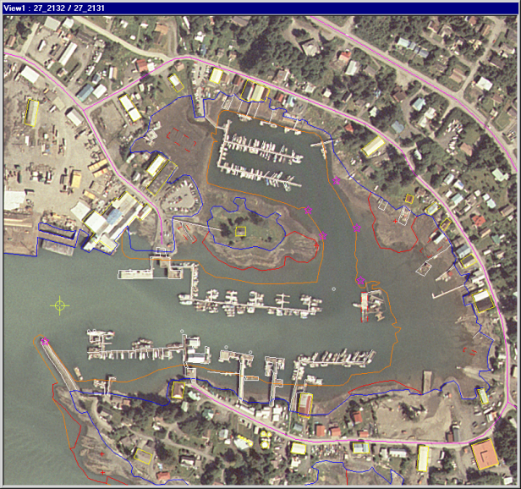
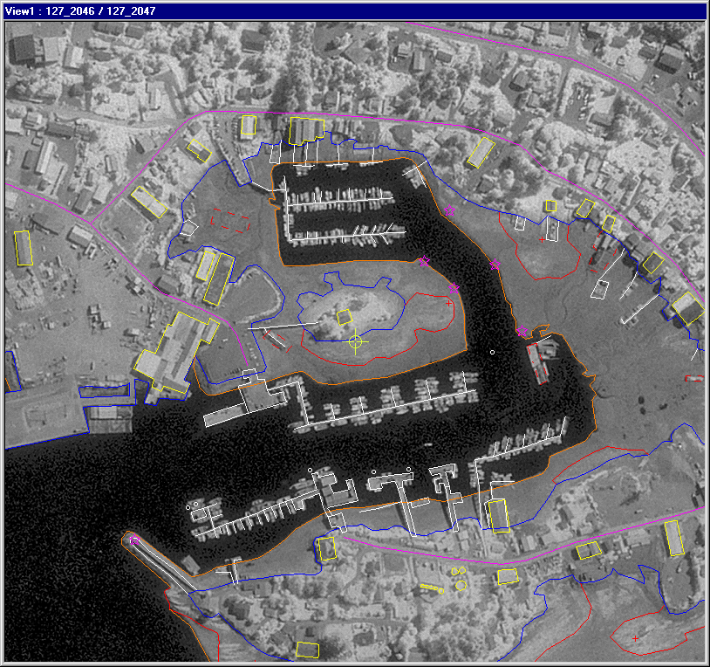
The RSD Coastal Mapping Program
A congressional mandate to conduct remote sensing surveys of coastal regions of the United States and its possessions for demarcating the nation’s legal coastline.
Goals:
Provide the Nation With Accurate,
Consistent, Up-to-Date
National Shoreline
Acquire Nearshore
Elevation Data
Sources:
Lidar
Digital Cameras
High Resolution Satellites
UAS

Slide 4
FY20 Metrics
11,300 miles* of shoreline compiled (6.8% of US)
Updated shoreline for >270 nautical charts
57 ports updated with new shoreline
50 ports analyzed for change (CSCAP)
1305 sqnm of ALB data delivered
1000 sqnm of ALB collected
*miles measured at 1:80,000 scale
NGS.Shoreline.Request@noaa.gov

Slide 5
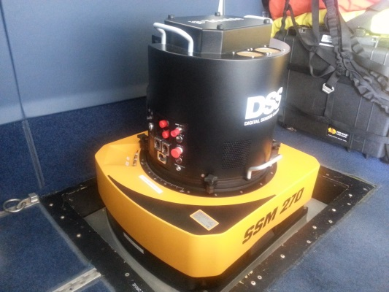
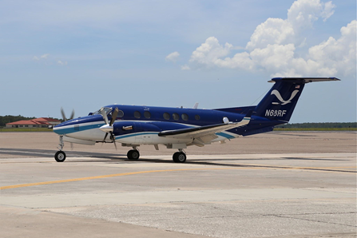
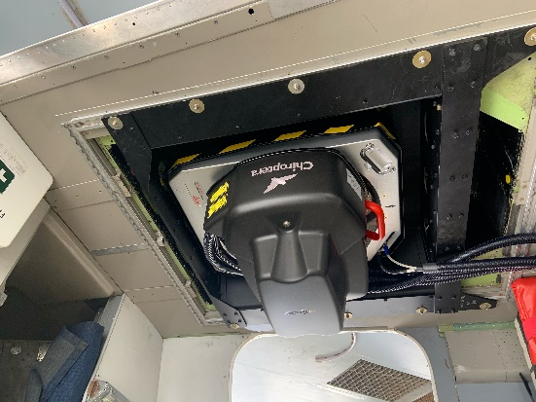
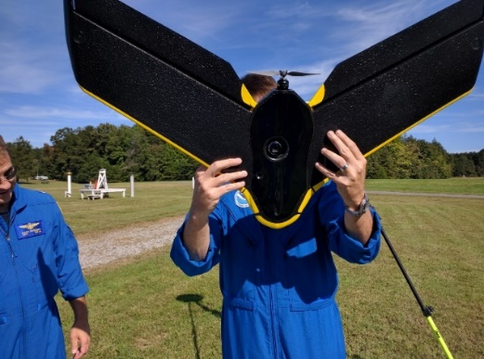
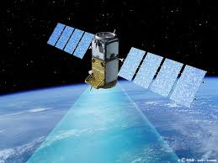
How do we do it?
NOAA and contract aircraft
Trimble DSS580 Dual Cam & DSS500 Dual Oblique Cam *
RGB & NIR cameras (NIR in DSS580 only)
35cm GSD at 10,500’ flying height
In-flight image processing
Topobathy LIDAR
Hexagon Chiropterra 4X*
Satellite Imagery
Private sector contracts
Shoreline Mapping IDIQ contract
4 Prime contractors (Dewberry, Fugro, QSI, Woolpert)
5 year awarded in Spring 2020
Notes:
King Air – Long endurance for greater efficiency (fewer flights to acquire large area). Fast acquisition speed means more miles mapped per flight hour. Fast transit speed allows us to quickly move from one acquisition area to another.
Applanix DSS – Digital camera. Two cameras mounted fore and aft. One collects color (RGB – red, green, blue) imagery, the other collects Near Infrared (NIR). The sensor resolution is 80 megapixels. We map to a Ground Sample Distance (GSD) of 35cm. This is achieved when flying at an altitude of 10,500’ above ground level (AGL). We process the raw imagery in the air which saves time on the ground post flight. We also have a DSS 500 Oblique Camera system with dual oblique cameras (one port and one starboard) with look angles of 40 degrees. Total swath width of the DSS580 and DSS500 at 10,500 feet is around 8km.
LIDAR – Topographic LIDAR maps above water level only.

Slide 6
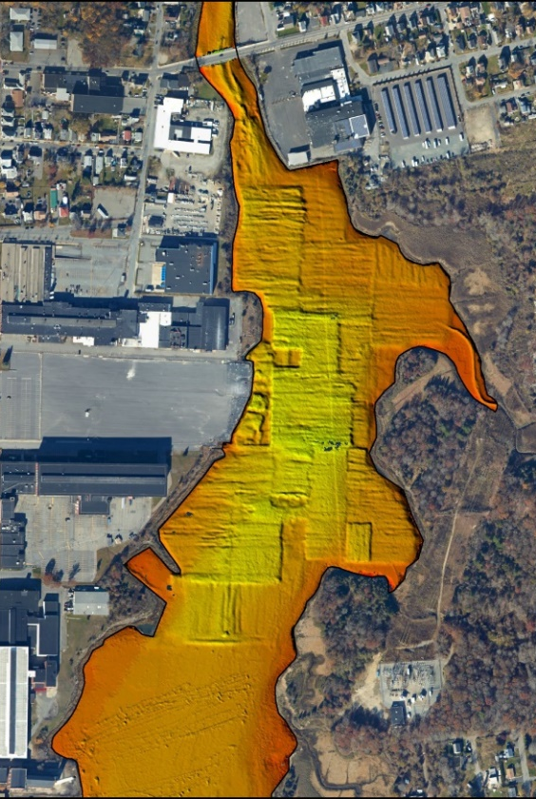
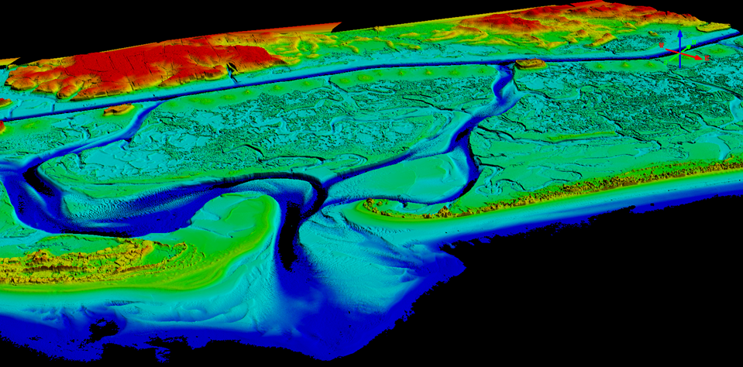
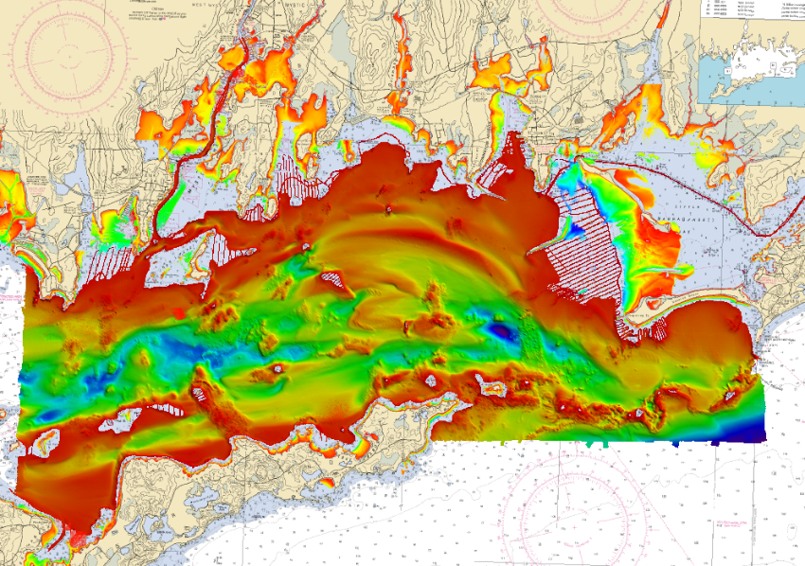
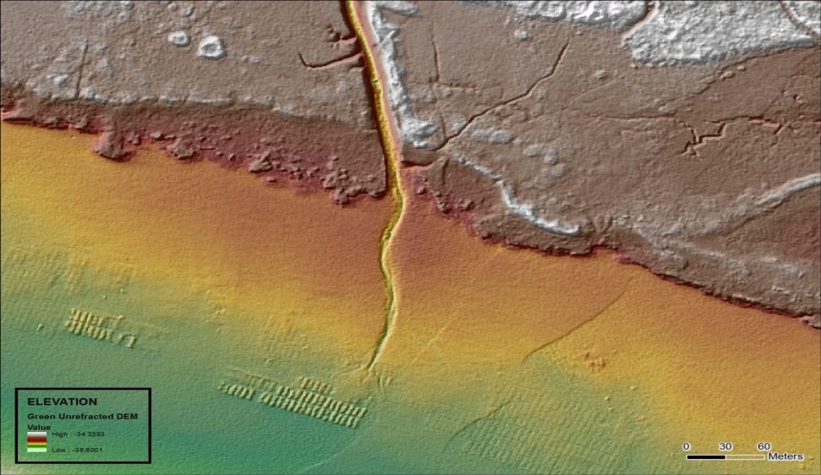
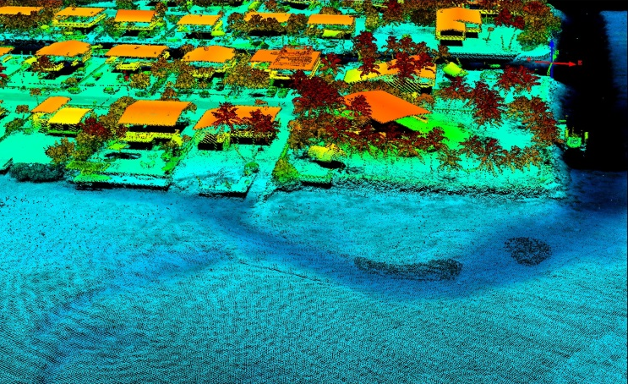
NGS’s Topobathy lidar data

Slide 7
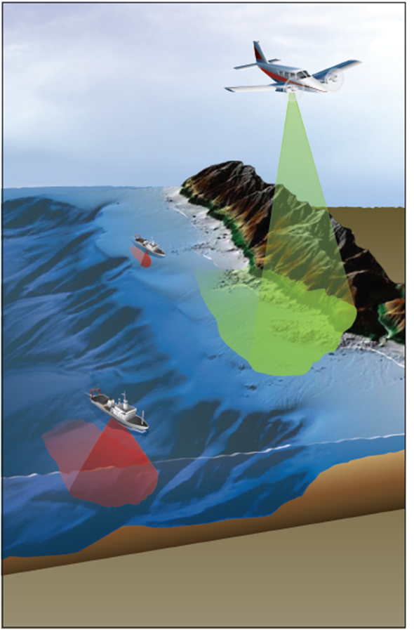
Support of Hydrographic Surveys
RSD collects nearshore topobathy lidar to the 4m NALL in the year prior to ship ops
RSD will provide both shoreline and nearshore bathymetry
Hydro operations use this data to plan operations to overlap with the lidar and overall situational awareness
Increases efficiency and safety of launch and ship operations
Graphic courtesy of Dewberry

Slide 8
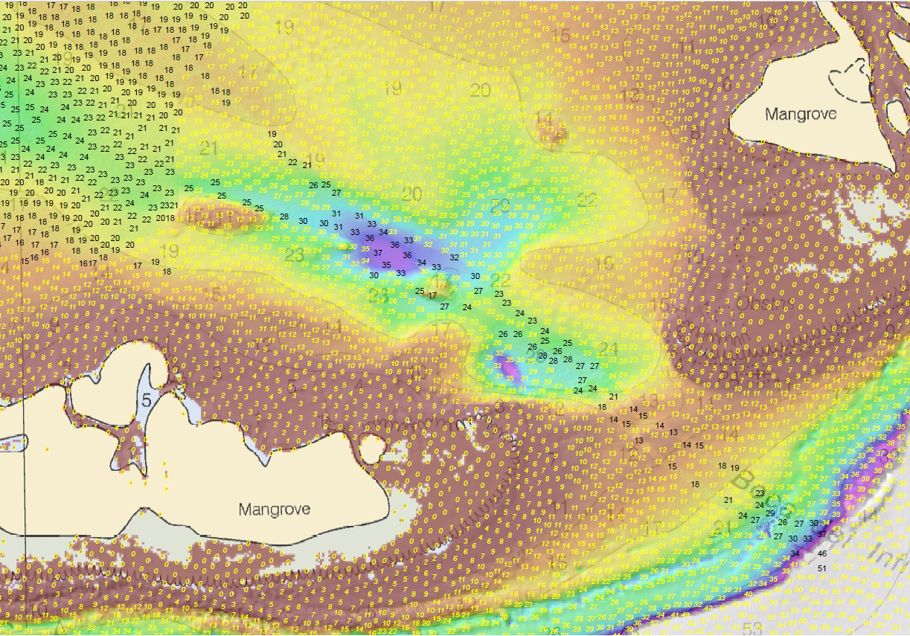
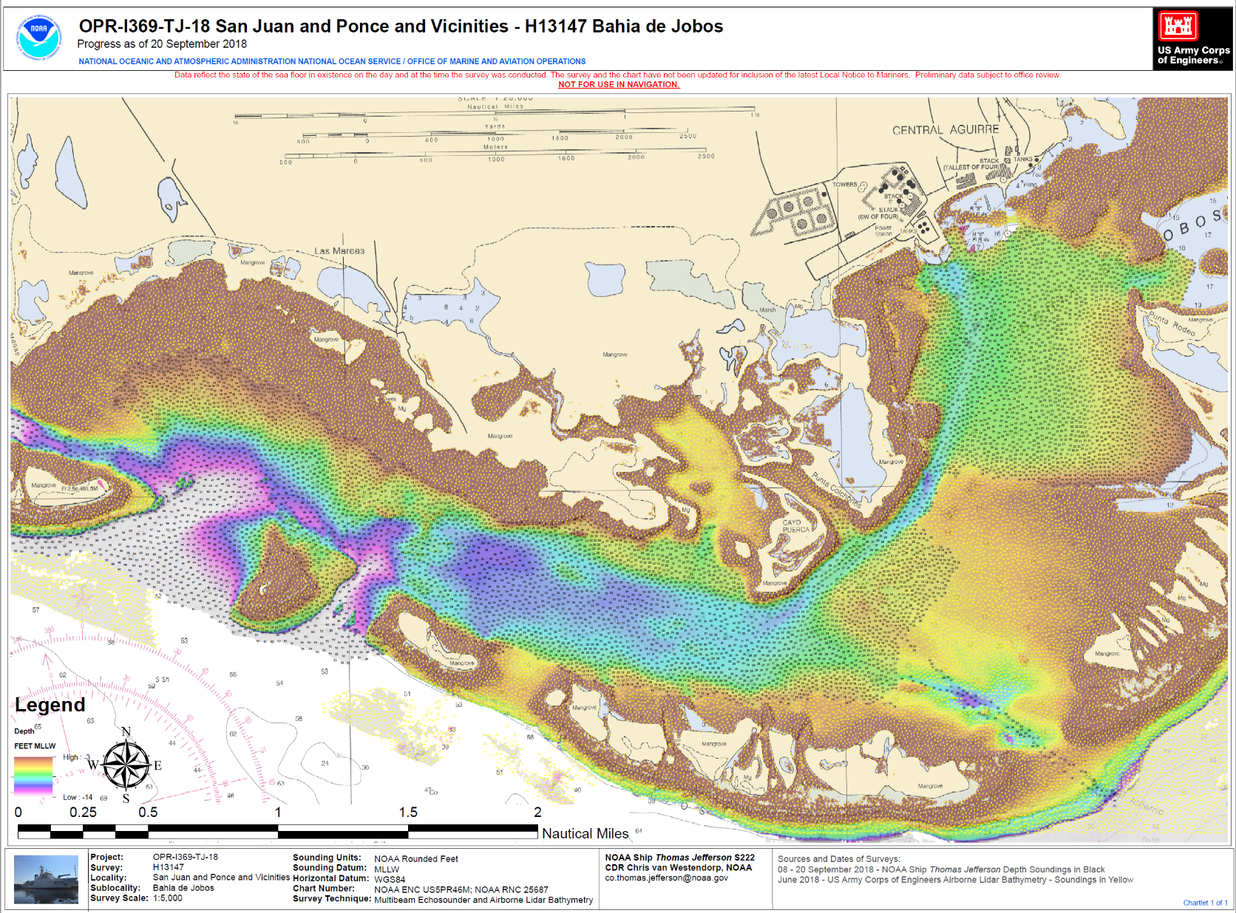
NOAA topobathy lidar and sonar operations
Courtesy of LT Anthony Klemm
Notes:
TJ MBES survey data in black and ALB data in yellow (circled in red)
Lidar was used where full coverage or set line spacing but not object detection requirements
Lidar was determined by HSD to satisfy Coast Surveys survey requirements in non-object detection areas (these typically shallow areas where there are less commercial traffic (deep draft) and some recreational marine traffic (shallow draft vessels))

Slide 9
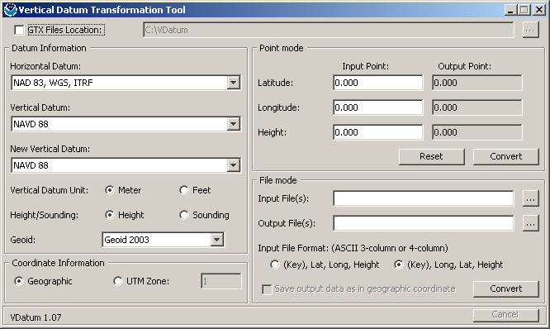
Lidar Shoreline Extraction
Edit Lidar Point Cloud
VDatum
Contour Shoreline from DEM
Quality Control &
Feature Attribution

Slide 10
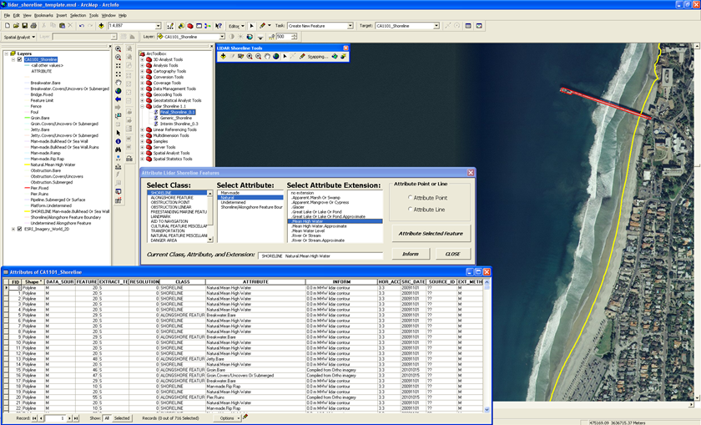
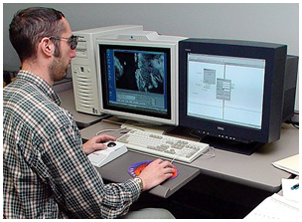
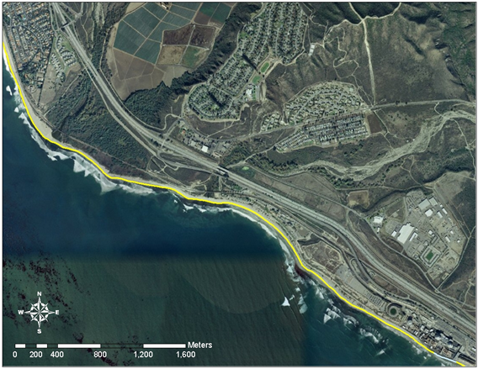
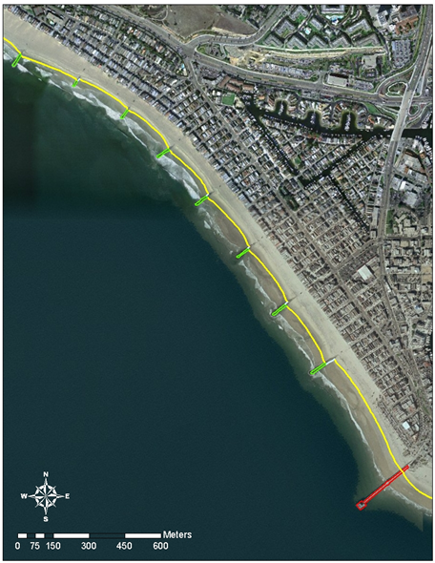
Imagery

Slide 11
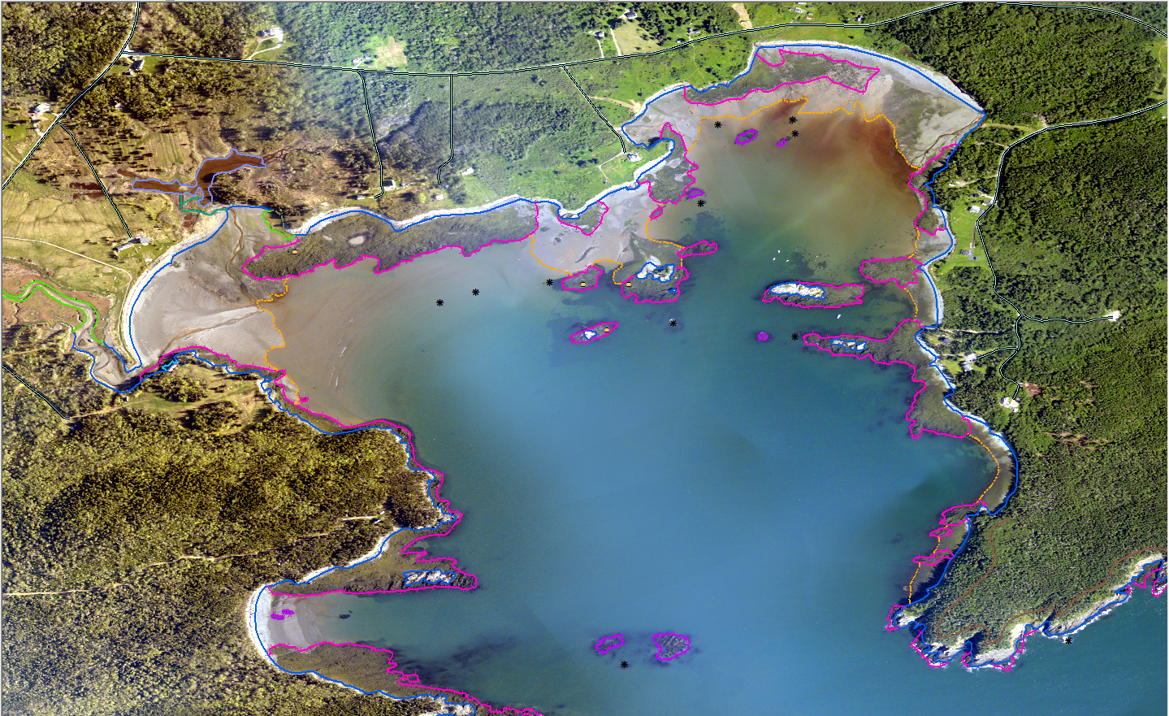
Bailey’s Mistake, ME
Notes:
Recent coastal mapping project near the eastern tip of Maine, ME1301C-CM-N (GC11137), compiled from MHW and MLLW tide-coordinated color and near-infrared aerial imagery. This shows a portion of the compiled features in the vicinity of the small cove “Bailey’s Mistake”, superimposed over the MLLW coordinated color imagery. Flip between this slide and the next to illustrate the differences between color and IR imagery, particularly focusing on the MLLW Depth Contour line (orange dash-dot line)
Captain Bailey's Mistake
Words: Charlie Ipcar and Judy Barrows ©2001
After a news story by Bruce Kyle
Bangor Daily News, 9/16/95
Original event occurred near Lubec, Maine, in 1809
Tune: after Ian Robb’s The Old Rose & Crown, ©1977 SOCAN
----------------------------------------------------------
Good friends gather round, and the truth I'll relate,
How a cove near Lubec became Bailey's Mistake;
There was a bold captain whose name was Bailey,
And his ship ended up where 'twas not s'posed to be.
Chorus:
So here's to our captain, where e'er he may be,
A friend to the sailor on land and on sea;
Ye mariners all, weigh the risks that ye take,
Lest you be remembered like Bailey's Mistake.
He set sail from Boston, Downeast for Lubec,
With a cargo of lumber piled high on the deck;
He skirted Cape Ann with nary a fear,
And our crew gave a cheer as the Maine coast drew near.
As we closed on Lubec, we was socked in by fog,
But continued to sail by compass and log;
As our ship ghosted in, "Look sharp!" Bailey said,
"You'll soon see the narrows off West Quoddy Head."
But, alas, for poor Bailey, no narrows we found,
And in a large cove our ship ran aground;
Said Bailey, "As sailors, there's no way we can win;
Let's unload the lumber, build homes and move in."
So here's to old Bailey, who sailed the salt sea,
'Till his ship ended up where 'twas not s'posed to be;
He'd be sailing still could he just navigate,
But he's doing quite well selling prime real estate!
(no chorus after the final verse)

Slide 12
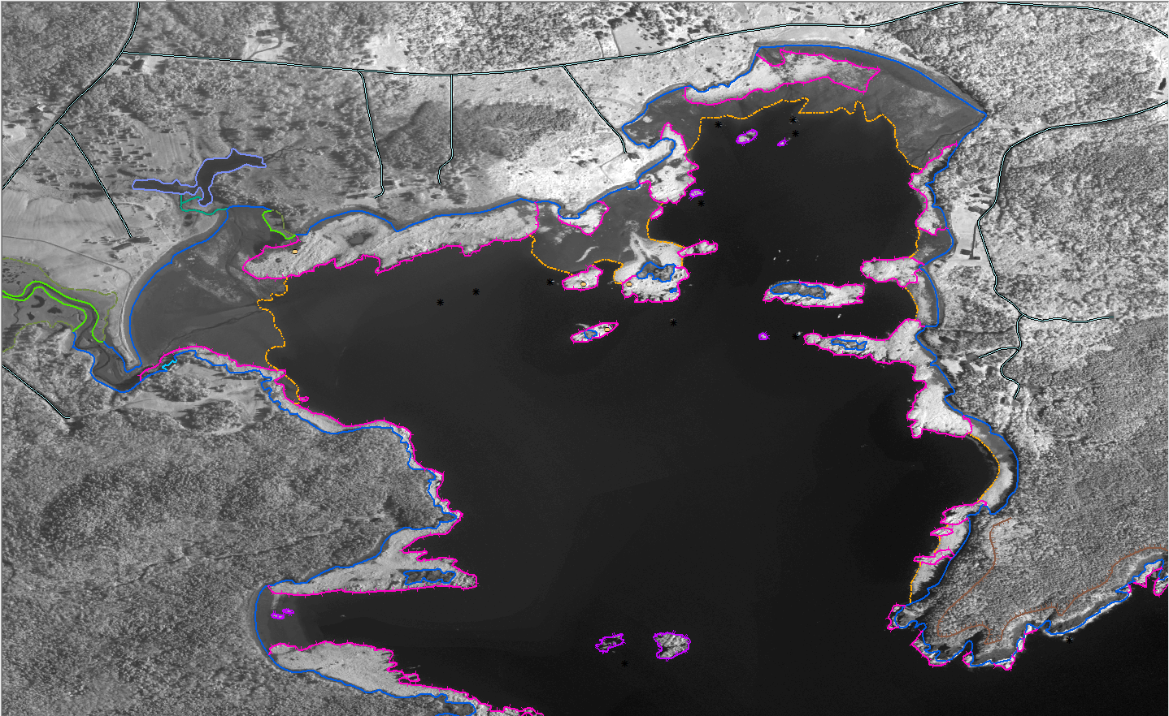
Road
MHW Shoreline
Marsh
MLLW Depth Contour
Ledge Covers/Uncovers
Reef Covers/Uncovers
Notes:
Various compiled features in Bailey’s Mistake, superimposed over the MLLW coordinated IR imagery. Flip between this slide and the previous slide to illustrate the differences between color and IR imagery, particularly focusing on the MLLW Depth Contour line.

Slide 13
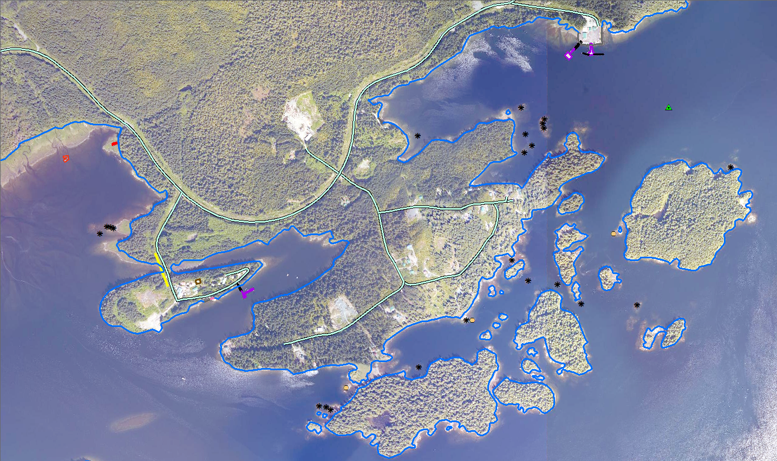
Fixed Pier
Rip Rap Shoreline
Road
Floating Pier
Daybeacon
Wrecks
Building
Overhead Cable
Covers/Uncovers Rock
Ramp
MHW Shoreline
Bare Rock
Notes:
The central part of the AK1620 project showing the various feature types compiled in GC11281, covering Clark Bay and Hollis Anchorage, superimposed over the project imagery.

Slide 14
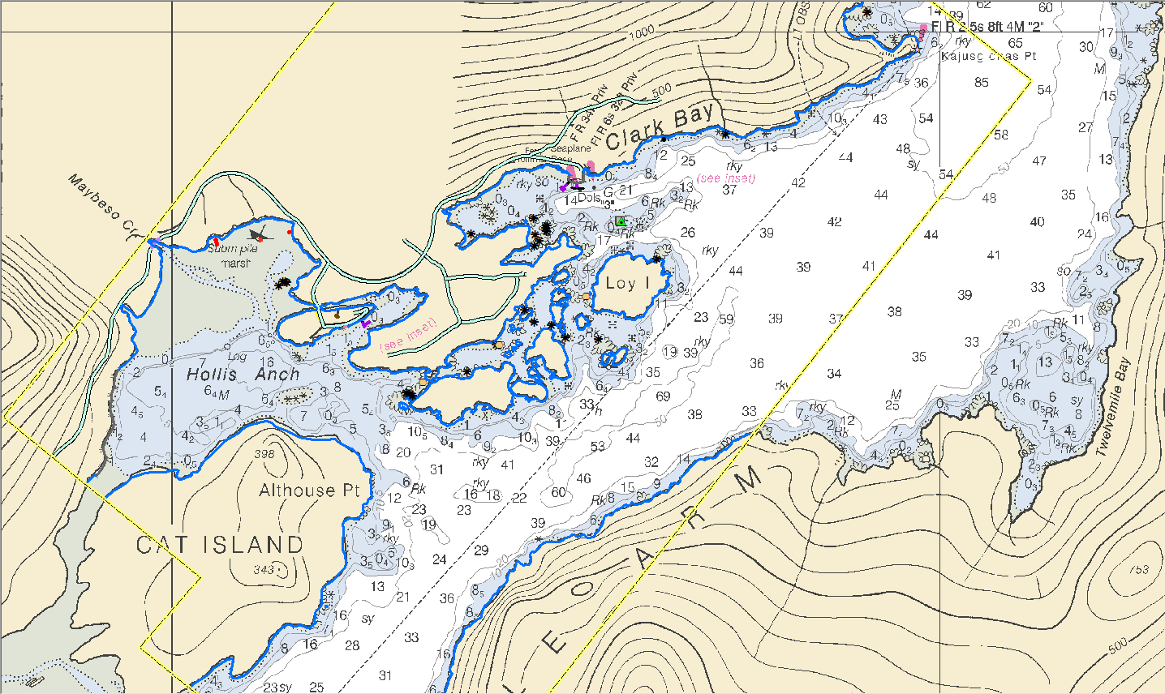
Geographic Cells (Nautical Chart Shoreline)
Notes:
Recent coastal mapping project in Alaska, AK1620-CM-N (GC11281), compiled from non-tide-coordinated color aerial imagery, in response to a request for updated shoreline to support a new large scale chart inset.

Slide 15
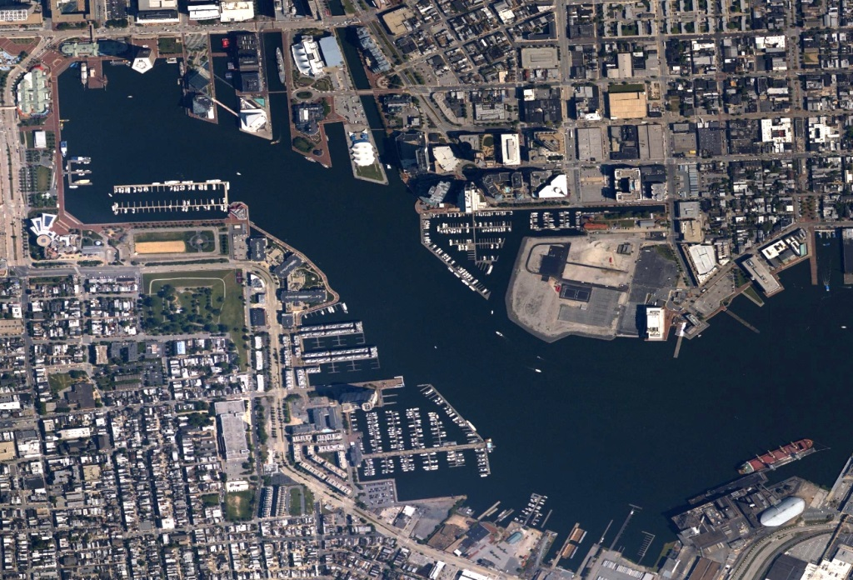
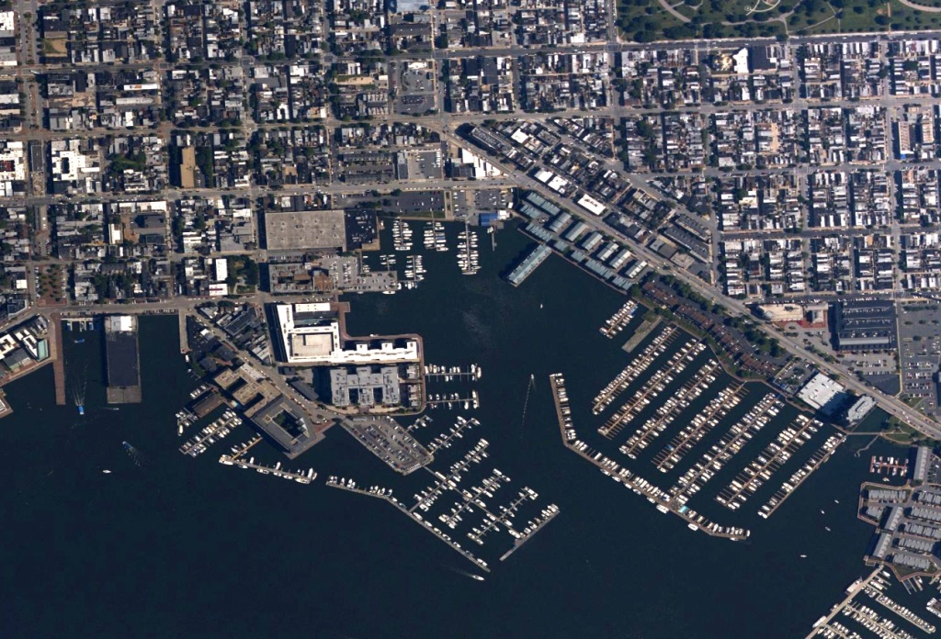
High Resolution Digital Aerial Imagery and Shoreline
Baltimore, MD
Notes:
NOAA imagery collected this year over Baltimore Harbor for the purpose of updating NOAA Nautical Charts.

Slide 16
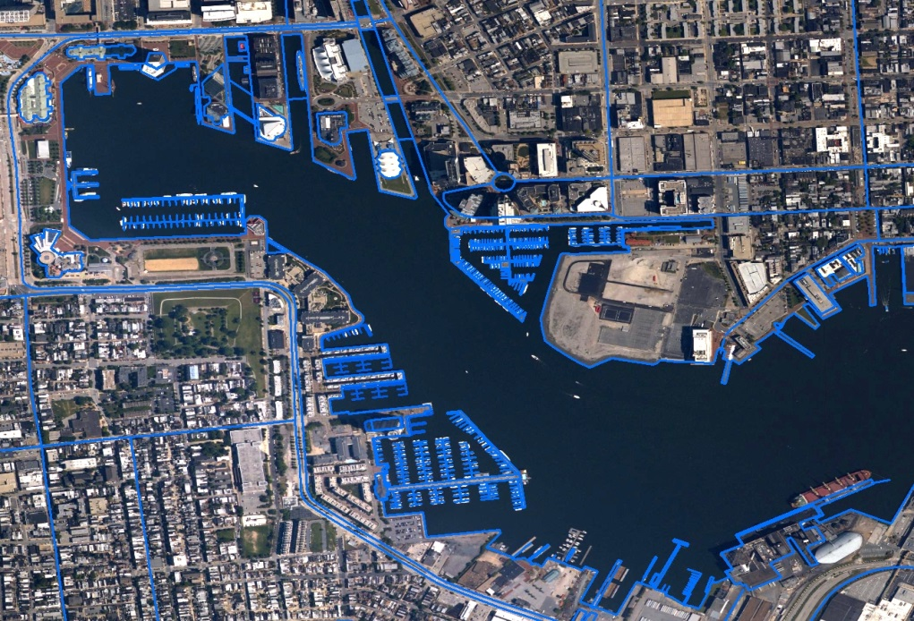
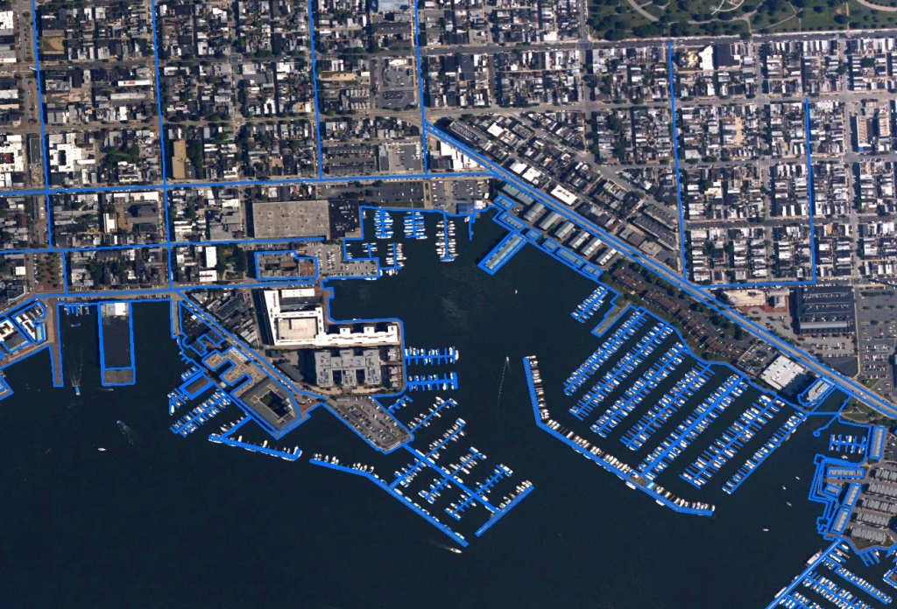
High Resolution Digital Aerial Imagery and Shoreline
Baltimore, MD
Notes:
Same imagery with new and updated shoreline for the NOAA Nautical Chart.

Slide 17
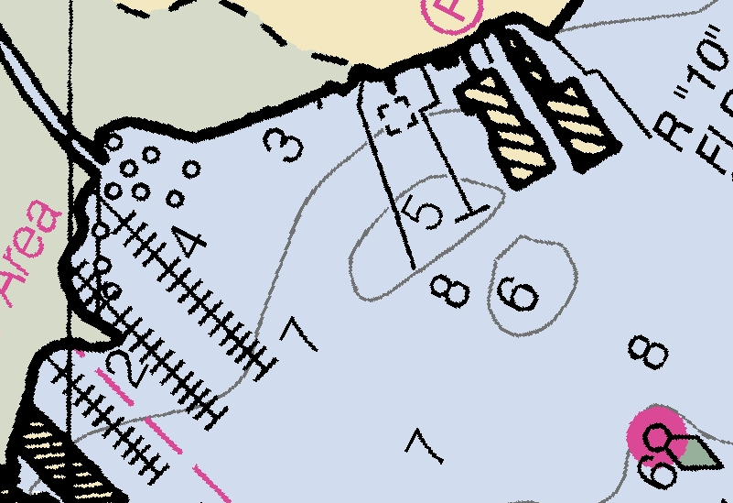
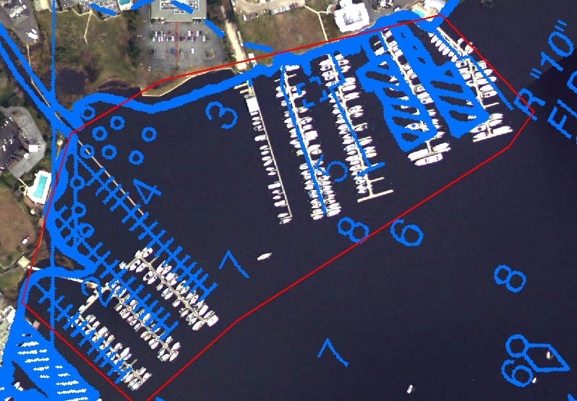
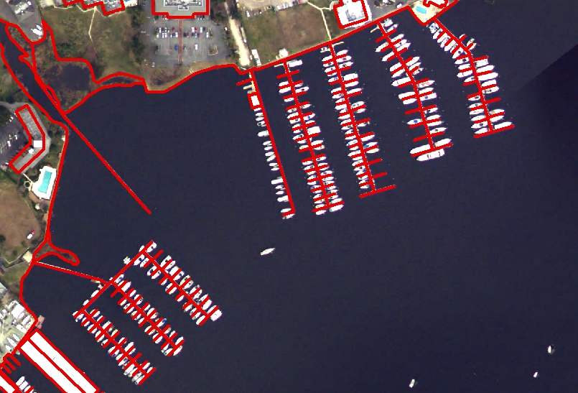
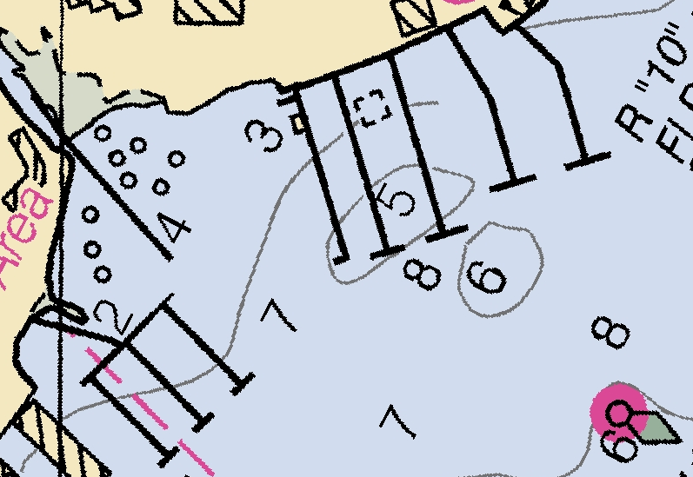
Coast and Shoreline Change Analysis Program (CSCAP)
RNC 11491 2/2015
Change Analysis
Shoreline Compilation (GC 11196)
Updated RNC

Slide 18
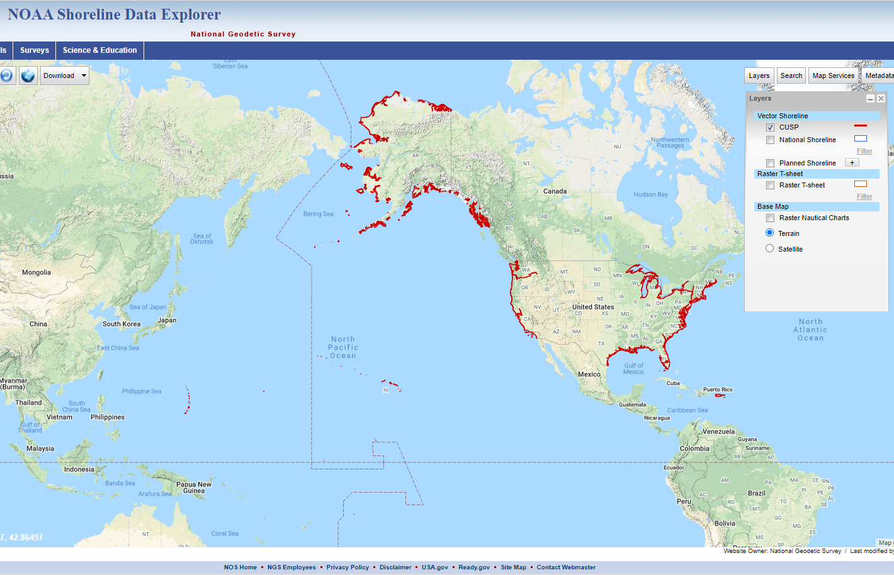
Continually Updated Shoreline Product (CUSP)
https://www.ngs.noaa.gov/NSDE/
Notes:
17165 nautical miles in FY18

Slide 19
Continually Updated Shoreline Product (CUSP)
To provide the most current shoreline representation
Designed to deliver continuous shoreline with frequent updates
Employ state-of-the-art technologies
Attributed shoreline features
Referenced to Mean High Water datum where applicable
Includes NOAA and non-NOAA contemporary sources
Notes:
One Pager for the NOAA’s Continually Updated Shoreline Product.

Slide 20
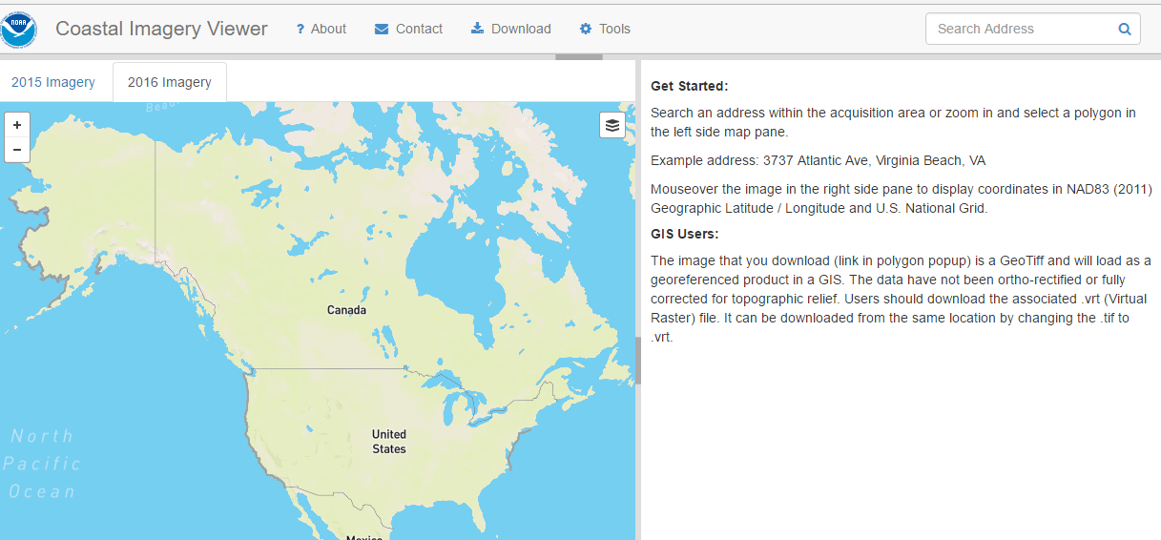
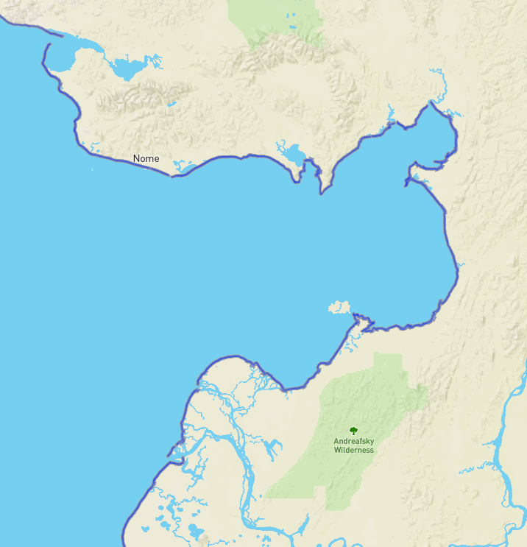
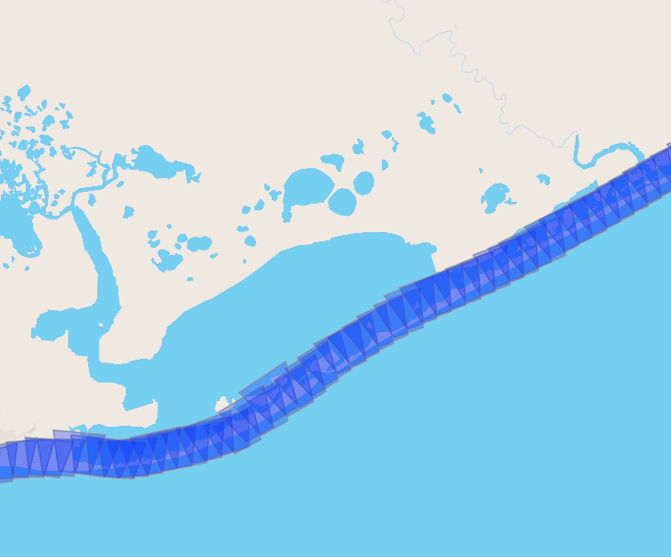
Coastal Semi-Oblique Imagery viewer
https://geodesy.noaa.gov/storm_archive/coastal/viewer/index.html

Slide 21
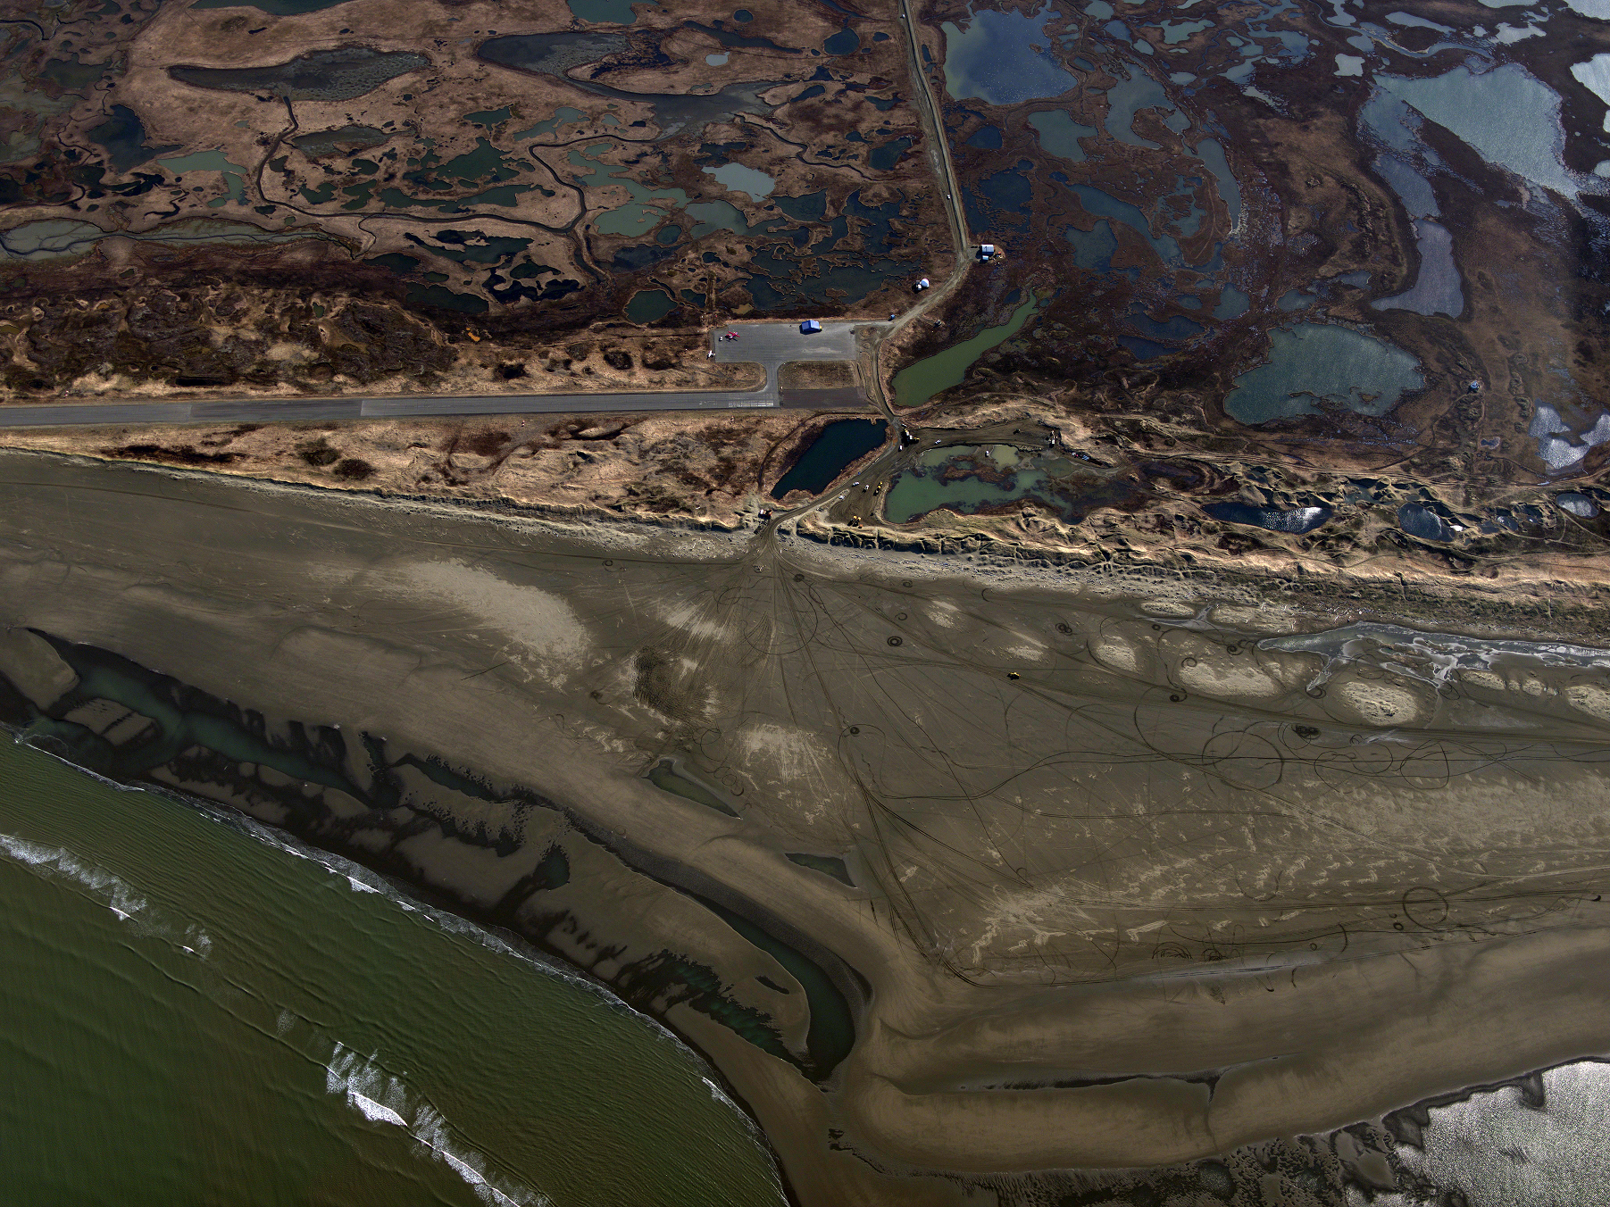
NOAA Semi-Oblique Coastal Imaging
Hooper Bay Airport, May 27 2016

Slide 22
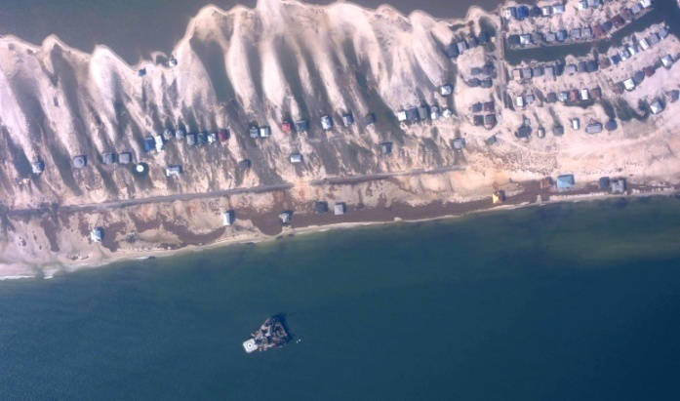
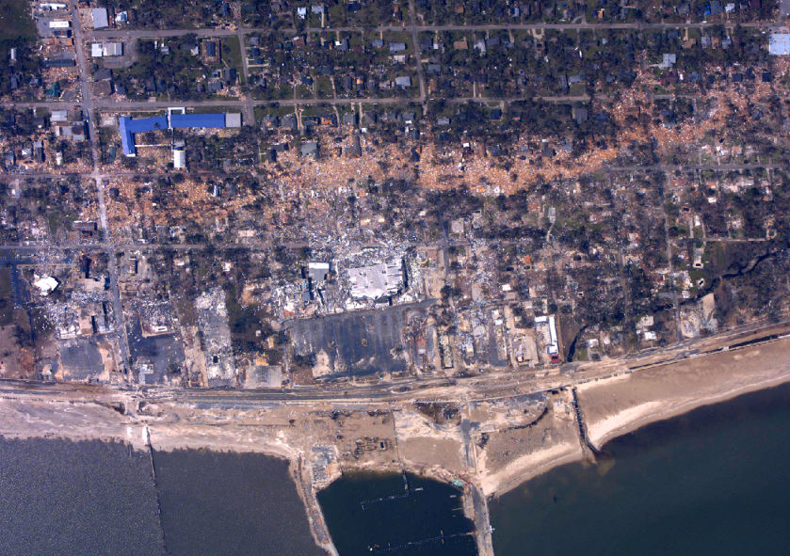
Emergency Response
Remotely sensed data is acquired to support NOAA’s homeland security and emergency response requirements.
NOAA maintains the capability to provide tools, technology, and expertise in a timely and efficient manner.
The remotely sensed data collected is disseminated to federal, state, and local government agencies as well as the general public to facilitate support efforts.

Slide 23
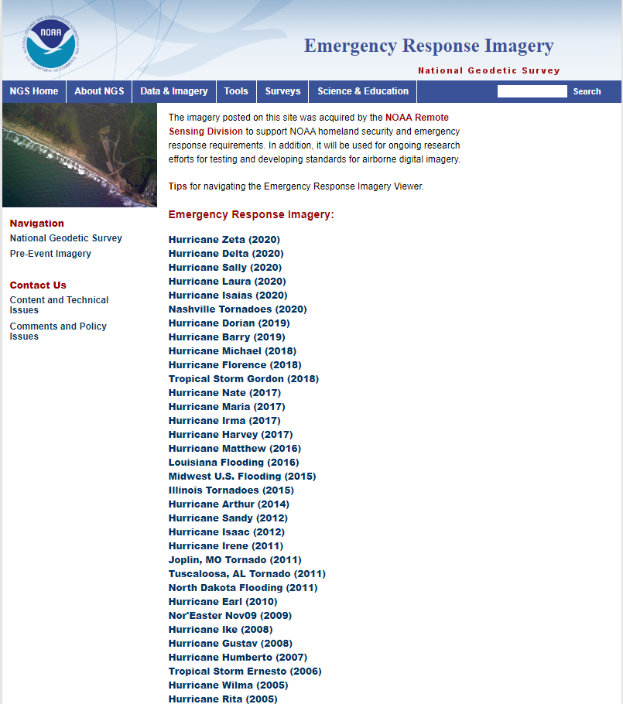
Emergency Response
https://storms.ngs.noaa.gov/

Slide 24
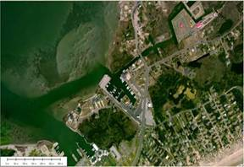
Integrated Ocean and Coastal Mapping (IOCM)
The practice of acquiring, managing, integrating and disseminating ocean and coastal geospatial mapping data in such a manner that permits these data and their derivative products to be easily accessed and used by and for the greatest range of users and purposes.
IOCM requires intra- and inter-agency coordination with a focus on streamlining operations, reducing redundancies, improving efficiencies, developing common standards, and stimulating innovation and technological development.
Notes:
These objectives of increasing intra- and interagency coordination and promoting multi-use of geospatial data are gaining a lot of traction.
One important driver was a 2004 National Research Council Report titled “A Geospatial Framework for the Coastal Zone: National Needs for Coastal Mapping and Charting.”
Key recommendation: increasing coordination and collaboration on ocean and coastal mapping across the federal gov.
Stimulated several other reports/initiatives, including the U.S. Ocean Action Plan. It turn, that led to the creation of the Interagency Working Group on Ocean and Coastal Mapping (IWG-OCM).
NRC Report
Consistent spatial framework for coastal data the allows a seamless transition from onshore to offshore
Increased collection and availability of data including land cover, shallow-water bathymetry, seafloor imagery, habitat distribution and classification standards
Easy access to up to date digital, geospatial data, imagery and mapping products
Compatibility among data formats – or standards and transformation protocols that allow each data exchange – and a means to evaluate data accuracy.
Increased inter- and intra-agency coordination, cooperation and communication.
U.S Ocean Action Plan
Develop and annual inventory of federal, federally-funded, and non-federal governmental ocean and coastal mapping programs and operations
Assess and report on common and shared needs for development of coordinated programs
Coordinate and leverage resources and efforts across the federal sector with industry, academic, NGO and non-federal government entities
Set priorities for standards development and developing strategies for promulgation of standards for data acquisition, data, metadata, tools and products
Develop shared and standardized mechanisms for processing, archiving, and distributing geospatial data, tools, products and services

Slide 25
IOCM Products/Deliverables
Shoreline
Ortho Mosaic Imagery
Lidar Point Cloud
(elevation)
Lidar Point
Cloud
(intensity)
RGB
Colorized Lidar
Point Cloud

Slide 26
Distribution of Data
Shoreline (http://www.ngs.noaa.gov/NSDE/)
Lidar and Imagery:
https://coast.noaa.gov/digitalcoast/
https://coast.noaa.gov/dataviewer/#/

Slide 27
Supplemental Lidar, Imagery, Shoreline Efforts
Florence, Michael, Yutu
Harvey, Irma, Maria

Slide 28
Hurricane Supplemental
2017 Hurricane Season
2018 Hurricane Season
4,430 square miles
8,264 square miles
Notes:
4,430 square miles of shoreline (Texas - 895 square miles; Florida - 2,135 square miles; Puerto Rico - 1,145 sq. miles; USVI - 255 sq. miles)
8,264 square miles of shoreline (Florida (Michael) - 3315 square miles; South Carolina (Florence) - xx square miles; North Carolina (Florence) - xx square miles; Pacific Islands (Yutu) - 267 square miles)
Three areas are currently getting Hurricane Supplemental Funds to Support the Coastal Mapping Program products:
High resolution topobathy lidar
Red,Green, Blue and Near-Infrared Imagery (both in Stereo and OrthoImagery deliverable formats) acquired,
Updated National Shoreline produced.
Areal extents in Texas are associated with Hurricane Harvey, the Florida Keys from Miami to Marquesas for Hurricane Irma, and the islands of Puerto Rico and U.S. Virgin Islands in response to Hurricane Maria.
Current acquisition and overall project completion percentages are presented here for the respective projects.This data will be utilized to produce updated highly accurate near shore depths and shoreline products to update nautical charting products for safe and efficient navigation and commerce. Data will be disseminated to support multi-use of the data from storm-surge and inundation mapping, to community resilience planning and decision-making, benthic and habitat mapping, as well as numerous other applications.

Slide 33
Memorandum on Ocean Mapping of the United States Exclusive Economic Zone and the Shoreline and Nearshore of Alaska
https://www.whitehouse.gov/presidential-actions/memorandum-ocean-mapping-united-states-exclusive-economic-zone-shoreline-nearshore-alaska/
November 19, 2019

Slide 34
Alaska Coastal Mapping Strategy (ACMS) Goals
Build on existing mapping partnerships to meet Alaska’s coastal mapping needs
Expand coastal data collection to deliver the priority geospatial products stakeholders require
Leverage innovation in mapping technology development
Conduct strategic communications to promote widespread stakeholder engagement
https://iocm.noaa.gov/about/strategic-plans.html
Notes:
The following slides were presented by ATG to OPC -- these are the main focus and interest of AMEC

Slide 35
ACMS Coordination Structure Through AMEC
Alaska Mapping Executive Committee
(designated to fulfill ACMS strategy)
Co-Chairs: USGS, NOAA
Members: USGS, BIA, BLM, BOEM, NPS, USFWS, NGA, NRO, USACE, FAA, EPA, FEMA, OMB, NCRS, USFS, State of Alaska
AMEC Coastal Subcommittee
(new)
Co-Chairs: NOAA, State of Alaska
Members: USGS, BOEM, BLM, NPS, FWS, USFS, NRCS, USACE, FEMA, USCG, AOOS

Slide 36
ACMS Goal 1: Build on existing mapping partnerships
Establish Coastal Mapping Technical Subcommittee
Implementation Plan underway, draft due December 2020
FY 2021 President’s Budget for interagency mapping strategy: +$8.5M for NOAA
User assessments, data studies, outcomes of 3D Nation Elevation Requirements and Benefits Study to inform Plan
Integrating with other AMEC mapping themes to factor in planning, e.g., elevation, terrestrial hydrography, wetland/vegetation mapping
Notes:
Level of effort to craft an implementation plan and follow-thru
Complementary AMEC mapping themes will factor into planning, including strategic timing of data collection or processing, and combined requirements in coastal and nearshore areas, to leverage resources and capabilities.
Good example -- terrestrial hydro needs coastal elevations for NOAA’s National Water Model, a hydrologic modeling framework that simulates
observed and forecasted streamflows in Alaska.

Slide 37
ACMS Goal 2: Expand coastal data collection to deliver priority geospatial products
Primary data types:
Nearshore bathymetry
Topobathymetry
Shoreline vector
Orthoimagery
Digital Elevation Models/Digital Shoreline Models
Begin Aleutian Island GRAV-D data collection in FY21 and complete in FY22
Negotiating adoption of three coastal National Science Foundation CORS into NOAA’s Foundation CORS Network in FY21
Notes:
Level of effort to craft an implementation plan and follow-thru

Slide 38
ACMS Goal 3: Leverage innovation in mapping technology
NOAA water clarity tool for AK topobathy upgraded using a composite of 2019 Sentinel 3 imagery
Testing new technologies for acquisition efficiencies:
Satellite-derived bathymetry, e.g. Sentinel 2, WorldView-3 and ICESat-2, cloud computing
UxS as force multipliers, sUAS ship launched operations; multiple sUAS for deriving bathymetry, continued development or UxM for “filling the gap” between airborne lidar and maritime hydrography
North Slope Saildrone Survey
Notes:
NOAA water clarity tool for AK topobathy upgraded using a composite of 2019 Sentinel 3 imagery
Monthly composites of Sentinel 3 more here https://www.ngs.noaa.gov/RSD/topobathy/sentinel_info.pdf
Using this methodology we will update with the previous years data. Revisit of the satellites at this latitude is 1.4 days
This will be used to inform and direct operations from aircraft and satellite
Testing new technologies for acquisition efficiencies:
Satellite-derived bathymetry, e.g. Sentinel 2, WorldView-3 and ICESat-2, cloud computing
Internal NOAA development for SDB SATBathy tool - a user-friendly global Satellite Derived Bathymetry (SDB) tool that will provide consistent and quick results utilizing the improved Cabellero and Stumpf SDB algorithm (Caballero, 2020). https://docs.google.com/presentation/d/1CzphHzmqlSH_vwHhTJveT2KU_CU9WmbxlfJHvylBljQ/edit?usp=sharing
External NOAA contract to Woolpert/TCarta - to evaluate TCarta’s SDB approach using Worldview 2 and 3 that is calibrated and validated using surfaces will be derived from the data products of the ICESat-2
Continued UxS research to operations leveraging:
Internal UxS funding for continued development of ship launched sUAS and imagery derived bathymetry from multiple sUAS - sUAS BATHYMETRIC MAPPING FOR FEATURELESS BOTTOM TOPOGRAPHY USING NATURALLY OCCURRING STRUCTURED LIGHT https://docs.google.com/document/d/1aIC4eisOn1AGatz7bEc30BT9Wy9TFxy4i8m2bRCqY4Y/edit?usp=sharing
Continued
UxM to “fill the gap” between airborne lidar and maritime hydrography leveraging ongoing and established efforts at the UNH Joint Hydrographic Center/CCOM
Lots of experience at NOAA and the JHC at UNH CCOM
https://coastalscience.noaa.gov/news/noaa-evaluates-capabilities-unmanned-surface-vessel/
https://www.nauticalcharts.noaa.gov/updates/noaa-ship-thomas-jefferson-tests-innovative-drix-autonomous-surface-vehicle/
https://www.nauticalcharts.noaa.gov/updates/unmanned-surface-vehicles-evaluated-for-hydrographic-survey/

Slide 39
ACMS Goal 4: Strategic communications for stakeholder engagement
Alaska Coastal Mapping Summit planned for December 2020
Online interactive maps to be hosted by the Alaska Geospatial Council
Performance measurement and progress will be tracked on Alaska DNR website
Plans and priorities shared through the IWG-OCM’s Federal U.S. coordination site (fedmap.seasketch.org)

Slide 40
Recent and Upcoming Activity
July 9 -- AMEC Coastal Subcommittee (CS) Kick-off Meeting
August 11 -- CS agency introductions (priorities, requirements)
September 1 -- Establish CS Implementation Plan (IP) tiger teams
November 20 -- Working Implementation Plan draft due
December 9-10 -- Alaska Coastal Mapping Summit
December 18 -- Final draft IP for AMEC review
January 2021 -- IP draft shared for public comment
March 2021 -- Final IP complete and ready to execute
Notes:
Juliana to introduce Ashley and Jaci to run thru this slide and current state of IP development
Ashley and Jaci to ask for questions

Slide 41
Draft Strategy for Sensor Utilization

Slide 42
RSD Products overlaid upon 2019 AK Stakeholder Spatial Prioritization Survey

Slide 43
Questions?
Mike Aslaksen
Chief, Remote Sensing Division
NOAA National Geodetic Survey
mike.aslaksen@noaa.gov

Slide 44
Continually Updated Shoreline Product (CUSP)
https://www.ngs.noaa.gov/NSDE/
Notes:
17165 nautical miles in FY18

Slide 45
Shoreline Update Expedite (SUE)
Goal: to provide the requested updates within 1-2 workdays.
Example workflow:
Received request from MCD on Thu. Aug. 23, 2018 for an update to chart 25670, depicting a large uncharted pier.
Determined that RSD aerial imagery flown on 9/24/17 in response to Hurricane Maria had captured the new pier.
Compiled the features in ArcGIS using the orthoimagery accessed directly through the NGS Storm Imagery web map tile service (WMTS), and delivered the shapefile to MCD just 3.5 hours after their request.
SUE-00022
Isla Grande, San Juan, PR
Notes:
usually we are able to provide the data the same day it is requested.

Slide 46
Water Clarity

Slide 47
NGS/RSD Shoreline Products

