Slide 1
Status of the New National Spatial Reference System
Jacob Heck, Ph.D.
Great Lakes Regional Geodetic Advisor
NOAA/National Geodetic Survey
Notes:
45 minutes

Slide 2
Outline
Brief overview of NSRS
Status of NSRS Modernization
News out of NGS
New coordinate types
Notes:
For the Modernization talk, I'll plan on covering new coordinate types, NSRS Modernization delay, and any other news that comes out of NGS between now and then. I won't go into too much detail about what NAPGD2022 and *TRF2022 are, unless you really think they would be interested in hearing it again.

Slide 3
National Spatial Reference System
Geometric Geodesy
Physical Geodesy
Horizontal Datums/Geometric Reference Frames
Latitude
Longitude
Ellipsoid Height
State Plane Coordinates
Geopotential Datums
Orthometric Height
Dynamic Height
Surface Gravity
Leveling
Main Components: latitude, longitude, height, origin, scale, gravity, and orientation

Slide 4
Replacing the NAD 83s
The Old | The New
NAD 83 (2011) | NATRF2022 - The North American Terrestrial Reference Frame of 2022
NAD 83 (2011) | CATRF2022 - The Caribbean Terrestrial Reference Frame of 2022
NAD 83 (PA11) | PATRF2022 - The Pacific Terrestrial Reference Frame of 2022
NAD 83 (MA11) | MATRF2022 - The Mariana Terrestrial Reference Frame of 2022
Notes:
The current horizontal datums in the NSRS are the latest realizations of the North American Datum of 1983. These are realized at epoch 2010.0. NAD 83 (2011) is the current datum on the North American and Caribbean plates. NAD 83(PA11) is the current datum on the Pacific plate, and NAD 83(MA11) is the current datum on the Mariana plate. As part of NSRS modernization, NGS will replace these horizontal datums with 4 terrestrial reference frames, one for each of the tectonic plates of NGS’s area of responsibility: The North American Terrestrial reference frame of 2022 (or NATRF2022), the Caribbean Terrestrial Reference Frame of 2022 (CATRF 2022), Pacific Terrestrial reference frame of 2022 or patrf2022, and the mariana terrestrial reference frame of 2022 or matrf2022. Each of these frames will be global in nature but will rotate with one tectonic plate.

Slide 5
Replacing NAVD 88
The New:
The North American-Pacific Geopotential Datum of 2022 (NAPGD2022)
- Will include GEOID2022
The Old:
NAVD 88
PRVD 02
VIVD09
ASVD02
NMVD03
GUVD04
IGLD 85
IGSN71
GEOID18
DEFLEC18
Orthometric
Heights
Normal
Orthometric
Heights
Dynamic
Heights
Gravity
Geoid
Undulations
Deflections of
the Vertical
Notes:
Currently the NSRS consists of a variety of vertical datums. NAVD88 is an orthometric heights datum in the continental United States. An orthometric
8 CLICKS slowly
All these listed datums and supporting products will be replaced by the North American-Pacific Geopotential Datum of 2022 (NAPGD2022), including the key product GEOID2022.

Slide 6
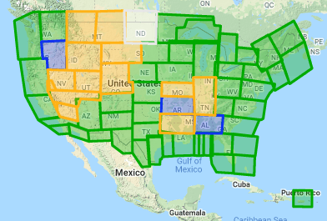
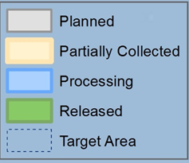
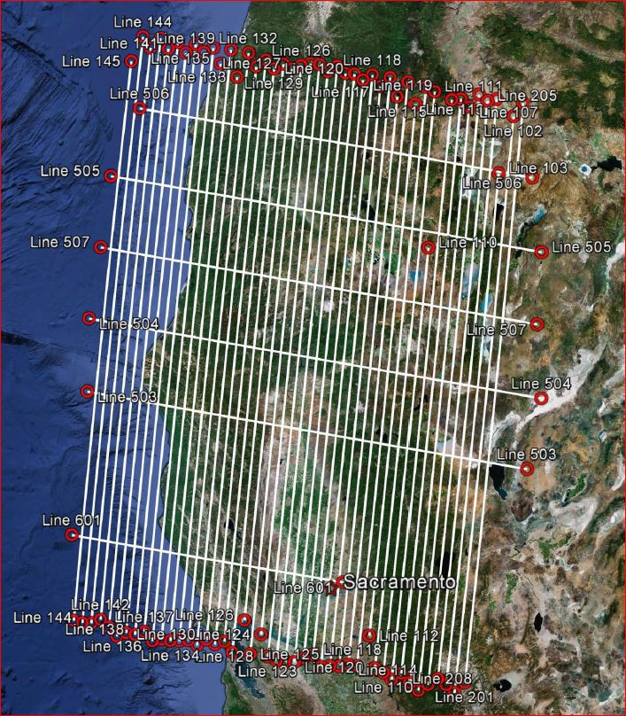
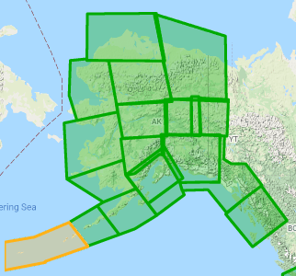
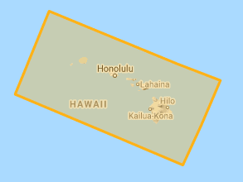
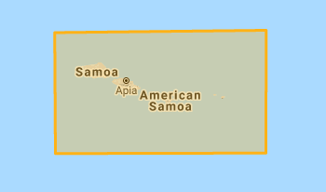
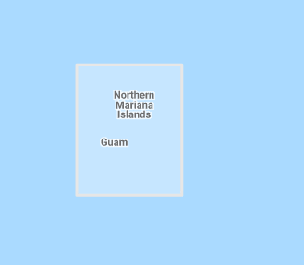
Gravity for the Redefinition of the American Vertical Datum (GRAV-D)
10 km data lines
70 km cross lines
20,000 ft altitude
230 kt flight speed
Alaska
Hawaii
American Samoa
Guam & CNMI
Notes:
To get the geoid height, that capital N, we need to make a geoid model. To do that, we need gravity information across the country. Since 2008 we have been flying airborne gravity as part of the GRAV-D program across the country.
Currently have collected more than 88.21% of goal.

Slide 8
NSRS Modernization: Delay
It’s official: we are delayed beyond 2022
How long is the delay?
Unknown. Years.
Will names change?
No, “GEOID2022”, “NATRF2022”, etc. will remain the same

Slide 9
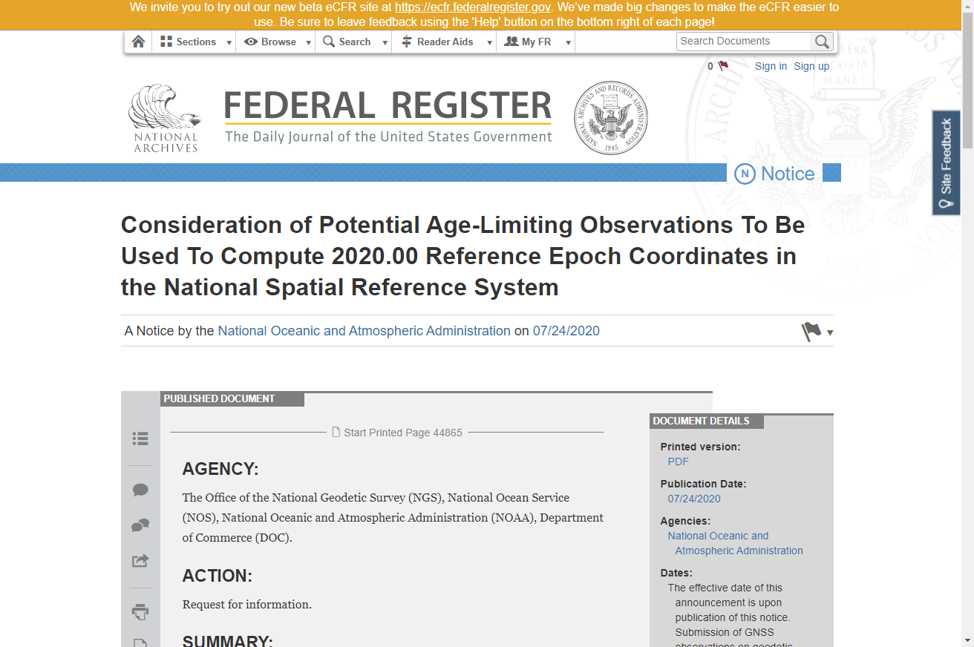
Time limits on coordinates
... While the cut-off for age-limited observations is unknown, certain assumptions are safe to make. For instance, it is unlikely that such an age-limit will be fewer than 10 years. Older observations may be used in the estimation of 2020 RECs, but this cannot be guaranteed. As such, NGS requests that users take new GNSS observations on geodetic control marks of interest that have not been surveyed since January 1, 2010, and asks the users to submit the observations to NGS before December 31, 2021. Users may either (a) submit existing unsubmitted observations through the OPUS-Share tool or (b) conduct new GNSS observations and submit the data to NGS via the OPUS-Share tool.

Slide 10
GPS on Bench Marks Deadlines
DECEMBER 31, 2021
Deadline for inclusion in the 2020.0 Reference Epoch Coordinate adjustment
Deadline for inclusion in the Transformation Tool
Notes:
Dec 31,2021 is cut-off for data to be included in the initial set of 2020.0 REC's. Subsequent sets of REC's will be computed after each "adjustment window".
We can only guarantee that the initial set of REC's will be used to create the Transformation Tool, however we will try to also include some of the subsequent sets of REC's if we can, but can't promise that at this point.
Once the Transformation grids are approved they will be locked, and subsequent REC's that are created will NOT be used to update the transformation grids.

Slide 11
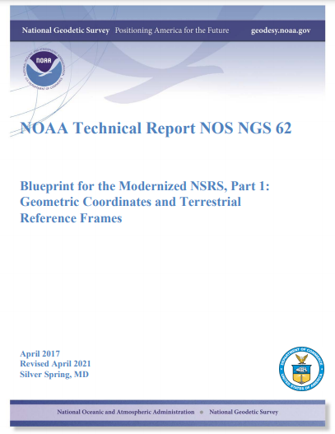
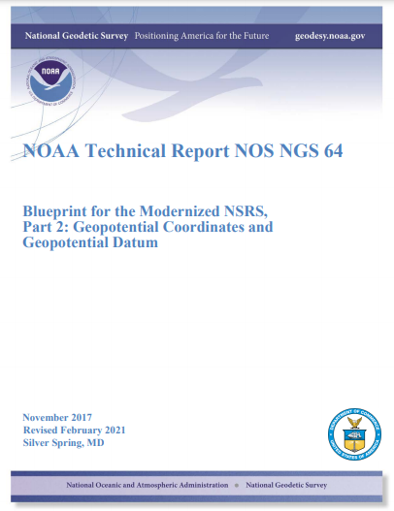
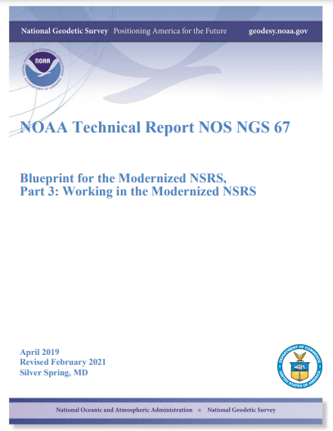
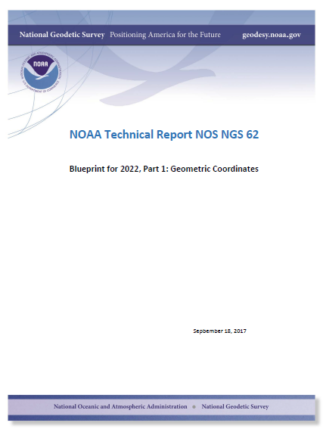
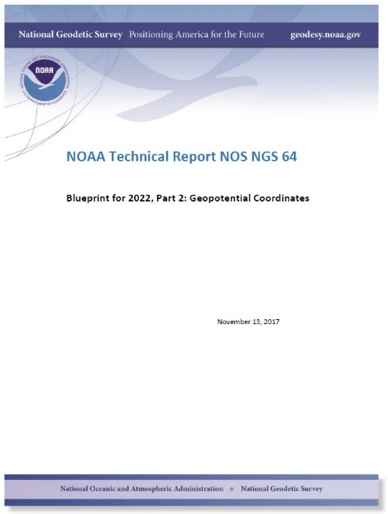
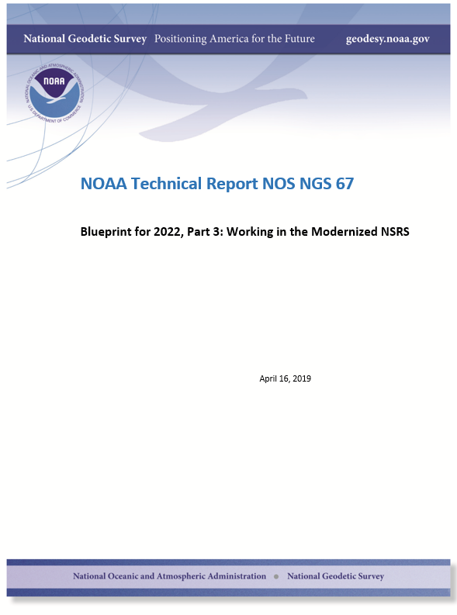
Updated blueprint documents
Available in the NGS Publications Library: https://geodesy.noaa.gov/library/
Geopotential:
Nov 2017
Revised Feb 2021
NOAA TR NOS NGS 64
53 pages
Working in the
Modernized NSRS:
April 2019
Revised Feb 2021
NOAA TR NOS NGS 67
133 pages
Geometric:
Sep 2017
Revised April 2021
NOAA TR NOS NGS 62
61 pages

Slide 12
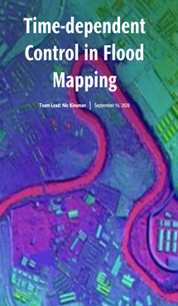
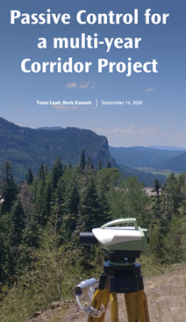
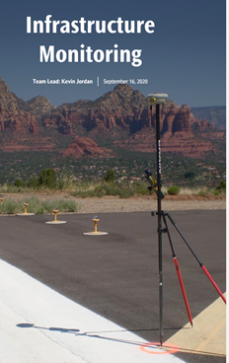
Use Cases

Slide 13
Updates to OPUS Projects
OP 4.0 is now live https://www.ngs.noaa.gov/OPUS-Projects/OpusProjects.shtml
Makes it easy to Bluebook your data
OP 5.0 now on Beta (since yesterday)! https://beta.ngs.noaa.gov/OPUS-Projects/OpusProjects.shtml
Processes RTN-derived vectors

Slide 14
New types of Coordinates

Slide 15
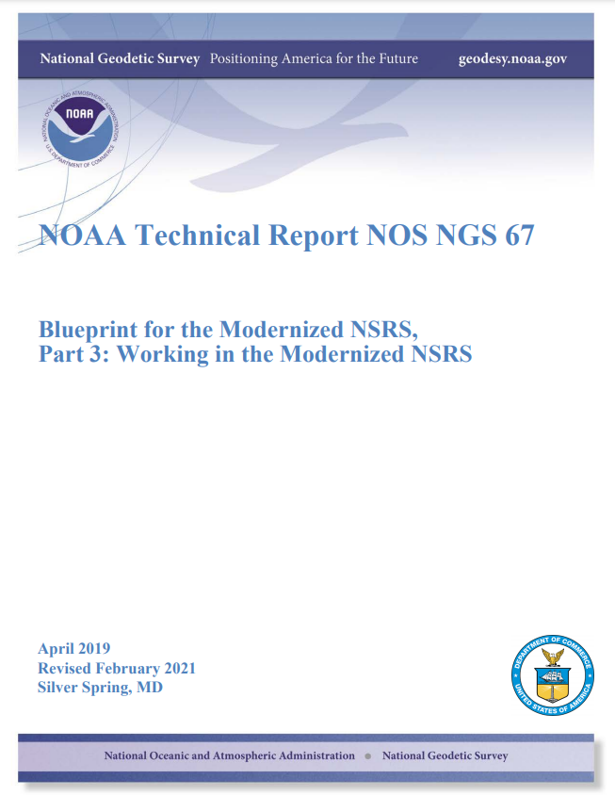
Coordinate: One of a set of N numbers designating the location of a point in N-dimensional space. Specific to the modernized NSRS, five types of coordinates will be supported.
Notes:
All of the information in this presentation is in the NGS Blueprint Part 3
Was updated in 2021
Definitions come directly out of it

Slide 16
New Types of Coordinates
NGS anticipates that 5 types of coordinates will be used in the NSRS. They are:
Reported
OPUS
Reference Epoch
Survey Epoch
Active
Notes:
These coordinate types apply to both geopotential coordinates and geometric coordinates.

Slide 17
“Part of the NSRS”
Only coordinates computed by NGS and stored in the NSRS database are “part of the NSRS”
Reference Epoch
Survey Epoch
Active
OPUS Coordinates can be “tied to the NSRS”

Slide 18
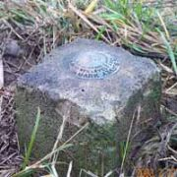
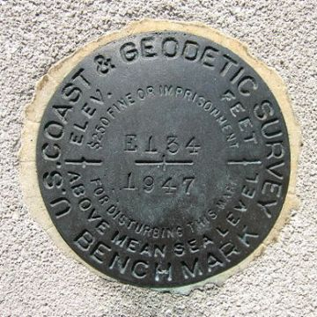
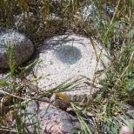
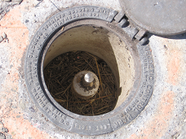
Passive Control
Any geodetic control point that is not active control. Common examples include a metal disk set in concrete or stone, or a stainless steel rod driven into the ground.

Slide 19
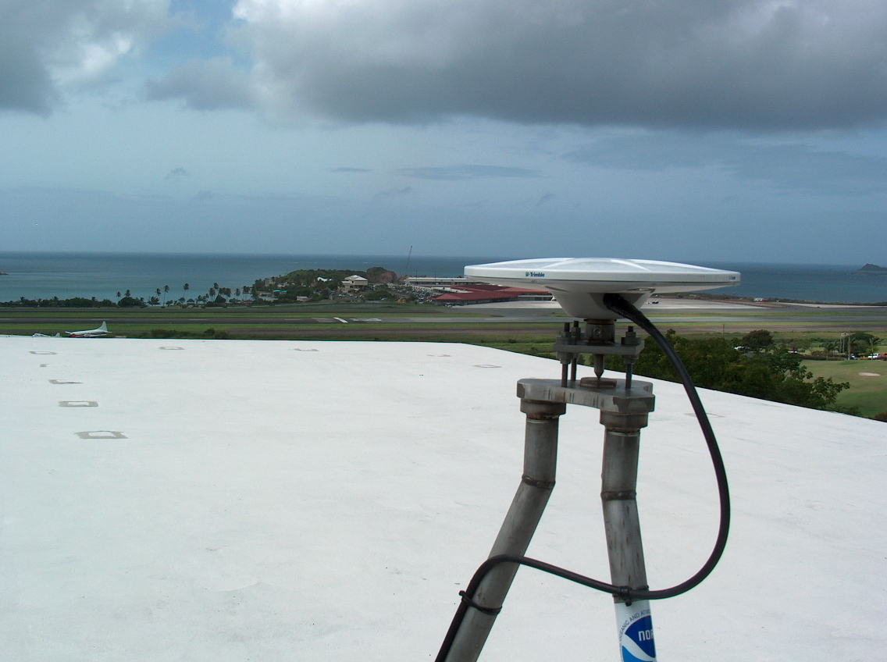
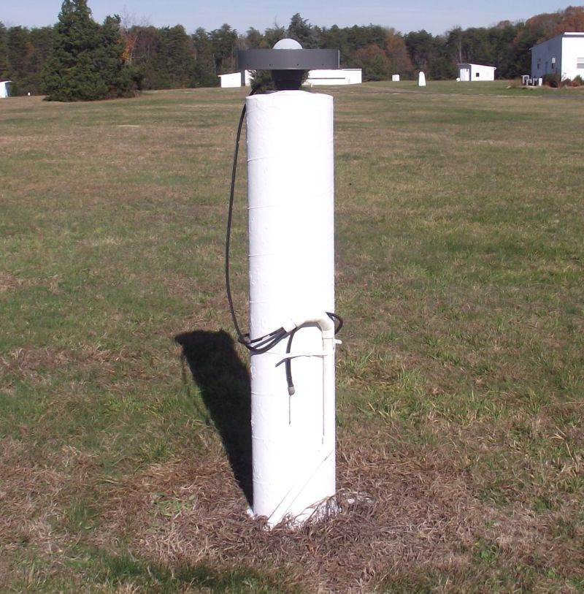
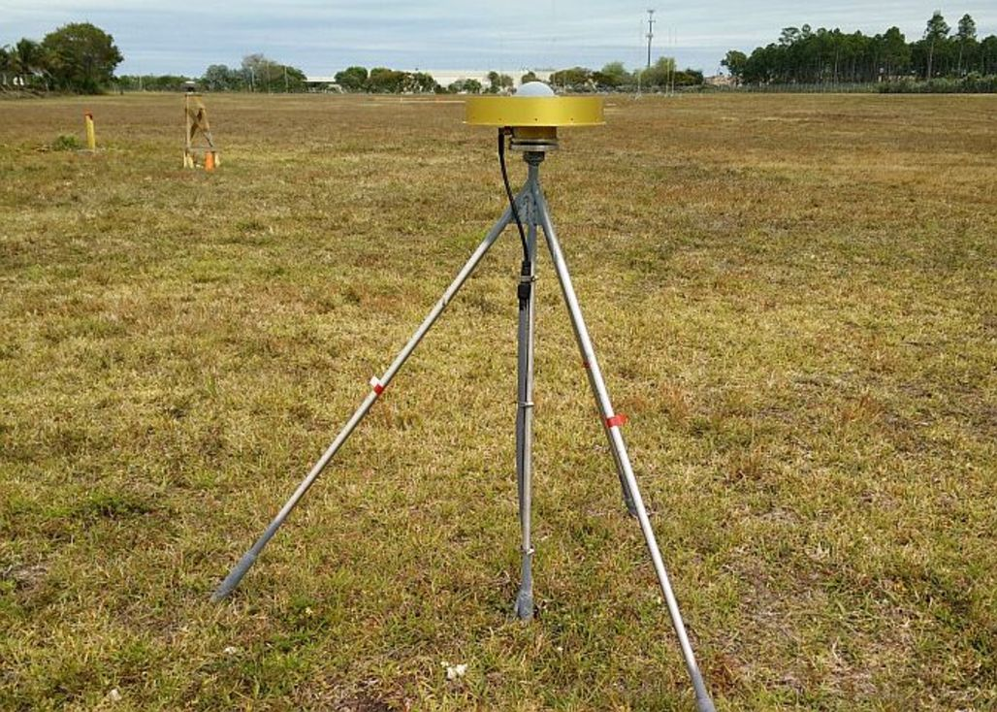
Active Control
A geodetic control point at a station occupied by equipment intended for and capable of continuously collecting geodetic quality data for multiple years and with active defined by or adopted by NGS.
CORS

Slide 20
Shift and Drift
When transitioning off of NAD 83, your coordinates will experience shift and drift
Shift: A one-time jump somewhere in the 0 to 4 meter range (latitude, longitude, ellipsoid height)
Drift: Coordinates are now time-dependent. The shift will take you to 2020.00. Working at any other epoch means you must account for the drift (velocity, as well as any other motions over time) of your coordinates

Slide 21
New Types of Coordinates
Reported
“Coordinates directly reported to NGS without the data necessary for NGS to replicate or evaluate them. These coordinates are neither ‘part of the NSRS’ nor ‘tied to the NSRS.’”
Scaled from a map
Transformed using NCAT or VDatum
Smartphone
Reported directly from an RTK rover without data files
Notes:
These are coordinates directly reported to NGS without the data necessary for us to replicate or evaluate them.

Slide 22
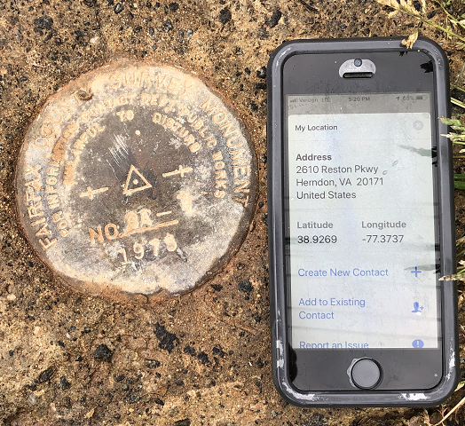
Reported Coordinates

Slide 23
Buyer Beware!
Reported coordinates might be very wrong!
Reported in NAD 27 or NAD 83 or WGS 84
Systematic Error: 2–100 meters
Scaled off of a USGS topographic map
Random Error: ± 600 meters
Smartphone
Random Error: ± 10–50 meters
NGS will show you reported coordinates
But their function is to get you “in the neighborhood” of a mark, not to use as geodetic control!

Slide 24
New Types of Coordinates
OPUS
“Coordinates computed by OPUS that have not been evaluated by anyone at NGS. As these coordinates are not computed by NGS they are not considered “part of the NSRS.” However, if NGS-provided OPUS recommendations are followed, they may be ‘tied to the NSRS.’ ”
User-computed values, such as they might get today from either OPUS-S or OPUS Projects
“OPUS” coordinates are the only coordinates a user will get directly from OPUS
NGS will not evaluate your OPUS coordinates!

Slide 25
New Types of Coordinates
OPUS coordinates may also come with the label “tied to the NSRS”
Only if a user restricts their computations to OPUS-recommended constraints
Users who deviate from OPUS-recommended constraints can still perform computations and will get OPUS coordinates, but they will not be “tied to the NSRS”, nor have any NSRS label at all.
In neither case will OPUS coordinates be considered “part of the NSRS” however.

Slide 26
Survey data
OPUS
data processing
Did you follow OPUS recommendations?
yes
no
If you choose to deviate from the OPUS recommendations:
OPUS will warn you when you do so
You will receive an explanation why your coordinates are not tied to the NSRS
OPUS Coordinates that are
“tied to the NSRS”
OPUS Coordinates that are
“not tied to the NSRS”
Do you want to “share” your results with the world?
yes
no
Unique, public URL for this survey which you can share with anyone
Your results are shown to you on screen or via email only
Notes:
- this is the modernized NSRS
- OPUS 6.0

Slide 27
New Types of Coordinates
Reference epoch coordinates (RECs)
“Coordinates estimated by NGS for one of the official reference epochs. As these coordinates are computed by NGS they are considered ‘part of the NSRS’”
These will be computed by NGS every 5 or 10 years
On a schedule 2–3 years past the reference epoch
Notes:
These are coordinates computed by NGS in an adjustment project to estimate the coordinates at one of the official (every five or ten years, as currently planned) reference epochs NGS will define
” As (generally) all such coordinates come from observations that did not take place at the reference epoch, such coordinates require the introduction of an intra-frame velocity model (IFVM) into the adjustment, and thus the coordinates so computed are subject to all uncertainties and assumptions in the IFVM. 38 See Section 2.11, and Figure 3.
Part of the NSRS
Based on “snapshot” of entire NSRS control network
Published every 5 or 10 years
Familiar to many users…NAD 83(2011) epoch 2010.00 (sort of) would’ve fallen under this category

Slide 28
New Types of Coordinates
Survey epoch coordinates (SECs)
“Coordinates computed by NGS for one survey epoch. As these coordinates are computed by NGS they are considered ‘part of the NSRS.’”
These represent the best estimates NGS has of the time-dependent coordinates at any mark
Adjusting multiple surveys in timespans called “adjustment windows”, to a single epoch within that window.
Initial plan: 4 weeks for GNSS; 1 year for leveling
Notes:
These are coordinates computed by NGS using submitted data and its metadata, then checked, adjusted and defined at one “survey epoch.” Thus, they are “part of the NSRS.” These represent the best estimates we have of the coordinates at any mark at some specific point in time

Slide 29
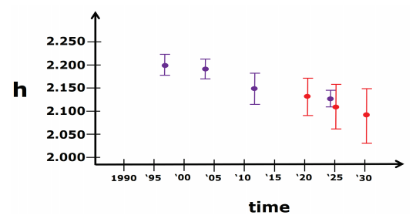
More on SECs and RECs
At passive control
SECs: adjusted to a midpoint epoch near the survey
(4 weeks for GNSS; 1 year for leveling)
RECs: adjusted to a ref. epoch (2020.00, etc.)
REC adjustments will include Some age-limited span of data
If that age-limit were 10 years prior and 2 years post R.E., Then 2020.00 RECs come from data spanning 2010.00 to 2021.99999
Notes:
SECs can be used to highlight changes over time
RECs can be used to “hide” changes over time
Exact age-limit won’t be known until we start experimenting in 2022 with the 2020.00 REC adjustments
Ellipsoidal height SECs (purple) and RECs (red) for a fictitious point. Note that RECs are computed on a regular and repeating schedule, but SECs are computed specifically for when data is collected. As such, note the growing error bars for RECs going forward in time as no new data is being collected on this point

Slide 30
New Types of Coordinates
Active coordinates (ACs)
Coordinate functions in time, generated by NGS, and not associated with a specific epoch. As these coordinates are computed by NGS (or adopted by NGS) they are considered “part of the NSRS.”
Which will be generated by a “fit” to regularly computed coordinates
Notes:
Unlike all other coordinates, active coordinates are actually coordinate functions in time, and not associated with a specific epoch. They will only be generated by NGS at stations with active control, such as a continuous GNSS receiver or a continuous gravimeter. Thus, they are “part of the NSRS”. At a CORS, they will be identical to the CORS coordinate function (see Terminology Guide). They will not exist on passive control
Daily or weekly CORS coordinates will be generated and the active coordinates will be a function fit to these regularly generated coordinates.

Slide 31
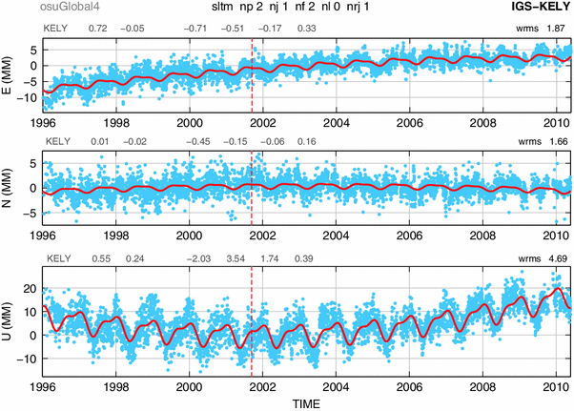
Examples of How Non-Linear CORS Coordinate Functions Might Look

Slide 32
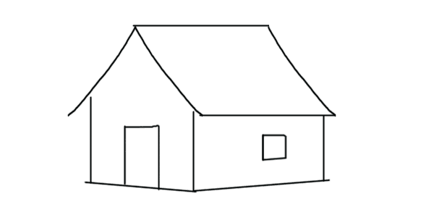
Published Coordinates
RECs ‘stable’ at project scales (5-10 years)

Slide 33
Published Coordinates
RECs ‘stable’ at project scales (5-10 years)
SECs reflective of narrow window in time
ACs or Coordinate Function at CORS
height
time

Slide 34
Coordinates
Five types:
Active: Continuous functions at a CORS
Survey Epoch: “Time dependent coordinates”
Reference Epoch: “Estimated at 2020, 2025, 2030, …”
OPUS: Computed by you, and as accurate or inaccurate as the choices you make
Tied to the NSRS if you follow OPUS recommendations
Reported: Good for finding a point somewhere on Earth.
Not to be used as geodetic control

Slide 35
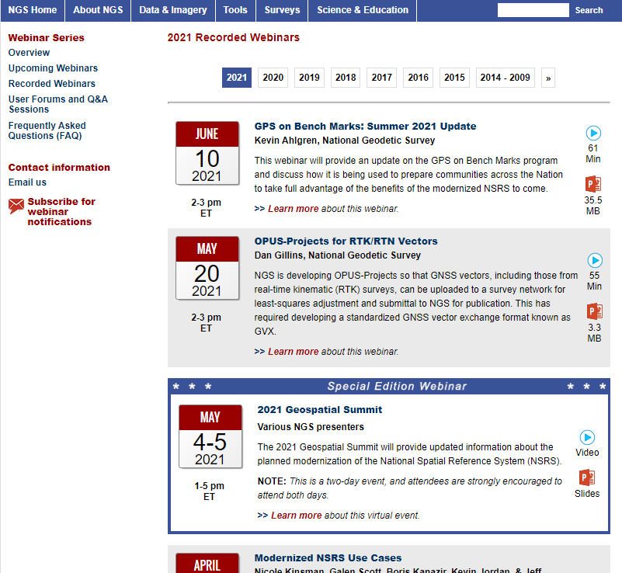
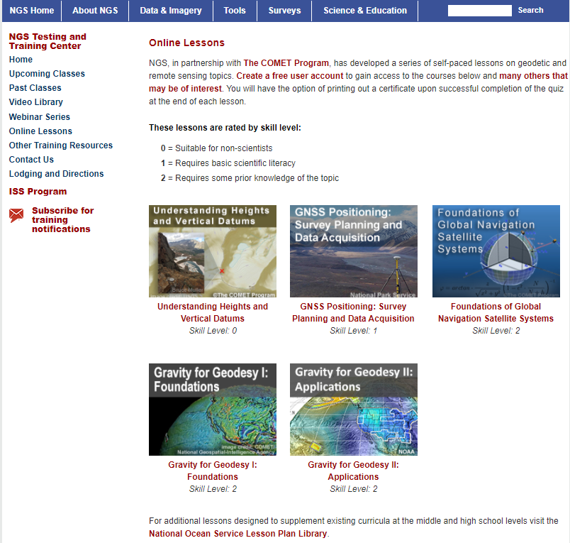
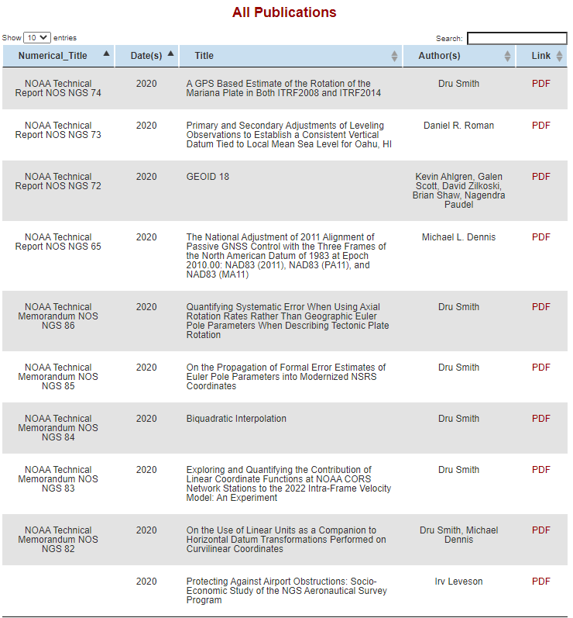
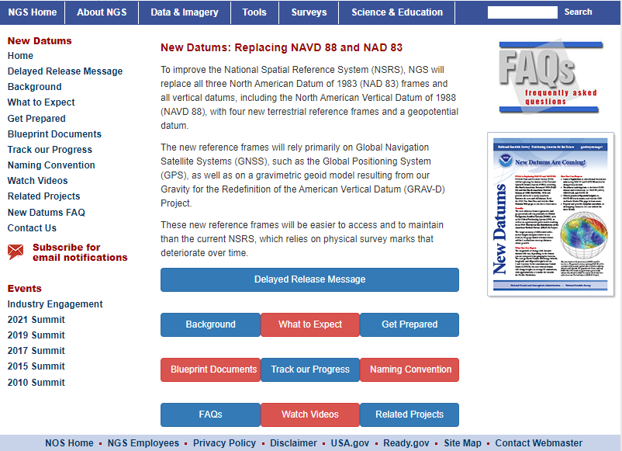
Online Resources
Monthly webinar series
All webinars are recorded and available online
Online lessons
Video library
Publication library
NSRS Modernization News
https://geodesy.noaa.gov/

Slide 36
Thank You!
Dr. Jacob Heck
Great Lakes Regional Geodetic Advisor (MI, IN, IL, WI)
U.S. National Geodetic Survey, NOAA
jacob.heck@noaa.gov
c/o NOAA Great Lakes Environmental Research Laboratory
4840 S. State Road
Ann Arbor, MI 48108
For more information, visit https://geodesy.noaa.gov

