Slide 1

National Spatial Reference System Access in 2022
Daniel R. Roman, Ph.D.
NOAA, National Geodetic Survey
Session A1: Modernized and Emerging GNSS
ION ITM 2017, Monterey CA 30 January – 02 February 2017

Slide 2
Outline
Why change?
Naming conventions of NSRS 2022
Geometric component
  Regional Reference Frames
  Intraplate Velocity Models
Geopotential component
  Static
  Time-varying
Future Plans and Summary

Slide 3
NGS Vision
Everyone accurately knows where they are and where other things are anytime, anyplace.
NGS 10 Year and Strategic Plans provide a more detailed description of NGS and the vision for the future looking ten years out.

Slide 4
Replace NAD 83
Simplified concept of NAD 83 vs. “2022”
Earth’s Surface
h_{”2022”}
h_{NAD83}
φ_{NAD83} – φ_{”2022”}
λ_{NAD83} – λ_{”2022”}
h_{NAD83} – h_{”2022”}
all vary smoothly by latitude and longitude
“2022” origin
~2.24 m
NAD 83 origin

Slide 5
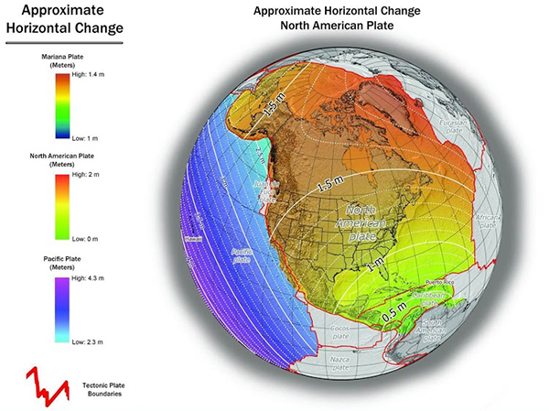
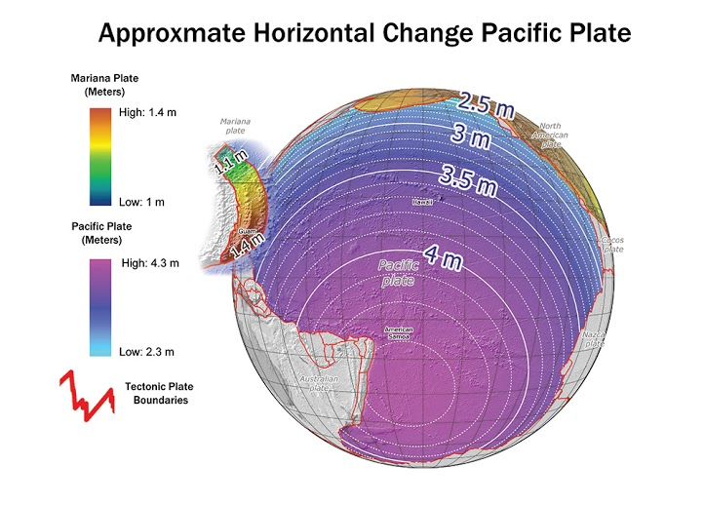
Horizontal Shifts
North America & Caribbean
Pacific & Mariana

Slide 6
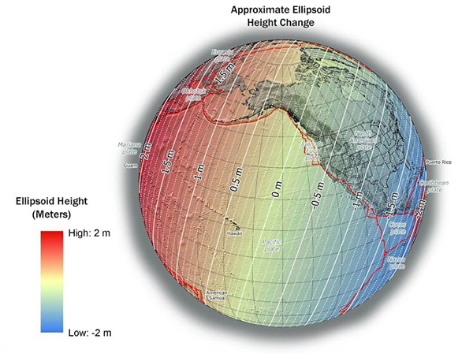
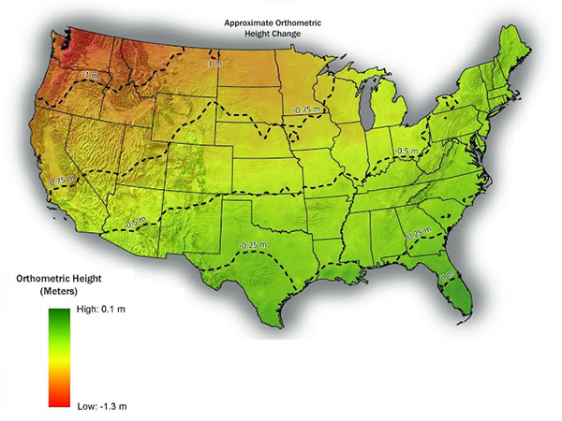
Vertical Shifts
Ellipsoidal
Orthometric

Slide 7
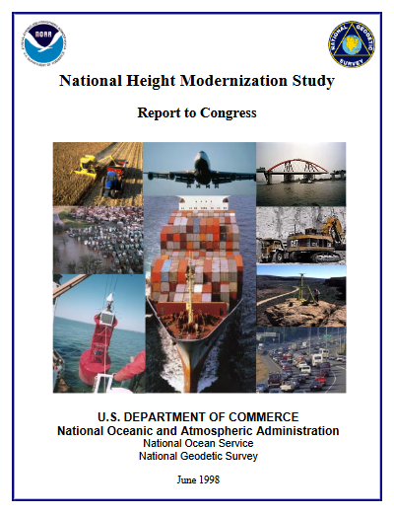

Remember:
“America needs a reliable and efficient means to determine absolute elevations,
relative only to the earth’s center”
Adapt:
“…the vertical datum will be accessed through GNSS and an accurate geoid model, rather than through publication of heights on passive geodetic bench marks…”
“…establish…a network of 55,000 bench marks with 10 km by 10 km…spacing…”

Slide 8
Outline
Why change?
Naming conventions of NSRS 2022
Geometric component
  Regional Reference Frames
  Intraplate Velocity Models
Geopotential component
  Static
  Time-varying
Future Plans and Summary

Slide 9
NSRS Modernization
The Old:
NAD 83(2011)
NAD 83(PA11)
NAD 83(MA11)
The New:
The North American Terrestrial Reference Frame of 2022
(NATRF2022)
The Pacific Terrestrial Reference Frame of 2022
(PTRF2022)
The Caribbean Terrestrial Reference Frame of 2022
(CTRF2022)
The Mariana Terrestrial Reference Frame of 2022
(MTRF2022)

Slide 10
NSRS Modernization
  The Old:
  NAVD 88
  PRVD 02
  VIVD09
  ASVD02
  NMVD03
  GUVD04
  IGLD 85
  IGSN71
  GEOID12B
  DEFLEC12B
  The New:
  The North American-Pacific Geopotential Datum of 2022 (NAPGD2022)
  - Will include GEOID2022

Slide 11
NSRS Modernization
  The Old:
  Bluebooking
  (PAGES, ADJUST, B files, G files, FORTRAN)
  The New:
  OPUS-Projects for Everything
  GPS
  Leveling
  Traverse
  Gravity
  RTK/RTN
  More?

Slide 12
Outline
Why change?
Naming conventions of NSRS 2022
Geometric component
  Regional Reference Frames
  Intraplate Velocity Models
Geopotential component
  Static
  Time-varying
Future Plans and Summary

Slide 13
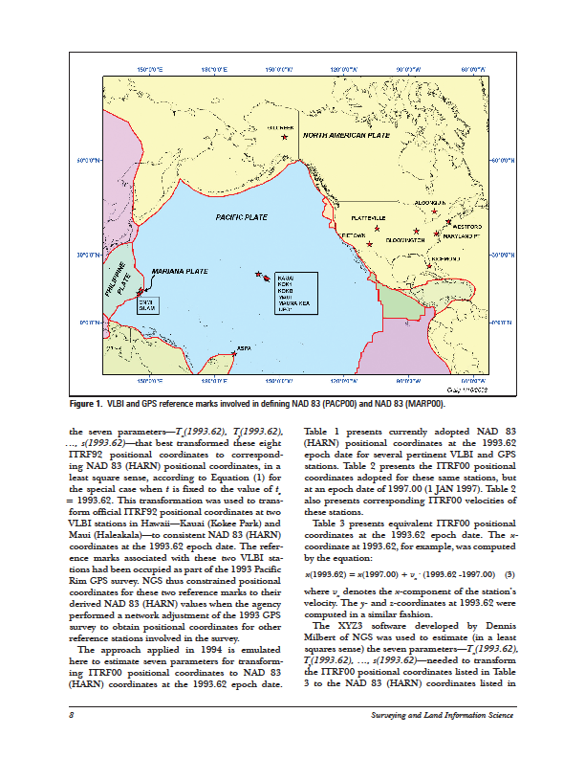
Four Frames/Plates in 2022
Previous NGS frames (Snay 2003)
  North America
  Pacific
  Mariana
Caribbean will be treated as 4th frame

Slide 14
Horizontal Vectors
NA coverage sufficient for EP determination
Caribbean possibly
Pacific & Mariana may require use of ITRF2014 EP values
Derived from 114 CORS in “stable” region
Repro1_pole

Slide 15
Outline
Why change?
Naming conventions of NSRS 2022
Geometric component
  Regional Reference Frames
  Intraplate Velocity Models
Geopotential component
  Static
  Time-varying
Future Plans and Summary

Slide 16
Intraplate Horizontal Velocities at CORS
Western US
Eastern US
Horizontal velocity remaining after removal of EP velocity
(e.g., velocity in the frame or intraplate velocity).

Slide 17
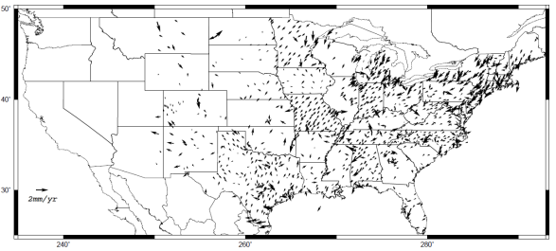
Residual Horizontal Velocities
Western US
Eastern US
Velocity remaining after removing a 0simply grid of CORS horizontal velocities

Slide 18
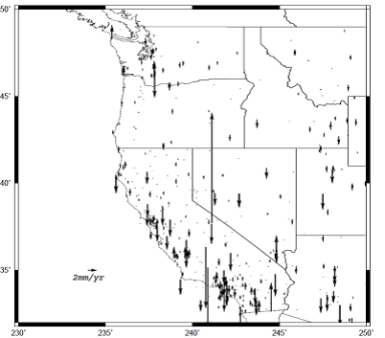
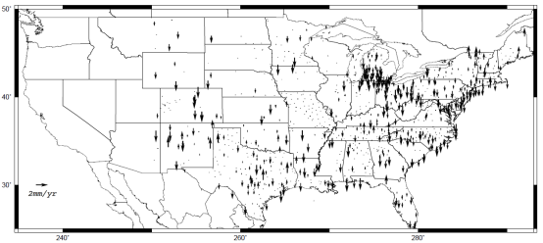
Intraplate Vertical Velocities at CORS
Western US
Eastern US
An Euler Pole cannot remove these

Slide 19
Outline
Why change?
Naming conventions of NSRS 2022
Geometric component
  Regional Reference Frames
  Intraplate Velocity Models
Geopotential component
  Static
  Time-varying
Future Plans and Summary

Slide 20
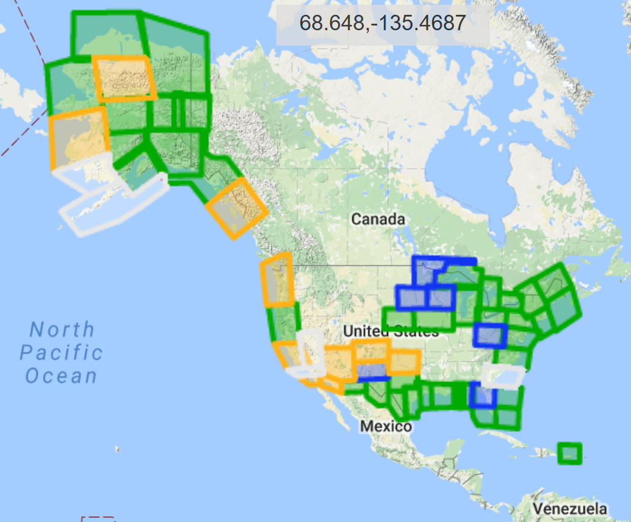
GRAV-D (25 January 2017)
Airborne Gravity Data - Map Key
Green: Available data and metadata
Blue: Data being processed
Orange: Data collection underway
White: Planned for data collection

Slide 21
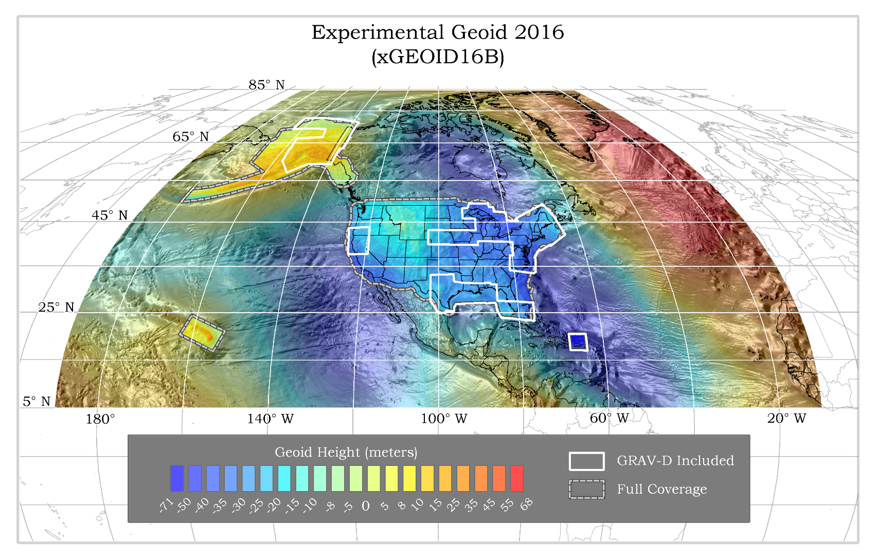
xGEOID16B => GEOID2022

Slide 22
Outline
Why change?
Naming conventions of NSRS 2022
Geometric component
  Regional Reference Frames
  Intraplate Velocity Models
Geopotential component
  Static
  Time-varying
Future Plans and Summary

Slide 23
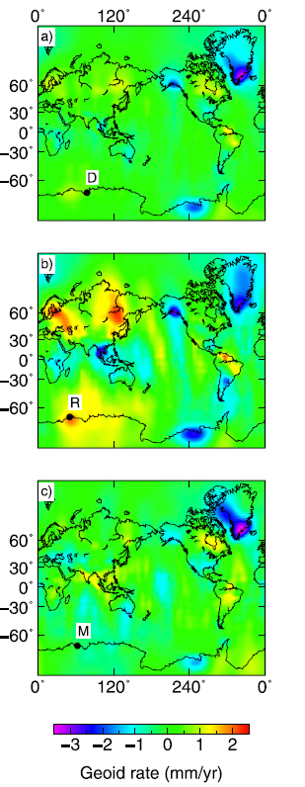
Time-Varying Geoid
GRACE/GFO
GeMS
Geoid Monitoring Service
Part of GRAV-D
Theresa Damiani, Ph.D. lead
SG and other meters to monitor select gravity BM’s
Supplements and validates satellite-derived models
GIA signals over Hudson Bay, Greenland, and Alaska
Figure 3 from
Tregoning et al.
(2009)
Non-Stationary
GRACE Signals

Slide 24
Outline
Why change?
Naming conventions of NSRS 2022
Geometric component
  Regional Reference Frames
  Intraplate Velocity Models
Geopotential component
  Static
  Time-varying
Future Plans and Summary

Slide 25
Future Plans and Summary
IGS Stations => Foundation CORS (FCORS)
  Sites collocated with other techniques (IERS)
  Adopt some/build others/cover all plates
Foundation CORS => Regional CORS/Repro’s
  Constrain Euler solutions/CORS positions to FCORS
  Standing up IAG NA WG on Euler Pole
  Forms four separate Frames

Slide 26
Future Plans and Summary
Models of Intraplate velocities (hor. & ver.)
  Could be simply modeled from existing CORS
    Density and quality of CORS impacts
    GIA signal must be taken into account (hor. & ver. vel.)
  Could be as complicated as Trans4D or equivalent
    How to maintain?
    Earthquakes? Re-surveys?
Orthometric heights in 2022: H(t) = h(t) – N(t) h(t) = survey epoch N(t) = N(t₀) +N (t – t₀)

Slide 27
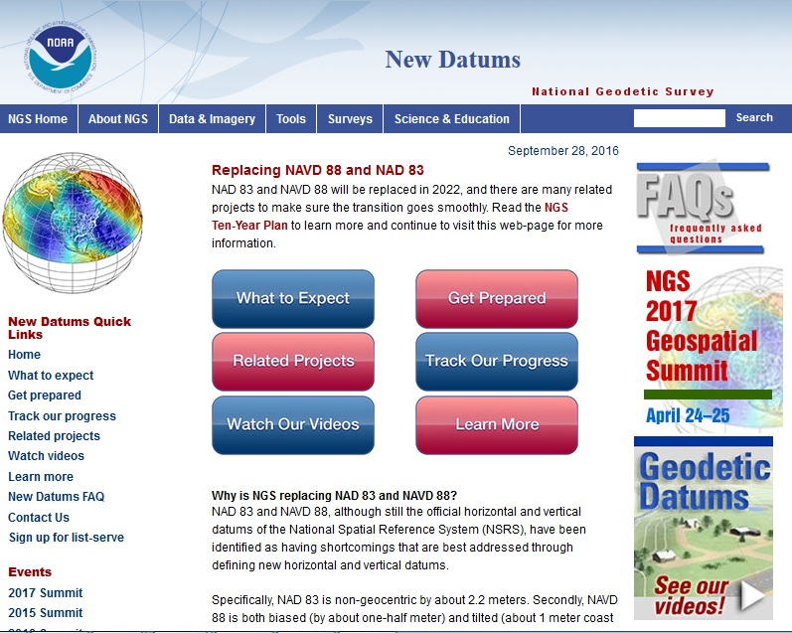
To Learn More
Visit the New Datums web page
geodesy.noaa.gov/datums/newdatums/index.shtml

Slide 28
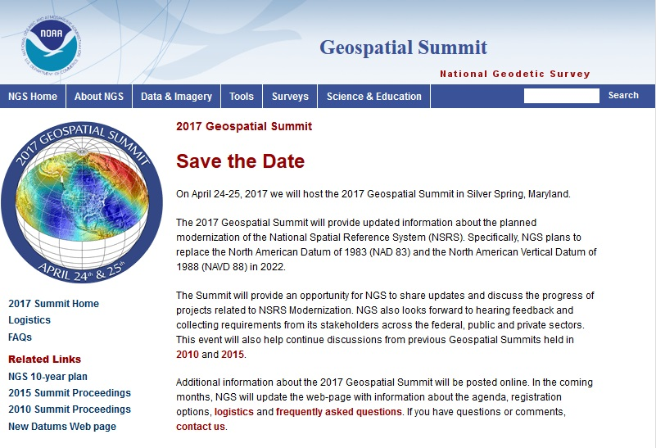
To Learn More
Attend the Geospatial Summit
Silver Spring, MD
April 24-25, 2017
FREE
geodesy.noaa.gov/geospatial-summit/index.shtml

Slide 29
Questions?
Daniel Roman, Ph.D.
acting Chief Geodesist
dan.roman@noaa.gov
+1-301-713-3200 (subject to change in near future)

Slide 30
NSRS Modernization
The New: Time Dependencies as a service

Slide 31
NSRS Modernization
The New: Time Dependencies as a service

