Slide 1
NGS Products Update
Alabama Society of Prof. Land Surveyors
2017 Annual Conference
Pelham, Alabama
October 18, 2017
Denis Riordan, PSM
NOAA, National Geodetic Survey
denis.riordan@noaa.gov

Slide 2
Presentation Outline
1. - NADCON 5.
2. - Updated NGS Database.
- OPUS Additions.
4. - OPUS Projects with Bluebooking features.
5. - Questions.

Slide 3
NADCON - Historical Overview
1989 : NAD 83(1986) released
1990: NADCON v1.0 released: NAD27 <--> NAD83 (86)
1990-1997: NADCON v2.1 NAD27 <--> NAD83 (HARN)
DOS based program, PC based
1997-2005: NADCON v2.1 NAD27 <--> NAD83 (HARN / FBN)
Only 19 states had significant shifts from HARN to FBN
Program expanded to handle FBN changes
Program still DOS / PC based
2004: NADCON v4.2 SAME TRANSFORMATIONS
Efforts made to improve NADCON, JAVA based / Windows driven menus
Program expanded to handle FBN changes

Slide 4
Historical Overview Cont.
2007: GEOCON v1.0 NAD83 (HARN / FBN) <--> NAD83 (2007)
Transformations from last NAD83, pre-2007 epoch
Program expanded to provide ability of on-line computations
Program built for transformations to be relative to “national” adjustment
2011: GEOCON11 v1.0 NAD83 (2007) <--> NAD83 (2011)
GEOCON expanded to go with latest NAD83 adjustment
Program expanded to provide ability of on-line computations
2012: GEOCON & 11 v1.0 SAME TRANSFORMATIONS
Program improvements / bug fixes
2012: GEOCON v2.0 SAME TRANSFORMATIONS
One combined “GEOCON” program
HARN & FBN Adjustment results accounted for on state by state basis
2007 & 2011 Nationwide

Slide 5
Historical Overview: Problems
Multiple DOS based programs
Lack of documentation
Inconsistent decision making
Accuracy reporting
State vs nationwide grids
Skipping over transformations
“Missteps” made by NGS…
Too many to list, can read in the report.

Slide 6
What is NADCON v5.0?
Transformations and error estimates for any point within a regional boundary, provided through biquadratic interpolation off of a grid
Lat/lon in arcseconds
Ellipsoidal height in meters
How?
Fresh pull of IDB
New suite of analysis tools
New grids from scratch
No realizations skipped
Make available through Geodetic Toolkit

Slide 7
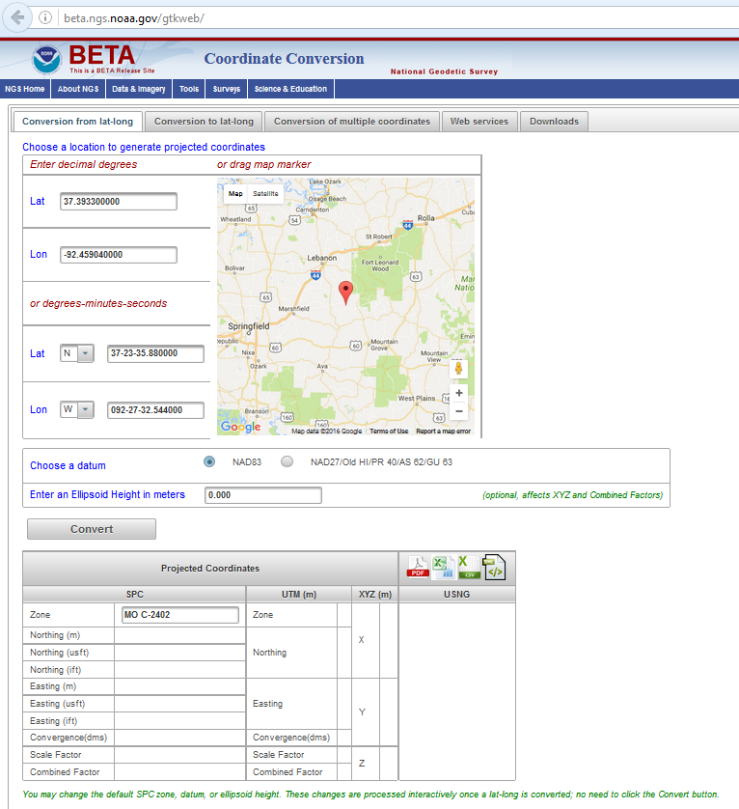
NADCON 5 in the Geodetic Toolkit
CURRENTLY
IN
BETA

Slide 8
φ, λ, h
NAD 83 (2011)
Allowable Regions:
CONUS
Alaska
Hawaii
PR/VI
AS
Guam/CNMI
St. Paul
St. George
St. Lawrence
xyz2plh
plh2xyz
SPC83
a,f (GRS 80)
NAD 83
X, Y, Z
SPC
USNG
NAD 83
UTMS
a,f (GRS 80)
USNG
UTM
USNG
NAD 83

Slide 9
X, Y, Z
Region: CONUS
NADCON 5 connections in RED
φ, λ, h
φ, λ, h
2022
X, Y, Z
SPC
UTM
USSD
USNG
UTM
φ, λ, h
φ, λ, h
SPC
NAD 27
X, Y, Z
NAD 83 (2011)
X, Y, Z
SPC
USNG
UTM
USNG
UTM
NAD 83 (NSRS2007)
NAD 83 (1986)
φ, λ, h
φ, λ, h
NAD 83 (FBN)
NAD 83 (HARN)
X, Y, Z
SPC
X, Y, Z
SPC
φ, λ, h
φ, λ, h
USNG
UTM
USNG
UTM
SPC
X, Y, Z
SPC
X, Y, Z
USNG
UTM
USNG
UTM

Slide 10
New NGS Database
It will “hold” everything.
GNSS, leveling, gravity, DoV, etc.
CORS and surveys
Equipment descriptions & histories, site logs, etc.
Models
Guidelines & strategies
It’s a tool, not just an archive of results.
Searches and filters.
Statistics
Plots
Reports
- Database will enable ability to track position changes over time

Slide 11
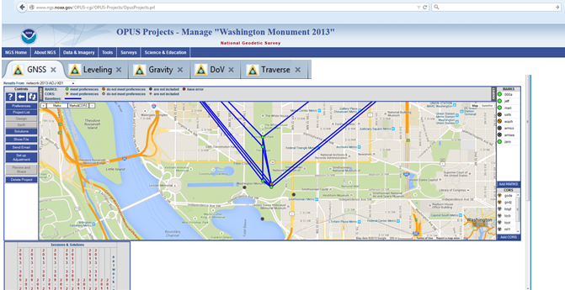
“Feeding” the database.
It’s common for projects to collect several types of data, e.g. gravity&GNSS, leveling&GNSS, static&kinematic GNSS. They’re related so let’s not treat them as separate.
OPUS-for-everything is a working name for a proposed web app to consolidate and process all data from a project.

Slide 12
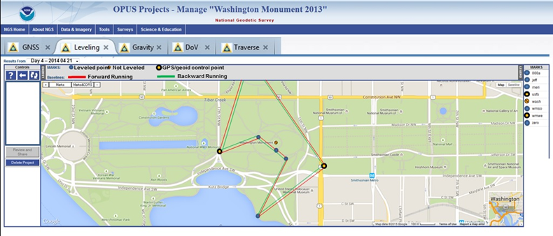
OPUS-for-everything

Slide 13
OPUS-Projects – new Bluebooking features
Improved view and features for session / marks table.
Changes to how OPUS Projects defines sessions.
Ability to Add / Delete CORS
Better baseline processing.
Adjustments using NGS software ADJUST.
Auto creation of B-file & G-file.

Slide 14
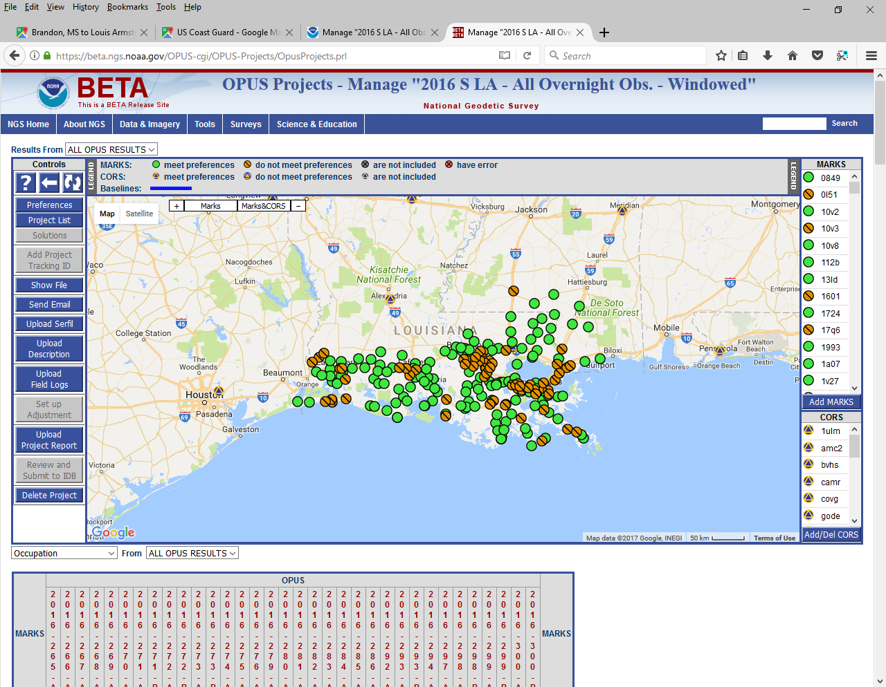
OPUS-Projects – new Bluebooking features

Slide 15
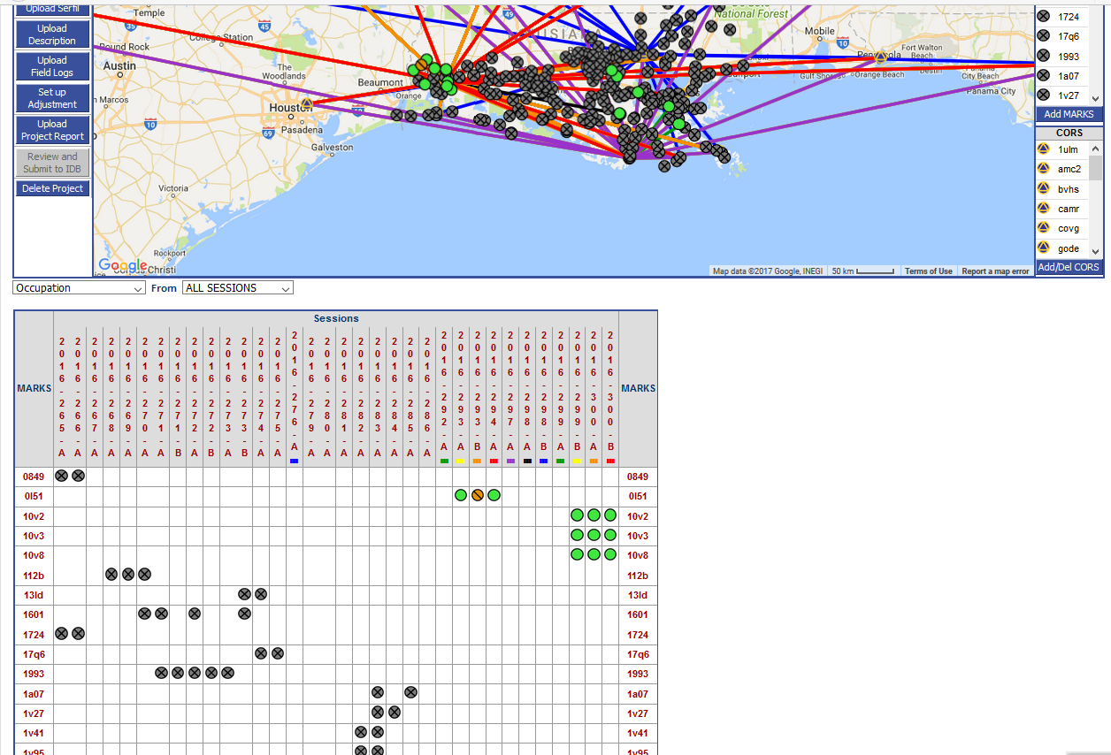
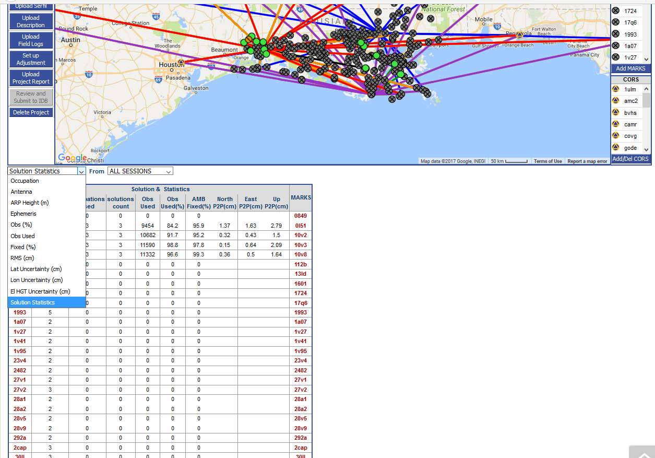
OPUS-Projects – new Bluebooking features

Slide 16
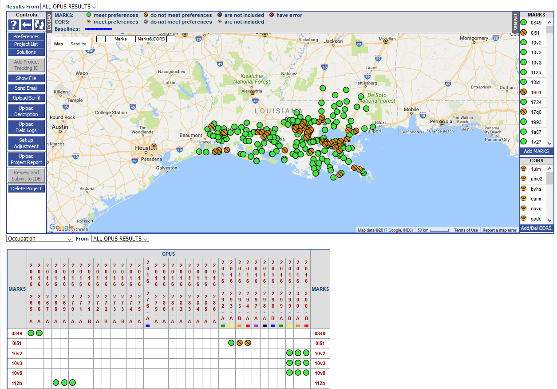
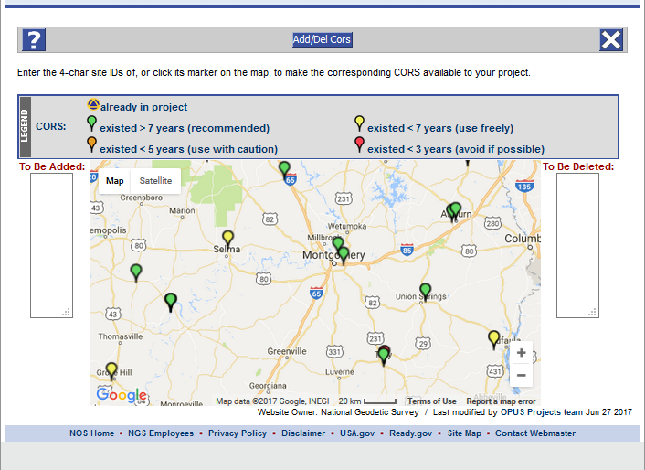
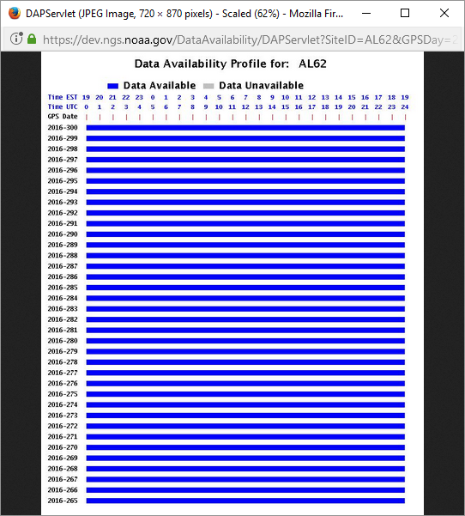
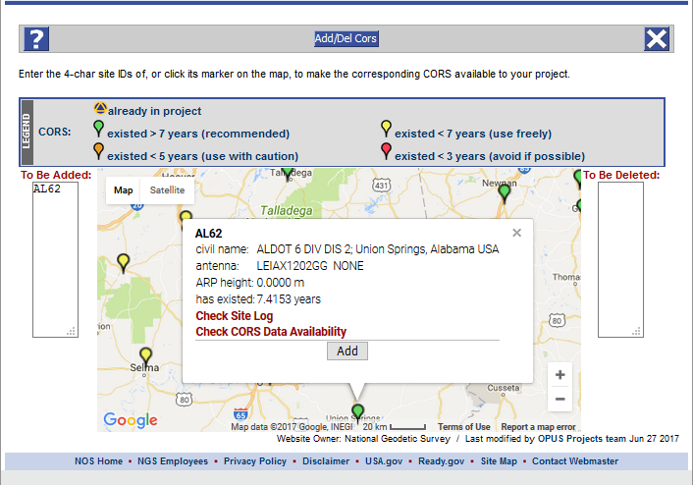
OPUS-Projects – new Bluebooking features
Notes:
https://www.youtube.com/playlist?list=PLsyDl_aqUTdFY6eKURmiCBBk-mP4R10Dx

Slide 17
More information on all updated products can be found on the NGS website at: www.ngs.noaa.gov

Slide 18
? ? QUESTIONS ? ?

