Slide 1
Giovanni Sella CORS Program Manager NOAA-National Geodetic Survey
CORS Program Updates FY2010-2011
Especially New Revised Coordinates
CGSIC - Portland, OR
19 September, 2011

Slide 2
CORS News for FY10-11
New CORS coordinates released September 6
New absolute antenna calibrations released
Updated HTDP to 3.1.2
Passive network adjustment in the works
Network grows to +1,800 stations
OPUS supports two reference frames

Slide 3
Previous CORS Coordinates
Mixed coordinates and velocities from: last reprocessing (1994-2002), and adjustments using 8-3 IGS ref. sites
Mixed HTDP vs. computed vel.; Vertical vel. = 0 mm/yr
NGS’s global frame was ITRF00 epoch 1997.0 projecting 14 yrs is unreliable; NAD 83(CORS96,MARP00,PACP00) epoch 2002.0 projecting 9 yrs becoming a problem
Metadata issues, discontinuities/offsets
Significant software changes
Absolute vs relative antenna phase center values
Need to revise CORS coordinates and velocities

Slide 4
Positions and Velocities Change!
CORS Multiyear soln.
Plate fixed

Slide 5
Reference Frame Definitions
ITRF frame (global) multi-technique—vlbi, slr, doris, gnss
IGS frame (global) GNSS only
NAD frame (plate fixed) related to ITRF/IGS
Critical to pay attention to frame tags and epoch dates and antenna calibration values
Frame Name | Epoch | Antenna PCV* | Data Duration
ITRF2000 | 1997.00 | Rel | 1994.0-2002.0
ITRF00 (NGS’s soln) | 1997.00 | Rel NGS | 1994.0-present
NAD 83(CORS96,MARP00,PACP00) | 2002.00 | Rel NGS | 1994.0-present
IGS08 | 2005.00 | Abs IGS08 | 1997.0-2009.5
IGS08 (NGS’s soln) | 2005.00 | Abs IGS08 | 1994.0-2011.5 (ongoing)
NAD 83(2011,MA11,PA11) | 2010.00 | Abs IGS08 | 1994.0-2011.5 (ongoing)
*PCV – phase center value; Abs-Absolute, Rel-Relative

Slide 6
Reference Frames Used
Basis is global frame inherited from ITRF2008 but not the same as ITRF2008
Name: IGS08
Epoch date: 2005.00 (same as ITRF2008, IGS08)
NGS has more discontinuities and weekly solutions than ITRF2008; and has applied IGS05_ATX -> IGS08_ATX corrections to be consistent with IGS08
Related to ITRF, but plate fixed (NAD 83)
Name: NAD 83(2011,MA11,PA11)
Epoch date: 2010.00
NAD 83(CORS96,MARP00,PACP00) to NAD 83(2011,MA11,PA11) identity transformation (i.e. same axes)
NAD 83(2011) axes origin different (~2m) from ITRF/IGS08 (expect reconciliation ~2022)

Slide 7
Reference Frames Used
NAD 83(2011) epoch 2010.00
“2011” is datum tag i.e. year adjustment complete
“2010.00” is “epoch date” (January 1, 2010)
Date associated with coordinates of control station
Frame fixed to North American tectonic plate
Includes California, Alaska, Puerto Rico, and US Virgin Islands
NAD 83(PA11) epoch 2010.00
Frame fixed to Pacific tectonic plate (Hawaii and American Samoa, and other islands)
NAD 83(MA11) epoch 2010.00
Frame fixed to Mariana tectonic plate (Guam and CNMI)

Slide 8
Reference Frames and Orbits
IGS08 positions are not equal to ITRF2008
ITRF2008 is multi-technique solution VLBI, SLR, DORIS, GPS
IGS08 is a GPS only solution
ITRF2008 GPS’s component was processed using IGS05 absolute antenna calibrations
To create IGS08 IGS took the ITRF2008 positions and applied a station specific correction to account for differences between IGS05 and IGS08 absolute antenna calibrations. Corrections of up to 5 cm
All IGS orbit products in NGS online storage from 1994-Jan-1 to 2011-Apr-16 are aligned to IGS05 and then to IGS08. For most non-research applications the orbits can be mixed

Slide 9
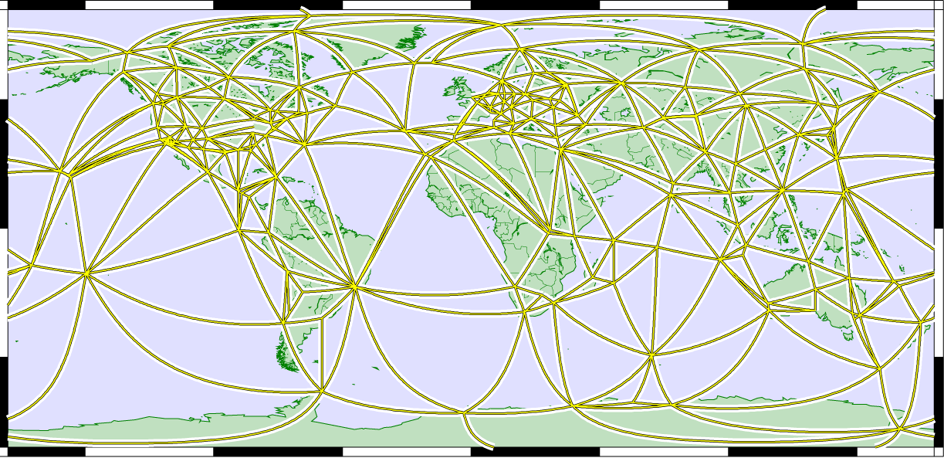
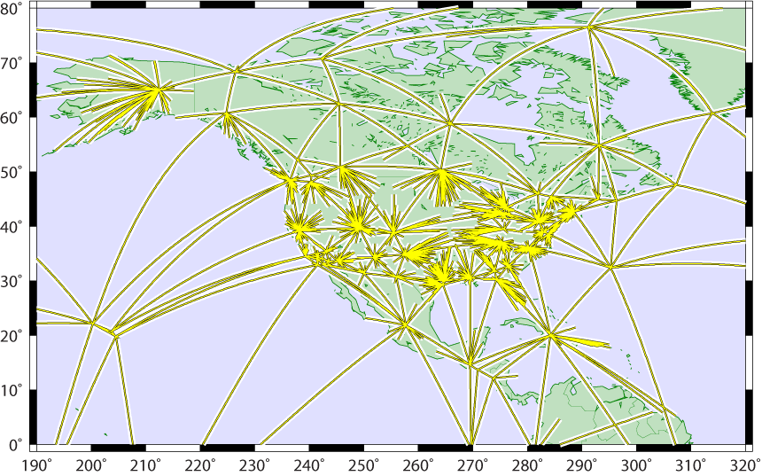
Tying CORS to Global Frame
global tracking network used for estimating:
GPS satellite orbits (15-min intervals)
terrestrial framework
Earth Orientation (EOPs)
global station positions (weekly averages)
Global
CORS tied to global framework via single baselines radiating from global stations
minimizes frame distortions from local effects in dense regional networks
Global+CORS

Slide 10
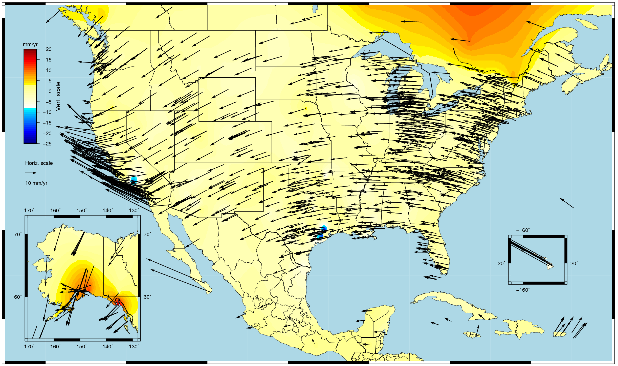
CORS IGS08 Velocity Field

Slide 11
What is the new NAD 83?
Same datum, so no transformation between NAD 83(CORS96,MARP00,PACP00) epoch 2002.00 and NAD 83(2011,MA11,PA11) epoch 2010.00
NAD 83 (2011,MA11,PA11) velocities should be used to move positions through time
To assess differences in frames, need to compare positions at same epoch date (2002.00).
Will do this by taking new positions at CORS at 2010.00 and using NAD 83(2011,MA11,PA11) velocities to move to 2002.00

Slide 12
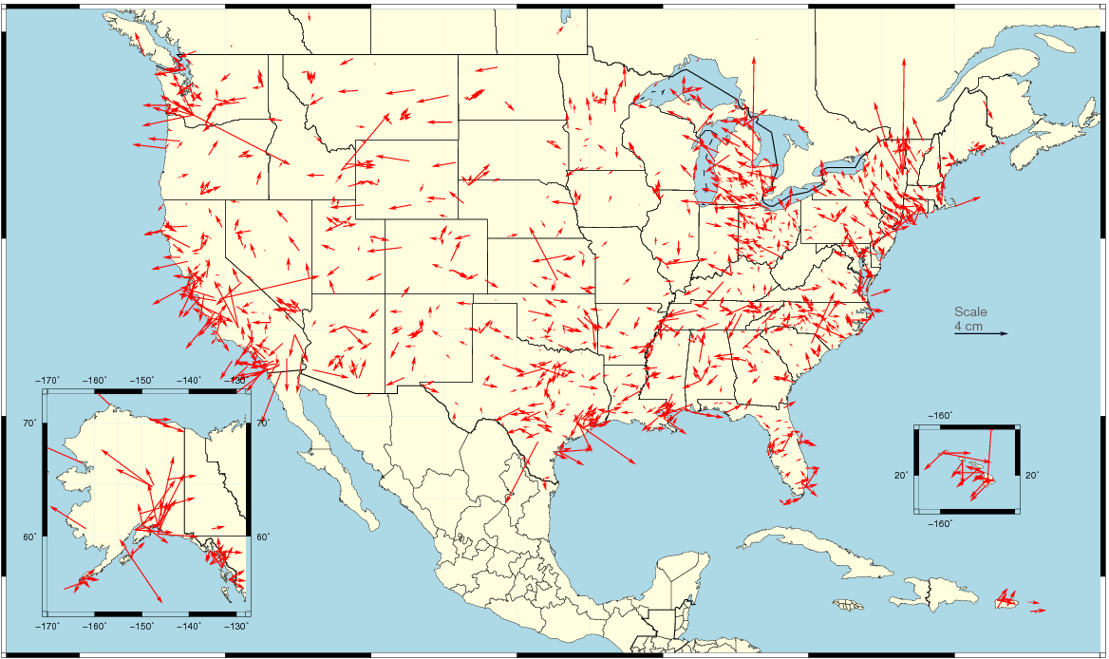
Changes in Horizontal NAD 83 Positions NAD 83(2011) epoch 2002.00 – NAD 83(CORS96) epoch 2002.00
Avg. shifts: ΔE = -0.14±1.04 (ME -0.10) cm ΔN = 0.19±0.94 (ME 0.20) cm
prescribing velocities using numerical models (i.e. HTDP)
smaller random part probably caused by change to absolute antenna calibrations

Slide 13
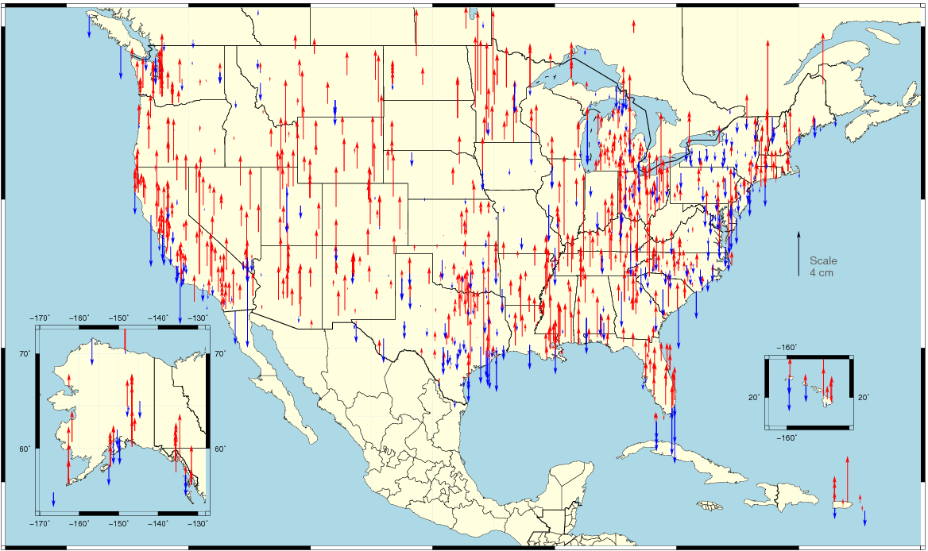
Changes in Vertical NAD 83 Positions NAD 83(2011) epoch 2002.0 – NAD 83(CORS96) epoch 2002.0
avg. shift: ΔU = 0.80±1.89 (ME -0.70) cm
random part mostly caused by switch to absolute antenna calibrations
shifts also caused by assuming V_{u} = 0 in NAD 83(CORS96)

Slide 14
The NAD 83 datum is the same. So what are the shifts caused by changing reference epoch to 2010?
Previous 2 slides show consequences of new realization:
approx. 1-2 mm avg. horiz. shift
less than 1 cm avg. vert. shift
BUT reference epoch has changed from 2002.00 to 2010.00
velocities are therefore critical
Let’s compare NAD 83(CORS96) positions @ 2002.00 to NAD 83(2011) positions @ 2010.00
differences dominated by effects of crustal motion, i.e., NAD 83 velocities are non-zero
e.g. 2 mm/yr velocity after 8 years = 1.6 cm change in position

Slide 15
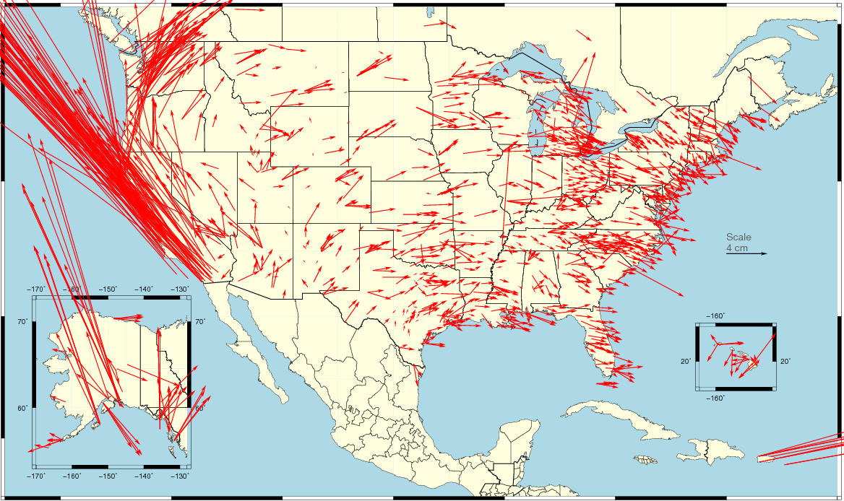
Changes in Horizontal NAD 83 Positions Different Epochs NAD 83(2011) epoch 2010.0 – NAD 83(CORS96) epoch 2002.0
Avg. shifts: ΔE = 0.05±5.25 (ME -0.12) cm ΔN = 2.12±6.08 (ME 0.00) cm
combination of position and velocity differences
due mostly to updated velocities (including up to 8 more years of data)
WA+OR
4.4E,5N cm
ID+MT+ND+SD+WY
1.7E,0.5N cm
East
1.4E, -0.2N cm
UT+CO+NM+AZ
0.5E,1.0N cm
CA+NV
10.8E, 14.4N
cm

Slide 16
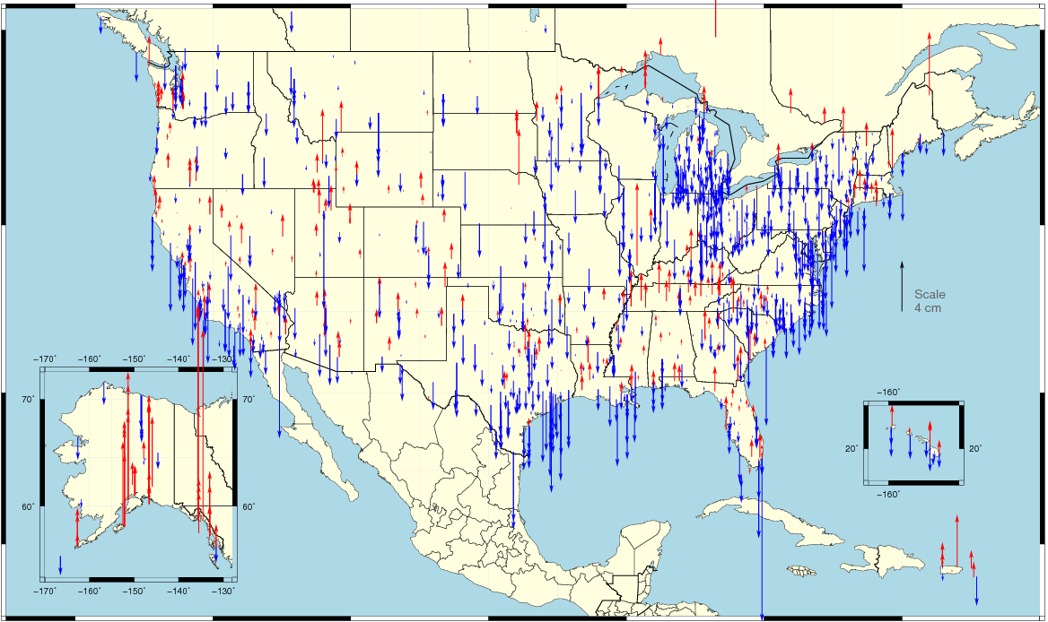
Changes in Vertical NAD 83 Positions Different Epochs NAD 83(2011) epoch 2010.0 – NAD 83(CORS96) epoch 2002.0
Avg. shifts: ΔU = -0.66±2.24 (ME -0.80) cm
combination of position and velocity differences from additional data, tectonics
assuming vertical velocity ≈ 0.00 in NAD 83(CORS96)

Slide 17
Changes with New Frames
Change from relative to IGS08 absolute antenna phase center values (PCV)
The global frame (IGS08) pos/vel are aligned to full global frame >100 sites
Change in epoch from 2002.00 to 2010.00 in NAD 83(2011/MA11/PA11)
No longer support coordinates in ITRF00 or NAD 83 (CORS96,MARP00,PACP00)
What amount of change/tolerance are permitted?
No change 2 cm horizontal, 4 cm vertical

Slide 18
Changes with New Frames
CORS coordinates clearly divided
>2.5 yrs of data with positions and velocities from stacked solution (i.e. computed). Valid for “fixed” coordinates.
<2.5 yrs of data positions from stacked solution, but velocities via HTDP (i.e. modeled).
Users encouraged not to use CORS with modeled velocities, until computed vels. are avail. (may take up to 3 yrs). Important if holding coordinates fixed.
CORS with unexplained coordinates changes marked as “questionable” until resolved/stable.

Slide 19
HTDP 3.1.2
HTDP supports new frames
Includes a basic gridded velocity field for Alaska
A detailed and robust velocity and block model for Alaska should be available next year
Preliminary work on a 3-dimensional has been completed, but more work is needed before it a beta version is ready

Slide 20
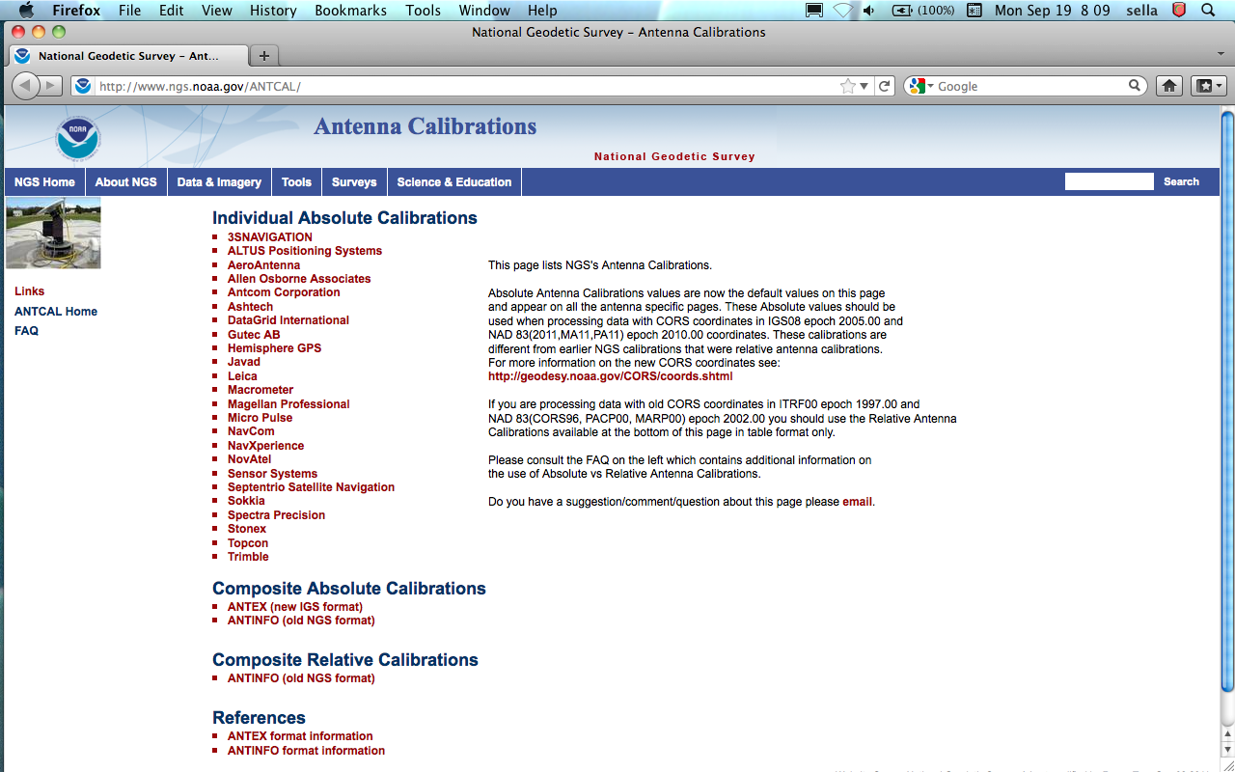
Antenna Calibrations
Hear Next talk by Andria Bilich

Slide 21
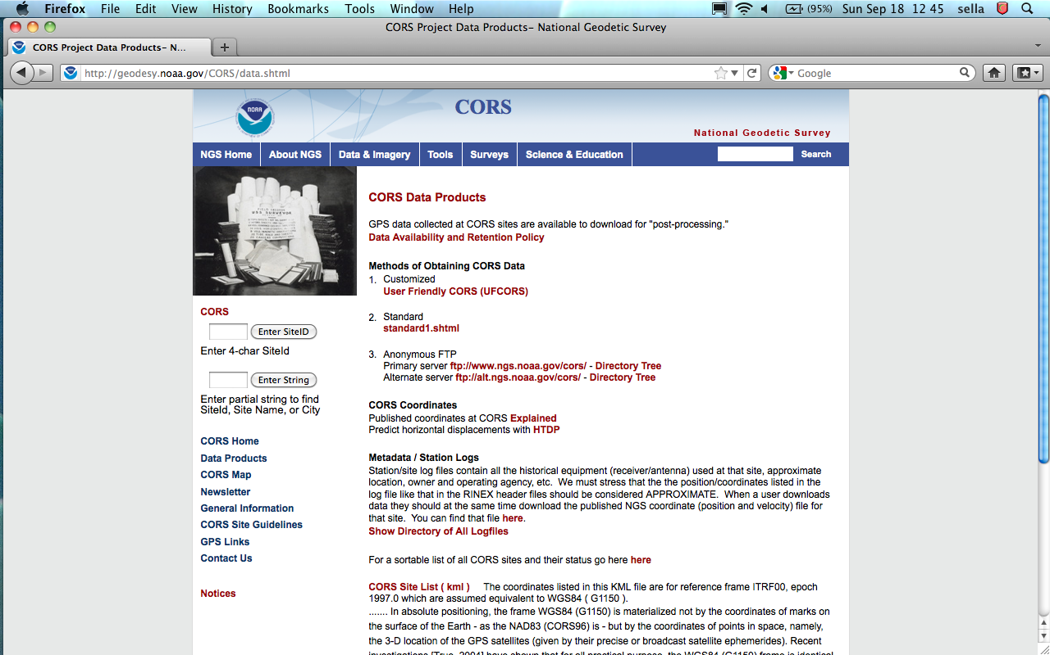
Information on New Coordinates

Slide 22
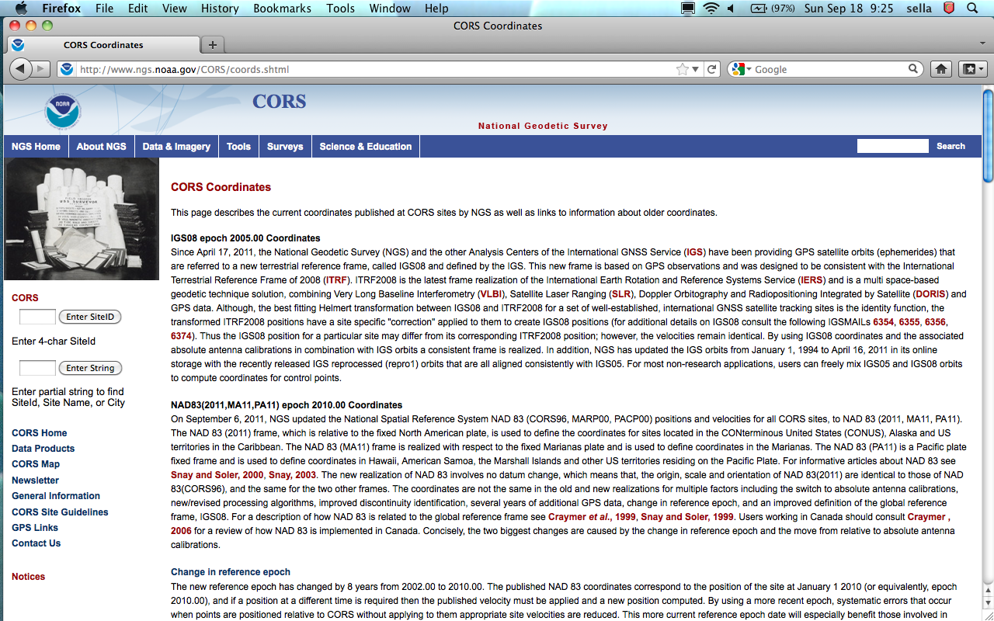
Info on New Coordinates

Slide 23
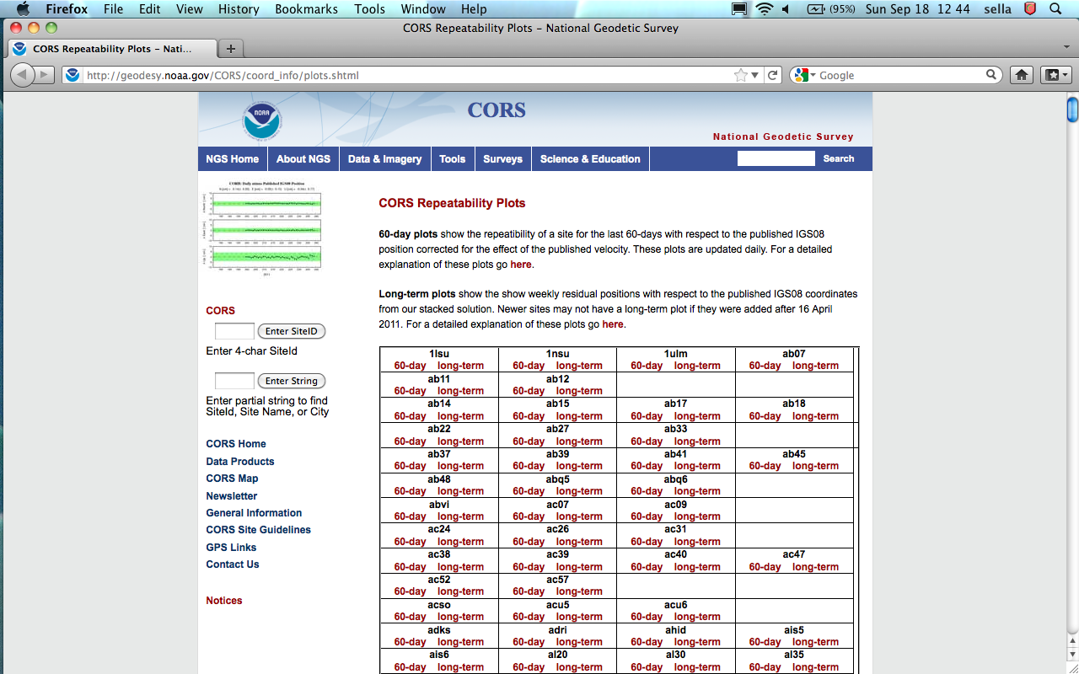
Info on New Coordinates

Slide 24
What About the Passive Network?
National Adjustment of 2011 (NA2011)
New adjustment of GPS passive control
GPS vectors tied (and constrained) to CORS NAD 83(2011/MA11/PA11) epoch 2010.00
Approximately 80,000 stations and more than 400,000 GPS vectors
Realization will be the same for CORS and passive marks
National Adjustment of 2011
Goal: Complete by end of CY 2011/early 2012
Deadline for submitted projects: Aug 31, 2011

Slide 25
What About the Passive Network?
Optimally align passive control with new CORS
Add >1000 projects submitted since 2007
Also observations for Hawaii, other Pacific islands
Network and local accuracies on all stations
Including future submitted projects
More consistent results in tectonically active areas
More current data, better tectonic modeling (HTDP 3.1.2)
Better computations and analysis techniques
Improved outlier detection
Incorporation of lessons learned from previous national adjustment

Slide 26
Orthometric Heights and Geoid Model
New hybrid geoid model (GEOID12)
Use NAD 83(2011) epoch 2010.00 ellipsoid heights on NAVD 88 benchmarks
Might also use OPUS-Database results on NAVD 88 benchmarks
Available after passive adjustment is completed
Considering performing a national vertical adjustment
Constrain vertically to NAVD 88 benchmarks
Perform a simultaneous nationwide adjustment
GNSS-derived orthometric heights
NAD 83(2011) ellipsoid heights with GEOID12
NOT a readjustment of NAVD 88 leveling

Slide 27
New Datasheets
Update to new Datasheet version (8.00)
Changed location, length, and text for many fields
Added new fields, deleted fields, augmented existing fields
Implemented by end of calendar year 2011
Will add announcement and prototype to NGS web site soon

Slide 28
OPUS
No changes in processing engines (OPUS-S and OPUS-RS)
User can choose to get results in either old or new frames
Old frame available till passive adjustment is completed
OPUS-DB results currently available in both frames.
When passive adjustment is completed all COR96/MARP00/PACP00 will be recomputed to 2011/MA11/PA11
OPUS-Projects still beta hopefully operational next year

Slide 29
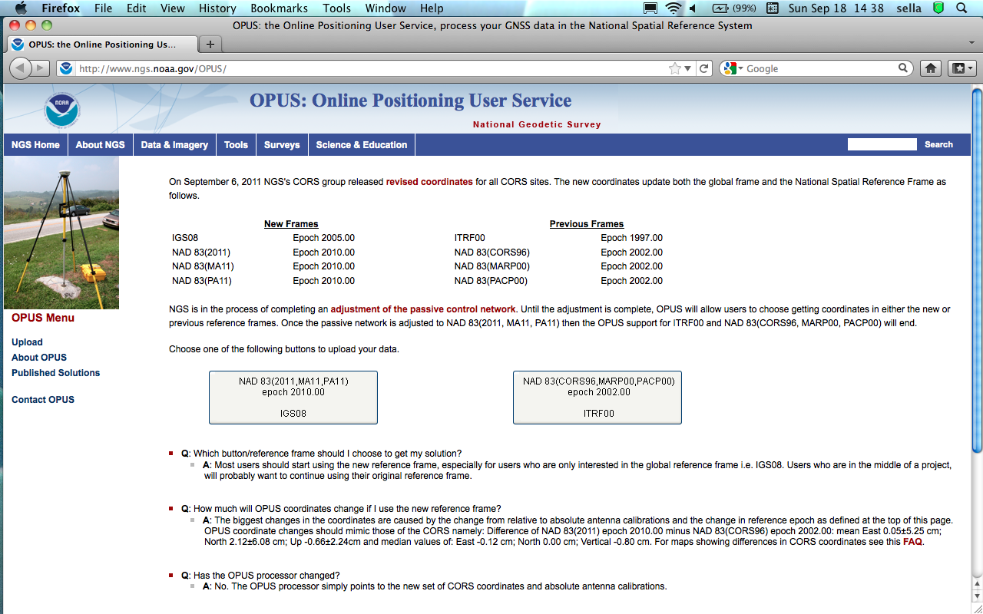
OPUS cont’d

Slide 30
Summary
Users must use appropriate antenna calibrations with particular reference frames
All NGS Products and Services will be in consistent frames in 2012:
IGS08 epoch 2005.00
NAD 83(2011,MA11,PA11) epoch 2010.00
User should start thinking that transforming between frames is problematic need to plan to reprocess with new frames

Slide 31
Questions/Comments
We recognize that NGS and the public want CORS to be the primary access to the NSRS, but accuracy and constancy are not always possible.
We are keen to hear your comments/concerns
Check: geodesy.noaa.gov/CORS/news.shtml
geodesy.noaa.gov/CORS
Choose Data Products
giovanni.sella@noaa.gov

Slide 32
Questions?
- What is the reliability of new velocities compared with current published values - especially in the vertical?
- If the new reference frame is called NAD 83(2011) epoch 2010.0 what efforts will NGS make to educate the user to minimize confusion with NAD 83(CORS96) epoch 2002.0?
What period of overlap will occur with solutions in both NAD 83(CORS96) epoch 2002.0 and NAD 83(2011) epoch 2010.0?
What format changes occur to NGS products e.g. data sheets, coordinate page, OPUS output?
Will there be a transformation between NAD 83(CORS96) and NAD 83(2011)?

Slide 33
Work Completed
CORS RINEX observations from 1994 thru 2011.4 processed in fully consistent global framework
evaluated approx. 90 billion double-difference observation eqs.
using latest IERS models and processing methods
switch to absolute antenna calibrations
reduced positioning errors and distortions of global frame
912 weekly (full history) CORS+global SINEX files containing X,Y,Z positions and full variance-covariance information
used CATREF software from Institut Géographique National (IGN) to stack weekly CORS+global SINEX files in three steps:
step 1: focused on attenuating aliasing of Helmerts from local non-linear motions
step 2: impose “unbiased” Helmert parameters on whole network & stack
step 3: obtain MYCS—i.e., align “unbiased” stacked TRF to ITRF2008 via GPS sites common to both SNXs
resulted in a set of new positions and velocities for CORS
4,906 position and velocity estimates for 2,264 CORS+global stations
solution aligned to ITRF2008 with negligible distortions of the frame
solution calibrated to be used with IGS08 absolute antenna calibrations

