Slide 1

Coastal Zone 2011 Conference
“Cool Geodetic Resources For Your Project”
A National Ocean Service, NOAA, Presentation
  TOOLS TO OBTAIN GEODETIC CONTROL
John Ellingson, National Geodetic Survey
  GEODETIC & TIDAL DATUMS and USING VDATUM
Marti Ikehara, National Geodetic Survey
  INTERNATIONAL GREAT LAKES DATUM OVERVIEW
Stephen Gill, Center for Operational Oceanographic Products and Services

Slide 2
Geodetic Vertical and Tidal Datums and using VDATUM
Marti Ikehara, CA Geodetic Advisor
NOAA’s NGS, Sacramento
Marti.ikehara@noaa.gov

Slide 3
What vertical datums are in use?
Orthometric: NAVD88, NGVD29 (superceded)
Ellipsoid: NAD83, WGS84 (4), ITRF## (11)
TIDAL
Island datums (HI, PR, VI, AM, GU, MAR)
Non-tidal: IGLD85 [details in next talk]

Slide 4
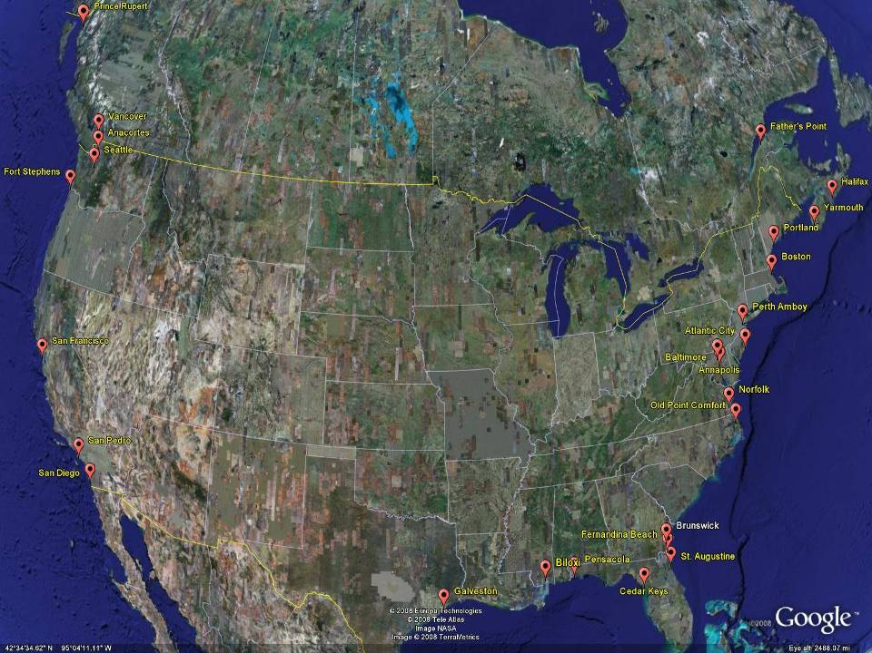
NGVD29
The National Geodetic Vertical Datum of 1929 is referenced to 26 tide gauges in the US and Canada
Notes:
It turns out that MSL is a close approximation to another surface, defined by gravity, called the geoid, which is the true zero surface for measuring elevations. Because we cannot directly see the geoid surface, we cannot actually measure the heights above or below the geoid surface. We must infer where this surface is by making gravity measurements and by modeling it mathematically. For practical purposes, we assume that at the coastline the geoid and the MSL surfaces are essentially the same. Nevertheless, as we move inland we measure heights relative to the zero height at the coast, which in effect means relative to MSL.
Definition: NGVD29 – The National Geodetic Vertical Datum of 1929…
The Sea Level Datum of 1929 was the vertical control datum established for vertical control surveying in the United States of America by the General Adjustment of 1929. The datum was used to measure elevation or altitude above, and depression or depth below, mean sea level (MSL).
Mean sea level was measured at 26 tide gauges: 21 in the United States and 5 in Canada. The datum was defined by the observed heights of mean sea level at the 26 tide gauges and by the set of elevations of all bench marks resulting from the adjustment. The adjustment required a total of 66,315 miles (106,724 km) of leveling with 246 closed circuits and 25 circuits at sea level.
Since the Sea Level Datum of 1929 was a hybrid model, it was not a pure model of mean sea level, the geoid, or any other equipotential surface. Therefore, it was renamed the National Geodetic Vertical Datum of 1929 (NGVD 29) in 1973. The NGVD 29 datum was subsequently replaced by the North American Vertical Datum of 1988 (NAVD 88) based upon the General Adjustment of the North American Datum of 1988.

Slide 5
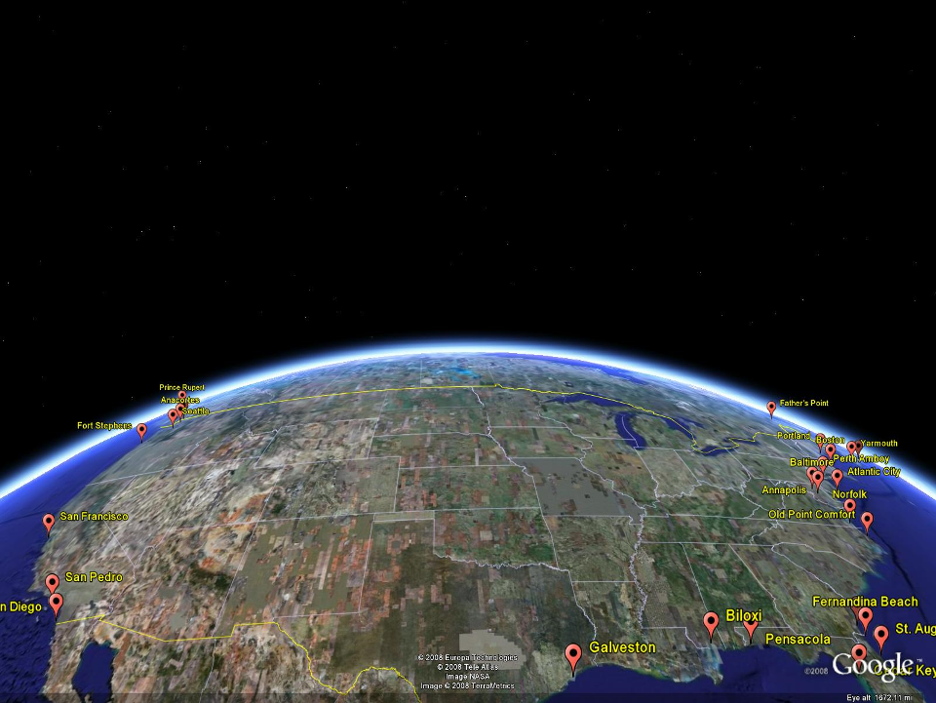
NAVD 88
Referenced to 1 Tide Gauge
(Father’s Point)
NGVD 29
Referenced to 26 Tide Gages
-11 cm
125 cm
-23 cm
85 cm
102 cm
NAVD88 minus LMSL(1960-1978)
70 cm
-11 cm
4 cm
-23 cm
Notes:
NGVD29 consisted of the national vertical network referenced to 26 tide stations along the coast of North America
Click
That network was warped or twisted to fit those tide stations. The difference between the geoid (what we run levels on) and LMSL is not the same for every tide station due to prevailing winds, ocean current, etc. It is that difference that warped the network.
Click
NAVD88 utilized additional leveling data along with gravity measurements (to measure the geoid) and was referenced to only one tide station on the St. Lawrence Seaway. As you can see in the graphic, the network was unwarped which changes those reference mark’s elevations (differences between NAVD88 and the local mean sea level shown) This is not the difference between NAVD88 and NGVD29 but it is a representation of what happened.

Slide 6
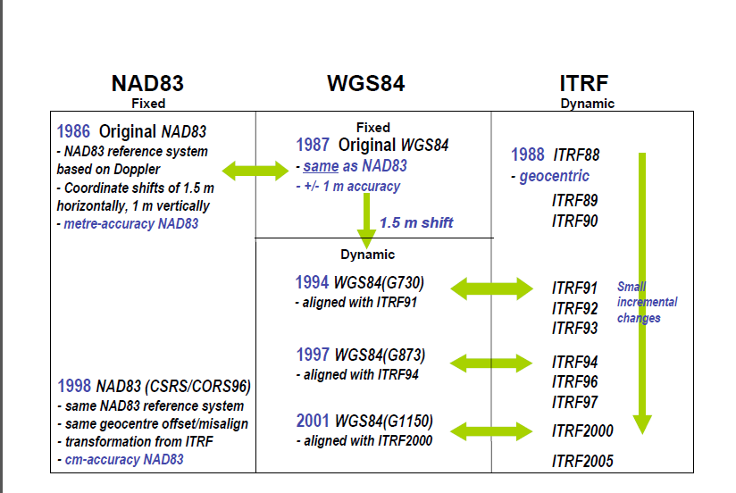
http://www.naref.org/transf/nad83_agu2007spr.pdf

Slide 7
Ellipsoid, Geoid, and Orthometric Heights
H = Orthometric Height (NAVD 88)
h = Ellipsoidal Height (NAD 83)
H = h - N
N = Geoid Height (Geoid09)
H
h
TOPOGRAPHIC SURFACE
N
GEOID 09
Geoid
Ellipsoid
GRS80/NAD83
Notes:
GEOID model provides relation between ellipsoid height (mathematical surface) and orthometric height (land surface)

Slide 8
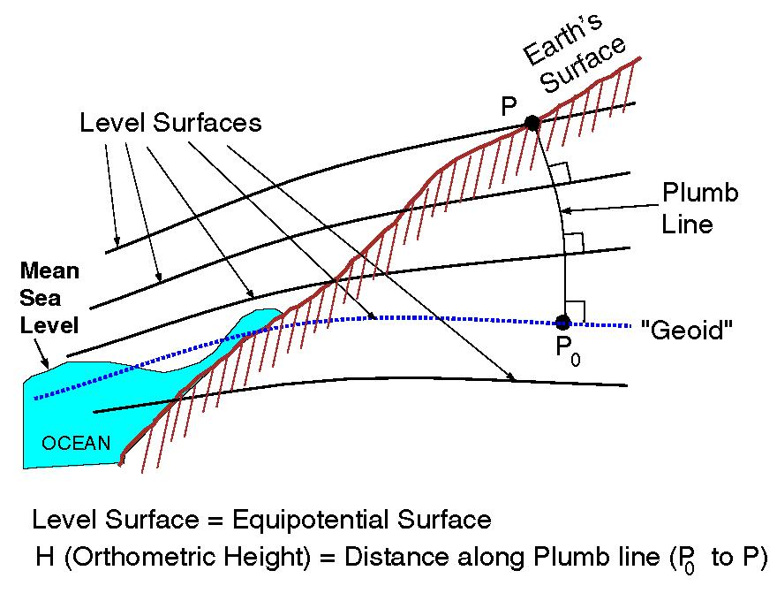
EQUIPOTENTIAL SURFACES
Notes:
A leveling measurement, using a traditional spirit level, is affected or impacted by the gravitational force at the point on the earth’s surface. Equipotential contours are where the gravity potential is the same, equal, and a ‘surface’ along which water will not flow.
It turns out that MSL is a close approximation to another surface, defined by gravity, called the geoid, which is the true zero surface for measuring elevations. Because we cannot directly see the geoid surface, we cannot actually measure the heights above or below the geoid surface. We must infer where this surface is by making gravity measurements and by modeling it mathematically. For practical purposes, we assume that at the coastline the geoid and the MSL surfaces are essentially the same. Nevertheless, as we move inland we measure heights relative to the zero height at the coast, which in effect means relative to MSL.

Slide 9
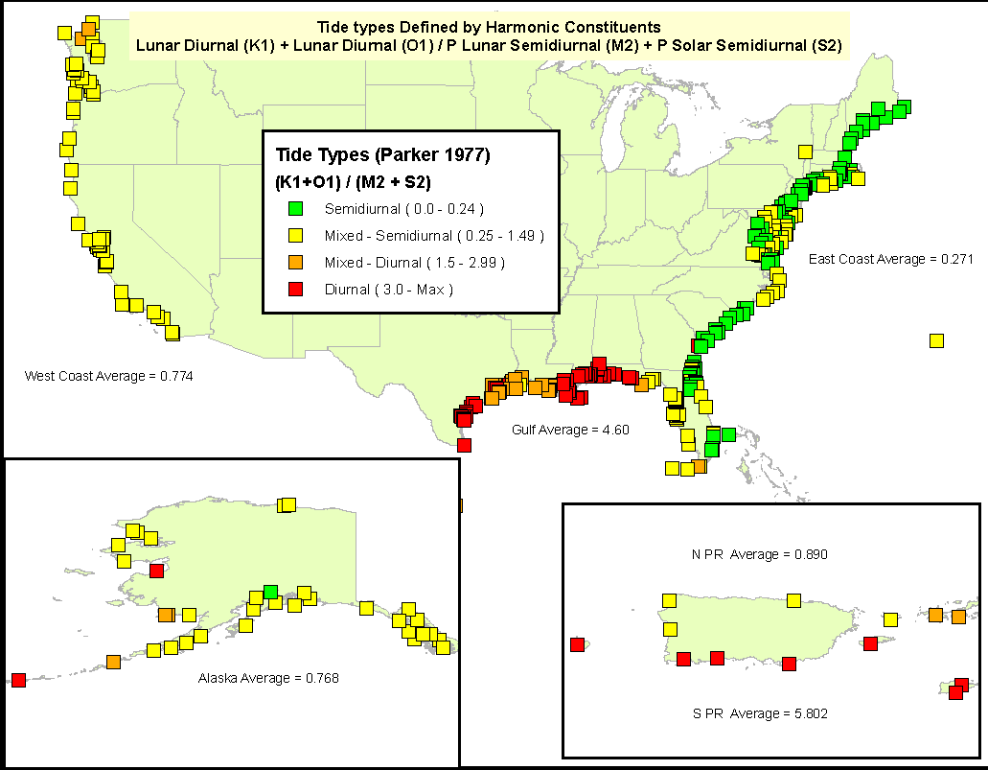
Types of Tides
Tide Type Varies by Region due to Local Hydrodynamics

Slide 10
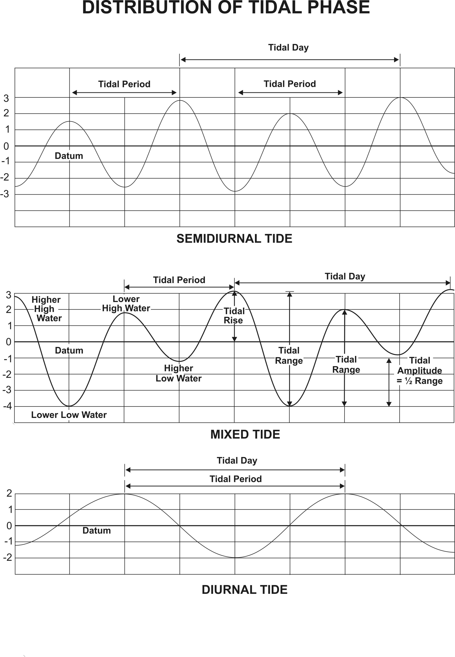
Types of Tides
Semidiurnal
two daily highs & lows
~ similar height
Most common
Mixed
two daily highs & lows
~ not similar height
Diurnal
one daily high & low

Slide 11
Tidal Datums
Station Datum: Unique to each water level station
  - Established at a lower elevation than the water is ever expected to reach.
  - Referenced to the primary bench mark at the station
  - Held constant regardless of changes to the water level gauge or tide staff
MHHW: Mean Higher High Water
The average height of the higher high water of each tidal day observed over the NTDE MHW: Mean High Water
The average of all the high water heights observed over the NTDE
MTL: Mean Tide Level
The arithmetic mean of mean high water and mean low water
MSL: Mean Sea Level or LMSL: Local Mean Sea Level
The arithmetic mean of HOURLY heights observed over the NTDE
MLW: Mean Low Water
The average of all the low water heights observed over the NTDE
MLLW: Mean Lower Low Water
The average of the lower low water height of each tidal day observed over the NTDE
GT: Great Diurnal Range
The difference in height between mean higher high water and mean lower low water
Notes:
These tidal datums are recomputed every 19 or so years. In some parts of our jurisdiction, the period is much shorter, eg, 5 years, because the land-sea interface is changing that rapidly, eg, plate tectonics causing upward land motion in Alaska.
Because LMSL includes the hourly values for the 19-yr period, it is the most accurately calculated tidal datum.
The 18.6 year period is called a NTDE.

Slide 12
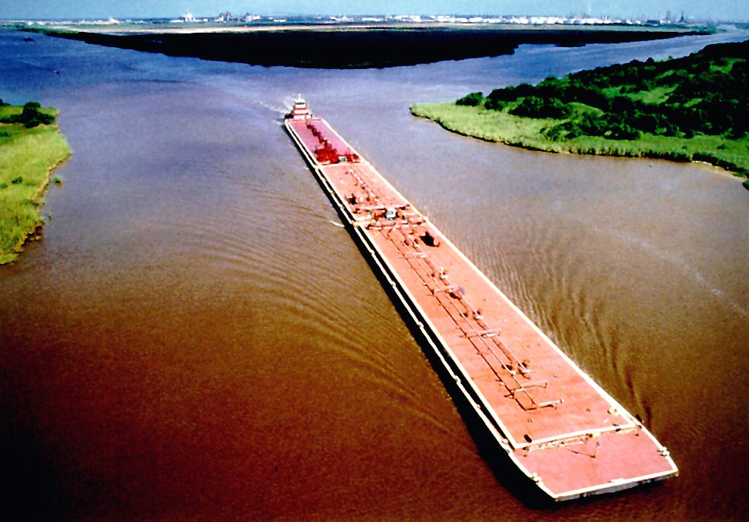
National Tidal Datum Epoch (NTDE)
A common time period to which tidal datums are referenced
A specific 19 year period that includes the longest periodic tidal variations caused by the astronomic tide-producing forces.
Averages out long term seasonal meteorological, hydrologic, and oceanographic fluctuations.
Provides a nationally consistent tidal datum network (bench marks) by accounting for seasonal and apparent environmental trends in sea level that affect the accuracy of tidal datums.
The NWLON provides the data required to maintain the epoch and make primary and secondary determinations of tidal datums.
Notes:
To understand tidal datums, you need to understand what a tidal epoch is and why we have them. Other than both having ‘time’ in their basic meaning, a tidal epoch has nothing to do with a geodetic epoch (or a geological epoch). A geodetic is a moment in time, a geological is a really really long time, and a tidal epoch is 18.6 years.
Epoch is how long it takes for the Sun, Moon, & Earth to complete an epoch tidal cycle
This takes 18.6 yrs, so we use 19 yrs (because statistically the 0.4 is not significant out of the 19 yr avg.)

Slide 13
Station datum
Unlike water level (tidal) datums that will change each epoch because the world is dynamic, a station datum is FIXED forever and ever (hopefully).
It is used to calculate and relate the difference in datum heights between tidal epochs.
MLLW datum, by convention, is always the reference tidal datum, eg, 0.0, for each tidal epoch. To know how much change there was between tidal epochs, one references the values to the station datum.

Slide 14
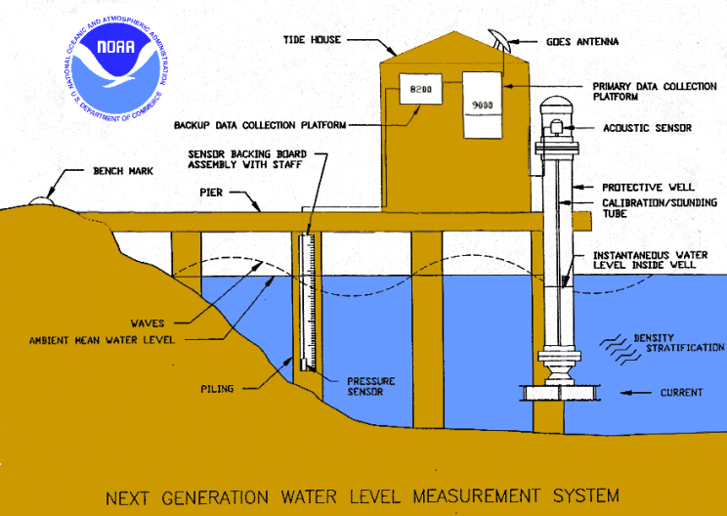
NWLON Stations
Equipment installed
Automatic water level sensor
Backup water level sensor
Backup & Primary data
  collection platform
Protective well
Shelter
Solar Panel
GOES satellite radios
Telephone modem
Ancillary geophysical instruments
System of Bench Marks
Observations Collected
Water Level
Wind Speed/Direction
Barometric Pressure
Air/Water Temp.
Conductivity/Temp
Chart Datum
Tsunami/Storm Surge

Slide 15
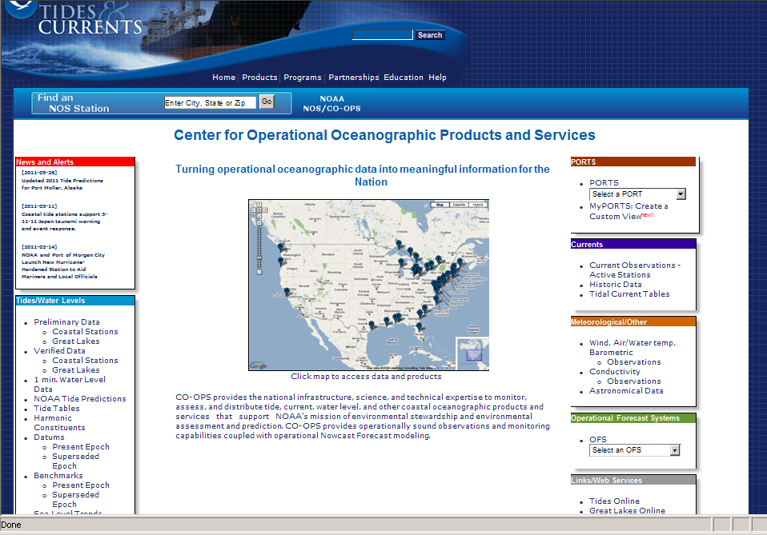
www.tidesandcurrents.noaa.gov

Slide 16
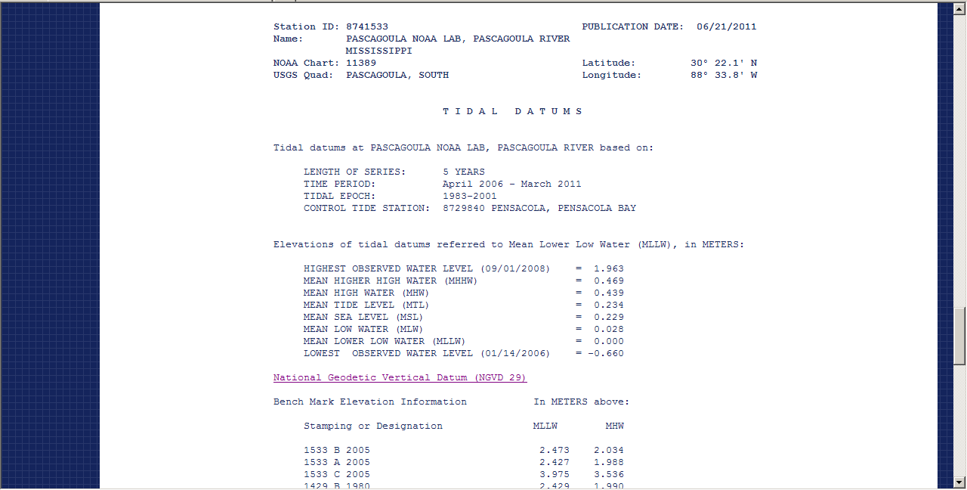
Notes:
No NAVD88 computed; use VDATUM model.

Slide 17
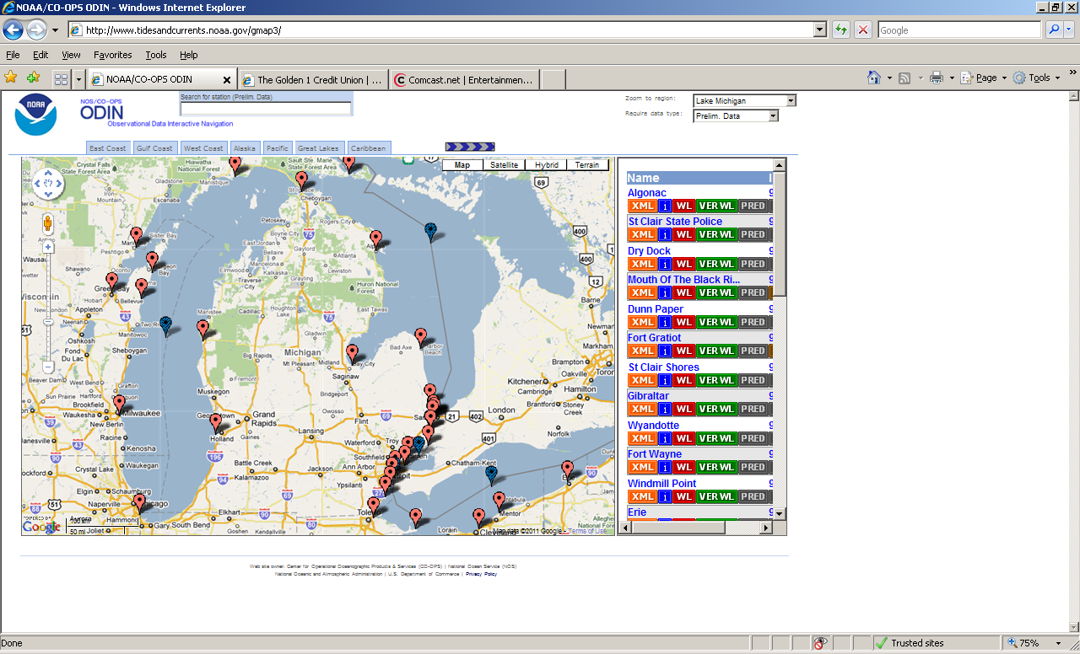

Slide 18
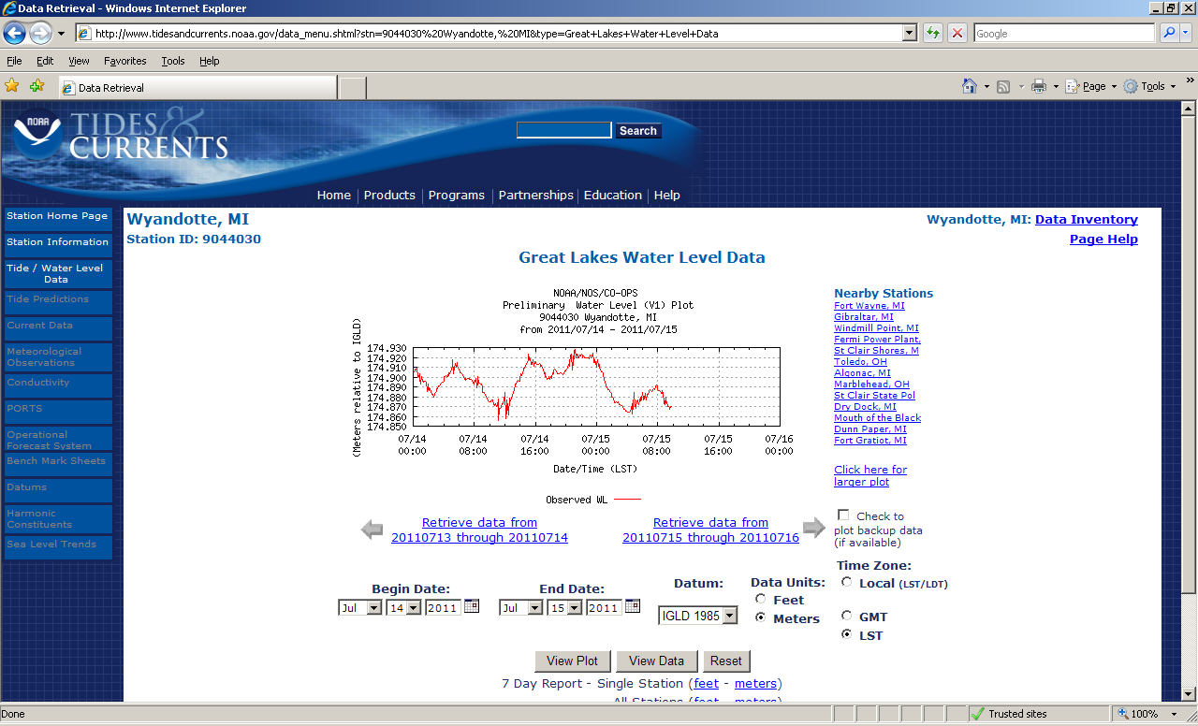

Slide 19
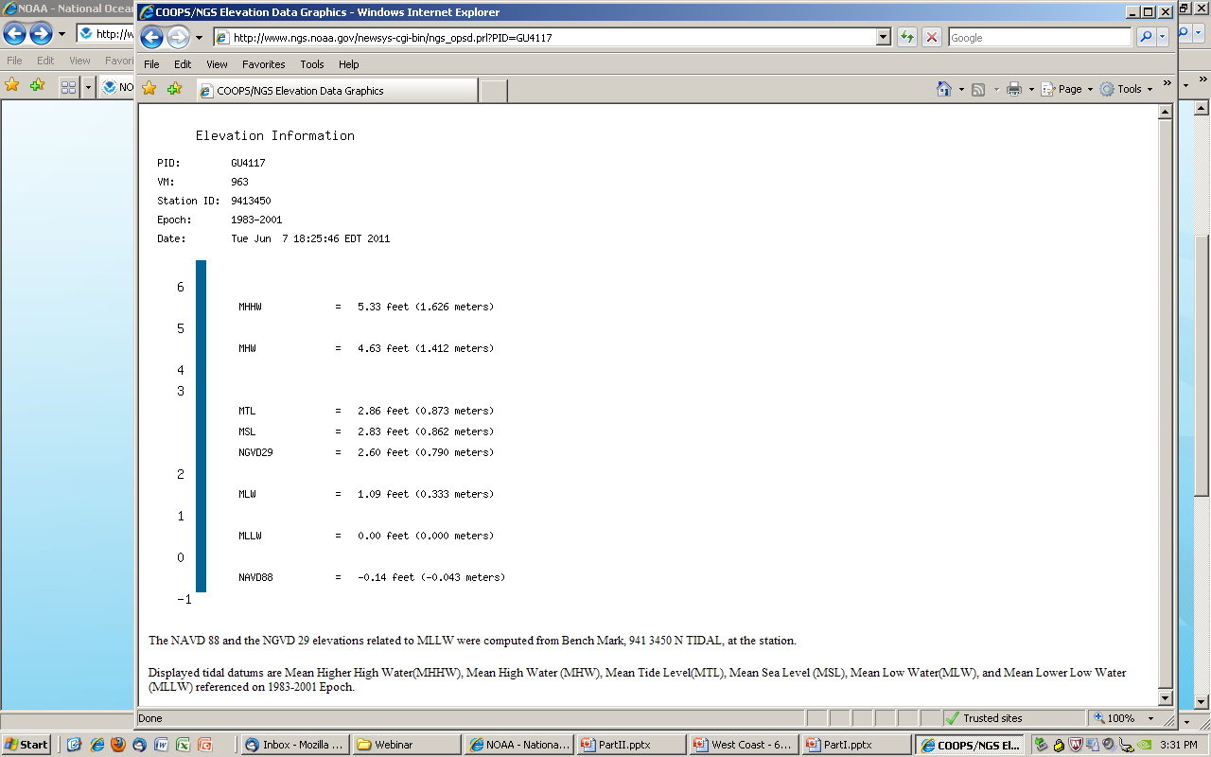
Don’t know this one’s Designation, only its PID, so retrieved DS by PID
GU4117 DESIGNATION - 941 3450 N TIDAL
Feet AND meters
Primary Bench Mark for the tide gage
Notes:
This PID is the Primary BM for the gage

Slide 20
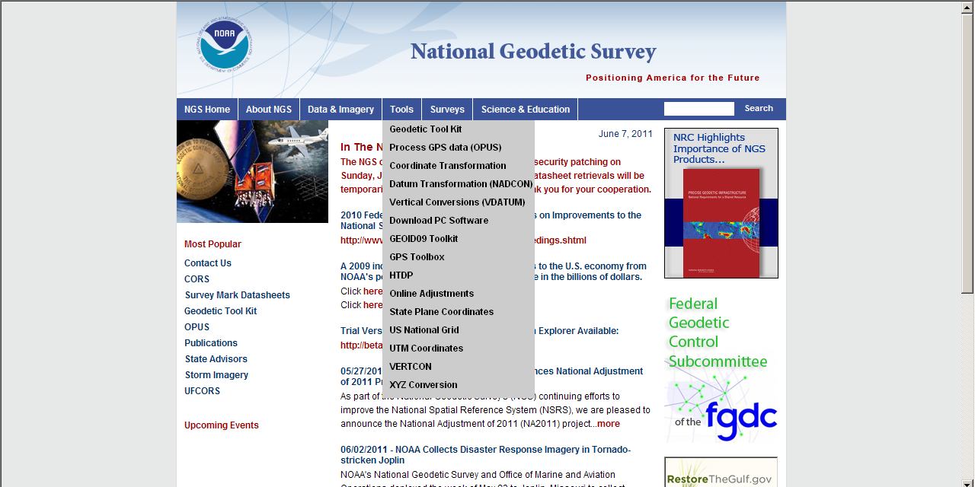
Notes:
There is a graphic representation available in the Geodetic Tool Kit.

Slide 21
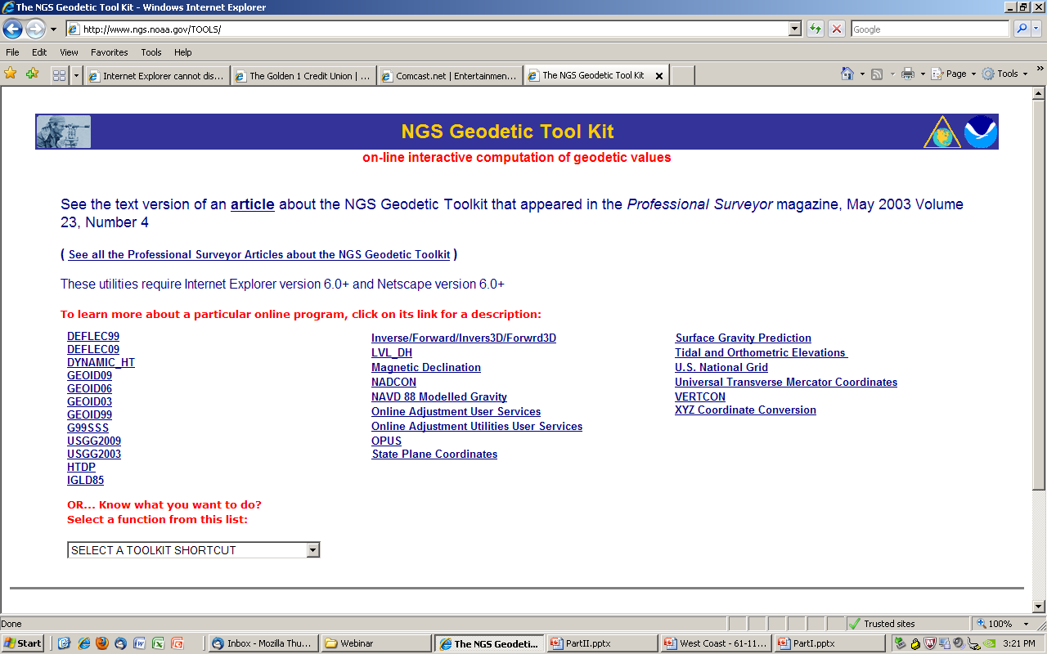

Slide 23
VDATUM
Modeling program that enables conversions between multiple vertical datums—ellipsoidal, geodetic, tidal- at your specified location
Be fully aware of the errors, eg, Standard Deviation, from transformations among datums, and from source data; types of error include:
  variations in the tidal range, tidal phase differences, bathymetric and coastal features, the density and proximity of nearby stations used in the corrections

Slide 24
Vertical Datum Transformation “Roadmap”
Orthometric datums
Ellipsoidal (geometric) datums
Tidal datums
WGS 84 (G1150)
Calibrated Helmert Transformations
WGS 84 (G873)
NGVD 29
WGS 84 (G730)
Tide Models
MHHW
WGS 84 (orig.)
ITRF2000
VERTCON
MHW
ITRF97
ITRF96
NAD83 (CORS96)
NAVD 88
LMSL
MTL
ITRF94
ITRF93
DTL
ITRF92
ITRF91
MLW
ITRF90
GEOID99,
GEOID03,
GEOID09
MLLW
ITRF89
TSS
(Topography of the Sea Surface)
ITRF88
SIO/MIT 92
NEOS 90
PNEOS 90
Notes:
This is the VDatum “roadmap”, which illustrates how different datums are transformed from one to another.
Helmert Transformations are used to transform between 3D ellipsoidal datums.
A GEOID model is used to transform data on NAD83 to an orthometric datum like NAVD 88.
A model of the “Topography of the Sea Surface” is used to transform NAVD 88 to LMSL.
A corrected tide model is used to transform from LMSL to a variety of other tidal datums.

Slide 25
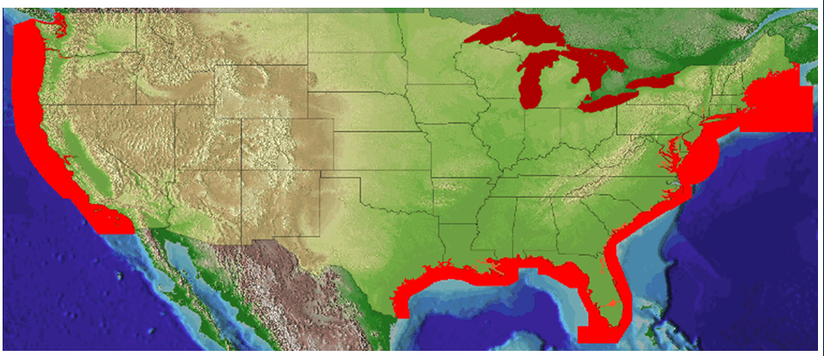
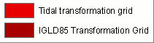
Current VDatum Availability
Notes:
This map illustrates where we have VDatum coverage at present.
The model of the Texas coast is scheduled for release not later than March.
The model for Northern New England is scheduled for release not later than June.
Another model that is in development will cover PR and VI, scheduled for release in the Q1 of FY12.
Transformations to IGLD 85 are available on the VDatum Website.

Slide 26
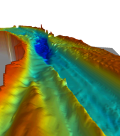
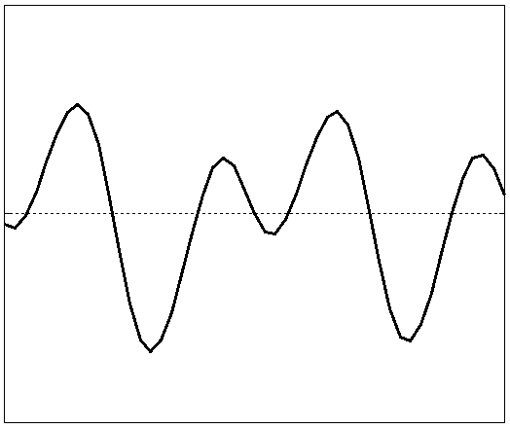
Steps to VDatum
Assess tidal & geodetic needs (CO-OPS)
Acquire base observational data (Tri-Office)
Model tidal datum variations across region (OCS)
Build topography of the sea surface (NGS)
Build grid of all transformations (OCS + NGS)
Determine uncertainty of model (OCS + NGS)
  (OCS=Office of Coast Survey)
Notes:
This is the first of several slides devoted to production of a VDatum model…
Developing a VDatum model is NOT an easy process.
It starts with assessing the tidal and geodetic needs for developing a VDatum model of a specific region.
Based on the assessment, observational data are collected.
This includes tide guage data over a period of at least a month
… and GPS observations of BMs tied to the tide guages,
… and updates to the geoid model based on any GRAV-D data available.

Slide 27
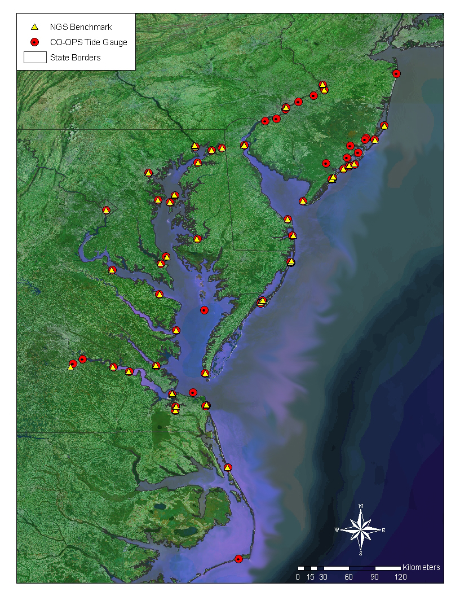
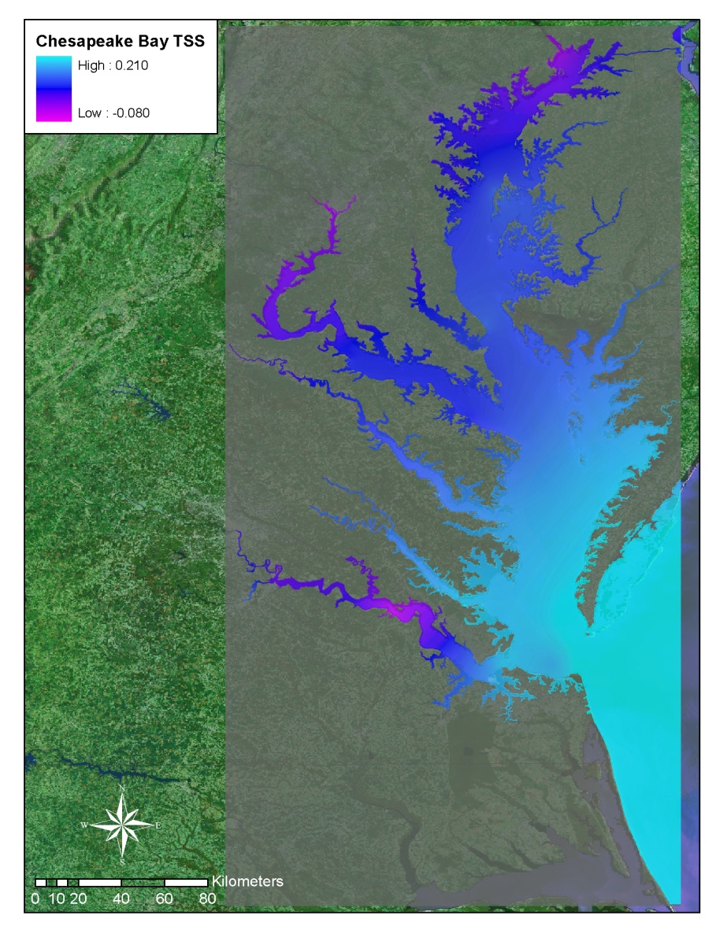
Topography of the Sea Surface
Defined here as the difference between NAVD 88 and local mean sea level
Observed NAVD88-LMSL differences at benchmark locations are spatially interpolated using a minimum curvature algorithm
Notes:
Developing the Topography of the Sea Surface (TSS) relates two datums,
Specifically, North American Vertical Datum of 1988 (NAVD88) and local mean sea level (LMSL).
In the VDatum Road Map, this grid allows for the transformation of NAVD 88 based data to LMSL over the region.
A positive value specifies that the NAVD88 reference value is further from the center of the Earth than the local mean sea level surface.

Slide 28
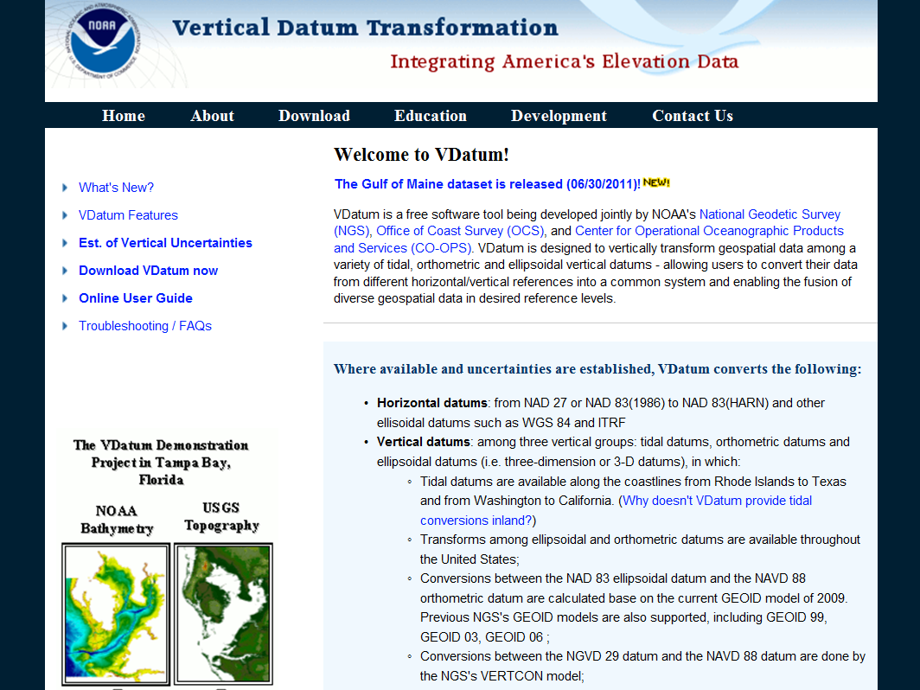
vdatum.noaa.gov

Slide 29
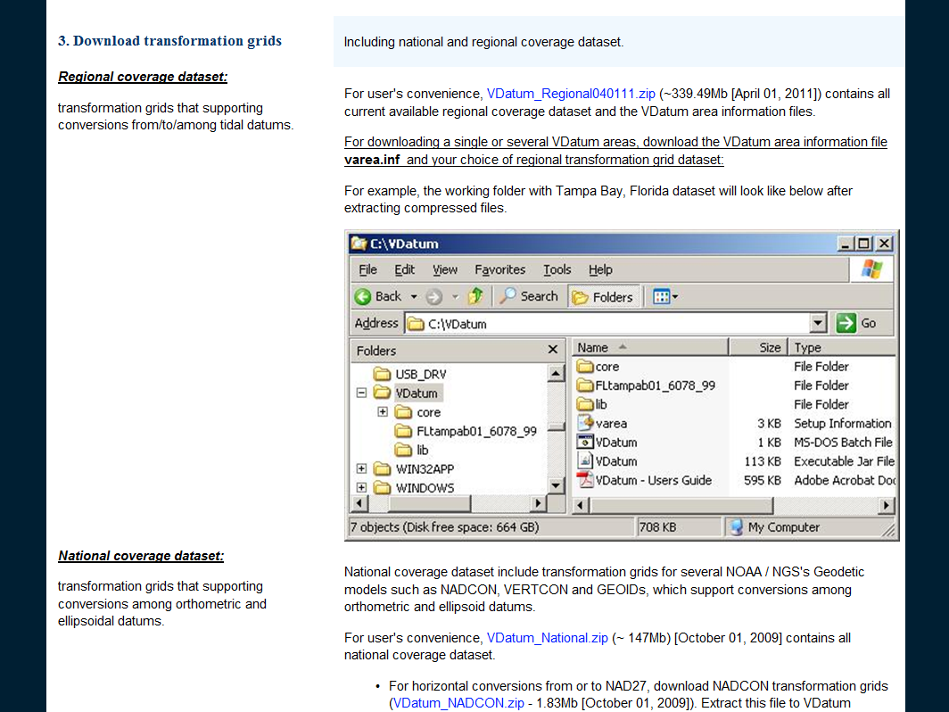
Need this for tidal datum transformations
Need geoid, NADCON, and VERTCON grids

Slide 30
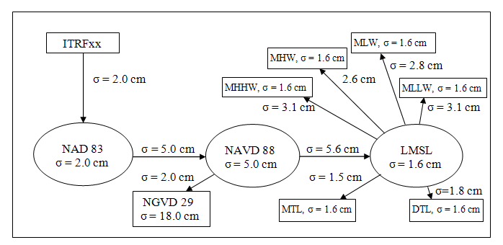
Uncertainty has been calculated for
transformations across the full process (at 1σ)
Chesapeake Bay Region
Ellipsoid
Orthometric
Tidal
Notes:
Users of VDatum must be aware of the uncertainties, or errors, in computed heights in the models.
Errors in VDatum may arise from inaccuracies in the gridded fields used in the datum transformations, such as the geoid model, AND from transformation, AND inaccuracies from the source observational data itself, such as the heights referenced to tidal datums or to NAVD 88.
The standard deviation (Greek letter sigma) is used to quantify the uncertainty in both the vertical datums and the transformations between them. Standard deviation is a simple measure of the average size of the errors in a data set (when errors are normally distributed)

Slide 31
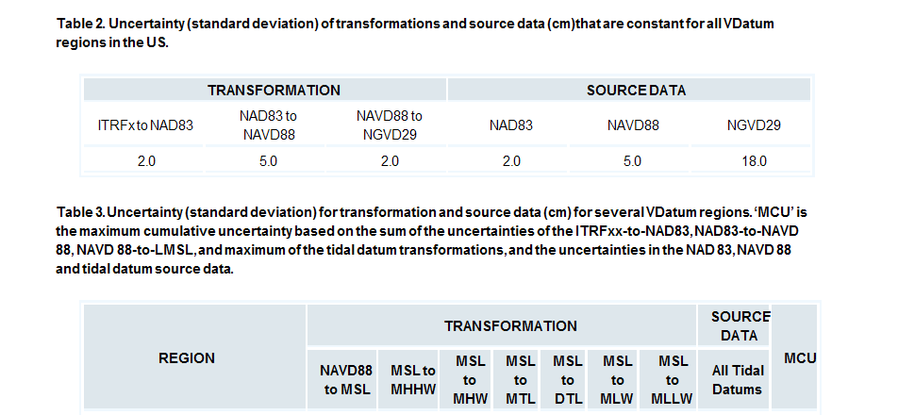
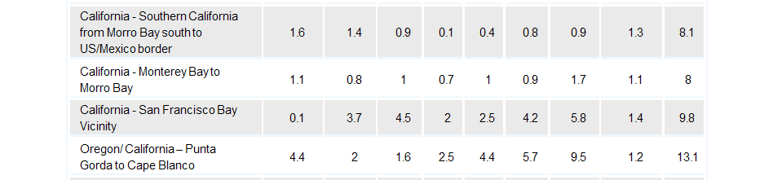
Each
Notes:
These show the actual errors for each of the 4 CA datasets for the vertical transformations as well as for the source data. If you involve another tidal datum besides just MSL, you have to add, for the SF Bay dataset, 1.4cm for MSL AND 1.4cm for another tidal datum.
So, if you start from a WGS ellipsoid height, which is equivalent to ITRF, and transform to MLLW:
2.0+5.0+2.0+5.0+0.1+5.8+1.4+1.4 –square each of those and add them= 93.61, sq rt of = 9.67 cm

Slide 32
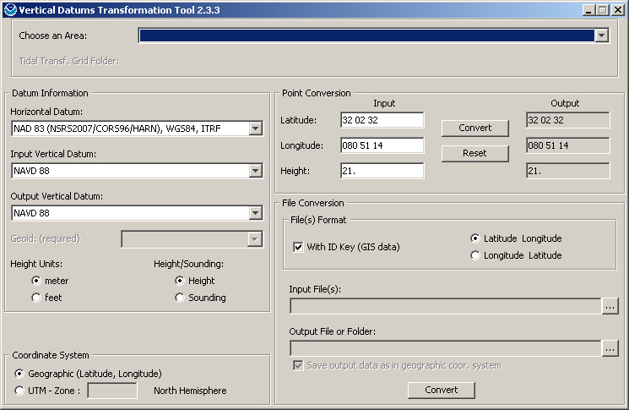
Choosing unloaded Area (East Coast) “blues” the box

Slide 33
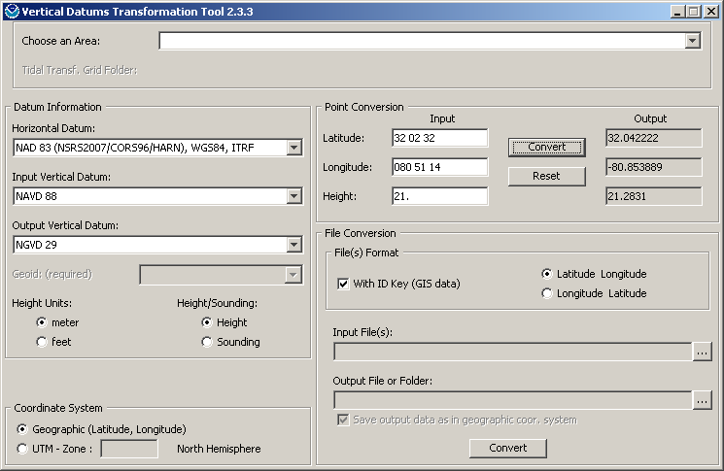
Geodetic vertical datums (VERTCON)

Slide 34
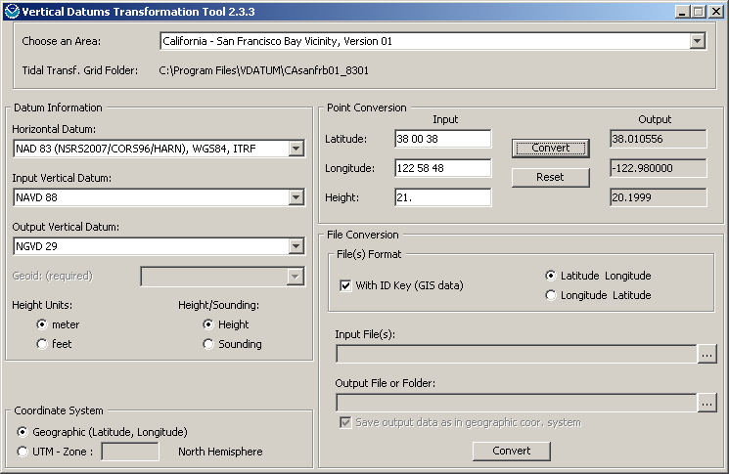
VERTCON conversion

Slide 35
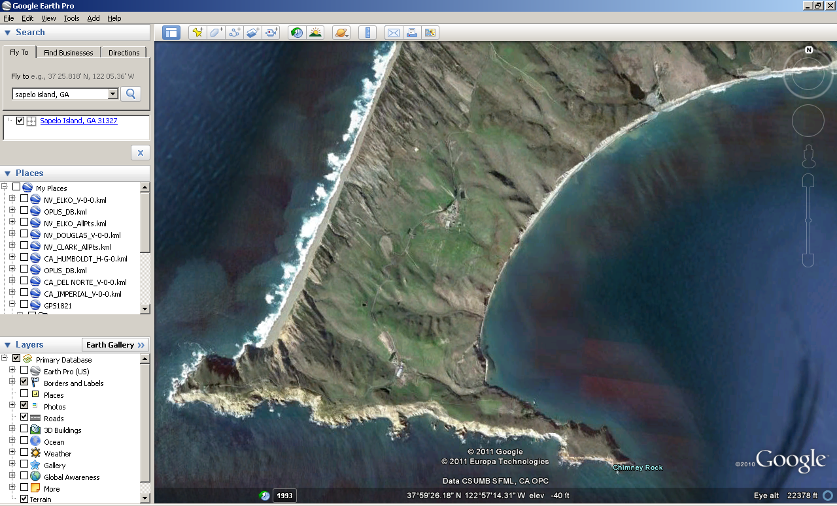
Pt Reyes, CA

Slide 36
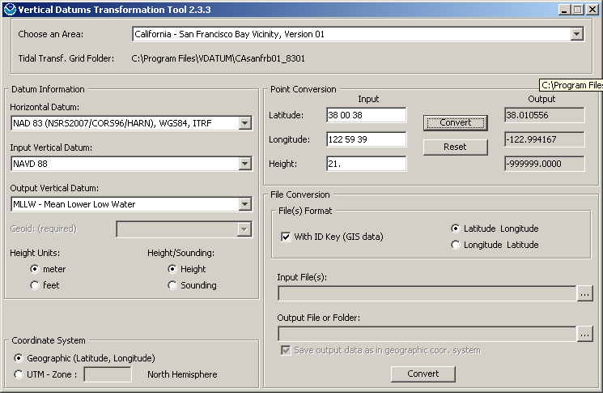
-999999.0000 usually means too far inland; not modeled

Slide 37
Pt Reyes, CA

Slide 38
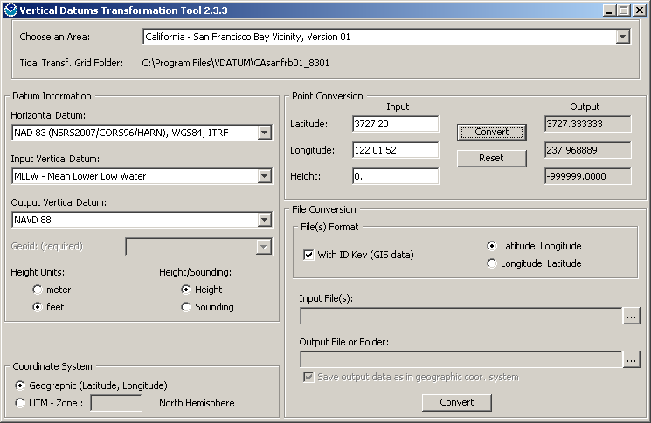
-999999: out of range or bad format

Slide 39

Correct Area Selected for a location near the ocean

Slide 40
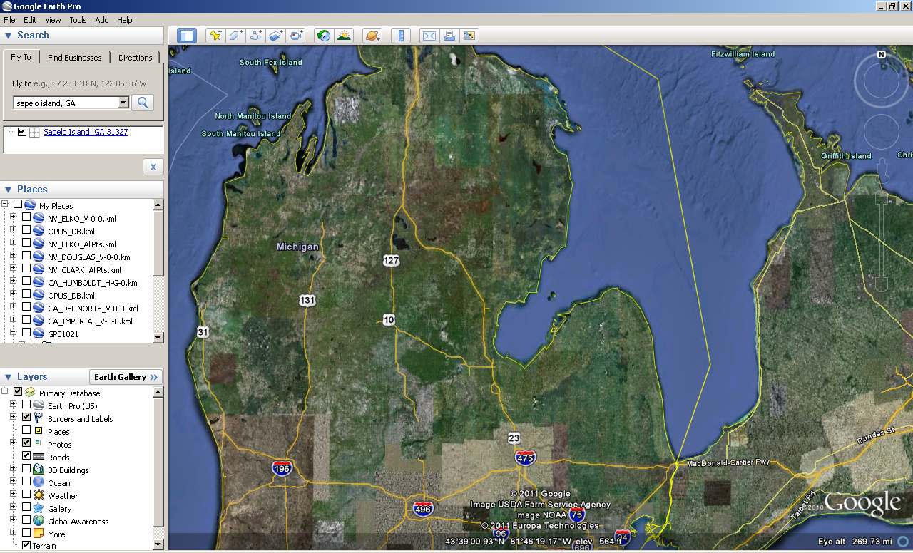

Slide 41
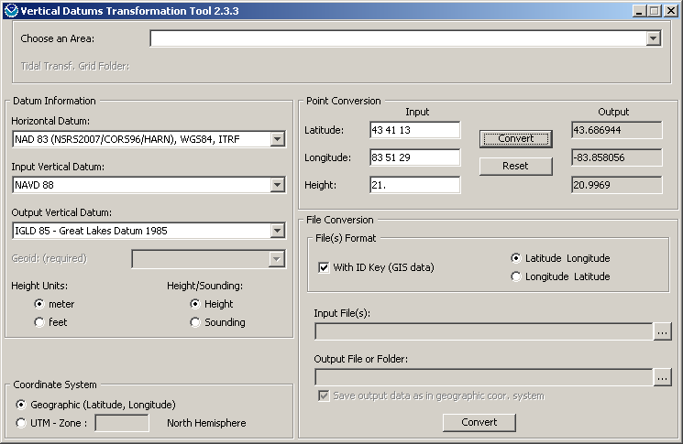
Using IGLD85 Datum in VDATUM

Slide 42

“Area” chosen doesn’t matter

Slide 43
Cautions using IGLD85 tool
Only pertinent to geodetic, not tidal, datums
Will utilize NAVD88 if a tidal datum is attempted to be chosen
Error estimates have not been made
Consider it a “Beta” usage
NOS is in process of fine-tuning accuracy
…and collecting data for a new IGLD datum
discussed next by Steve Gill, CO-OPS NOS NOAA

Slide 44
URL for Presentations to be Posted
http://www.ngs.noaa.gov/web/science_edu/presentations_archive/
Marti.ikehara@noaa.gov

