Slide 1
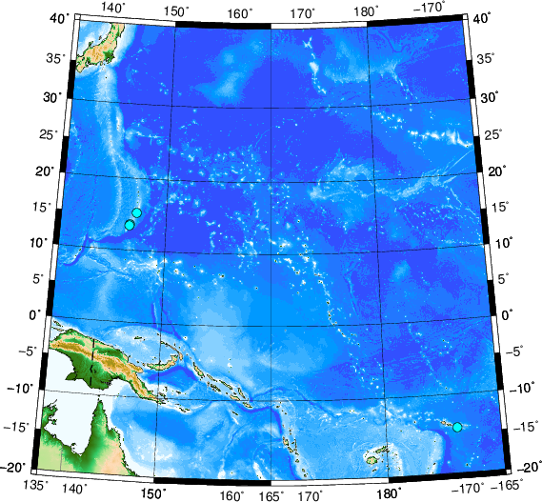
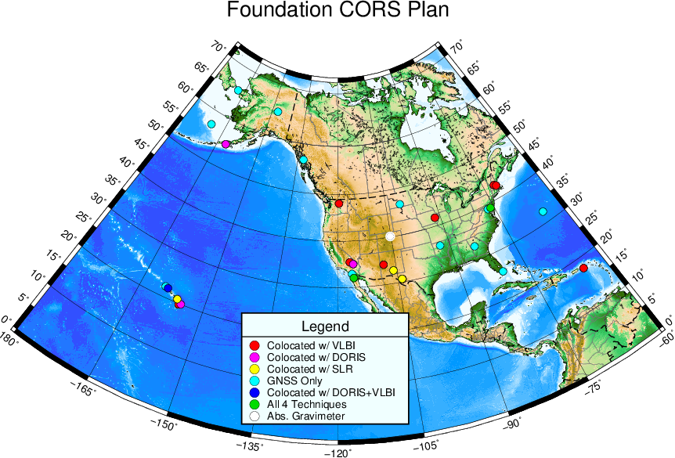
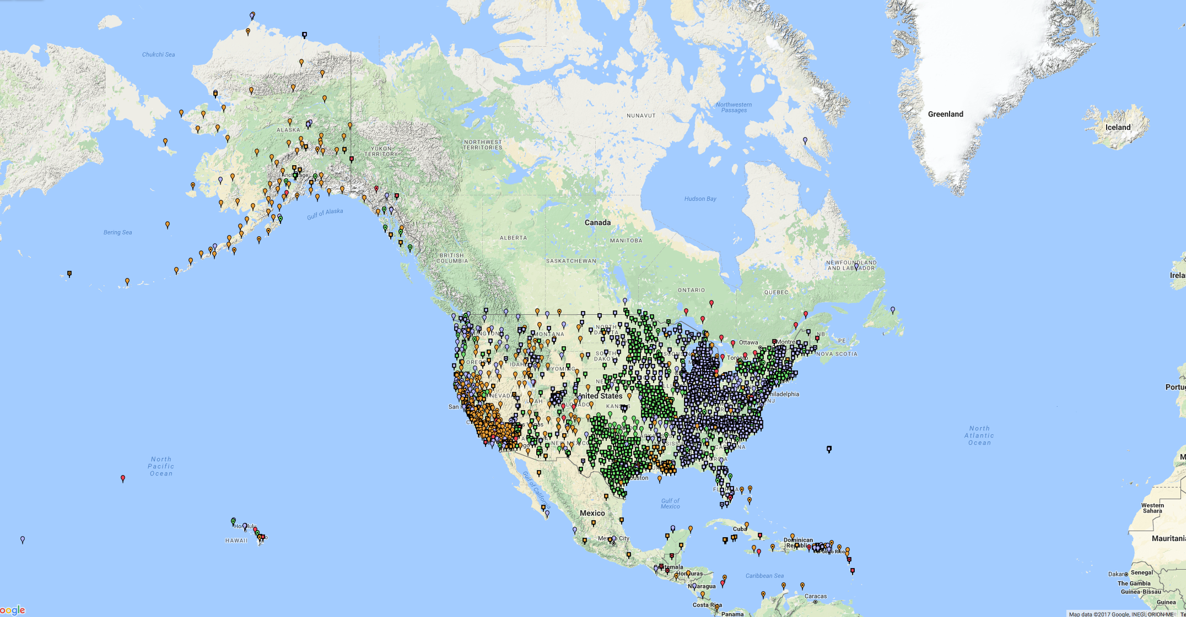
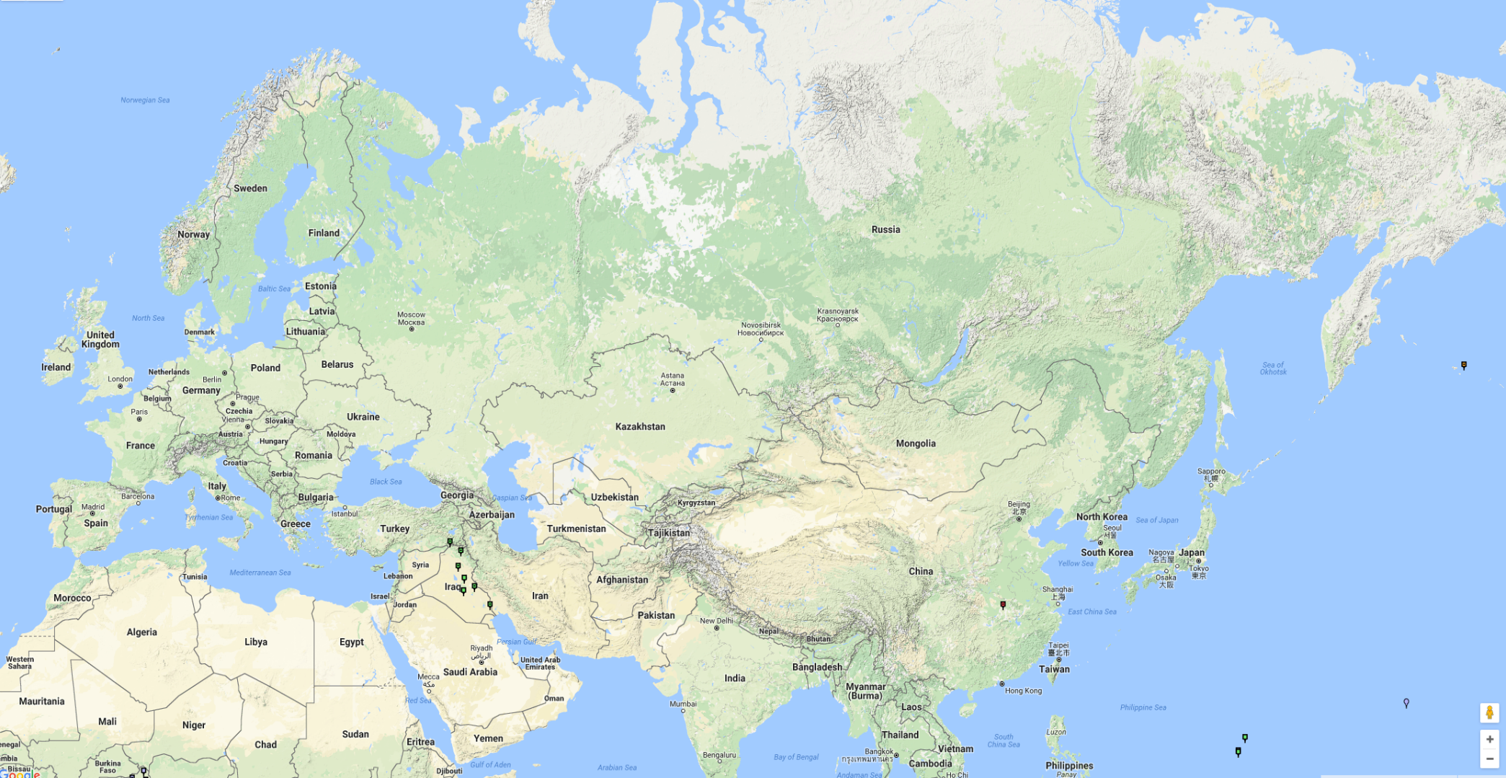
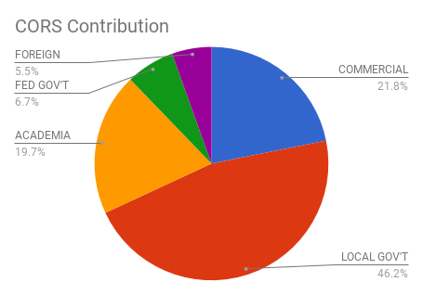
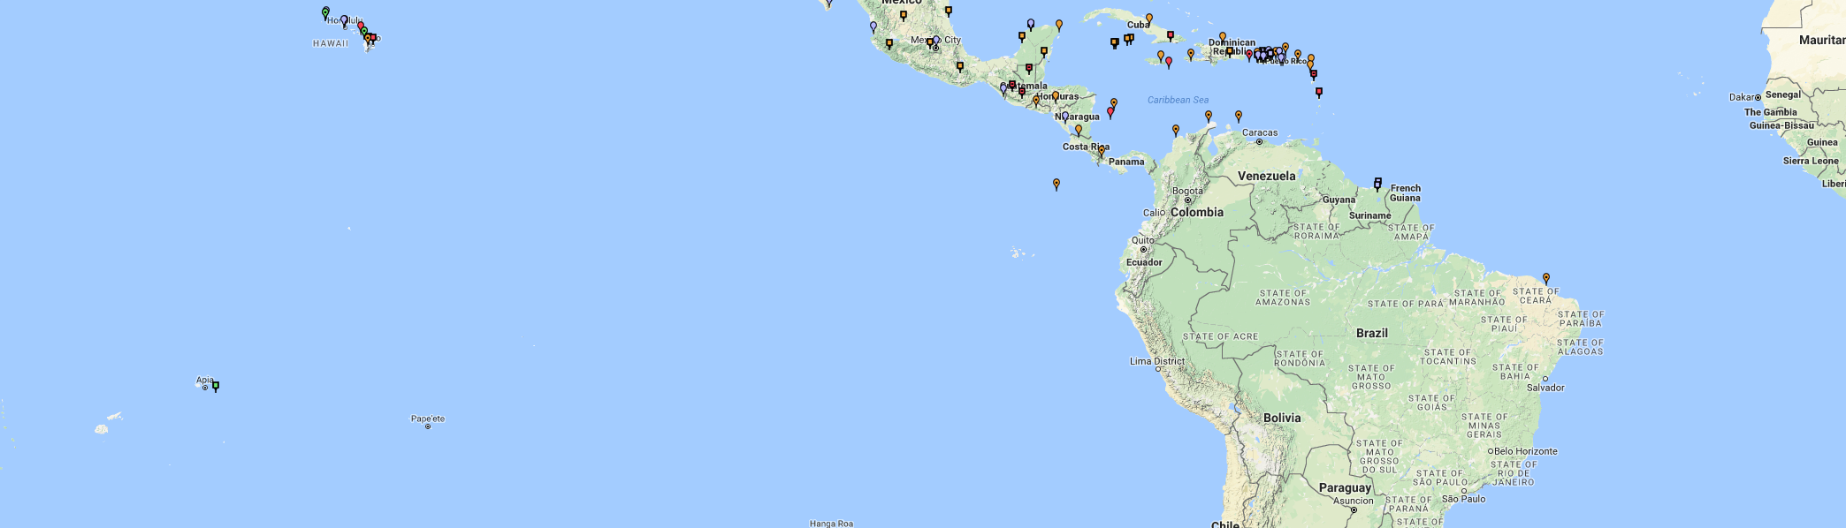
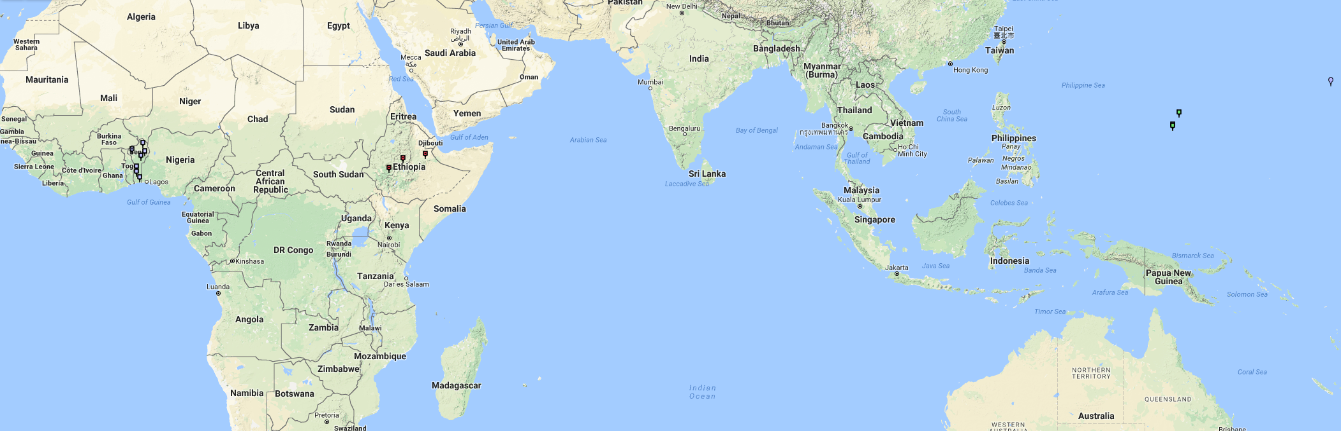
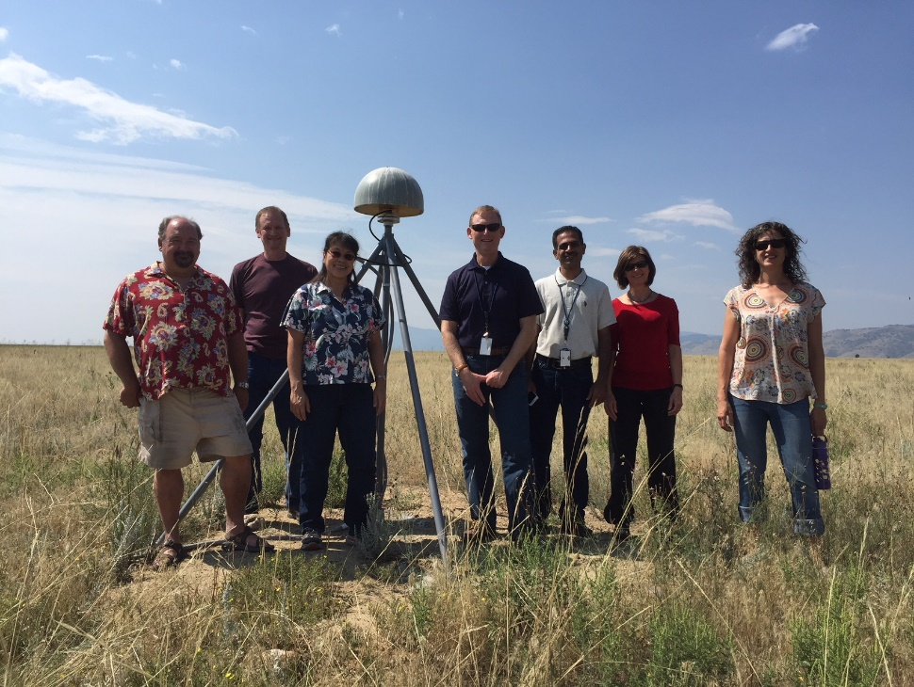
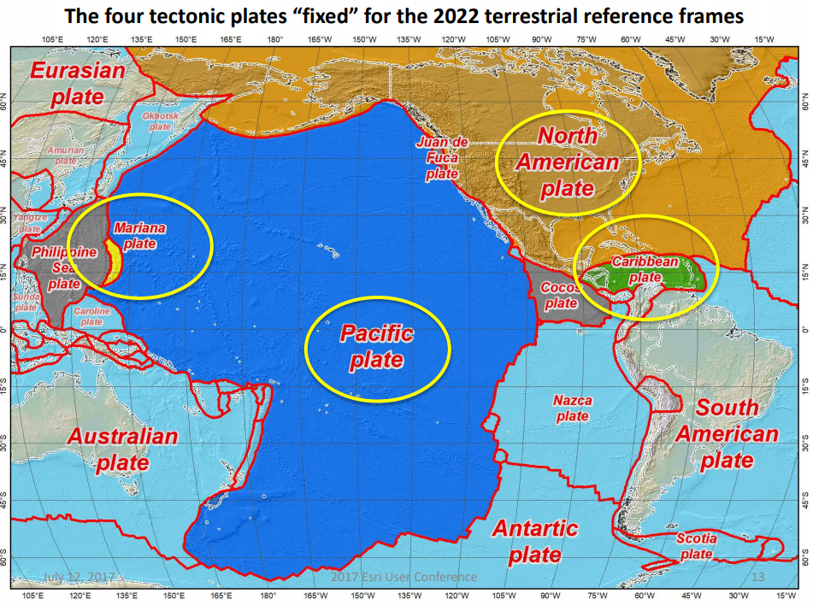
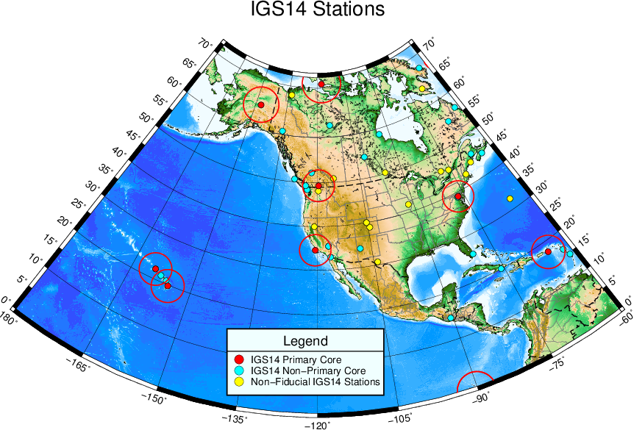
Foundation CORS – An Ultra-Stable, High-Reliability Backbone for the U.S. CORS Network
G33B-0683
Theresa Damiani and Kevin Choi NOAA- National Geodetic Survey, Silver Spring, MD, USA
Background
Foundation CORS Target Sites and Goals
Since 1994 the National Geodetic Survey has fostered a collaborative network of permanently installed geodetic-grade GPS reference stations, known as Continuously Operating Reference Stations (CORS). The CORS network is a multi-purpose cooperative network of GNSS observations collected from over 200 of government, academic, and private organizations. Each agency owns and operates its own stations and shares the observation data with NGS. The primary objective of the CORS network is to enable GPS users by providing precise positioning relative to the U.S. National Spatial Reference System (NSRS)- the source of official U.S. coordinates. Each CORS shares its data with NGS, and NGS in turn analyzes and distributes the data to the general public free of charge.
Despite the large number of partner agencies and stations, the global reference frame stations in the US are limited due to density considerations and quality issues. In order to maintain long-term consistency between the NSRS and International Terrestrial Reference Frame (ITRF), it is desirable to maintain a set of reference frame sites to the highest standard.
The U.S. CORS Network
GPS only | 524
GPS+GLO | 1075
GPS+GLO+GAL | 169
The Foundation CORS targeted locations provide:
1. A geographic distribution no greater than 800 km to provide 1.5 cm accuracy ellipsoidal height results through NGS’ OPUS tools anywhere in the U.S.
2. Support for the ITRF by co-locating at existing space-based geodetic sites.
3. Favorable geometry to monitor tectonic plate (Euler Pole) rotation.
4. Gap Filling in international areas where foundational stations are needed to support the U.S. NSRS, e.g. Caribbean Nations for plate rotation modeling.
Motivation 1: Modernizing the U.S. NSRS
By 2022, the National Spatial Reference System (NSRS) will be modernized with the CORS network becoming its critical component for definition and access.
To ensure equal, high-quality access everywhere in the nation (including its holdings) NGS will establish a backbone for the NGS CORS Program– called the Foundation CORS sub-network.
The Foundation CORS sub-network will be made of 36 ultra-stable, high- reliability, federally-controlled stations.
The NSRS will continue to be defined
in relation to the ITRF.
Four Tectonic Plates to monitor:
NATRF2022 - North America
PATRF2022 - Pacific
CATRF2022 - Caribbean
MATRF2022 - Mariana
Colocation
Plate Rotation
Geographic Distribution
Gap Filling
Collaboration
# Sites | Status/Description
7 | Current NGS Foundation CORS
8 | New NGS Foundation CORS to build
1 | Partner Foundation CORS to renovate (NASA- NLIB)
12 | NASA-Operated Foundation CORS
6 | NSF-Operated Foundation CORS
2 | Other, non-federal partners
36 | Total Target Foundation CORS
U.S. Federal Partners | Site ID | Location
National Science Foundation (NSF) Existing Sites Program: Network of the Americas (NOTA) | AB09 | Wales, AK
 | P777 | Dennard, AR
 | P804 | The Rock, GA
 | AB51 | Petersburg, AK
 | ATQK | Atqasuk, AK
 | P043 | New Castle, WY
National Aeronautics and Space Administration (NASA) Existing Sites Program: Global GNSS Network (GGN), operated by Jet Propulsion Laboratory | CRO1 | Saint Croix, VI*
 | BREW | Brewster, WA*
 | GCGO | Fairbanks, AK
 | GODE | Greenbelt, MD*
 | TBD | Goldstone, CA*
 | MDO1 | McDonald Observatory, Texas*
 | MONP | Mount Laguna, CA*
 | NLIB | North Liberty, IA*
 | PIE1 | Pie Town, NM*
 | GUAM | Dededo, Guam
 | KOKB | Kauai, HI*
 | MKEA | Mauna Kea, HI*
 | HAL1 | Haleakala, HI*
NOAA- National Geodetic Survey (NGS) Existing and New Sites Program: Continuously Operating Reference Stations (CORS) | ASPA | Pago Pago, American Samoa
 | CNMR | Saipan, TQ
 | GUUG | GUAM*
 | BRSG | Bermuda
 | FLF1 | Richmond, FL*
 | WES2 | Westford, MA*
 | TMG2 | Boulder, CO
 | NEW | Apache Point, NM*
 | NEW | Fort Davis, TX*
 | NEW | Fort Irwin, CA*
 | NEW | Hancock, NH*
 | NEW | Los Alamos, NM*
 | NEW | Kitt Peak, AZ*
 | NEW | Owens Valley, CA*
 | NEW | Cold Bay, AK*
TBD | TBD | Caribbean existing location
 | TBD | Caribbean existing location
.
Motivation 2: Increase the number of IGS Reference Stations in the U.S.
OPERATIONAL GOALS
Formal agreements signed with NASA and NSF for project support.
All NGS-owned Foundation CORS are submitted to the IGS.
Targeted Up-time:
Network availability > 90 % at all times.
Individual Station down time < 14 days
Stations provide definitional support for the international frame and plate rotation model with densified ITRF stations (bolded lines in table →).
IERS site surveys are repeated on a 5-year cycle.
To support international
activities such as the
Global Geodetic
Observing System
(GGOS), ITRF, and
International GNSS
Service (IGS), the United
States needs additional
ultra-stable GNSS reference stations. The NGS-owned Foundation CORS are intended to become IGS reference stations. Also, 11 of 15 of those are co-located at sites with other geodetic reference frame observing techniques (VLBI, SLR, DORIS, etc.) to further densify and strengthen the ITRF in the U.S. Territories

