Slide 1
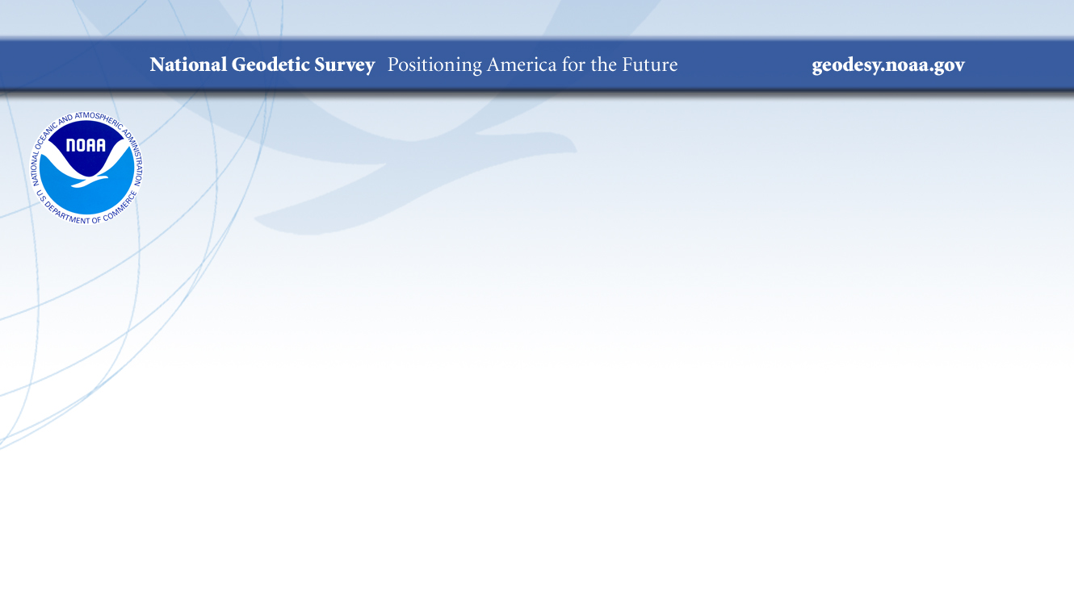
Modernizing the
National Spatial Reference System
Foundation
Continuously Operating Reference Stations
2018 NSRS Modernization Industry Workshop
May 5, 2018

Slide 2
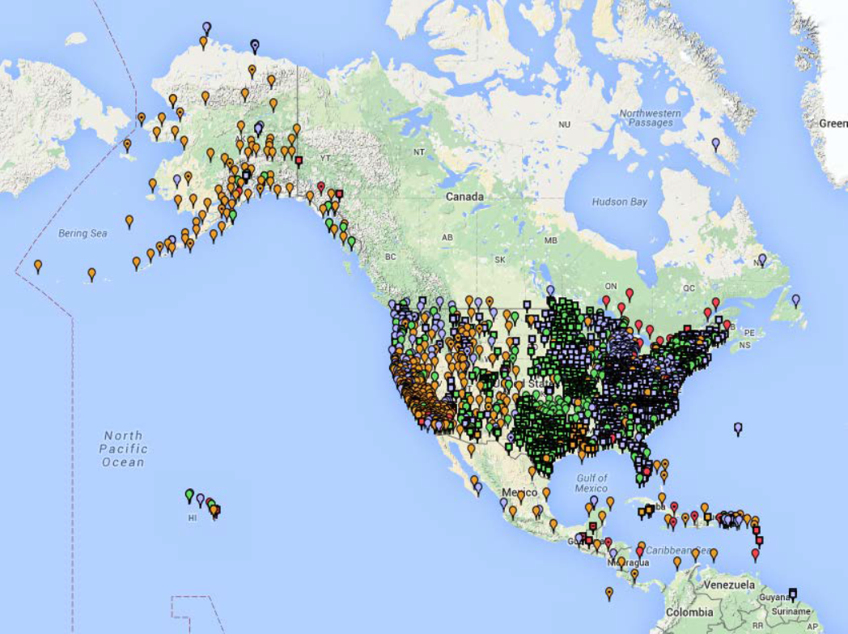
Continuously Operating Reference Stations (CORS)
1
  ~1800 Continuously Operating Reference Stations
  Run by more than 200 organizations (various government, academic, and private organizations)
  Provide access to the
  U.S. National Spatial Reference System

Slide 3
Guiding Principles for
Continuously Operating Reference Stations
2
By 2022, the National Spatial Reference System (NSRS) will be
modernized, with CORS becoming a more foundational component.
The International Earth Rotation and Reference Systems Service (IERS) International Terrestrial Reference System (ITRF) will continue to be
the worldwide standard reference system.
NGS will continue to support the ITRF through International GNSS Service (IGS) reference sites—or “Foundation CORS.”
The NSRS will continue to be defined in relation to the ITRF.

Slide 4
Foundation CORS Requirements
3
Baseline Foundation CORS
Network:
Collocate:
All sites within the Foundation CORS
target area of the United States,
with existing space geodetic techniques
(SLR, VLBI or DORIS), will have
a collocated Foundation CORS.
  Additional Desired Foundation CORS Network Requirements:
  Density: Install or adopt new stations within the Foundation CORS target area of the United States. (Fulfill the spacing criteria of 800 kilometers within the Foundation CORS target area.)
  Plate Rotation (Euler Pole): Install or adopt new stations within the U.S. Foundation CORS target area to raise the minimum number of Foundation CORS to three on each of the four plates of interest, once the above criteria are met.
  Additional (Gap Filling): Install or adopt new stations, on a case-by-case basis, once the above criteria is met (*).

Slide 5
Foundation CORS Requirement Breakdown
4
Frame | Requirement | Comment | Count
CATRF2022 |  |  | 3
 | #1 - Collocate | 1 collocated site | 1
 | #2 - Density | 800 km spacing achievable once above criteria are met | 0
 | #3 – Euler | A total of 3 per plate requires that 2 more FC’s be installed | 2
 | #4 – Gap Filling | none | 0
MATRF2022 |  |  | 3
 | #1 - Collocate | none | 0
 | #2 - Density | 1 station for achievable 800 km spacing | 1
 | #3 – Euler | A total of 3 per plate requires that 2 more FC’s be installed | 2
 | #4 – Gap Filling | none | 0
NATRF2022 |  |  | 26
 | #1 - Collocate | Collocations required, several sites have multiple space based systems only requiring 1 CORS | 17
 | #2 - Density | 800 km notional spacing requires at least 6 more sites to be installed | 7
 | #3 – Euler | Achievable once the above criteria are met | 0
 | #4 – Gap Filling | 1 additional station at Bermuda | 2
PATRF2022 |  |  | 4
 | #1 - Collocate | Three collocations required (all Hawaii) | 3
 | #2 - Density | 800 km spacing requires 1 installation (American Samoa) | 1
 | #3 – Euler | Achievable with current station | 0
 | #4 – Gap Filling | none | 0
Total Number of Foundation CORS Required |  |  | 36

Slide 6
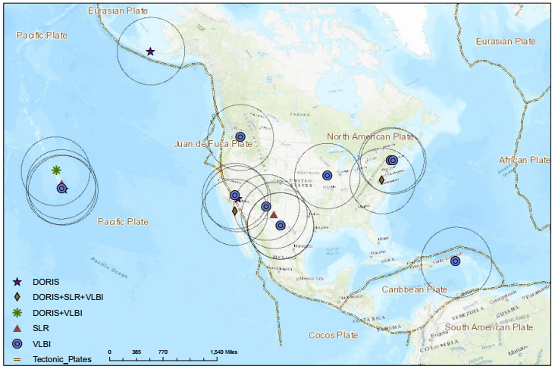
Collocated with NASA Spaced-Based Technology (SBT)
5
DORIS = Doppler Orbitography and Radiopositioning Integrated by Satellite
SLR = Satellite Laser Ranging
VLBI = Very Long Baseline Interferometry

Slide 7
Collocated + Density + Plate Rotation + Additional
6

Slide 8
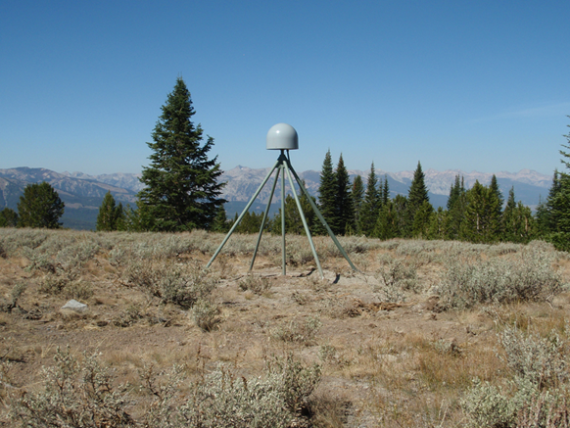

7
Foundation CORS Development Phases
Phase 1: Incorporate ~28
existing NASA and NSF partner stations and NGS stations into the Foundation CORS network.
Phase 2: Upgrade existing CORS to GNSS to meet Foundation CORS requirements
Phase 3: Construct ~8 new Foundation CORS

Slide 9
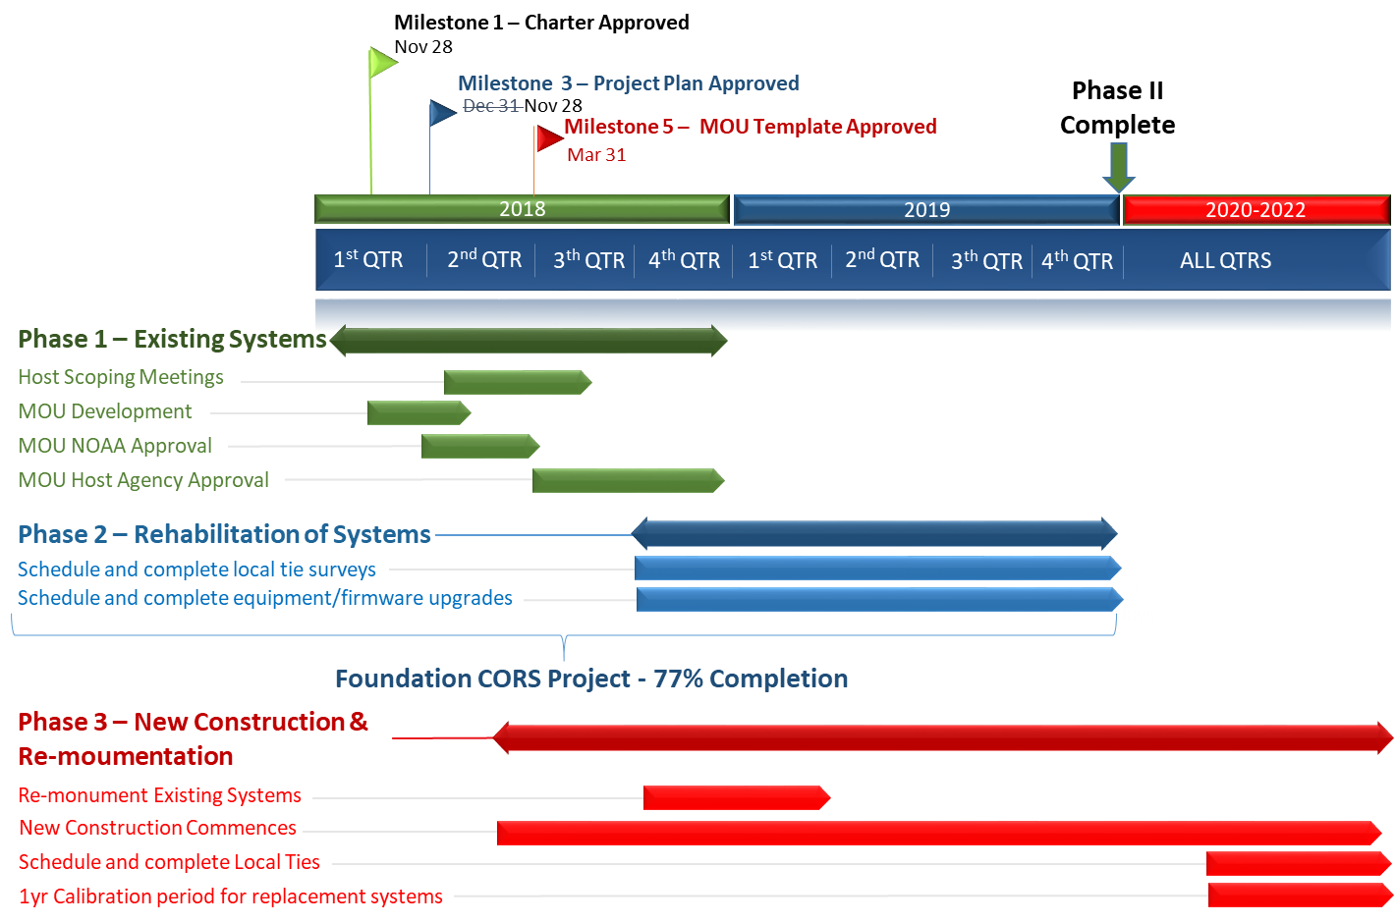
Foundation CORS Project Timeline
8
2017
2017
9/3 - 9/17
Today
9/3 - 9/4
9/5 - 9/9
9/10 - 9/16
9/17
9/18 - 10/3
9/18 - 9/23
9/24 - 9/26
9/27 - 10/3
9/27 - 10/2

