Slide 1

Comparison of Gravimetric Geoid Models Over the Great Lakes Region
Daniel R. Roman and Xiaopeng Li

Slide 2
OUTLINE
Known Errors
GRAV-D
GGM Comparisons
Conclusions
Future Work

Slide 3
1. Known Errors
NAVD 88
  Meter-level national trend
  Localized 10-50 cm features
  IGLD 85 tied to NAVD 88 geopotential numbers
  Replacing NAVD 88 is the impetus for GRAV-D
Surface Gravity Data
  Saleh et al. (2012) lays out problems in U.S. data
  Systematic effects below GOCE resolution
  Aerogravity supplements reference model signal

Slide 4
NAVD 88 Systematic Errors
(Figure 2 in Wang et al. 2012)
Developed from fairly low resolution GGM (600 km filter)
Aim will be to develop an improved a priori model of NAVD 88 errors
Above image should gain high resolution signal possibly through 200 km
Aids future hybrid geoid modeling: residual = h – N – H – H_err
This should vastly simplify hybrid modeling by removing bulk of signal

Slide 5
Surface Gravity Observations
Saleh et al. (2012) Fig. 11 Biases of all 244 significantly biased surveys
Saleh et al. (2012) Fig. 12 The effect of significant gravity biases on the geoid

Slide 6
2. GRAV-D
Status Plot
Collection Plans
Production Work (Internal error analysis)
Synthetic Harmonic Analysis
  External error analysis & blending
Surface gravity error detection & cleaning
Geoid modeling
Data
Fusion

Slide 7
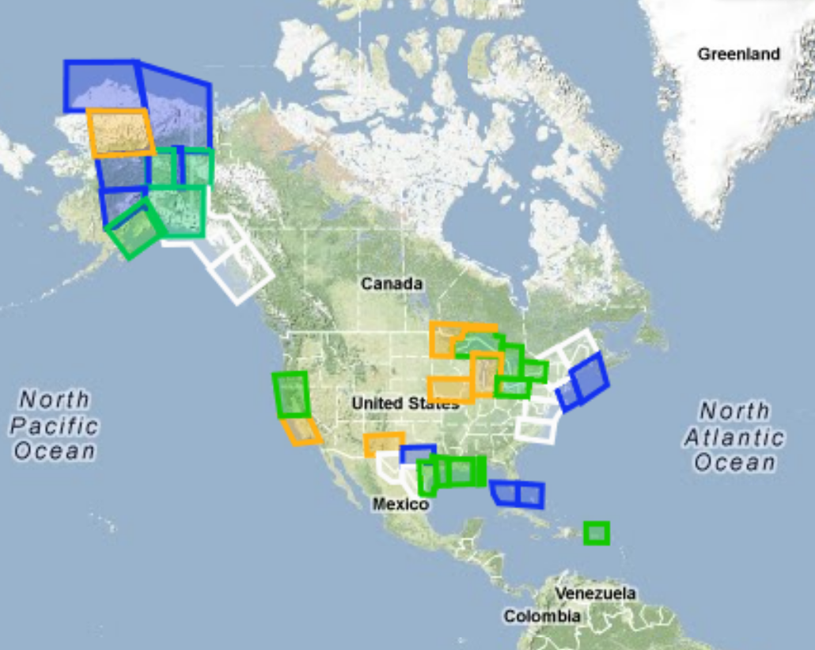
2.A GRAV-D Data Products
(as of 13 May 2013)
Map Key - Airborne Gravity Data
Green: Available data and metadata
Blue: Data being processed
Orange: Data collection underway
White: Planned for data collection

Slide 8
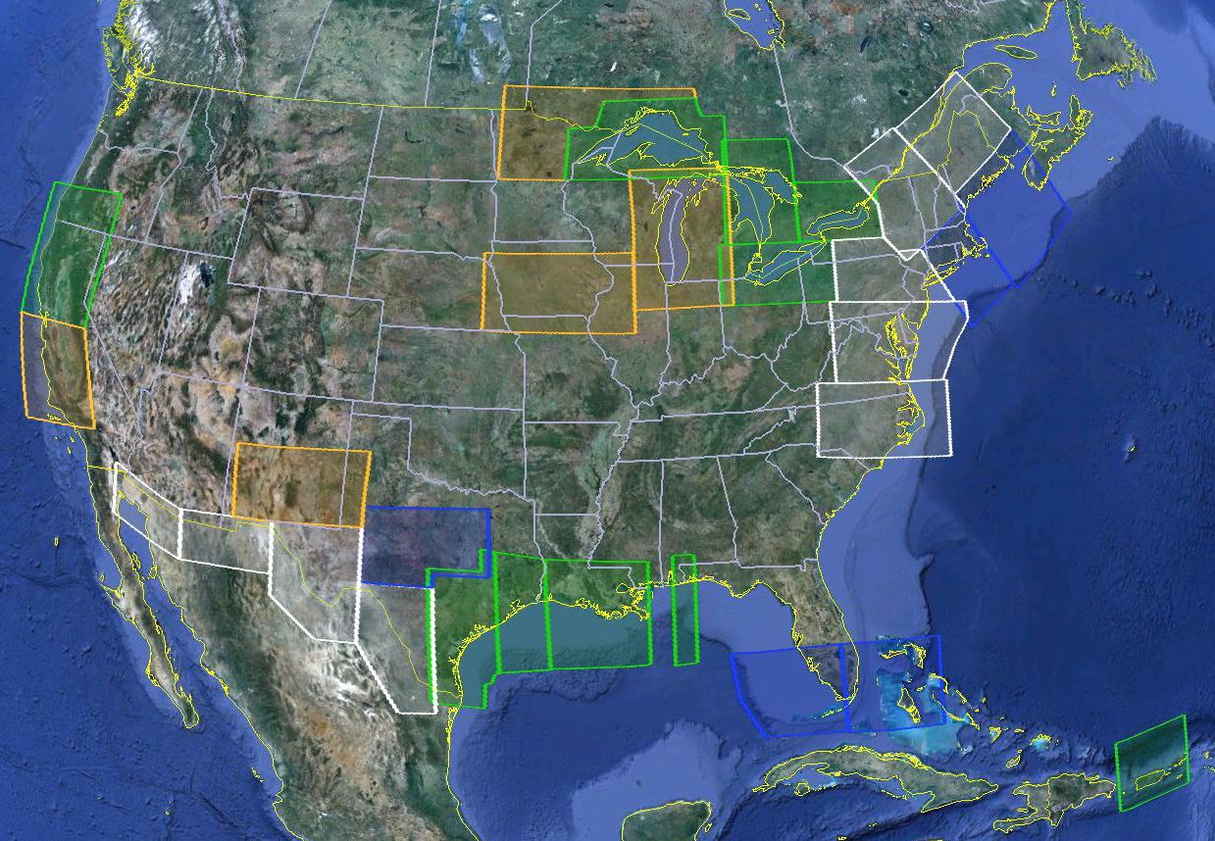
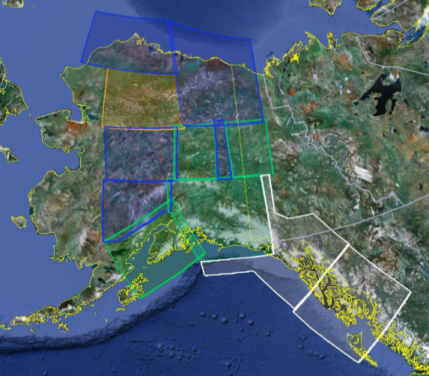
Gravity for the Redefinition of the American Vertical Datum (GRAV-D)
FY13
FY13
FY13
FY13
FY13
FY13
FY14
Available on the Website
FY14
In Processing
Partially Collected
FY13/14
Planned
FY14
Status of and plans for data collection – more information and data available at www.ngs.noaa.gov/GRAV-D

Slide 9
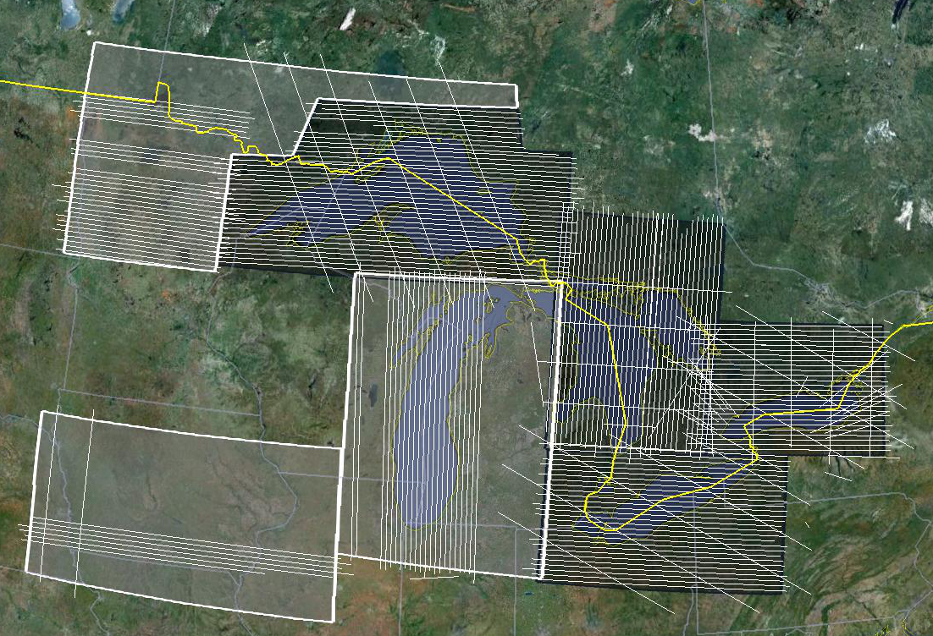
Gravity for the Redefinition of the American Vertical Datum (GRAV-D)
Great Lakes Airborne Gravity Collection Effort
Collection possible in Aug/Sept 2013, unlikely to complete
Collection in Sept/Oct 2013, likely to complete
Collection in August 2013, very likely to complete

Slide 10
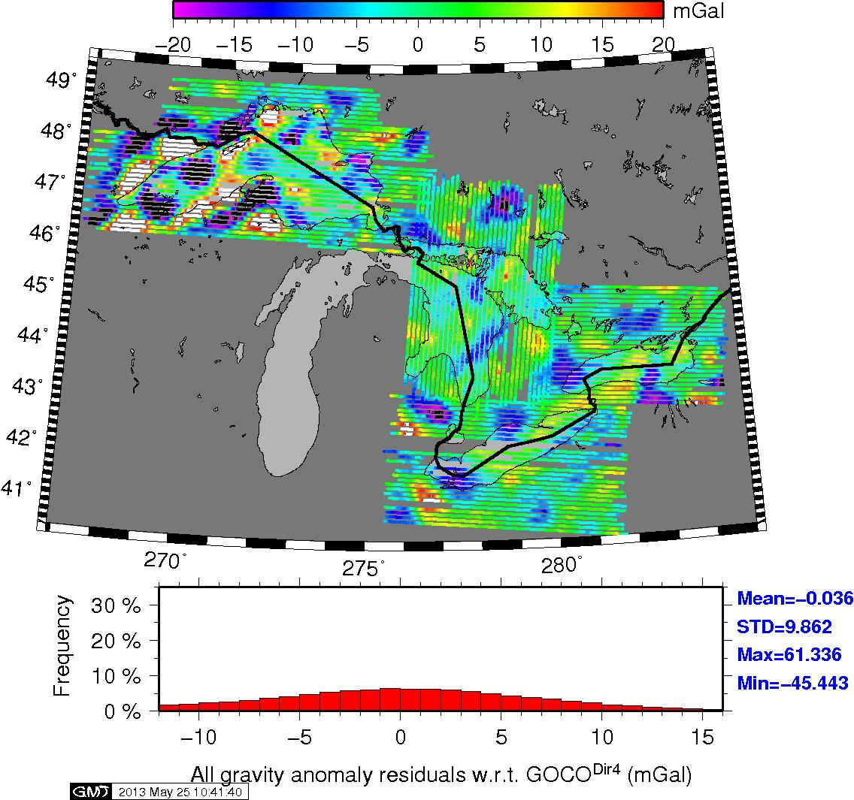
Aerogravity – GOCE DIR Rel. 4

Slide 11
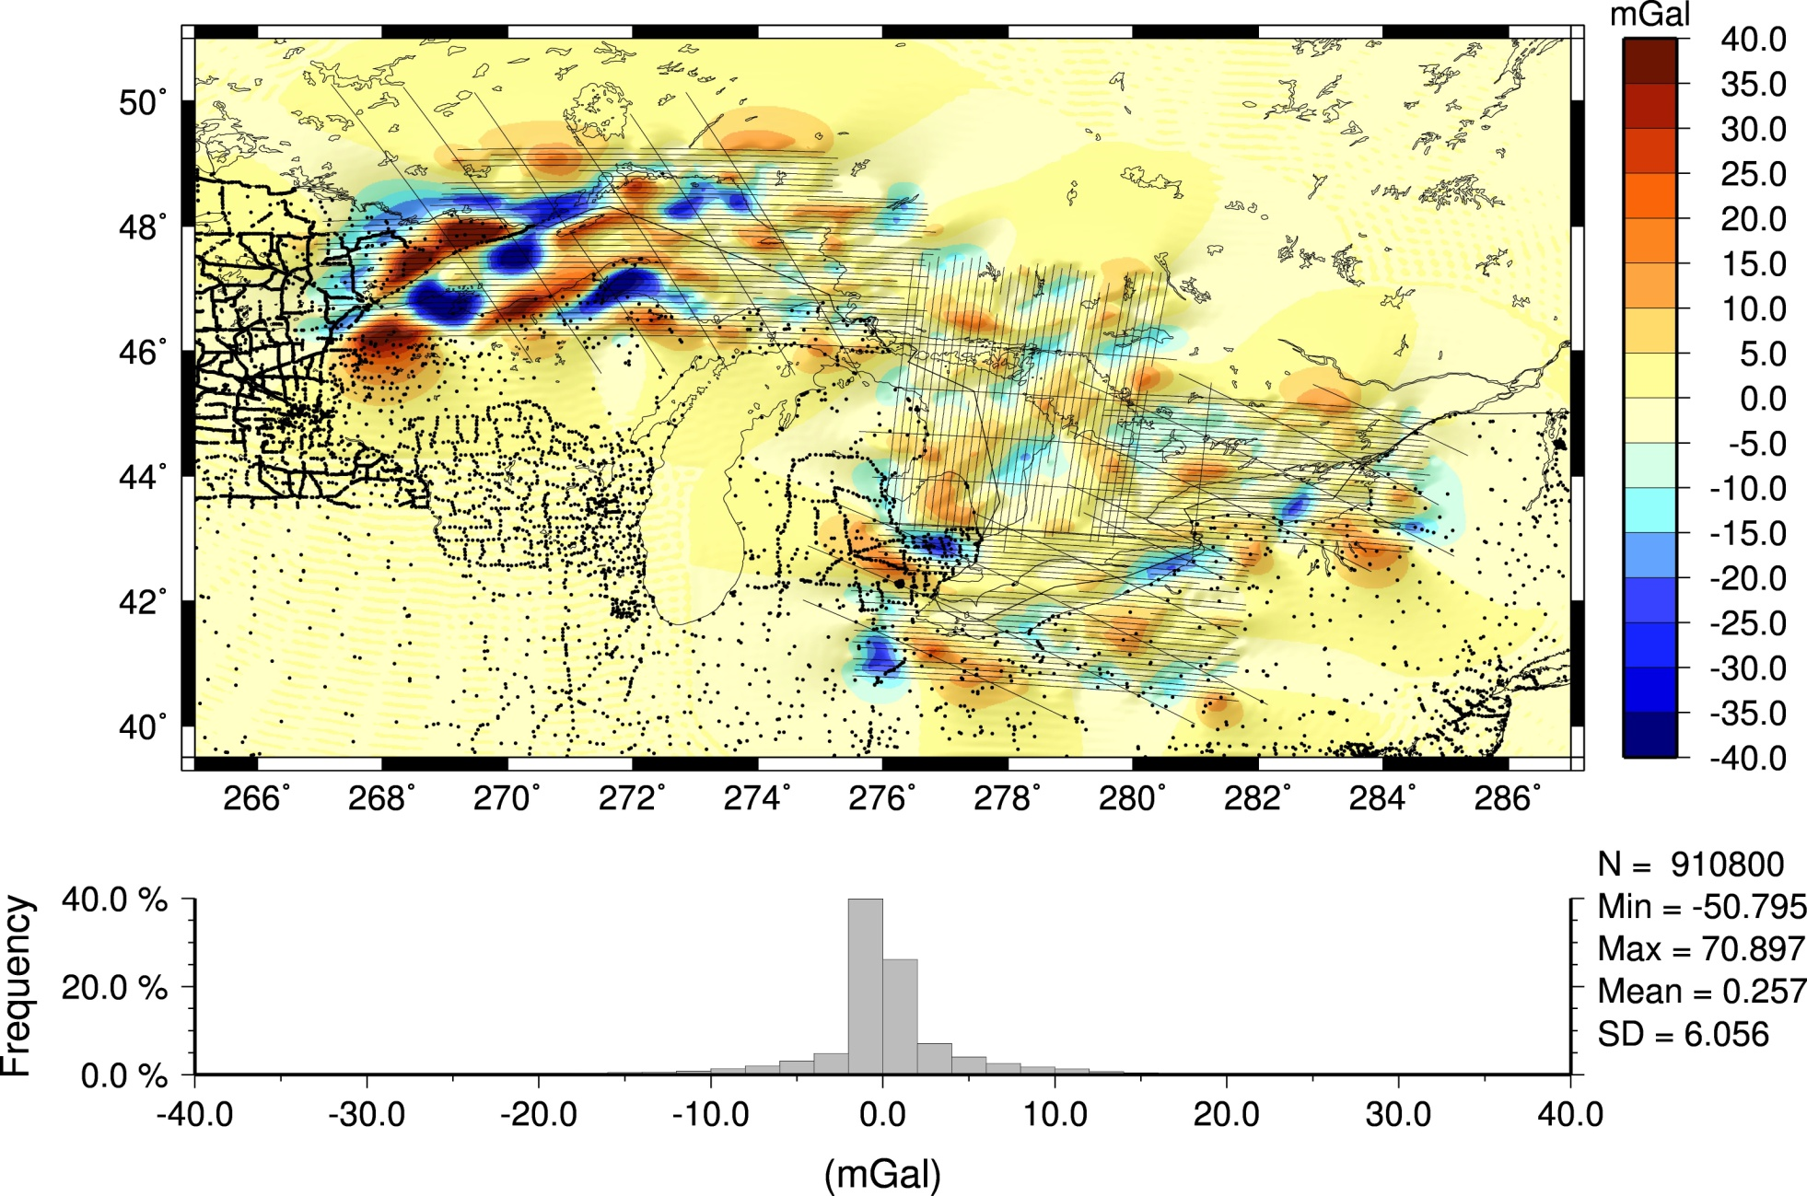
S.H. M(1) (2190) - DIR4 (200)
Notes:
Away from the survey area, Model (1) reproduces DIR4 taken 100% out to n=200. Inside it's 'all' airborne. I've attached a plot of the residuals of gravity disturbances at flight altitude (6.3km) showing:

Slide 12
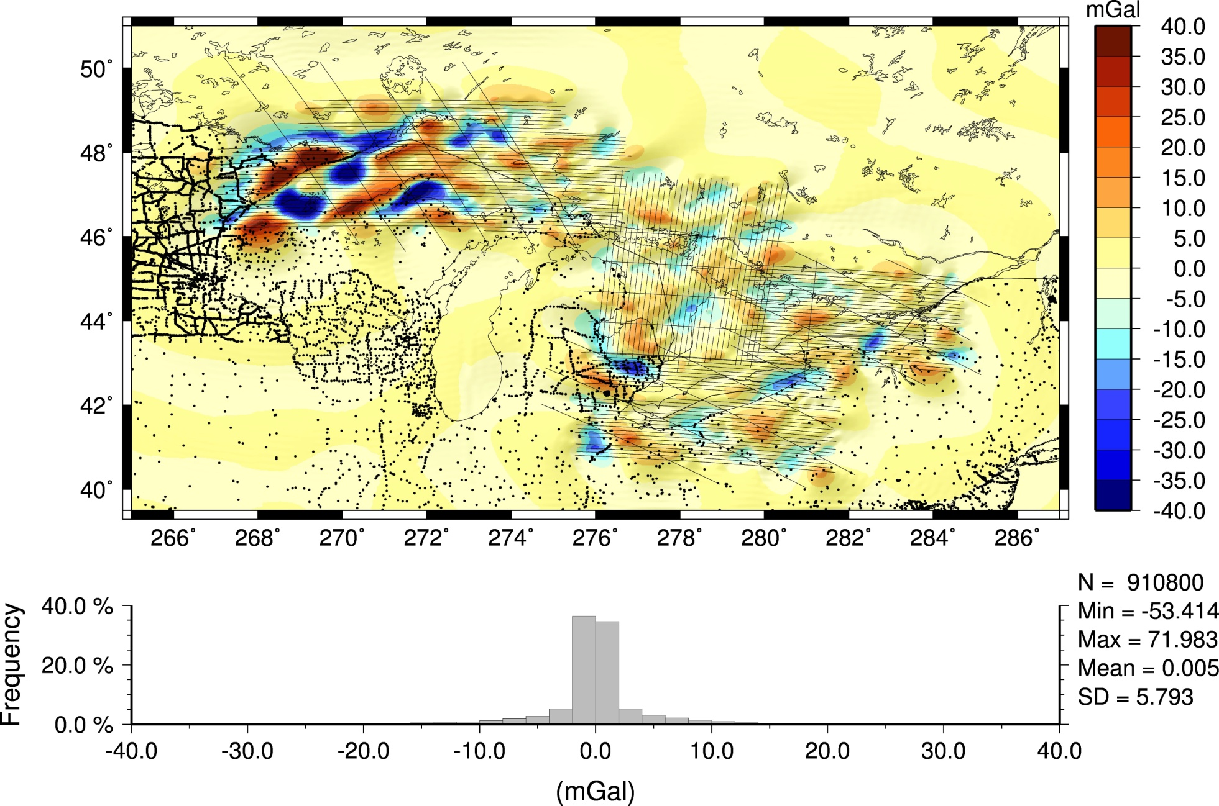
S.H. M(2) (2190) - DIR4 (200)

Slide 13
2.B GRAV-D Collection Plan
Remainder of Michigan – 01-21 August (NOAA Turbo-Commander)
Region NW of Superior – August/September*
Iowa for GSVS 14 – September (BLM Pilatus)
NE region through the mid-Atlantic region
  Finish by December (Fugro)
  Maine, Vermont, New Hampshire, New York, eastern Pennsylvania, Delaware, Maryland, Virginia, and North Carolina
* Maybe – time permitting

Slide 14
2.C GRAV-D Production
Internal Analysis – yields raw aerogravity
Processing of GPS/IMU data to remove effects of aircraft accelerations and fix locations
Near-term timeline
  ITRF00 => IGS08: Final Block in Alaska – May/June
  ITRF00 => IGS08: Erie and Ontario – June/July
  Partial release of NE data (ME/NH) – June/July
  Northern AK – July/August
  Michigan - end of August

Slide 15
2.D GRAV-D SHA
Intermediate step in GRAV-D (data fusion)
GRAV-D Analysis Process at NGS
  Mission Planning and Prioritization
  Collection via airborne sensors
    Ties to absolute stations on the ground
    GPS/IMU information also collected during flights
  Internal Analysis
    Tilt/off-level, and other corrections applied
    Removal of Accelerations, Filtering, Cross-overs, etc.

Slide 16
2.D GRAV-D SHA
  External Analysis (SHA)
    Comparisons at various degree cut-offs with GPSBM’s
      This is where GSVS lines will be very helpful
      Minimally constrained solutions independent of NAVD 88
    Best fit (lowest RMSE) is selected for transition
    Width of filter window is similarly determined
    Same process for GOCE or aerogravity into EGM2008
    Finds optimal fit of different data sources with overlapping spectral bands
  Geoid modeling follows Wang et al. (2012)
    Modified kernel approach using above for reference

Slide 17
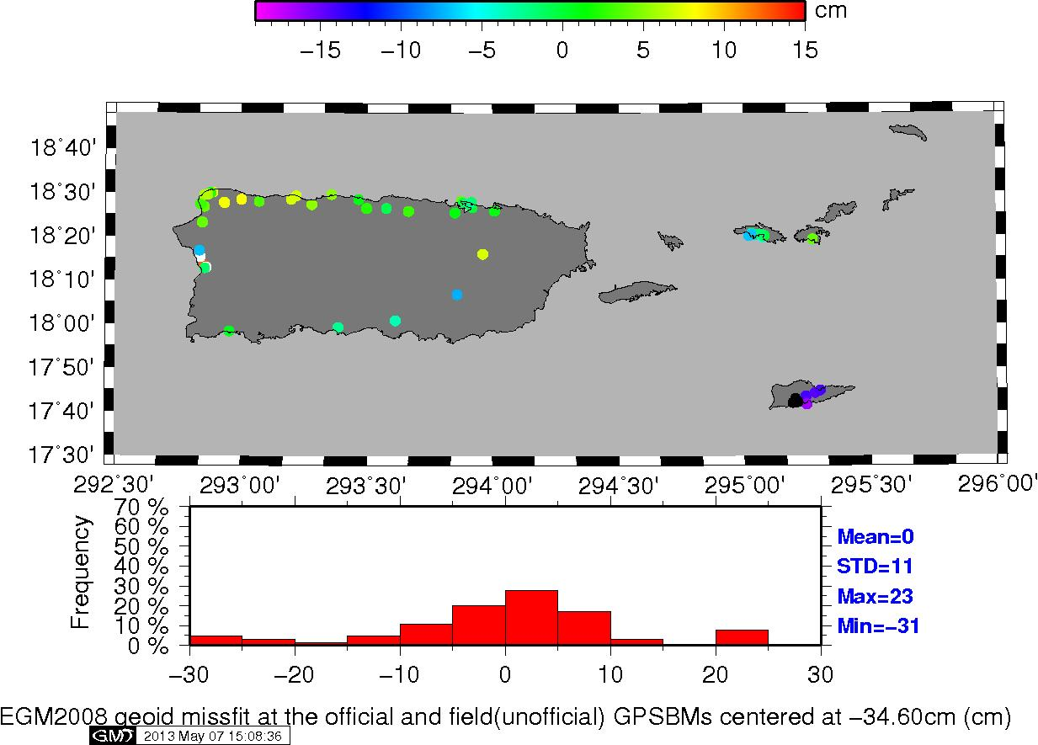
PR GPSBM Locations (PRVD02)

Slide 18
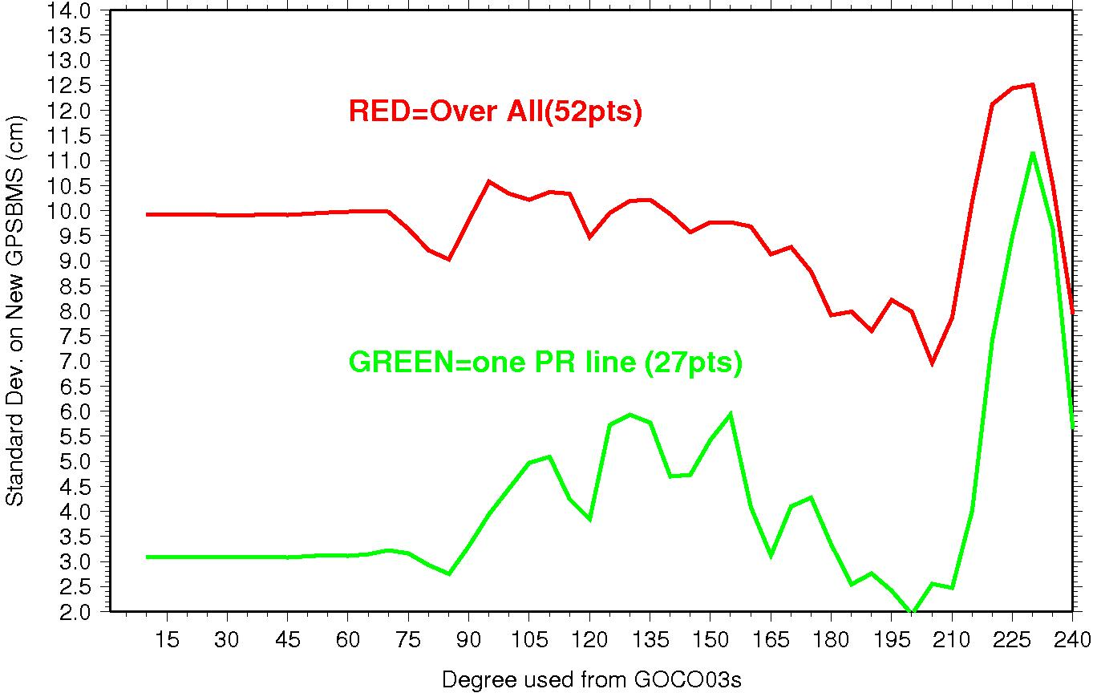
PR Errors: Satellite
Degree Cutoff vs. GPSBM’s
Degree 200 yields lowest overall error as EGM2008 is cut in at higher harmonics

Slide 19
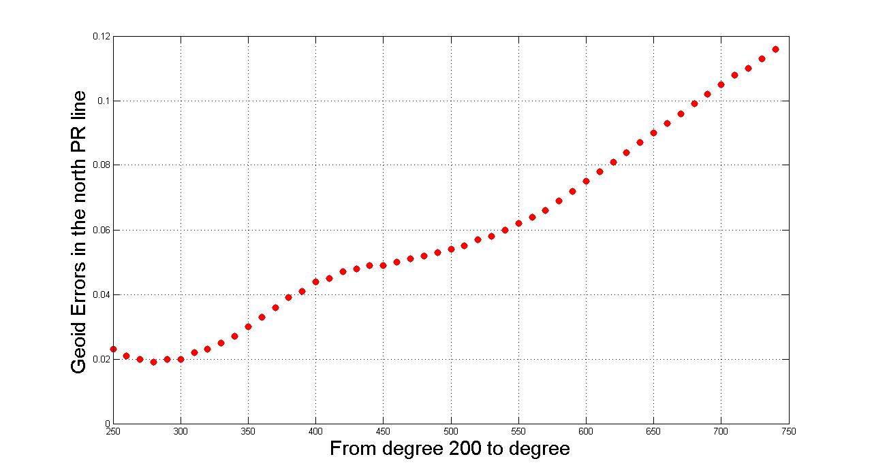
PR Errors: Aerogravity
Degree Cutoff vs. GPSBM’s
Degree 280 yields lowest overall error as EGM2008 is cut in at higher harmonics

Slide 20
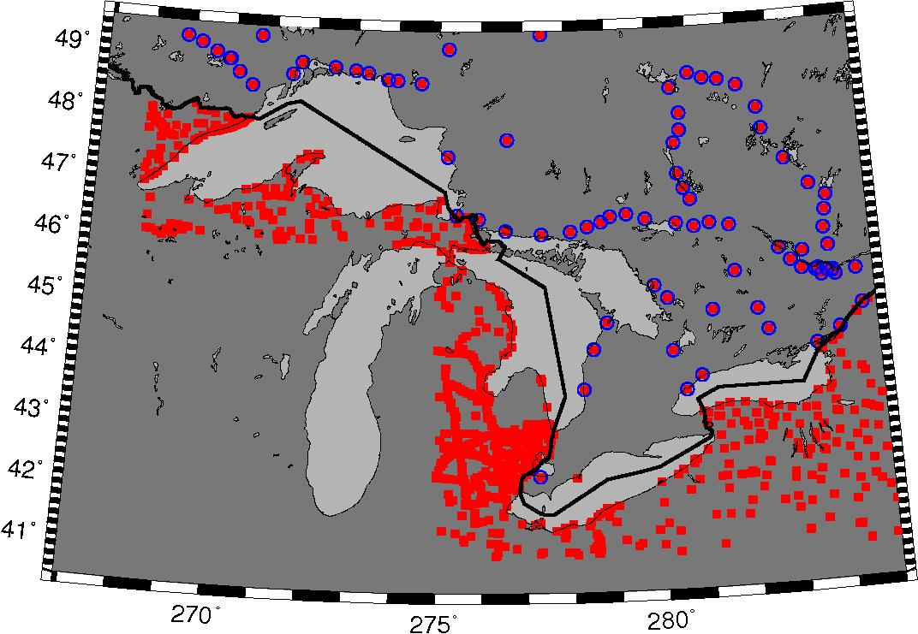
Great Lakes GPSBM Locations (NAVD 88)
Alternatives:
SEPT 12
NOV 07
Min. Constr.
GPSBM’s (WI)

Slide 21
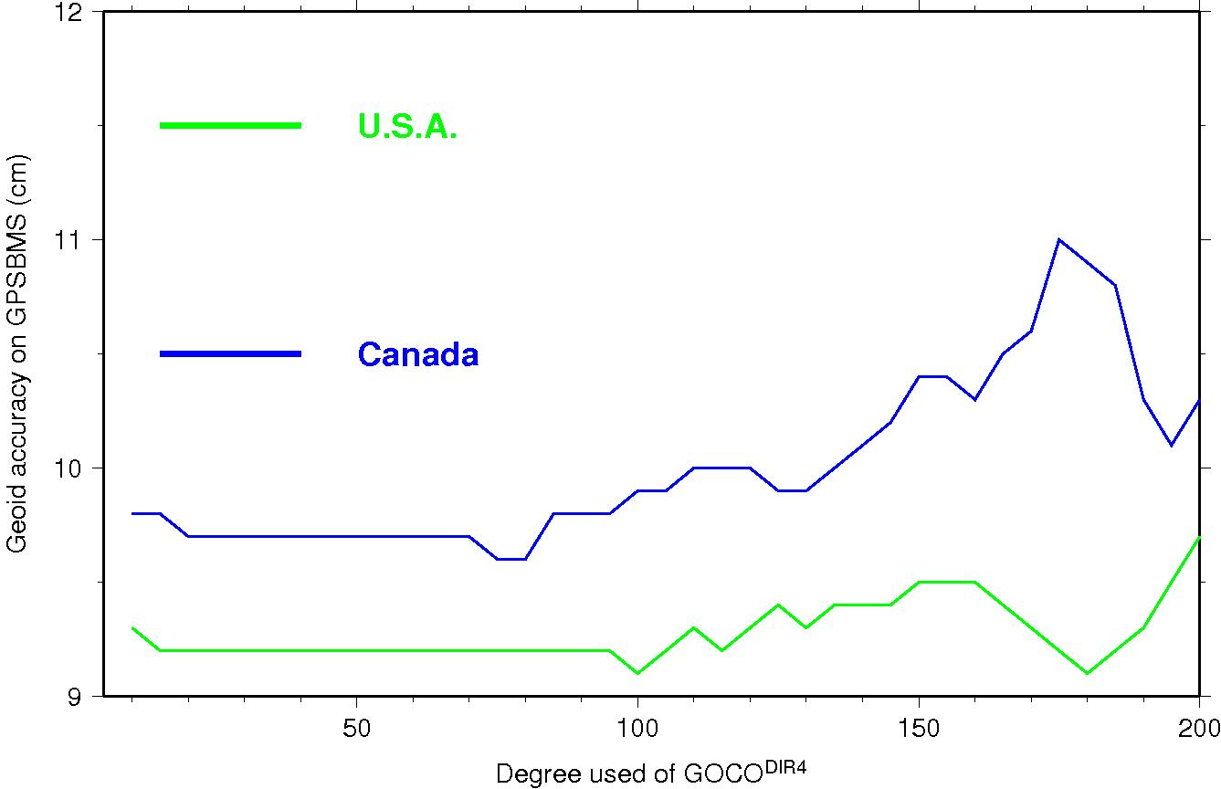
Great Lakes Errors: Satellite
Degree Cutoff vs. GPSBM’s
Two separate nadir points at degrees100 and 180: must try both

Slide 22
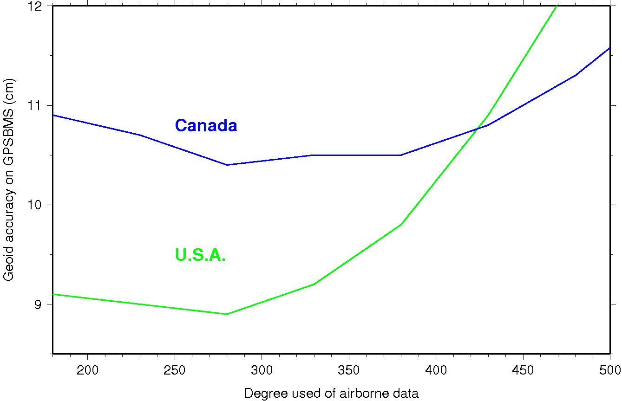
Great Lakes Errors: Aerogravity
Degree Cutoff vs. GPSBM’s
Degree 280 yields lowest overall error as EGM2008 is cut in at higher harmonics

Slide 23
2.D GRAV-D SHA
Timeline
  Erie, Ontario, Huron, Superior – May
    Lakes Erie and Ontario are in ITRF00
    HTDP will be used to convert to IGS08
    Makes available model for Geoid Workshop
  Erie, Ontario – July
    Reprocessed directly into IGS08 to update model
  PR/VI – May & low altitude data in July/August
  Michigan – mid-September
    Update to Lakes model to include all five Great Lakes

Slide 24
2.E GRAV-D Surface Gravity Error Detection and Cleaning
Check terrestrial gravity at suspect sites noted by Saleh et al. (2012)
Determine and remove potential biases trends in 40 km and longer bandwidth

Slide 25
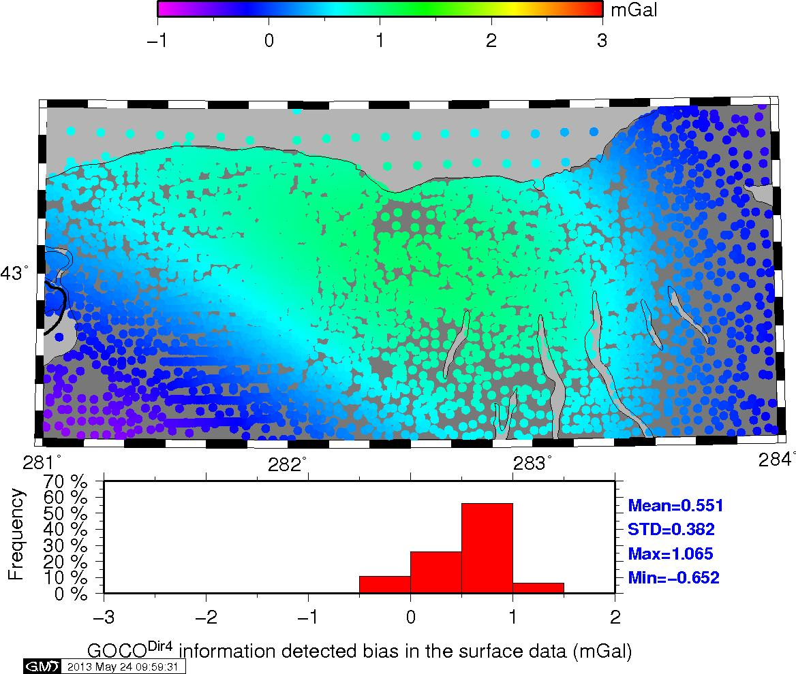
Errors Detected by GOCE DIR Rel. 4
Location is western New York State and the southeastern portion of Lake Ontario

Slide 26
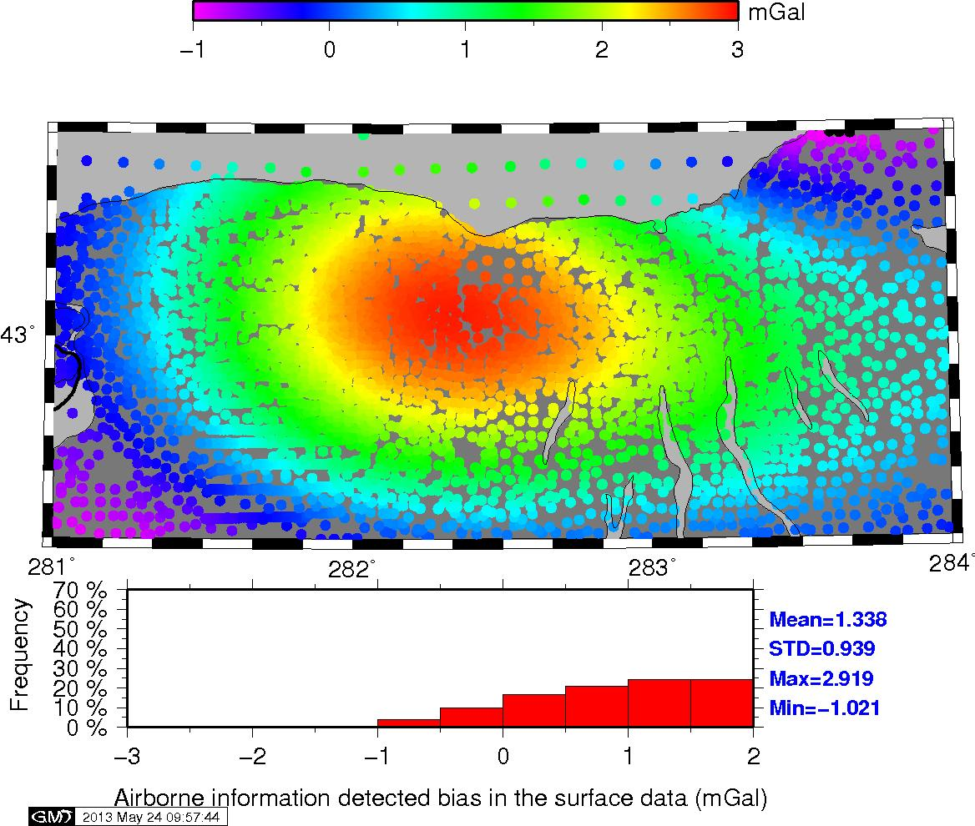
Errors Detected by Aerogravity
Location is western New York State and the southeastern portion of Lake Ontario

Slide 27
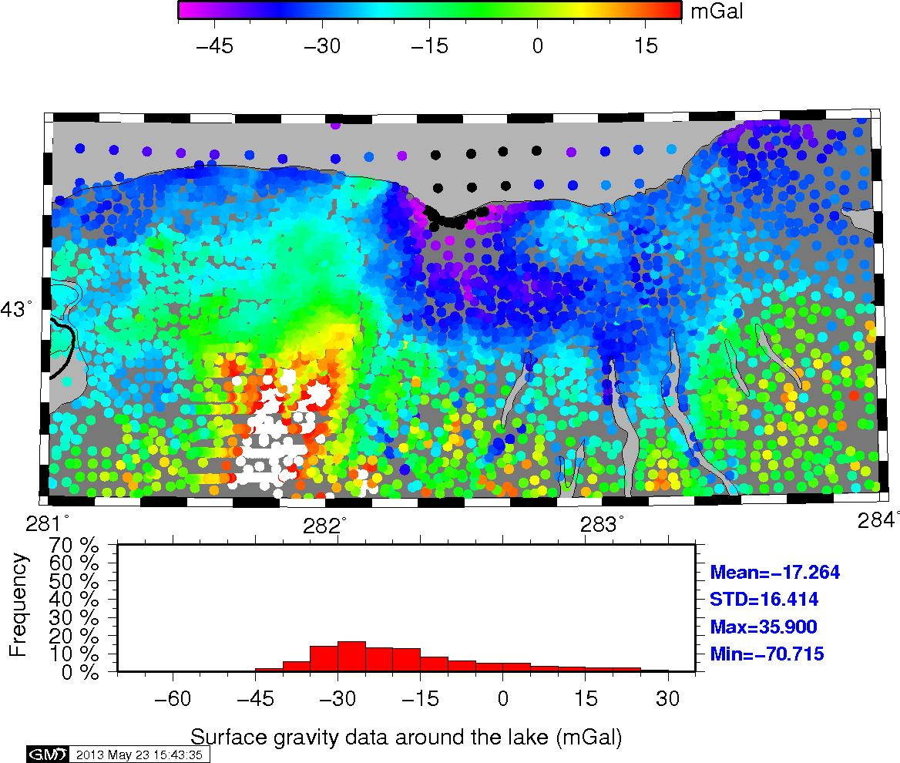
Surface Gravity Anomalies (SGA)
Location is western New York State and the southeastern portion of Lake Ontario

Slide 28
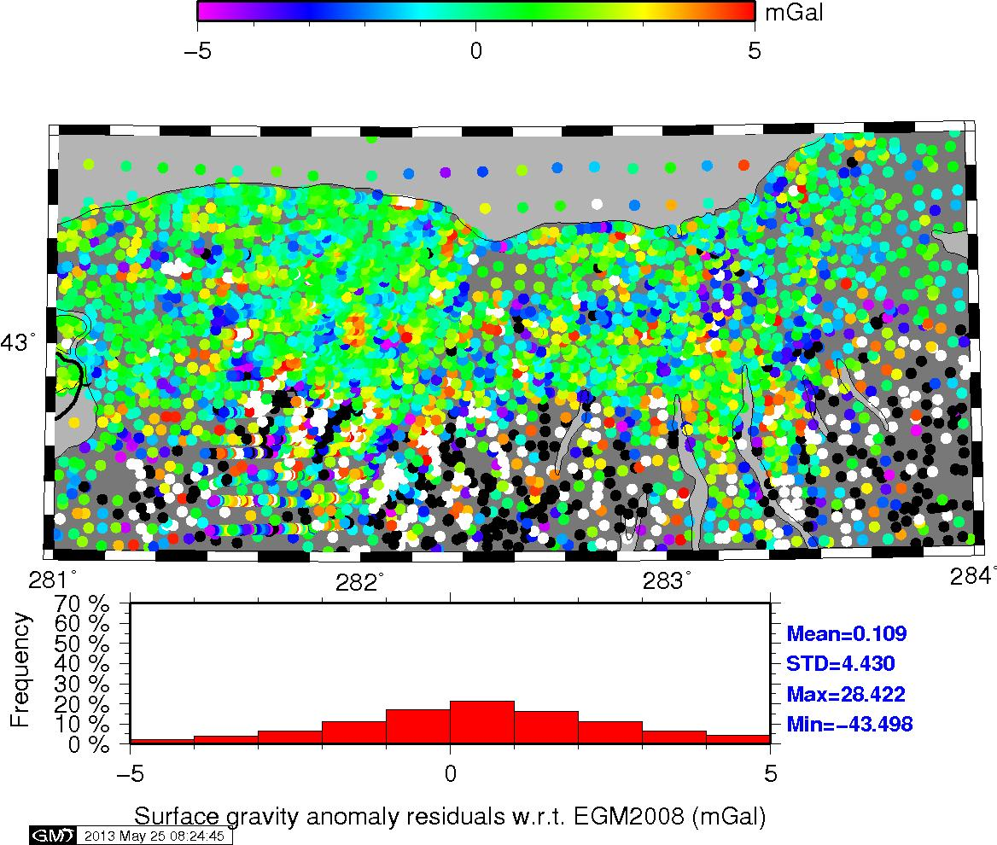
SGA – EGM2008
quiet

Slide 29
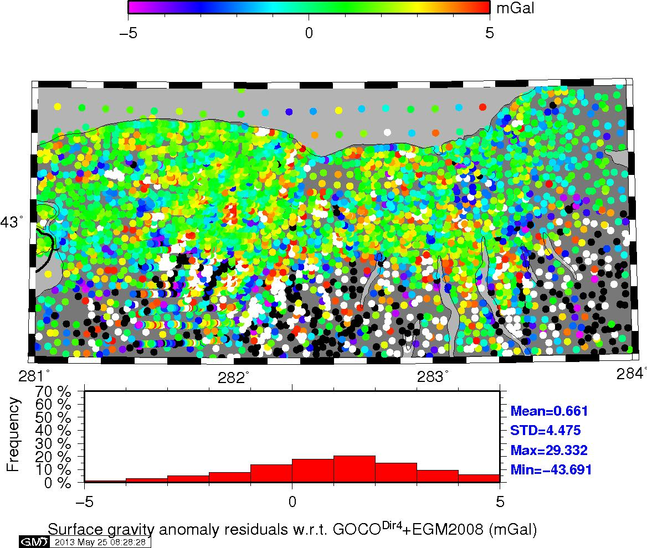
SGA – EGM2008/GOCE-DIR R. 4
noise

Slide 30
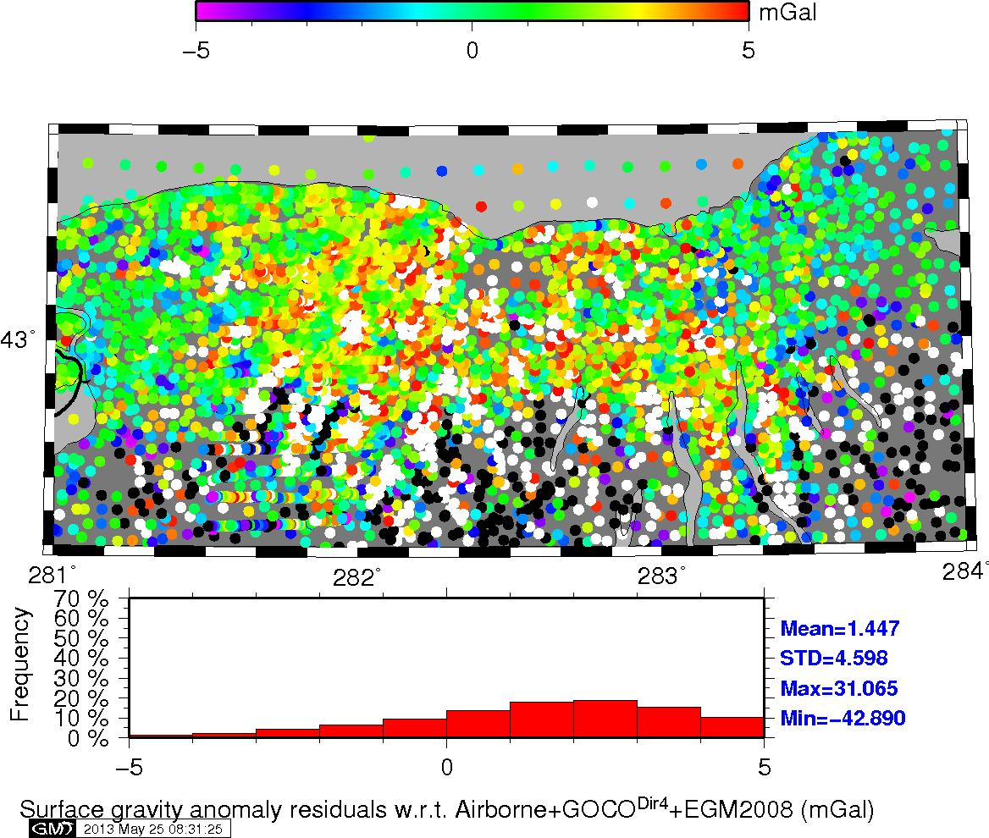
SGA – EGM2008/GOCE/Aerogravity
noiser

Slide 31
2.F Geoid Modeling
Develop new geoid model with cleaned data
  Follow procedures outlined by Wang et al. (2012)
XGG13D, experimental regional geoid model
  GOCE Direct Solution, Release 4 as reference field
    Satellite only: GOCE, GRACE, LAGEOS
    GO_CONS_GCF_2_DIR_R4 (260), Bruinsma et al. 2010
  GRAV-D aerogravity from Lakes Ontario, Erie, Huron, and Superior
  Existing NGS/NGA surface gravity from database
Comparisons - Closing the Loop
  USGG2012 www.ngs.noaa.gov/GEOID/USGG2012/
CGG2010

Slide 32
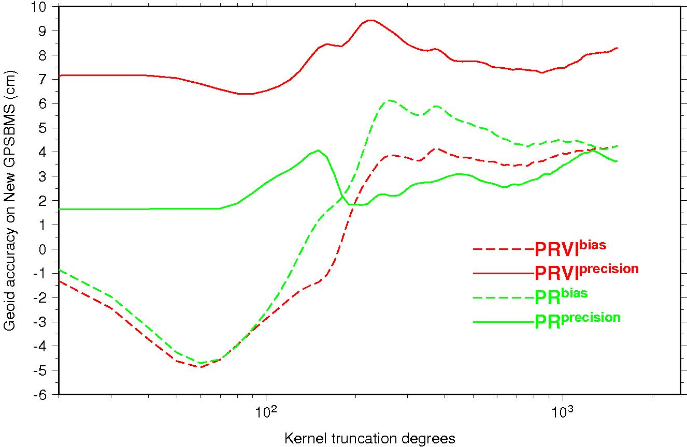
Kernel Modification/PRVI Case (the following plot requires over a thousand runs of geoid modeling.i.e. based on thousands of geoid models, which in term requires some time to be done. I will try to do the same for the great lakes in July. For now, it is kind of too late. Sorry.)
Surface data starting contribution from degree 50
Geoid getting worse if relying on reference model too much

Slide 33
3. GGM Comparisons
CGG2010/CGG2013(preliminary Model 8)
USGG2012 (http://www.ngs.noaa.gov/GEOID/USGG2012/)
XGG13D, experimental regional geoid model
  GOCE Direct Solution, Release 4 as reference field
    Satellite only: GOCE, GRACE, LAGEOS
    GO_CONS_GCF_2_DIR_R4 (260), Bruinsma et al. 2010
  GRAV-D aerogravity from Lakes Ontario, Erie, Huron, and Superior
  Existing NGS/NGA surface gravity from database

Slide 34
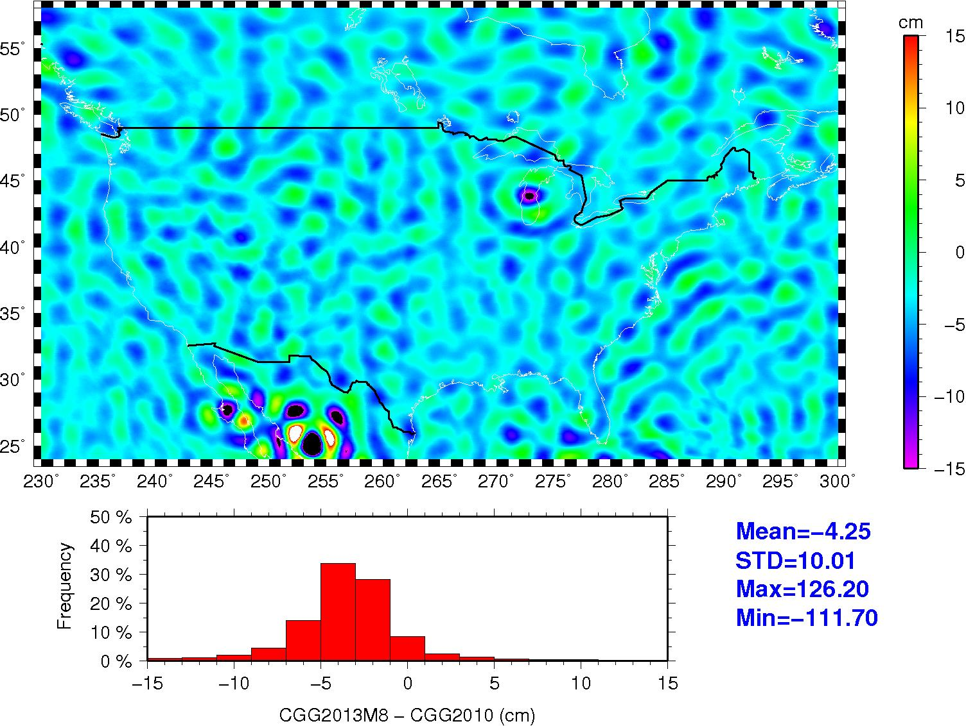
CGG2013M8 – CGG2010
Model 8:
GOCE DIR Release 4
Surface gravity
Modified Kernel with Cosine filter between 140-200

Slide 35
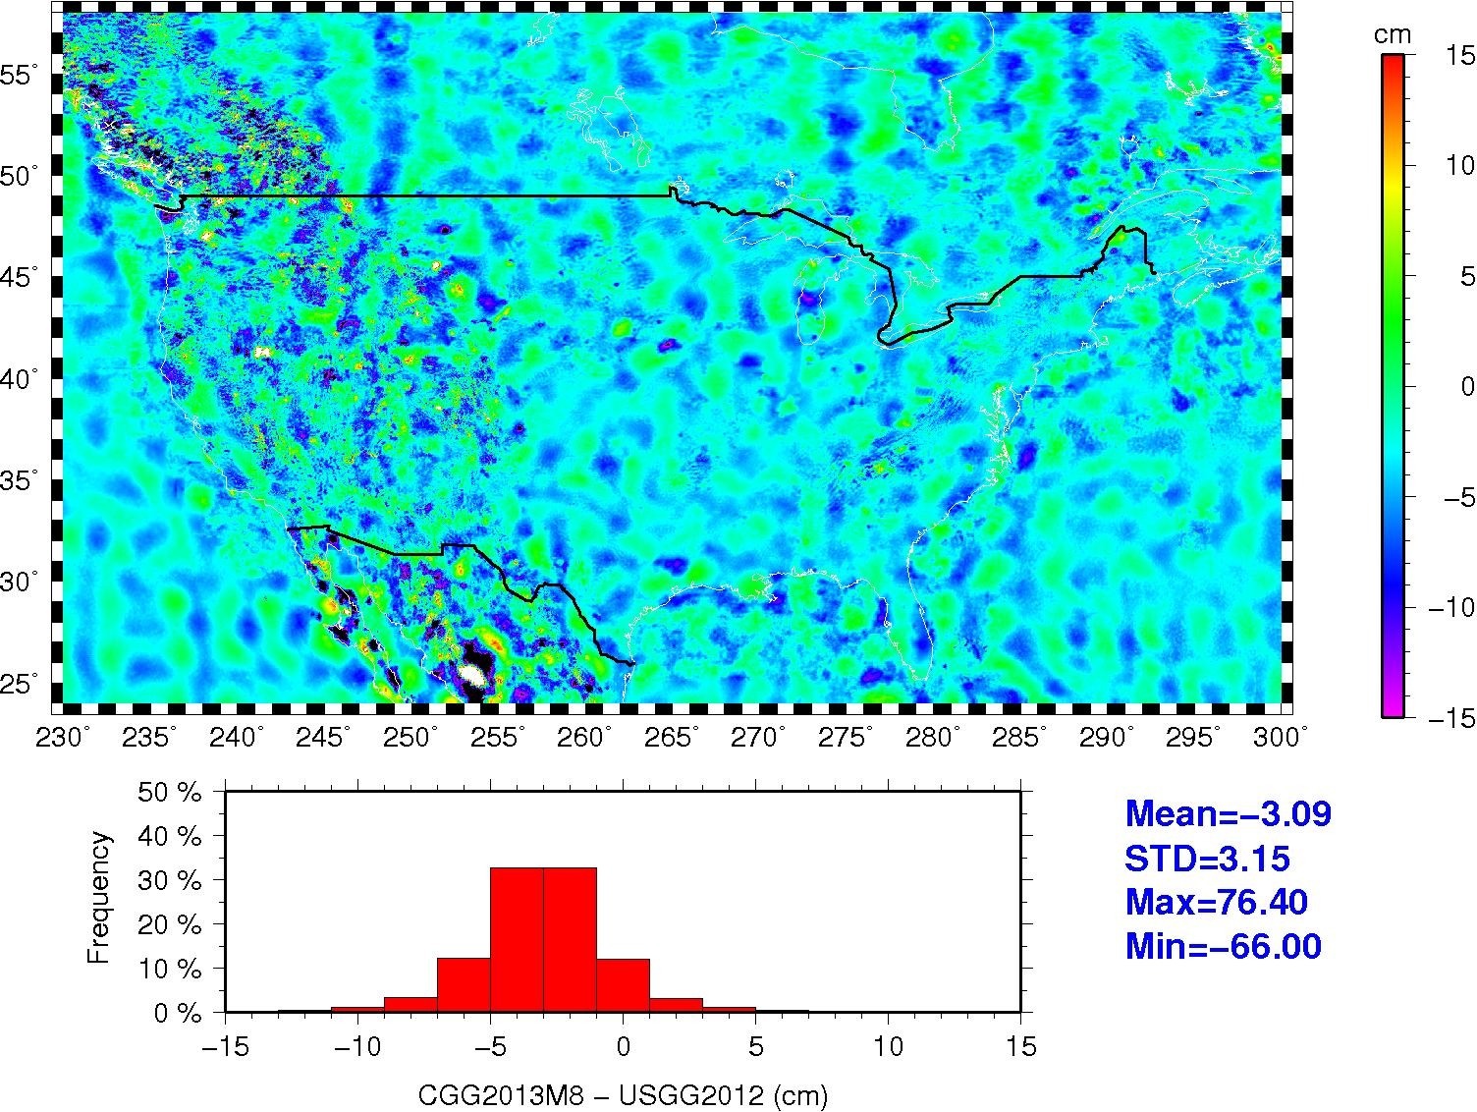
CGG2013M8 – USGG2012

Slide 36
XGG13D – CGG2013M8

Slide 37
XGG13D - USGG2012

Slide 38
4. Conclusions
Aerogravity bridges the gap between satellite and surface gravity data
Suspect surface gravity data was confirmed
Assessment of cleaning of surface data and potential impact is ongoing
With adoption of common W₀ and use of aerogravity to constrain middle wavelengths, a common gravity field model is possible

Slide 39
Decisions
How to incorporate aerogravity?
  100% aerogravity signal where it exists
    S.H. M(1) aerogravity to 2190 – DIR4 outside areas
  Blended based on GPS/leveling
    Spectral tapering based on best fit
    S.H. M(2) blend of aerogravity/DIR4 in Lakes
Use as reference model
  Kernel modification by region or globally?
TIM vs. DIR
Interest in other data – Maine/NE

Slide 40
Available Models
ftp://ftp.ngs.noaa.gov/dist/droman/
  GOCODir4EHM
  AirborneGOCODir4EHM
http://terra.sgt-inc.com/pub/sholmes/CGW2013/
  Cnm_dg09_v052513A_1x1_s2-2190_7.gz (M1)
  Cnm.TGM052513C_s2190_zt_10.gz (M2)

Slide 41
GPS/Leveling Data Sets
GPSBM2012A
  detrended
NOV 07
SEP 12
Minimally constrained GPSBM’s

Slide 42
5. Future Work
Use NOV 07, SEPT 12, & M.C. GPSBM to model
Test all surface gravity data in region
Develop regional model spanning same region as CGG2013
Compare final CGG2013 against USGG2012, XGG13D, and any follow-on models
Test against tide gauges/MODT
Water level gauges on Lakes

Slide 43
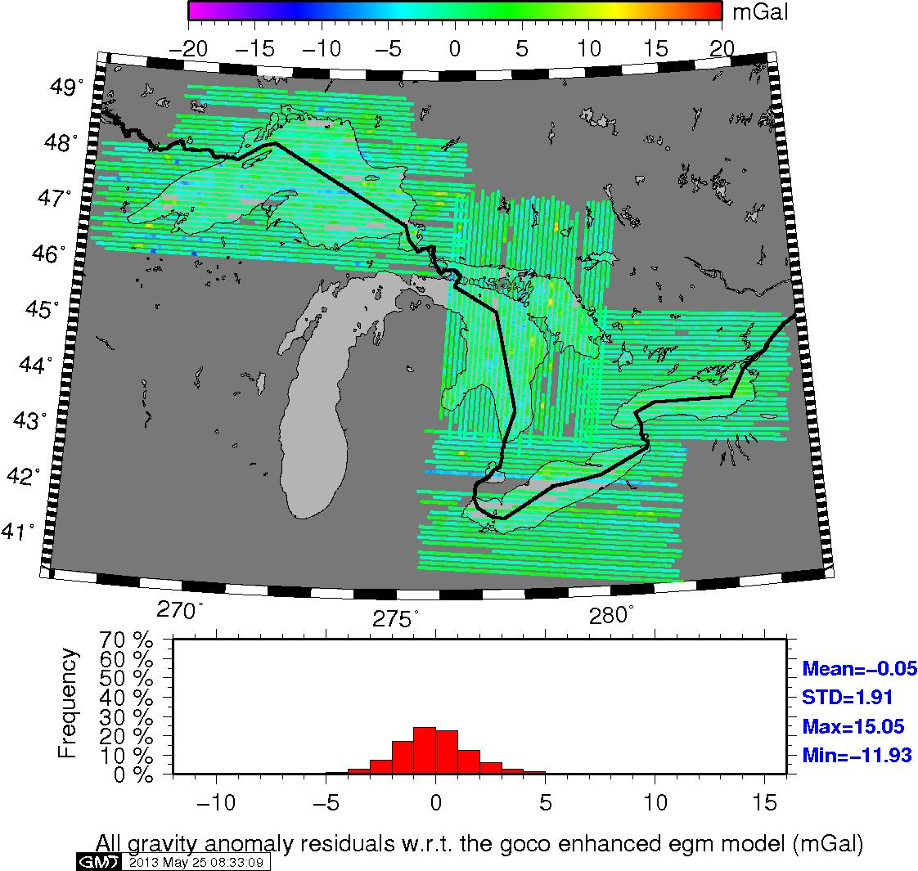
Back Up slides Aerogravity – GOCE DIR Rel. 4+EGM2008

