Slide 1
The Basis of NGS’ New Geopotential Datum and the Geoid Slope Validation Survey of Southern Colorado
PLSC Summit, March 7 2018
Derek van Westrum, Ph.D.
NGS Observations and Analysis Division
derek.vanwestrum@noaa.gov
NOAA’s National Geodetic Survey
geodesy.noaa.gov

Slide 2
Outline
NGS, its history and mission
Height
  Historical methods
  Equipotential surfaces and the geoid
  The new Geopotential Reference System (NAPGD2022)
  Modern height determinations
GRAV-D operations (Gravity for the Redefinition of the American Vertical Datum)
Geoid Slope Validation Surveys
  Texas, Iowa, and Colorado

Slide 3







NGS Mission Statement
To define, maintain, and provide access to the National Spatial Reference System (NSRS) to meet our nation’s economic, social, and environmental needs.
The NSRS is a consistent coordinate system that defines latitude, longitude, height, scale, gravity, and orientation throughout the United States, for all federal agencies.
Nautical charts, among many other geospatial applications
Topographic Maps and interior water data for the nation
Emergency Response Imagery, Flood zones
NSRS gravity data for the geospatial mission of NGA
Levee Safety Program
Aeronautical Data Quality Assurance

Slide 4

The National Geodetic Survey
Ten-Year Plan
Support the users of the National
Spatial Reference System.
Modernize and improve the National Spatial Reference System.
Expand the National Spatial Reference
System stakeholder base through
partnerships, education, and outreach.
Develop and enable a workforce with
a supportive environment.
Improve organizational and administrative functionality.
Notes:
The NGS “State Geodetic Advisor” program has engaged a long-standing cost-sharing partnership between NGS and various states. On many levels it is a success... However, the program has been a patchwork success and does not serve the nation equitably. Recognizing this imbalance… NGS determined to transition to a regional advisor program. The regional program will consist of a smaller cadre of advisors, all well-trained and dynamic educators capable of serving multi-state regions, and the new program will be run all at the cost to NGS alone.
NGS Ten-Year Strategic Plan, 2013
The NGS Ten-Year Plan was adopted at the beginning of 2013, including four major goals and an enterprise goal:
Goal 1: Support the Users of the National Spatial Reference System.
Goal 2: Modernize and Improve the National Spatial Reference System.
Goal 3: Expand the National Spatial Reference System Stakeholder Base through Partnerships, Education and Outreach.
Goal 4: Develop and Enable a Workforce with a Supportive Environment.
Enterprise Goal: Improve Organizational and Administrative Functionality.

Slide 5
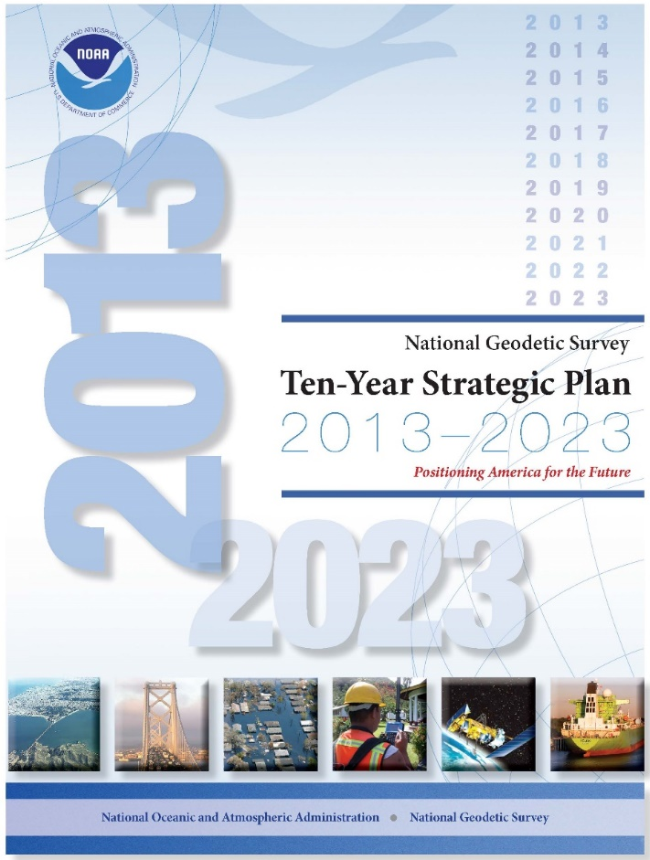
National Geodetic Survey Ten-Year Strategic Plan
  By 2022, reduce all definitional & access-related errors in geometric reference frame to 1 cm when using 15 min of GNSS data
  “Replace NAD83”
  (NAD83 = North American Datum 1983)
  By 2022, reduce all definitional & access-related errors in orthometric heights in geopotential datum to 2 cm when using 15 min of GNSS data
  “Replace NAVD88”
  (NAVD88 = North American Vertical Datum 1988)
https://geodesy.noaa.gov/web/about_ngs/info/tenyearfinal.shtml

Slide 6
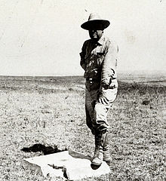
Current NSRS
NAD83
  North American Datum of 1983
  Horizontal reference system: Latitude and Longitude
  Replaces NAD27
NAVD88
  North American Vertical Datum of 1988
  Replaces NGVD29
  (I’ll say more about it, but mainly: its replacement is the focus of this talk…)
Meades Ranch Triangulation Station (NAD27)

Slide 7
Height
It’s just the distance¹ up² from somewhere³, right?
Measured how?
Exactly which direction is that?
Where?
We’ll kinda go in reverse order…

Slide 8
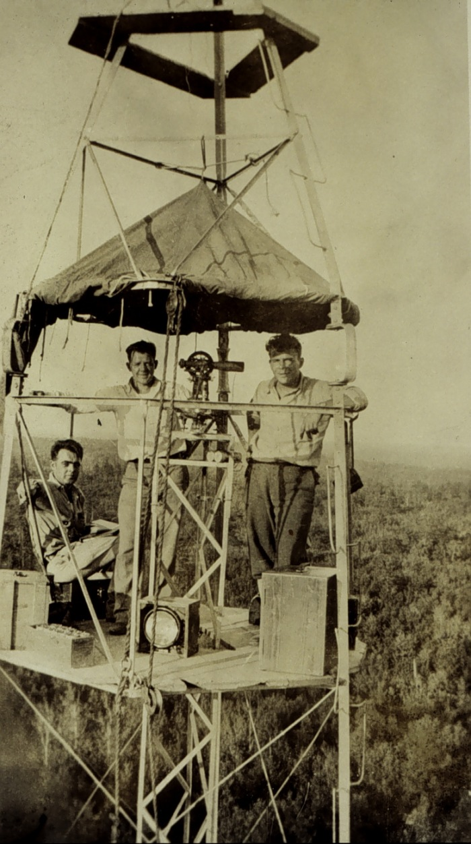
“Old Man and The Sea (Level)”
The National Geodetic Survey, our Nation's first civilian scientific agency, was established by President Thomas Jefferson in 1807 as the Survey of the Coast. Its mission was, and still is, to survey the U.S. coastline and create nautical charts of the coast to help increase maritime safety. As the nation grew westward surveys of the U.S. interior began. In 1878 the agency was given a new name, the U.S. Coast and Geodetic Survey (USC&GS), which it maintained until 1970.
So, you basically went down to the seashore with a ruler, and kept track of much you went up as you went inland…

Slide 9
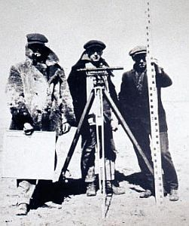
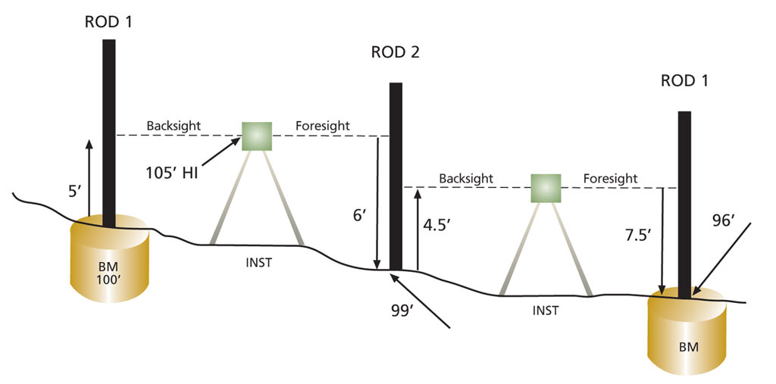
Leveling
“Simply” keep track of accumulated height differences.
“First order” accuracy: 0.7mm/√km
Need gravity (or model) at each benchmark

Slide 10
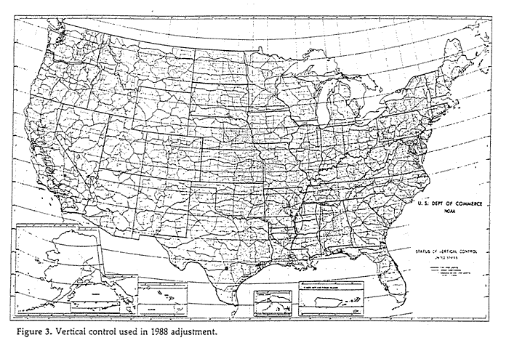

Slide 11
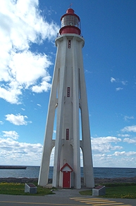
“Old Man and The Sea (Level) cont.”
NAVD88, the current vertical datum is still based on sea level
“…a leveling network on the North American Continent, ranging from Alaska, through Canada, across the United States, affixed to a single origin point on the continent:
Tide Station & Location = Pointe-au-Pere, Rimouski, Quebec, Canada
PID = TY5255
GSD* Designation = 54L071
Bench Mark = 1250 G
Height above LMSL = 6.271m
  Massive leveling and gravity campaign across the country in the 1980s yielded measurements at >500,000 benchmarks

Slide 12
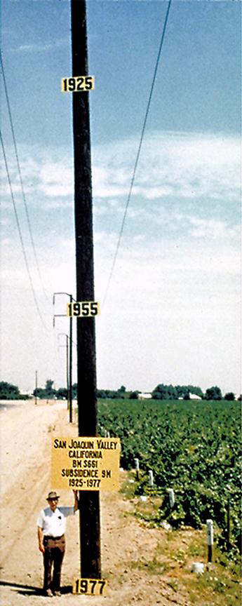
Problems with NAVD88
It is only realized at the benchmarks it occupies. “New” points, or local survey control, must be leveled to an existing benchmark
Benchmarks change (height, especially) or disappear with time:
  Hydrology – subsidence from ground water usage (10s of meters in California!)
  Cryospheric – glacial isostatic adjustment (post-glacial rebound)
  Earthquakes, volcanoes
  Pesky vandals…

Slide 13
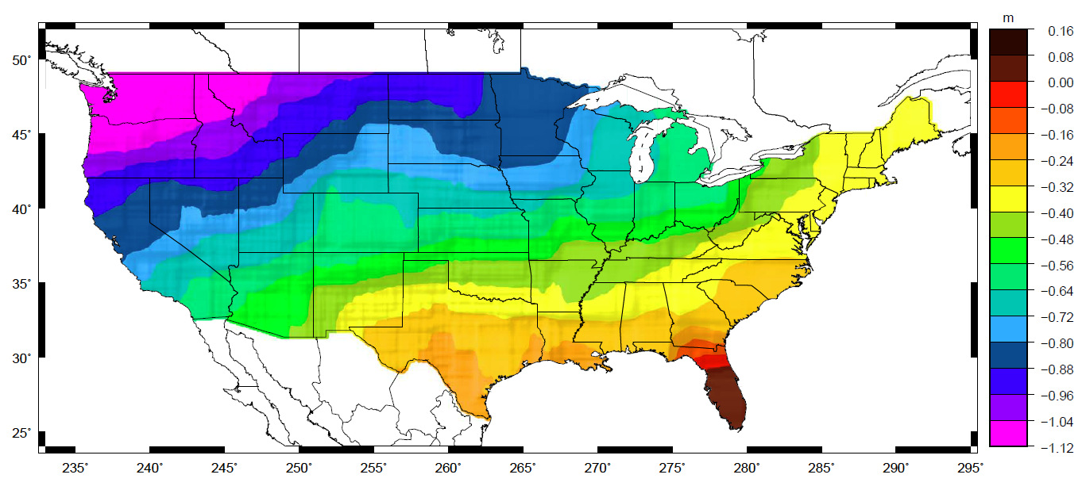
Problems with NAVD88 cont.
It has an annoying “tilt” with respect to “sea level”*
Sea level isn’t level (dynamic topography)
Sea level isn’t constant with time…
*by which, I mean the “geoid”…

Slide 14
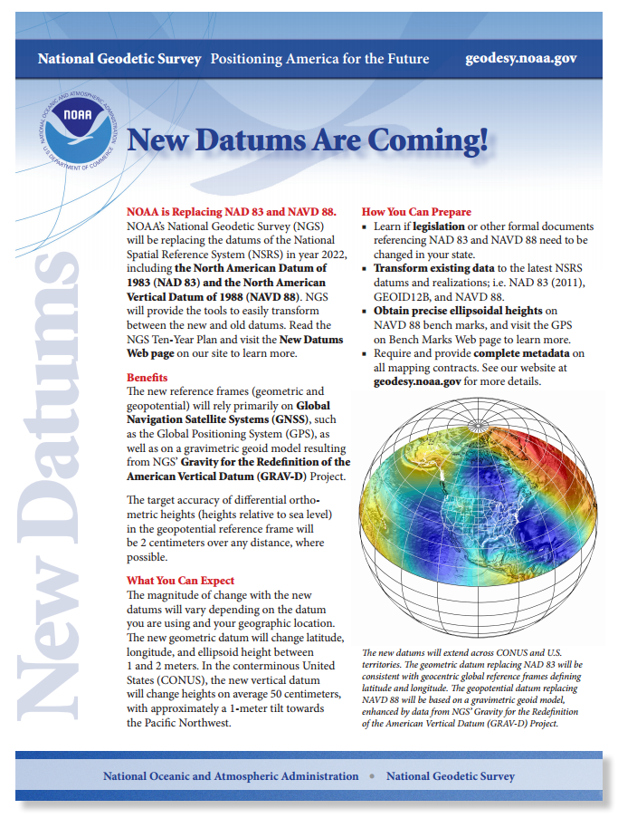
So, we need new datums!
New Datums (horizontal and vertical) are coming in 2022:
http://www.geodesy.noaa.gov/datums/newdatums/index.shtm
Replacing NAD83 with a geocentric reference fame. GNSS based
Replacing NAVD88 with a gravity based geoid. The GRAV-D project combines satellite, airborne, and terrestrial gravity measurements…

Slide 15

Back to Basics
How do we best measure and describe the shape of the Earth?
Through a series of successive models:
Most everyone not paying attention (~forever): the earth is flat
Eratosthenes (~200 BC) used wells to show the
Earth is a sphere, and calculated its radius to ~10%.
Cassini (1666) noticed Jupiter appears elliptical, and Richer (1672) noticed his pendulum had a longer period near the equator => Newton and Huygens figured out why the Earth is actually an ellipsoid based on physical principles
Laplace, Gauss, Bessel, Stokes… (~1820) developed the mathematics that allowed them to precisely declare the Earth is a lumpy blob => Geodesy.

Slide 16
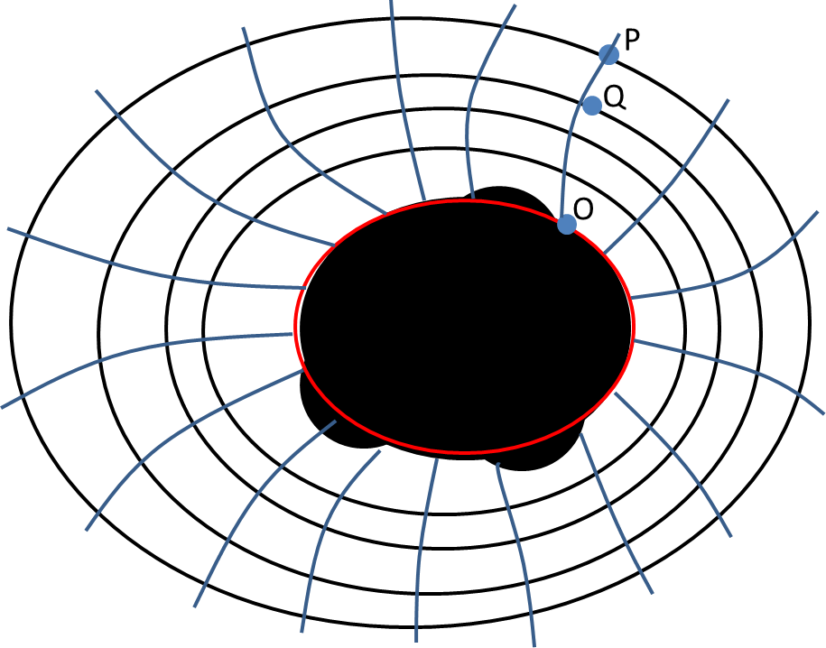
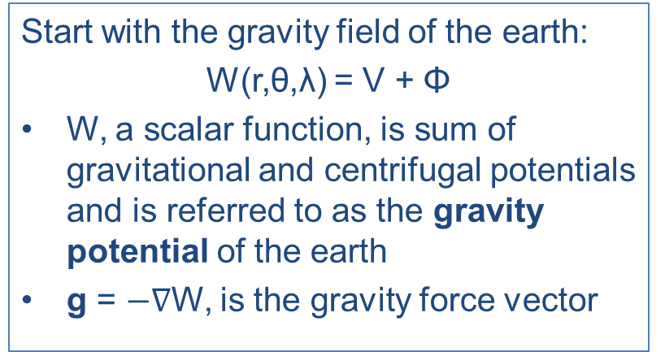
Modern Geodesy
W = const defines a surface of equipotential or geopotential
There are infinitely many equipotential surfaces. They are not necessarily parallel to each other, but never intersect.
Water doesn’t flow along an equipotential surface, or equivalently, such a surface is said to be “level”.
Plumb lines are always perpendicular to every surface they intersect.
The one equipotential surface that, on average, best matches sea level is defined as the geoid ≡ W₀.
Notes:
Mention that the geoid is not an ellipsoid shape, but lumpier. Only 170m_pp though!

Slide 17
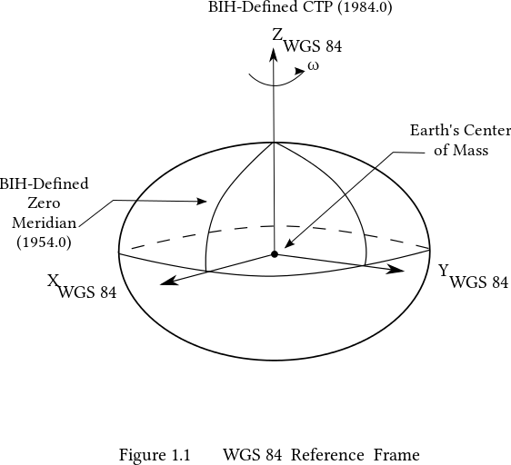
One last, extra modern, piece of the puzzle: Satellites.
GPS (and GLONASS, and Galileo, etc. – collectively referred to as GNSS) allows for very precise (~1cm) location determinations relative to a specific ellipsoid model of the earth (which is all that these high-altitude [~20,000km] satellites “see”).
The ellipsoid model currently used by GPS is WGS84. Its origin is located at the CM of the Earth.

Slide 18
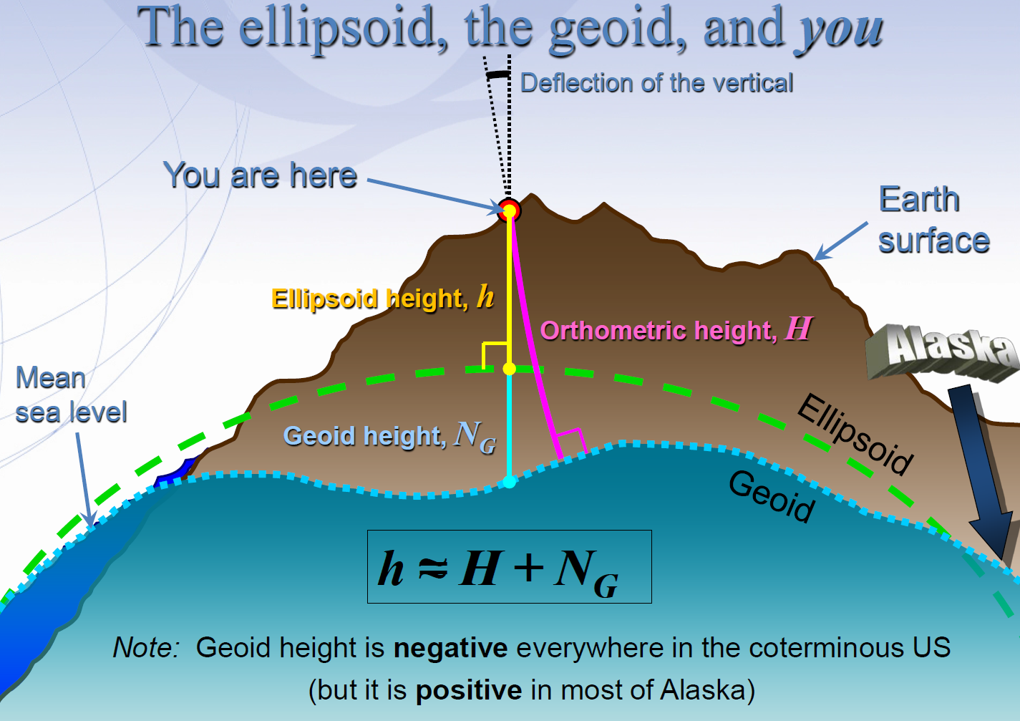

Slide 19
Putting it all together…
Your “cellphone” (actually, geodetic grade GNSS) will give you ~1cm Ellipsoidal Height, h, in a few tens of minutes.
NGS will provide (via your cellphone) the Geoidal Undulation (or geoid height), N_{G ,} accurate to ~1cm.
Your (orthometric) height* above “sea level” is then simply h – N_{G}; good to about 2cm. Voila!
*measured along the plumb line from your location to the geoid

Slide 20

A few, minor, details….
Getting N_{G} isn’t trivial…
  You’ve got to know the difference in true surface gravity from what you’d expect if the earth was a perfect ellipsoid. This is referred to as the gravity anomaly, ∆g.
  Then solve Stokes’ integral:
  Which also means you need to know ∆g over the entire surface of the earth (or, at least a continental-sized chunk of it…)
  (R is the mean radius of the earth, ɣ₀ is mean surface gravity on an equivalent ellipsoidal earth, S is an analytic (geometrical) function of position.)
And then, once you know N_{G} “everywhere”, you still need to be able to communicate it somehow…

Slide 21
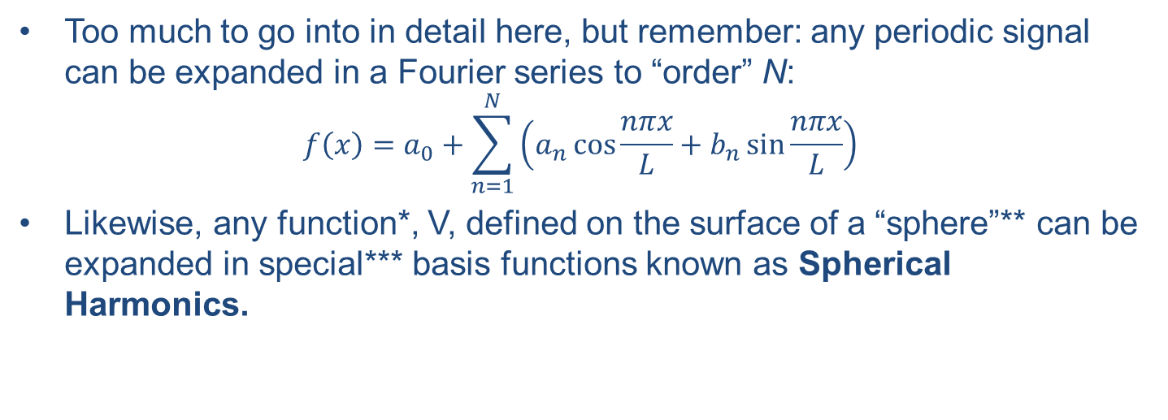
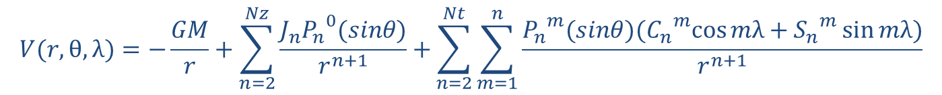
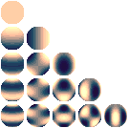
…which is where Spherical Harmonics come in
Like a Fourier decomposition, there are low-order, long wavelength terms, and successively higher-order, shorter wavelength terms.
n = 0
n = 1
n = 2
n = 3
n = 4
n = 5
* must be an “harmonic function”
**sphere or ellipsoid…
***feel free to confuse “special” and “spatial”

Slide 22
And we’re done! With the theory…
So NGS first determines the geoid by
  Using GRACE/GOCE satellites to obtain surface gravity anomaly data (250km wavelengths and longer – longer wavelength means small “n”)
  Using airborne gravity (TAGS) to fill in shorter wavelengths (~20km to 500km). Meant to overlap shortest satellite wavelengths
  Surface gravity where needed/possible.
  We now have ∆g.
Then, NGS will calculate and distribute a geoid model (N_{G}) via coefficient values for each spherical harmonic (currently over 2000).
Finally, GNSS gives a precise ellipsoidal height (i.e. it will notice you, standing on a chair outside, to ~1cm).
The geoid height is known precisely for your location, so your “absolute” (orthometric) height above the geoid is known precisely, to about 2cm.

Slide 23

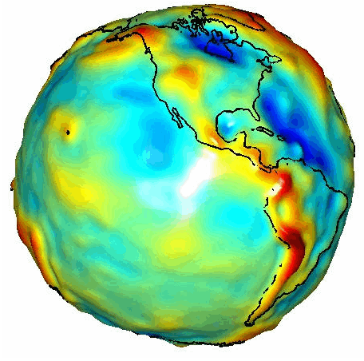
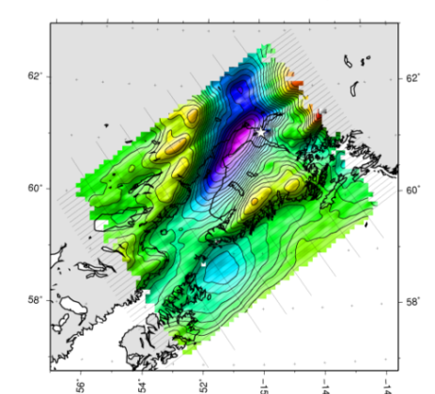
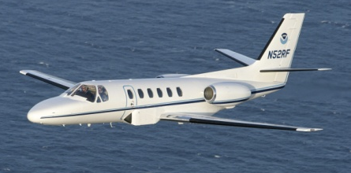
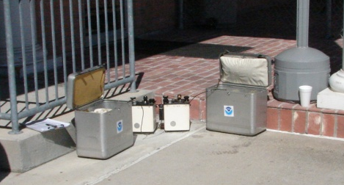
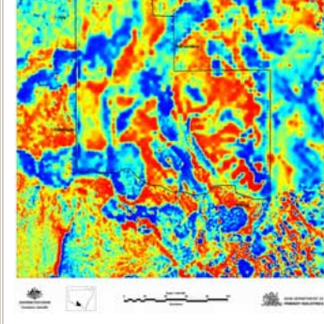
Building a Gravity Field
Long Wavelengths
(≥ 250 km)
GRACE/GOCE/Satellite Altimetry
+
Intermediate Wavelengths
(500 km to 20 km)
Airborne Measurement
+
Short Wavelengths
(< 100 km)
Surface Measurement and
Predicted Gravity from Topography

Slide 24
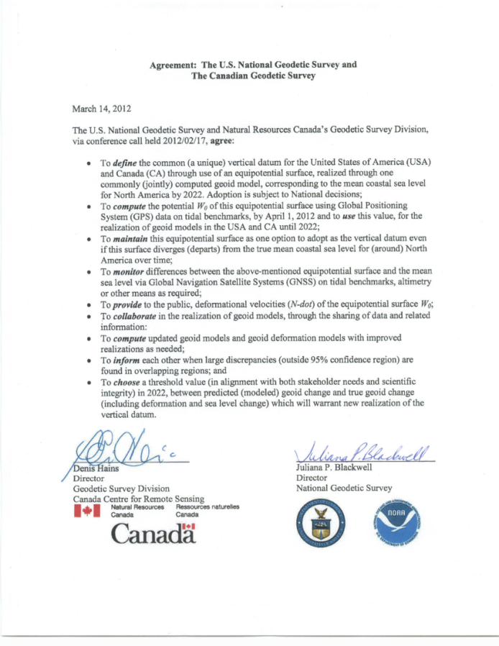
Wait, one last detail!
We still have to choose the W value that will define which geopotential surface is the geoid. Again, it’s nice if it’s pretty close to what people have been using as “mean sea level”.
W₀ ≡ 62,636,856.0 m²s⁻²
(Note: W₀ ~ GM_{e}/R_{e}. The above definition effectively defines the combination of the gravitational constant and the mass and radius of the Earth.)
The North American-Pacific Geopotential Datum of 2022 (NAPGD2022) will contain information for:
  Orthometric heights
  Geoid undulations (GEOID2022 – purely gravity)
  Gravity anomalies (GRAV2022)
  Deflections of the vertical (DEFLEC2022)
  & other gravity field information (GM2022)

Slide 25
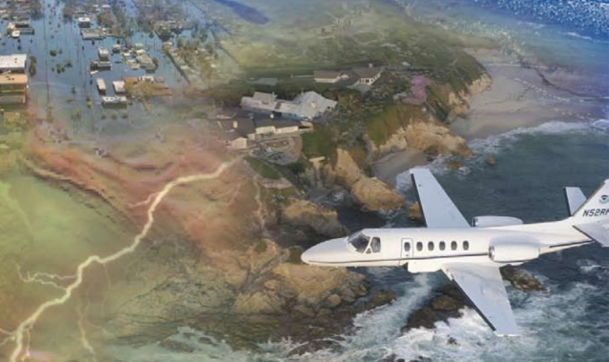
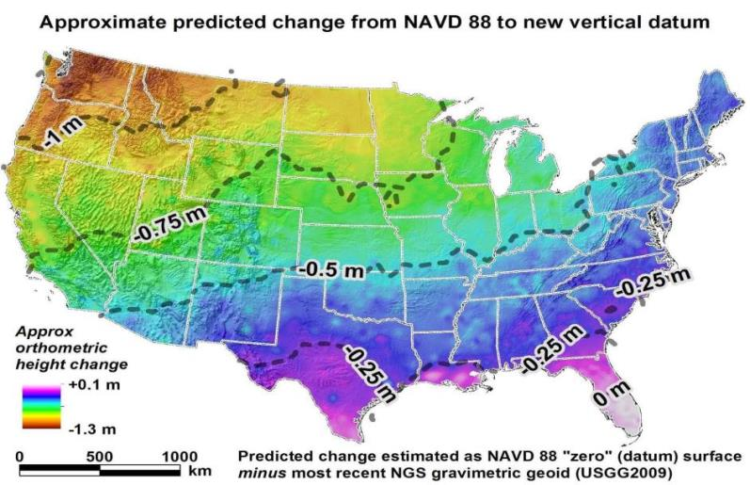
GRAV-D Operations
Gravity for the Redefinition of the American Vertical Datum
From the Science Fundamentals link at http://www.ngs.noaa.gov/GRAV-D/:
“The specific goal of GRAV-D is … to model and monitor Earth’s geoid (a surface of the gravity field, very closely related to global mean sea level) to serve as a zero reference surface for all heights in the nation.”’
This is done by using airborne gravity as a high(er) resolution enhancement to space-based gravity (GRACE, GOCE)

Slide 26
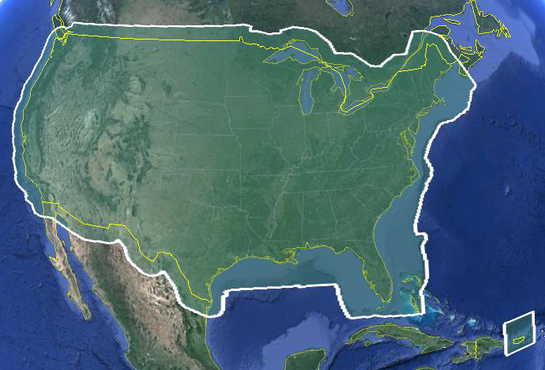
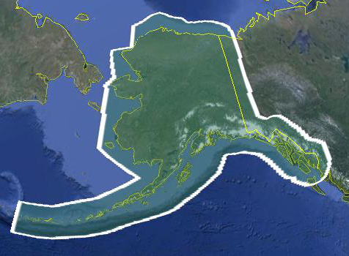
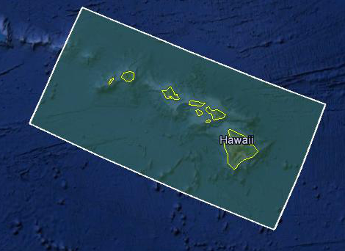
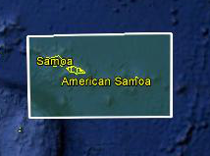
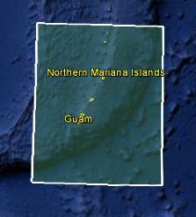
Data Collection Scope
Entire U.S. and territories
  Total Square Kilometers: 15.6 million
  ~200 km buffer around territory or shelf break if possible
  Initial target area for 2022 deadline
Notes:
Project Scope:
Scope of the project: cover roughly 15.6 million square kilometers – contiguous united states, Alaska, Hawaii, Guam, and American Samoa
In order to blend with satellite altimetry data the airborne survey is done to the continental shelf where possible or ~ 200 km beyond the shoreline or border, whichever is further
Deadline of 2022 for datum rollout, which means a target of 2021 to finish the airborne survey
Priority areas were defined as Alaska and coastal areas
Challenges:
Fixed annual budget and time → design of surveys had to fit within an annual budget of $3.5 million and meet the deadline
This was a major factor in setting altitude and line spacing

Slide 27
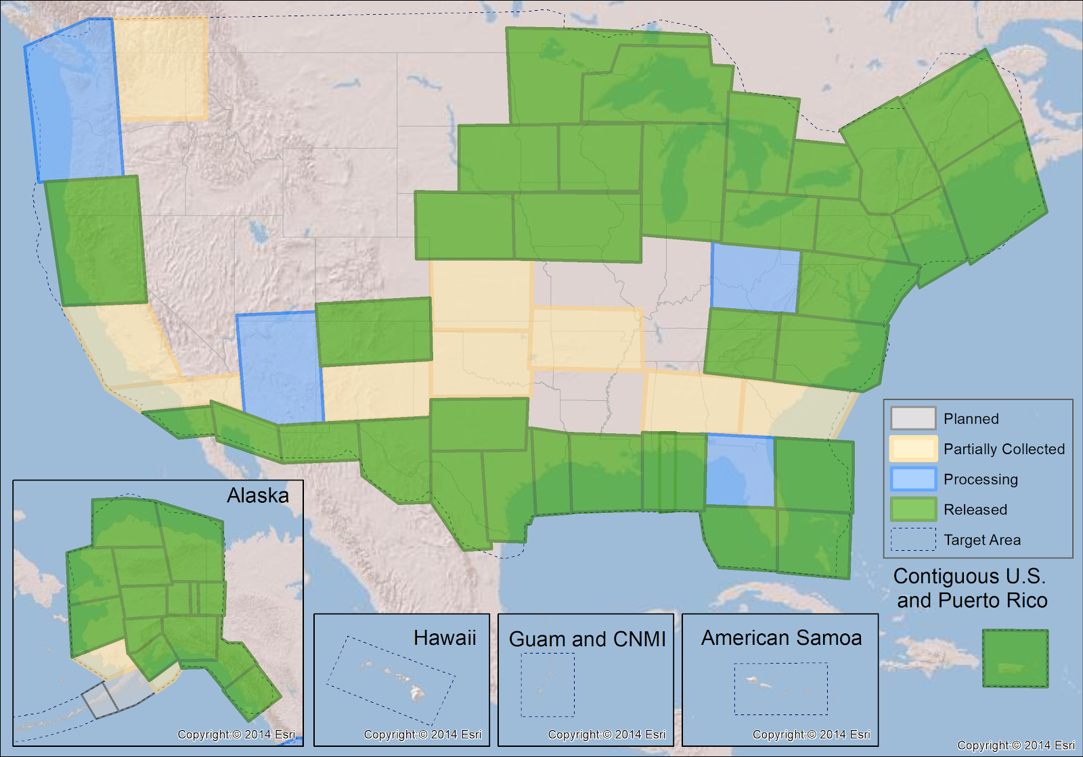
GRAV-D Status March 2018: 66%

Slide 28
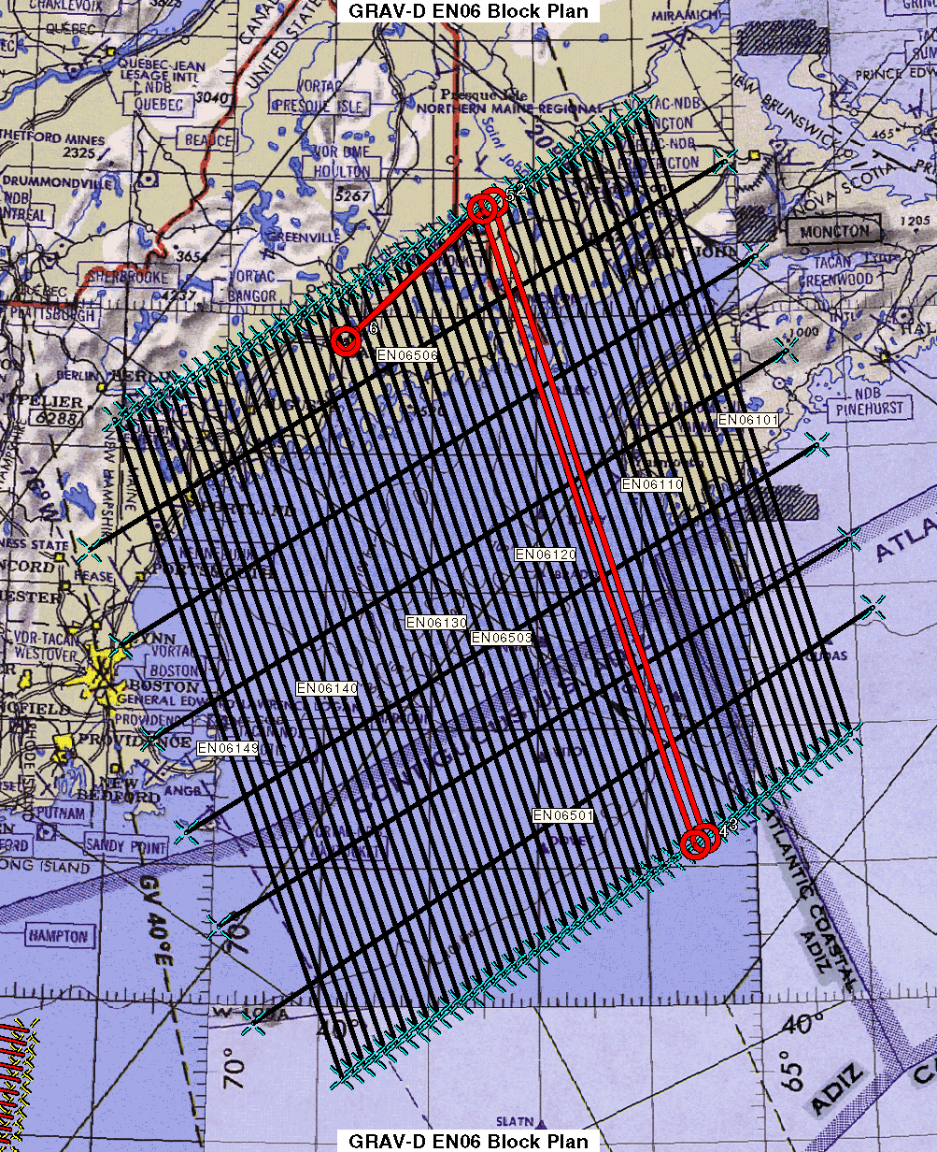
Survey and Block Plans
Data lines spaced 10 km apart
Cross lines spaced 60-80 km apart (QC purposes)
Flight altitude 20,000 ft
Nominal speed 220-250 kts
Notes:
Block layout based on aircraft, adjust size of block if needed

Slide 29
Data Handling
Complete metadata logs daily and survey report written
Field processing for quality control
Ship the data back to HQ for final processing
GPS/Gravity data reprocessed at HQ with precise orbits
Released to the geoid team
Released to the public via the GRAV-D website
Lake Huron survey

Slide 30
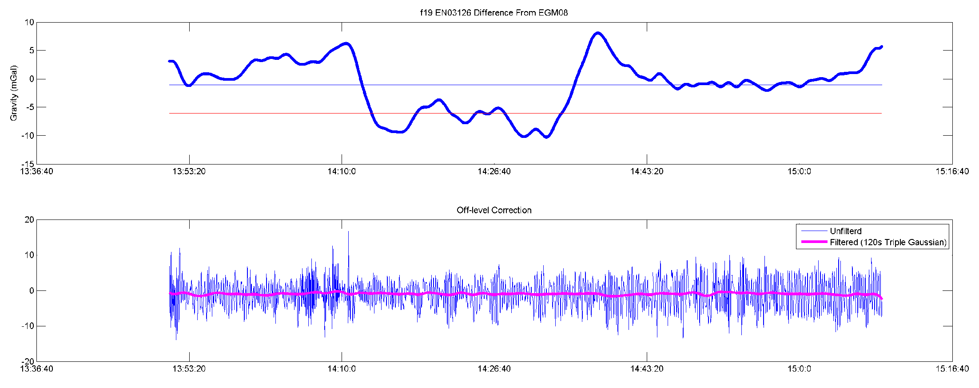
Data Processing
Field Quality Control Processing
  Lever arm applied
  Differential GPS in the field
  Gravity processing with in-house software
  Identify lines needing reflights
Final Processing
  GPS/IMU combined solution using Precise Point Positioning
  Newton (internally developed software) used to process gravity
  Quality evaluated and data minimally trimmed
  Processed data and documentation released
Notes:
Data Processing
In the field a differential GPS-IMU solution is used to evaluate daily whether flights need to be reflown because precise ephemeris are not available
Final processing is done using Precise Point Positioning (PPP) – an analysis was done comparing differential and PPP, there was either no effect or small improvements in the gravity solutions from PPP
Gravity processing done using in-house software, Newton, which applies the absolute gravity tie, removes drift, and applies a vertical acceleration, Eotvos, and offlevel corrections and then is filtered three times with a time-domain frequency filter
End of line trimming
Data documentation produced and package released on the website
This plot is an example of part of the output. We aim for +/- 5 mGals from EGM08 – as you can see in this plot there is a significant section that deviates from that. However, part of the goal of the airborne campaign is to improve upon EGM08, so while it is a good guide, it cannot be the final determination. This line, for example, if you compare to an adjacent line it looks like this.

Slide 31
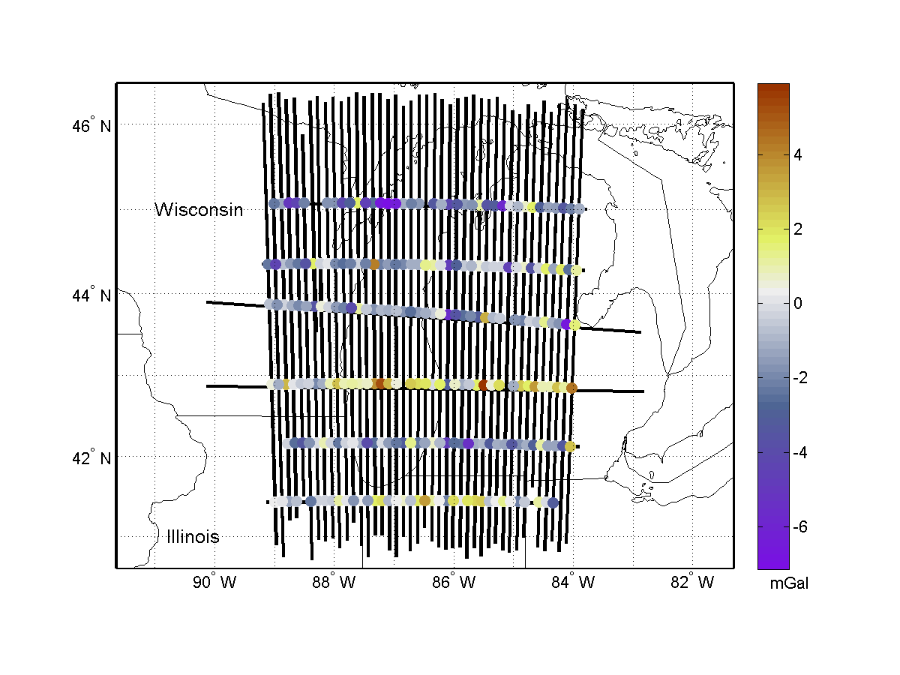
Internal Validation
Internal Validation
  Crossover analysis
  Line to line comparison
  Line reflights
Data Release Factor
  This check along with line-to-line comparisons is why partial blocks are not released.
Notes:
Internal:
Start with internal comparison
Crossover analysis compares intersection points, aim for RMS of residuals of less than 5 mGals – identifies errors that may need to be removed
Line to line comparison, as was shown earlier, but look at the cross correlation of the entire block
Reflights of lines provide repeatability statistics
External:
Geoid comparison --
Compared to EGM08 the airborne data often agrees with the satellite gravity
Most updates are seen in areas of poor data coverage
Shown is Lake Michigan, the gridded airborne data, EGM2008 versus GOCE, and then adding the airborne data to EGM2008 and again comparing with GOCE
GSVS –
Three surveys: first flat and low gravity signal, second flat and high gravity signal, third rugged and high gravity signal
First is completed and published, second completed and papers in progress, third in the planning stages
2011 survey confirmed that the airborne gravity was contributing to the goal of a 1 cm accurate geoid

Slide 32
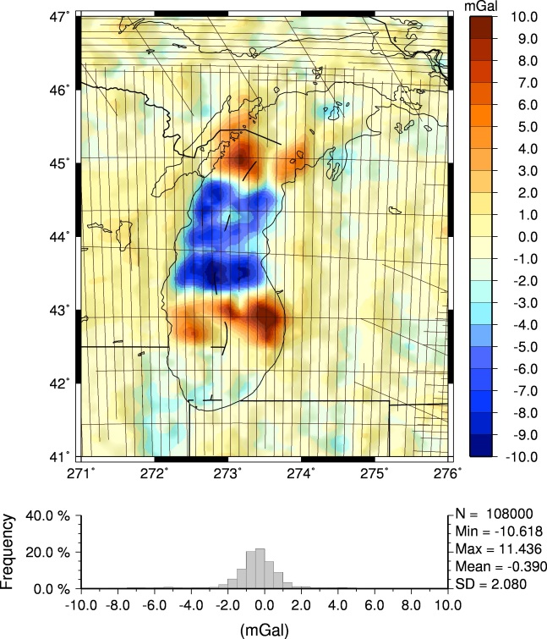
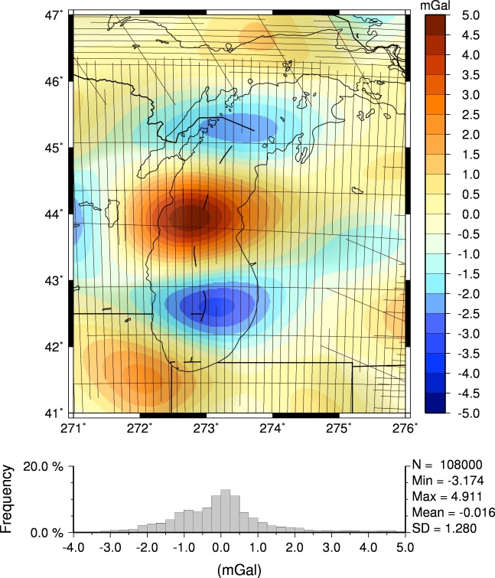
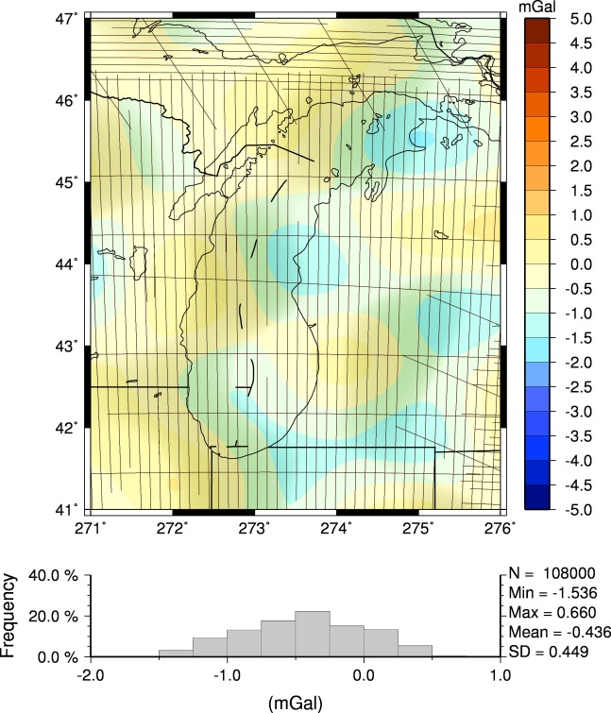
Updating Gravity Models
Comparing EGM08 and EGM08 updated with airborne gravity compared with GOCE
Airborne vs. EGM08
EGM08 vs. GOCE
EGM08 + Airborne vs. GOCE

Slide 33
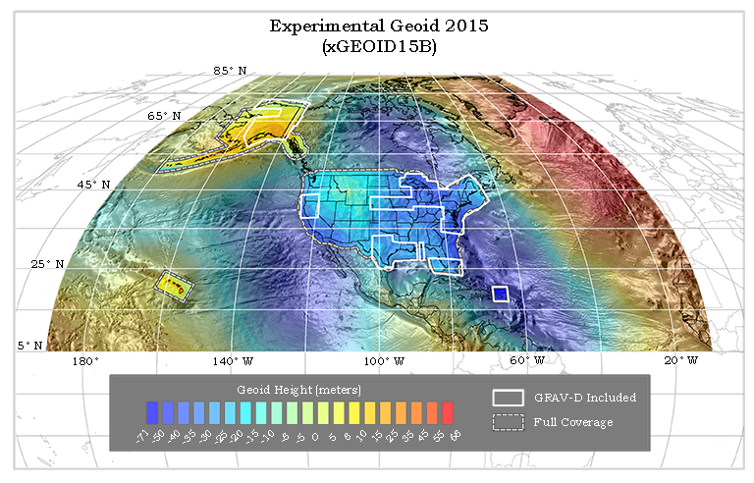
Experimental Geoids
The gravity data from satellites, airborne, corrected surface data, and terrain predictions will be blended into a gravity field
Methods for blending will be tested to prepare for 2022
Available on the Website: http://beta.ngs.noaa.gov/GEOID/xGEOID/

Slide 34
Geoid Slope Validation Surveys
How do we know any of this is working?
The Geoid Slope Validation Surveys (GSVSs) use high precision, high resolution (~1.5km spacing), ground-based survey techniques to determine the shape of the geoid consistently along a large (~300km) distance.
This allows for the direct comparison of the geoid shape predicted by various, gravity-based geoid models.
This also allows for a quantification of the airborne gravity’s contribution to the improvement of these models.

Slide 35
Objective of the GSVSs (cont.)
Why compare the shape of the models?
Rather than using “absolute” values of the geoid at specific locations to compare models, it is actually more useful to look at the changes in the shape of the geoid over various distance scales (i.e. looking at slopes)
Method 1:
Leveling & Gravity provide terrain-corrected geodetic heights (“Rise”)
GNSS provides horizontal distance (“Run”)
Slope_{i} = Rise_{i} / Run_{i}
Rise 3
Rise 2
Run 2
Run 3
Run 1
Rise 1
Ellipsoid
Geoid
Geoid Slope

Slide 36
Slopes (cont.)
Method 2:
GNSS provides ellipsoidal position (lat, lon)
Deflection of Vertical measured directly with Astro-geodetic Camera (difference from normal to ellipsoid and local plumb line)
Camera knows what stars it “should” see normal to the ellipsoid at a specific time and location. DoV is difference between that and with what is actually “straight up”
Slope = Vector sum of North and East deviations of camera axis
Ellipsoid
Geoid
Geoid Slope

Slide 37
Objective of the GSVSs (cont.)
We thus have two independent methods of measuring geoid slopes.
Next, we look at the changes in the shape of the geoid over various distance scales (i.e. looking at the slope between various pairs of survey points separated by 1, 2, 5, 10, 20, 50, 100, 200 km, etc.)
Example of slopes over various distance scales:
Every 1 interval
Every 2 intervals
Finally, we compare these “ground truth” results to various geoid models.
Further, we can compare models with/without airborne gravity to quantify the contribution
Every 3 intervals
Every 4 intervals

Slide 38
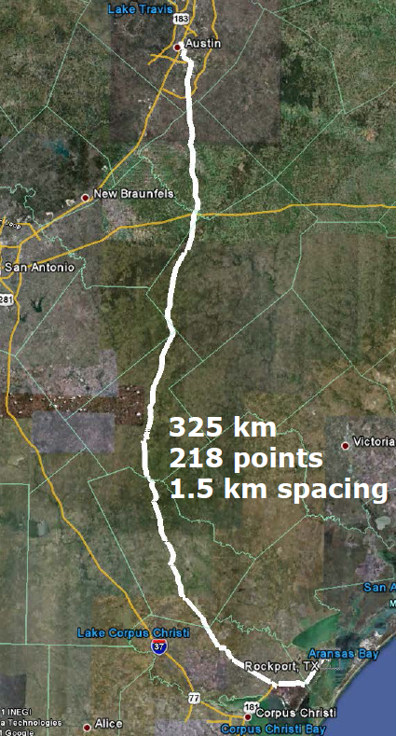
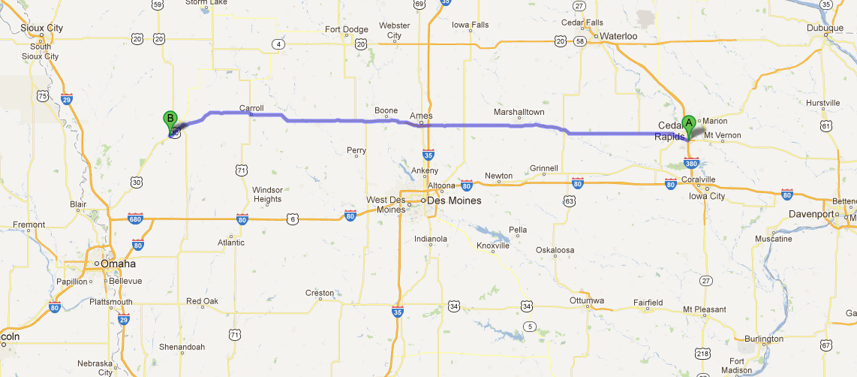
Previous GSVS Surveys
South Texas, 2011
Flat, close to the geoid
Iowa, 2014
Higher elevation and geologically interesting terrain (traversing the Midcontinent Rift System).

Slide 39
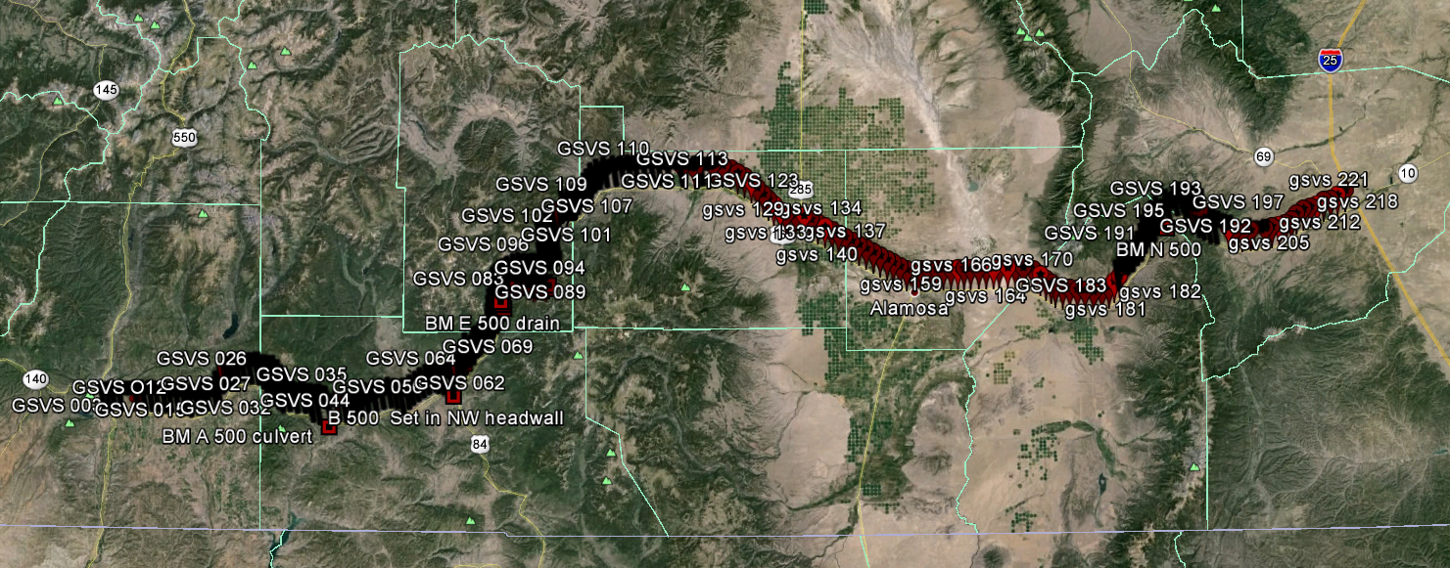
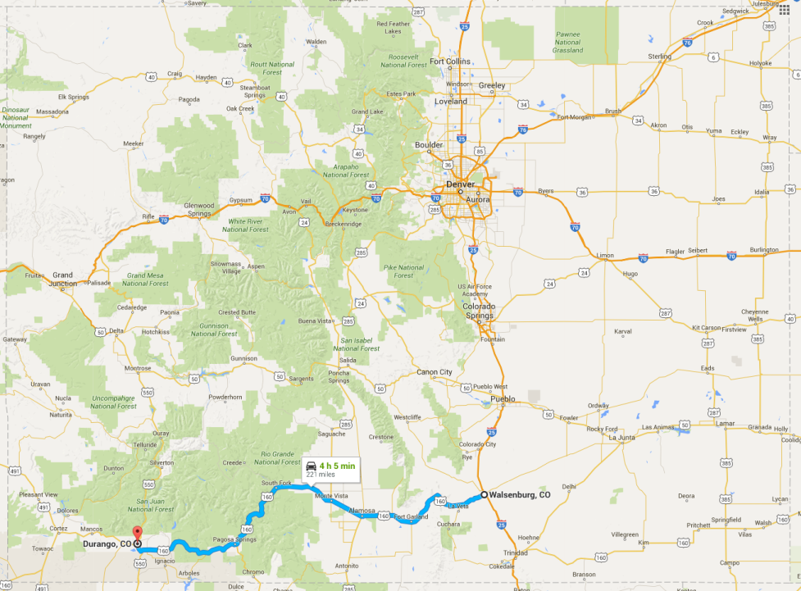
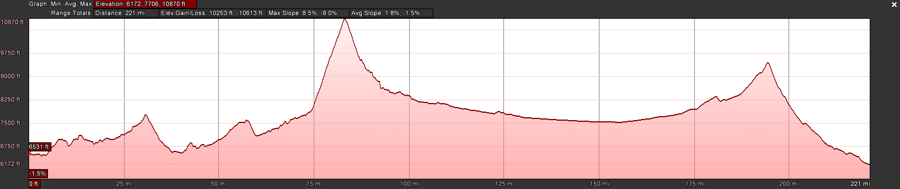
GSVS17 Colorado
The third (and likely final) GSVS took place along US160, from Durango to Walsenburg, in southern Colorado in the summer of 2017.
High elevation and rugged topography. “Worst case” for geoid modeling.
Variation from 6,000’ (MSL) to 11,000’, over two passes. 223 bench marks

Slide 40
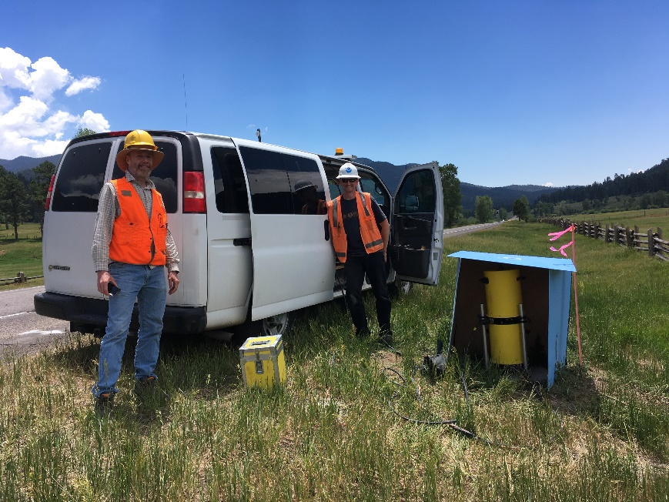
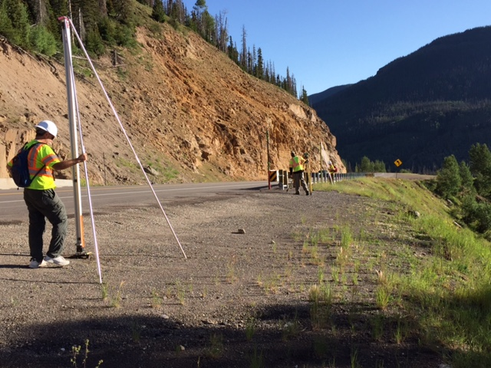
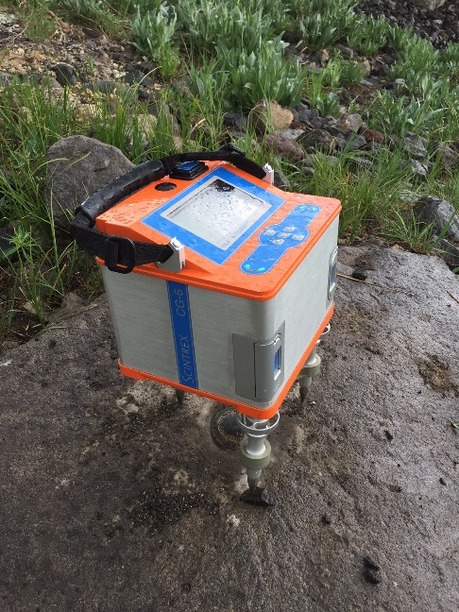
Survey Techniques: Leveling and Gravity
The entire line was leveled (double-run). Geodetic heights provided at each benchmark.
Leveling and gravity are both needed for orthometric height determination. Usually gravity is modeled, but in this case was actually measured at every point.
  Absolute gravity (A10 and/or FG5) at every benchmark
  Vertical gravity gradient (CG6) at every benchmark

Slide 41
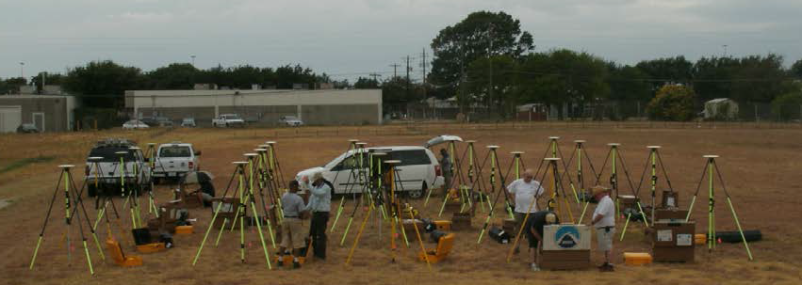
Survey Techniques: Long Period GPS
Calibrated, fixed-height antennas, all identical models
In Colorado 2017:
  24 complete sets of equipment (2 parties, 10 sets each)
  Each party observed 5 new stations each day
  24 hours & 16+ hours of observation each day
  Project processed with OPUS Projects

Slide 42
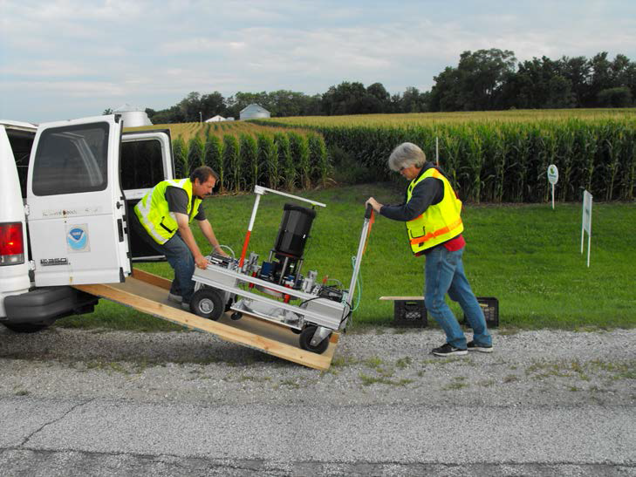
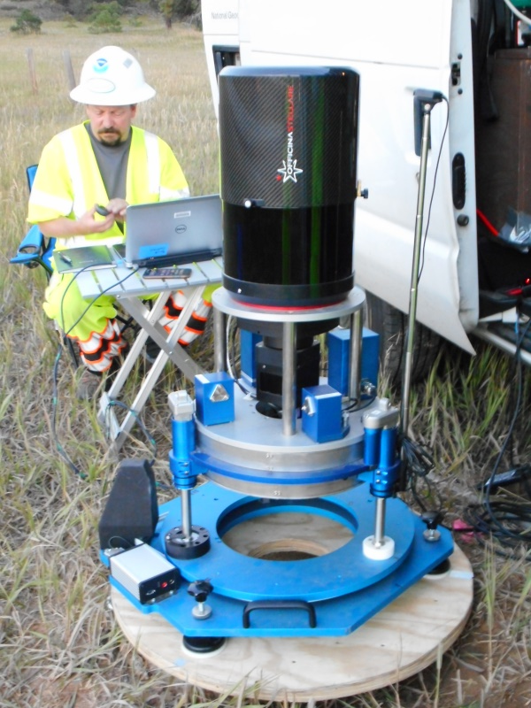
Survey Techniques: Deflection of the Vertical (DoV)
Measure the slope of the geoid directly!
Precision tilt meters provide alignment “level” to the geoid.
Celestial almanacs provide predicted alignment with star field (relative to ellipsoid).
The difference between the two vectors (broken into orthogonal components) are the Deflections of the Vertical (or “slopes”).
In Colorado, 2017:
  223 stations (14 repeat observations)
  39 nights
  ~6 stations/night
  Observing with Swiss CODIAC (COmpact DIgital Astrometric Camera), courtesy Technical University of Zurich.

Slide 43
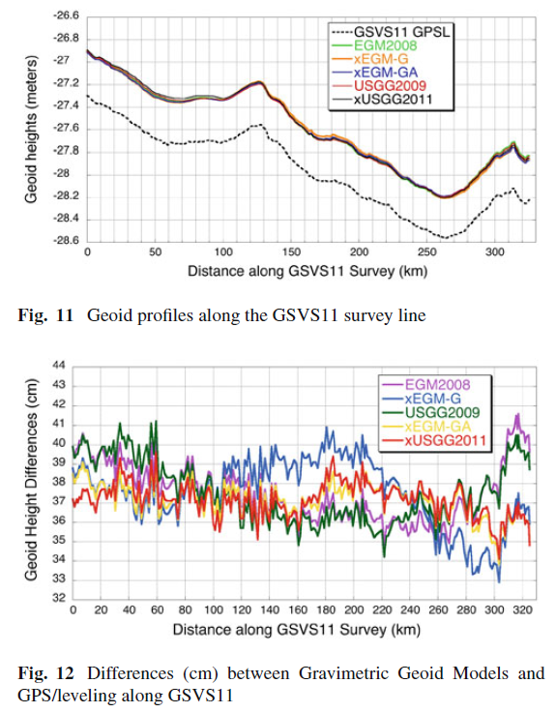
Results from Texas and Iowa*
Measured slopes were compared with NGS (and other) geoid models
Texas and Iowa GSVS both confirmed 1-2cm geoid accuracy, as expected!
Texas 2011
"Confirming regional 1 cm differential geoid accuracy from airborne gravimetry: the Geoid Slope Validation Survey of 2011", Smith et al., Journal of Geodesy, 2013.
Iowa 2014
“The Geoid Slope validation Survey 2014 and GRAV-D airborne gravity enhanced geoid comparison results in Iowa", Wang et al., Journal of Geodesy, 2017 91:1261-1276.
* Again, the 2017 Colorado data are still being analyzed

Slide 44
Summary
The new vertical height system, NAPGD2022, will use a surface of constant geopotential as the vertical datum (the geoid).
NGS will provide the geoid undulation “correction” to get orthometric heights from ellipsoidal heights.
To verify geoid precision, ground-based geoid slope measurements (derived from both classic techniques and direct measurements of DoV) over varying distance scales were used to compare various geoid models.
Comparing this “ground truth” to the models also allows for a direct quantification of the improvement when airborne gravity data are included.
To date, two such surveys have been conducted successfully in reasonably flat terrain.
Colorado has now been observed for a final, challenging test. Look for final results later in 2018!

Slide 45
Questions, comments?
Please don’t hesitate to contact me: derek.vanwestrum@noaa.gov

Slide 46


Geoid Height Change Over Time
How often will updates be needed to maintain a 1-2 cm accuracy geoid?
Which areas of U.S. will see the most change?
Their Answer: Approximately every 10 years for the Nation; Local adjustments may be needed after disasters

