Slide 1
Designing a Data Delivery System (DDS) for the Future
Jay Howard
Notes:
-This presentation is going to be a little bit different than other presentations during this Geospatial Summit.
-The idea of the DDS is new so we are in more of an information gathering / design phase
-Eager for our users’ opinions, feedback, and input
- We need to understand for our constituents what tools and services we need to develop

Slide 2
What is the DDS?
The Data Delivery System is a collection of tools that will be used to deliver data from NGS
The DDS will be responsible for any tool that extracts data from the NSRS Database
Notes:
Collection of tools. This is not a one stop shop. We have different types of data that need to be displayed, it wouldn’t be efficient to create one tool. There will be web pages that help organize the tools
The DDS effort originated internally to answer the question: “What will replace the datasheet?”
It has evolved into all tools / methods to extract information from the database

Slide 3
Elements of the DDS
Web tools developed by NGS
Examples:
Passive Mark Page
Leveling Projects Page
APIs
Examples:
Geoid Height Service API
OPUS Share API
Data provided via web services
ArcGIS Online
Web map services (WMS)
Notes:
Current examples:
Datasheets
CORS Pages

Slide 4
Timeline
Planning / Design Stage
What products do we need to develop?
Requirements gathering
Constituent input
Development Stage
Initial development / testing
Beta Stage
Release of beta products (public)
Final Release

Slide 5
Design Philosophy
Simplicity
Intuitive design
Purpose of the tool should be obvious
Avoid scope creep
Common look and feel to all DDS products
All pages will use the same HTML/CSS/JavaScript framework
Leaflet mapping library
Linking of related tools

Slide 6
Demo
Notes:
Have these pulled up ahead of time
https://beta.ngs.noaa.gov/datasheets/passive-marks/index.html?PID=OM1256
https://www.ngs.noaa.gov/cgi-bin/ds_mark.prl?PidBox=OM1256
Show how it is like the datasheet but looks like a webpage.
Talk about the ability to connect with other NGS tools (recovery, leveling project page, even the datasheet)

Slide 7
Poll 1

Slide 8
Feedback
ngs.feedback@noaa.gov
What data delivery tools do you need NGS to develop to satisfy your goals?
What current data delivery tools do you rely on?
What do you like/dislike about existing data delivery tools?
What file formats do you want to be made available?
How important is it that the tools are mobile friendly?
Is the “look and feel” of the Passive Mark Page and the Leveling Projects Page sufficient?
Are Web Map Services and APIs useful to you or do you only need web tools?

Slide 9
Questions

Slide 10
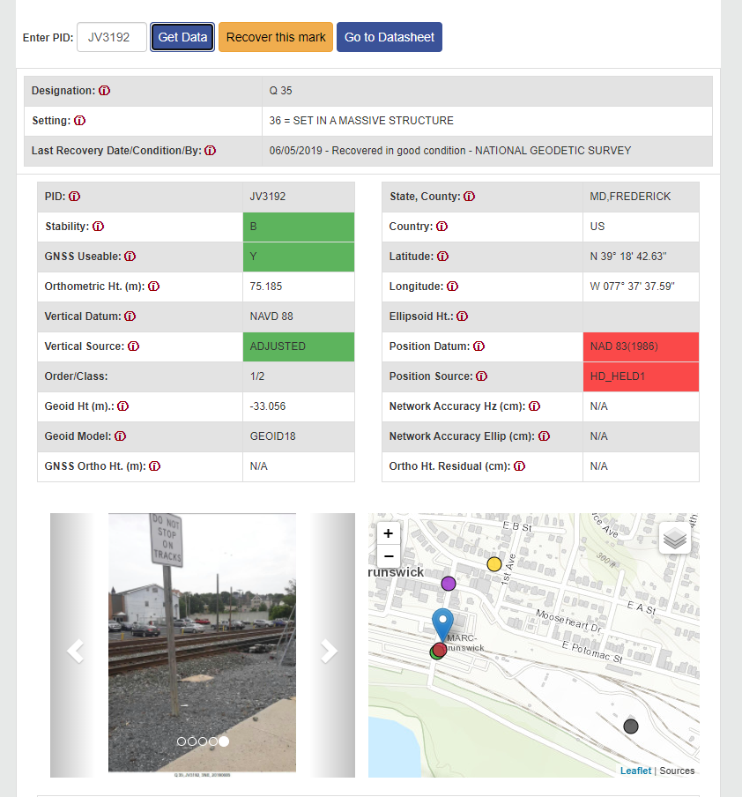
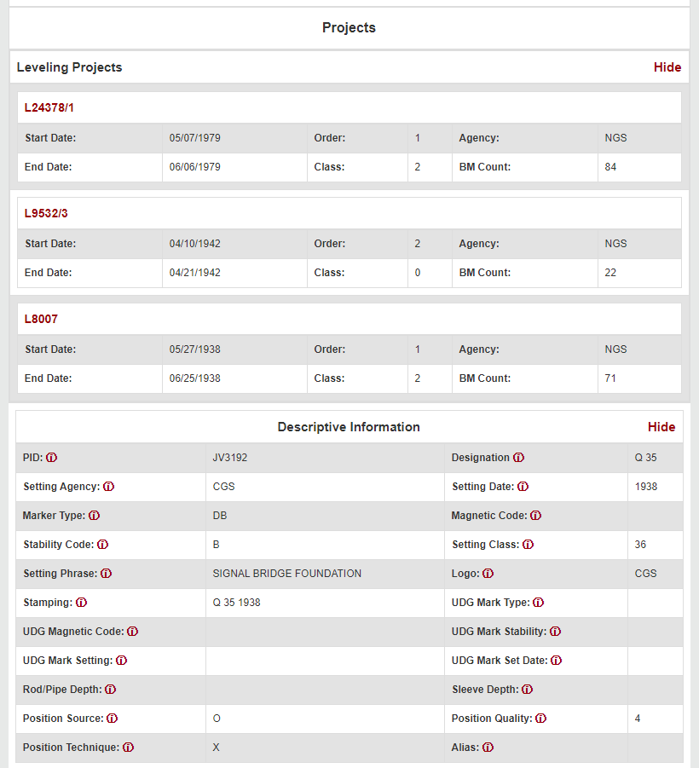
Passive Mark Page

Slide 11
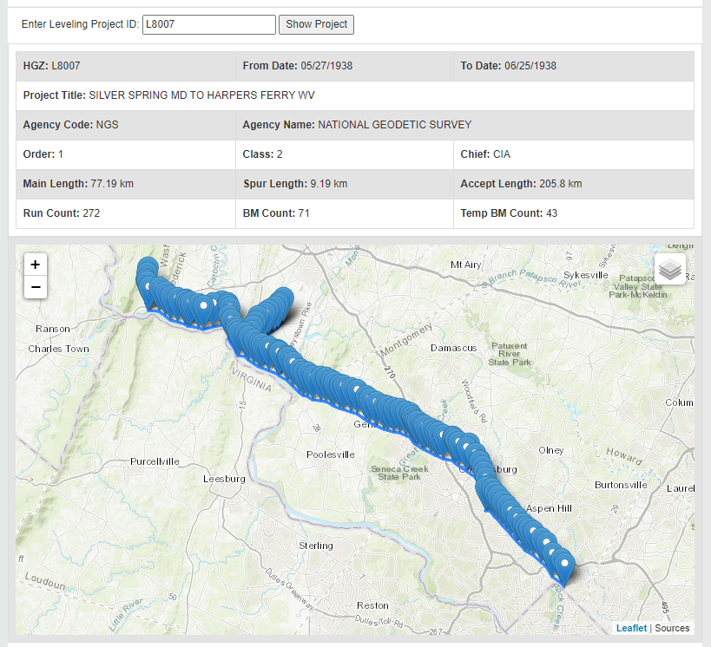
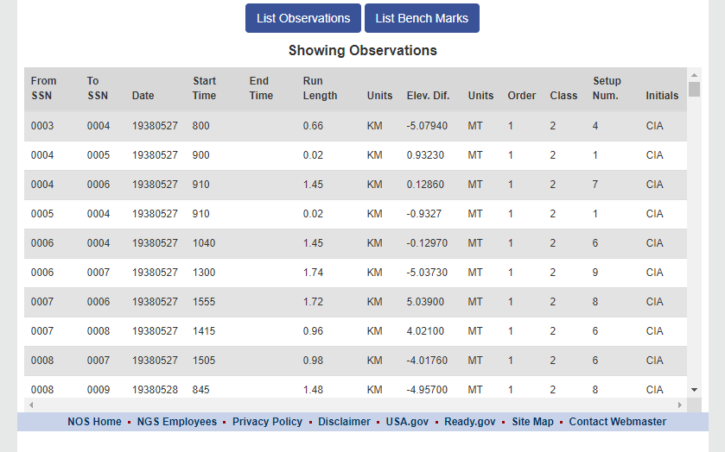
Leveling Projects Page

