Slide 1
Input for Intra-Frame Velocity Models for the U.S. N.S.R.S. in 2022
Daniel Roman
NOAA’s National Geodetic Survey

Slide 2
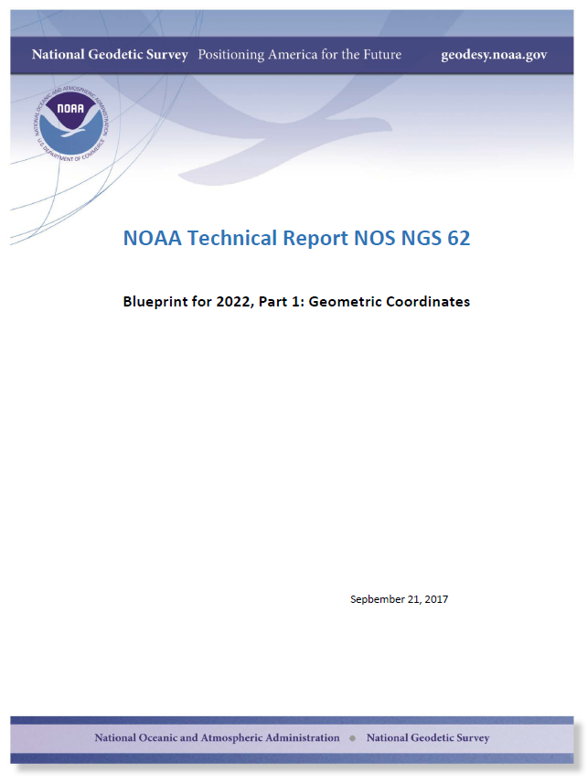
OUTLINE
National Spatial Reference System Update in 2022
  Densified ITRF (e.g., SIRGAS) positions and velocities
  Euler Pole Parameters (EPP)
  Infra-Frame Velocity Models (IFVM)
Available Input Data and Models
  NOAA CORS Network
  RTN and cGNSS
  Geodynamic modeling
  InSAR
Summary and Outlook

Slide 3
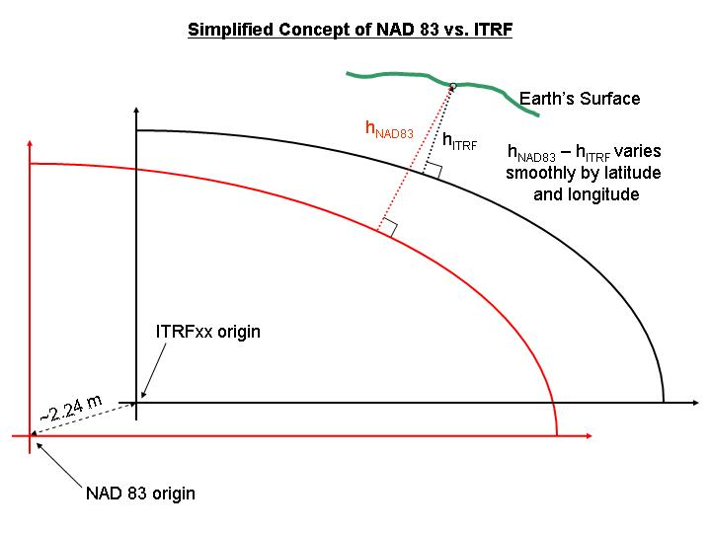
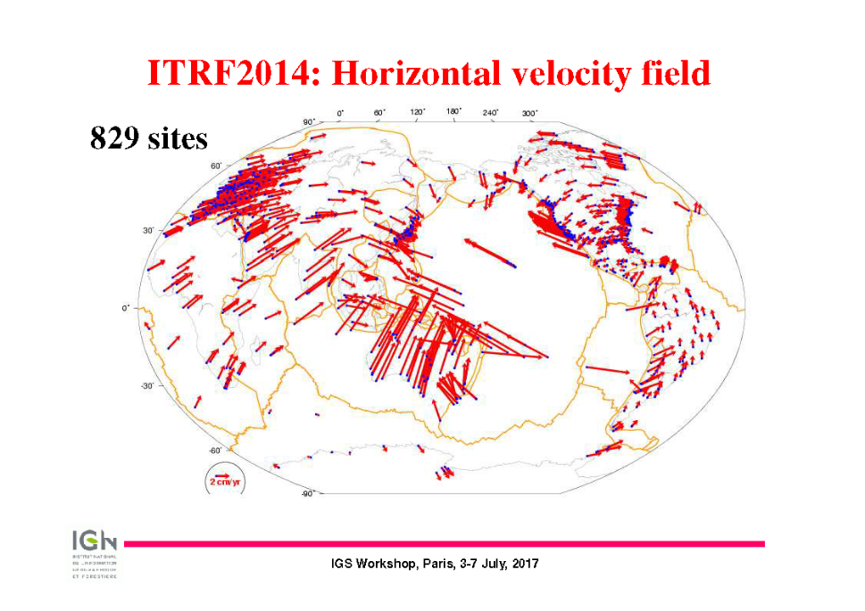
Why are we updating the NSRS?
1. Non-Geocentricity
2. Dynamism
Altamimi
3. UN–GGRF: United Nations Global Geodetic Reference Frame
Notes:
WGS-84 iterated closer to ITRF – both are now 2+ meters from NAD 83
Fixing this will remove ambiguities in positioning dependent on reference frame
NAD 83 is static while the Earth is not
All plates are moving w.r.t. the frame and each other.
Image also on ly shows the horizontal motion and doesn’t capture any vertical motion

Slide 4
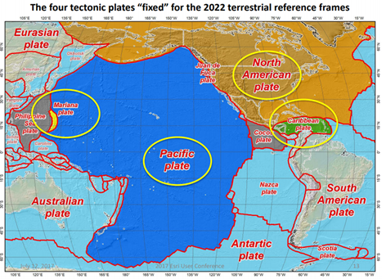
The 4 TRF’s for the U.S. NSRS in 2022
NATRF: North American TRF
CATRF: CAribbean TRF
PATRF: PAcific TRF
MATRF: MAriana TRF

Slide 5
NSRS Modernization
The New:
The North American Terrestrial Reference Frame of 2022
(NATRF2022)
The Caribbean Terrestrial Reference Frame of 2022
(CATRF2022)
The Pacific Terrestrial Reference Frame of 2022
(PATRF2022)
The Mariana Terrestrial Reference Frame of 2022
(MATRF2022)
The Old:
NAD 83(2011)
NAD 83(PA11)
NAD 83(MA11)
EPP2022 (NA)
EPP2022 (CA)
Densified
ITRF2014
EPP2022 (PA)
EPP2022 (MA)

Slide 6
Reference Frames
The NSRS in 2022 will contain four terrestrial reference frames
  Each one related to a densified International Terrestrial Reference Frame (ITRF) by a plate rotation model only
    Plate rotations determine Euler Pole Parameters (EPP2022)
    EPP will be defined separately for each plate
    This will leave residual velocities
    EPP will capture significant horizontal motion but not all
    EPP cannot account for any vertical motion (e.g., subsidence)
  NGS will model those residual velocities in an Intra-Frame Velocity Model (IFVM)
    This approach will facilitate work over/near plate boundaries
    Linear relationship between ITRF velocities, EPP rotation and IFVM:
    ITRF = EPP(NA) + IFVM(NA) = EPP(CA) + IFVM(CA)
    = EPP(PA) + IFVM(PA) = EPP(MA) + IFVM(MA)
    The absolute velocity can be described equally by all the above
EPP
ITRF
IFVM

Slide 7
The relation of five global reference frames through time
Rotations are not to scale
NATRF2022
MATRF2022
Rotation of North American Plate
CATRF2022
PATRF2022
Rotation of Pacific Plate
ITRF frame
IGS frame through time
ITRF frame
Rotation of Caribbean Plate
PATRF2022
CATRF2022
Rotation of Mariana Plate
NATRF2022
Time “t ” when
all four TRFs and the
IGS are identical.
(2020.00)
MATRF2022
0
t=t - Δt
(“the past”)
t=t + Δt
(“the future”)
0
0

Slide 8
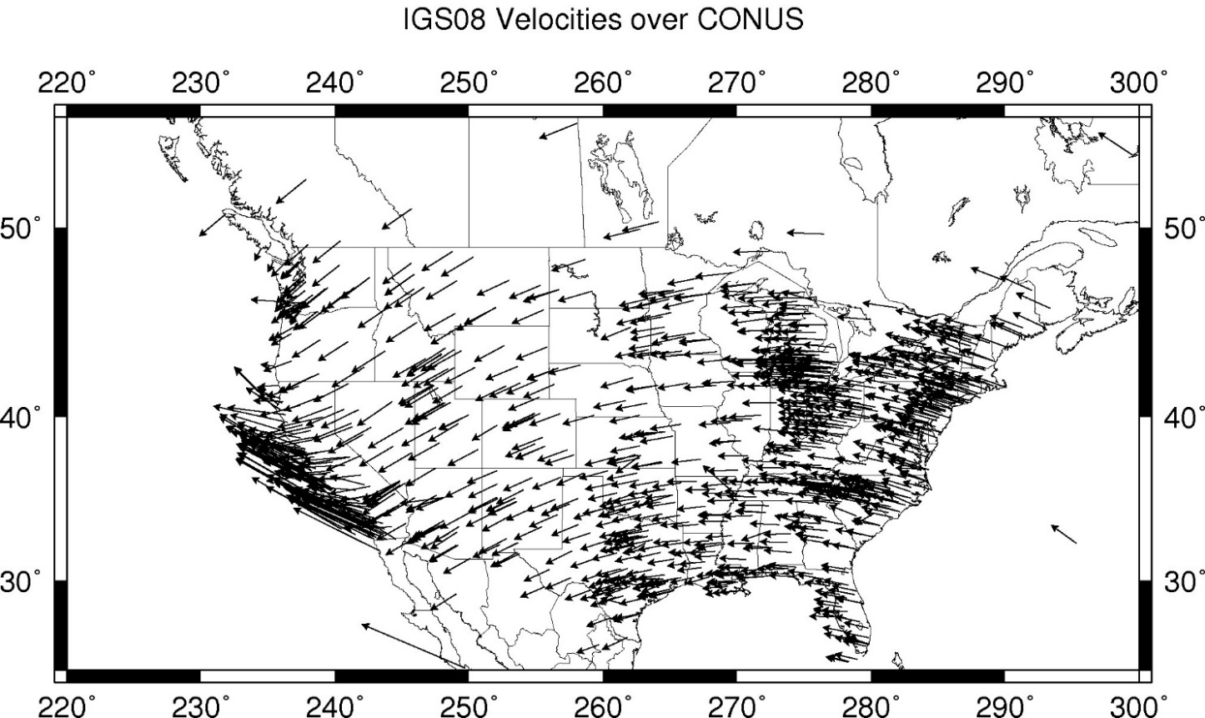
CORS Velocities – IGS08

Slide 9
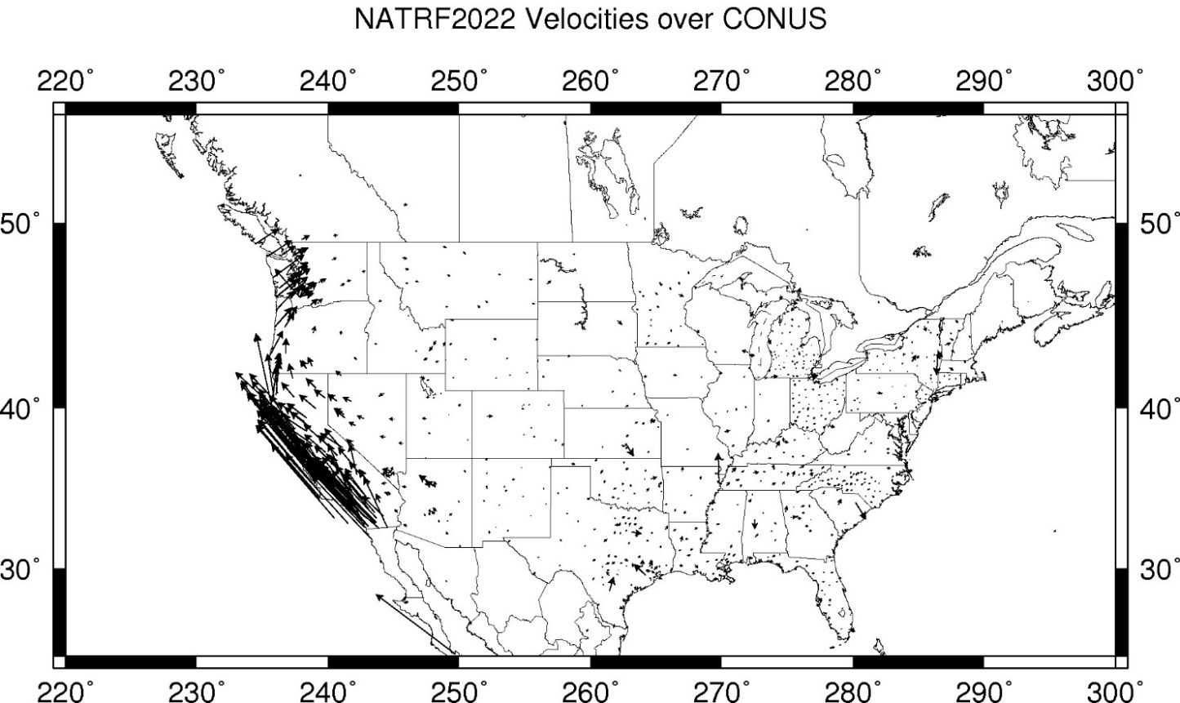
CORS Velocities – NATRF2022

Slide 10
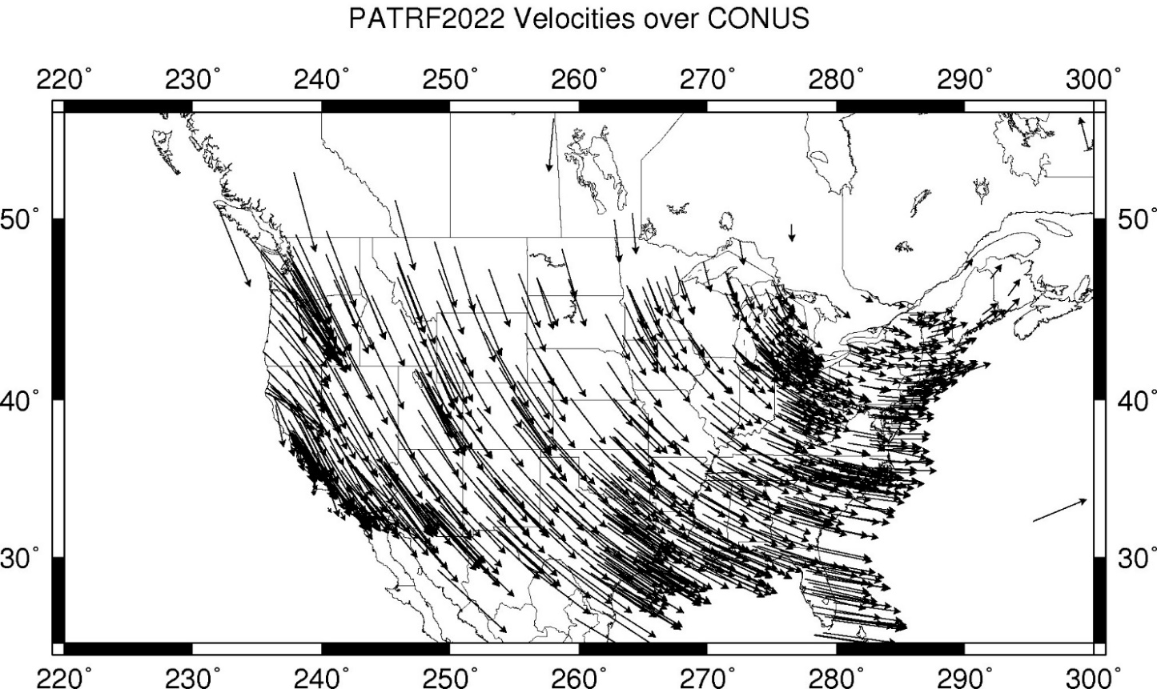
CORS Velocities – PATRF2022

Slide 11
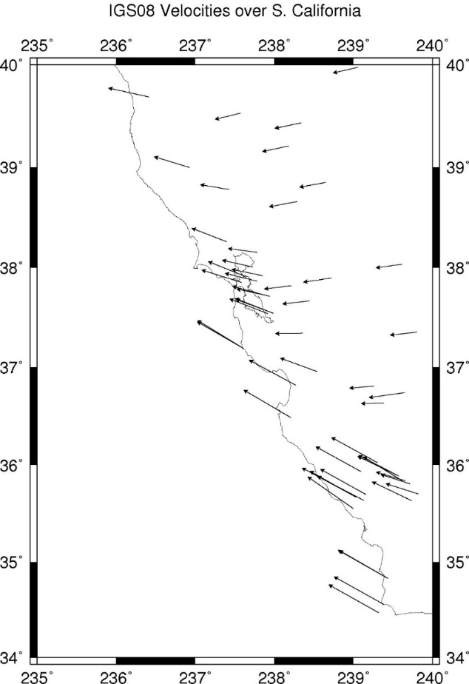
CORS Velocities – IGS08 – western U.S.
Looking at West Coast more closely
Vectors in absolute frame vary
Not consistent with the bulk of NA vectors
Indicates there will be residual vectors

Slide 12
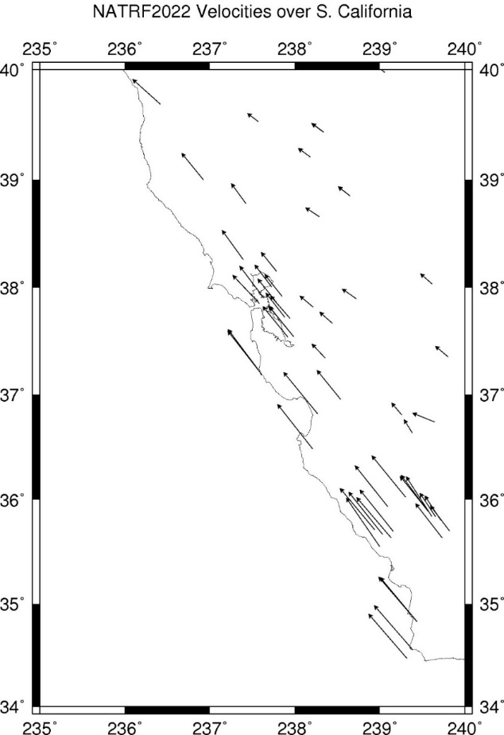
CORS Velocities – NATRF2022 – western U.S.
Same as previous except now w.r.t. a North American Frame
Some residual velocities in interior
More significant residual velocities in southern California

Slide 13
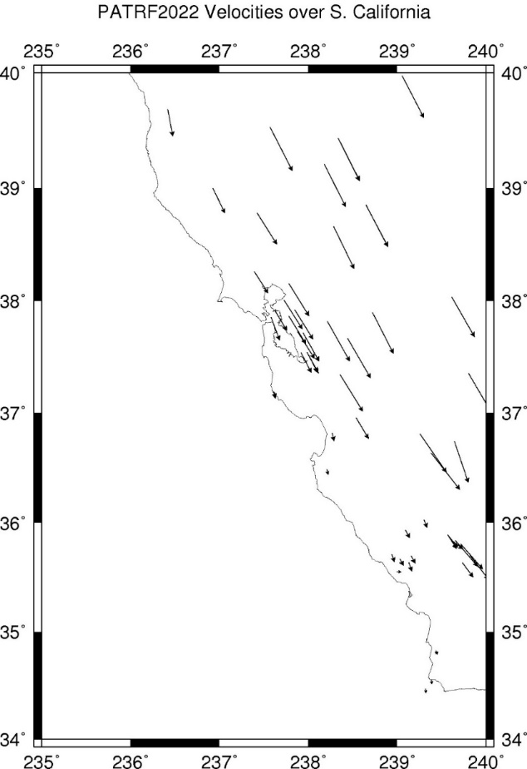
CORS Velocities – PATRF2022 – western U.S.
Residual velocities now w.r.t. Pacific plate
More significant residual velocities in interior
Southern California has almost none
The plate boundary position is uncertain
Hence, the reason for Intra-Frame Velocity Models and not Intra-Plate Velocity Models

Slide 14
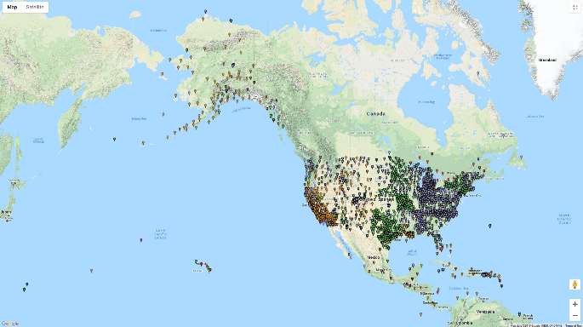
NOAA CORS Network - Distribution

Slide 15
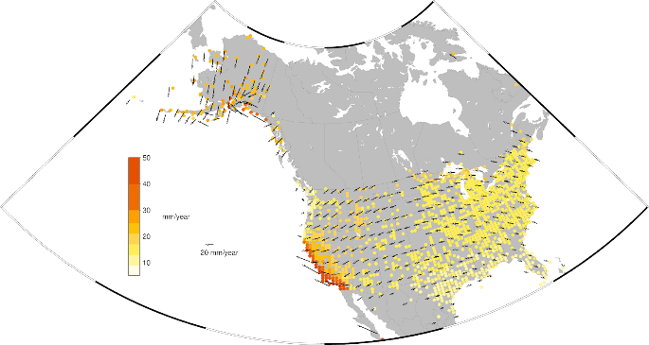
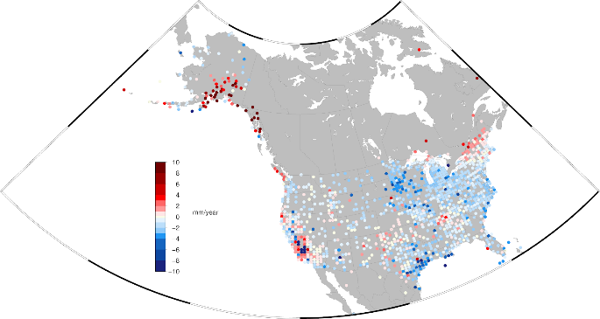
NOAA CORS Network – Horizontal and Vertical Velocities
Horizontal Velocity Field in ITRF2014
Vertical Velocity Field in ITRF2014
Grids are 50 km x 50 km derived by reprocessing and stacking data (Repro2)
Interpolation between sites is possible – but assumes a great deal in between the CORSs

Slide 16
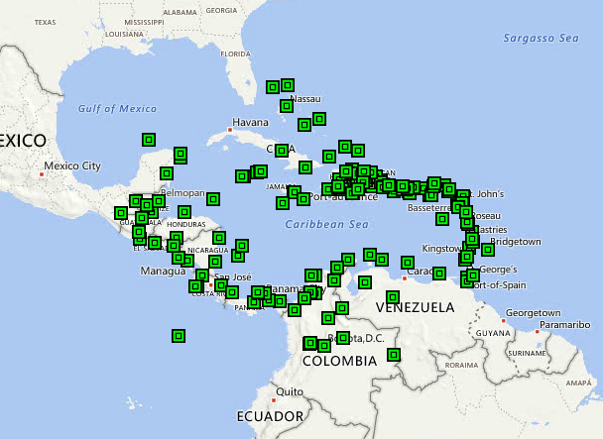
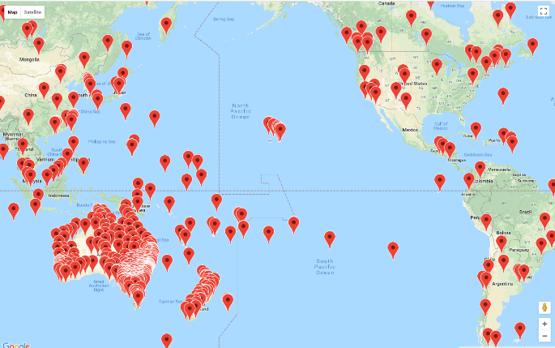
Other CORS Networks
COCONet
Asia-Pacific Reference Frame (APREF)

Slide 17
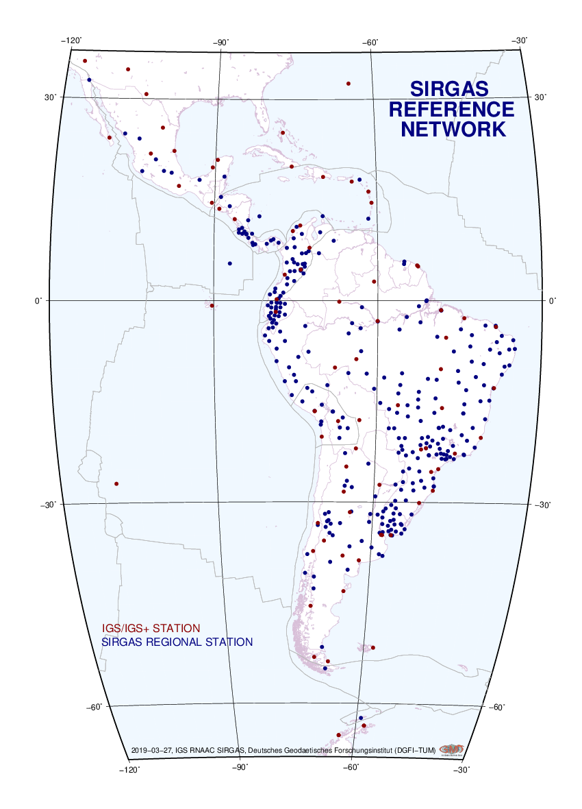
SIRGAS-CON
Sistema de Referencia Geocéntrico para las Américas (SIRGAS) maintains a Continuously Operating Network
It is a densified ITRF
It forms the backbone for national densifications
It is recognized by the UN-GGIM-Americas
The U.S. is now a member
SIRGAS-CON is lacking somewhat in North America

Slide 18
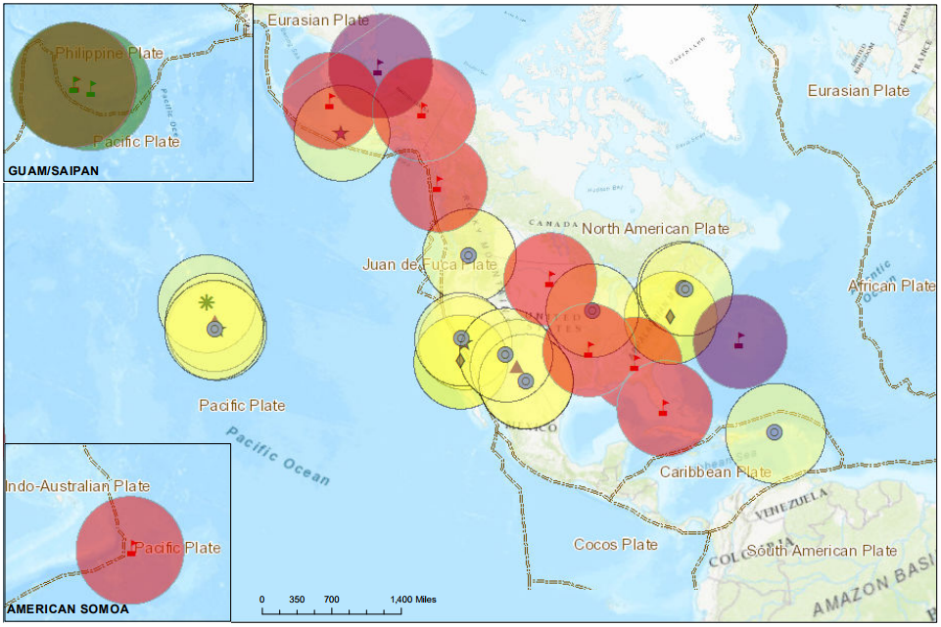
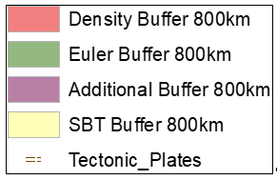
The Foundation CORS targeted locations
A geographic distribution no greater than 800 km to provide 1.5 cm accuracy ellipsoidal height results through NGS’ OPUS tools anywhere in the U.S.
Support for the ITRF by co-locating at existing space-based geodetic sites.
Favorable geometry to monitor tectonic plate (Euler Pole) rotation.
Gap Filling in international areas where foundational stations are needed to support the U.S. NSRS, e.g. Caribbean
An input data set for SIRGAS-CON

Slide 19
Building the Velocity Grids in the ITRF
FCORS expands coverage of SIRGAS-CON into North America
The existing CORS provide a national densification
However, they have been shown to lack sufficiency of coverage
Supplemental CORS Networks would provide a further densification
Even this may not be sufficient in dynamic regions
Need to supplement with InSAR or geodynamic modeling

Slide 20
InSAR in Hampton Roads area
Figure 4 from Bekaert et el. (2017) study on use of InSAR in conjunction with GPS for subsidence monitoring

Slide 21
Summary and Outlook
The U.S will adopt a new National Spatial Reference System in 2022
This will be based on the ITRF frame existent at the time (ITRF2019)
FCORS will augment SIRGAS-CON and provide IGS stations for ITRF
FCORS then provide basis for national densification
NOAA CORS Network provides access to the NSRS
Other CORSs, InSAR information, and possibly geodynamic models will provide greater resolution at any spot in the four TRFs
Need reliable estimate of motion (deformation) in any of the four TRF’s
Numerous NGS projects will ensure adoption of the new NSRS in 2022

Slide 22
Contact Information
Dr. Daniel R. Roman
Chief Geodesist
NOAA’s National Geodetic Survey
Silver Spring MD U.S.A.
Phone: +1-240-533-9673
Email: dan.roman@noaa.gov

