Slide 1
NGS Educational Offerings and New Certificate Tool
Erika Little
NGS Training Coordinator
10/4/2022

Slide 2
Current learning opportunities
New Certificate Tool for Recorded Webinars
Request for input

Slide 3
Educational Videos
Partnership with the University Corporation for Atmospheric
Research’s (UCAR) COMET Program
geodesy.noaa.gov

Slide 4
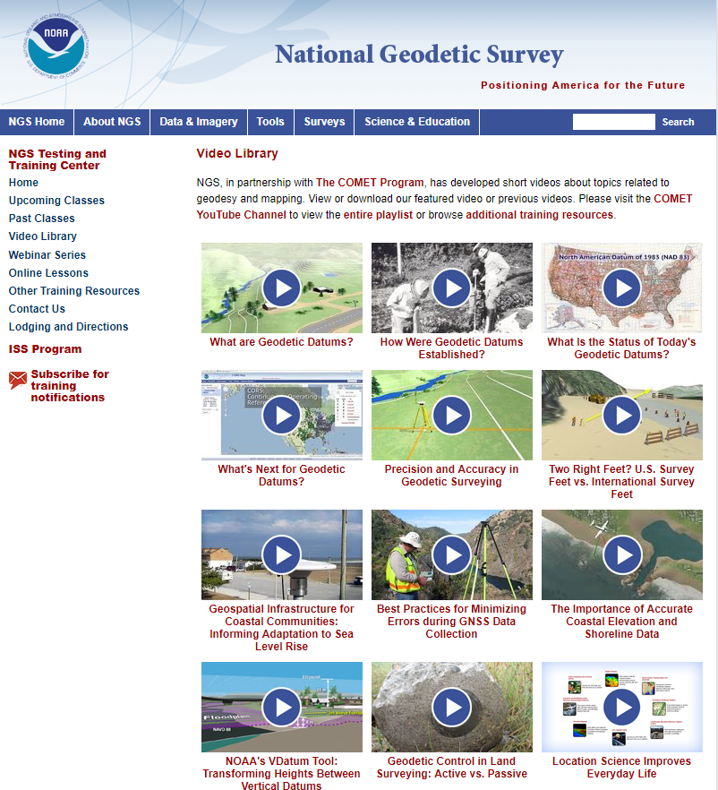
Educational Videos
Partnership with the University Corporation for Atmospheric
Research’s (UCAR) COMET Program
Average around 5 minutes each
Could be incorporated into in-person or virtual lectures
Currently 12 videos in the collection

Slide 5
Educational Videos
Partnership with the University Corporation for Atmospheric
Research’s (UCAR) COMET Program
Most Viewed on COMET YouTube channel (through 8/30/2022)
What are Geodetic Datums? | 175,790
Best Practices for Minimizing Errors During GNSS Data Collection | 90,436
Precision and Accuracy in Geodetic Surveying | 72,944
These two videos now available in Spanish!

Slide 6
Online Lessons
Partnership with the University Corporation for Atmospheric
Research’s (UCAR) COMET Program

Slide 7
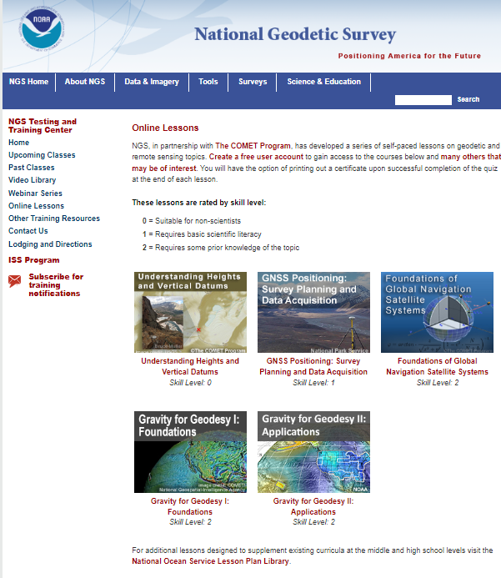
Online Lessons
Partnership with the University Corporation for Atmospheric
Research’s (UCAR) COMET Program
Take anywhere from 45 minutes to 2 hours to complete
All lessons allow the user to receive a certificate *if* a quiz is passed
Currently 5 lessons available
Could be assigned as course work or possibly CEUs, depending on your state

Slide 8
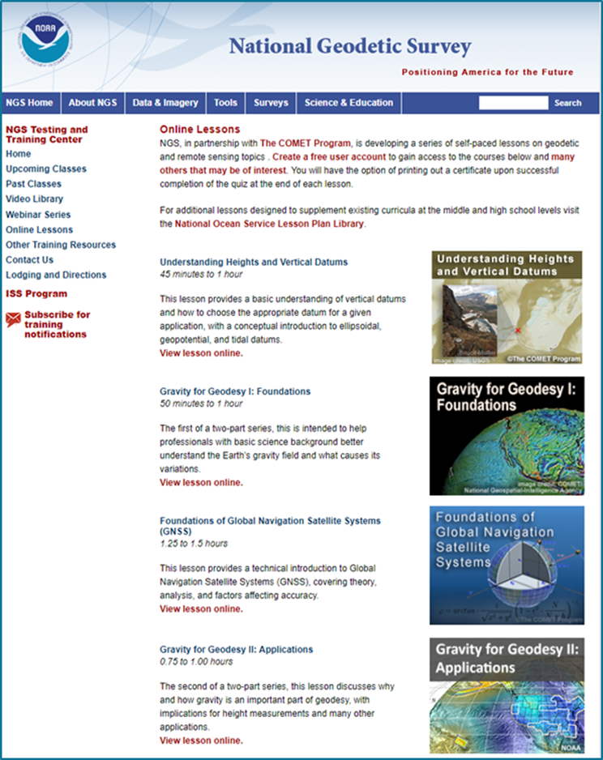
Online Lessons
Partnership with the University Corporation for Atmospheric Research’s (UCAR) COMET Program
Quiz completions to date (through 8/30/2022)
GNSS Positioning: Survey Planning and Data Acquisition | 820
Gravity for Geodesy II: Applications | 435
Foundations of Global Navigation Satellite Systems (GNSS) | 1,574
Gravity for Geodesy I: Foundations | 796
Understanding Heights and Vertical Datums | 2,282

Slide 9
Online Lessons
Partnership with the University Corporation for Atmospheric Research’s (UCAR) COMET Program
Module/Quiz completions to date by sector (through 8/30/2022)
Education | 3,024
Other | 1,215
Private Sector | 418
State or Local | 368
DOD | 276
Other US Federal | 188
NOAA | 160
Weather Enthusiast | 158
International | 40

Slide 10
Presentation Library

Slide 11
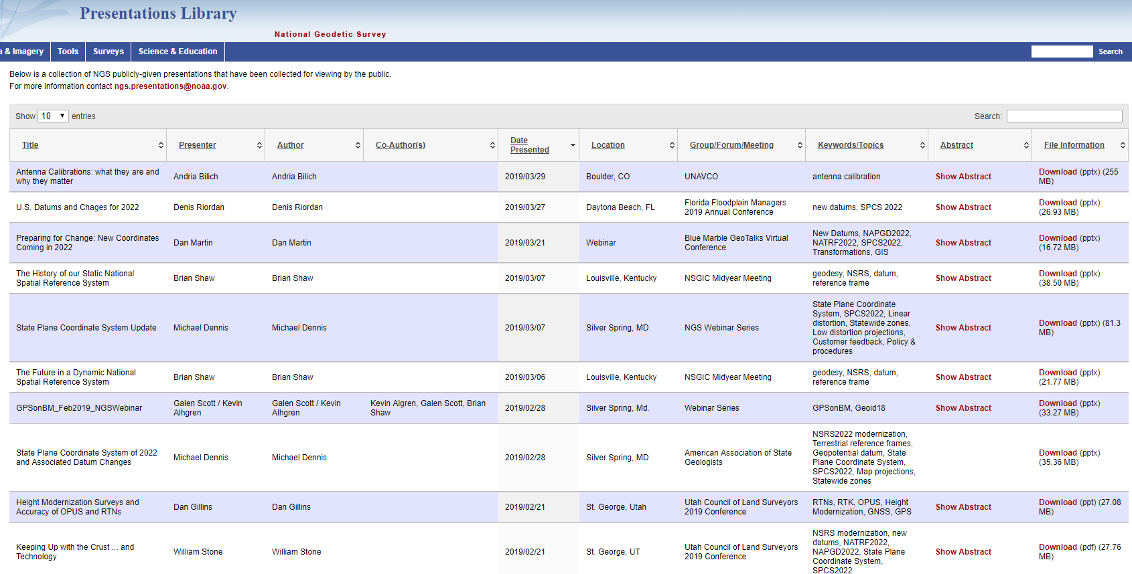
Presentation Library
Over 780 presentations given by NGS employees, available for your viewing and use
Great search function if you’re looking for something specific!

Slide 12
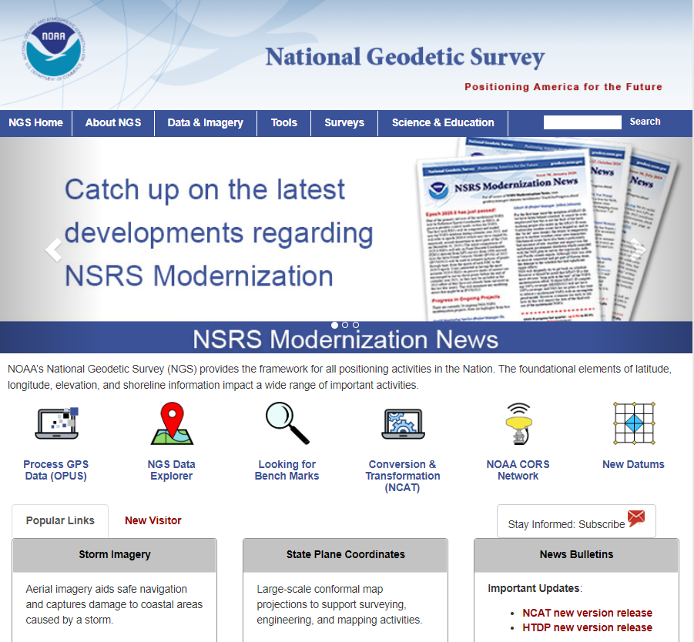
Subscription Lists

Slide 13
Subscription Lists
Good way to keep up with NGS updates, job announcements, NSRS Modernization, new educational resources, and much more!
Subscribers
NGS News | 6,254
Training | 6,275
Webinar Series | 6,662
GPS on Bench Marks | 4,900

Slide 14
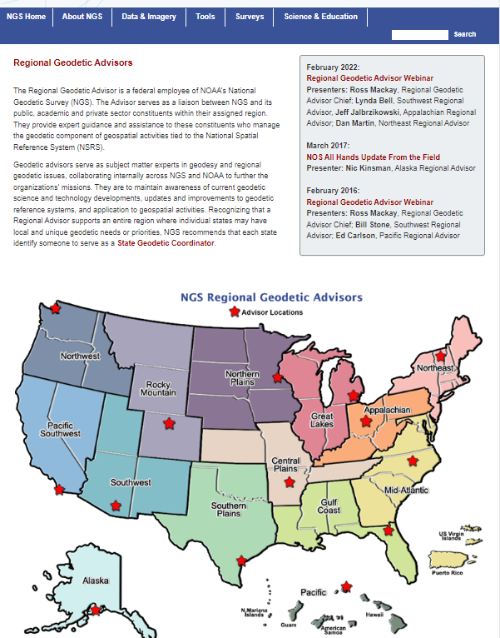
14 Regional Geodetic Advisors
Expert sources for training and education

Slide 15
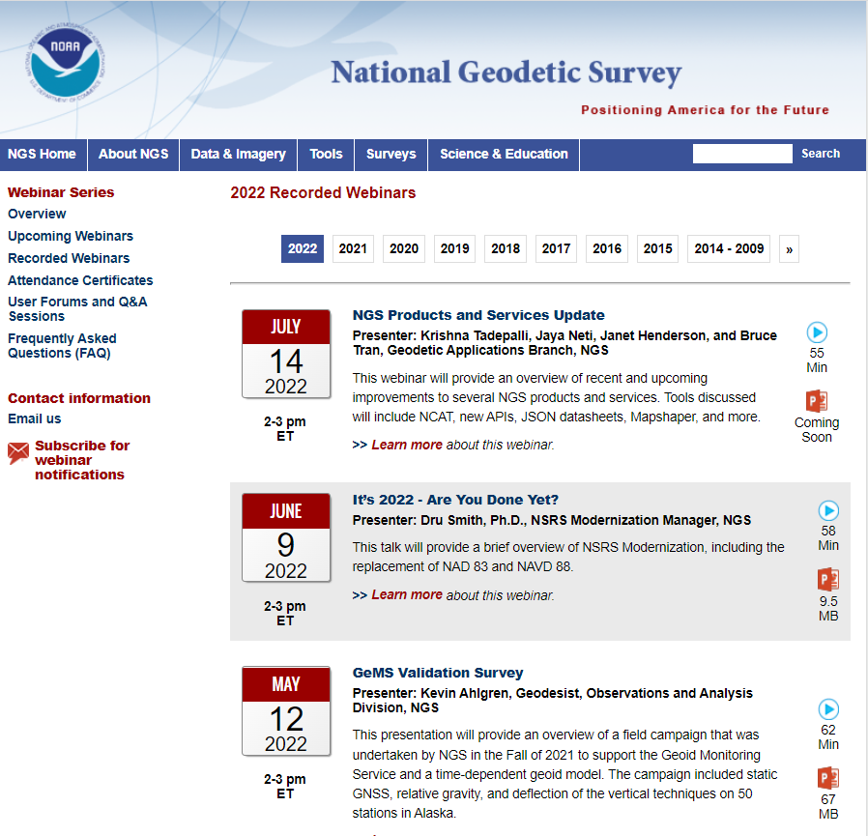
NGS Webinar Series
Generally held monthly (10-12 per year)
100+ recorded webinars available
Have added quarterly OPUS User Forums, advertised through the Webinar Series subscription list

Slide 16
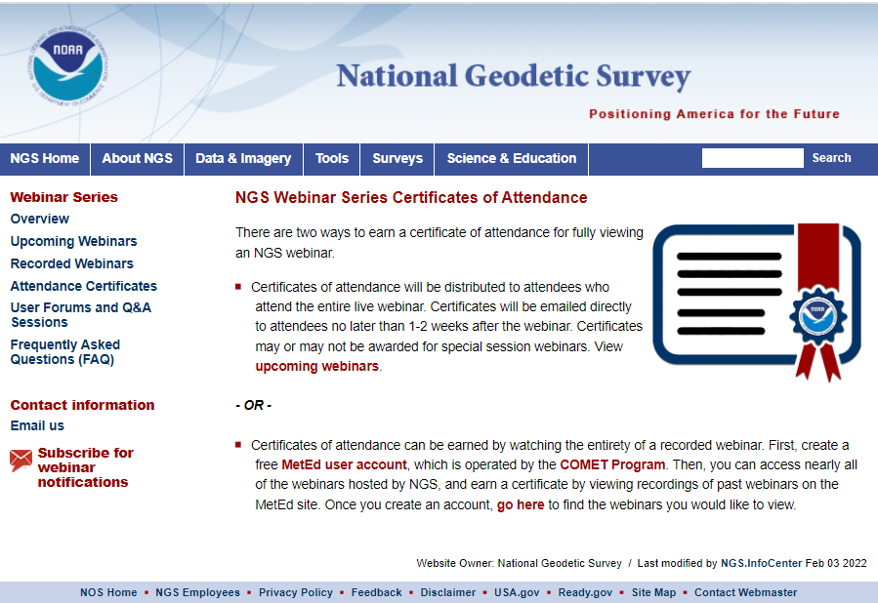
New Tool to Earn Webinar Certificates on
Your Schedule
Can’t make a webinar during the scheduled time? A recorded version is always available on the NGS website.
But NOW you can earn a certificate for viewing a recorded webinar.

Slide 17
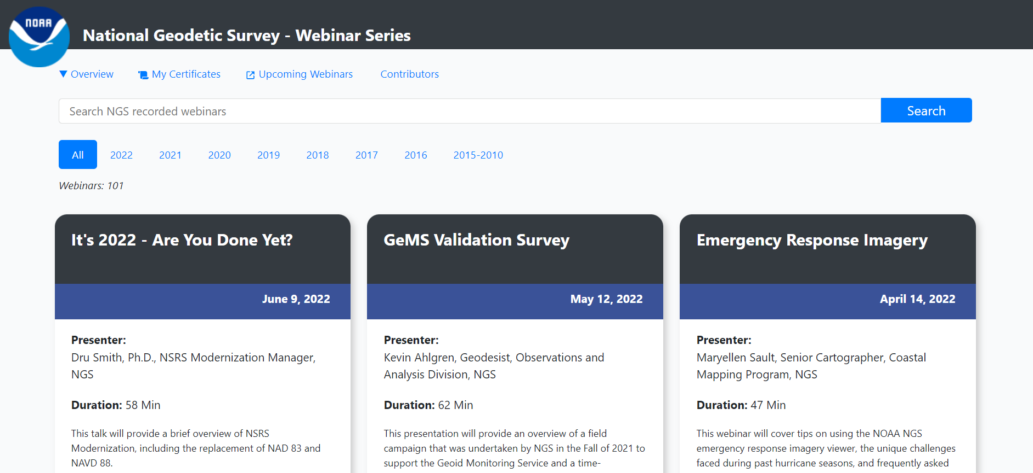
New Tool to Earn Webinar Certificates on
Your Schedule
NGS again worked with the COMET MetEd program to develop a tool through which you can earn a certificate by viewing recordings of past webinars.
Over 100 recorded webinars available.

Slide 18
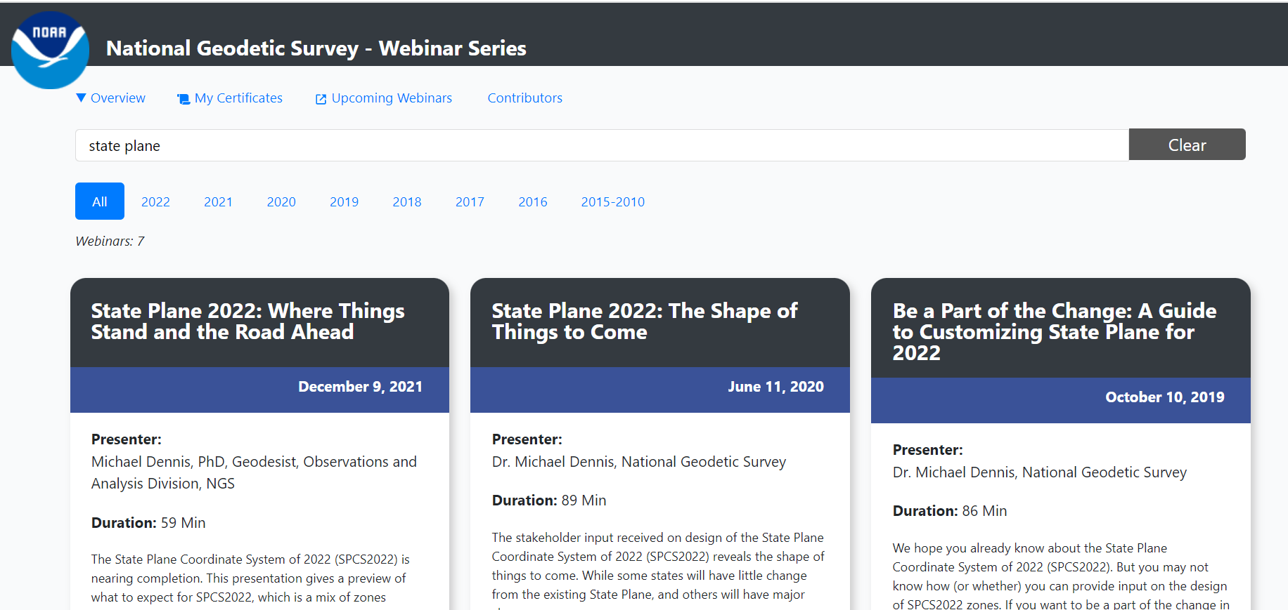
New Tool to Earn Webinar Certificates on
Your Schedule
Great search function to find webinars on a certain topic.
If you are in the education field, you could assign these as pre-requisites, class work, extra credit, etc.

Slide 19
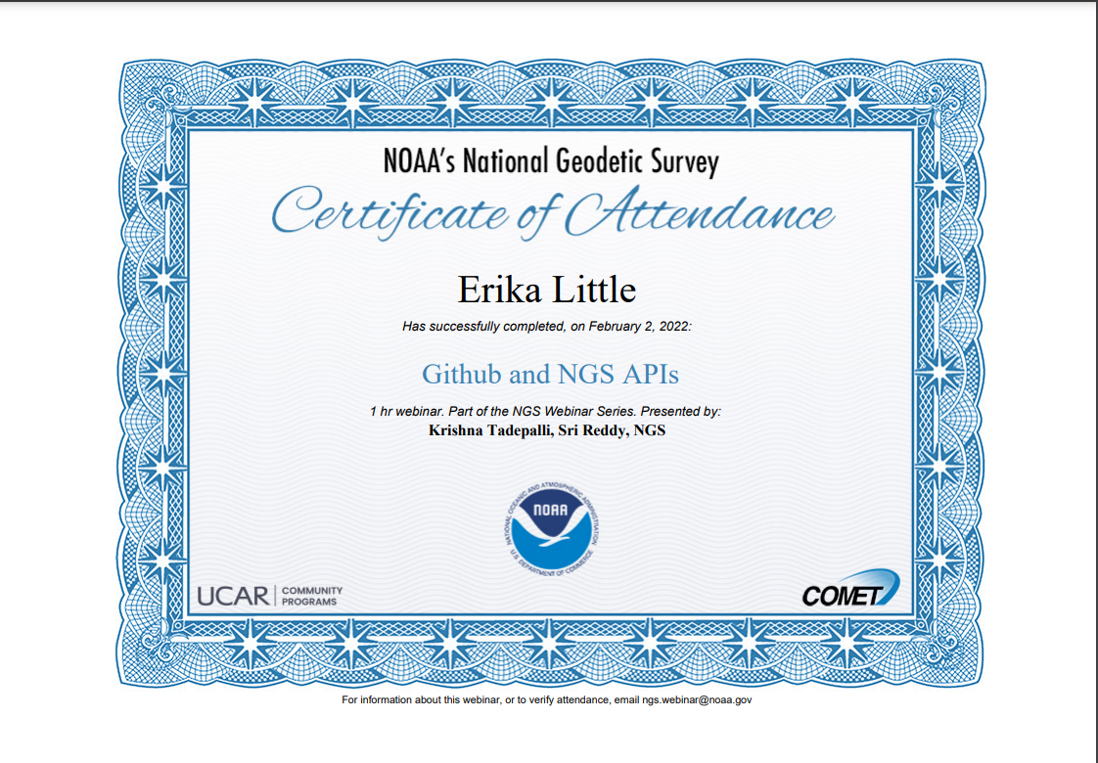
New Tool to Earn Webinar Certificates on
Your Schedule
Once you watch the entirety of a webinar, you can download a Certificate of Attendance.

Slide 20
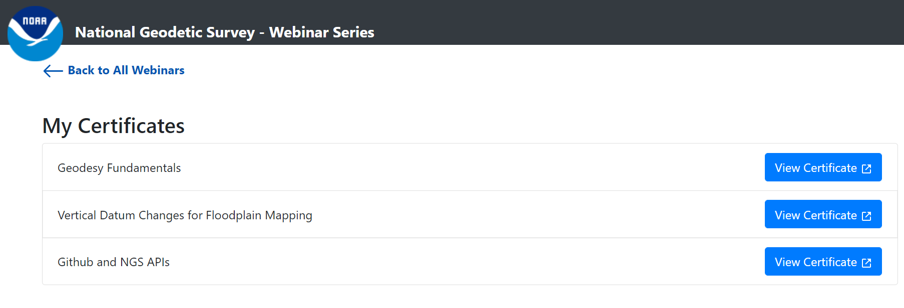
New Tool to Earn Webinar Certificates on
Your Schedule
COMET MetEd will store all earned certificates.

Slide 21
Your Input is always welcome on:
Topics
Content
Delivery methods
And/or examples of how you have used NGS materials. Thank you!
Send to ngs.training@noaa.gov

