Slide 1


NGS Update
North Carolina Geodetic Advisory Committee
December 06, 2022
Dan Martin
Northeast Regional Geodetic Advisor
ME, NH, VT, MA, CT, RI, NY, NJ
Dan.martin@noaa.gov
240-676-4762

Slide 2
Mid-Atlantic Advisor
Position hopefully advertised in December
  Would look to hire within first few months of 2023
Working to temporarily fill with an “acting” in January 2023
Currently, contact Charlie Geoghegan Charlie.geoghegan@noaa.gov (Acting Advisor Branch Chief) for questions, or Erika Little Erika.little@noaa.gov for speaker requests

Slide 3
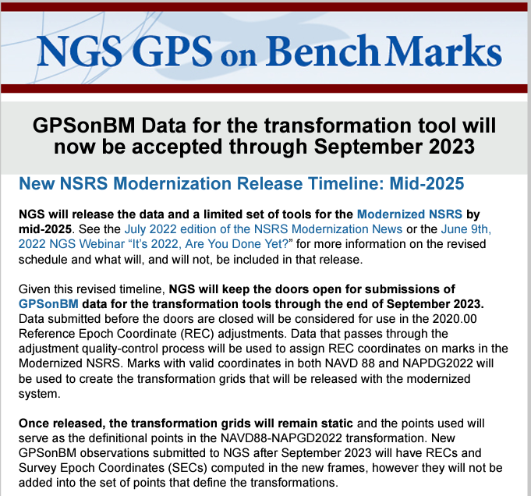

Slide 4
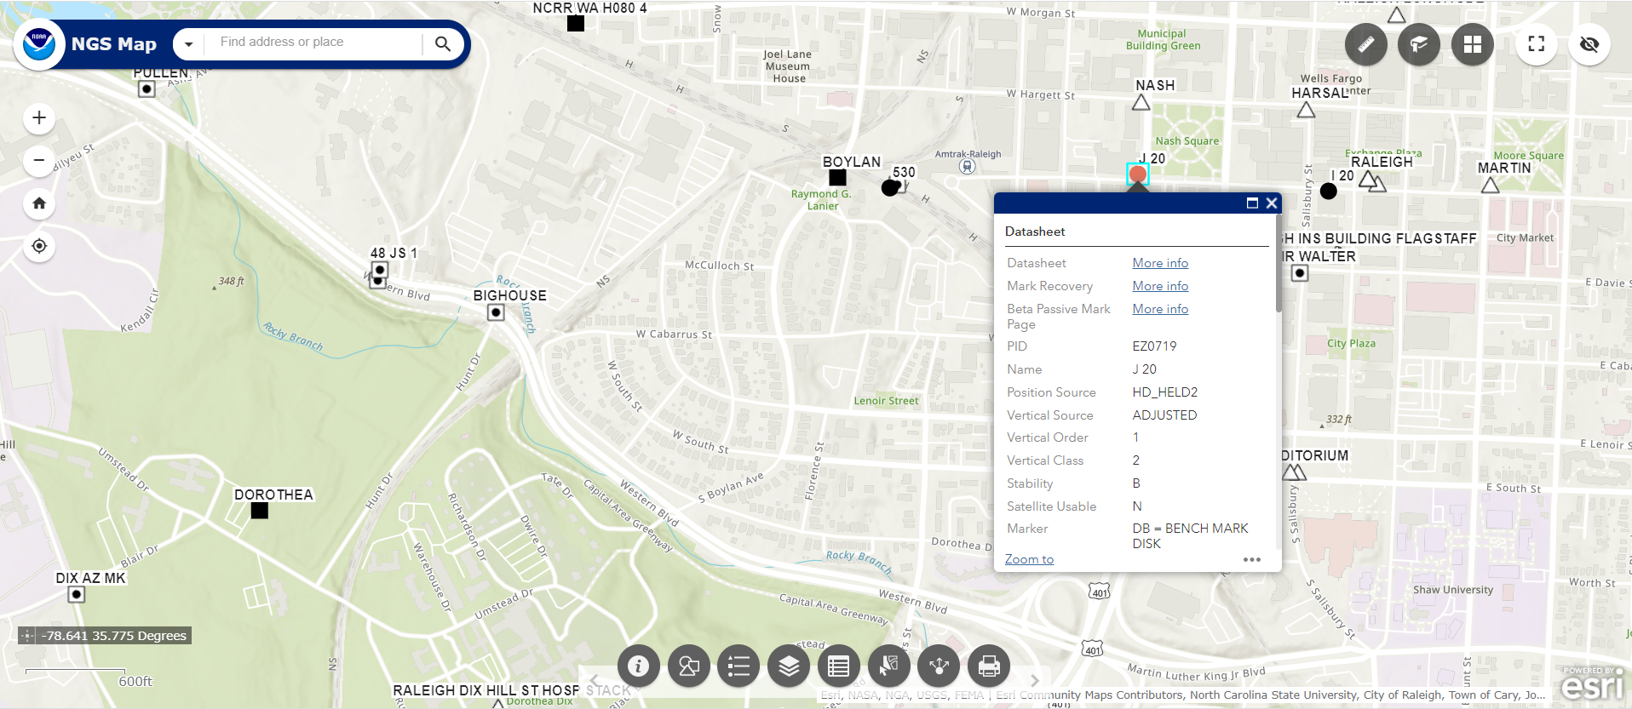
NGS Map to Production
Uses ARCGIS Online
Can View
  Marks in IDB
  Marks In OPUS Share
  CORS

Slide 5
M-PAGES = Multi-GNSS PAGES (alpha)
Capable of ingesting all GNSS observables currently supported by the global infrastructure.
Capable of using more than two frequencies.
Capable of ingesting RINEX 2 or 3.
Capable of using pseudorange and phase.
Capable of multi-GNSS processing.
Uses a single-difference processing strategy.
See August 11 Webinar
  https://geodesy.noaa.gov/web/science_edu/webinar_series/multi-ngss-world-at-ngs.shtml
Likely release to OPUS BETA by February 2023

Slide 6
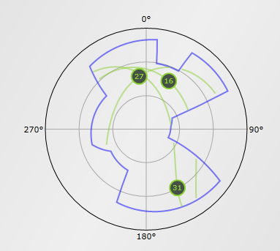
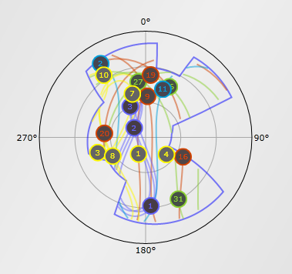
Obstructed View
Simulated sky coverage in urban or natural canyon.
GPS-only (left) isn’t viable. Multi-GNSS (right) is.
http://www.gnssplanningonline.com
January 26, 2021
Multi-GNSS OPUS : First Call for Internal Testing

Slide 7
OPUS Projects 5.1 (beta)
Went to BETA 08/03/22
  https://beta.ngs.noaa.gov
Ability to include RTK/RTN vectors (any vector for that matter)
  Has sample data to try
  Contact your vendor about converting to gvx format

Slide 8
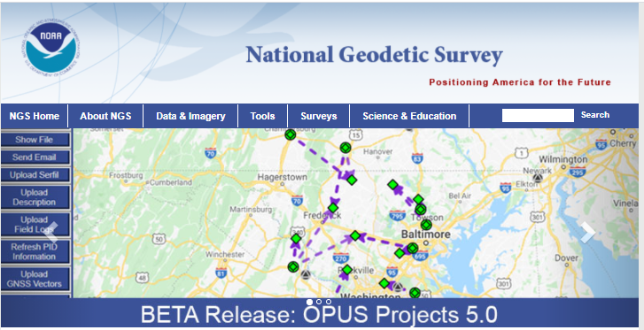

Slide 9
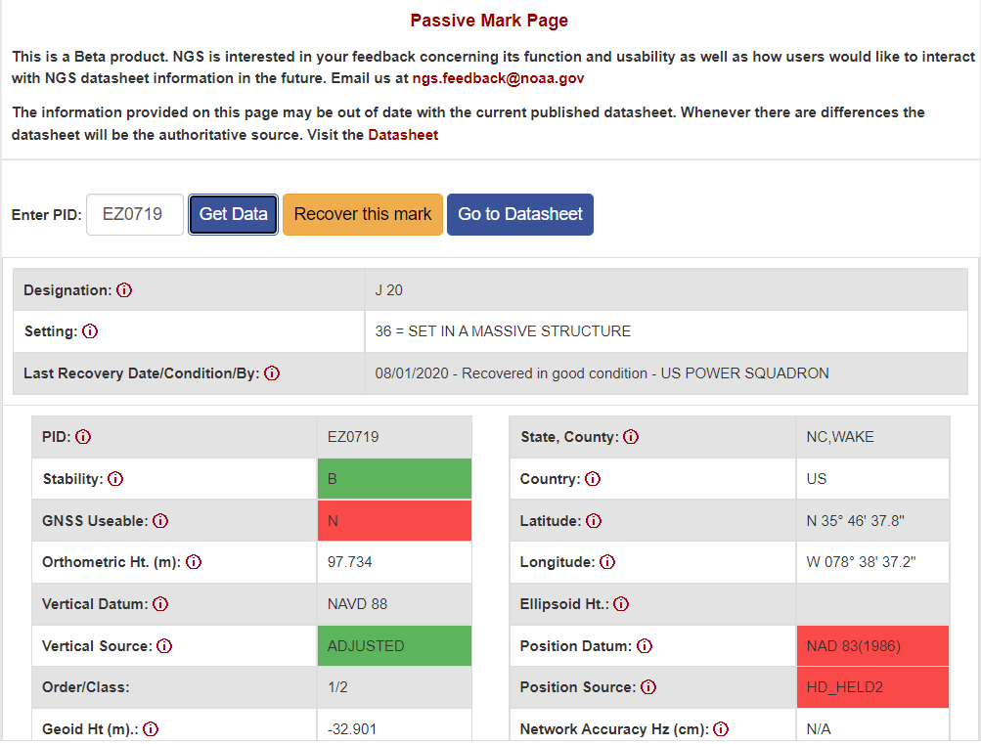
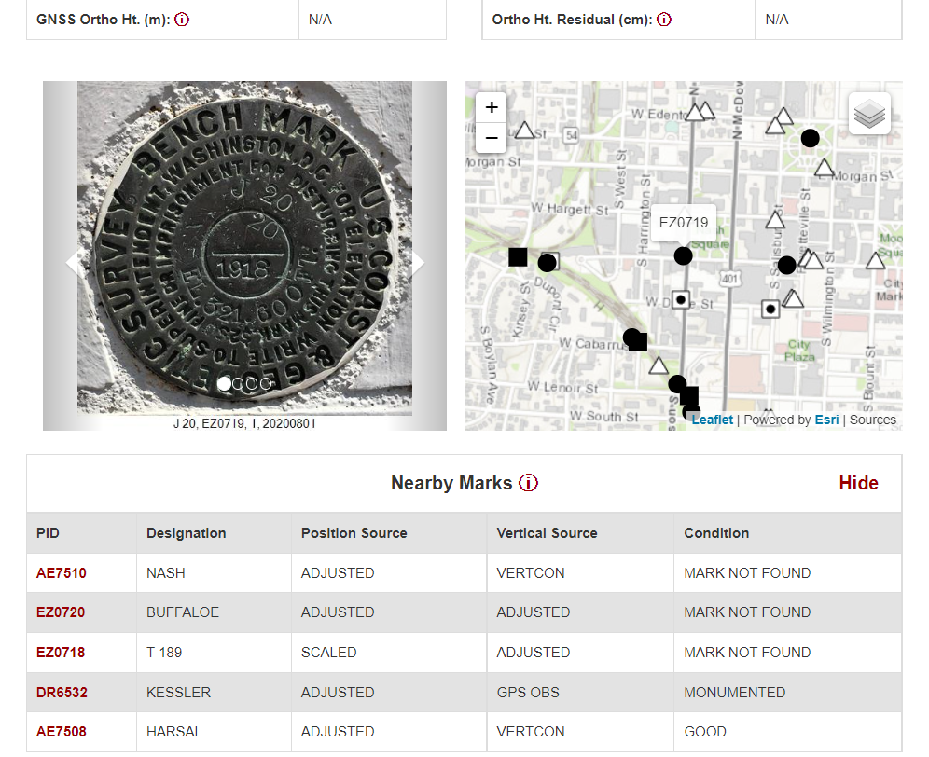
Passive Mark Page (beta)

Slide 10
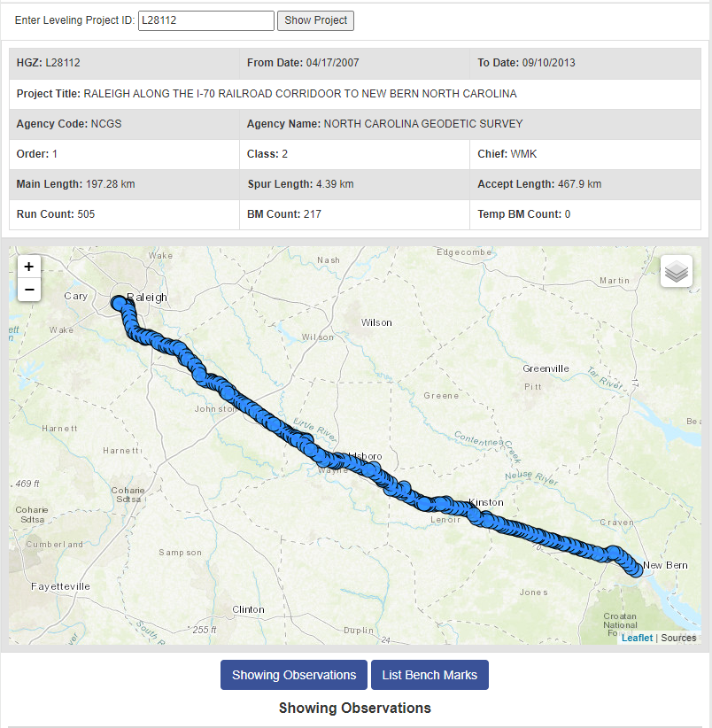
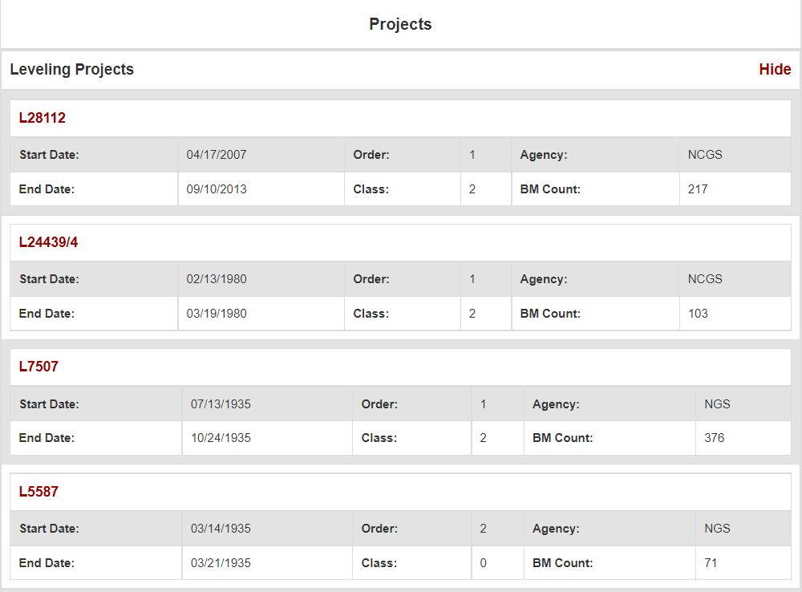
Passive Mark Page cont.

Slide 11
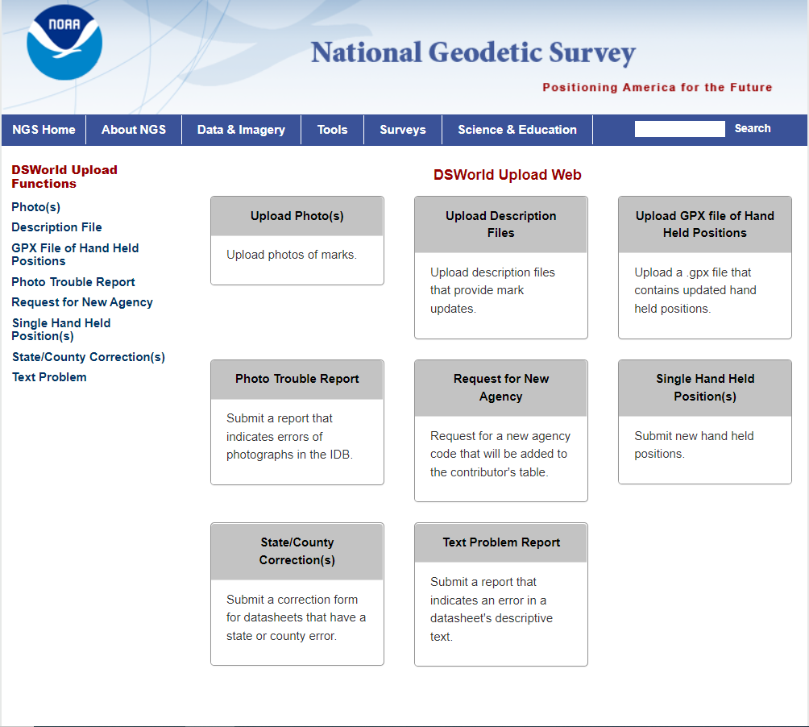
DSWorld Web Form

Slide 12
NCAT 2.1
Option to specify units for heights
Option to customize data export
  Select which fields to output
More FAQ’s
Link to source code on github

Slide 13
Thanks!

