Slide 1

Tidbits and Progress
Towards Modernization
Dana Caccamise
Pacific Southwest Regional Geodetic Advisor
NOAA/National Geodetic Survey
CPP Geomatics Conference
Notes:
Update on SPCS2022
Working with time-dependent coordinates
Update on rollout of the new datums
Update on the next Geoid model rollout
OPUS Projects updates
Data Sheets / Data Delivery
GPS on BM’s
IGLD if we have time?

Slide 2

My Background
Working at the NGS since 2014 and has graduate degrees in the fields of Earth Sciences, Geophysics, and Geodesy and currently resides in San Diego, California.
The California Spatial Reference Center (CSRC), located at Scripps Institution of Oceanography (SIO) at the University California San Diego (UCSD), is hosting his position.
Research Associate position in the SIO’s Institute of Geophysics and Planetary Physics (IGPP).
Notes:
Title:
NSRS Tidbits and Progress Towards Modernization
Topic:
The National Geodetic Survey (NGS) for over 15 years has been working on updating the National Spatial Reference Systems (NSRS). The NSRS work is simply too much for a single discussion, but I will cover some of the tastier morsels. I plan to talk about key bits related to the rollout of the new datums.
-----
BIOGRAPHICAL INFORMATION
Dana J. Caccamise II, Ph.D
NOAA’s National Geodetic Survey (NGS)
dana.caccamise@noaa.gov
Dana Caccamise is the NOAA/National Geodetic Survey’s (NGS) Pacific Southwest Region Geodetic Advisor. Assisting the geospatial community throughout California and Nevada—including public- and private-sector surveyors, GIS professionals, engineers, and earth scientists—with the proper application of the National Spatial Reference System.
Dana has graduate degrees in Earth Sciences, Geophysics, and Geodesy and currently resides in San Diego, California. The California Spatial Reference Center (CSRC), located at Scripps Institution of Oceanography (SIO) at the University of California San Diego (UCSD), is hosting his position. In addition, Dana holds a Research Associate position in the SIO’s Institute of Geophysics and Planetary Physics (IGPP).

Slide 3
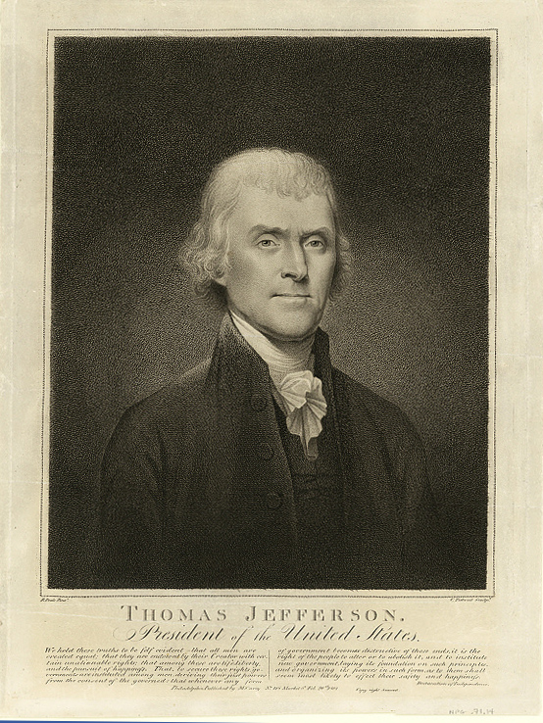
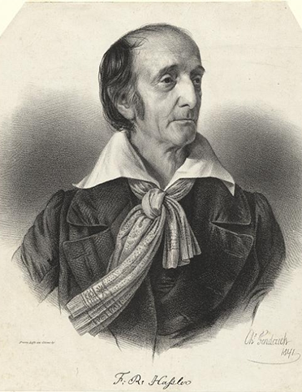



NOAA and NGS
Our Nation’s First Civilian Science Agency
1807
Thomas Jefferson
Survey of the Coast
1811
Ferdinand Hassler
Superintendent
1836
U.S. Coast
Survey
1878
U.S. Coast and
Geodetic Survey
1970
NOAA is established
Notes:
NGS has been around a long time. For more than 200 years, NGS and its predecessor agencies have collaborated with public and private organizations to establish reference stations at precisely determined locations.
We began on a mission established by Thomas Jefferson in 1807 to conduct a “Survey of the Coast” (as the United States Coast Survey).
(Pictured are Thomas Jefferson and Ferdinand Hassler, the first Superintendent of the Coast Survey). We were renamed the U.S. Coast and Geodetic Survey in 1878. NOAA was established in 1970.
Traditionally, precise positioning locations have been identified by setting a survey mark—usually a brass, bronze, or aluminum disk. Locations might also be identified by a deeply driven rod, or a prominent object, such as a water tower or church spire.

Slide 4
NGS’ Mission
To define, maintain and provide access
to the National Spatial Reference System (NSRS) to meet our Nation’s economic, social, and environmental needs.
…………………………………………….........................
The NSRS is a consistent coordinate system that defines latitude, longitude, height, scale, gravity, orientation, and shoreline throughout the United States.
Notes:
The National Spatial Reference System is our nations geospatial infrastructure from which all positioning (with the exclusion of military/DOD) is referenced to.
This system provides a consistent framework that allows people to use data in the same reference system to perform analysis and make meaningful comparisons and decisions from that analysis.

Slide 5
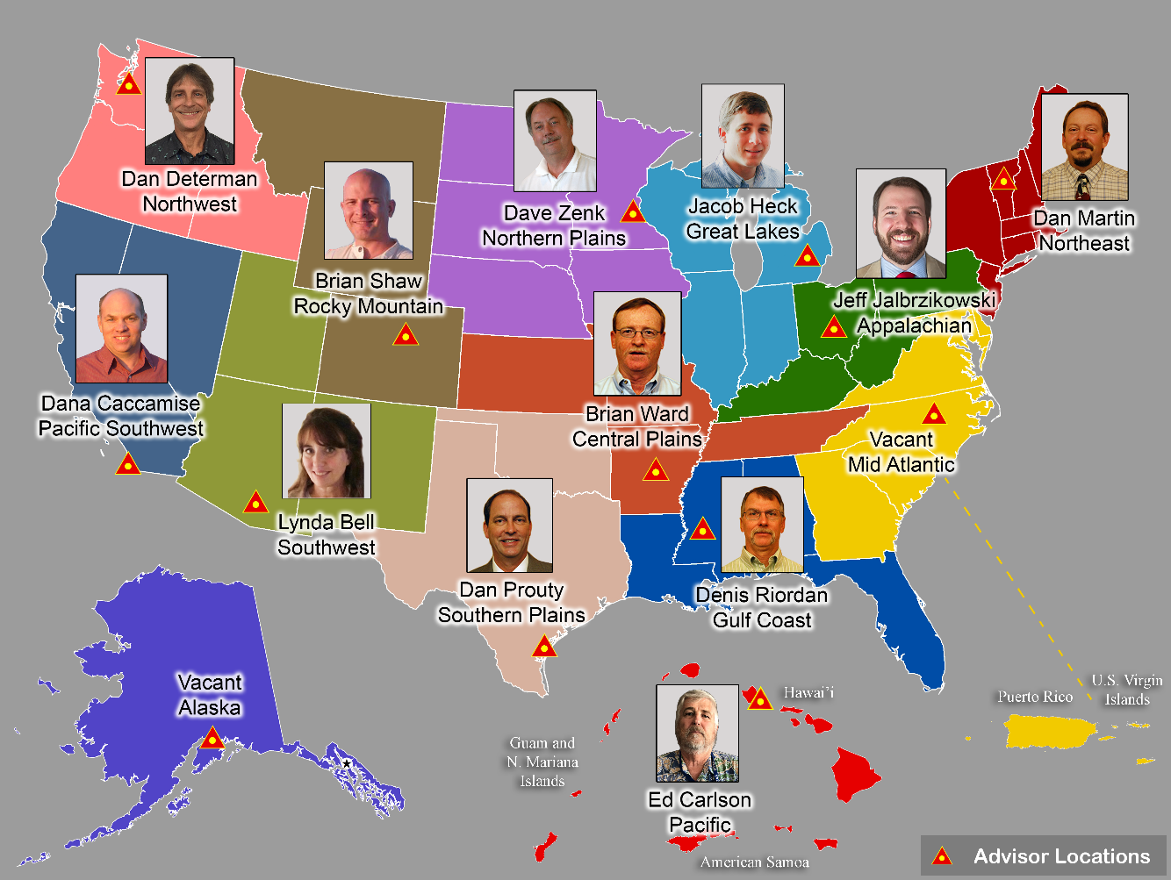
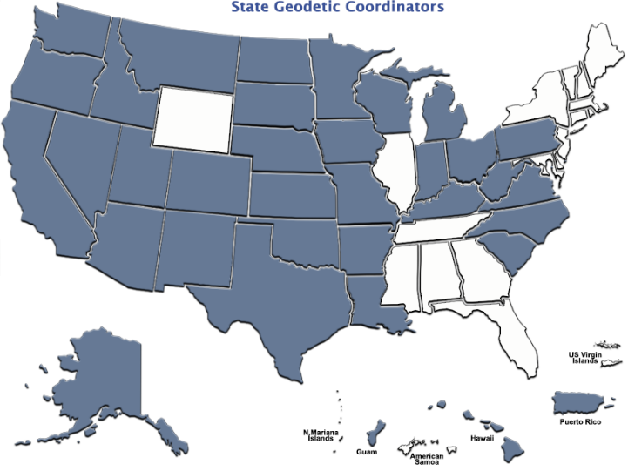
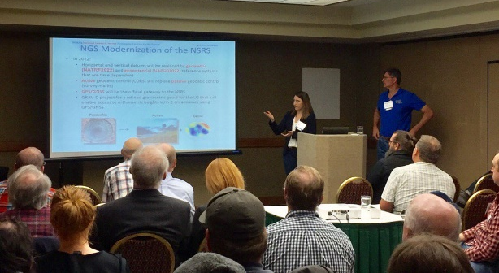
Importance of Coordination
14 Advisors
(2 acting)
38 Coordinators
Notes:
NGS Regional Geodetic Advisors
https://geodesy.noaa.gov/ADVISORS/
State Geodetic Coordinators
https://geodesy.noaa.gov/ADVISORS/state-geodetic-coordinators.shtml

Slide 6
NSRS Modernization Delay
Operational, workforce retention and other issues have delayed NSRS Modernization
SPCS2022 zones should be finalized in 2022 but will not be rolled out until all of the NSRS is modernized.
GPS on Bench Marks deadline extended
September 30, 2023
https://geodesy.noaa.gov/datums/newdatums/delayed-release.shtml
https://geodesy.noaa.gov/datums/newdatums/FAQNewDatums.shtml

Slide 7

NGS Resources
NGS Training Center
  https://geodesy.noaa.gov/web/science_edu/training/
Educational Videos
  https://geodesy.noaa.gov/datums/newdatums/WatchVideos.shtml
NGS Webinar Series
  https://geodesy.noaa.gov/web/science_edu/webinar_series/
Geospatial Summit (2021, 2019 recorded sessions)
  https://geodesy.noaa.gov/geospatial-summit/
Presentation Library
  https://geodesy.noaa.gov/web/science_edu/presentations_library/

Slide 8
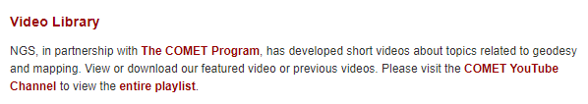
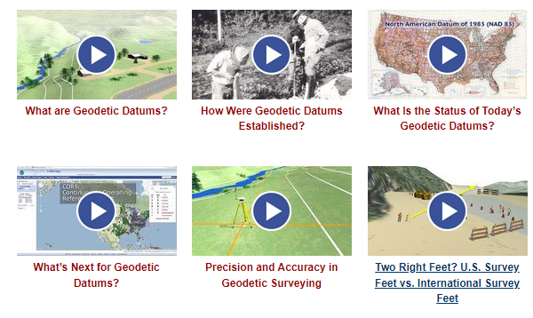

NGS Resources – Educational Videos
  https://geodesy.noaa.gov/datums/newdatums/WatchVideos.shtml

Slide 9


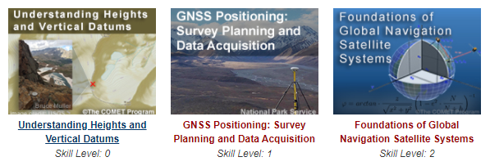
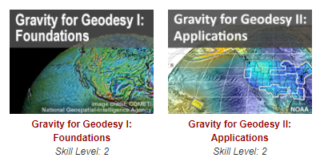
NGS Resources – Online Lessons
  https://geodesy.noaa.gov/web/science_edu/online_lessons/index.shtml

Slide 10
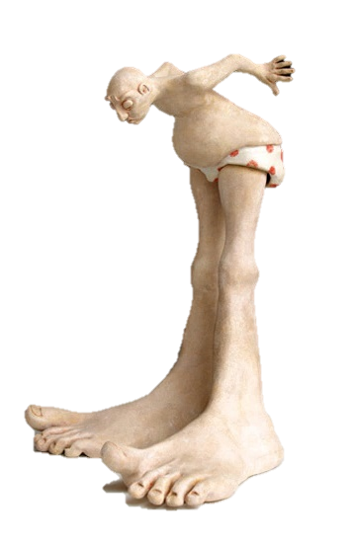
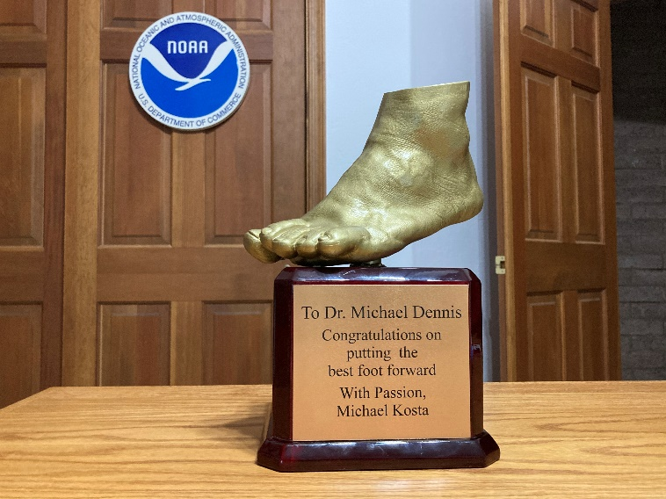
Deprecation of US Survey Foot
December 31, 2022
Will NOT impact current SPCS 83 coordinates. The US Survey Foot (sft) will
continue to be supported in the SPCS 83 system indefinitely.
The International Foot (ift) will be used in the Modernized NSRS and SPCS2022
Webinar
https://geodesy.noaa.gov/web/science_edu/webinar_series/ending-us-survey-foot.shtml
FRN
https://www.federalregister.gov/documents/2020/10/05/2020-21902/deprecation-of-the-united-states-us-survey-foot
Notes:
Links on the slide.

Slide 11
SPCS2022

Slide 12
Getting acquainted with SPCS2022
Distortion design philosophy
  Linear distortion minimized at topographic surface (not at ellipsoid surface)
  Purpose: to reduce difference between projected “grid” and actual “ground” distances
Other things:
  Zone “layers”
  Low distortion projections (LDPs)
  Status and performance of zone designs
  The timing of it all…

Slide 13
SPCS2022 “layers” and designs
Max of up to 3 zone “layers” allowed
  One must be statewide zone
  California will have total of 2 layers
NGS designs:
  Statewide zone for every state
  Multiple zones not designed by stakeholders
Many states made requests and proposals
  Requests for zones designed by NGS
  Proposals for zones designed by stakeholders

Slide 14
Linear distortion magnitudes
Parts per million | Centimeters per kilometer | Feet per mile | Dimensionless ratio
20 ppm | 2 cm/km | 0.1 ft/mile | 1:50,000
50 ppm | 5 cm/km | 0.3 ft/mile | 1:20,000
100 ppm | 10 cm/km | 0.5 ft/mile | 1:10,000
400 ppm | 40 cm/km | 2.1 ft/mile | 1:2,500

Slide 15
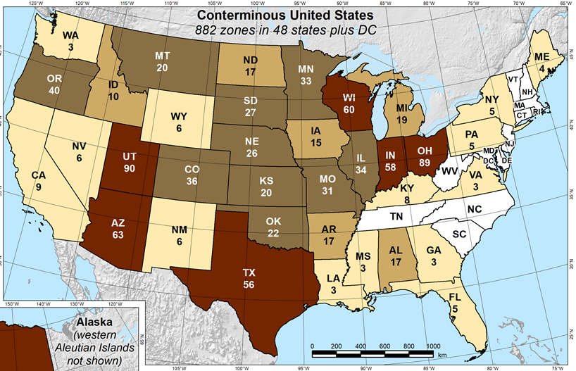
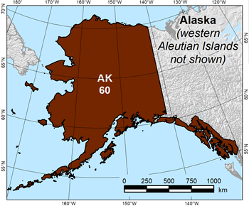
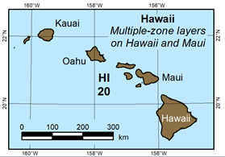
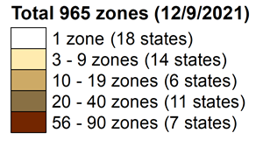
State Plane Coordinate System of 2022 (CONUS, Alaska and Hawaii)
Three territory zones not shown:
    Puerto Rico and U.S Virgin Islands
  American Samoa
  Guam and Commonwealth of the
  Northern Mariana Islands
https://geodesy.noaa.gov/SPCS/

Slide 16
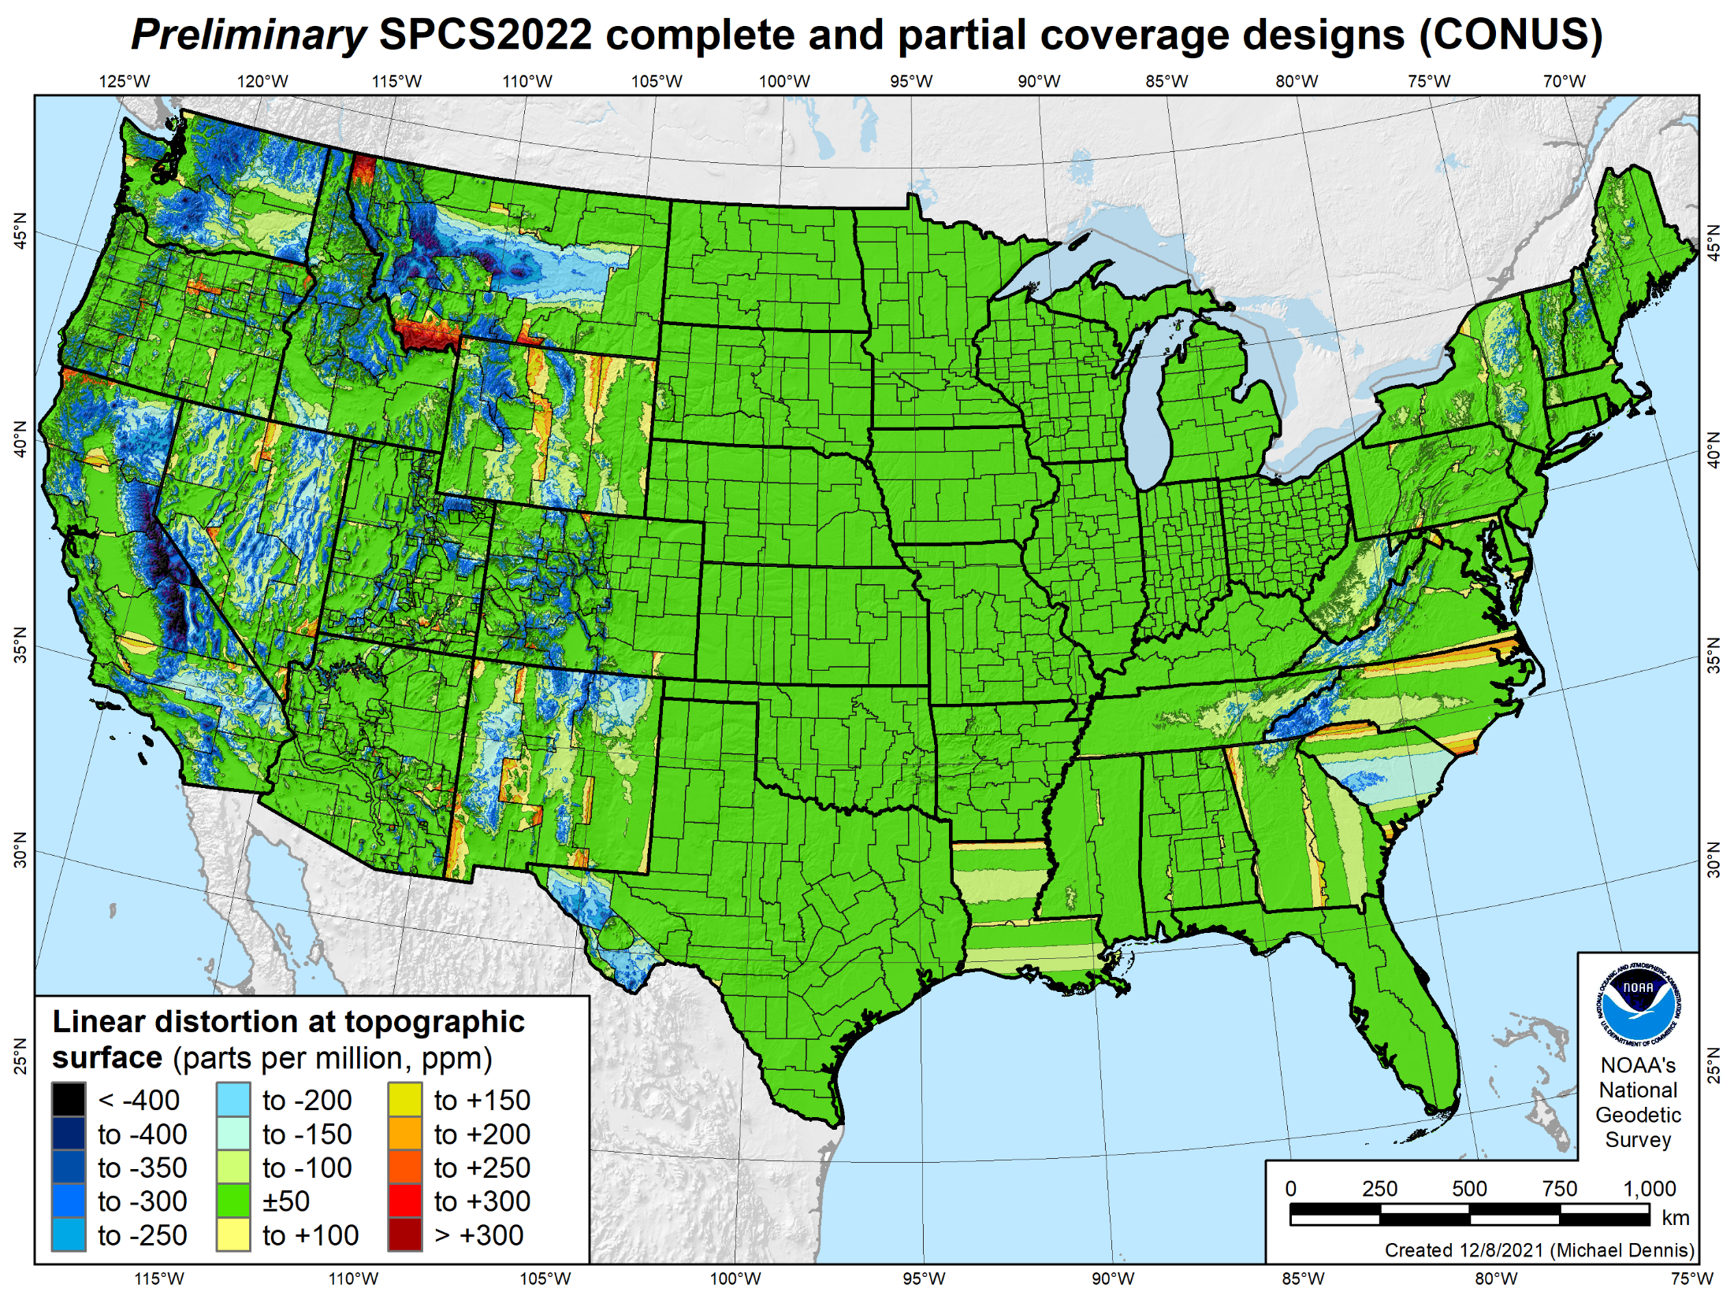
846 zones
Distortion increment 50 ppm (1:20,000 = 0.26 ft/mile)
Percent area within:
±20 ppm = 58%
±50 ppm = 76%
±100 ppm = 89%
±400 ppm = 99.9%

Slide 17
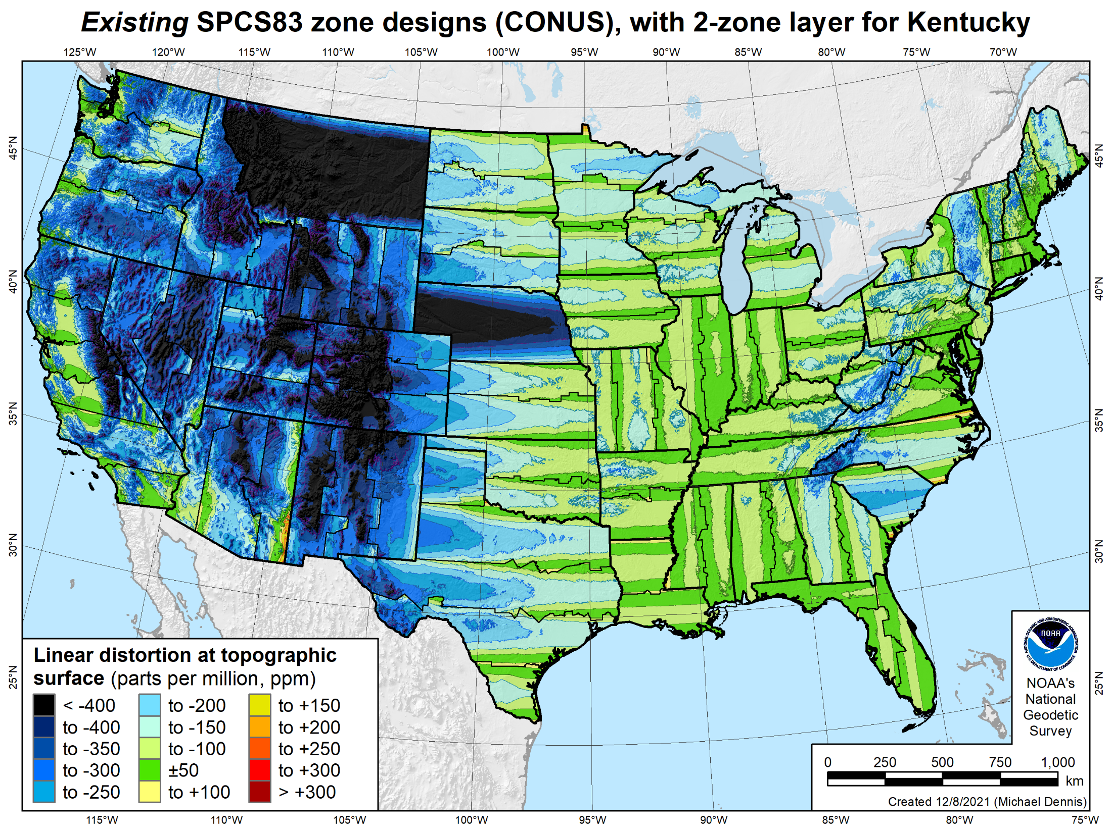
106 zones
Distortion increment 50 ppm (1:20,000 = 0.26 ft/mile)
Percent area within:
±20 ppm = 6%
±50 ppm = 17%
±100 ppm = 41%
±400 ppm = 91%

Slide 18
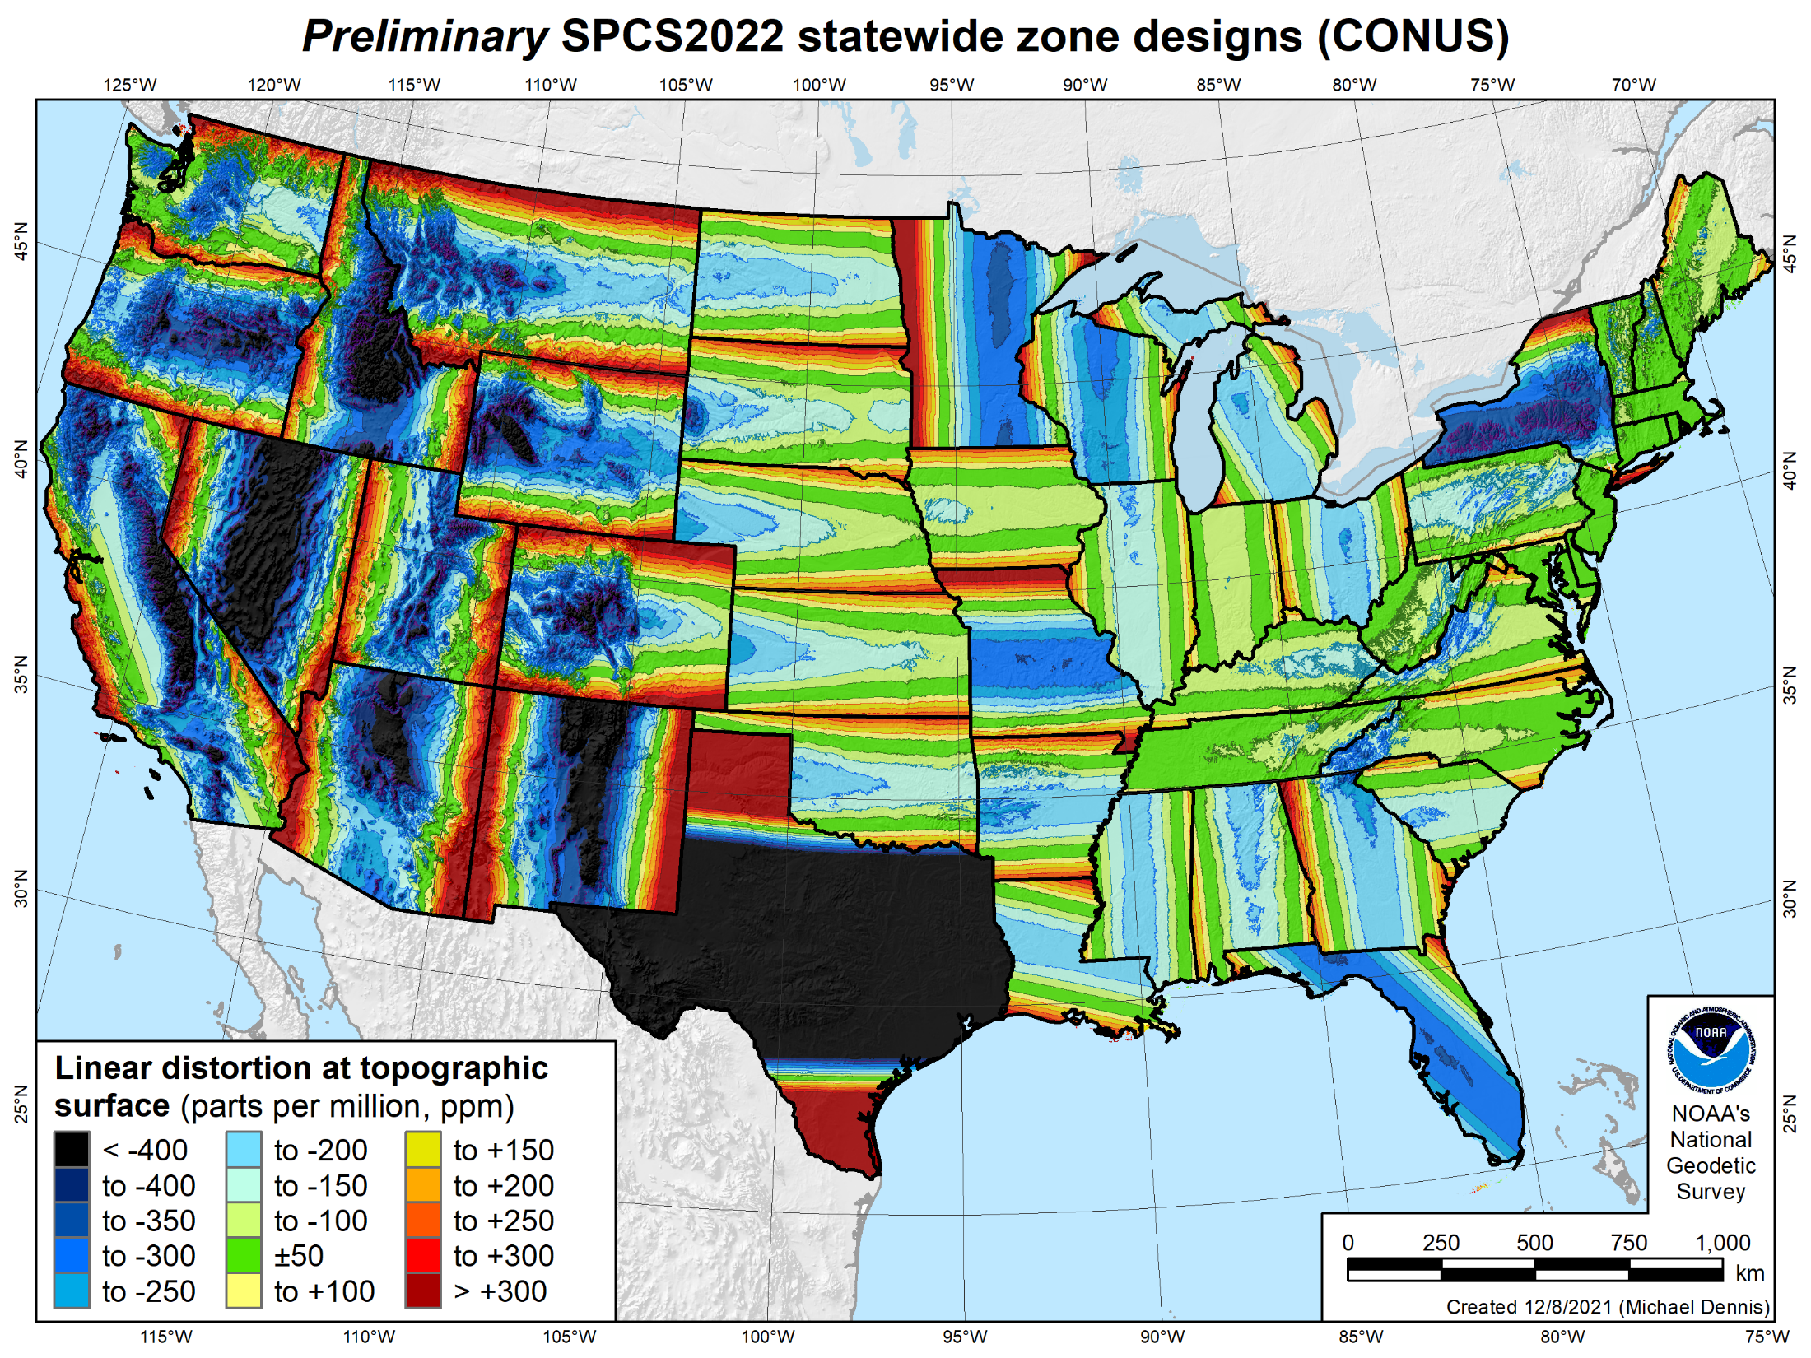
49 zones
Distortion increment 50 ppm (1:20,000 = 0.26 ft/mile)
Percent area within:
±20 ppm = 7%
±50 ppm = 18%
±100 ppm = 36%
±400 ppm = 88%

Slide 19
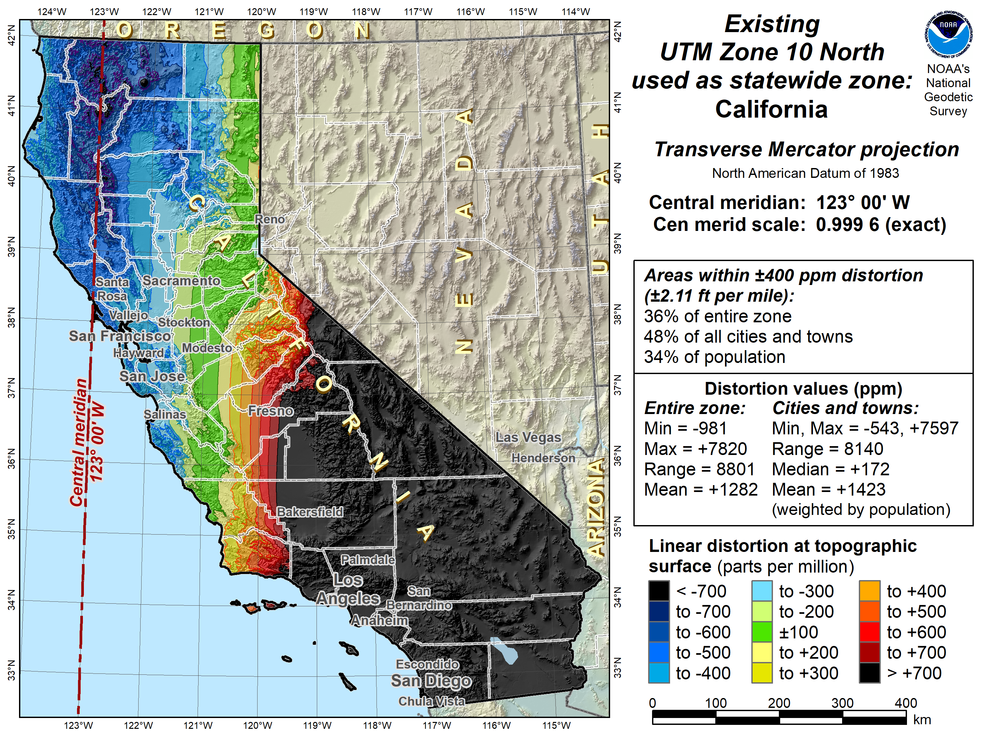

Slide 20
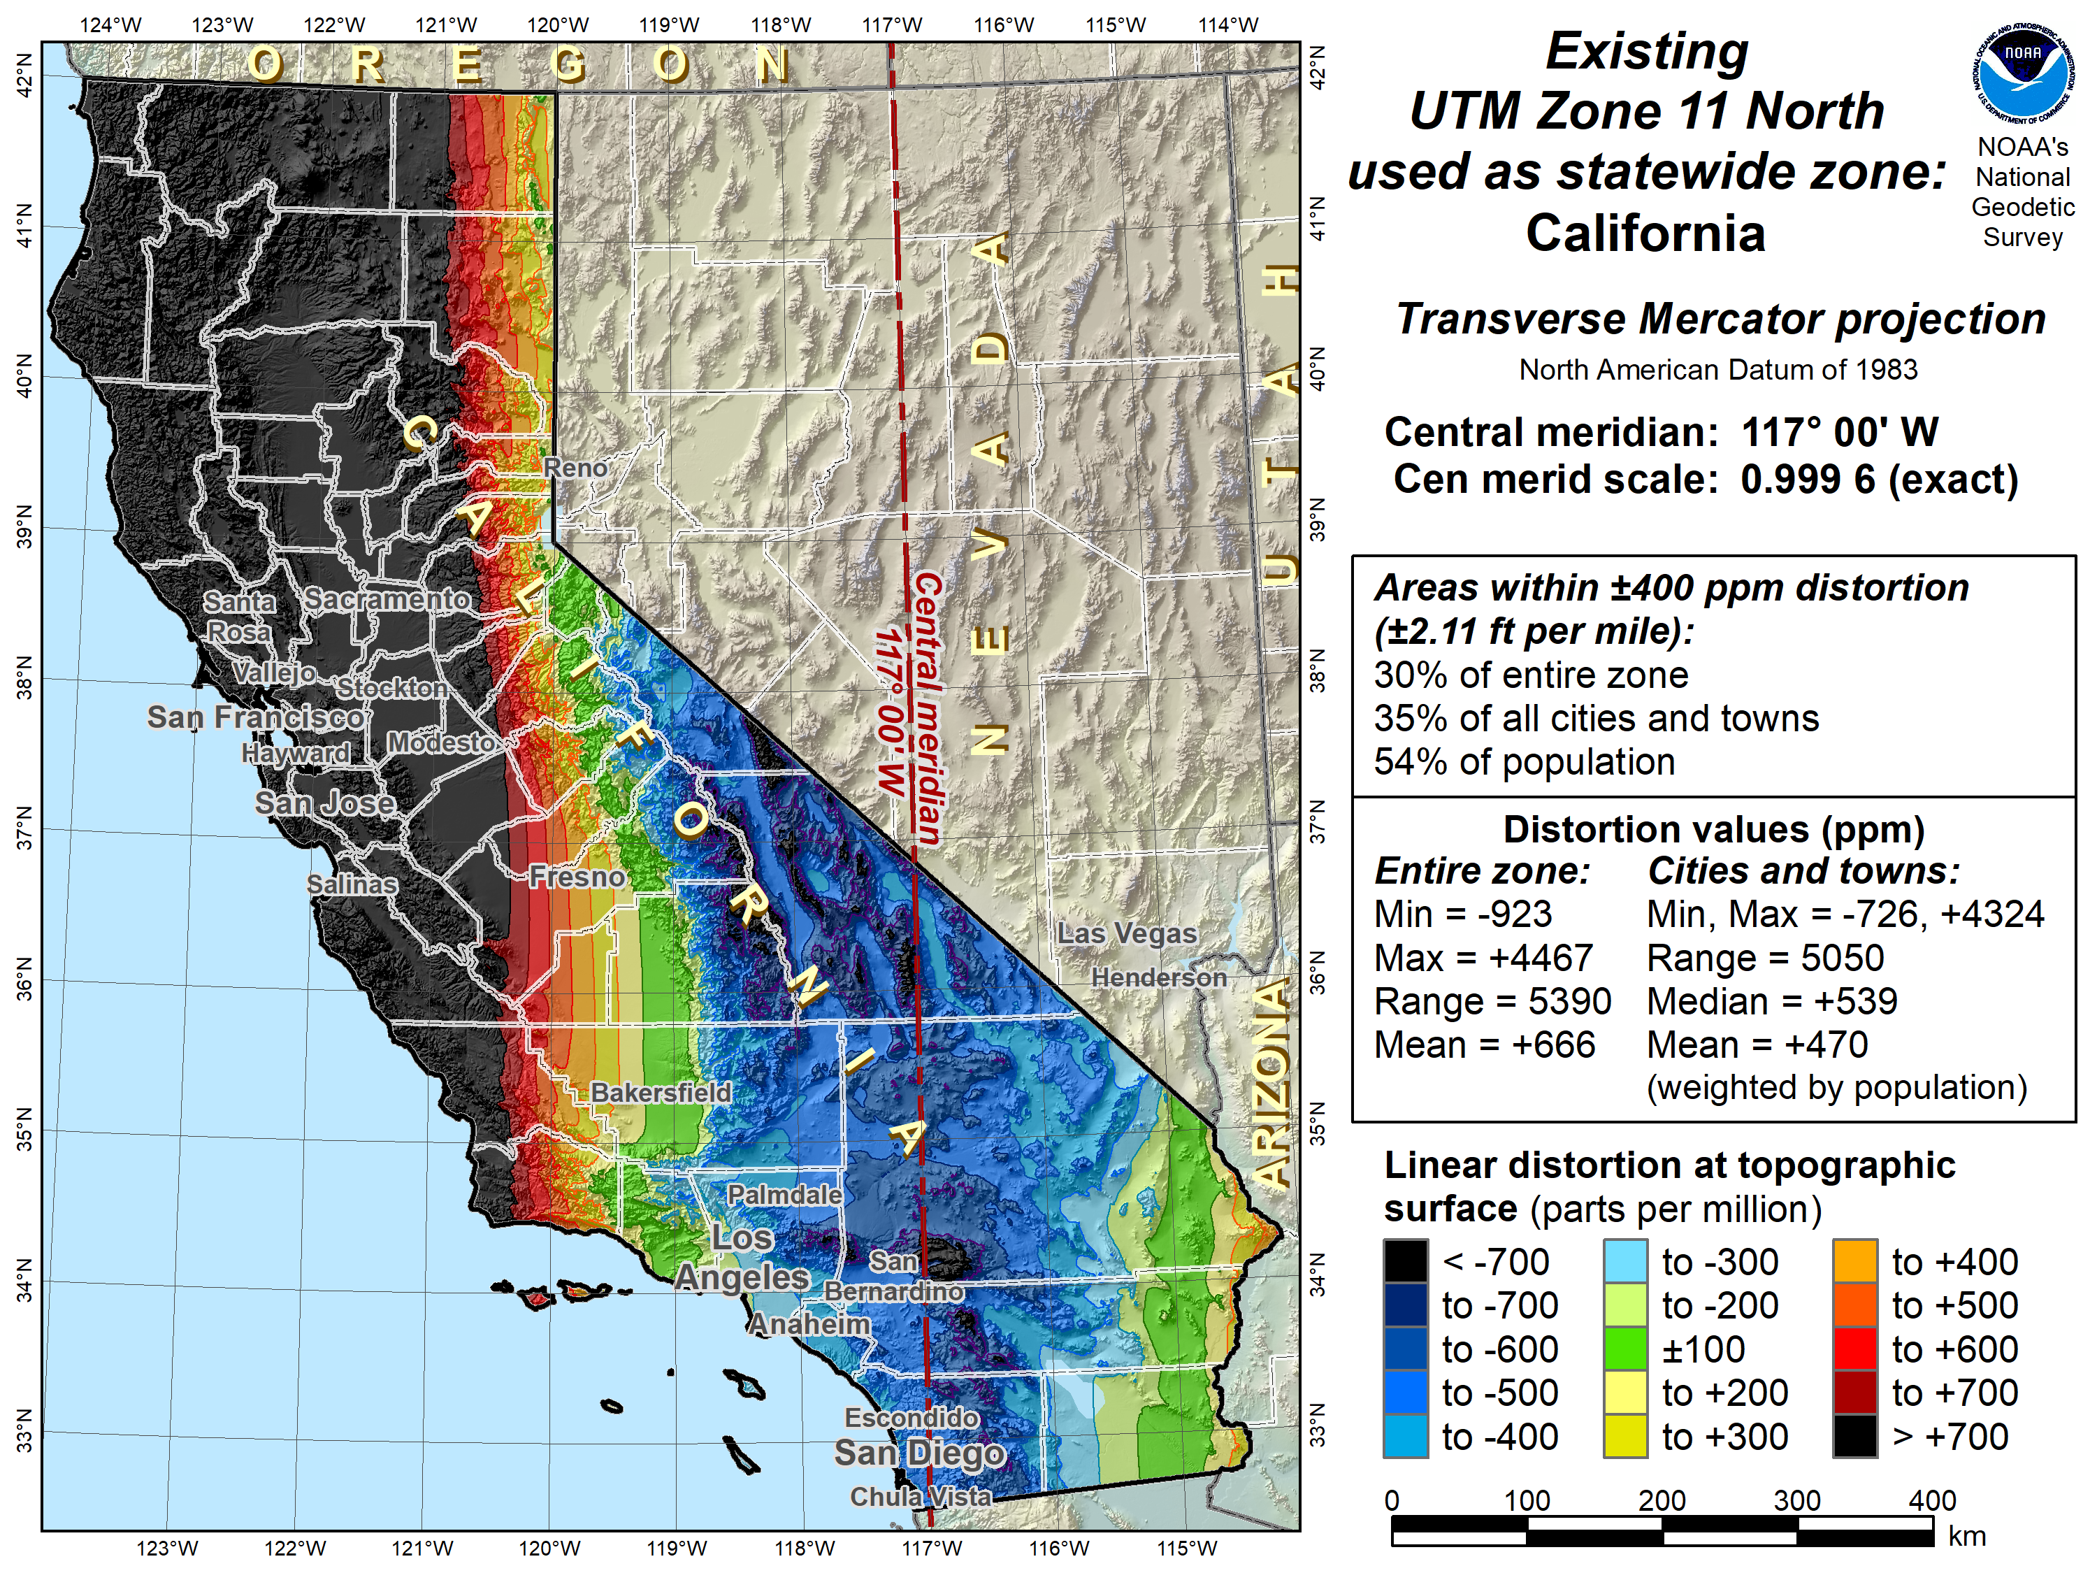

Slide 21
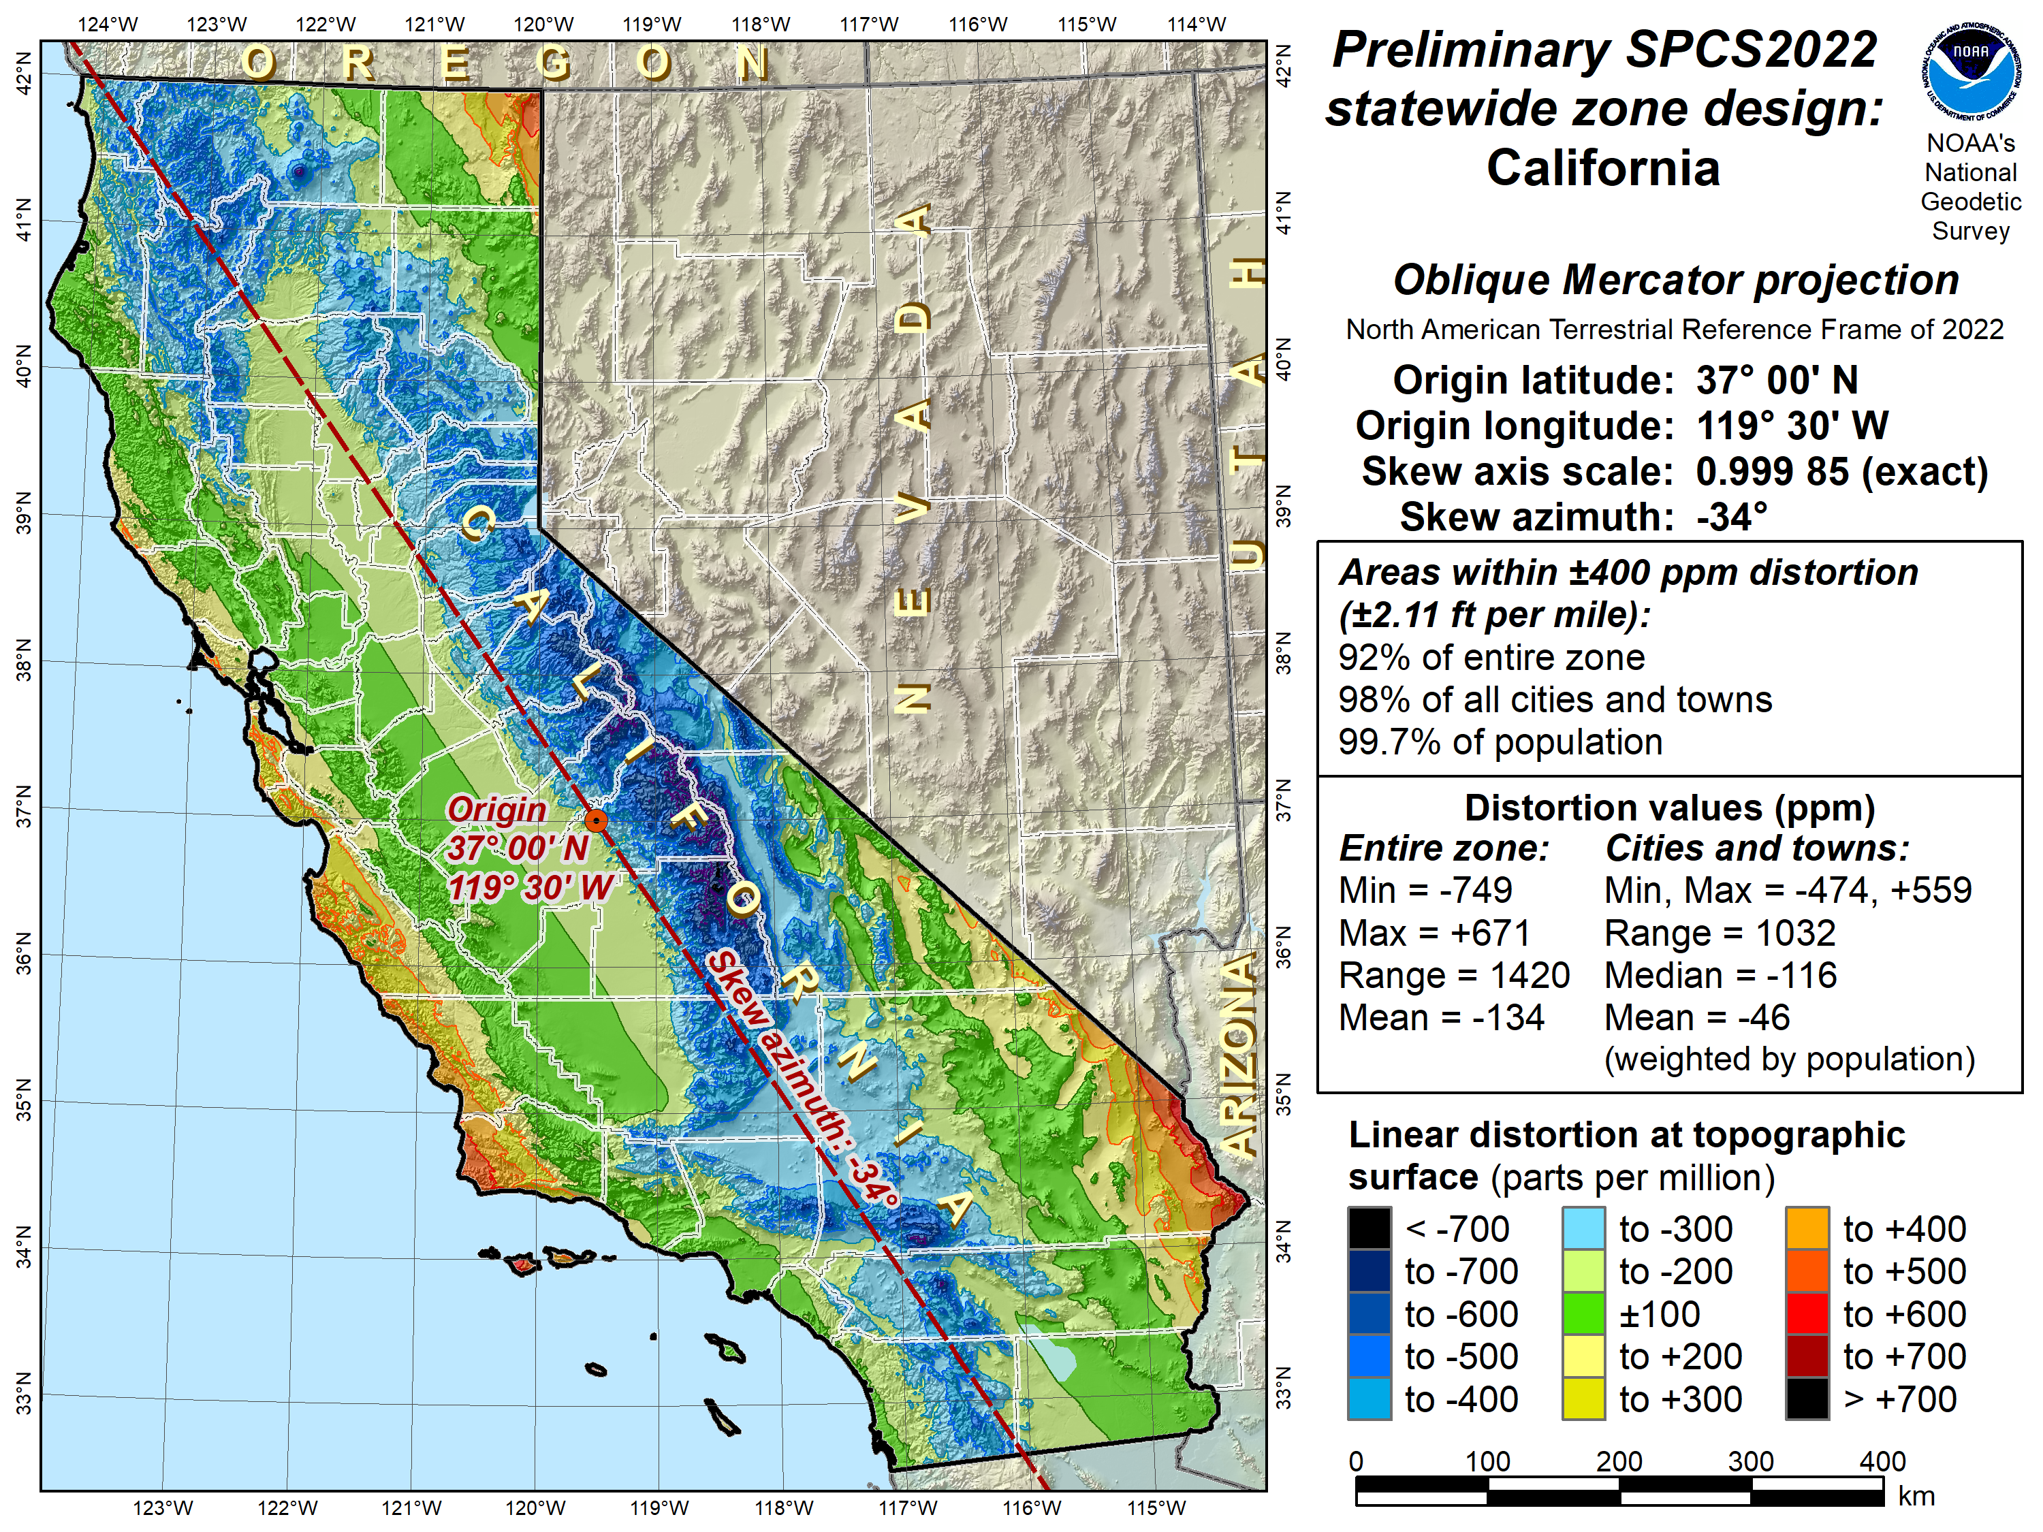

Slide 22
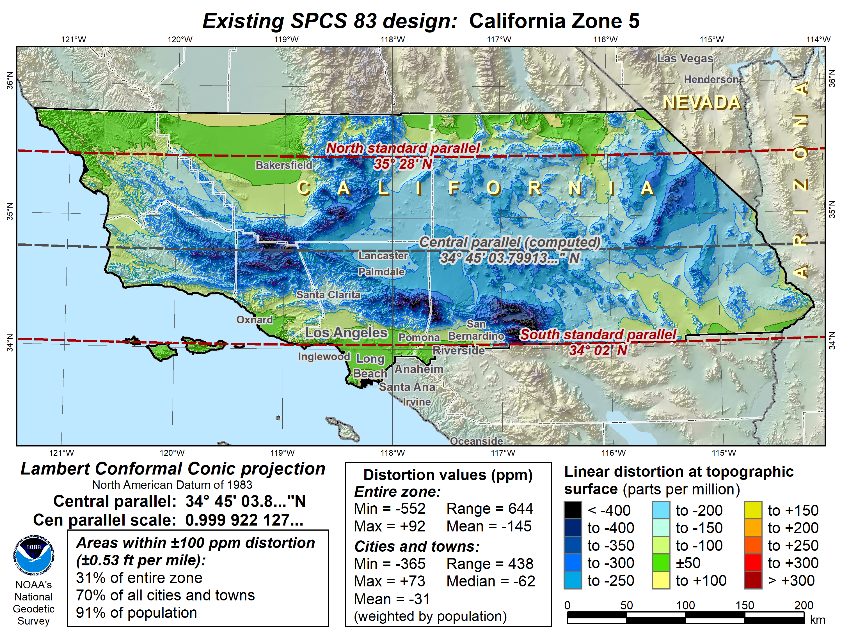

Slide 23
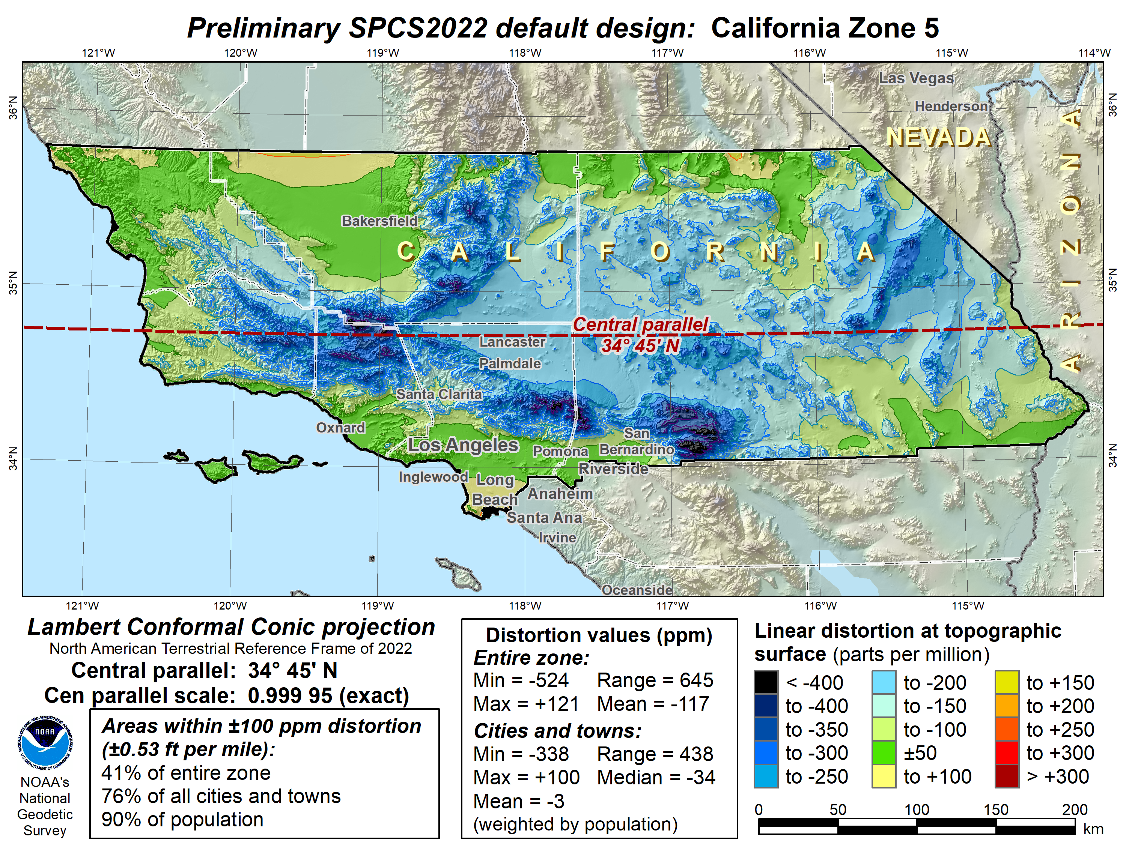

Slide 24
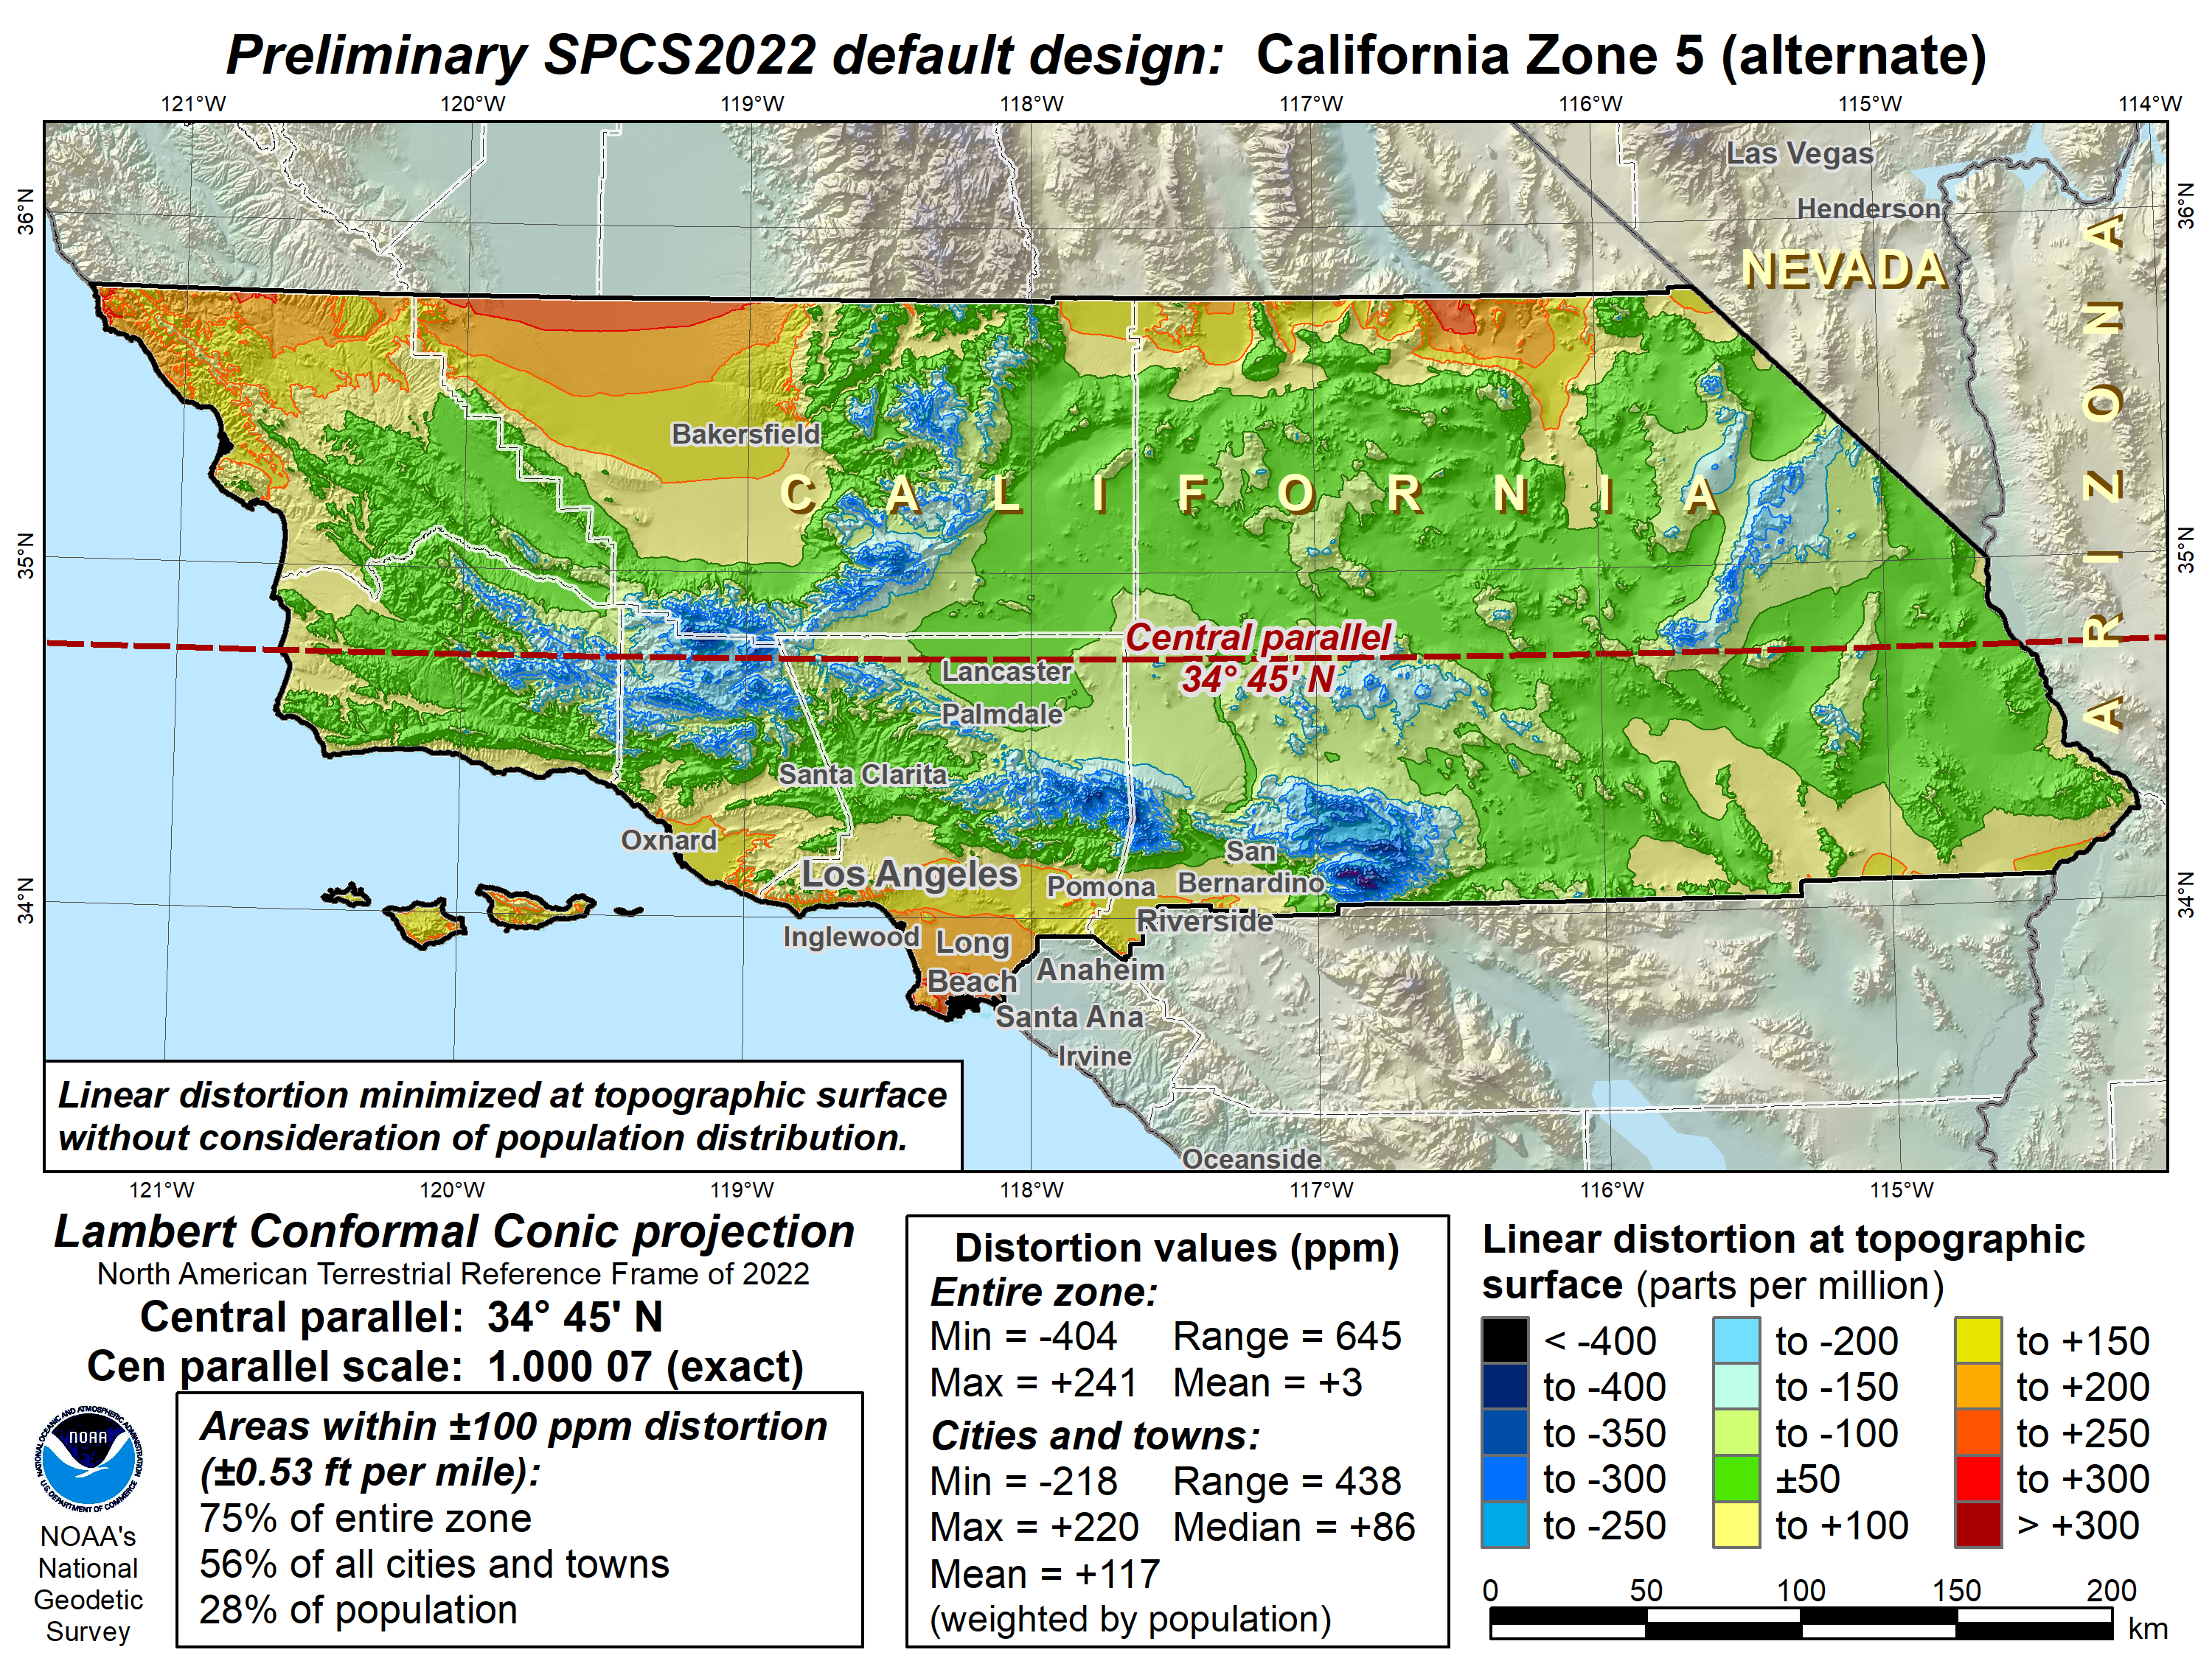

Slide 25
What to expect for SPCS2022
Coordinates will change by at least 10,000 m
  Latitude and longitude change about 1-2 m
  Rest of change due to projection definition
Less difference between “grid” and “ground”
More than one zone layer in most states
  Zones will be similar to SPCS 83 in some states
  Zones will be very different in most states
Every state will have a statewide zone layer

Slide 26
Deprecation of the U.S. survey foot
SPCS2022 parameter definitions metric
  Output coordinates in feet → international feet
  Can use name “foot” or “international foot”
  1 foot = 0.3048 meter (exact)
U.S. survey foot deprecated after Dec 31, 2022
  Will not be used for SPCS2022
  But legacy applications supported (e.g., SPCS 83)

Slide 27
SPCS2022 summary
Minimize distortion at topo surface, not ellipsoid
Up to 3 zone “layers” allowed
  Some layers very similar to existing SPCS 83
  Some layers very different
Total of 968 zones (likely will decrease somewhat):
  54 statewide zones
  911 zones that cover part of a state
  3 special use zones
Will be implemented along with Modernized NSRS
  Earlier usage with NAD 83 will not be supported by NGS
  Can change/add/remove zones after modernized NSRS

Slide 28
New types of Coordinates

Slide 29
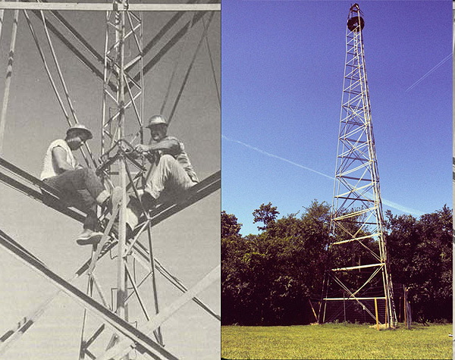
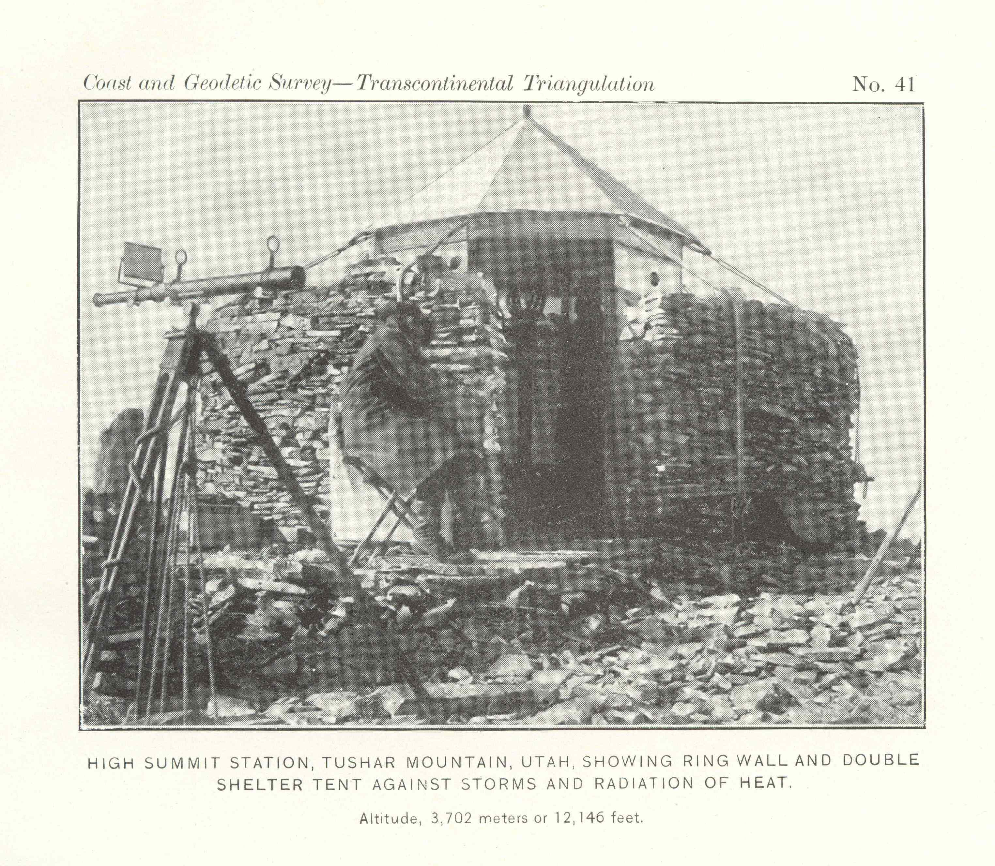
STEEL BILBY TOWER
Notes:
This is how we used to determine coordinates. Time dependency couldn’t be detected. It took years to make observations

Slide 30
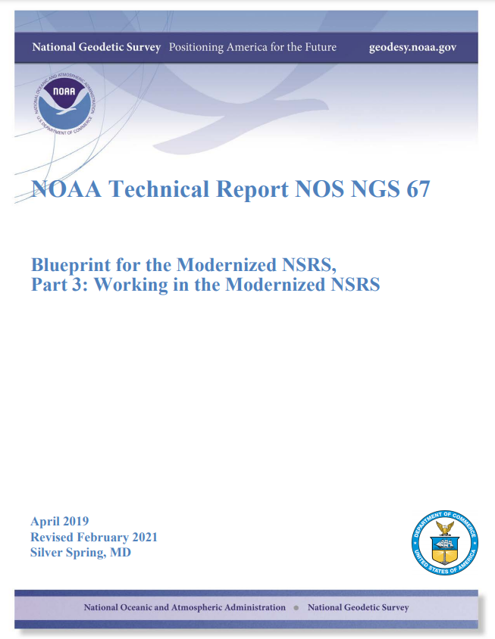
Coordinate: One of a set of N numbers designating the location of a point in N-dimensional space. Specific to the modernized NSRS, five types of coordinates will be supported.
Notes:
All of the information in this presentation is in the NGS Blueprint Part 3
Was updated in 2021
Definitions come directly out of it

Slide 31
New Types of Coordinates
NGS anticipates that 5 types of coordinates will be used in the NSRS. They are:
Reported
OPUS
Reference Epoch
Survey Epoch
Active
Notes:
These coordinate types apply to both geopotential coordinates and geometric coordinates.

Slide 32
“Part of the NSRS”
Only coordinates computed by NGS and stored in the NSRS database are “part of the NSRS”
  Reference Epoch
  Survey Epoch
  Active
OPUS Coordinates can be “tied to the NSRS”

Slide 33
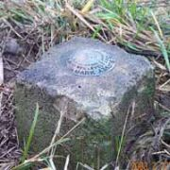
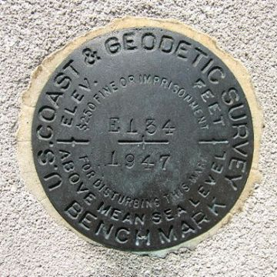
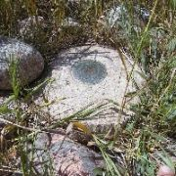
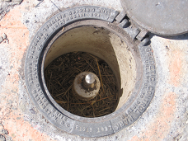
Passive Control
Any geodetic control point that is not active control. Common examples include a metal disk set in concrete or stone, or a stainless steel rod driven into the ground.

Slide 34
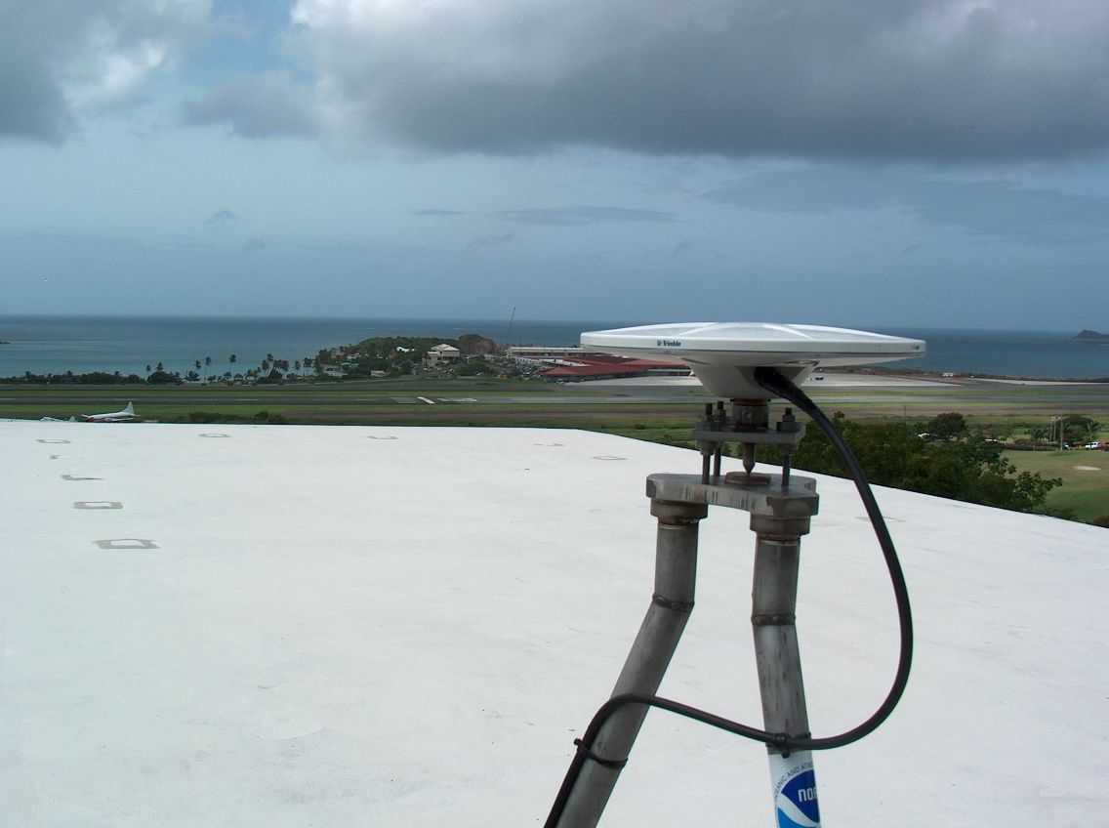
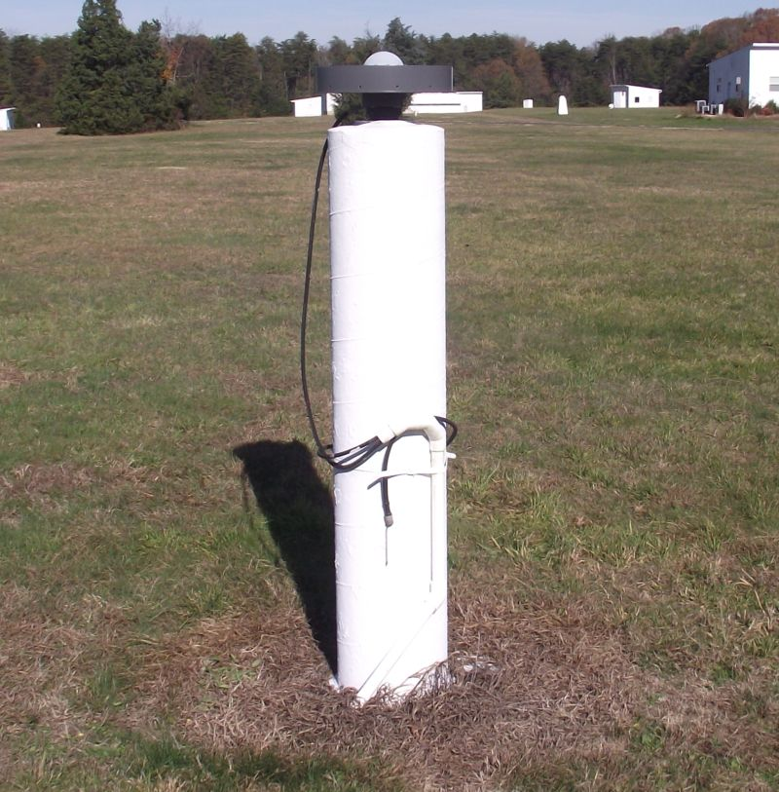
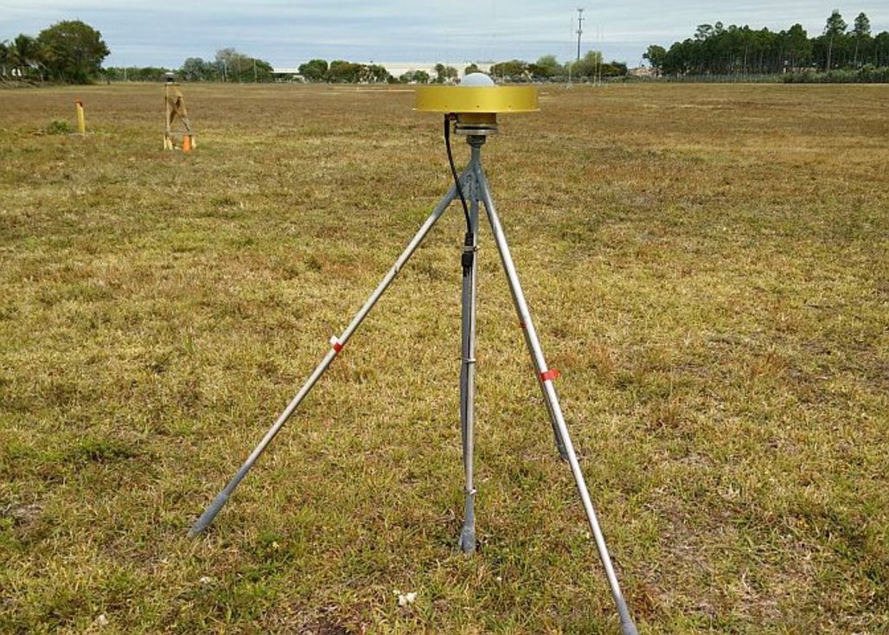
Active Control
A geodetic control point at a station occupied by equipment intended for and capable of continuously collecting geodetic quality data for multiple years and with active defined by or adopted by NGS.
CORS

Slide 35
Shift and Drift
When transitioning off of NAD 83, your coordinates will experience shift and drift
  Shift: A one-time jump somewhere in the 0 to 4 meter range (latitude, longitude, ellipsoid height)
  Drift: Coordinates are now time-dependent. The shift will take you to 2020.00. Working at any other epoch means you must account for the drift (velocity, as well as any other motions over time) of your coordinates

Slide 36
New Types of Coordinates
Reported
  “Coordinates directly reported to NGS without the data necessary for NGS to replicate or evaluate them. These coordinates are neither ‘part of the NSRS’ nor ‘tied to the NSRS.’”
    Scaled from a map
    Transformed using NCAT or VDatum
    Smartphone
    Reported directly from an RTK rover without data files
Notes:
These are coordinates directly reported to NGS without the data necessary for us to replicate or evaluate them.

Slide 37
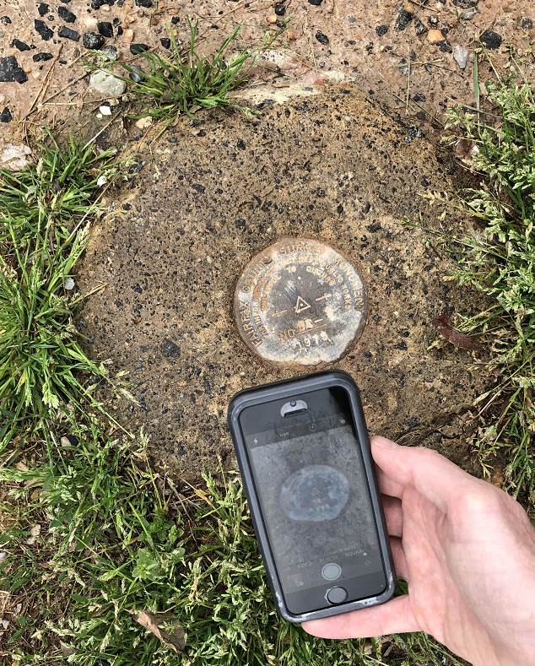
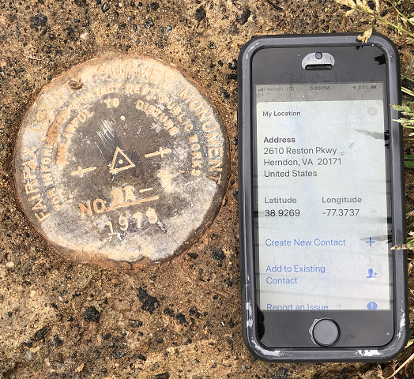
Reported Coordinates

Slide 38
Buyer Beware!
Reported coordinates might be very wrong!
  Reported in NAD 27 or NAD 83 or WGS 84
    Systematic Error: 2–100 meters
  Scaled off of a USGS topographic map
    Random Error: ± 600 meters
  Smartphone
    Random Error: ± 10–50 meters
NGS will show you reported coordinates
  But their function is to get you “in the neighborhood” of a mark, not to use as geodetic control!

Slide 39
New Types of Coordinates
OPUS
  “Coordinates computed by OPUS that have not been evaluated by anyone at NGS. As these coordinates are not computed by NGS they are not considered “part of the NSRS.” However, if NGS-provided OPUS recommendations are followed, they may be ‘tied to the NSRS.’ ”
    User-computed values, such as they might get today from either OPUS-S or OPUS Projects
    “OPUS” coordinates are the only coordinates a user will get directly from OPUS
    NGS will not evaluate your OPUS coordinates!

Slide 40
New Types of Coordinates
OPUS coordinates may also come with the label “tied to the NSRS”
  Only if a user restricts their computations to OPUS-recommended constraints
  Users who deviate from OPUS-recommended constraints can still perform computations and will get OPUS coordinates, but they will not be “tied to the NSRS”, nor have any NSRS label at all.
  In neither case will OPUS coordinates be considered “part of the NSRS” however.

Slide 41
Survey data
OPUS
data processing
Did you follow OPUS recommendations?
yes
no
If you choose to deviate from the OPUS recommendations:
OPUS will warn you when you do
You will receive an explanation why your coordinates are not tied to the NSRS
OPUS Coordinates that are
“tied to the NSRS”
OPUS Coordinates that are
“not tied to the NSRS”
Do you want to “share” your results with the world?
yes
no
Unique, public URL for this survey which you can share with anyone
Your results are shown to you on screen or via email only
Notes:
- this is the modernized NSRS
- OPUS 6.0

Slide 42
New Types of Coordinates
Reference epoch coordinates (RECs)
  “Coordinates estimated by NGS for one of the official reference epochs. As these coordinates are computed by NGS they are considered ‘part of the NSRS’”
  These will be computed by NGS every 5 or 10 years
      On a schedule 2–3 years past the reference epoch
Notes:
These are coordinates computed by NGS in an adjustment project to estimate the coordinates at one of the official (every five or ten years, as currently planned) reference epochs NGS will define
” As (generally) all such coordinates come from observations that did not take place at the reference epoch, such coordinates require the introduction of an intra-frame deformation model (IFDM) into the adjustment, and thus the coordinates so computed are subject to all uncertainties and assumptions in the IFDM. 38 See Section 2.11, and Figure 3.
Part of the NSRS
Based on “snapshot” of entire NSRS control network
Published every 5 or 10 years
Familiar to many users…NAD 83(2011) epoch 2010.00 (sort of) would’ve fallen under this category

Slide 43
New Types of Coordinates
Survey epoch coordinates (SECs)
  “Coordinates computed by NGS for one survey epoch. As these coordinates are computed by NGS they are considered ‘part of the NSRS.’”
    These represent the best estimates NGS has of the time-dependent coordinates at any mark
    Adjusting multiple surveys in timespans called “adjustment windows”, to a single epoch within that window.
      Initial plan: 4 weeks for GNSS; 1 year for leveling
Notes:
These are coordinates computed by NGS using submitted data and its metadata, then checked, adjusted and defined at one “survey epoch.” Thus, they are “part of the NSRS.” These represent the best estimates we have of the coordinates at any mark at some specific point in time

Slide 44
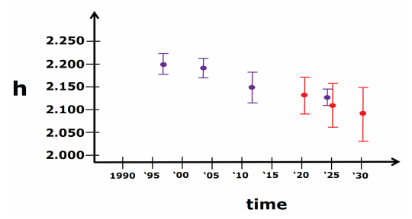
More on SECs and RECs
At passive control
SECs: adjusted to a midpoint epoch near the survey
  (4 weeks for GNSS; 1 year for leveling)
RECs: adjusted to a ref. epoch (2020.00, etc.)
REC adjustments will include Some age-limited span of data
  If that age-limit were 10 years prior and 2 years post R.E., Then 2020.00 RECs come from data spanning 2010.00 to 2021.99999
Notes:
SECs can be used to highlight changes over time
RECs can be used to “hide” changes over time
Exact age-limit won’t be known until we start experimenting in 2022 with the 2020.00 REC adjustments
Ellipsoidal height SECs (purple) and RECs (red) for a fictitious point. Note that RECs are computed on a regular and repeating schedule, but SECs are computed specifically for when data is collected. As such, note the growing error bars for RECs going forward in time as no new data is being collected on this point

Slide 45
New Types of Coordinates
Active coordinates (ACs)
  Coordinate functions in time, generated by NGS, and not associated with a specific epoch. As these coordinates are computed by NGS (or adopted by NGS) they are considered “part of the NSRS.”
  Which will be generated by a “fit” to regularly computed coordinates
Notes:
Unlike all other coordinates, active coordinates are actually coordinate functions in time, and not associated with a specific epoch. They will only be generated by NGS at stations with active control, such as a continuous GNSS receiver or a continuous gravimeter. Thus, they are “part of the NSRS”. At a CORS, they will be identical to the CORS coordinate function (see Terminology Guide). They will not exist on passive control
Daily or weekly CORS coordinates will be generated and the active coordinates will be a function fit to these regularly generated coordinates.

Slide 46
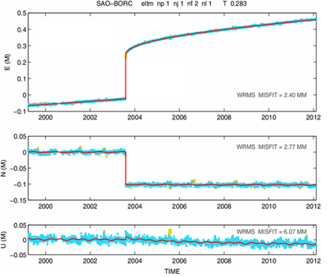
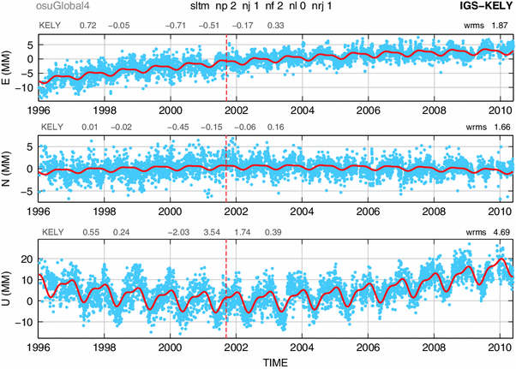
Examples of How Non-Linear CORS Coordinate Functions Might Look

Slide 47
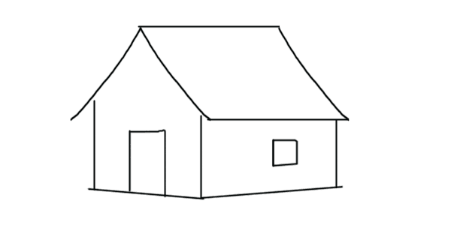
Published Coordinates
RECs ‘stable’ at project scales (5-10 years)

Slide 48
Published Coordinates
RECs ‘stable’ at project scales (5-10 years)
SECs reflective of narrow window in time
ACs or Coordinate Function at CORS
height
time

Slide 49
NCAT https://www.ngs.noaa.gov/NCAT/
X, Y, Z
φ, λ, h
X, Y, Z
SPC
φ, λ, h
NATRF2022
epoch 2020.00
UTM
USSD
USNG
UTM
φ, λ, h
φ, λ, h
NAD 27
NAD 83 (2011)
epoch 2010.00
X, Y, Z
SPC
X, Y, Z
SPC
USNG
UTM
Transformations in RED
Conversions in BLACK
USNG
UTM
NAD 83 (NSRS2007)
φ, λ, h
NAD 83 (1986)
φ, λ, h
NAD 83 (FBN)
NAD 83 (HARN)
φ, λ, h
X, Y, Z
SPC
X, Y, Z
SPC
φ, λ, h
USNG
UTM
USNG
UTM
X, Y, Z
SPC
X, Y, Z
SPC
USNG
UTM
USNG
UTM
Notes:
9 CLICKS slowly
RED are “transformations”. Black are “conversions”. ALL are inside of NCAT.
2 CLICKS slowly
When it is released, NATRF2022 will be added to NCAT.

Slide 50
Coordinates
Five types:
  Active: Continuous functions at a CORS
  Survey Epoch: “Time dependent coordinates”
  Reference Epoch: “Estimated at 2020, 2025, 2030, …”
  OPUS: Computed by you, and as accurate or inaccurate as the choices you make
    Tied to the NSRS if you follow OPUS recommendations
  Reported: Good for finding a point somewhere on Earth.
    Not to be used as geodetic control

Slide 51
Update on Rollout of New Datums

Slide 52
NSRS Modernization: Delay
It’s official: we are delayed beyond 2022
Will names change?
    No, “GEOID2022”, “NATRF2022”, etc. will remain the same

Slide 53
Timeline
Resources are being diverted from tool building to the assurance of quality data first and foremost
As such, based on this new approach, NGS anticipates the release of all data, and limited tools, by the middle of 2025.
  Some of this may depend on things outside of NGS control (we have already delayed beyond 2022!)
Work on additional tools will continue in the out-years

Slide 54
What to look for by the end of 2022
OPUS-S to be updated to M-PAGES
Science papers focusing on least squares adjustments
An “alpha” set of 2020.00 RECs
Notes:
REC=Reference Epoch Coordinates

Slide 55
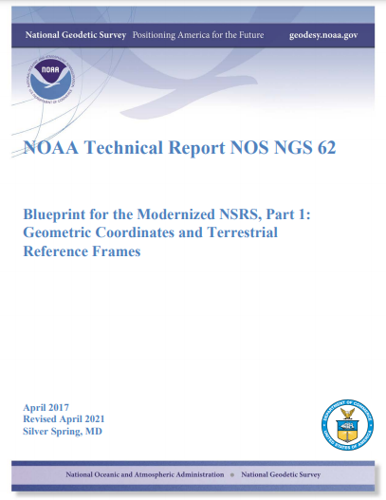
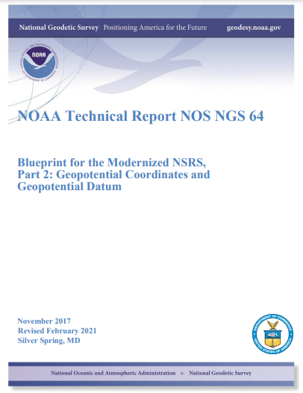
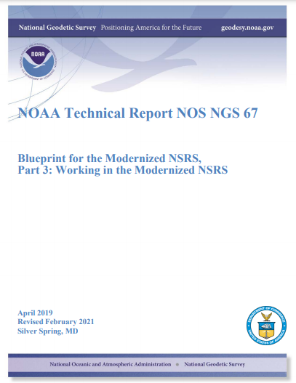
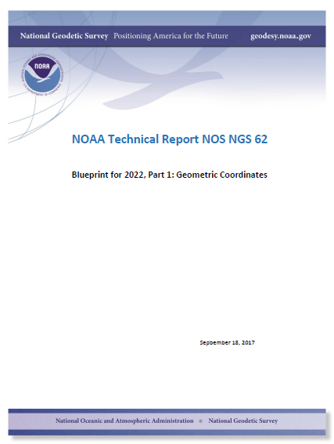
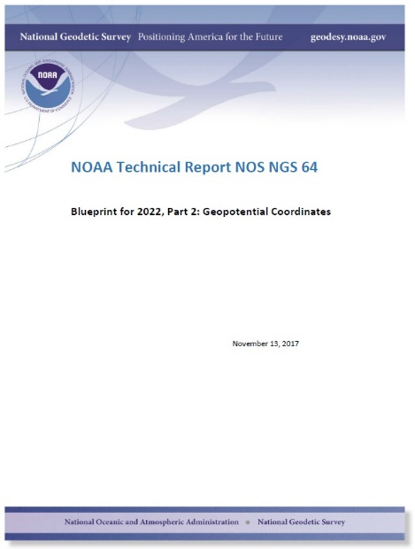
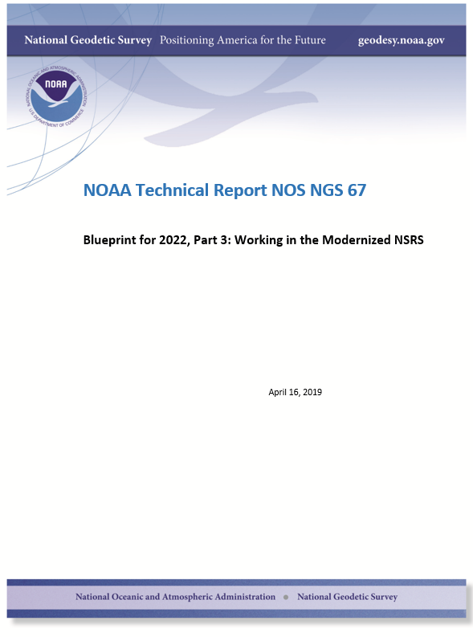
Updated blueprint documents
Available in the NGS Publications Library: https://geodesy.noaa.gov/library/
Geopotential:
Nov 2017
Revised Feb 2021
NOAA TR NOS NGS 64
53 pages
Working in the
Modernized NSRS:
April 2019
Revised Feb 2021
NOAA TR NOS NGS 67
133 pages
Geometric:
Sep 2017
Revised April 2021
NOAA TR NOS NGS 62
61 pages

Slide 56
A two-track approach to coordinates
Reference Epoch Coordinates
Survey Epoch Coordinates
An estimated “snapshot” of entire network
Every 5 or 10 years
Similar to NAD 83(2011) epoch 2010.00
Time-dependent!
Reflects coordinates at time of observation
Multiple SECs can show changes over time

Slide 57
Replacing NAD 83
The Old:
NAD 83(2011)
NAD 83(PA11)
NAD 83(MA11)
The New:
The North American Terrestrial Reference Frame of 2022
(NATRF2022)
The Caribbean Terrestrial Reference Frame of 2022
(CATRF2022)
The Pacific Terrestrial Reference Frame of 2022
(PATRF2022)
The Mariana Terrestrial Reference Frame of 2022
(MATRF2022)

Slide 58
Replacing NAVD 88
  The Old:
  NAVD 88
  PRVD 02
  VIVD09
  ASVD02
  NMVD03
  GUVD04
  IGLD 85
  IGSN71
  GEOID12B
  DEFLEC12B
  The New:
  The North American-Pacific Geopotential Datum of 2022 (NAPGD2022)
  Will include:
  GEOID2022
  DEFLEC2022
  GRAV2022
  DEM2022
  More
Orthometric
Heights
Normal
Orthometric
Heights
A HUGE component of this
effort is GRAV-D:
Gravity for the Redefinition of
the American Vertical Datum
Dynamic
Heights
Gravity
Geoid
Undulations
Deflections of
the Vertical

Slide 59
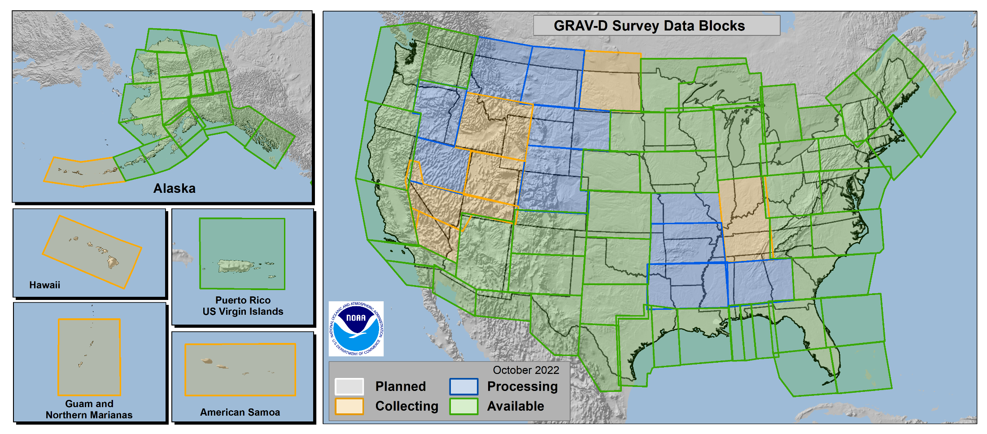
Gravity for the Redefinition of the
American Vertical Datum
GRAV-D
96.8% Complete (11/21/2022)
Notes:
10 km data lines
70 km cross lines
20,000 ft altitude
230 kt flight speed
More information on GRAV-D
https://geodesy.noaa.gov/GRAV-D/
Data Download for GRAV-D blocks
https://geodesy.noaa.gov/GRAV-D/data_products.shtml

Slide 60
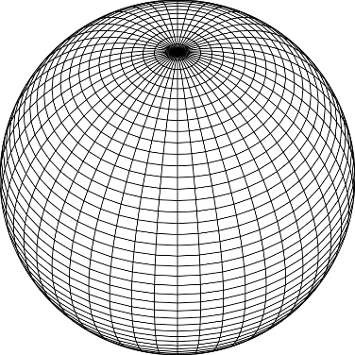
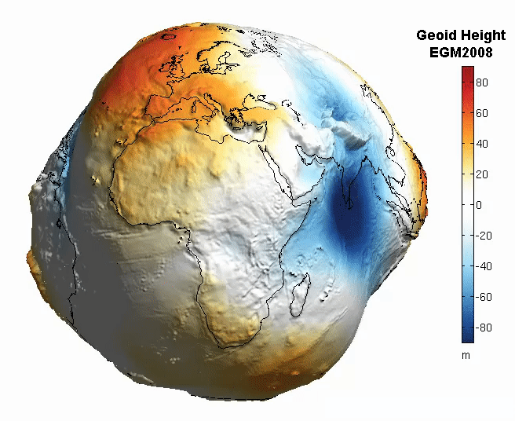
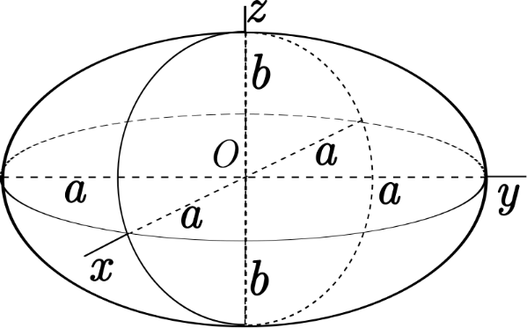
The Earth is Infinitely Complex
Build Models to Simplify
Notes:
Models are used to simplify complex phenomena for humans and computers to understand and perform calculations and analysis.
The geoid is an approximation of sea level and used to calculate elevations (orthometric heights) above this “sea level” surface
Spheroid image https://www.kisspng.com/png-sphere-shape-ball-grid-line-circle-draw-5378189/
Ellipsoid image https://www.kisspng.com/png-figure-of-the-earth-oblate-spheroid-ellipsoid-4129812/
Geoid Image https://www.reddit.com/r/MapPorn/comments/3xf6a0/geoid_height_of_new_global_gravity_field_models/

Slide 61
The Geoid, and Heights
h
= H
+ N
h: ellipsoidal height
H: orthometric height
N: geoid undulation
Topography
h
H
The geoid
N
A chosen
ellipsoid
Notes:
Fundamental changes to how we access the vertical datum

Slide 62


What modernization means
Positions and Heights will change

Slide 63
OPUS-PROJECTS Updates

Slide 64
NGS Products and Services
Not just OPUS
All exist in three environments:
  Development (DEV) - internal testing and development
    same as when you hear a company talk about an “Alpha” product
  Beta - continued internal testing, open for public testing
    key features have already been vetted/tested
  Production - final product, open to public use
    this is what you see first when navigating our website
Notes:
I’ll be talking about OPUS today, but I need to clarify one of our processes for this to all be clear. I will also mention that this is a new-ish workflow for NGS, began in the past 8 or so years.
So all NGS Products & Services go thru this process as they are created, tested internally, open for testing by you our constituents, and then rolled out as final products.
CLICK
There’s three environments that products will exist in, listed here in the order they occur
First, a tool will be created on the “DEV” servers for internal NGS-only development, testing, and otherwise “working the bugs out”
→this is the same phase as when you hear a software company or video game maker talk about their alpha products
CLICK
Next, after some level of confidence in the product is gained, it will be migrated to the Beta servers, thereby open to the public for their own testing
→it’s important to note that when a product is available via our Beta page, when you use it you are indeed now a “beta tester”
key features will have already been tested in the Development environment, but it is still a beta, so as a beta tester please let us know if you have issues/complications/struggles or the like
CLICK
At some point, when all I’s are dotted and T’s crossed, the thing will be moved to the Production environment.
→ by then, the tool is integrated into others, has been vetted with 2 testing phases and functions as expected, but may still continue to receive version updates by repeating this process

Slide 65



www.ngs.noaa.gov
beta.ngs.noaa.gov
Remember, you won’t see the DEV environment…
Notes:
So here we have 3 screenshots, first here showing the Production OPUS Projects gateway page
CLICK
Second is the Beta page, with the text here showing the URL for our Beta homepage
-How do you find that beta page? substitute “beta” for “www”
-or most tools that have a beta will have a link to that beta platform
CLICK
Last is the Development or DEV example, which again you will not see unless via a demo from NGS personnel

Slide 66
Why use OPUS-Projects?
Supports both static GPS and RTK GNSS surveys
Organizes data for multiple occupations on more than one mark
  Campaign-style surveys for control
Performs least squares adjustments of control survey networks
  Estimate relative accuracy between marks
Constrains NAVD 88 bench marks – check/establish NAVD 88 heights
Ensures survey is tied to the NSRS
  CORS data and published coordinates/heights
  Official models (HTDP, GEOID18)
Submits survey to NGS for review, loading in database, and publication on datasheets
  Establishment of geodetic control
  NGS will use data for making models (e.g., future transformation model for the new datums)

Slide 67
OPUS-Project 4.0
Currently on Production
What does this version add?
  Allows you to submit campaign style GPS survey to NGS for inclusion in the IDB (Integrated DataBase)
    Upload GPS data to OPUS-S
    Upload photos and mark descriptions
    Process simultaneous/overlapping sessions
    Run network adjustment (using GPSCOM and ADJUST)
    Click the “Submit” button to send to NGS!
(must be created using WinDesc)
Notes:
OP 4.0, our recent improvement allows users to submit campaign-style GPS surveys for inclusion into the NGS Integrated Database
→if you haven’t heard the phrase IDB before, that’s the database that holds the coordinates that you get on a Datasheet
So with version 4.0 you can
CLICK
Upload GPS data to OPUS-S
CLICK
Upload mark descriptions and photos … I do want to point out that descriptions and photos must be created/formatted with another tool we provide called WinDesc
CLICK
Process simultaneous/overlapping sessions
CLICK
Run least squares adjustment on the resulting network
CLICK
Then when you’re ready to submit just click the “Submit” button to send to us!
CLICK
For full details see our Webinar Series, recorded on 11 February 2021

Slide 68
OPUS-Projects 5
Available on BETA at: https://beta.ngs.noaa.gov/OP-bluebook/OpusProjects.shtml
Continues to support static GPS baseline processing and network adjustments
Continues to prepares all files according to FGCS Bluebook for submission to NGS for loading in the NGS Integrated Database and publication on Datasheets
Supports GVX → uploading of previously processed GNSS vectors
  Single-base RTK vectors
  Network RTK vectors
  Vectors post-processed in other software
Automatically “weights” uploaded vectors in a network least squares adjustment

Slide 69

Real-Time Networks
Virtual Reference Stations (VRS)
Master-Auxiliary Concept (MAC)
Vector “tails” referenced to virtual base station
Base station position is variable
Vector “tails” connected to physical base station
Base station position is fixed
RTN Base
RTN Base
VRS
Control
Center
(Landau et al. 2002)
RTN Base
(Leica 2005)
Notes:
VRS
1.) Rover sends approx. position to RTN control center
2.) Control center assigns this position as the location of an imaginary base station and interpolates corrections at this virtual location
3.) These interpolated corrections are used to generate corrected pseudo-observables that are “transmitted” from the virtual base to the rover to be processed using conventional single-base RTK algorithms to solve for precise geodetic coordinates at the rover (Wang et al. 2010)
MAC
1.) The rover transmits an uncorrected point position to the central server, and then the server searches and selects a “cell” of reference stations for generating corrections
2.) The phase ranges from all selected stations are reduced to a common ambiguity level, and dispersive and nondispersive errors for each frequency and satellite-receiver pair are computed relative to the master station
3.) The residual corrections between the auxiliary stations and the master station, as well as the full corrections and published coordinates at the master station are transmitted to the rover. The rover then interpolates the received corrections and network information to derive its precise position (Janssen 2009).

Slide 70

Empirical Evaluation of the Accuracy of RTNs
95% Confidence
± 5.0 cm, vertical
± 2.5 cm, horizontal
Or similar to accuracy of a 2-h OPUS-S solution!
Ellipsoid Height
Horizontal
[Allahyari et al. 2018]

Slide 71
GNSS Vector EXchange Format (GVX)
Website: https://www.ngs.noaa.gov/data/formats/GVX/index.shtml
Detailed documentation
Schema (XSD)
Example vector files
GVX is written in Extensible Markup Language (XML)
Designed to store and carry data in plain text format
Flexible representation of arbitrary data structures
Extensible – new elements can be added later without breaking applications
Both machine-readable and human-readable
Schemas can be used to define “must haves” and “should haves”

Slide 72
GVX Flow Chart

Slide 73





Status of GVX Exporters
Available Now
Trimble Business Center (TBC) 5.60 (11/15/2021)
Topcon MAGNET Field v. 7.2 (11/18/2021)
Coming Soon
Leica Infinity 4.0.0 (coming in 2022)
i-GAGE X-PAD
JAVAD in Triumph-LS device

Slide 74
Steps for Submitting a Survey to NGS
Submit a survey project proposal and obtain a project tracking ID
Create descriptions for marks in WinDesc. Tutorial video available
Upload all static data via Beta OPUS-S
Upload GVX file(s)
Upload description files from WinDesc
Perform session baseline processing
Run all 5 network adjustments
Upload 3 photos per mark (close-up of mark, horizon photo, and downward from eye-level)
Upload observation logs (as a single PDF), and a project report
Submit to NGS (button not enabled on Beta)
All but step 4 is currently explained in the OPUS-Projects User Guide!

Slide 75

Guidance for RTK Surveys

Slide 76
Additional Guidance
Repeat occupations:
  Start time differs by > 3 hours
  Recommended allowable precision
Vertical Standard | Horizontal Precision (cm) | Vertical Precision (cm)
3.0 | 3.0 | 6.0
2.5 | 2.5 | 5.0
2.0 | 1.0 | 2.0

Slide 77

Equipment Setup
When using VRS, store points as vectors

Slide 78



Three Cases for RTK/RTN Bases
RTN Base = CORS
Automatically attaches GVX vectors to official coordinates for CORS
Constrain CORSs
RTK/RTN Base = Not a CORS and new to NGS
Upload static GPS data logged at the base during the days of the RTK survey
Perform session baseline processing to connect to CORSs
Constrain CORSs
3. RTK/RTN Base = Not a CORS but has a datasheet
Could constrain coordinates on datasheet
Or, upload static data at the RTN base, logged during the days of the RTK survey; perform session baseline processing; constrain CORSs

Slide 79
Future Directions
Perform Beta Testing and respond to feedback from users
  Provide your feedback! NGS.Feedback@noaa.gov
Finish OPUS-Projects 5 development and enable “submit” button
Update OPUS-Projects User Guide materials to include GVX workflow
Draft new guidelines for surveying with RTK/RTN to replace NGS-58/59

Slide 80
Brief overview:
Re-inventing “Bluebooking” or
The Modernized OPUS
AKA
“OPUS 6”

Slide 81




Static GNSS
RTK/RTN
Classical
Leveling
Rel. Gravity
RINEX
GVX
CVX
LVX
RGX
RINEX
GVX
CVX
LVX
RGX
RINEX
GVX
CVX
LVX
RGX
RINEX
GVX
CVX
LVX
RGX
Upload multiple types of data and multiple files into a single survey project
Process RINEX into a position (like today’s OPUS-S)
Process RINEX into mark-to-mark vectors
Process Classical into mark-to-mark angles/distances
Process Leveling into mark-to-mark ortho. differences
Process Rel. Gravity into mark gravity
Combine GNSS, RTK/N, Classical in a Geometric Adjustment
Combine Classical and Leveling in an Orthometric Adj.
Adjust Relative Gravity for either gravity or vertical gradients in a Gravimetric Adjustment
Special settings for “Calibration Base Lines”
Choose your epoch and frame
All coordinates returned are “OPUS Coordinates”
Submit your data to NGS for QA/QC, database loading, and improvement of future passive mark coordinates (RECs and SECs)
OPUS 6
Notes:
OPUS 6 will allow you to upload multiple types of data, and multiple files for each type, to a single survey project. You can then process/reduce the data, and adjust it.
The colors imply how finished each format is. RINEX is well established, GVX was released in 2021 but requires an update, likely in 2022 in a joint roll-out with CVX and LVX. RGX has not been substantially fleshed out yet.

Slide 82
Data delivery system
The future of datasheets

Slide 83
Data Delivery System
The Data Delivery System (DDS) is a system for querying the new NSRS database
  The most common query will be for a new version of datasheets
  But other queries will be part of the DDS
    Mark recovery and mark reporting
    Active control (CORSs)
    Projects, observations, data, etc.

Slide 84

Datasheets are the current way to access the NSRS
Give information about passive marks, including coordinates

Slide 85
ASCII Datasheet for PID=AC6803
Starting Datasheet Retrieval...
1 National Geodetic Survey, Retrieval Date = JULY 1, 2022
AC6803 ***********************************************************************
AC6803 HT_MOD - This is a Height Modernization Survey Station.
AC6803 PACS - This is a Primary Airport Control Station.
AC6803 DESIGNATION - AZC A
AC6803 PID - AC6803
AC6803 STATE/COUNTY- AZ/MOHAVE
AC6803 COUNTRY - US
AC6803 USGS QUAD - LOST SPRING MOUNTAIN EAST (2018)
AC6803
…

Slide 86
JSON Datasheet for PID=AC6803
{"datasheet":
{
"datasheetHeading":"National Geodetic Survey",
"datasheetRetrievalDate":"JULY 1, 2022",
"htMod":"This is a Height Modernization Survey Station.",
"pacs":"This is a Primary Airport Control Station.",
"determinedProjects":[
{"project":"GPS1154"},{"project":"GPS2300"},{"project":"GPS2507"},{"project":"GPS280"},
{"project":"GPS2846"}
],
"observedProjects":[{"project":"GPS1154"},{"project":"GPS1195/11"},{"project":"GPS2507"}],
"occupiedProjects":[{"project":"GPS1154"},{"project":"GPS1195/11"}],
"designation":"AZC A",
"pid":"AC6803",
"state":"AZ",
"county":"MOHAVE",
"country":"US",
"quad":"LOST SPRING MOUNTAIN EAST (2018)",
…
}
}

Slide 87

Beta Passive Marks page
Easier to read
Includes geospatial information
A preview of the future data delivery system
https://beta.ngs.noaa.gov/datasheets/passive-marks/index.html
Notes:
Show DE9524, a mark near Springfield

Slide 88


Beta Passive Marks page

Slide 89


Beta Passive Marks page

Slide 90

Easy to use mark recovery tool
https://geodesy.noaa.gov/cgi-bin/mark_recovery_form.prl

Slide 91

NGS Map
https://noaa.maps.arcgis.com/apps/webappviewer/index.html?id=190385f9aadb4cf1b0dd8759893032db

Slide 92
GPS on Bench Marks

Slide 93

GPS on Bench Marks
Priority Map:
https://noaa.maps.arcgis.com/apps/webappviewer/index.html?id=6093dd81e9e94f7a9062e2fe5fb2f7f5
https://geodesy.noaa.gov/GPSonBM/

Slide 94




GPS on Bench Marks - What & Why?
GPS on Bench Marks is about preparing the country and our communities to take full advantage of the benefits of the Modernized NSRS, by collecting new GPS observations on bench marks with published NAVD 88 heights.
Primary GPSonBM Campaign Benefits:
2020.0 Reference Epoch Coordinates (REC’s)
Data for NAVD 88 – NAPGD2022 Transformation Tools
Build time series of observations in areas of motion
Added benefits:
Evaluate gravimetric geoid models
Check your RTN results
Update and maintain passive control marks
Identify marks suspected of movement
Notes:
NGS’ GPSonBM program is now requesting data to build the models that NCAT and VDatum will use to transform geospatial data from existing datums to the Modernized National Spatial Reference System.
These are the benefits that we derive that other countries could derive as well. The processes, tools, workflow, and technical specifications that we have developed can be applied in other places. We are keeping in house the definition of the NSRS, outsourcing the observations to realize the frames
Went back to marks that were set before that are no longer accessible or gpsable – so this provides ongoing maintenance. Marks were set open fields and now are developments – road widening (Chicago grew)
revisit Geodetic infrastructure regularly for maintenance

Slide 95


GPSonBM Measurements Connect
Current and Future Datums
The relationship between the old and new datums vary by location. GPSonBM data is used to measure that relationship. The accuracy of the transformations in any particular place will be directly related to the density of GPSonBM data available in that area.
  In moving from NAVD 88 to NAPGD2022, there will be a Shift: A one-time 0 to 2 meter jump in orthometric heights
  -From fixing biases and/or tilts in NAVD 88
PID: EZ0840
GPSonBM data is used to measure the Shift

Slide 96



2022 Transformation Tool Campaign
NGS will make a national scale, mapping grade transformation tool with the data we have in the NGS Database and Shared through OPUS. We must interpolate over areas with data gaps.
Uncertainties in the transformed coordinates will grow larger as the distance from a GPSonBM data point increases.

Slide 97




Data Contribution Routes
 | via OPUS option “share my solution” | via OPUS option “project ID”
WHAT DATA? | minimal one receiver, one 4+ hour observation | more; many receivers, redundant sessions, network adjusted by project manager
USE, in transformation tool | Will be used in modeling, existing BMs only (with published ortho heights) | Will be used in modeling, all marks, as projects publish new NGS datasheets with ortho heights
USE, in current generation datasheets | for all marks, results appear as ‘shared solutions’ = not published geodetic control for existing BM datasheets only, updates “SCALED”>“HD_HELD2” coordinates | for all marks, results appear as NGS datasheets = published geodetic control
USE, in next generation datasheets | will be published with 2020.00 RECs in the modernized NSRS
see also, mark recovery to update mark descriptions and add photos

Slide 98



FAQ’s #1
Q: What is the deadline to submit GPSonBM for the Transformation Tool?
A: December 31, 2022 – so that observations can be used to create 2020.0 Reference Epoch Coordinates (See Blueprint 3 -Working in the Modernized NSRS)
Q: Can we submit previous observations?
A: Yes! Observations made within the past 3 years may be submitted if you have the required metadata and pictures.
Q: What do we do if we can’t find the priority mark or if it not observable with GPS?
A: 1) Submit a Mark Recovery with the new Mark Recovery Form.
2) Find and observe a secondary mark listed in the hexagon layer on the web map.

Slide 99
FAQ’s #2
Q: Can we submit offset observations for marks that are not GPS-able?
A: Not for now, unless you follow the NGS Mark Reset Procedures. In the future, OPUS 6.0 will enable you to process and adjust GPS, leveling, and total station observations together, and submit them to NGS.
Q: Can we submit less than 4 hours of data?
A: Yes, but only by using OPUS Projects to Bluebook the data.
Q: Can we submit RTK observations?
A: YES! The recently released BETA version of OPUS Projects 5.0 enables processing of Hybrid Survey Networks that include both static and real-time observations uploaded in the new GVX vector exchange file format.

Slide 100

https://geodesy.noaa.gov/
Notes:
Monthly webinar series
All webinars are recorded and available online
Online lessons
Video library
Publication library
NSRS Modernization News

Slide 101
Thank You!
Dana J Caccamise II, Ph.D.
Pacific Southwest Regional Geodetic Advisor (CA NV)
U.S. National Geodetic Survey, NOAA
Dana.Caccamise@noaa.gov
Hosted by the California Spatial Reference Center (CSRC)
located at Scripps Institution of Oceanography (SIO) at the University California San Diego (UCSD)
For more information, visit https://geodesy.noaa.gov

Slide 102
IGLD Update

Slide 103
What is IGLD?
International Great Lakes Datum (IGLD) is a common height reference system by which water levels can be measured and meaningfully related to each other
Joint effort between the United States and Canada
Maintained by the Coordinating Committee on Great Lakes Basic Hydraulic and Hydrologic Data
Due primarily to Glacial Isostatic Adjustment, IGLD is updated every 25-35 years
The next update will be IGLD (2020)

Slide 104

Current IGLD
IGLD (1985) replaced IGLD (1955) in 1992
Same reference zero as NAVD 88 (at Pointe au Père, Québec)
Surface determined by leveling
Dynamic heights
Hydraulic correctors

Slide 105



IGLD (1985) Reference Surface
Reference surface is each lake (equipotential surface) to which heights are referenced
IGLD 1955 & 1985 used 1000’s miles of geodetic leveling to indirectly define the reference surface
  Very time consuming & cost prohibitive
  Datum accessible only where leveling exists (benchmarks)
  Susceptible to accumulation of systematic errors
Extends the reference zero inland

Slide 106


Why a new IGLD?
Glacial Isostatic Adjustment – (GIA)
Uplifting in north
Subsiding in south
Overall tilting ~7 mm/year (21cm or 0.7’ over 30 year)
Need to update IGLD every 25-30 years
Process of Glacial Isostatic Adjustment (left) and the resulting tilting of the entire Great Lakes region (right) as determined by high accuracy GPS measurements in units of mm/year. M. Craymer and C. Wisotzkey, 2021.

Slide 107

Definition of IGLD (2020)
Reference Zero
  $W_{0}$ = 62,636,856.00 m²/s² that the U.S. and Canada have adopted for the new geoid-based North American-Pacific Geopotential Datum of 2022 (NAPGD2022) & Canada has already adopted for the Canadian Geodetic Vertical Datum of 2013 (CGVD2013)
Realization of the Reference Surface
  NAPGD2022 geoid model representing the reference zero everywhere over the Great Lakes – St. Lawrence River system, not only where leveling and bench marks exist
Reference Epoch
  2020.0, the central epoch of the 7-year water level observation period of 2017–2023
Dynamic Height
  IGLD (2020) will use dynamic heights derived from GNSS occupations
  The dynamic height represents the difference in potential above the reference surface and is the same at all points on a level surface
Notes:
IGLD (2020) will be completely compatible with dynamic heights in CGVD2013

Slide 108
Status of IGLD Update
GNSS field campaign planned for 2022 – no plans to postpone again
Seasonal gauging continues
Hydraulic corrector working group set up to investigate the need for HCs in IGLD (2020)
IGLD (2020) is planned for release about one year after the release of the NAPGD2022 vertical datum

Slide 109


