Slide 1



U.S. Datums: Where We’ve Been,
Where We’re Going
University of Florida Geomatics Program
Webinar Presentation
October 2, 2018
Denis Riordan, PSM
NOAA, National Geodetic Survey
denis.riordan@noaa.gov

Slide 2
Presentation Outline
1. - Introductions.
- National Geodetic Survey.
- Horizontal Datums / New Reference Frames.
- Vertical Datums / New Geopotential Datum.
- Update on NGS Products.
- Questions.

Slide 3
U.S. Department of Commerce
National Oceanic & Atmospheric Administration
National Geodetic Survey
Mission: To define, maintain & provide access to the
National Spatial Reference System (NSRS)
to meet our Nation’s economic, social & environmental needs
National Spatial Reference System
* Latitude * Scale
* Longitude * Gravity
* Height * Orientation
& their variations in time
Notes:
- NSRS benefit to the nation = $2.5B/year
est. 300K precision GPS users worldwide (2008); ¼ in US
- Very exciting to us at NGS to see how it has evolved over the years – now cm-accuracy capability / tracking with time

Slide 4
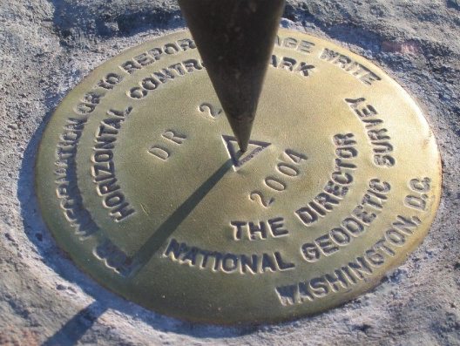
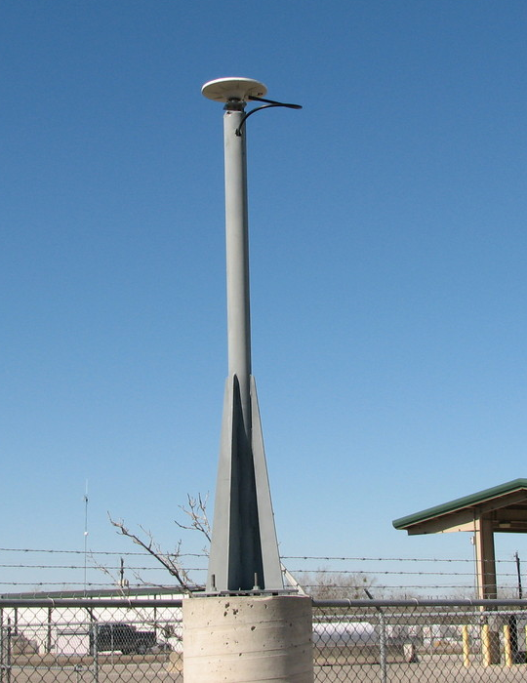
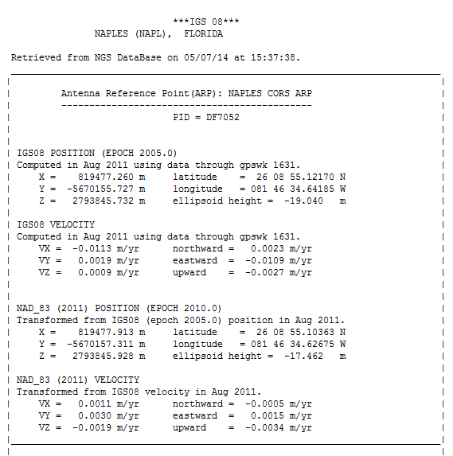
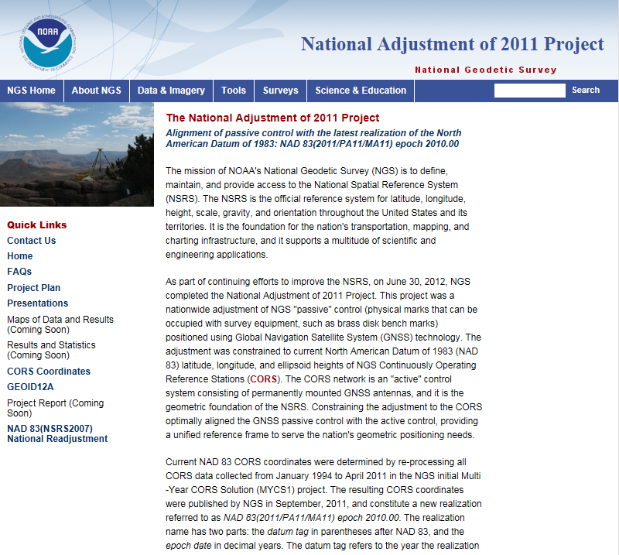
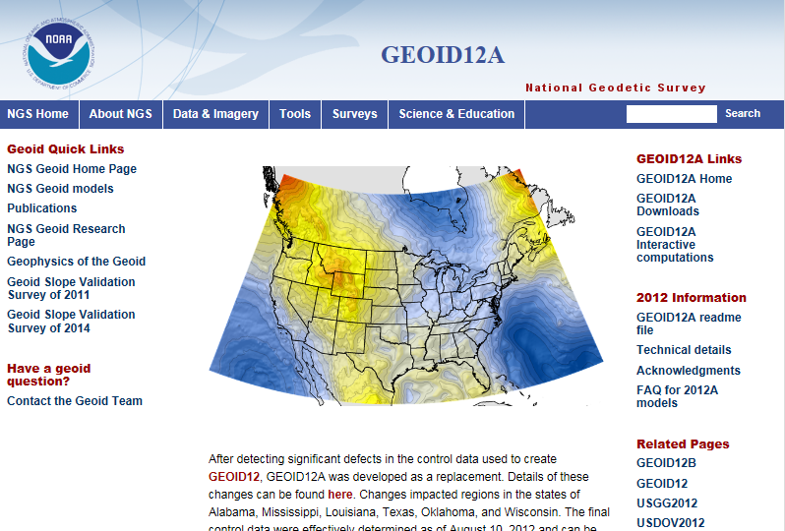
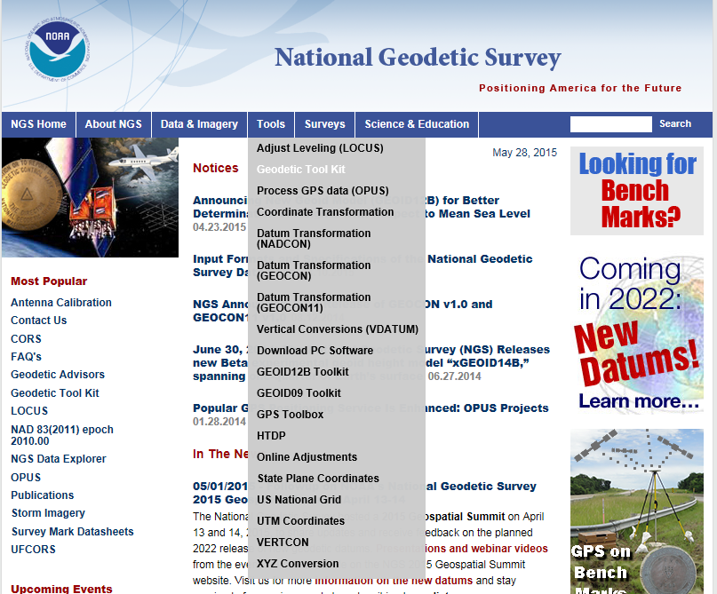
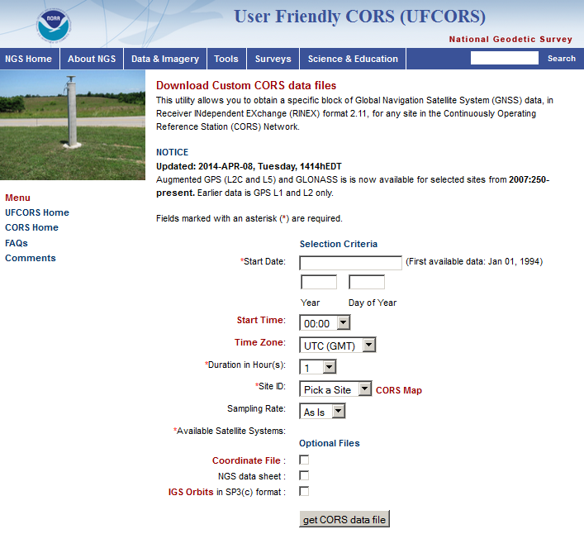
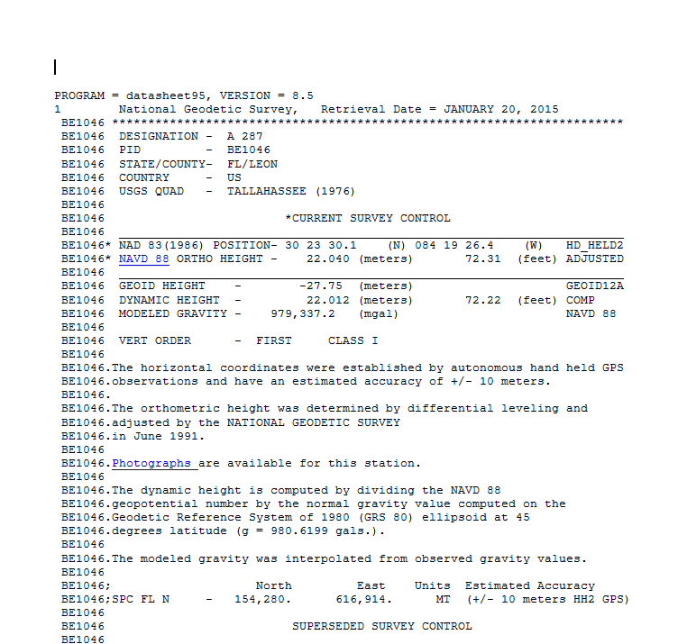
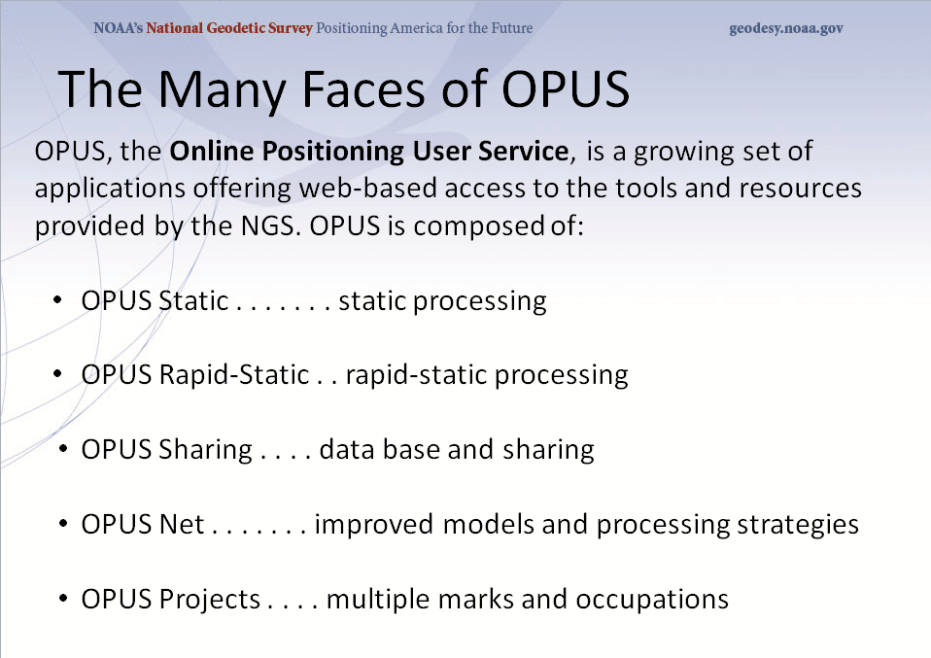
NGS MISSION - The NSRS
Define - National Coordinate Sys. (NSRS)
Maintain - the NSRS
Provide Access
Notes:
Define: explain how NSRS was developed through the passive network, status of passive network, and how NSRS now based on CORS network.
Maintain: determination of CORS positions and the changes to those positions, datum (ref. frame) updates (ex. NAD (2011), updated hybrid geoid models, programs and tools for transformations, inverses, on-line vertical leveling adjustments, Geodetic Tool kit.
Access: provide access to the NSRS through CORS static data, control mark datasheets, and the suite of OPUS products.

Slide 5
U.S. Horizontal (& Geometric) Datums

Slide 6
Datums - Horizontal
Horizontal
North American Datum Of 1927
- Used early triangulation surveys (first called US Std Datum).
- Based at Meades Ranch, KS & used Clarke 1866 spheroid.
North American Datum of 1983 (1986)
- Used 250,000 points (triangulation, Doppler, a few GPS pts).
- Based at geocentric location using Geodetic Ref. Sys. 1980.
Updates*
NAD83 (1990’s) – State HARN / FBN surveys.
NAD83 (late 90’s – early 2000’s) – Efforts to establish ellipsoid heights.
NAD83 (2007) – Remove regional distortions, better with align CORS.
NAD83 (2011) – Adjustment to realign CORS / passive control.
* Not a new datums

Slide 7
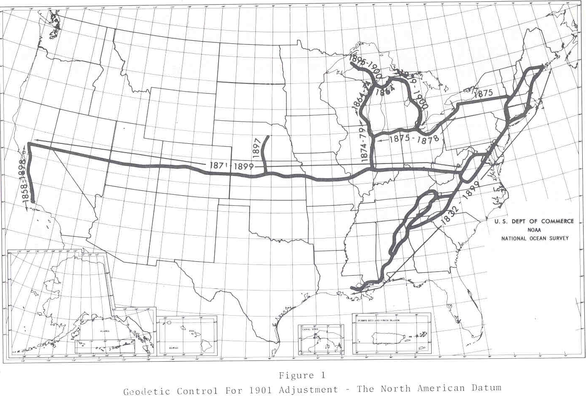
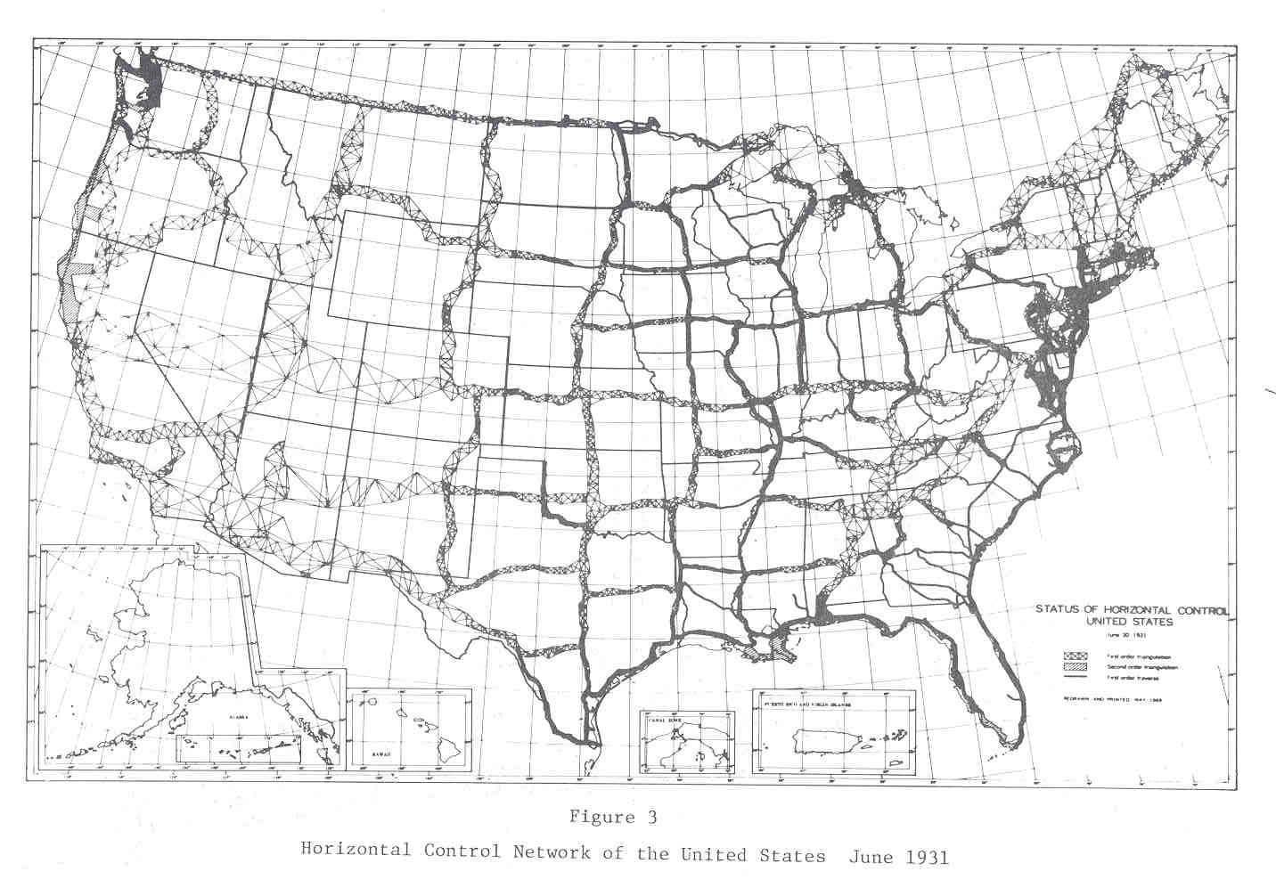
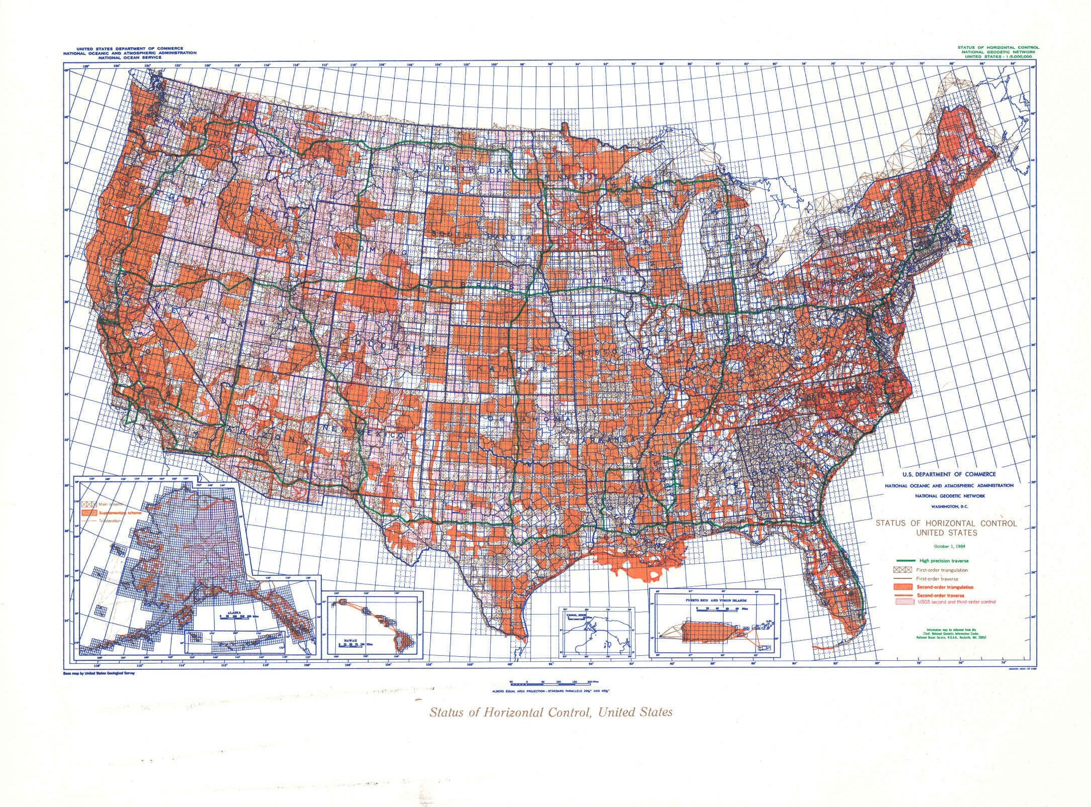
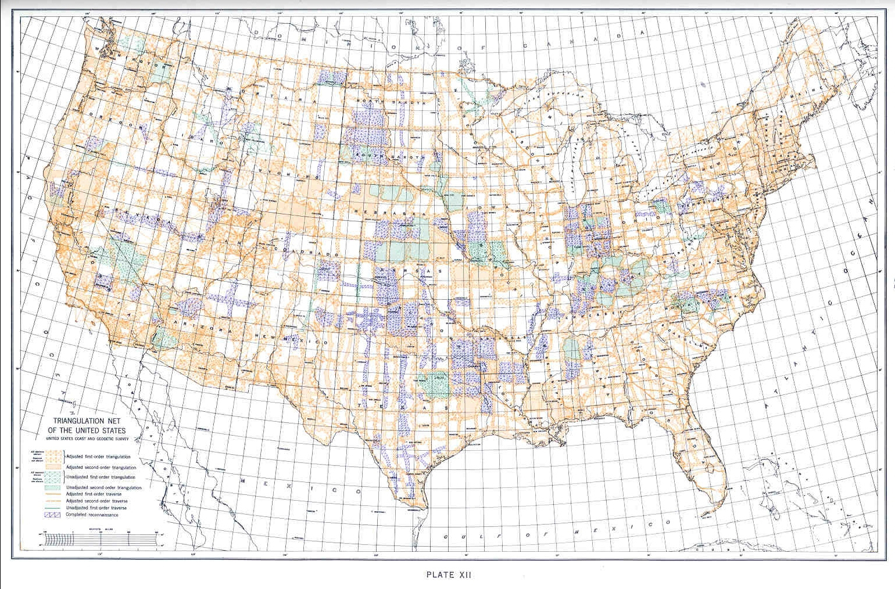

Slide 8
National Spatial Reference System(NSRS)
Improvements in the Horizontal Datums
TIME NETWORK METHOD
NETWORK SPAN ACCURACY OF REFERENCE
NAD 27 1927-1986 10 meter (1 part in 100,000)
NAD83(86) 1986-1990 1 meter (1 part in 100,000)
NAD83(199x)* 1990-2007 0.1 meter B-order (1 part in 1 million)
HARN A-order (1 part in 10 million)
NAD83(2007) 2007 - 2011 0.01 meter 0.01 meter
(CORS)
NAD83(2011) 2011 - 2022 0.01 meter 0.01 meter
(CORS)
TRAVERSE & TRIANGULATION -
GROUND MARKS USED FOR REFERENCING THE NSRS.
GPS BECOMES MEANS OF POSITIONING – STILL GRND MARKS.
GPS – CORS STATIONS ARE MEANS OF REFERENCE FOR THE NSRS.

Slide 9
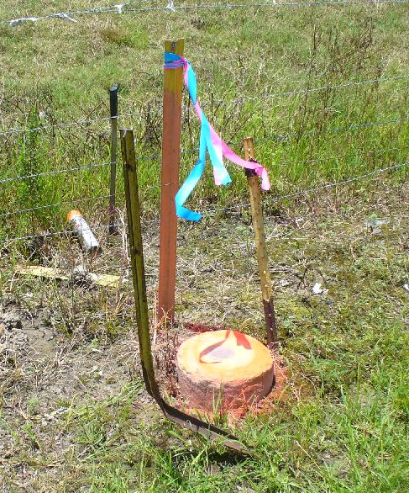
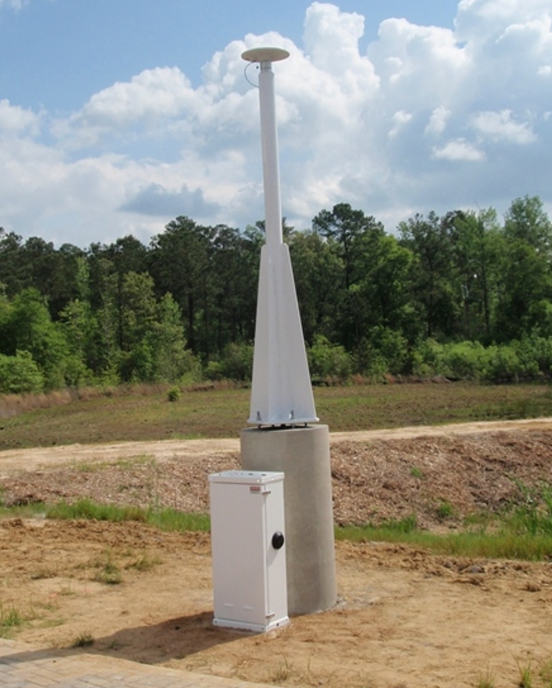
NSRS Reference Basis
Old Method - Ground
Marks (Terrestrial)
New Method - GNSS Stations
(CORS)

Slide 10
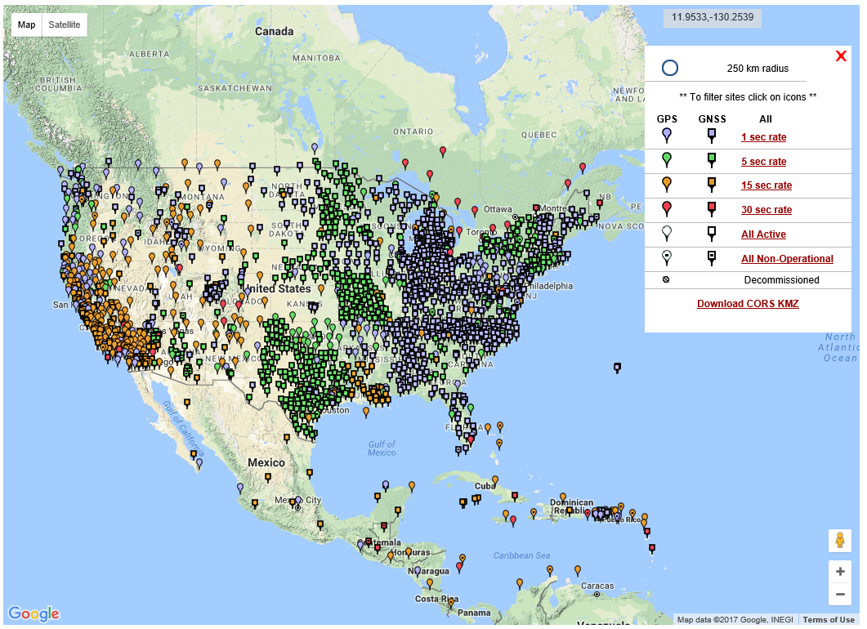
NGS Published CORS

Slide 11
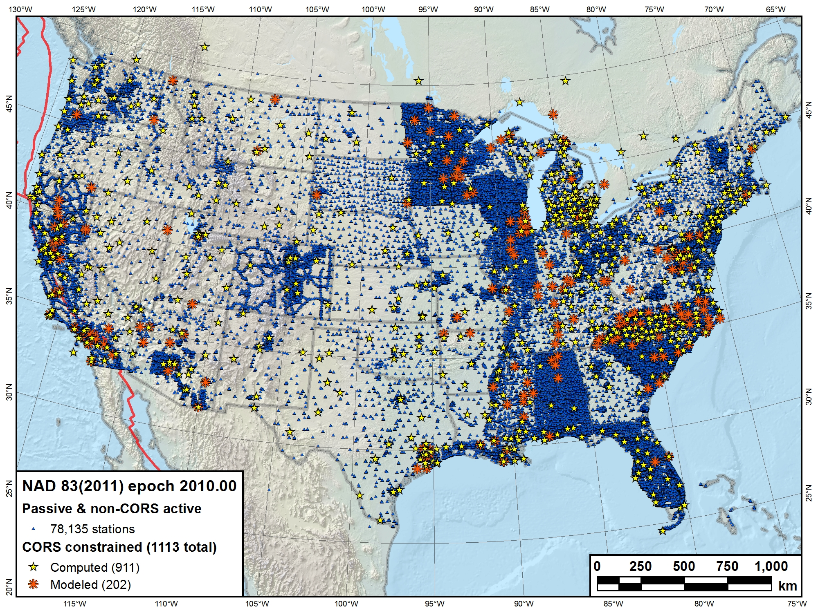

Slide 12
Why Replace NAD83?
NAD83 is NON-geocentric & hence inconsistent w/GNSS
(datum is near 40 years old)
Difficult to maintain consistency between CORS & passive networks
NAD 83 does not track / report passive mark motion
Lack of monument stability / permanency
Necessary for agreement with future ubiquitous positioning capability

Slide 13
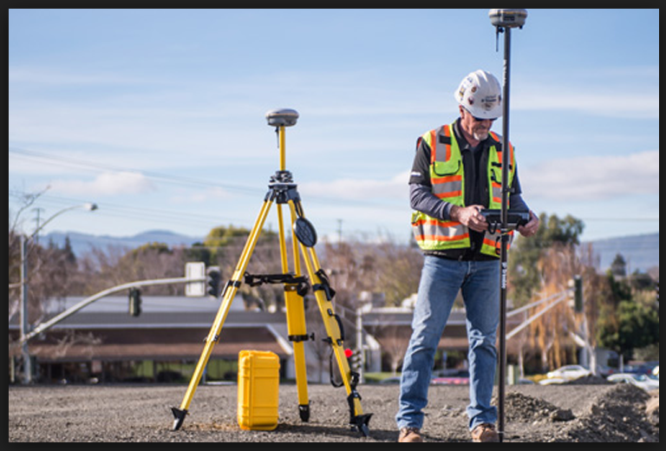
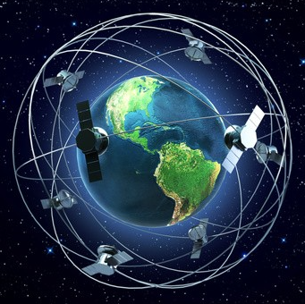
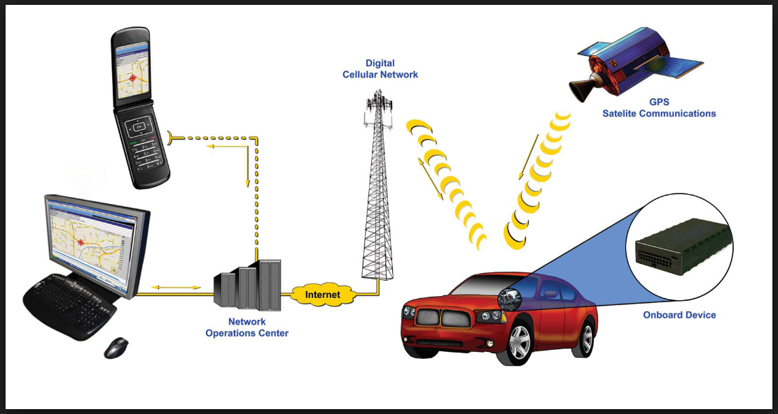
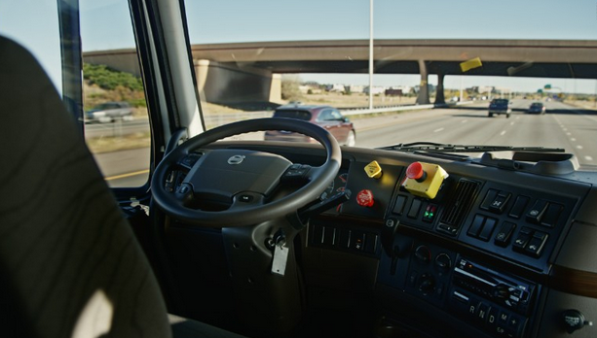
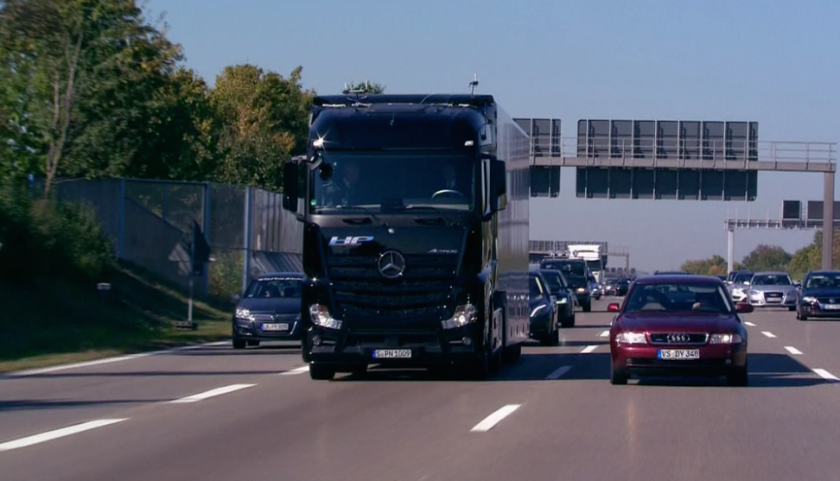
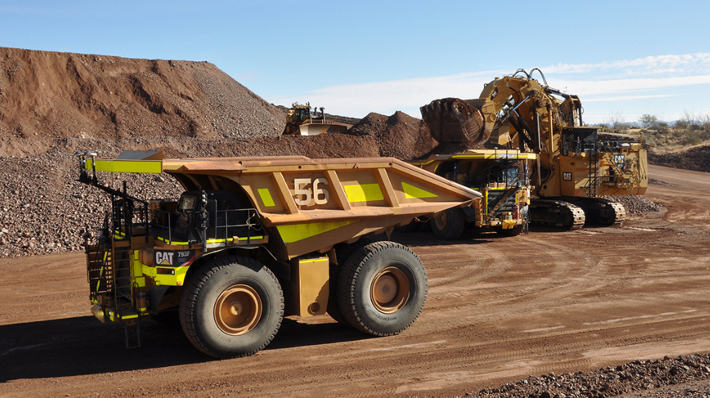
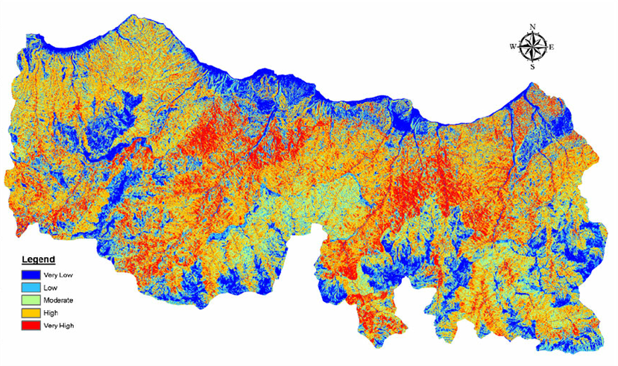
Why Replace NAD83? – Future Uses of the NSRS
Notes:
Use of GNSS technology is widely used today in surveying, mapping, navigation will cell. Phones, auto on-board navigation, and autonomous driving is fine in open pit mines, but do we really want autonomously driven trucks operating with maps that may be in error because of the difference between NAD83 and GNSS positioning?

Slide 14
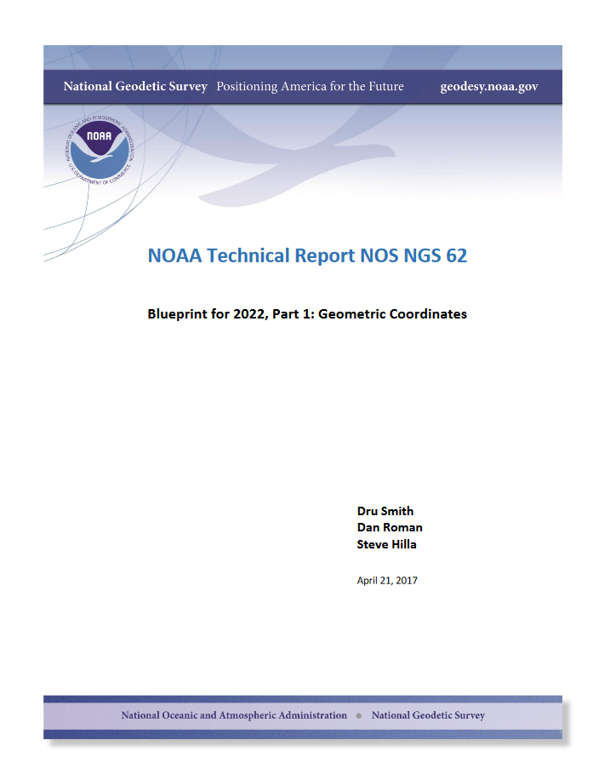
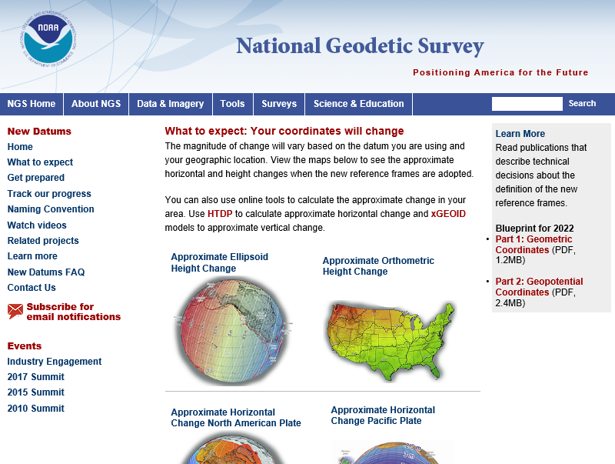

Slide 15
Future Geometric (3-D) Reference Frame
Blueprint for 2022: Part 1 – Geometric Datum
Replace NAD83 with new geometric reference frame – by 2022.
CORS-based, accessed via GNSS observations.
Coordinates & velocities in ITRF (IGS) & new US reference frame.
Passive control tied to new reference frame (not a component).
Transformation tools will relate NAD83 to new US reference
frame (NCAT with 2022 transformation).

Slide 16
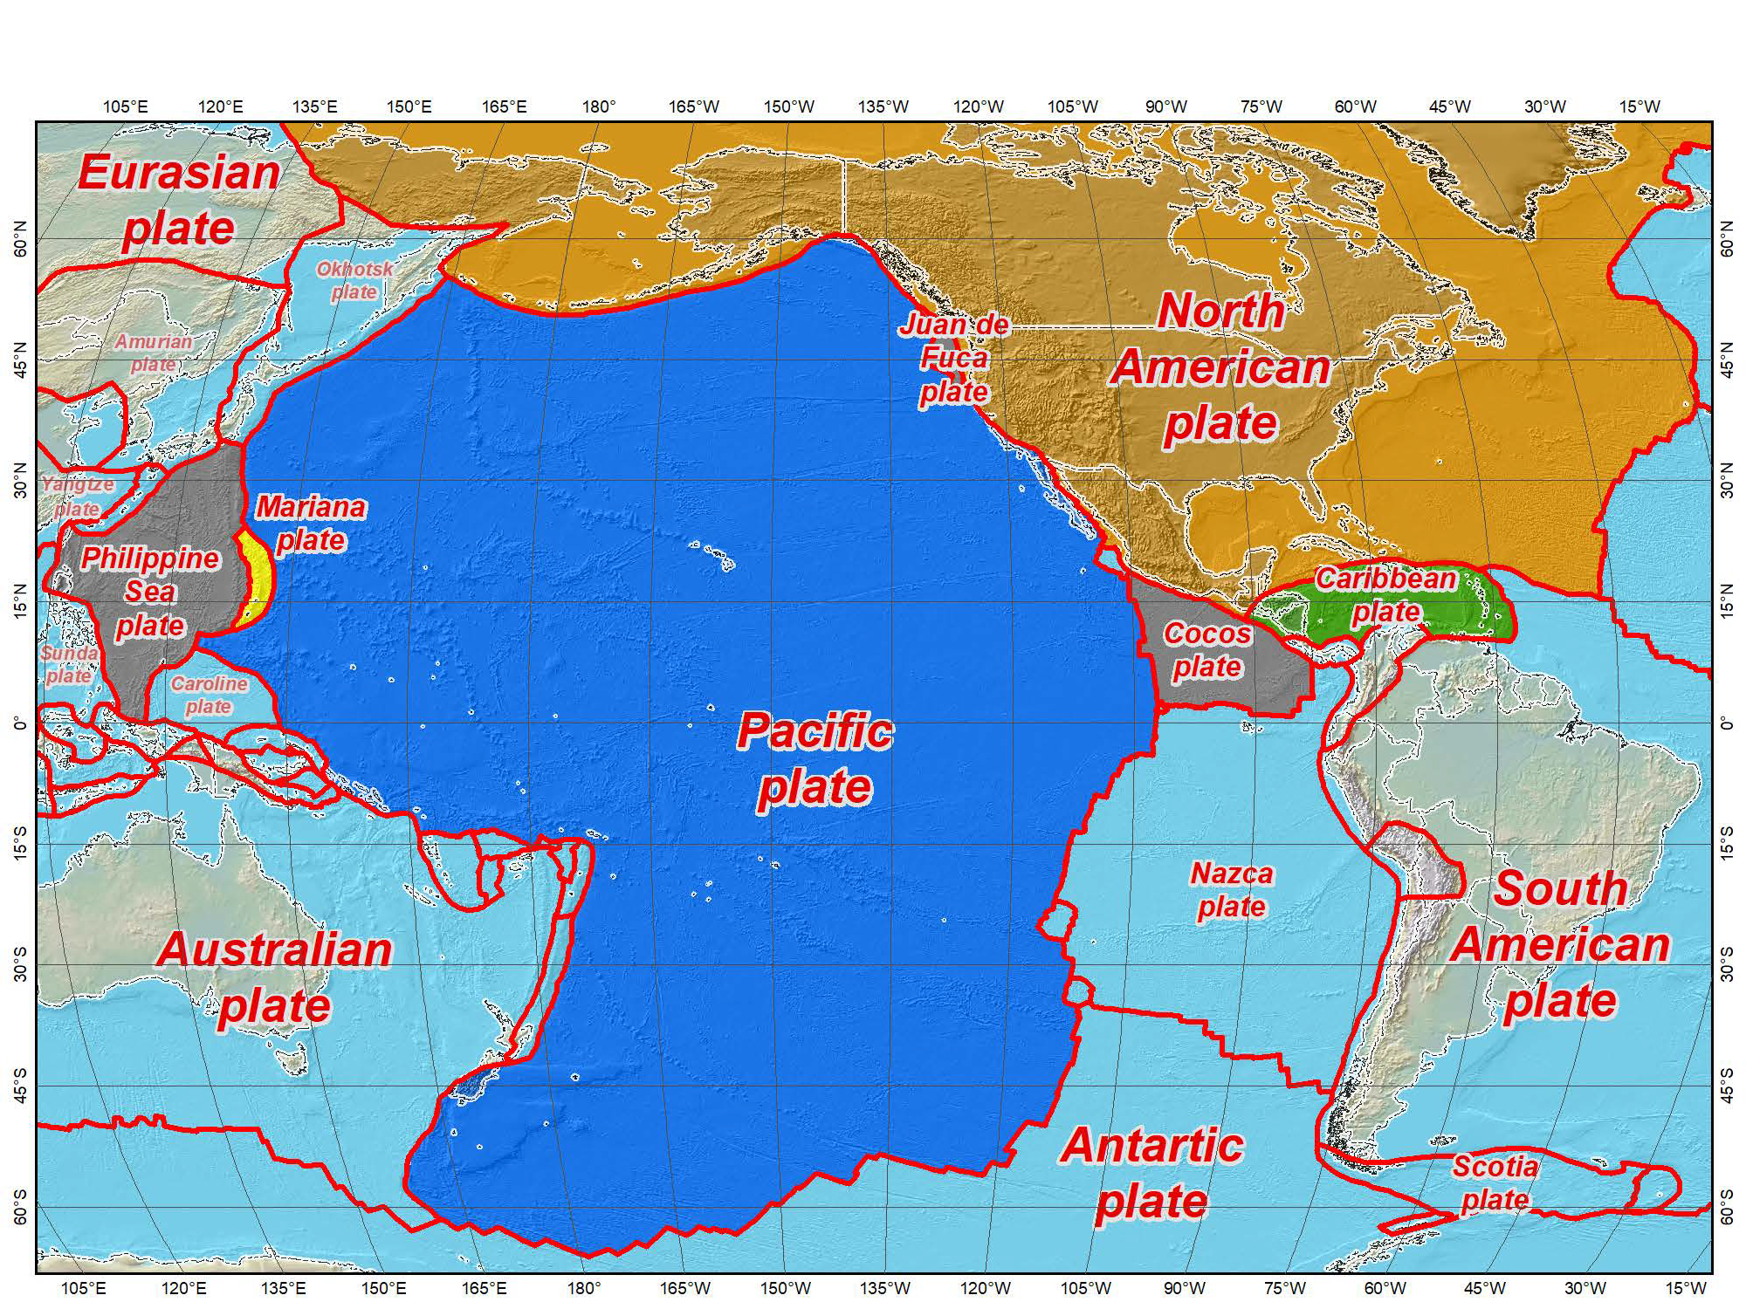

Four Frames/Plates in 2022
Tectonic plates modeled by NGS
July 12, 2017
2017 Esri User Conference
13

Slide 17
Datum Names
The Old:
NAD 83(2011)
NAD 83(PA11)
NAD 83(MA11)
The New:
The North American Terrestrial Reference Frame of 2022
(NATRF2022)
The Caribbean Terrestrial Reference Frame of 2022
(CATRF2022)
The Pacific Terrestrial Reference Frame of 2022
(PATRF2022)
The Mariana Terrestrial Reference Frame of 2022
(MATRF2022)

Slide 18
NSRS Plate Rotation Modeling
Each frame will get 3 parameters
Euler Pole Latitude
Euler Pole Longitude
Rotation rate (radians / year)
This will be used to compute
time-dependent TRF2022
coordinates from time-dependent
IGS coordinates.
EULER Pole
18

Slide 19
Intra-frame velocities
This is the velocity of the
point in NATRF2022.
Rotation of plate removed.
It is not constant because
the point still suffers small
“intra-frame” velocities.
Such IFVs will be captured
in a model by NGS.
This is the velocity of the
point in ITRF. Includes all
movements, but the
dominant one is the
rotation of the N.A. Plate.

Slide 20
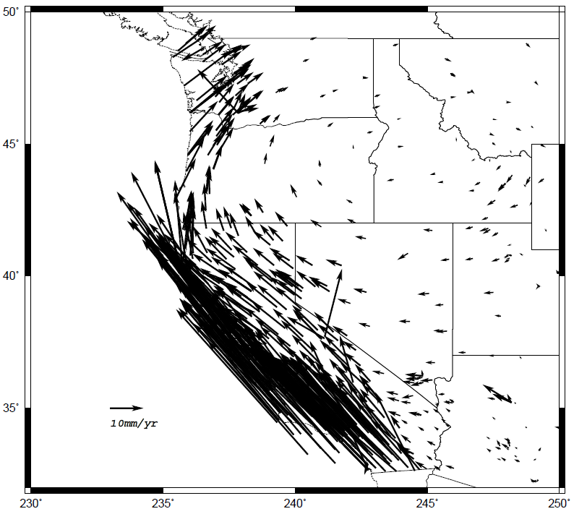
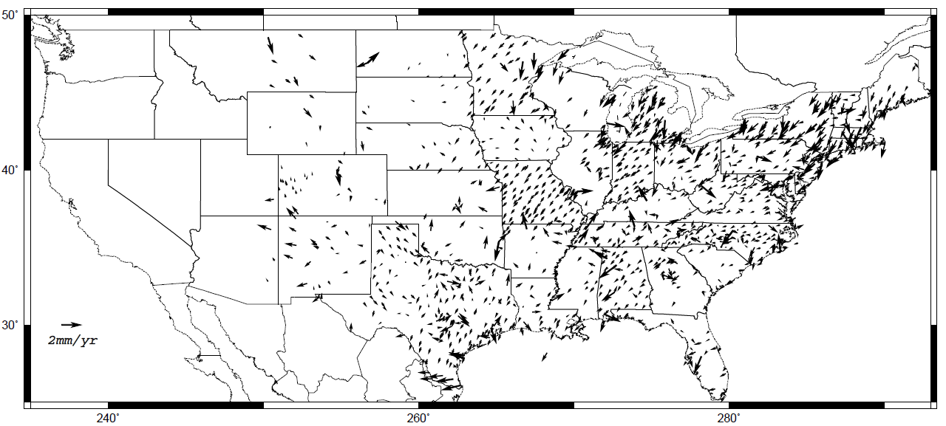
Horizontal velocities after Repro1
Note scale difference between West (10 mm/yr) and east (2 mm/yr)
Intra Frame Velocity Models to be defined for each TRF.

Slide 21
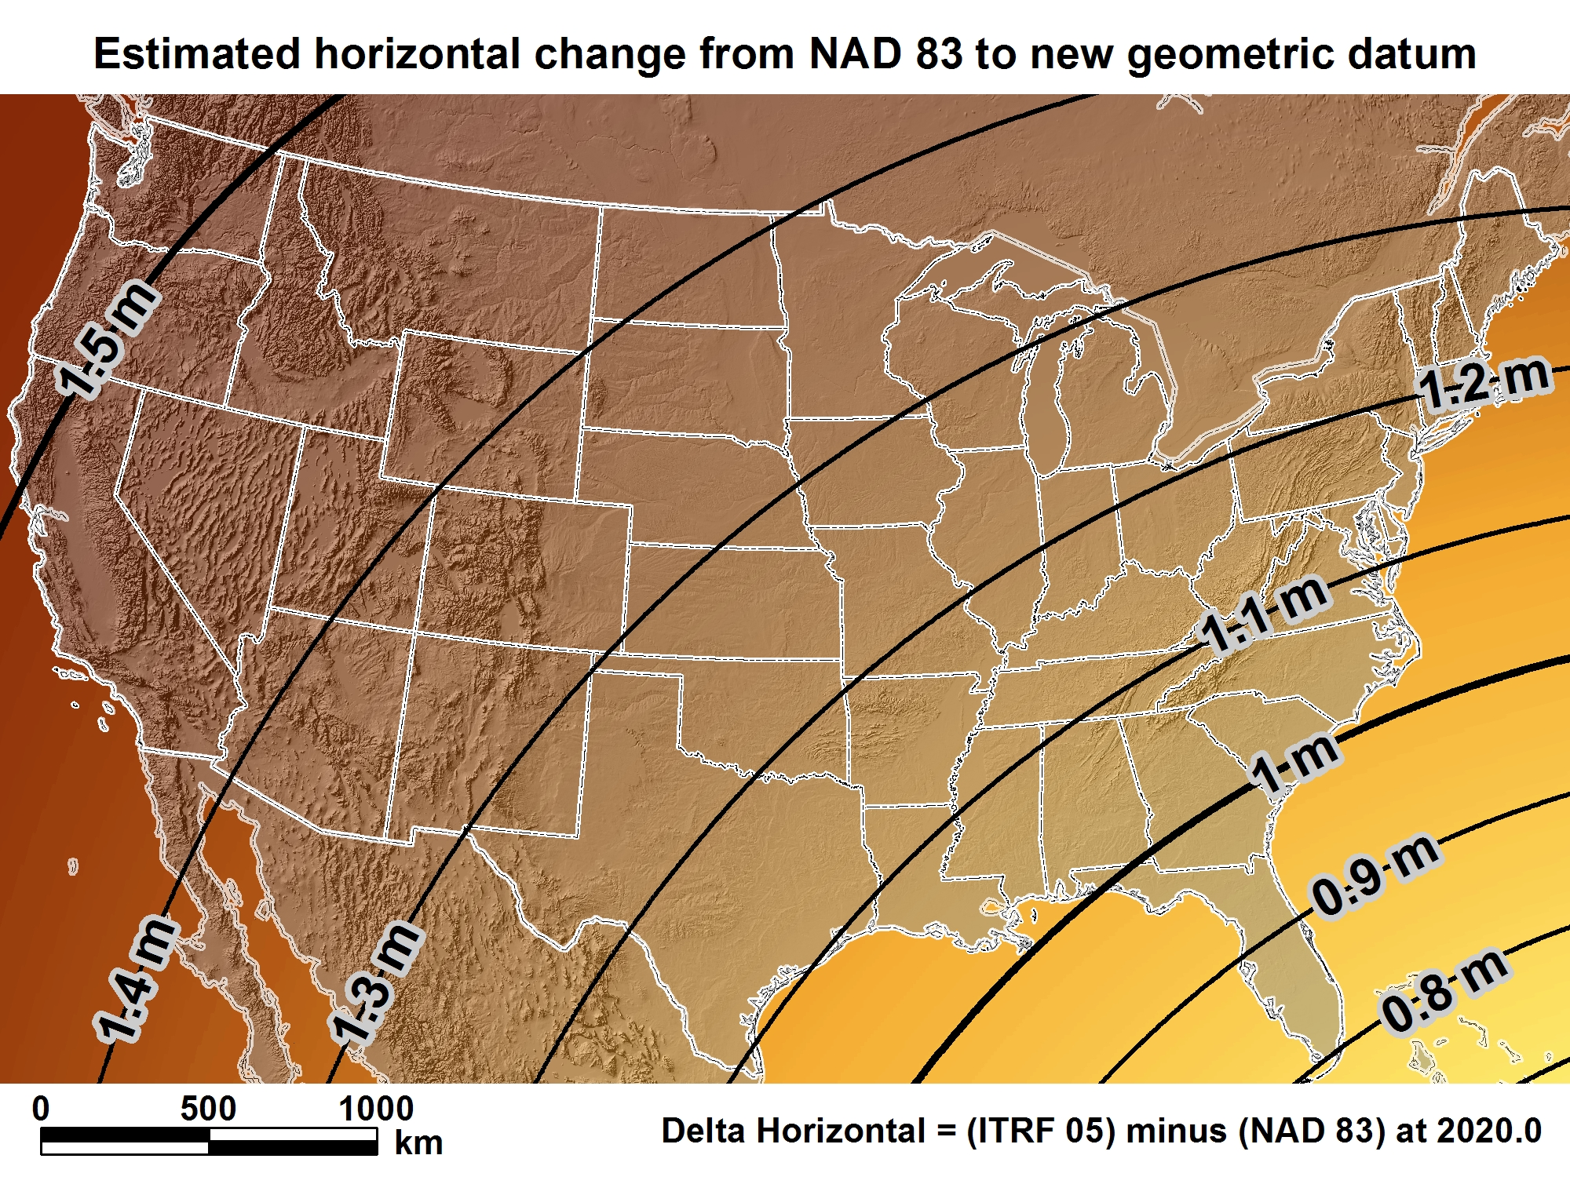
New geometric datum minus NAD 83 (horizontal)
For Florida = 0.8 > 1.02 m (2.6 > 3.3 ft.)

Slide 22
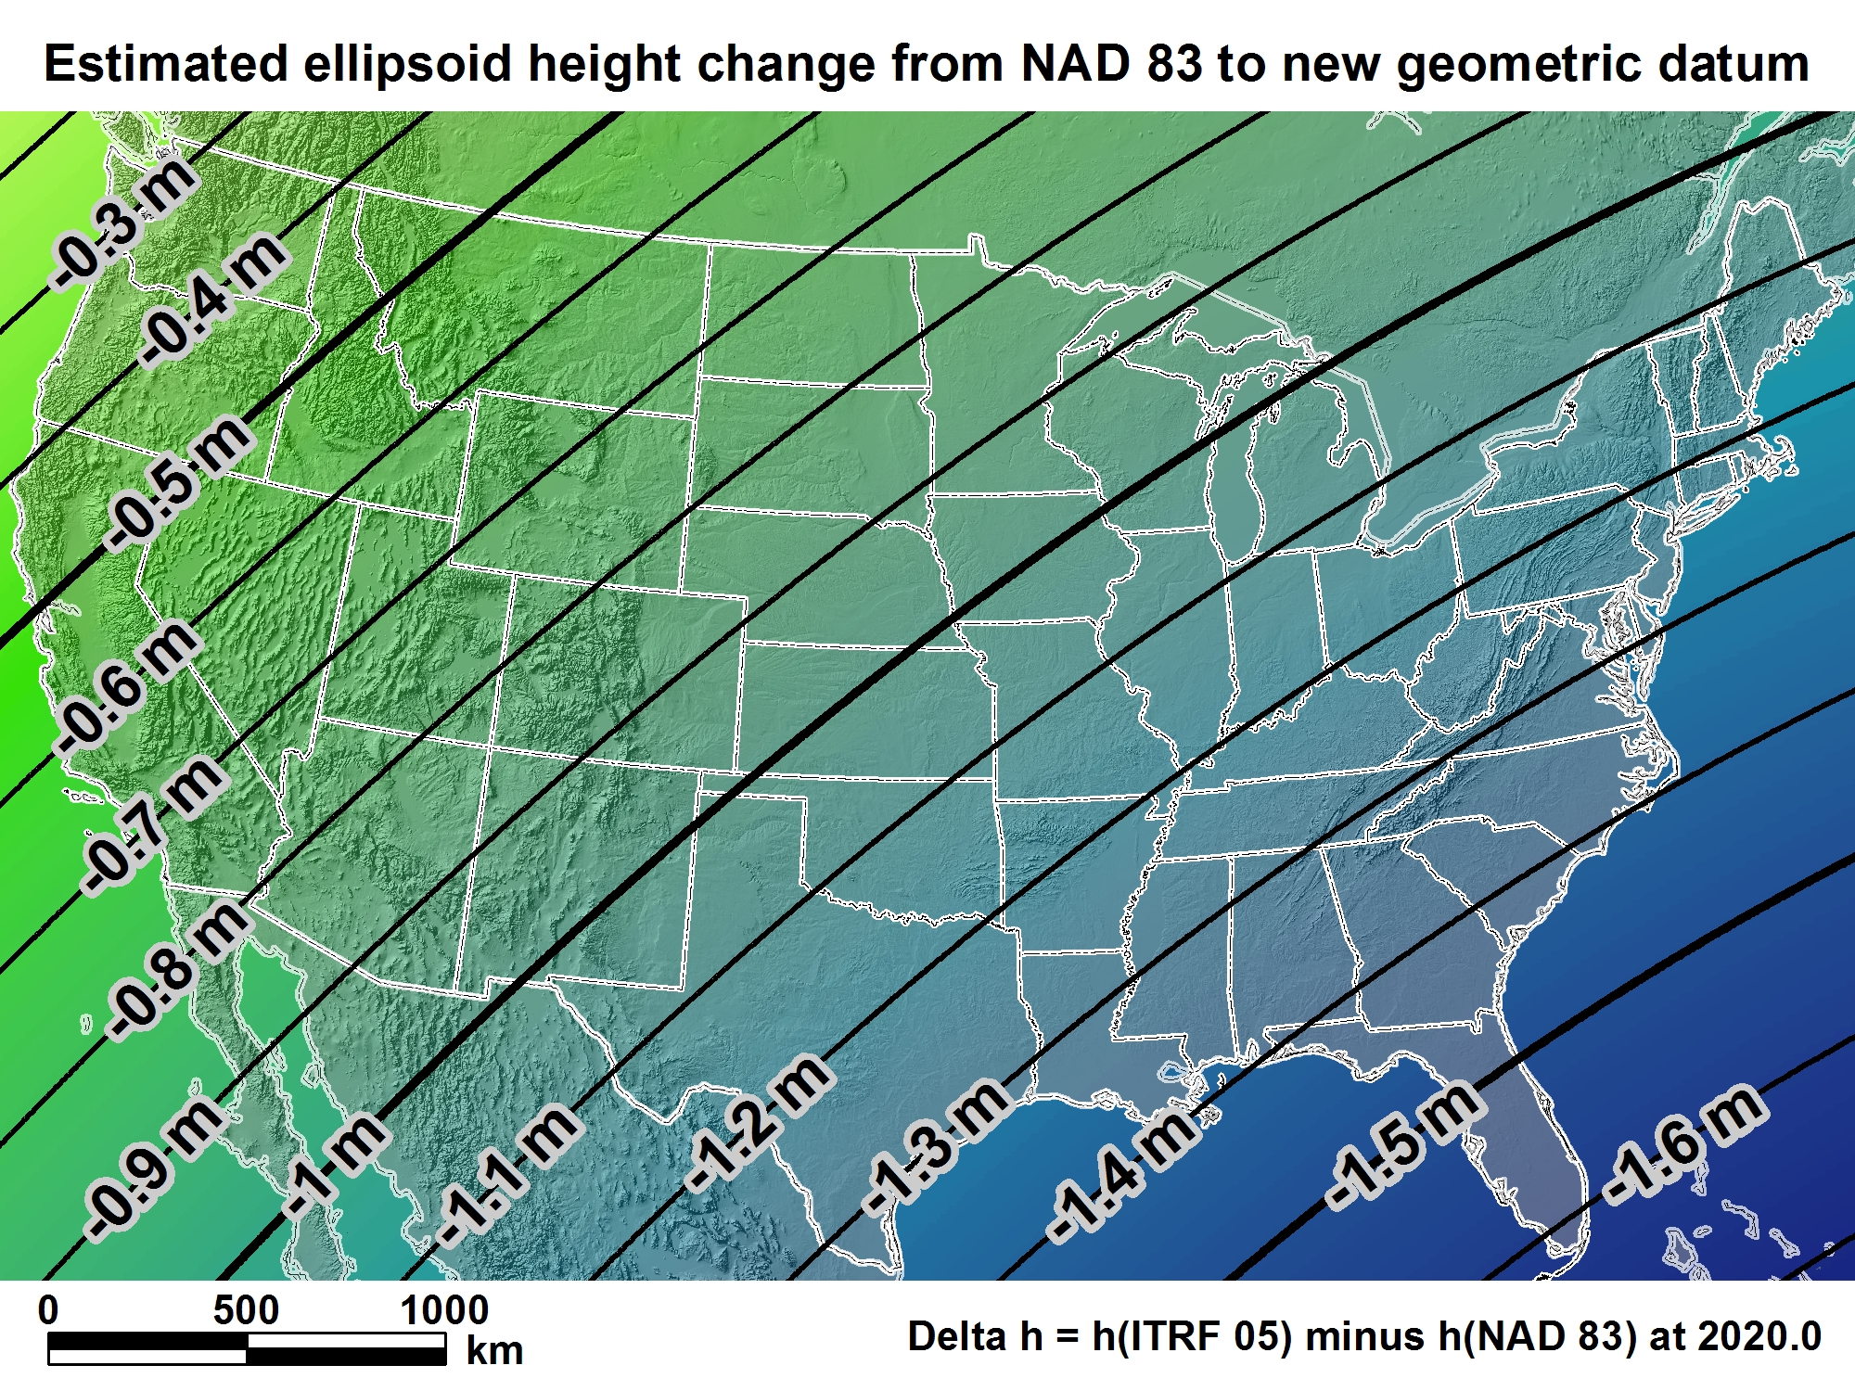
New geometric datum minus NAD 83
(ellipsoid height)
For Florida = -1.39 > -1.62 m (-4.5 > -5.3 ft.)

Slide 23

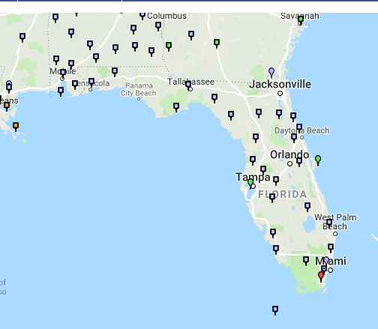
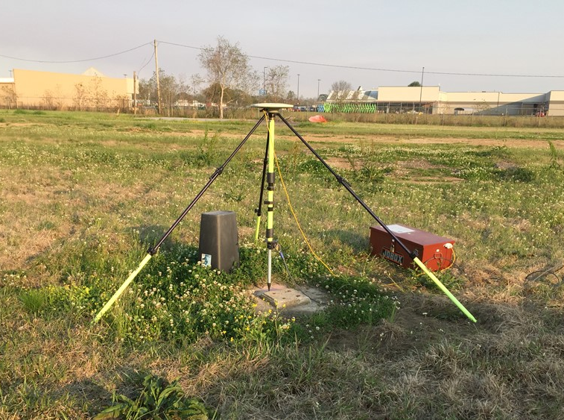
Determining Geometric Positions After 2022
GNSS Lat., Long., Hght
CORS Ref. Positions
GNSS Lat., Long., Hght
Real-Time
Positioning
Post Processing
TRF Referenced
Positions
Notes:
Use of GNSS technology is widely used today in surveying, mapping, navigation will cell. Phones, auto on-board navigation, and autonomous driving is fine in open pit mines, but do we really want autonomously driven trucks operating with maps that may be in error because of the difference between NAD83 and GNSS positioning?

Slide 24
U.S. Vertical Datums

Slide 25
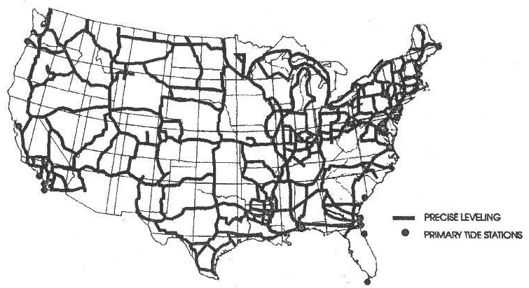
VERTICAL CONTROL USED FOR NGVD 1929 DATUM

Slide 26
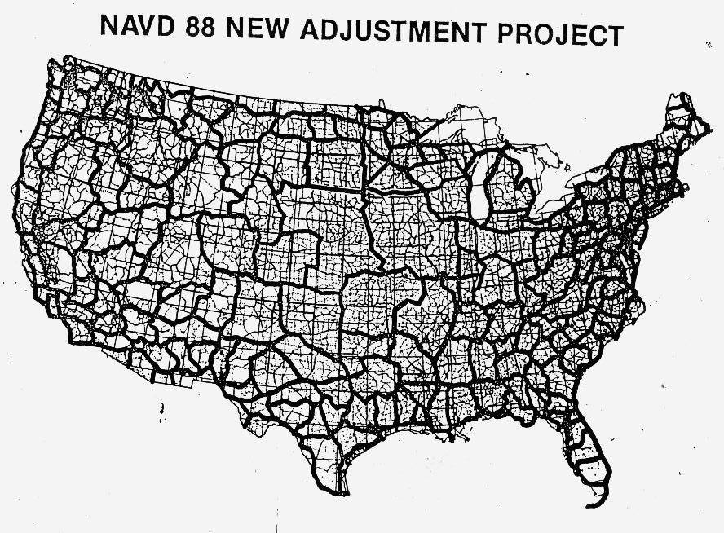

Slide 27
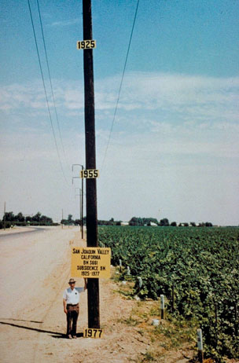
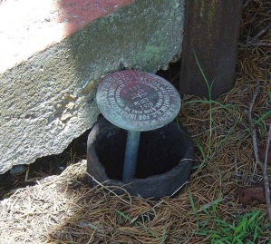
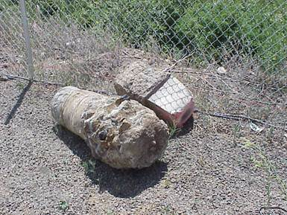
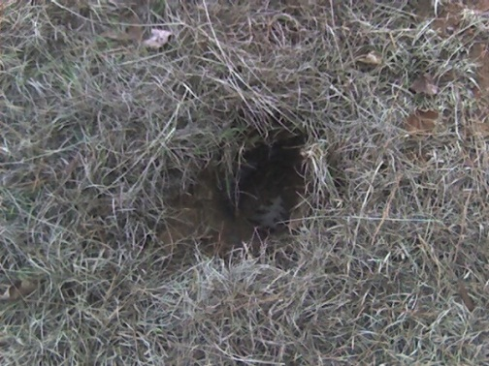
Why isn’t NAVD 88 good enough anymore?
* NAVD 88 is a terrestrial based vertical datum that changes as the land changes.
NAVD 88 suffers from use of bench marks that:
  Are almost never re-checked for movement
  Disappear by the thousands every year
  Are not funded for replacement
  Are not necessarily in convenient places
  Don’t exist in most of Alaska
  Were determined by leveling from a single point, allowing cross-country error build up

Slide 28
Can NAVD 88 be fixed?
Long term fix: Re-level some/all of NAVD 88
  81,500 km of 1st order leveling at least
  625,000 km of mixed 1st and 2nd order leveling
Re-leveling NAVD 88 estimated to cost between
  $200 Million and $2 Billion
Time factor in that amount of leveling
Still would have problems related to passive control
Notes:
Re-leveling NAVD 88 won’t fix:
Sparseness of the bench marks
Continued subsidence or uplift of bench marks
Destruction of bench marks
Canada’s decision not to adopt NAVD 88
Whatever errors caused a continent-wide 1 meter build up in the leveling the first time around

Slide 29
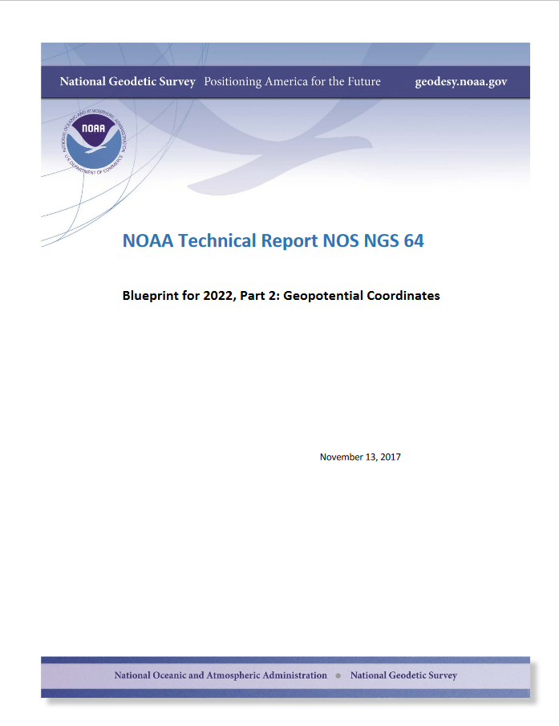

Slide 30
NEW VERTICAL DATUM (Rationale)
  A move away from differentially leveled passive control as the defining mechanism of the reference surface
  To be consistent with the shift in the geometric reference frame/ellipsoid (2022)
  Improvement in our technical abilities in reference surface realization (geopotential gravimetric reference surface - 1cm accuracy of the geoid (GNSS/GRAV-D))
  Goal - ability to establish 2cm orthometric height anywhere in U.S. using a minimum of 15 min. of GNSS data.
  The new geopotential reference surface will be aligned with the geometric reference frame/ellipsoid (i.e., no hybrid geoid)

Slide 31
Names
  The Old:
  NAVD 88
  PRVD 02
  VIVD09
  ASVD02
  NMVD03
  GUVD04
  IGLD 85
  IGSN71
  GEOID12B
  DEFLEC12B
Orthometric
Heights
  The New:
  The North American-Pacific Geopotential Datum of 2022 (NAPGD2022)
Normal
Orthometric
Heights
Dynamic
Heights
Gravity
Geoid
Undulations
Deflections of
the Vertical

Slide 32
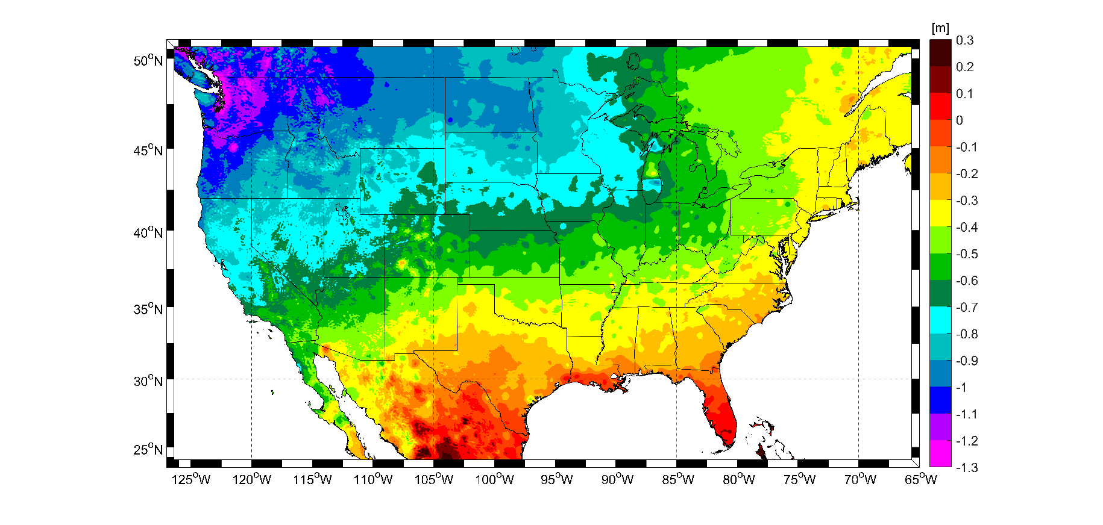
Expected changes to orthometric heights
For Florida = 0.1 > -0.3 m (4 > -11 in.)

Slide 33
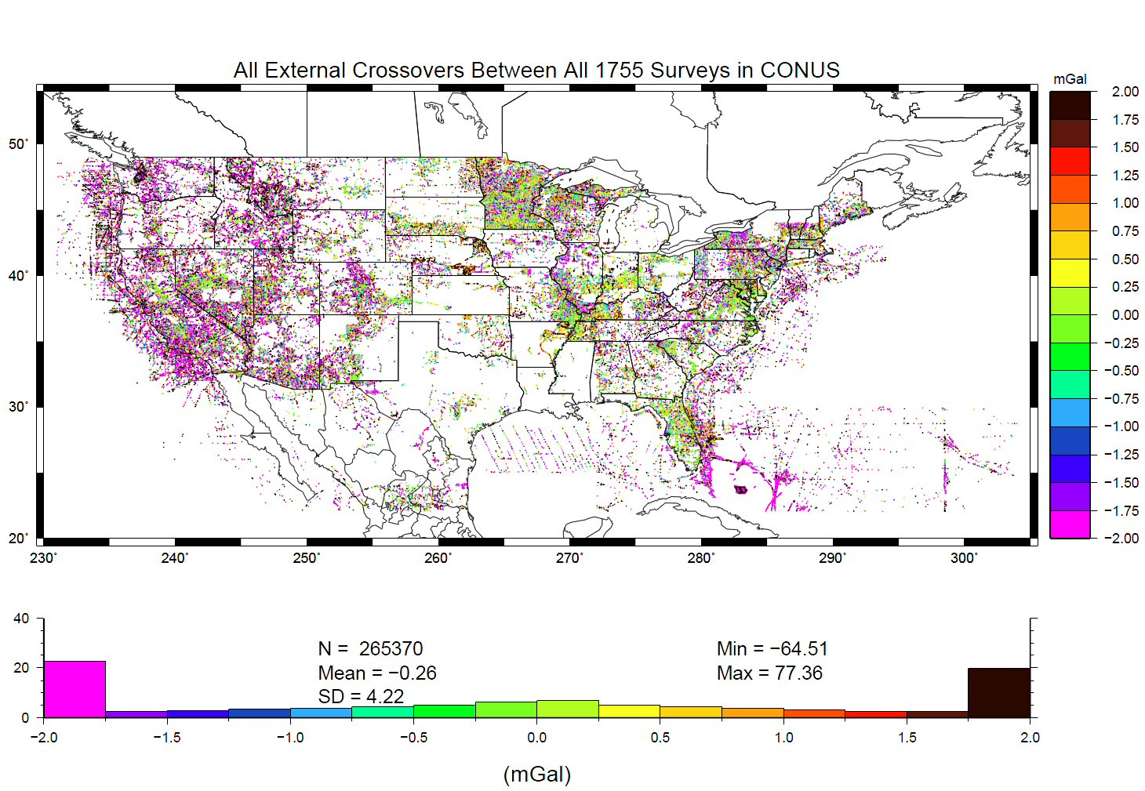
Problems with Gravity Holdings
Decades of gravity surveys are inconsistent with one another (1755 surveys)
Airborne gravity will provide a baseline for removing these inconsistencies…
… as well as “filling in” information between the resolutions of satellite and ground data.
%
Notes:
This slide shows “crossovers” between any of the 1755 terrestrial gravity surveys which NGS holds in its database. These are
basically mismatches between surveys that overlap one another, plotted at the point of overlap. Note that the color bar
is +/- 2 mGals, and how many surveys disagree with one another at that level. GRAV-D flights should yield about 2 mGal
accuracy surveys, and help reduce the level of disagreement to that range.
The vertical axis of the lower plot is “Percent of points with this level of crossover error” So while it is bell-shaped around -0.26 mGals, the “wings” at the >+2 or <-2 range contain a good 45-50% of all crossovers.
Added October 2010.

Slide 34
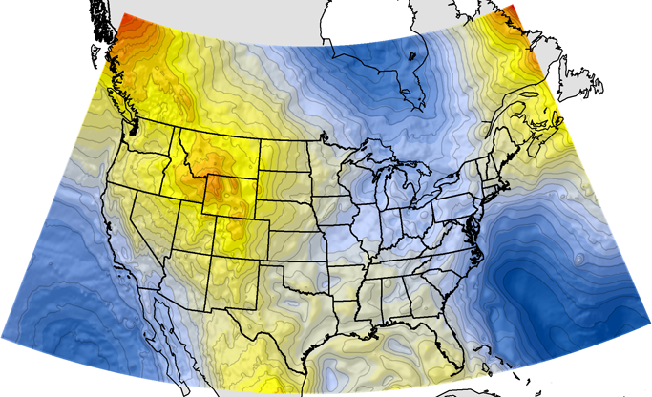
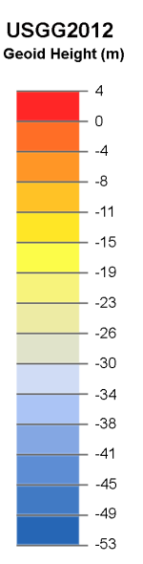
Current and Best NGS Geoid: USGG2012
GRACE + 2 yrs. of GOCE + other satellite data
+ World Gravity Model (EGM2008)
+ Estimated Gravity from Topography
+ Around Two Million Surface Gravity Points
But even this isn’t good enough for a 1-2 cm accuracy vertical reference surface

Slide 35
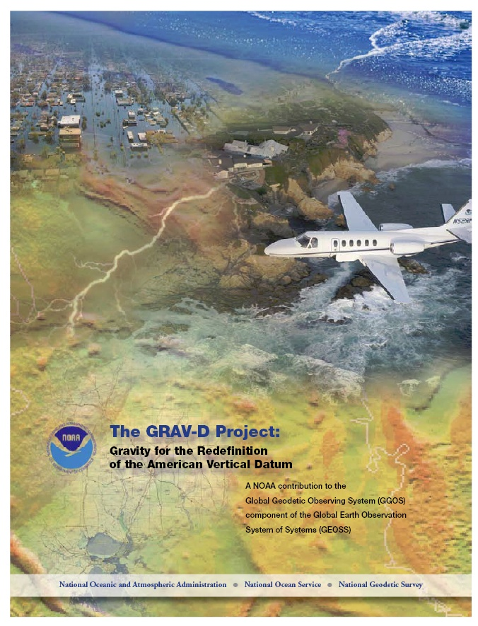
Gravity for the Redefinition of the American Vertical Datum (GRAV-D)
Replace the Vertical Datum of the USA by 2022 (at today’s funding)
GRAV-D is:
  An airborne gravity survey of the entire country and its holdings
  A 2022 gravimetric geoid accurate to 1 cm
  Long-term monitoring of geoid change over time
  Partnership surveys
Working to launch a collaborative effort with the USGS for simultaneous magnetic measurement
Acting Manager: Monica Youngman
Monica.Youngman@noaa.gov
Gravity and Heights are
inseparably connected
Notes:
GRAV-D is the NGS project designed to replace NAVD88 with a vertical datum based upon a gravimetric geoid accurate to 1 cm. Heights above this datum will be accessed via GNSS measurements. Three thrusts of project. Launch USGS collaboration for simultaneous mag measurement.

Slide 36

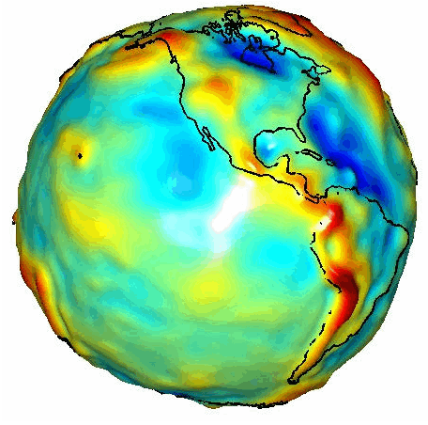
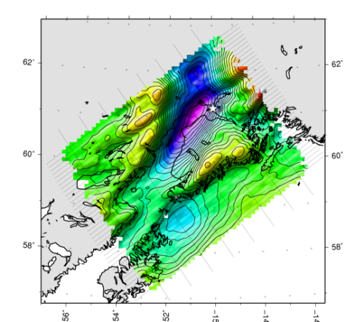

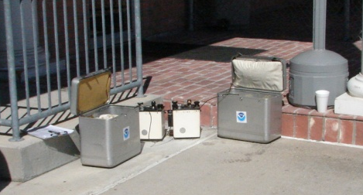
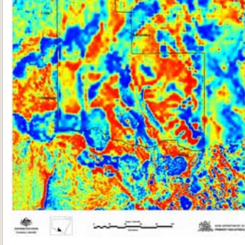
Building a Gravity Field
Long Wavelengths
(≥ 250 km)
GRACE/GOCE/Satellite Altimetry
+
Intermediate Wavelengths
(500 km to 20 km)
Airborne Measurement
+
Short Wavelengths
(< 100 km)
Surface Measurement and
Predicted Gravity from Topography
Notes:
Give example of how short wavelength information is like low altitude aerial photos (1/2” pixel accuracy) in that it provides very accurate and detailed information. The long wavelength gravity can be likened to the old LANDSAT imagery (3 meter pixel accuracy) in that it was good over large areas, but didn’t give much detail for local areas. The intermediate wavelength gravity data gives us a connection between the two (the short and long), allowing the NGS gravity team to use all available gravity information in working toward the production of a 1 cm accurate gravitational surface.

Slide 37
“Action speaks louder than words
but not nearly as often.” ― Mark Twain
Prove that our goal with GRAV-D is possible:
“...the gravimetric geoid used in defining
the future vertical datum of the United States should have an absolute accuracy of 1 centimeter at any place and at any time.”
-- The NGS 10 year plan (2008-2018)
Notes:
The above quote refers to one of many ambitious goals in the NGS 10 year plan. While admirable, its achievability remains an open question. In order to begin addressing the actual achievable accuracy of a gravimetric geoid model, NGS will engage in a variety of testing methods prior to the 2022 date when the gravimetric geoid will serve as the reference surface for a new vertical datum. The first such testing method took place in the summer of 2011 and is known as the Geoid Slope Validation Survey of 2011, or GSVS11. As its name implies, this survey tested the accuracy of differential geoid undulations between points ("geoid slopes") from NGS's gravimetric geoid models. The baseline for comparison will be independently computed geoid slopes from two methods, GPS and leveling as well as Deflections of the Vertical.

Slide 38
Validating Geoid Accuracy
NGS has performed 3 surveys to validate the accuracy of the gravimetric geoid model
  Geoid Slope Validation Survey (GSVS) 2011
    2011; Low/Flat/Simple: Texas; Done; Success!
  GSVS14
    2014; High/Flat/Complicated: Iowa; Field work Complete
  GSVS17
    2017; High/Rugged: Colorado; Field work complete.

Slide 39
Surveys Performed
GPS: 20 identical units, 10/day leapfrog, 40 hrs. ea.
Leveling: 1st order, class II, digital barcode leveling
Gravity: FG-5 and A-10 anchors, 4 L/R in 2 teams
DoV: ETH Zurich DIADEM GPS & camera system
LIDAR: Riegl Q680i-D, 2 pt/m² spacing, 0.5 km width
Imagery: Applanix 439 RGB DualCam, 5000’ AGL
Other: RTN, short-session GPS, extra gravity marks around Austin, gravity gradients

Slide 40
GSVS11 Results
Geoids
without
GRAV-D
xUSGG2011
Geoids with
GRAV-D
“1 cm geoid”
Notes:
This slide is a companion to the previous one, but the h-H errors have been removed, in an RMS sense, from the total h-H-N errors, leaving gravimetric geoid model errors only.
As seen previously, the geoids based on airborne gravity data are the best performers, and the very slight degradation using new high resolution software at short wavelengths is noticeably offset by the significant improvement at medium wavelengths.
In fact, as a general statement, it could be said that adding airborne gravity data to the gravimetric geoid model has yielded about 1 cm differential geoid undulation accuracy across all distances (orange and red bars), in the region of GSVS11, and that this can be further improved by continued improvement to the high resolution modeling software.

Slide 41
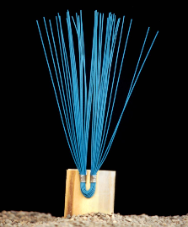
Determining Orthometric Heights After 2022
Ellipsoid Height
Geoid Height
Orthometric Height
Notes:
Use of GNSS technology is widely used today in surveying, mapping, navigation will cell. Phones, auto on-board navigation, and autonomous driving is fine in open pit mines, but do we really want autonomously driven trucks operating with maps that may be in error because of the difference between NAD83 and GNSS positioning?

Slide 42
Geoid Monitoring Service (GeMS)
Goal: Track all changes to the geoid which would prevent 1 cm accuracy
Aspects included:
  Shape, Secular: e.g. Hudson Bay
  Shape, Episodic: e.g. Massive Earthquakes
  W0, Secular: Global Sea Level Change (see next slides)
Examples of things excluded:
  Size, Secular: Mass quantity of Earth is effectively static
  Shape, Periodic: Seasonal glacier cycle

Slide 43

Extent of 2022 gravimetric geoid model used for NAPGD2022

Slide 44
Preparing for New Reference Frames

Slide 45
How to Plan for 2022
Move to newest realizations
  NAD 83(2011) epoch 2010.00
  GEOID12B (hybrid geoid)
Move to NAVD 88
  understand the accuracy of VERTCON in your area
Utilize passive marks that are up to date
  Stay aware of what marks are included in datum updates
  Use OPUS & Hgt. Mod procedures to update mark positions
Use OPUS for GPSBMs
  Help improve future geoid models & relationship with new datum
NGS Outreach Efforts
  Participate in NGS webinars, Geospatial summits, contact NGS Regional Advisor, etc.

Slide 46
Metadata is Critical
Your positional metadata should include:
  datum
  epoch
  source / methods
These will facilitate transforming from current to new datum
Maintaining your original survey data will provide more accurate results
Notes:
Metadata related to how someone establishes control is important. Important for today’s positions, but especially as we moving toward and into the coming new datums in 2022.

Slide 47
State Plane Coordinates System 2022

Slide 48


Slide 49

SPCS Special Publication
History of NGS projections (1853 to present)
SPCS policies and legislation
Departures from policy and convention
Recent developments in projected coordinate systems
Appendices
  Defining parameters for ALL zones of ALL versions of SPCS, plus additional information
  Status of SPCS 83 legislation and foot conversions

Slide 50


Slide 51


Slide 52


Slide 53


Slide 54
GPS on Bench Mark Project & Geoid 18

Slide 55


www.ngs.noaa.gov

Slide 56

What is “GPS on Bench Marks“ ?
Collecting GPS observations on a bench mark that has a NGS published orthometric height from leveling, which provides accurate information:
latitude, longitude, and ellipsoid height

Slide 57
  Why have another GPS on BM Project?
In preparation for new U.S. datums in 2022 (NATREF2022 / NAPGD2022).
Transformation model between NAVD88 & NAPGD2022 using NCAT.
Significant amount of new Blue Booking projects across U.S. (leveling, GNSS (GPS)) since the publishing of Geoid 12B. (FL - 203 new BM’s)
Many new OPUS Share submittals since Geoid 12B
(FL – 878 on NGS BM’s).
Will help in the production of Geoid 18 (April 2019).

Slide 58


Slide 59


Notes:
https://www.youtube.com/playlist?list=PLsyDl_aqUTdFY6eKURmiCBBk-mP4R10Dx

Slide 60
Coordinate Conversions - NCAT

Slide 61

NADCON5 in the Geodetic Toolkit

Slide 62
NAD 83 (2011)
Allowable Regions:
CONUS
Alaska
Hawaii
PR/VI
AS
Guam/CNMI
St. Paul
St. George
St. Lawrence
φ, λ, h
xyz2plh
plh2xyz
SPC83
a,f (GRS 80)
NAD 83
X, Y, Z
SPC
USNG
NAD 83
UTMS
a,f (GRS 80)
USNG
UTM
USNG
NAD 83

Slide 63
X, Y, Z
φ, λ, h
φ, λ, h
Region: CONUS
NADCON 5 connections in RED
2022
X, Y, Z
SPC
UTM
USSD
USNG
UTM
φ, λ, h
φ, λ, h
NAD 27
NAD 83 (2011)
X, Y, Z
SPC
X, Y, Z
SPC
USNG
UTM
USNG
UTM
NAD 83 (NSRS2007)
φ, λ, h
NAD 83 (1986)
φ, λ, h
NAD 83 (FBN)
NAD 83 (HARN)
φ, λ, h
X, Y, Z
SPC
X, Y, Z
SPC
φ, λ, h
USNG
UTM
USNG
UTM
X, Y, Z
SPC
X, Y, Z
SPC
USNG
UTM
USNG
UTM

Slide 64

? ? QUESTIONS ? ?

