Slide 1


NOAA’s National Geodetic Survey
Update
Michael L. Dennis, RLS, PE
Michael.Dennis@noaa.gov

Slide 2
Some updates since last we met…
OPUS-Projects
GRAV-D and new experimental geoid models
Geoid Slope Validation Survey of 2014 (GSVS14)
NGS 58/59 update project
GPS on bench marks campaign
Transformation tools

Slide 3
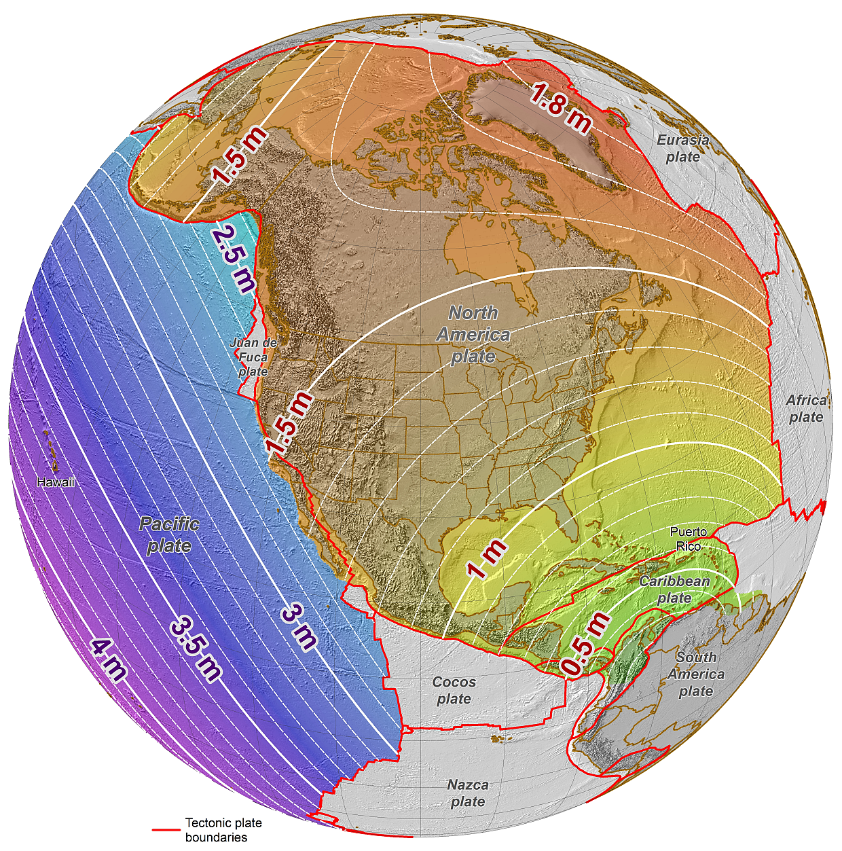
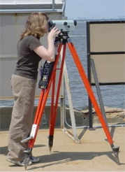
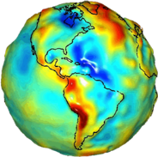
NGS Mission Statement
To define, maintain and provide access to the National Spatial Reference System (NSRS) to meet our nation’s economic, social, and environmental needs.
The NSRS is a consistent coordinate system that defines latitude, longitude, height, scale, gravity, and orientation throughout the United States.
Notes:
Geodesy is the business of the National Geodetic Survey (NGS). NGS develops and maintains the National Spatial Reference System, a national coordinate system that provides the foundation for transportation, navigation, land record systems, mapping and charting efforts, and a multitude of scientific and engineering applications. This system defines position (latitude, longitude, and elevation), distances and directions between points, strength and direction of gravity (no, it is not simply “straight down”), and how these change over time.

Slide 4
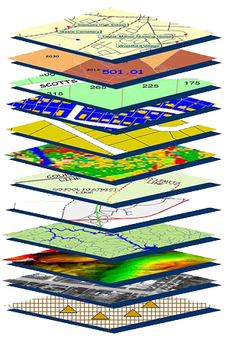
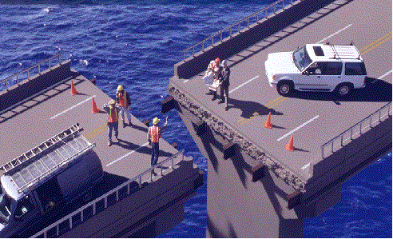
Accurate positioning begins
with accurate coordinates
geodetic control (the NSRS) is the foundation for all geospatial products.
without Geodetic Control as a “base map” layer, GIS applications will not work properly
Source: Zurich-American Insurance Group
Notes:
Digital services must ensure that geo-referenced data collected and published are consistent with NOAA’s National Spatial Reference System (NSRS), which provides the foundation for all positioning and navigation activities in the United States and is defined and maintained by NGS.

Slide 5



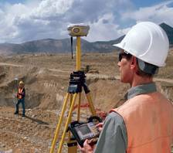


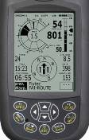




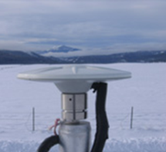
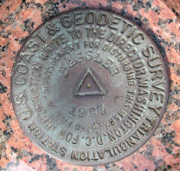
The NGS-defined NSRS provides the Geospatial Infrastructure essential to our economy
Aviation
Satellite
Operations
Precision Agriculture
Disaster Response
Surveying & Mapping
Personal
Navigation
Trucking & Shipping
Fishing &
Boating
Oil Exploration

Slide 6





The NSRS Supports:
National Oceanic and Atmospheric Administration
NSRS positioning data provides the reference for NOAA’s Nautical Charts, among many other geospatial applications
Federal Emergency Management Agency
FEMA uses NSRS elevations to determine flood zones for the National Flood Insurance Program
United States Army Corps of Engineers
USACE uses NSRS elevations to determine levee heights and positions in their Levee Safety Program
United States Geological Survey
USGS uses the NSRS to geospatially reference their Topographic Maps and interior water data for the nation
National Geospatial Intelligence Agency
NSRS gravity data contributes to the geospatial mission of NGA

Slide 7
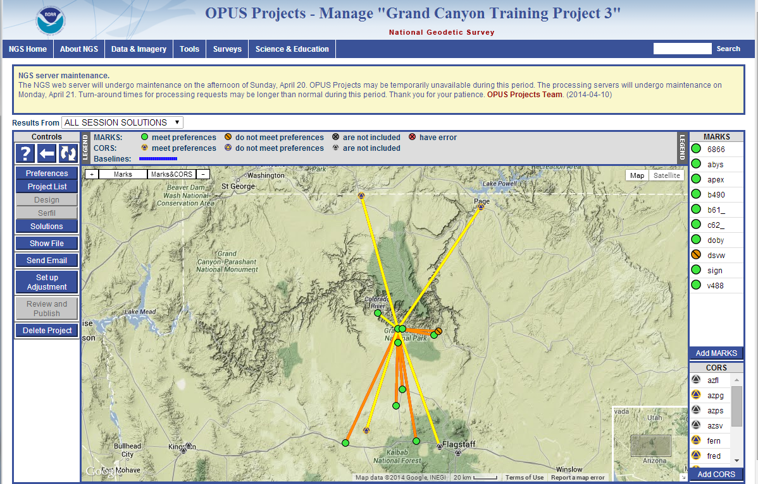
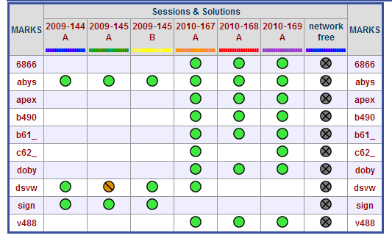
OPUS-Projects
Officially operational Jan 2014
Enhancement to OPUS-Static
Network solution of GPS data from multiple receivers and occupations
Intuitive graphical user interface
Requires attending training to get access

Slide 8
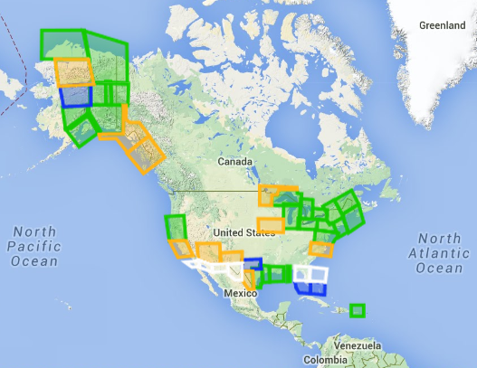
GRAV-D and new experimental geoid models
Green: Available data and metadata
Blue: Data being processed
Orange: Data collection underway
White: Planned for data collection
Data collection > 35% complete
Basis for new vertical datum
Data used in new (beta) experimental geoid model, xGEOID14B
  Spans one-quarter of Earth
  Includes all available gravity data
  GRAV-D data has significant impact (geoid height change from -35 to +43 cm)
GRAV-D status, July 2014

Slide 9
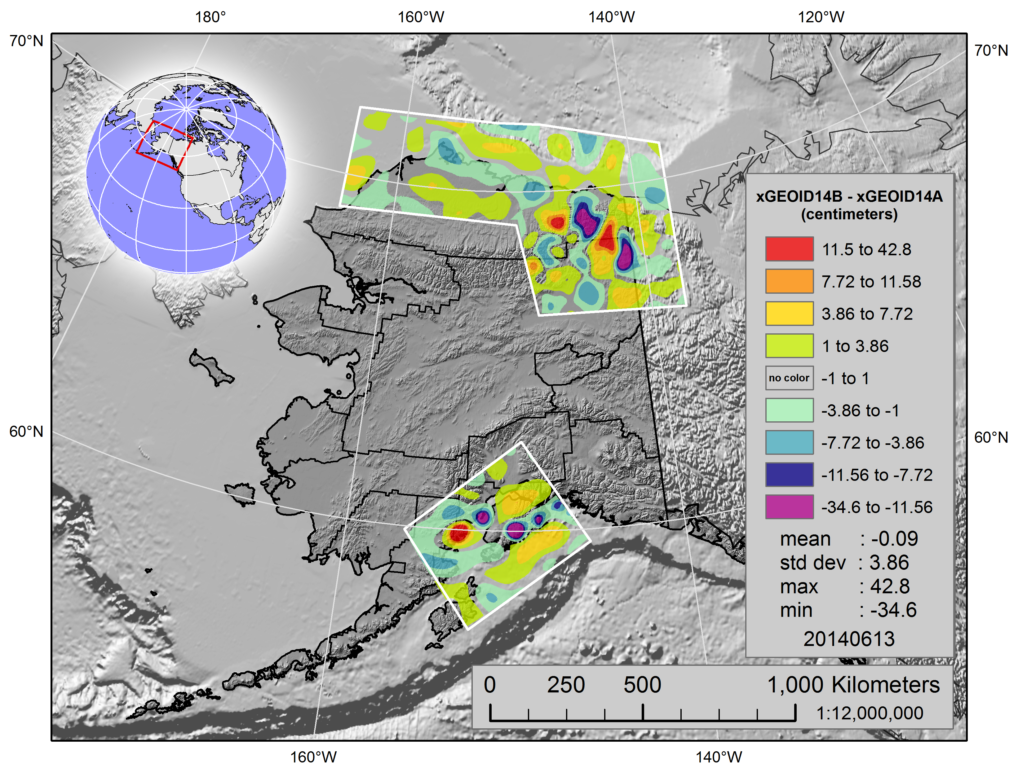
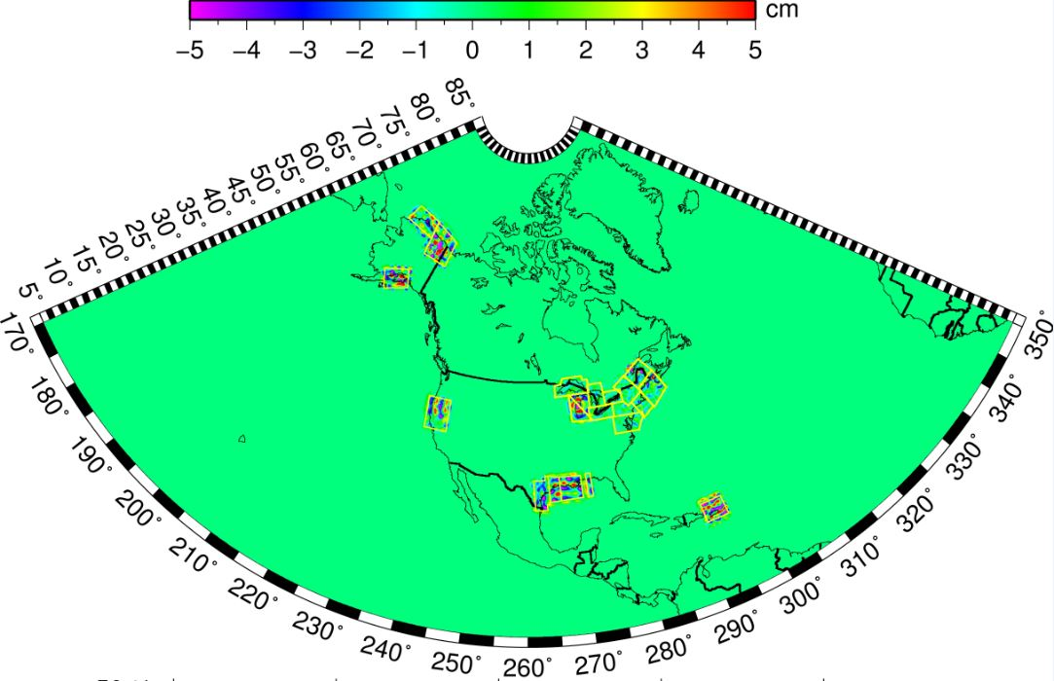
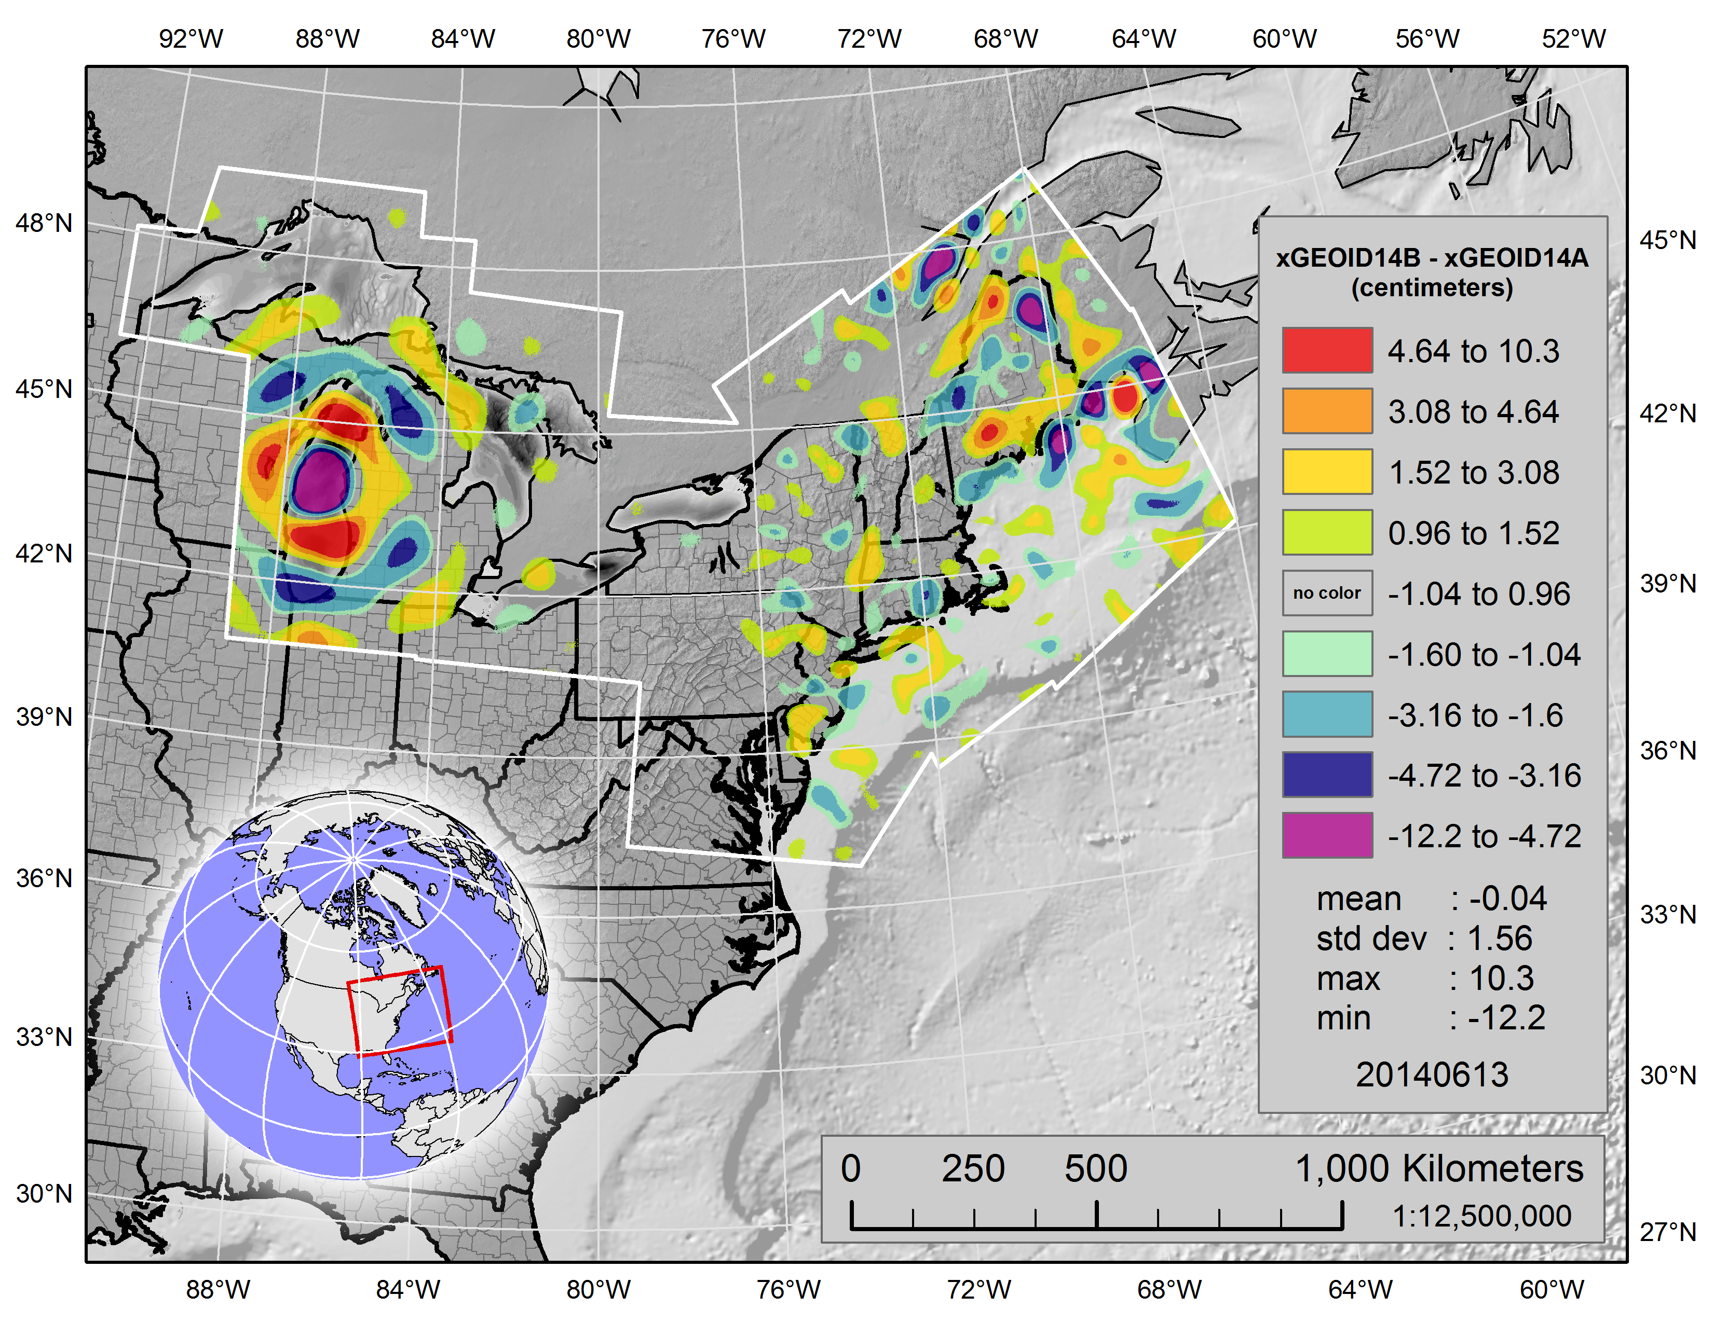
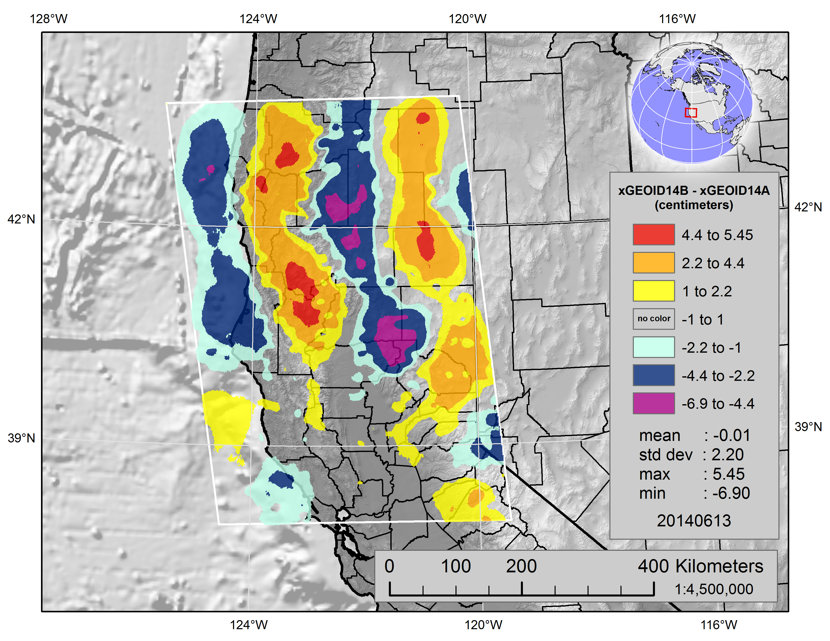
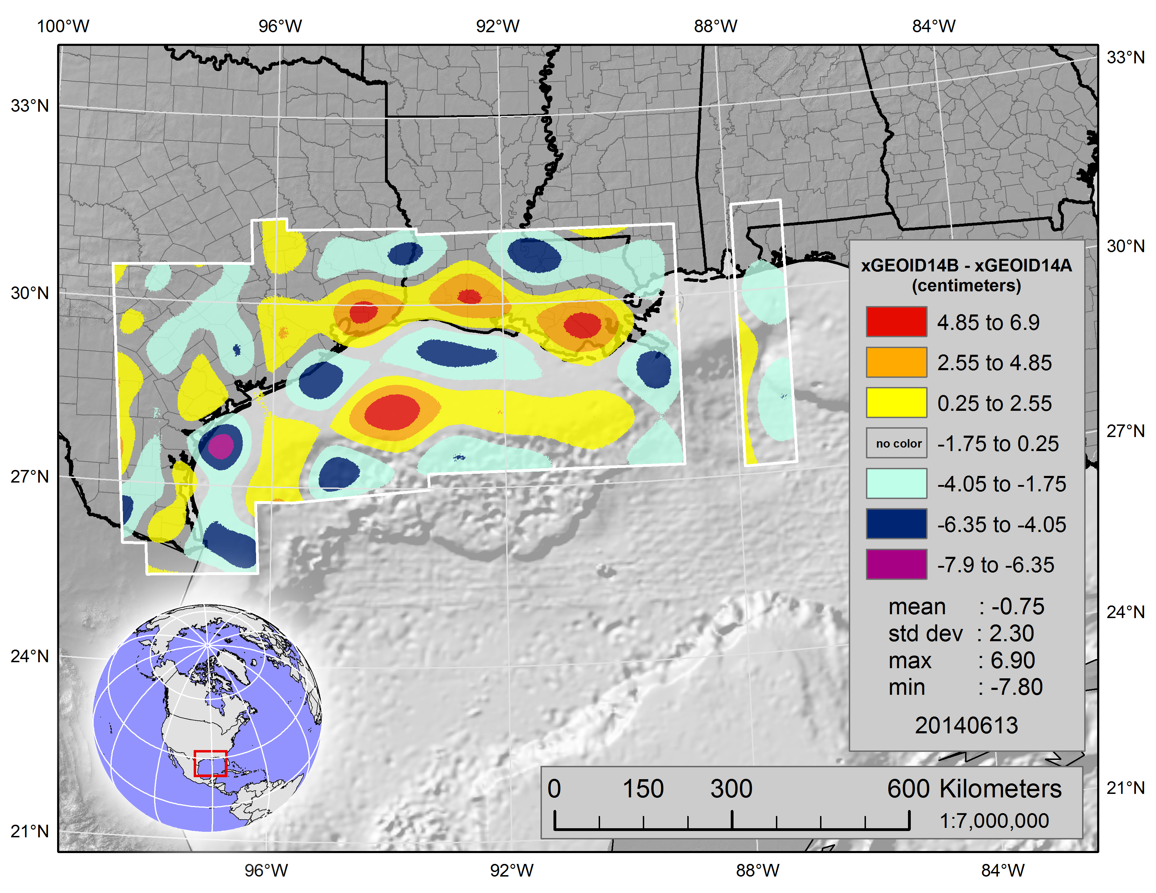
x

Slide 10
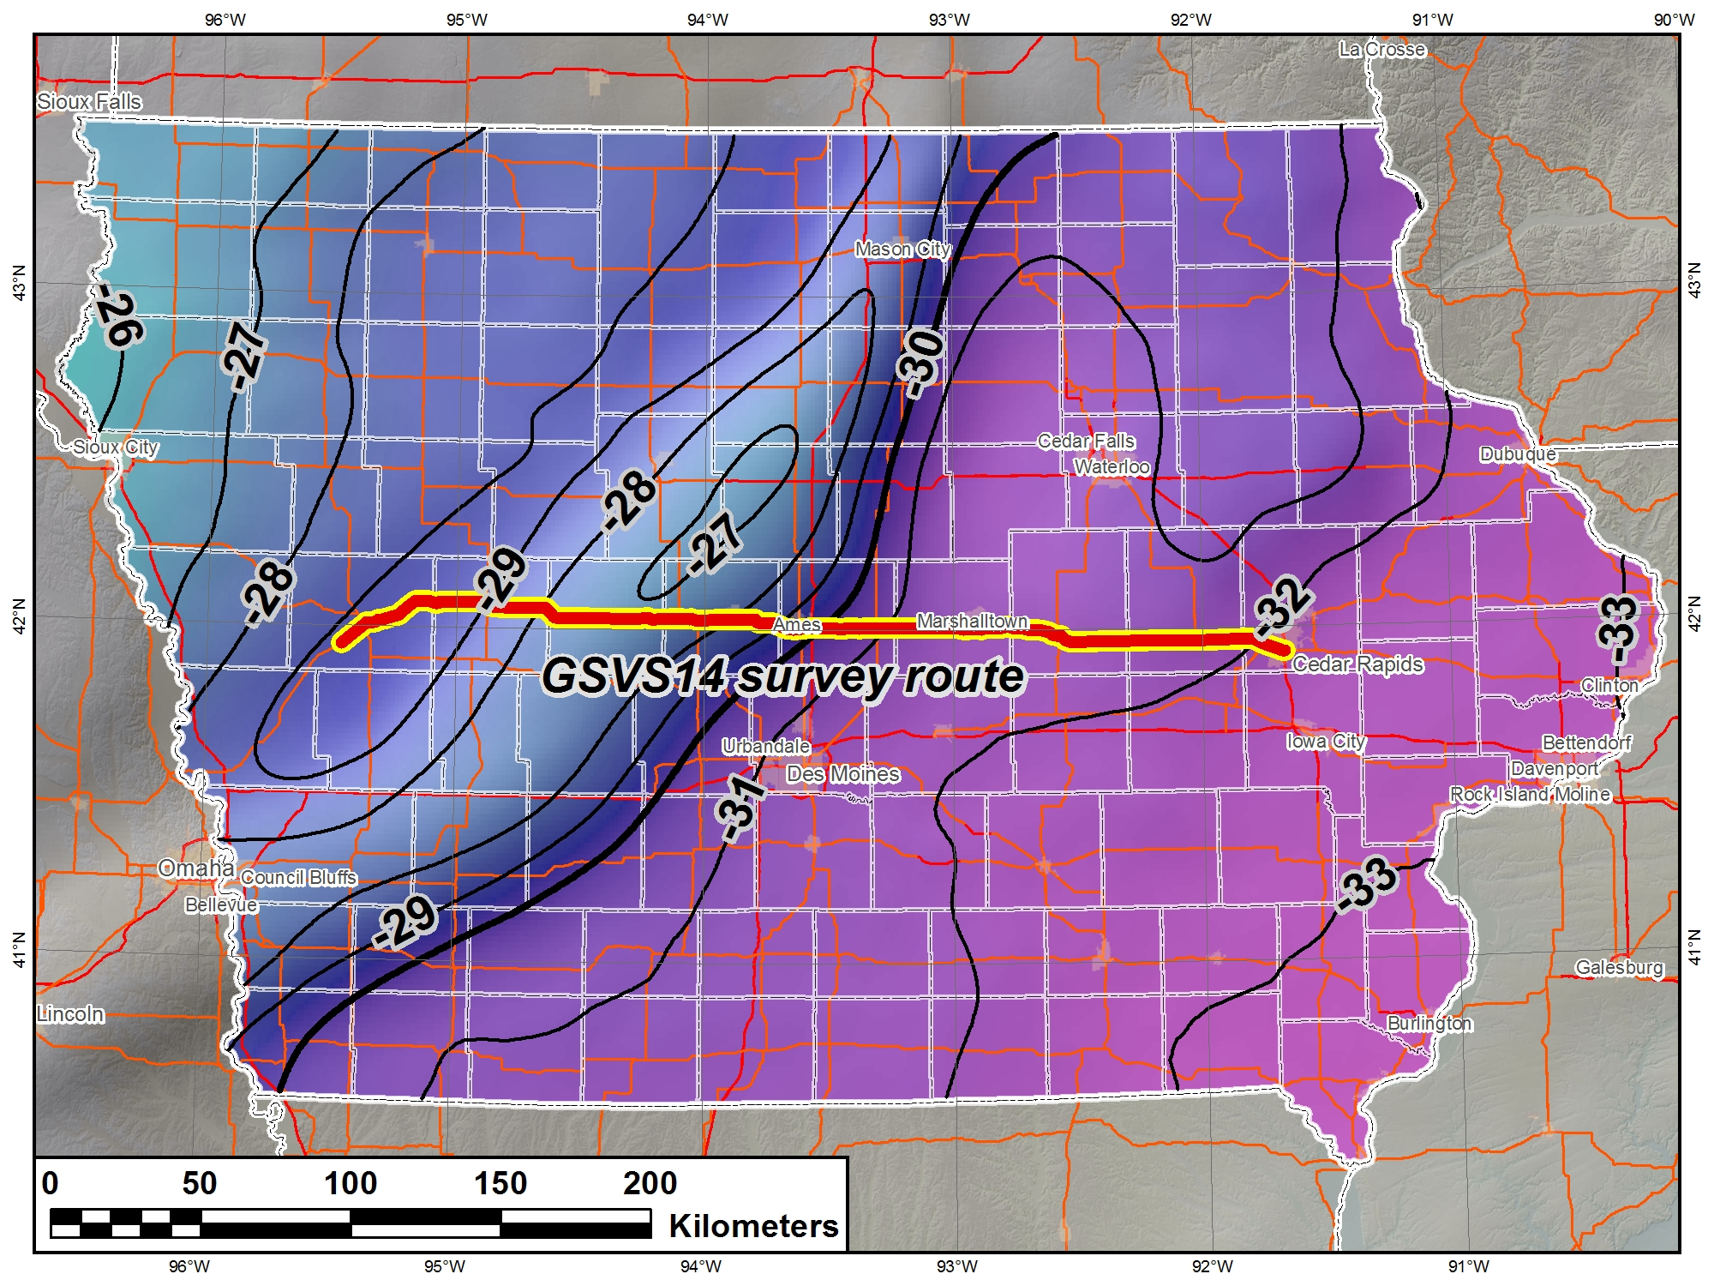
Geoid Slope Validation Survey of 2014 (GSVS14)
Research toward new vertical datum
E-W line across Iowa
Observations began in May 2014
Includes:
  Differential leveling
  GPS
  Terrestrial gravity
  Aerial gravity
  Deflection of vertical
This is the second GSVS project
  First in 2011 (GSVS11)

Slide 11
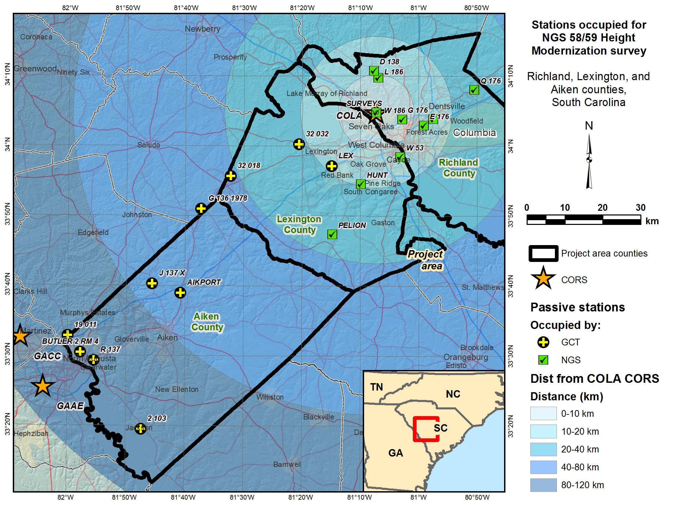
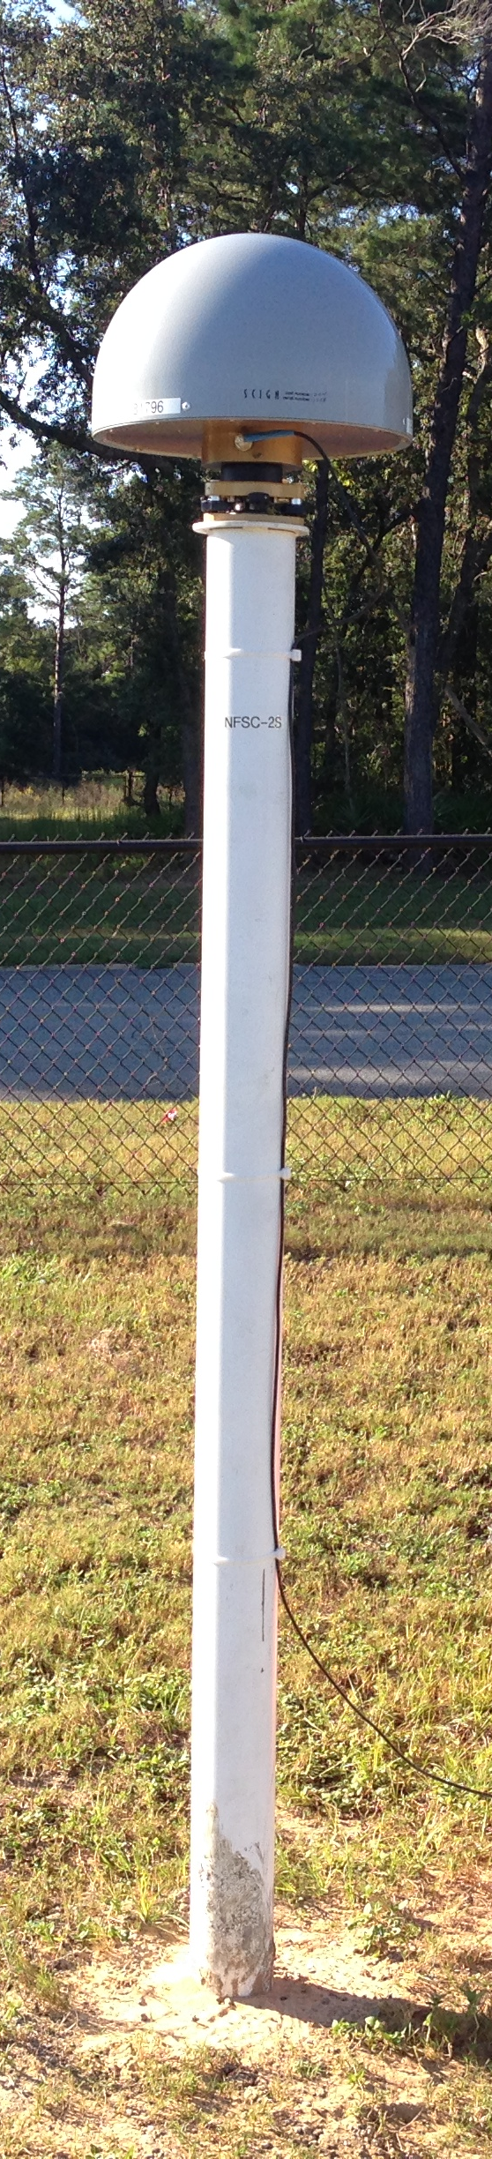
NGS 58/59 update project
An update for guidelines on GNSS-derived ellipsoid and orthometric heights
Two phases
  Vertical precision (FL)
  GPS bench mark Height Mod (SC)
Fieldwork done Dec 2013
Analysis of data underway
Will be used for new guidelines to replace
NGS 58/59 documents

Slide 12
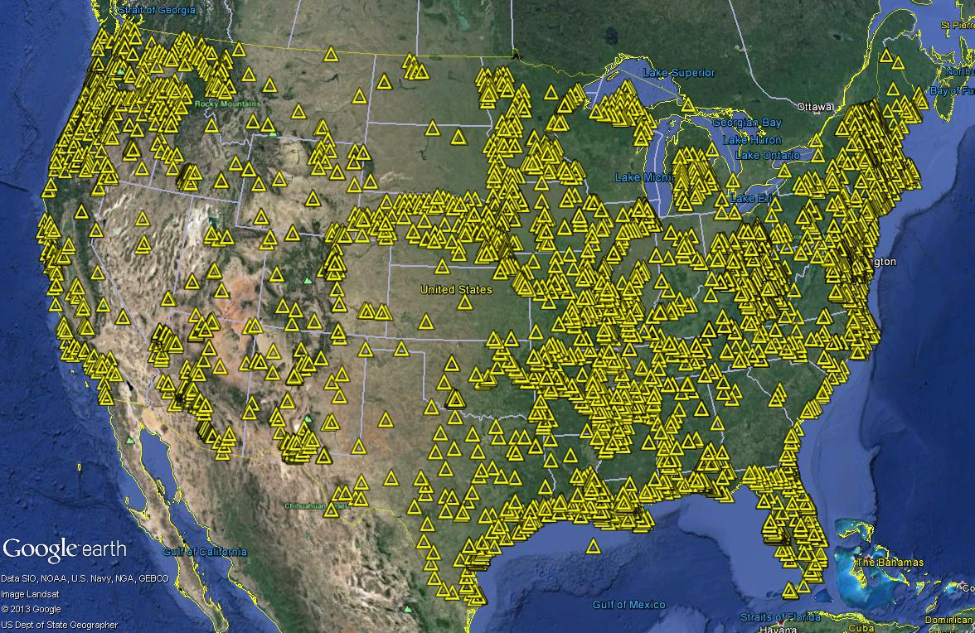
GPS on bench marks campaign
Performed during GPS Week (Mar 16-22)
Volunteers occupied leveled bench marks with GPS
Record number of shared OPUS solutions
Will help improved hybrid geoid model and conversion to new vertical datum

Slide 13
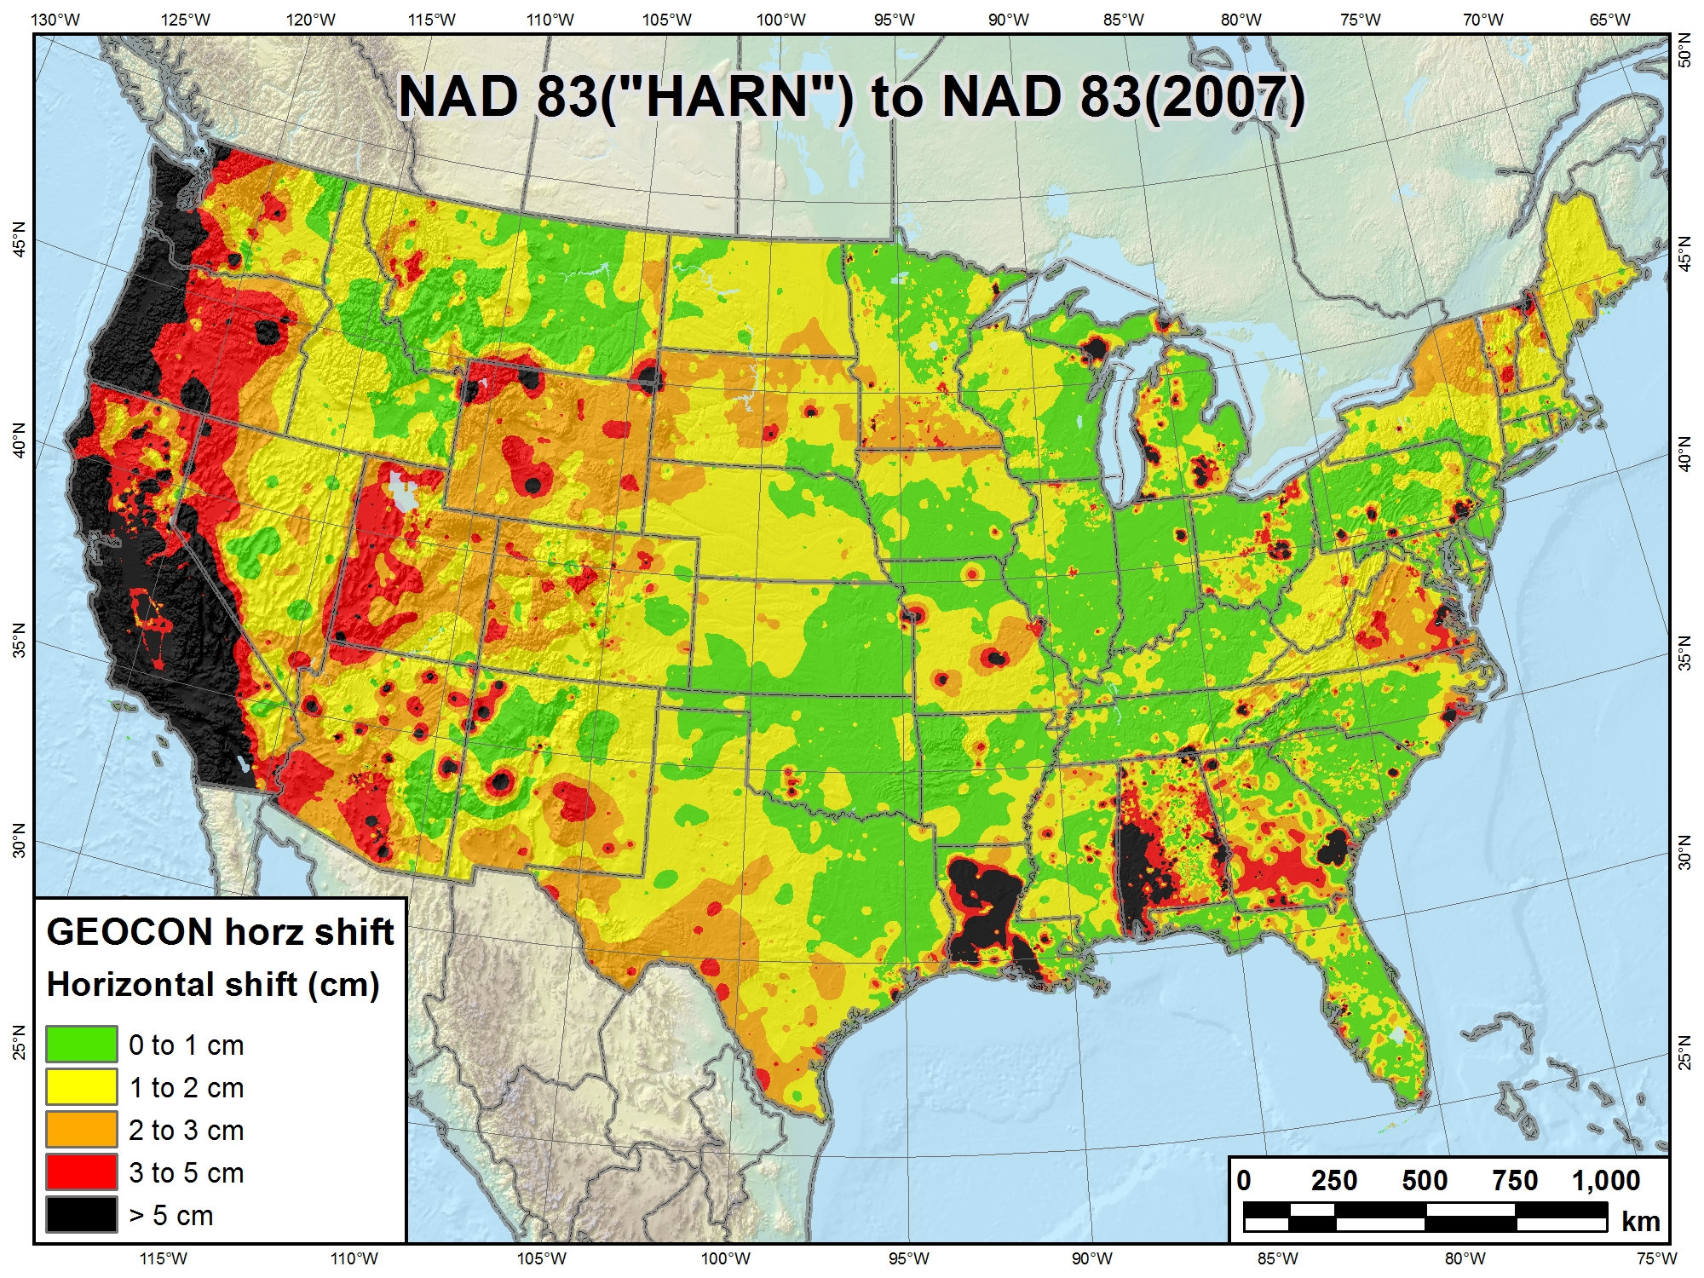
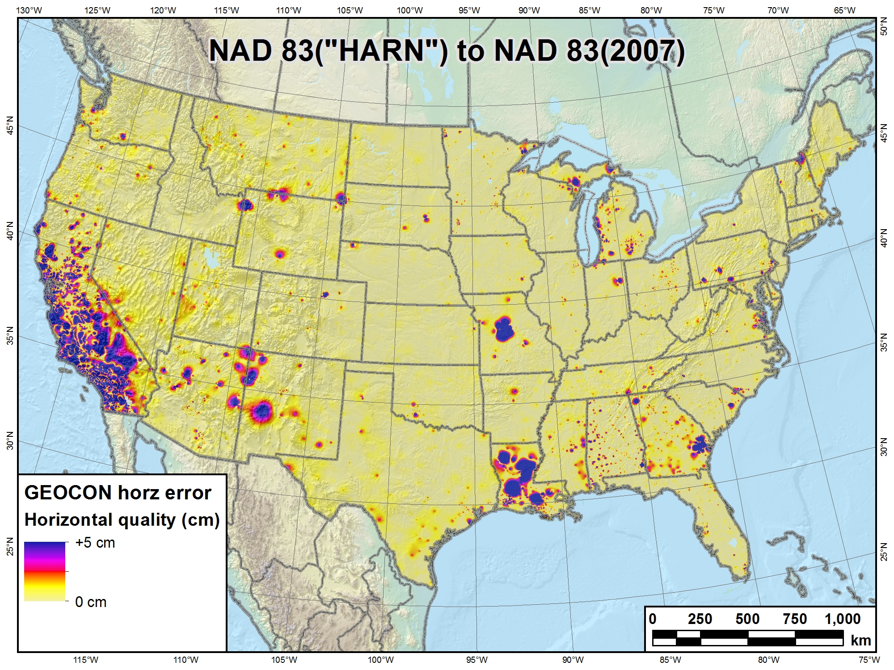
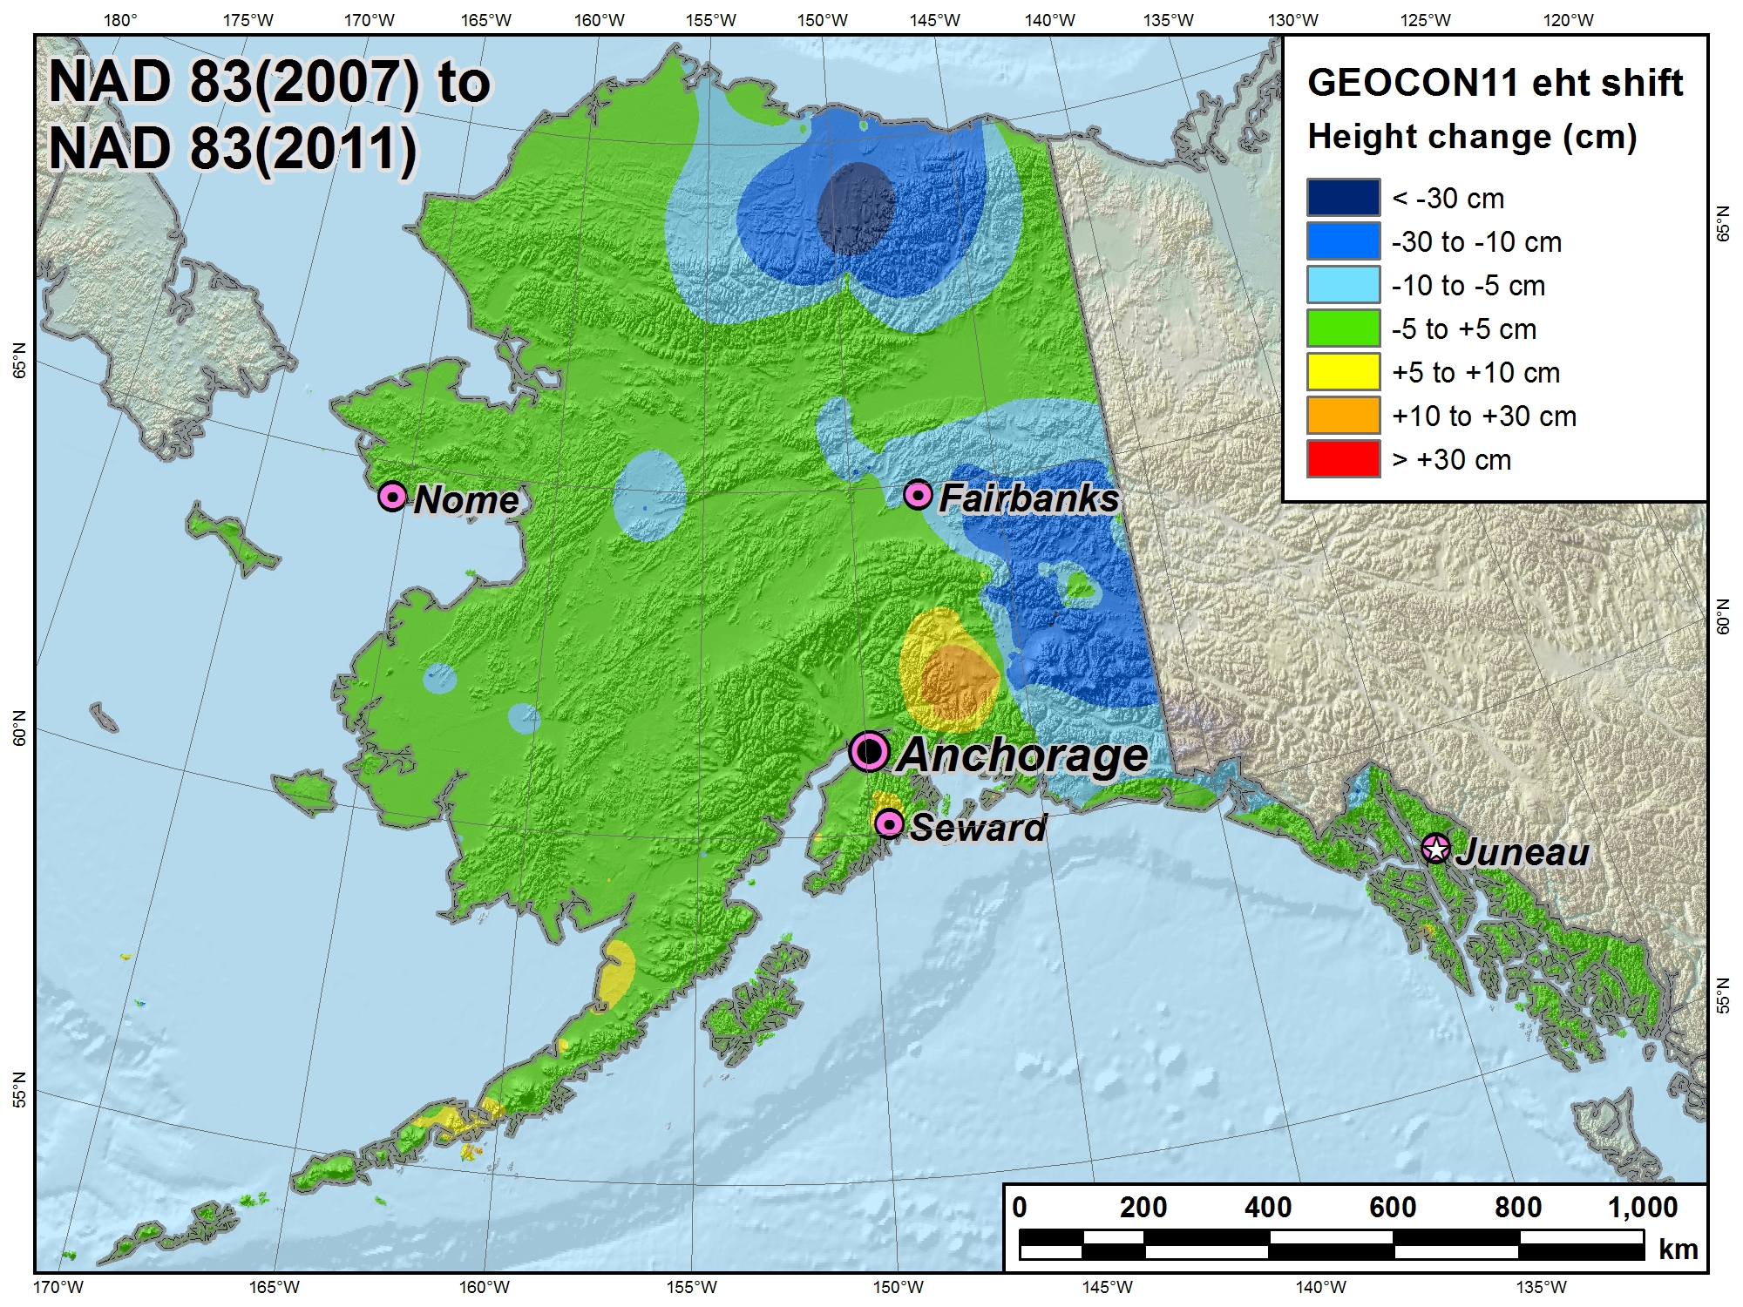
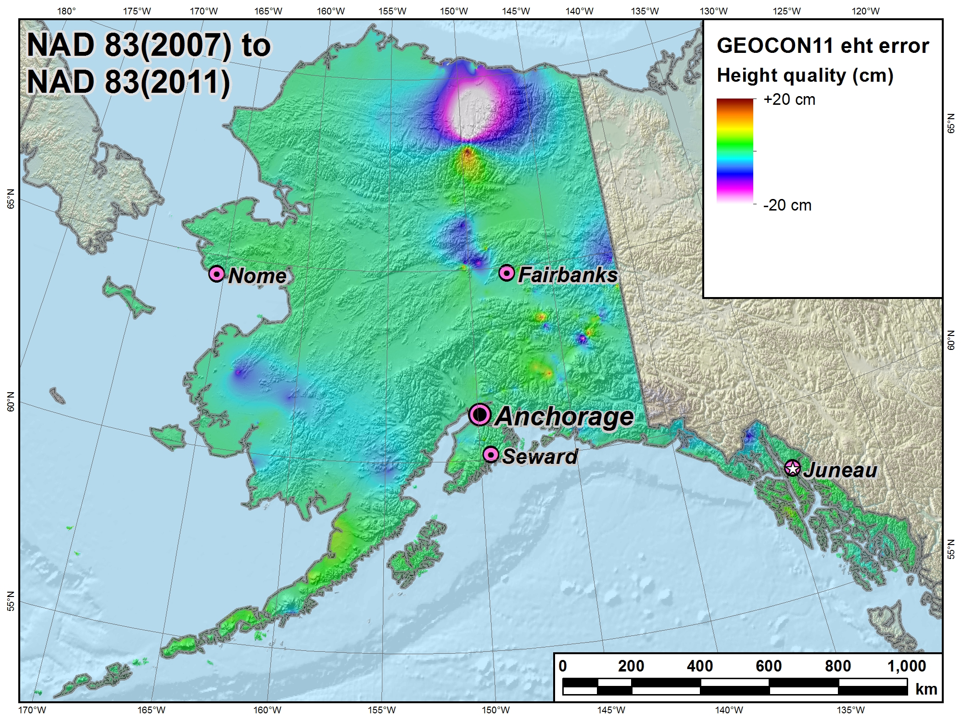
Transformation tools
GEOCON and GEOCON11
  Version 1.0 operational Jan 2014
  Continued improvements over time
  Will include Pacific
VDatum and HTDP
  Also being improved over time

Slide 14
The NGS mission remains the same
Define
Maintain
Provide access
NSRS
National Spatial Reference System
More information at www.geodesy.noaa.gov

