Slide 1
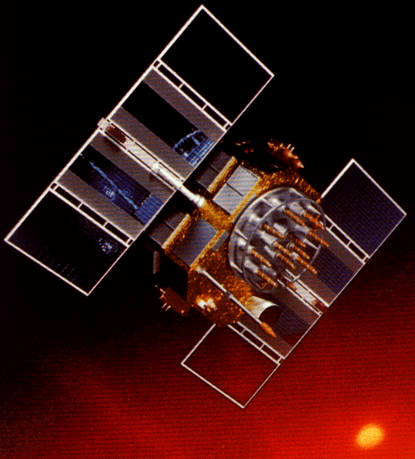
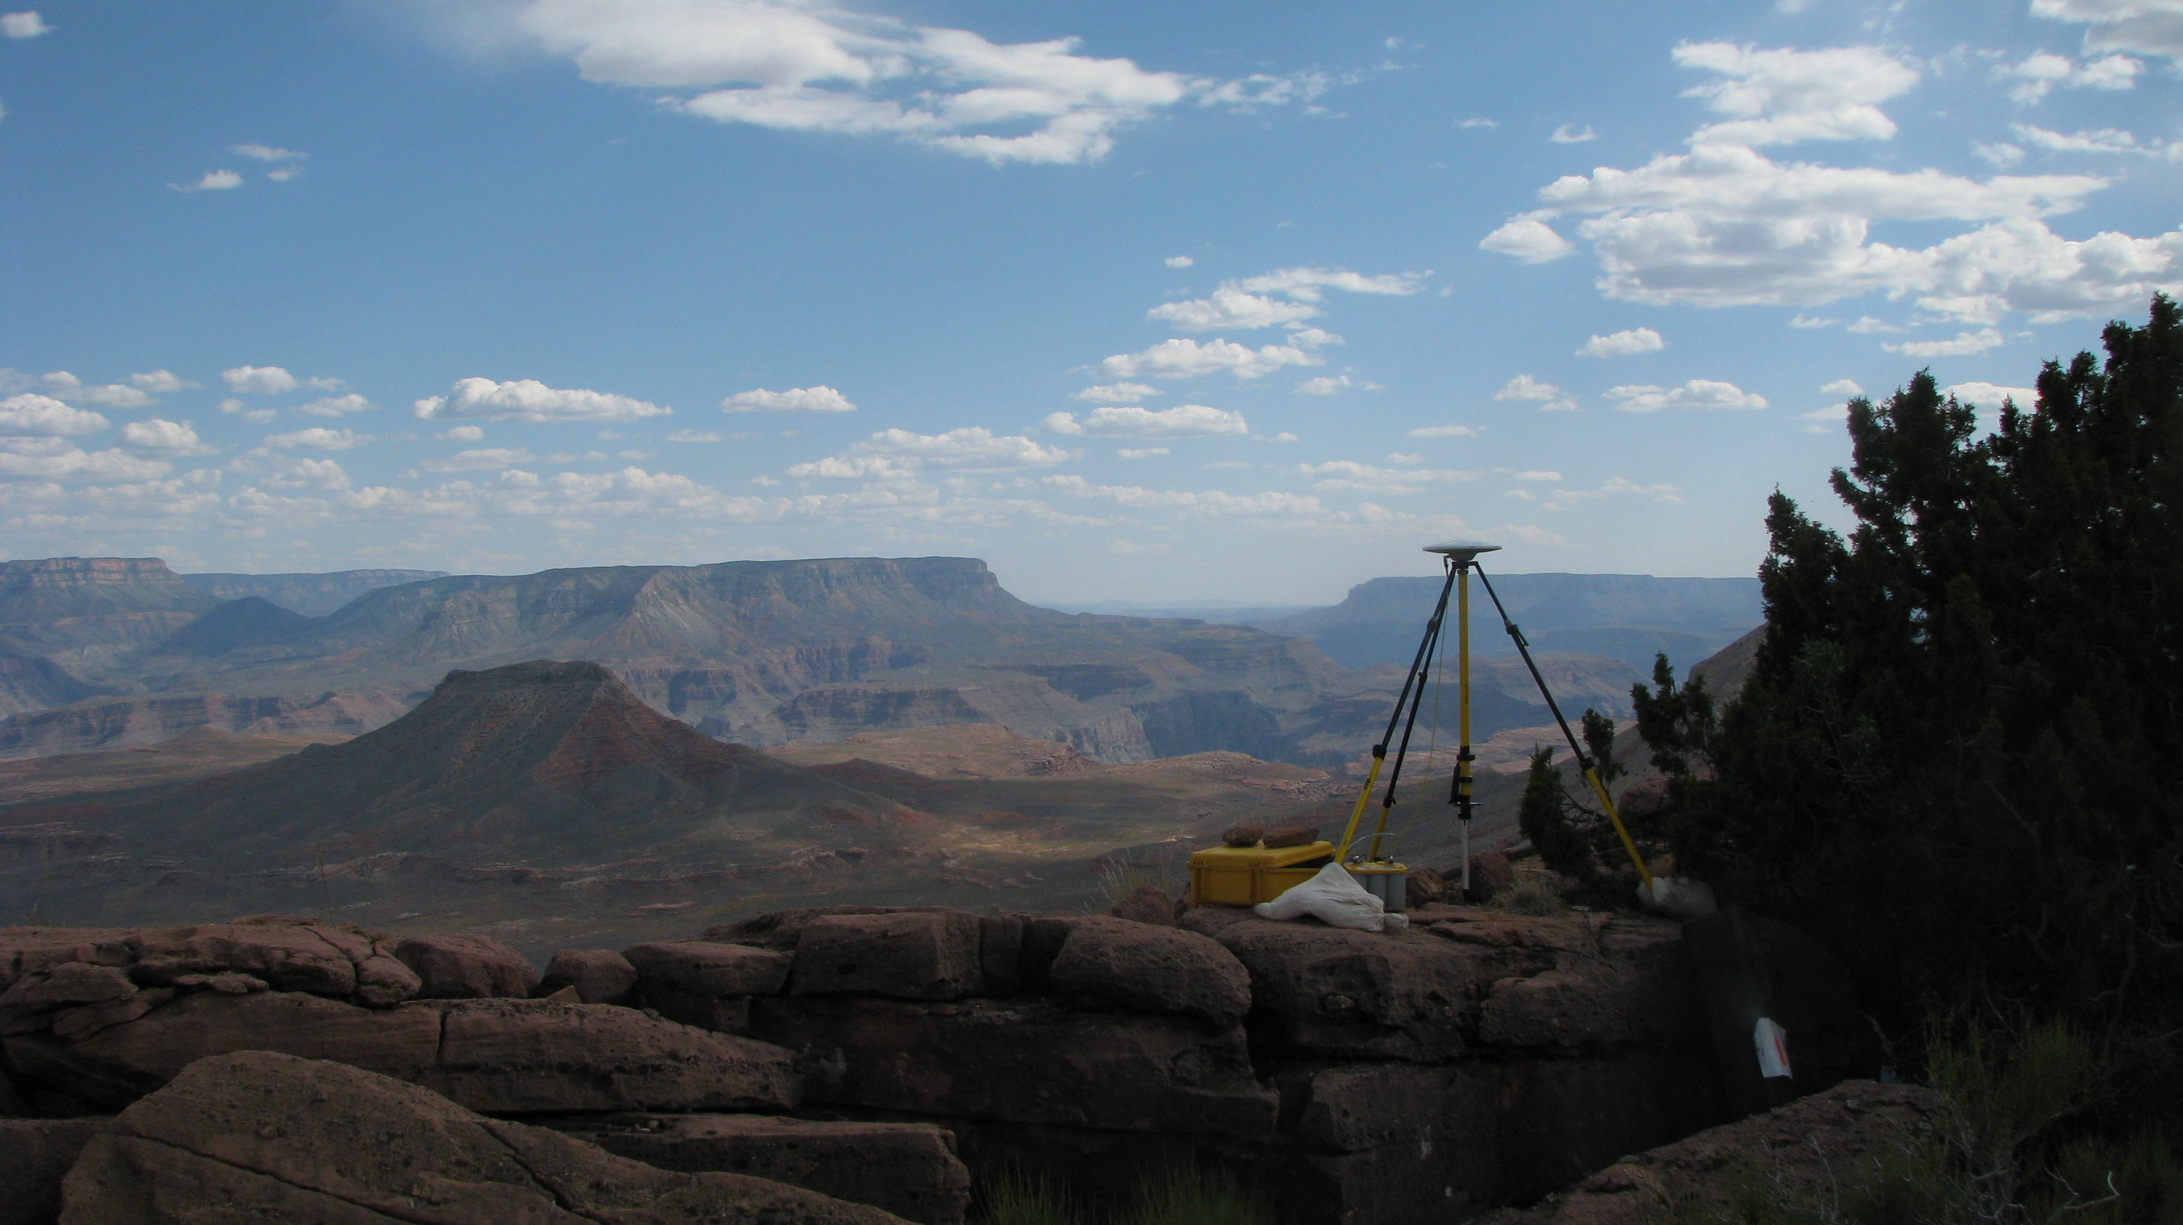
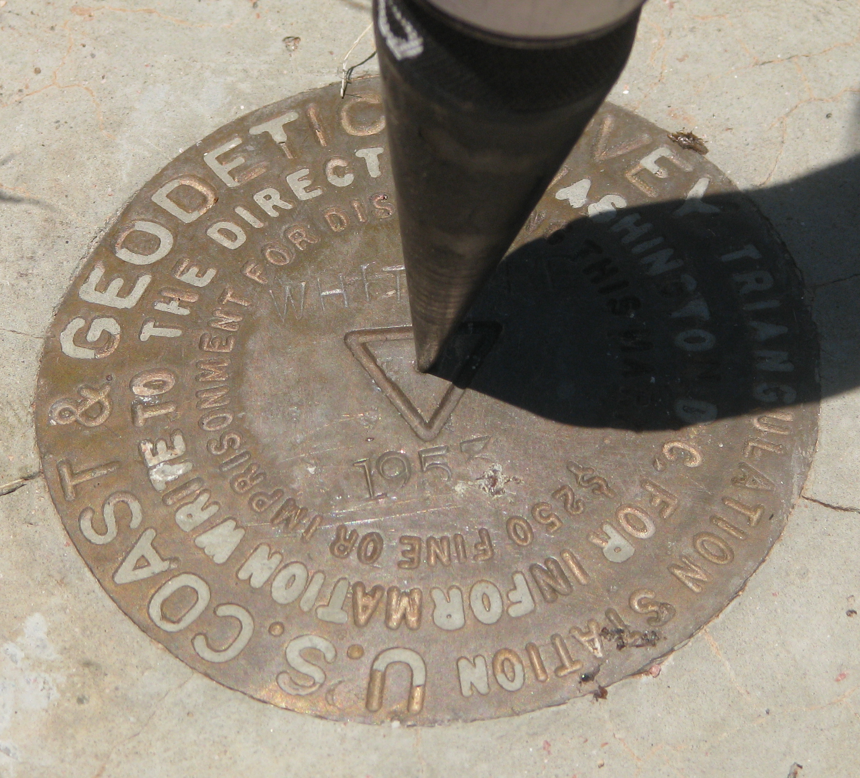
The Many Faces of OPUS and the Siren Call of Bluebooking
48th Annual Alaska Surveying & Mapping Conference March 28, 2014 ● Westmark Fairbanks Hotel & Conference Center
Michael Dennis, RLS, PE
michael.dennis@noaa.gov

Slide 2
The Plan
The Online Positioning User Service (OPUS)
OPUS Static
OPUS Rapid Static
OPUS Net (under development)
OPUS Projects (released January 2014)
Contributing to the NSRS: “Bluebooking”
NSRS = National Spatial Reference System
The NGS mission and NGS policy
NGS terminology for contributing to the NSRS:
“Share”, “Submit”, “Publish”, “Datasheet”

Slide 3
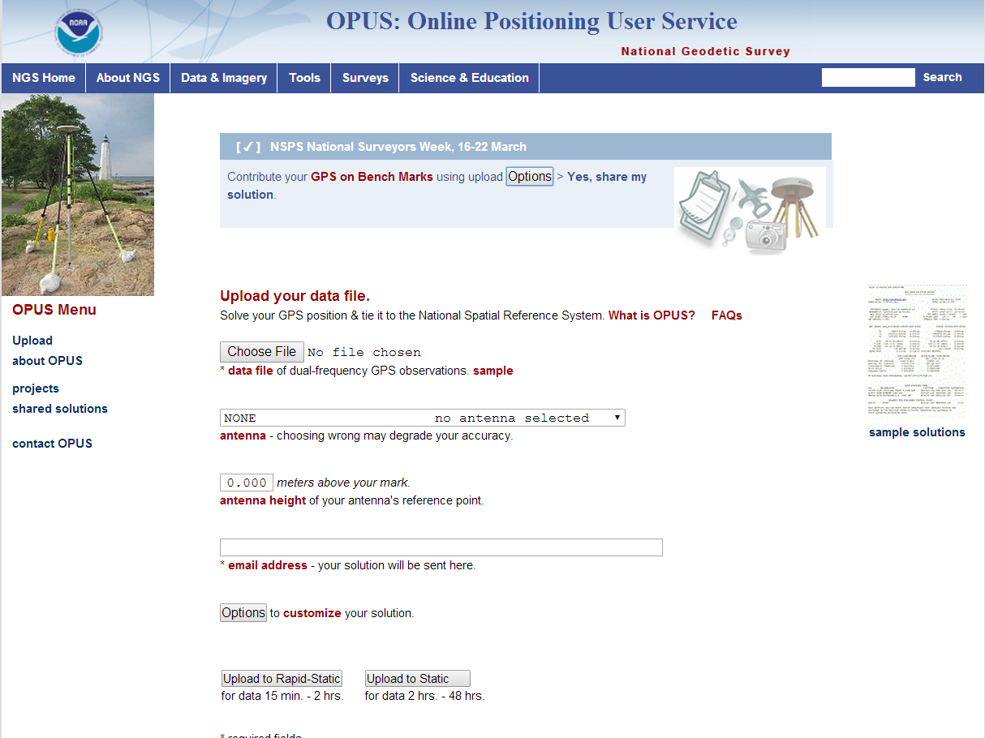

Slide 4
The Many Faces of OPUS
OPUS, the Online Positioning User Service, is a growing set of applications offering web-based access to the tools and resources provided by the NGS. OPUS is composed of:
OPUS Static . . . . . . . static processing
OPUS Rapid-Static . . rapid-static processing
OPUS Sharing . . . . data base and sharing
OPUS Net . . . . . . . improved models and processing strategies
OPUS Projects . . . . multiple marks and occupations

Slide 5
The OPUS Static Interface
Beautiful in its simplicity, the user need only provide:
Their email address.
The antenna type.
The offset to the antenna reference point (ARP).
2- to 48-hours of GPS L1 + L2 data.
In turn, the user receives:
Coordinates accurate to a few centimeters.

Slide 6
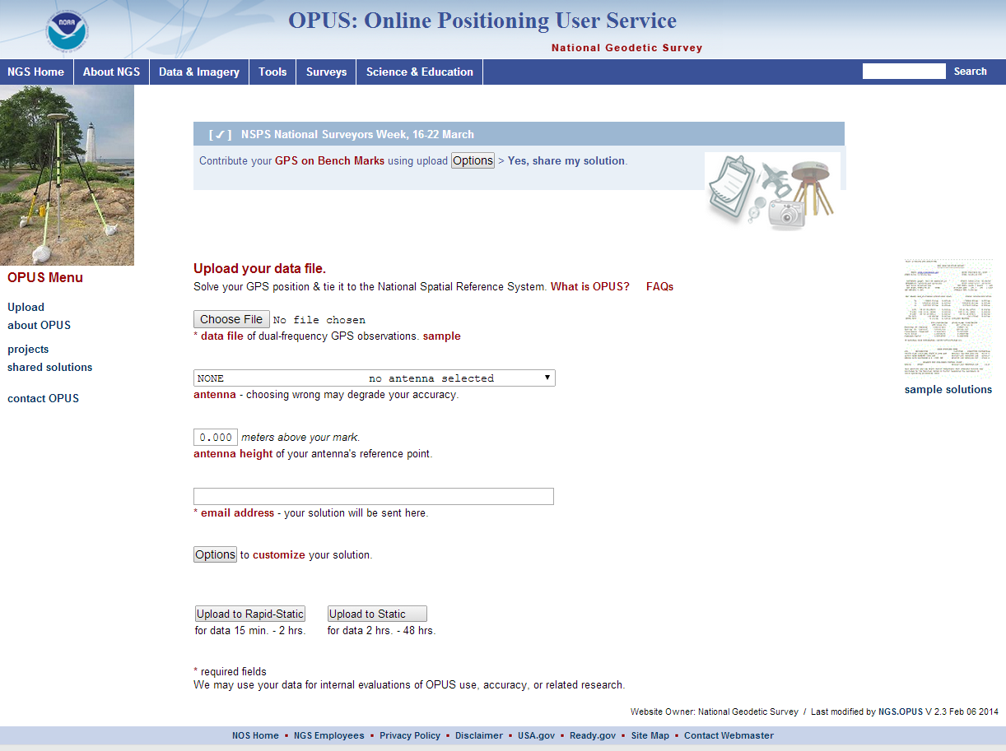
The OPUS Static Interface
This is the OPUS home page used to submit data to the processing queues.
To use OPUS Static, complete the four fields, then click the “Upload to STATIC” button. In a few minutes, an email arrives with the results.

Slide 7
How Good Can I Do With OPUS Static?
OPUS Static reliably addresses the more historically conventional requirements for GPS data processing. It typically yields accuracies of:
1 – 2 cm horizontally
2 – 4 cm vertically
However, there is no guarantee that this stated accuracy will result from any given data set. Confirming the quality of the OPUS solution remains your responsibility. That’s the “price” for automated processing.

Slide 8
The OPUS Rapid-Static Interface
With OPUS Rapid-Static, the beautiful simplicity remains. In fact the entry form is the same as for OPUS Static. The user provides:
Their email address.
An antenna type.
The vertical offset to the ARP.
15-minutes to 2-hours of GPS L1 + L2 data.
The user receives:
Coordinates accurate to a few centimeters.

Slide 9
The OPUS Rapid-Static Interface
The same interface is used except one clicks the “Upload to RAPID-STATIC” button instead.
http://geodesy.noaa.gov/OPUS/

Slide 10
The Standard Report
USER: mark.schenewerk@noaa.gov DATE: April 01, 2013
RINEX FILE: corv059f.09o TIME: 18:39:20 UTC
SOFTWARE: rsgps 1.37 RS74.prl 1.87 START: 2009/02/28 05:00:00
EPHEMERIS: igs15206.eph [precise] STOP: 2009/02/28 06:59:00
NAV FILE: brdc0590.09n OBS USED: 9090 / 13572 : 67%
ANT NAME: ASH700936E_C NONE QUALITY IND. 35.62/ 90.50
ARP HEIGHT: 1.521 NORMALIZED RMS: 0.289
REF FRAME: NAD_83(2011)(EPOCH:2010.0000) IGS08 (EPOCH:2009.15959)
X: -2498422.514(m) 0.008(m) -2498423.316(m) 0.008(m)
Y: -3802821.127(m) 0.012(m) -3802819.928(m) 0.012(m)
Z: 4454736.691(m) 0.010(m) 4454736.737(m) 0.010(m)
LAT: 44 35 7.91301 0.003(m) 44 35 7.92684 0.003(m)
E LON: 236 41 43.48303 0.003(m) 236 41 43.42280 0.003(m)
W LON: 123 18 16.51697 0.003(m) 123 18 16.57720 0.003(m)
EL HGT: 105.978(m) 0.017(m) 105.610(m) 0.017(m)
ORTHO HGT: 128.521(m) 0.023(m) [NAVD88 (Computed using GEOID12A)]
UTM COORDINATES STATE PLANE COORDINATES
UTM (Zone 10) SPC (3601 OR N)
Northing (Y) [meters] 4936954.983 105971.632
Easting (X) [meters] 475821.361 2277335.426
Convergence [degrees] -0.21381369 -1.98897463
Point Scale 0.99960719 0.99994603
Combined Factor 0.99959058 0.99992941
US NATIONAL GRID DESIGNATOR: 10TDQ7582136954(NAD 83)
BASE STATIONS USED
PID DESIGNATION LATITUDE LONGITUDE DISTANCE(m)
DH4503 P376 EOLARESVR_OR2004 CORS ARP N445628.315 W1230608.099 42648.2
DG5352 STAY STAYTON COOP CORS ARP N444950.532 W1224915.034 47031.0
DE6258 MCSO MARION CNTY COOP CORS ARP N445825.703 W1225720.637 51226.8
DE6433 WDBN WOODBURN COOP CORS ARP N451015.096 W1225212.130 73553.4
DG9893 NWBG ADEPAZ COOP CORS ARP N451800.172 W1225831.850 83544.6
DI0946 LFLO FLORENCE COOP CORS ARP N435900.967 W1240627.690 92644.0
Shown here is part of the OPUS Rapid-Static standard report.
Given the number of significant figures and uncertainties, this result is identical to the OPUS Static result.
Estimated and empirical accuracies from OPUS Rapid-Static within CONUS are comparable to OPUS Static.

Slide 11
OPUS-Net
This processing strategy was implemented in an OPUS-like application, called OPUS-Net during its testing phase. It includes:
Absolute antenna models.
An ocean-tide loading (OTL) model.
A combination of near-by and more-distant CORS.
Implementing these changes results in better precision and consistency with other sources (such as from IGS).

Slide 12
What Is OPUS Projects?
OPUS Projects gives users web-based access to simple visualization, management and processing tools for multiple marks and multiple occupations.
These tools include:
The advantages of data uploading through OPUS.
Data visualization and management aids.
Enhanced data processing using the PAGES suite.
Solution visualization aids.
A simplified means for producing some “Bluebook” files.

Slide 13
What Is OPUS Projects?
OPUS Projects exists in a hierarchical structure
Create . . . . . . . . creates a project.
Upload . . . . . . . . data submission.
Session . . . . . . . session review & processing.
Manage . . . . . . . network adjustments.

Slide 14
What Is OPUS Projects?
Your OPUS Project
OPUS Solution
Data &
Metadata
Session
Solution
OPUS Solution
Processor or Manager
Session
Solution
Manager
Network
Adjustment
Share
Session
Solution
Session
Solution
OPUS Solution
Submit for “Bluebooking” (to publish in NGSIDB)
Copy To User
Copy To User
Copy To User

Slide 15
Why complicate OPUS?
OPUS
Session
Adjustment
CORS3
CORS5
CORS2
CORS1
CORS4
solution HATFIELD
solution MCCOY
Notes:
In OPUS, “rover” data files are processed as if they are independent of each other.
That’s not a bad assumption - and it’s the only assumption possible for OPUS - but, in reality, some files might be related through a deliberate effort to “see” how marks are related to each other. We often call these observing “campaigns”.
If occupied simultaneously, data from marks:
Will “share” some aspects of their environment (similar atmosphere overhead for example) if they are within a few kilometers of each other.
Will “share” a similar satellite geometry if they are within a few tens of kilometers of each other.
And regardless of distances, tmight use the same types of equipment, or the same CORS in processing, etc..
These campaigns are most common kind of GNSS data that NGS collects and its stakeholders share.

Slide 16
Why complicate OPUS?
OPUS
Session
Adjustment
CORS3
CORS5
CORS2
CORS1
CORS4
solution HATFIELD
solution MCCOY
session 001
Notes:
This is a good thing. Combining data from simultaneously occupied marks while processing can improved the results. For example:
Neutral atmosphere (tropo) corrections will improve.
Common CORS and satellites can be de-correlated.
In turn, these help with other things like phase ambiguity resolution (fixing integers).
This simple “trick” will improve the accuracy of the relative positions of the marks in the campaign. This is often the desired end-product.
But include some CORS or occupy some surveyed marks as part of the campaign and NSRS (National Spatial Reference System) coordinates for the marks can be determined.

Slide 17
Why complicate OPUS?
OPUS
Session
Adjustment
CORS3
CORS5
CORS2
CORS1
CORS4
solution HATFIELD
solution MCCOY
session 001
session 002
session N
Notes:
The same will be true for other simultaneous occupations.
If we think about it a bit, we’ll realize that a new, derived data type has been created, the occupation solutions, that has the potential to be better for some purposes.
Now, I’ll introduce in some OPUS Projects jargon. These simultaneous occupations several marks will be called sessions. The processing results will be called session solutions.

Slide 18
Why complicate OPUS?
OPUS
Session
Adjustment
CORS3
CORS5
CORS2
CORS1
CORS4
solution HATFIELD
solution MCCOY
session 001
session 002
session N
network adjustment
Notes:
Taking this one more step, if the session solutions are combined:
The “signal” (what we’re trying to measure - in other words the positions of the marks) will reinforce and be easier to detect.
The “noise” (anything we don’t really care about) will, hopefully, be random and diminish.
Ultimately, combining session solutions into a network adjustment (more OPUS Projects jargon) can improve the results for the entire network.

Slide 19
What’s all that really mean for me?
OPUS solutions = pretty good, but each treated as independent and assumes “perfect” CORS.
Sessions = simultaneously-observed marks processed together in sessions increases consistency.
Adjustments = interlinking sessions through network adjustments increases accuracy.
Notes:
The figures are from a “real world” example from the mid-Atlantic region. Your results will vary.
The light (white) shaded areas indicate +/- 2 cm horizontally and +/- 4 cm vertically.
The OPUS results repeat better than these limits.
But (only) slightly more complex processing improves the results.
Not just for this mark, but for all marks in the project.

Slide 20
Are There Any Other Advantages?
Faster, simpler setup
A project’s data are consolidated in on-line storage.
Initial data quality assessments provided on upload.
The data are organized automatically.
Faster, simpler work flow
Project specific preferences and the on-line GUI simplifies running PAGES.
Software and models are always up-to-date.
The quality of the processing results is visually indicated in maps, plots and tables.
Many useful files are created automatically.
Notes:
Gather data and metadata without having to physically carry it to a location can mean a faster start to processing.
Gathering data by uploading through OPUS gives the “bonus” of an OPUS solution for quick quality control.
Automatically associating data to marks and simultaneously observed data files into sessions can mean less organizational effort is needed.
The ability to set project preferences and GUI (graphical user interface) facilitating this type of processing will permit more folks to use PAGES effectively without having to be a PAGES expert.
The processing occurs on NGS computers so the software and ancillary files are always up-to-date.
Dynamically created maps, plots and table, plus the preferences, help evaluate the results through visual cues.
OPUS Projects builds some useful files saving time.

Slide 21
Any Limitations?
Internet access is required.
OPUS Static upload restrictions apply.
Dual-frequency pseudorange & phase.
2 hrs ≤ data span ≤ 48 hrs.
Observation interval = a factor of 30 (seconds).
Minimum project size.
1 data file from 1 mark.
Maximum project size.
About 100 marks in a single session.
Number of data files < a few hundred.
Notes:
No internet means no access. Users have to be online.
OPUS Static data file limits apply, but we hope to allow Rapid-static files – probably with restrictions – by the end of the year.
1 data file from 1 mark is OPUS so no real gain. Multiple occupations of 1 mark starts to have advantages. But the purpose and, therefore, the strength of OPUS Projects is multiple marks with multiple occupations.
There are practical limits to a project’s size. The number of data files < a few hundred implies:
A few marks occupied many times.
Many marks occupied a few times.

Slide 22
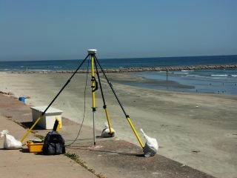
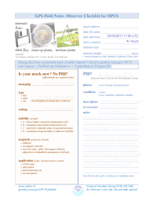
G.I.G.O.
Good coordinates come from good data collected using good practices. We hope OPUS Projects can help make processing and publishing easier, but it can’t spin straw into gold. Folks still need to:
Follow their project’s specifications.
Use best practices and careful field procedures.
Select permanent marks of public interest.
http://gis.larc.nasa.gov/
Notes:
I’m not saying we NGS doesn’t need surveyors or that surveyors don’t need NGS. I am saying a surveyor shouldn’t have to be passable programmer or geodesist, and NGS should be helping surveyors do their job, not teaching them to be passable programmers or geodesists.
GIGO = garbage in, garbage out

Slide 23
OPUS Projects Training
Because of its increased complexity, training is required to be an OPUS Projects manager.
Workshops are small allowing ample time for one-on-one interaction with the instructor.
The NGS Training Center will schedule workshops run by NGS.
Notes:
NGS requires training to manage a project under the assumption that the manager will provide the necessary training for others participating in the project.
Two types of workshops will be offered:
Projects only: 1.5 days in length.
Bluebooking using Projects: 4 days in length.

Slide 24
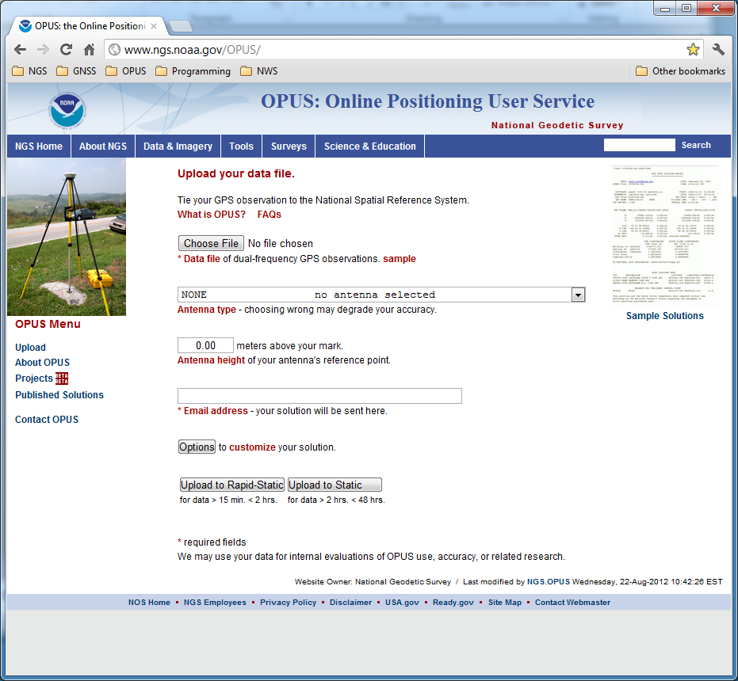
The OPUS upload page is the access point for all things OPUS.
Notes:
The OPUS gateway page is found at http://geodesy.noaa.gov/OPUS/.

Slide 25
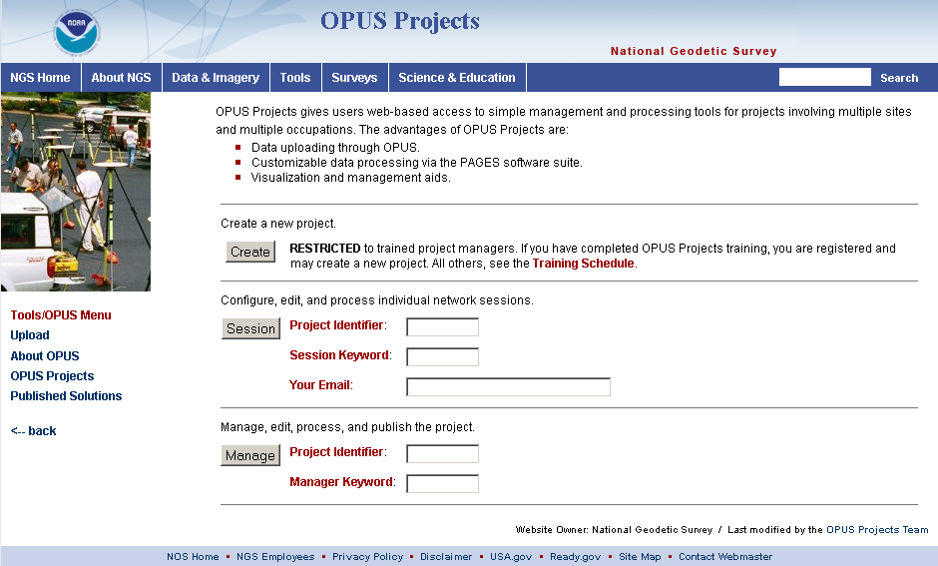
This is the OPUS Projects gateway page.

Slide 26
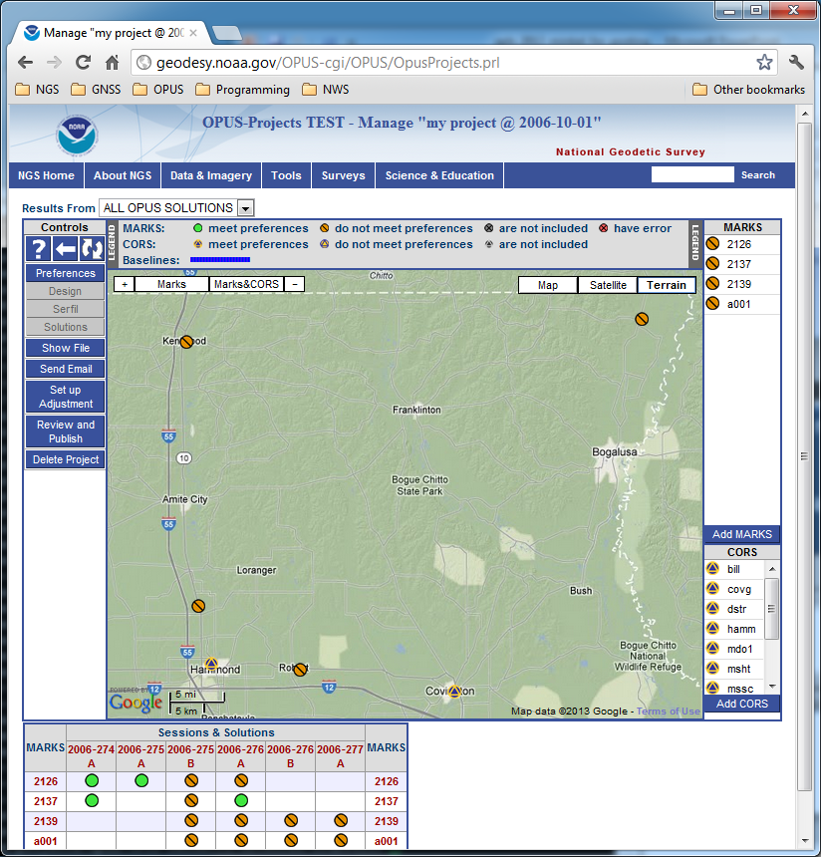
This is the manager’s page.

Slide 27
The map shows the relative location of the project’s marks. If the Session solutions were completed, they would be shown, but the OPUS solution results can always be displayed.

Slide 28
View And Process A Session
OPUS Projects groups the data into sessions.
Sessions are groups of mark occupations that overlap significantly in time. Note that
a mark may appear in more than one session.
as new data are submitted, the definitions of the sessions may change.
Now that some data has been submitted to the project, processing can begin.

Slide 29
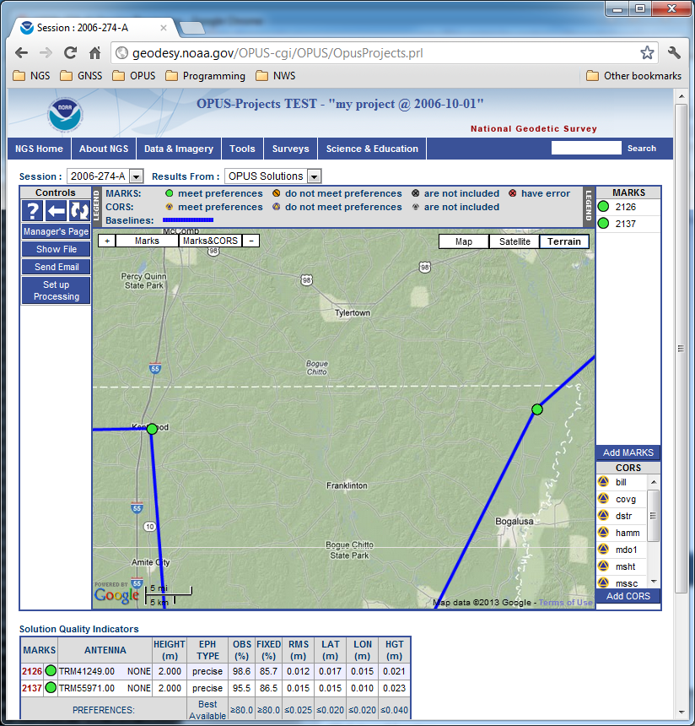
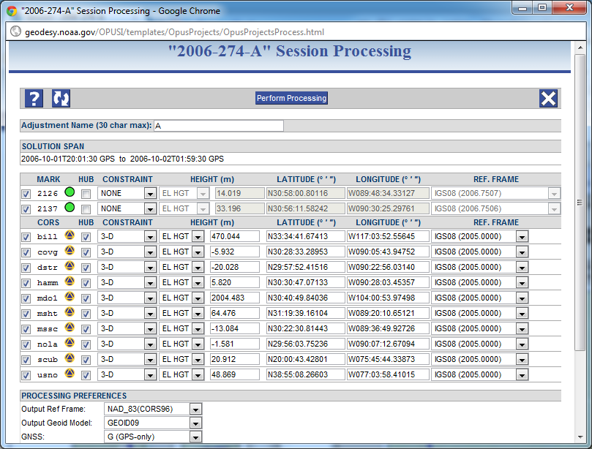
Setup for processing a session’s data.

Slide 30
Once Session processing has been completed, Session and OPUS solutions will be available. Network adjustments will be available too as they are completed.

Slide 31
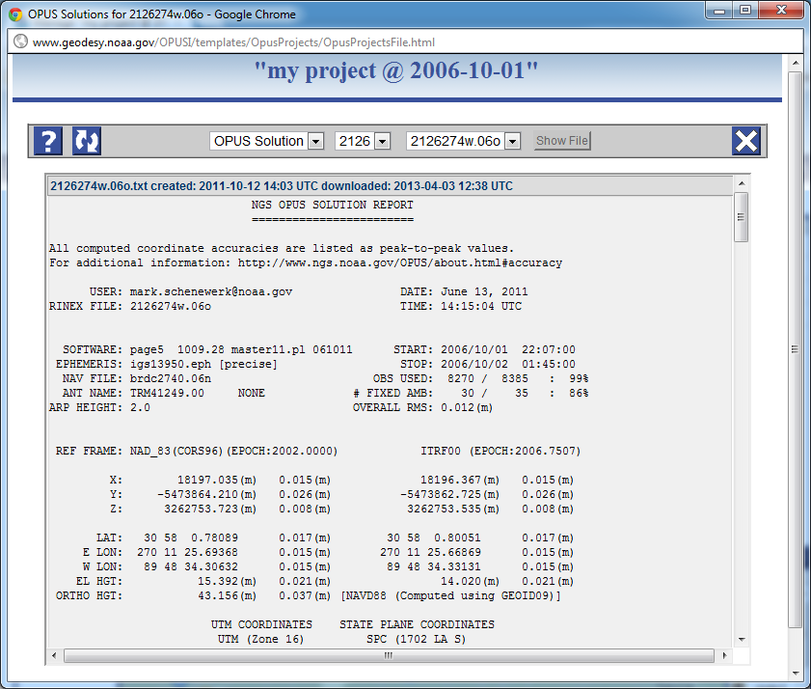
The reports created during OPUS, Session or Network processing are available through the Show File controls. The selected files are display in a separate window for printing or saving locally.

Slide 32
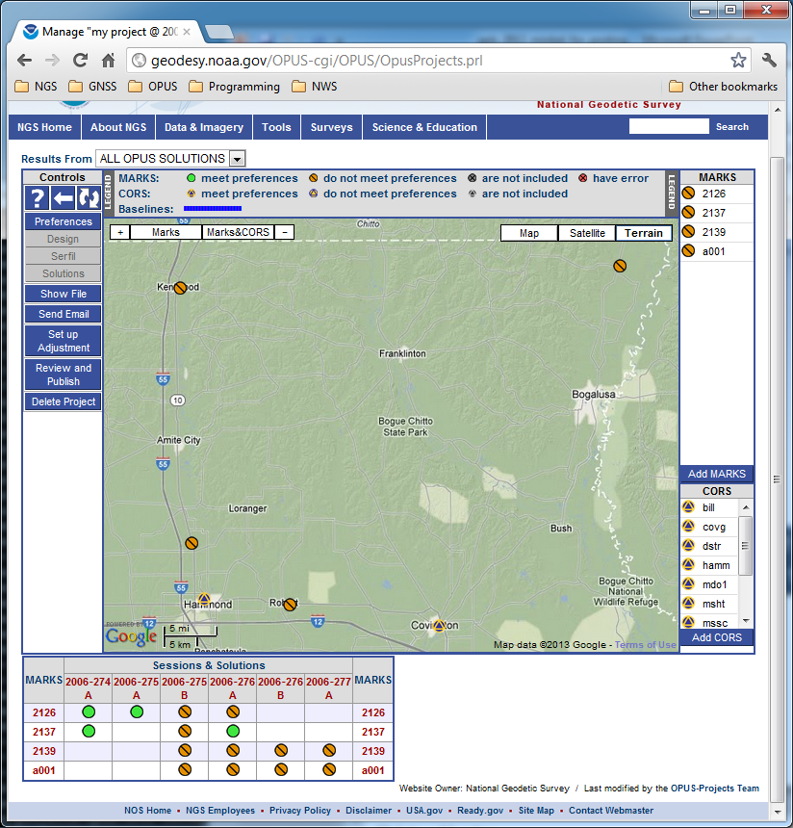
Go to a Mark summary page to see results. To navigate to the 2126 page, click on the Session & Solution table row header for Mark 2126. Similar access is possible from any session page which includes this mark.
Notes:
Going back to the manager’s page, now let’s go to a mark.

Slide 33
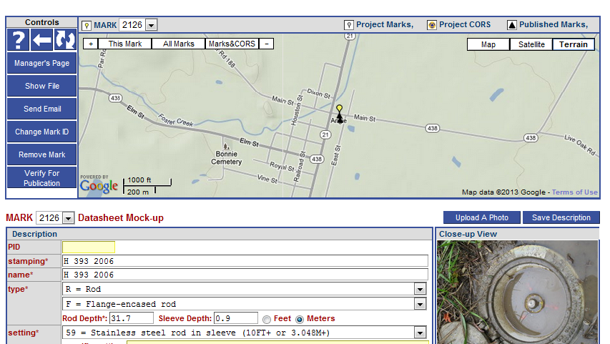
Here’s the page for mark 2126. The individual mark pages are the busiest, so I’ll only describe the contents generally.
Notes:
Mark 2126 page (top).
Note that this is the page the manager sees. Others will see a slightly different presentation.

Slide 34
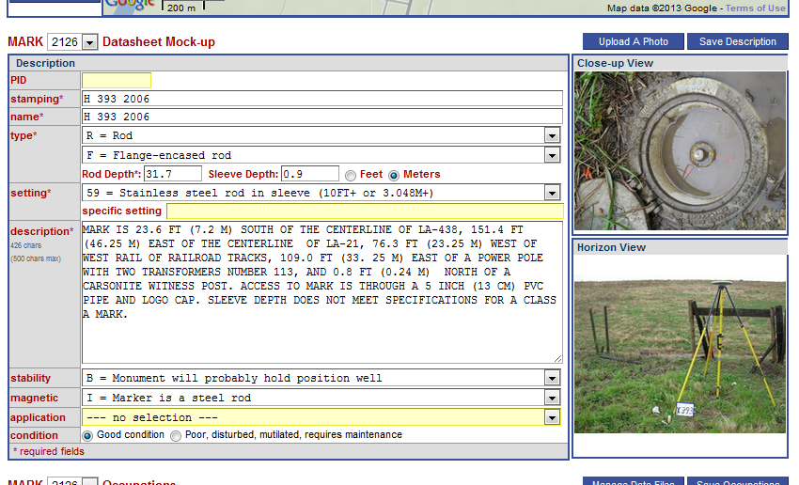
Scrolling down the page, we find a mock-up of the datasheet for this mark. Because we accessed this mark as the project manager, we can modify this information for our own use or in preparation for publishing.

Slide 35
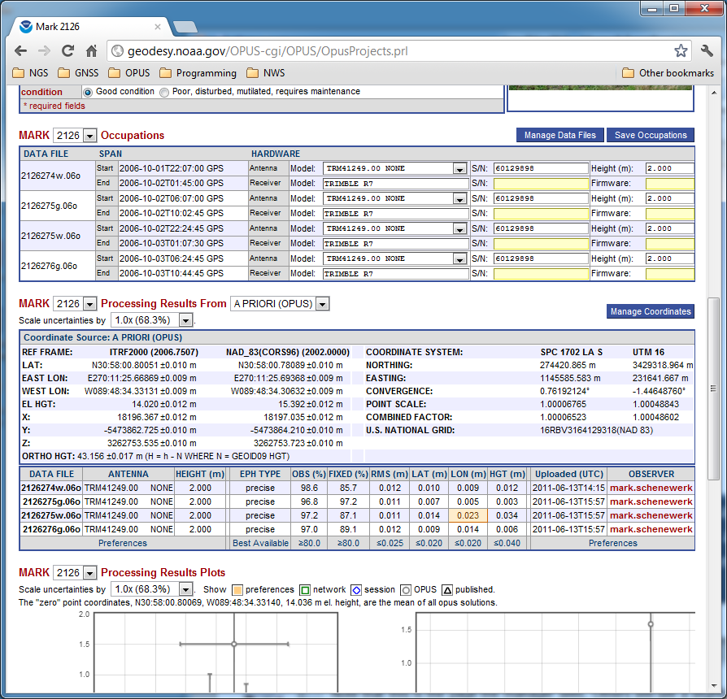
Next on the page is a summary of the occupation information for this mark. Again, because we accessed this mark as the project manager, we can modify this information for our own use or in preparation for publishing.

Slide 36
Next, we can review the processing results for this mark.

Slide 37
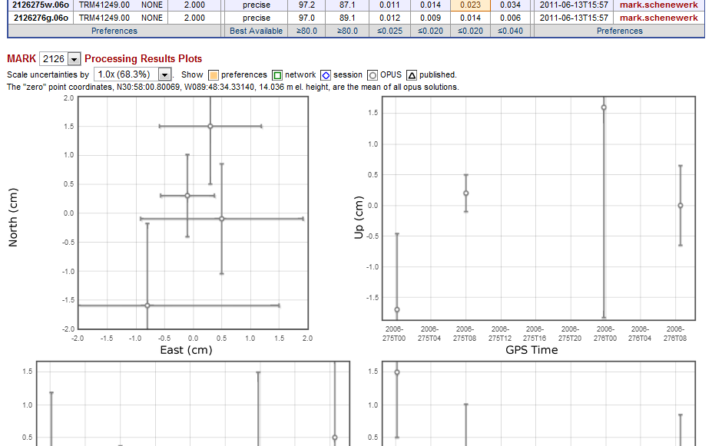
At the bottom are interactive plots and tables summarizing all the processing results for this mark: OPUS results from the uploads, Session Solutions and Network Adjustments. Project preferences are indicated, but, in this case, the results are all within those preferences.

Slide 38
Sharing OPUS results
To share or not to share?
The intent is to make sharing as easy as possible. The requirements are minimal:
4 or more hours of data.
A quality, “GPS-able” mark.
Good field practices.
Good data.
Good description.
http://geodesy.noaa.gov/OPUS/about.jsp#publishing
Only OPUS-Static results can be shared at this time. In the near future will be able to share OPUS-Projects results.
No longer called “Publish” through OPUS interface.

Slide 39
“Share” vs. “Publish”
Share. The act of a user releasing to NGS the observations, metadata, and results of geodetic surveys tied to the NSRS for public dissemination.
Submit. The act of a user releasing to NGS the observations, metadata and results of geodetic surveys tied to the NSRS for the express purpose of NGS evaluating and publishing if appropriate.
Publish. The action of NGS providing to the public, the official NSRS geodetic coordinates set on a mark.
Datasheet. A report containing the published NSRS coordinates on a mark, as well as subsidiary information and metadata such as superseded coordinates, descriptions, and recovery history.

Slide 40
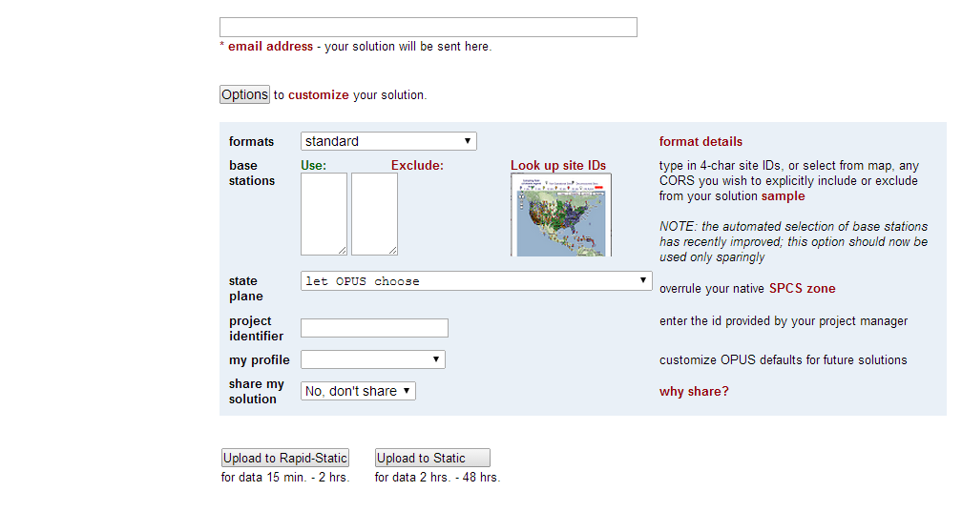
OPUS Sharing Interface
The first step in OPUS Sharing is to upload suitable data to OPUS. At that time, you must explicitly designate that your results should be shared. This is done through the “share my solution” option near the bottom of the Options list.

Slide 41
Viewing Shared Solutions
To a view shared solution, use the Shared Solutions link in the menu on the left of the OPUS upload page.

Slide 42
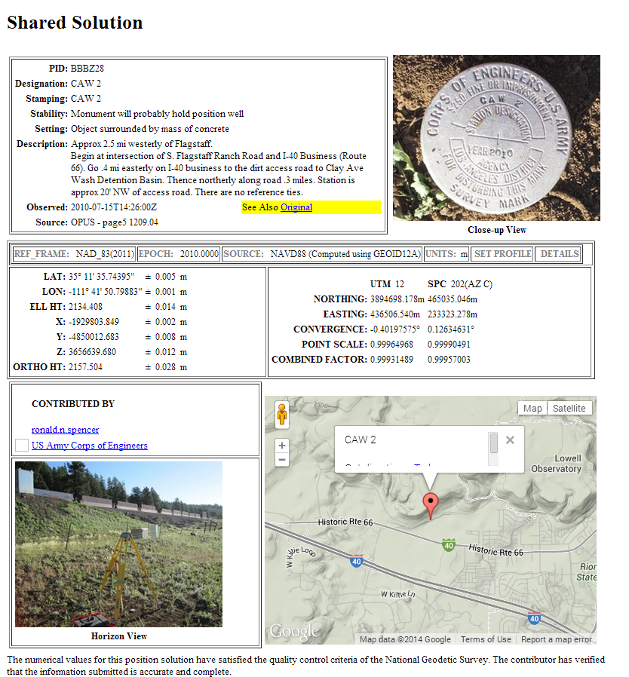
Viewing Shared Solutions
Here’s an example of a datasheet shared through OPUS.

Slide 43
Publishing survey results
“Publishing” means to an NGS database that can be accessed by the public. Two such databases are nominally available for “geodetic control”:
The NGS Integrated Database (NGSIDB)
Official repository for “authoritative” NSRS geodetic control
Specific FGDC/FGCS metadata and QA/QC requirements
Process for populating referred to as “Bluebooking”
OPUS Database
Created to allow sharing of OPUS results by public
Content not vetted or reviewed by NGS (not “control”)
But OPUS data and results must meet certain requirements

Slide 44
Database Blues
The NGS Integrated Data Base (NGSIDB)
Every mark has a single set of current coordinates
Latitude, longitude, ellipsoid height, orthometric height, etc.
Includes geometric and vertical control
But Bluebooking to populate NGSIDB is overly onerous
OPUS Database
Individual marks can have multiple coordinates
Marks in common with NGSIDB do not have same coords
Currently only contains geometric positions
Orthometric heights are directly from a geoid model
But easy to populate with minimal effort (no Bluebooking!)

Slide 45
Opinions vary about “Bluebooking”
I’d rather be
Bluebooking
Friends …
don’t let friends …
Bluebook

Slide 46
What is “Bluebooking” anyway?
The NGS “Bluebook” is a set of data formats
For electronic transfer of geodetic data to NGS database
Defined by NGS and formally part of FGDC
So “Bluebooking” is just putting data into specified formats
A means for our customers to help build the NSRS
Users get the control they want, where they want it
NGS gets data for small fraction of total cost of performing work
Great example of Fed, local gov’t, and private cooperation
“Bluebooking” now viewed as much more than formats
Standards & specifications for performing control work
Strongly associated with high-quality data and results
But difficult, expensive, inefficient, and (somewhat) error-prone

Slide 47
Matters of Mission and Policy
The NGS Mission
Define, maintain, and provide access to the NSRS

Slide 48
At NOAA’s NGS, location is our mission
National Spatial Reference System
NSRS
Define
Maintain
Access

Slide 49
Matters of Mission and Policy
The NGS Mission
Define, maintain, and provide access to the NSRS
Interpreted as providing authoritative geodetic control
Non-unique current coordinates at odds with NGS mission
Different results from different processes are problematic
Governing policies
Encapsulated within existing FGDC and FGCS documents
Derived also from executive orders, congressional acts, etc.
The NGSIDB and “Bluebook” are part of such policy
Changes must go through FGCS and FGDC
OPUS-DB in conflict with existing NGS policy
But its existence implies a de facto policy. What to do?

Slide 50
The way forward
NGS is committed to improving the Bluebooking process
WHAT we are (and are not) doing
WHY we are doing it
WHERE we are going
HOW we will get there
WHEN all this is going to happen

Slide 51
OPUS-Projects Training
Fairbanks, AK
March 29 and 30, 2014
March 29, 8 am to 5 pm
March 30, 8 am to noon
Includes breakfast and lunch both days
University of Alaska Fairbanks
Community & Technical College (CTC)
604 Barnette Street, Fairbanks, AK
3rd Floor, near Room 303
Questions?

