Slide 1

NSRS Modernization
PSLS Annual Conference
January 2020
Jeff Jalbrzikowski, P.S., GISP, CFS
Appalachian Regional Geodetic Advisor
jeff.jalbrzikowski@noaa.gov
240-988-5486

Slide 2
My Background
Licensed Surveyor in OH, PA, and WV (PS)
Certified GIS Professional (GISP)
Certified Floodplain Surveyor (CFS)
BS in Surveying & Mapping, Univ. of Akron
Came to NGS from USACE Pittsburgh District
  primary experience is engineering surveys, including structural deformation, hydrographic/bathymetric, terrestrial lidar, GNSS control, local/legacy datum resolution

Slide 3
Have you already heard that NAD83 and NAVD88 are scheduled to be replaced?
Who’s nervous?
Who’s ready?
Who’s already working in ITRF?

Slide 4



Organizational Structure
Federal Government – Executive Branch
  -Department of Commerce (DoC)
  (~47,000 employees)
  -National Oceanic and Atmospheric Administration (NOAA)
  -National Ocean Service (NOS)
  -National Geodetic Survey (NGS)
  (~175 employees)

Slide 5
NGS Mission
To define, maintain and provide access to the National Spatial Reference System (NSRS) to meet our Nation’s economic, social, and environmental needs.

Slide 6
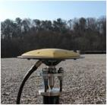
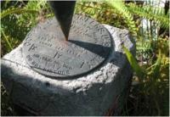

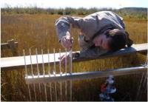
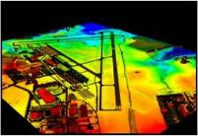
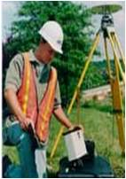
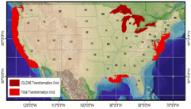
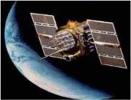
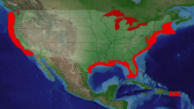
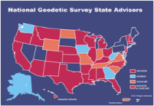
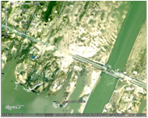
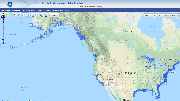
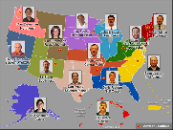
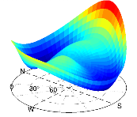
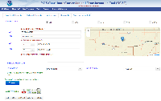
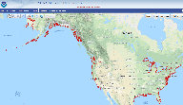
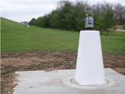
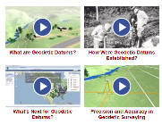
NGS Overview
Modernizing the NSRS
CORS
NHMP
GRAV-D
ECO
NGS Products and Services
ASP
OPUS
VDatum
Orbit Data
National Shoreline
Geodetic Advisors
ERI
Antenna Calibrations
NCAT
CUSP
CBL
Outreach

Slide 7
NGS Overview
Modernizing the NSRS
CORS
NHMP
GRAV-D
ECO
NGS Products and Services
ASP
OPUS
VDatum
Orbit Data
National Shoreline
Geodetic Advisors
ERI
Antenna Calibrations
NCAT
CUSP
CBL
Outreach

Slide 8
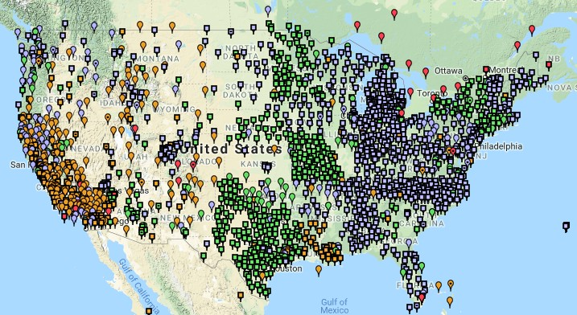
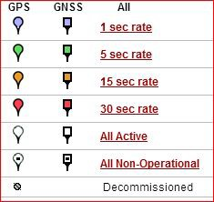
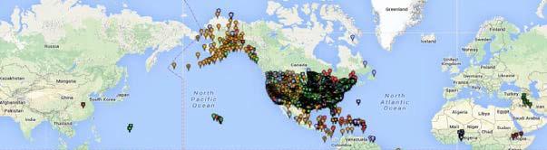
Continuously Operating Reference Station (CORS)
2000+ sites
~225 organizations

Slide 9
NOAA CORS Network (NCN)
2000+ sites
~225 organizations

Slide 10
NGS Overview
Modernizing the NSRS
CORS
NHMP
GRAV-D
ECO
NGS Products and Services
ASP
OPUS
VDatum
Orbit Data
National Shoreline
Geodetic Advisors
ERI
Antenna Calibrations
NCAT
CUSP
CBL
Outreach

Slide 11
National Height Modernization Program
…the establishment of accurate, reliable heights using GNSS technology in conjunction with traditional leveling, gravity, and modern remote sensing information…
-propagation and long-term monitoring of control thru static GPS campaigns, GPS on BMs, digital leveling
-combined with relative gravity data, lidar, etc.

Slide 12
National Height Modernization Program
Funded partners
States engaged in HM without Federal funding
Spatial Reference Centers
Regional Leaders
Other funded partners

Slide 13
National Height Modernization Program
supports various Federal Programs
  FEMA Flood Hazard Mapping Program (FIRM, etc.)
  USACE: Levee & Dam Safety Programs, etc.
and countless non-Federal programs
technically still an active program but there have not been any grants in a few years

Slide 14
NGS Overview
Modernizing the NSRS
CORS
NHMP
GRAV-D
ECO
NGS Products and Services
ASP
OPUS
VDatum
Orbit Data
National Shoreline
Geodetic Advisors
ERI
Antenna Calibrations
NCAT
CUSP
CBL
Outreach

Slide 15
Gravity for the Redefinition of the American Vertical Datum
Two major campaigns within GRAV-D
High-resolution snapshot of gravity
  primarily airborne observations, all relative gravity, estimated cost of ~$39 million
Low-resolution “movie” of gravity changes
  primarily terrestrial, episodic observations of absolute gravity sites

Slide 16
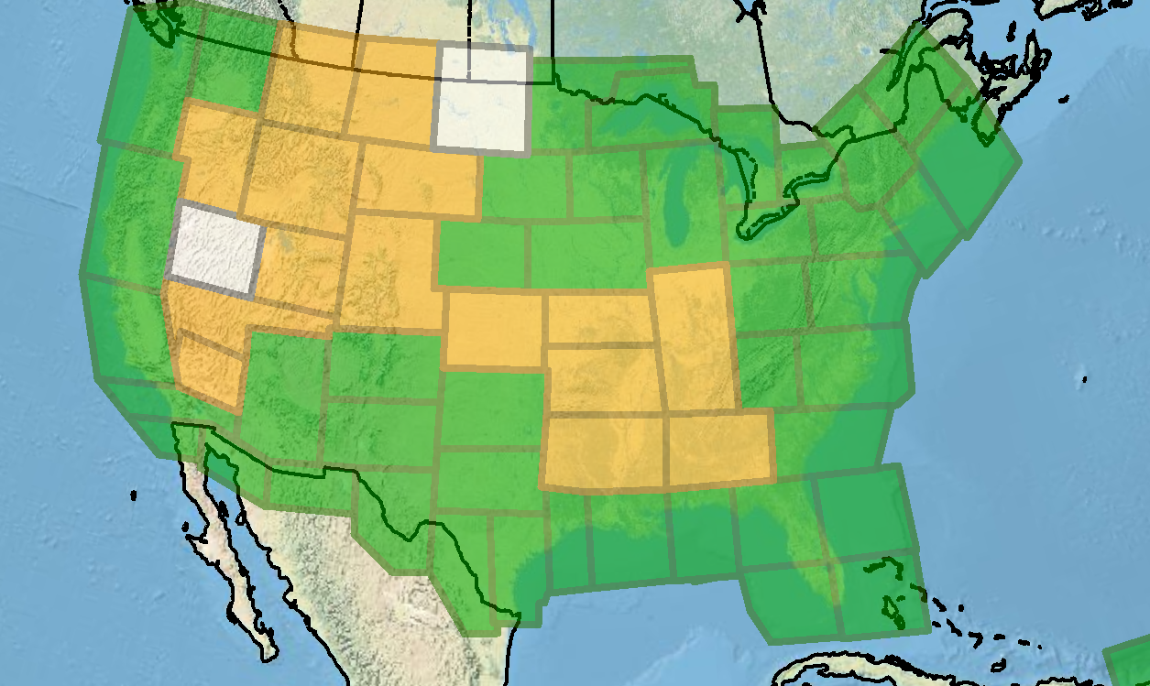
Gravity for the Redefinition of the American Vertical Datum
Green = Complete
Blue = In Processing
Yellow = Underway
White = Planned
10 km data lines
70 km cross lines
20,000 ft altitude
230 kt flight speed
As of DEC2019:
81% complete

Slide 17
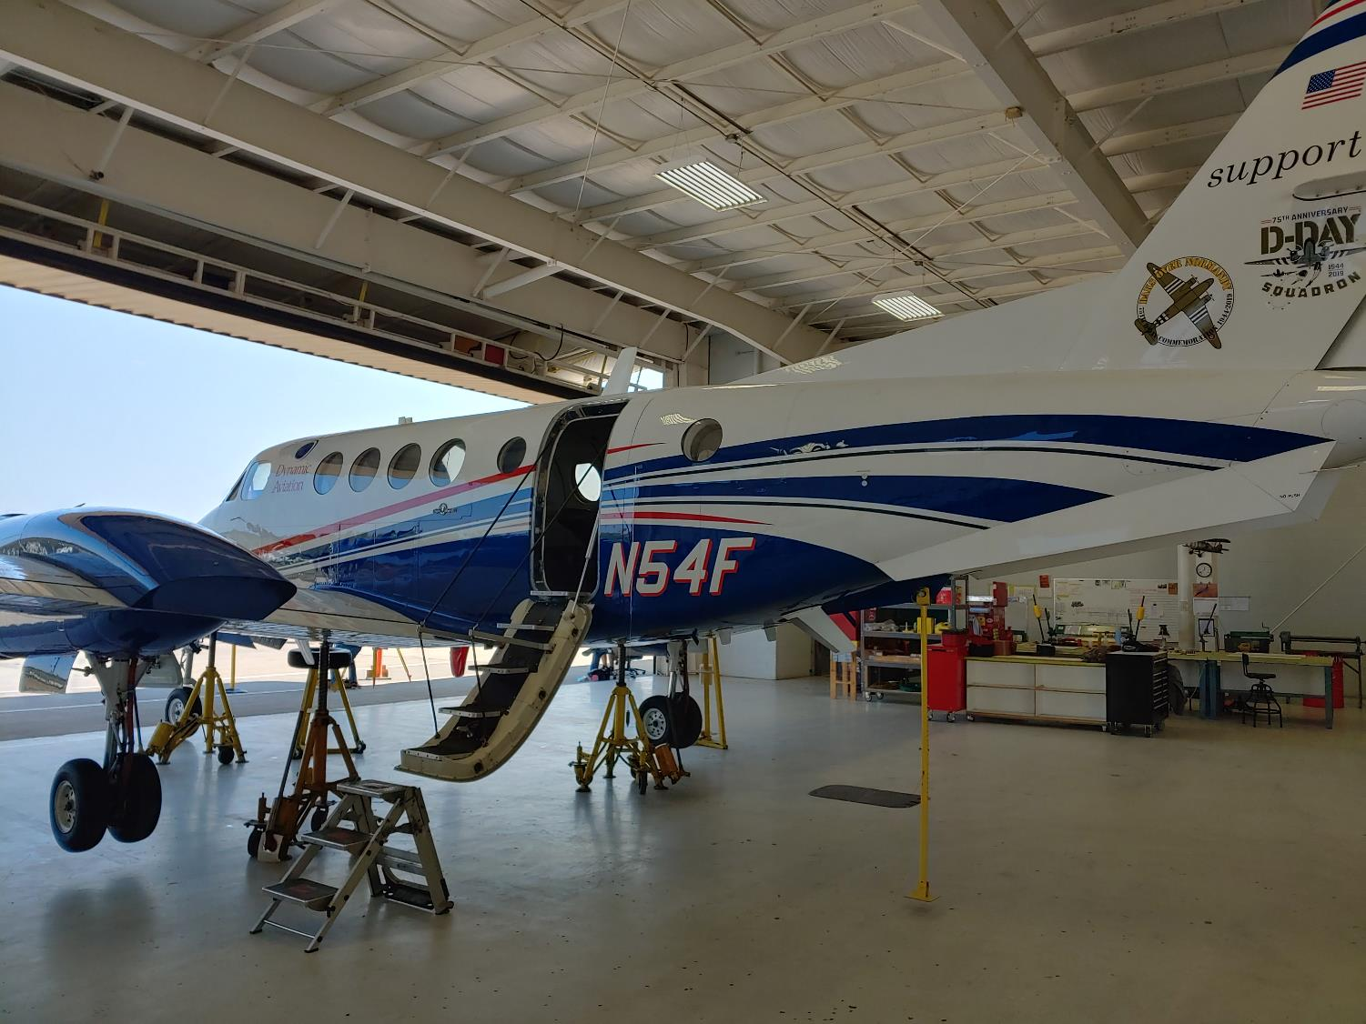
Dynamic Aviation’s King Air 200T

Slide 18

NOAA’s Gulfstream IV-SP

Slide 19
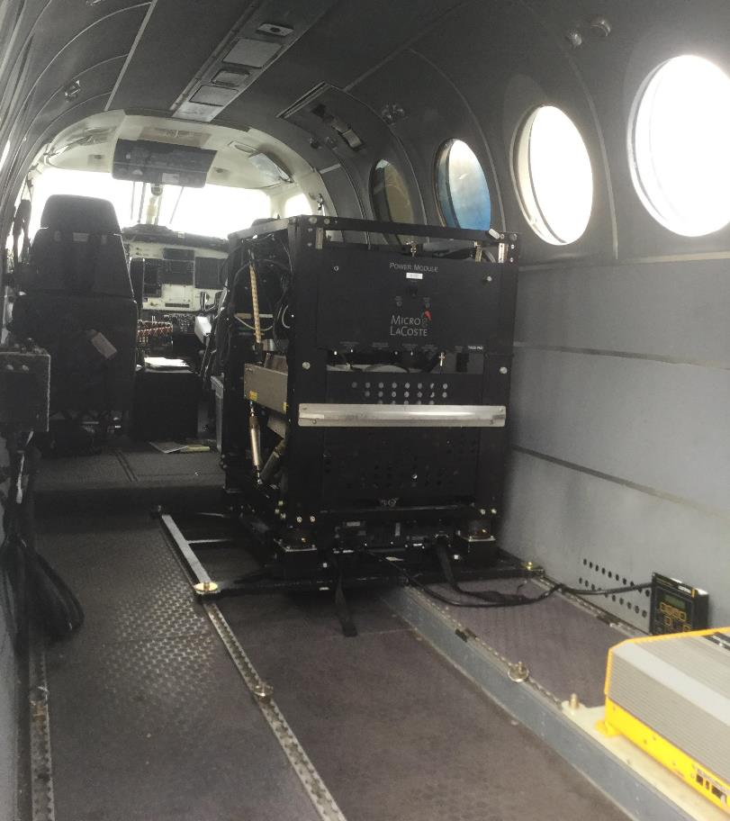
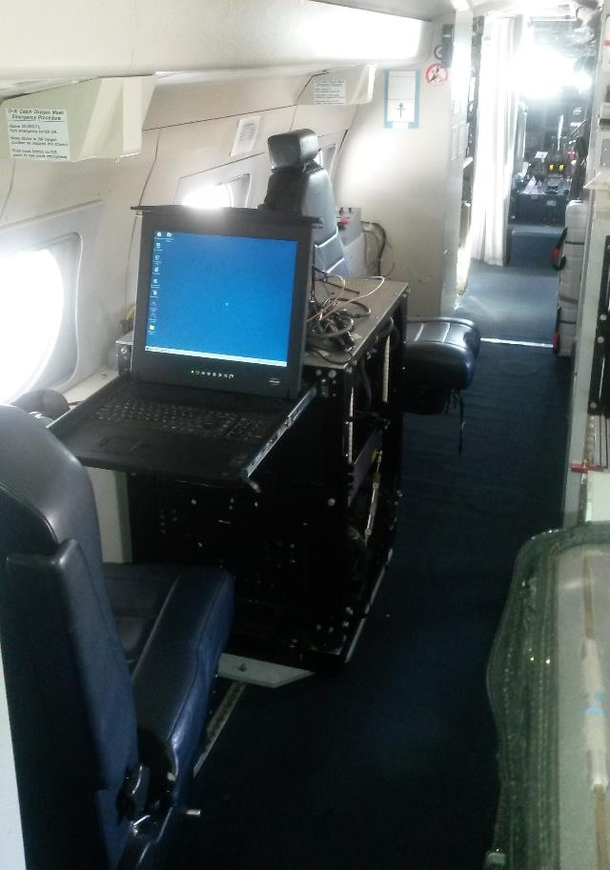
Gravimeters in the Aircraft
in the King Air
in the Gulfstream IV

Slide 20
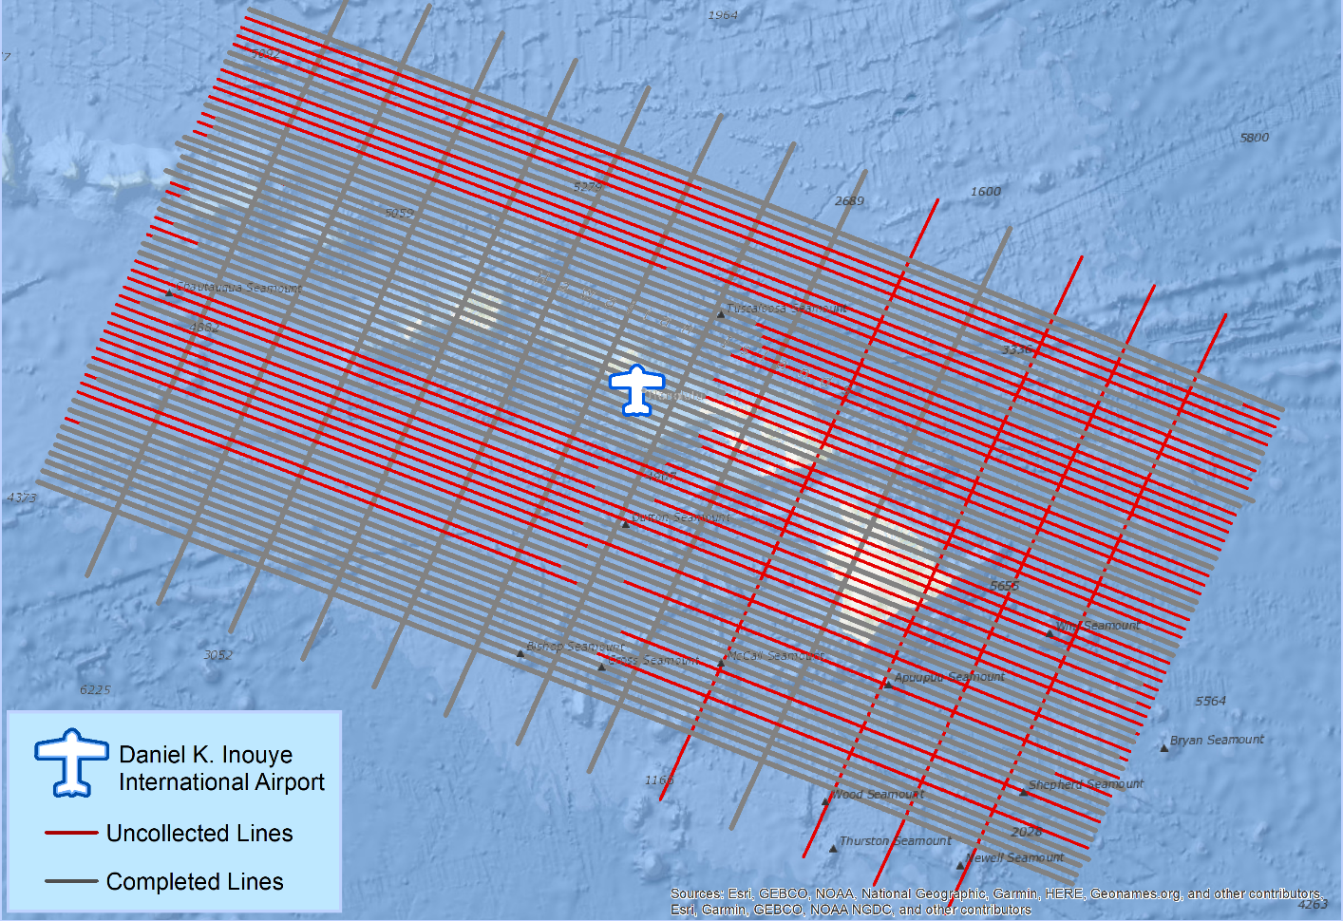
What does a flight plan look like?

Slide 21
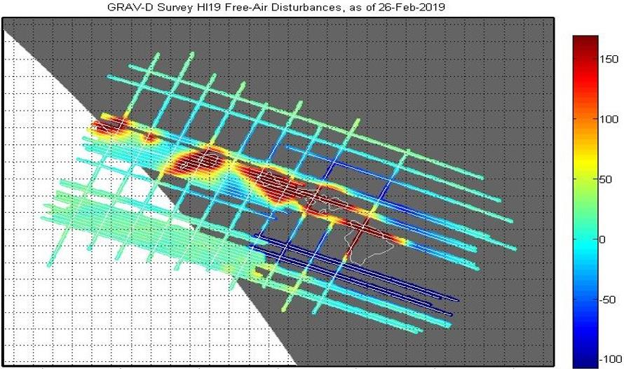
What does processed data look like?
mGal
mGal = milligal

Slide 22
NGS Overview
Modernizing the NSRS
CORS
NHMP
GRAV-D
ECO
NGS Products and Services
ASP
OPUS
VDatum
Orbit Data
National Shoreline
Geodetic Advisors
ERI
Antenna Calibrations
NCAT
CUSP
CBL
Outreach

Slide 23
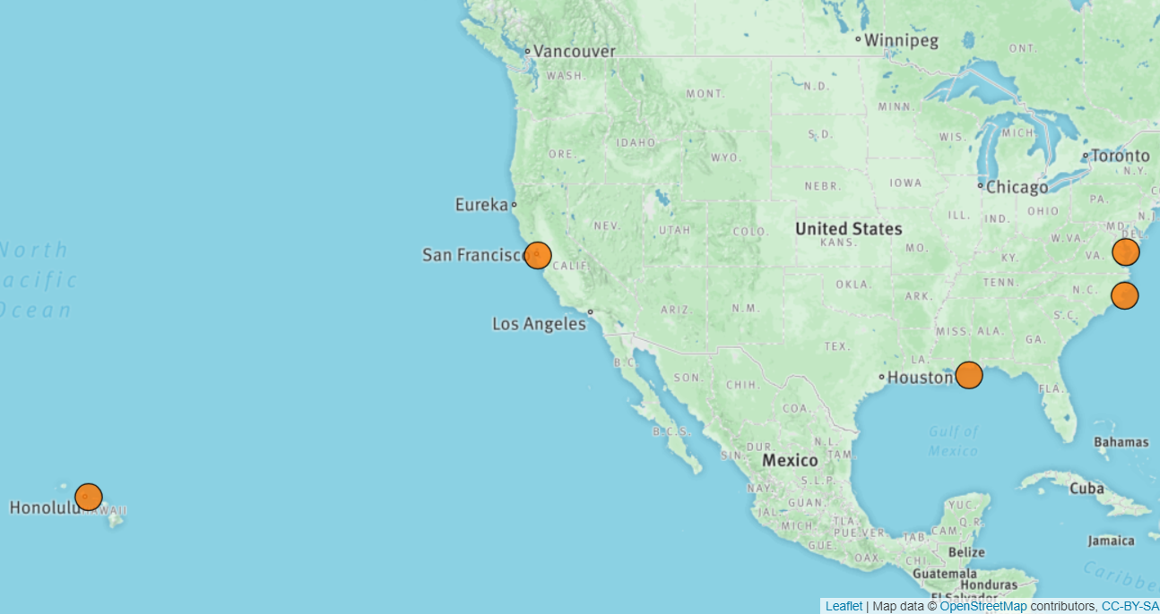
Ecosystem and Climate Operations

Slide 24
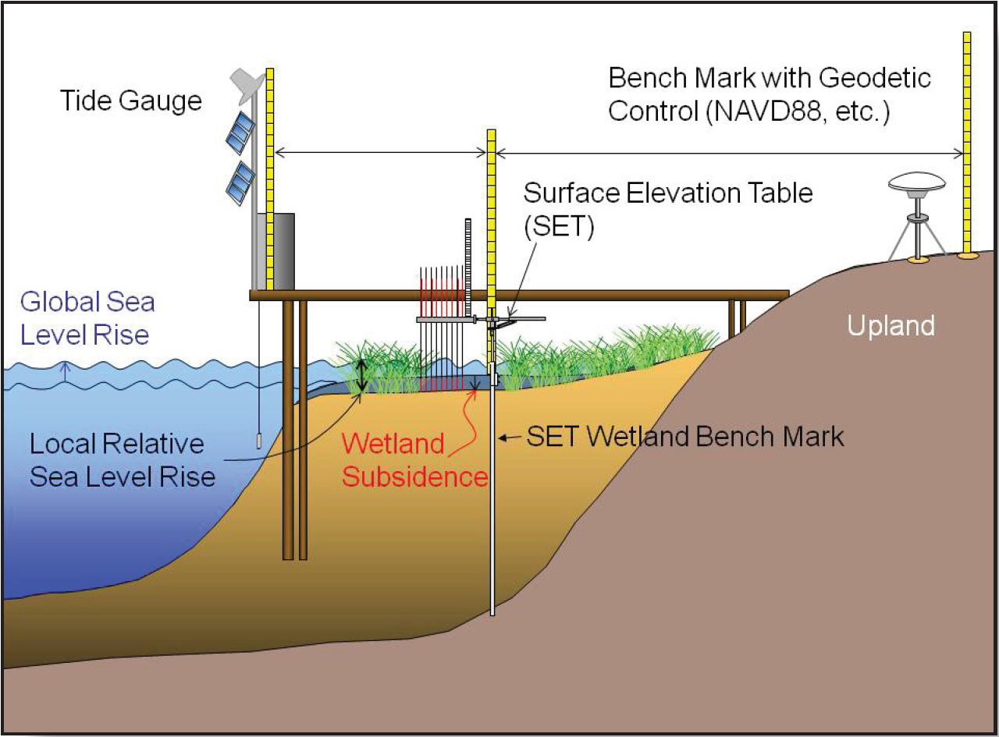
Ecosystem and Climate Operations

Slide 25
NGS Overview
Modernizing the NSRS
CORS
NHMP
GRAV-D
ECO
NGS Products and Services
ASP
OPUS
VDatum
Orbit Data
National Shoreline
Geodetic Advisors
ERI
Antenna Calibrations
NCAT
CUSP
CBL
Outreach

Slide 26
Aeronautical Survey Program
Interagency Program: FAA and NGS
  Primary Airport Control Station (PACS) and Secondary Airport Control Stations (SACS)
  Airports GIS (AGIS)
  Airport Obstruction Charts (AOC)
Primary function of NGS is to serve as QA and subject-matter expert for ASP surveys that are contracted by airports

Slide 27
NGS Overview
Modernizing the NSRS
CORS
NHMP
GRAV-D
ECO
NGS Products and Services
ASP
OPUS
VDatum
Orbit Data
National Shoreline
Geodetic Advisors
ERI
Antenna Calibrations
NCAT
CUSP
CBL
Outreach

Slide 28
Online Positioning User Service
  OPUS Rapid Static (OPUS-RS)
      dual frequency receiver data
      static sessions only
      30 seconds epoch rate (aka recording interval)
      15 minutes to 2 hours of GPS data
  OPUS Static (OPUS-S)
      same requirements as above
      2 to 48 hours of GPS data
  OPUS Projects (OP)
      adds session processing and network adjustment
      training by NGS required; typically 12 hours
      files uploaded to OPUS with a “Project ID” keyed in Options
  Beta OPUS Projects (BOP)
      enhancements and added features

Slide 29
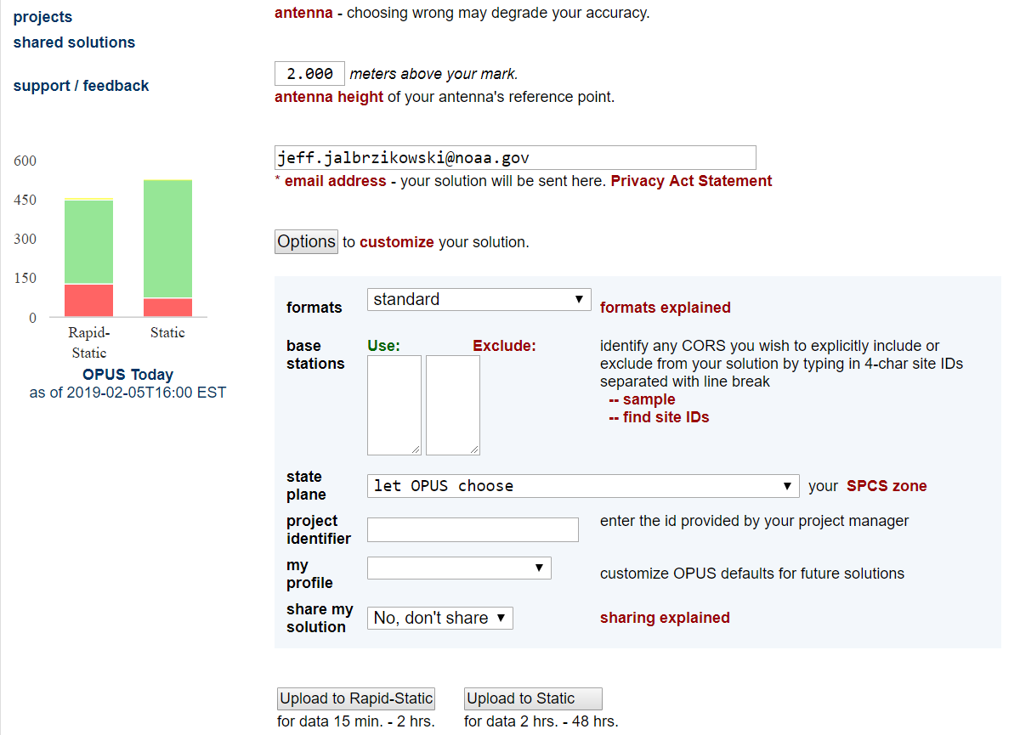
a note on OPUS “my profile”
be careful!

Slide 30
NGS Overview
Modernizing the NSRS
CORS
NHMP
GRAV-D
ECO
NGS Products and Services
ASP
OPUS
VDatum
Orbit Data
National Shoreline
Geodetic Advisors
ERI
Antenna Calibrations
NCAT
CUSP
CBL
Outreach

Slide 31

GPS Orbit Data aka Ephemerides
NGS orbit analysis and computation is performed together with, and as a component of, the International GNSS Service (IGS)
  IGS coordinates the collection of satellite tracking data
  these orbits are what give us post-processed accuracy
Designated with this responsibility by the Civil GPS Service Interface Committee (CGSIC)
If you’re using OPUS, it’s all behind-the-curtain!

Slide 32
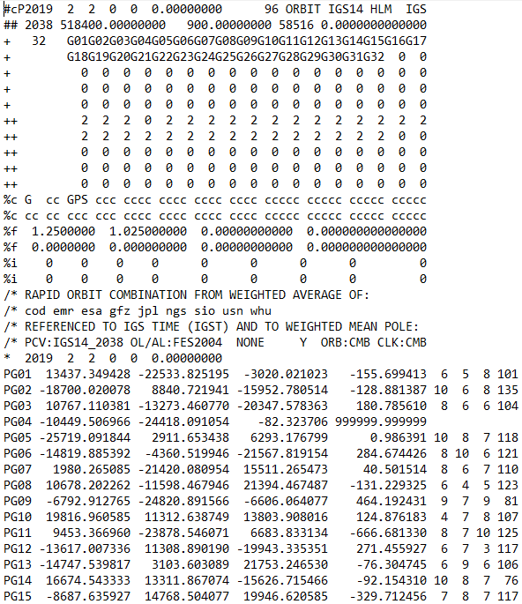
.sp3 file
Link to NGS GPS Calendar

Slide 33
NGS Overview
Modernizing the NSRS
CORS
NHMP
GRAV-D
ECO
NGS Products and Services
ASP
OPUS
VDatum
Orbit Data
National Shoreline
Geodetic Advisors
ERI
Antenna Calibrations
NCAT
CUSP
CBL
Outreach

Slide 34
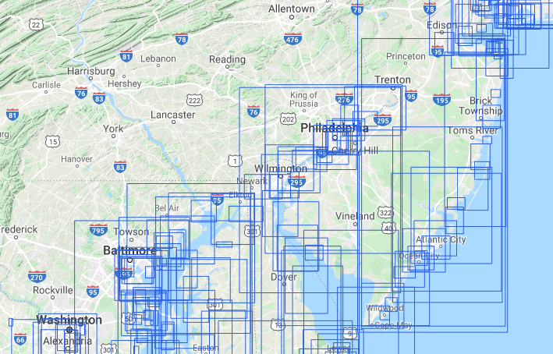
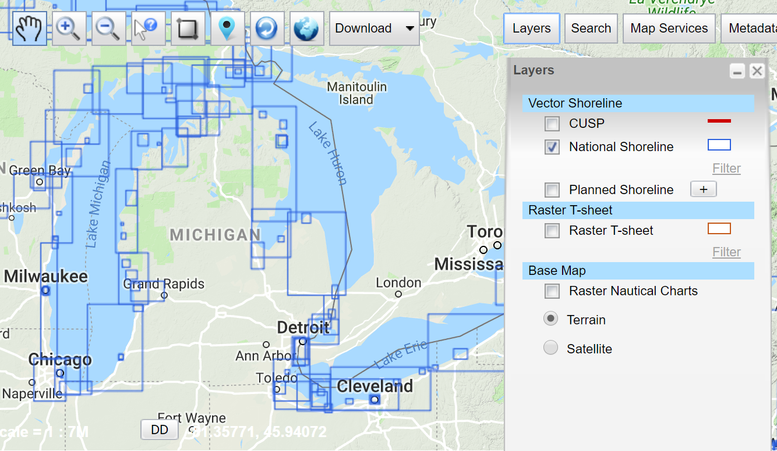
National Shoreline
The official shoreline for the Nation, in support of NOAA’s nautical charting mission
Available for download as shapefile in Mean High Water and Mean Lower Low Water datum
Organized by “Project Area” – the blue boxes
hyperlink to the National Shoreline homepage

Slide 35
NGS Overview
Modernizing the NSRS
CORS
NHMP
GRAV-D
ECO
NGS Products and Services
ASP
OPUS
VDatum
Orbit Data
National Shoreline
Geodetic Advisors
ERI
Antenna Calibrations
NCAT
CUSP
CBL
Outreach

Slide 36
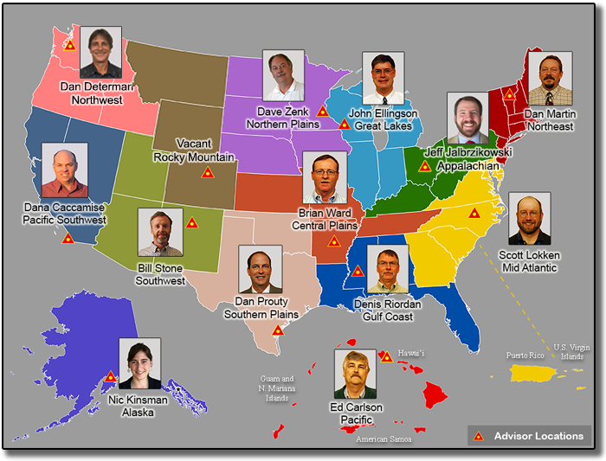
https://www.ngs.noaa.gov/ADVISORS/

Slide 37
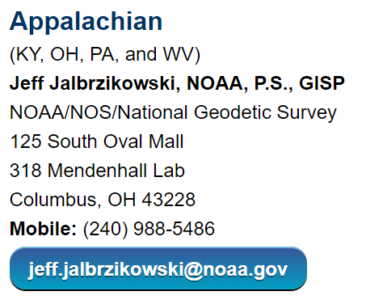
Regional Geodetic Advisor Program
www.ngs.noaa.gov/ADVISORS/
query any major search engine: “ngs advisors”

Slide 38

State Geodetic Coordinators
Not an NGS employee
Serves as a liaison between the State’s geospatial community and the NGS
Brian Naberezny over at PSU
Are you in here Brian?

Slide 39
NGS Overview
Modernizing the NSRS
CORS
NHMP
GRAV-D
ECO
NGS Products and Services
ASP
OPUS
VDatum
Orbit Data
National Shoreline
Geodetic Advisors
ERI
Antenna Calibrations
NCAT
CUSP
CBL
Outreach

Slide 40
Emergency Response Imagery
Mission of our Remote Sensing Division
Pre-Storm and Post-Storm photos are taken mostly along the coastal CONUS, and some other disasters natural or human
Supports Dept. of Homeland Security (DHS) and other emergency management organizations (FEMA, State, local, etc.)

Slide 41
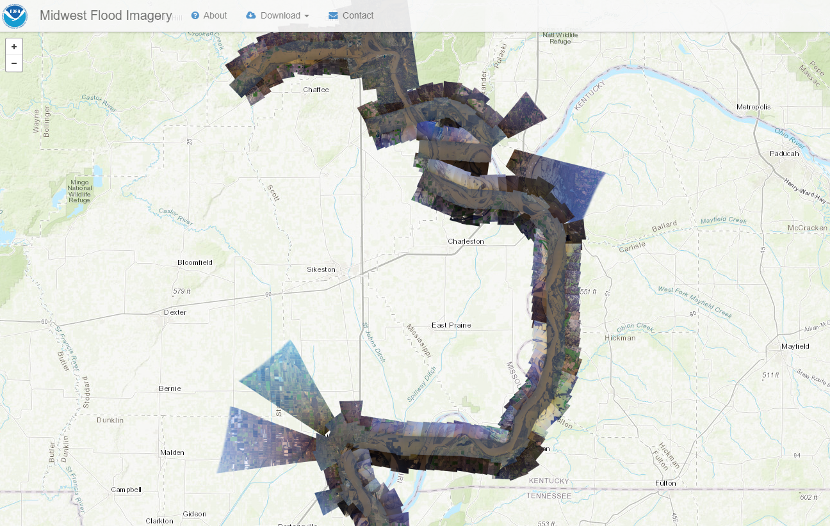
Emergency Response Imagery

Slide 42
NGS Overview
Modernizing the NSRS
CORS
NHMP
GRAV-D
ECO
NGS Products and Services
ASP
OPUS
VDatum
Orbit Data
National Shoreline
Geodetic Advisors
ERI
Antenna Calibrations
NCAT
CUSP
CBL
Outreach

Slide 43
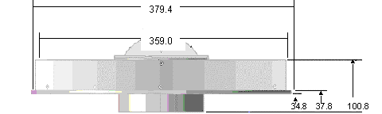
Phase Center Offset - conceptual
Orange dot = mean point of signal reception
Blue dot = Antenna Reference Point (ARP)
Red line = Phase Center Offset (PCO)

Slide 44
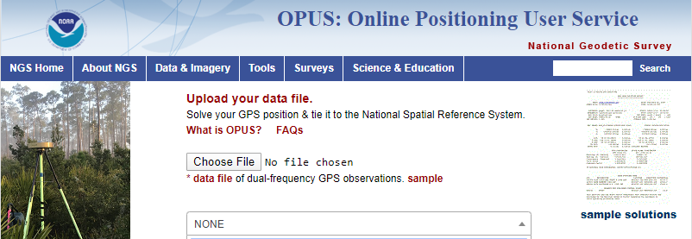
Phase Center Offset
The PCO is one reason it is important to select the correct antenna for OPUS upload!
choose
carefully!
if you have questions… drop me a line

Slide 45
NGS Overview
Modernizing the NSRS
CORS
NHMP
GRAV-D
ECO
NGS Products and Services
ASP
OPUS
VDatum
Orbit Data
National Shoreline
Geodetic Advisors
ERI
Antenna Calibrations
NCAT
CUSP
CBL
Outreach

Slide 46
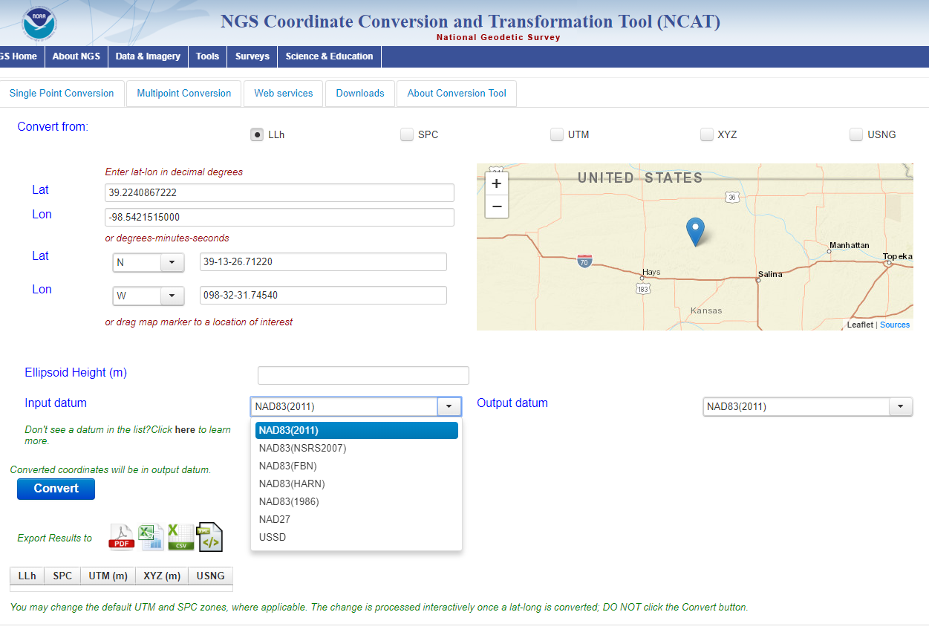
NGS Coordinate Conversion and Transformation Tool
NCAT

Slide 47
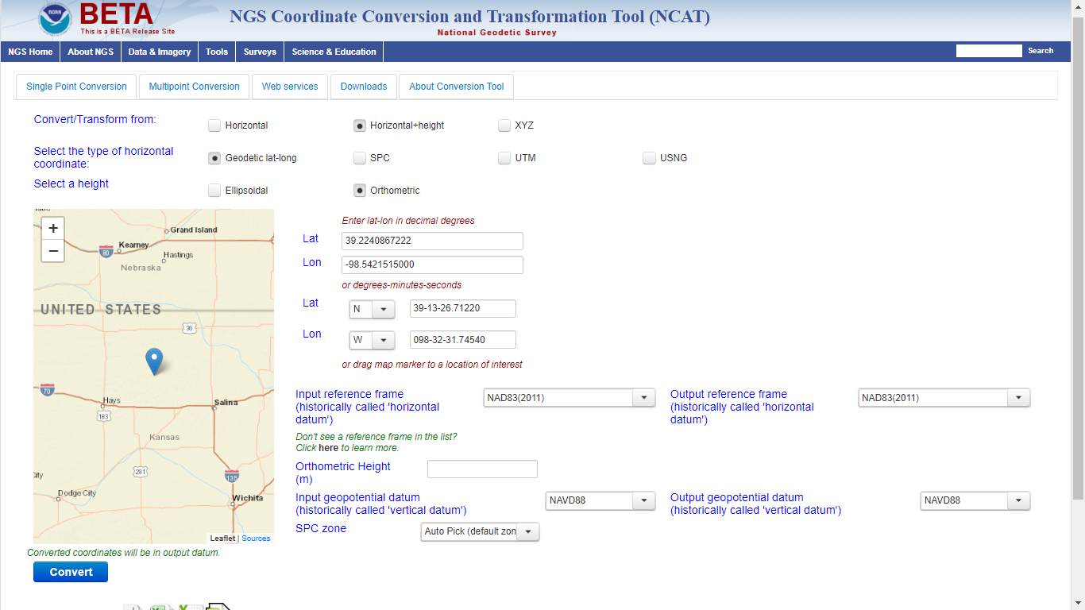
Beta NCAT – includes VERTCON 3.0 for NGVD29 to NAVD88 transformation

Slide 48
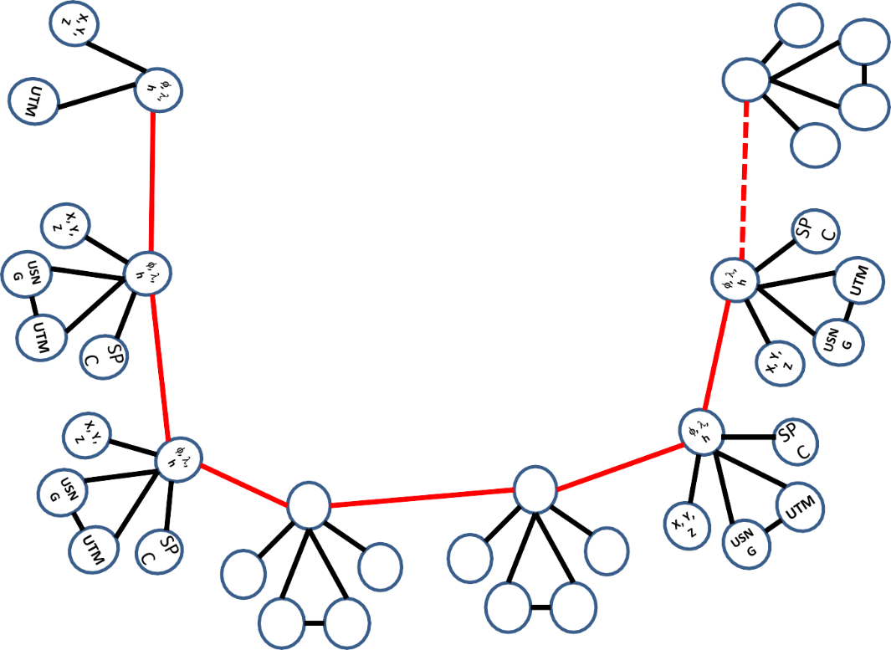
Coordinate Transformation Tool
SP
C
UTM
(NCAT / NADCON 5.0)
2022
φ, λ, h
USSD
USN
G
Relating coordinates: then & now
NAD 83 (2011)
X, Y,
Z
NAD 27
NAD 83 (NSRS2007)
NAD 83 (1986)
NAD 83 (FBN)
φ, λ, h
NAD 83 (HARN)
φ, λ, h
SP C
X, Y, Z
SP C
X, Y, Z
USN G
USN G
UTM
UTM

Slide 49
NGS Overview
Modernizing the NSRS
CORS
NHMP
GRAV-D
ECO
NGS Products and Services
ASP
OPUS
VDatum
Orbit Data
National Shoreline
Geodetic Advisors
ERI
Antenna Calibrations
NCAT
CUSP
CBL
Outreach

Slide 50
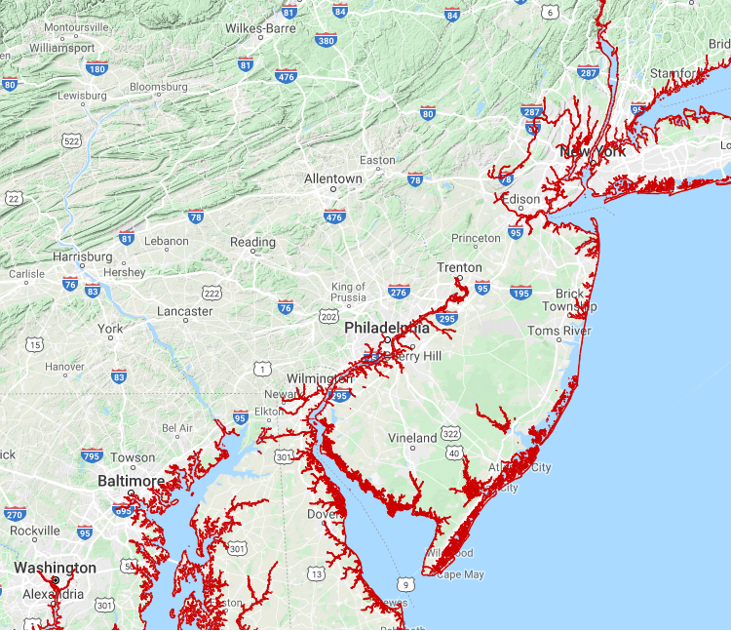
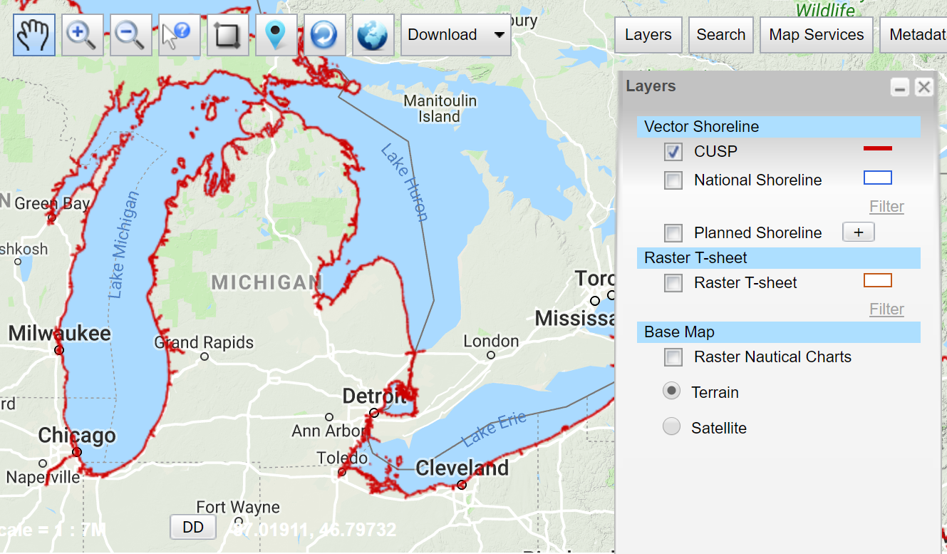
Continually Updated Shoreline Product
Just as the name says… it’s dynamic
Available for download as shapefiles
Developed by image interpretation and/or vertical modeling using water level stations (tide or lake gages)
Referenced to a computed Mean High Water
hyperlink to the CUSP homepage

Slide 51
NGS Overview
Modernizing the NSRS
CORS
NHMP
GRAV-D
ECO
NGS Products and Services
ASP
OPUS
VDatum
Orbit Data
National Shoreline
Geodetic Advisors
ERI
Antenna Calibrations
NCAT
CUSP
CBL
Outreach

Slide 52
Calibration Base Lines - CBL
Three types of CBL defined by NGS
  Primary CBL (PCBL): in Woodford, VA at NGS TTC; it is open for use to organizations like the PLSO
  Federal CBL (FCBL): established with EDM checked at the NGS PCBL and IAW NOAA TM NGS-8
      8 across Pennsylvania; 1 reported destroyed in Warminster
  Cooperative CBL (CCBL): established with EDM checked on an FCBL and IAW that same NGS-8 manual

Slide 53
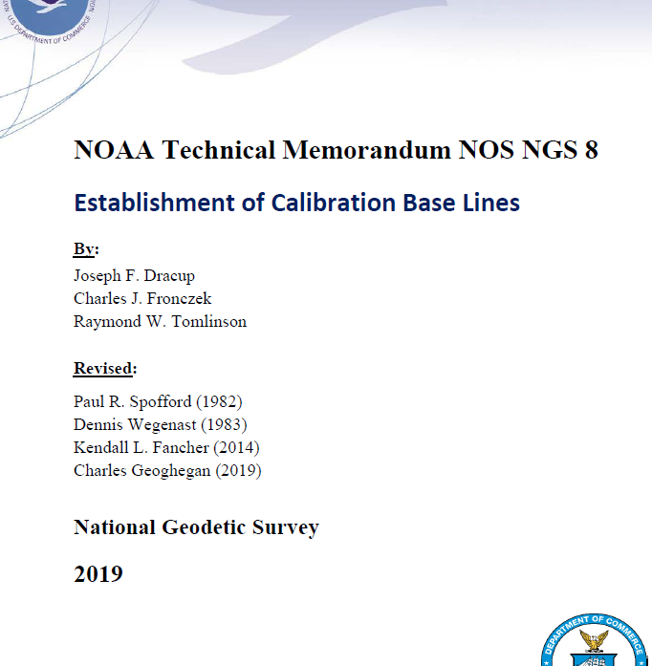
Calibration Base Lines - CBL
NGS commitment to the CBL Program:
  A minimum of one FCBL per State
  Establishment procedures document
  Public access to the CBL database
  Software to process your observations
  Verification and re-measurement data review
  Technical support (Advisors or other personnel)
https://www.ngs.noaa.gov/CBLINES/

Slide 54
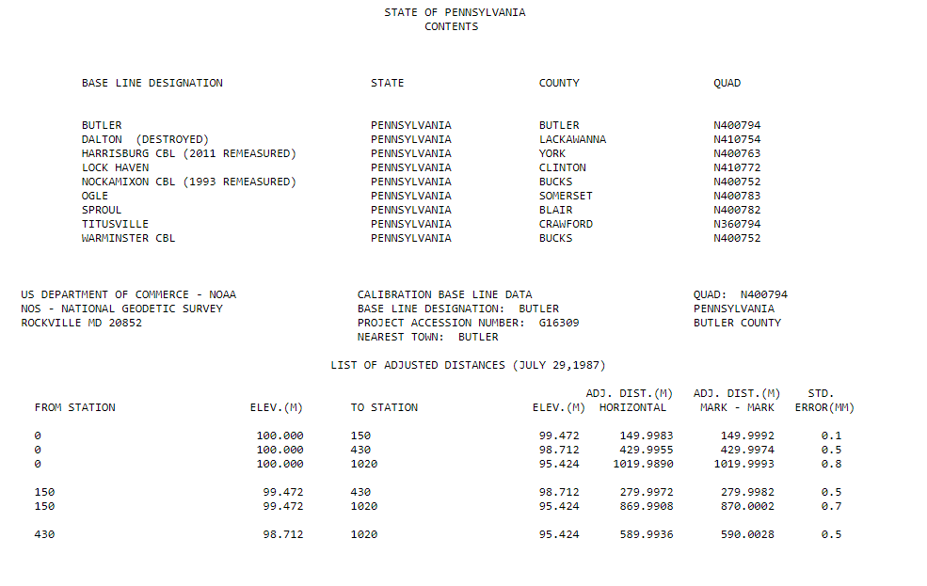
CBL Datasheets

Slide 55
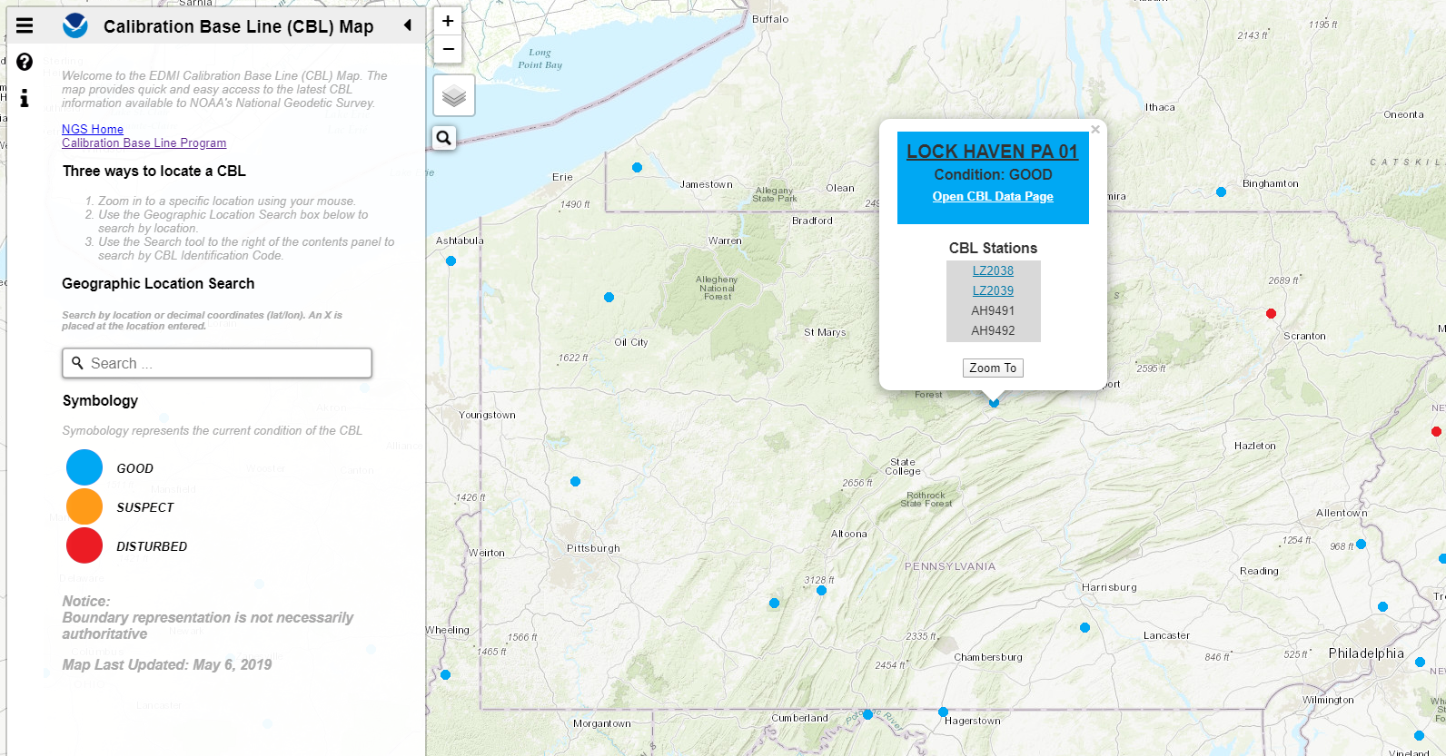
Beta CBL Map Viewer
https://www.ngs.noaa.gov/CBLINES/

Slide 56
NGS Overview
Modernizing the NSRS
CORS
NHMP
GRAV-D
ECO
NGS Products and Services
ASP
OPUS
VDatum
Orbit Data
National Shoreline
Geodetic Advisors
ERI
Antenna Calibrations
NCAT
CUSP
CBL
Outreach

Slide 57
Cooperative program for Operational Meteorology, Education, and Training
Meteorology… why?
The origin of the program was the National Weather Service, also a NOAA office
It expanded to various NOAA missions, including NGS

Slide 58
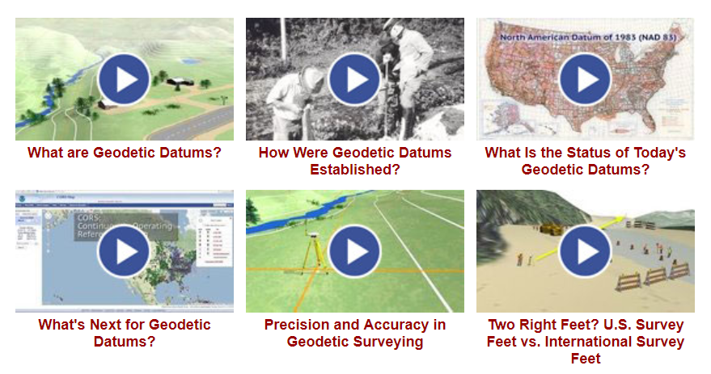
Outreach and COMET

Slide 59
NGS Mission
To define, maintain and provide access to the National Spatial Reference System (NSRS) to meet our Nation’s economic, social, and environmental needs.

Slide 60
National Spatial Reference System (NSRS)
A consistent coordinate system that defines
latitude
longitude
height
scale
orientation
gravity
throughout the United States.
…and their time variants

Slide 61
National Spatial Reference System (NSRS)
These items ARE part of the NSRS
Horizontal Datums (aka Geometric Reference Frames) | Vertical Datums | Great Lakes Datums | Geoid Models | Transformations and Conversions
NAD83 | NAVD88 | IGLD85 | GEOID12A & B | NADCON
NAD27 | NGVD29 | IGLD55 | GEOID09 | VERTCON
USSD | VIVD09 |  | GEOID06
 | GUVD04 |  | GEOID03 | SPCS83
 | NMVD03 |  | GEOID99 | SPCS27
 | ASVD02 |  | GEOID96
 | PRVD02 |  | ALASKA94
 |  |  | GEOID93
 |  |  | GEOID90

Slide 62
National Spatial Reference System (NSRS)
These items are NOT part of the NSRS
Horizontal Datums (aka Geometric Reference Frames) | Vertical Datums | Geoid Models | Transformations and Conversions
WGS84 | IHRS (by IAG) | OSU91A | CORPSCON
WGS72 |  | EGM96 | Appendix B.6 of DMA TR 8350.2 (WGS 84)
ITRF (Intl. Terrestrial Reference Frame by IERS) |  | EGM2008 | Oregon Coordinate Reference System (ORCS)
IGS (Intl. GNSS Service reference frame) |  |  | The Kansas Regional Coordinate System
Hyperlink to ITRF station map

Slide 63
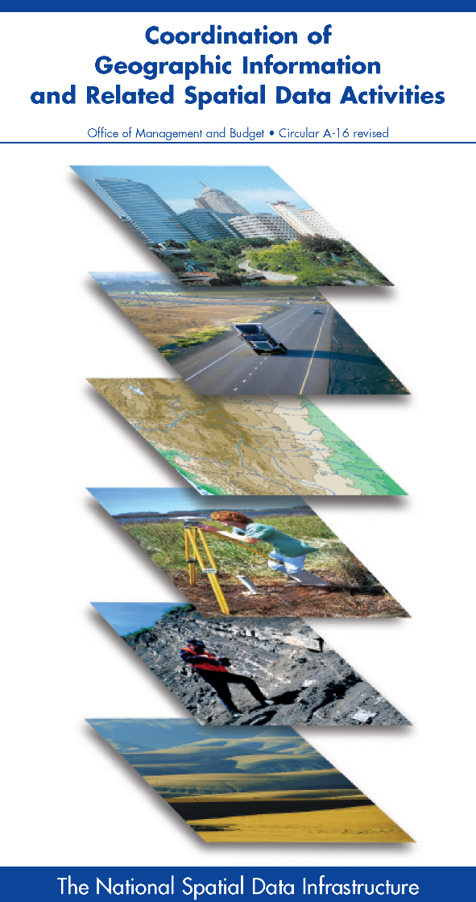



NSRS … do I have to use it?
OMB Circular A-16
  requires all Federal civilian agencies to utilize geodetic control for their geospatial activities
  places NOAA in responsible charge of that control
  NGS has defined that control as the NSRS
  FGCS has issued requirements, via FRNs, to reference data to the most recent components of the NSRS
            1989 FRN designated NAD 83
            1993 FRN designated NAVD 88
Hyperlink to NAVD88 FRN
Hyperlink to NAD83 FRN

Slide 64
NSRS … do I have to use it?
Not necessarily, but it’s a great idea!
States may mandate use (not Pennsylvania)
All spatial data and GIS activities financed directly or indirectly, in whole or in part, by federal funds are required to be tied to the NSRS
If you want to get involved in survey contracting with the Federal Government it’s a necessity

Slide 65
Not just new datums…
  NSRS Modernization
Replace NAD83
Replace NAVD88
Re-invent Bluebooking
Improve Geodetic Toolkit
Better Surveying Methods
Blueprint for 2022, Part 1
Blueprint for 2022, Part 2
Blueprint for 2022, Part 3

Slide 66
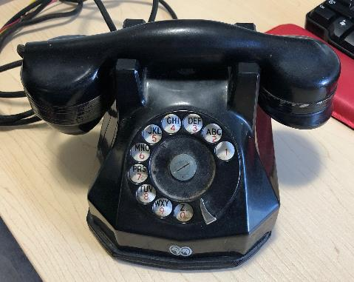
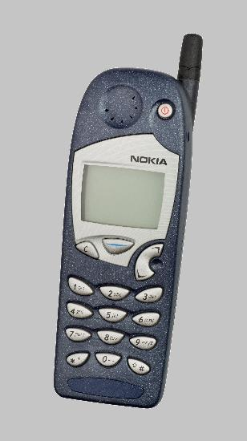
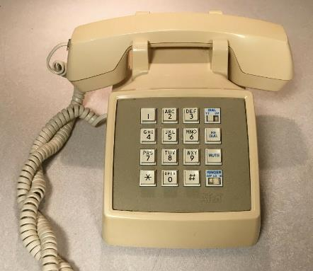
Evolution of the NSRS
NAD27
NAD83 (1986)
NAD83 (2011)

Slide 67

Modernized NSRS is our “smartphone”
You resisted it for a while…
It was a little cumbersome to get used to…
But soon you were hooked!

Slide 68
Two Major Components of Modernized NSRS
Geometric (LLh)
Latitude, Longitude, Ellipsoid Height
Geopotential (H)
Orthometric Height

Slide 69
North American Terrestrial Reference Frame of 2022
NATRF2022
(pronounced: nat-ref)

Slide 70
Reference Frame ≈ Datum
Reference Frame is a more scientifically appropriate way of saying “datum”
could be debated that “datum” was misused
you will continue to see NGS use the phrase “New Datums” for 2022

Slide 71
Reference Frame Defined
A point of view or a ‘frame of reference’.
If your reference frame is North America, you are standing somewhere within North America, seeing how other places move from your point of view.

Slide 72
Why replace NAD83?
Main driver: Global Navigation Satellite System (GNSS)
ACCESS
  GNSS equipment is fast, inexpensive, reliable
  Reduces reliance on physical control marks
ACCURACY
  Insensitive to distance-dependent errors
  Immune to instability; active control via CORS
CONSISTENCY
Eliminates systematic errors in current datums
Aligned with global reference frame

Slide 73



A very brief history of U.S. horizontal & geometric datums
GNSS
triangulation
NAD83(HARN/199#)
US Standard Datum
NAD83(HARN/199#)
NAD83(2007)
NATRF2022
NAD83(1986)
NAD83(2011)
NAD27
+
+
+
+
+
+
+
time
tens of meters
few 0.1m
few 0.01m
few 0.01m
<10 m
~2m
shift

Slide 74
Replacing NAD83
develop four "plate-fixed" reference frames
remove non-geocentricity of NAD83
align to ITRF2014 at epoch 2020.00
remove most of tectonic plate rotation from ITRF2014 via Euler Pole Parameters
Shift and Drift…

Slide 75
Replacing NAD83
develop four "plate-fixed" reference frames
remove non-geocentricity of NAD83
align to ITRF2014 at epoch 2020.00
remove most of tectonic plate rotation from ITRF2014 via Euler Pole Parameters
Shift and Drift…

Slide 76
Four “Plate-Fixed” Reference Frames
North American Terrestrial Reference Frame of 2022
(NATRF2022)
Pacific Terrestrial Reference Frame of 2022
(PATRF2022)
Caribbean Terrestrial Reference Frame of 2022
(CATRF2022)
Mariana Terrestrial Reference Frame of 2022
(MATRF2022)

Slide 77



Slide 78
Four “Plate-Fixed” Reference Frames
North American Terrestrial Reference Frame of 2022
(NATRF2022)
Pacific Terrestrial Reference Frame of 2022
(PATRF2022)
Caribbean Terrestrial Reference Frame of 2022
(CATRF2022)
Mariana Terrestrial Reference Frame of 2022
(MATRF2022)

Slide 79
Replacing NAD83
develop four "plate-fixed" reference frames
remove non-geocentricity of NAD83
align to ITRF2014 at epoch 2020.00
remove most of tectonic plate rotation from ITRF2014 via Euler Pole Parameters
Shift and Drift…

Slide 80

Non-geocentricity?
Geocentric:
  relating to, measured from, or as if observed from the earth's center of mass
The goal was to accomplish that… but didn’t.

Slide 81

Non-geocentricity of NAD83
ITRF2014
GRS80 ellipsoid
NAD83
GRS = Geodetic Reference System

Slide 82
Non-geocentricity of NAD83
ITRF2014
GRS80 ellipsoid
NAD83

Slide 83
Non-geocentricity of NAD83
Earth’s
Surface
h₁₄
h₈₃
NAD83
origin
ITRF2014
origin
~2.2 meters
GRS80
ellipsoid

Slide 84
Non-geocentricity of NAD83
Earth’s
Surface
h₂₂
NAD83
ITRF2014
NATRF2022
GRS80
ellipsoid
Shift…

Slide 85


Geometric change due to ellipsoid non-geocentricity
Horizontal (Lat, Lon)
Ellipsoidal (h)
Shift…

Slide 86
Replacing NAD83
develop four "plate-fixed" reference frames
remove non-geocentricity of NAD83
align to ITRF2014 at epoch 2020.00
remove most of tectonic plate rotation from ITRF2014 via Euler Pole Parameters
Shift and Drift…

Slide 87


International Terrestrial Reference Frame
(ITRF)
International Earth Rotation and Reference Systems Service (IERS)
International Union of Geodesy and Geophysics (IUGG)

Slide 88
International Terrestrial Reference Frame
The stable coordinate system that allows us to measure change over space, time and evolving technologies.
An accurate, stable set of station positions and velocities.
Network measurements interconnected by co-location of different space geodetic techniques.
“Approximately represents the motions of the tectonic plates with respect to the Earth's deep interior”… huh?

Slide 89

ITRF concept
Watch the grid!
Drift…

Slide 90

Epoch?
eh-puck? ee-pock? … to-may-to, to-mah-to
  an instant of time or a date selected as a point of reference

Slide 91
Replacing NAD83
develop four "plate-fixed" reference frames
remove non-geocentricity of NAD83
align to ITRF2014 at epoch 2020.00
remove most of tectonic plate rotation from ITRF2014 via Euler Pole Parameters
(pronounced: “oiler”)
Shift and Drift…

Slide 92
The wrong question, circa 2022:
“What’s the position of that point?”
The right question, circa 2022:
“What’s the position of that point, on some specific date?”
Drift…

Slide 93
Two types of drift
Tectonic Plate Rotation
    horizontal
Everything Else
    residual motions left after rotation
    regional linear motions
    localized subsidence or uplift
simple to model
complex

Slide 94
Tectonic Plate Rotation
    horizontal
simple to model

Slide 95
Euler Pole Parameters
of 2022
EPP2022

Slide 96

Plate Rotation visualized
Drift…

Slide 97

Euler Poles and “Plate-Fixed”
  In the ITRF, many tectonic plates have a dominant motion: rotation
  Euler Pole - point about which a plate rotates (yellow star)
NATRF2022 Euler Pole

Slide 98
Euler Poles and “Plate-Fixed”
ITRF
Frame = constant
NA Plate = rotating
NATRF
Frame = rotating
NA Plate = constant

Slide 99
Euler Poles and “Plate-Fixed”
ITRF
Frame = constant
NA Plate = rotating
NATRF
Frame = rotating
(relative to ITRF)
NA Plate = constant
(relative to NATRF2022)

Slide 100

ITRF – constant frame, rotating plate

Slide 101
“Plate-Fixed”
NATRF – rotating frame, constant with plate

Slide 102
ITRF or NATRF – your choice, just use EPP

Slide 103
EPP – Euler Pole Parameters
Latitude
Longitude
Rotation Speed
yellow star off west coast of S. America

Slide 104
CORS Velocities in ITRF2014
Drift…

Slide 105

CORS Velocities in NATRF2022
Think of this map as ITRF2014 + EPP2022
Still SomeDrift…

Slide 106
ITRF2014 + EPP2022 = --TRF2022
Rotation of the
North American Plate
NATRF2022
CATRF2022
PATRF2022
MATRF2022
Rotation of the
Caribbean Plate
ITRF2014
Rotation of the
Pacific Plate
Rotation of the
Mariana Plate
EPP2022

Slide 107
ITRF2014 + EPP2022 = --TRF2022
Rotation of the
North American Plate
NATRF2022
EPP2022
ITRF2014

Slide 108
Two types of drift
Tectonic Plate Rotation
    horizontal
Everything Else
    residual motions left after rotation
    regional linear motions
    localized subsidence or uplift
simple to model
complex

Slide 109
Everything Else
    residual motions left after rotation
    regional linear motions
    localized subsidence or uplift
Still SomeDrift…
complex

Slide 110
Intra-Frame Velocity Model of 2022
IFVM2022

Slide 111
Concept of goal of IFVM
Longitude (Easting) History of DI4044
Trend: -1.7 mm / year
RED IS NATRF2022
COORDINATE
Still Some Drift…
Trend: -14.3 mm / year
BLUE IS ITRF COORDINATE
2004 2006 2008 2010 2012 2014 2016 2018

Slide 112
CORS Velocities in NATRF2022
Think of this map as ITRF2014 + EPP2022
Still SomeDrift…

Slide 113

IFVM goal = model all velocities
Think of this map as ITRF2014 + EPP2022 + IFVM2022

Slide 114
Still Some Drift…
  Everything in the world moves
  Coordinates will be associated with the actual date when the data was collected!
  Velocities at all marks can be estimated using this Intra-Frame Velocity Model
  IFVM goal being to move collected data thru time to Reference Epochs for coordinate comparisons/analysis

Slide 115
Intra-Frame Velocity Model
A model of all residual velocities, after removal of tectonic rotation via EPP:
  Horizontal residual motion
  Total vertical motion (ellipsoid heights)
  Replaces / Improves upon HTDP
Given t₁ and t₂, compute Δλ, Δϕ, Δh at any point, accounting for all motions
Likely be built upon CORS data, geodynamic models and InSAR, but not yet finalized

Slide 116
EPP2022 – Euler Pole Parameters – Simple Rotation
  Three parameters: lat, lon, rotation speed
  Horizontal only: just latitude and longitude
  Changes the frame: ITRF2014 + EPP2022 = NATRF2022
  Does not change the epoch
IFVM2022 – Intra-Frame Velocity Model - Complex
  Complex set of parameters
  Residual horizontal motion: all the motion leftover after Euler Pole rotation
  All vertical motion: localized subsidence or uplift
  Changes the epoch
  Does not change the frame: “intra” = on the inside; within

Slide 117
EPP2022
IFVM2022
Two new tools that will make time dependent geodetic control practical
They work together to account for the Drift…

Slide 118
Example of application of EPP and IFVM
It’s 2039 and you are working in San Diego using NATRF2022
And you want to compare your work to another survey from 2028
Important: This slide only covers geometric coordinates.
…the catch is, that survey was done in PATRF2022
PATRF2022
ep. 2028.048
EPP2022
(PA)
ITRF2014
ep. 2028.048
EPP2022
(NA)
NATRF2022
ep. 2028.048
IFVM2022
(PA)
IFVM2022
(NA)
PATRF2022
ep. 2039.704
EPP2022
(PA)
ITRF2014
ep. 2039.704
EPP2022
(NA)
NATRF2022
ep. 2039.704

Slide 119
Alright Jeff... enough jibba-jabba, what’s the impact?

Slide 120


Slide 121

What’s that going to look like?
PHOTO = NAD83
RED = NAD83 shoreline data
GREEN = shoreline transformed to NATRF2022

Slide 122

If you’re only working in this region…
North American Terrestrial Reference Frame of 2022
(NATRF2022)

Slide 123
North American-Pacific Geopotential Datum of 2022
NAPGD2022
(pronounced: nap-jee-dee)

Slide 124
A very brief history of (the most prevalent) U.S. vertical datums

Slide 125

NGVD29
Referenced to 26 tide gauges in the US and Canada

Slide 126

Referenced to a single tide gauge in Canada
Why one gage fixed this time?
removed local sea level variation problem of NGVD29
But it did introduce possibility of cross-continent error build-up…
Father Point Lighthouse, Quebec

Slide 127

Approximate Error in NAVD88 "zero elevation” (H=0)
Map is the H=0 surface overlaid onto satellite gravity data

Slide 128

NAVD 88
Referenced to 1 Tide Gauge
(Father’s Point)
NGVD 29
Referenced to 26 Tide Gages
-11 cm
125 cm
-23 cm
85 cm
102 cm
NAVD88 minus LMSL(1960-1978)
70 cm
-11 cm
4 cm
-23 cm

Slide 129


Why Replace NAVD88?
tilt/bias in zero reference surface
subsidence, uplift, freeze/thaw of BMs
limited access, availability of undisturbed marks
Approximate Error in NAVD88 "zero elevation”

Slide 130
Known Issues with NAVD88
tilt/bias in zero reference surface
subsidence, uplift, freeze/thaw of BMs
limited access, availability of undisturbed marks
Approximate Error in NAVD88 "zero elevation”

Slide 131

Passive marks may lie still… but they still may lie! small instability x long time = large inaccuracy

Slide 132
Replacing NAVD88
primary access via GNSS and geoid (OPUS, etc.)
accurate continental gravimetric geoid (1-2 cm)
aligned with:
  NATRF2022 (or CATRF, PATRF, MATRF)
  global mean sea level (GMSL)
monitor time-varying nature of gravity (NGS Geoid Monitoring Service GeMS)

Slide 133
Two flavors of geoid models…
  Gravimetric
  Hybrid

Slide 134
Gravimetric → Hybrid
  Gravimetric geoid is created from “scratch” with various types of gravity data
      USGG2003, USGG2009, USGG2012, xGEOID19
  Hybrid geoid is simply a gravimetric geoid warped to fit some vertical datum… like NAVD88
      GEOID03, GEOID09, GEOID12B, GEOID18

Slide 135
Gravimetric → Hybrid
      USGG2003, USGG2009, USGG2012, xGEOID19
      GEOID03, GEOID09, GEOID12B, GEOID18
best fit to NAVD88
best fit to NAVD88
best fit to NAVD88
best fit to NAVD88

Slide 136
Which NAD83 with which geoid?
GEOID18
GEOID12B
NAD83(2011) →
NAD83(2007) →
NAD83(HARN/FBN)
NAD83(CORS96)
GEOID09
GEOID06 (AK only)
GEOID03
GEOID99
GEOID96
Notes:
SIDEBAR!

Slide 137


Slide 138

Obtaining N_{g} is not easy!
First you need a gravity field (data from diff. distances)
  combine satellite, airborne, terrestrial, ship track data, etc.
Next calculate gravity anomaly, or ∆g
Then, just solve Stokes’ integral!
R is the mean radius of the earth
ɣ0 is mean surface gravity on ellipsoid
S is a geometric function of position
…there’s a catch
Need to know ∆g over entire surface of the earth

Slide 139
Obtaining N_{g} is not easy!
First you need a gravity field (data from diff. distances)
  combine satellite, airborne, terrestrial, ship track data, etc.
Next calculate gravity anomaly, or ∆g
Then, just solve Stokes’ integral!
R is the mean radius of the earth
ɣ0 is mean surface gravity on ellipsoid
S is a geometric function of position
…there’s a catch
Need to know ∆g over entire surface of the earth

Slide 140







Building a Geopotential Field Model
Long Wavelengths (> 250 km)
GRACE/GOCE/Satellite Altimetry
+
Intermediate Wavelengths (20km to 300 km)
Airborne Observations
+
Short Wavelengths (< 100 km)
Terrestrial/Surface Observations and Predicted Gravity from Topography

Slide 141

GRACE - 2 Satellites measuring separation

Slide 142

GRAV-D – airborne relative gravimeters

Slide 143

Terrestrial Gravimeter - Relative

Slide 144

Terrestrial Gravimeter - Relative

Slide 145

Terrestrial Gravimeter - Absolute

Slide 146

Terrestrial Gravimeters - Absolute and Relative

Slide 147
Individual Components of NAPGD2022
Global Model of the geopotential field
  GM2022
Geoid undulation models by region
  GEOID2022 aka “0 elevation”
Deflection of the Vertical (DoV) models by region
  DEFLEC2022
Surface Gravity models by region
  GRAV2022

Slide 148


Slide 149

Sea Level Change and the Geoid

Slide 150

Sea Level Change and the Geoid

Slide 151

Sea Level Change and the Geoid

Slide 152

Estimated change in orthometric heights from NAVD88 to NAPGD2022
(NAPGD2022 approximated using xGEOID16B)

Slide 153


Estimated change in orthometric heights from NAVD88 to NAPGD2022
(NAPGD2022 approximated using xGEOID16B)
Vertical change of about -0.6 to -2.0 feet

Slide 154

North American-Pacific Geopotential Datum of 2022
(NAPGD2022)

Slide 155
How can I prepare?
Where did this all start?
How is all this possible?
What’s the benefit to me?
Well, besides learning a whole new set of terminology and methods…

Slide 156
How can surveyors prepare?
Get familiar with terms, ask now, be ready
Set/occupy RTN Validation Stations (OPUS)
Research your published control
    pre-1995 will NOT get new coordinates (GPS only)
Use OPUS Projects to re-observe/process

Slide 157

NGS Ten-Year Strategic Plan
  By 2022, reduce all definitional & access-related errors in geometric reference frame to 1 cm when using 15 min of GNSS data
  aka “Replace NAD83”
  By 2022, reduce all definitional & access-related errors in orthometric heights in geopotential datum to 2 cm when using 15 min of GNSS data
  aka “Replace NAVD88”
https://geodesy.noaa.gov/web/about_ngs/info/tenyearfinal.shtml

Slide 158

How is all this possible?
CORS
Co-location of space geodetic instruments worldwide that feed into ITRF development
Teamwork with other geodetic organizations
Research and Development
Testing
Science!

Slide 159





Co-location Site
NASA Goddard Space Flight Center, Greenbelt MD, USA
  GNSS, SLR, VLBI, DORIS

Slide 160

Co-location Site
NASA Goddard Space Flight Center, Greenbelt MD, USA
  GNSS, SLR, VLBI, DORIS

Slide 161
Co-location Site
NASA Goddard Space Flight Center, Greenbelt MD, USA
  GNSS, SLR, VLBI, DORIS

Slide 162
SLR
Satellite Laser Ranging

Slide 163


Slide 164
Co-location Site
NASA Goddard Space Flight Center, Greenbelt MD, USA
  GNSS, SLR, VLBI, DORIS

Slide 165
VLBI
Very Long Baseline Interferometry

Slide 166

VLBI

Slide 167
Co-location Site
NASA Goddard Space Flight Center, Greenbelt MD, USA
  GNSS, SLR, VLBI, DORIS

Slide 168
DORIS
Doppler Orbitography and Radiopositioning Integrated by Satellite

Slide 169

Doppler Orbitography and Radiopositioning Integrated by Satellite

Slide 170

Space Geodesy Co-location Diagram
Generic concept of “co-location survey”, typically more complex.

Slide 171


Altogether now!
All these techniques work together to create a well-defined, robust reference frame that improves positioning for users globally.

Slide 172
Not just new datums…
  NSRS Modernization
-OPUS enhancements/additions
-new types of coordinates
-new methods for establishing control
-streamlined Bluebooking
-retire the US Survey Foot

Slide 173

Blueprint for 2022, Part 3

Slide 174
Let’s look at some new terminology

Slide 175
The NOAA CORS Network (NCN)
As of 2019, this is the official name of the network managed at NGS
  Historically referred to as “CORS” or “the CORS”

Slide 176
GPS Month
A span of four consecutive GPS weeks, where the first GPS week in the GPS month is an integer multiple of 4
  GPS Month 0 = GPS Weeks 0, 1, 2 and 3
  GPS Month 1 = GPS Weeks 4, 5, 6 and 7
  GPS Month 2 = GPS Weeks 8, 9, 10, and 11
  GPS Month 3 = GPS Weeks 12, 13, 14, and 15
  You get the idea…

Slide 177
New Types of Coordinates

Slide 178
Five types of coordinates in Modernized NSRS
Name | Generally on… | Description
Reported | Passive | “Quick and Dirty”. Smartphone accuracy. (aka HD_HELD)
Preliminary | Passive | Computed by you with OPUS using your data. Unchecked by NGS.
Final Discrete | Passive | Most accurate. Time-dependent. Computed by NGS every four weeks.
Final Running | CORS | Continuous time-dependent CORS coordinates. Checked by NGS every day.
Reference Epoch | Passive and CORS | Modeled from Final Discrete, Final Running, IFVM2022 and GeMS. Computed by NGS every five years.

Slide 179
Reported Coordinates
  These are from any source in which the coordinate is directly reported to NGS without the data necessary for NGS to replicate the coordinate.
  Compares to:
    SCALED – like on a datasheet
    HD_HELD – like on a datasheet
    Smartphone/Device GNSS
    From NCAT or VDatum
    Coordinates from and RTK/RTN rover without data files

Slide 180


Reported Coordinates

Slide 181
Preliminary Coordinates
  These are coordinates at survey epoch that have been computed from OPUS, but not yet quality checked and loaded into the National Spatial Reference System Database (NSRS DB).
  Compares to:
    OPUS Solution Report – NGS does not QC these
    OPUS-Projects results – only QC’d if submitted
  Note:
    These are the only coordinates a user will get directly from OPUS

Slide 182
Final Discrete Coordinates
  These are coordinates computed by NGS using submitted data and metadata, checked, adjusted, and referenced to a single survey epoch for loading into the NSRS DB.
    Represent the best estimates of the time-dependent coordinates at any mark
  What will the Survey Epochs be?
    GNSS: GPS Month
      Stand-alone occupations, RTK/RTN, Campaigns, etc.
    Leveling: Calendar Year; Annually
      Will be adjusted to GNSS-based orthometric heights

Slide 183
Final Running Coordinates
  These are the only type which will have a published coordinate at any epoch.
    Generally will only be available at CORSs
    Will be generated by a “fit” to daily processed data
    Another new term!
      We’ll refer to these as the Coordinate Function

Slide 184
Reference Epoch Coordinates
  These are coordinates which have been estimated by NGS based on time-dependent (final discrete and final running) coordinates, at an Official NSRS Reference Epoch (ONRE).
  Compares to:
    NAD 83(2011) epoch 2010.00 on a Datasheet
  When will NGS compute these?
    Every 5 years, on a timeline of 2-3 years post-date
    2020.00 coordinates will be computed in 2022
    2025.00 coordinates will be computed in 2027

Slide 185
Reference Epoch Coordinates from
Time-Dependent Coordinates

Slide 186
Assume “h” was determined four different times:
1990: 2.100
1994: 2.110
2002: 2.190
2009: 2.180
h
2.250
2.200
2.150
2.100
2.050
2.000
1990
‘95
‘00
‘05
‘10
‘15
‘20
‘25
‘30
time

Slide 187
All measurements have error. Shown here are the same
Values of “h”, but with their error estimates.
1990: 2.100 +/- 0.0375 (3.75 cm)
1994: 2.110 +/- 0.0250 (2.50 cm)
2002: 2.190 +/- 0.0200 (2.00 cm)
2009: 2.180 +/- 0.0250 (2.50 cm)
h
2.250
2.200
2.150
In the modernized NSRS these time-dependent
coordinates, estimated at the actual date when
the surveys took place, will be called
Final Discrete Coordinates
2.100
2.050
2.000
1990
‘95
‘00
‘05
‘10
‘15
‘20
‘25
‘30
time

Slide 188
h
In today’s NSRS, a height is held fixed until replaced. So plotting the height of these Final Discrete Coordinates as seen on a datasheet over time would look like this:
2.250
2.200
2.150
2.100
2.050
2.000
1990
‘95
‘00
‘05
‘10
‘15
‘20
‘25
‘30
time

Slide 189
In the modernized NSRS we will also have an estimate of
crustal motion from IFVM2022
h
2.250
2.200
2.150
2.100
Combining Final Discrete Coordinates
with IFVM2022 allows NGS to estimate Reference Epoch Coordinates
2.050
2.000
1990
‘95
‘00
‘05
‘10
‘15
‘20
‘25
‘30
time

Slide 190
The IFVM2022 will (statistically)
align to these Reference Epoch Coordinates.
h
2.250
2.200
2.150
2.100
2.050
2.000
1990
‘95
‘00
‘05
‘10
‘15
‘20
‘25
‘30
time

Slide 191
h
2.250
2.200
2.150
2.100
2.050
In the absence of new survey data, error estimates will
grow through time.
2.000
1990
‘95
‘00
‘05
‘10
‘15
‘20
‘25
‘30
time

Slide 192
The (in)ability of current approach to
properly inform users of the height of
this mark can be seen in blue.
2.250
2.200
2.150
2.100
2.050
2.000
1990
‘95
‘00
‘05
‘10
‘15
‘20
‘25
‘30

Slide 193
State Plane Coordinate System of 2022
SPCS2022

Slide 194



geodesy.noaa.gov

Slide 195
SPCS2022 stakeholders
State groups that formally interface with NGS
  Departments of transportation
  Cartographer/GIS office
  Professional surveying, engineering, GIS societies
  Colleges/universities with geospatial curriculum
Can submit requests and proposals for designs
  Requests are for designs by NGS
  Proposals are designs by stakeholders
Stakeholder input must be unanimous

Slide 196
General SPCS2022 characteristics
Distortion design requirements
  Linear distortion minimized at topographic surface
  (not at ellipsoid surface)
  Purpose: to reduce difference between projected “grid” and actual “ground” distances
Other characteristics
  Default designs (if no consensus stakeholder input)
  Statewide and “layered” zones
  Positive east longitudes
  Low-distortion projections (LDPs)
  “Special use” zones

Slide 197


Linear distortion with respect to ellipsoid
Projection axis
Projection surface (secant)
Ellipsoid distance
Grid distance > ellipsoid distance
Ellipsoid distance
Ellipsoid surface
This design approach used for SPCS 27 and 83 (minimizes distortion with respect to ellipsoid)
Grid distance < ellipsoid distance

Slide 198










Changing projection axis to reduce distortion variation
Topographic surface
Grid distance = ground distance at many points
Projection axis
Ellipsoid height of surface not constant:
h₁ ≠ h₂
h₂
h₁
Only way to reduce variation in distortion is to change projection axis location.
IMPORTANT: For large areas, there is no single defining ellipsoid height, h, for scaling the projection.
Ellipsoid surface
This design approach is being used for SPCS2022 (minimizes distortion with respect to topography)

Slide 199



“Non-intersecting” conformal map projection
Topographic surface
Grid distance = ground distance at a point
Grid distance = ground distance at a point
Projection axis
Non-intersecting
Grid distance ≈ ground distance over finite distance
Purpose is to reduce linear distortion at “ground” (topographic surface).
But distortion can vary considerably across area of interest.
Ellipsoid surface

Slide 200
Default SPCS2022 zones
To ensure all states and U.S. territories covered
  For complete system if no consensus stakeholder input
  Nearly same as SPCS 83 but with some changes
  Almost all zone projection types and extents the same
Modify existing zones to meet SPCS2022 policy
  Scale redefined with respect to topographic surface
  Use 1-parallel Lambert and local Oblique Mercator
NGS will create a statewide zone for all states

Slide 201
Zone “layers” and LDPs
Each state may have max of THREE zone “layers”
  One layer must be statewide zone (designed by NGS)
  Other layers have two or more zones (“multi-zone”)
  Only one layer can have discontinuous coverage
Multi-zone layer can consist of LDPs
  Designed by stakeholder “contributing partners”
  Minimum zone width 50 km (if height range < 250 m)
OR 10 km (if height range > 250 m)
  LDP coverage can be discontinuous

Slide 202

Alaska statewide “base” layer
Alaska zone layers
1. Statewide layer

Slide 203

Alaska complete “intermediate” layer
Alaska zone layers
1. Statewide layer
2. “Intermediate” layer (complete state coverage)
203

Slide 204

Alaska with THREE SPCS2022 layers
Alaska zone layers
1. Statewide layer
2. “Intermediate” layer (complete state coverage)
3. LDP layer (partial state coverage)
204

Slide 205
SPCS2022 deadlines
Consensus input per SPCS2022 procedures
  Requests for designs done by NGS
  Proposals for designs by contributing partners
Submittal of approved designs
  Proposal must first be approved by NGS
  Designs must be complete for NGS to review
Later requests will be for changes to SPCS2022
by March 31, 2020 for requests and proposals
by March 31, 2021 for submittal of approved designs

Slide 206
SPCS2022 in Pennsylvania
PSLS Geospatial Committee has formalized (and currently disseminating) desired criteria for submitting a request to NGS
  4-5 zones; respect county boundaries and metro areas
NGS will design a single statewide Zone that covers the entire State (eliminate N-S zones)
  this will enable Commonwealth agencies to maintain all data within one zone

Slide 207

US Survey Foot
and
International Foot
…or Feets Don’t Fail Me Now

Slide 208
The problem
Two versions of same unit in current use
  “New” international foot and “old” U.S. survey foot
  “New” shorter than “old” by 2 ppm (0.01 ft per mile)
  A real problem with real costs
What’s in a name?
  “U.S. survey” versus “international”
Who is using U.S. survey feet?
  Surveyors exclusively, in most (not all) states
  But it impacts everyone

Slide 209

2 parts per million (ppm)
1,000,000.00 sft = 999,998.00 ift
10,000,000.00 sft = 9,999,980.00 ift
International → 1 ft = .3048 m
US → 1 ft = .30480061 m (approx.)
  frequently calculated by $\frac{1200}{3937}$

Slide 210
What’s impacted?
When does this matter?
  Not typically in lengths/distances
  But in published planar coordinate systems
Like what?
  SPCS and UTM are very popular and both fall victim to mix-ups
Why?
  Large false eastings and northings

Slide 211




Who is responsible for standards?
National Institute of Standards and Technology

Slide 212
Adopted International Foot in 1959
1 foot = 0.3048 meter exactly (1 yard = 0.9144 m)
New foot definition adopted by NASA predecessor
National Bureau of Standards created
Adopted as “new” foot for entire U.S.
1901
1933
1952
1954
1959
With one little exception…
New foot definition adopted by ANSI predecessor
International nautical mile
1,852 m exact

Slide 213
With one little exception…
“Any data expressed in feet derived from and published as a result of geodetic surveys within the United States will continue to bear the following relationship as defined in 1893: 1 foot = 1200/3937 meter
The foot unit defined by this equation shall be referred to as the U.S. Survey Foot and it shall continue to be used, for the purpose given herein, until such a time as it becomes desirable and expedient to readjust the basic geodetic survey networks in the United States, after which the ratio of a yard, equal to 0.9144 meter, shall apply.”

Slide 214
More Federal Register Notices
Surveying and mapping only (pending analysis, never resolved)
Proposed permanent use of U.S. Survey Foot
Restatement that metric used for U.S.
International vs. U.S. Survey Foot
1975
1977
1988
1989
1990
NGS goes entirely metric (for NAD 83)
NAD 83 announced
International foot used for “engineering”
U.S. survey foot used for “mapping and land measurement”
We readjusted the basic geodetic network!

Slide 215

Out of order, chaos
A foot still in limbo
2008 - NIST “Guide to the
Use of the SI”
U.S. survey foot still used
  but never officially permanently adopted
Repeats 1975 FRN ideas
about the two feet:
  International ft used for engineering
  U.S. ft used for surveying & mapping
At odds with very idea of “standards”

Slide 216

Oops!
Problem created and perpetuated by NGS
In 1959. Then in 1986. And again in 2016…

Slide 217
What are the choices?
Do nothing (i.e., NGS stays “metric” only)
  States choose whatever foot they want
  Both feet will creep back into NGS products & services
Officially adopt U.S. survey foot for specific things
  U.S. survey foot for surveying and mapping
  International foot for engineering (and everything else)
Use international foot for everything
  Support only foot = 0.3048 meter after 2022
Use U.S. survey foot for everything (highly unlikely)
Go entirely metric (ideal situation, but also unlikely)

Slide 218
NGS proposal
Only one foot after 2022 (1 foot = 0.3048 meter)
  Make official through NIST
  NO option for U.S. survey foot in NATRF/SPCS2022
NGS will help with the transition
  Will fully support backward compatibility
  Use “correct” foot for SPCS83 and SPCS27
  Automatically done by NGS products and services
Guiding ideas
  Of all changes in 2022, this is the least significant
  About the future, not the past

Slide 219
Putting our best “foot” forward…
NGS created problem, will help fix it
  Fully support backward compatibility (NAD83, NAD27)
  Unit change minor compared to other 2022 changes
  Contact us at NGS.Feedback@noaa.gov
Federal Register Notice – 17 October 2019
  Deprecate US Survey Foot on 31 December 2022
  After, use International conversion (1 ft = 0.3048 m)
  Drop “International” refer to unit simply as “foot”
  Comment period open thru 02 December 2019
  Follow-up webinar was 12 December - recorded

Slide 220
Using the modernized NSRS
OPUS
  Guidance (such as pre-selected CORSs and assistance in locating marks in project areas)
  Users will decide what control to hold fixed and what epochs they wish to set for the adjustment
    “Preliminary coordinates”
  If submitted to NGS (aka “Shared”), we will harvest your raw GNSS data and use it to compute Final Discrete coordinates

Slide 221
Using the modernized NSRS
GNSS is your only entry (for now)
  Leveling and Classical/TS surveys will need some GNSS if you wish to submit your survey to NGS for inclusion in the NSRS database
    Some GNSS = RTK or RTN is fine
    No decision yet on whether OP will operate if projects have no GNSS
      If it does, this tends to encourage reliance upon passive control
        which is “so 90’s” …1890s brah!

Slide 222
So much more to NSRS Modernization!
New version of PAGES
  Multi-Constellation → GPS, Galileo, GLONASS, Beidou, QZSS, etc.
  Target: 15 minute occupations
OPUS expansion plan
  RTK/RTN: 2020 rollout, already mentioned
  Leveling, Classical (Total Station), Gravity: 2020-2025
  Fully integrated (GPS projects with leveling and gravity? No problem!)
  Ease of submission to NGS for inclusion in the NSRS
New Mark Recovery Tool
  mentioned earlier, search: “NGS mark recovery” and go to Beta
Fully integrated toolkit
  NCAT and VDatum

Slide 223
Bluebooking a Project now
geodesy.noaa.gov/ project_tracking/
GPS survey
data files
photos
descriptions
etc.
Process data using vendor software or PAGE-NT.
Construct bluebook files using software and editor.
Run ADJUST.
review and publish to IDB

Slide 224
Bluebooking with OPUS Projects in the future
geodesy.noaa.gov/ project_tracking/
GPS survey
data files
photos
descriptions
etc.
Process data using vendor software or PAGE-NT.
Construct bluebook files using software and editor.
Run ADJUST.
review and publish to IDB
Available now!
(with certain caveats)
Upload to OPUS-Projects
Process in OPUS-Projects

Slide 225

Mark Recovery – mobile browser compatible
use your smartphone to submit recovery
Any major search engine:
  “NGS survey mark recovery”
beta.ngs.noaa.gov/cgi-bin/recvy_entry_www.prl
Try it out! Give us feedback!
NGS.Feedback@noaa.gov

Slide 226


Mark Recovery – mobile browser compatible

Slide 227
What new tools are already live?
VERTCON 3.0 – functionality in Beta NCAT
Mark Recovery – mobile browser compatible
VDatum 4.0.1 – released in October
GEOID18 – latest, greatest, and last hybrid
GPSonBM – updated tracking map (AGOL)
    for NAVD88→NAPGD2022 transformation

Slide 228
www.ngs.noaa.gov
beta.ngs.noaa.gov

Slide 229
https://www.ngs.noaa.gov/ADVISORS/
-use any major search engine: “NGS advisors”
Jeff Jalbrzikowski, P.S., GISP, CFS
Appalachian Regional Geodetic Advisor
jeff.jalbrzikowski@noaa.gov
240-988-5486

