Slide 1
Modeling Airborne Gravimetry with High-Degree Harmonic Expansions
Holmes SA, YM Wang, XP Li and DR Roman
National Geodetic Survey/NOAA
Vienna, Austria, 02 – 07 May 2010
Notes:
CT
DE Mark Eckl
MA Curtis Crow
MD Donald M. Mulcare
ME
NH Curtis Crow
NJ Warren Payton
NY
PA
RI
VT Dan Martin

Slide 2
Overview
Application of high degree spherical harmonic series on the airborne gravimetry
Comparisons with local functional methods: 3D Fourier series, and the solution of the LSC
Reality check with synthetic data over Alaska flight tracks
Discussion and conclusions

Slide 3
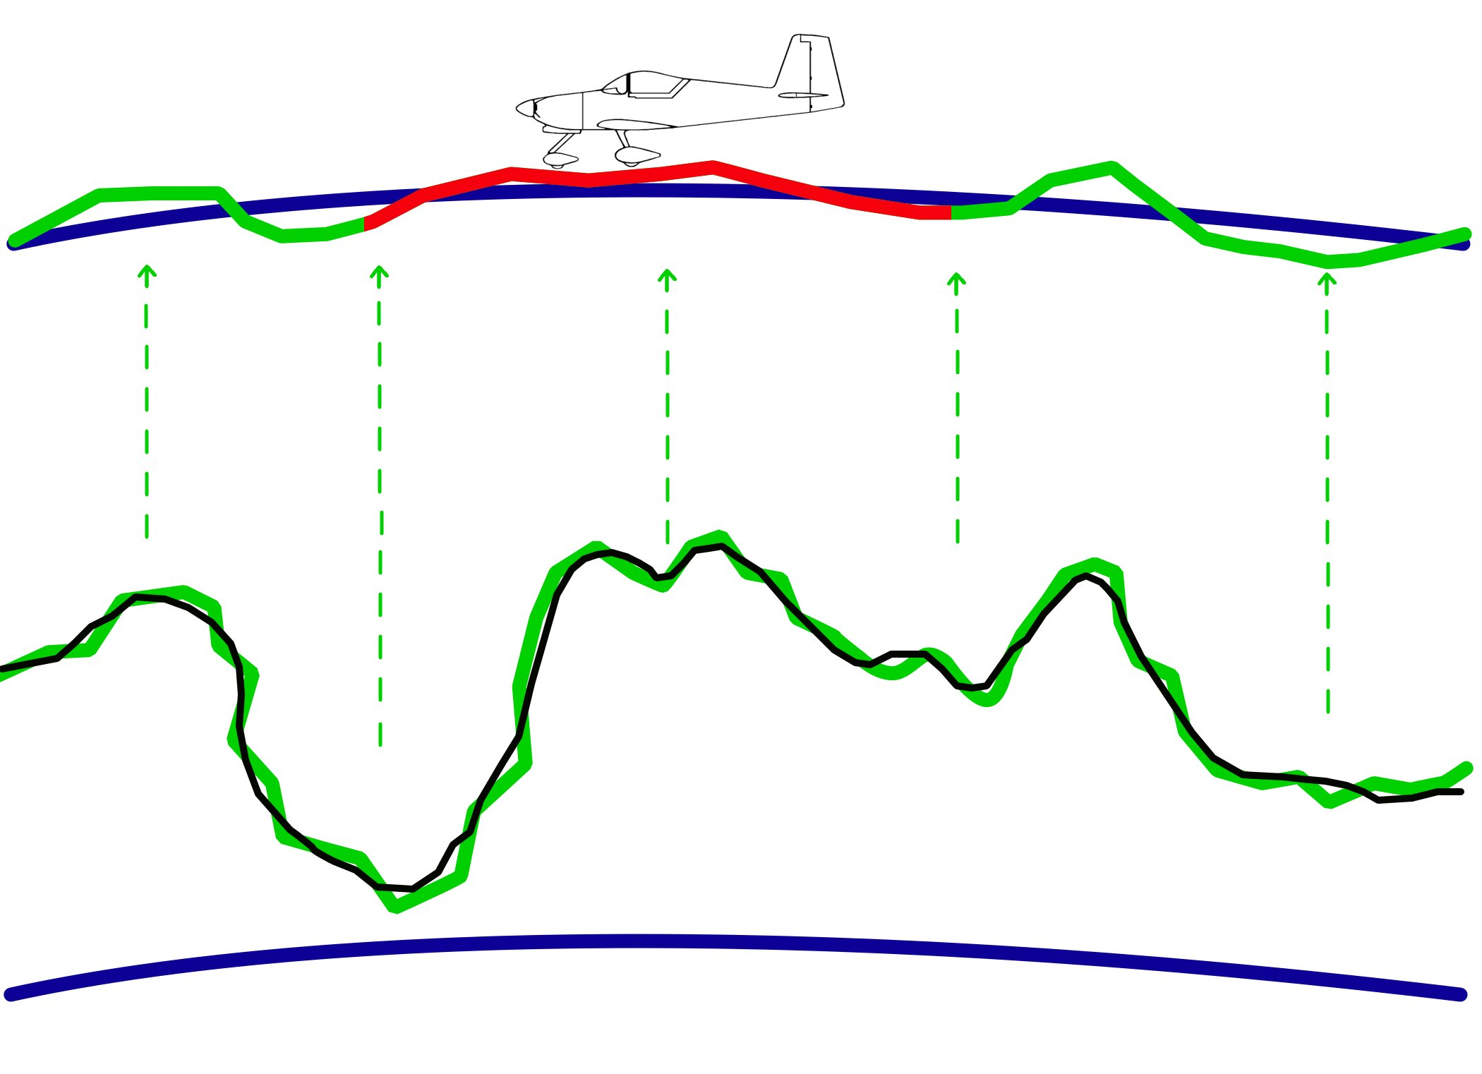
Illustration of Airborne Gravity
Big Ellipsoid
Flight Altitude
Terrestrial Gravimetry
GRS Ellipsoid

Slide 4
High-Degree Expansions for Modeling A-gravity I
Limited expanse of the each airborne gravity survey does not support application of the spherical harmonic expansion
EGM08 provides a global coverage and is used as a reference field
Reality check with synthetic data over Alaska flight tracks
Discussion and conclusions

Slide 5
High-Degree Expansions for Modeling A-gravity I

Slide 6
High-Degree Expansions for Modeling A-gravity II

Slide 7
Local function approach
Let I be a functional of the disturbing potential defined as:
where ψ is a function that approximates the disturbing potential, Γ is a functional, and f is an observation of Γ(ψ).
In this work, we choose the local functions, ψ_{k}, as a 3-D Fourier Series (FS).

Slide 8
The LSC Solution
Downward continuation of the airborne gravity by using LSC
Use of GEOCOL programmed by Tscherning

Slide 9
The LSC Solution
Downward continuation of the airborne gravity by using LSC
Use of Tschning/Rapp covariance model and GEOCOL (Tscherning)

Slide 10
Synthetic gravity data
Gravity disturbance (GD) is computed from a synthetic gravity model along the flight tracks over Alaska (alight altitude from 10.>>11km)
EGM08 used as reference model
The residual GD is modeled by the high degree spherical harmonic series to degree and order ?????. The residual GD is computed at the sea level (h=0)

Slide 11
Statistics of the missfit
Cutoff degree and orders at 90 for all models and augmented by EGM96 to 360 improves the comparisons
GGM01S (n<=90)+EGM96 performs the best in GPS/leveling comparisons
GGM01C performs the best in lake surface comparisons
Recommendations: GGM01S (n<=90)+EGM96 is recommended

Slide 12
Conclusions
Cutoff degree and orders at 90 for all models and augmented by EGM96 to 360 improves the comparisons
GGM01S (n<=90)+EGM96 performs the best in GPS/leveling comparisons
GGM01C performs the best in lake surface comparisons
Recommendations: GGM01S (n<=90)+EGM96 is recommended

Slide 13
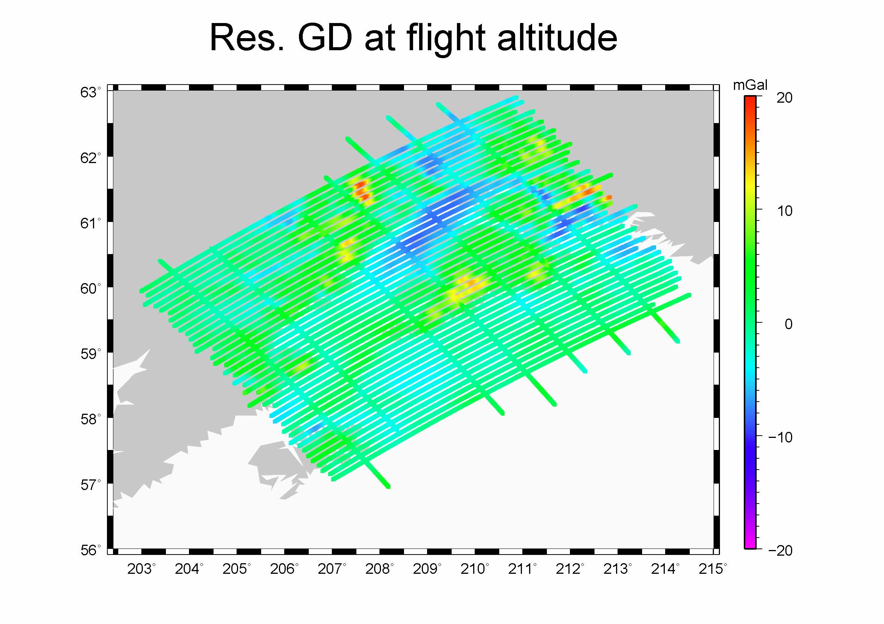

Slide 15
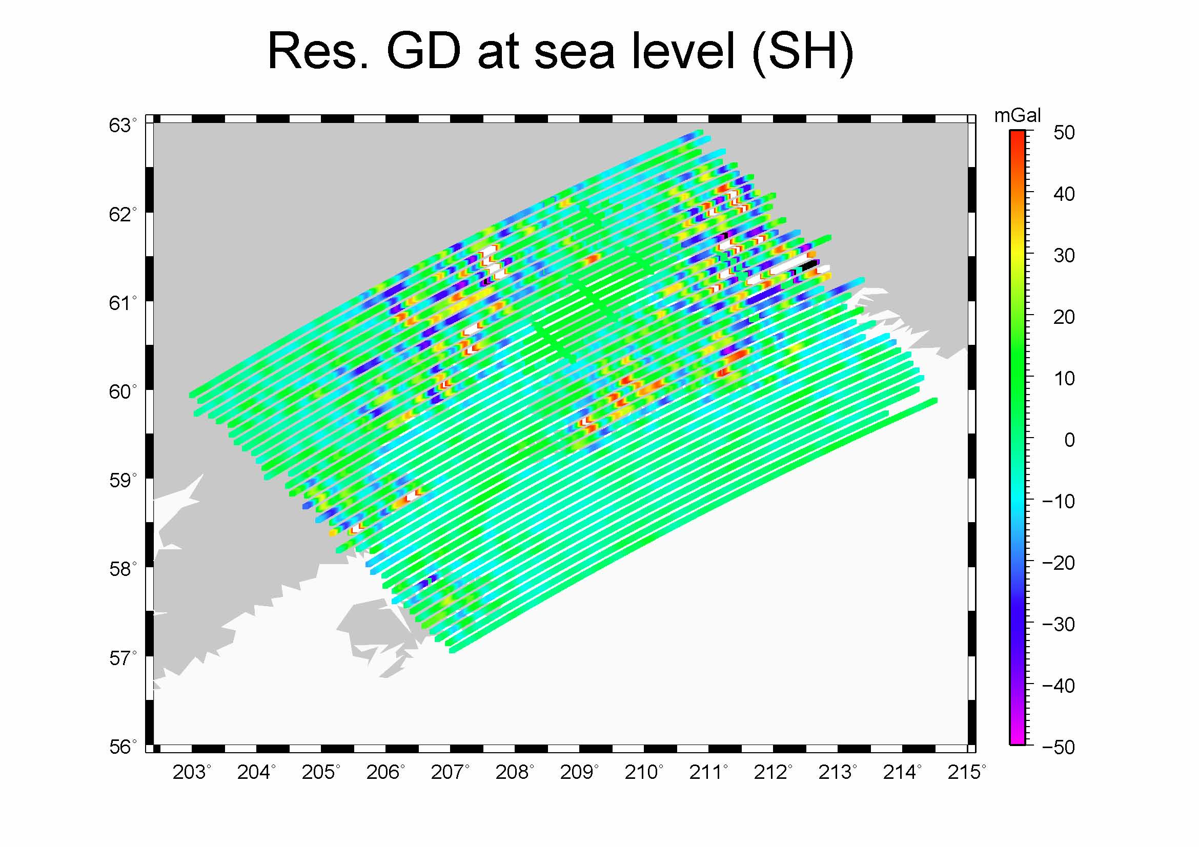

Slide 16
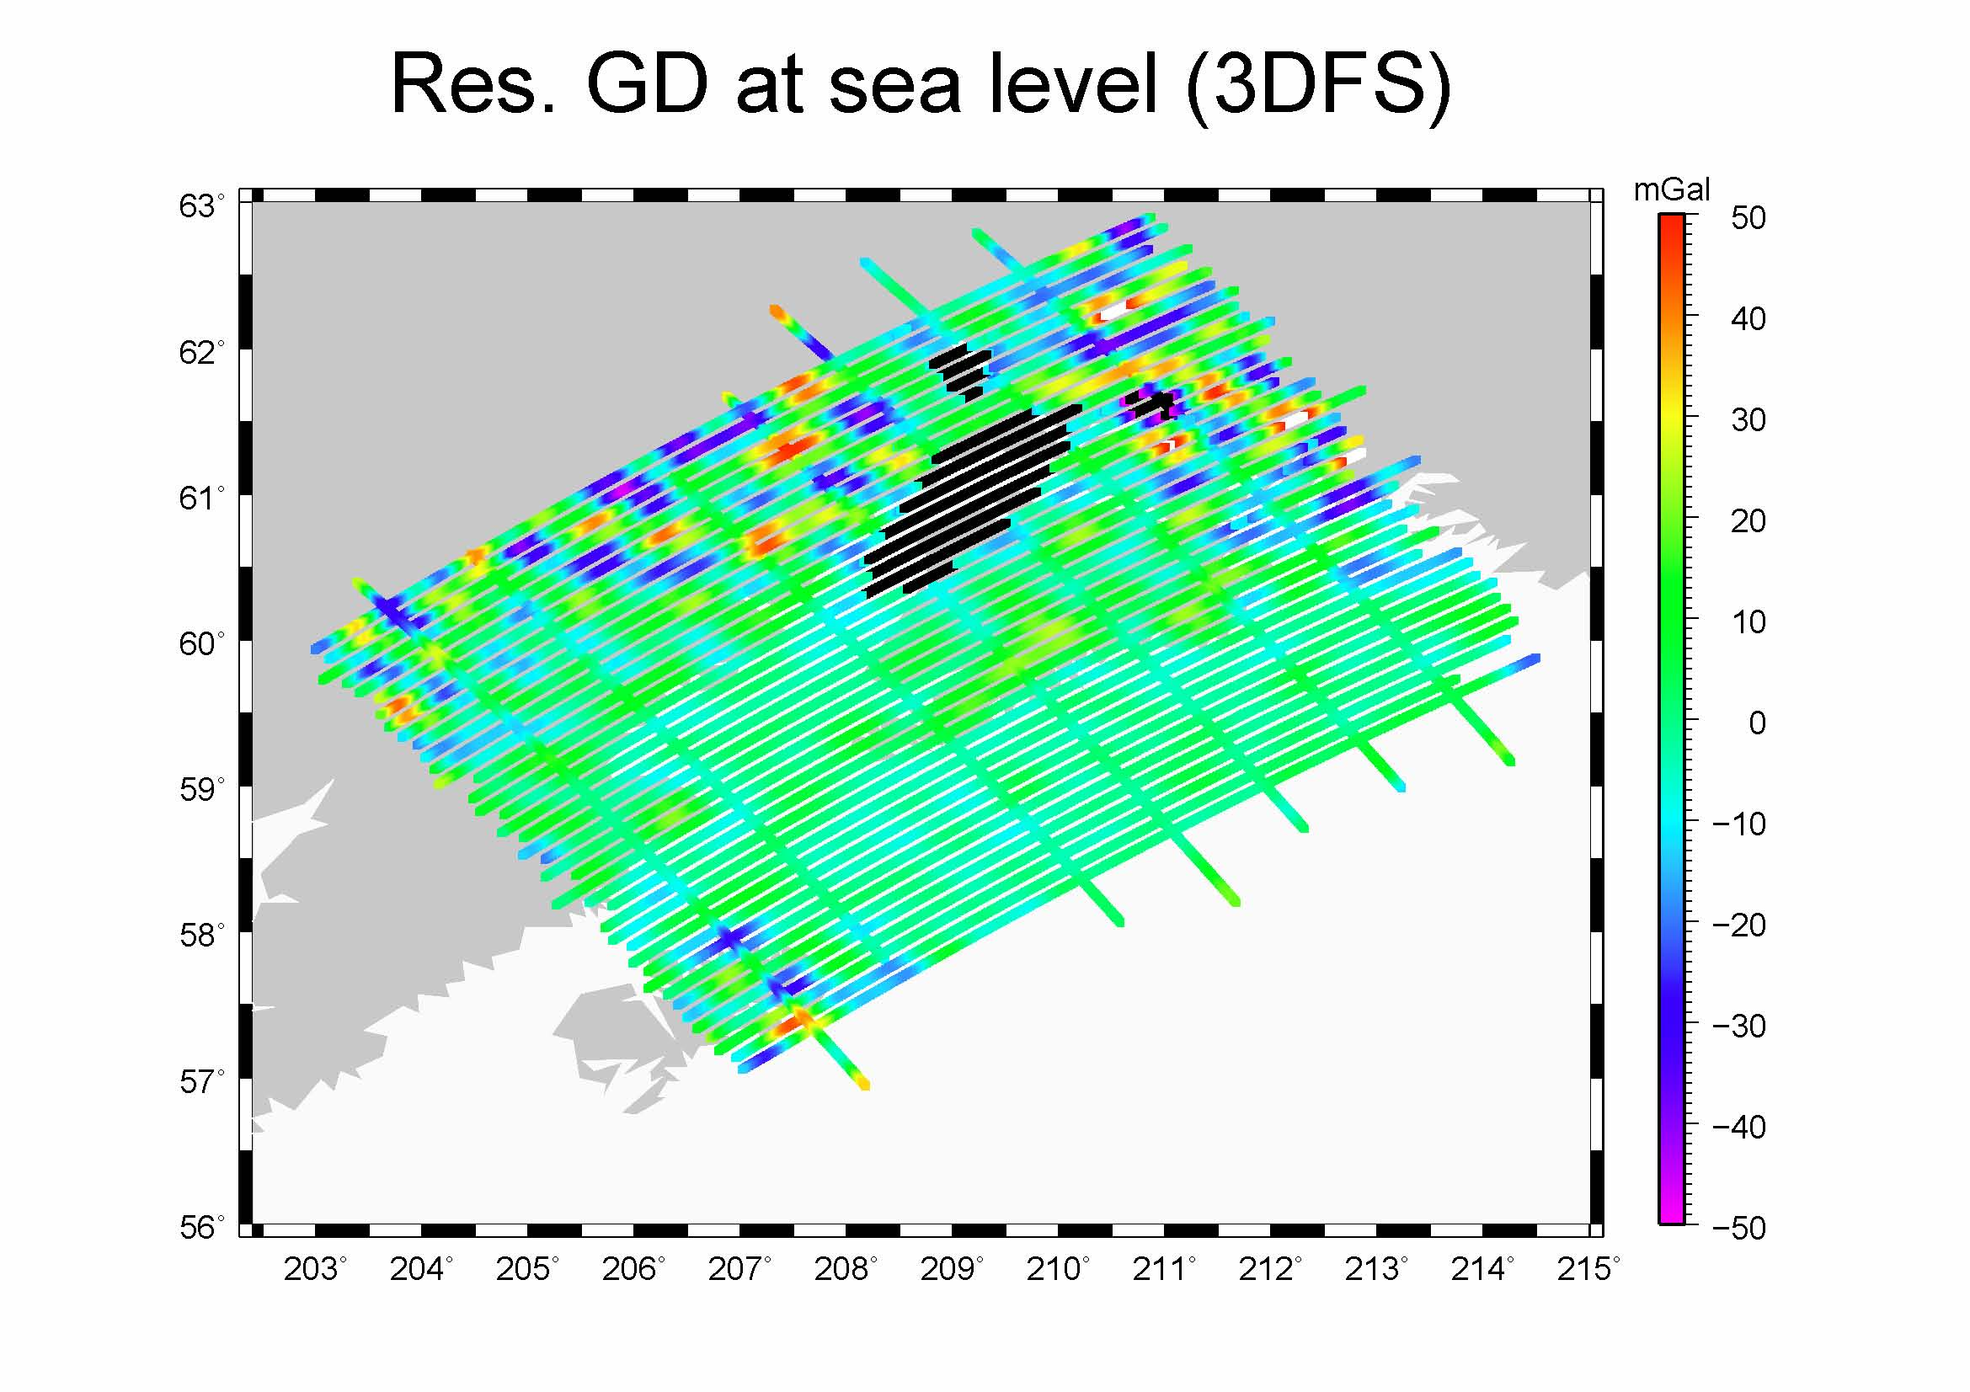

Slide 17
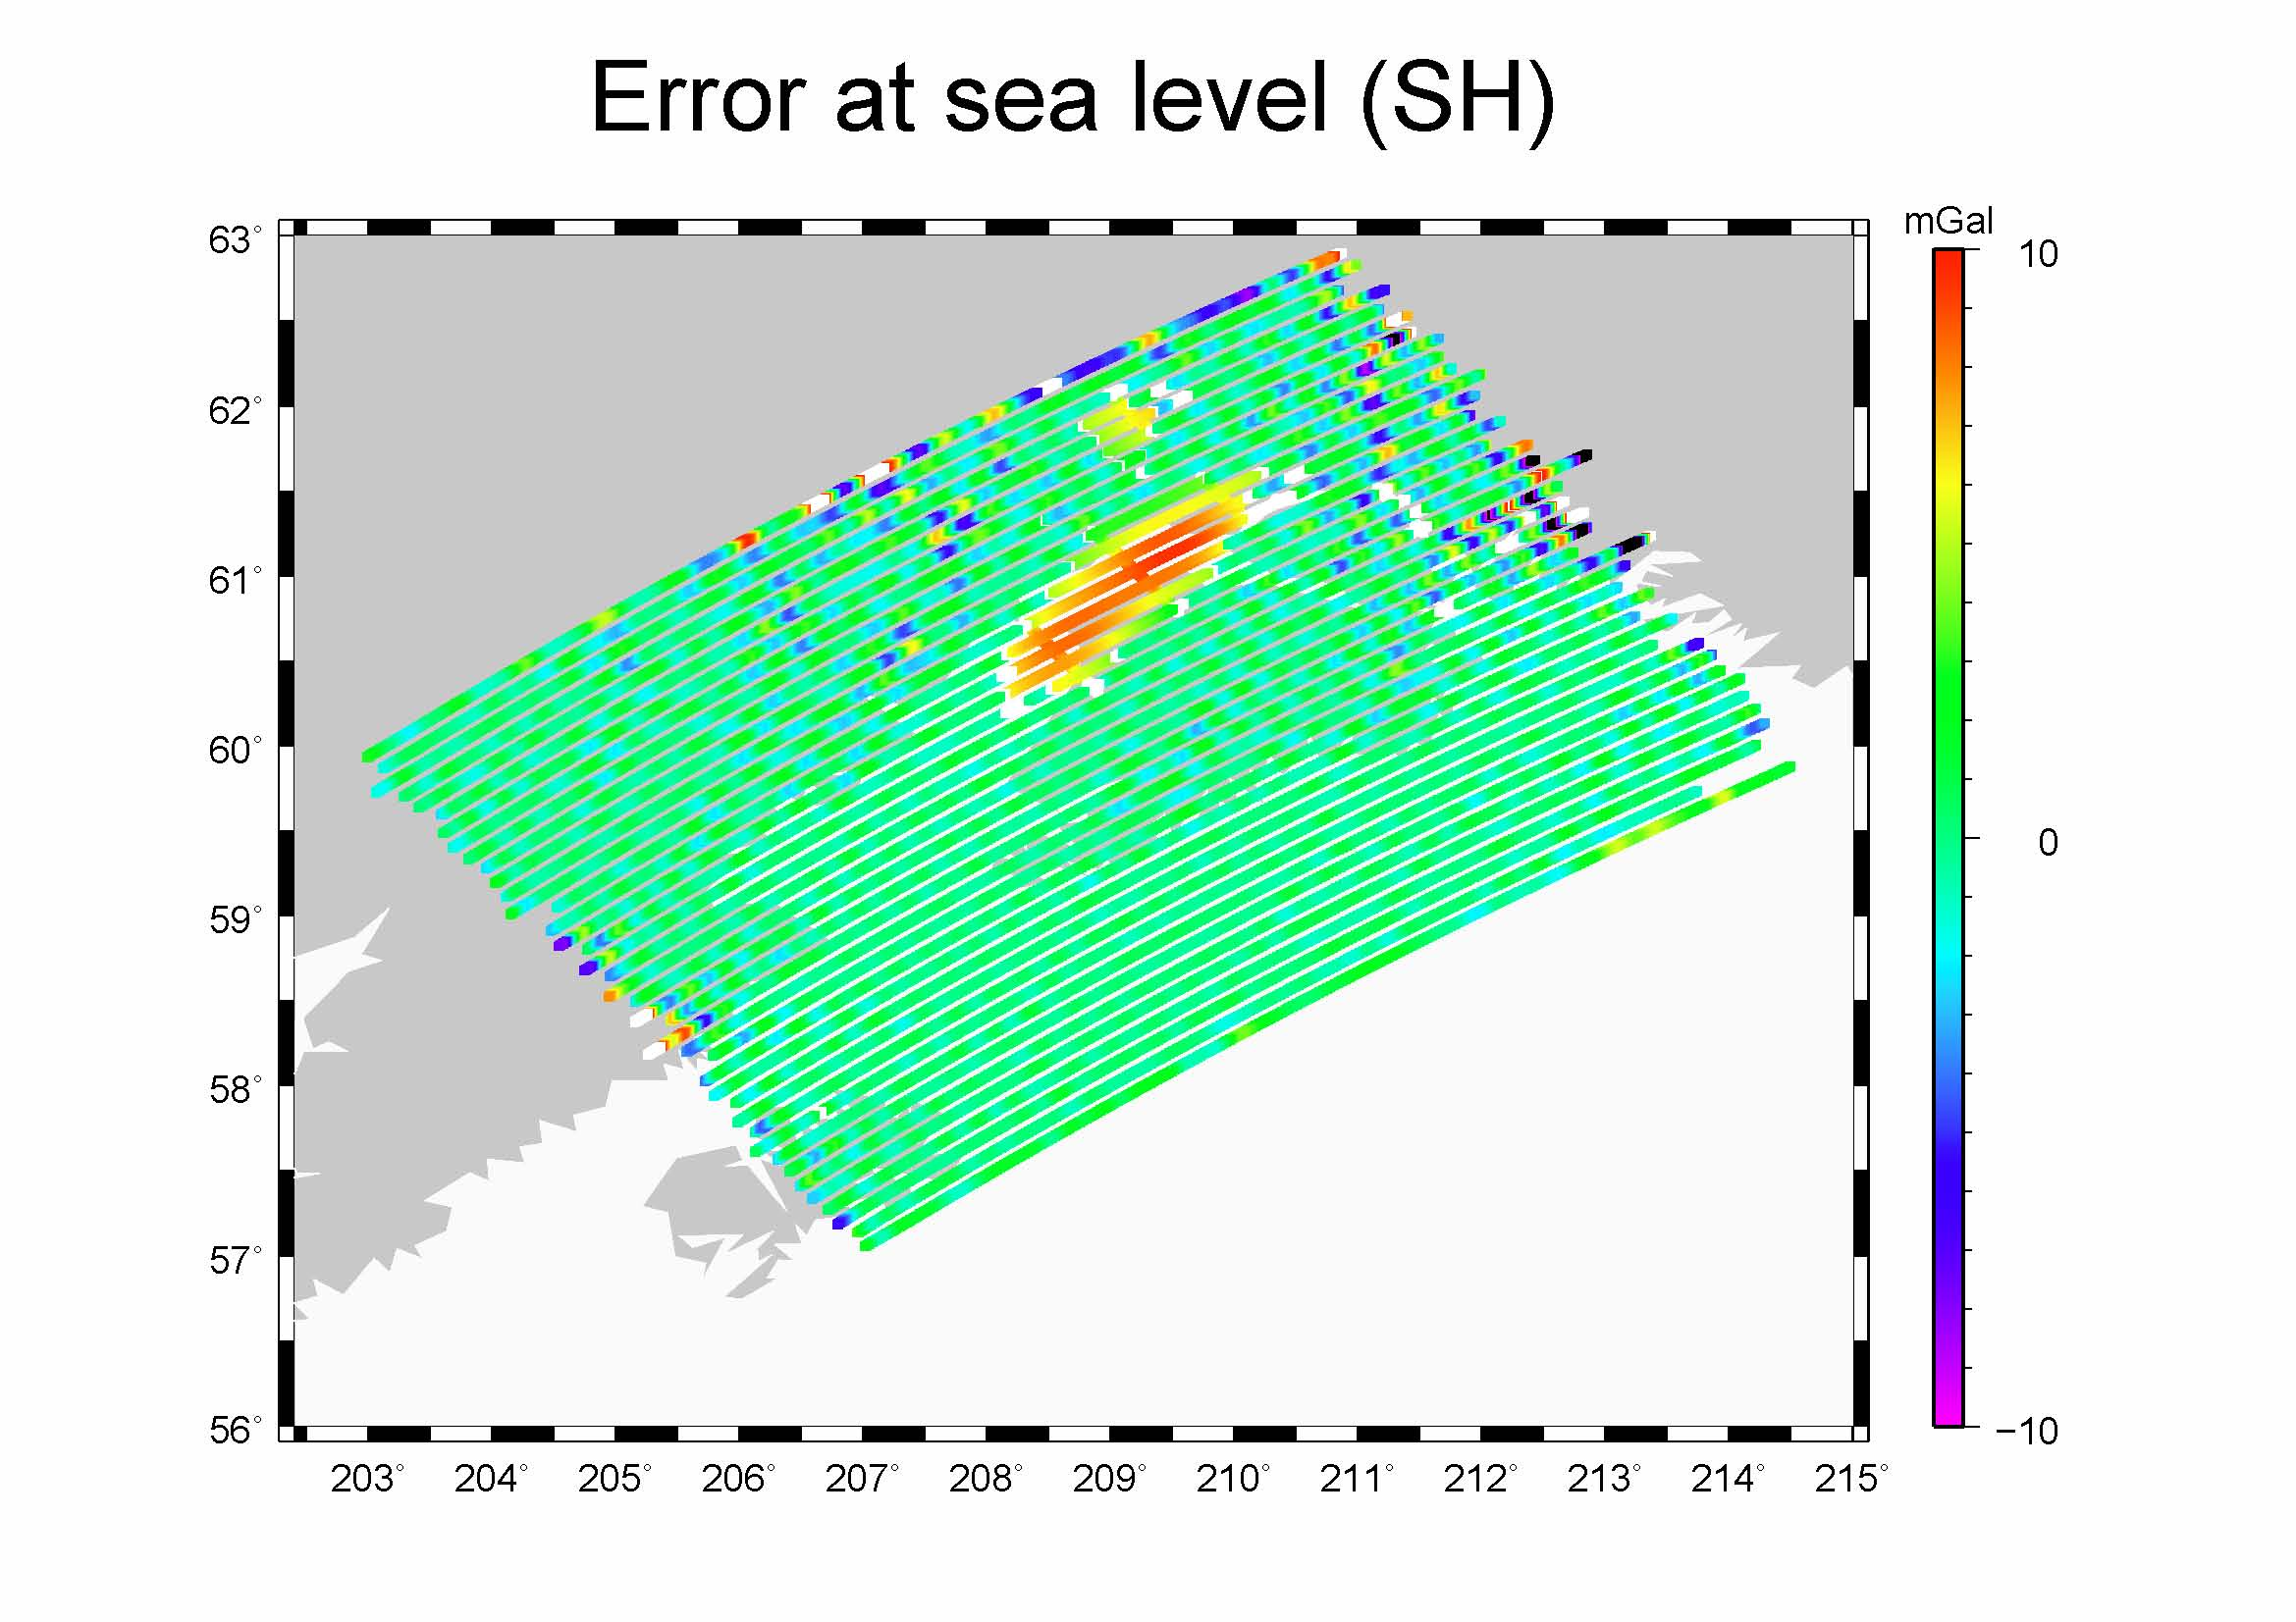

Slide 18
Web Information
Lake monitoring program supported by USDA:
http://www.pecad.fas.usda.gov/cropexplorer/global_reservoir

