Slide 1
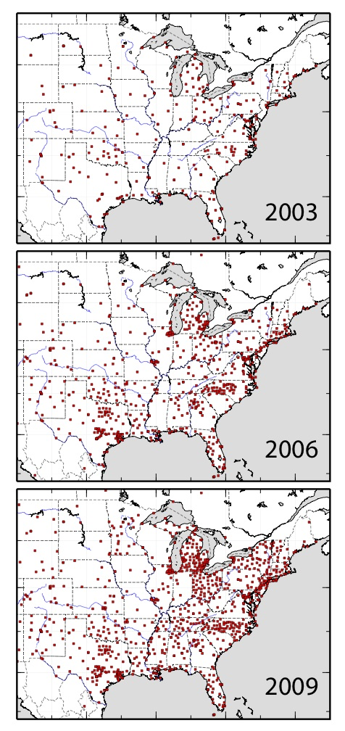
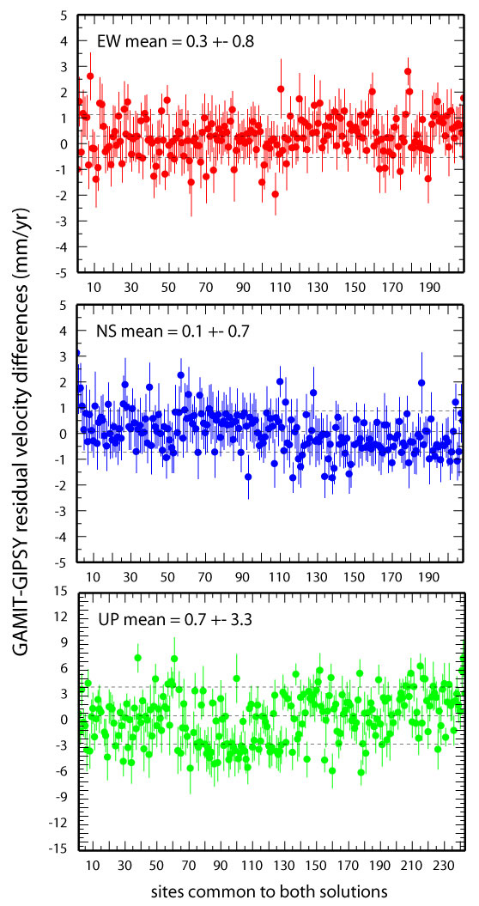

Slide 2
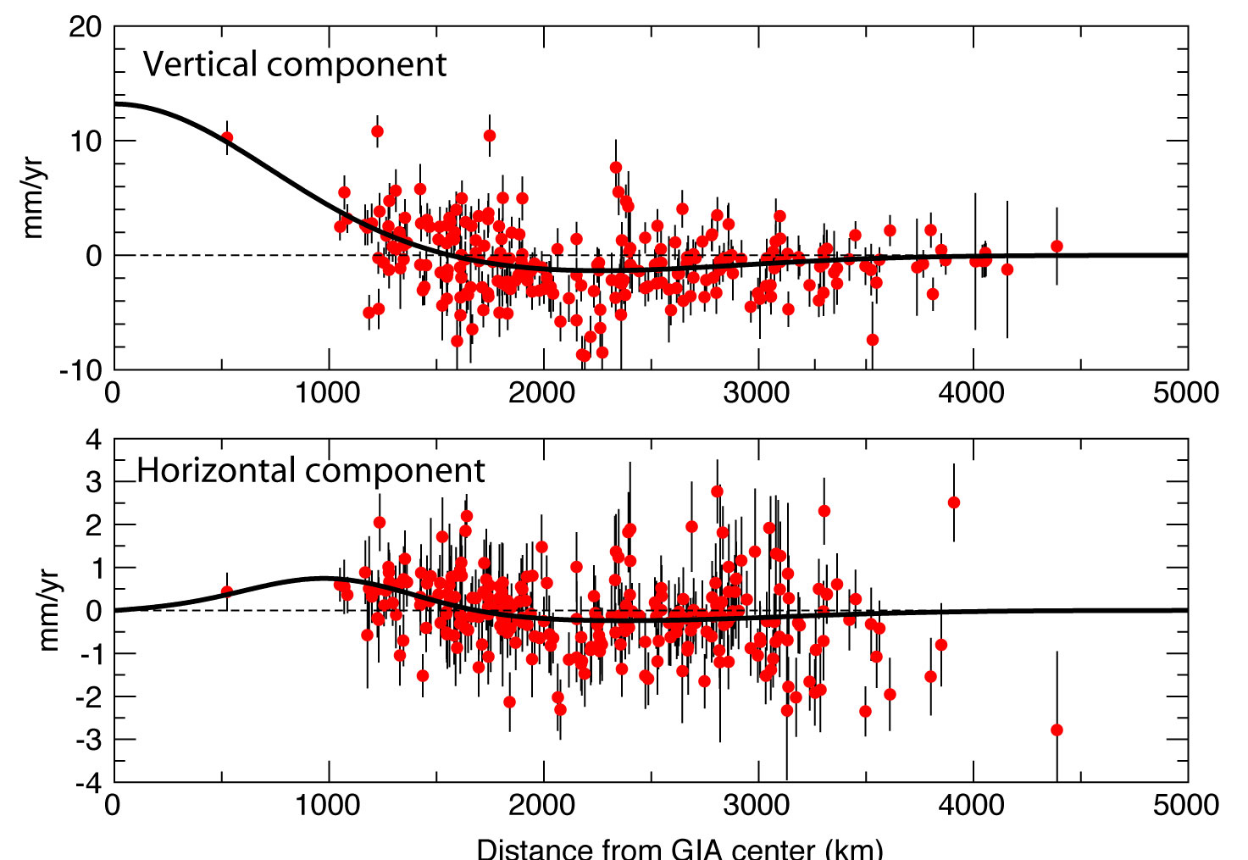
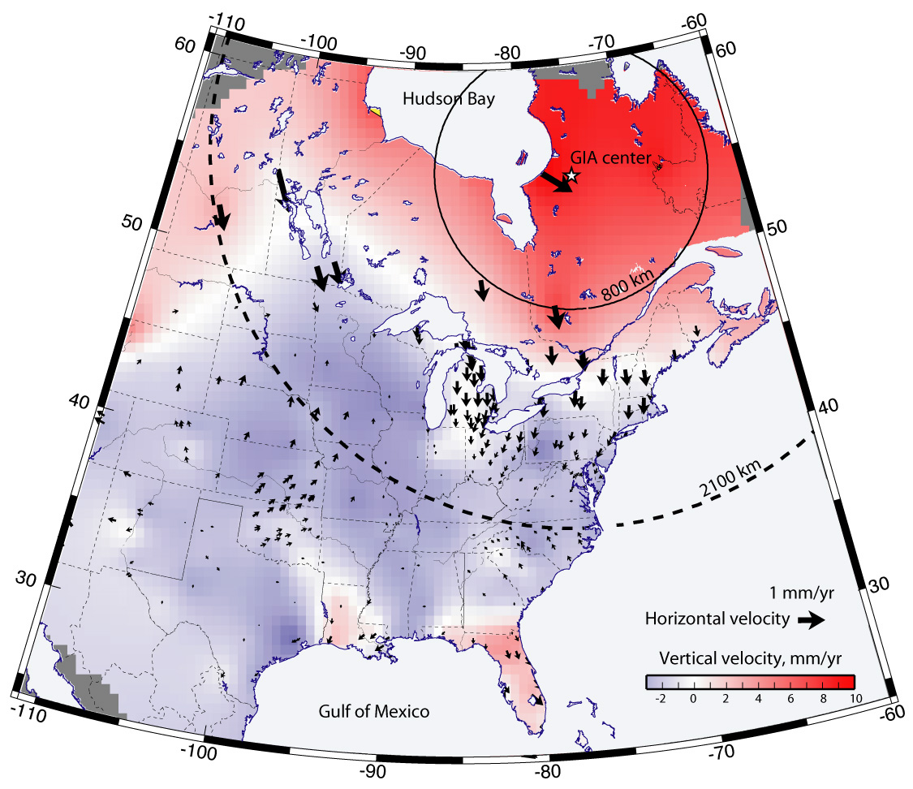
Calais, E., J.Y. Han, C. DeMets, and J.M. Nocquet, Deformation of the North American plate interior from a decade of continuous GPS measurements, J. Geophys. Res., 111, B06402,
doi:10.1029/2005JB004253, 2006.

Slide 3
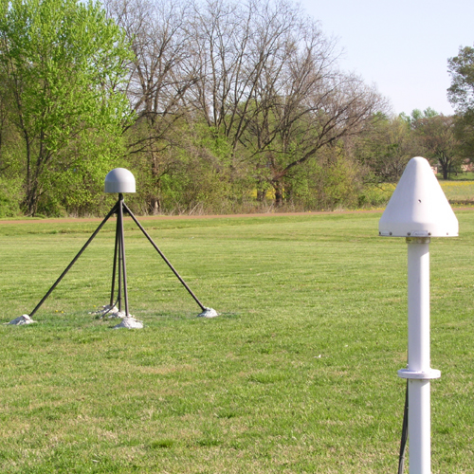
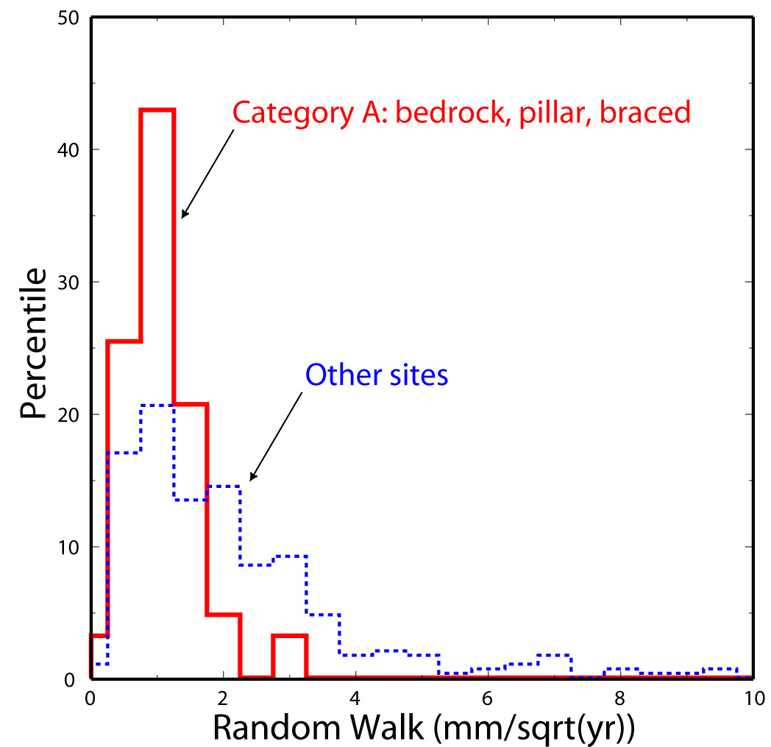
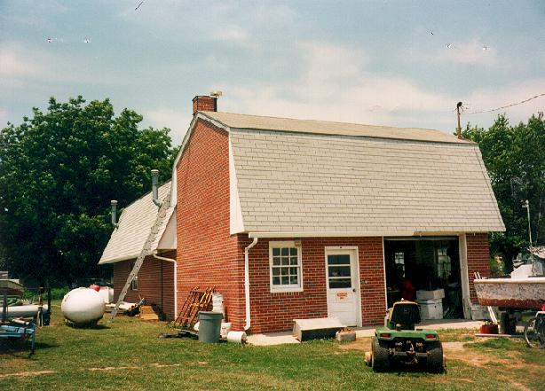
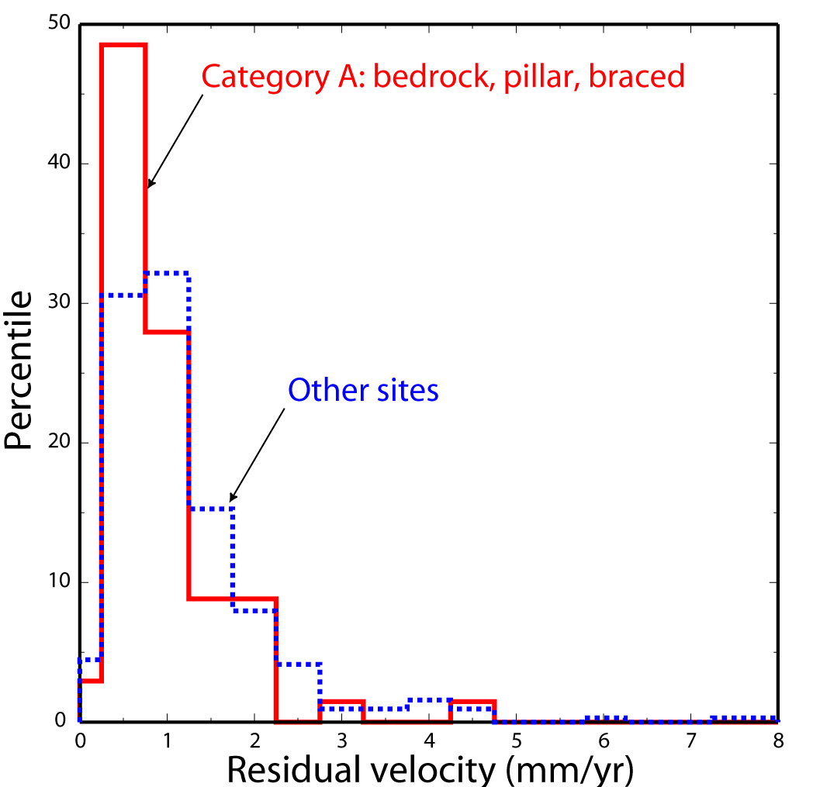

Slide 4
