Slide 1
The Modernized U.S. National Spatial Reference System – Aligning National Geospatial Data to the Globe
Juliana Blackwell,
Director, National Geodetic Survey
FIG 2023 Working Week
Orlando, FL

Slide 2
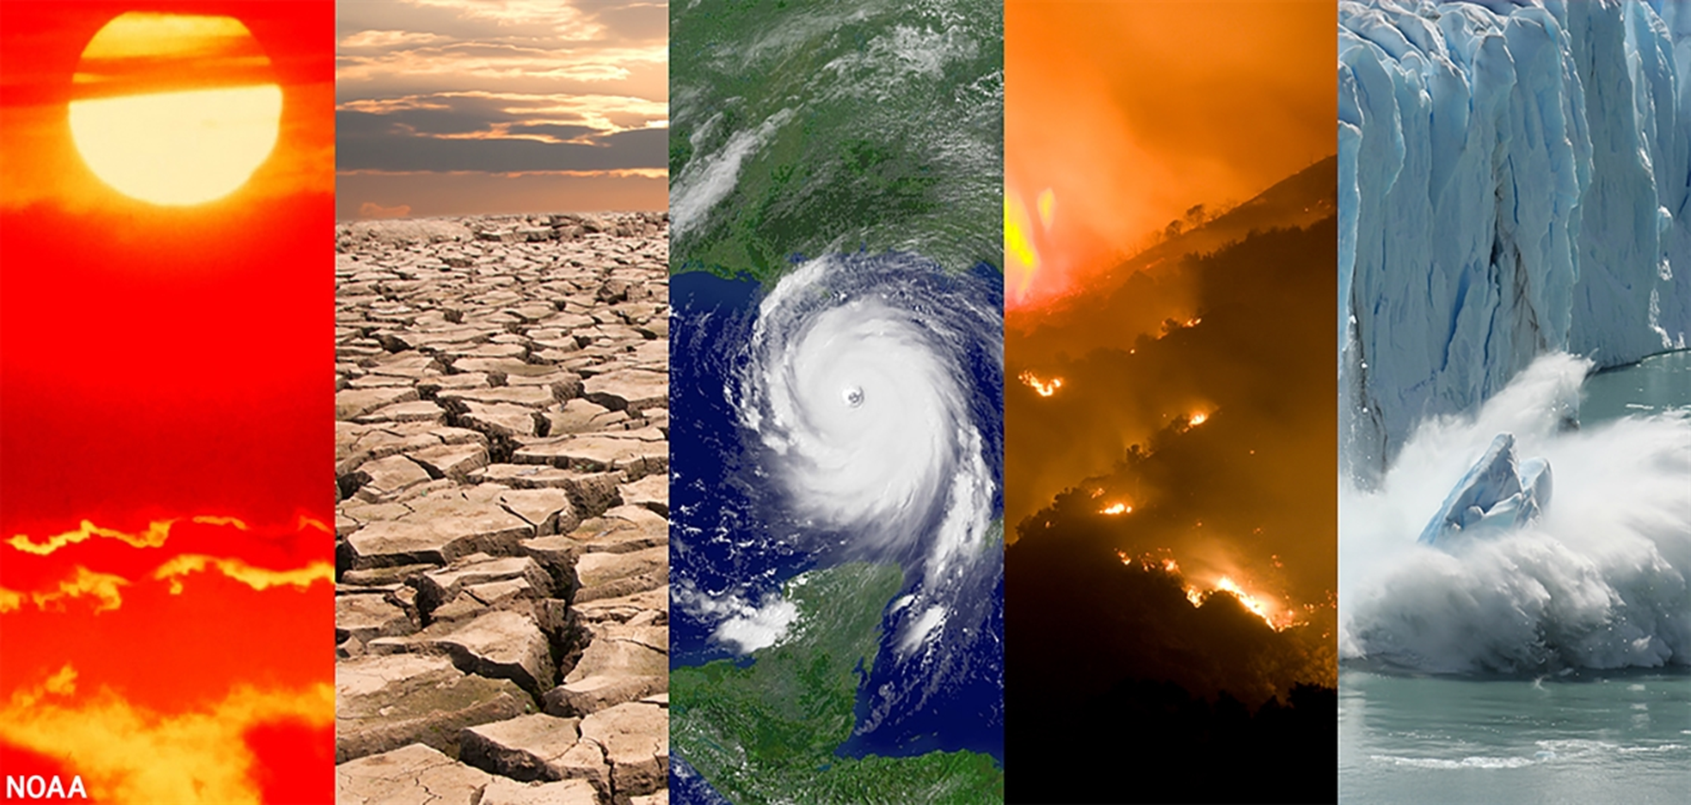
NOAA

Slide 4
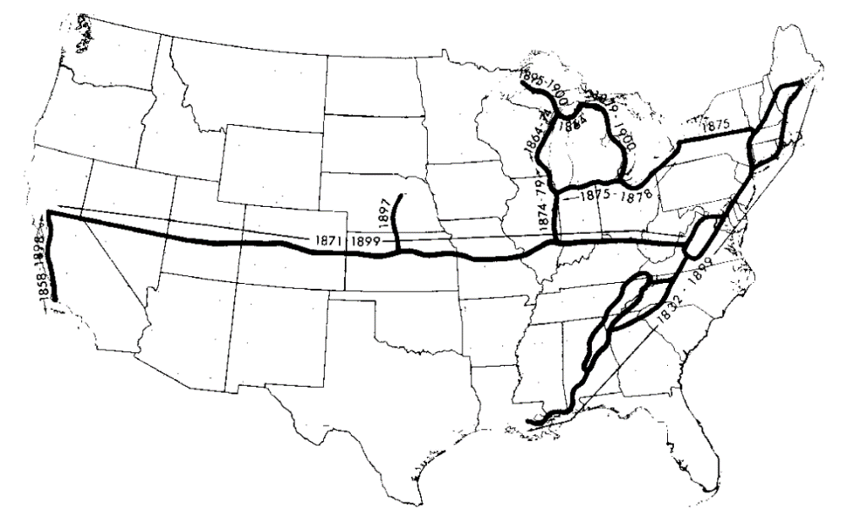
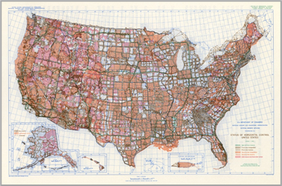
NOAA and NGS
Our Nation’s First Civilian Science Agency
1807 - Survey of the Coast established
1836 - U.S. Coast Survey
US Standard Datum 1900
1878 - U.S. Coast and Geodetic Survey
1970 - NOAA is established
Status of Horizontal Control 1983

Slide 5
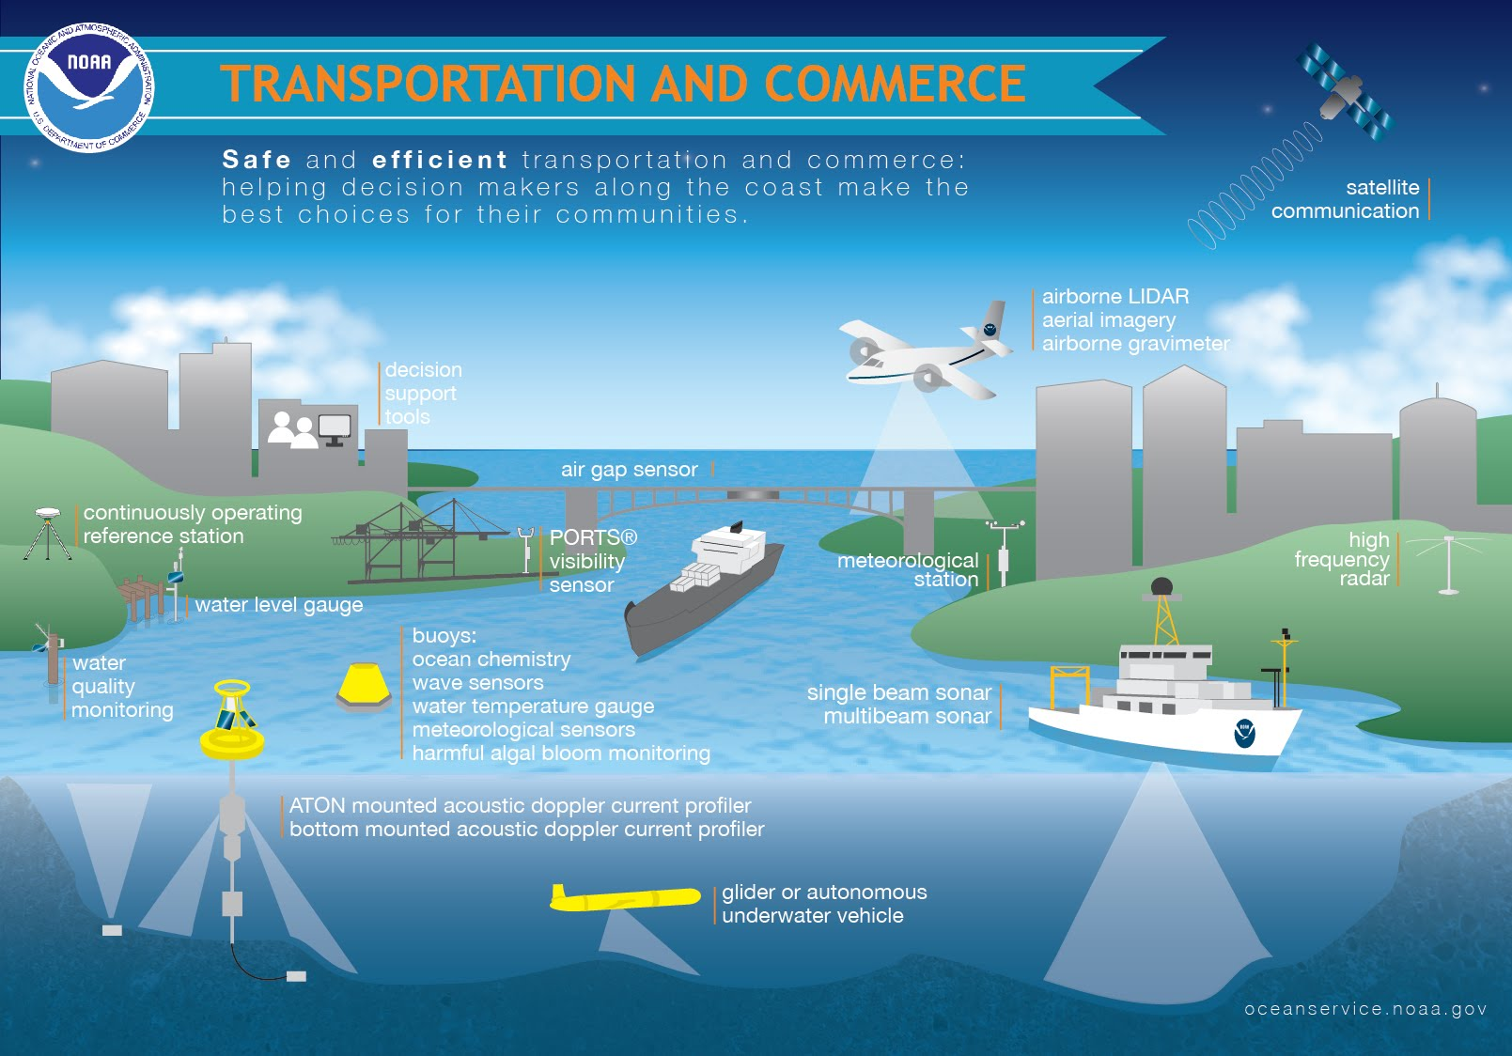
Foundational Data

Slide 6
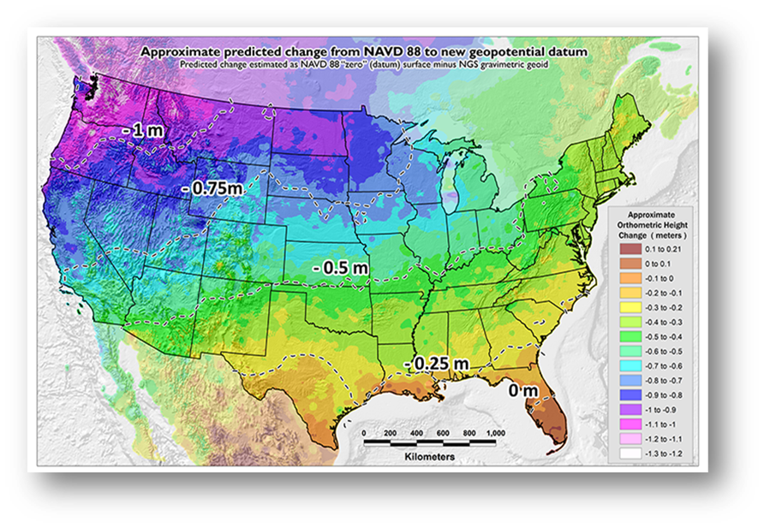
Benefits of Modernizing the NSRS
Why Modernize?
Current Datums were defined before GPS technology and rely on physical survey marks in the ground
Modernization will:
Improve accuracy, access, and alignment of our positioning systems
Changes coordinates up to 1-2 meters, depending on location

Slide 7
Global Alignment of the NSRS
Governance (United Nations)
Standards (ISO)
Infrastructure (IAG and IERS)

Slide 8
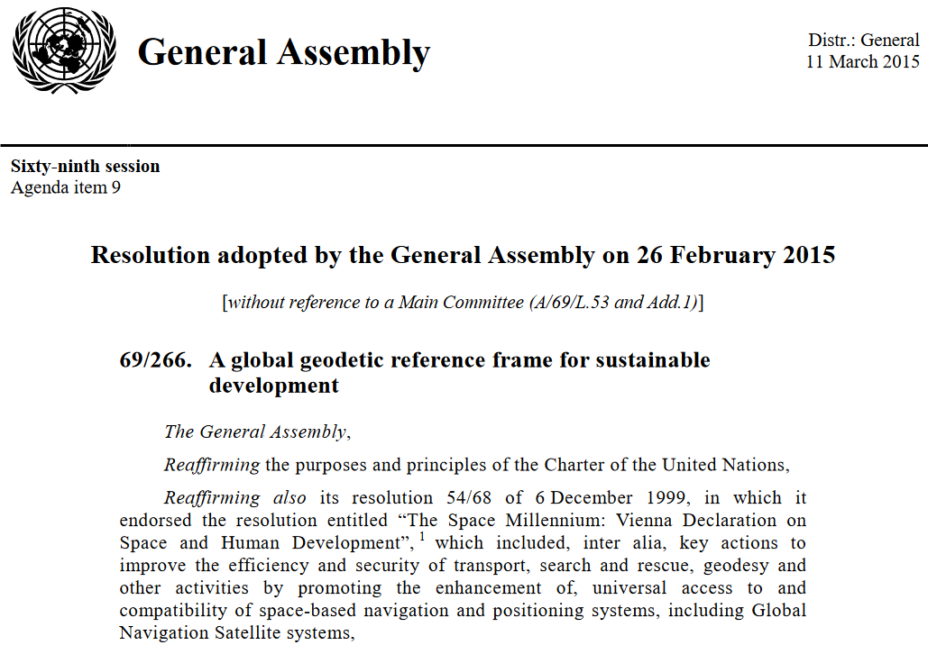
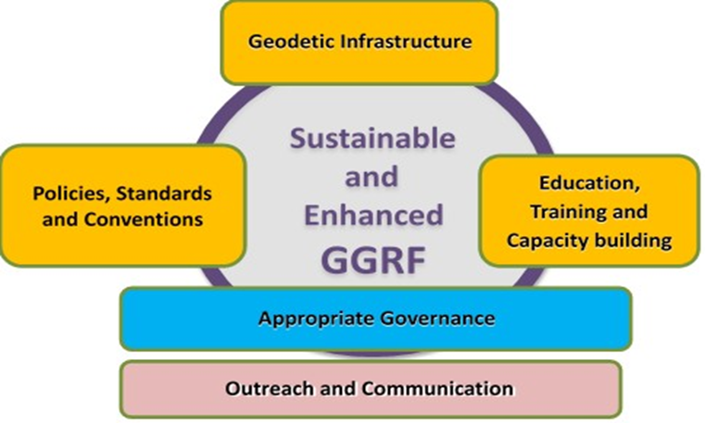
International Alignment per the United Nations
Global Geodetic Reference Frame
United Nations Resolution 69/266
ggim.un.org/knowledgebase/KnowledgebaseArticle50334.aspx

Slide 9
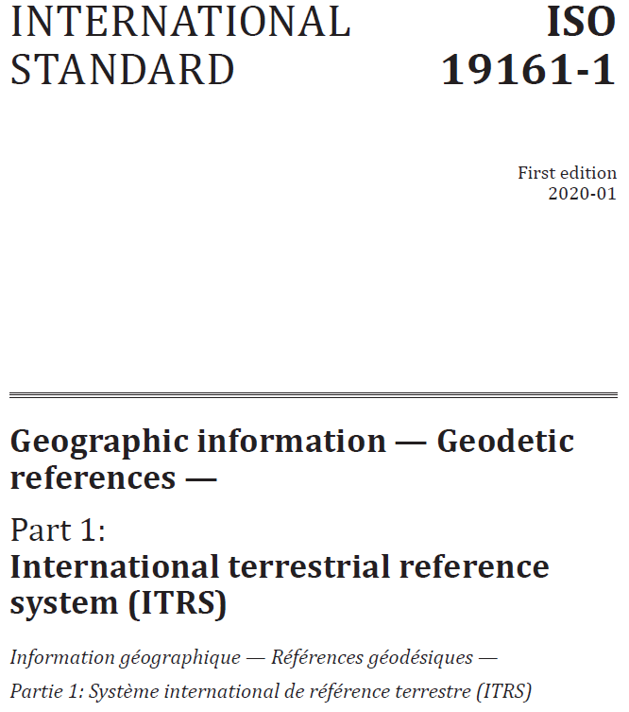
International Geospatial Standards
Technical Committee 211 Standardization of digital geographic data
Many standards apply to all users ISO 19161 has specific application to NOAA’s NGS
Nations align national spatial reference systems to the International Terrestrial Reference System (ITRS)

Slide 10
International Terrestrial Reference System
A world spatial reference system co-rotating with the Earth
Maintained by the International Association of Geodesy (IAG) and the International Earth Rotation and Reference Systems Service (IERS)
An ITRF is a realization of that system at a given epoch
Current realization is ITRF2020
Provides a reference for GNSS satellite and receiver locations

Slide 11
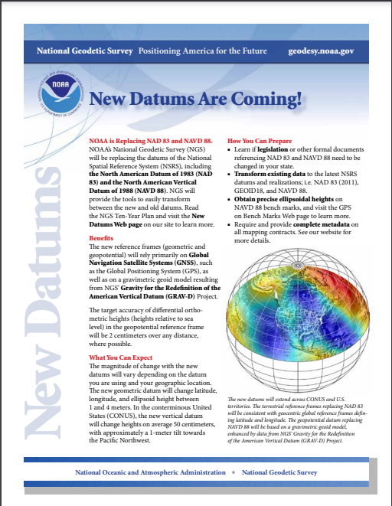
NSRS Modernization
Four terrestrial reference frames
Geopotential datum
Time-dependent coordinates
Updated products and tools
geodesy.noaa.gov

Slide 12
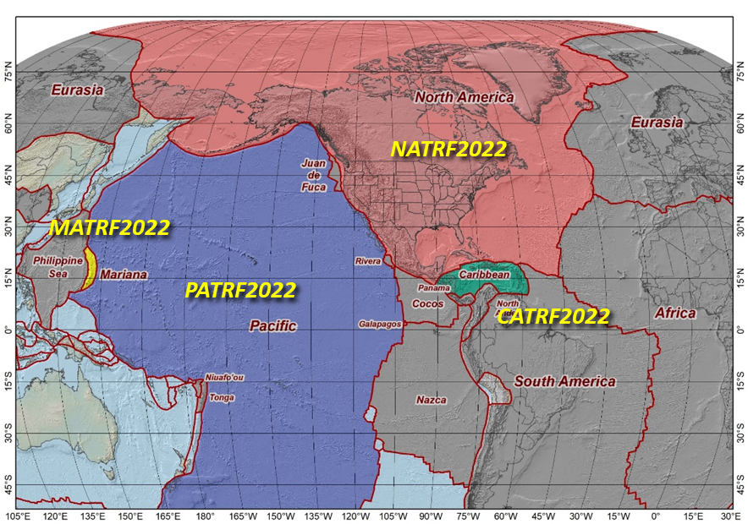
Terrestrial Reference Frames
Tectonic plate based:
North America
Mariana
Pacific
Caribbean

Slide 13
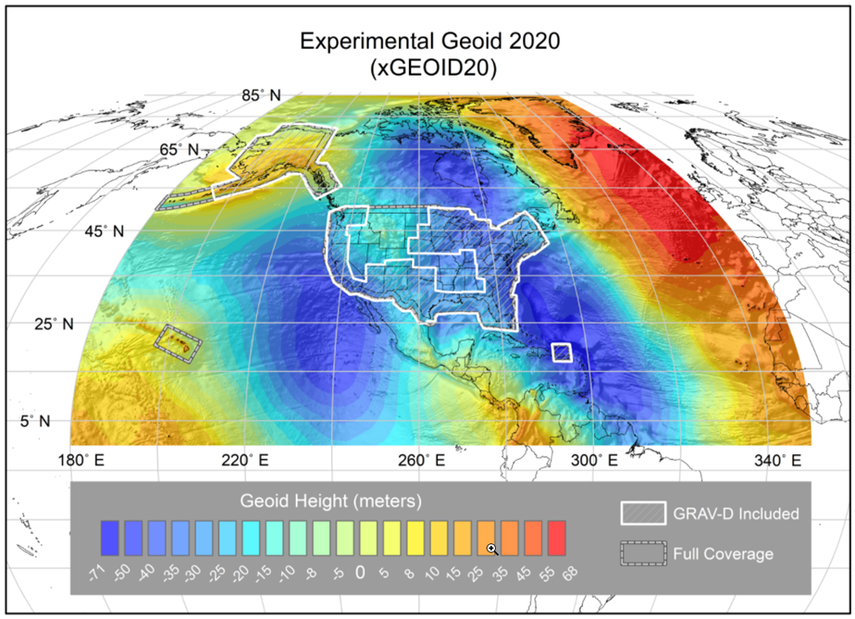
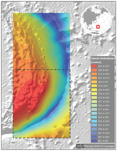
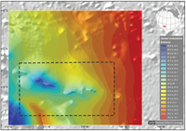
Geopotential Datum
+ Guam/CNMI
+ American Samoa

Slide 14
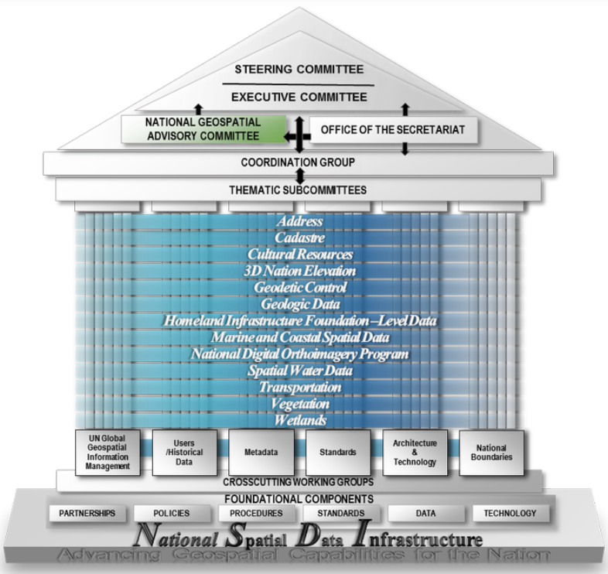
Federal Governance and Coordination
Federal Geographic Data Committee (FGDC)
Organized structure of Federal geospatial professionals and constituents
Executive direction and oversight for Federal geospatial decisions and initiatives
Geospatial Data Act of 2018 (GDA)
Codifies the FGDC duties into law
Stipulates adoption of international standards such as the ITRS

Slide 15
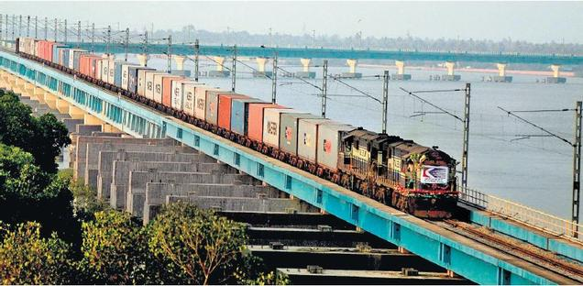
Supports Safe and Efficient Commerce

Slide 16
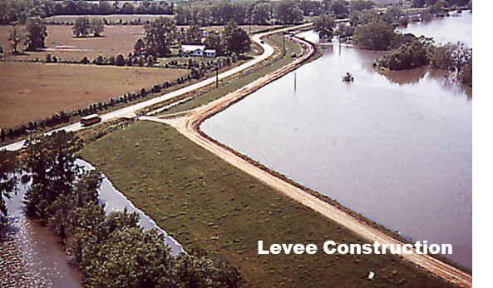
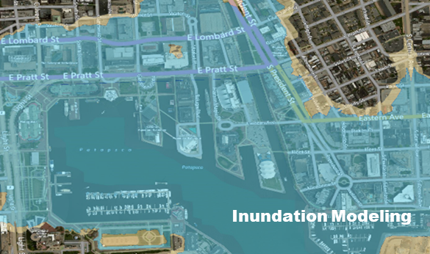
Improves Resilience

Slide 17
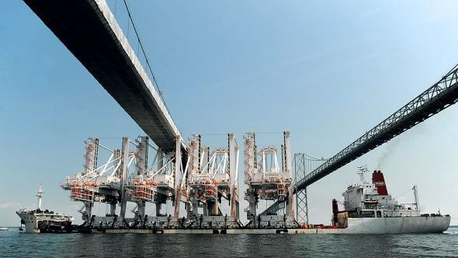
Empowers Growth
Drone Package Delivery
Precision Navigation
Precision Agriculture

Slide 18
Informs Decision Making
Align critical geospatial data assets within global data inventories
Enable improved analysis and modeling of climate changes and impacts to society and the environment

Slide 19
NGS@FIG Day Agenda
May 31 Technical Sessions
11:30 - 13:00 Practical implications of National Spatial Reference System (NSRS) Modernization
Practical impacts of the modernized NSRS
Canada’s implementation of the modernized frames
Changes Afoot: State Plane 2022 and Retirement of the U.S. Survey Foot
Preparing for the Modernization of the NSRS
Q&A
14:30 - 16:00 Update on the NOAA CORS Network and OPUS
The NOAA CORS Network (NCN) Services
Updating OPUS-S to Support Multi-GNSS
OPUS-Projects 5: Supporting RTK for Establishment of Geodetic Control
OPUS-Projects for Manager’s Training - Transitioning from Instructor-led to Online, Self-paced instruction
Augmenting Data exchange formats for OPUS of the future
Q&A
16:30 - 18:00 Case studies of Surveys NGS does now and how they will change
Implementing NGS OPUS Projects’ GVX feature to align RTK vectors to the NSRS to establish Geodetic Control for FirstNet Indoor Mapping.
IGLD: A case study for leveraging digital tools to enhance QA/QC on large scale static GNSS observation campaigns
Geodetic Leveling in the Modernized NSRS
NGS Field Operations: Modernizing in Many Ways
Q&A
Closing Remarks by Director of National Geodetic Survey
June 22 Webinar 14:00 - 15:30 NGS Partner Panel Session: Discussion of the Benefits and Challenges of Transitioning to the Modernized NSRS (geodesy.noaa.gov/web/science_edu/webinar_series/Webinars.shtml)

