Slide 1
Mastery Paths Learning in Geosciences
Stacey D. Lyle, PhD, RPLS
College of Geosciences

Slide 2
Online Masters in Geoscience

Slide 3
Online Masters in Geosciences
The online Master of Geoscience from Texas A&M University offers you the skills and knowledge to delve into exciting and evolving areas of Geodesy, Surveying, Geophysics, Geographic Information Science and Technology with applications specifically to the Oil and Gas Industry.
With the increasing demand for Gesocience expertise, graduates are also in the position to drive innovation and apply modern technologies to careers.

Slide 4
Courses
GEOG 651 | Remote Sensing for Geographical Analysis | 3 credit hours
GEOG 659 | GeoDatabases | 3 credit hours
GEOG 660 | Applications in GIS | 3 credit hours
GEOG 663 | GIS in Petroleum | 3 credit hours
GEOP 635 | Methods of Geophysical Exploration | 3 credit hours
GEOL 617 | Petroleum Industry | 3 credit hours
GEOG 662 | GIS in Land Management | 3 credit hours
GEOG 665 | GIS-Based Spatial Analysis and Modeling | 3 credit hours
GEOG 676 | GIS Programming | 3 credit hours
GEOG 678 | Web GIS | 3 credit hours
GEOS 676 | Capstone Experience in Petroleum Geosciences | 6 credit hours

Slide 5
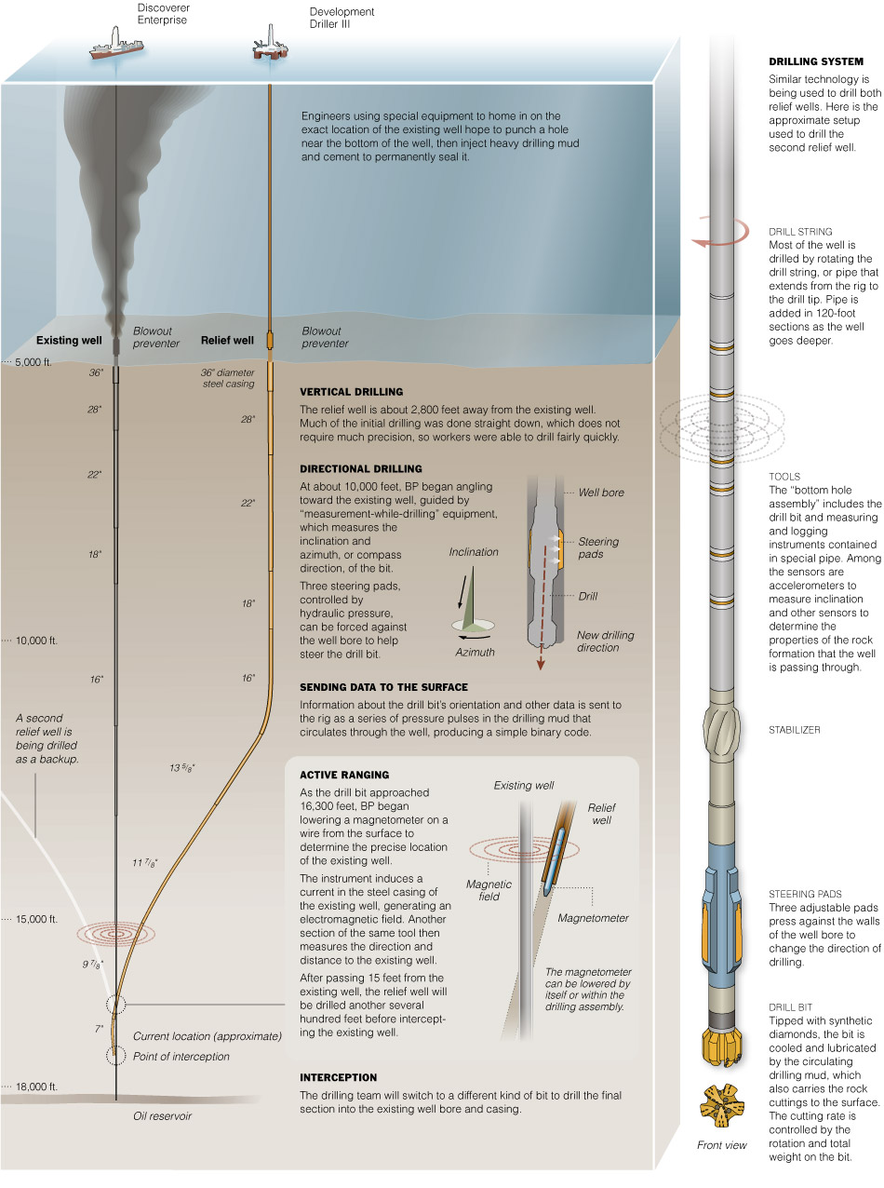
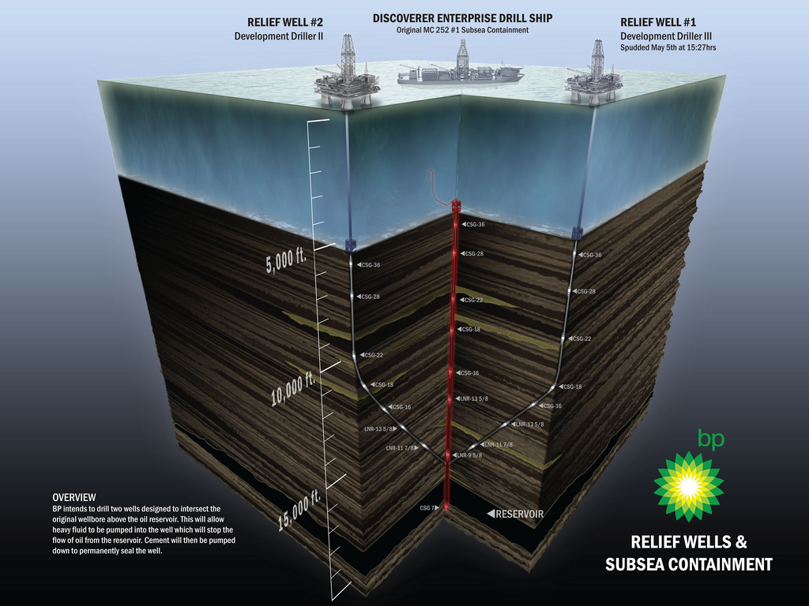
Geodesy Why is it important

Slide 6
Global Education

Slide 7
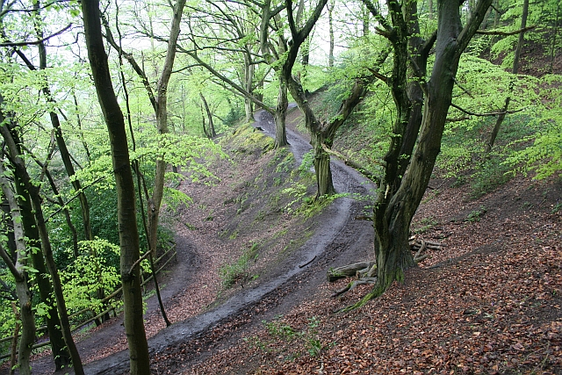
This Photo by Unknown Author is licensed under CC BY-SA

Slide 8
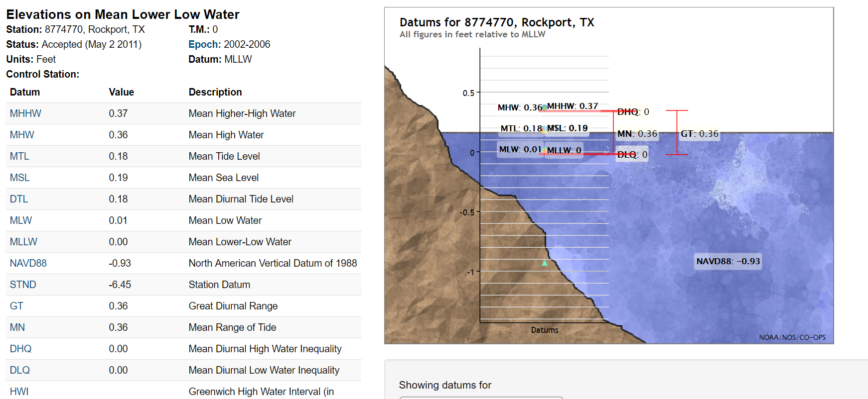
Mean Sea Level

Slide 9
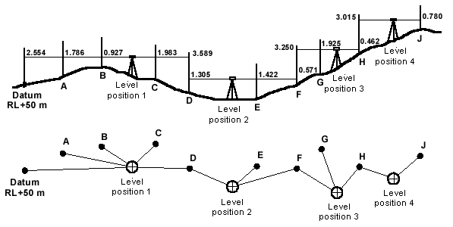
Leveling

Slide 11
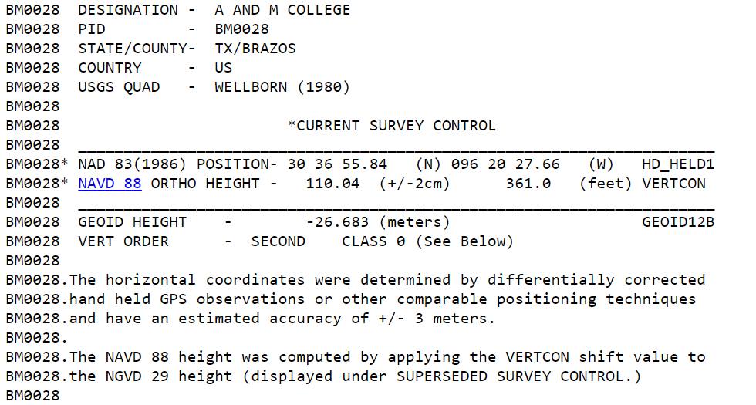

Slide 12
3 D Earth Centered
Cartesian X, Y, Z 3D Coordinates
Origin coincides with Earth’s center of mass
X and Y axes are perpendicular to each other in the equatorial plane
Z axis is at right angle to the X,Y plane and coincides with the Earth’s rotational axis
Z
P
h
ϕ
Y
λ
X

Slide 14
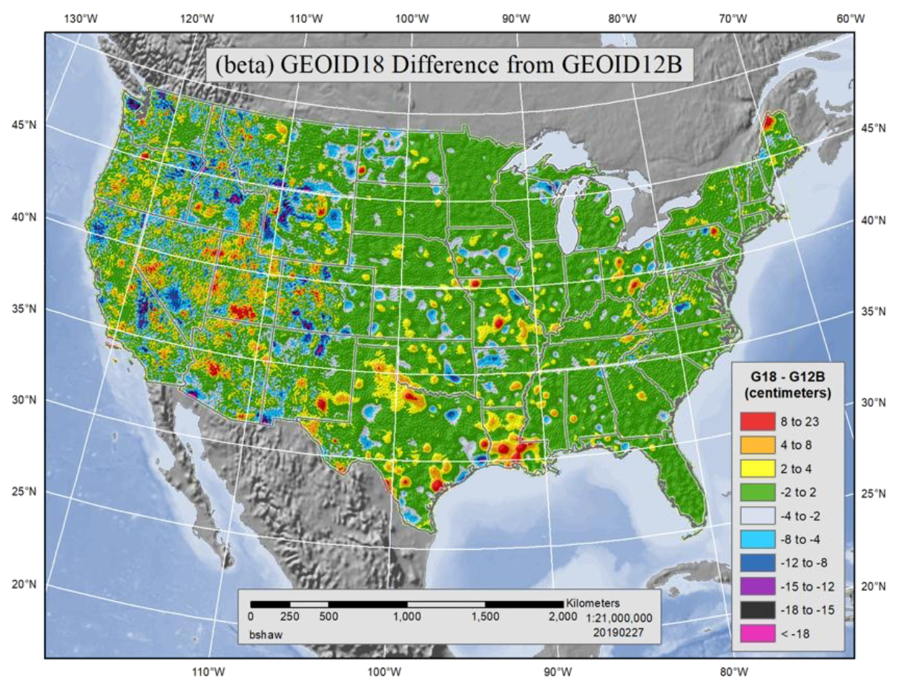
NA Datums

Slide 15
Multiple Paths to Mastery
This Photo by Unknown Author is licensed under CC BY-SA

Slide 16
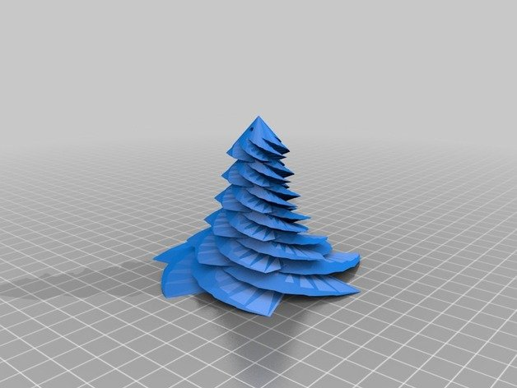
Design Customized
Notes:
Course designer to customize learning experiences to students based on student performance.

Slide 17
Polled Questions
Notes:
You identify activities for each student’s learning path and differentiate assignments for required learning, optional learning, or choosing their own content and assignments within a specific path, which helps them achieve course mastery.

Slide 18
Mastery Paths
Notes:
MasteryPaths is based on differentiated assignments, which allows targeted learning activities to be assigned to different users and sections. With MasteryPaths, assignments are differentiated to individual students automatically and no additional work is required aside from grading student assignments as usual.

Slide 19
At the end of the day!
Notes:
the student’s score designates which conditional items(s) they are assigned as a learning path.

Slide 20
Mastery Paths Learning in Geosciences
College of Geosciences
Stacey.Lyle@tamu.edu

