Slide 1
NOAA-University of Puerto Rico at Mayagüez Memorandum of Understanding: An Overview of 20 Years of Partnership
Linda L. Vélez-Rodríguez,MS, PE, PLS
Professor
University of Puerto Rico-Mayagüez Campus
Mayagüez, Puerto Rico 00681-9000
linda.velez@upr.edu 787-313-4740 (cel.)/787-265-5405 (Ofic.)

Slide 2
Topics
About Puerto Rico
About Land Surveying Profession in Puerto Rico
About the Memorandun Of Understanding (MOU)
About the PRVD02 and GRAV-D
About the Commemorative Marks in Puerto Rico
About the Research, Education and Outreach Projects at UPRM

Slide 3
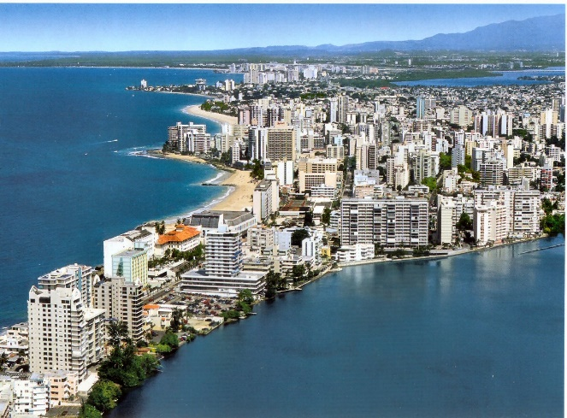
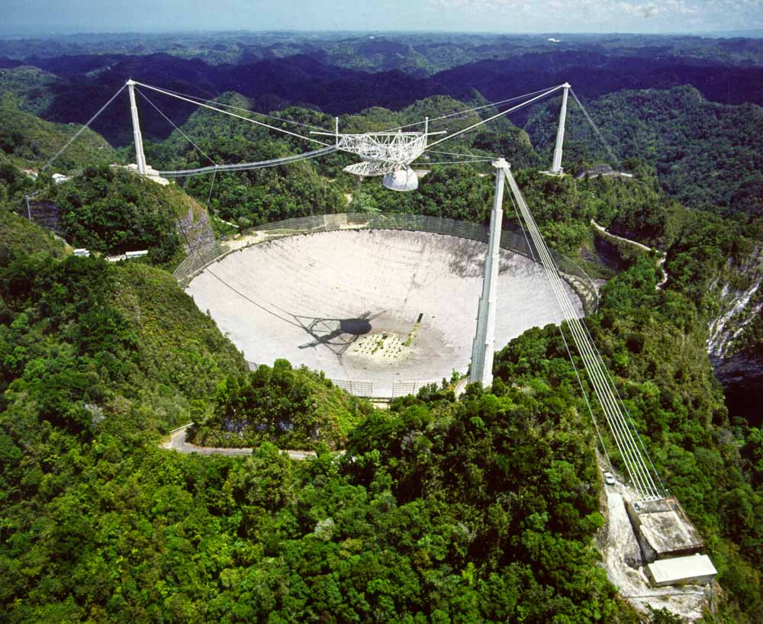
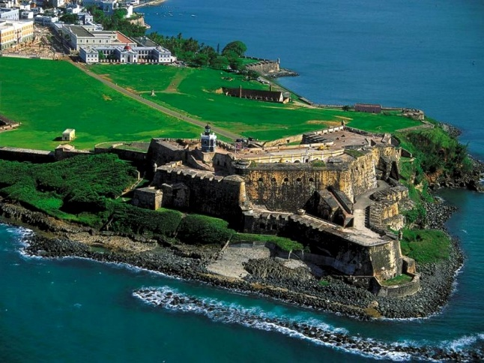
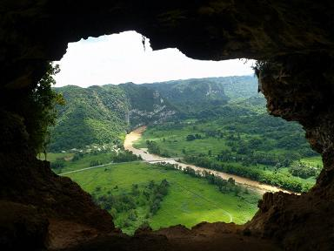
About Puerto Rico:
Puerto Rico is located in the western hemisphere in the Caribbean Sea.
As a result of the Spanish American War, Puerto Rico was ceded to the United States of America in 1898.
The Jones Act of 1917 extended to the people of Puerto Rico United States citizenship and in 1952 Commonwealth Status was adopted called “Estado Libre Asociado de Puerto Rico”.

Slide 4
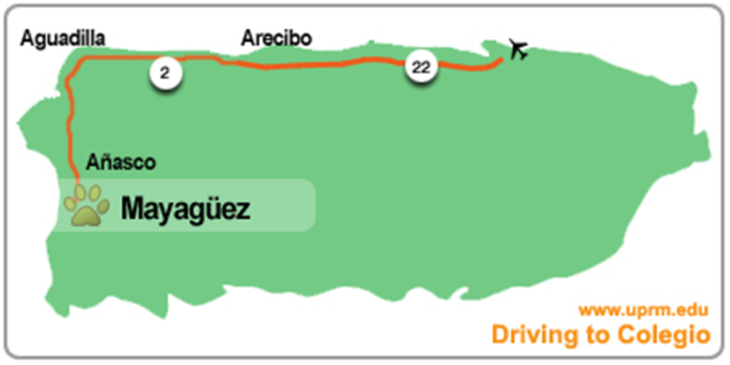
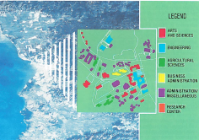
Location of Puerto Rico :
with in a frame of: φ =17°-50’N to 18°30’N & λ = 65°-00’W to 67°-30’W

Slide 5
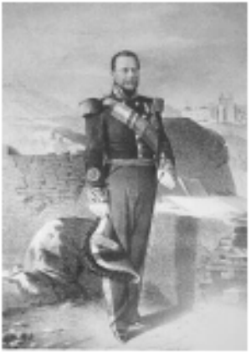
Land Surveying Profession in Puerto Rico
The “’Conde de Mirasol”’ Don Rafael Aristegui y Vélez, Governor and General Caption of Puerto Rico approved regulations on 1846 for “the Corps of Land Surveyors”.
1966: First Bachelor of Science in Surveying and Mapping in the island.
1978: The University of Puerto Rico – Mayagüez (UPRM) established the Land Surveying and Topography Program (Bachelor of Science) at the School of Engineering.
1988: Law 173, land surveying professionals must have a bachelor's degree in surveying from a recognized university and pass exams from the board of engineers and surveyors of Puerto Rico.
2018: At the present UPRM has conferred over 350 Bachelor of Science in Land Surveying and Mapping.
Don Rafael Aristegui y Vélez, Governor
and General Caption of Puerto Rico
from 1843 to 1847 aka “Conde de Mirasol”

Slide 6
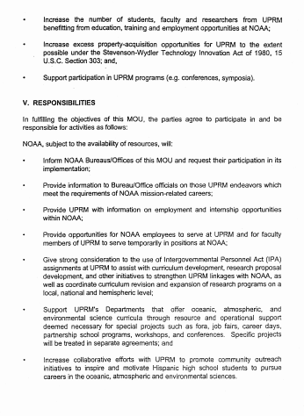
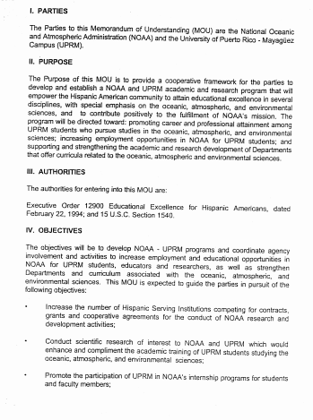
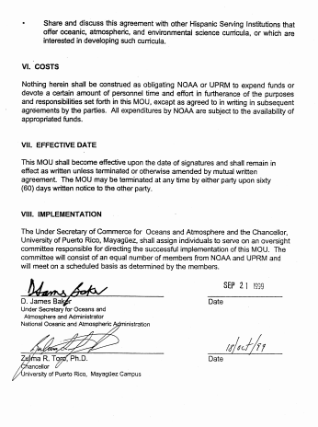
LET SEE IN SOME
DETAIL ARTICULES:
II. PURPOSE
III. AUTHORITIES
VII. EFFECTIVE DATE
VIII. IMPLEMENTATION

Slide 7
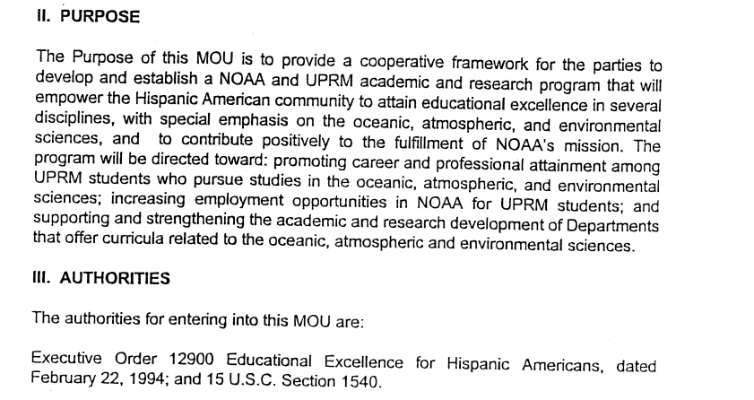
LET SEE IN SOME DETAIL ARTICULES:
II. PURPOSE
III. AUTHORITIES

Slide 8
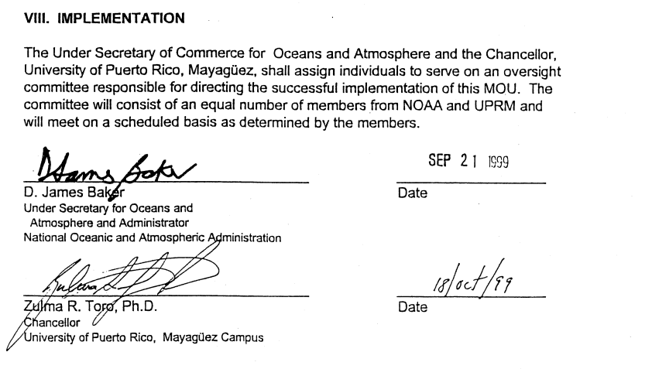
VII. EFFECTIVE DATE
VIII. IMPLEMENTATION

Slide 9
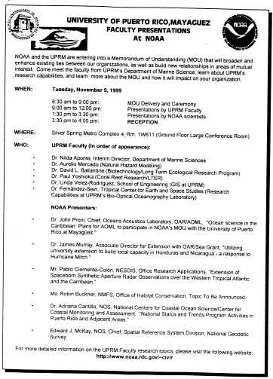
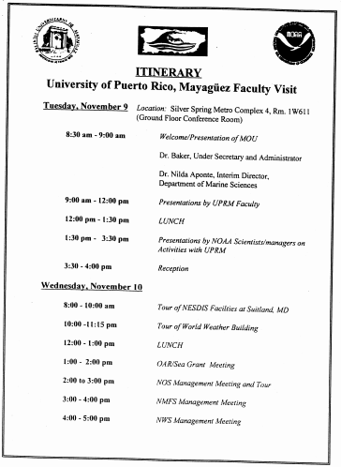
UPRM Faculty
Dr. Nilda Aponte
Prof. Aurelio Mercado
Dr. David L. Ballantine
Dr. Paul Yoshioka
Prof. Linda Velez-Rodriguez
Dr. Fernandez-Sein
NOAA Personnel
Dr. John Proni
Dr. James Murray
Mr. Pablo Clemente-Colon
Ms. Robin Buckner
Dr. Adriana Cantillo
Dr. Edward J. McKay

Slide 10
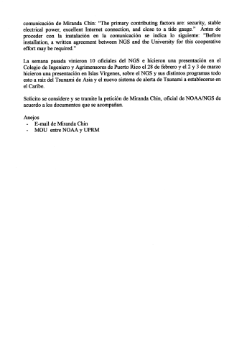
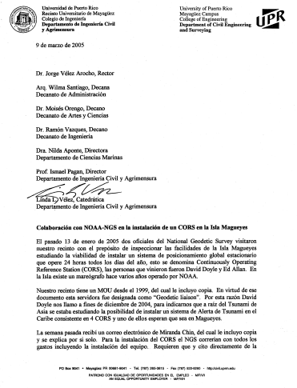
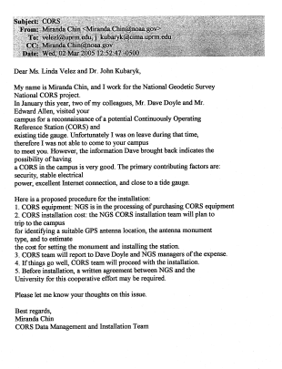
NOAA MAGUEYES ISLAND CORS REQUEST LETTERS March 9, 2005

Slide 11
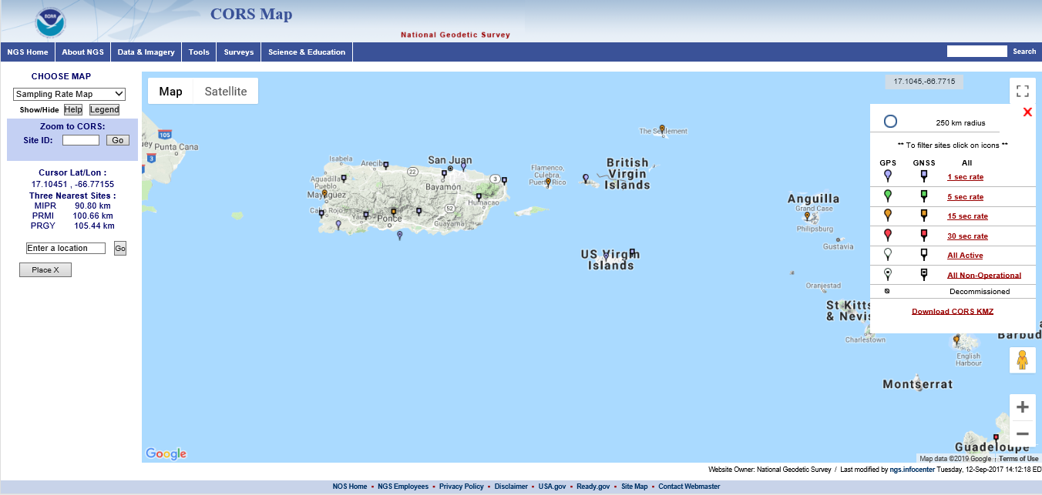
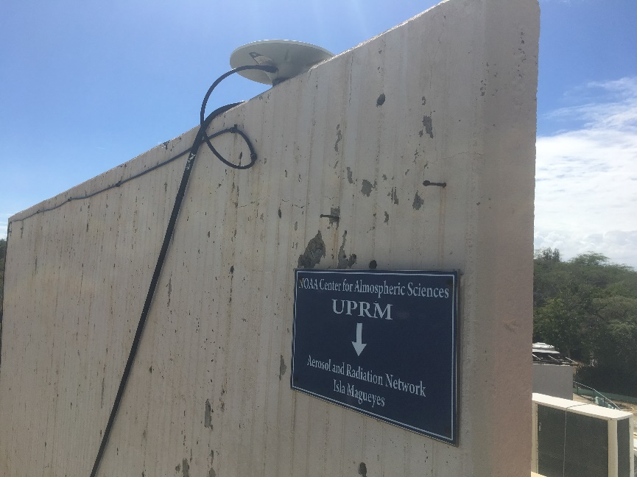

Slide 12
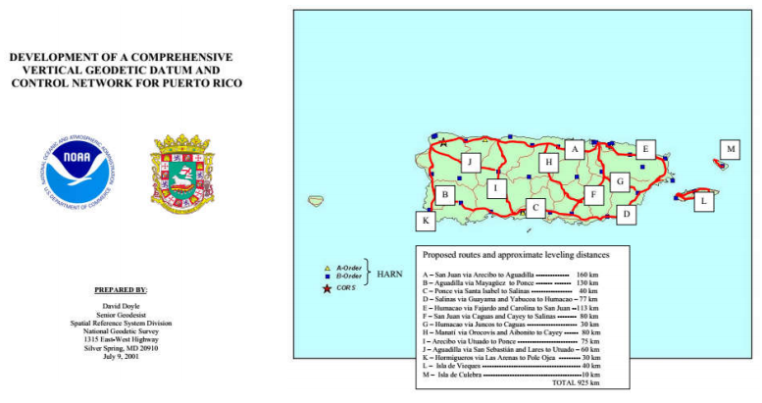
PUERTO RICO VERTICAL DATUM 2002 – PRVD 02 – PROPOSAL
( Cover Page and the map)

Slide 13
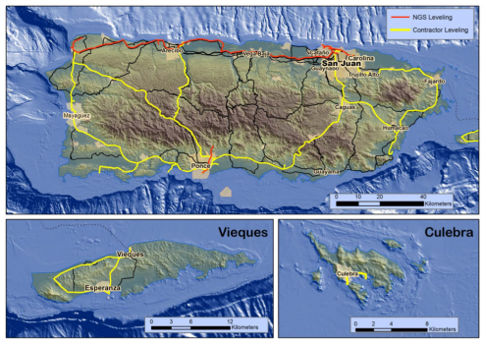
PUERTO RICO VERTICAL DATUM 2002 (PRVD 02) FINAL PROJECT

Slide 14
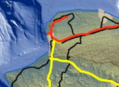
Vélez 2002 PID - DE5545
HORZ ORDER - B
NAD 83(2002)-
φ=18° 26’ 41.28060” N λ=67° 08’ 48.93357” W
SPC PRVI – N=267,825.241m E=124,618.857m
UTM 19 – N=2,040,399.173m E=695,701.034m
NAD 83(2011) Epoch 2010.00-
φ=18° 26’ 41.28162” N λ=67° 08’ 48.92893” W
SPC PRVI – N=267,825.272m E=124,618.993m
UTM 19 – N=2,040,399.206m E=695,701.169m
VERT ORDER - FIRST CLASS II
PRVD02 - 134.320meters 440.68feet

Slide 15
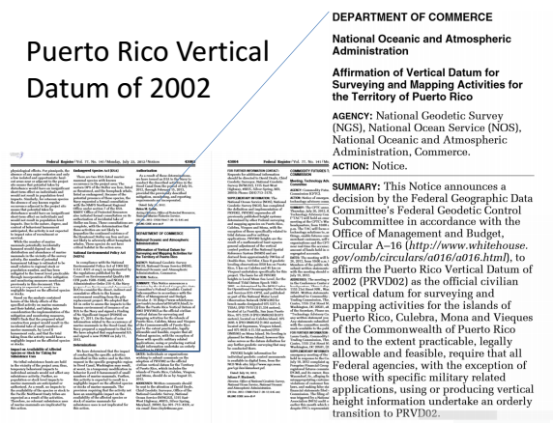

Slide 16
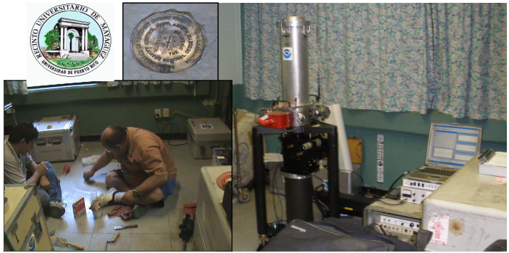
Gravity Observation on 2008 by Daniel Winester, Geodesist at NGS for 48 hours with an Absolute Gravimeter FG-5, with Juan A. Rodriguez, student

Slide 17
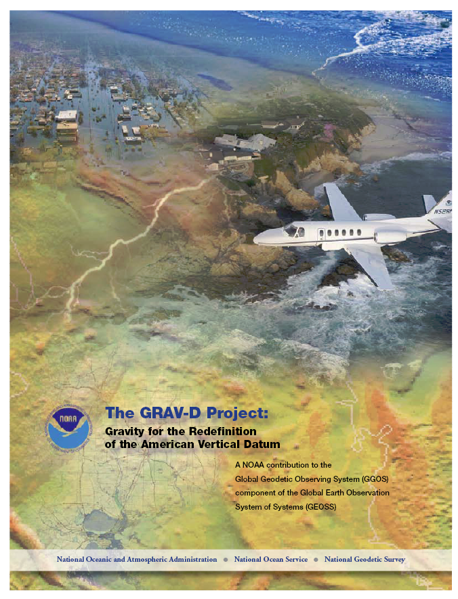
What is GRAV-D? A Plan (released Dec 2007)
Official NGS policy as of Nov 14, 2007
$38.5M over 10 years
Airborne Gravity Snapshot
Absolute Gravity Tracking
Re-define the Vertical Datum of the USA by 2017

Slide 18
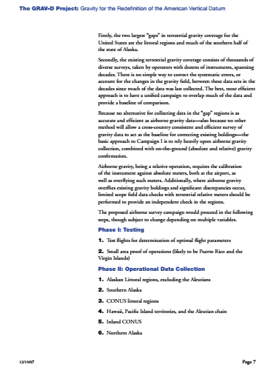
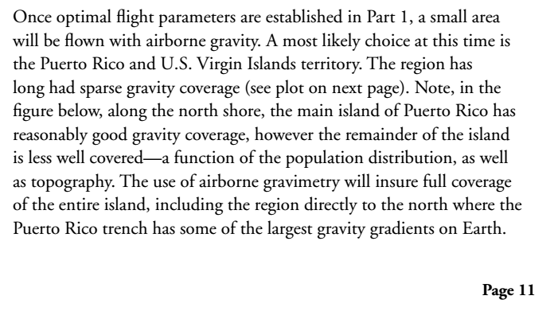
PAGE 7 AND PART OF PAGE 11

Slide 19
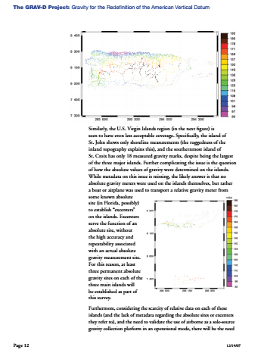
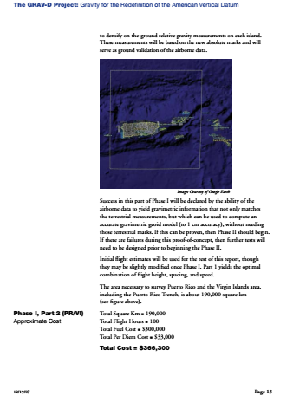
PAGES 12 AND 13

Slide 20
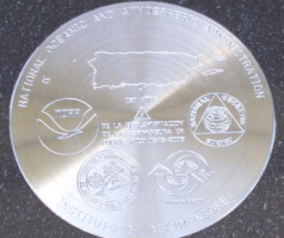
CoMmemorantive Mark of the 160 years of the regulation of land surveying iN PUERTO RICO (1846 al 2006) at the entrance of “Colegio de Ingenieros y Agrimensores de Puerto Rico” at SAN JUAN, PUERTO RICO
On 18 of November of 2006,
Prof. Linda L. Vélez, President of the Institute of Surveyors of CIAPR with Ingeniero Juan Pérez, President of Colegio de Ingenieros y Agrimensores de Puerto Rico (CIAPR), during the activity.
The mark was donated by
NOAA-NGS

Slide 21
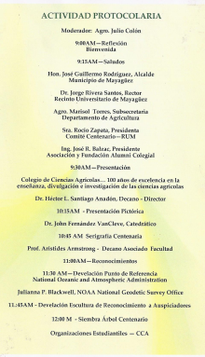

Slide 22
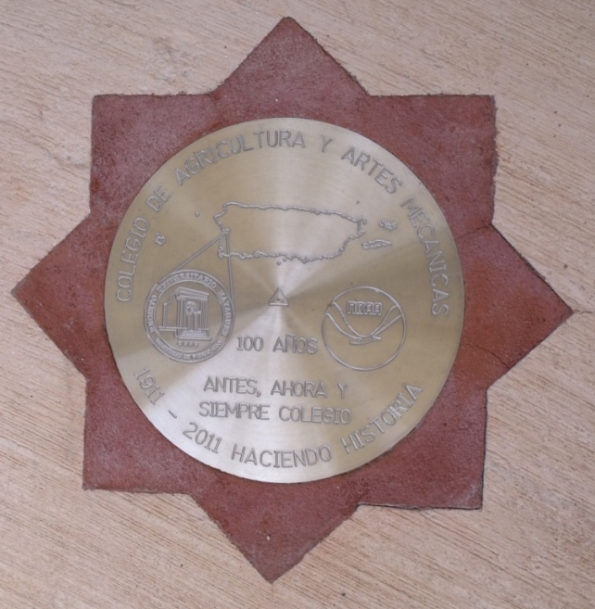
CENTENNIAL MARK OF THE UNIV. OF PUETO RICO aka “Colegio de Agricultura y Artes Mecanicas 1911-2011
On 23 of September of 2011,
Julianna P. Blackwell, Director of NOAA National Geodetic Survey” (NGS) with Dr. Jorge Rivera Santos, Chancellor Discovery the Mark.

Slide 23
News at the National Geodetic Survey Web Page www.ngs.noaa.gov

Slide 26
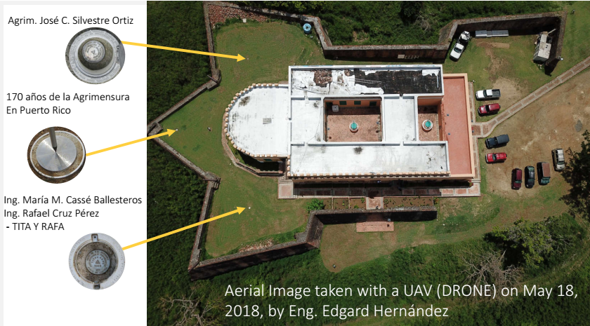

Slide 27
About the Research, Education and Outreach Projects
NOAA’s Electronic Navigational Charts – 2006
Tidal Stations and Bench Marks: Tools for spatial information managements - since 2006 to present
Puerto Rico LTAP Center – www.uprm.edu/pr2
CoHemis and PRYSIG – www.cohemis.uprm.edu/
MEGA VIERNES CIVIL – www.megaviernes.com/
CariCOOs - Caribbean Coastal Observing System
NOAA-CREST
Pueto Rico Sismic Network
PR Component of NTHMP-TsunamiReady ® Program

Slide 28
NOAA’s Electronic Navigational Charts
Project: NOAA’s Electronic Navigational Chart (ENC)
Validation Initiative
Location: Coast of Ponce, Peñuelas and Guayanilla
Petitionary: National Geodetic Survey, Remote Sensing
Division
Date: November through December 2006
Work: GPS Control Points
Applications: Update Navigational Charts and GIS of Area

Slide 29
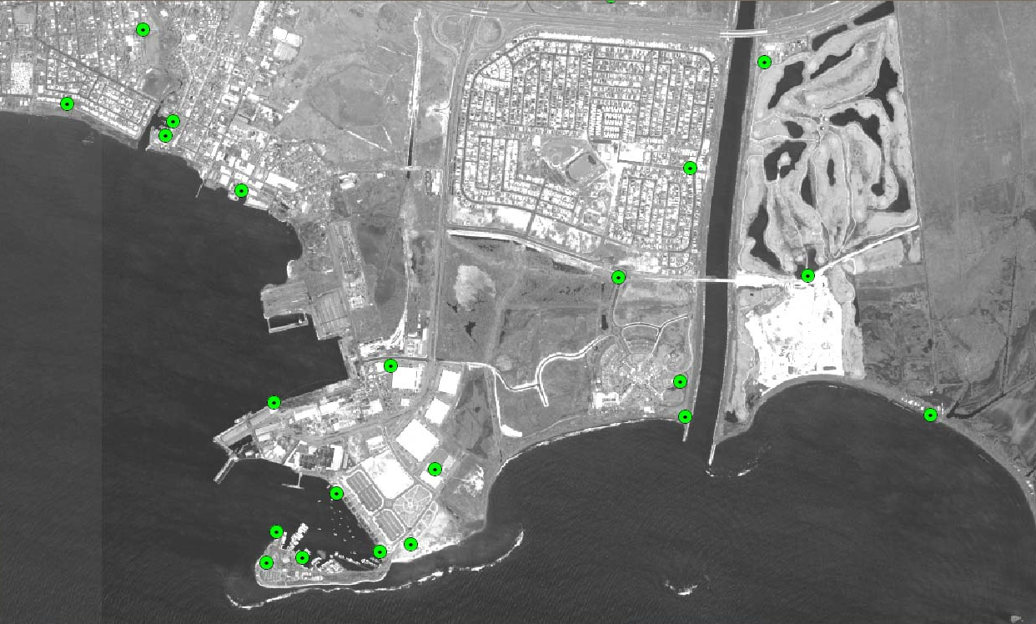
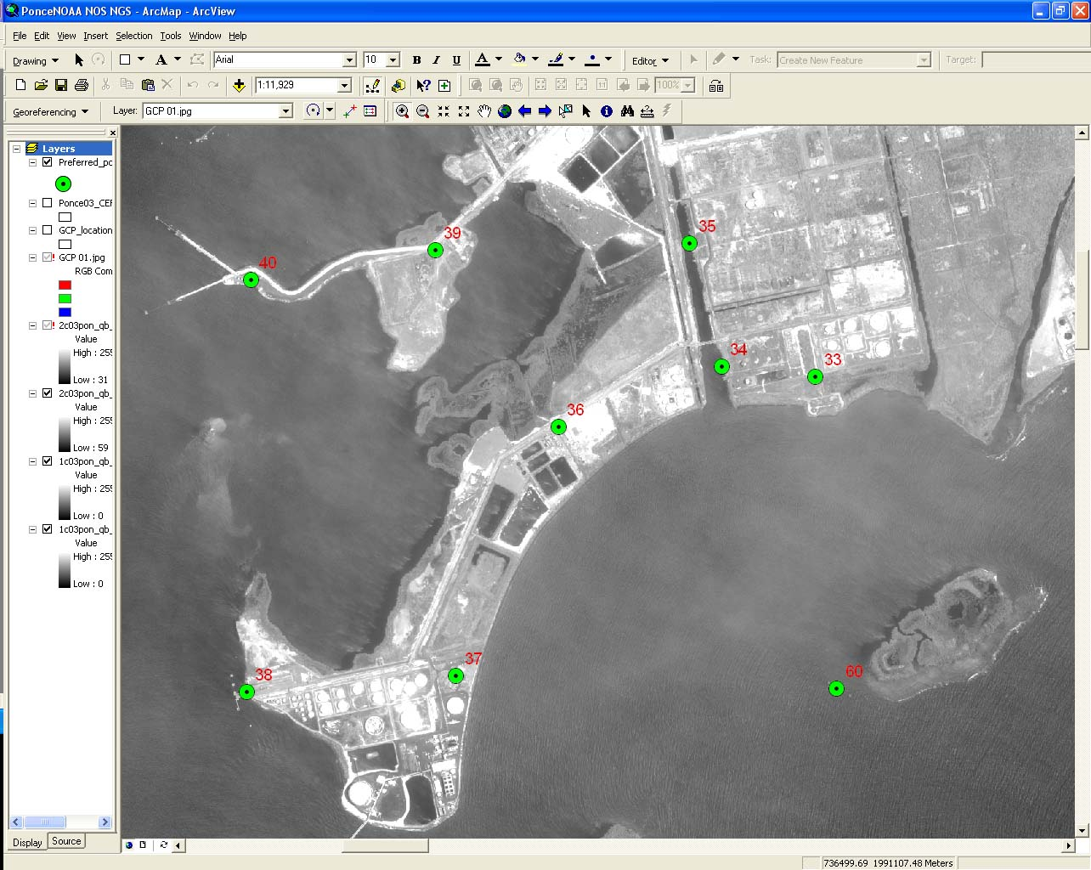
NOAA Electronic Navigational Charts Validation Initiative
NOAA Needed Ground Control Points with GPS Observations for Geo-Referencing Purposes
Guayanilla, Puerto Rico
Port of Ponce, Puerto Rico

Slide 30
NOAA Electronic Navigational Charts Validation Initiative
Each Ground Control Point had been Identified
With a Total of 60 Points
Points in Docks at Guayanilla Bay

Slide 31
NOAA Electronic Navigational Charts Validation Initiative
Coordinated Access with Different Land Owners, Private Companies and Local Agencies Essential
PT 60

Slide 32
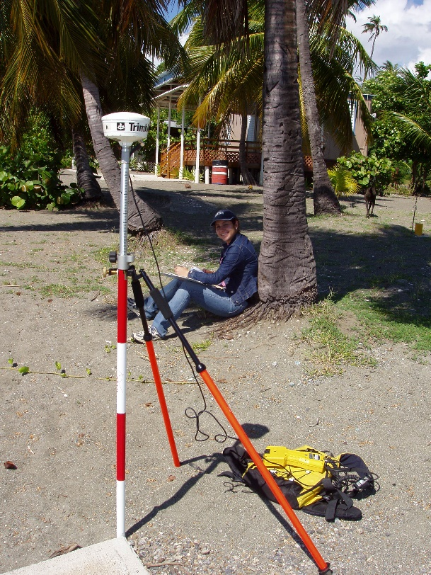
NOAA Electronic Navigational Charts Validation Initiative
GPS Data Collection with PRO-XR of Trimble
Morning
Noon
Night

Slide 33
NOAA Electronic Navigational Charts Validation Initiative
Points had to be Photographed and Sketched
Photograph
Sketch

Slide 34
NOAA Electronic Navigational Charts Validation Initiative
After Being Post Processed these would be Used for Geo-Referencing Purposes
San Diego, CA: IKONOS image registration before geo-referencing. The image and nautical chart (green lines) are not accurately registered.
San Diego, CA: IKONOS image registration after geo-referencing. The image and nautical chart (green lines) are accurately registered.

Slide 35
NOAA Electronic Navigational Charts Validation Initiative
Conclusions
Highly Accurate Electronic Charts will be a Primary Cornerstone of a Safe and Efficient Marine Transportation System
Mariners will become Increasingly Dependent on Electronic Charts for Route Planning and Transit Monitoring in Congested Waters

Slide 36
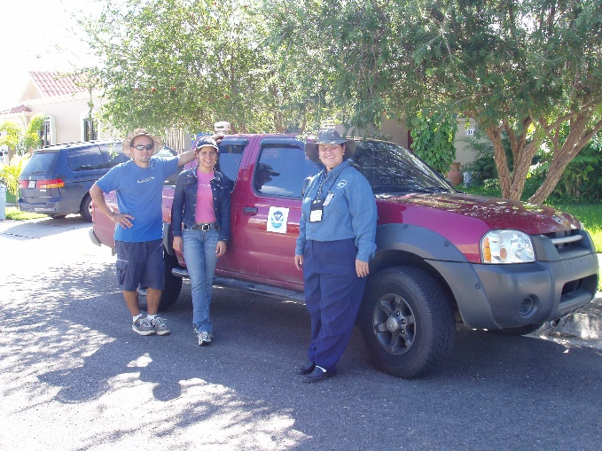
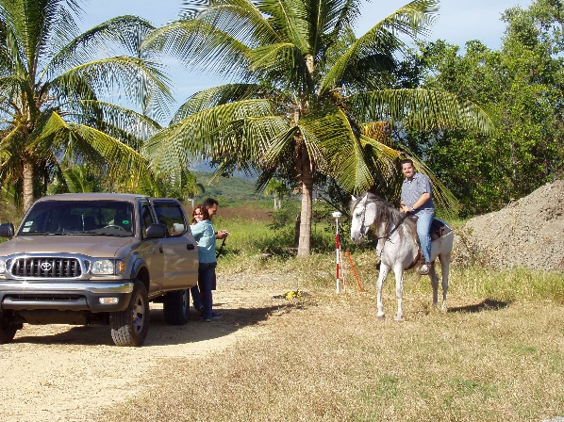
NOAA Electronic Navigational Charts Validation Initiative
Special thanks to People who Collaborated in this Project in any way

Slide 37
NOAA Electronic Navigational Charts Validation Initiative
Special Thanks to NOAA for the Opportunity to be a Partner of and be able to Transmit this Experience to Others

Slide 38
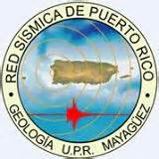
Tidal Stations and Bench Marks: Tools for spatial information managements
The Puerto Rico Seismic Network (PRSN) at the Geology Department with in the College of Arts and Sciences of the University of Puerto Rico at Mayagüez, installed a Puerto Rico Tsunami Ready Tide Gauge Network which will include 6 tsunami ready tide gauge stations and a central receiving station.
All sites fulfilled the requirements of the National Oceanographic and Atmospheric Administration (NOAA), National Ocean Service (NOS), Center for Operational Oceanographic Products and Services (CO-OPS) network and follow the guidelines of the National Tsunami Hazard Mitigation Program.
The Land Surveying Program personnel Level and Monument the tide gauge stations are according to NGS standards so that the data of the tide stations are incorporated into the systems of NOS and other agencies. This is very important because it will provide quality control for the data.

Slide 39
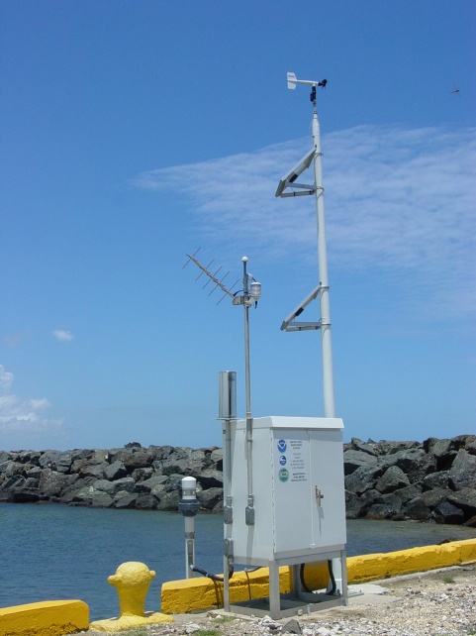
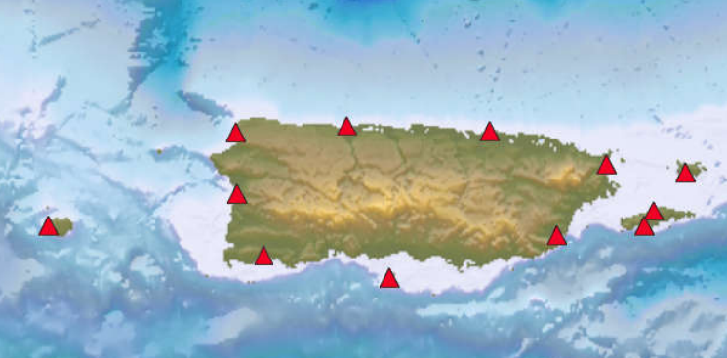
NOAA and PRSN - Puerto Rico Tide Gauge Network at 2006 :
The six Tidal Stations of
the PRSN are at: 1-Mayaguez,
2-Arecibo, 3-Fajardo, 4-Yabucoa,
5-Peñuelas, and 6-Vieques

Slide 40
Puerto Rico Tide Gauge Network at 2014:
The six Tidal Stations of the PRSN are at 2014:
1-Aguadilla,
2-Arecibo,
3-Fajardo,
4-Yabucoa,
5-Caja de Muertos
6-Vieques

Slide 41
Puerto Rico Tide Gauge Network after Hurricane Maria - September 20, 2017:
The six Tidal Stations of the PRSN at 2014 were reduced to 3:
1-Aguadilla,
2-Arecibo,
3-Fajardo,
4-Yabucoa,
5-Caja de Muertos,
6-Vieques

Slide 42
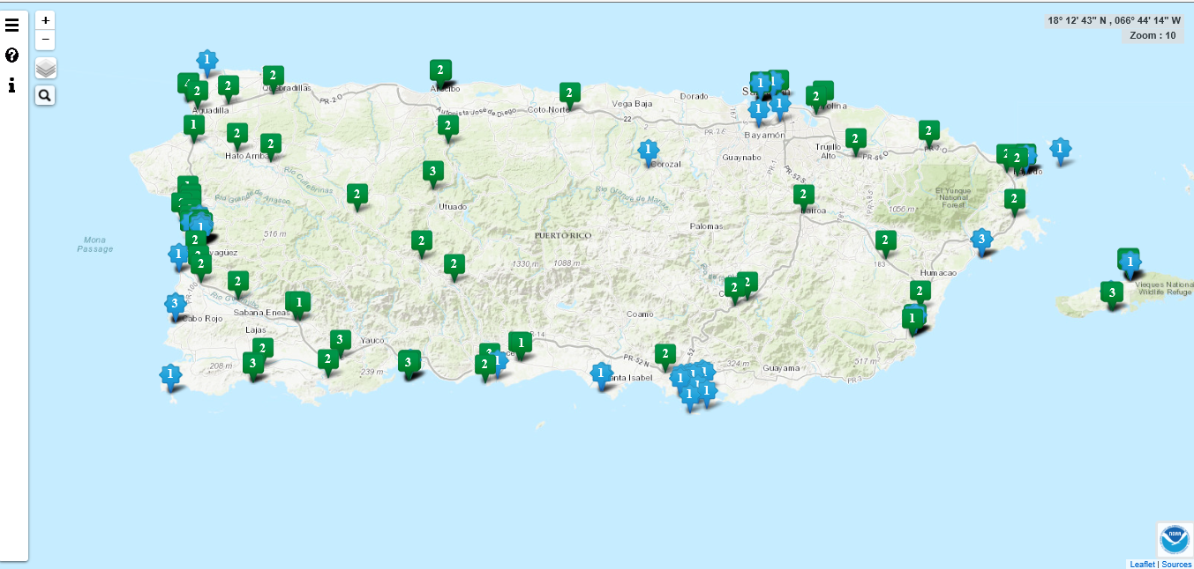

Slide 43
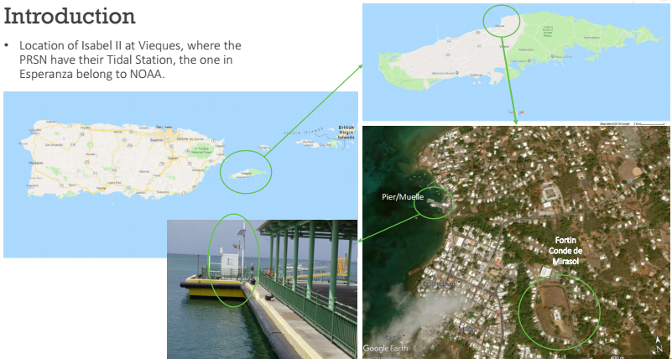
2018 Leveling at Isabel II, Vieques
Leveling Party: Jon Rivera, Carlos Huerta,
Marcos Vélez, Roberto Caraballo, Kiarimar
Class, and Linda Vélez

Slide 44
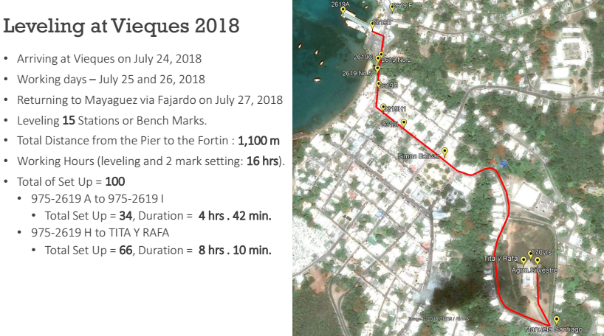
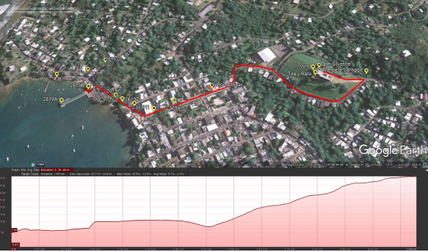
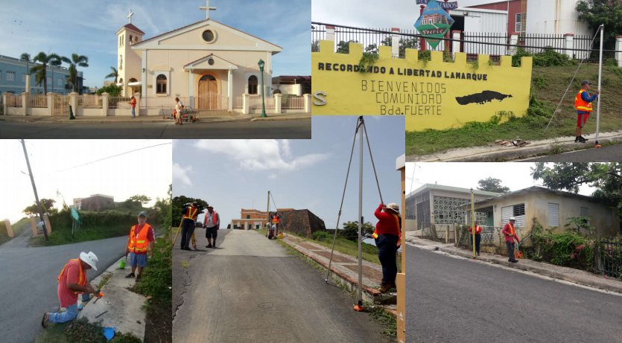
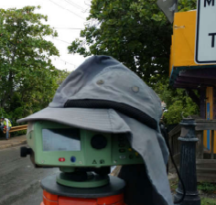

Slide 45
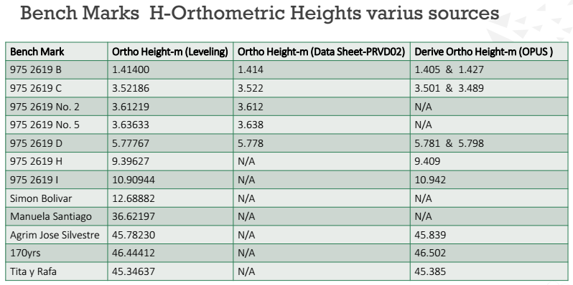

Slide 46
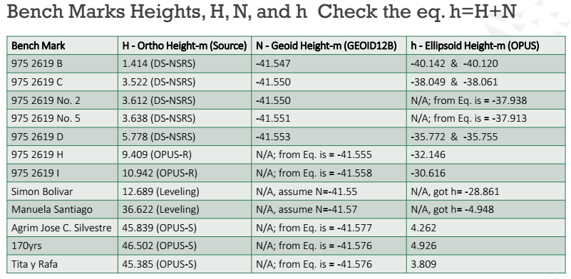

Slide 47
PRYSIG is an annual meeting, since 2003 to present
Remote Sensing and GIS projects

Slide 48
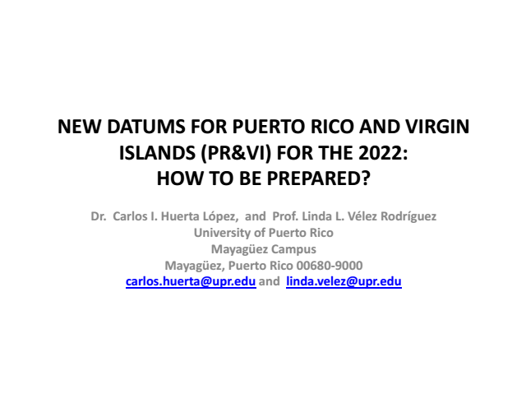

Slide 49
Visit this web site for the
presentations of this year and
a video summary of last year
http://megaviernes.com/

Slide 50
CariCOOs: Caribbean Coastal Observing System http://www.caricoos.org/drupal/

Slide 52
Education and Outreach activities of the PRSN
Open House at University of PR in Mayagüez
Informative Panel at the EcoExploratorio
Science Museum

Slide 53
Hurricane Hunters in Aguadilla, April 13th , 2019

Slide 55
PR Component of NTHMP-TsunamiReady ® Program
In PR, 45 TsunamiReady communities have been recognized by the NWS under the TsunamiReady Program guidelines that include a 24/7 local tsunami focal points, evacuation and inundation maps, evacuation routs and signage installed, establish an educational program and to elaborate response plans.
The National Tsunami Hazard Mitigation Program (NTHMP) vision is reduced loss of life and property when a tsunami strikes any U.S. state or territory. The main goal is to prepare government agencies, emergency managers and coastal communities about the tsunami hazard.
In PR the NTHMP funds for the TsunamiReady program are administrated by the Puerto Rico Seismic Network (PRSN) from UPRM (NA18NWS4670077).
To accomplish this mission PRSN work in collaboration with federal, state and municipal agencies, as well as communitarian leaders.
The Puerto Rico Emergency Management Agency (PREMA) has a sub award to help and support PRSN in the TsunamiReady program (NA17NWS4670014).
www.redsismica.uprm.edu/tsunamiready

Slide 56
PR Tsunami Evacuation Zones and Alert Messages
The yellow polygon are the exposed areas that need to be evacuated if a Tsunami Warning is issued.
PRSN

Slide 57
Tsunami
Evacuation Map
Example

Slide 58
Puerto Rico TsunamiReady Recognition
June 2016
Notes:
20050-02016 = 11 años lograr que todo PR fuera reconocido TR.

Slide 60
THANKS

