Slide 1
Case Study and User Perspective National Park Service Assateague Island
Neil Winn
GIS Specialist
Assateague Island National Seashore

Slide 2
Overview
Show spatial data collection/analysis examples
Case Study: Assateague Island National Seashore
Demonstrate how the NPS has applied NAD83 2011 (2010.0)
Demonstrate how the NPS is preparing NATRF2022
Identify what we need from the NGS to succeed

Slide 3
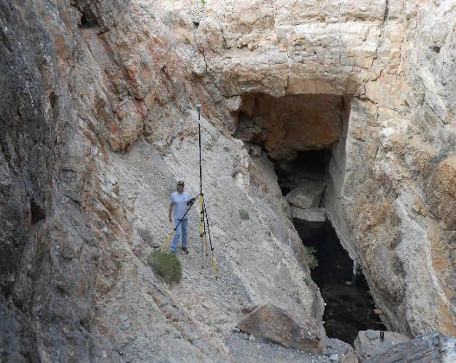
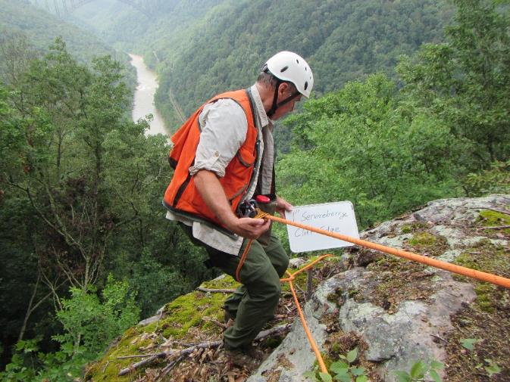
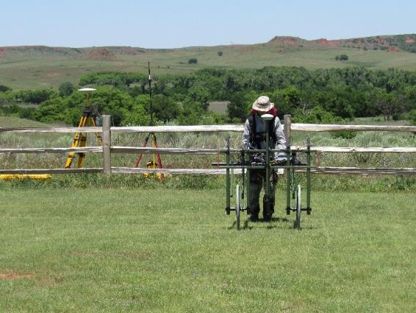
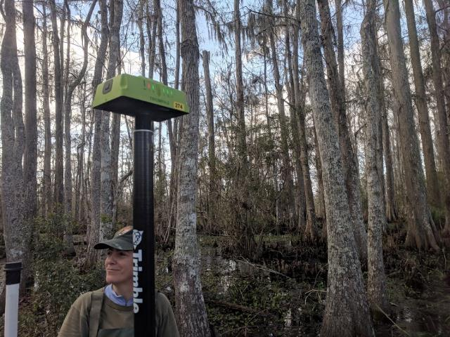
Death Valley National Park (Devil’s Hole) - Nevada
New River Gorge National River – West Virginia
Washita Battlefield National Historic Site - Oklahoma
Jean Lafitte National Historical Park and Preserve - Louisiana
Notes:
Every National Park Service presentation seems to need pretty photos. Here are some examples of field staff doing things that require some level of positioning accuracy.

Slide 4
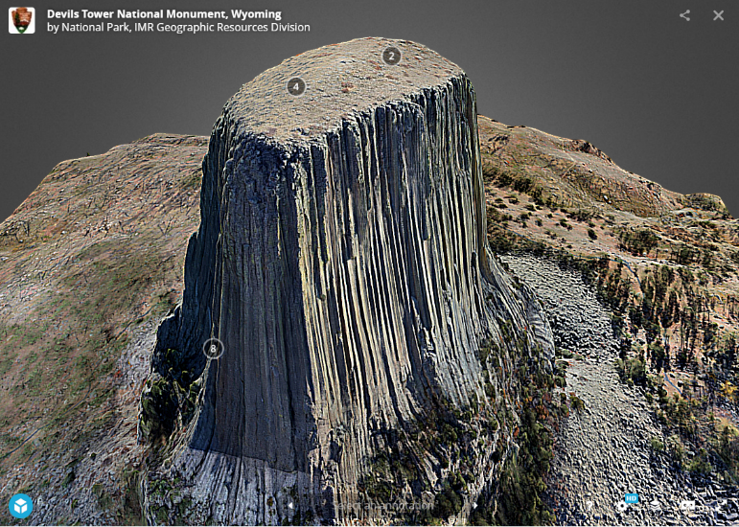
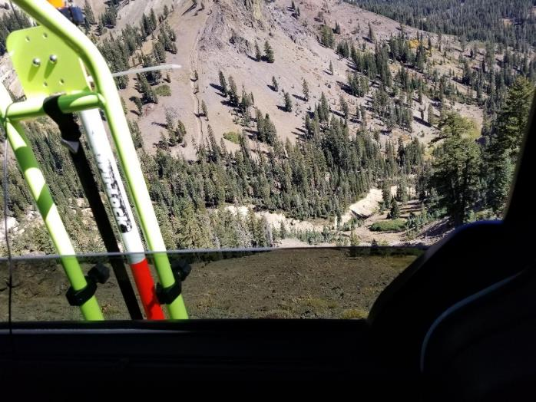
Devil’s Tower National Monument, WY
https://skfb.ly/6HITD
Lassen Volcanic National Park, CA
Notes:
This is a reminder that while focusing on the single dataset of the Assateague Island shoreline monitoring program there is a huge variety of other applications throughout the National Park Service. With the increasing ease to collect precise positions proving accuracy to a particular reference frame is even more critical. Examples: Devil’s Tower National Monument 3D model uses OPUS to refer to NAD83 2011 (2010.0) and NAVD88 (Geoid12B). The second photo comes from setting up high accuracy snow plowing at Lassen Volcanic National Park. Just on the other side of that window is a very, very large drop.

Slide 5
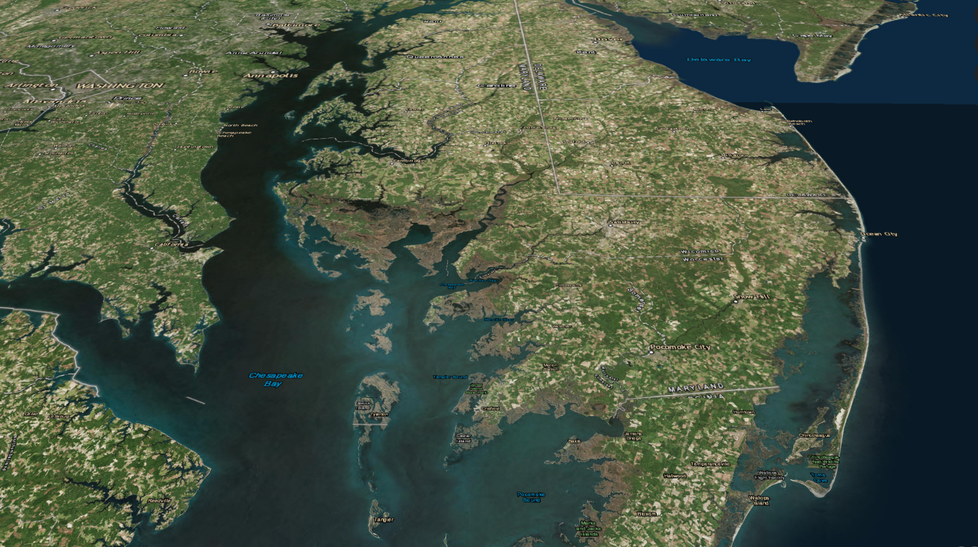
Assateague Island National Seashore
Notes:
Overview of the Delmarva peninsula indicating Assateauge Island outlined in red. Assateague Island is a barrier island that continuously changes. This presentation highlights the shoreline monitoring aspect of that program.

Slide 6
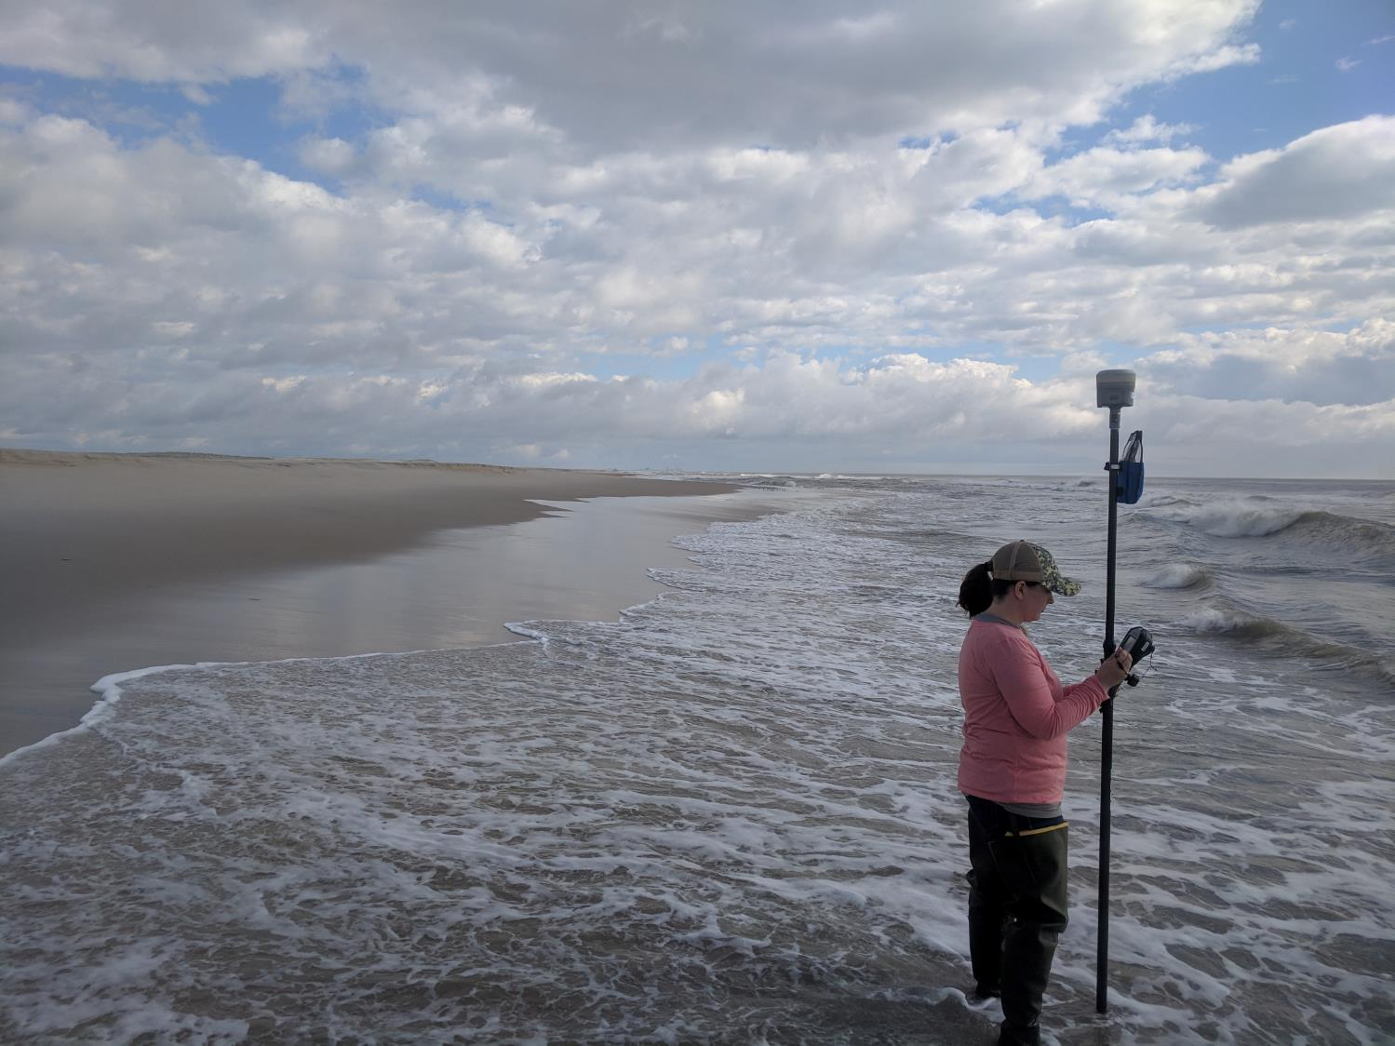
Topographic Profiles
Notes:
Cross-island topographic profiles are collected Spring and Fall annually. These datasets help determine three dimensional changes to the barrier island.

Slide 7
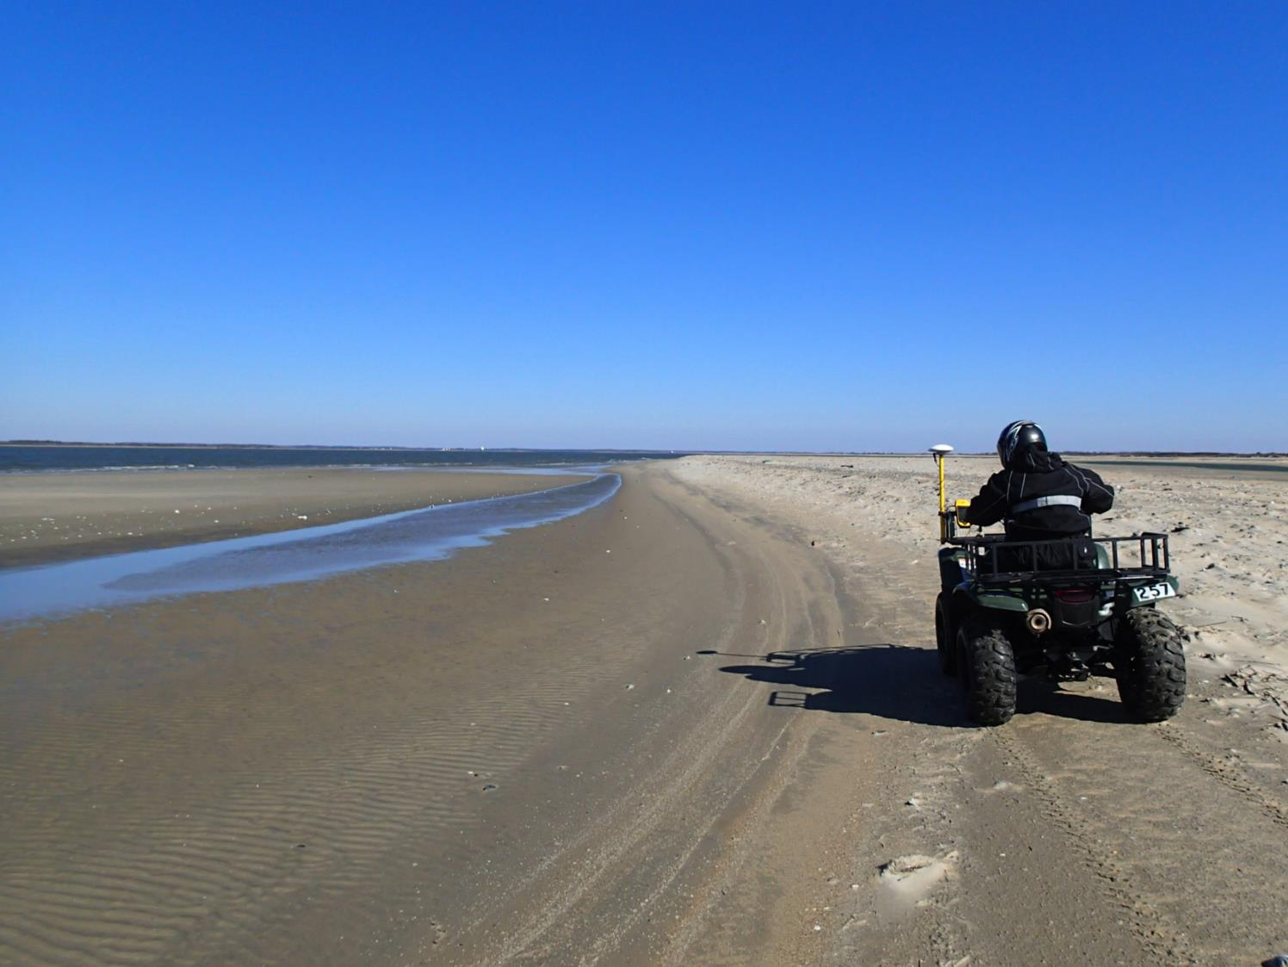
Shoreline Monitoring
Notes:
The focus of this presentation is the oceanic shoreline monitoring aspect of the program. Every Spring and Fall park the approximate MHT shoreline is mapped using an ATV with sub-meter GNSS. This program has been in place since 1996 and has provided invaluable information that aids park management in managing park assets. For a recent example, Assateague Island National Seashore is currently going through the process of moving campsites to a sustainable location that will hopefully remain for 25 years.

Slide 8
Notes:
The GNSS-derived shoreline datasets are used to determine trends like this one showing rate of shoreline change per year. The island varies in stability and predictability.

Slide 9
Notes:
Zooming into a single site like the one above shows a good example of what the shoreline positions look like over time. This specific transect is a good example because it has a strong trend. Since the beginning of surveying in 1996 this particular site has eroded approximately 30 meters. The purpose of this slide is to show that in order to compare shorelines and develop a trend all positions need a common reference. The declared sub-meter accuracy is critical for a shorter-term dataset and even more critical where the shoreline wouldn’t have such a strong trend.

Slide 10
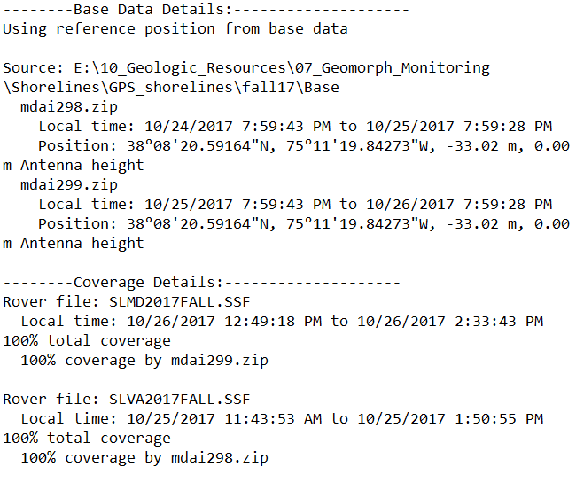
Maintaining Data Accuracy: 1996-2016
Trimble Pathfinder Office
Post-processed Differential Correction
Sub-meter Accuracy
Relative to CORS Datum
NAD1983 (Whatever)
2014 Update
Reprocess all data
NAD1983 2011 (2010.0)
Begin occupying passive control as a requirement
Notes:
The method for keeping these shoreline datasets has varied. From 1996-2016 all data were collected using Trimble Pathfinder Office Software. During this time the post-processed datum changed. In 2014, all shoreline datasets were reprocessed to be consistently referencing NAD1983 2011 (2010.0).

Slide 11
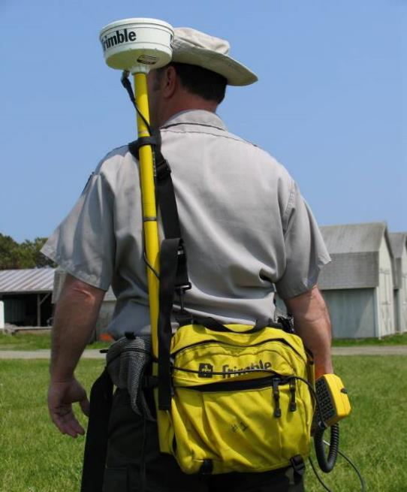

Slide 12
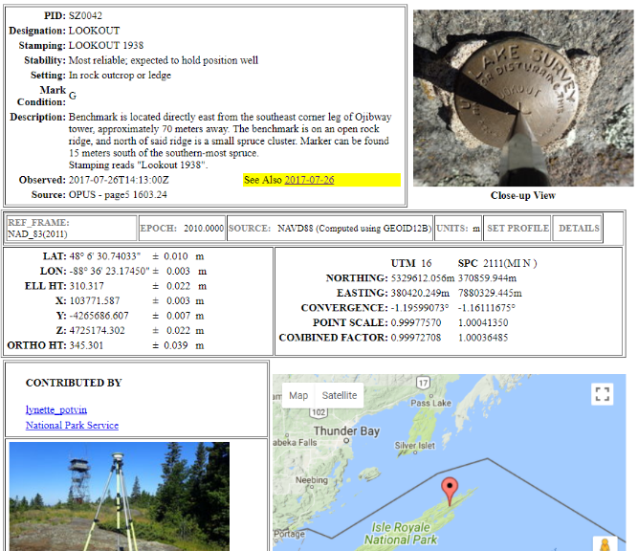
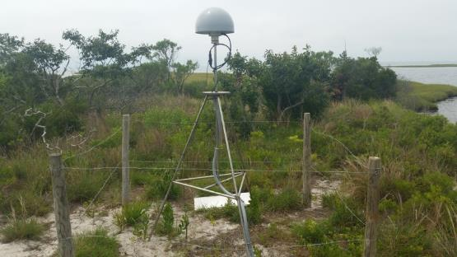
Maintaining Data Accuracy: 2016-Present (2019)
Trimble Access or ESRI Collector
RTK Streaming via NTRIP
NAD1983 2011 (2010.0)
ALWAYS check-in on a control mark
Notes:
Starting in 2016, the geomorphological program implemented NTRIP streaming to maintain accuracy. The streaming source (CORS MDAI) references NAD83 2011 (2010.0). Every survey is not required to occupy an OPUS-shared control mark to prove its accuracy.

Slide 13
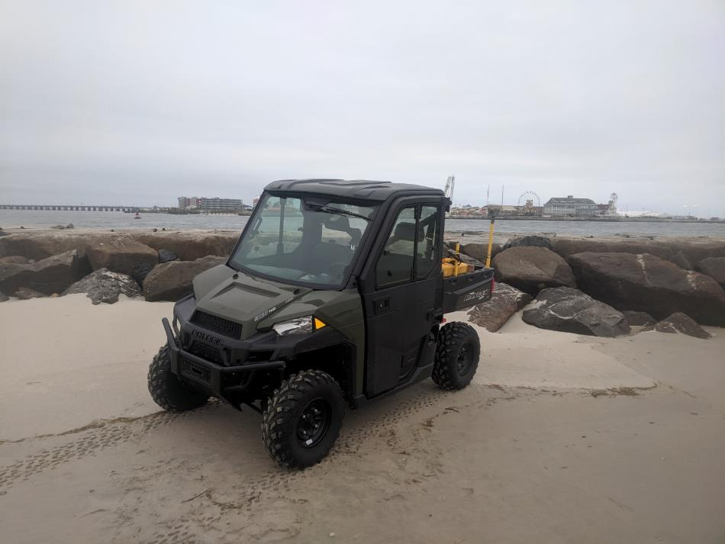

Slide 14
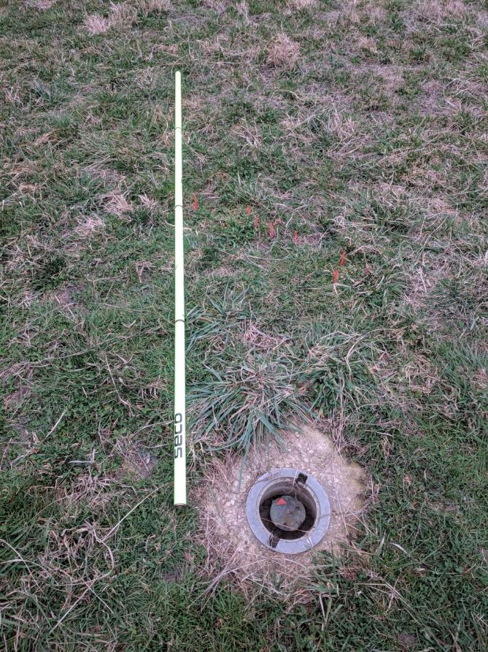
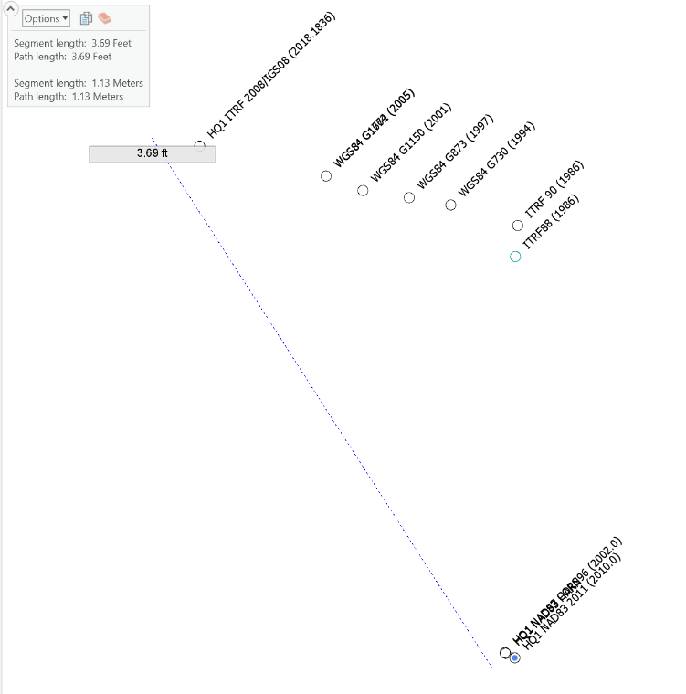
Reference Frame Comparison
Assateague Island National Seashore - Maryland
WGS84 Gxxxx
2.0 Meters
ITRFxx YYYY.yyyy
Datum Conversion Source: HTDP
NAD83
Notes:
Various streaming services are starting to make this complicated:
With the improved wide availability of high-precision data the control of accuracy has become a more difficult task. There are a lot of options for spatial datum reference from positioning sources. For this individual point (2010ASISHQ1) datum differences between a variety of reference frames are displayed on the ground. At Assateague Island National Seashore in Maryland this spread of potential datum references is generally around 1m horizontally. The image represents the real-world display of these points alongside a 2.0 meter survey rod. It’s critical to understand the datum differences and more so what a correction service might be offering. For example, a streaming RTK connection might broadcast 2cm precision data in NAD83 2011 (2010.0) but a satellite-based augmentation system might broadcast 4cm precision data in ITRF2008 (2018.72). Both very precise but not different by around 1 meter (in Maryland).

Slide 15
How is the National Park Service preparing for NATRF2022?
Ask software manufacturers how they are preparing
Complete NGS OPUS Shared Solutions
Updating solutions post-NATRF2022 release
Bonus: Improves transformation NAD83 ->NATRF2022
Training in accurate geodetic mapping.
In need of “How to Prepare for NATRF2022” training
That’s it!
Notes:
The National Park Service relies on software to do geography. We need our software to solve these problems for us. The recent history with our vendors is not great but field staff understand the workarounds to ensure accuracy to NAD83 2011 in many cases. The real truth is that a lot of our people are just lucky that their data collection has been consistent. We will check our work on OPUS Shared solutions. We will also, where possible, update OPUS solutions over time to gain confidence in the mark and improve velocity models. We have no other known way to prepare for NATRF2022. I hope that’s okay.

Slide 16
What we need from the NGS
Reference Epochs
See Blueprint for 2022, Part 3 (Thank you NGS)
Remember that GIS users are a very large user group and are accurately accessing the NSRS
Ensure vendor software can accurately reference/transform to NATRF2022
Help us prove those transformations work
Example: Streaming GIS services for passive control
Improved access to the NOAA CORS Network
OPUS for RTK
Streaming CORS
Maybe limited to Foundation CORS?
Notes:
We need a NATRF2022 Roadmap from the National Geodetic Survey. This needs to include how GIS users can use the NSRS. GIS users regularly adhere to the National Spatial Reference Frame even though they do not use Rinex files, OPUS, or fourtran. We also need the NGS to ensure our vendors are able to accurately reference the NSRS and adjust accordingly. Though the NGS may not be able to restrict software use there should be a way to approve if software is capable or, from an outside approach, prove that a particular transformation works. The NGS should consider streaming services for passive control (i.e. IDB or OPUS-shared). This will be difficult, but if the NGS can’t apply accuracy to GIS it’s likely that no one else will be able to either.

Slide 17
Contact Info:
Neil Winn
neil_winn@nps.gov

