Slide 1
GEOCON and GEOCON11 (beta)
Transformation grids for latest realizations of NAD 83
GEOCON: NAD 83 “HARN” ←→ NAD 83(NSRS2007/CORS96)
GEOCON11: NAD 83(NSRS2007/CORS96) ←→ NAD 83(2011)
Both horizontal AND “vertical” (i.e., ellipsoid height)
1 arc-minute spatial resolution
Include output that indicates “quality” of transformation
Quantified using station within grid cell that is worst match with model
Complication: Some states have > 1 HARN realization
Beta release only uses Bluebook format as input/output
Difficult to use because format not readily available
Will provide more flexible input and output soon

Slide 2
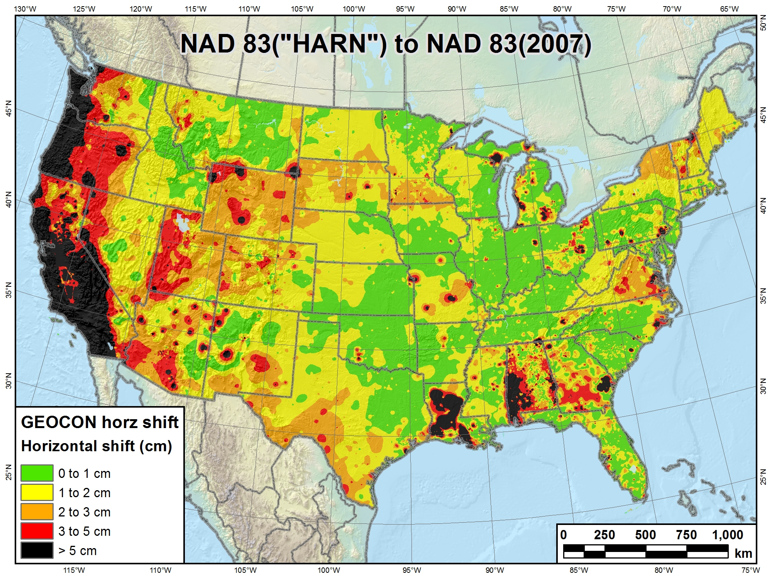
GEOCON and GEOCON11 (beta)

Slide 3
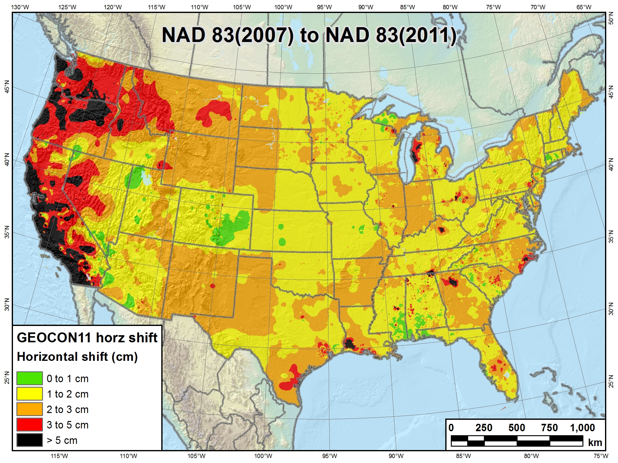
GEOCON and GEOCON11 (beta)

Slide 4
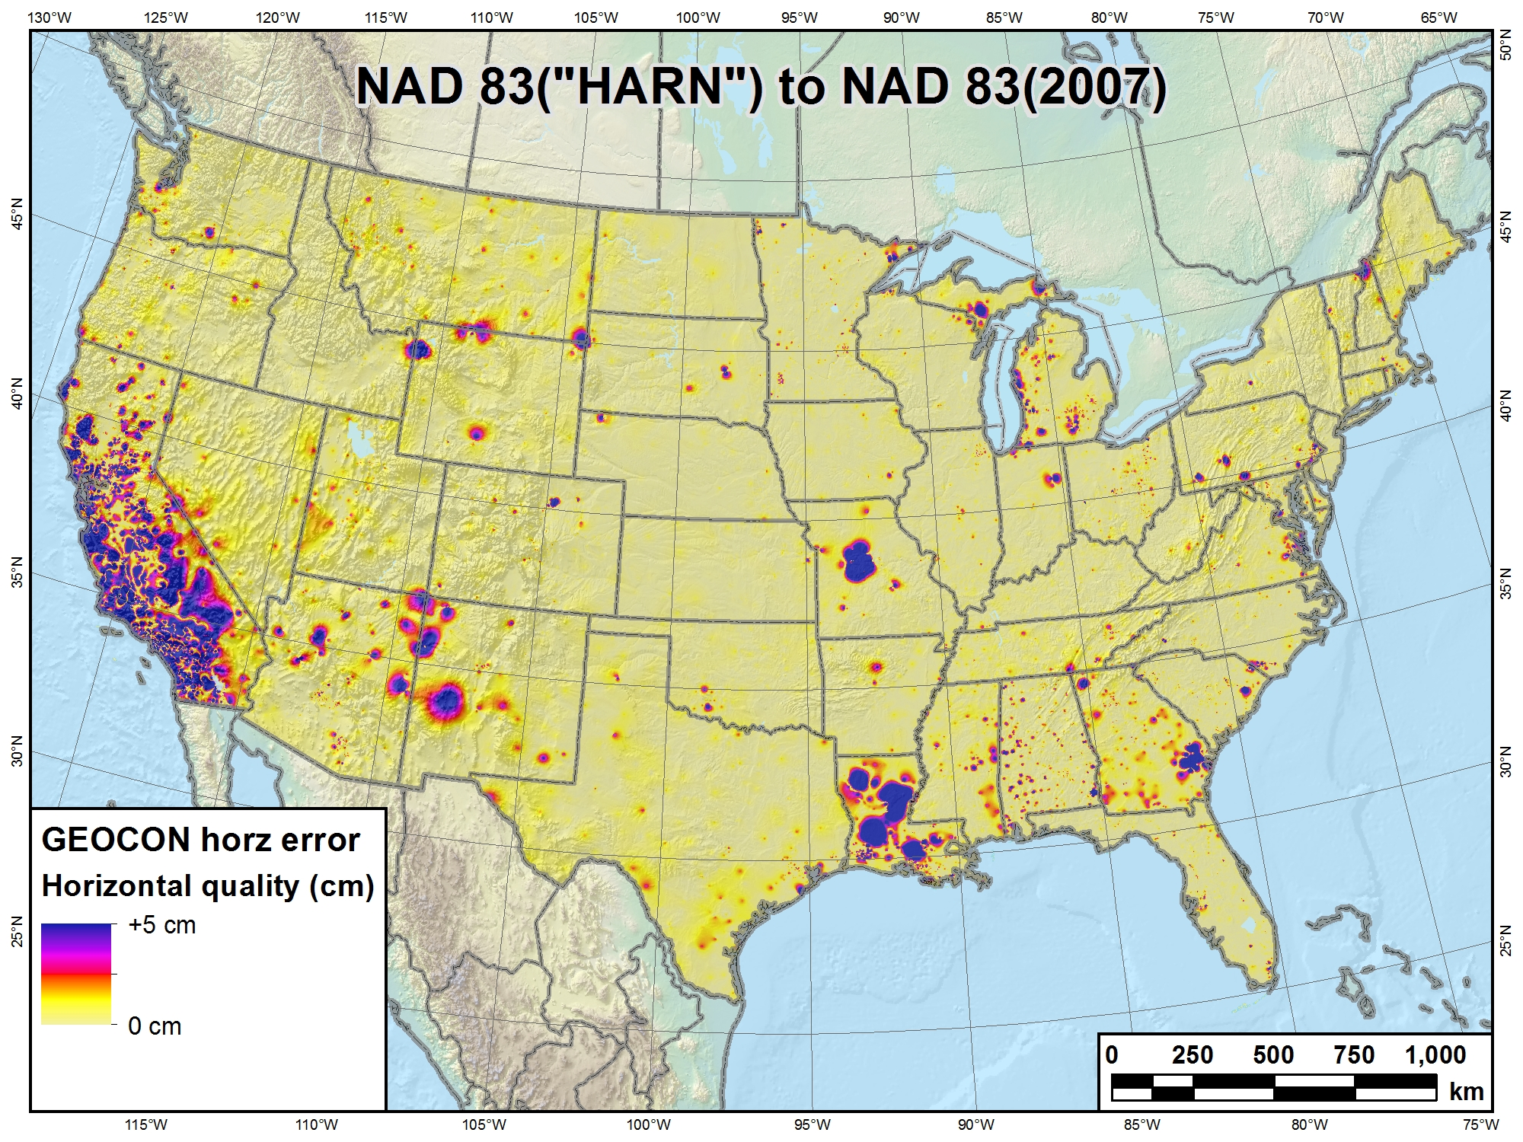
GEOCON and GEOCON11 (beta)

Slide 5
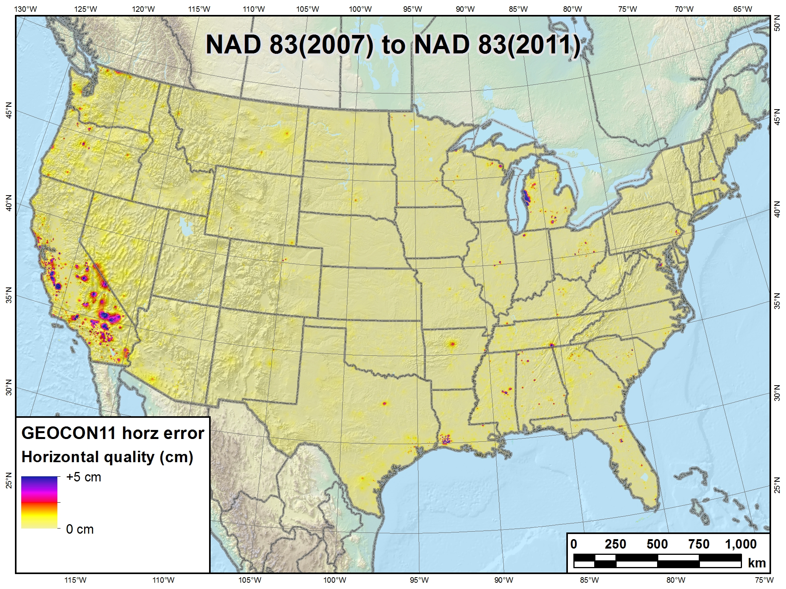
GEOCON and GEOCON11 (beta)

Slide 6
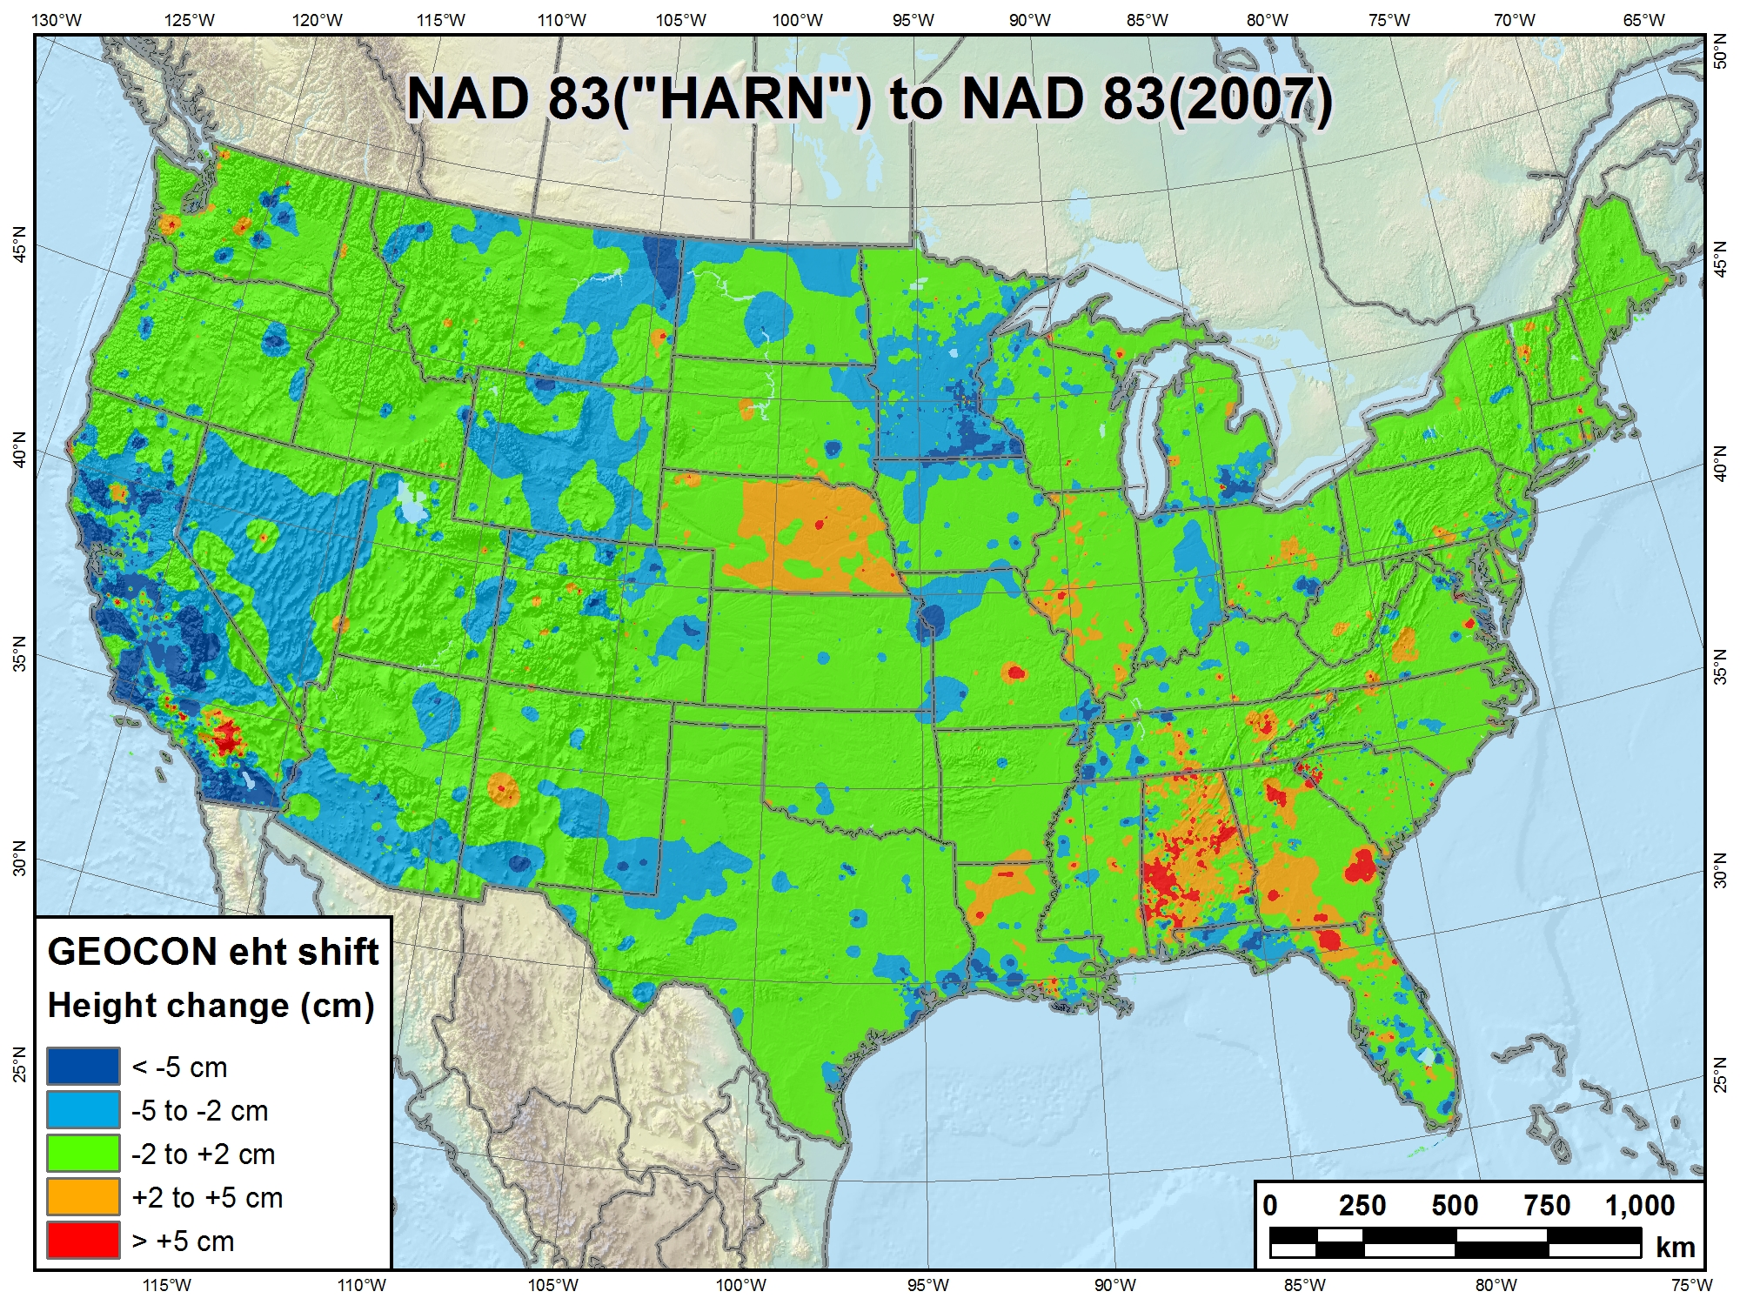
GEOCON and GEOCON11 (beta)

Slide 7
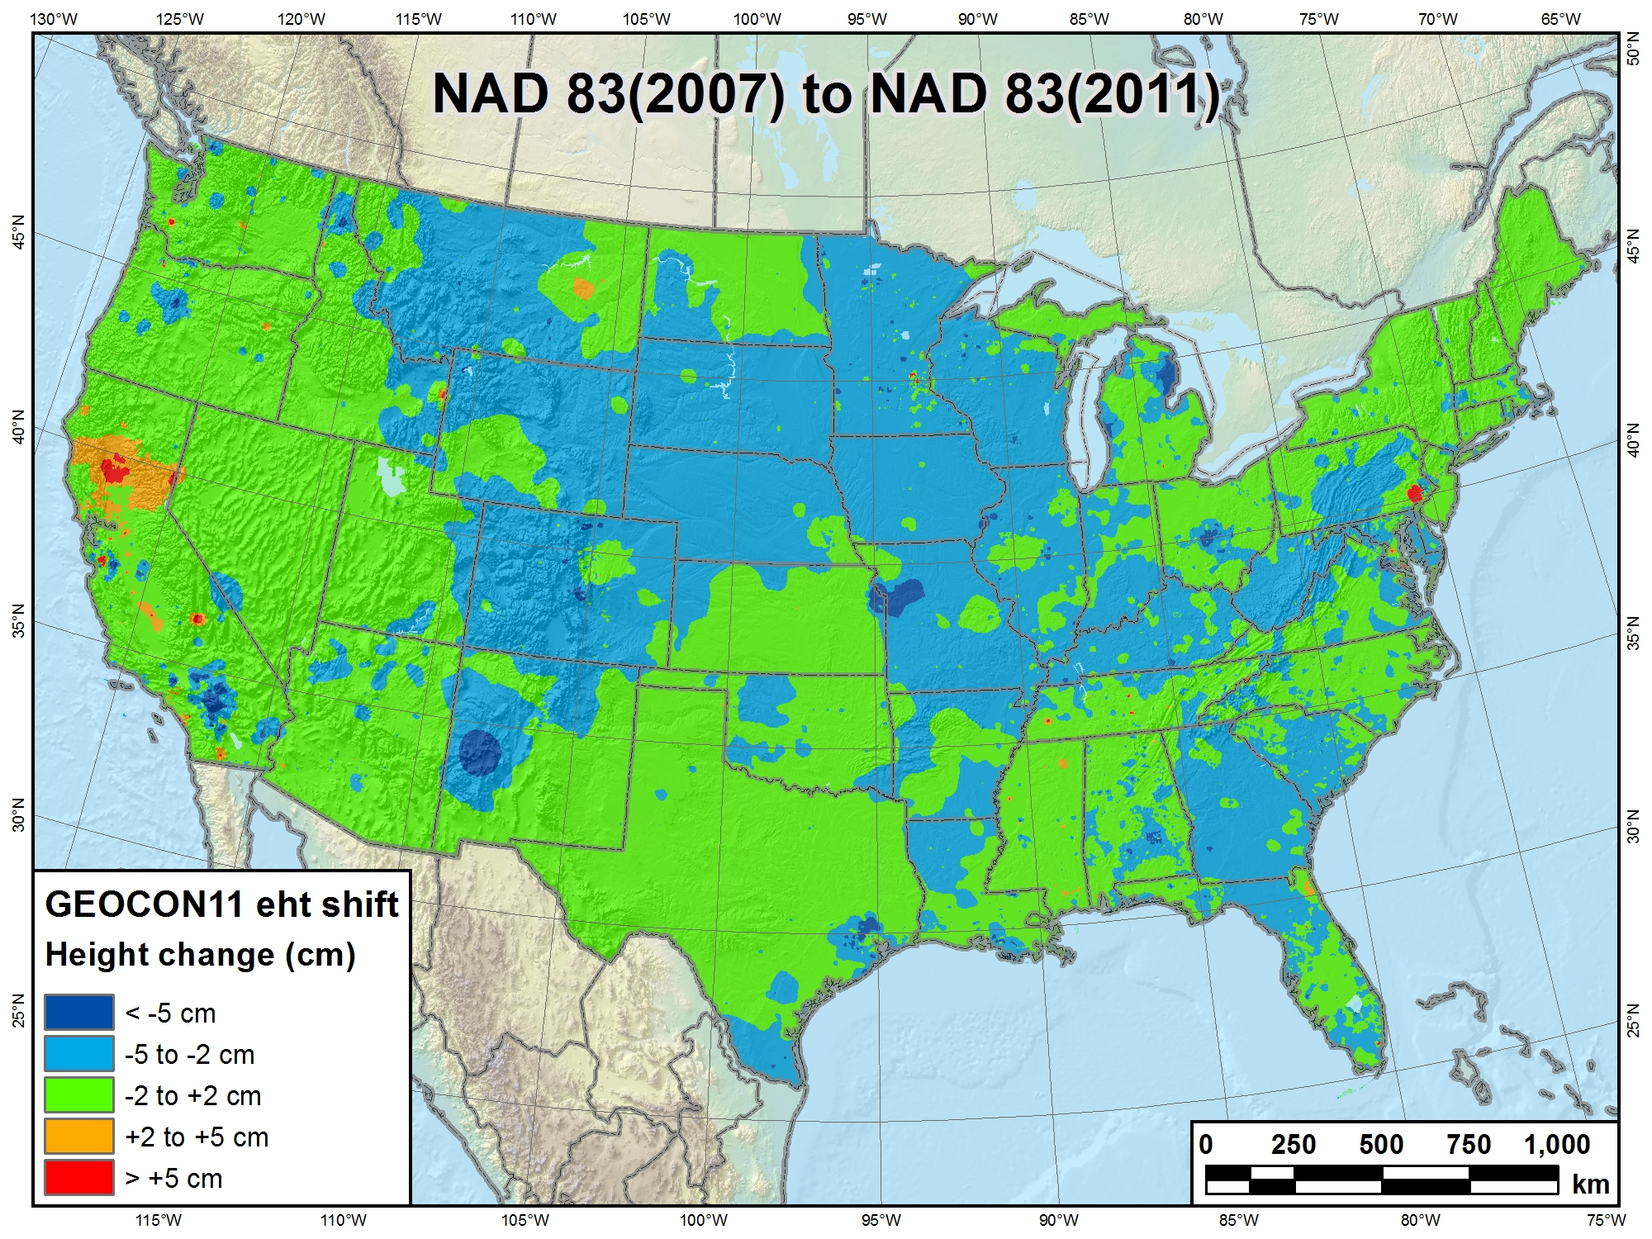
GEOCON and GEOCON11 (beta)

Slide 8
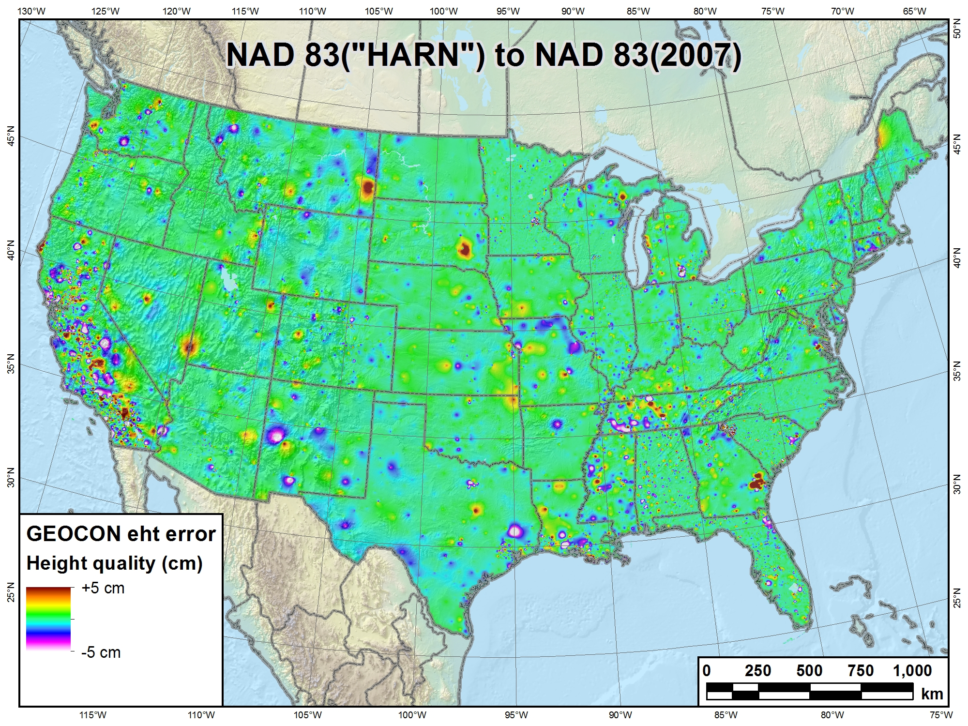
GEOCON and GEOCON11 (beta)

Slide 9
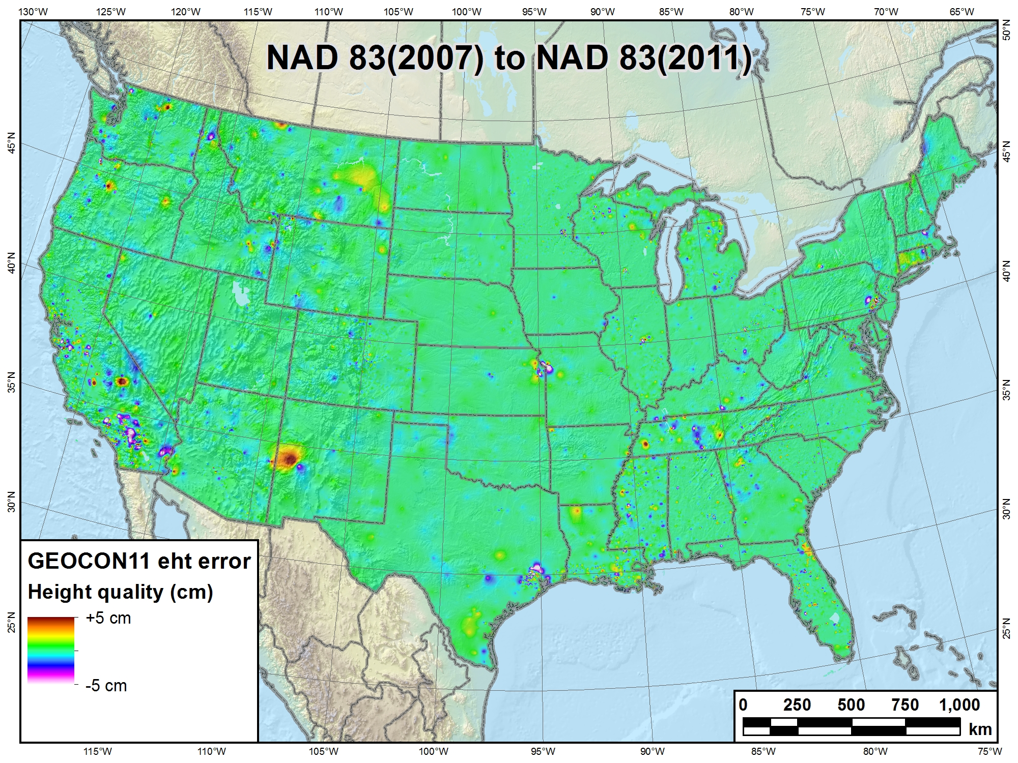
GEOCON and GEOCON11 (beta)

