Slide 1
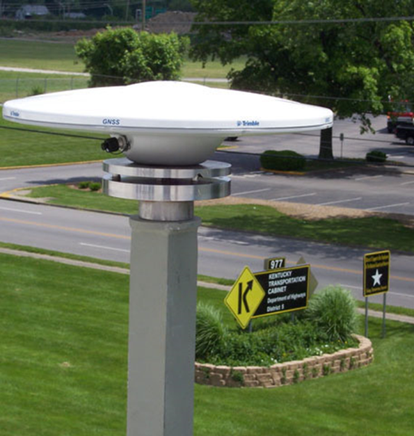
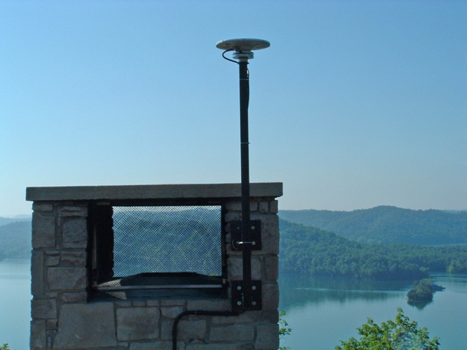
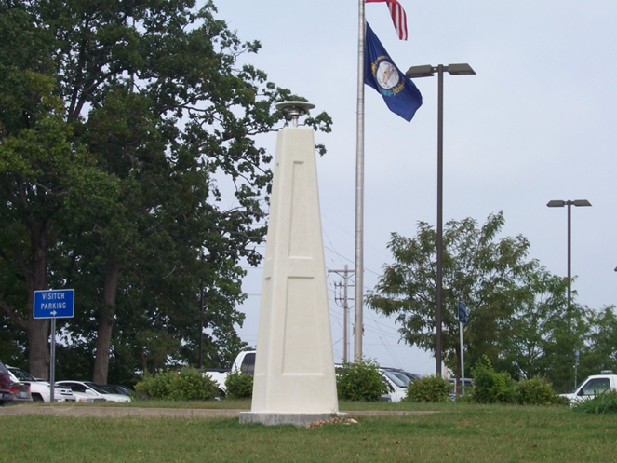
KYCORS 2013 State Update

Slide 2
Outline
Current Network
Web Sites
State Geodetic Control
Archive Server
Funding
Current Height Mod Activities
KYAPED
Workshops
Future Height Mod Plans

Slide 3
KYCORS
Notes:
The KYCORS network is owned and operated by the KY Transportation Cabinet. The network is composed of 38 stations. Data from 13 of those stations is contributed by TN, IN and WV. The Cumberland Gap (KYCG) station will be coming on line next month. KYTA was initially declined due to metal roof but the roof was recently replaced and the antenna mount had to be removed. The antenna was mounted in a different spot to accommodate the design of the new roof and will be renamed and submitted (along with 6 other stations) for consideration as a national CORS.
We also have new hardware for 6 new stations that will be installed before the end of the year.

Slide 4
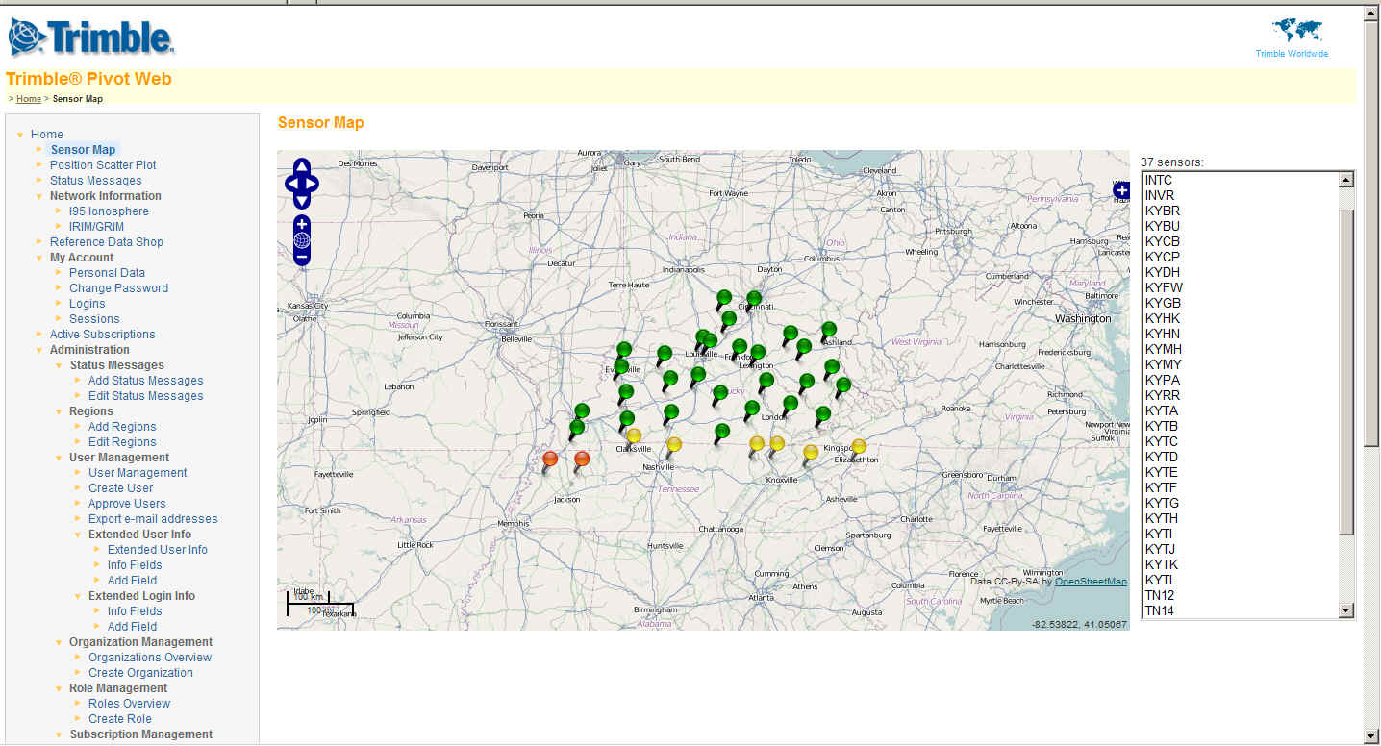
KYCORS Pivot Platform – NAD83(2011)

Slide 5
KYCORS http://kycors.ky.gov
Notes:
KYCORS web site (http://kycors.ky.gov) operated by KYTC; this site allows user to register and provides various information about the network. Registered users can also download RINEX files from any KYCORS (NGS & non-NGS) for post processing. There was some confusion last year about which site to register at because KY Transportation Research Center at UK (www.kycors.com) had a beta site up;

Slide 6
KY Geodetic Control http://kygeonet.ky.gov/ngs/
Notes:
Approximate baseline lengths as well as CORS locations and horizontal & vertical control and can be found on the Geodetic Control site.

Slide 7
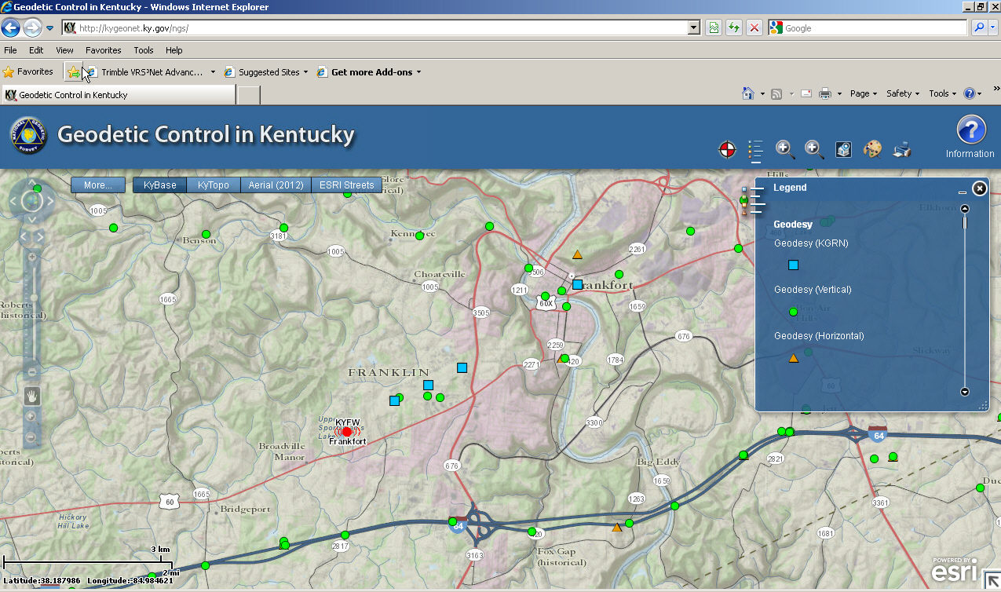
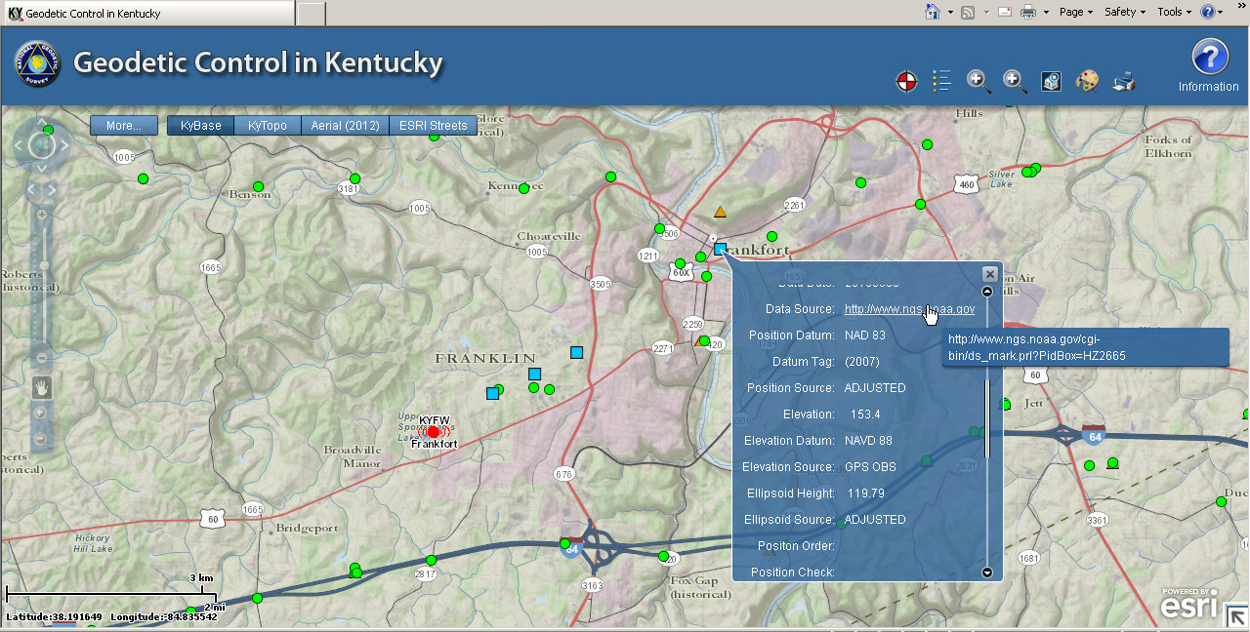
KY Geodetic Control http://kygeonet.ky.gov/ngs/

Slide 8
KYCORS Archive Site www.kycors.com
Notes:
The UK site is now clearly distinguished as the data archive site for KYCORS. The Kentucky Transportation Center stores data from all KYCORS (NGS and non-NGS). Their plan is to keep at least a year or more of data.

Slide 9
Height Mod Funding
2006-2012 Funding
Notes:
The Commonwealth of Kentucky received $1,541,118.00 in Height Mod funds. KYTC received $1,072,235.00 of those funds which was used to for CORS hardware & software and geodetic leveling. Over the past 6 years, an additional $2,046,007.00 of state funds have been invested in expanding and administering the CORS network.
In addition, KY began the KYAPED project FY2012 – KYTC has committed $2.75 million over FY 2012-2014.

Slide 10
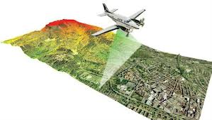
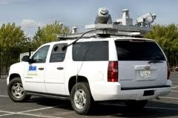
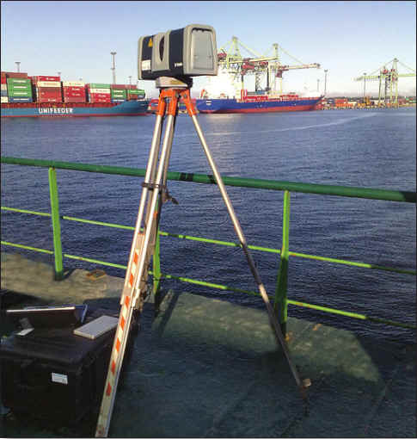
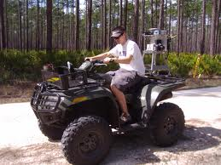
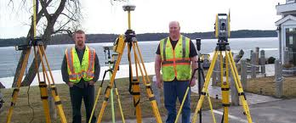
Kentucky Aerial Photography and Elevation Data Program

Slide 11
Educational Outreach
Workshops & Presentations
2012 KAPS Conference
2012 KY GIS Conference
2012 ESRI Poster
2012 KYTC/FHWA/ACEC Partnering Conference
2012 Trimble Dimensions Conference
EEC GIS Lunch & Learn 2013
GIAC March 2013
KAMM Conference 2013

Slide 12
Future Height Mod Activities
Advance GRAV-D in KY
Identify areas lacking vertical control
Consult with NGS to determine best course of action to compliment GRAV-D
Develop Scope of Work
Cost Estimate and Funding Source
Expansion of KYCORS Network
Funded by Highway Design Survey Budget
Completion of KYAPED

Slide 13
Questions?
Danielle.Kelly@ky.gov
Kentucky Transportation Cabinet
Division of Highway Design
200 Mero St, Frankfort, KY
502-564-9900 ext 3413
859-421-6698
HTTP://KYCORS.KY.GOV

