Slide 1
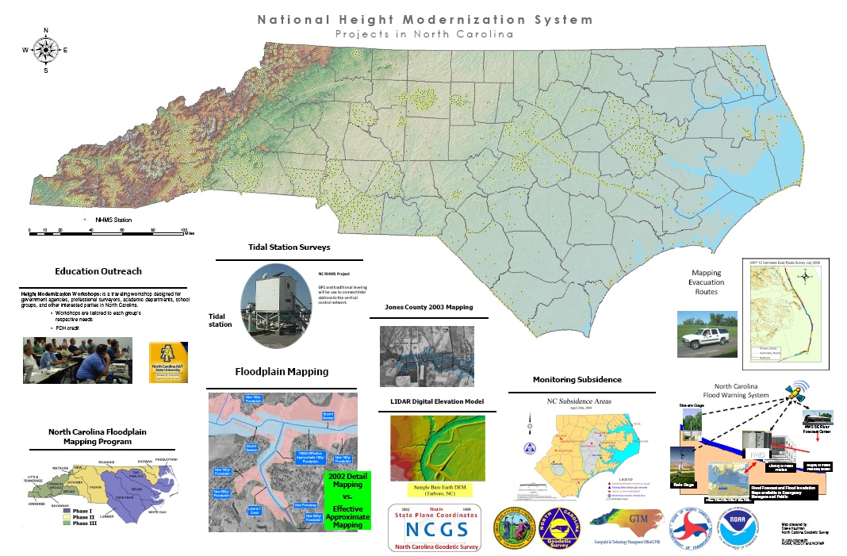
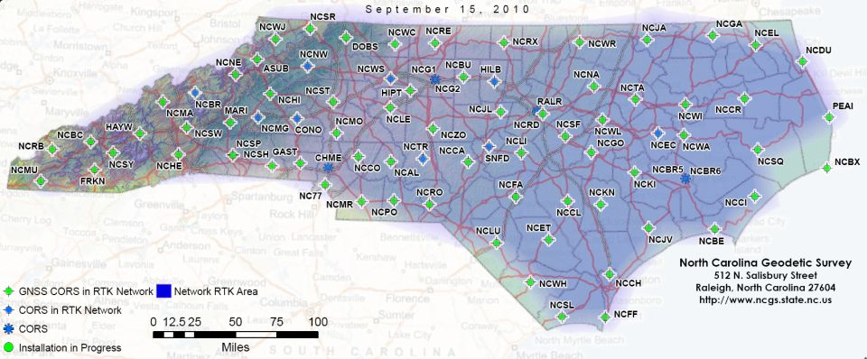

NCGS: Positioning NC for the future now!
North Carolina
Geodetic Survey
Establishing and Maintaining
the Official Survey Base
in North Carolina

Slide 2


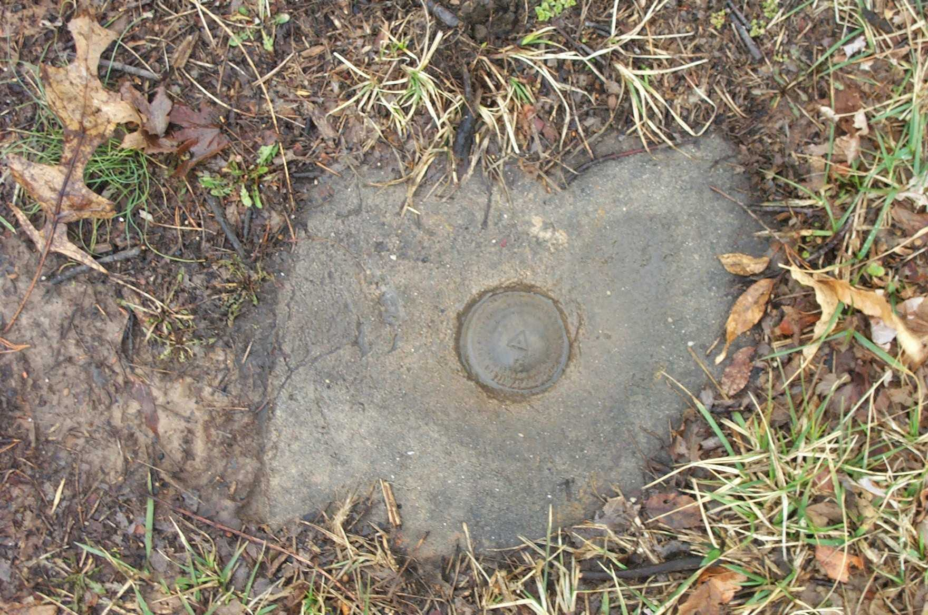
North Carolina Geodetic Survey
North Carolina General Statute 102
  Official survey base
  Establish and maintain the NC State Plane Coordinate System (NCSPCS)
  Protect and provide access to geodetic monuments

Slide 3
Benefits to North Carolina
Geodetic control network
CORS/RTN
North Carolina Floodplain Mapping Program (FMP)
Highway construction
Statewide aerial imagery
North Carolina Land Records Management Program
Environment and natural resources programs
Emergency management
Precision agriculture

Slide 4
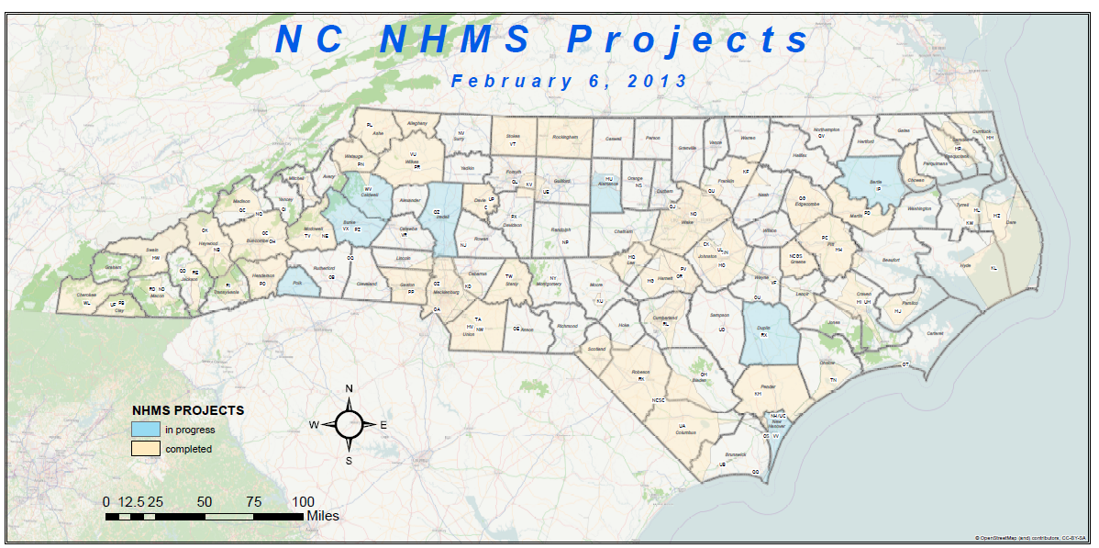
NC NHMS projects

Slide 5
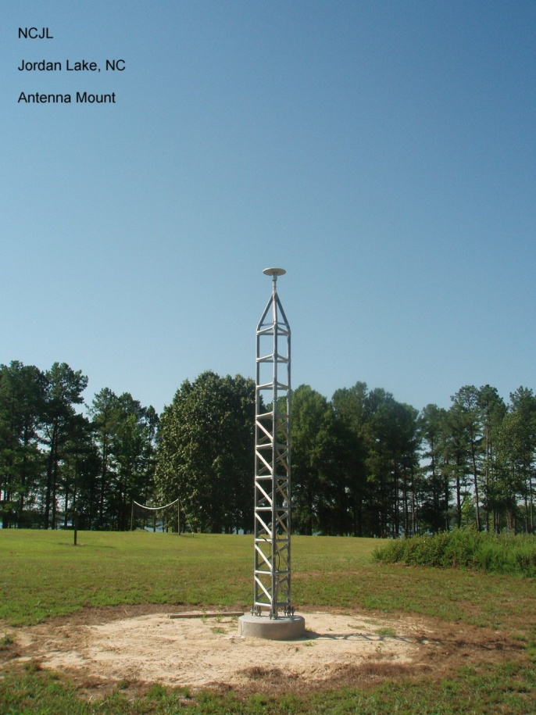
NC CORS Network
Continuously Operating Reference Station (CORS)
  A permanent and continuously recording Global Navigation Satellite System (GNSS) receiver, antenna (with a surveyed reference position), & support equipment
  NC CORS Network
      Composed of 88 CORS
        3 new CORS have been installed
          Bodie Island (NCBI)
          Bethel (NCBT)
          UNCC (NC49)

Slide 6
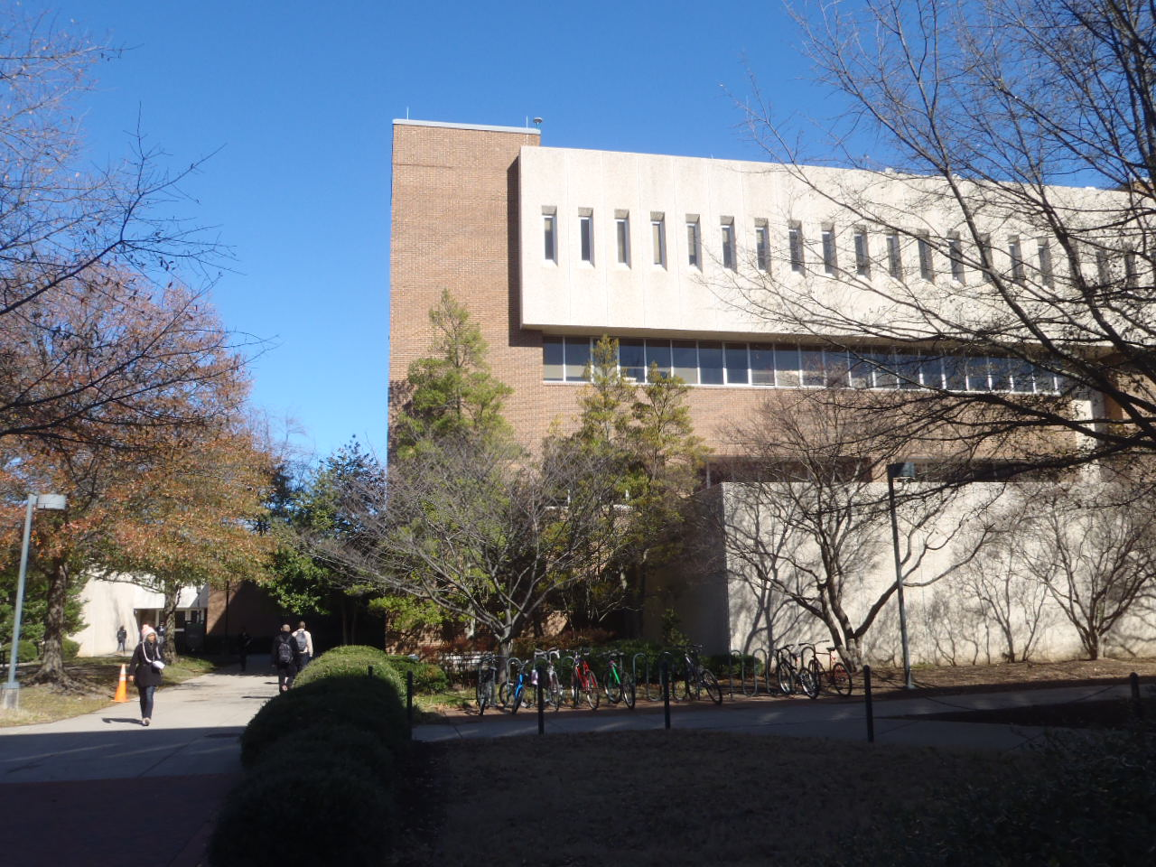
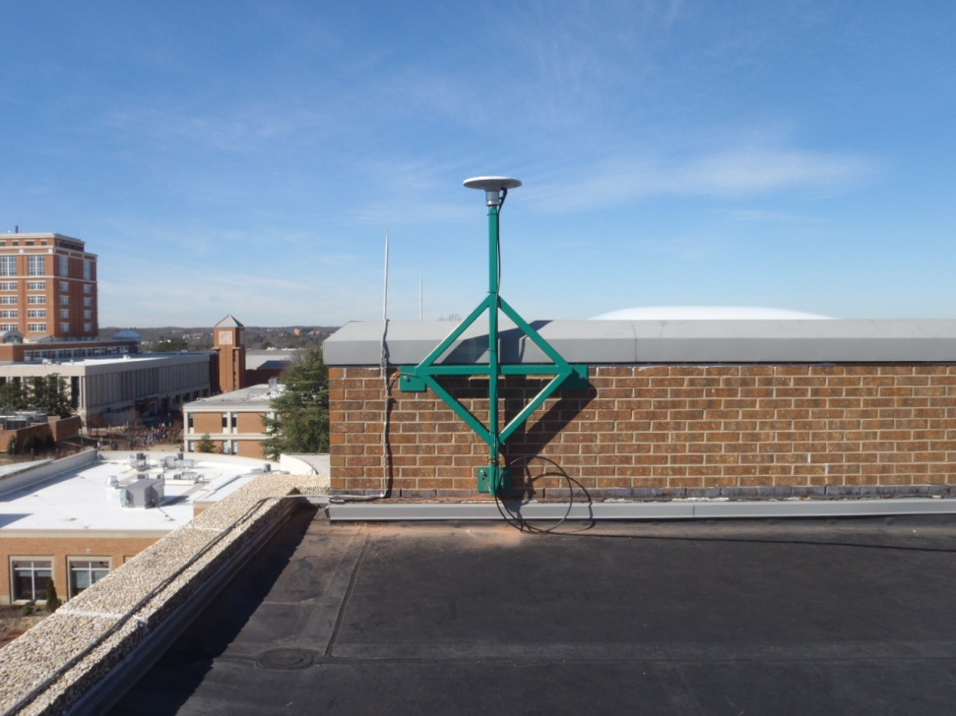
UNCC CORS (NC49)

Slide 7
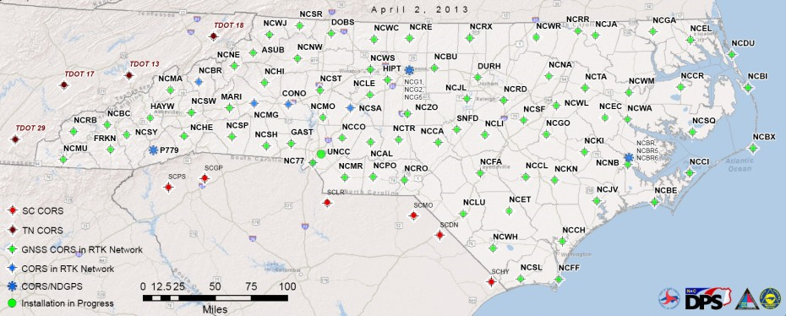

NC CORS Network

Slide 8
CORS/RTN
Added three (3) TDOT CORS to the RTN
  Funding provided by NCDOT
Upgraded four (4) CORS to GNSS
  Durham (DURH)
  Sanford (SNFD)
  Troy (NCTR)
  Winston Salem (NCWS)

Slide 9
CORS/RTN
Moved FTP servers from DENR to DEM
Added 4th RTN server at WDC
Submitted budget for 2014 aerial imagery project, which includes the following items
  Upgrade three (3) CORS to GNSS
    Burnsville
    Morganton
    Salisbury
  Add two (2) TDOT CORS to the RTN
  Software/CORS maintenance

Slide 10
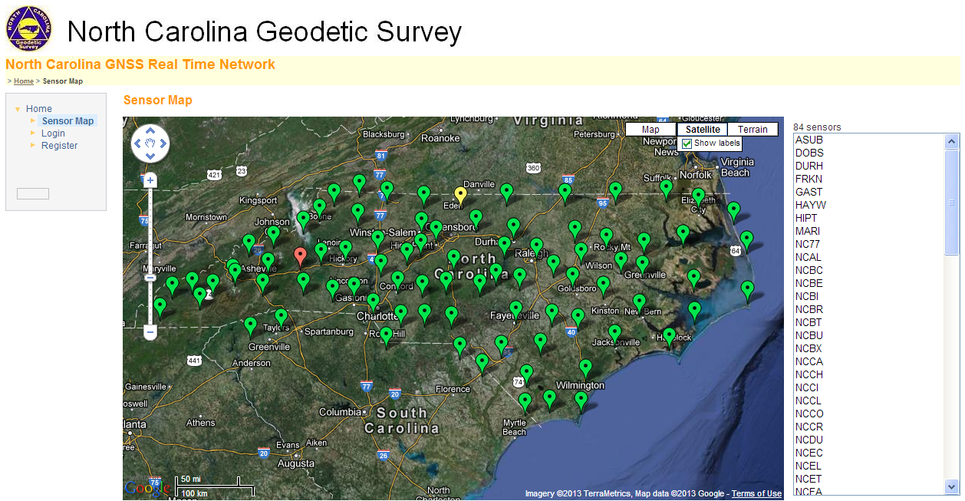
GNSS Real Time Network (RTN)

Slide 11
Financial benefit of NC CORS
Product | *User benefit in 2008/ quantifiable unit | Quantity in 2012 | Total benefits in 2012 (using the 2008 user benefits & the 2012 quantities) | 30% for broader societal benefits | 15% annual growth for 4 yrs | Total benefits + 30% broader + 15% annual growth for 4 yrs
UFCORS downloads | $133/download | 38,058 downloads | $5,061,714 | $1,518,514 | $2,655,891 | $9,236,119
NGS FTP downloads | $30/download | 1,480,009 downloads | $44,400,270 | $13,320,081 | $23,296,905 | $81,017,256
OPUS-S solutions | $500/solution | 5,500 solutions | $2,750,000 | $825,000 | $1,442,930 | $5,017,930
OPUS-RS solutions | $500/solution | 5,200 solutions | $2,600,000 | $780,000 | $1,364,225 | $4,744,225
OPUS-DB solutions | $400/submission | 23 solutions | $9,200 | $2,760 | $4,827 | $16,787
NC RTN | $100/hour | 195,128 hours | $19,512,800 | $5,853,840 | $10,238,403 | $35,605,043
 |  | Total benefits in 2012 | $74,333,984 | $22,300,195 | $39,003,181 | $135,637,360

Slide 12

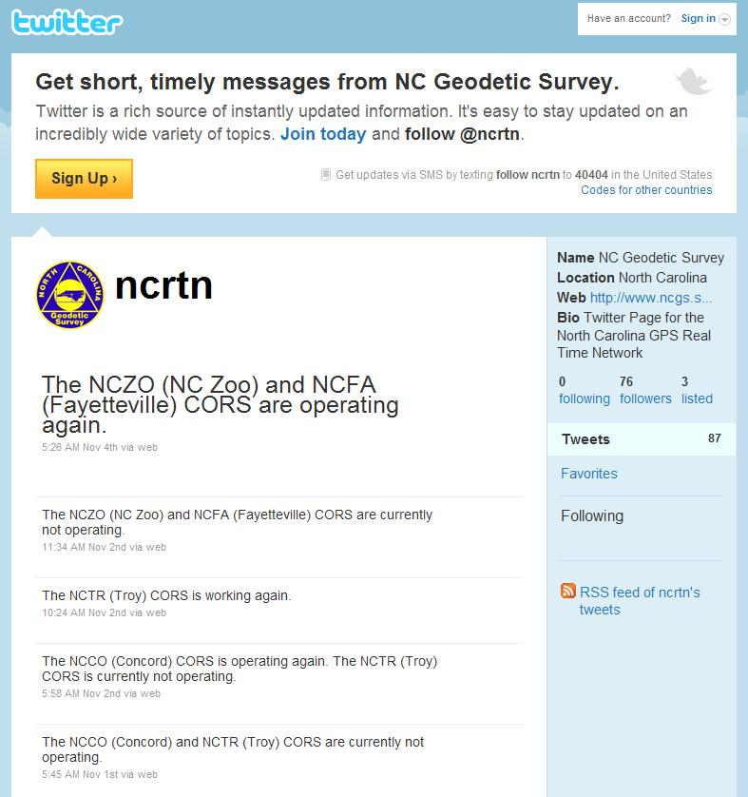

NC Geodetic Survey
on Twitter
NCGS has developed a Twitter web page (http://twitter.com/ncrtn), which is similar to the NCDOT Twitter page (http://twitter.com/ncdot)
Provides information on the status of NC CORS, RTN, and other web features.

Slide 13
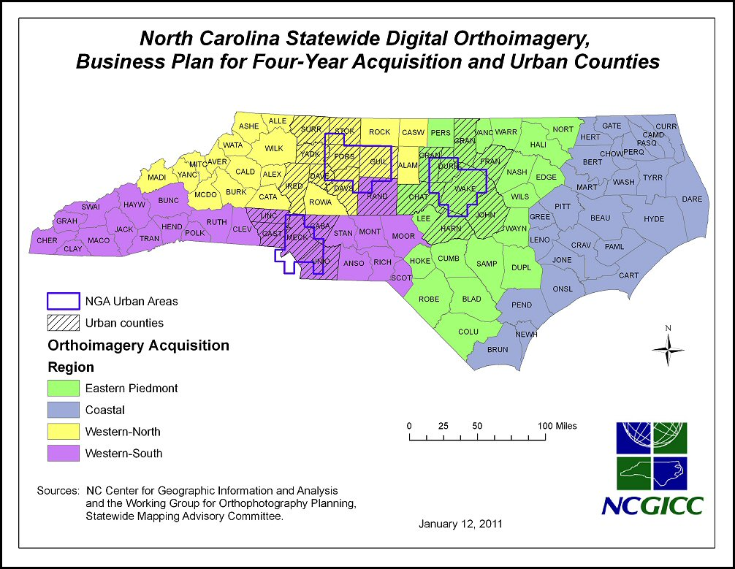
Statewide Imagery Project

Slide 14
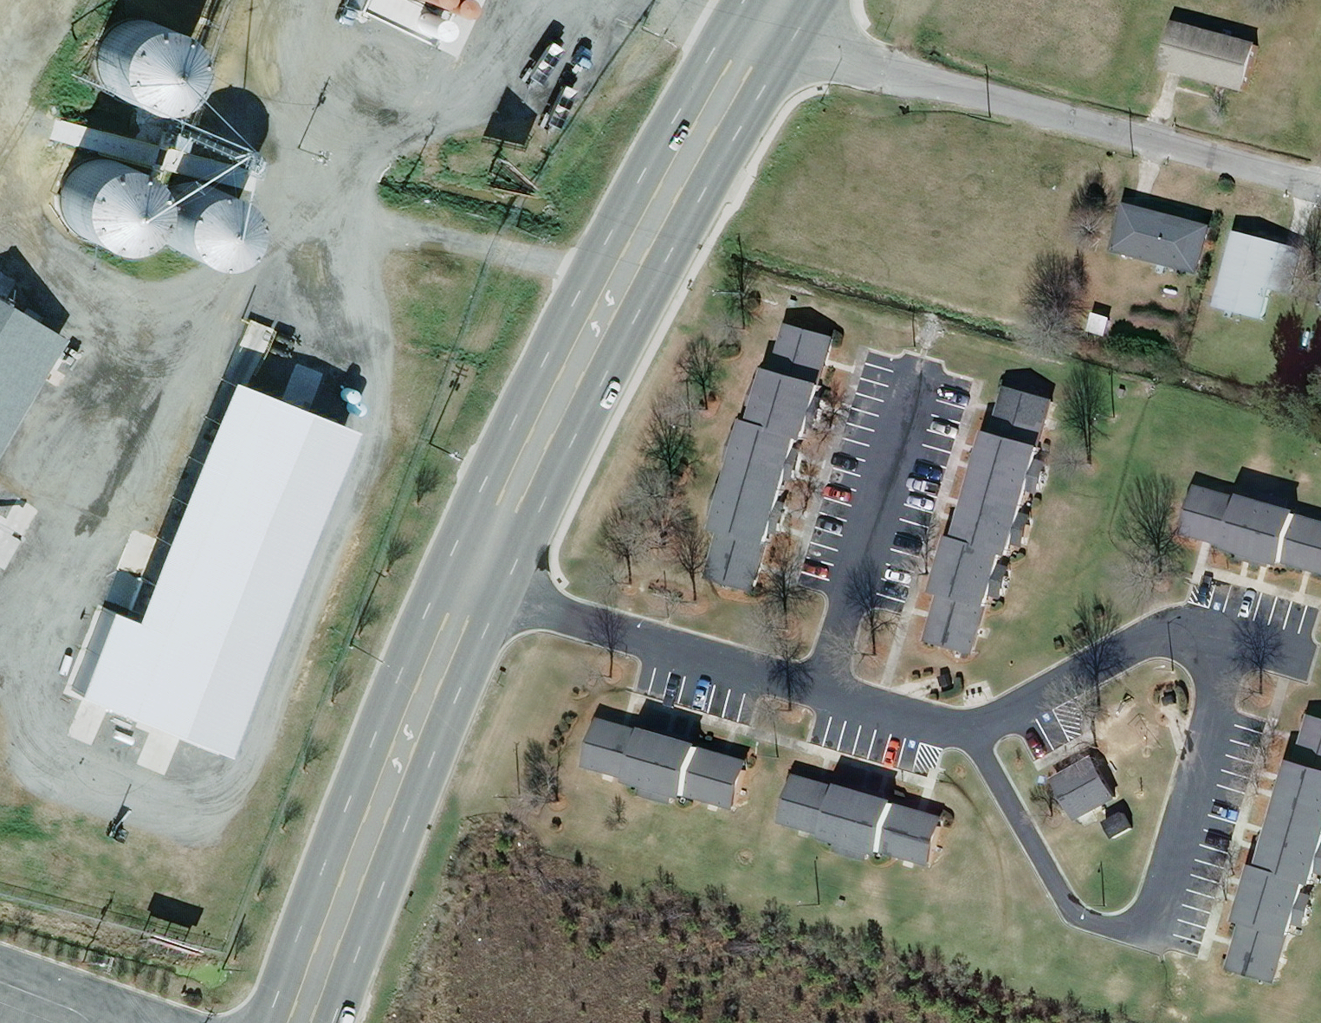

Slide 15
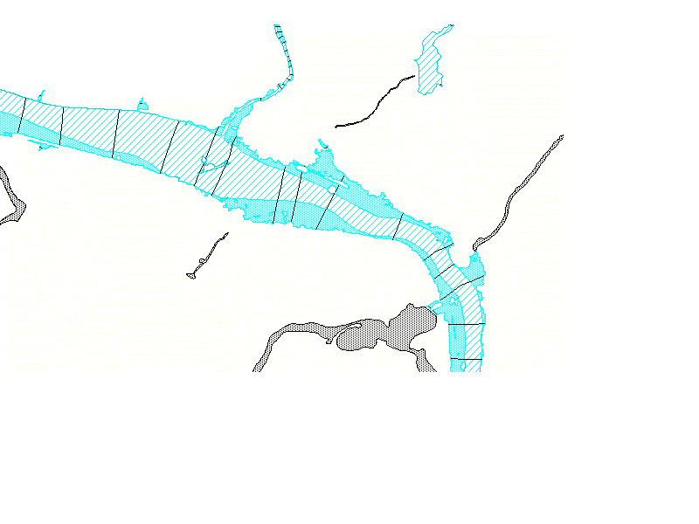
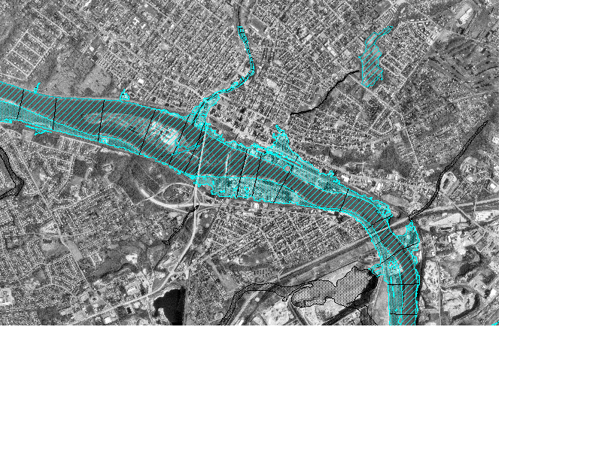
NC Floodplain Mapping Program
Components of a DFIRM
Base
Topography
Flood Data
=
DFIRM

Slide 16
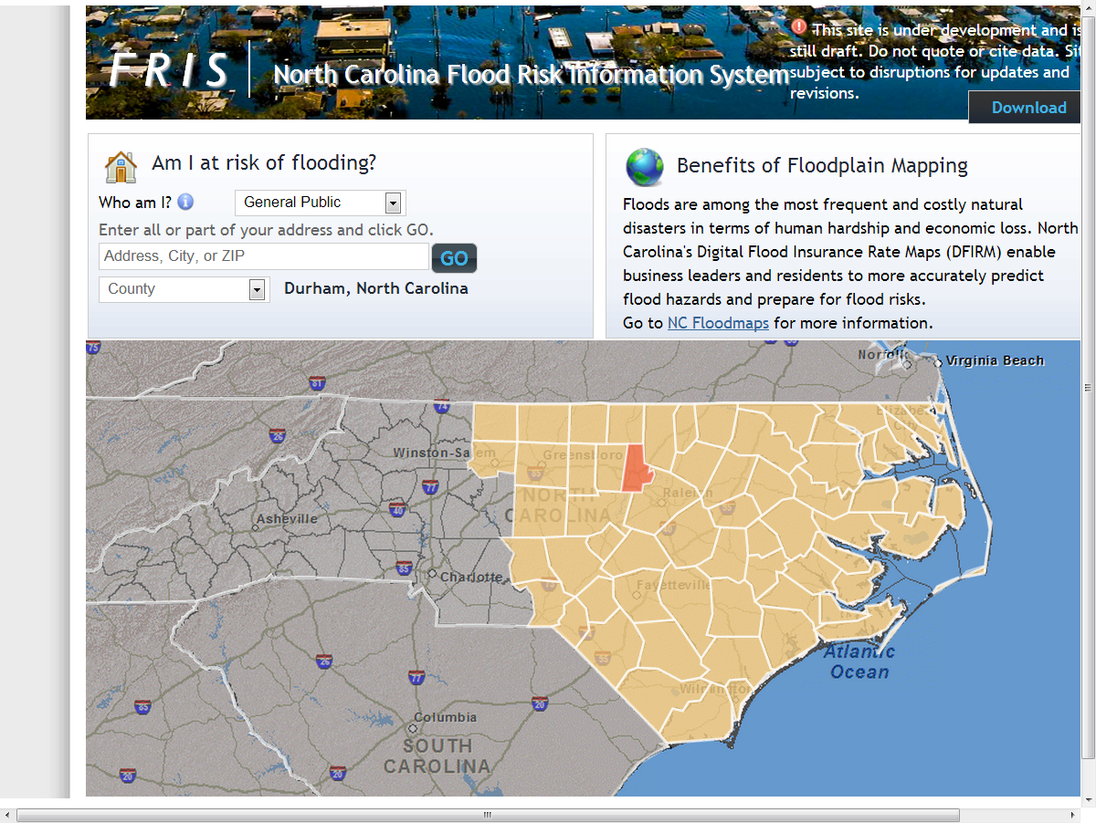
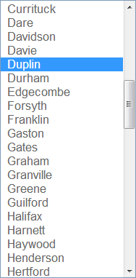

Slide 17
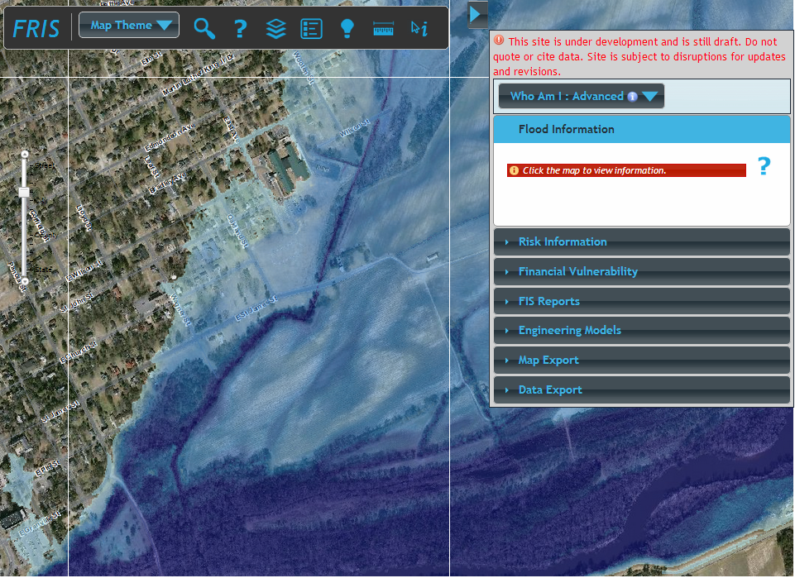

Slide 18
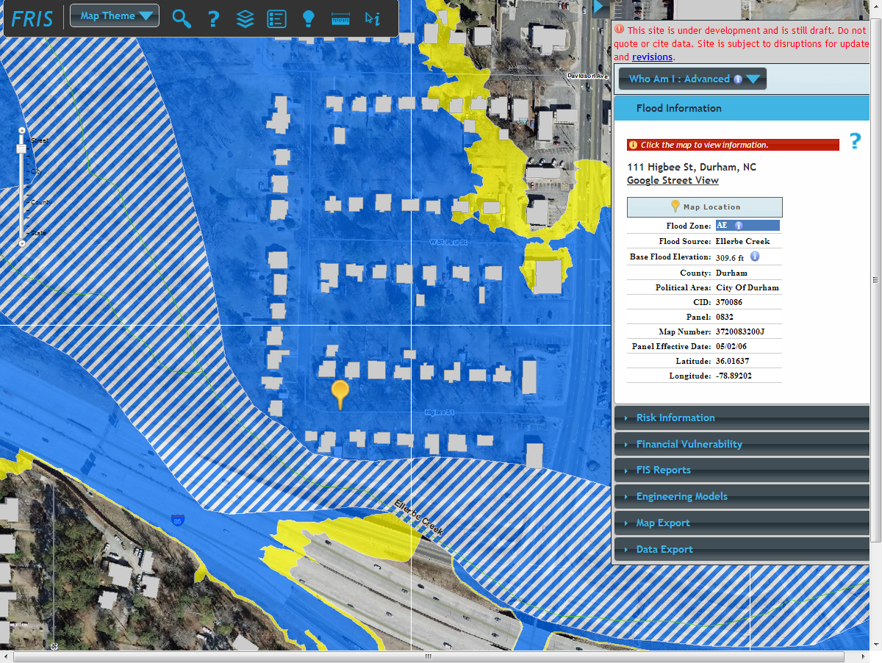

Slide 19
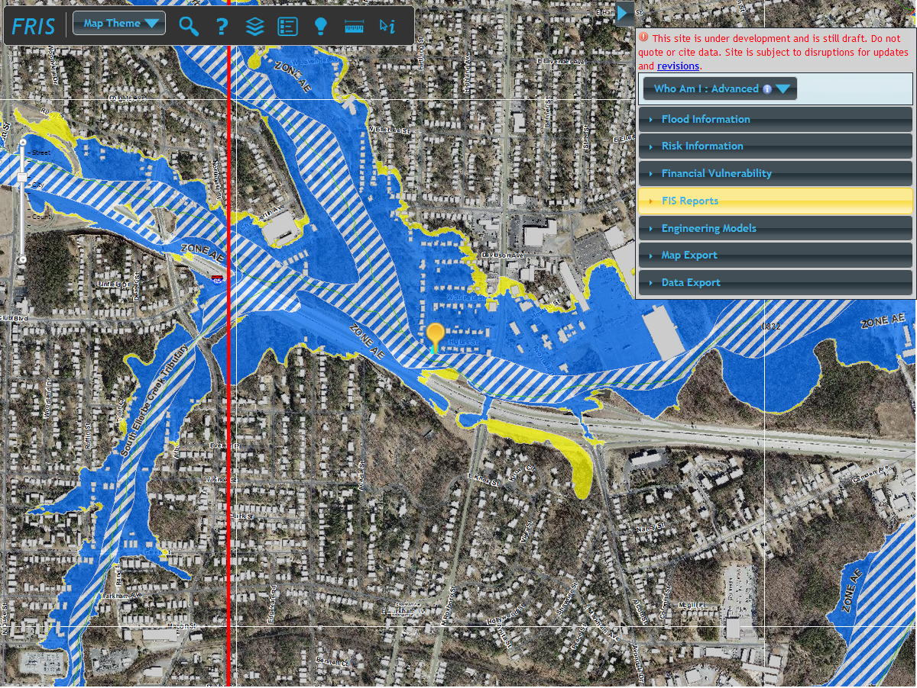


Slide 20
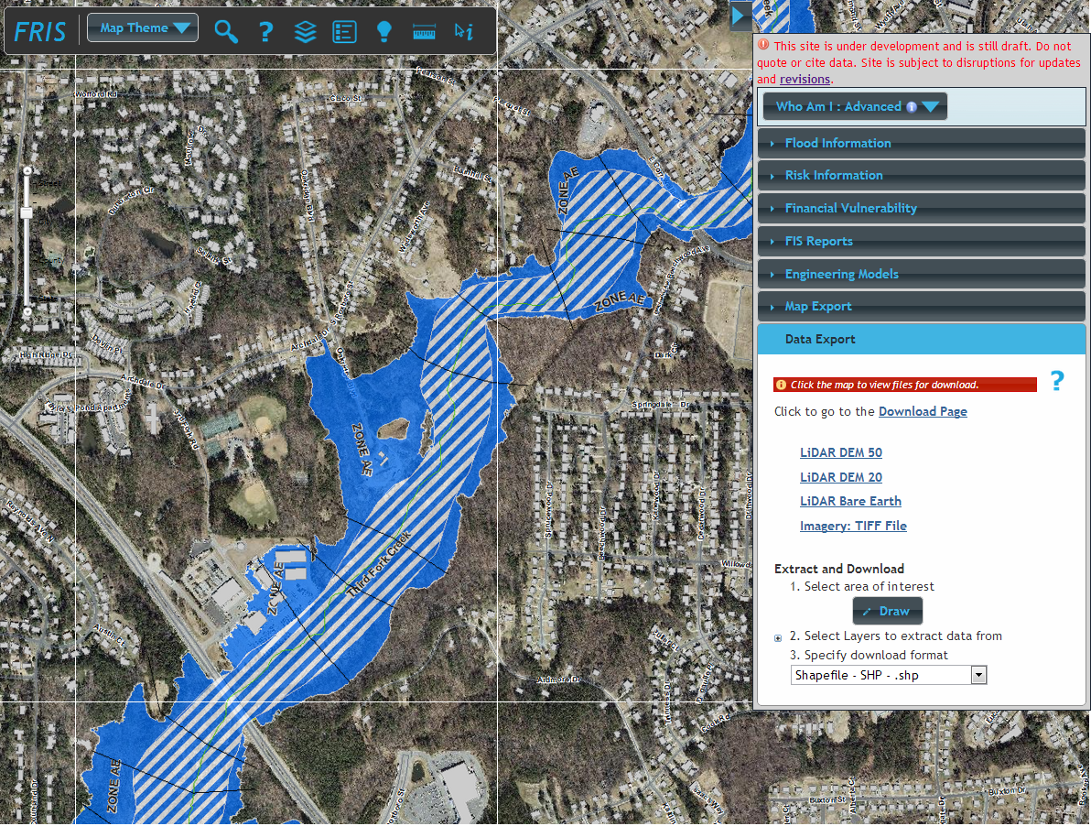

Slide 21
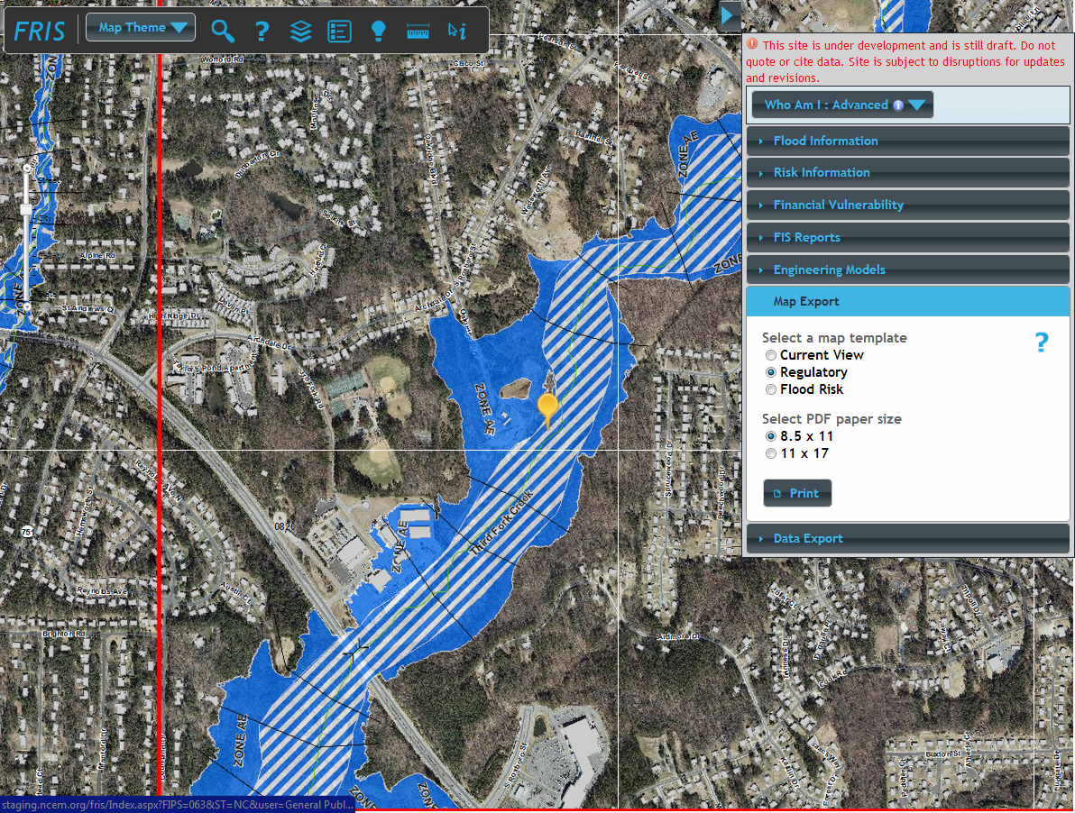
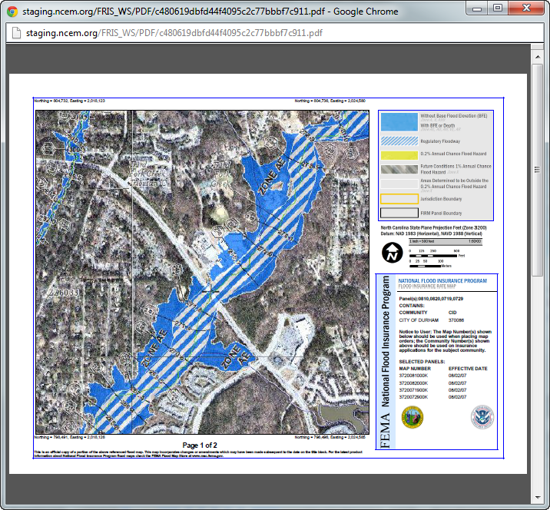
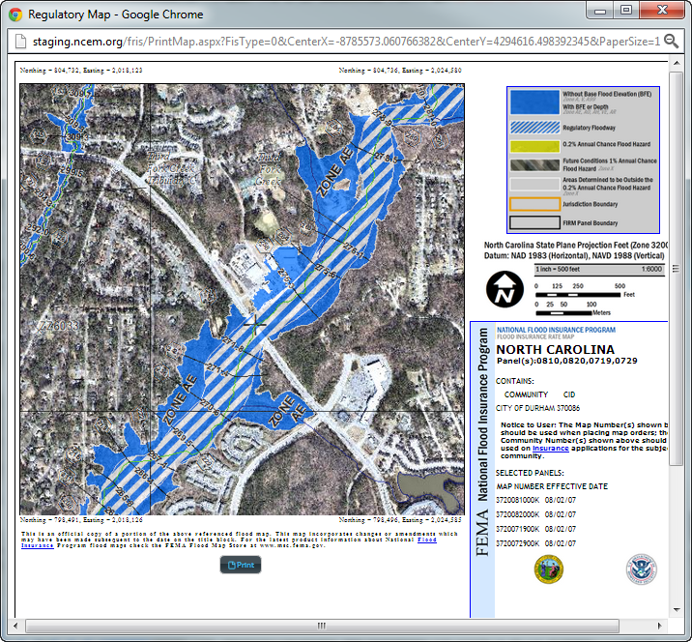
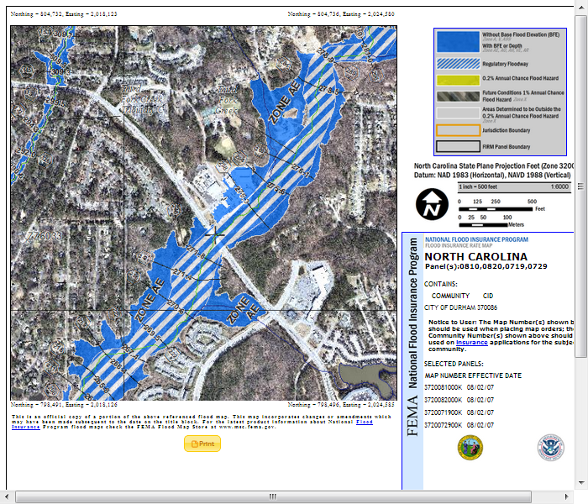
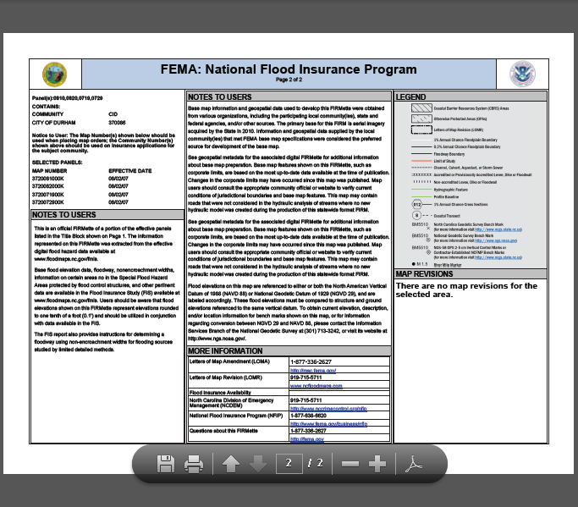
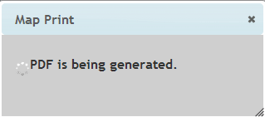

Slide 22
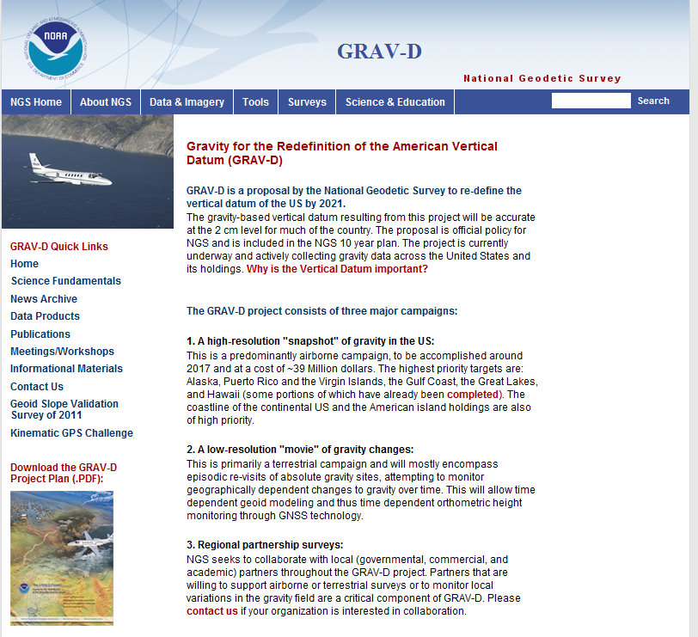
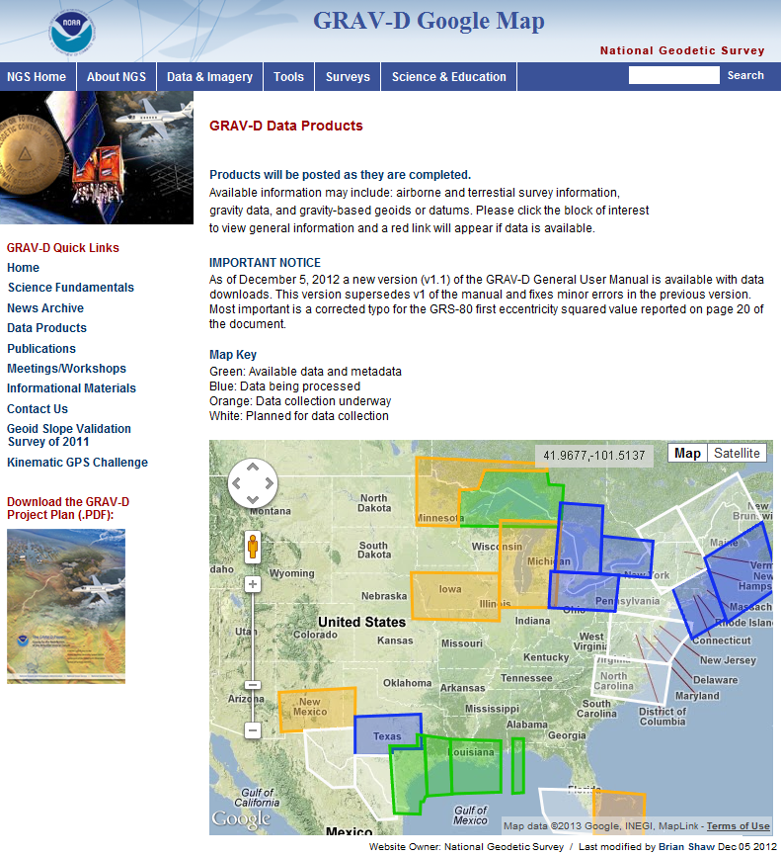
GRAV-D

Slide 23
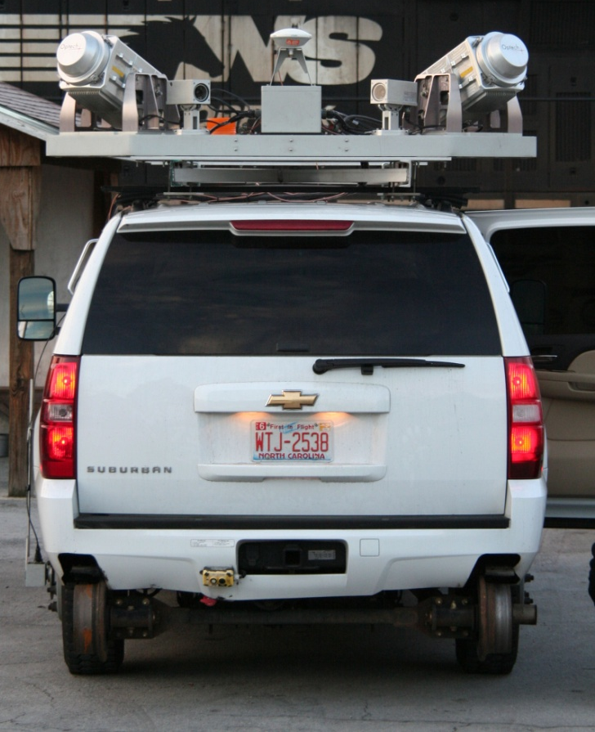
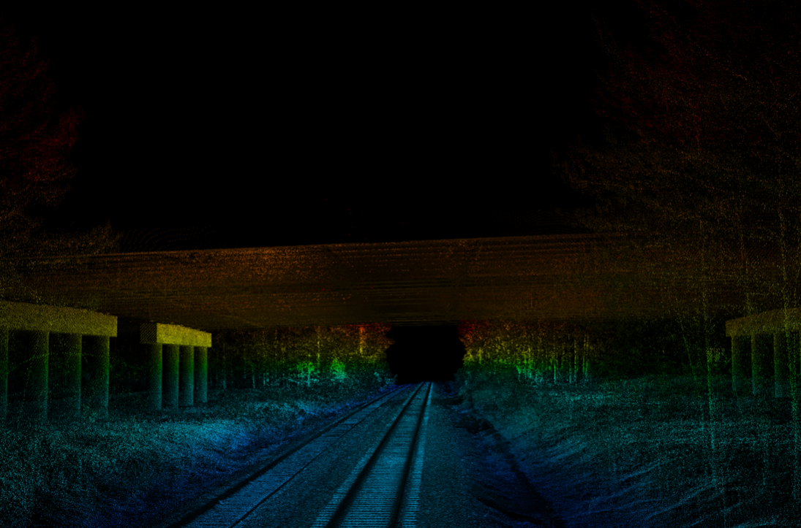
HM supports mobile scanning applications
NC Railroad Company’s Hy-Rail vehicle
Mobile scanners and positioning equipment installed on vehicle
NC CORS provides real-time positioning info to support the Hy-Rail vehicle’s GNSS equipment

Slide 24
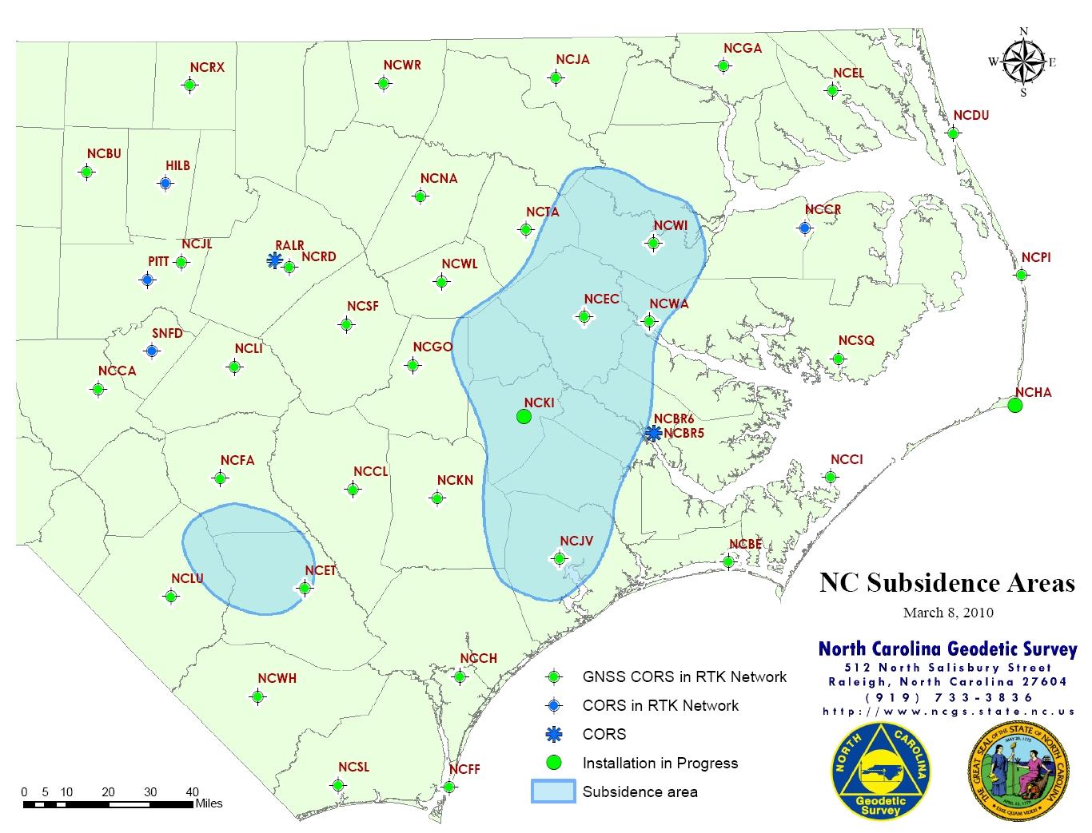
HM supports
subsidence monitoring

Slide 25
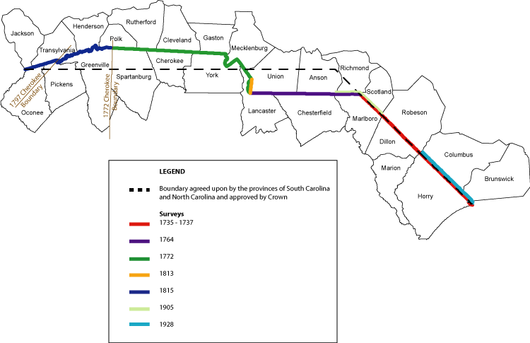
How did North Carolina get its shape?
The line shall:
Begin at the sea, 30 miles from the west side of the mouth of the Cape Fear River
From thence, it shall run on a northwest course to 35⁰ N latitude
From thence due west to the South Seas

Slide 26
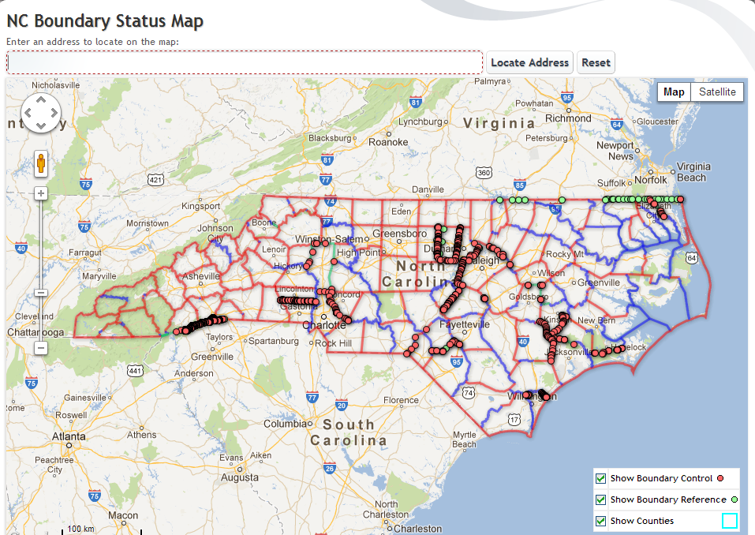
County and state boundaries

Slide 27
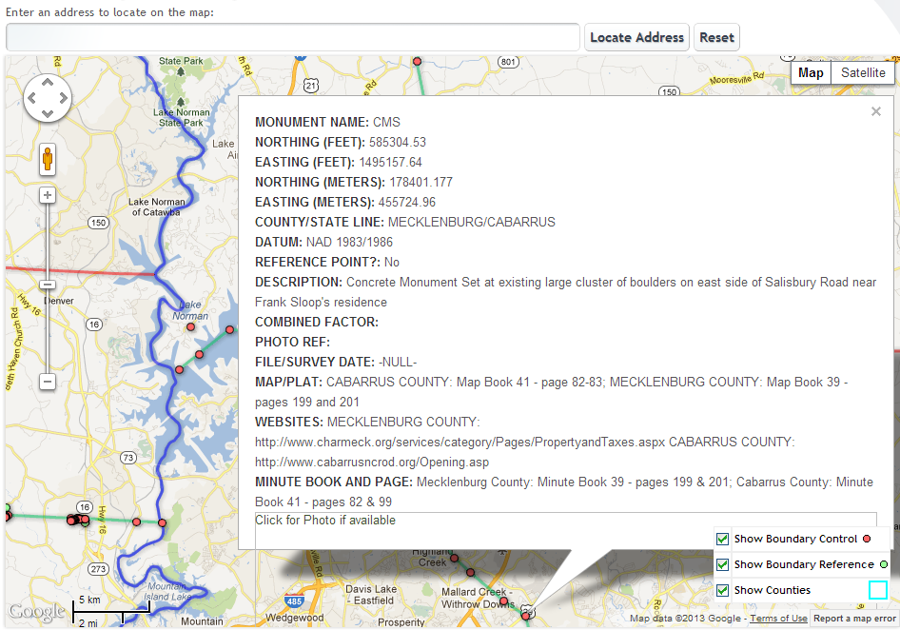
County and state boundaries

Slide 28


Educational outreach
Height Modernization Workshop:
  Traveling workshop designed for government agencies, professional surveyors, academic departments, school groups, and other interested parties in North Carolina.
  Workshops tailored to each group’s respective needs
  Professional Development Hour (PDH) credit
  Developed with NC A&T State University

Slide 29
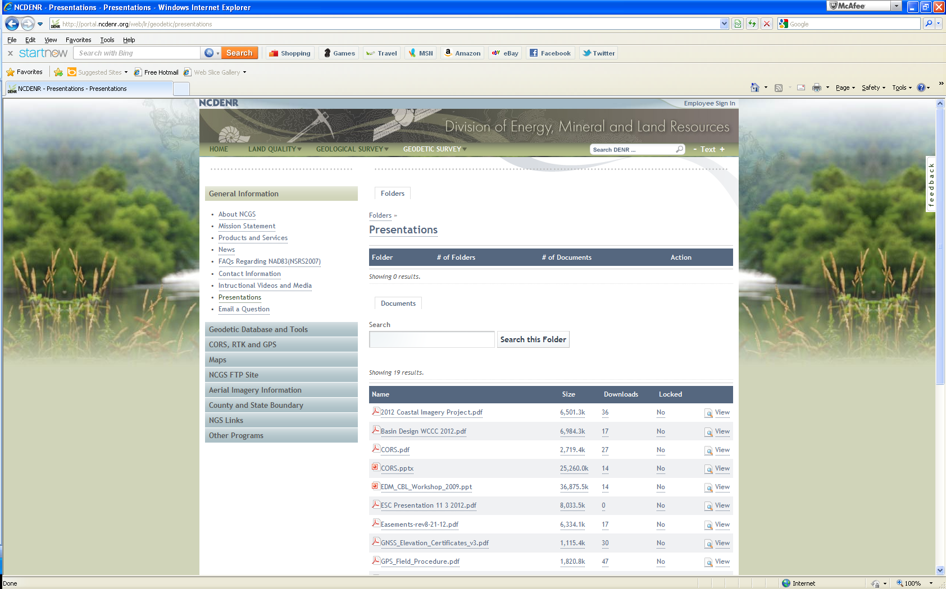
Presentations

Slide 30
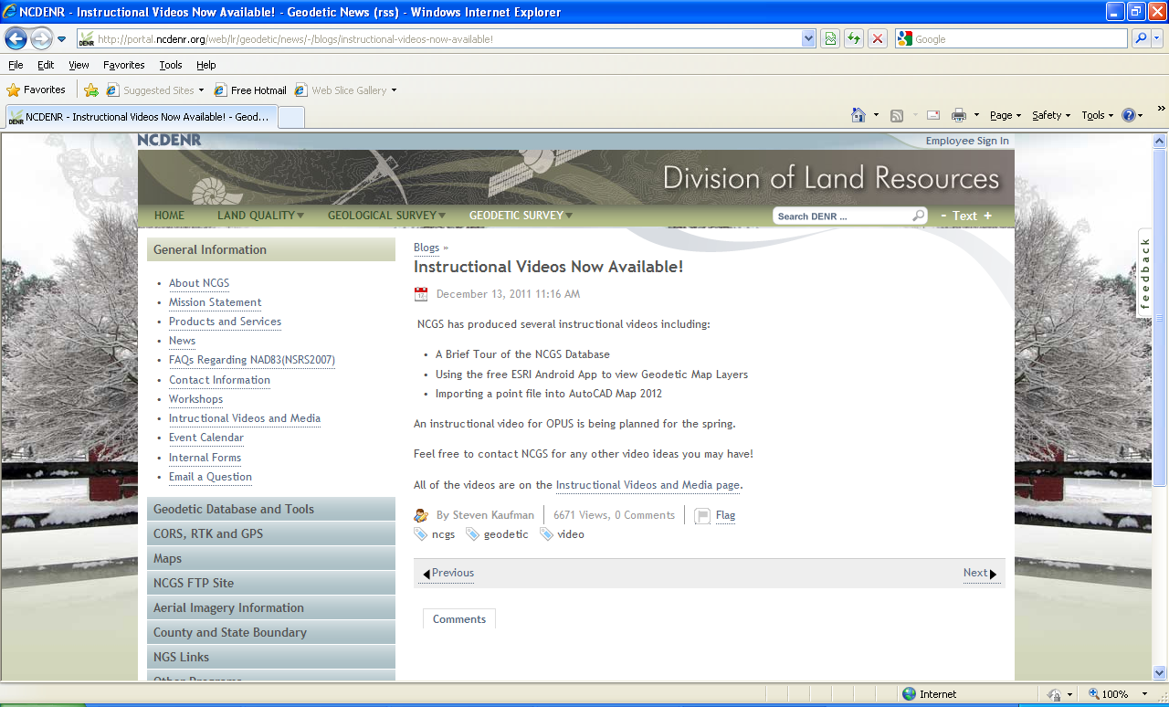
Instructional Videos

Slide 31
Future projects
Statewide collection of gravity data to support GRAV-D
Statewide collection of elevation data (LiDAR)
NC drone test range
Web page and database upgrade

Slide 32
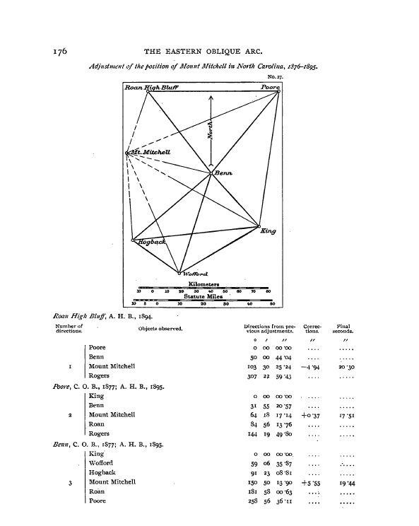
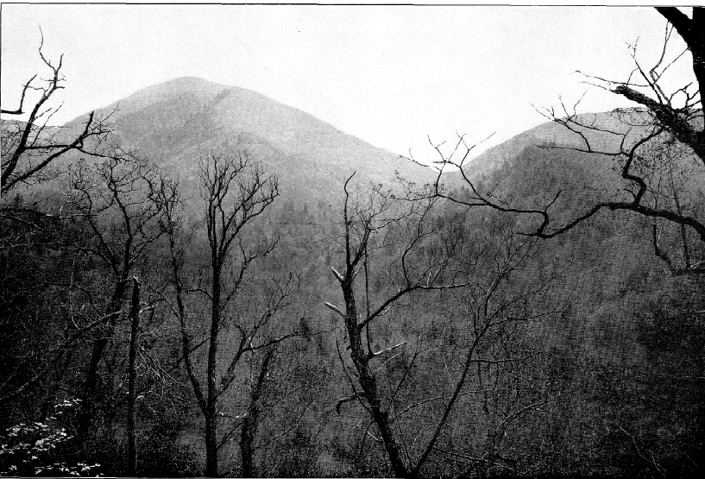
The Eastern Oblique Arc
1876-1895

Slide 33

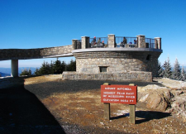
Questions?
Gary W. Thompson, PLS Office: 919-733-3836 Direct: 919-948-7844 Email: gary.thompson@ncdps.gov
Mailing address: | Building (shipping) address:
Gary W. Thompson, PLS NC Geodetic Survey 4298 Mail Service Center Raleigh, NC 27699-4298 | Gary W. Thompson, PLS NC Geodetic Survey Bowers Building NC National Guard complex 4105 Reedy Creek Rd Raleigh, NC 27607

