Slide 1
The South Carolina Geodetic Survey

Slide 2
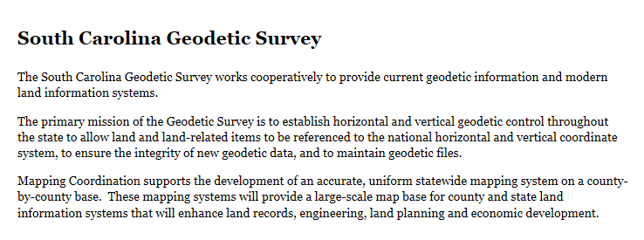
Mission Statement

Slide 3
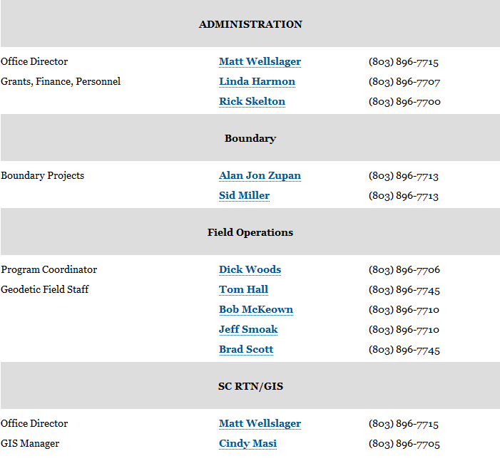
SCGS Staff

Slide 4
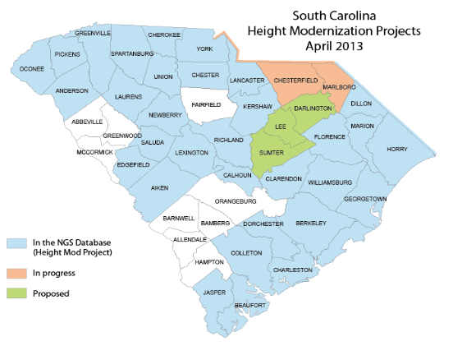
SC Defines Height Modernization as…

Slide 5
Height Modernization Goals
Complete Height Mod survey in all 46 counties.
When performing reconnaissance, attempt to recover all possible bench marks and determine if site is GPSable. These observations are used when improving the geoid.
Make ties to historical tide gages and barrier islands.
Help improve VDATUM
Ensure all of the SC RTN sites have Height Mod coordinates.
Monitor and create Height Mod control using the states RTN.
Create a database for geodetic control.

Slide 6
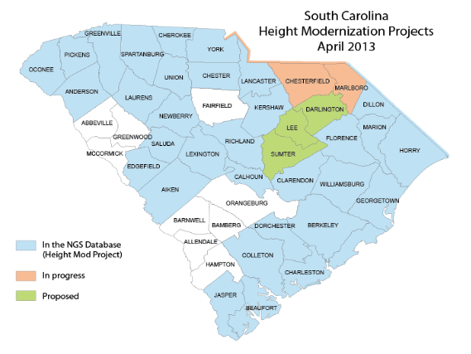
Accomplishments
The SCGS has performed Height Mod surveys for 80% of the counties in the state. The SCGS just completed 2 regional projects that added control to 6 different counties. 3 counties per project. With these projects, a total of 480 monuments with 0.02 m 3D control have been added.
The SCGS has collected QA/QC data using the SC RTN for counties as LiDAR checkpoints. We have done this as an in-kind service for 4 years.

Slide 7
The South Carolina Real Time Network

Slide 8
Funding
The SCGS has been fortunate to receive Height Modernization grants in the past. Last grant ended July 31, 2012.
SCGS will participate in any competitive grant application process if, and when, the application process is made available again.
South Carolina has appropriated funding. It is limited but available.

Slide 9
Biggest Challenges
Learning the new Adjust Program
Creating a database for SC.
Funding – Need I say anymore?

Slide 10
Thank-you!
Matt Wellslager
South Carolina Geodetic Survey
5 Geology Rd
Columbia, SC 29212
803-896-7715
Matt.wellslager@scgs.sc.gov

