Slide 1
WISCONSIN HEIGHT MODERNIZATION PROGRAM
NATIONAL HEIGHT MODERNIZATION
PARTNER MEETING
APRIL 30 TO MAY 1, FRANKFORT, KY

Slide 2
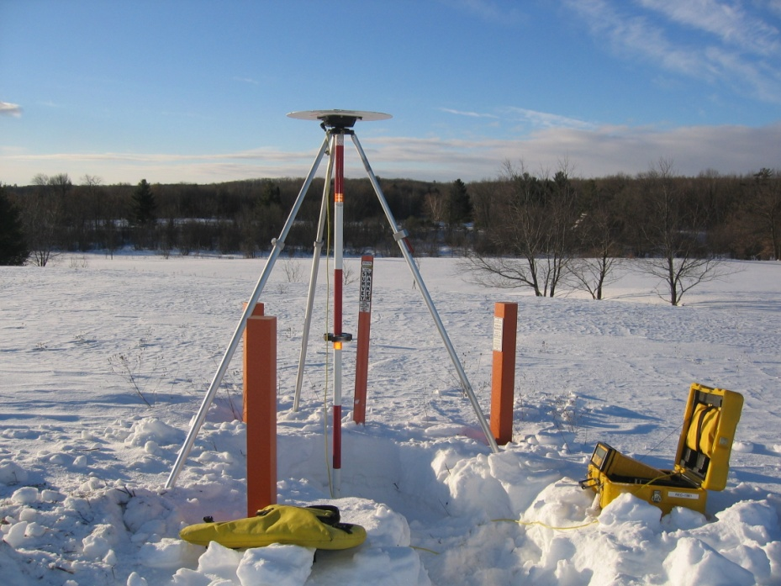
WI-HMP OBJECTIVES
TO PROVIDE REAL-TIME, SUB 2 CM-HORIZONTAL AND VERTICAL POSITIONING STATEWIDE
TWO RELIABLE, INDEPENDENT NETWORKS ARE NECESSARY TO MAKE THIS ACCURACY POSSIBLE. THE PASSIVE NETWORK IS THE GEODETIC CONTROL MONUMENTS AND THE ACTIVE NETWORK IS WISCORS

Slide 3
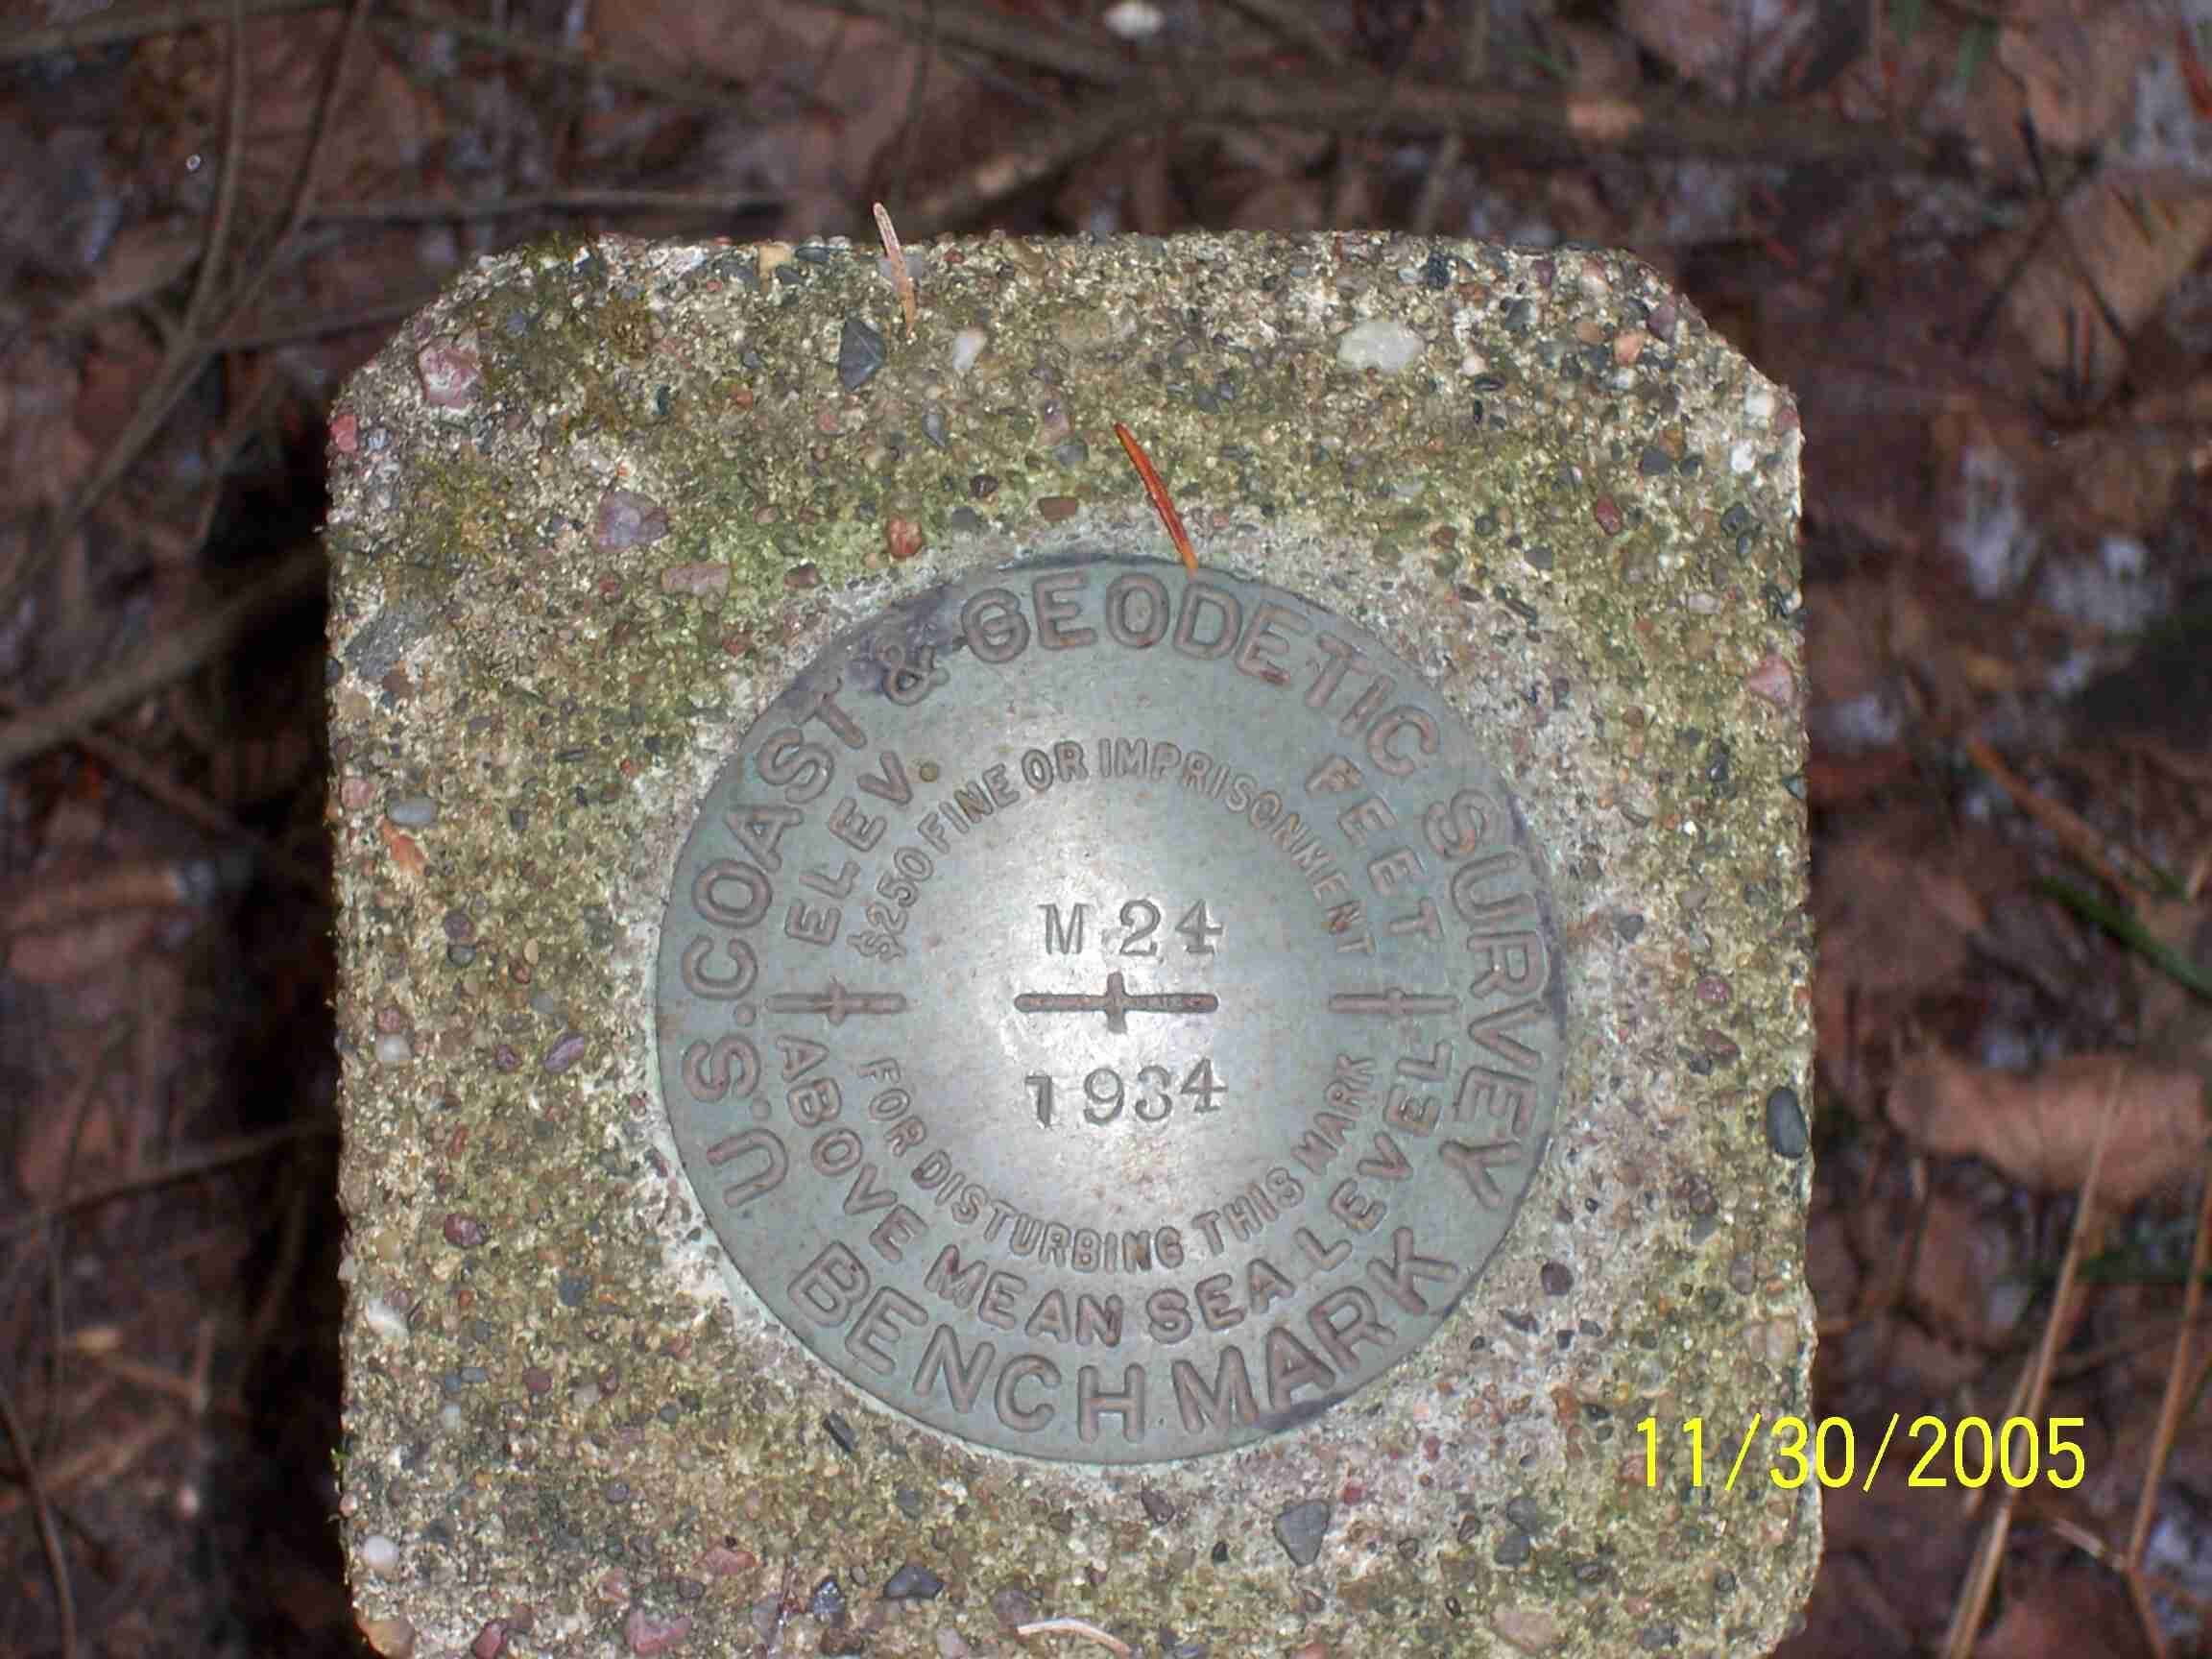
HISTORY OF WI-HMP
COMPLETED THE ORIGNAL HARN IN 1991 USING 80 STATIONS AT 50 Km SPACING
STARTED REMONUMENTING THE STATE IN 1999
FIRST ZONE OF 24 WISCORS STATIONS CAME ONLINE IN 2008 WITH 200 REGISTERED USERS

Slide 4
HISTORY OF WI-HMP FUNDING
Fiscal Year | NOAA Grant | State Match
2002 | $425,000 | $330,000
2003 | $400,000 | $465,000
2004 | $2,661,666 | $750,000
2005 | $2,661,273 | $700,000
2006 | $2,649,747 | $382,804
2007 | $1,200,000 | $300,000
2008 | $300,000 | $200,000
2009 | $2,147,900 | $200,000
2010 | $999,000 | $493,000
2011 | $0 | $495,000
2012 | $0 | $1,550,000
2013 | $0 | $700,000
Total | $13,444,586 | $6,565,804
FROM 1998 TO 2001 THE STATE PROVIDED APPROXIMATELY $2 MILLION IN FUNDING
2009 AND 2010 GRANTS WILL BE CLOSING DECEMBER 31, 2013

Slide 5
POSSIBLE FEE
THE DEPARTMENT IS AGAIN CONSIDERING IMPLEMENTING A NOMINAL RECOVERY FEE TO OFFSET OPERATIONAL COSTS

Slide 6
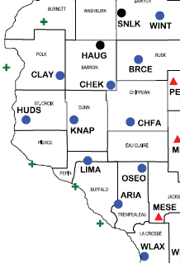
NEW CORS STATIONS
WINTER
BRUCE
CHETEK
CLAYTON
HUDSON
KNAPP
CHIPPEWA FALLS
LIMA
OSSEO
ARCADIA
LA CROSSE

Slide 7
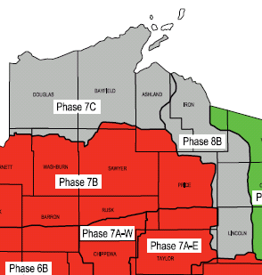
NEW NGS PUBLISHED MARKS
PHASE 7C & 8B
DOUGLAS, BAYFIELD, ASHLAND, IRON, VILAS, ONEIDA AND LINCOLN COUNTIES

Slide 8
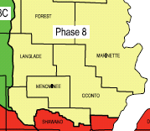
2013 MONUMENTATION
220 MONUMENTS LEFT TO CONSTRUCT IN THE NORTHEAST
WORKING THROUGH TRIBAL LEGISLATION IN MENOMINEE COUNTY

Slide 9
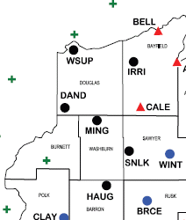
2013 CORS CONSTRUCTION
SUPERIOR
IRON RIVER
DANBURY
MINONG
SAND LAKE
HAUGEN
SIREN (MNCORS)

Slide 10
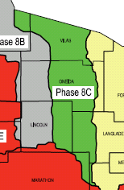
2013 SURVEY CAMPAIGNS
GPS AND LEVELING CAMPAIGNS SCHEDULED FOR PHASE 8C
IRON, VILAS, ONEIDA, LINCOLN, LANGLADE AND MARATHON COUNTIES

Slide 11
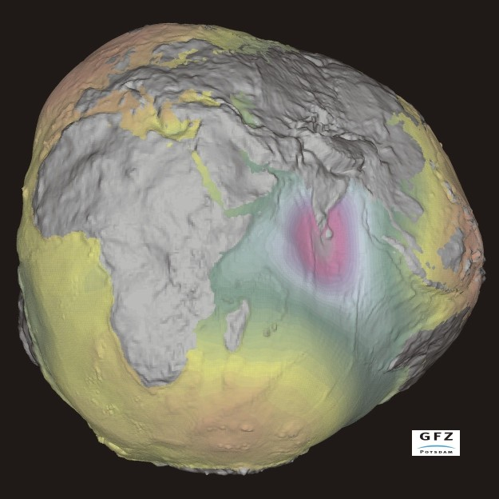
NA2011 WISCORS ADJUSTMENT
1.5 cm SHIFT PRIMARILY TO THE EAST
PURPOSE WAS TO MAINTAIN CONSISTENCY WITH THE NATIONAL NETWORK
TO BE USED WITH THE MOST CURRENT GLOBAL REFERENCE FRAME – IGS08

Slide 12
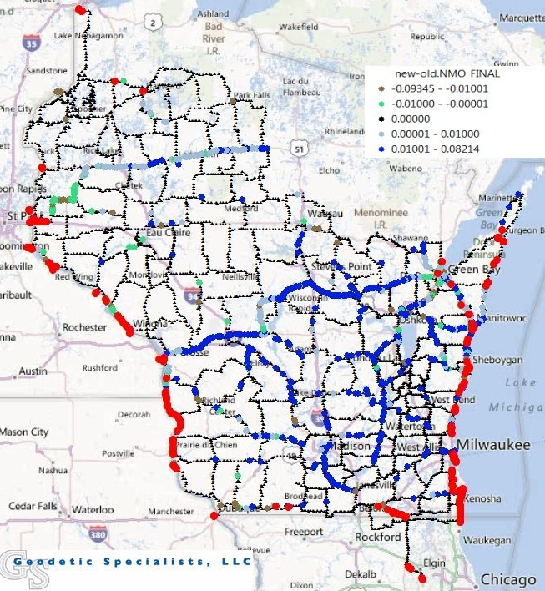
STATEWIDE LEVELING ADJUSTMENT
PUBLISHED BENCHMARKS AND WATER GAUGE STATIONS HAD MISCLOSURE
221 COASTLINE, WATER GAUGE STATIONS AND NEIGHBORING STATE BENCHMARKS WERE CONSTRAINED
RESULTED IN GEOID MODEL 12A

Slide 13
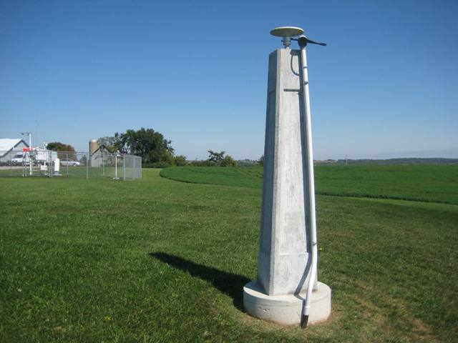
MONROE CORS STATION
CATASTROPHIC DESTRUCTION OF MONROE AIRPORT TERMINAL
THE STATION WILL BE OPERATING DURING THE AIRPORT CONSTRUCTION PROJECT

Slide 14
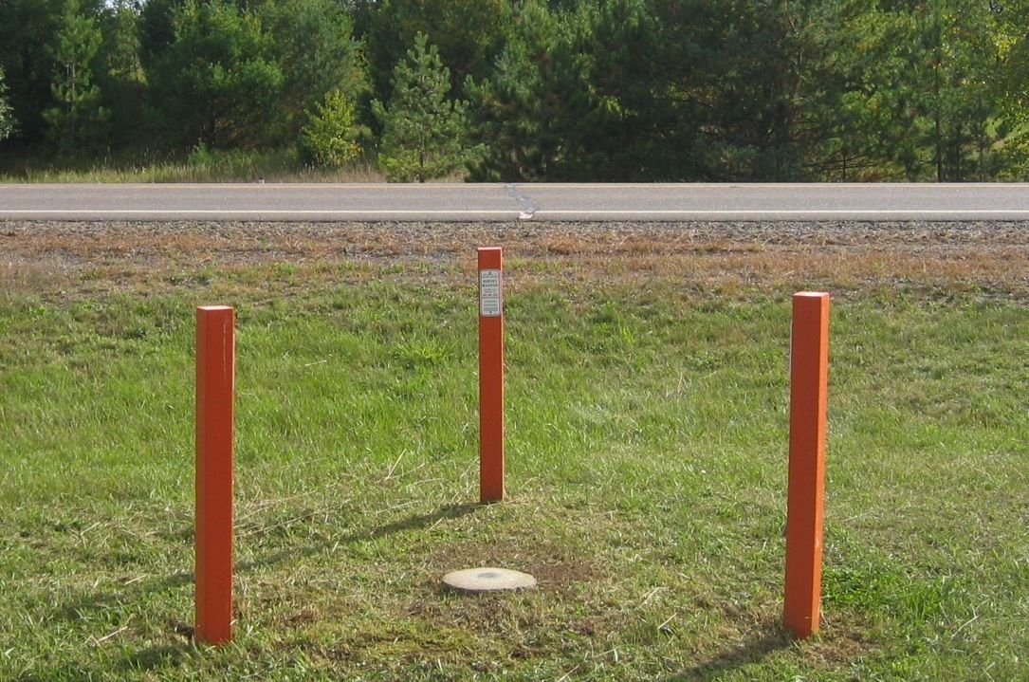
MONUMENT PRESERVATION
WISDOT REPLACEMENT DOCUMENT OUTLINING ROLES AND RESPONSIBILITIES FOR REESTABLISHMENT OF GEODETIC CONTROL STATIONS DESTROYED BY WISDOT CONSTRUCTION PROJECTS

Slide 15
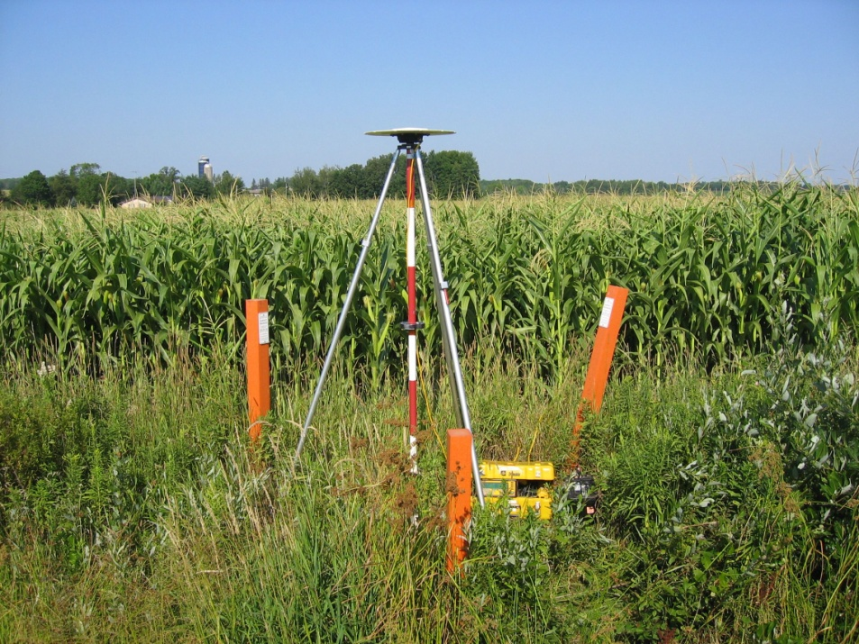
MONUMENT PRESERVATION
TO REPORT AN ISSUE WITH A MONUMENT PLEASE CALL
866-568-2852
OR EMAIL geodetic@dot.wi.gov
PLEASE INCLUDE THE COUNTY, THE HIGHWAY OR ROAD THE MONUMENT IS LOCATED ON, THE DESIGNATION STAMPED ON THE DISC, A BRIEF DESCRIPTION OF THE ISSUE HAPPENING AT THE MONUMENT SITE AND A CALL BACK NUMBER

Slide 16
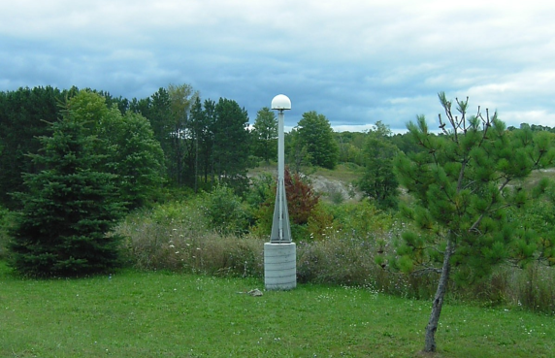
SHARING CORS STATIONS
PURSUING LICENSING TO BE ABLE TO INCLUDE 10 STATIONS FROM IOWA, MICHIGAN AND MINNESOTA IN THE WISCORS NETWORK

Slide 17
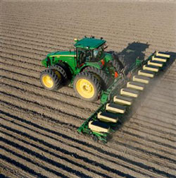
PRODUCTS AND ACCESS TO DATA
NATIONAL GEODETIC SURVEY
http://www.ngs.noaa.gov/
STATE CARTOGRAPHERS OFFICE
http://www.sco.wisc.edu/
SHAPE AND TEXT FILES AVAILABLE
COUNTY MAPS IN .pdf FORMAT
REFERENCE DATA FOR POST PROCESSING
https://wiscors.dot.wi.gov

Slide 18
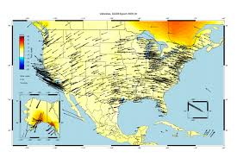
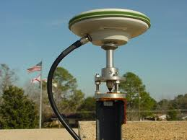
RESEARCH PARTNERS
GIOVANNI SELLA, PhD.
NATIONAL CORS PROGRAM MANAGER
CHUCK DEMETS, PhD.
PROFESSOR OF GEOLOGY
UW - MADISON

Slide 19
EDUCATION AND OUTREACH
WSLS ANNUAL INSTITUTE
WISDOT SURVEY WORKSHOP
CORN/SOY EXPO
WLIA ANNUAL CONFERENCE
WISDOT REGIONAL UTILITY CONFERENCES
WISDOT AERONAUTICS CONFERENCE
DIGGER’S HOTLINE SAFETY MEETINGS
MINNESOTA SURVEY TECHNICAL WORKSHOP
FARM TECHNOLOGY DAYS
WISCONSIN COUNTY SURVEYORS ASSOCIATION
GREAT LAKES REGION HEIGHT MODERNIZATION CONSORTIUM
WIGICC – ELEVATION WORKGROUP
UW GIS DAY

Slide 20
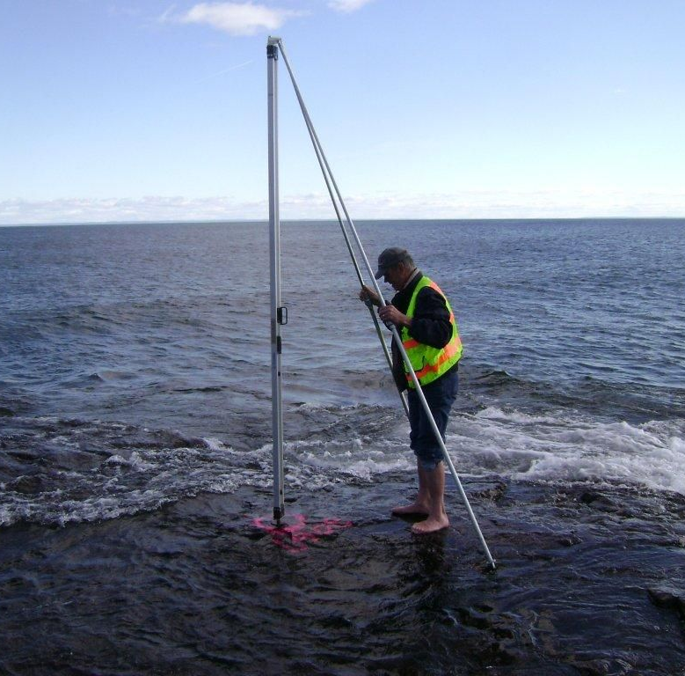
COOL WEBSITES
www.spaceweather.com
www.landsurveyorsunited.com
www.marinesurvey.org
www.gps.gov
www.wisconsinview.org
www.noaa.gov

Slide 21
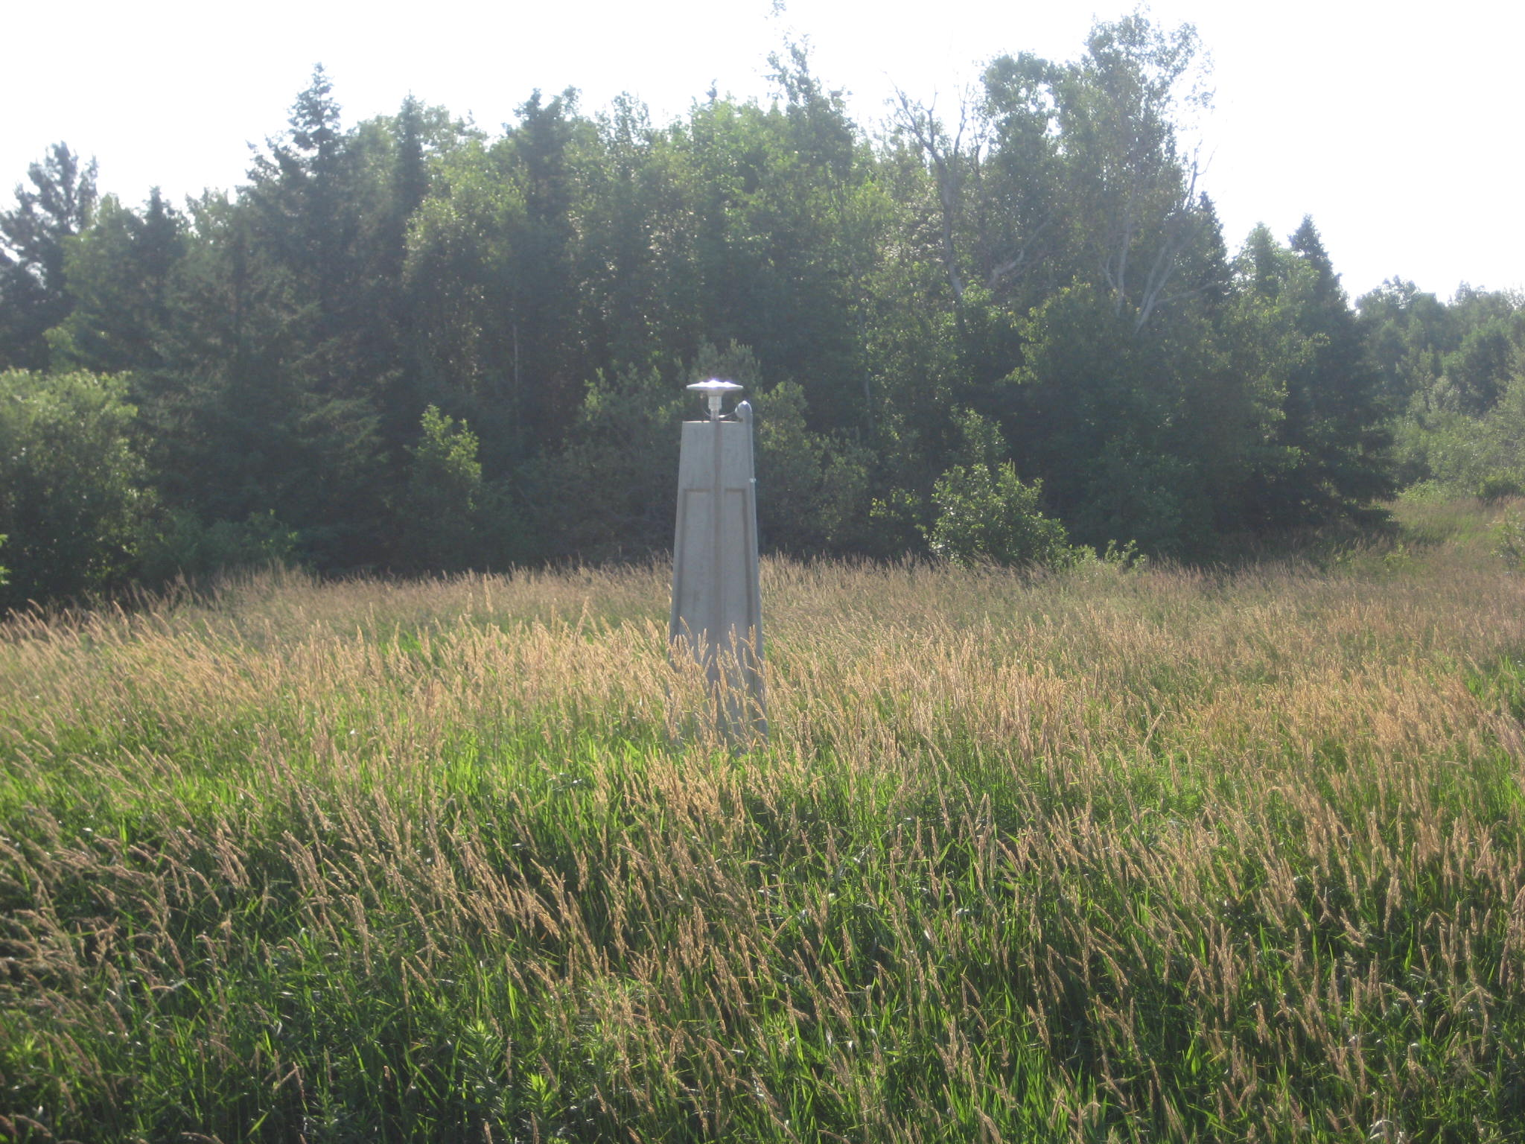
QUESTIONS OR COMMENTS?

