Slide 1

WISCONSIN HEIGHT MODERNIZATION PROGRAM
NATIONAL HEIGHT MODERNIZATION
PARTNER MEETING
APRIL 29 to 30 MOBILE, AL

Slide 2
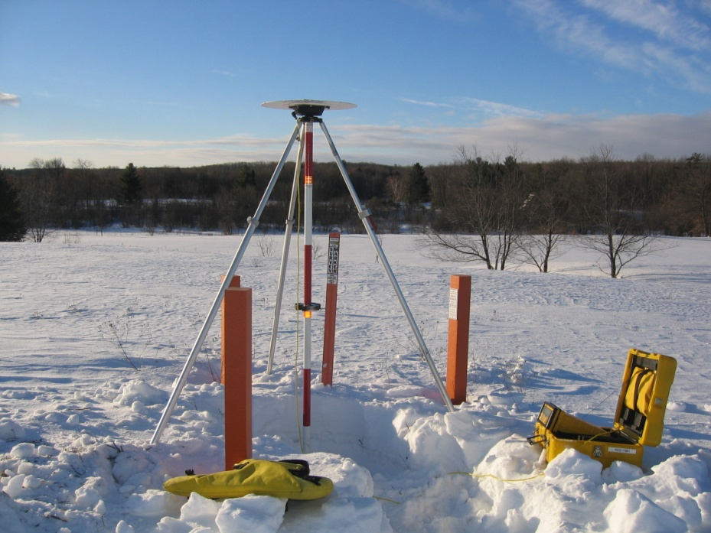
WI-HMP OBJECTIVES
TO PROVIDE REAL-TIME, SUB 2 CM-HORIZONTAL AND VERTICAL POSITIONING STATEWIDE
TWO RELIABLE, INDEPENDENT NETWORKS ARE NECESSARY TO MAKE THIS ACCURACY POSSIBLE. THE PASSIVE NETWORK IS THE GEODETIC CONTROL MONUMENTS AND THE ACTIVE NETWORK IS WISCORS

Slide 3
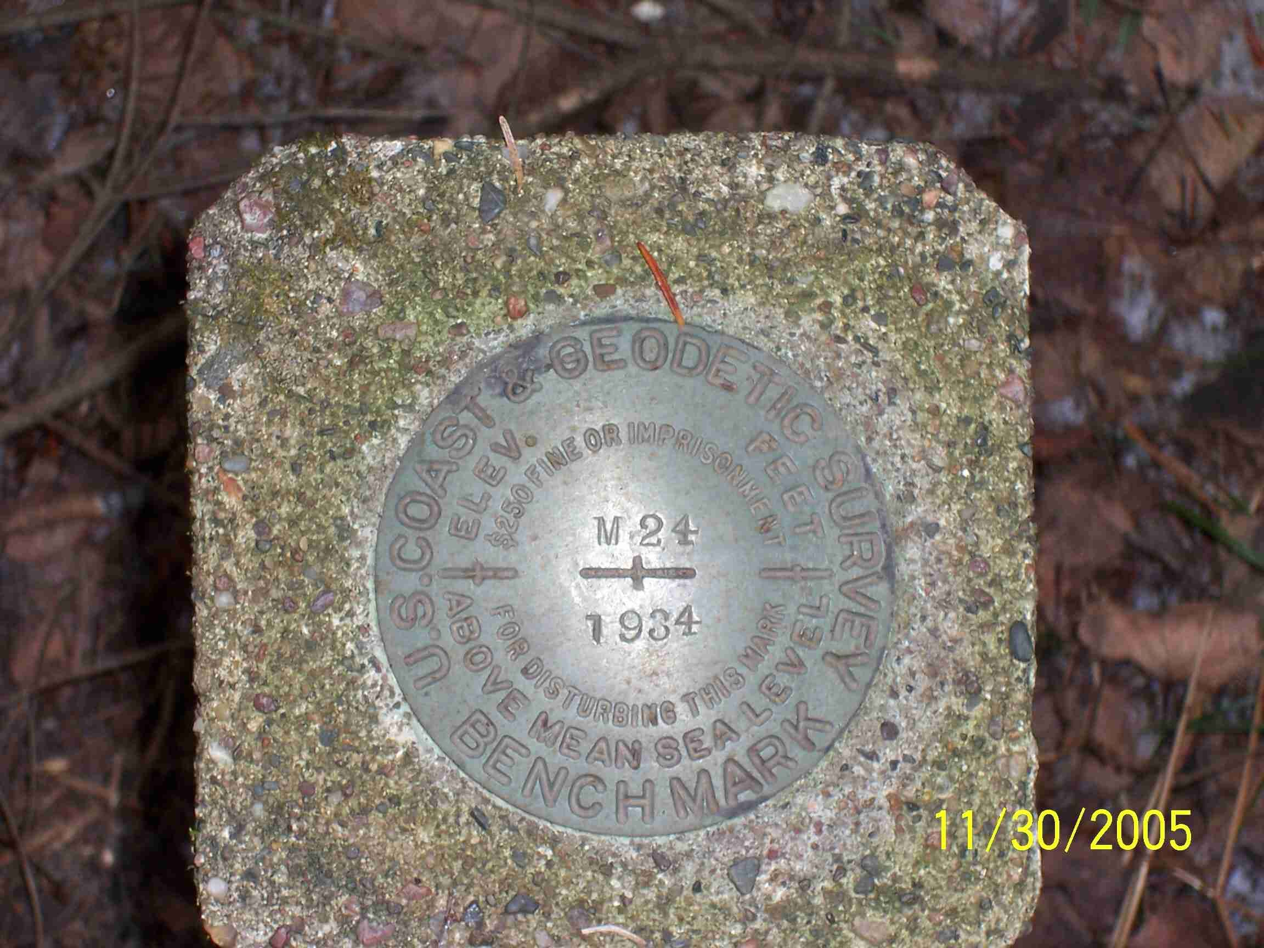
HISTORY OF WI-HMP
COMPLETED THE ORIGNAL HARN IN 1991 USING 80 STATIONS AT 50 Km SPACING
STARTED REMONUMENTING THE STATE IN 1999
FIRST ZONE OF 24 WISCORS STATIONS CAME ONLINE IN 2008 WITH 200 REGISTERED USERS

Slide 4
HISTORY OF WI-HMP FUNDING
Fiscal Year | NOAA Grant | State Match
2002 | $425,000 | $330,000
2003 | $400,000 | $465,000
2004 | $2,661,666 | $750,000
2005 | $2,661,273 | $700,000
2006 | $2,649,747 | $382,804
2007 | $1,200,000 | $300,000
2008 | $300,000 | $200,000
2009 | $2,147,900 | $200,000
2010 | $999,000 | $493,000
2011 | $0 | $495,000
2012 | $0 | $1,550,000
2013 | $0 | $700,000
Total | $13,444,586 | $6,565,804
FROM 1998 TO 2001 THE STATE PROVIDED APPROXIMATELY $2 MILLION IN FUNDING
ALL GRANTS ARE CLOSED AS OF DECEMBER 31, 2013

Slide 5
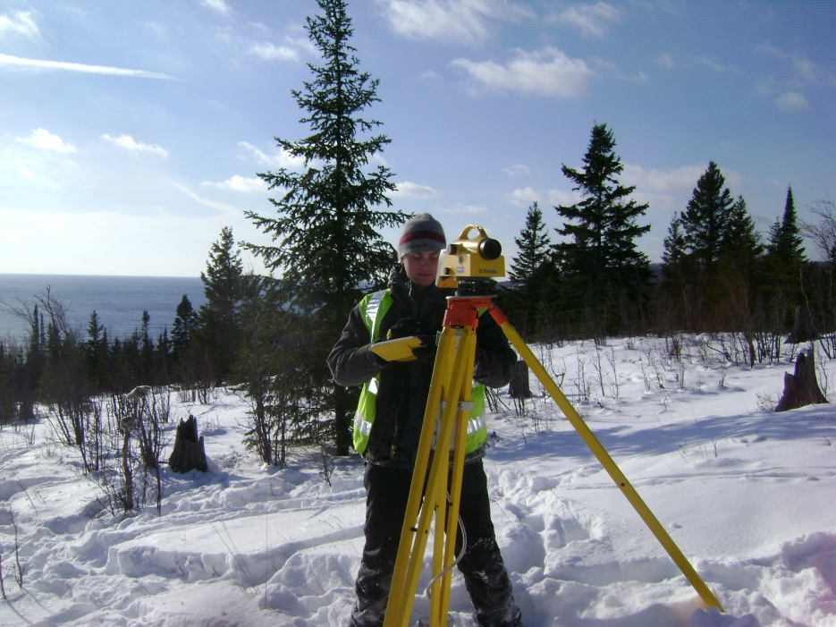
REPLACEMENT PROCEDURE
DESCRIBES THE ROLES, RESPONSIBILITIES AND FUNDING NECESSARY TO REPLACE A WI-HMP CONTROL STATION THAT IS DESTROYED AS A RESULT OF A WISDOT IMPROVEMENT PROJECT
SUBMIT A JOURNAL VOUCHER REQUEST TO EXPENDITURE ACCOUNTING TO TRANSFER FUNDS FROM THE WISDOT PROJECT ID TO THE WI-HMP PROJECT ID

Slide 6

WISCORS TRANSITIONING TO THE PIVOT PLATFORM
WE ARE AT MAXIMUM CAPACITY
CUT OVER IS SCHEDULED FOR JULY 31, 2014

Slide 7
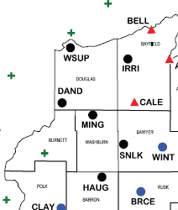
NEW WISCORS STATIONS
SUPERIOR
IRON RIVER
DANBURY
MINONG
SAND LAKE
HAUGEN
SIREN (MNCORS)

Slide 8
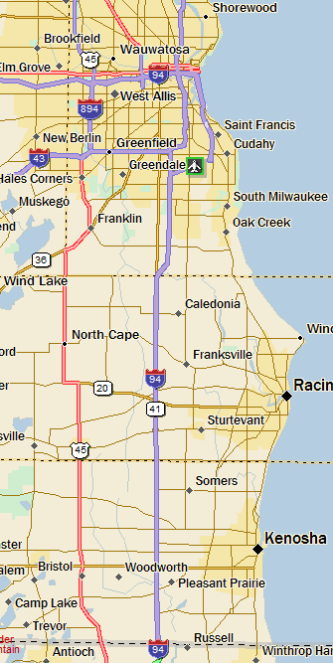
SE FREEWAY PROJECT
41 MILES OF INTERSTATE 94 FROM ILLINOIS STATE LINE TO THE ZOO INTERCHANGE IN WAUKESHA COUNTY.

Slide 9
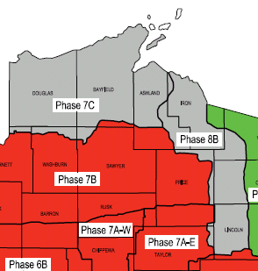
NEW NGS PUBLISHED MARKS
PHASE 7C & 8B
DOUGLAS, BAYFIELD, ASHLAND, IRON, VILAS, ONEIDA AND LINCOLN COUNTIES

Slide 10
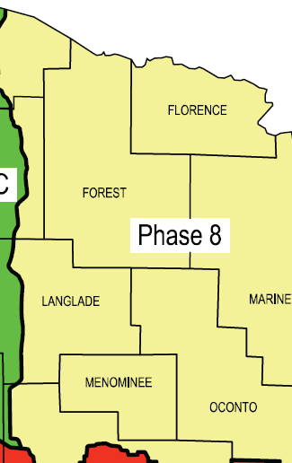
2014 SURVEY CAMPAIGNS
GPS AND LEVELING CAMPAIGNS SCHEDULED FOR PHASE 8D
800 Km OF LEVELING. GPS CAMPAIGN BEING DEVELOPED

Slide 11
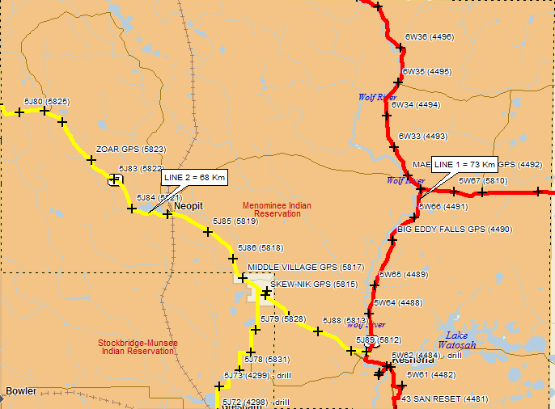
MENOMINEE INDIAN RESERVATION
47 MONUMENTS
8 YEARS IN THE MAKING
QUALITY CONTROL FOR KEY LAND MANAGEMENT USES IN A REMOTE AREA

Slide 12
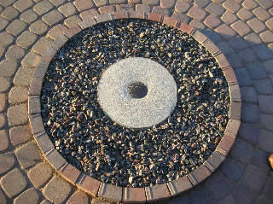
OPUS PROJECTS TRAINING
OPUS PROJECTS TRAINING IN MAY FOR WISDOT EMPLOYEES
RON RIPP GPS WILL BE OUR PILOT PROJECT

Slide 13
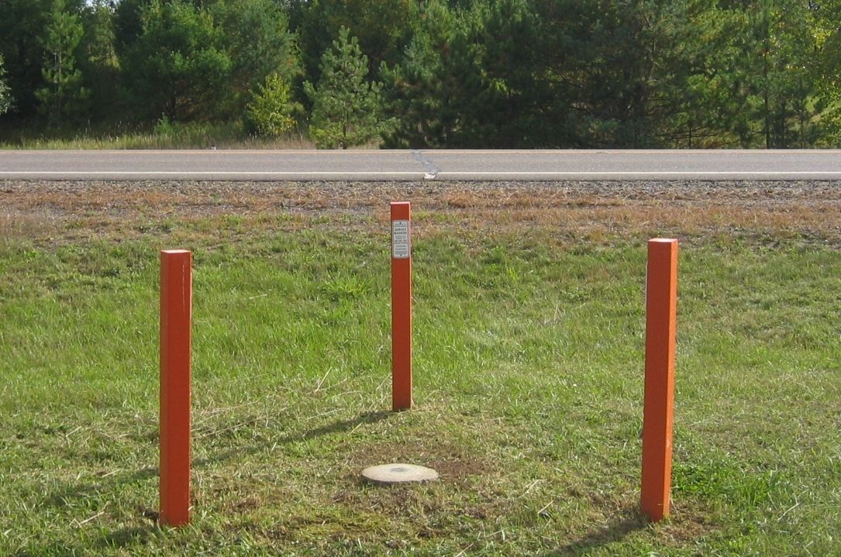
3D TECHNOLOGY POLICY
WISDOT REQUIRING ALL UTILITY FACILITIES WITHIN THE HIGHWAY RIGHT-OF-WAY TO HAVE AN ACCURATE VERTICAL COMPONENT

Slide 14
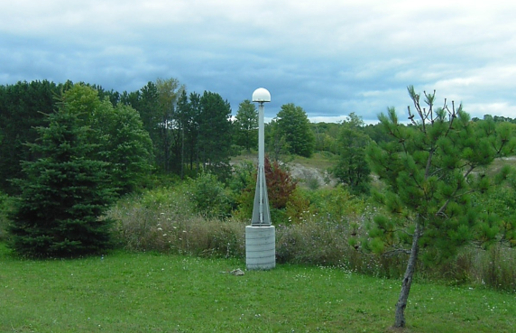
SHARING CORS STATIONS
PURSUING LICENSING TO BE ABLE TO INCLUDE 10 STATIONS FROM IOWA, MICHIGAN AND MINNESOTA IN THE WISCORS NETWORK

Slide 15
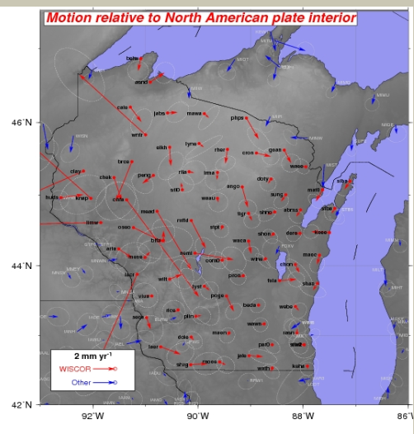
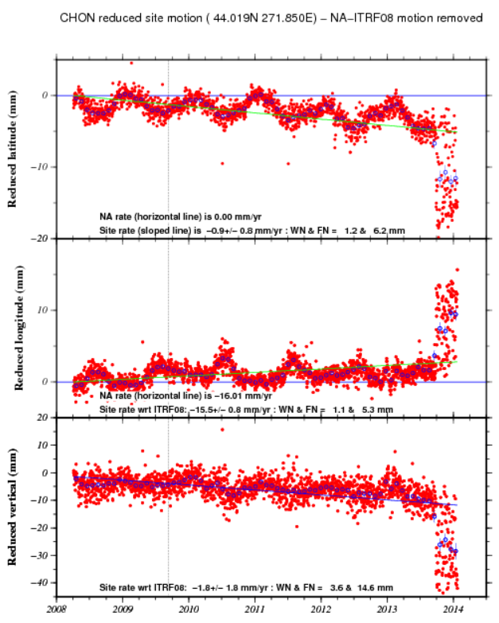
UW-MADISON Hi-Fi WISCORS www.geoscience.wisc.edu
WISCORS TIME SERIES
VELOCITY MAPS

Slide 16

EDUCATION AND OUTREACH
WSLS ANNUAL INSTITUTE
WISDOT SURVEY WORKSHOP
CORN/SOY EXPO
WLIA ANNUAL CONFERENCE
WISDOT REGIONAL UTILITY CONFERENCES
WISDOT AERONAUTICS CONFERENCE
DIGGER’S HOTLINE SAFETY MEETINGS
MINNESOTA SURVEY TECHNICAL WORKSHOP
FARM TECHNOLOGY DAYS
WISCONSIN COUNTY SURVEYORS ASSOCIATION
GREAT LAKES REGION HEIGHT MODERNIZATION CONSORTIUM
WIGICC – ELEVATION WORKGROUP
UW GIS DAY

Slide 17




PRODUCTS AND ACCESS TO DATA
NATIONAL GEODETIC SURVEY
http://www.ngs.noaa.gov/
STATE CARTOGRAPHERS OFFICE
http://www.sco.wisc.edu/
SHAPE AND TEXT FILES AVAILABLE
COUNTY MAPS IN .pdf FORMAT
REFERENCE DATA FOR POST PROCESSING
https://wiscors.dot.wi.gov

Slide 18
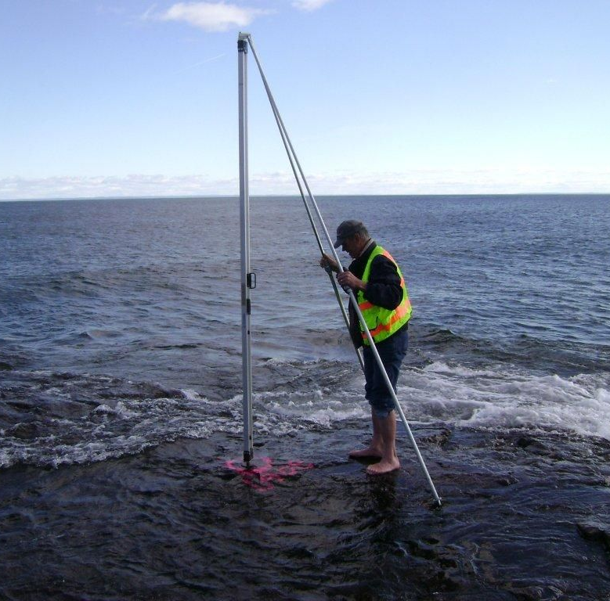
COOL WEBSITES
www.spaceweather.com
www.landsurveyorsunited.com
www.marinesurvey.org
www.gps.gov
www.wisconsinview.org
www.noaa.gov

Slide 19
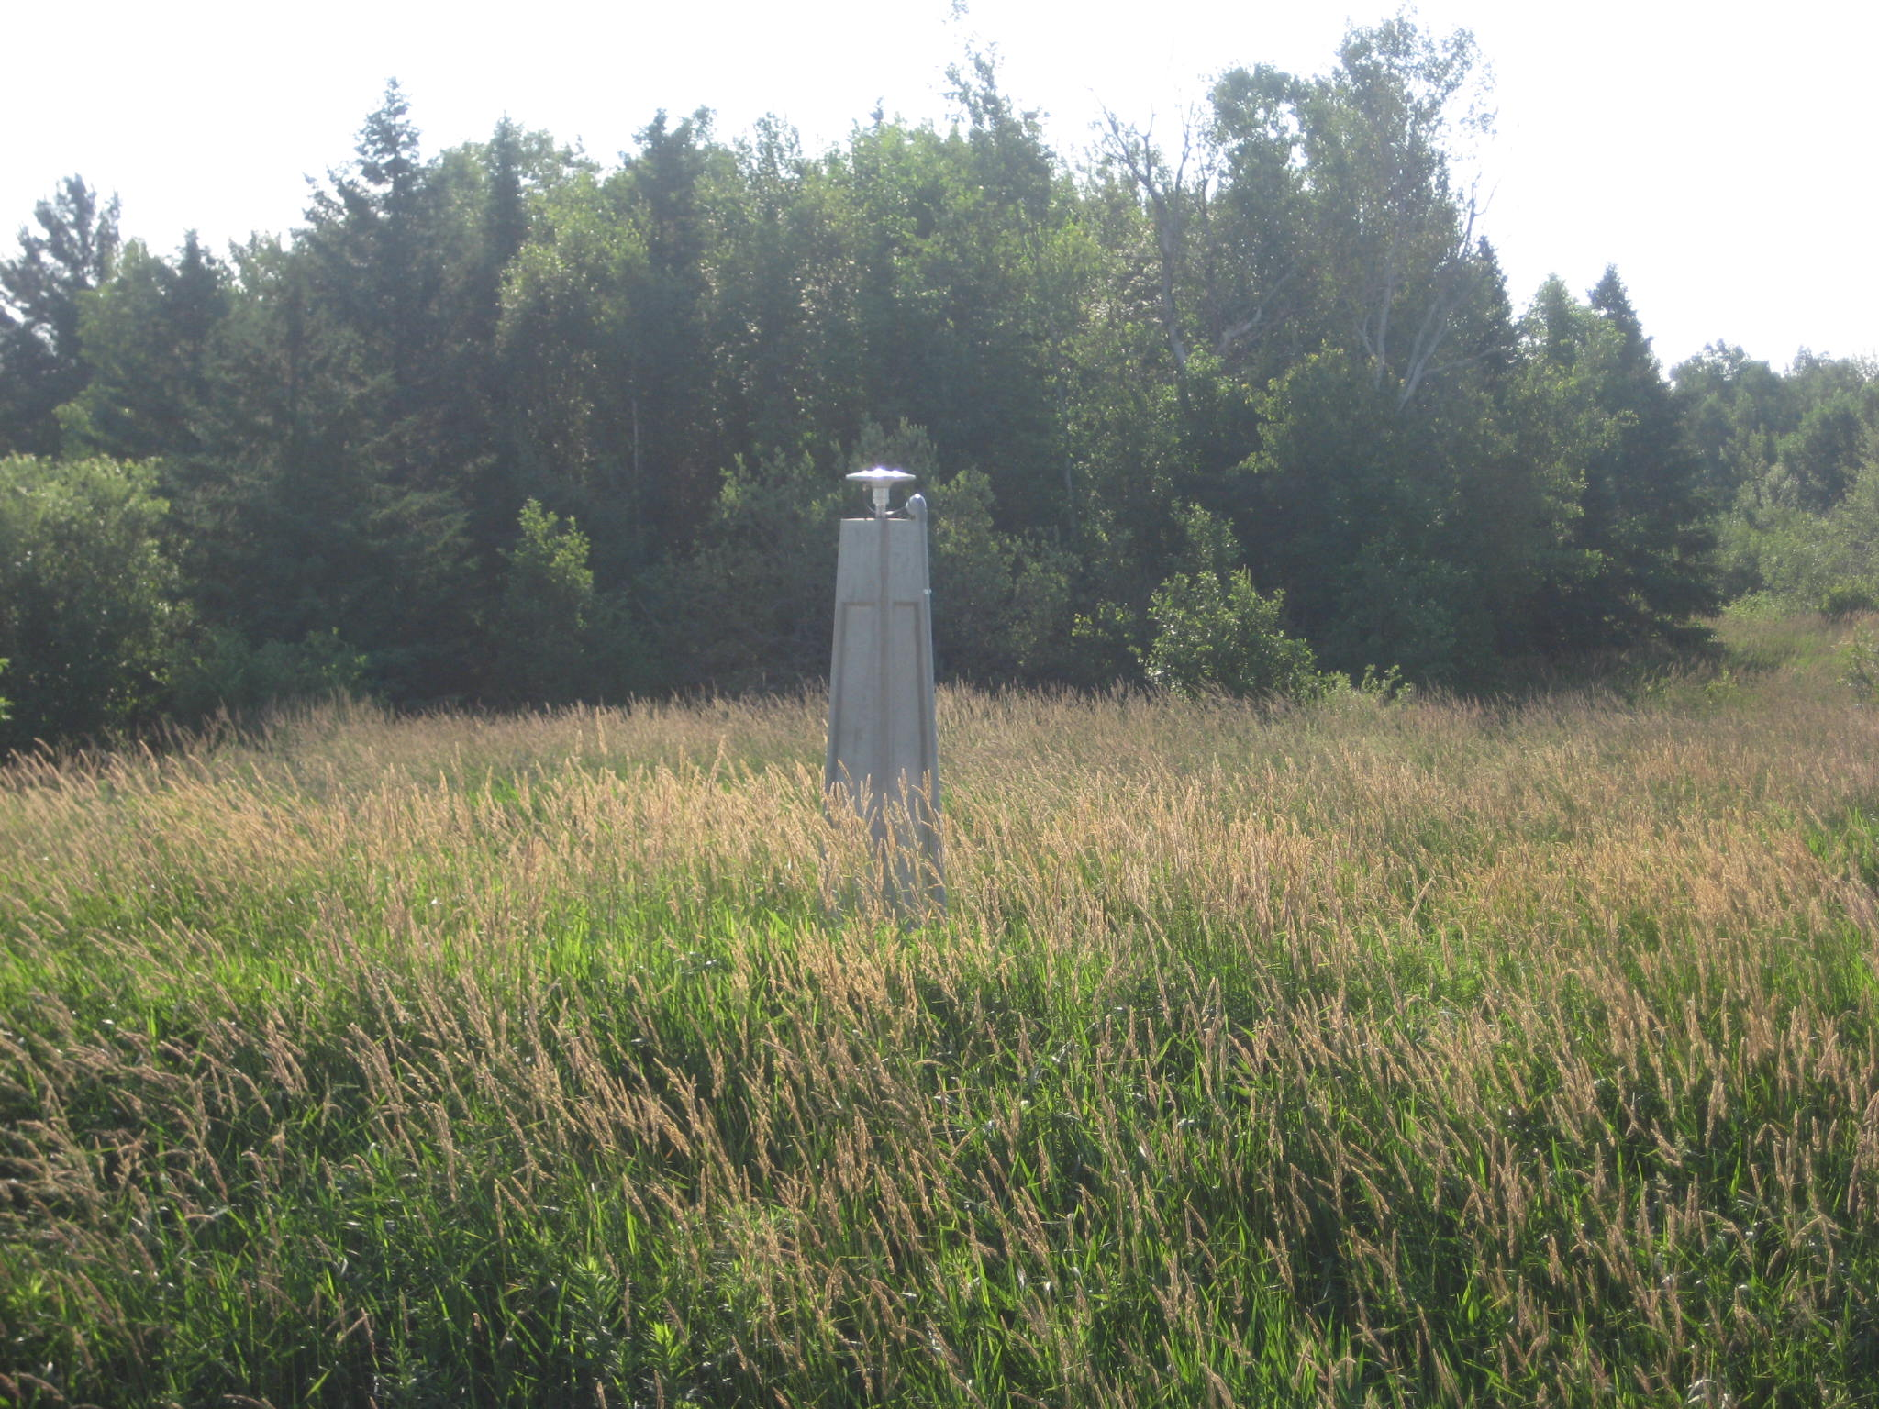
QUESTIONS OR COMMENTS?

