Slide 1
Delaware Height modernization
Drexel Siok
Delaware Department of Natural Resources and Environmental Control
Delaware Coastal Programs

Slide 2
Project Work Plan
Task 1. Inventory and Compile Existing Vertical Control Infrastructure
Phase 1. Detailed assessment of existing Benchmark infrastructure
Phase 2. Gap analysis in Coverage
Task 2. Conduct Height Modernization to establish backbone network and sentinel network
Phase 1. Installation of Benchmarks in Key Areas or Data Gaps
Phase 2. Conduct Height Modernization of Benchmark Network
Phase 3. Perform Orthometric Height Analysis
Phase 4. Publish Result of Height Modernization to NGS Database
Task 3. Development of Guidance Document and Distribution to the Community of Users in Delaware.

Slide 3
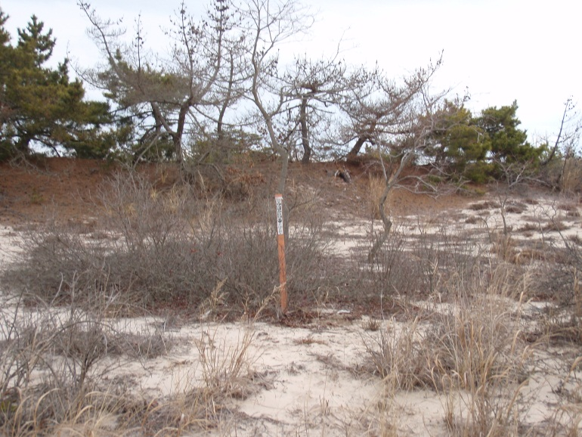
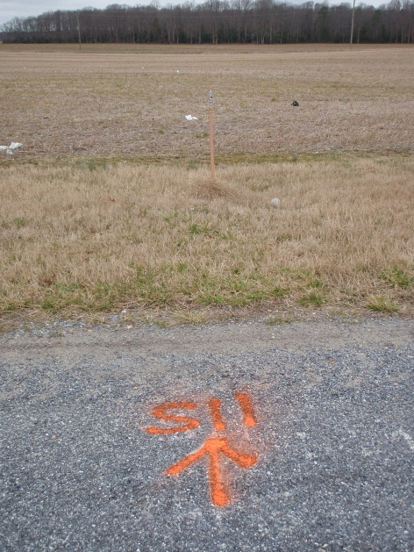
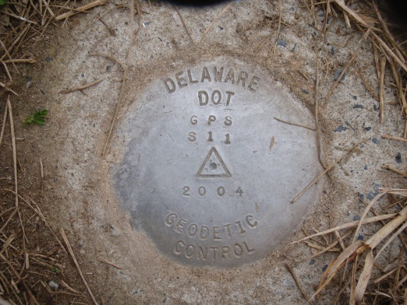
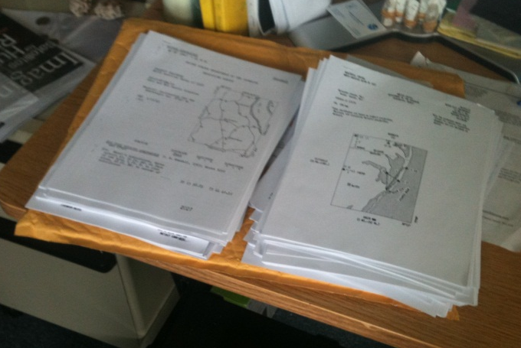
Existing Benchmarks
Source
NGS
DCP
Shoreline and Waterway Section
USFWS

Slide 4
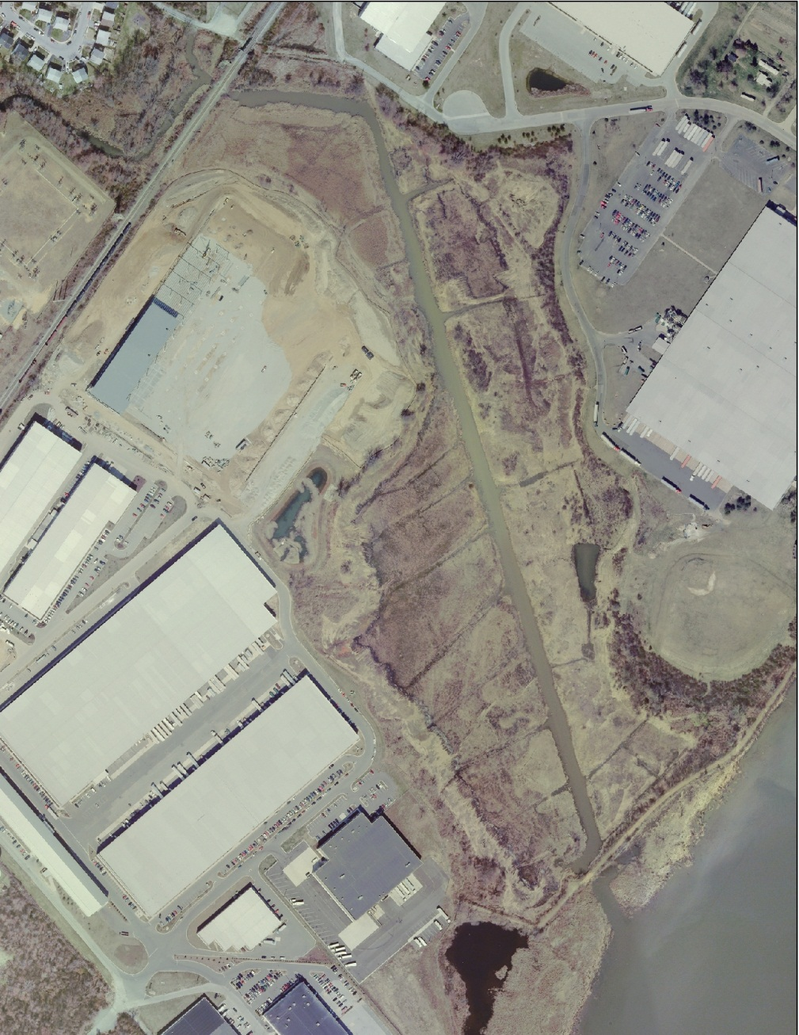
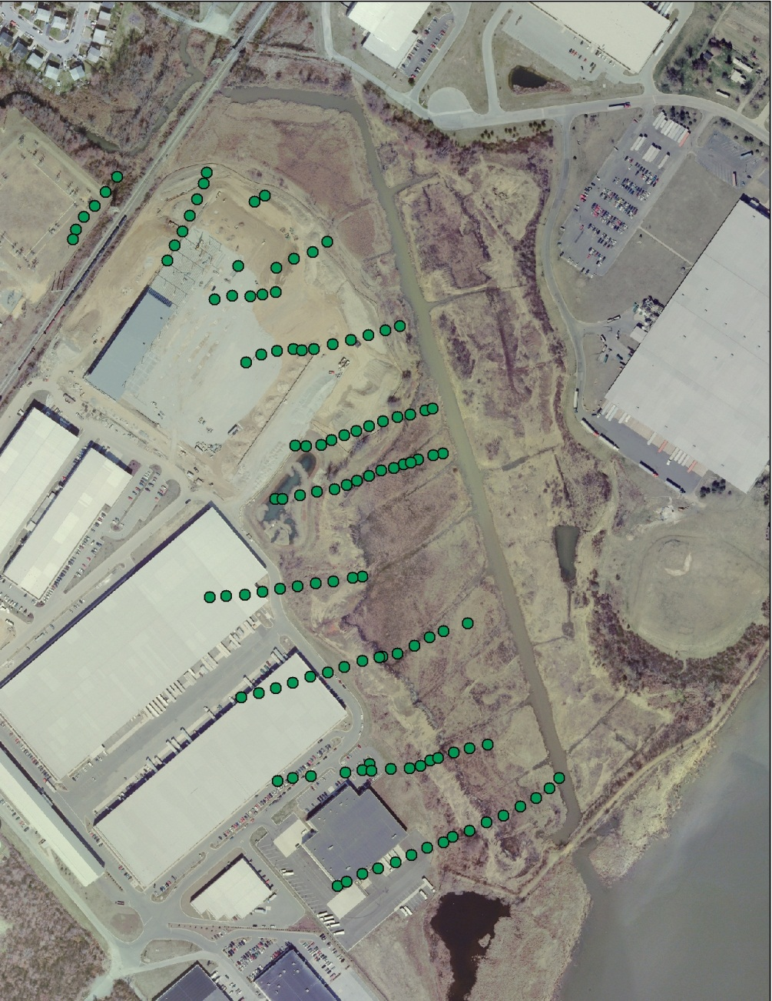
Identifying the Problem

Slide 5
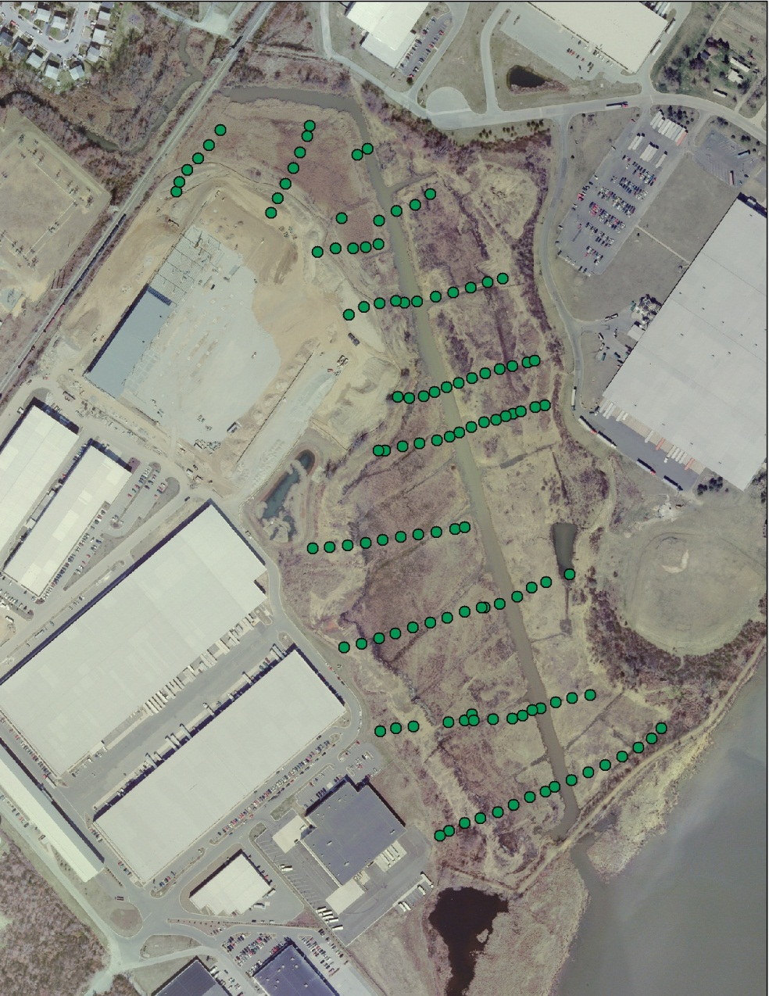
Solution to the Problem

Slide 6
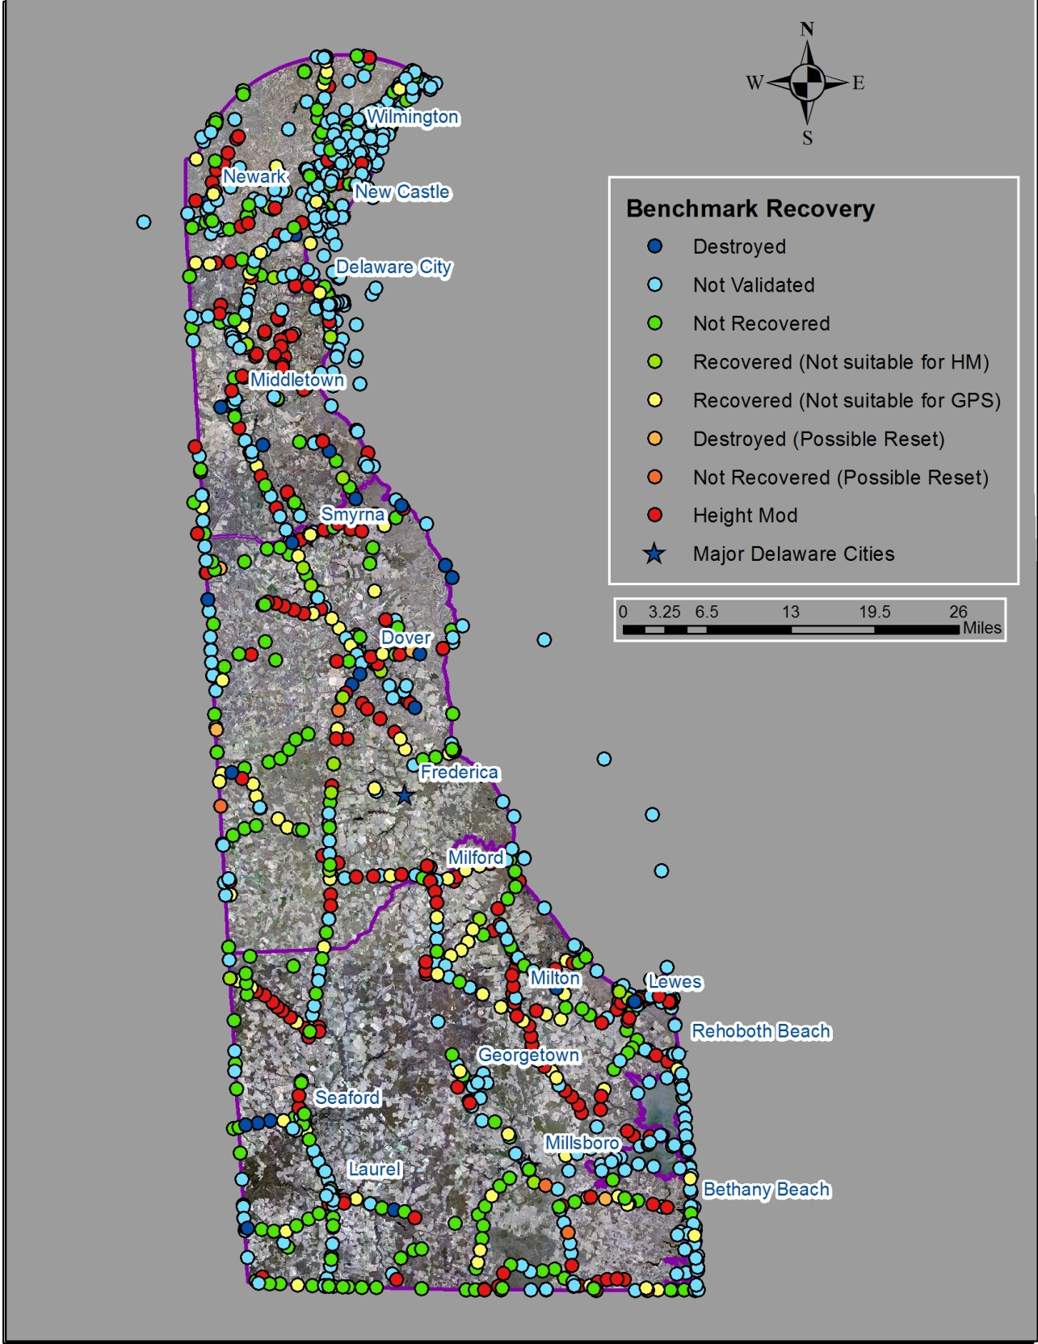
Task 1. Inventory and Compile Existing Vertical Control Infrastructure
Delaware Reconnaissance
1,465 Total benchmarks
413 Recovered
238 Suitable for Height Mod
36 Not Suitable for Height Mod
139 Not Suitable for GPS
327 Not recovered
692 Not Validated
Access issues
Thought to be destroyed
Water tower/Spire

Slide 7
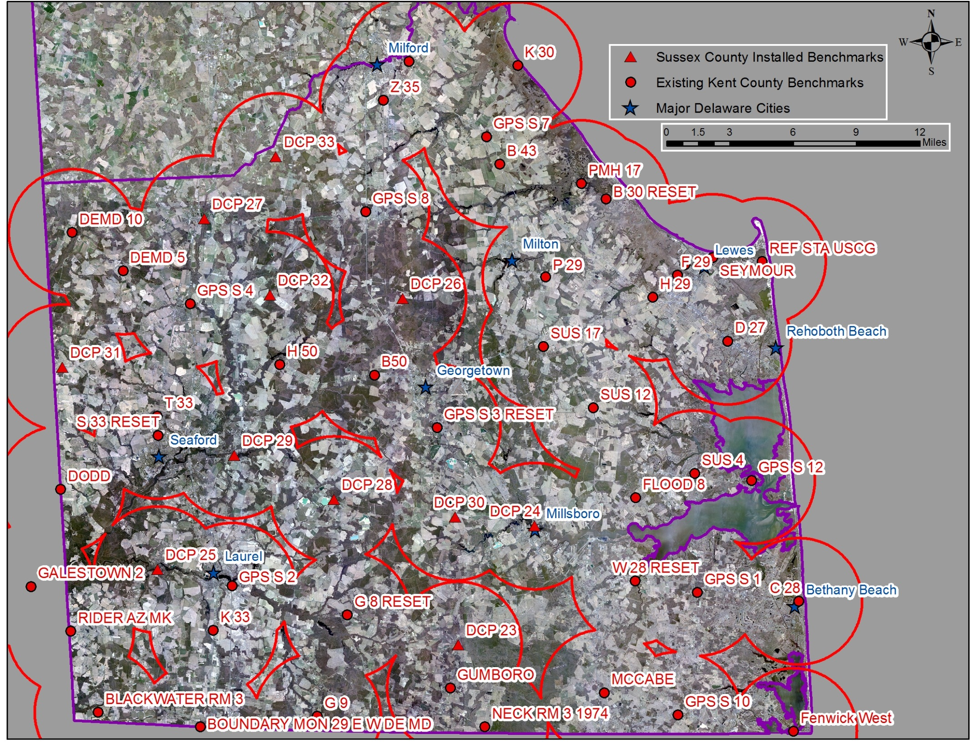
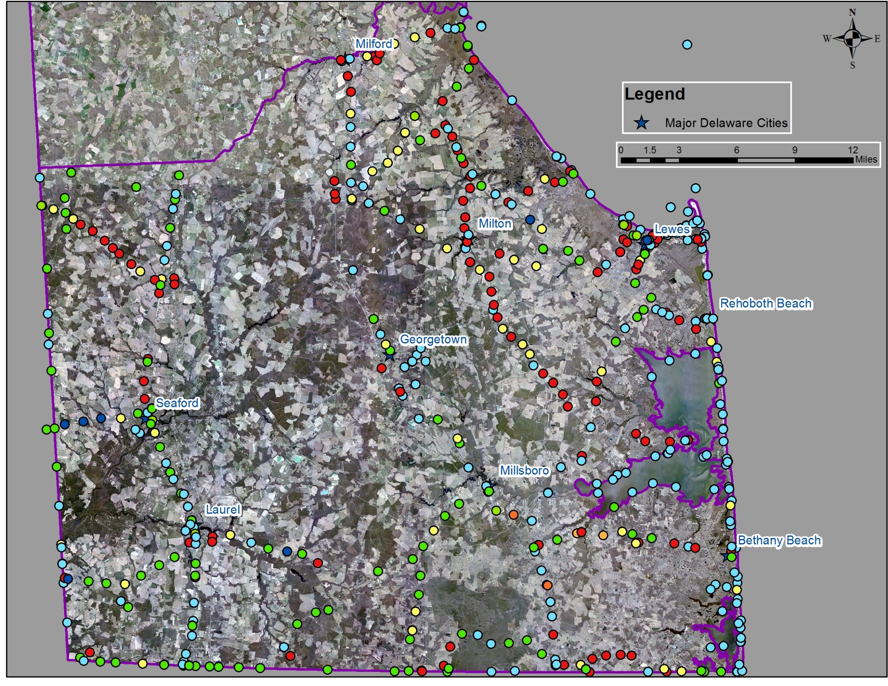
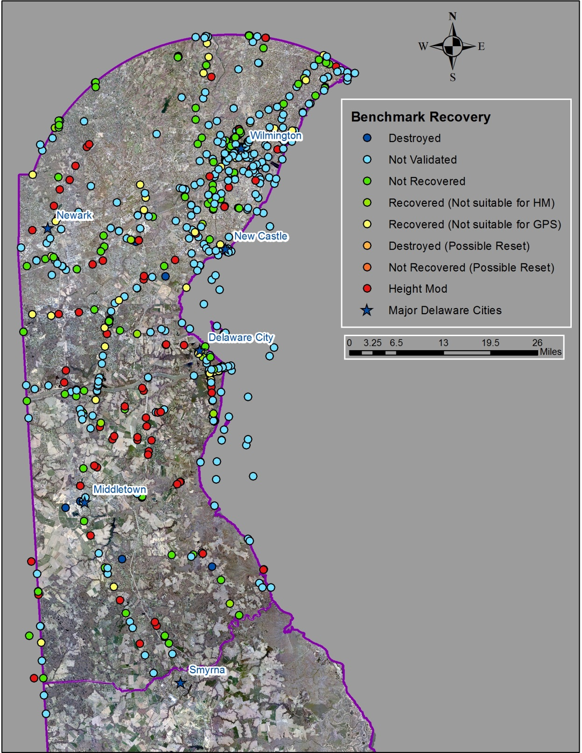
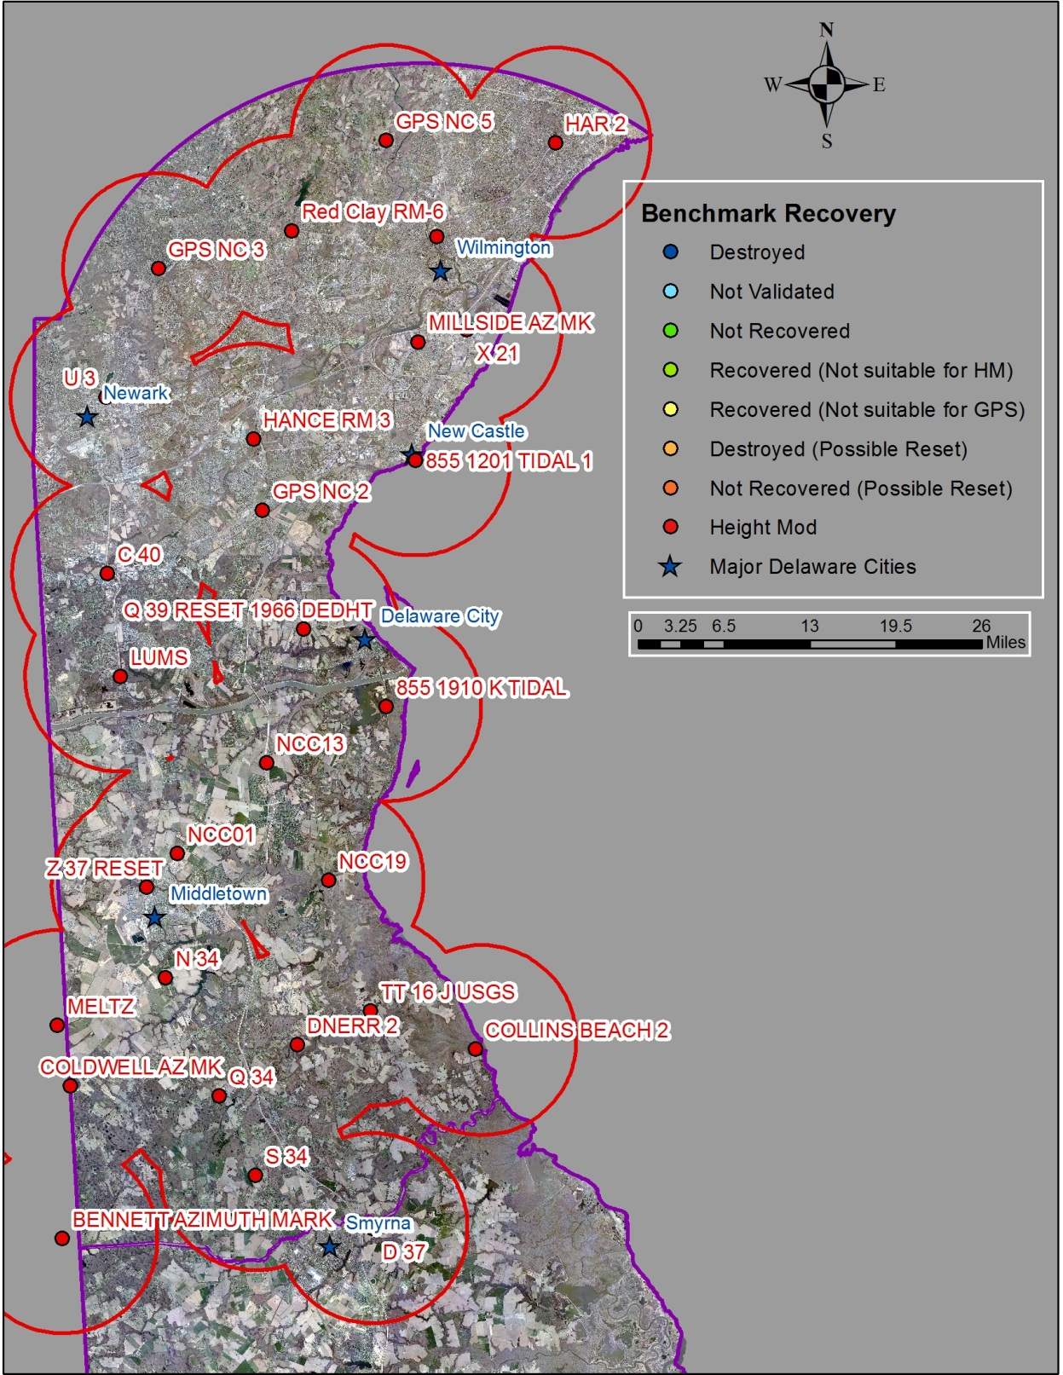
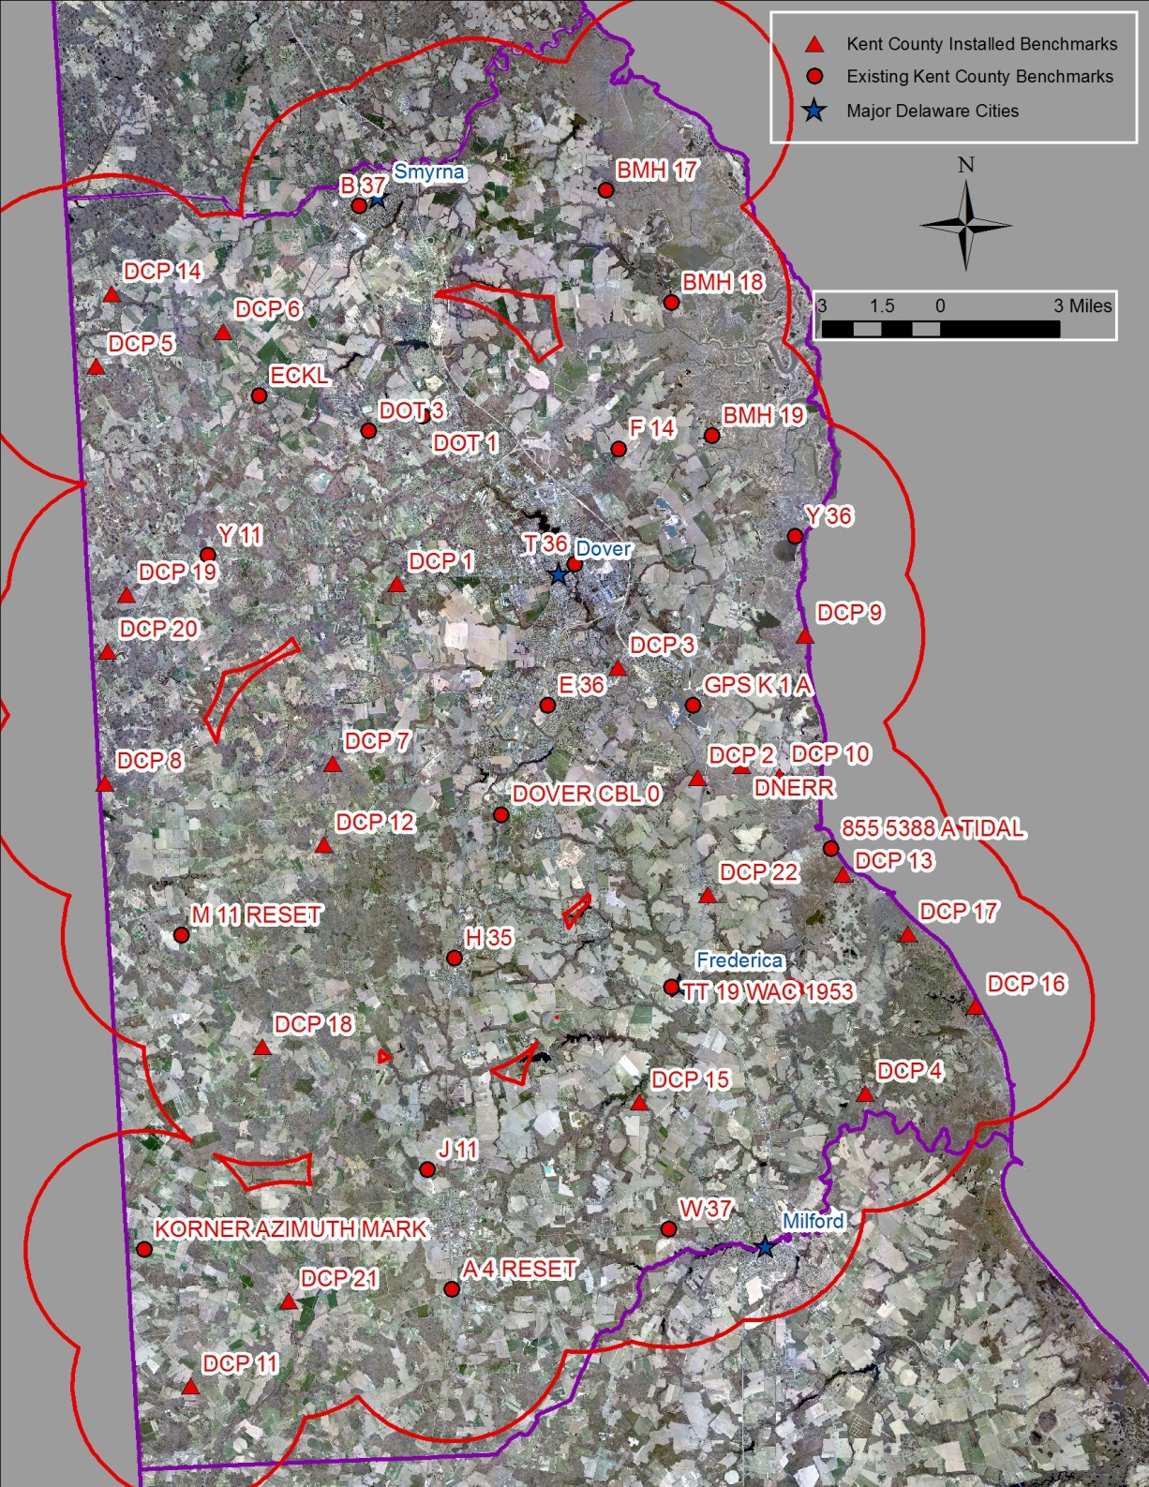
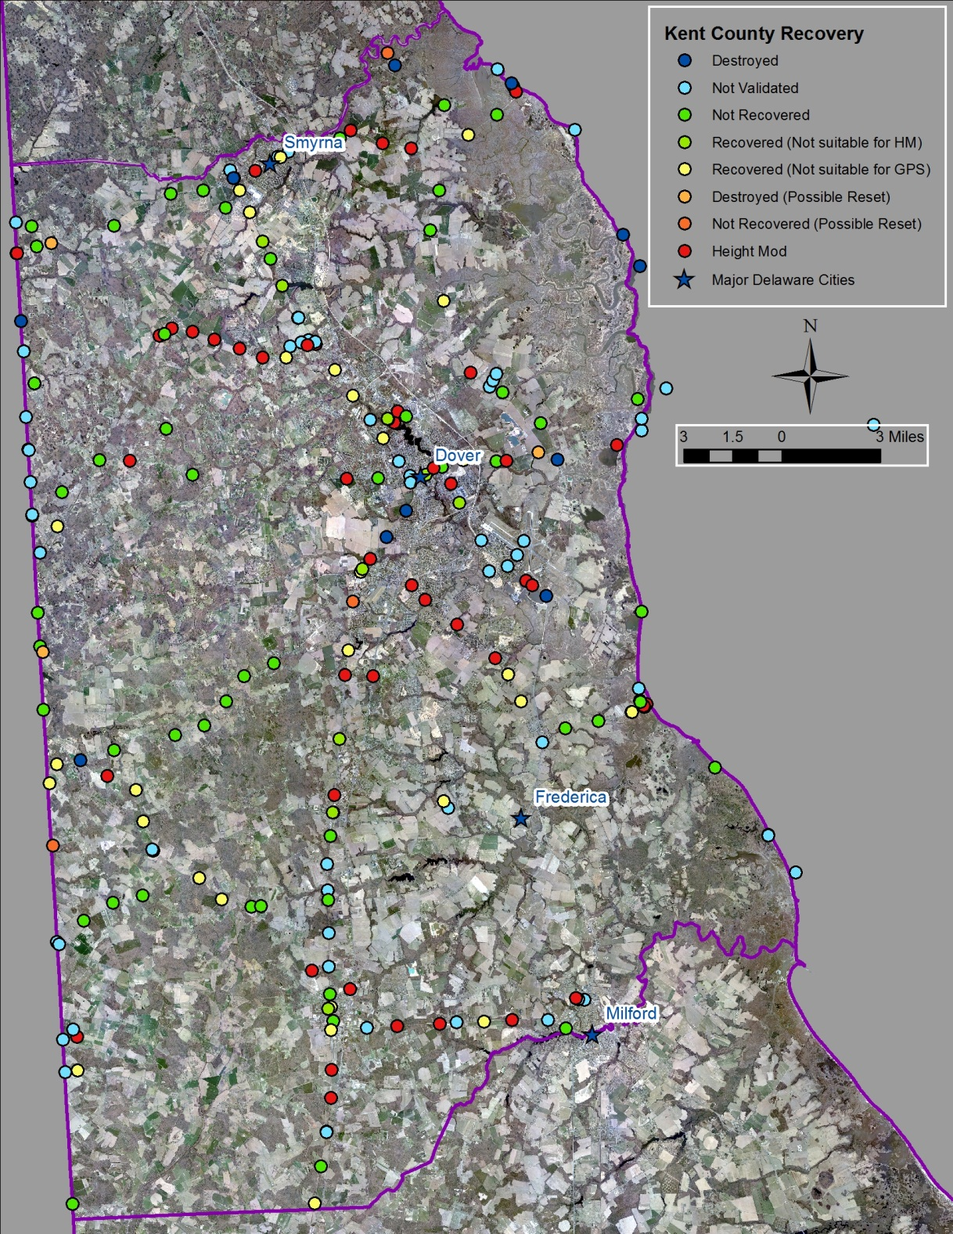
Task 2. Conduct Height Modernization to establish backbone network and sentinel network
New Castle County
No additional benchmarks needed
Kent County
22 New benchmarks installed
Sussex County
11 new benchmarks installed

Slide 8
Delaware Coastal Programs Current Needs for Accurate Elevation Data
Water Level Monitoring
Kitts Hummock
New Castle County Dikes
5 historic dikes which serve for flood protection
Water Control Structures
In all three counties
Road Elevation Profiles
Access roads to coastal communities
Emergency Evacuation routes

Slide 9
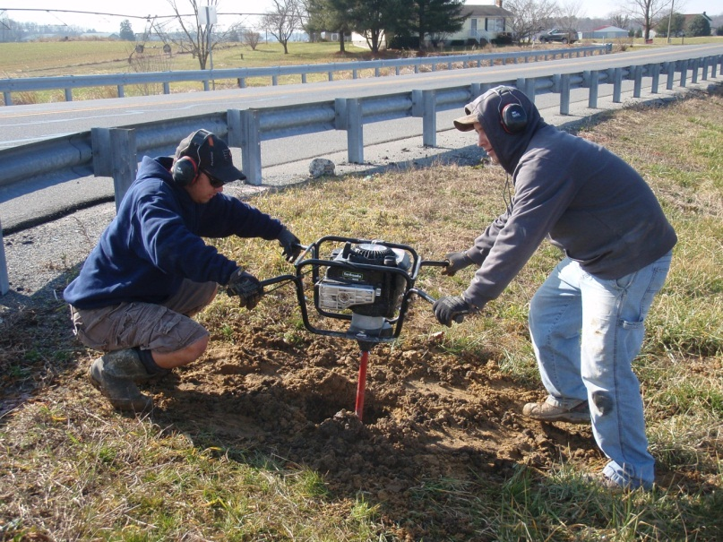
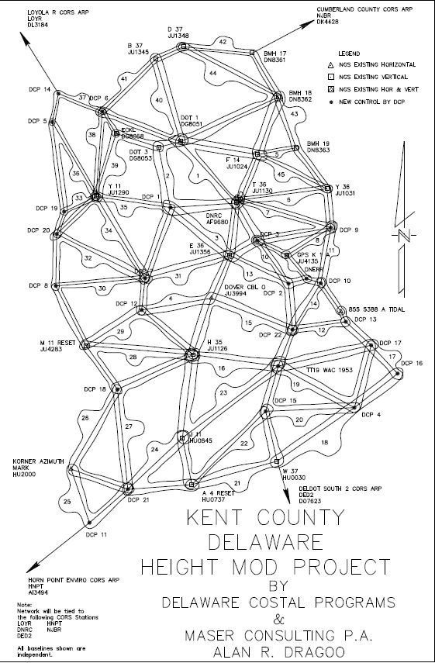
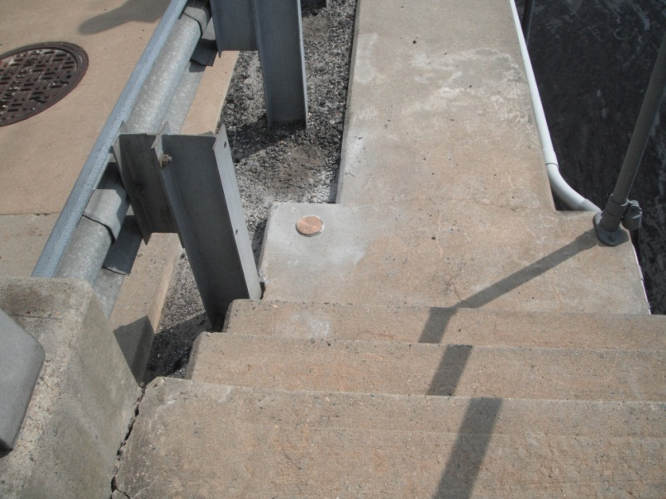
Challenges
Advice

Slide 10
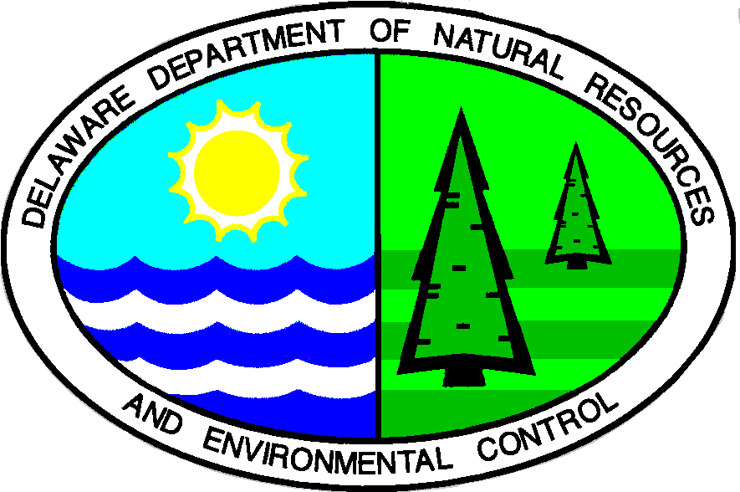
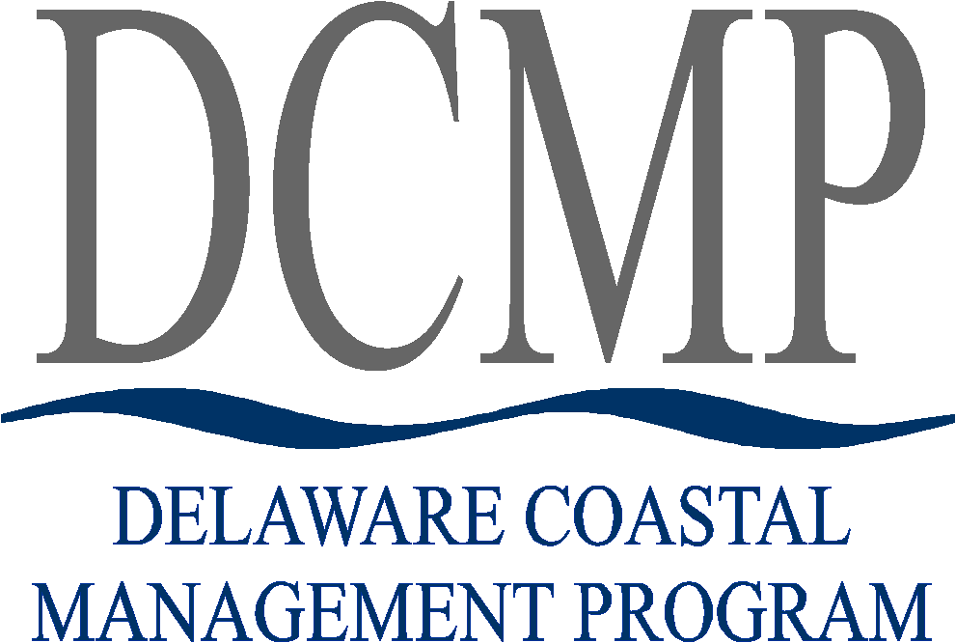
Can Only be Accomplished with Partners and Support!
USFWS
Susan Guiteras, Laura Mitchell
Delaware Geologic Survey
Tom Mckenna
Delaware Coastal Program
Kenny Smith, Christina Pinkerton, Carl Yetter
Shoreline and Waterway Section
Allen Macdonald

Slide 11
Questions or Comments?
Drexel Siok
Delaware Coastal Program; DNREC
5 East Reed Street, Suite 201
Dover, De 19901
302-739-9283
Drexel.Siok@state.de.us

