Slide 1
Connecticut Height Modernization 2010
Thomas H Meyer (UConn)
Robert Baron (CT DOT)
Darek Massalski (CT DOT)
Kazi Arifuzzaman (UConn)

Slide 2
Overview
Goal: to assess the accuracy of GEOID03 and GEOID09 in Connecticut
Means: how well do GPS-determined orthometric heights compare with NAVD 88 published heights

Slide 3
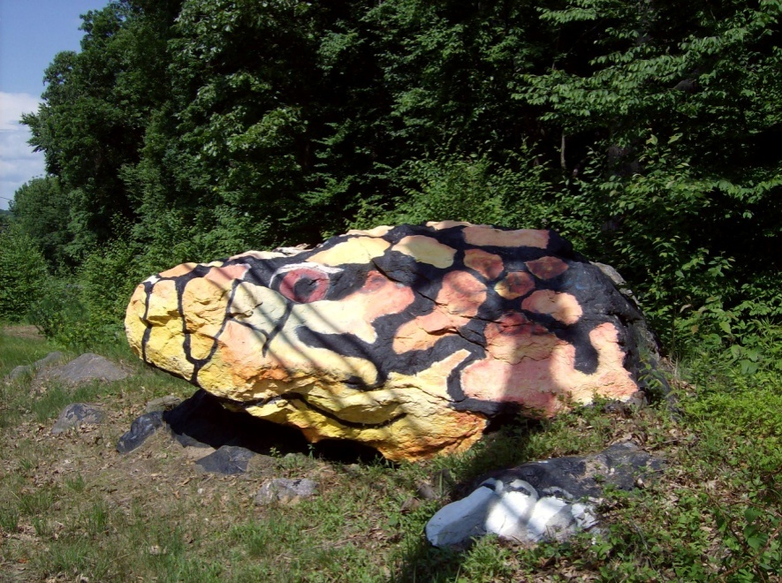
Markers
70 markers
22 class A
10 class B
11 class C
2 class D
25 transfers

Slide 4
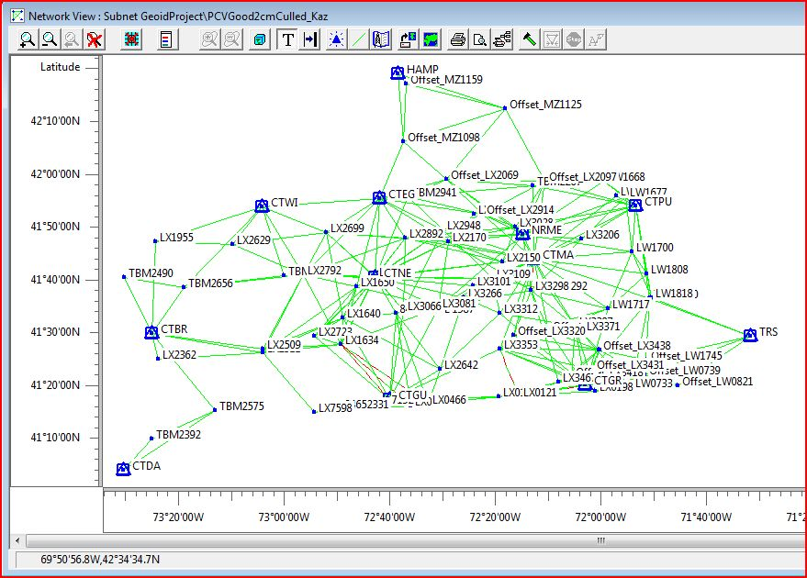

Slide 5
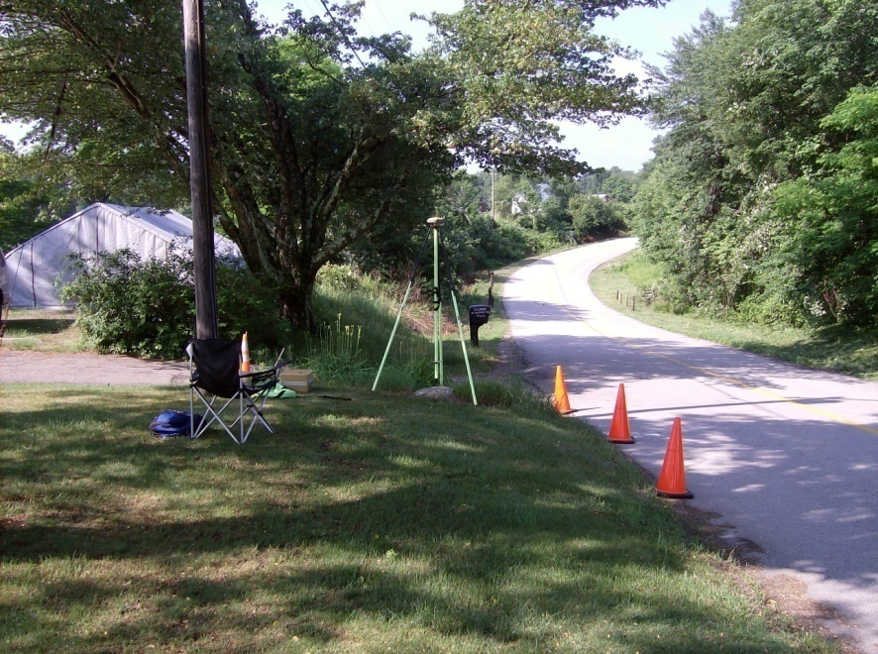
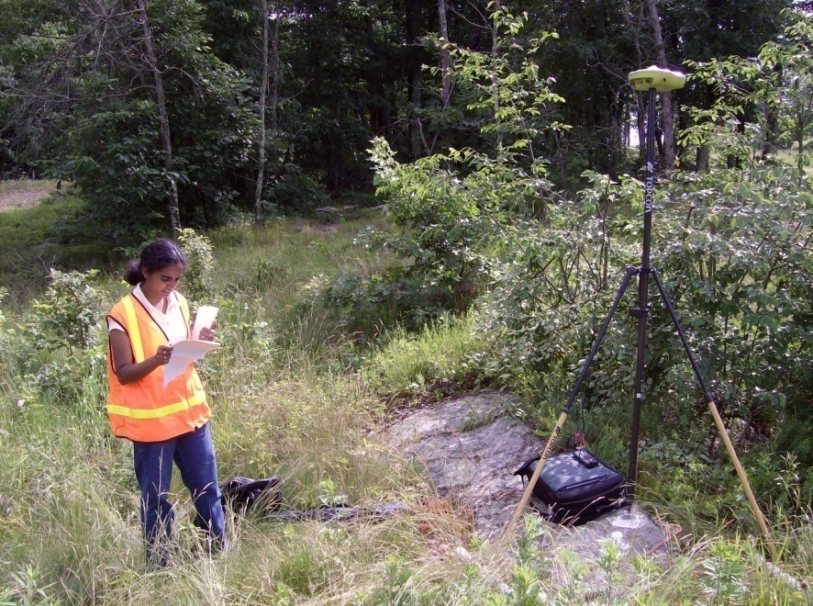
Occupations
2007-2008
Summer, Fall
Only First-Order bench marks
At least three occupations per mark
4 hour duration
Re-level range pole each hour

Slide 6
GPS Equipment
Receivers
UConn
TOPCON HipPer Lite+ (internal)
Javad Legacy (LegAnt)
Odyssey (internal)
CTDOT
Trimble 5700 (Zephyr)
2-m, fixed-height tripods

Slide 7
GPS Processing
Pinnacle and OPUS
RINEX v.2
IGS precise ephemerides
NGS guidelines
CORS for control (no benchmarks)

Slide 8
Checks
Pinnacle vectors against CORS inversed vectors
None statistically different (95%)
Pinnacle and OPUS
Compare ellipsoid heights
Different differencing kernels

Slide 9
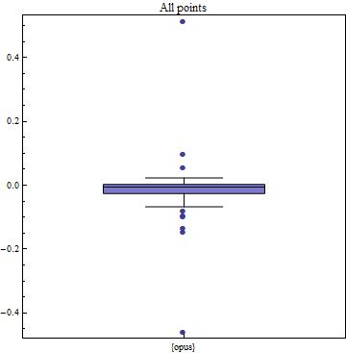
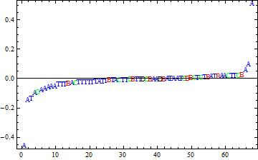
Pinnacle h – OPUS h
Box-whisker plot
Letters/colors indicate stability classes
Dots indicate outliers.

Slide 10
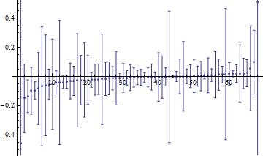
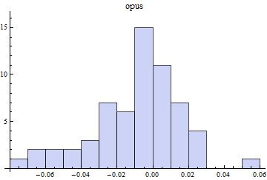
Pinnacle – OPUS no outliers
Error-bar plot
Frequency histogram

Slide 11
Conclusion
Pinnacle seems to be producing ellipsoid heights that are consistent with PAGES

Slide 12
Networks
NGS specifications
No “bad” vectors
All vectors, including substandard
No phase-center variation correction

Slide 13
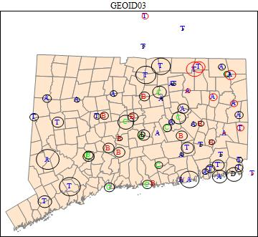
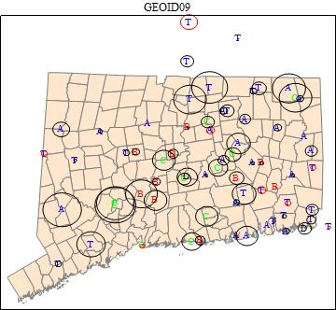
Marker Locations
Letter indicates stability class. Circles indicate stdev (1-s) of H_{G03} and H_{G09}. Black: too low; red: too high.

Slide 14
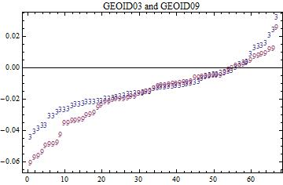
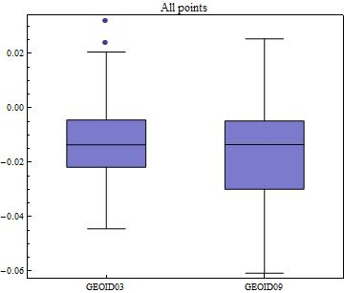
General Results
H_{G03} – H₈₈ and H_{G09} – H₈₈
Box-whisker plots

Slide 15
Frequency Histogram

Slide 16
By Stability Class
Class A and transfers the same.
Others indicate settling.

Slide 17
Residual Trend Analysis
Normalize eastings and northings
(-1, 1), unit variance
Fit a plane through differences
Constant terms (These are consistent with Tranes et al. [2007])
GEOID03: -0.012 m (significant (99%) )
GEOID09: -0.017 m (significant (99%) )
Slope terms
GEOID03: significant (99%)
GEOID09: not significant (99%)

Slide 18
Conclusions
GEOID03 and GEOID09 are accurate at their stated levels in CT
GEOID09 out-performed GEOID03
H_{G03} and H_{G09} too low by about 1 cm
Subsidence
Re-observe the bench marks
No “correction surface” warranted

Slide 19
Thomas.meyer@uconn.edu
http://www.nre.uconn.edu/Faculty_and_Staff/Meyer.php

