Slide 1
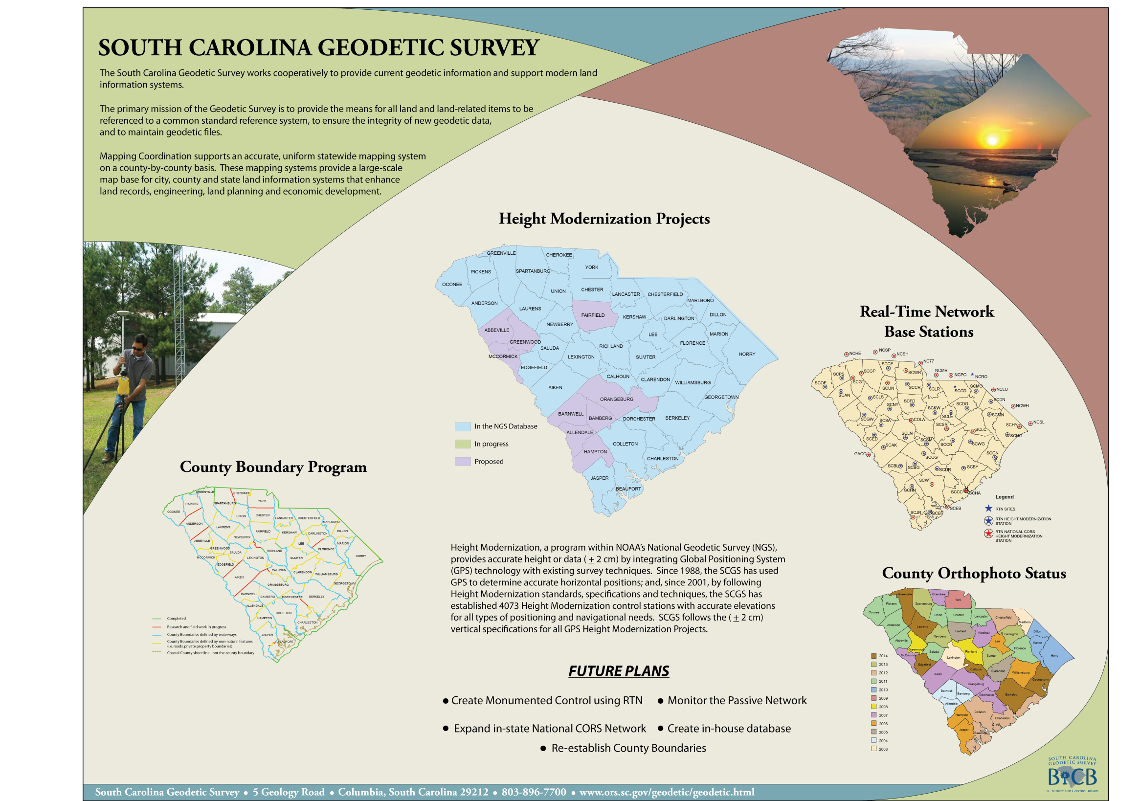

Slide 2
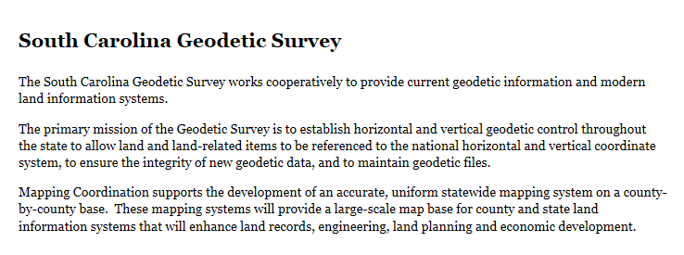
Mission Statement

Slide 3
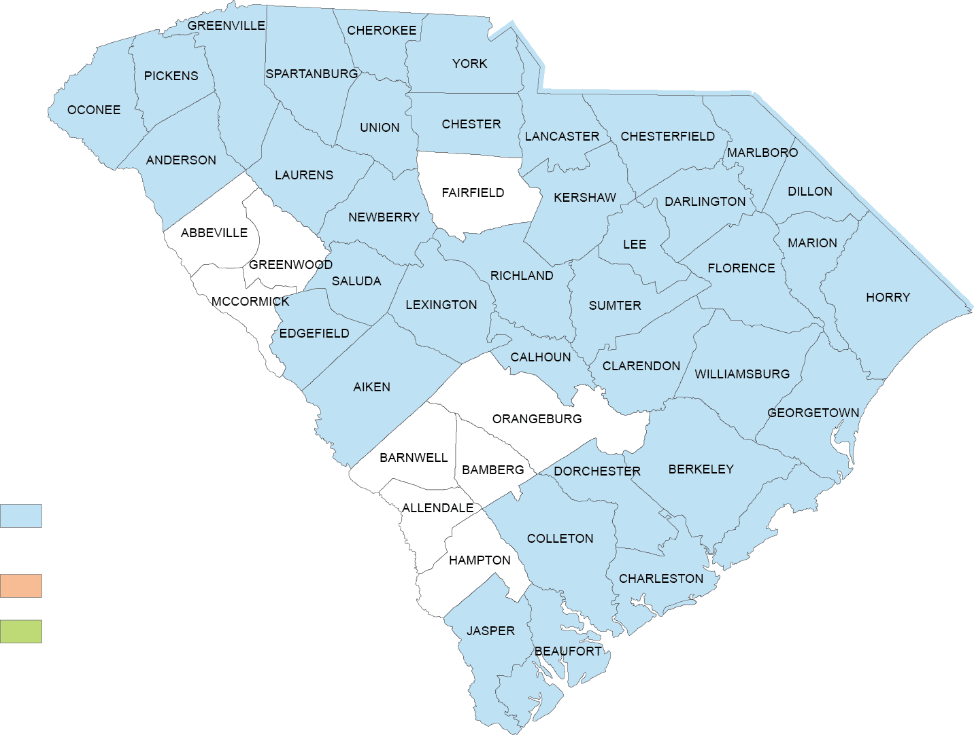
SC Height Modernization Status
In the NGS Database
(Height Mod Project)
In progress
Proposed

Slide 4
Height Modernization Goals
Complete Height Mod survey in all 46 counties.
When performing reconnaissance, attempt to recover all possible bench marks and determine if site is GPSable. These observations are used when improving the geoid.
Make ties to historical tide gages and barrier islands.
Ensure all of the SC RTN sites have Height Mod coordinates.
Monitor and create Height Mod control using the states RTN.
Create a database for geodetic control.

Slide 5
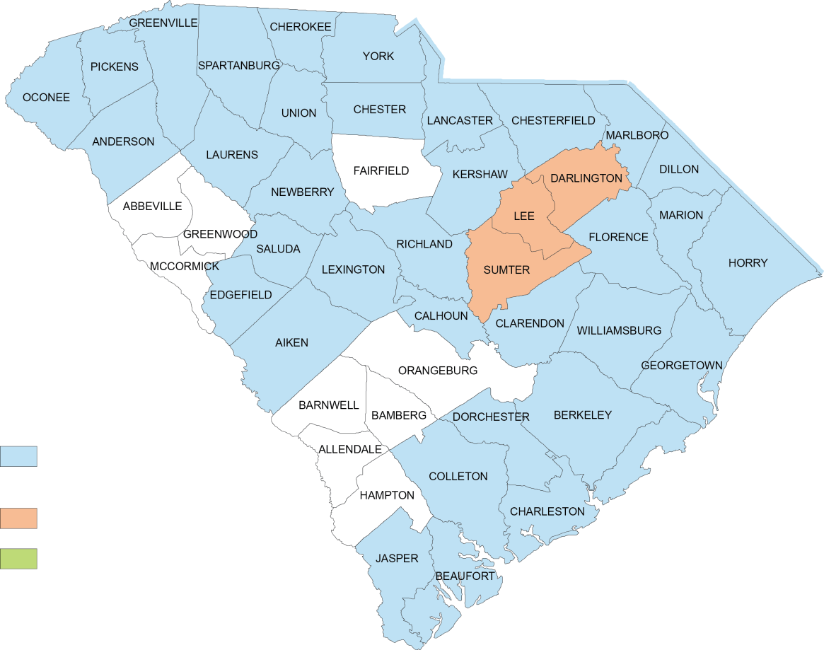
Accomplishments
The SCGS has performed Height Mod surveys for 80% of the counties in the state. The SCGS just completed one regional project that added control to three different counties.
With these projects, a total of 170 monuments with + 0.02 m 3D control have been added.
The SCGS has collected QA/QC data using the SC RTN for counties as LiDAR checkpoints. We have done this as an in-kind service for four years.
South Carolina
Height Modernization Projects
December 2013
In the NGS Database
(Height Mod Project)
In Progress
Proposed

Slide 6
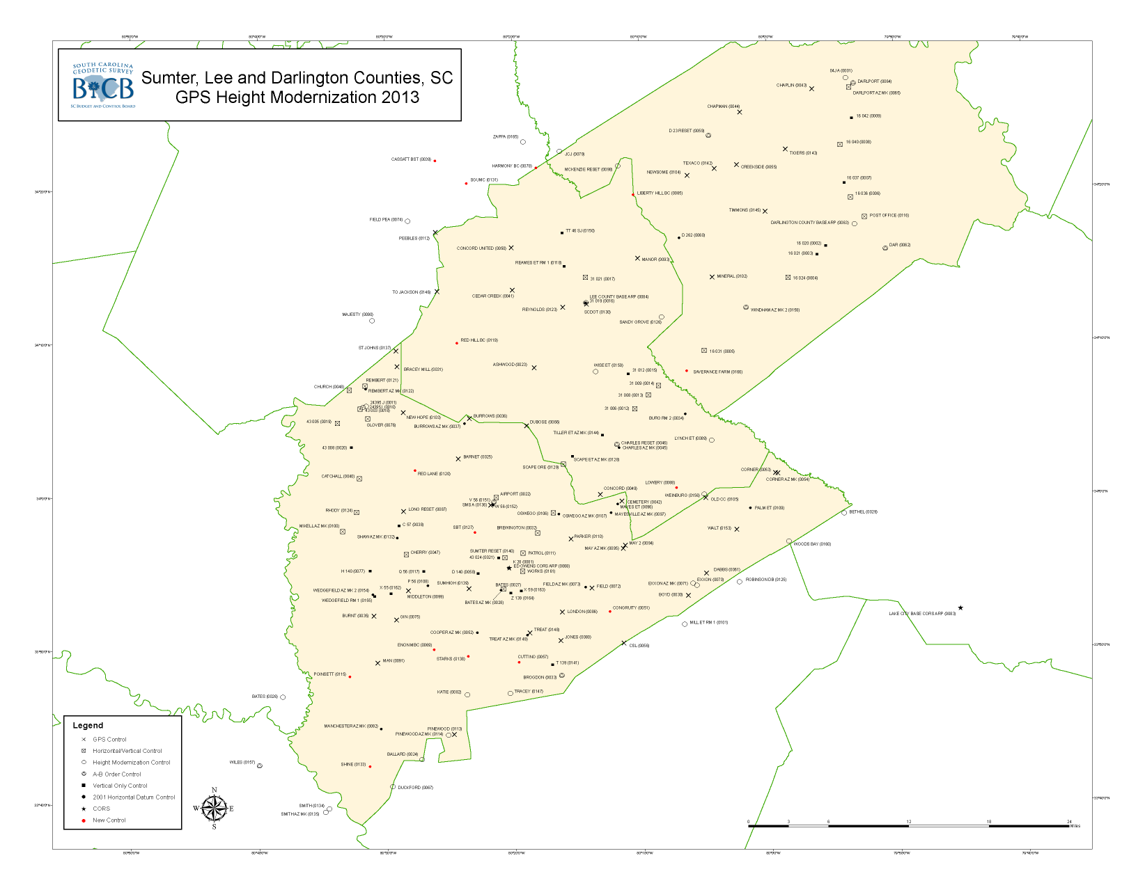
Current Projects

Slide 7
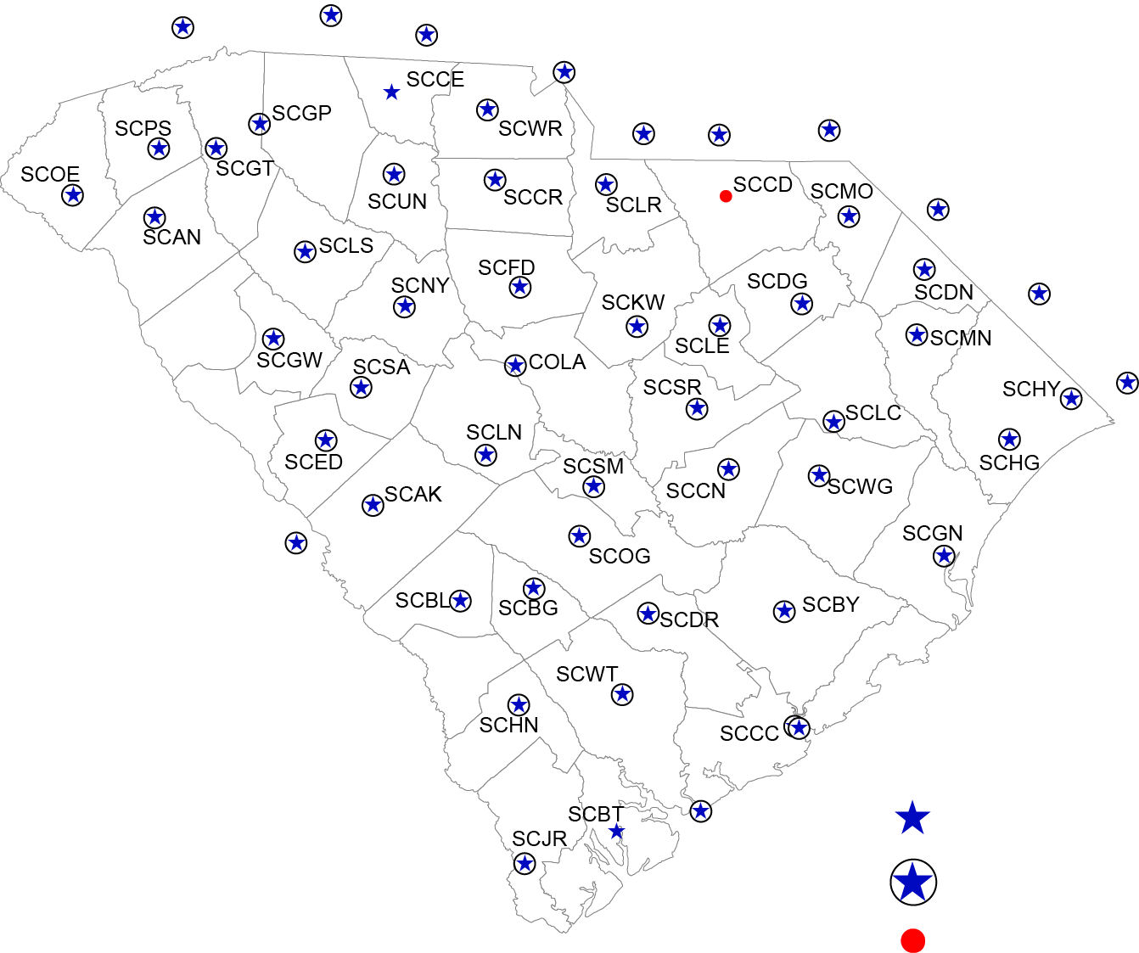
The South Carolina Real Time Network
NCHE
NCSP
NCSH
NC77
NCMR
NCPO
NCRO
NCLU
NCWH
NCSL
GACC
SC Real Time GPS Network (SC RTN)
SC RTN comprised of 53 base stations continuously collecting
and transmitting GPS data
SC RTN provides real time corrections, via cell phones, to users
in the field operating GPS equipment
Users in the field provided with real-time coordinates and
elevations accurate to + 0.1 foot
471 Subscribers to the SC Real Time Network include, but are
not limited to:
Registered Professional Land Surveyors and Engineers
Geographic Information System (GIS) Professionals
Federal, State, County and Municipal Planners
SCDOT and SCDOT Contractors using GPS Machine
Control for Road Construction
The Army Corps of Engineers
SCHA
Legend
SCEB
RTN SITES
HEIGHT MOD
STATION
PROPOSED SITES

Slide 8
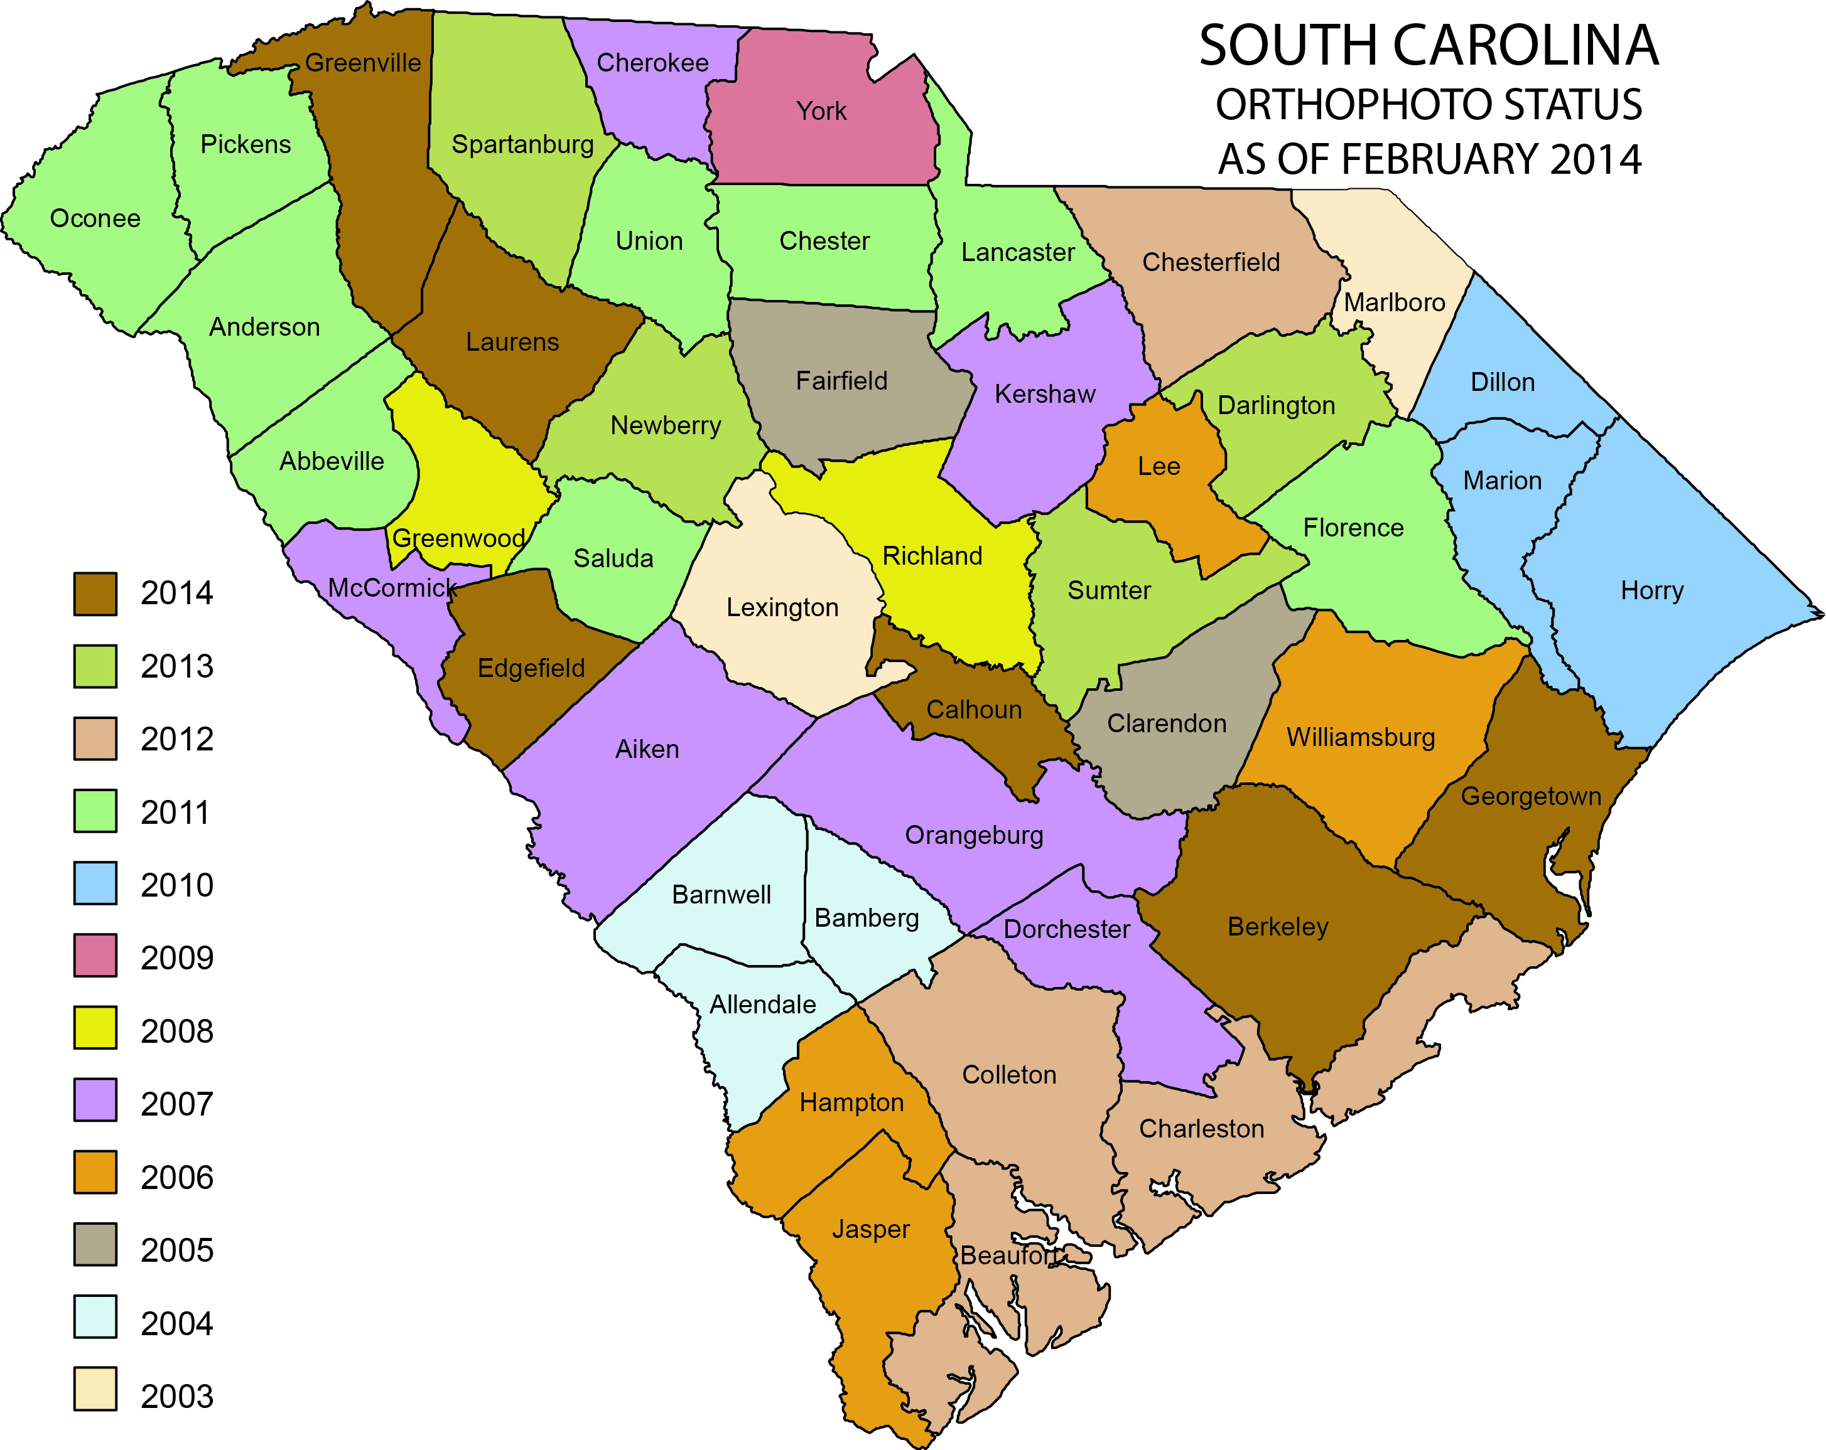
State Mapping Program

Slide 9
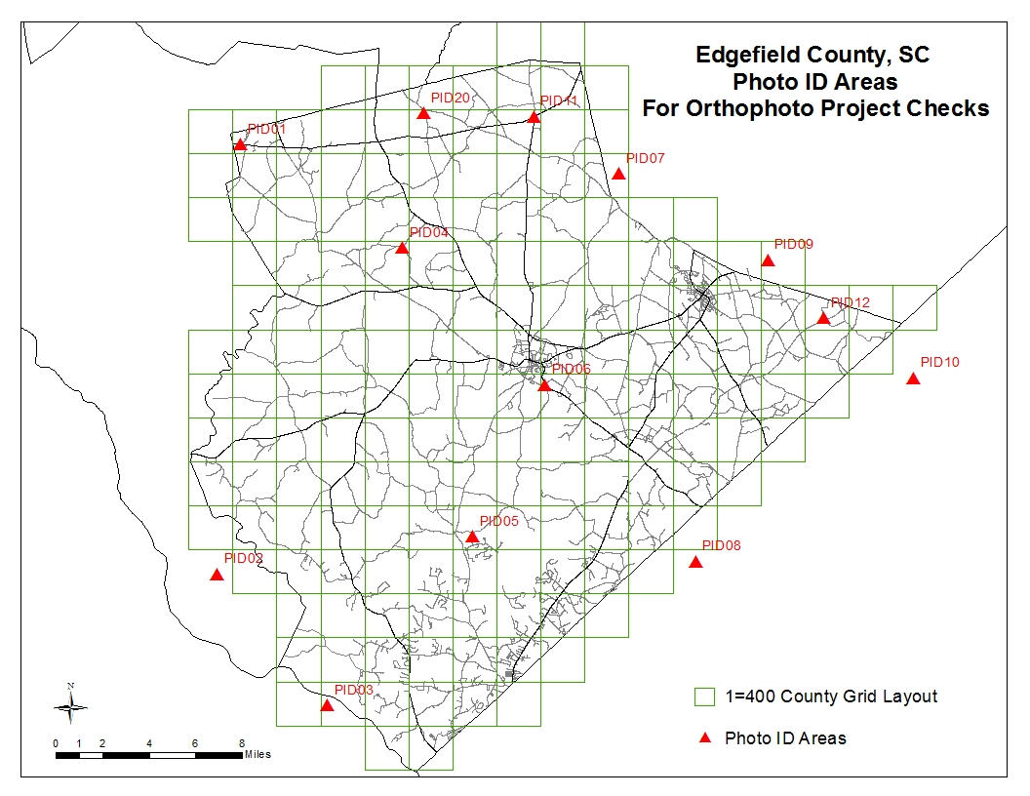
QA/QC of Orthoimagery

Slide 10
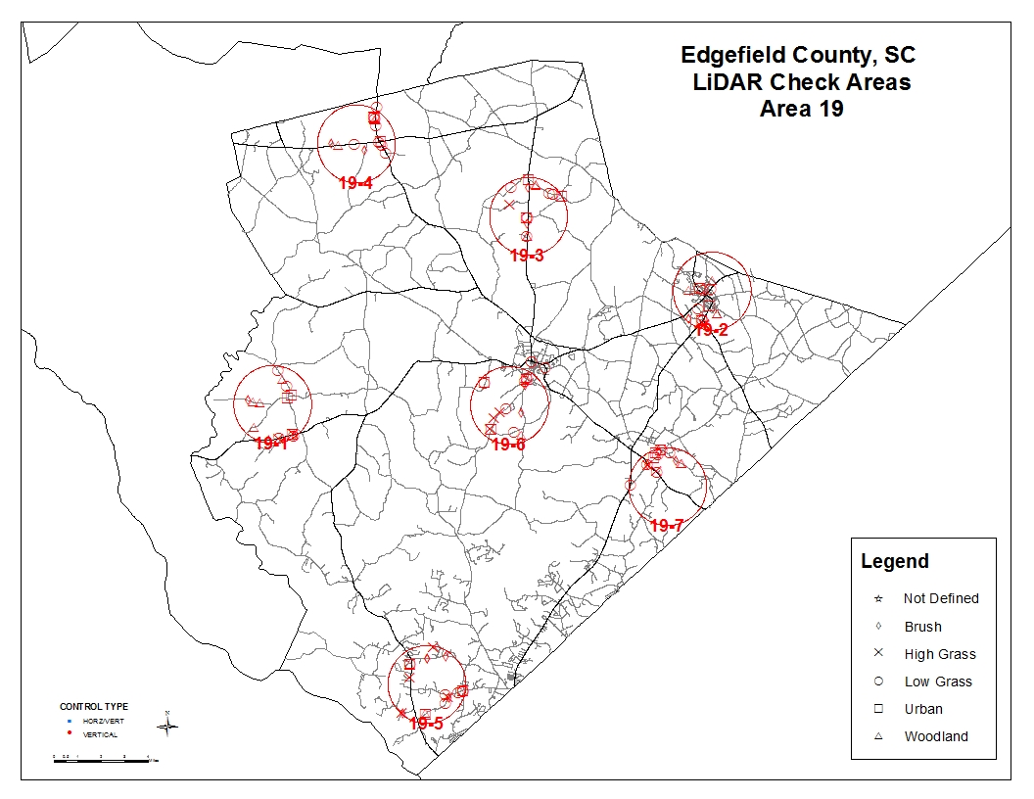
QA/QC for Lidar

Slide 11
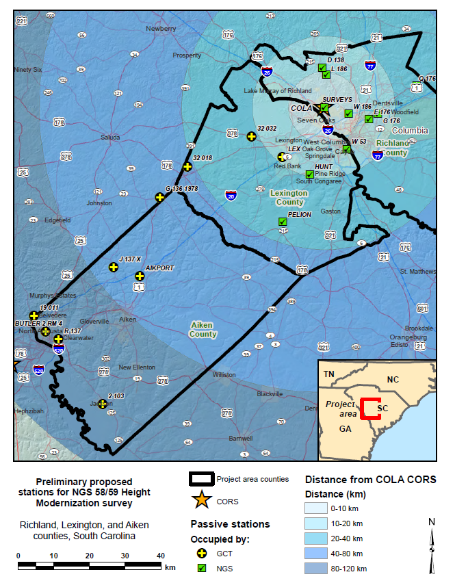
NGS 58/59 Height Modernization Survey
NGS published guidelines for using static, post-processing GPS technology to establish accurate ellipsoid heights (NGS 58 in 1997) and accurate orthometric heights (NGS 59 in 2008) on passive control.
data was collected both for post-processing and as real-time solutions.
Real-time data collection shall consist of a series of six fixed-integer positions, with the following durations: 5 sec, 30 sec, 1 min, 3 min, 5 min, and 10 min (all using the same initialization). This will be done in four separate sets: as RTN and single-base RTK, both with GPS+GLONASS and GPS only.

Slide 12
Funding
The SCGS has been fortunate to receive Height Modernization grants in the past. Last grant ended July 31, 2012.
SCGS will participate in any competitive grant application process if, and when, the application process is made available again.
South Carolina has appropriated funding. It is limited but available.

Slide 13
Biggest Challenges
Investigate the use of Trimble Business Center in lieu of Trimble Geomatics Office
Creating a database for SC.
Funding – Need I say anymore?

Slide 14
Thank-you!
Matt Wellslager
South Carolina Geodetic Survey
5 Geology Rd
Columbia, SC 29212
803-896-7715
Matt.wellslager@rfa.sc.gov

