Slide 1
NCGS: Positioning NC today and for the future!
North Carolina Geodetic Survey
April 2014
National Height Modernization Partner Meeting

Slide 3
Total LiDAR Collection/Classification

Slide 4
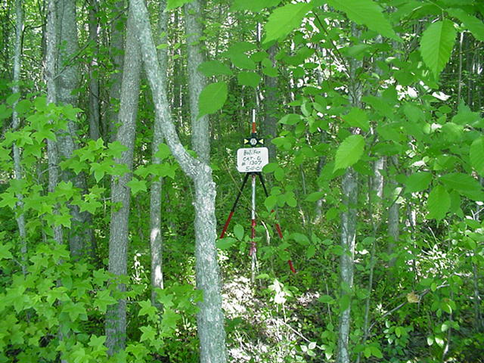
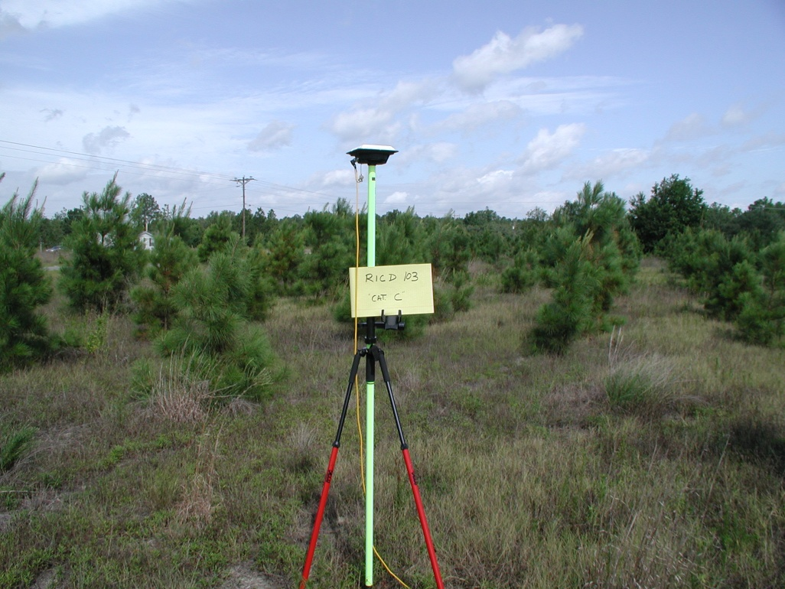
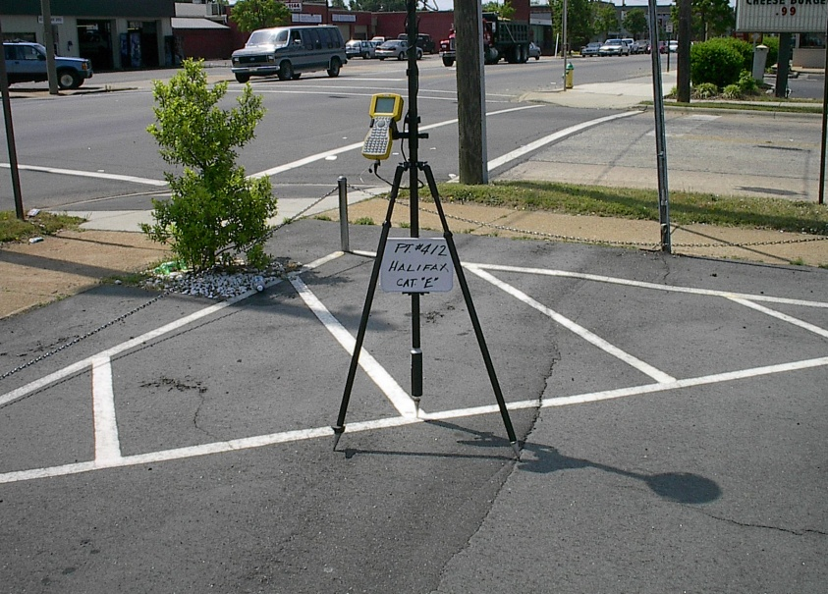
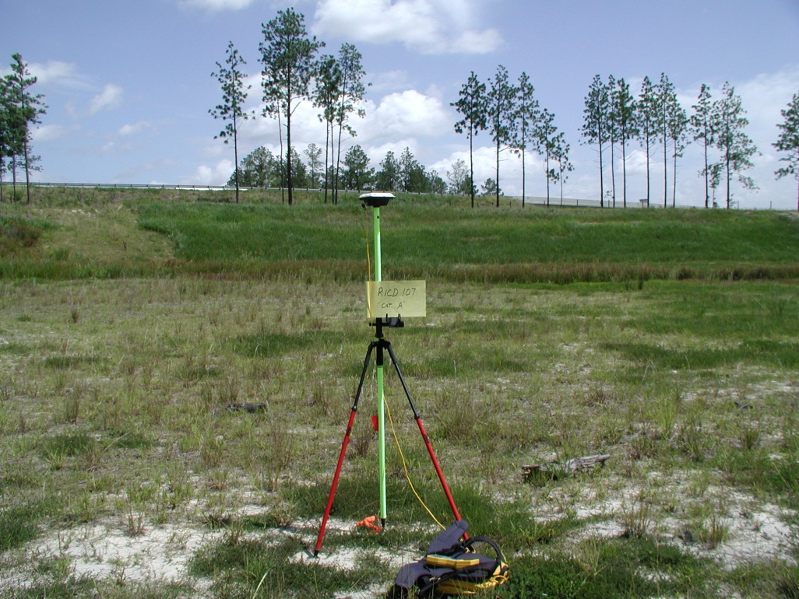
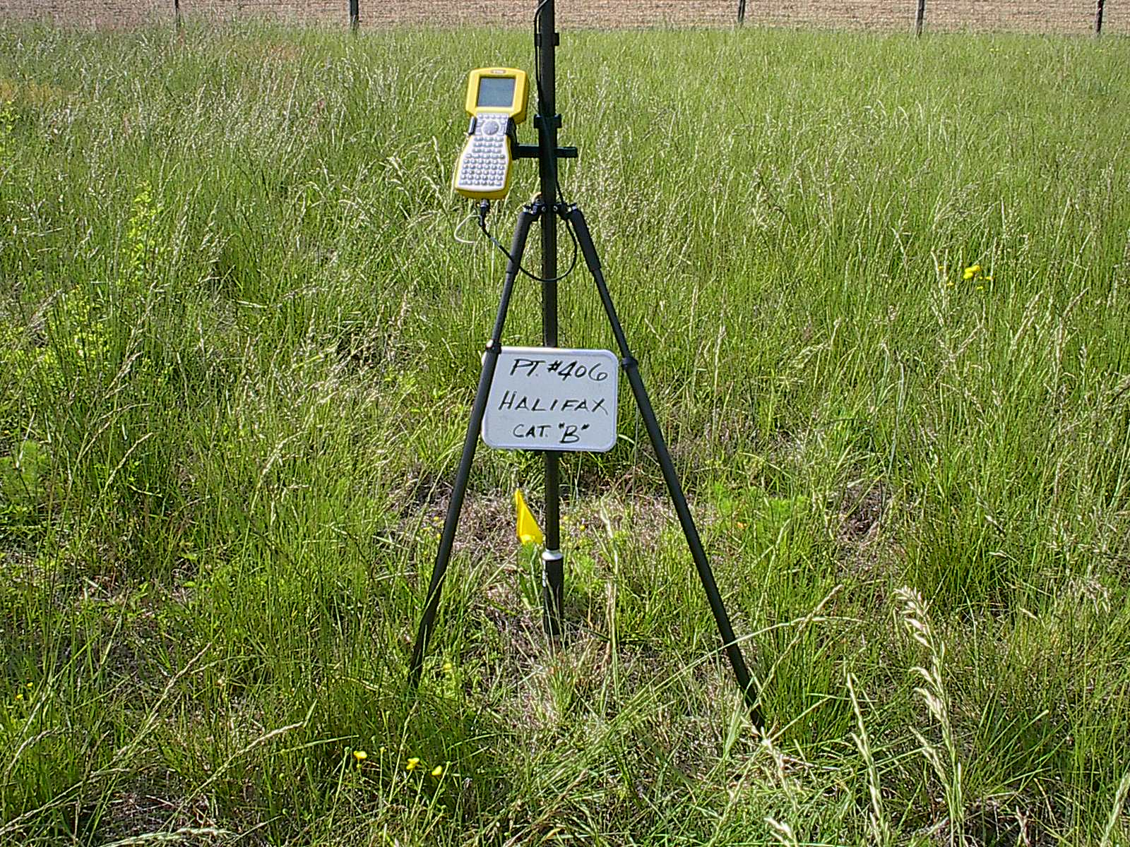
Wooded/Forest
Scrub/Shrub
Urban/Built-up
Survey 100 points per county in 5 land-use classes
Bare-Earth and Low Grass Weeds/Crops Scrub Forest Built up
Weeds/Crops
Bare-Earth & Low Grass

Slide 5
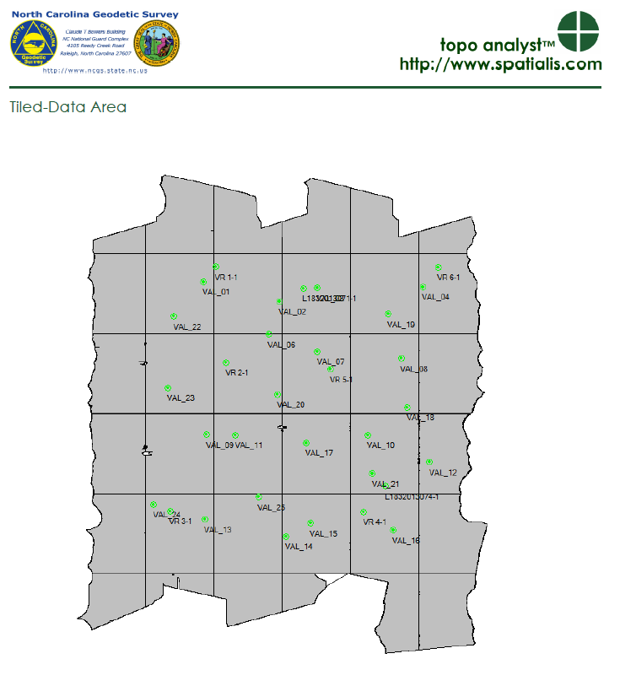

Slide 6
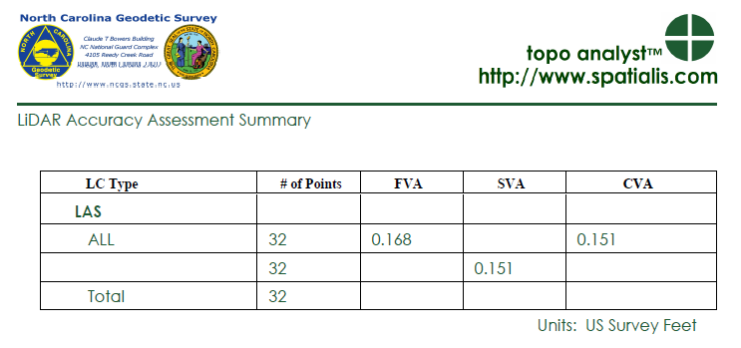
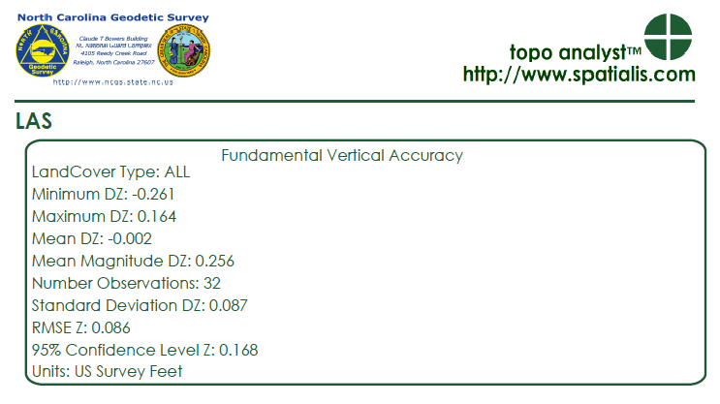

Slide 7
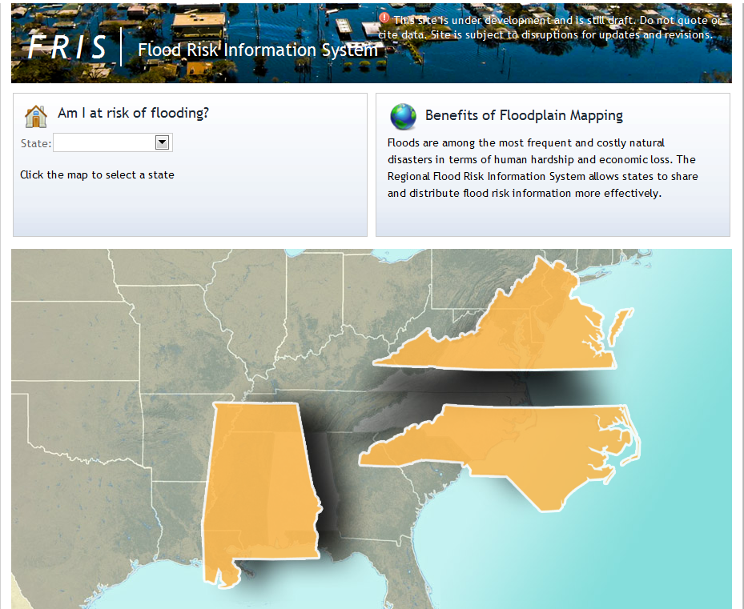
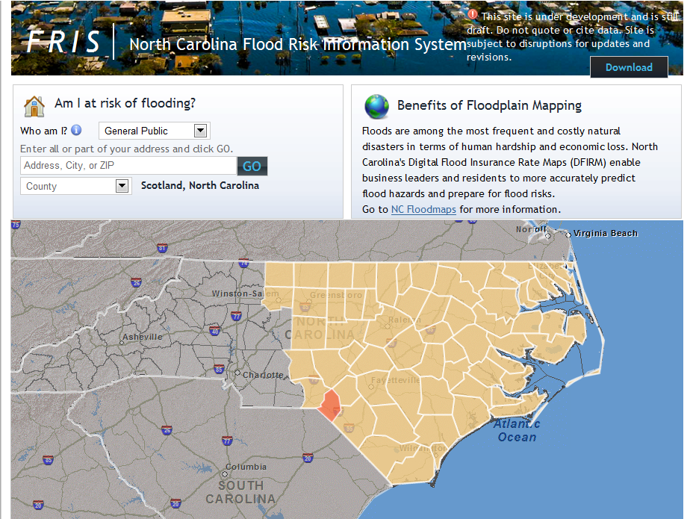
Flood risk information systems- FRIS
Notes:
Multiple states.
Each of these links will lead you to the information within each of these states. Each state maintains their information in different ways. All meet the FEMA requirements but in North Carolina we have a more robust set of information than the other two states currently in the system.
Both states are working to update their information.

Slide 8
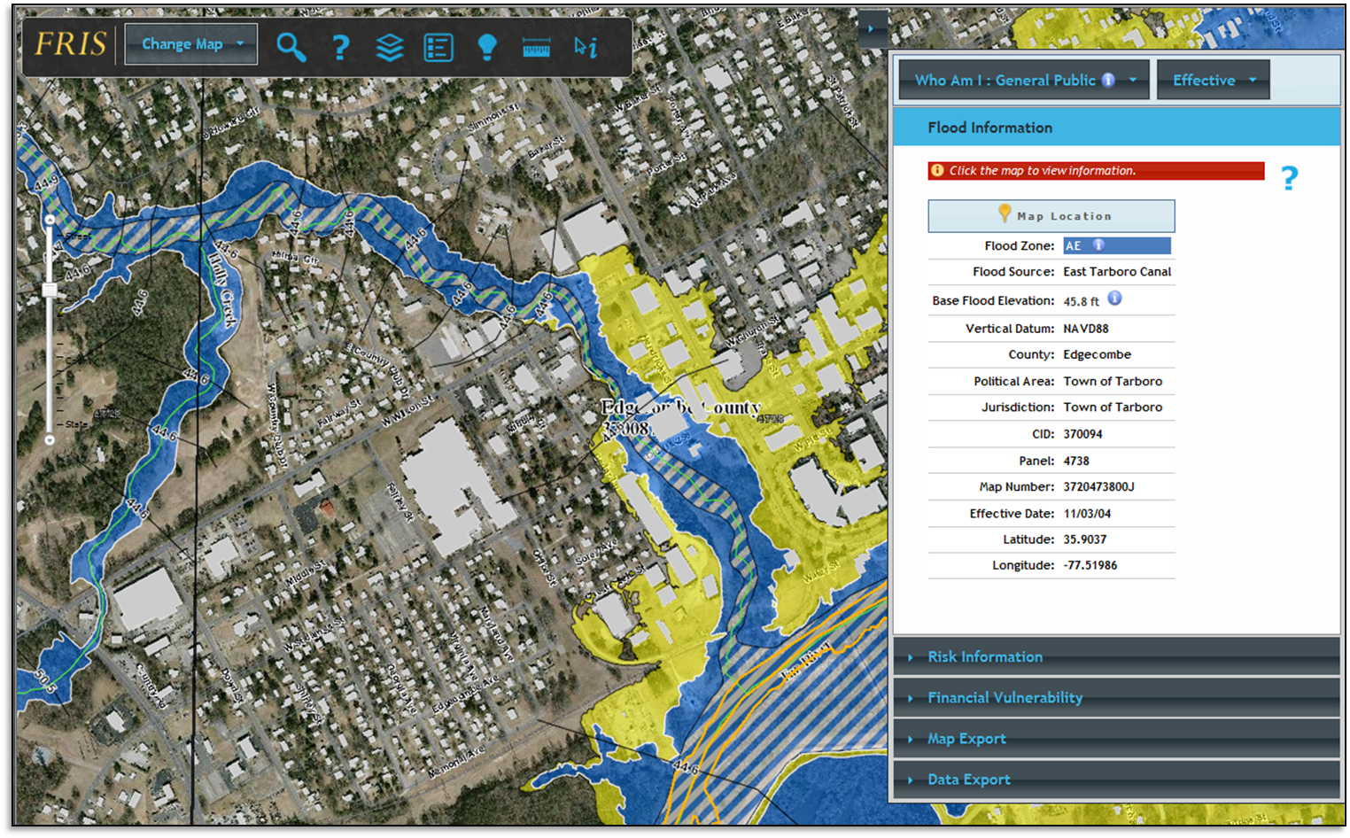
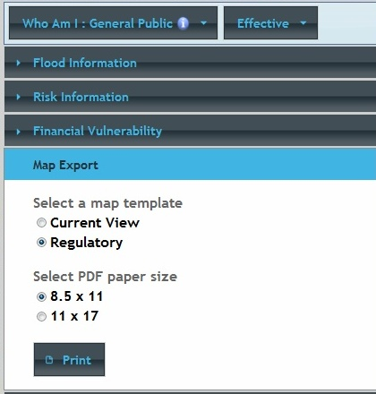
FRIS Display View/Print/Map Export

Slide 9
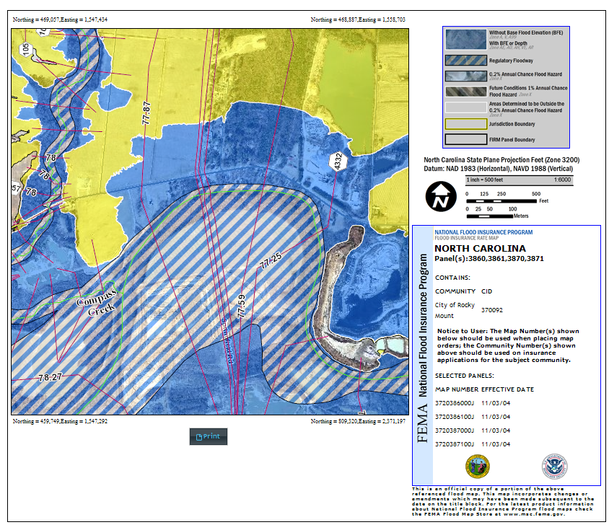
FRIS Produce a FIRMETTE

Slide 10
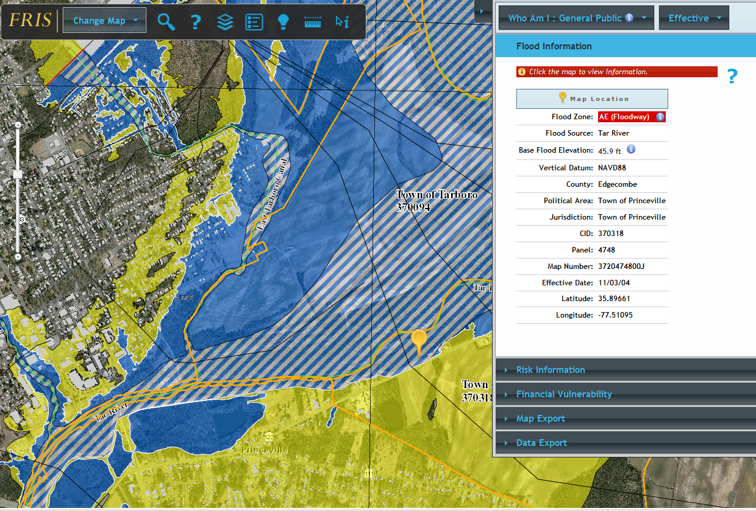
FRIS DFIRM Floodway

Slide 11
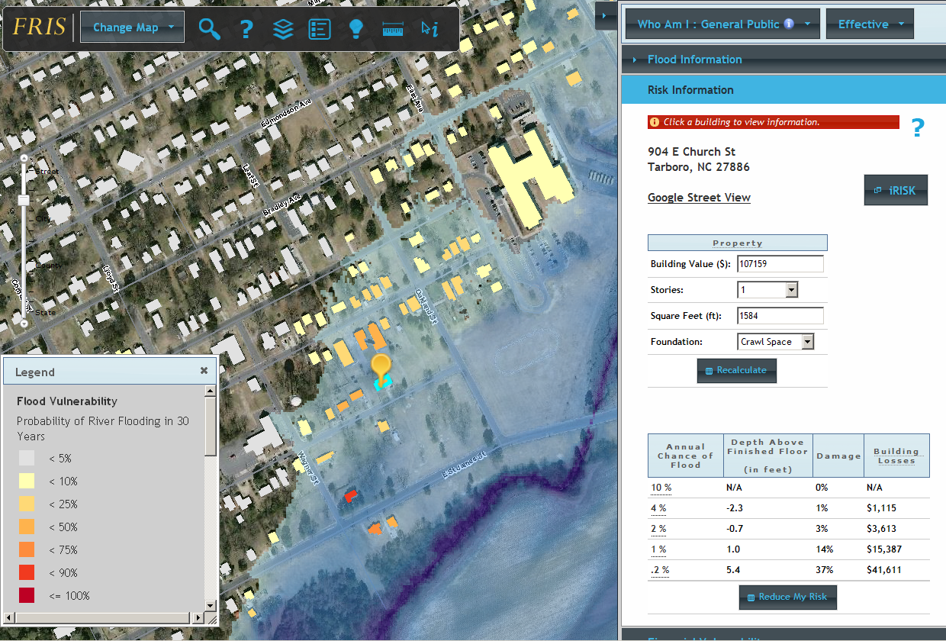
FRIS Vulnerability/Risk Information

Slide 12
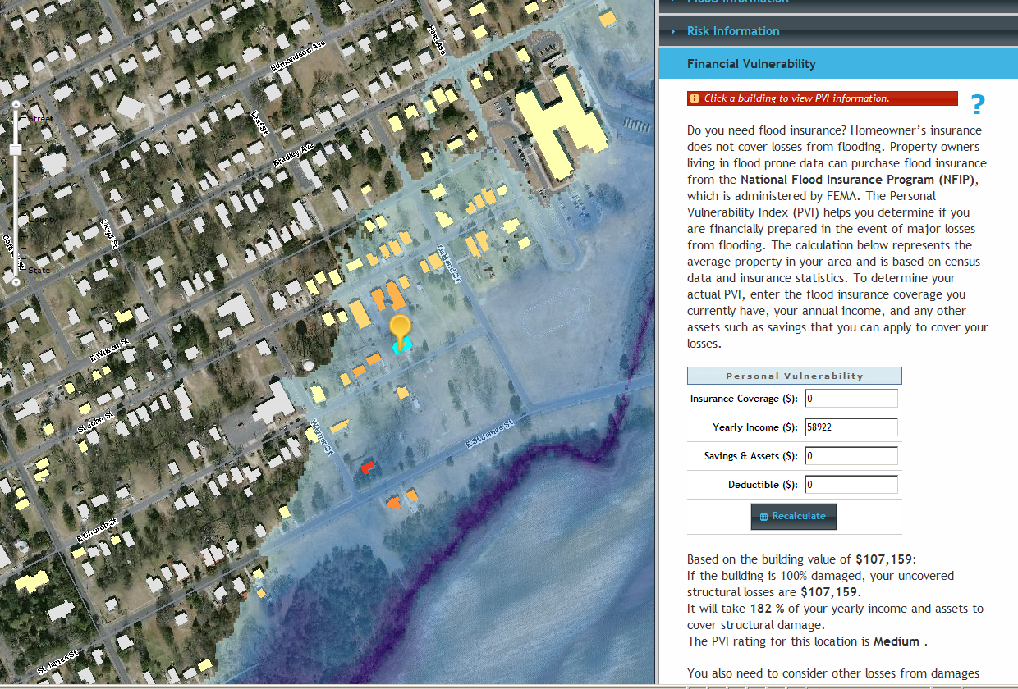
FRIS Financial Vulnerability/Risk

Slide 13
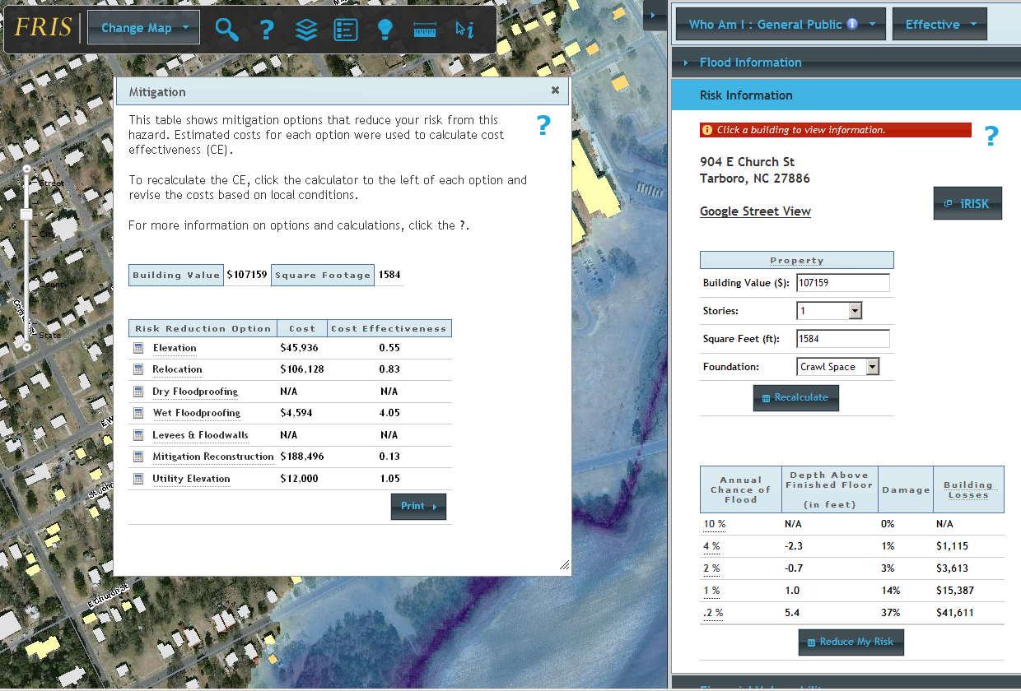
FRIS Reduce My Risk

Slide 14
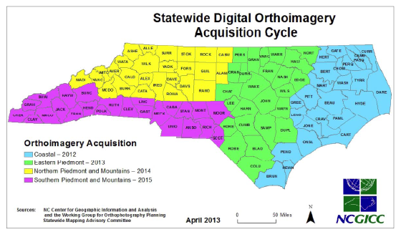
Statewide Imagery Project

Slide 15
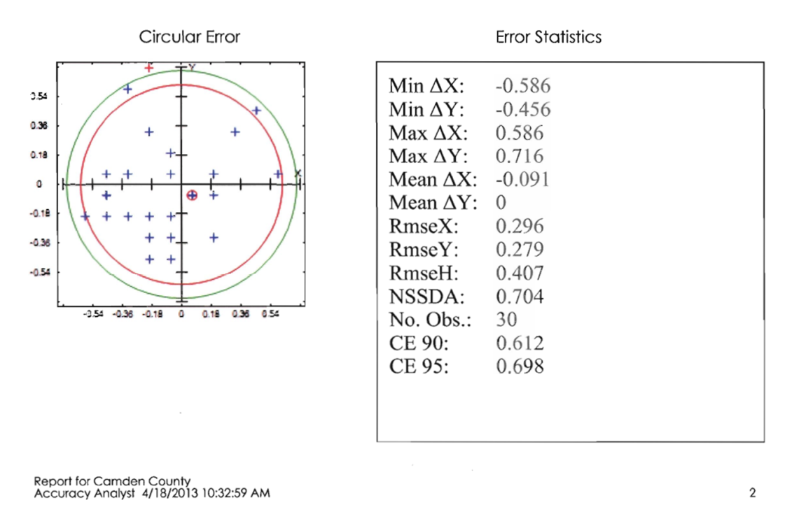
Statewide Imagery Project
Quality Control Report

Slide 16
Monitoring Subsidence

Slide 17
NC CORS Network
Continuously Operating Reference Station (CORS)
A permanent and continuously recording Global Navigation Satellite System (GNSS) receiver, antenna (with a surveyed reference position), & support equipment
NC CORS Network
Composed of 91 CORS
2 new CORS have been installed
Bethel (NCBT)
UNCC (NC49)
1 decommissioned
Clinton (NCCL

Slide 18
Clinton (NCCL) CORS
Before
After

Slide 19
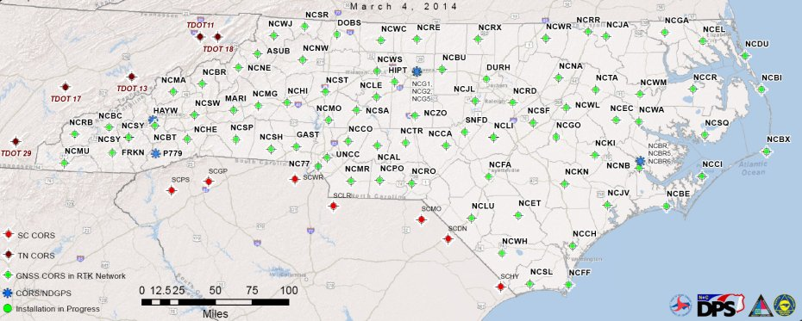
NC CORS Network

Slide 20
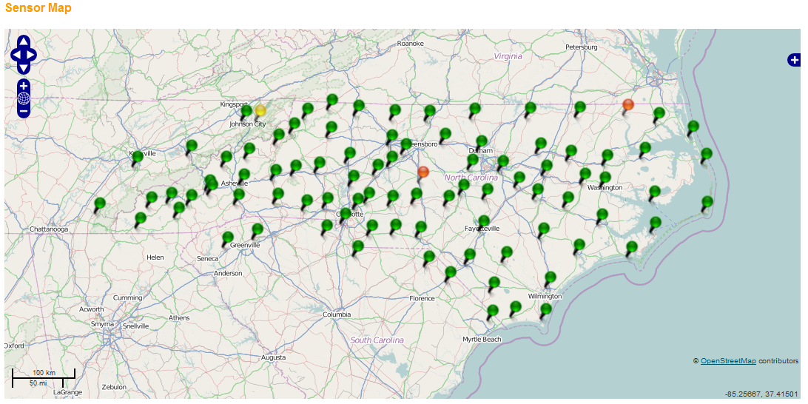
NC Real Time Network Fact Sheet
User information
Ports assigned
1717
RTN hours used in 2013
229,560

Slide 21
Financial benefit of NC CORS in 2013
Product | *User benefit in 2008 dollars/ quantifiable unit | Quantity in 2013 | Total benefits in 2013 (User benefits in 2008 dollars x the 2013 quantities) | Broader societal benefits (30% of Total benefits in 2013) | 15% annual growth for 5 yrs on the Broader societal benefits | Total benefits (User benefits in 2008 $s x 2013 qtys) + 15% annual growth for 5 yrs on the Broader societal benefits
UFCORS downloads | $133/download | 41,058 downloads | $5,460,714 | $1,638,214 | $3,295,034 | $8,755,748
NGS FTP downloads | $30/download | 1,605,420 downloads | $48,162,600 | $14,448,780 | $29,061,658 | $77,224,258
OPUS-S solutions | $500/solution | 2,509 solutions | $1,254,500 | $376,350 | $756,974 | $2,011,474
OPUS-RS solutions | $500/solution | 6,994 solutions | $3,497,000 | $1,049,100 | $2,110,115 | $5,607,115
OPUS-DB solutions | $400/submission | 12 solutions | $4,800 | $1,440 | $2,896 | $7,696
NC RTN | $100/hour | 229,560 hours | $22,956,000 | $6,886,800 | $13,851,815 | $36,807,815
 |  | Total benefits in 2013 | $81,335,614 | $24,400,684 | $49,078,492 | $130,414,106

Slide 22
CORS/RTN
Relocate NCSQ (Swanquarter) CORS (new ferry office being built)
Install NCCL (Clinton) CORS replacement
Upgrade P779 (Rosman) CORS
Install new CORS in Raeford area
Test the PIVOT VRS post processing option
Summer intern will collect data
Test RTKLIB

Slide 23
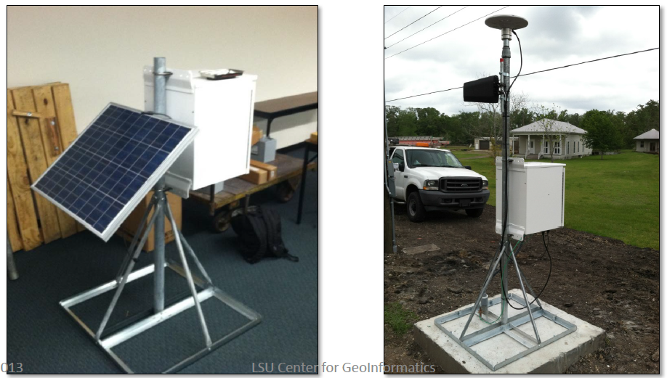
CORS/RTN
Work with NCDOT and NPS to install temporary CORS near Bonner Bridge and along NC 12

Slide 24
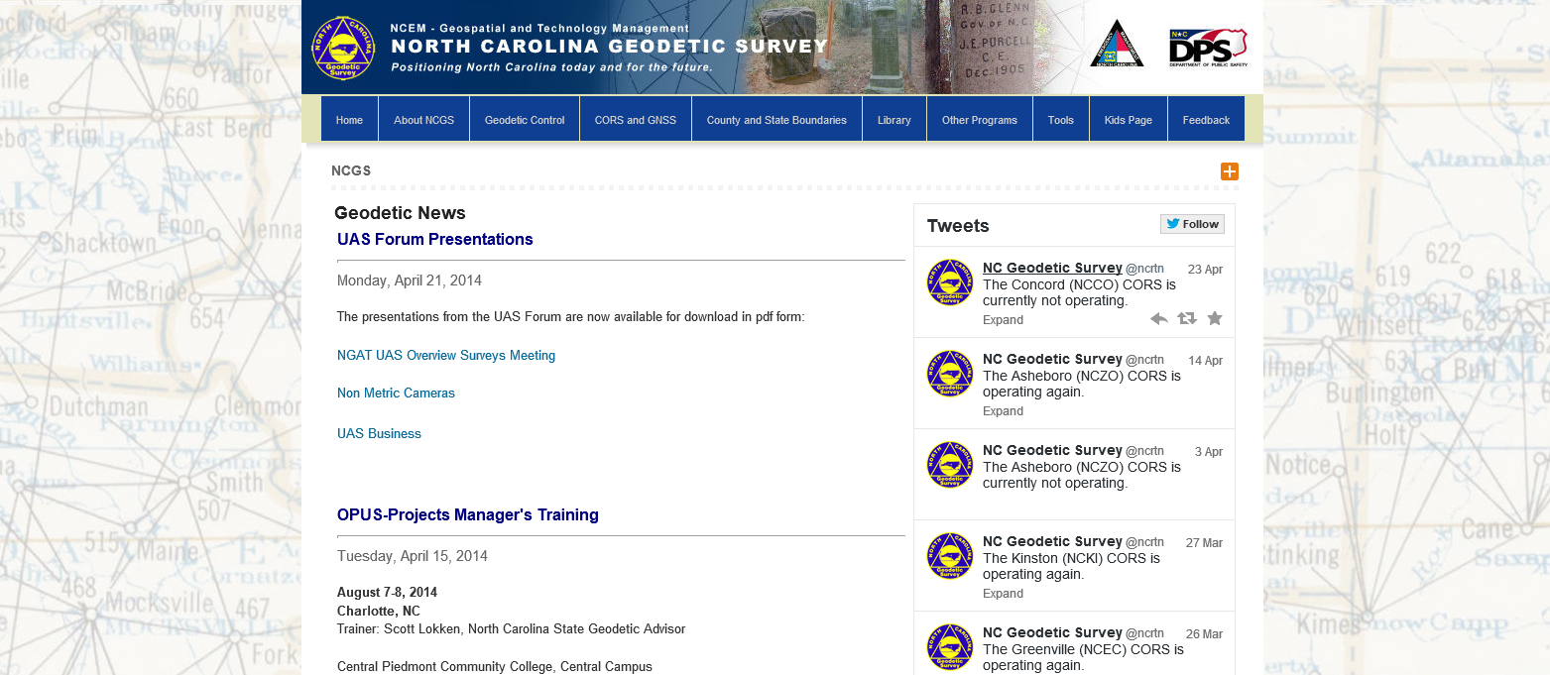

Slide 25
North Carolina Geodetic Survey
New Database
steve.kaufman@ncdps.gov
(919) 948-7839

Slide 26
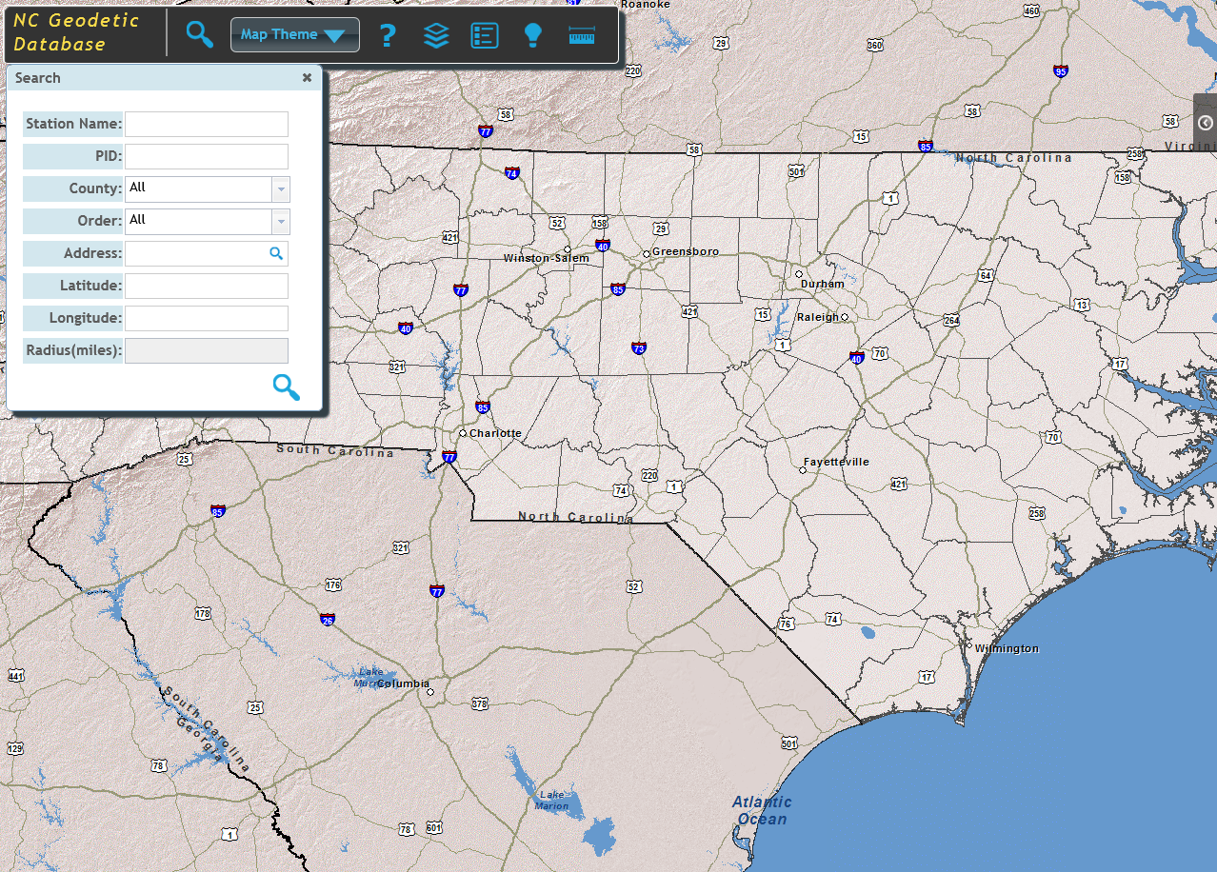

Slide 27
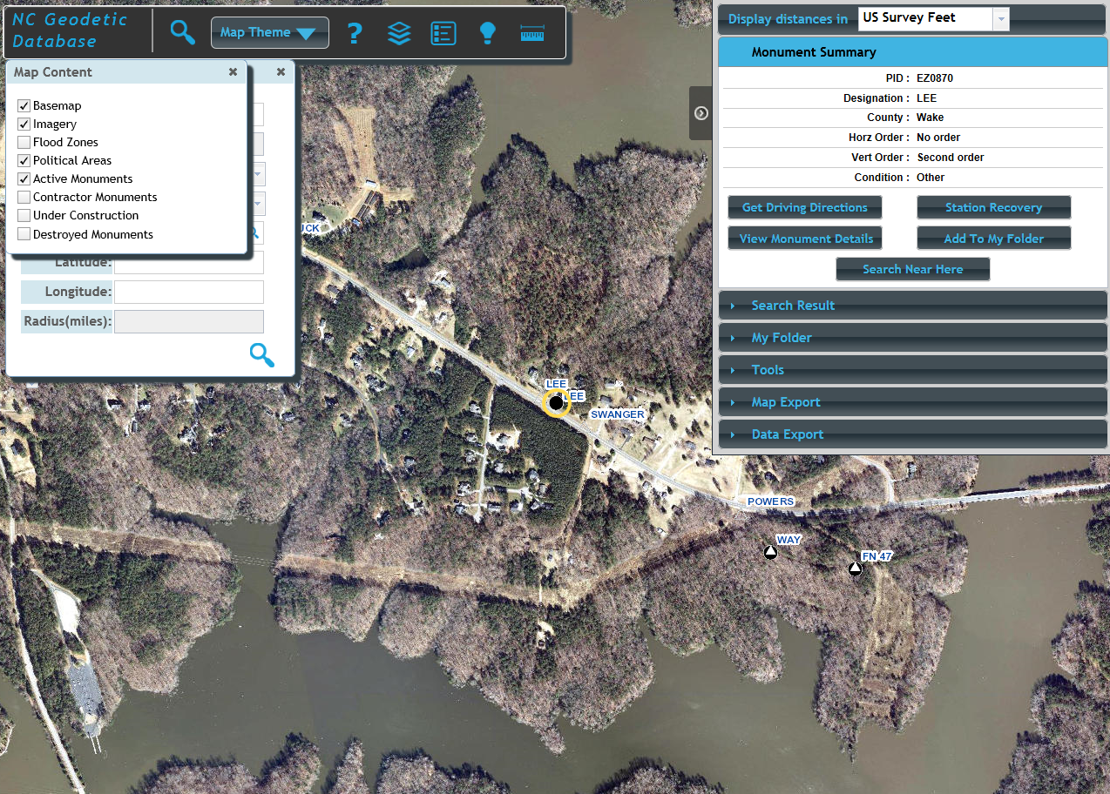

Slide 28
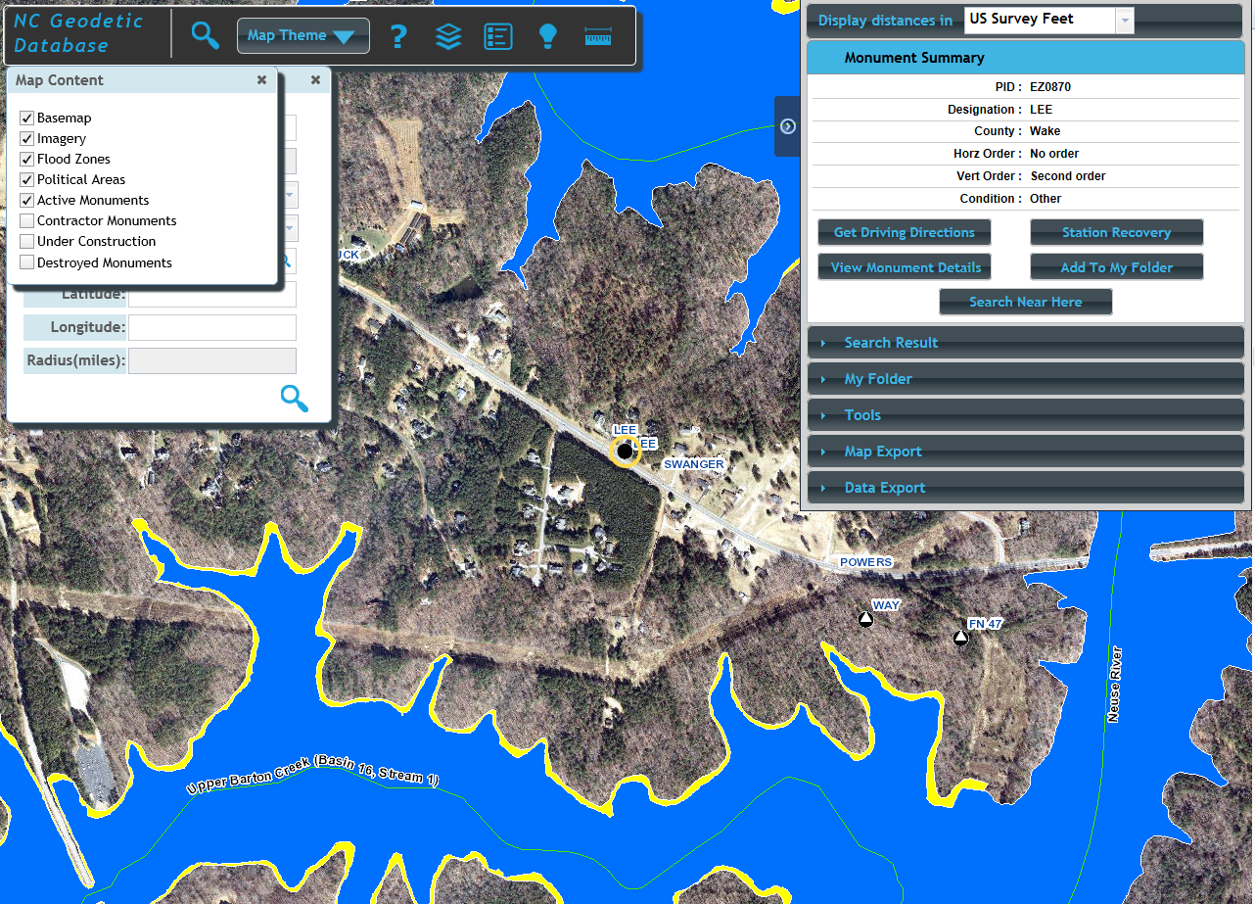

Slide 29
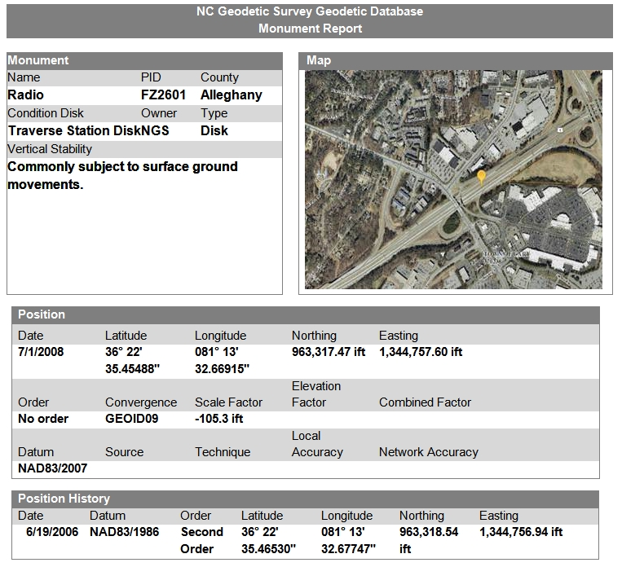

Slide 30
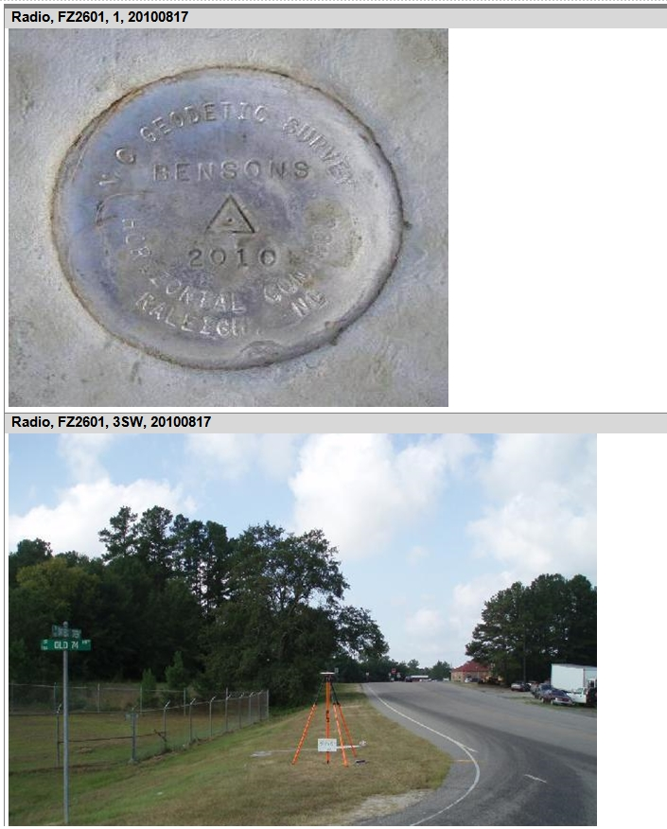

Slide 31
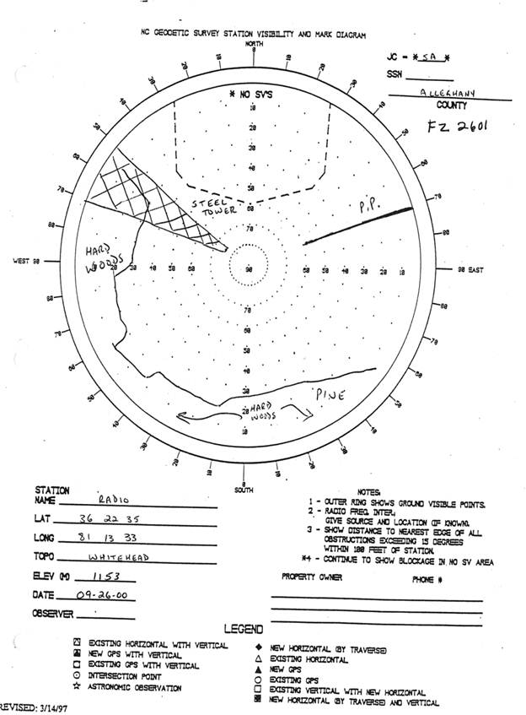

Slide 32
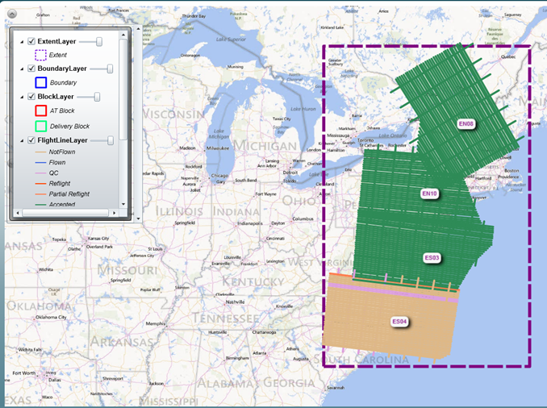
Future projects
Statewide collection of gravity data to support GRAV-D
Collected terrestrial gravity data in 2013-2014 (relative)
National Science Foundation grant

Slide 33
Future projects
NC Unmanned Aircraft Systems (UAS) test range
UAS forums
April 10, 2014 (Raleigh)
June 12, 2014 (Asheville)
Perform testing with NCDOT

Slide 34
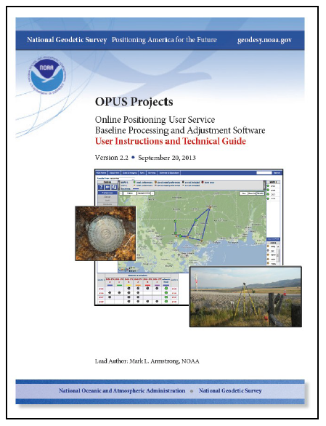
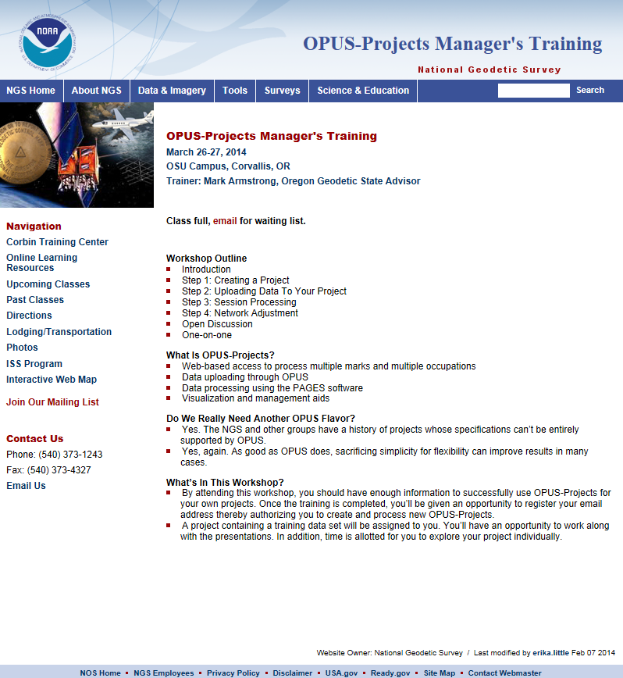
OPUS Projects

Slide 35
OPUS Projects Training
February 19-20, 2014 in Raleigh
18 attendees
Future training sessions
Greensboro (NC A+T) May 22-23
Sylva (SWCC) June 12-13
Charlotte (CPCC) August 7-8
Wilmington (Cape Fear CC) Date TBD
Gastonia (Gaston College) Date TBD

Slide 36
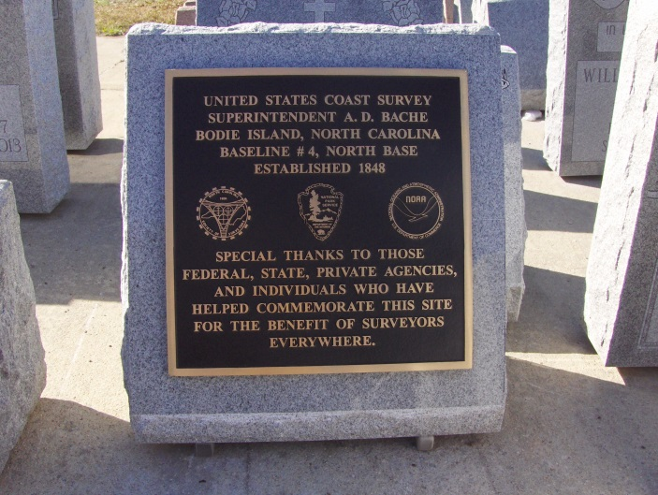
Bodie Island Baseline

Slide 37
Questions?
Gary W. Thompson, PLS Office: 919-733-3836 Direct: 919-948-7844 Email: gary.thompson@ncdps.gov
Mailing address: | Building (shipping) address:
Gary W. Thompson, PLS NC Geodetic Survey 4298 Mail Service Center Raleigh, NC 27699-4298 | Gary W. Thompson, PLS NC Geodetic Survey Bowers Building NC National Guard complex 4105 Reedy Creek Rd Raleigh, NC 27607

