Slide 1
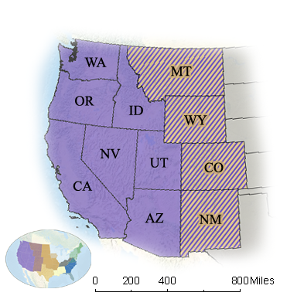
Western Region Height Modernization Consortium
Val Schultz PLS
Surveyor / Reviewer
Weber County Surveyors Office Ogden, Utah
Co-Organizer along with
Scott Martin PLS
Senior Transportation Surveyor
Geodetic Control & GPS Surveys
California Department of Transportation Sacramento, California

Slide 2
Western Region Height Modernization Consortium
We presently have 36 individuals that have indicated their interest in attending our monthly meeting.
5 NGS Representatives include:
Christine Gallagher-National Height Modernization Manager
Bill Stone-SW Region Advisor
Mark Armstrong-Oregon Advisor
Pam Fromhertz-Colorado Advisor
Mike Londe (BLM)-Wyoming Coordinator

Slide 3
Western Region Height Modernization Consortium
4 Unavco/PBO Representatives include:
Glen Mattioli – Director of Geodetic infrastructure
Chris Walls - Manager SW Region
Ken Austin – Manager Pacific NW Region
Tim Dittman – Manager Intermountain Region

Slide 4
Western Region Height Modernization Consortium
Arizona 4
California 8
Idaho 1
Nevada 2
Oregon 3
Utah 4
Washington 3
Colorado 1
Montana 1
New Mexico 0
Wyoming 1

Slide 5
Western Region Height Modernization Consortium
Experience varied from being very experienced in height mod projects to some experience to no experience.
Several members had experience with OPUS, OPUS-Projects, RTNs, first order levels, large GPS control projects and low distortion projections.
We have people from the private sector, government sector, and the academic sector.
OPUS-Projects training 2 in California - Mark & Bill in June, 1 in New Mexico in June - Bill, 1 in Utah in June - Bill, and 1 in Oregon - Mark
Reasons for involvement – general interest, networking, information to help with projects, RTN needs, wanting to improve future geoid models, help with Future New Datum, & funding.

Slide 6
Western Region Height Modernization Consortium
Had good participation in National Survey Week Activities in Colorado, Washington, Oregon, with a few being observed in Utah but not yet finished in OPUS.
Briefing with Diane Arendt of Great Lakes Height Mod Consortium went very well, coming up with two documents that may well help us move ahead forming structure, mission statement, goals and issues.
We’ve taken on the task of doing a poster for the ESRI conference in July in Illinois. The word is out for help and Scott has received some but would like more.

