Slide 1

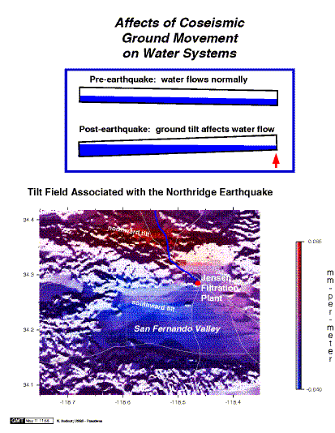
Ken Hudnut
USGS
Advances in GPS and Imagery Differencing for Observing Vertical Changes and for Restoration of Geodetic Infrastructure After Major Earthquakes
April 29, 2014 – NOAA/NGS Height Modernization Partners Workshop; Mobile, Alabama

Slide 2
Evolution of GPS Earthquake Geodesy
The pre-GPS era; leveling, EDM
GPS survey-mode (set up a tripod)
GPS continuous-mode
  PGGA & DGGA
  SCIGN
  PBO
From one week (in 1994) to a few seconds (in 2014)
GPS is ready for inclusion in EEW

Slide 3
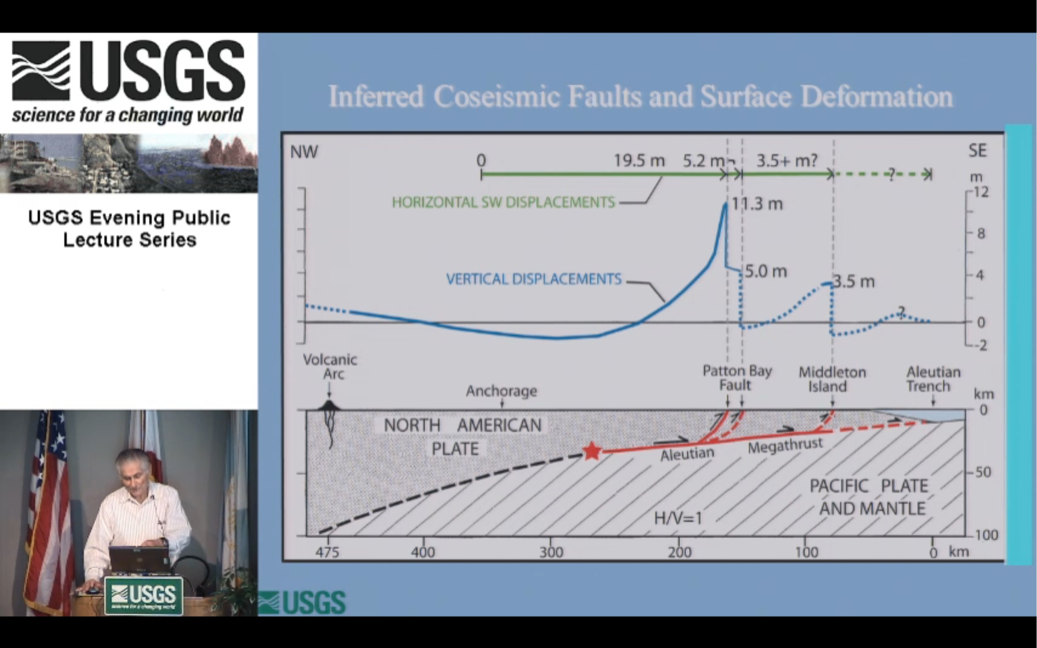
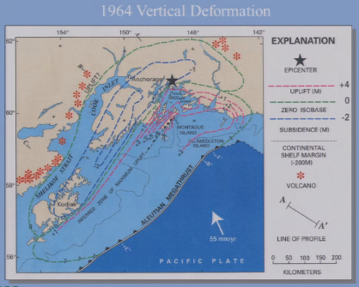
1964 Alaska (50th anniversary)
George Plafker, USGS

Slide 4
Courtesy of George Plafker, USGS

Slide 5


Slide 6
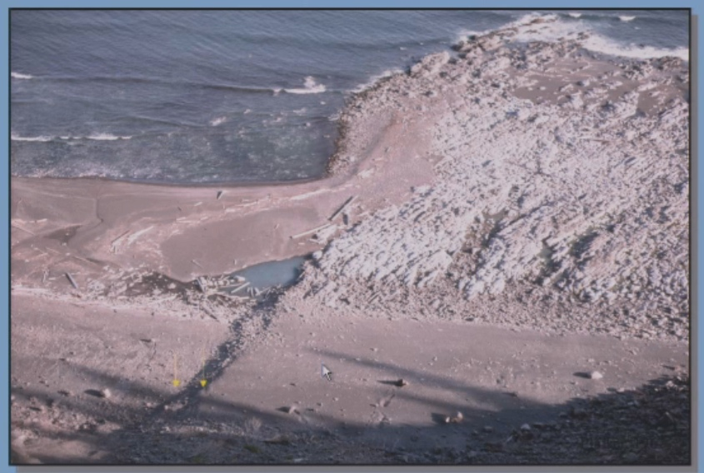

Slide 7
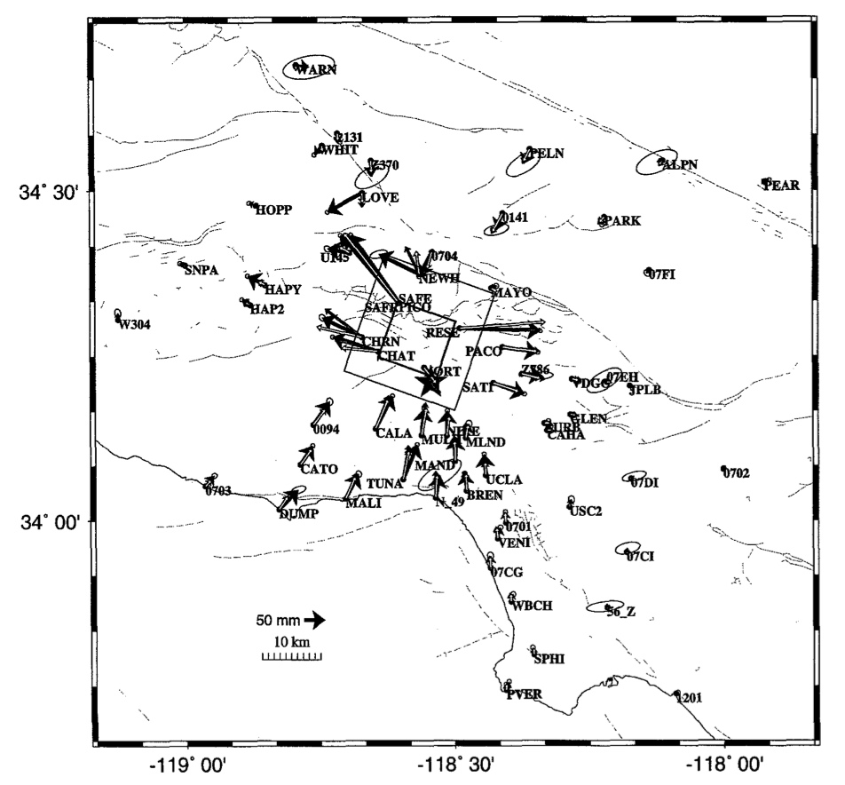
Northridge Co-Seismic Displacements
Hudnut et al.
BSSA, 1996

Slide 8
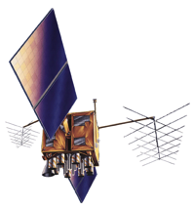
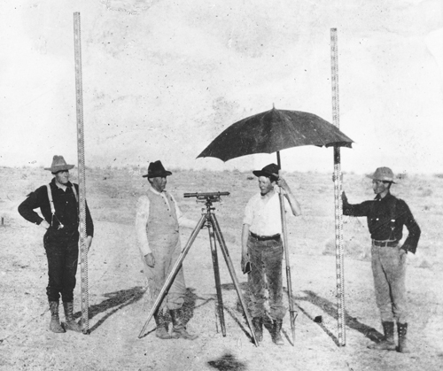
Alaska 1964
Northridge 1994
In 1994,
GPS was
still being
tested vs.
previous
methods
The GPS
constellation
had just
achieved
Initial
Operational
Capability
Leveling was GOOD!

Slide 9
Evolution of GPS Earthquake Geodesy
The pre-GPS era; geodolite, 2-color EDM
GPS survey-mode (set up a tripod)
GPS continuous-mode
  PGGA & DGGA
  SCIGN
  PBO
From one week (in 1994) to a few seconds (in 2014)
GPS is ready for inclusion in EEW

Slide 10
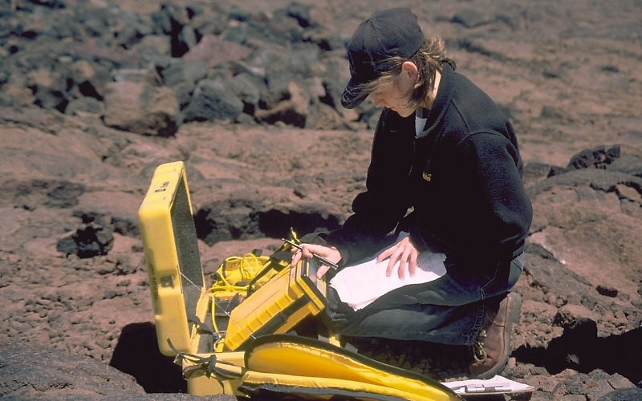
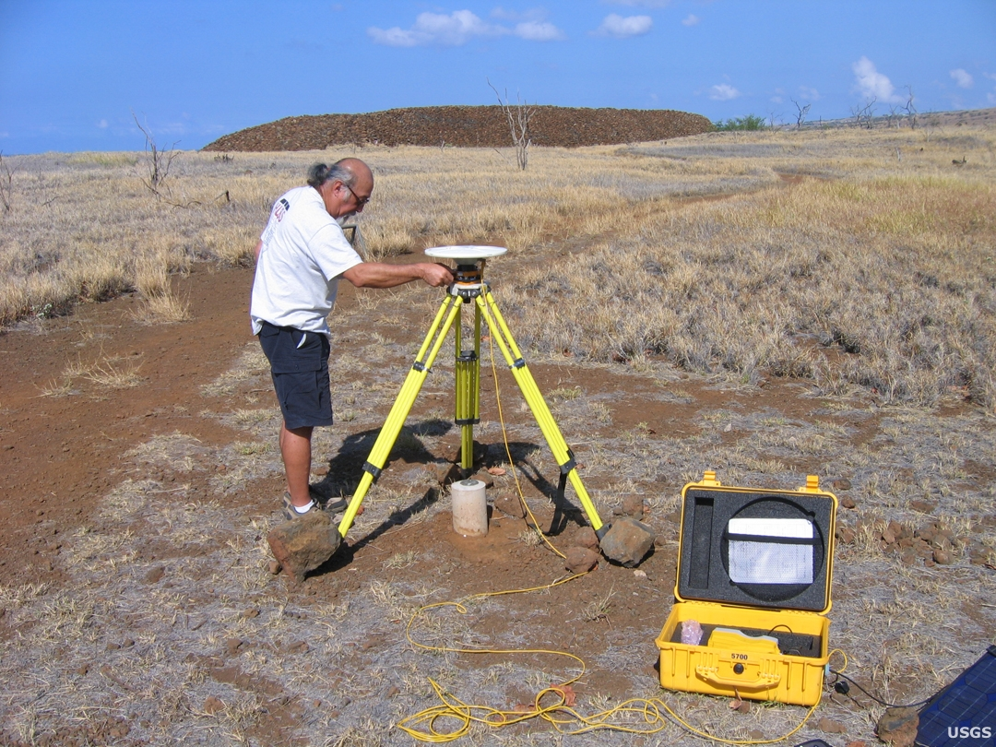
Survey-mode GPS
Drive to site
Set up GPS
Record data & wait
Break down GPS
Drive back to office
Download GPS
Process GPS data
Repeat several days
Modeling (hands on)

Slide 11
Northridge Earthquake GPS
Initial focal mechanism – but fault rupture could have been on either plane; no surface rupture
  1971 dipped north, what about 1994?
  Aftershocks of Northridge in first several days did not clearly delineate one plane or the other
GPS displacements showed a strong preference for a deeper hypocenter and a south-dipping fault plane; NORT moved SE and up – anomalous?
  Displacement of station NORT proved not to be the only influential station in the solutions
  Confidence in a south-dipping plane came from geodesy

Slide 12
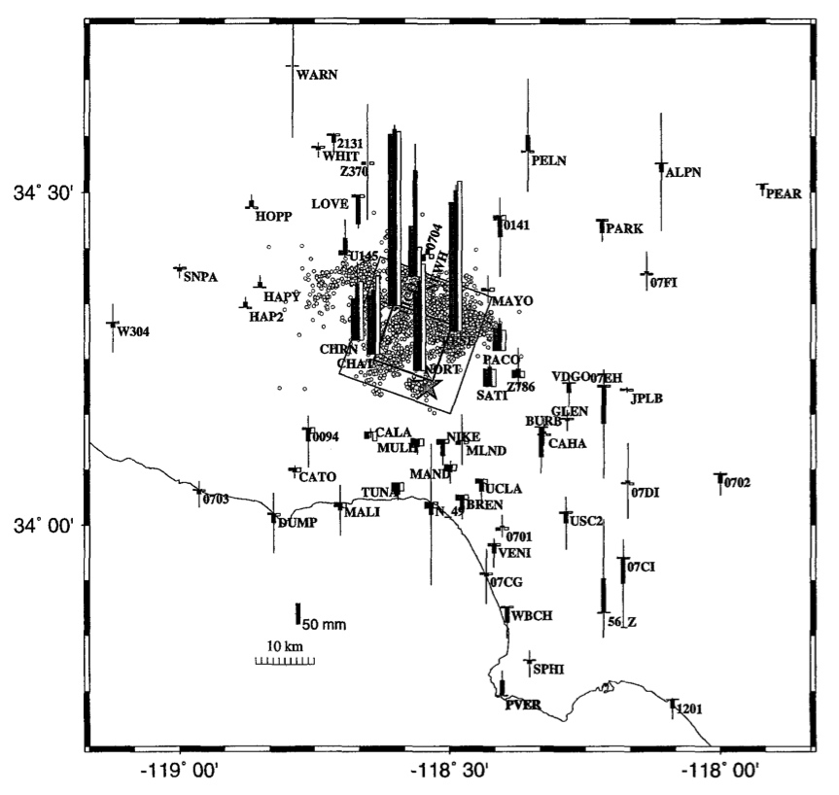
Northridge Co-Seismic Displacements
Hudnut et al.
BSSA, 1996

Slide 13
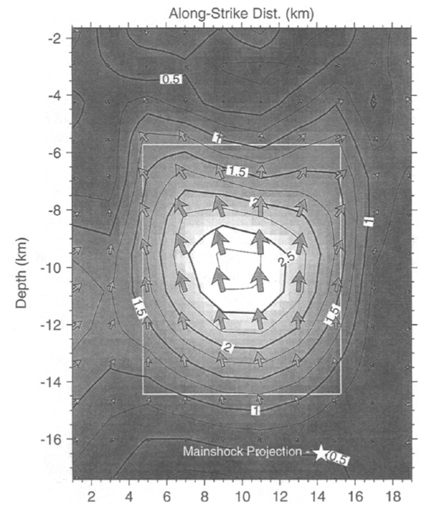
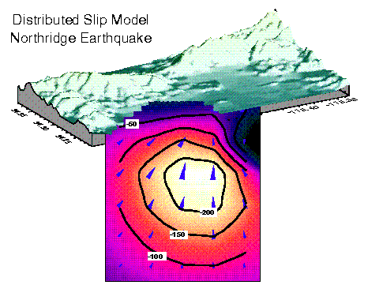
Northridge Co-Seismic Displacements
Hudnut et al.
BSSA, 1996
fault plane dips south
beneath San Fernando Valley

Slide 14
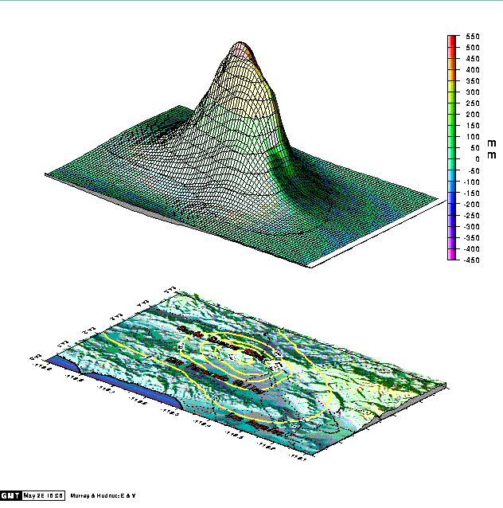
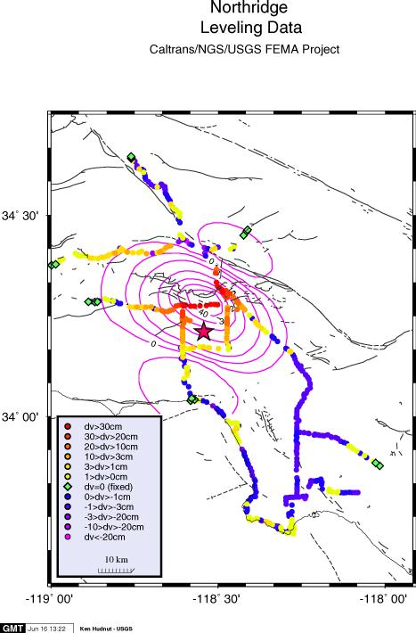
Northridge Co-Seismic Displacements
Impacts – Water!
Caltrans
MWD & LADWP
needed
vertical
deformations
tilt of 40 cm
in 10 km

Slide 15
Evolution of GPS Earthquake Geodesy
The pre-GPS era; leveling, EDM
GPS survey-mode (set up a tripod)
GPS continuous-mode
  PGGA & DGGA
  SCIGN
  PBO
From one week (in 1994) to a few seconds (in 2014)
GPS is now ready for inclusion in EEW
How can these
steps be done
much faster?

Slide 16
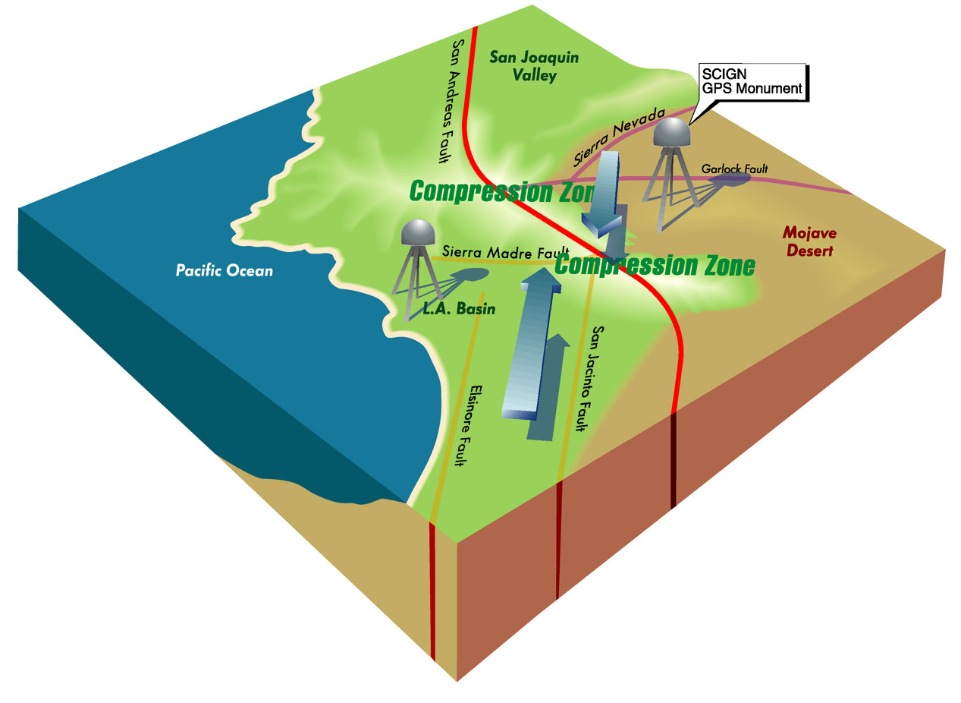






Slide 17
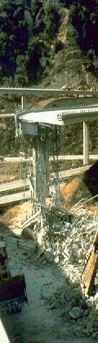

The major objectives of the
SCIGN array are:
To provide regional coverage for estimating earthquake potential throughout Southern California
To identify active blind thrust faults and test models of compressional tectonics in the Los Angeles region
To measure local variations in strain rate that might reveal the mechanical properties of earthquake faults
In the event of an earthquake, to measure permanent crustal deformation not detectable by seismographs, as well as the response of major faults to the regional change in strain

Slide 18
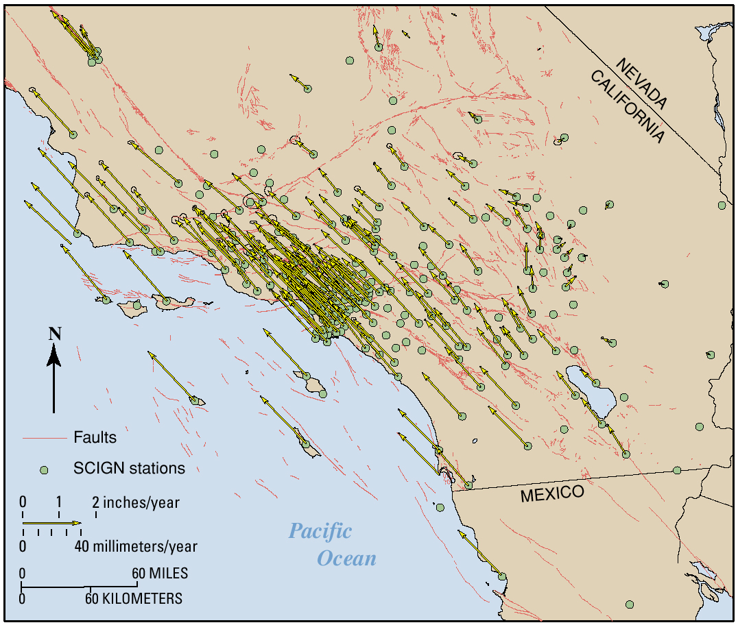

Slide 19
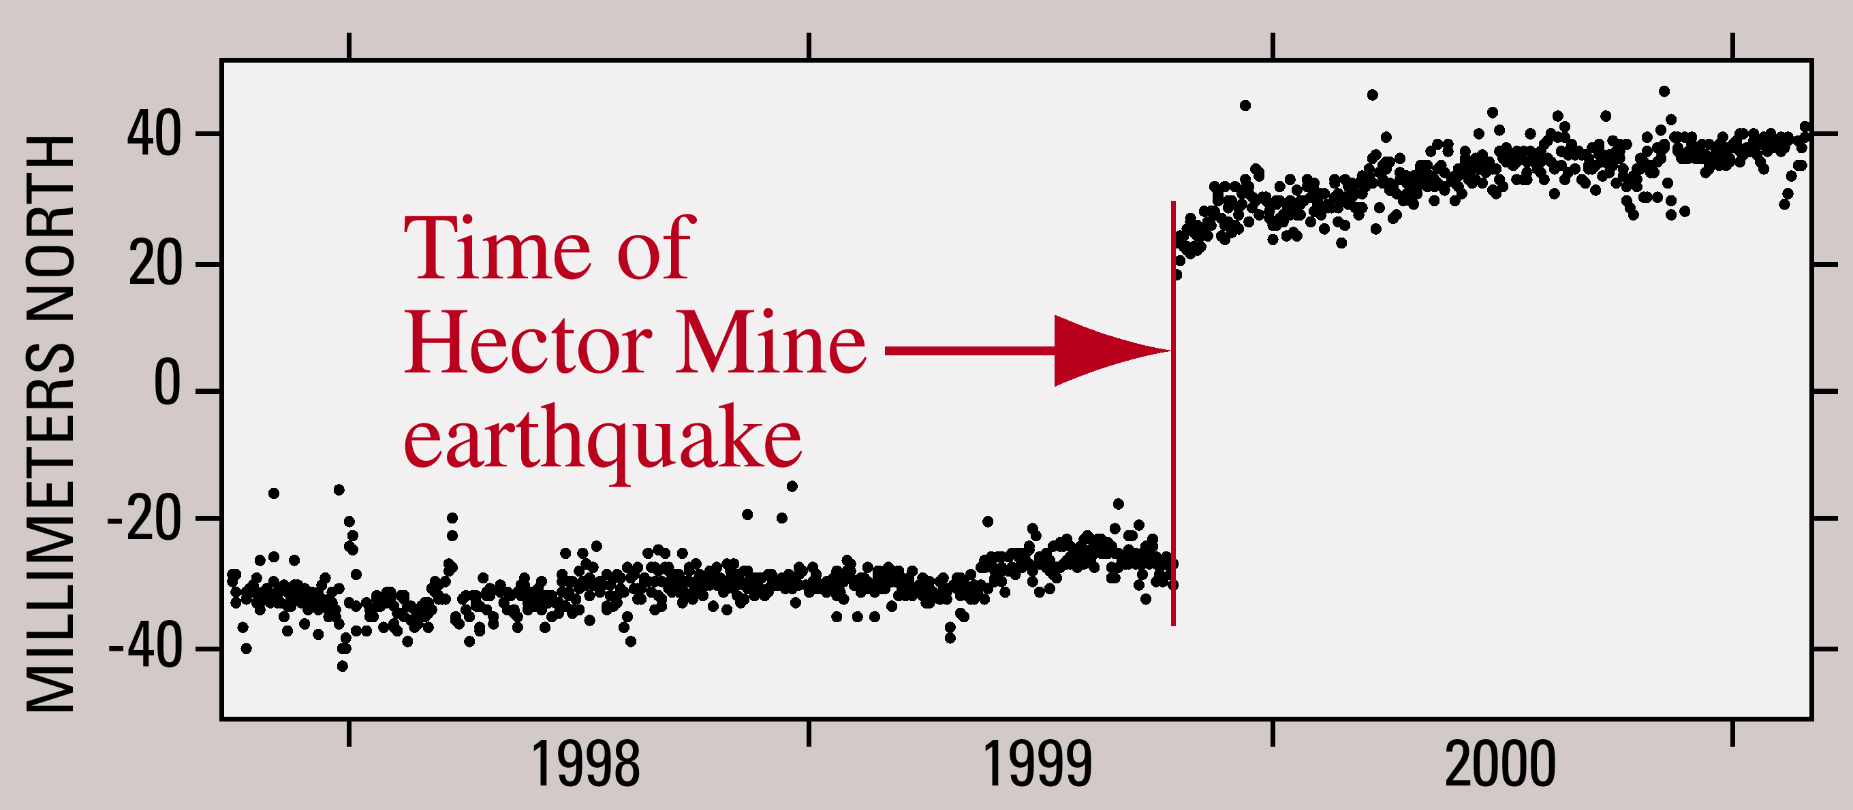

Slide 20
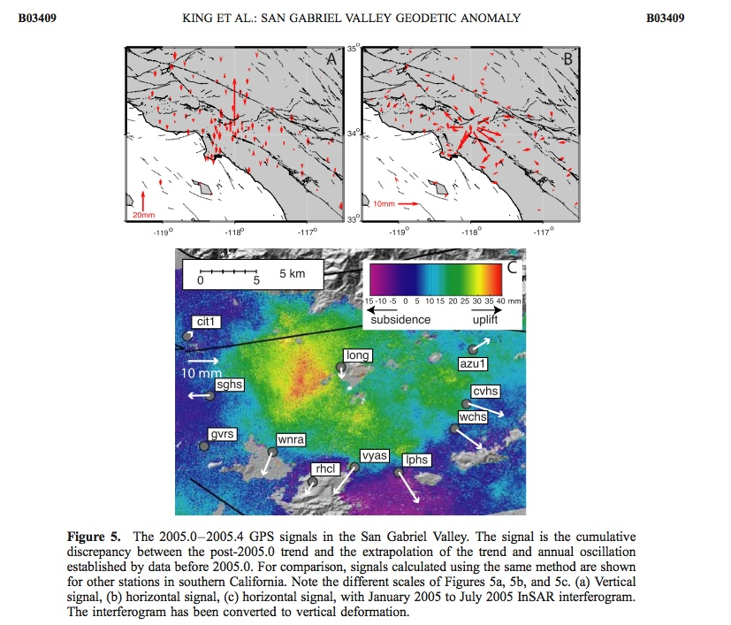
Courtesy of
Nancy King, USGS

Slide 21
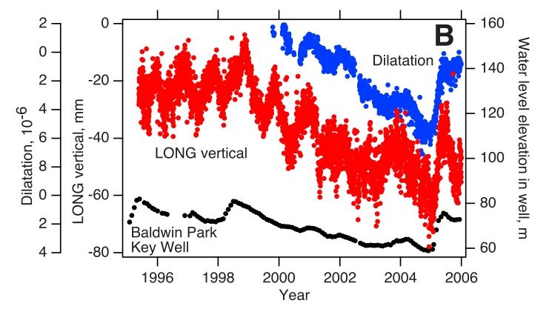
Courtesy of
Nancy King, USGS

Slide 22
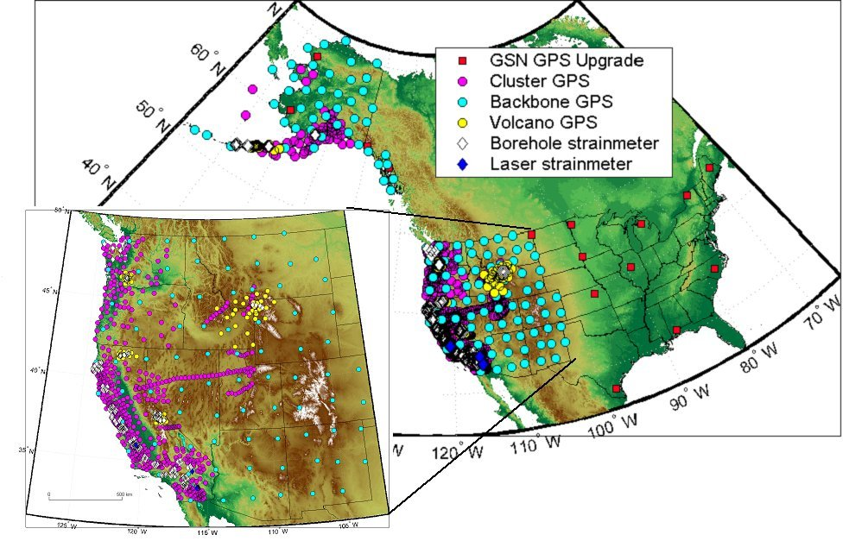

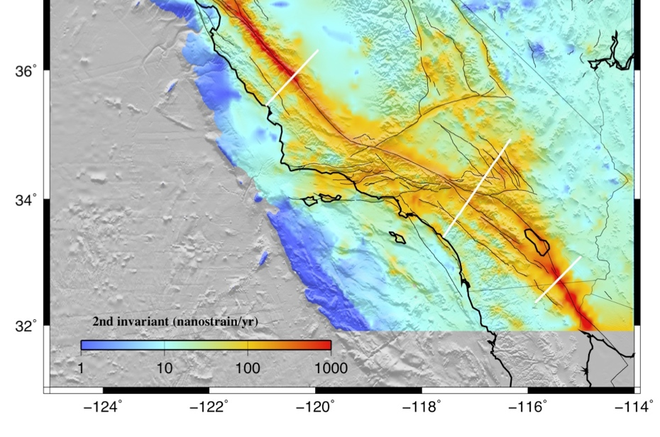

Plate Boundary Observatory
Courtesy
of Bill Holt

Slide 23
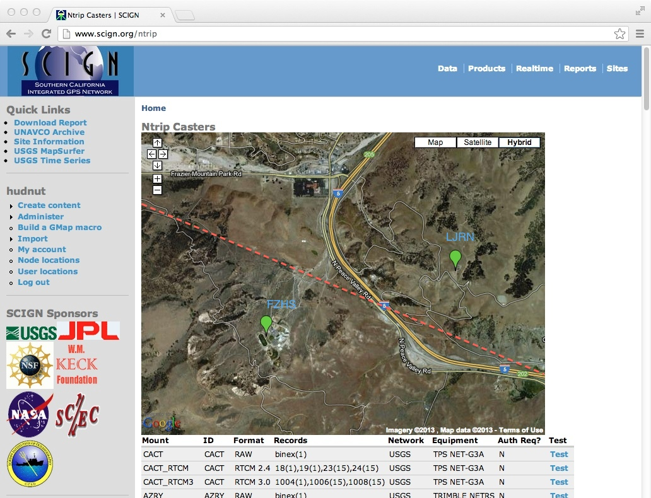
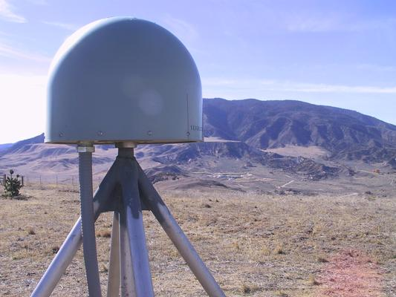
San Andreas fault

Slide 24
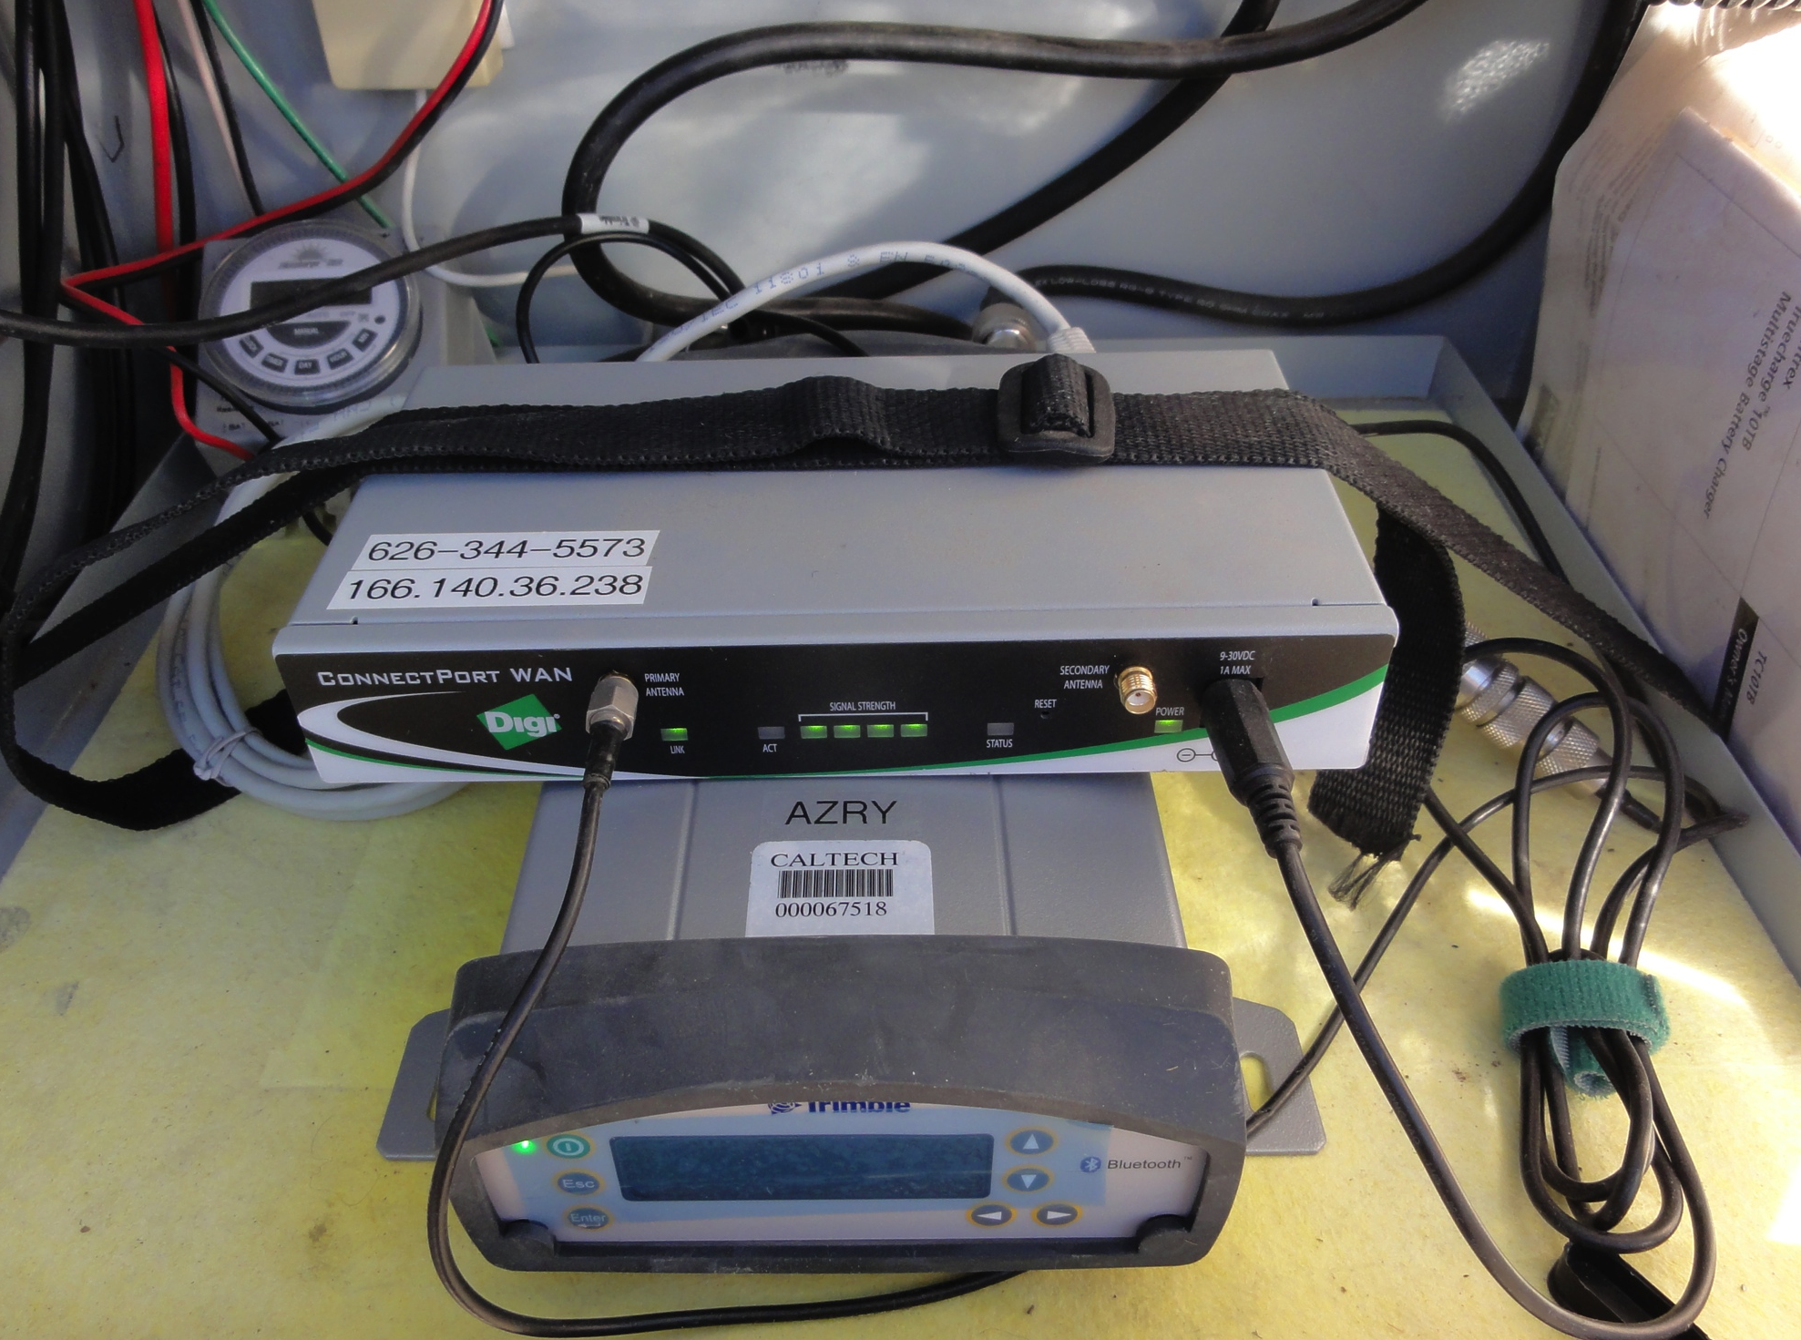
CISN ShakeAlert; Earthquake Early Warning
Courtesy of M. Böse
Fault Slip Detector (‘GPSlip’)
Future Processing:
(Böse, Heaton, Hudnut, Felizardo et al.)
USGS Pasadena
Caltech
GPS sensor
Real-time estimation of fault slip
(using back-projection)
raw data
RTK/PPP(AR) using RTNet software
position
time series
for each sensor location
(JSON format)
UserDisplay
GPS sensor
internal testing
TOPCON and other receivers
GPS sensor
...
GPS sensor
Real-time conversion to EW tracebuf2
GSOF
~40 sites
NetR9 with RTX
...
SoSAFz zipper
array UASI upgrades

Slide 25



http://uavsar.jpl.nasa.gov/

Slide 26
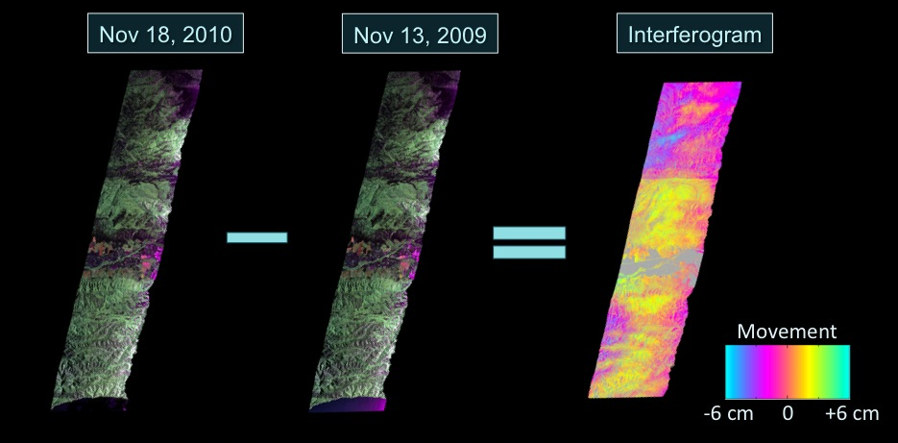
UAVSAR example interferogram (L-band)
Similar to satellite InSAR, but airborne so it has higher resolution
and more control over flight planning for rapid response uses

Slide 27
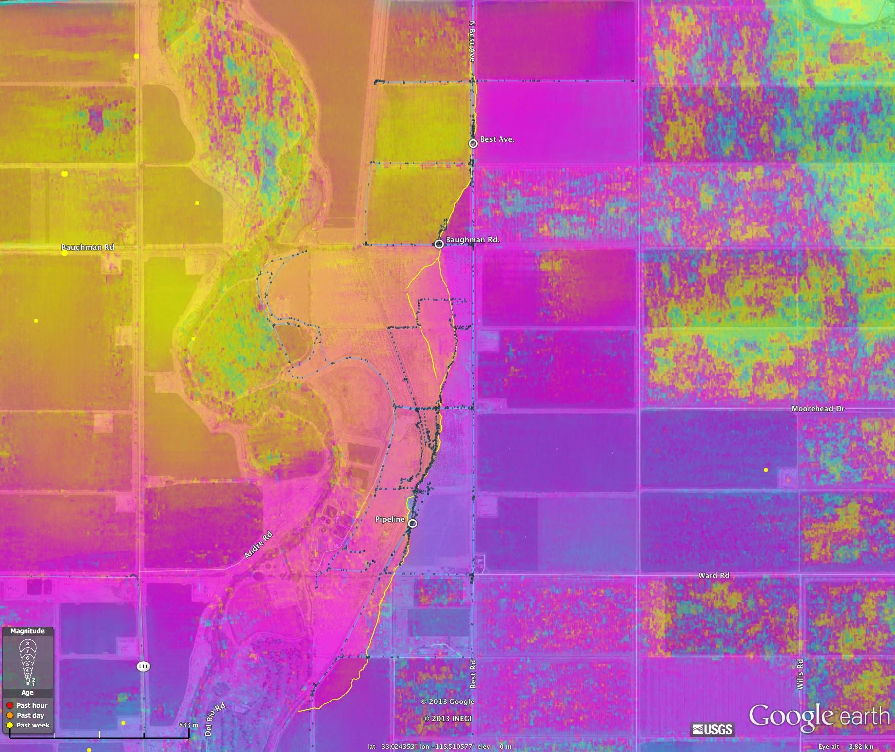
Aug. 2012 Brawley, CA Swarm – UAVSAR (NASA/JPL)

Slide 28
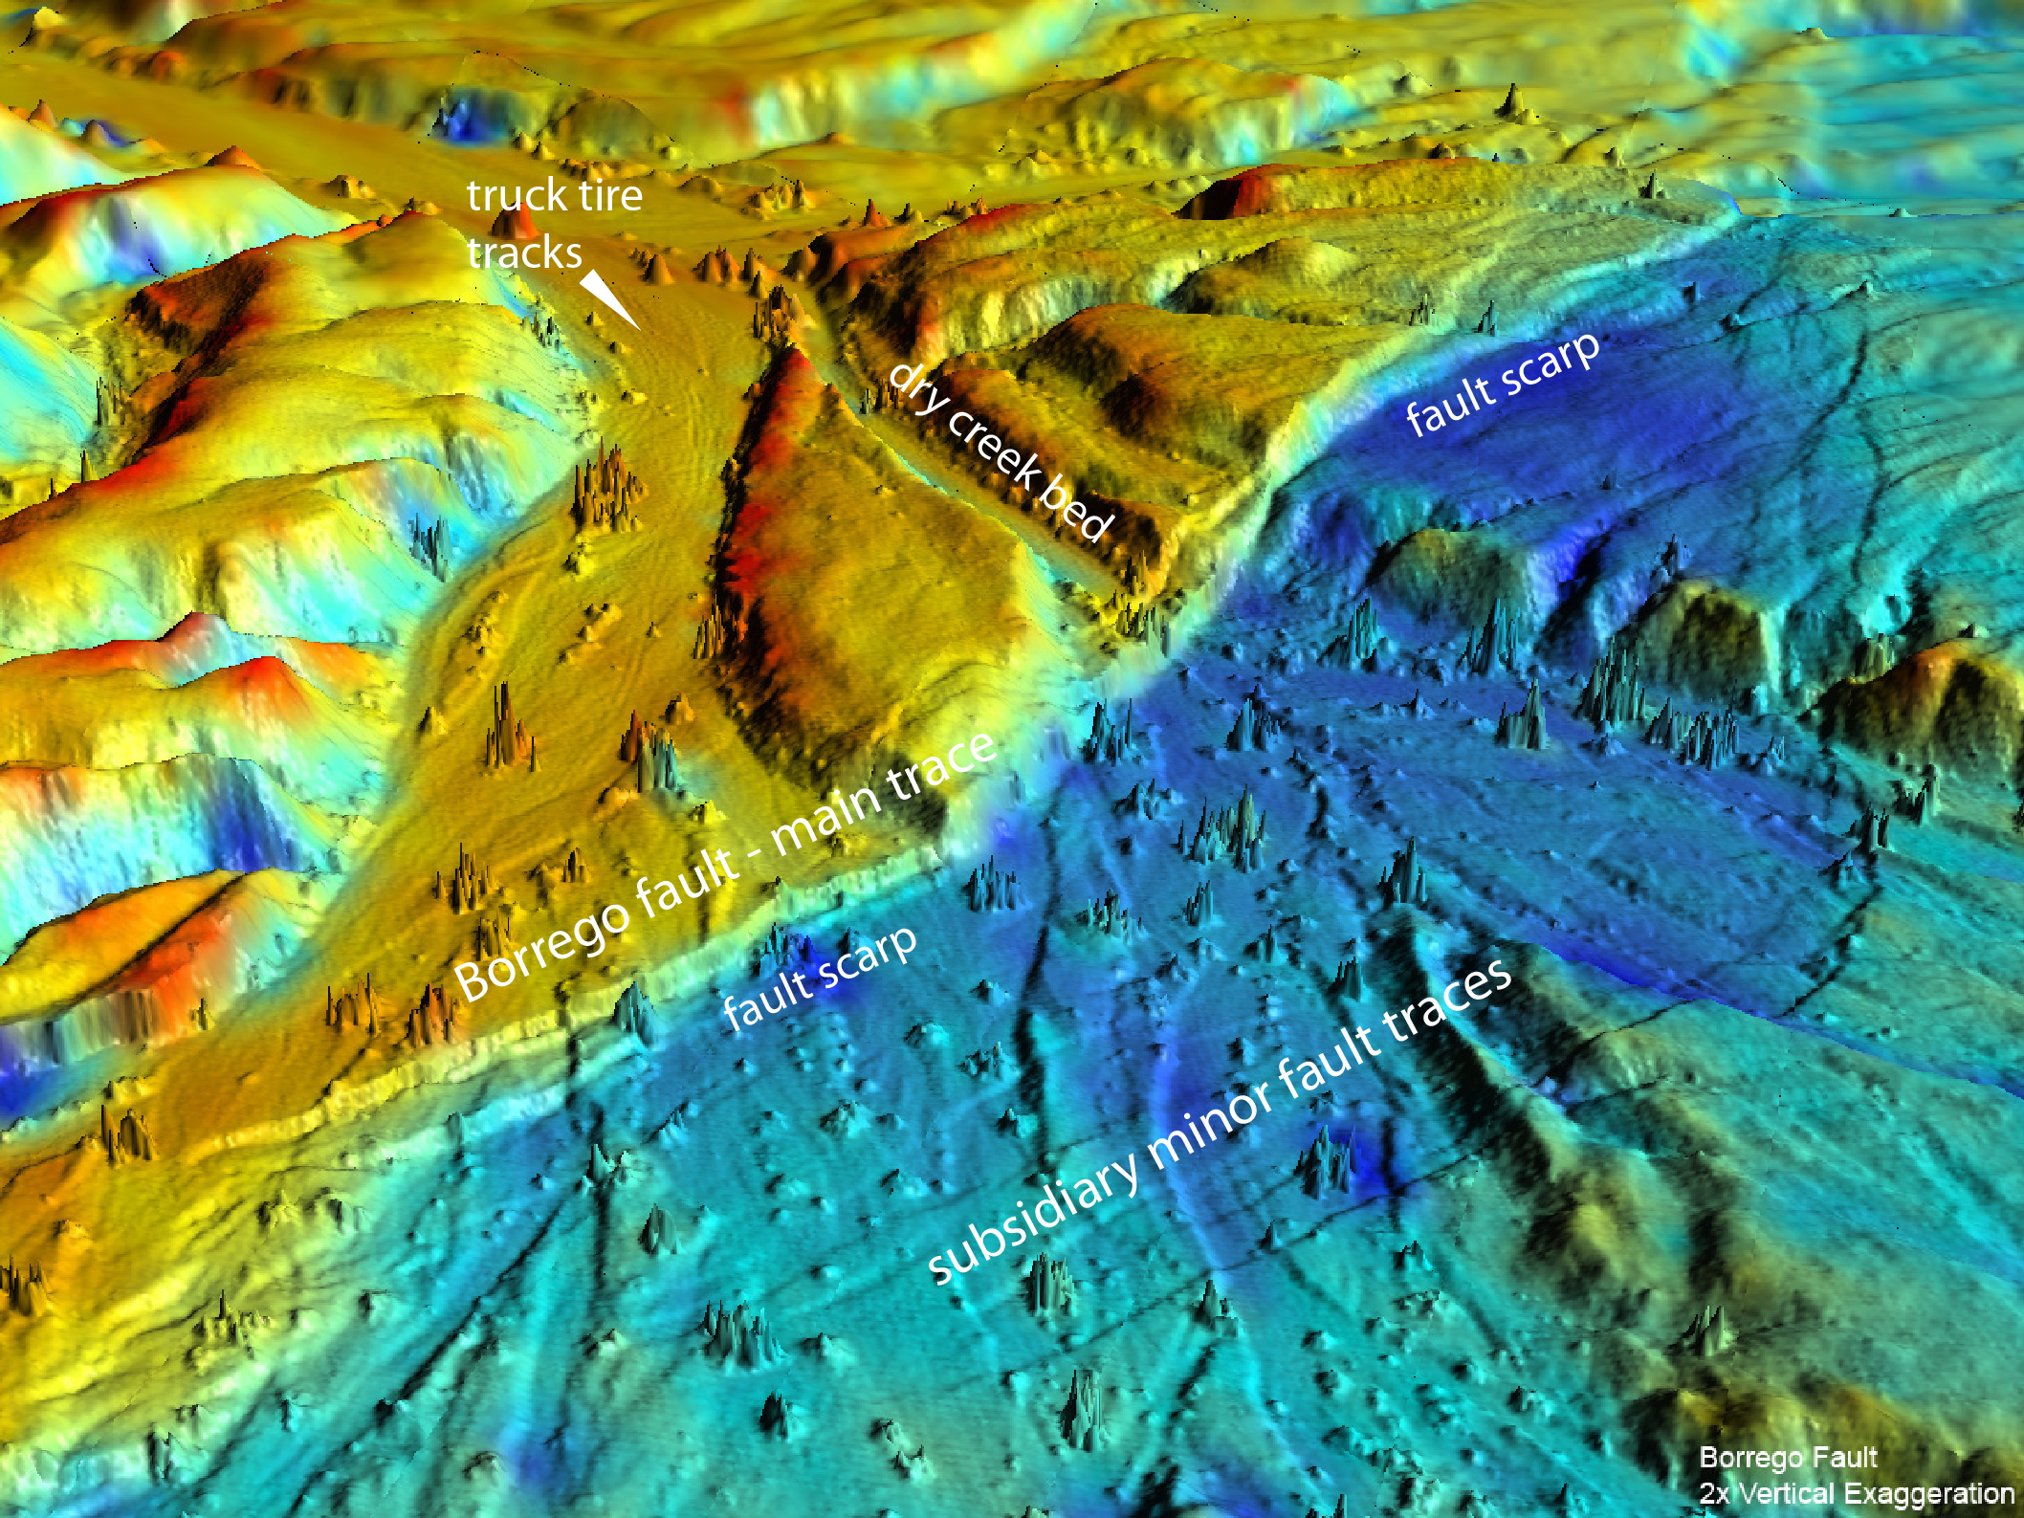
Airborne LiDAR pre- & post-earthquake difference
Courtesy of Mike Oskin, UC Davis

Slide 29
Summary
Before Northridge 1994 M 6.7 we had only 3 continuously operating GPS stations in SoCal
  We measured the GPS displacements within one week
After Northridge, we built the SCIGN array (1994-2001)
The Hector Mine 1999 M 7.1 earthquake occurred
  We measured the displacements within one day
  Technical achievements led to real-time, automatic, high-rate
PBO was built based on SCIGN innovations
  We now measure displacements continuously in real-time with GPS and have built it into the prototype West Coast Earthquake Early Warning System
  Instantaneous observation of displacements is now ~routine

Slide 30
Recommendations
Continue to fully integrate GPS into earthquake monitoring system & earthquake response op’s
Continue to build GPS into EEW operations
Ensure budget for sustainable out-year O&M for earthquake monitoring networks (GPS & seismic)
New methods of pre- and post-earthquake imagery differencing have transformed deformation mapping, providing spatial details
Anticipate all-new approach to restorating geodetic infrastructure after future earthquakes
Continue cooperative geospatial community efforts between earthquakes (and after them!)

Slide 31
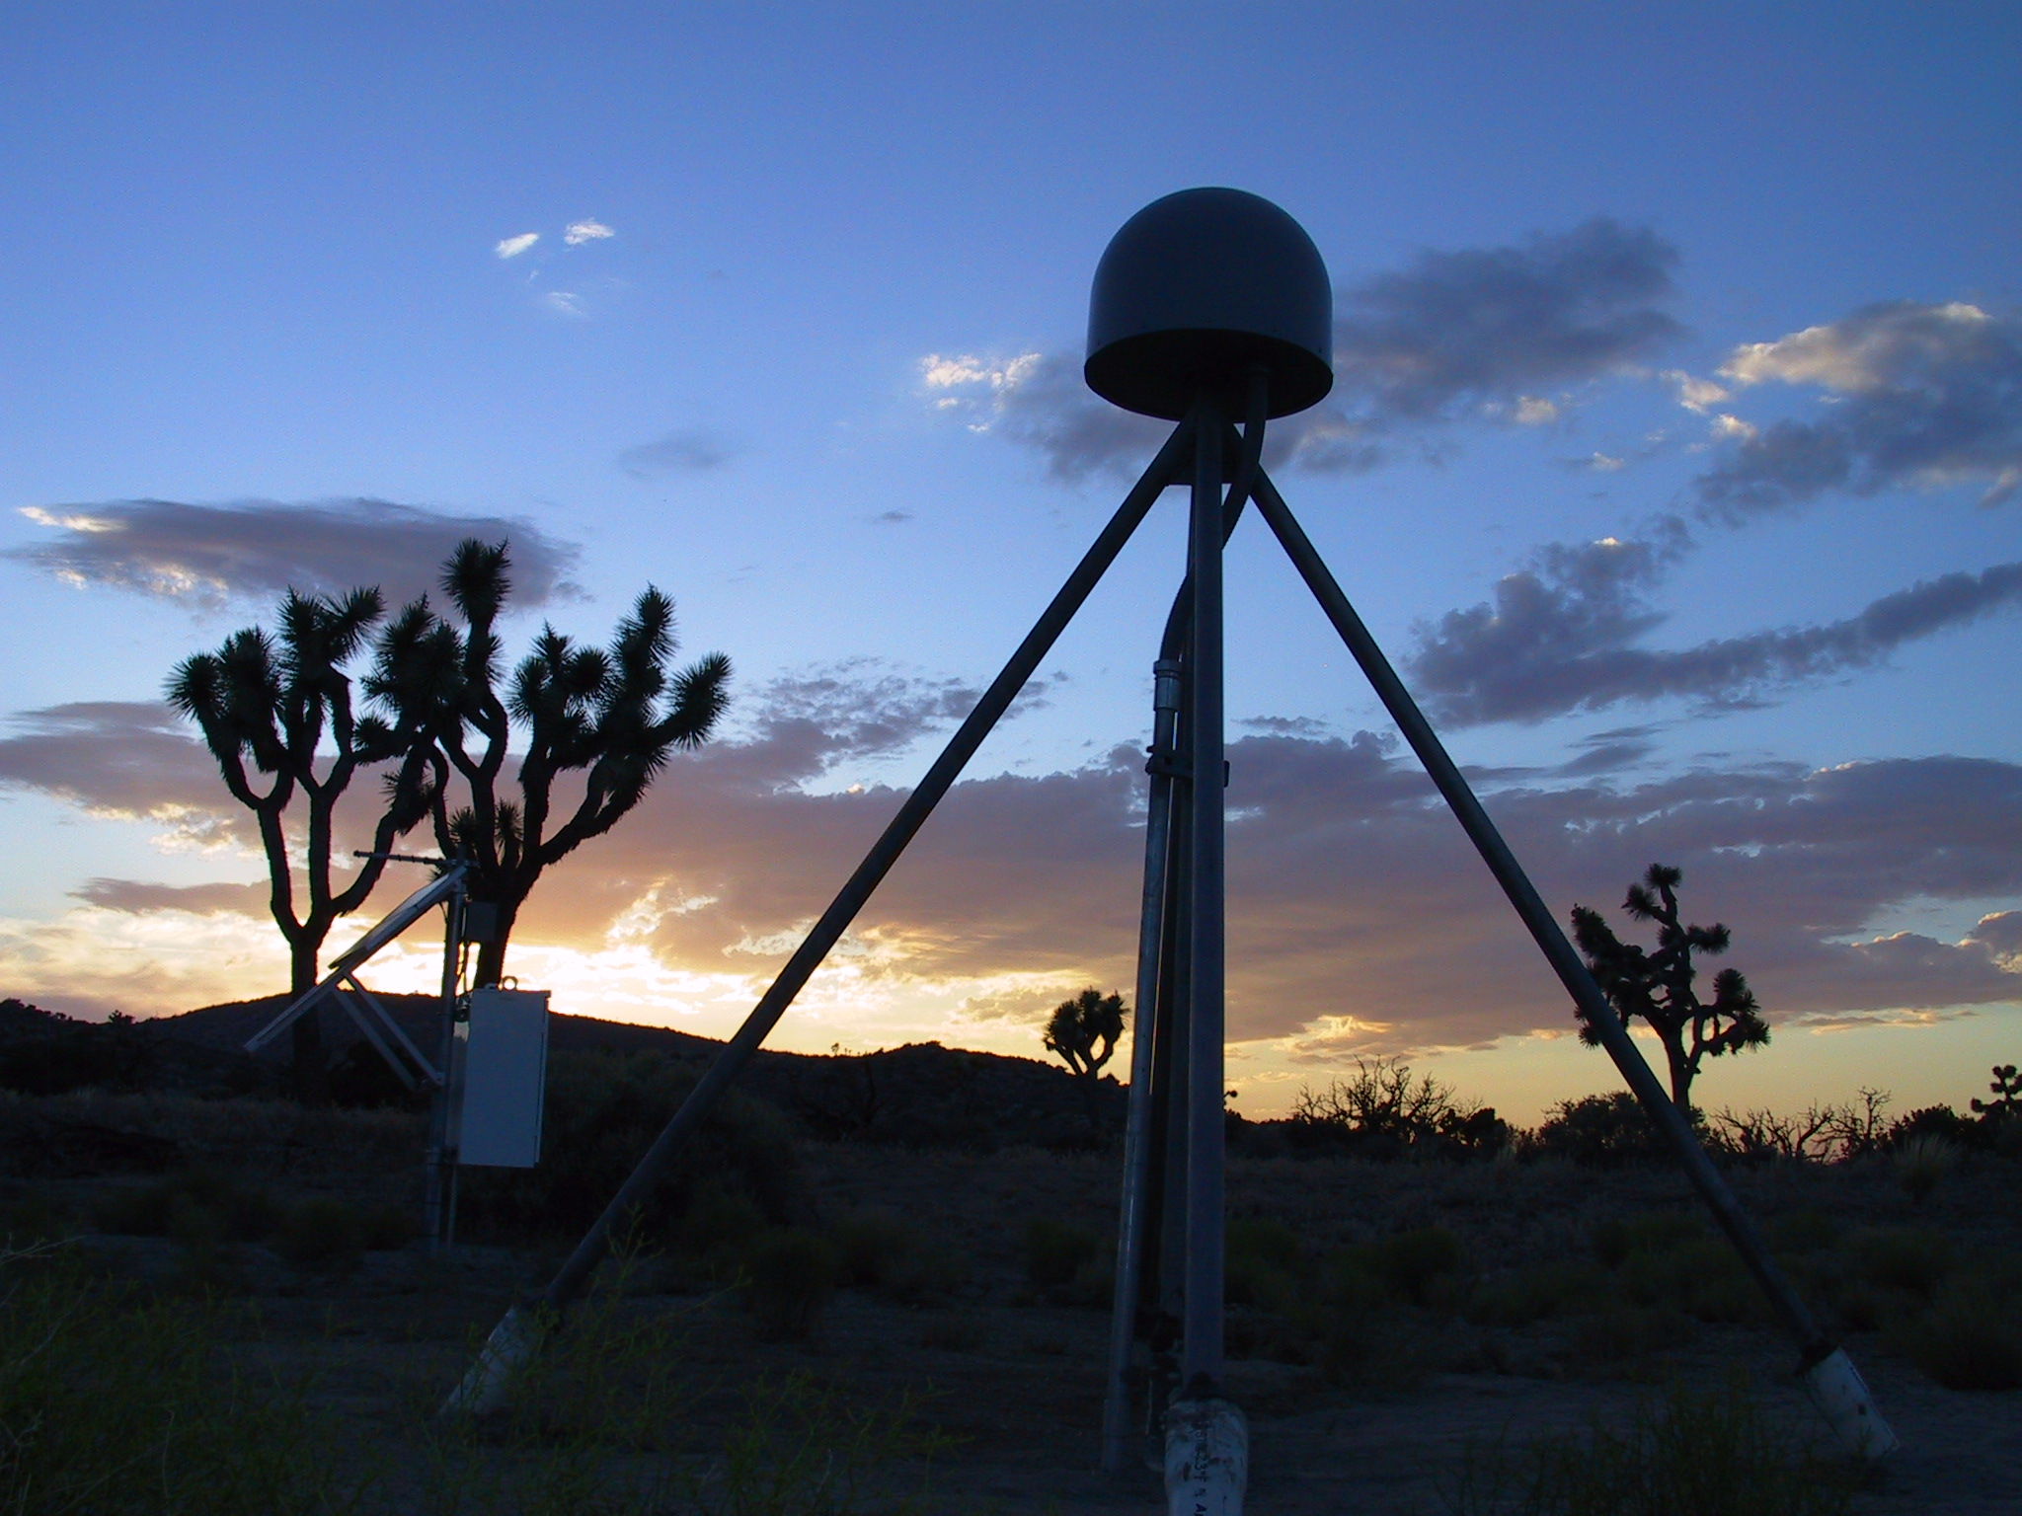
Ken Hudnut
(626)583-7232
hudnut@usgs.gov

