Slide 1

Height Mod Mississippi
NGS National Meeting 2014

Slide 2
Gulf Coast Geospatial Center
University of Southern Mississippi
Research Enterprise
Located at Stennis Space Center
The Gulf Coast Geospatial Center (GCGC) was established September 2001 though a grant from the National Aeronautics and Space Administration.
Self Funded (external only)
  Multiple Federal and State projects
    Remote sensing, ecosystem monitoring, heightmod, GIS/technical services, etc.

Slide 3
History
NOAA Height Mod
  Began 2003 (1.45M)
  Katrina
  Network Expansion
  2007 Spatial Reference Center Designation
  O&M
  2012 RTN.USM.EDU rollout

Slide 4
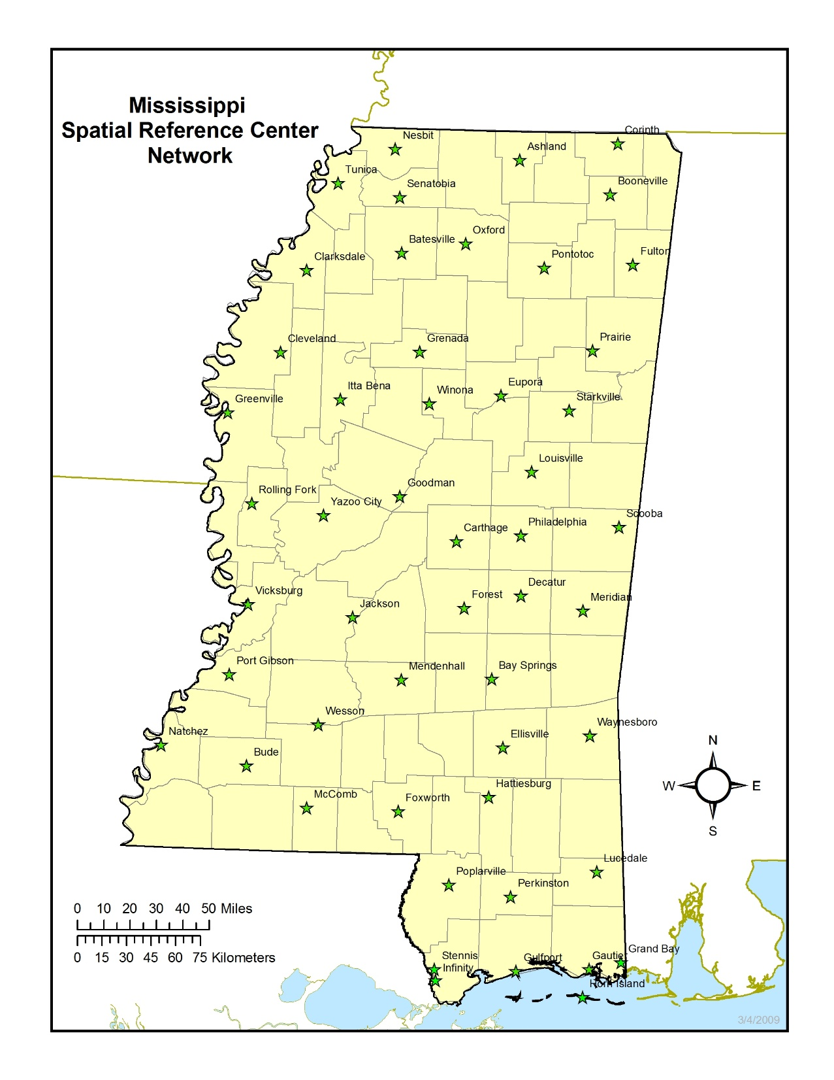
`

Slide 5
Mississippi CORS
53 Stations
June 24, 2013 All Stations GPS+GLONASS
October 1, 2012 Adjusted to NAD 83(2011) epoch 2010.00
Annual “full” network position adjustment completed Aug 1, 2013.

Slide 6
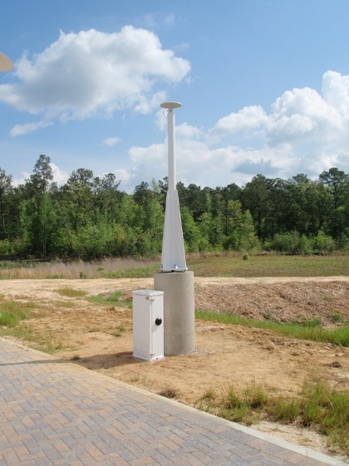
CORS Station
Infinity Science Center
NASA Visitors Center
24 in. concrete pillar 12 feet in length
Spun aluminum mast
SECO adjustable CORS mount
Trimble NetR9 GNSS multi-constellation receiver
Trimble Zephyr Geodetic Model 2 antenna

Slide 7
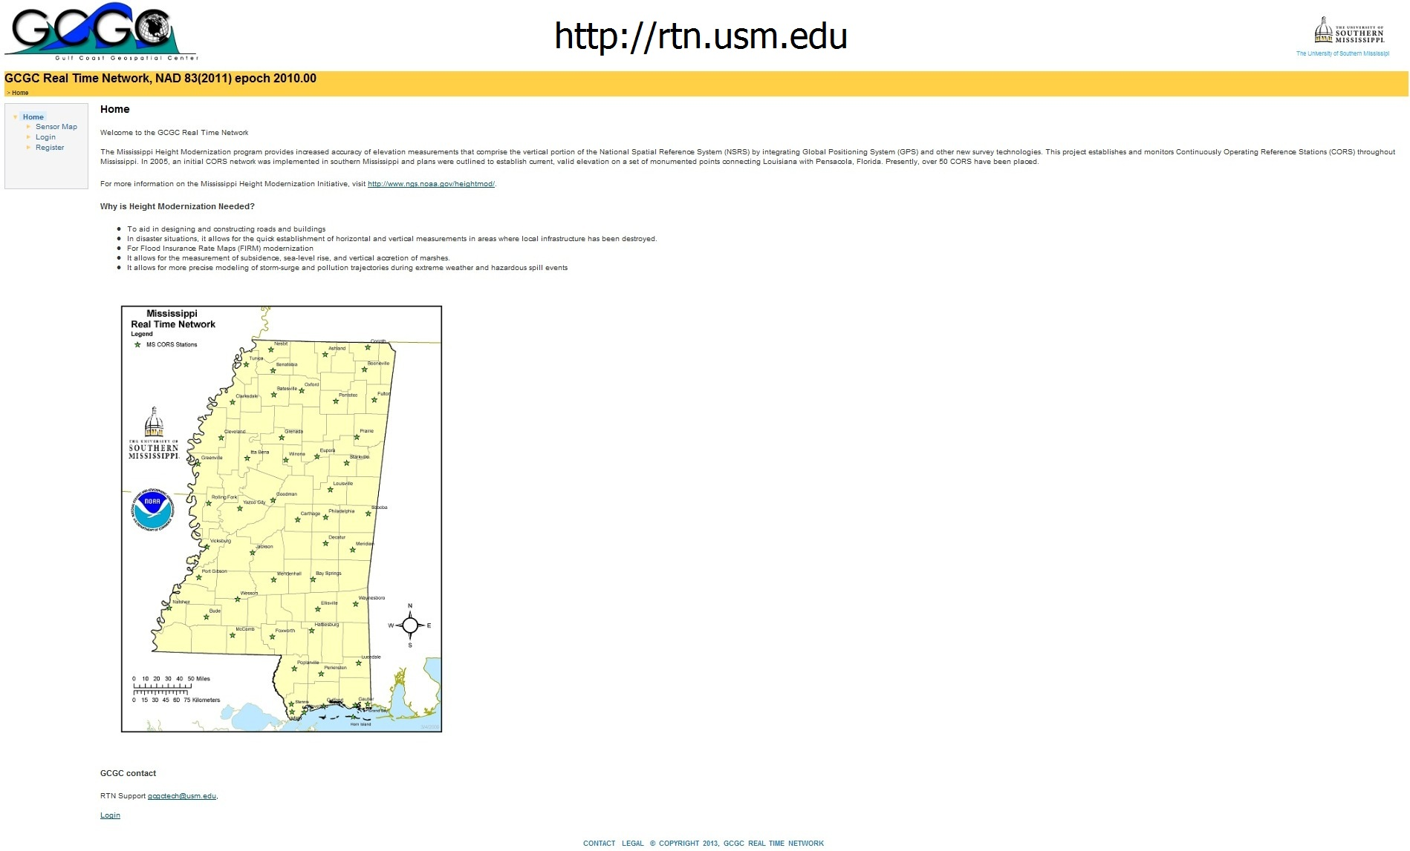

Slide 8
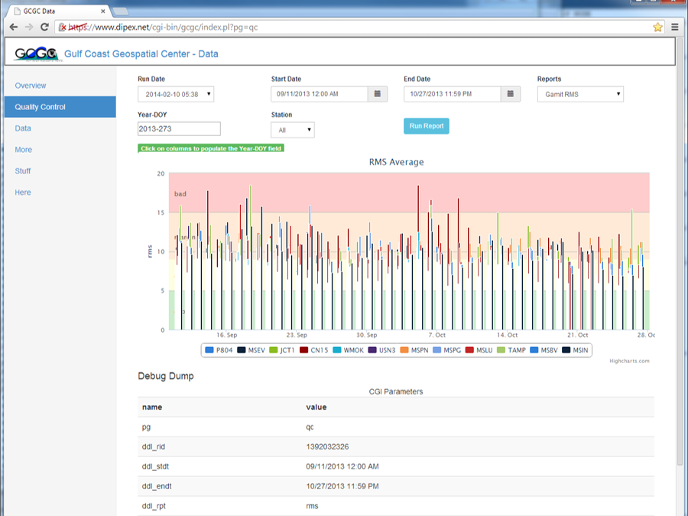

Slide 9
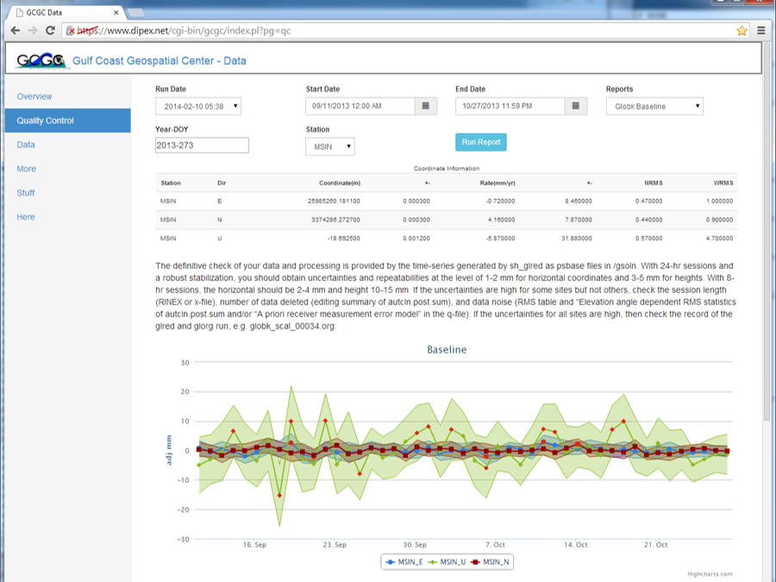

Slide 10
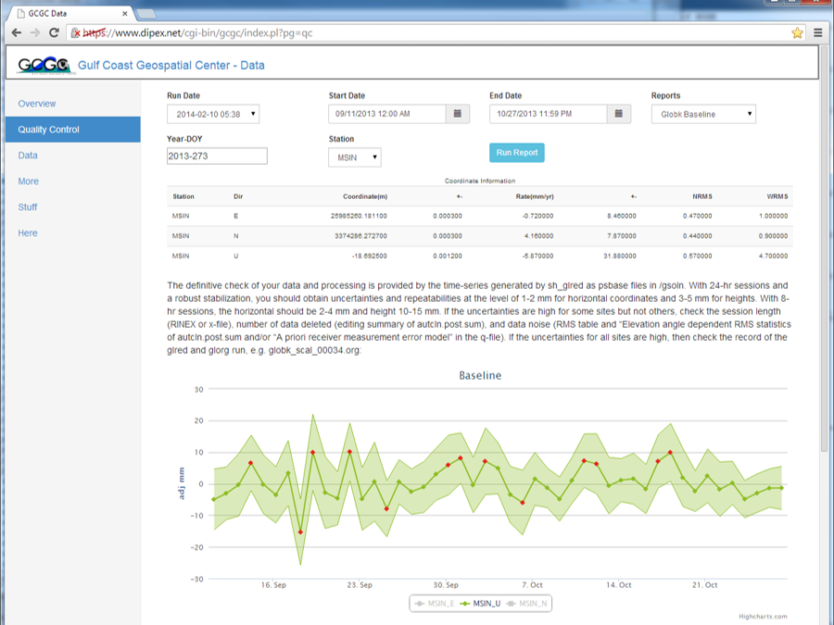

Slide 11
Region
NGS Legacy partners in 4 of the 5 Gulf States
Best use of future funds
Gulf of Mexico Initiative

Slide 12
Questions?
David.Mooneyhan@usm.edu

