Slide 1


Texas Height Modernization
National Height Modernization Partner Meeting
NOAA Gulf of Mexico Disaster Response Center
Mobile, Alabama – April 2014
Dr. Gary Jeffress, RPLS
Texas Spatial Reference Center

Slide 2
Recent Projects
2012-2013 GPS Precise Network Observations Along the Texas Gulf Coast
  TCOON Tide gauge Benchmarks
  Historic USACE tidal benchmarks
  Texas CORS
  GPS-able NGS first & second order Benchmarks
A total of 72 network sessions and 153 stations observed (Adjust and Pages)
All stations Bluebooked
Funded by US Army Corps of Engineers

Slide 3
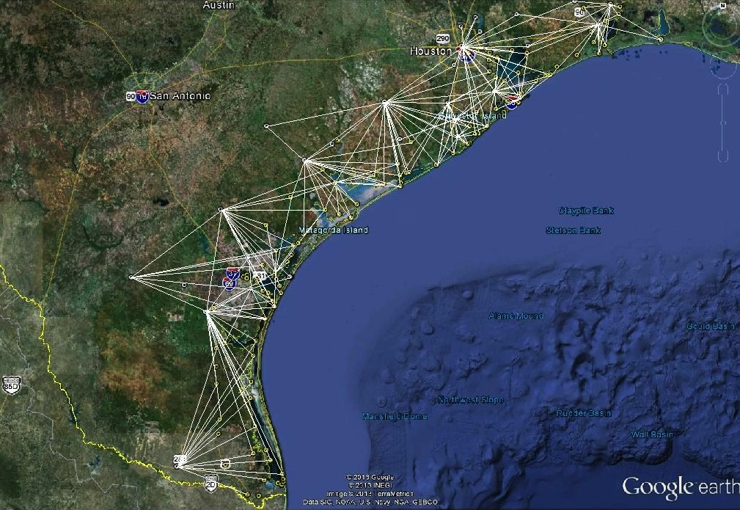
2012-2013 GPS Precise Network Observations Along the Texas Gulf Coast

Slide 4
2013-2014 GPS Precise Network Observations
Along the Florida Gulf Coast

Slide 5
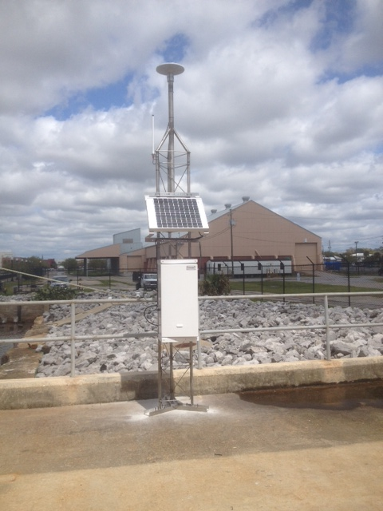
CORS on Tide Gauges Florida
Pensacola, FL

Slide 6
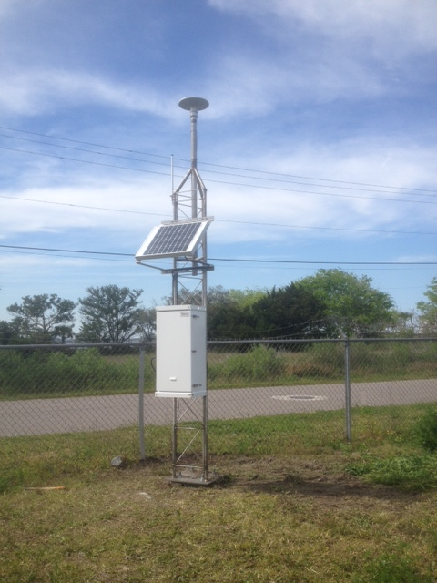
CORS on Tide Gauges Florida
Fernandina, FL

Slide 7
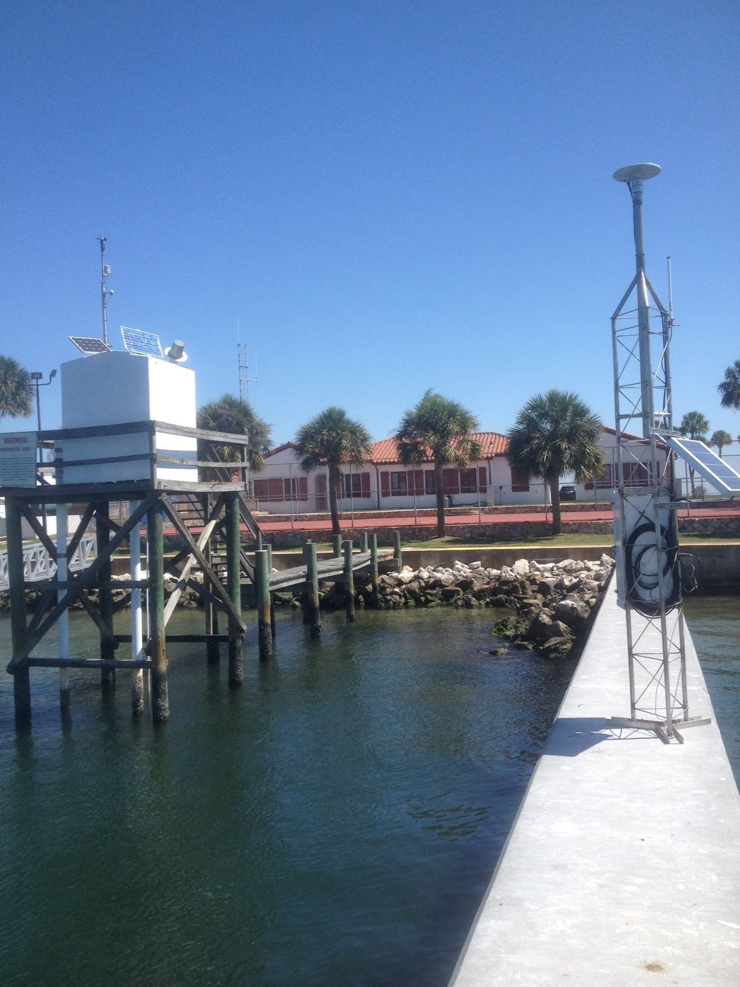
CORS on Tide Gauges Florida
St. Petersburg, FL

Slide 8
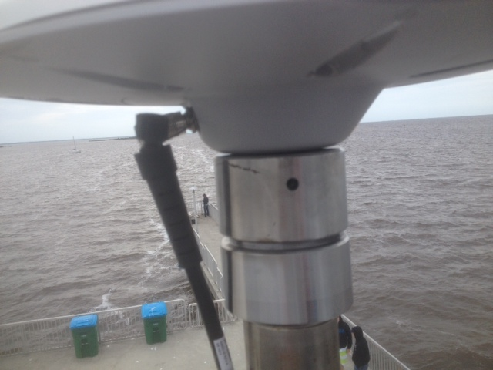
CORS on Tide Gauges Florida
Cedar Key, FL

Slide 9
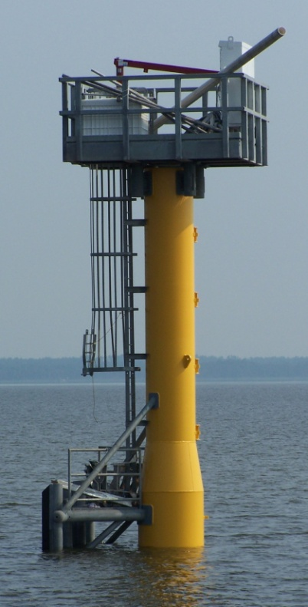
CORS on Tide Gauges Texas
Existing CORS 4
(USACE 2,
NERRS 1,
USFW 1)
Proposed
Sentinel CORS 4
(USFW)
Proposed
Height Mod.
CORS 5
TOTAL 13
Sentinel

Slide 10
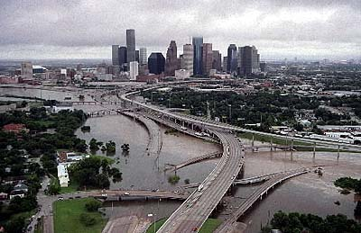
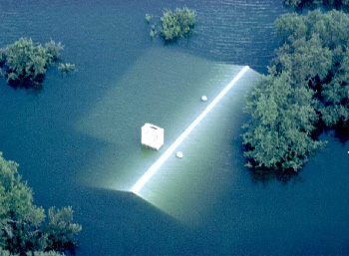
The need for accurate Elevation in Texas
Austin, 1991
Houston, 2001
Lives are lost and
$Billions of property are lost.

Slide 11
National Flood Statistics (2001)
From http://floodsafety.com/national/life/statistics.htm

Slide 12
Licensed Surveyor’s Role

Slide 13
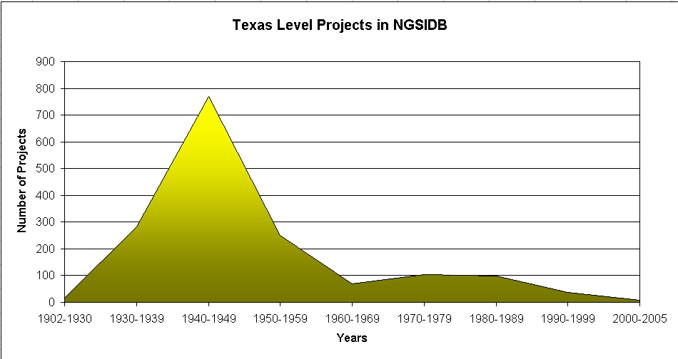
Why are Elevations so bad?
Answer: The data are old and subject to change and destruction.
Up to 80% of these benchmarks have disappeared

Slide 14
Why are Elevations Important?
An Example from Galveston Bay, Texas

Slide 15
An Example from Galveston Bay, Texas
From Google Street View

Slide 16
An Example from Galveston Bay, Texas
From Google Maps
X

Slide 17
An Example from Galveston Bay, Texas
X

Slide 18
An Example from Galveston Bay, Texas
X
X

Slide 19
An Example from Galveston Bay, Texas

Slide 20
An Example from Galveston Bay, Texas
FF = Finished Floor Level
FF = 13.86 feet
FIRM September 1999
Zone AE EL 12 = 12.00 feet
FIRM September 2012
Zone AE EL 15 = 15.00 feet

Slide 21
An Example from Galveston Bay, Texas
Surveyor’s Elevation Datum

Slide 22
Flood Insurance Quote

Slide 23
For Sale $1,028,697 ?

Slide 24
Thank you for listening.
gary.jeffress@tamucc.edu

