Slide 1
Gravity for the Redefinition of the American Vertical Datum
Project Update
Vicki Childers, Ph.D
GRAV-D Project Manager
*
National Height Mod Partners Mtg
*

Slide 2
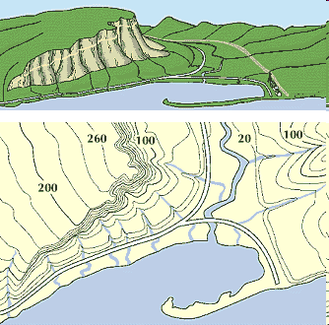
What is a Vertical Datum?
Surface: representing zero elevation
Heights: how are heights determined above the zero elevation surface
Vertical datum must have:
A definition: parameters
A realization: how you access it
"topographic map." Online Art.
Britannica Student Encyclopædia.
17 Dec. 2008
<http://student.britannica.com/ebi/art-53199>
*
National Height Mod Partners Mtg
*

Slide 3
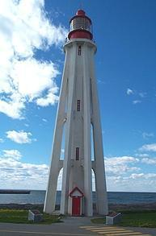
NAVD 88: Current Vertical Datum
NAVD 88: North American Vertical Datum of 1988
The surface of equal gravity potential to which orthometric heights shall refer in the US
How Defined:
Massive leveling and gravity campaign across the country in the 1980’s yielded measurements at >500,000 benchmarks
Minimally constrained adjustment of level/grav data, holding geopotential value fixed at one point: 6.271 meters (along the plumb line) below the geodetic mark at “Father Point/Rimouski” (NGSIDB PID TY5255)
Realization:
NAVD 88 is only defined at these benchmarks.
Father Point Lighthouse, Quebec
*
National Height Mod Partners Mtg
*
Notes:
By fixing the geopotential value at the origin point, it was possible to ensure that the origins of IGLD 85 and NAVD 88 aligned.
“This constraint satisfies the requirements of shifting the datum vertically to minimize the impact of NAVD 88 on U.S. Geological Survey (USGS) mapping products, and provides the datum point desired by the IGLD Coordinating Committee for IGLD 85.”
*It should be pointed out that while the datum was defined in such a way as to be usable on the North American continent, it was never actually adopted in Canada. It can be used there, but it’s not their official civilian datum.
Note that the designation of the vertical control point at Father Point is “1250 G=NAVD 88 DATUM POINT” for PID# TY5255 and is not available from the publicly accessible NGSIDB.

Slide 4
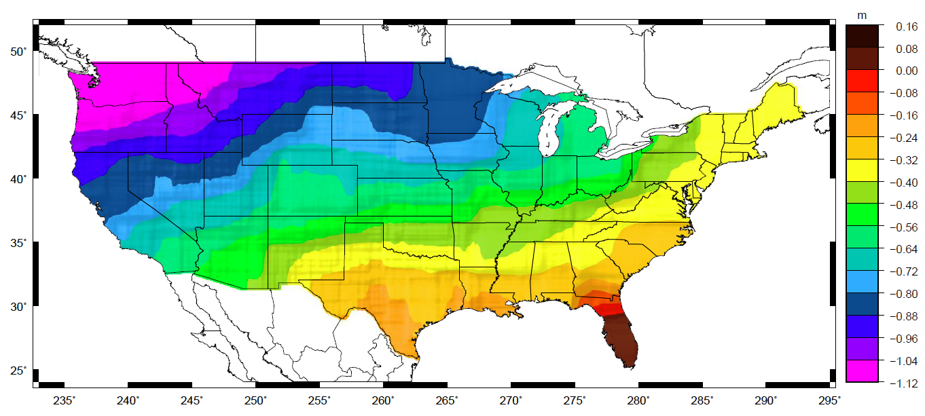
NAVD 88
Approximate mismatch between NAVD 88
(zero surface) and the global geoid (i.e. sea level)
*
National Height Mod Partners Mtg
*
Notes:
NAVD 88 is a very useful and internally consistent reference surface. The problems with the datum, though, have resulted in our decision to replace it:
This slide shows the mismatch between NAVD 88 and the global geoid derived from GRACE data. This plots shows an estimate of the mismatch of NAVD 88 with Sea Level. In an age of rising sea levels and storm surges from increasingly intense storms, it becomes more important than ever to have our orthometric heights match our “heights above sea level”.
NAVD 88 is a one-dimensional datum defined only at bench marks.
There is no mechanism for the
This map reflects the sort of height changes that users could expect if NAVD 88 were replaced with a geoid-based vertical datum.
This is only a large scale approximation and should not be used as an absolute guide. Each benchmark might have its own level
Of mismatch, say from uplift or subsidence, not captured by this broad brush.
Also, this is the difference between the zero level of NAVD 88 and the actual geoid. The difference between NAD 83 ellipsoid heights and
ITRF/GRS-80 ellipsoid heights has NO influence on this graph and should not be part of the story.
Updated October 2010
*

Slide 5
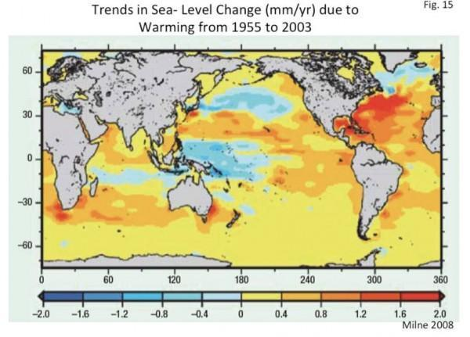
!!!
Milne, G. (2008), How the climate drives sea-level changes. Astronomy & Geophysics, 49: 2.24–2.28. doi: 10.1111/j.1468-4004.2008.49224.x
*
National Height Mod Partners Mtg
*

Slide 6
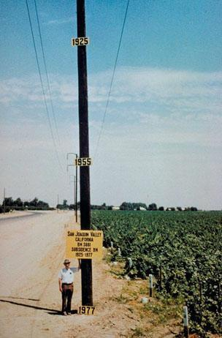
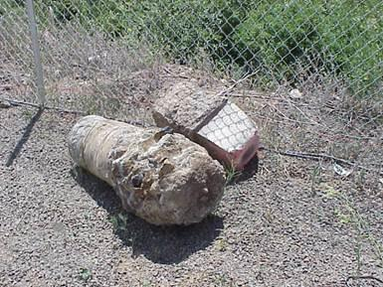
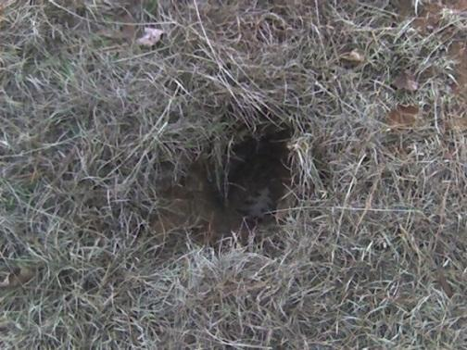
Bench Marks
NAVD 88 is defined (realized) at bench marks that:
Were determined by leveling from a single point, allowing cross-country error build up
Are not always conveniently located
Disappear by the thousands every year
Are not funded for replacement
Are rarely re-checked for movement
Don’t exist in most of Alaska
PID: EZ0840
*
National Height Mod Partners Mtg
*
Notes:
Clarification on the word “convenient” – this is used to mean “there isn’t always a bench mark around when you need one – sometimes you have to find one far away and level from it to your site of interest”
*

Slide 7
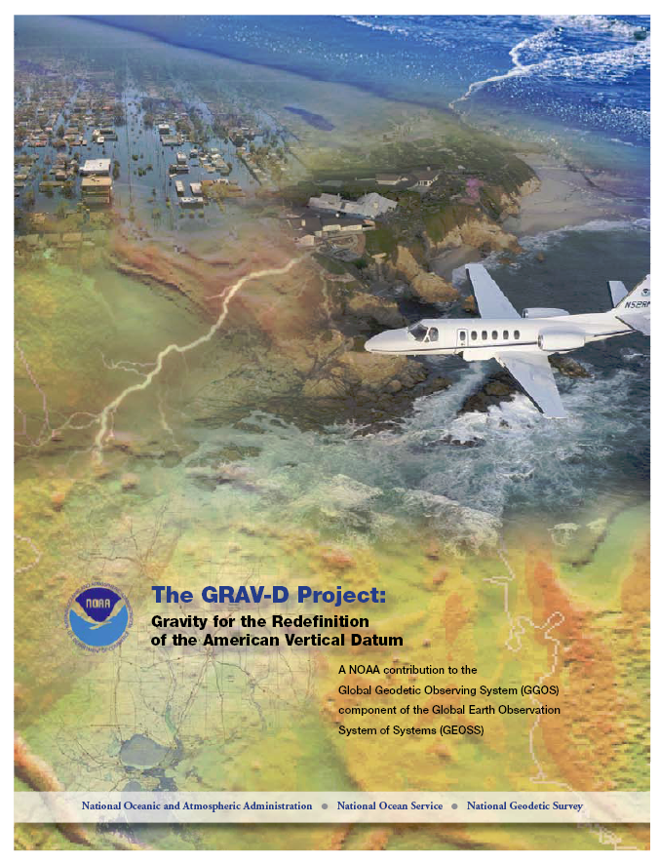
The GRAV-D Project
Objective: To create and maintain a gravimetric geoid to serve as reference surface for a new vertical datum
Official NGS policy as of Nov 14, 2007
Airborne Gravity Snapshot
Absolute Gravity Tracking
Re-define the Vertical Datum of the USA by 2022
$38.5M projected over 10 years
34% Complete as of 3-31-14
*
National Height Mod Partners Mtg
*
Notes:
*

Slide 8
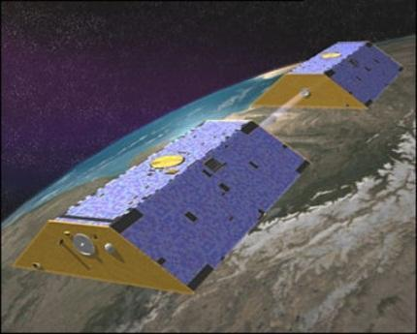
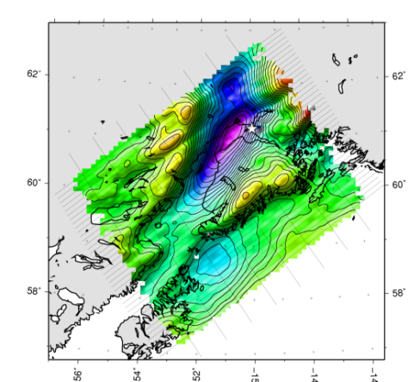
Building a Gravity Field
Long Wavelengths
(≥ 250 km)
GRACE/GOCE/Satellite Altimetry
+
Intermediate Wavelengths
(500 km to 20 km)
Airborne Measurement
+
Short Wavelengths
(< 100 km)
Surface Measurement and
Predicted Gravity from Topography
*
National Height Mod Partners Mtg
*

Slide 9
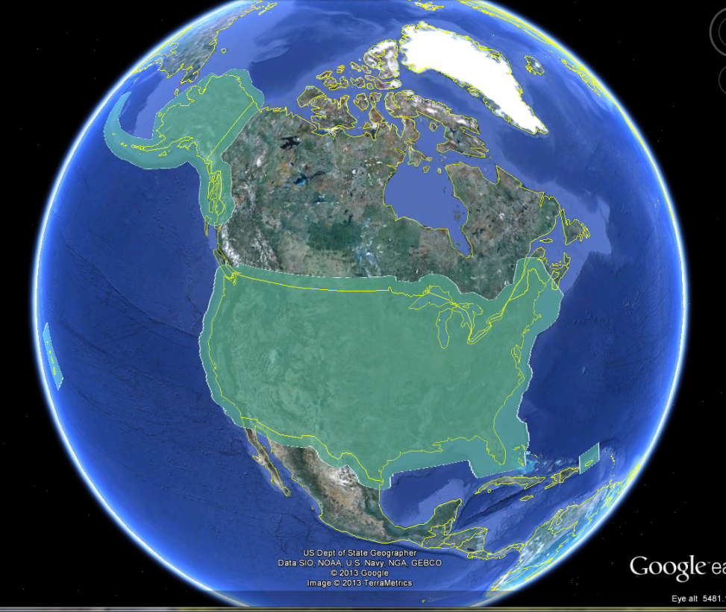
GRAV-D Coverage Area: CONUS & Alaska
*
National Height Mod Partners Mtg
*
Notes:
Let’s look more closely at the area that must be covered by the GRAV-D airborne survey. The green polygon shows: 1) States and territories, 2) Shallow water areas to the shelf break, 3) 150 km into Canada and Mexico.
*

Slide 10
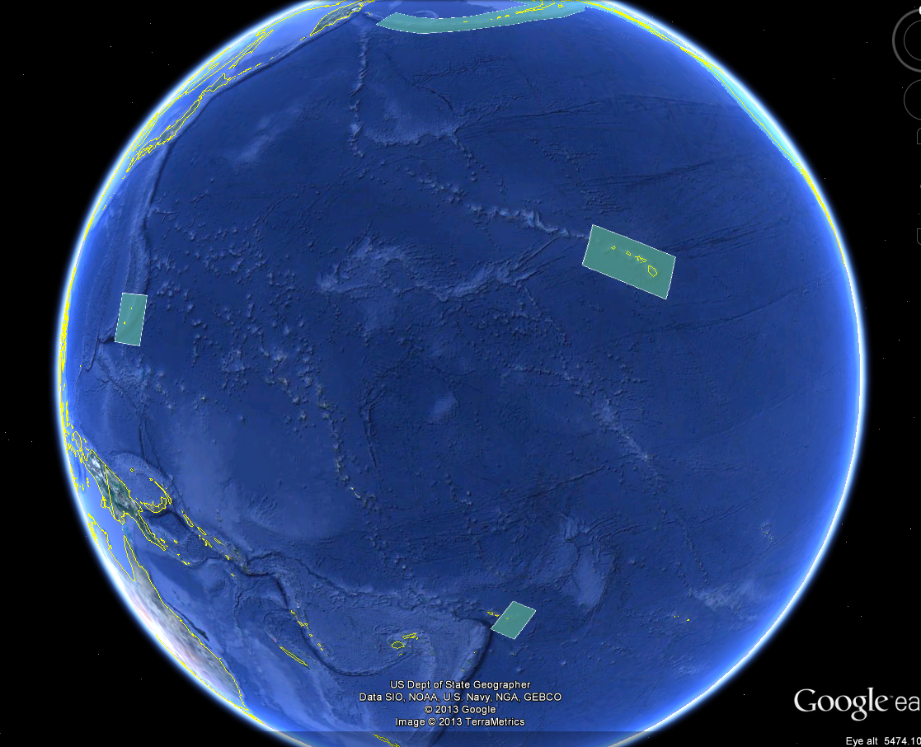
GRAV-D Coverage Area: Pacific Islands
*
National Height Mod Partners Mtg
*
Notes:
4) For pacific island surveys, the minimum dimension of the surveys is 300-500 km on a side. We always strive to have a block large enough to provide sufficient spectral overlap with the GRACE mission gravity field.
*

Slide 11
Priority Order for Surveys
Greatest Datum Needs
Other Variables to Consider
Alaska
Coastal US & Great Lakes
Hawaii & Pacific Islands
Aleutians
Interior CONUS
Mountains first
Need to meet GPRA Objective
Aircraft availability and capability
Appropriate season for measurement
Contract fuel availability
*
National Height Mod Partners Mtg
*
Notes:
NGS evaluated the US and all of its territories and established a priority order according to the where the datum is in greatest need of repair. Alaska has the biggest need, so tops the list. Next in priority are the coastal regions of the US and the Great Lakes. Then the Hawaiian and Pacific Islands, the Aleutians, and then interior CONUS. The mountainous regions have the greatest geoid errors and will get our first attention. The actual order we fly the surveys is also informed by the availability of aircraft, the appropriate seasons for measurement, the availability of government contract fuel, and the coordination of logistical constraints so as to most efficiently use our resources.
*

Slide 12
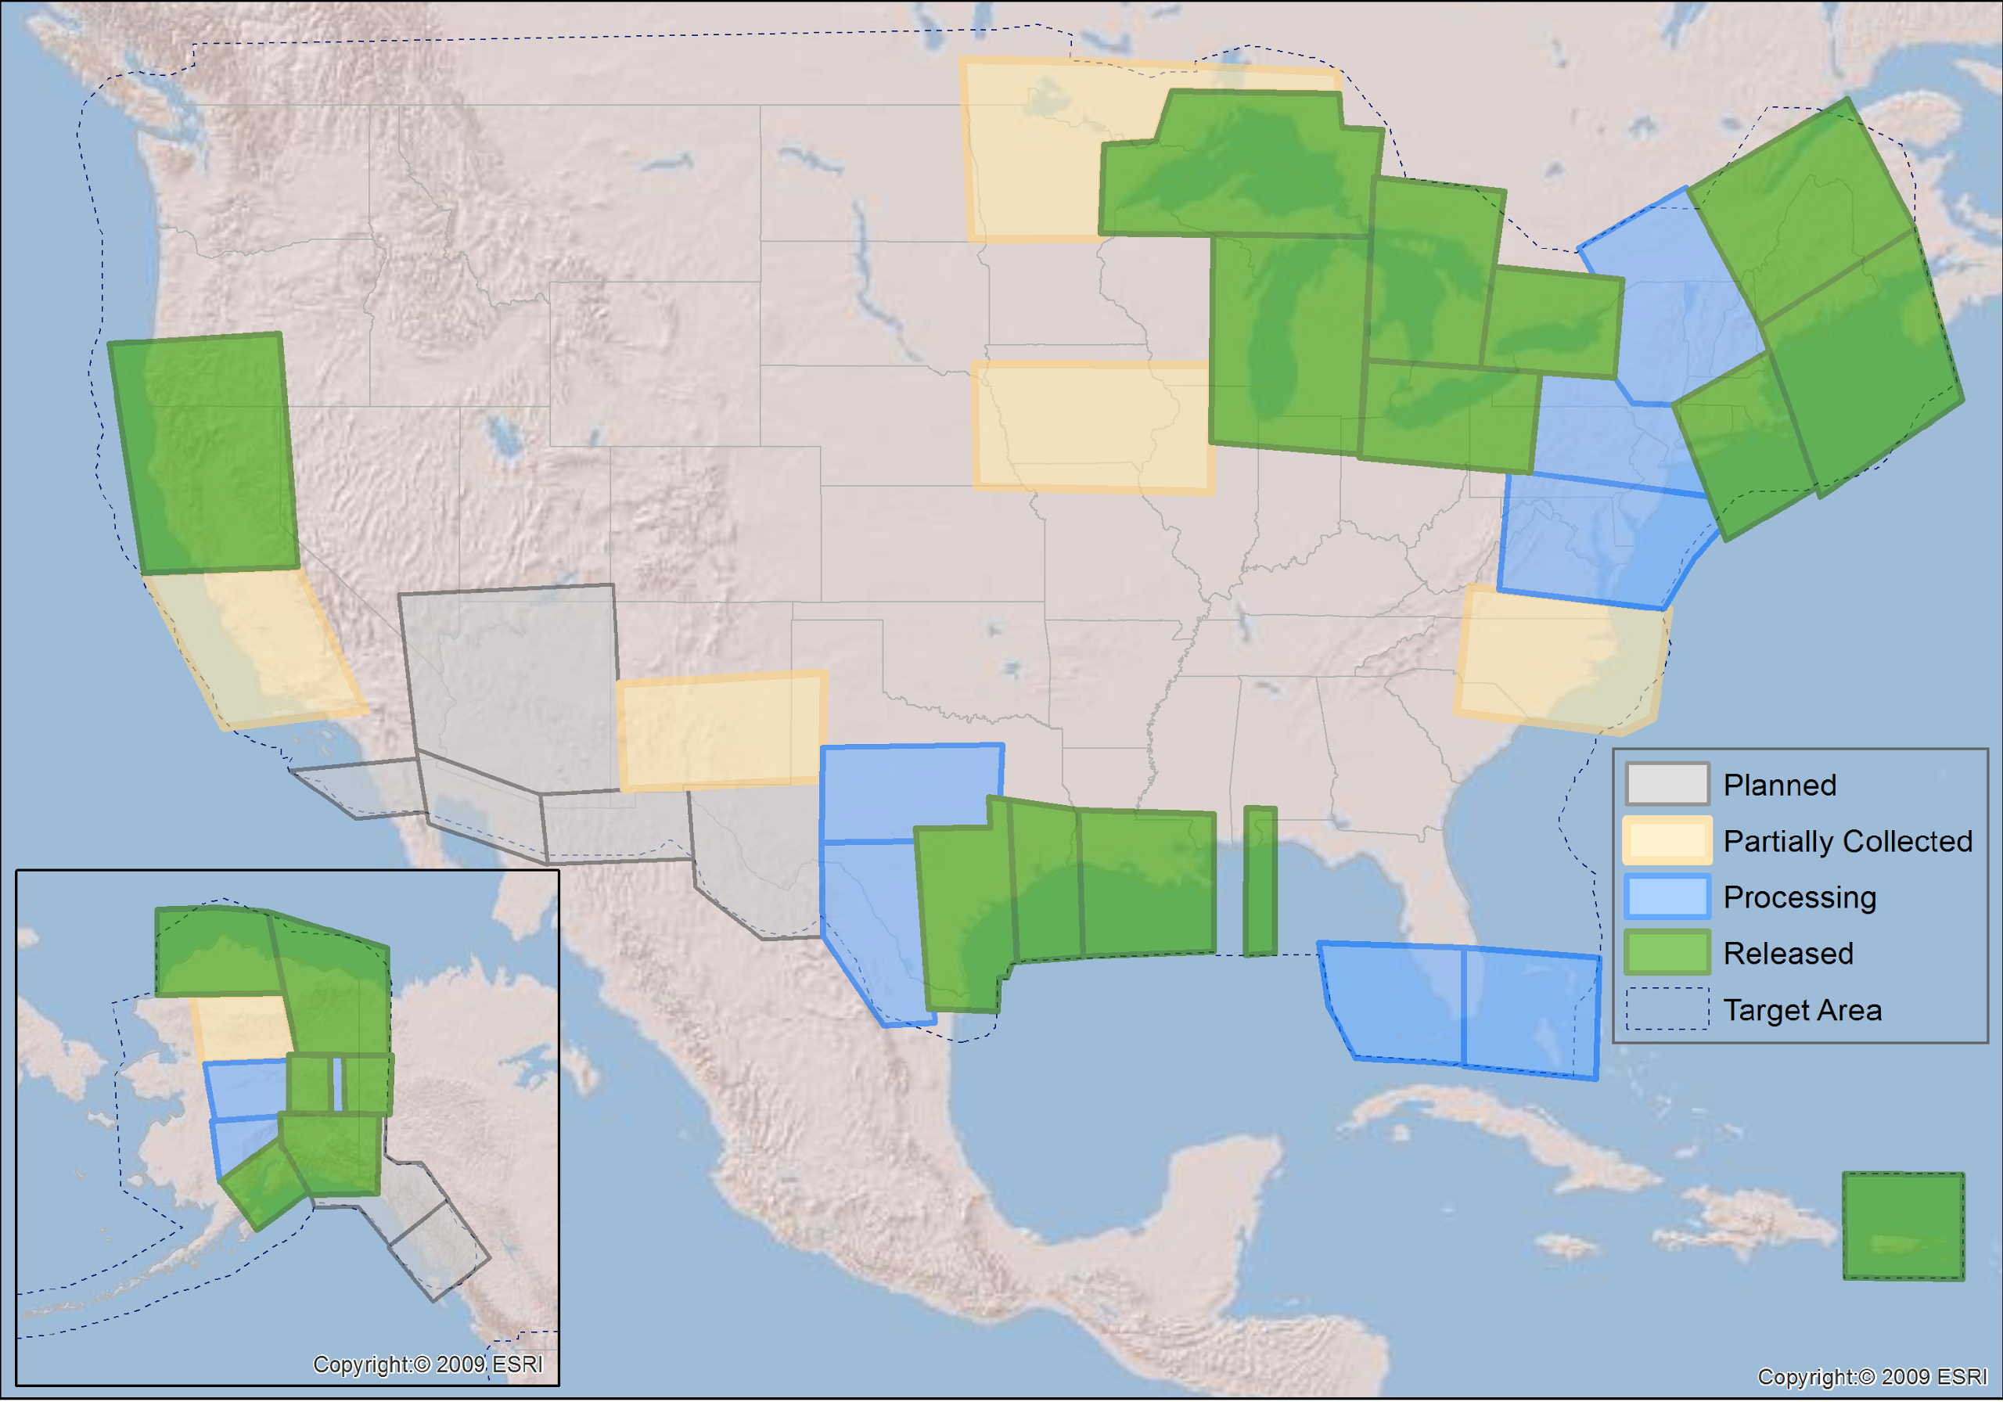
GRAV-D Status 3-31-14: 34%
*
National Height Mod Partners Mtg
*

Slide 13
GPRA* Performance MetricFor Airborne Surveys
FY09 Baseline | Targets vs Actual
 | FY10 | FY11 | FY12 | FY13 | FY14 | FY15 | FY16 | FY17 | FY18 | FY19 | FY20 | FY21 | FY22
6.14% | 7.5% | 12% | 20% | 28% | 36% | 44% | 52% | 60% | 68% | 76% | 84% | 92% | 100% and Implement
6.14 | 7.8 | 14.7 | 23.9 | 31%
Measure: Percentage of the U.S. and its territories with GRAV-D data available
to support a 1 cm geoid supporting 2 cm orthometric heights.
*
National Height Mod Partners Mtg
*
*GPRA = Government Performance and Results Act of 1993
Notes:
*

Slide 14
Survey and Block Plans
Layout rectangular survey 400 x 500 km
Extends beyond the shelf break
Block size will reflect the endurance of the aircraft
*
National Height Mod Partners Mtg
*
Notes:
Size of survey based on aircraft legs (how far it can go)
Location dependent on aircraft (over water?), in this case only a 2 engine aircraft
*

Slide 15
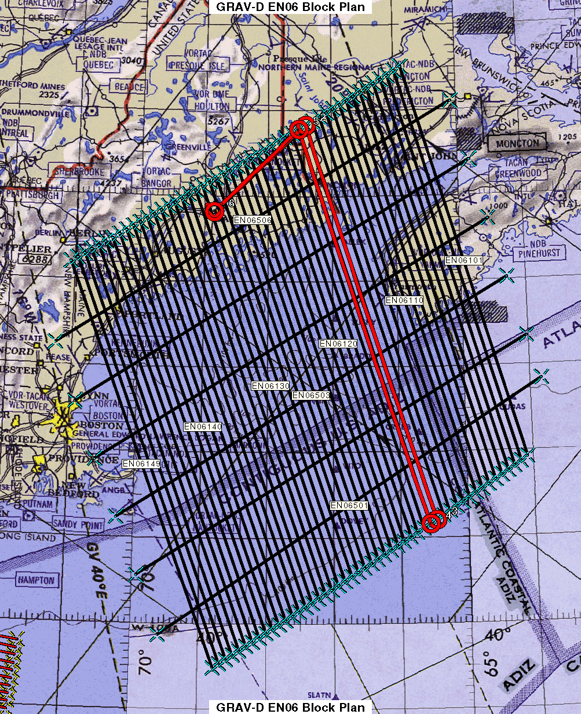
Survey and Block Plans
Data lines spaced 10 km apart
Cross lines spaced 60-80 km apart
Flight altitude 20,000 ft
Nominal speed 220-250 kts
*
National Height Mod Partners Mtg
*
Notes:
Block layout based on aircraft, adjust size of block if needed
*

Slide 16
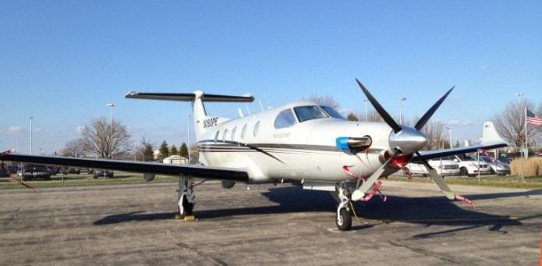
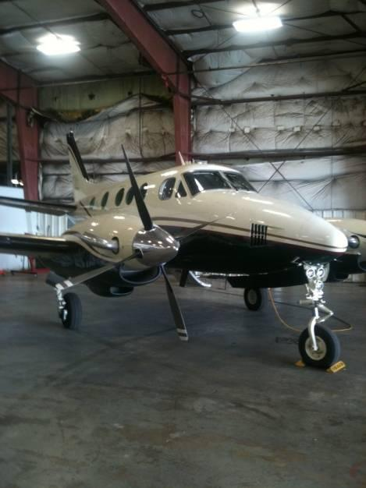
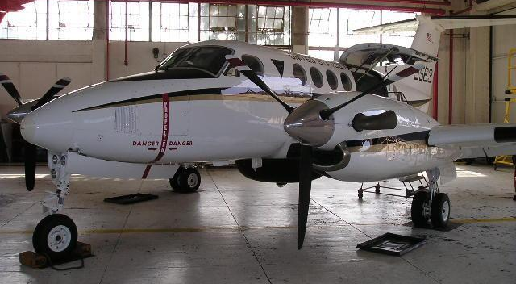
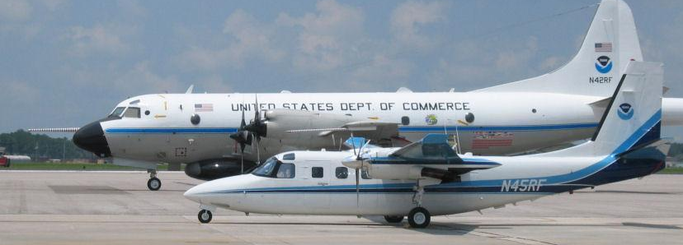
GRAV-D Aircraft
DOI Bureau of Land Management
Pilatus PC-12
Fugro
King Air E-90A
Cessna Conquest
Naval Research Lab
King Air RC-12
NOAA
Gulfstream Jet Prop
NOAA P-3 Hurricane Hunter
Pilatus PC-12
King Air E-90A
King Air RC-12
*
National Height Mod Partners Mtg
*
Notes:
GRAV-D surveys have been operating on a number of aircraft. In order to accomplish our objectives within budget, we utilize a “portfolio” of aircraft of both government and contract origin. We’ve used the NOAA Jet Prop and the P-3, although little opportunity exists for further use of these aircraft. We operate about five months/year aboard the BLM Pilatus PC-12 aircraft. This aircraft is used for fire-spotting during warmer weather months in AK and the western US. This year we began working with Fugro to provide us aircraft services. We plan also to work this year with the Naval Research Lab and the VXS-1 Navy Squadron aboard their RC-12 King Air aircraft.
*

Slide 17
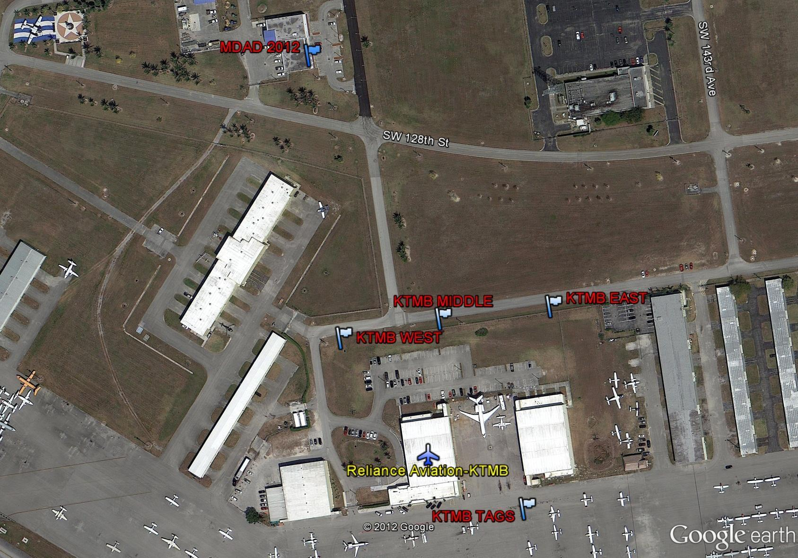
Reconnaissance Survey
Absolute Gravity
Station
GPS Base Stations
Parking Space
Gravity Tie
*
National Height Mod Partners Mtg
*

Slide 18
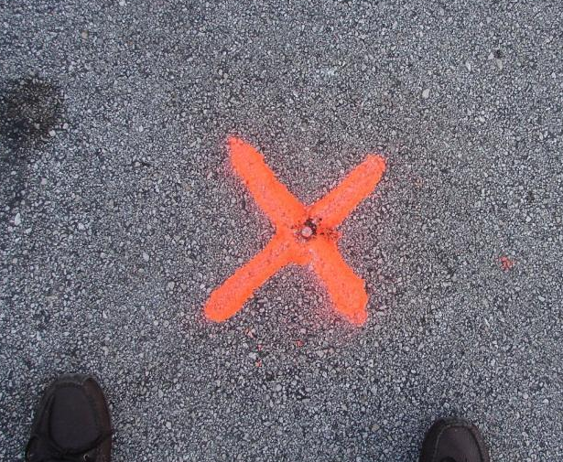
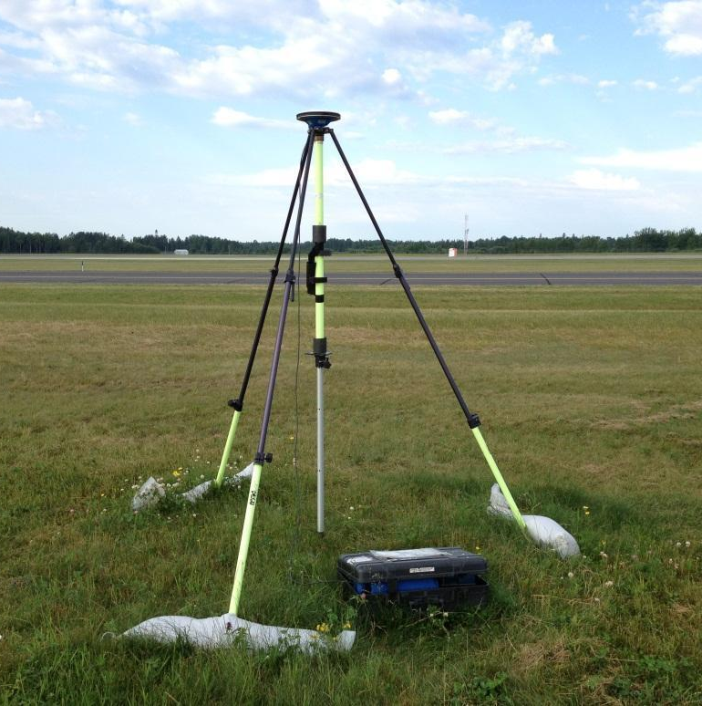
Gravity Tie and GPS Base Stations
Parking spot ID
A10 measurement
GPS Base Stations
*
Vertical gravity gradient
National Height Mod Partners Mtg
*

Slide 19
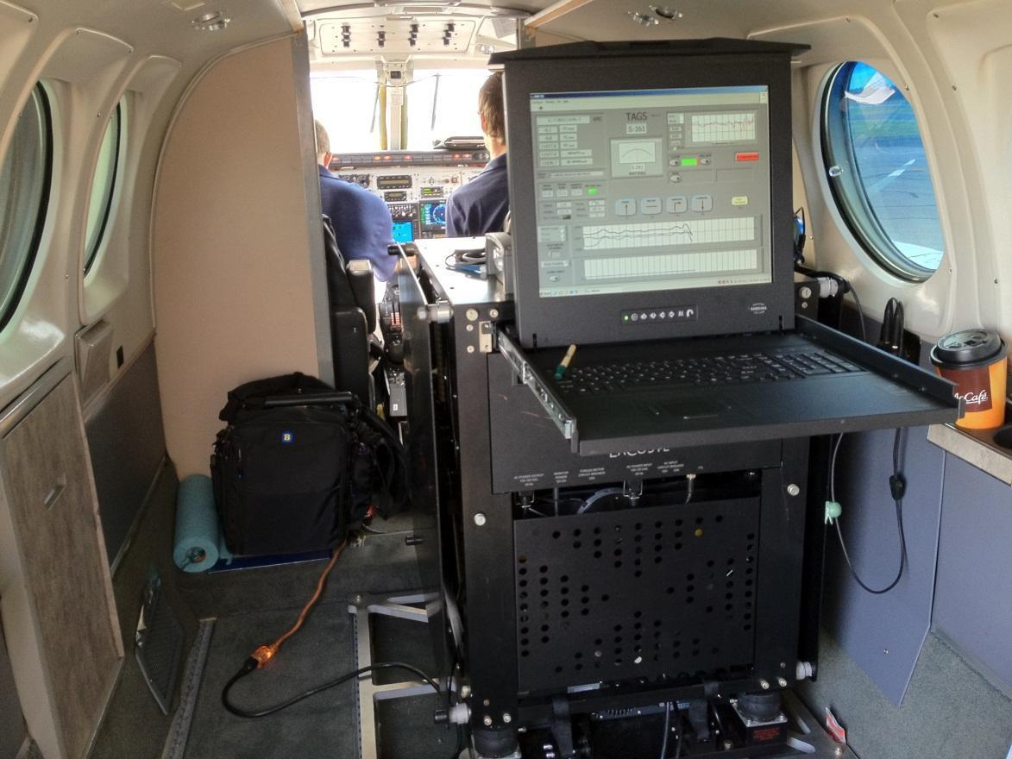
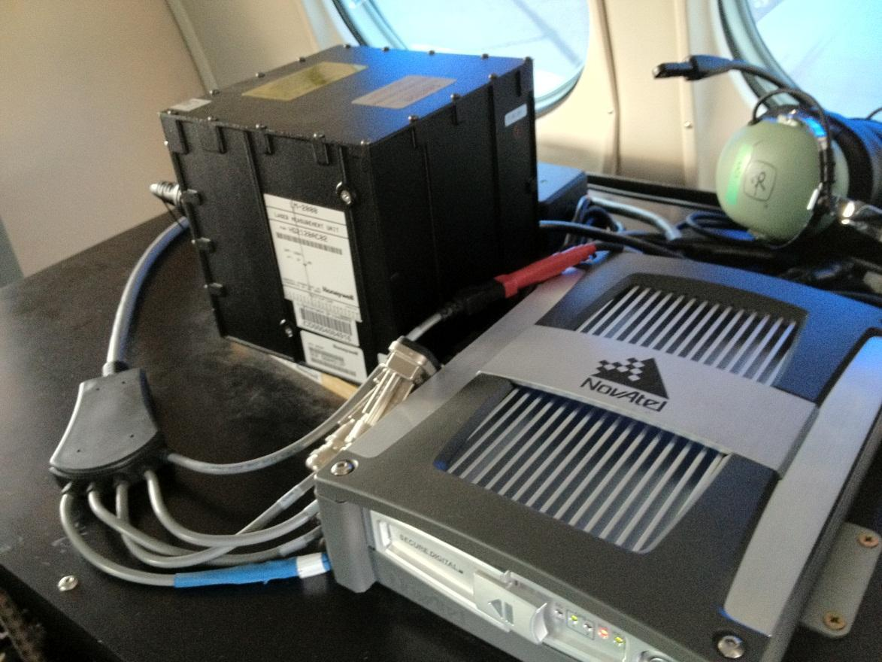
GRAV-D Instrumentation
Micro-g LaCoste
TAGS Gravimeter
NovAtel SPAN-SE
w/ Honeywell µIRS IMU
Both instruments include GNSS receivers
SPAN system allows for tightly coupled GPS/IMU solutions
*
National Height Mod Partners Mtg
*

Slide 20
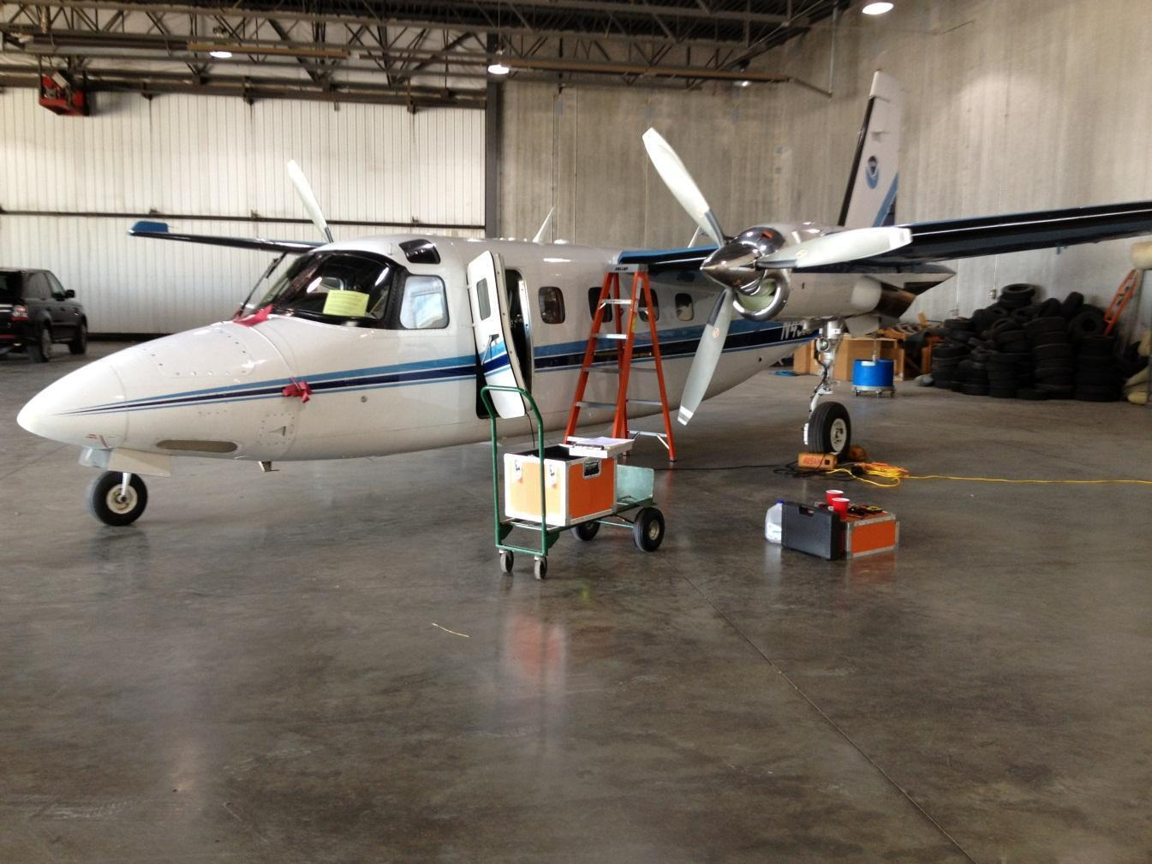
Instrument Installation
Instrument suite installed
Lever arm survey required
Test flight performed
*
National Height Mod Partners Mtg
*

Slide 21
Data Collection and Field Data QC
Goal is two flights per day when/if:
Weather/atmosphere is calm (TAGS cannot tolerate turbulence)
Instruments and aircraft are in working order
Good GPS geometry
Military airspaces are not “hot”
We have the operators/pilots to support two flights per day
*
National Height Mod Partners Mtg
*

Slide 22
Data Collection and QC
Data are evaluated to verify instrument performance and data quality
OBJECTIVE: Identify ASAP lines that must be reflown
*
National Height Mod Partners Mtg
*

Slide 23
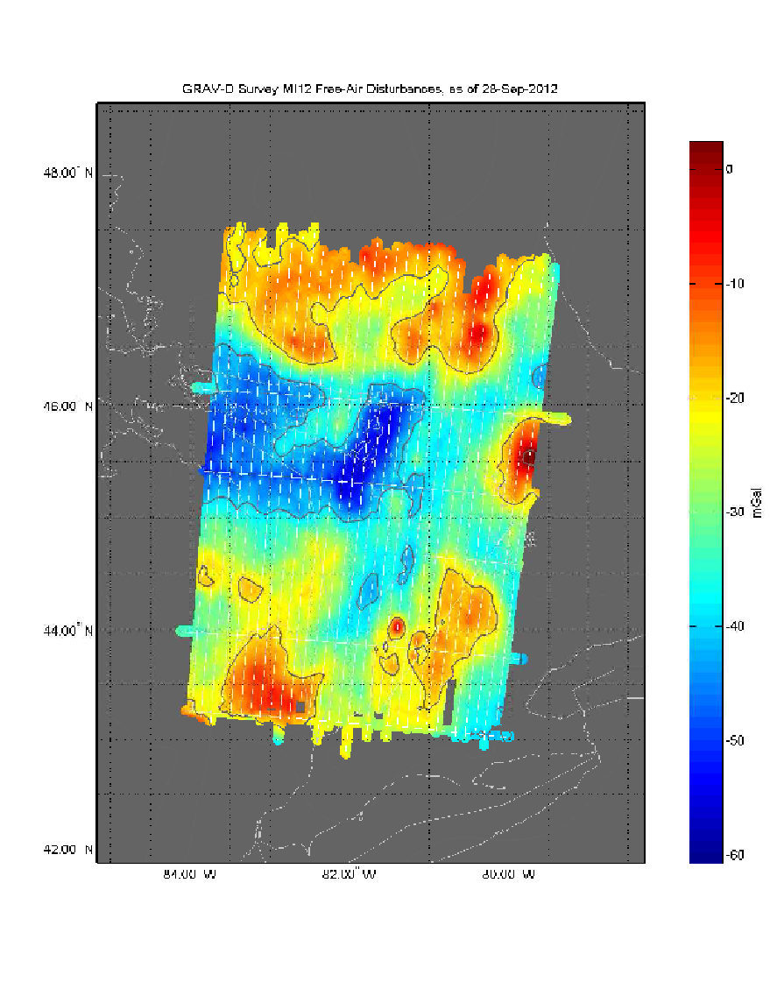
Data Handling
Complete metadata logs daily and survey report written
Ship the data back to HQ for final processing
GPS/Gravity data reprocessed at HQ with precise orbits
Released to the public via the GRAV-D website
Released to the geoid team
Lake Huron survey
*
National Height Mod Partners Mtg
*

Slide 24
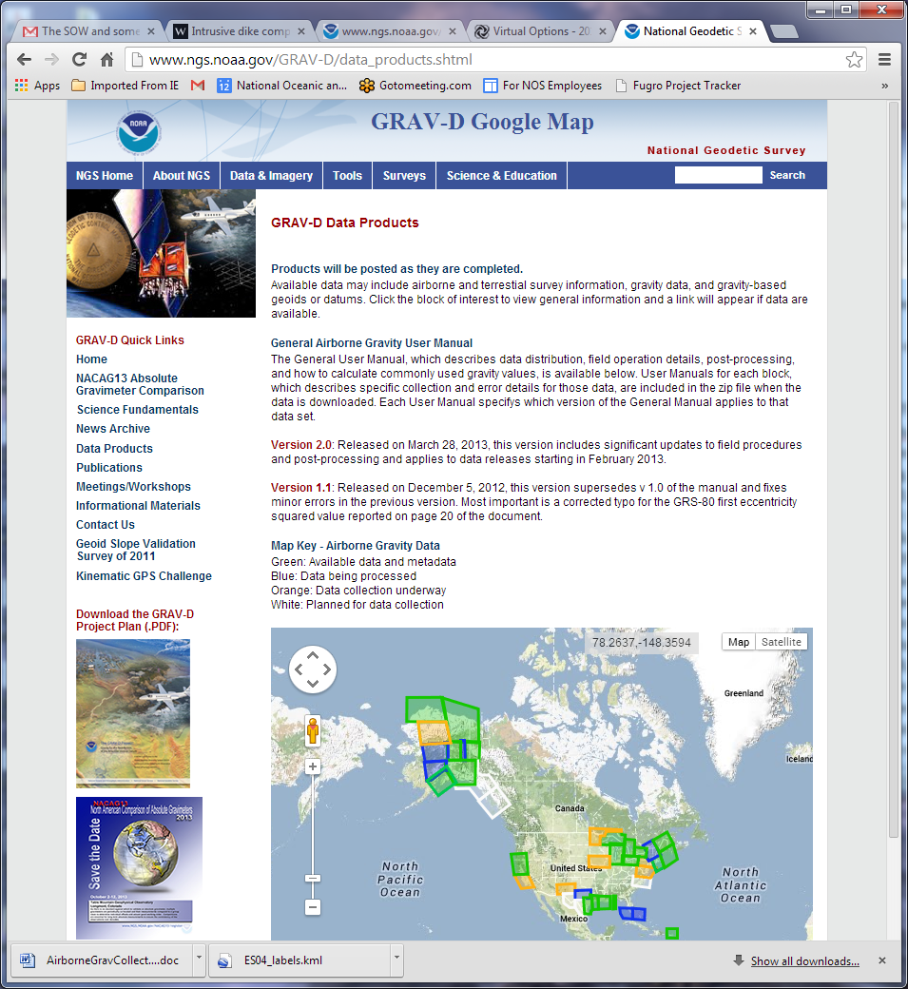
GRAV-D Website
http://www.ngs.noaa.gov/GRAV-D
*
National Height Mod Partners Mtg
*

Slide 25
Creation of New Geoid
The gravity data from satellites, airborne, corrected surface data, and terrain predictions will be blended into a gravity field
As regions are completed, “beta” experimental geoids will be created and released to the public for annually for local testing
Create a gravimetric geoid that will be the basis of the new vertical datum
*
National Height Mod Partners Mtg
*

Slide 26
New Datums Released
In 2022, the new geometric datum and the new vertical (geopotential) datum will be released
The realization of the new datums will be through GNSS receivers
*
National Height Mod Partners Mtg
*

Slide 27
The Way Forward
Continue the GRAV-D airborne survey through both in-house and contract efforts to completion in 2022
Continue to release data to the geoid team and to the public
Launch our effort to monitor long-term geoid changes
Increase our outreach and education efforts
*
National Height Mod Partners Mtg
*

Slide 28
Questions?
Contact information
Vicki Childers: vicki.childers@noaa.gov
Monica Youngman: monica.youngman@noaa.gov
GRAV-D webpage: http://www.ngs.noaa.gov/GRAV-D/
*
National Height Mod Partners Mtg
*

