Slide 1


NATIONAL HEIGHT MODERNIZATION PARTNER MEETING
USACE Comprehensive Evaluation of Project Datums (CEPD)
David J. Robar, P.E.
Chief, Geomatics Section
USACE Jacksonville District
30 April 2014
Mobile, Alabama

Slide 2
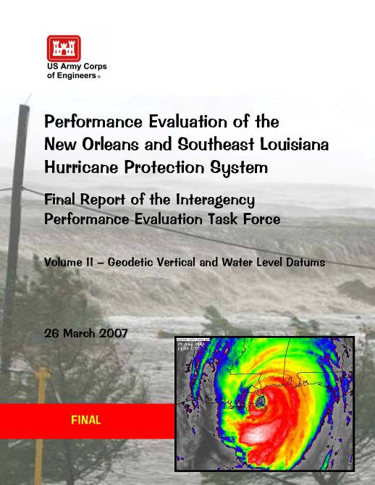
Volume II of IX Volumes
Geodetic Vertical and Water Level Datums
FINDINGS & LESSONS LEARNED
Notes:
Following Katrina, a multi-agency Task Force, including NOAA performed a study to investigate the cause of critical failures in the area’s hurricane protection projects. Volume II of IX was dedicated to geospatial concerns.

Slide 3
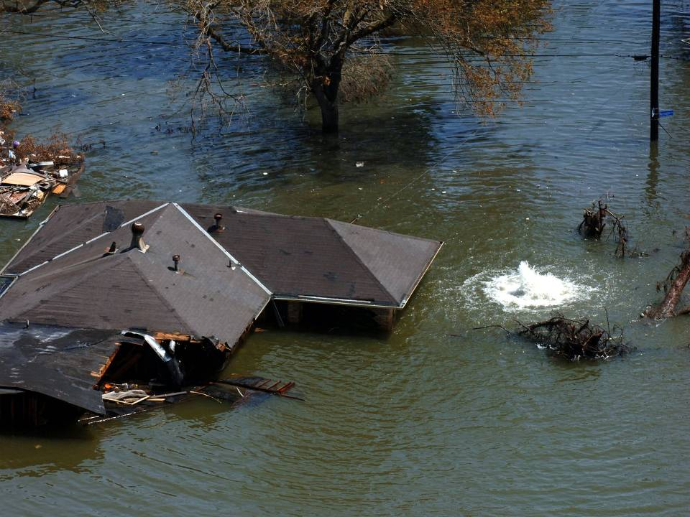
How high is the water?
a. 0.0 feet ?
LMSL (1983-2001)
b. 0.5 feet?
NAVD 88 (2004.65)
c. 7.0 feet?
Above the Slab
d. All of the Above!
d. All of the Above?
Notes:
Corps is moving away from individual project datums and unsupported legacy datums and moving to the NSRS.

Slide 4
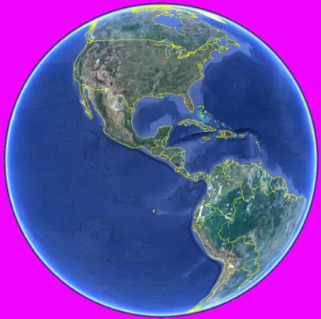
IPET Volume II--Geodetic Vertical and Water Level Datum Assessment
FINDINGS & LESSONS LEARNED
Most Significant Finding:
Flood control, hurricane protection, shore protection & navigation projects need to be relative/referenced to the current Local Mean Sea Level (or river/pool low water reference plane) datum and epoch [and NAVD88/NAD83]
Resultant Action:
Issue HQUSACE Corps-wide guidance to address these IPET findings ...
e
Z
n
H
ф
Y
λ
X
Notes:
MSL assumed equal to NGVD29 (and NAVD88)
Vertical reference not indicated on design & construction documents
Vertical datum epochs not updated (geodetic & tidal)
Sea level/subsidence changes not updated
Misunderstood definitions of MSL, LMSL, NGVD, NAVD, MLLW, WGS, orthometric, hydraulic, ellipsoidal, etc.
Topo (LIDAR) elevation mapping not ground truthed
Inconsistent vertical datums used in numerical models
Project documents such as P&S did not indicate datum, epoch, or units of measure.
No evidence that subsidence was incorporated into design heights
Gage network not maintained
A 19 year tidal epoch was too large a period in areas of crustal motion (go to 5 yr)

Slide 5
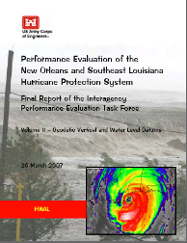

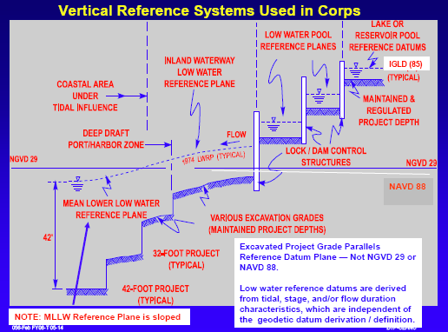
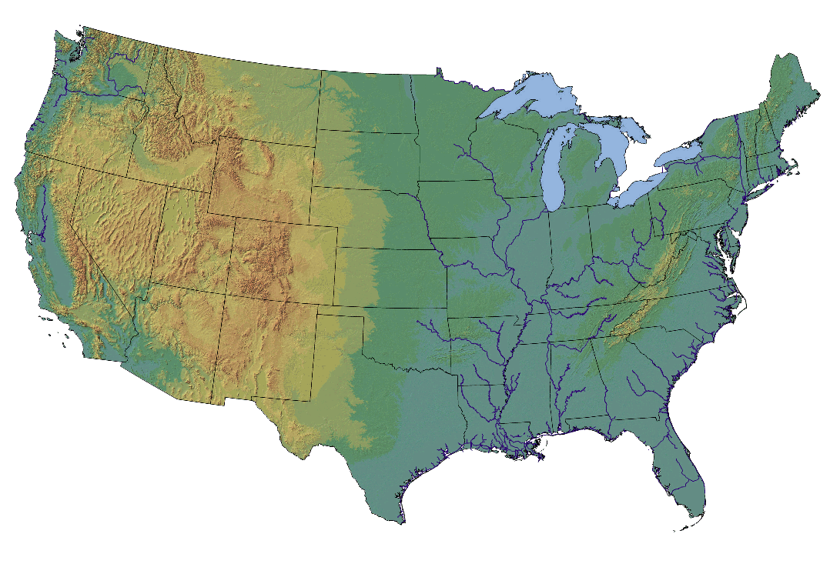
Actions for Change
Relate all to a Single Nationwide
Reference System (i.e. NSRS/NWLON)
Notes:
It is the policy of the Corps of Engineers that the designed, constructed, and maintained elevation grades of projects shall be reliably and accurately referenced to a consistent nationwide framework, or vertical datum—i.e., the National Spatial Reference System (NSRS) and the National Water Level Observation Network (NWLON) maintained by the US Department of Commerce (NOAA).

Slide 6
Comprehensive Evaluation of Project Datums (CEPD)
Implement lessons learned from Hurricane Katrina IPET Report … reference CG memo dated 4 Dec 06
(1) Inventory Vertical Datums on Projects
Adequacy of elevation connections with US Dept of Commerce (NOAA) federal geodetic & water level reference systems
(2) Evaluate Projects (Identify Deficiencies)
Critical items for HQ (and District) per project
  Reference datums compliant or non-compliant
  Cost to bring into compliance
  Estimated date of completion--programmed
  Cost avoidance (navigation projects)
Phase I
Notes:
Phase I began in the spring of 2007.
In collaboration with NOAA, USACE developed guidance, training, and workshops.
Initial guidance was established in 2007 and finalized in 2010 as an Engineering Manual (cover on previous slide) but will be updated periodically.
Each District sent 1-3 representatives to District Datum Coordinator training in 2007. This training is now offered annually as a PROSPECT course by the USACE Learning Center.
Phase I was completed 6 months after training, in the fall of 2007, with all data submitted via web-application.
Workshops were held at each District for supervisors, project managers, modelers, planners, etc. (non-geospatial personnel).

Slide 7
CEPD (Cont’d)
Develop plan to update project to correct datum
If both geodetic and hydraulic/tidal reference datums are compliant with CEPD standards
  Attach verification documents to Project Report
Notify local sponsor of any deficiencies
(3) Transition to correct datum
Re-Survey/Adjustments to update project datum
Corrective Action Database
(4) Make Necessary changes to Project
Notify PM/Engineer of changes to control
Raise levee, decrease dredging, etc…
Phase II
Phase III
Notes:
Phase II commenced immediately upon completion of Phase I and will be officially complete in September 2014.
Documentation is submitted via web-application [CEPD Compliance Tracking Tool (CCTT)] and tracked by the Army Geospatial Center and HQ.
Phase III is ongoing alongside another collaborative effort with NOAA to address climate change.

Slide 8
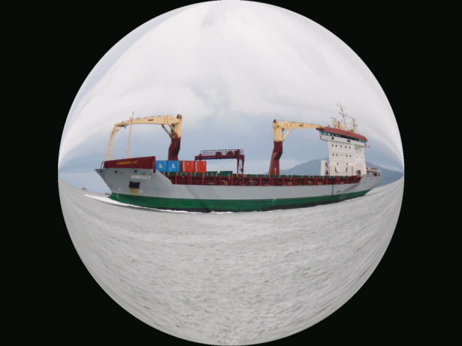
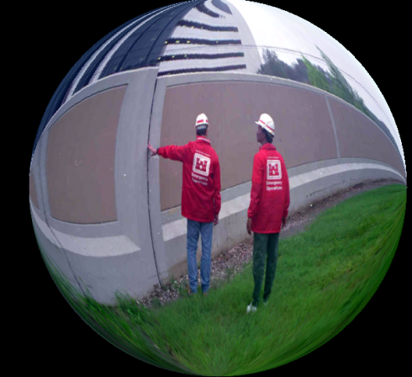
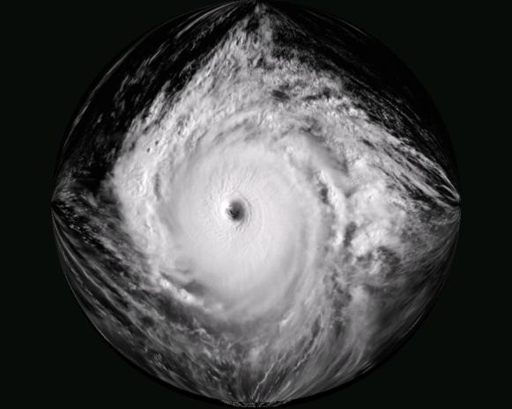
Inland Flood Risk Management, Navigation, and Water Control Systems (to include levees, floodwalls, multipurpose hydropower projects, locks and dams, and non-tidal inland navigation systems):
Designed or constructed flood protection or navigation clearance grades, hydraulic or hydrodynamic water surface profiles, river or pool stages, and stream gages in inland flood risk and water control systems shall be accurately referenced to the NSRS (e.g., NAVD88).
Coastal Navigation Projects:
Designed, constructed, dredged, and maintained navigation project grades in coastal areas shall be directly referenced to a local Mean Lower Low Water (MLLW) datum modeled on the latest NTDE as defined by NOAA for the project area.
Coastal
Navigation
Inland Flood Protection
and
Water Control Systems
Hurricane & Shore Protection Projects (HSPP):
In coastal areas subject to tidal influence, hurricane and shore protection design or constructed grades shall be directly referenced to NWLON tidal gages and coastal hydrodynamic tidal models established and maintained by the US Department of Commerce (NOAA).
Hurricane and Shore
Protection
Notes:
Enforcing use of RTK Tides and VDatum.

Slide 9
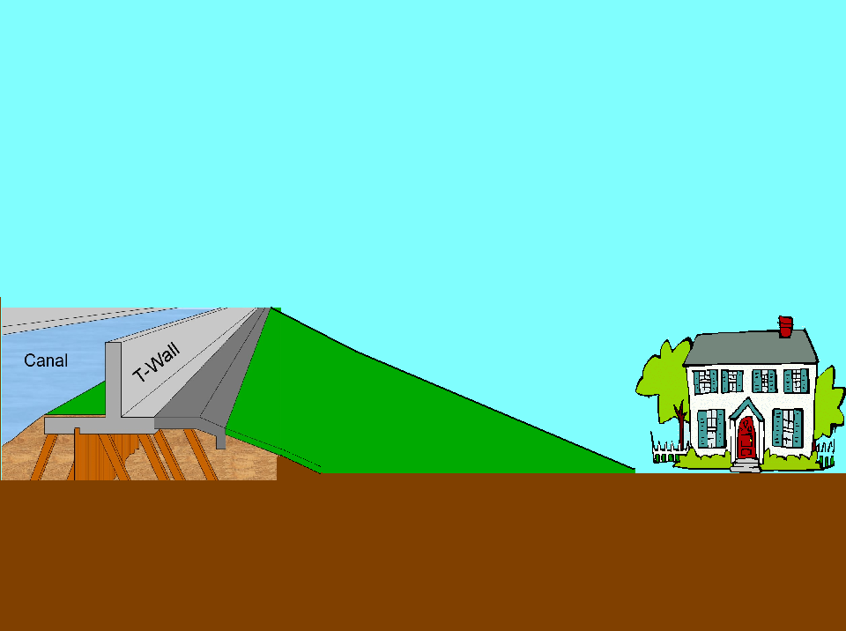

GRS80 (NAD83/GPS)
-59.56'
14.00'
13.51'
13.01'
LMSL
NAVD88
NGVD29
Notes:
By properly defining the relationship between the legacy datums of our historic data and current datums we can better evaluate whether or not project meets the design criteria or level of protection, and if it is compliant with the project authorization set forth by Congress.

Slide 10

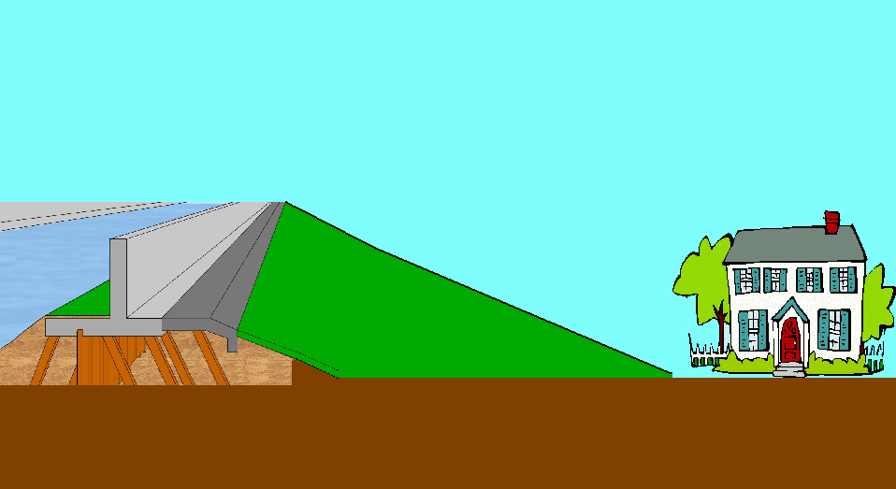


GRS80 (NAD83/GPS)
1970
2000
2020
1980
1990
2030
2010
-59.56'
The floodwall sinks due to subsidence as the sea level rises resulting in reduced level of protection
Subsidence
Level of Protection
14.00'
13.01'
12.76'
12.49'
12.22'
12.01'
11.75'
13.51'
11.53'
12.03'
12.52'
LMSL
Sea Level Rise
NAVD88
NGVD29
Notes:
In addition to thoroughly establishing the relationship between datums, we’re monitoring the effect of subsidence, glacial rebound, sea level rise, etc. on our projects so we can make more informed decisions in the future with respect to the performance of each project.

Slide 11
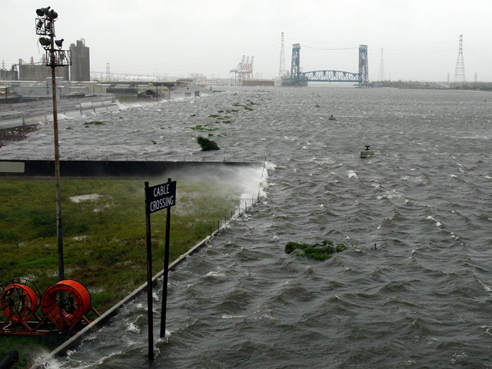
Every Inch COUNTS!
DO NOT DISMISS WHAT APPEARS TO BE INSIGNIFICANT
Notes:
Every Inch Counts! Gustav 2008
Sea Level Rise
Subsidence/Post Glacial Rebound
Seasonal Sea Level Biases
Relationship between construction and tidal datums
Relative errors in control network
Gage maintenance

Slide 12
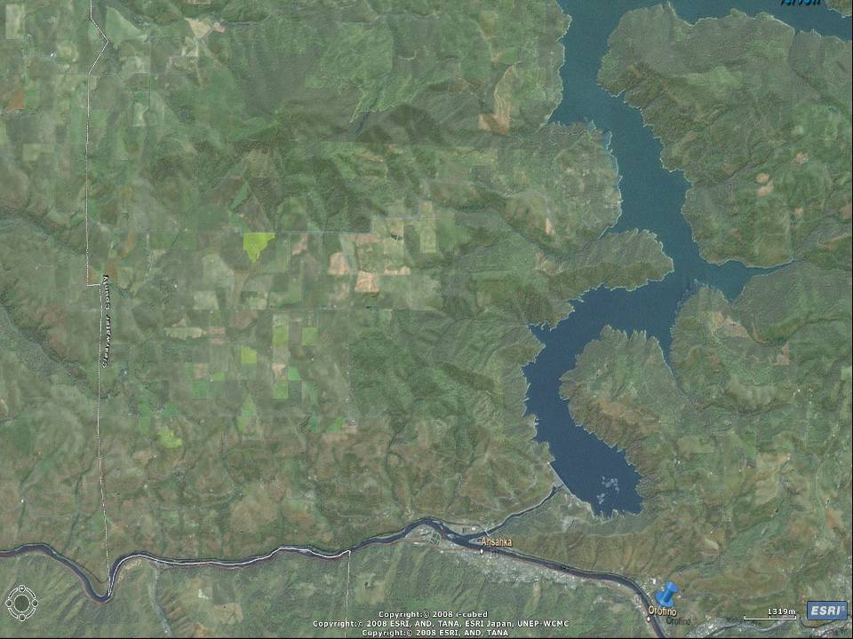
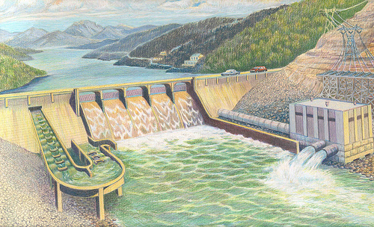
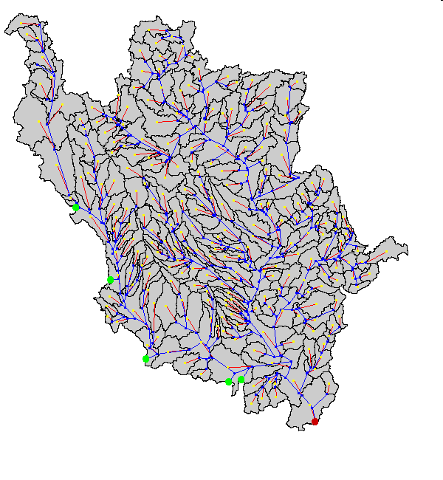

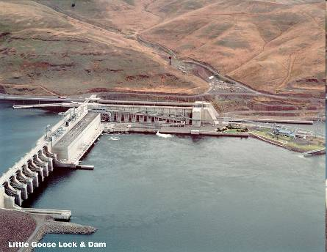
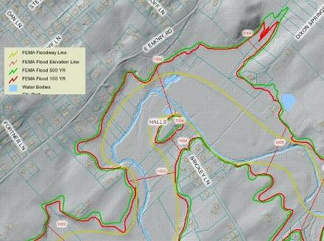


The NSRS provides that common reference
Flood Insurance Rate Maps
Adjacent Projects
HEC Models
Ties are easily accomplished with GPS and OPUS-DB
THE HISTORIC OR LEGACY REFERENCE NETWORK IS NOT CHANGE OR ELIMINATED. THIS PROCESS JUST RELATES LOCAL NETWORKS TO THE NATIONAL SPATIAL REFERENCE SYSTEM
LiDAR Datasets
NSRS Control
Project Primary Control
Project Local Control
Notes:
Some of our projects are seemingly independent but by tying them to the NSRS, all project information is available and can be related to downstream projects, FEMA’s flood maps, numerical models, residential areas (consequence studies), etc.
Instead of performing our own extensive surveys for planning efforts over a large region, we’re much more likely to utilize available data from States, USGS, etc. to feed our models and do site comparisons. This allows us to focus funding, which is more and more limited, on modeling and on getting more accurate, detailed data for engineering and design in the much smaller final project area. Our data is then available for others to use as well.

Slide 13
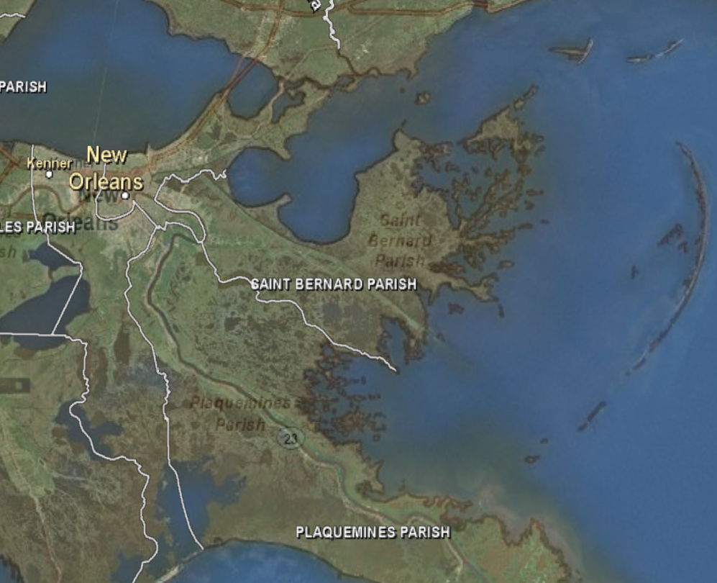
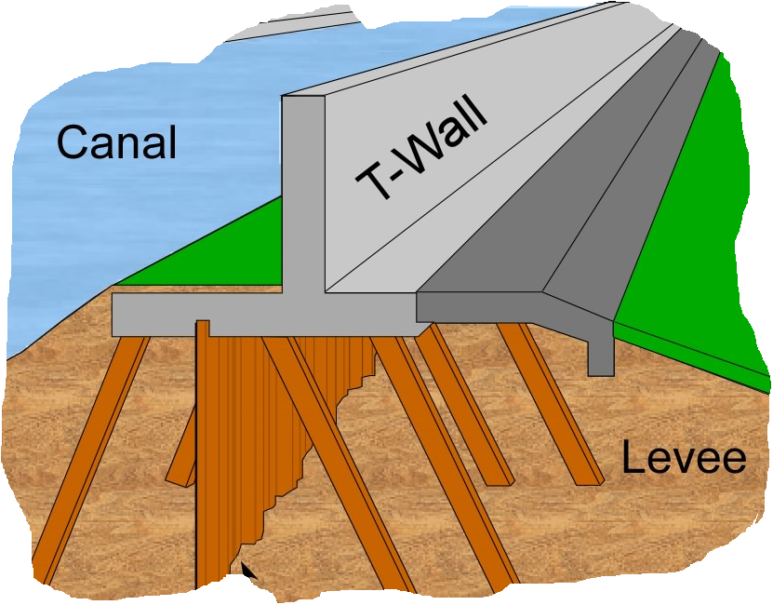
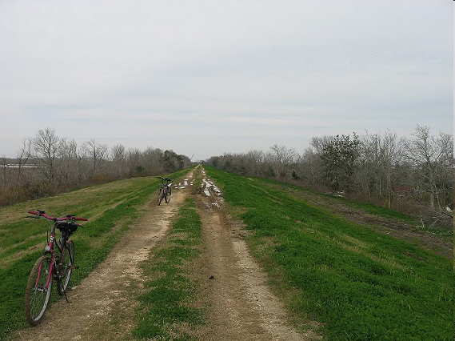
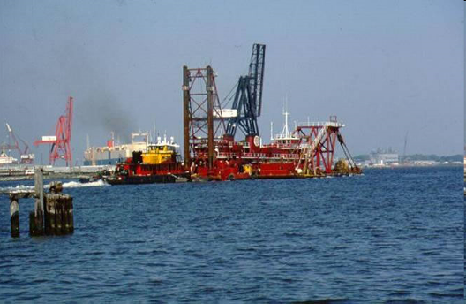
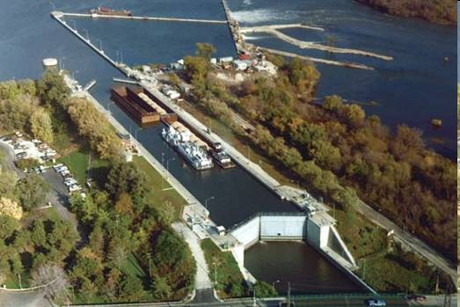
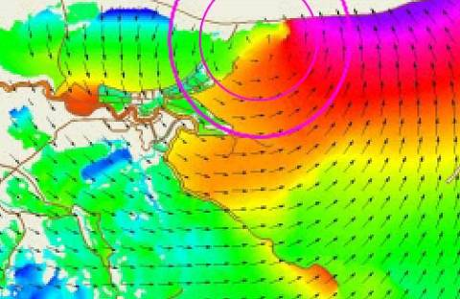
Connection to the NSRS
ADCIRC Models
DFIRMS
HEC Models
Other Projects
Notes:
Another slide illustrating potential interdependency between projects. An upstream project can establish the boundary conditions for a model downstream. A failure of an upstream feature obviously affects performance and consequences downstream. By having everything in a common reference frame, we’re setting ourselves up to do better analysis for less cost.

Slide 14
Top of Structure
(Present)
Displacement of Top of Structure
Due to Non-linear Subsidence
Coastal Storm Protection Structure
Design Height Considerations
Top of Structure
(Future)
Freeboard
(Safety Factor)
Present/Design Structure Height above
LMSL, Epoch: yyyy - yyyy
100 -Year Flood Height
(Above LMSL or Geodetic Zero
at end of Design Life)
Min. Structure Height above
LMSL @ End of Design Life
100 -Year Flood Height
(Above Present LMSL or Geodetic Zero)
100 -Year Flood Height
(Above LMSL or Geodetic Zero
at end of Design Life)
Present/Design Geodetic Elev. of
Top of Structure
100 -Year Flood Height
(Above Present LMSL or Geodetic Zero)
LMSL, Epoch: yyyy - yyyy
LMSL, Epoch: yyyy - yyyy
Minimum Geodetic Elev. of
Top of Structure @ End of Design Life
LMSL, Epoch: yyyy - yyyy
LMSL, Epoch yyyy-yyyy
Displacement of Local Mean Sea Level
Due to Eustatic Rise (assumed linear)
Present
Geodetic Elev. of LMSL,
Epoch: yyyy - yyyy
Future Geodetic Elev. of
LMSL, Epoch: yyyy - yyyy
NAVD88
Initial PBM Elev.
NAVD88
Epoch: yyyy.yy
PBM
PBM
Inter-Epoch Displacement of
Geodetic Datum “Zero”
NAVD88
Epoch: yyyy.yy
Future
PBM Elevation
Displacement of PBM
and Tide Staff Zero
Due to Non-linear Subsidence
NAVD88
Epoch: yyyy.yy
PBM
PBM
NAVD88
Epoch: yyyy.yy
Proposed Design Life of Structure
Notes:
Datum relationships
Subsidence over time (differential over features/project)
Water level changes over time
Subsidence of control
Adjustments/epochs
Multiple data to be tracked by project feature and by projects across the Corps.

Slide 15

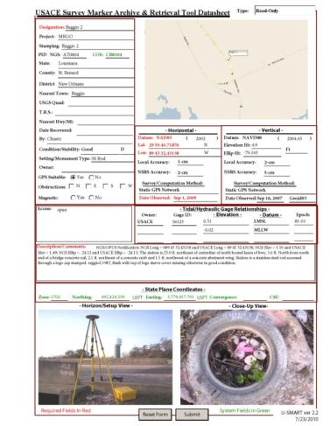
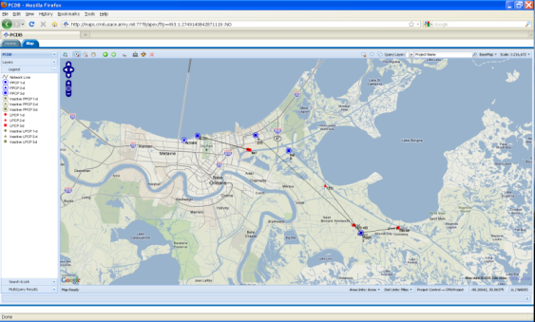
U-SMART
USACE Survey Monument Archival and Retrieval Tool
Web-Based U-SMART GIS Interface For Archival and Retrieval of Project Control
Linked to the CorpsMap System, an easy to use GIS interface facilitates the retrieval of survey control from the database of USACE and NGS control points. The marks are also referenced to their respective projects making it easy to link up projects and their associated vertical control points.
U-SMART
Notes:
Warehouse of USACE control with a web-based GIS type interface
Provides a one stop source for
USACE control
NGS IDB control
NGS OPUS-DB control
CORS control
NOAA Tide Gauges
USGS Staff Gauges
USACE Staff Gauges
Simplified documentation and tracking while leveraging the expertise and work of NOAA.

Slide 16
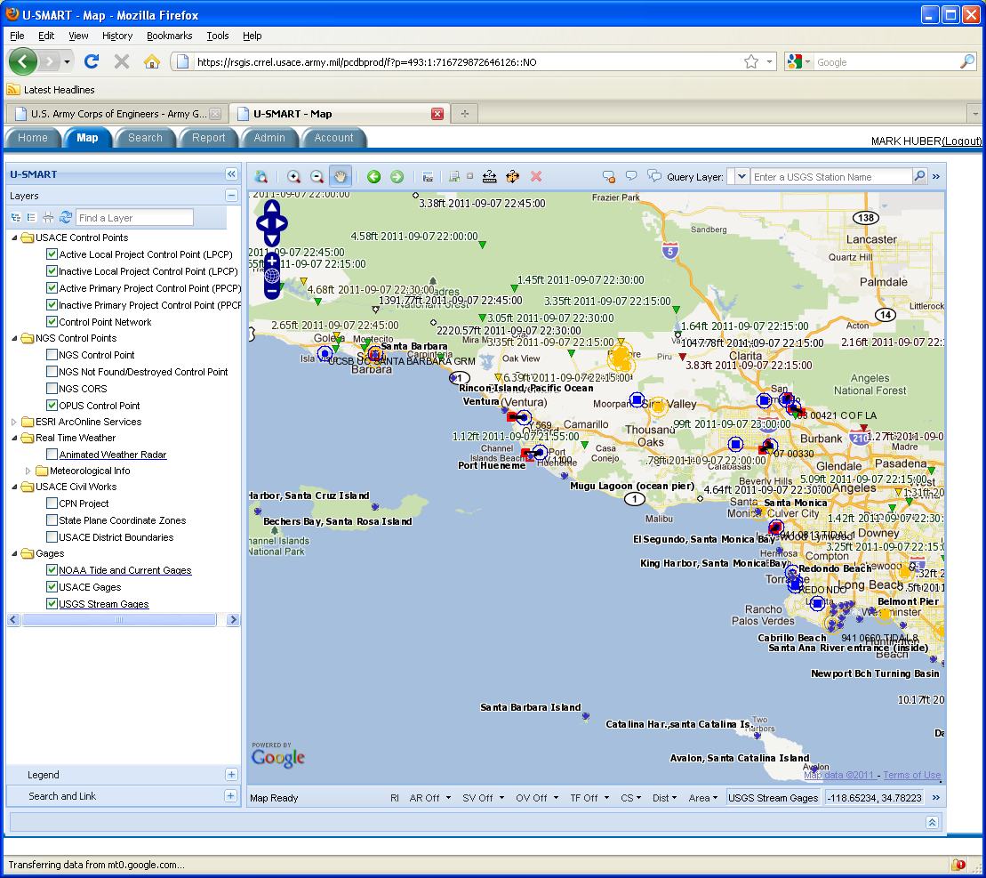
U-SMART
USACE Survey Monument Archival and Retrieval Tool
Web Map Interface
Toggle On/Off
  Labels
  Primary Control Points
  Project Control Points
Standard Map Symbology
  Circle = 1D
  Triangle = 2D
  Triangle In Circle = 3D
Default Map Displays User’s District.
Allow User To Click On Survey Monument
To Display Datasheet And History
Allow User To Show/Hide NGS Points On Map

Slide 17
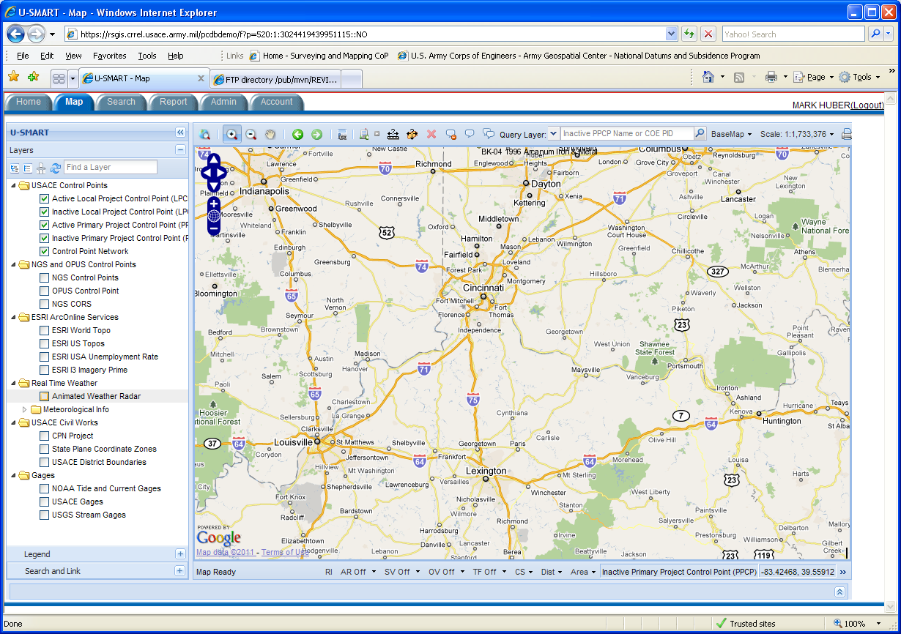
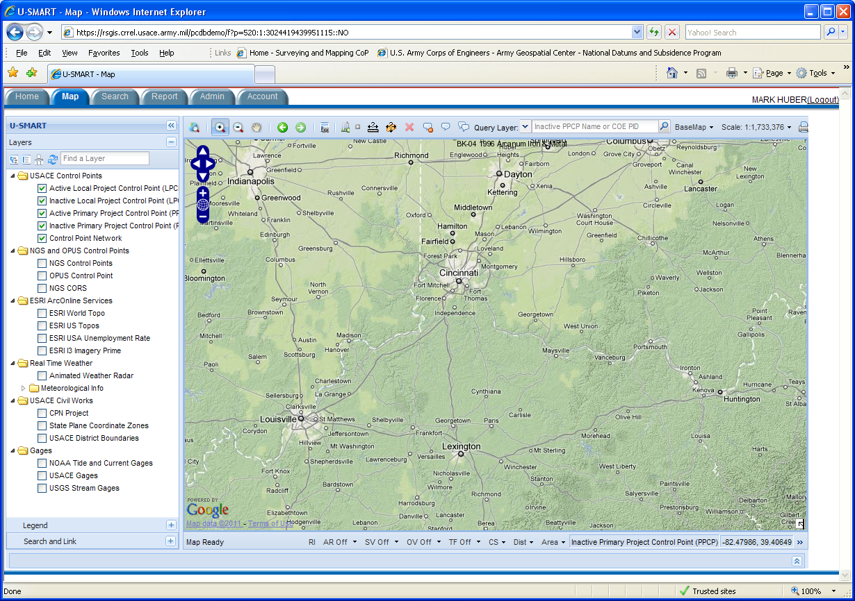
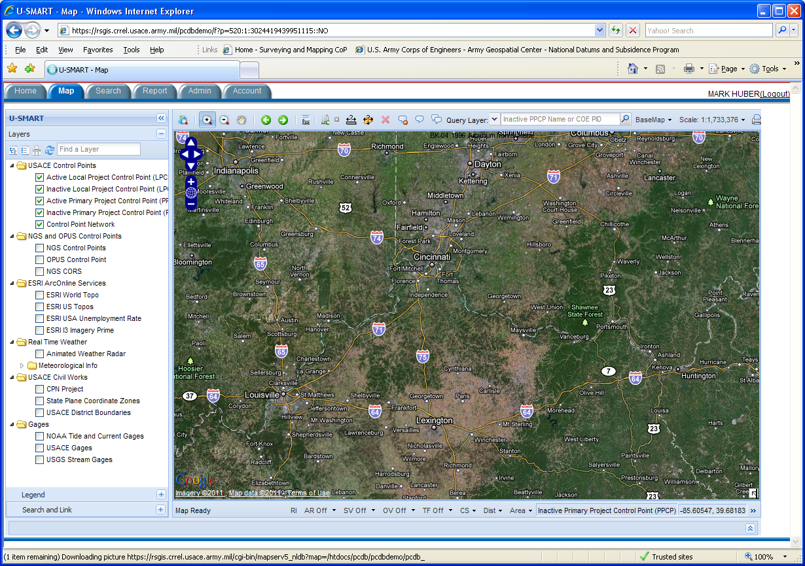
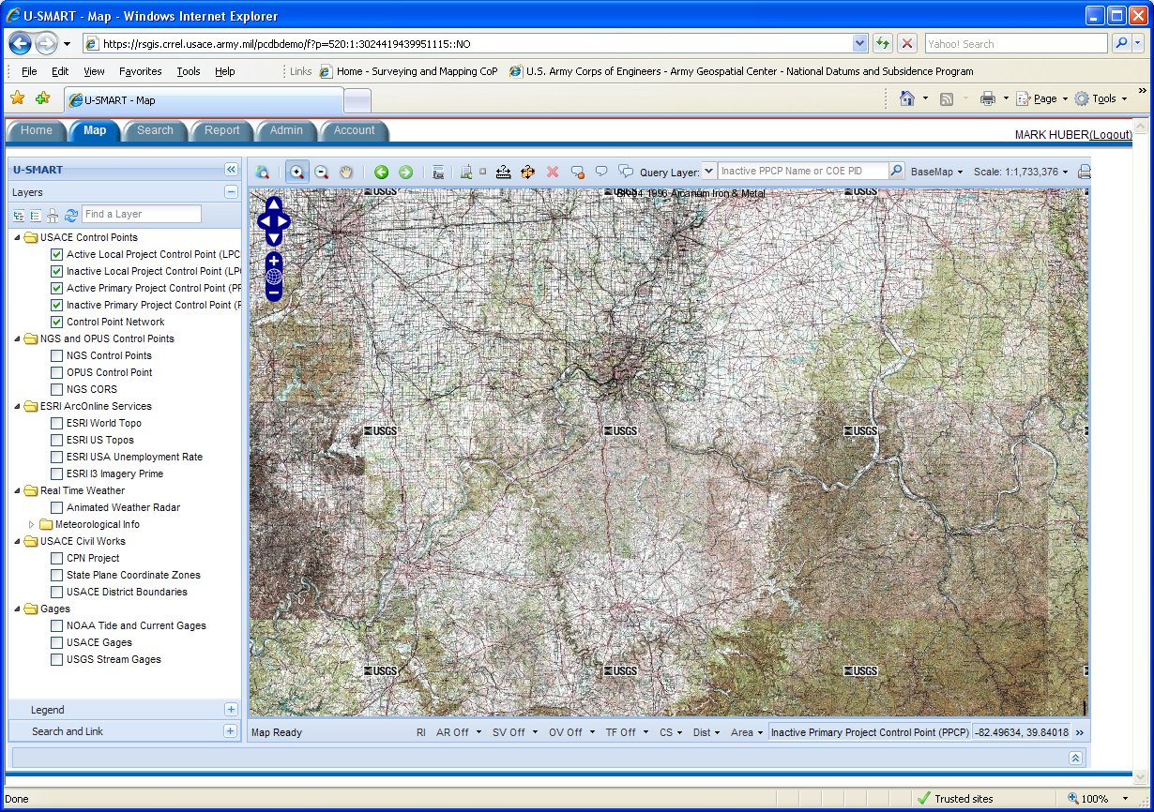
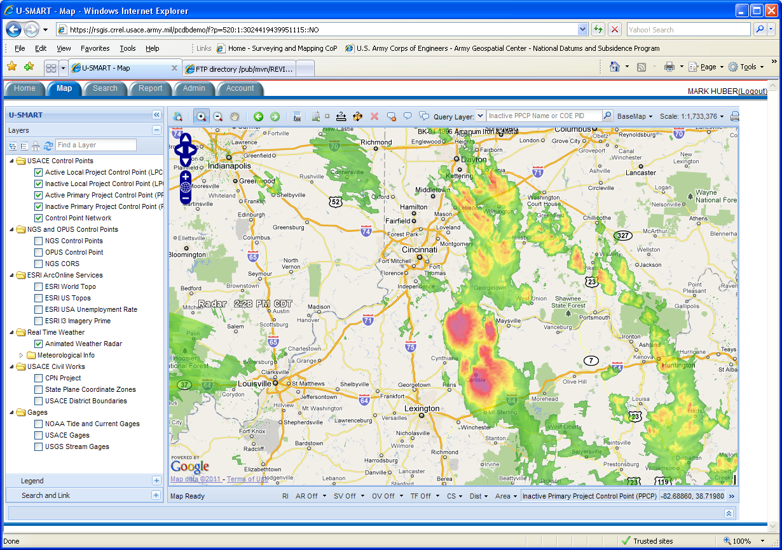
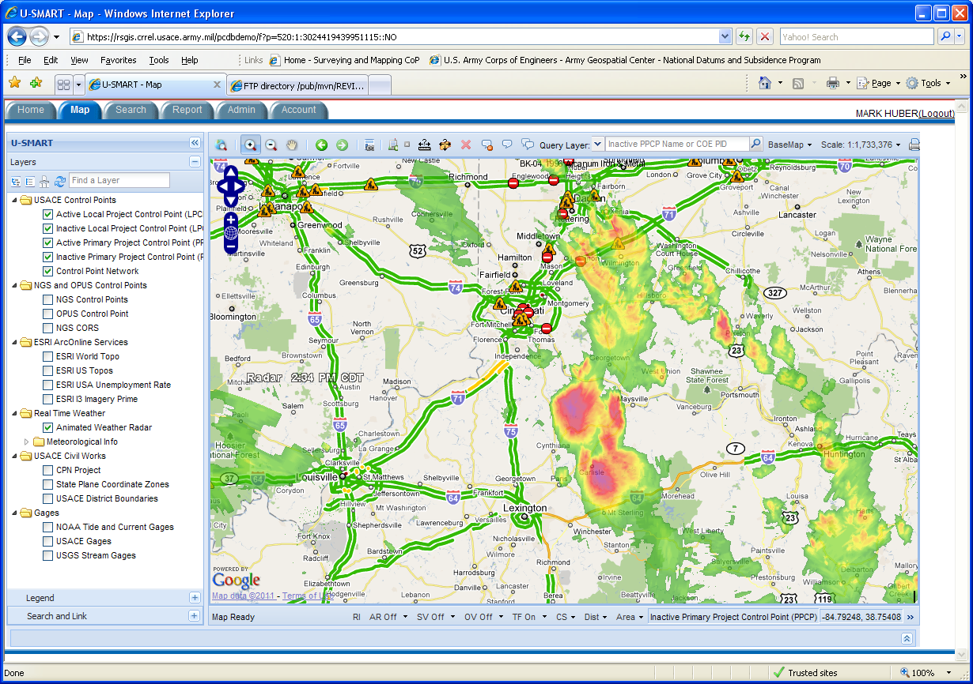

Slide 18
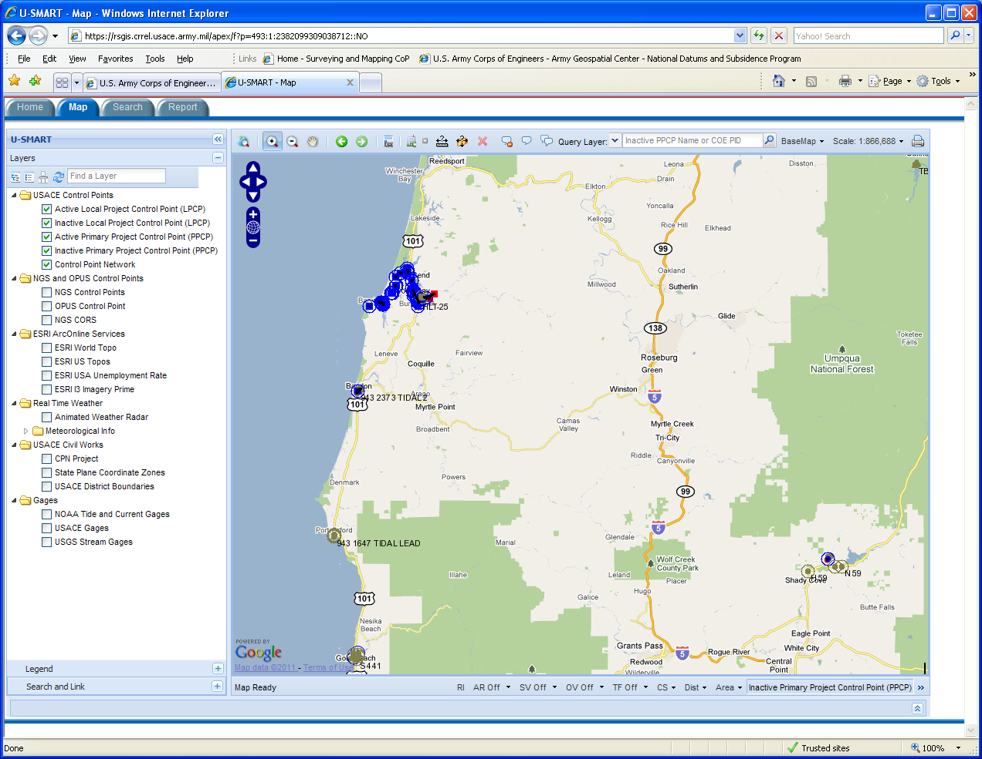
USACE Project Control Points

Slide 19

USACE Project Control Points
Live Traffic

Slide 20
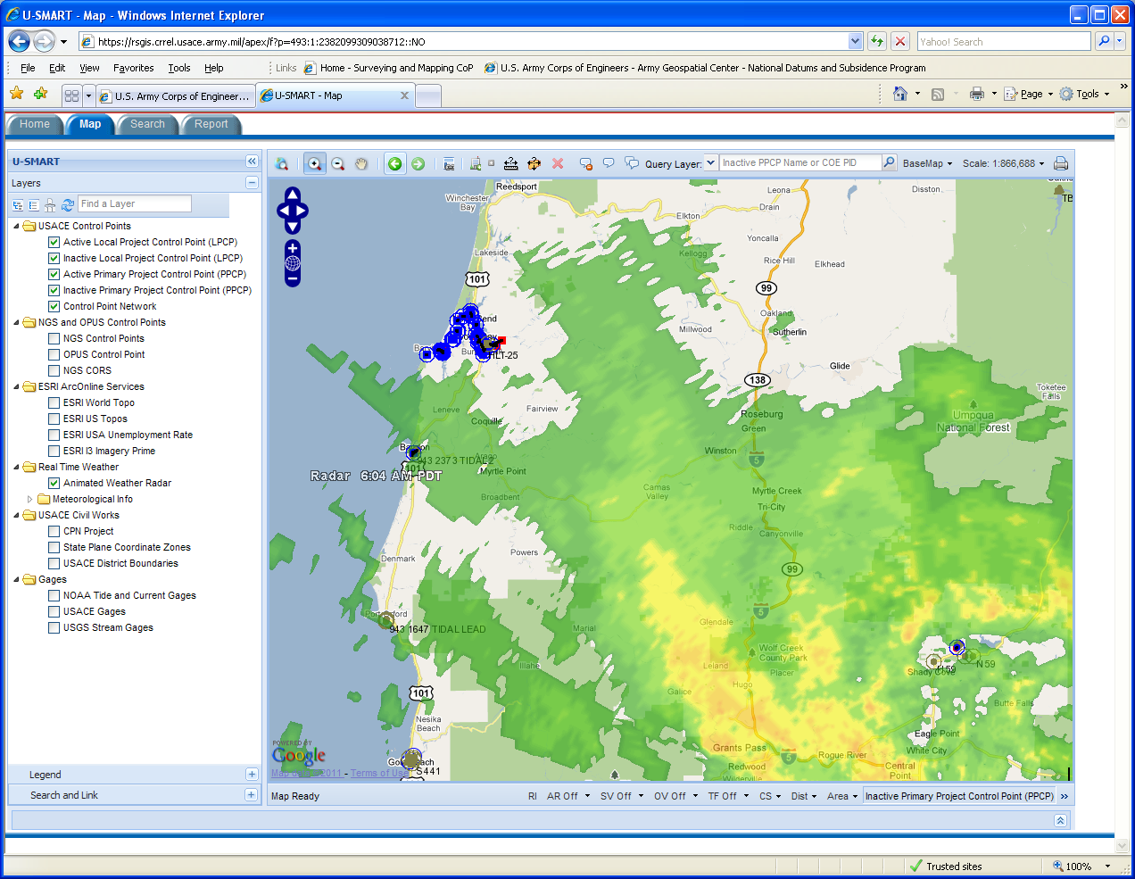
USACE Project Control Points
Live Radar

Slide 21
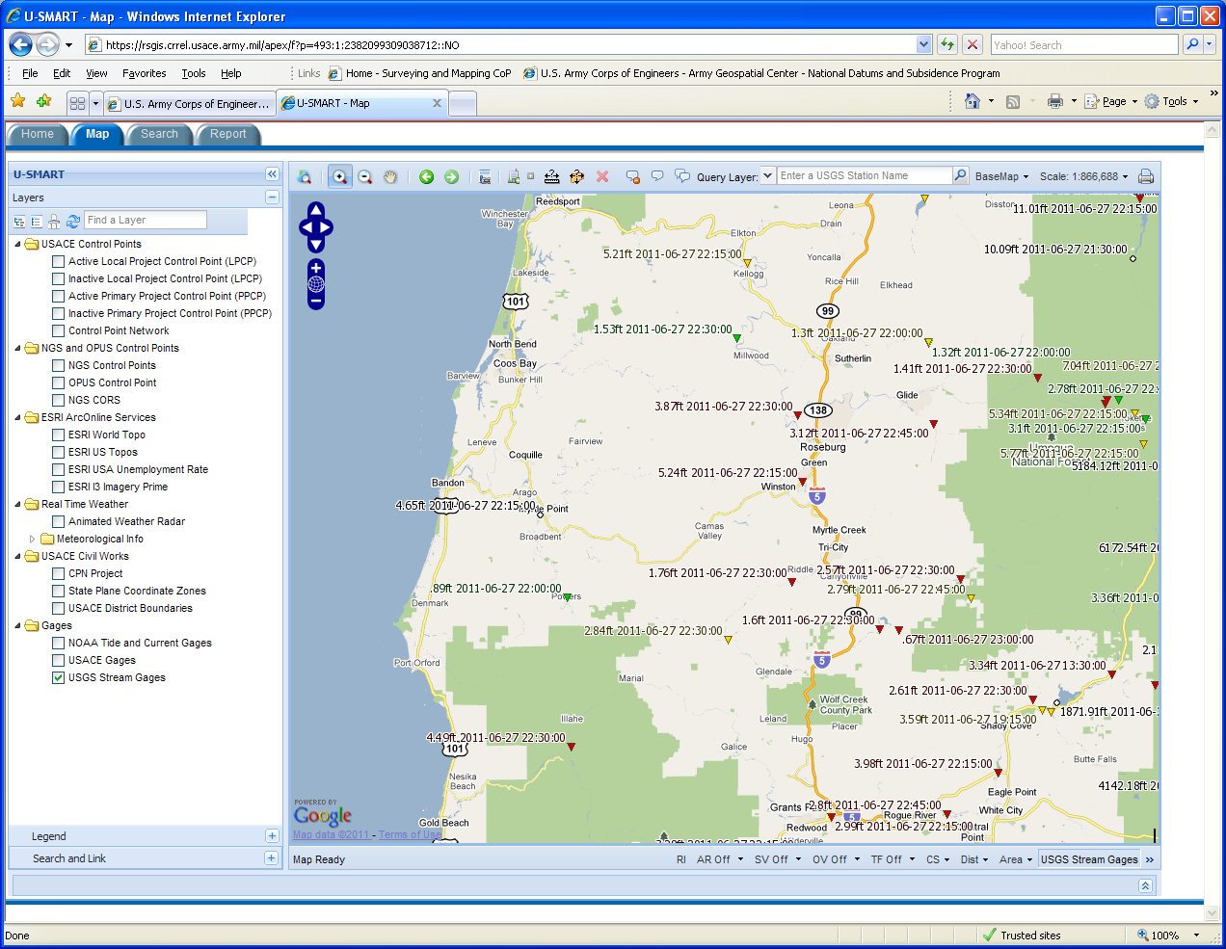
USGS Stream Gauges

Slide 22
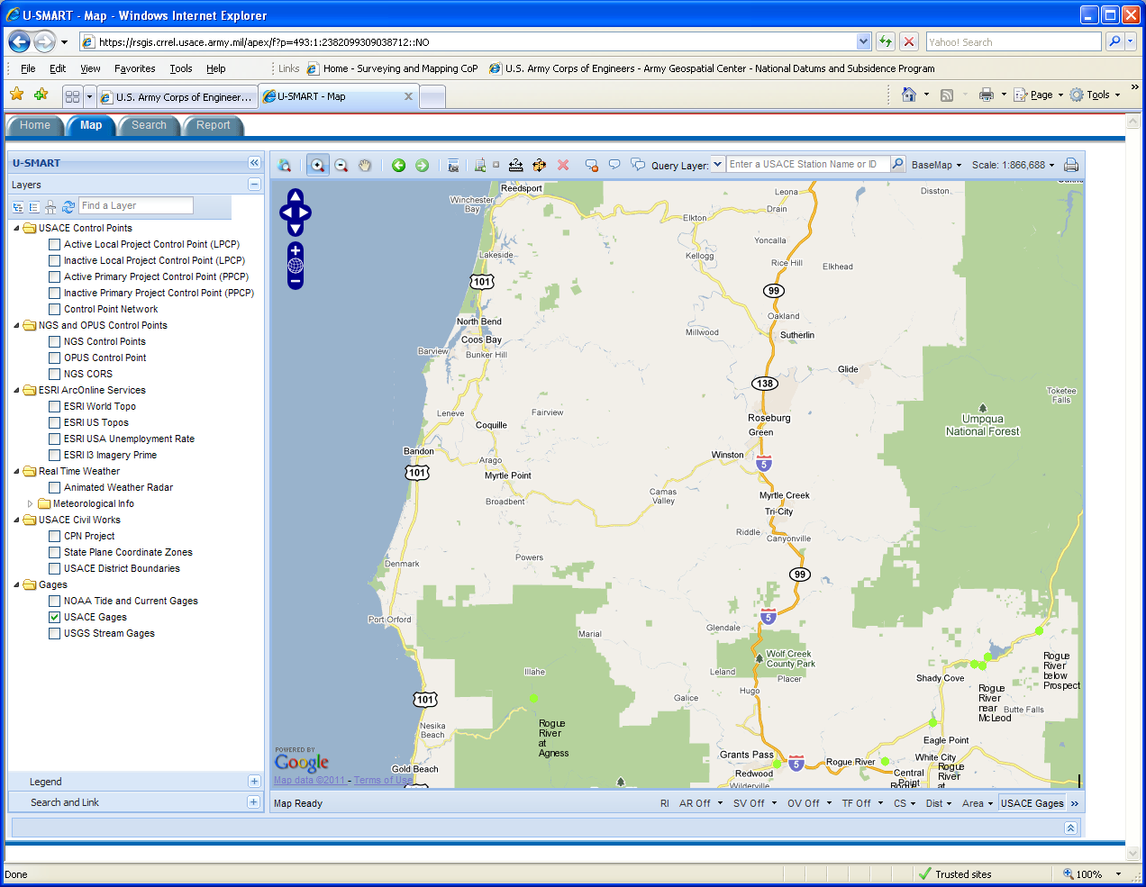
USACE Gauges

Slide 23
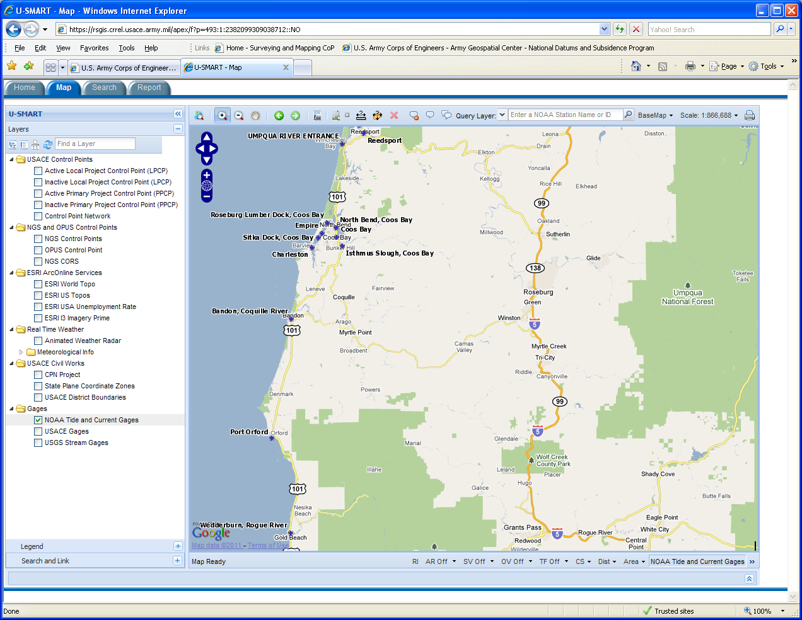
NOAA Gauges

Slide 24
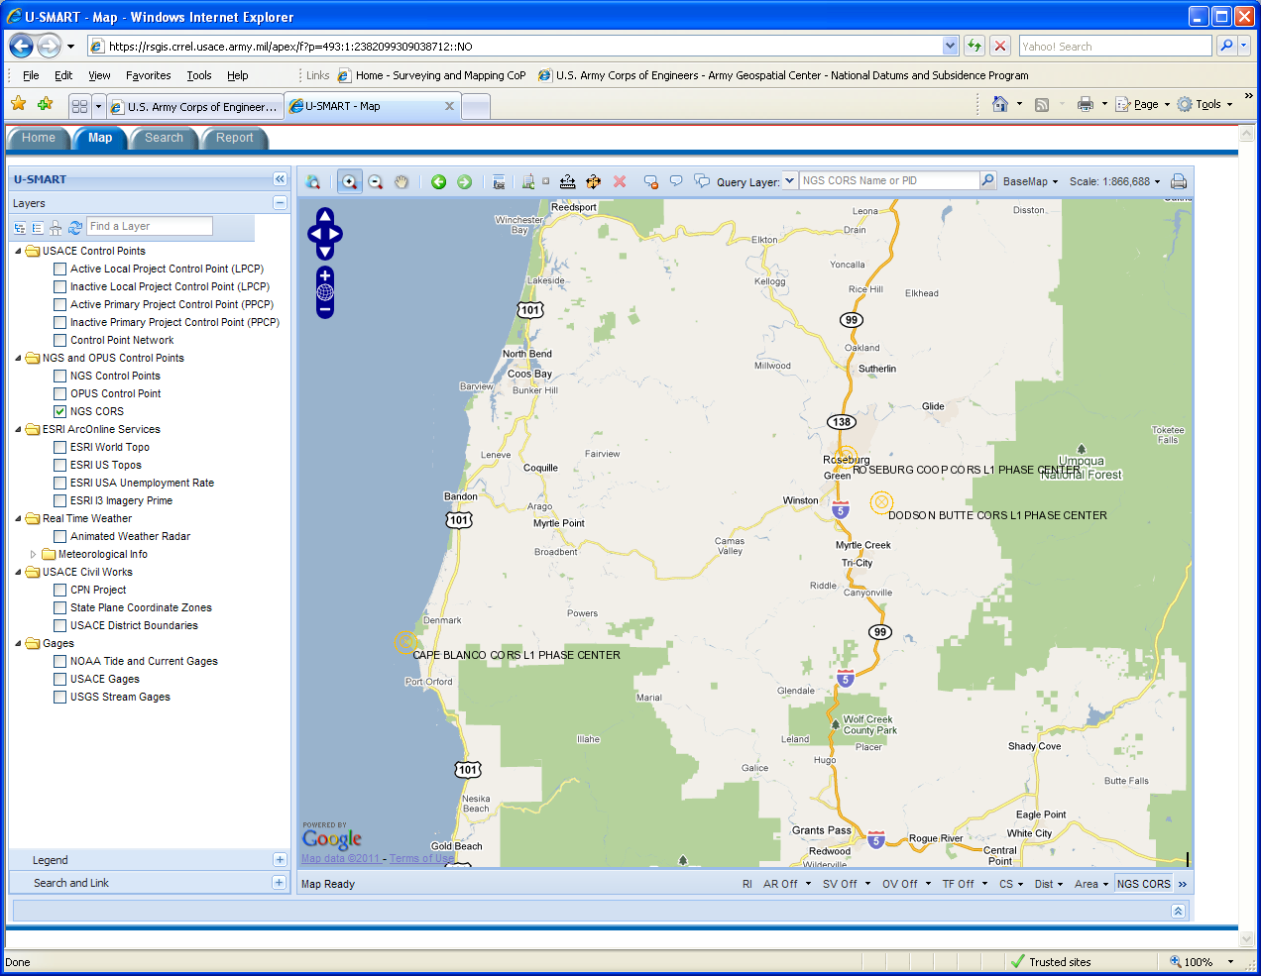
NGS CORS

Slide 25
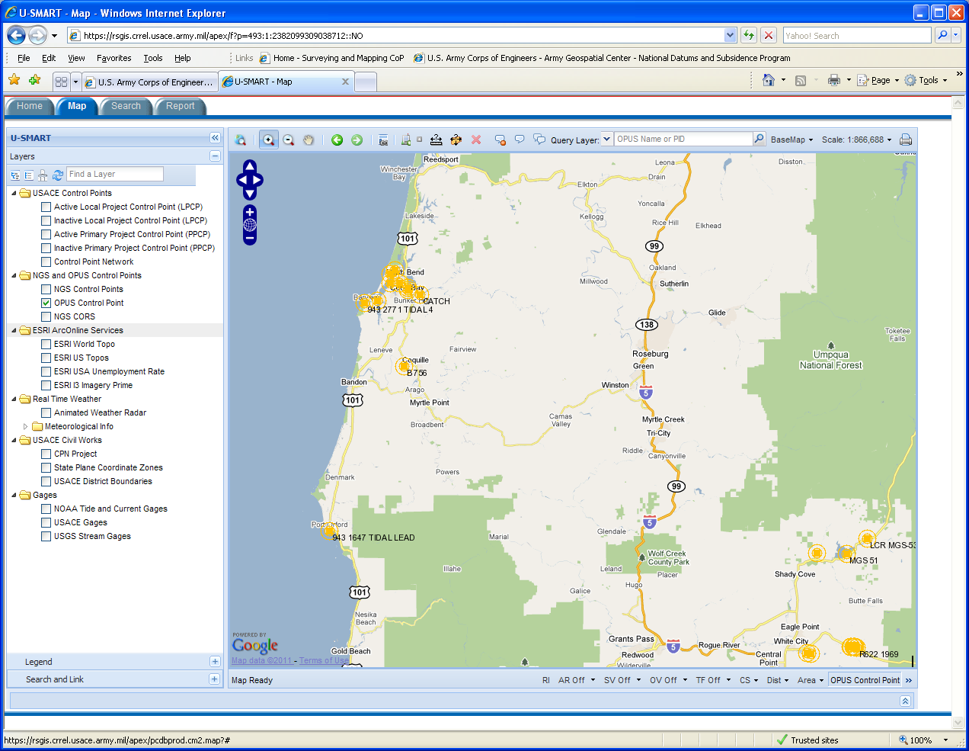
NGS OPUS-DB

Slide 26
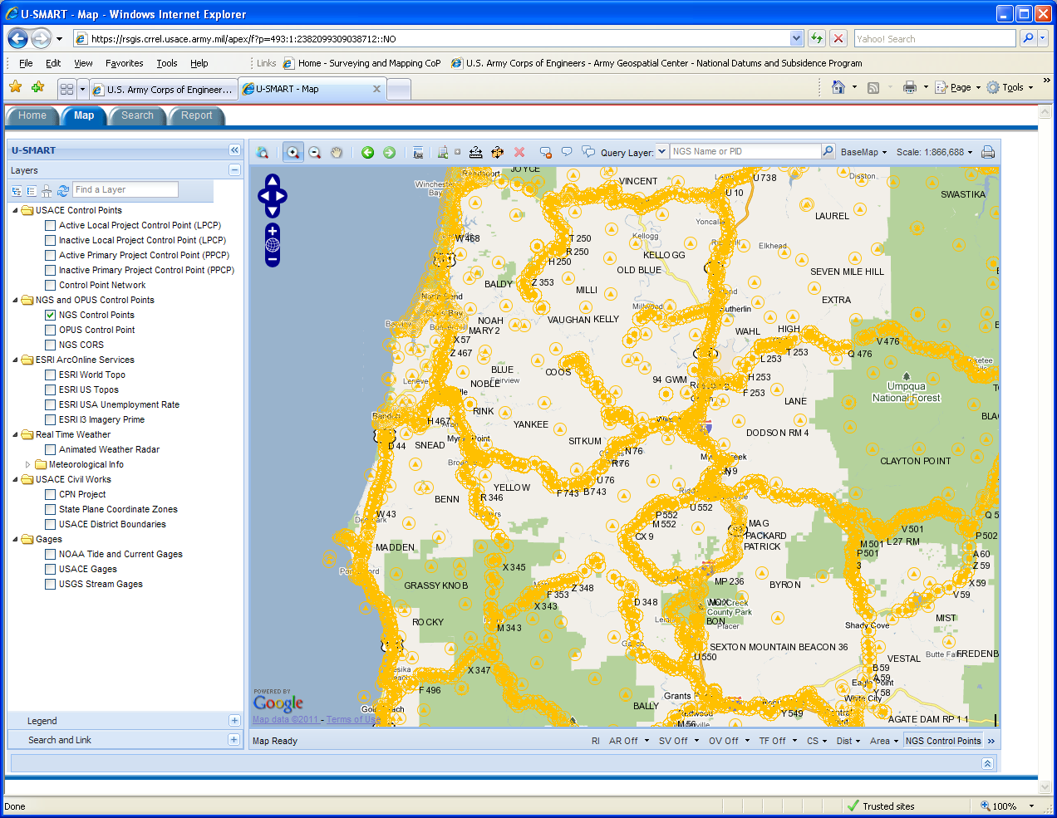
NGS NSRS Control Points

Slide 27
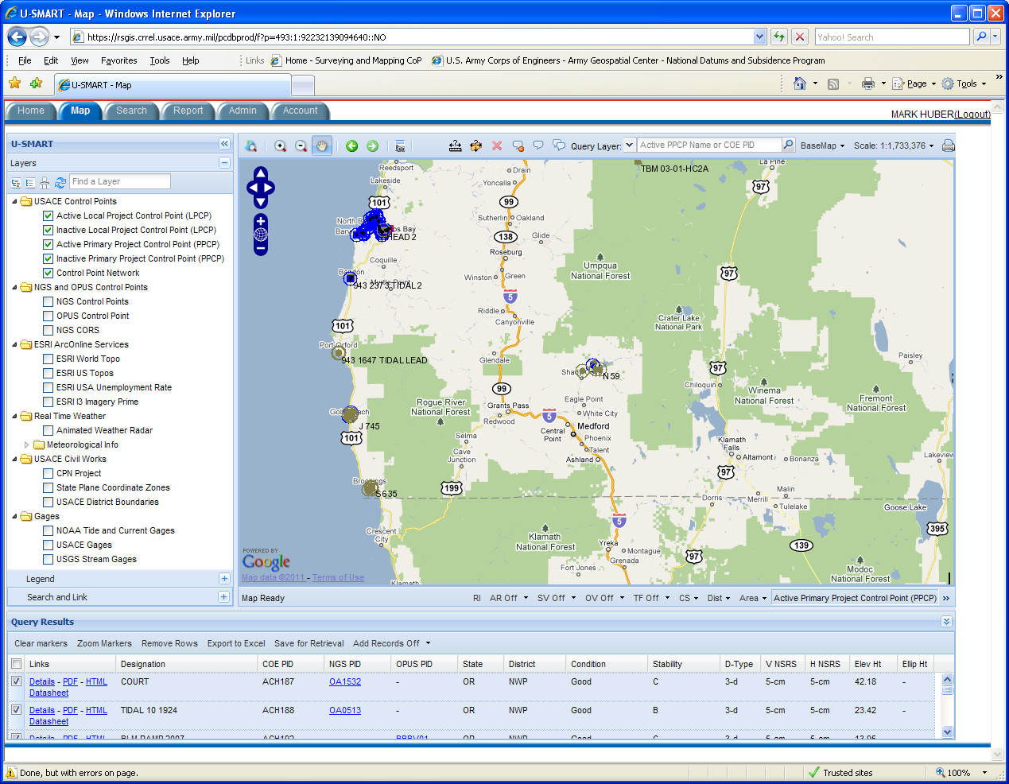
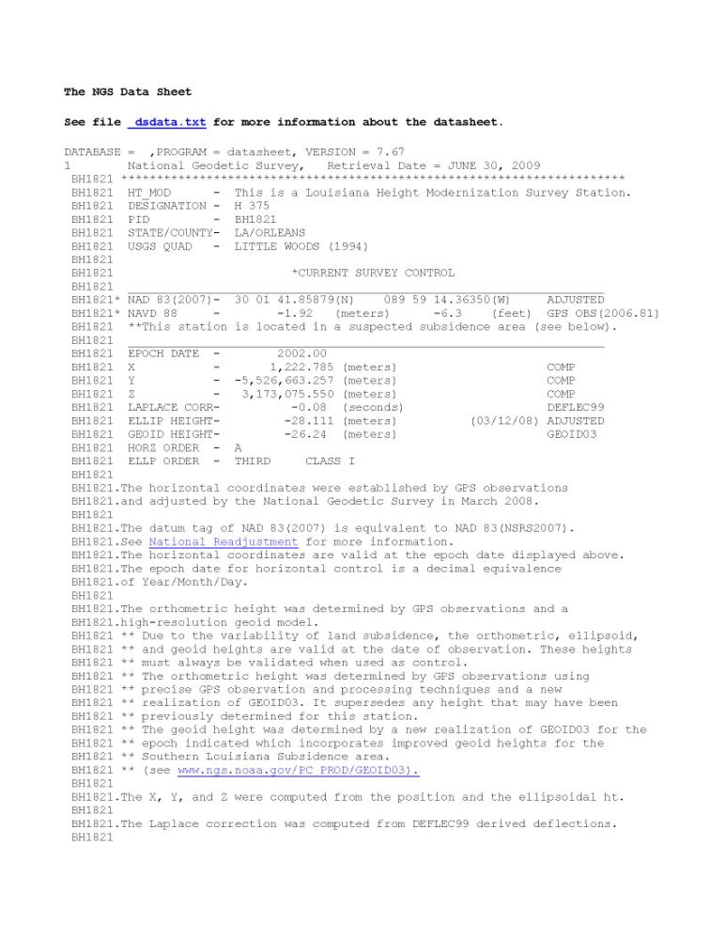
Links

Slide 28
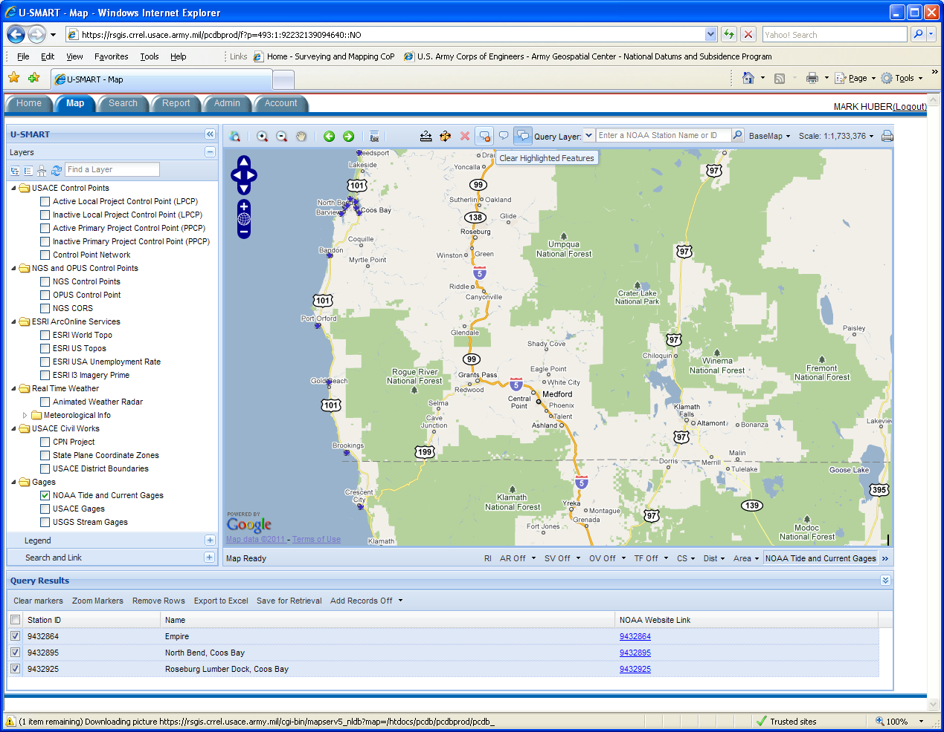
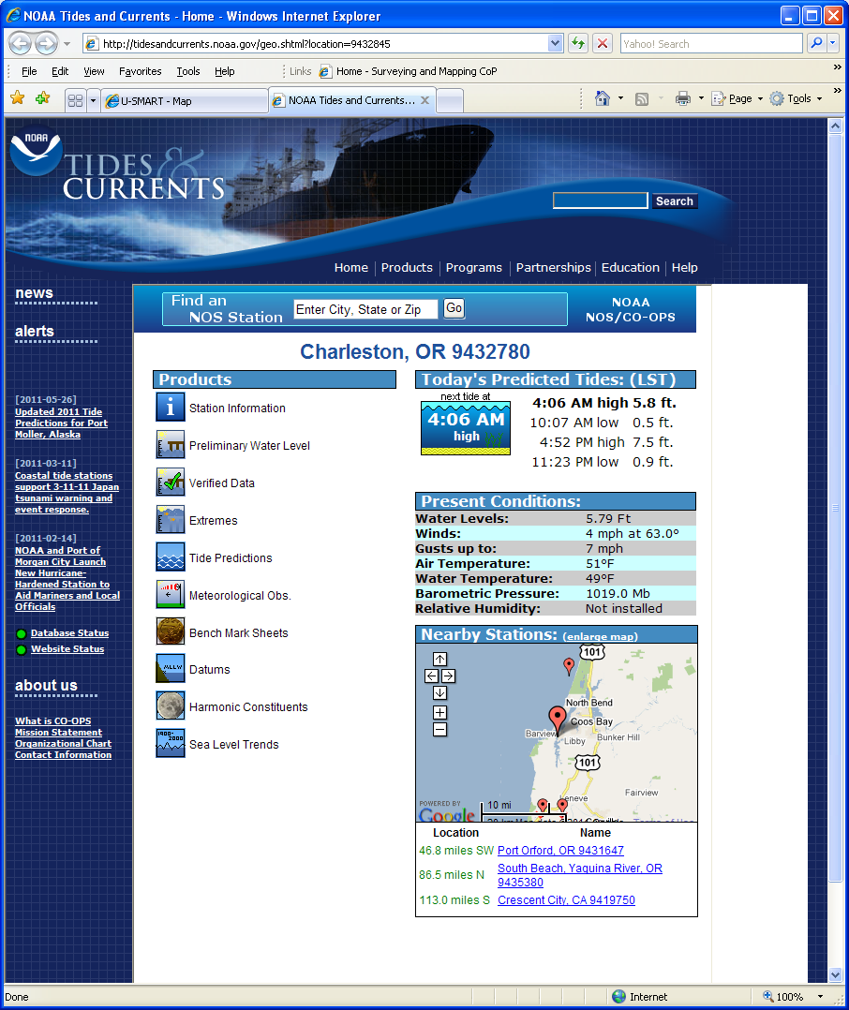
Links

Slide 29
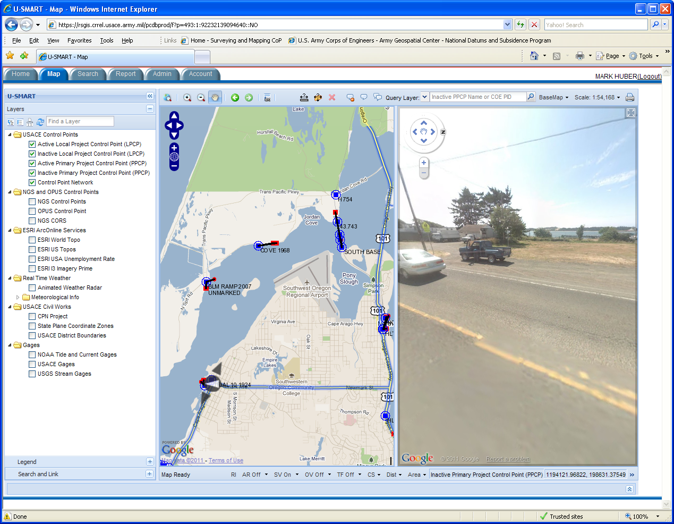
Google Street View

Slide 30
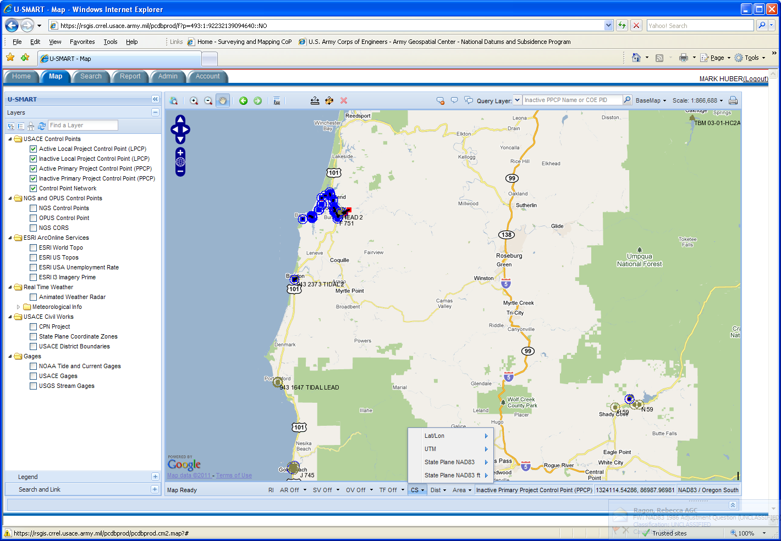
Coordinate System Selection

Slide 31
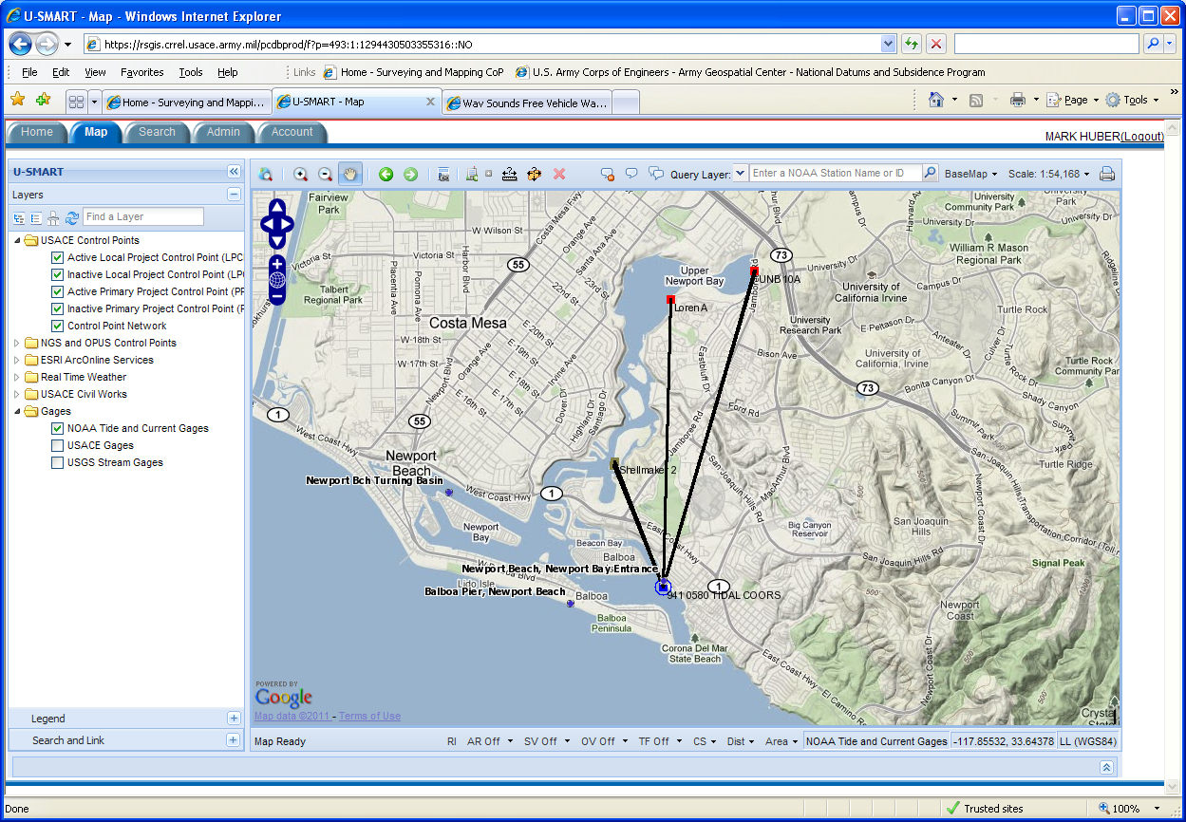
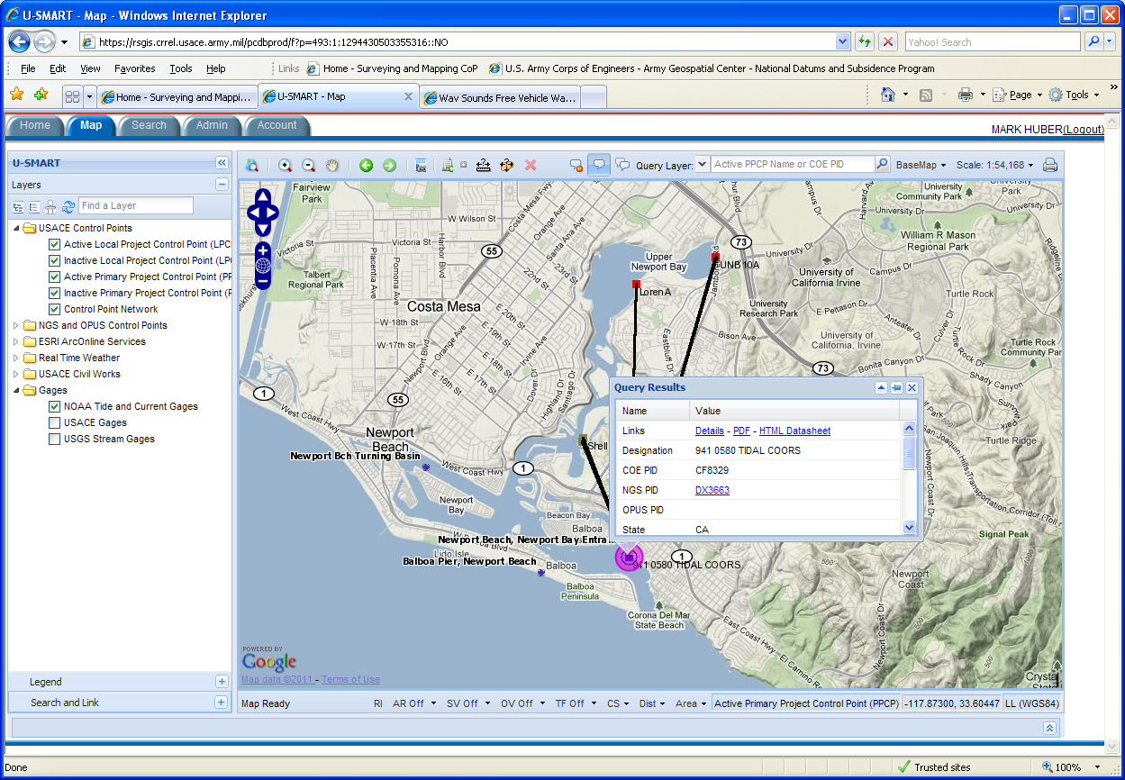
U-SMART
USACE Survey Monument Archival and Retrieval Tool
31/15

Slide 32
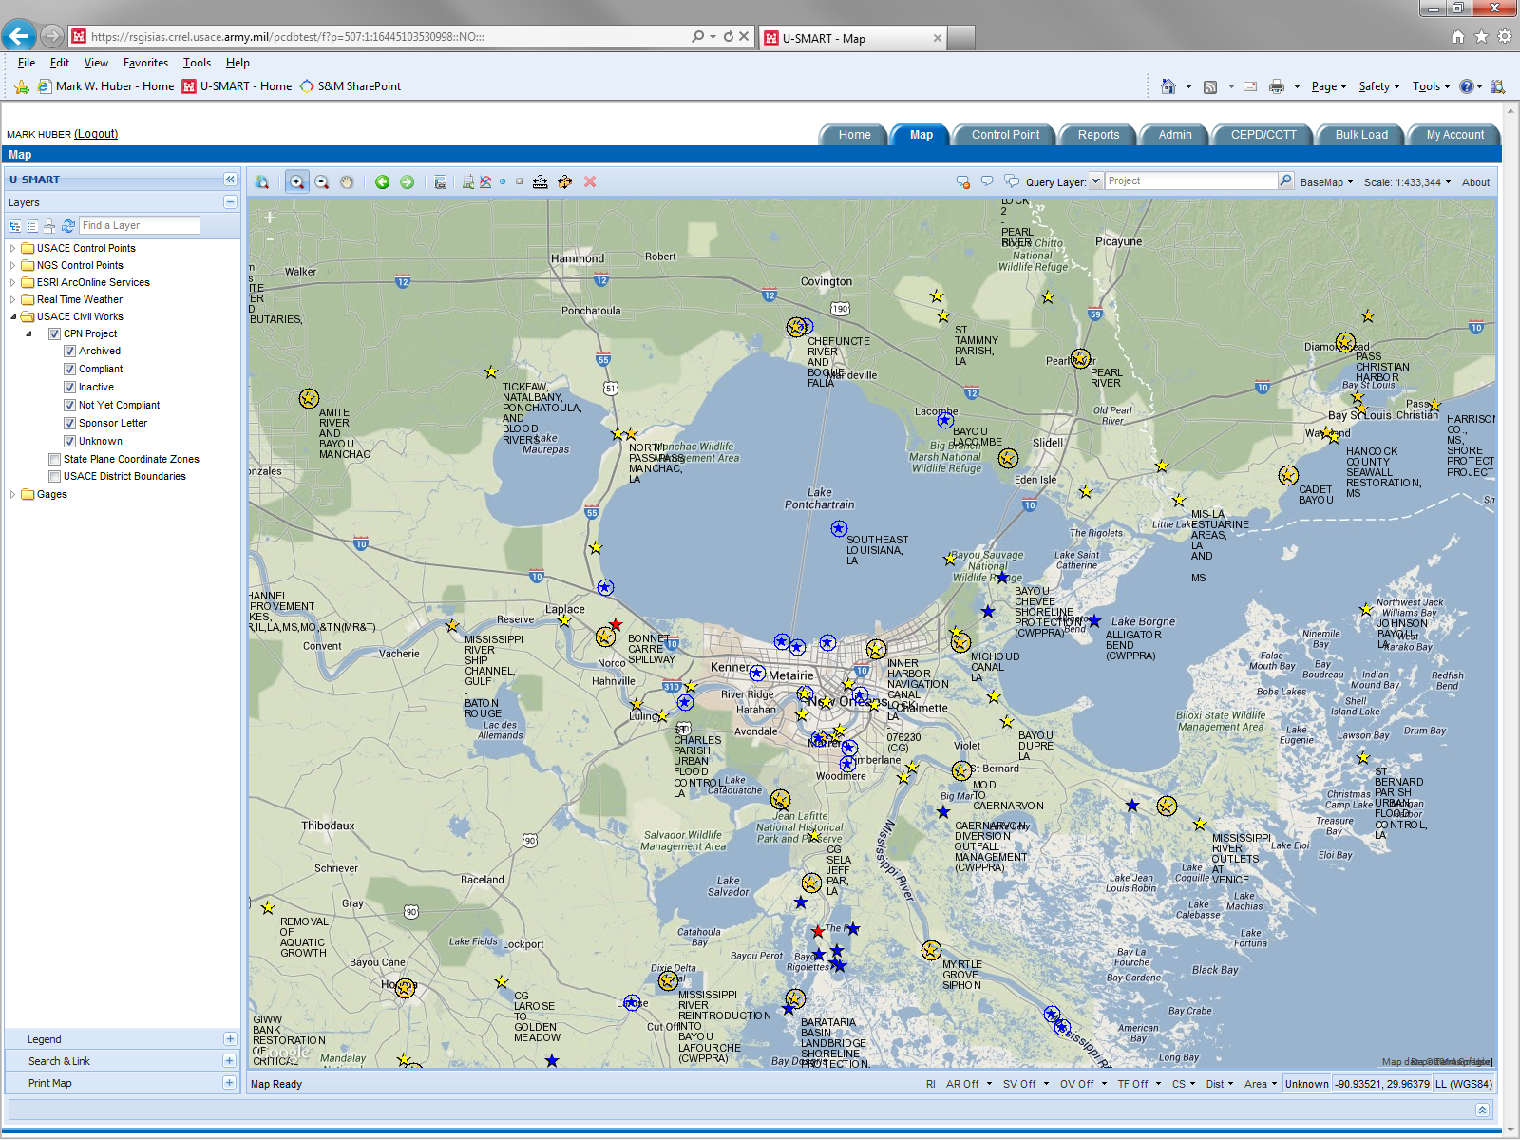
New Project Symbology
Archived - orange circle
Compliant - blue circle w/ outer circle
Inactive - orange circle w/ outer circle
Sponsor Letter - blue star
Unknown - yellow star
non-compliant - red circle

Slide 33
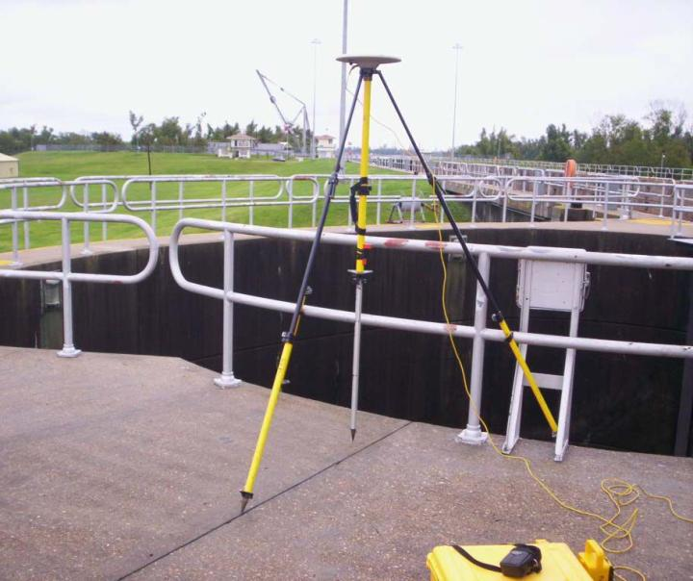
U-SMART
USACE Survey Monument Archival and Retrieval Tool
Summary
Layering of Datasets
Common Source For All Control
  No Desk Drawer Files
  Everyone On Same Page
Compares Coordinates Against NGS
Links Control To Projects
Links Primary Control To Local Project Control Networks
Minimized Maintenance At The Local Level
Easy Archival And Retrieval
Notes:
Control points linked to projects.
DB linked to NGS. Notifications when values are adjusted. Historic values retained. Allows for easy transition.

Slide 34

Levee Performance Assessment
Notes:
LPI – Levee Performance Inspection tool for post catastrophic event “forensic engineering”. Allows RMC to evaluate design and monitoring data in a geospatial environment.

Slide 35

Notes:
MMC DB allows for pre-catastrophic event planning/preparation.
Modeling (dam breach scenarios), Mapping (inundation), and Consequences (life loss, economic) – data and maps provided to local emergency managers for planning and evacuation routing.

Slide 36

Notes:
MMC DB – has animated modeling results.
Layers on right show data available for emergency managers.

Slide 37

MMC Data Viewer
Notes:
MMC DB – hydrograph in elevation here (depth on previous slide for time to 2-ft rise).

Slide 38

Notes:
Near real time geospatial application for emergency managers during 2011 spring floods. Publically accessible for news agencies (used by local ABC channel) and emergency managers with modeling and inundation maps.

Slide 39

Notes:
FEMA and USACE merging levee inventories into a single Federal database.

Slide 40

NLD Public View
Notes:
Publically accessible version.

Slide 41

Notes:
Unified database for inspections, tracking compliance, and managing risk.

Slide 42

Questions?
Additional Information Available at:
http://www.agc.army.mil/Missions/NationalDatumsandSubsidenceProgram.aspx
james.k.garster@usace.army.mil
mark.w.huber@usace.army.mil
david.j.robar@usace.army.mil

